Slide 1

Notes:
[BRIEF INTRO]
Welcome
Beginning a 7-week fall sermon series – The Gospel of the Kingdom
SUMMARY: The world seems to be falling apart and the darkness is visible all around us. It raises questions like, “What is God doing about it? Where are things going? How should we respond to it all?” Jesus said, “The kingdom of God has come near. Repent and believe the good news!” But what is this gospel of the kingdom? And how do we partner with God as believers in his good news? Over the next 7 weeks, we will explore the redemptive story of God and what it looks like when the gospel intersects with our lives and impacts the world through the local church.
And here is an overview of our series… [NEXT SLIDE]

Slide 2
Sermon Series Overview
Gospel as Story
Gospel Truths
Gospel in You
Gospel in Us
Gospel Living
Gospel to Others
Gospel Saturation
Notes:
[BRIEF COMMENTS ON EACH]
[BRIEF PRAYER & THEN NEXT SLIDE]

Slide 3
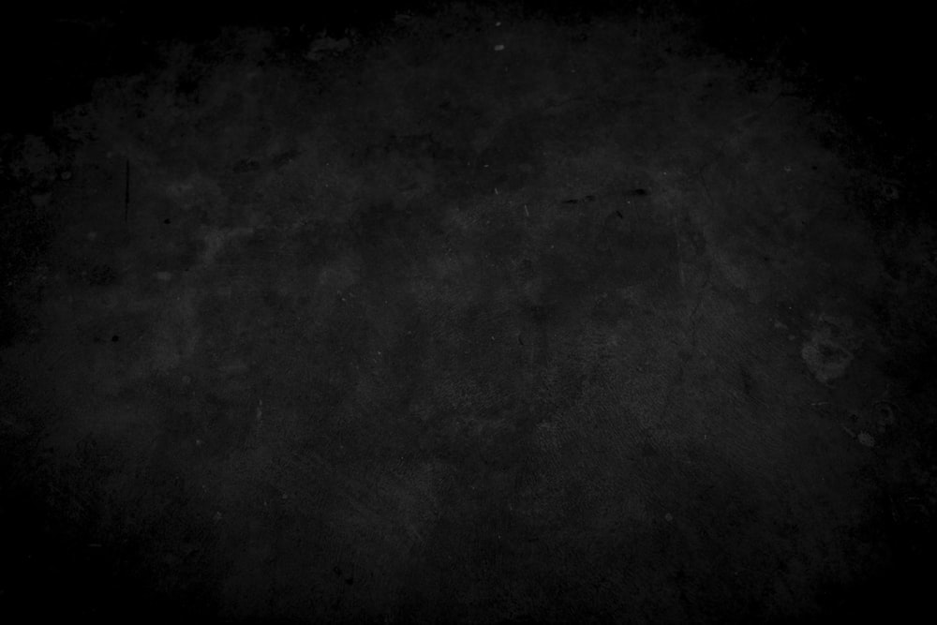
Scripture Reading
Mark 1:1-15 NIV
Notes:
[INVITATION TO STAND FOR SCRIPTURE READING]
[READ MARK 1:1-15 NIV]
This is the word of the Lord. Thanks be to God
You may be seated. [NEXT SLIDE]

Slide 4
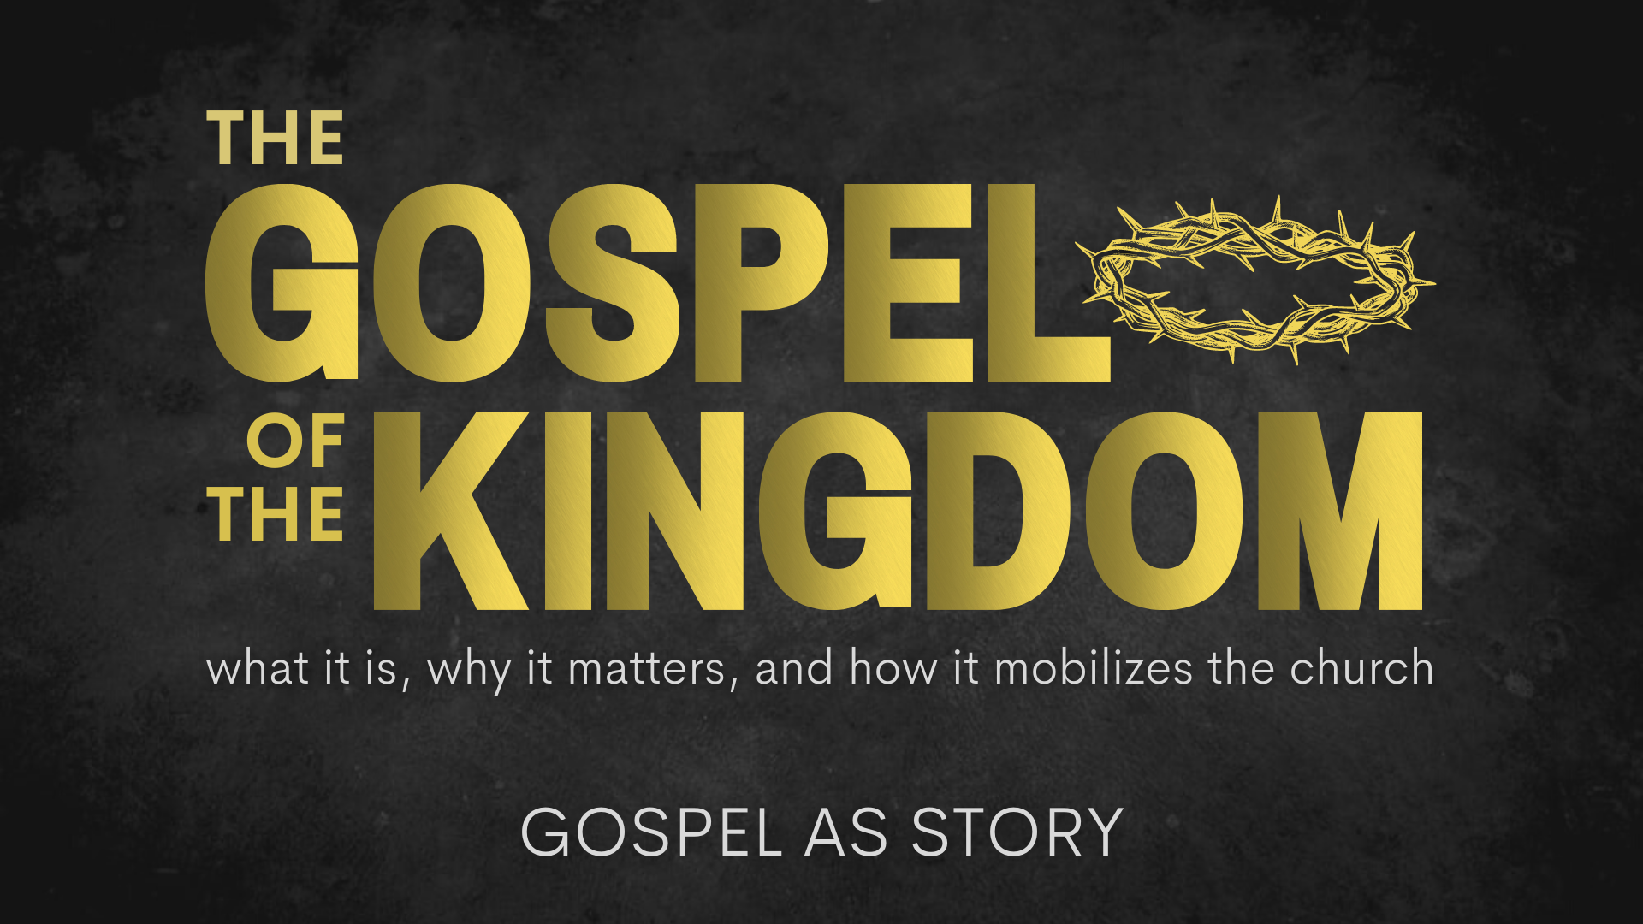
Notes:
[BRIEF COMMENTS]
Gospel as Story
Did you notice? The gospel is a story. It’s not 4 spiritual laws, the Roman Road, an atonement theory, or even a sinner’s prayer. Listen to how Mark began his gospel (1:1-2) – ”The beginning of the good news about Jesus the Messiah, the Son of God, as it is written in Isaiah the prophet…”
To understand the good news, we need to grasp the larger redemptive narrative of God’s work in the world. As we will see this morning, we end up distorting the good news when we don’t view the gospel as story.
But before we look at that story, I want to give us a common (or shared) definition of gospel and kingdom for this series and beyond. Let’s define those this way… [NEXT SLIDE]

Slide 6
What is the Good News?
The gospel story of how God has been at work in the world and is now redeeming it in Jesus Christ—who will one day return to bring the fullness of the Kingdom.

Slide 7
What is the Good News?
The gospel story of how God has been at work in the world and is now redeeming it in Jesus Christ—who will one day return to bring the fullness of the Kingdom.
What is the Kingdom of God?
The reign and rule of God on the earth, which always looks like Jesus (e.g., loving others, healing, reconciling, sacrificing self, showing mercy, doing justice, etc.).
Notes:
[BRIEF COMMENTS ON EACH]
Why is the story so important? Well, let’s think about that. As human beings, we need story to make sense of who we are, our purpose and meaning, where we come from, and where we’re going. Because the stories we tell and live into (even subconsciously or intuitively) impacts the soul and directs the entire course of our life, and ultimately the direction of humankind.
Think about how we’ve been doing this for thousands of years… [NEXT SLIDE]

Slide 8
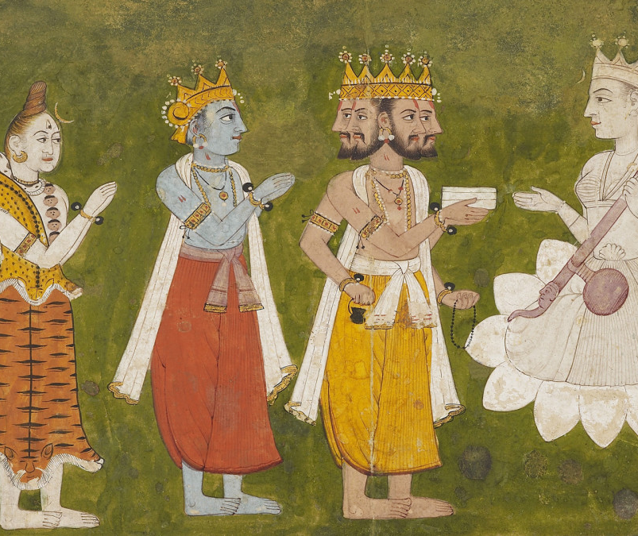
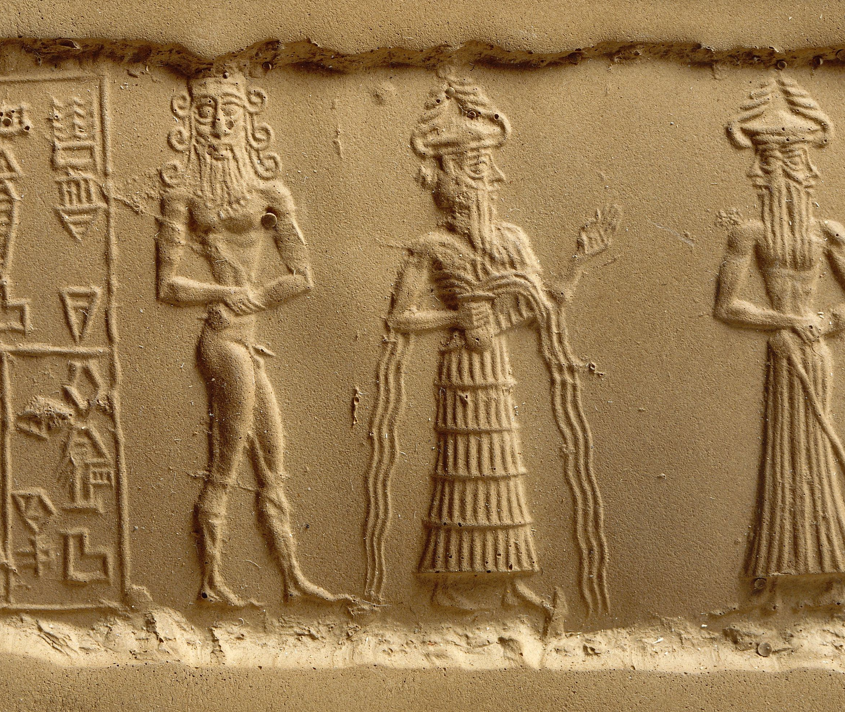
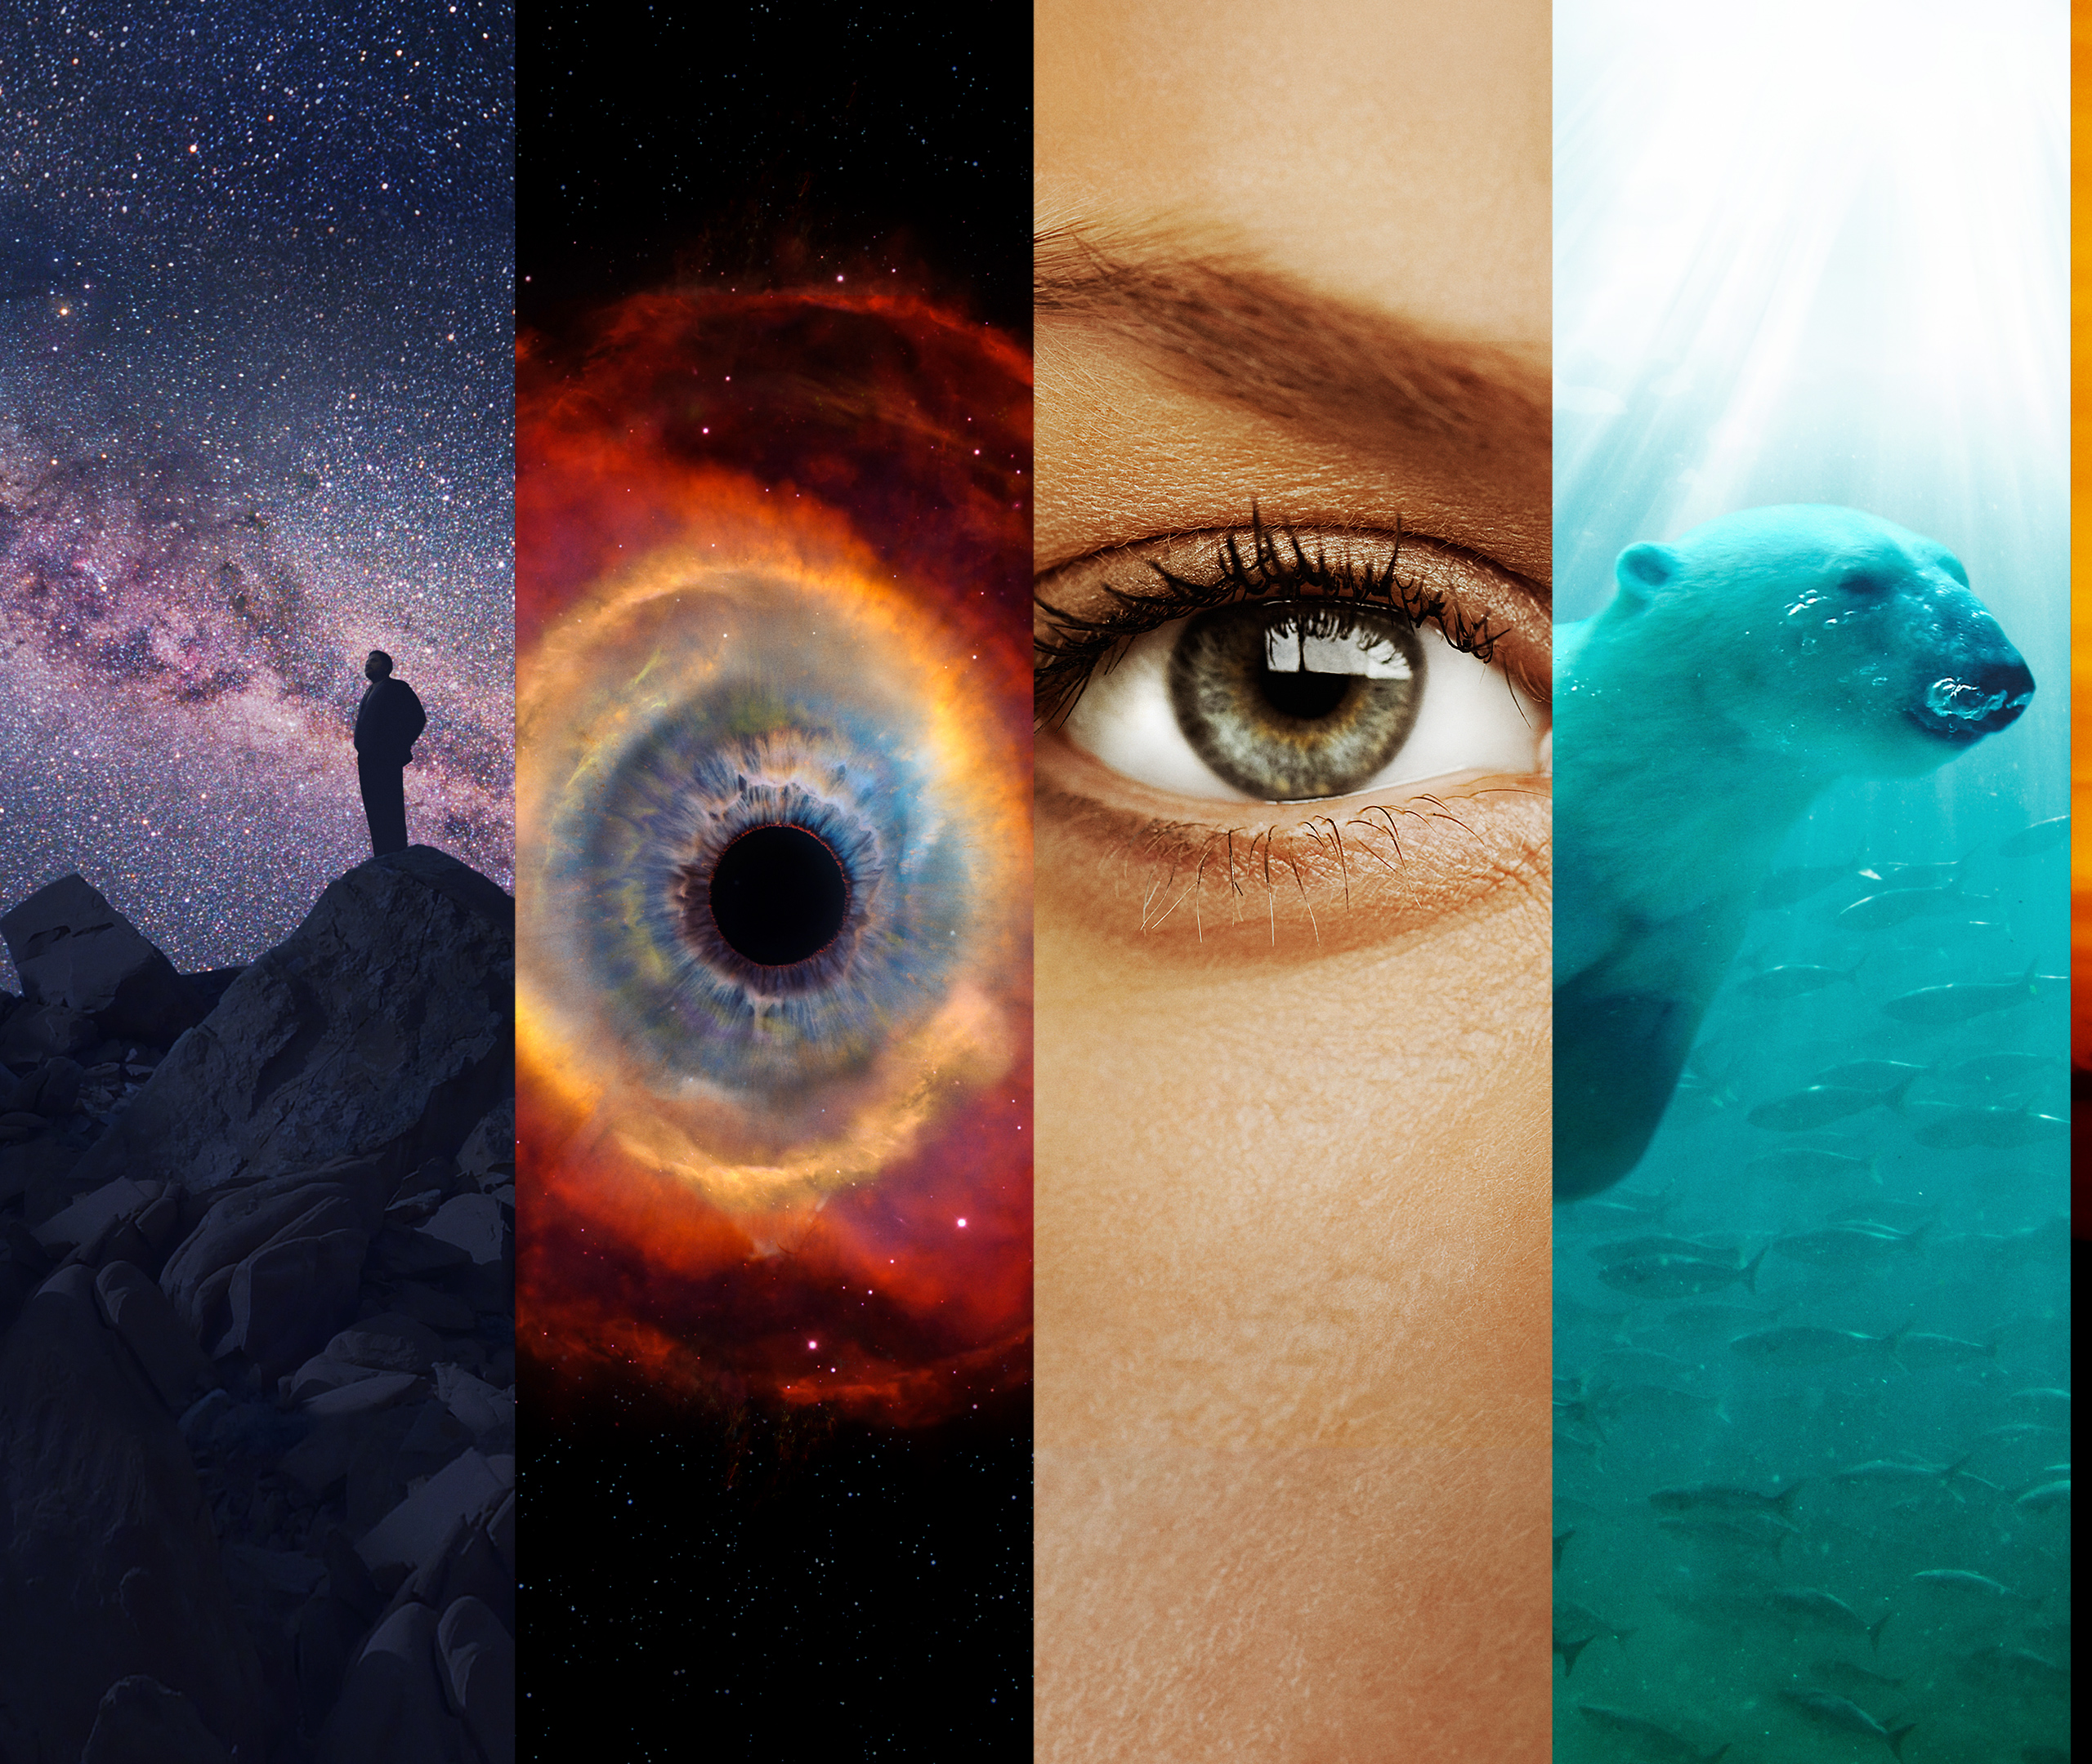
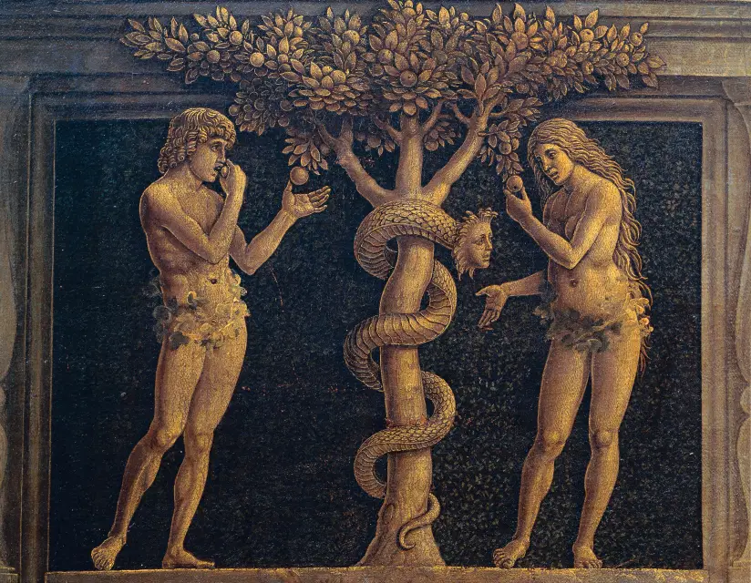
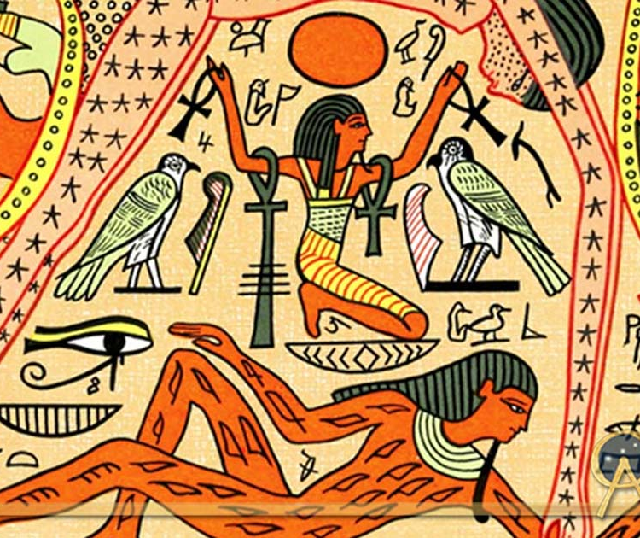
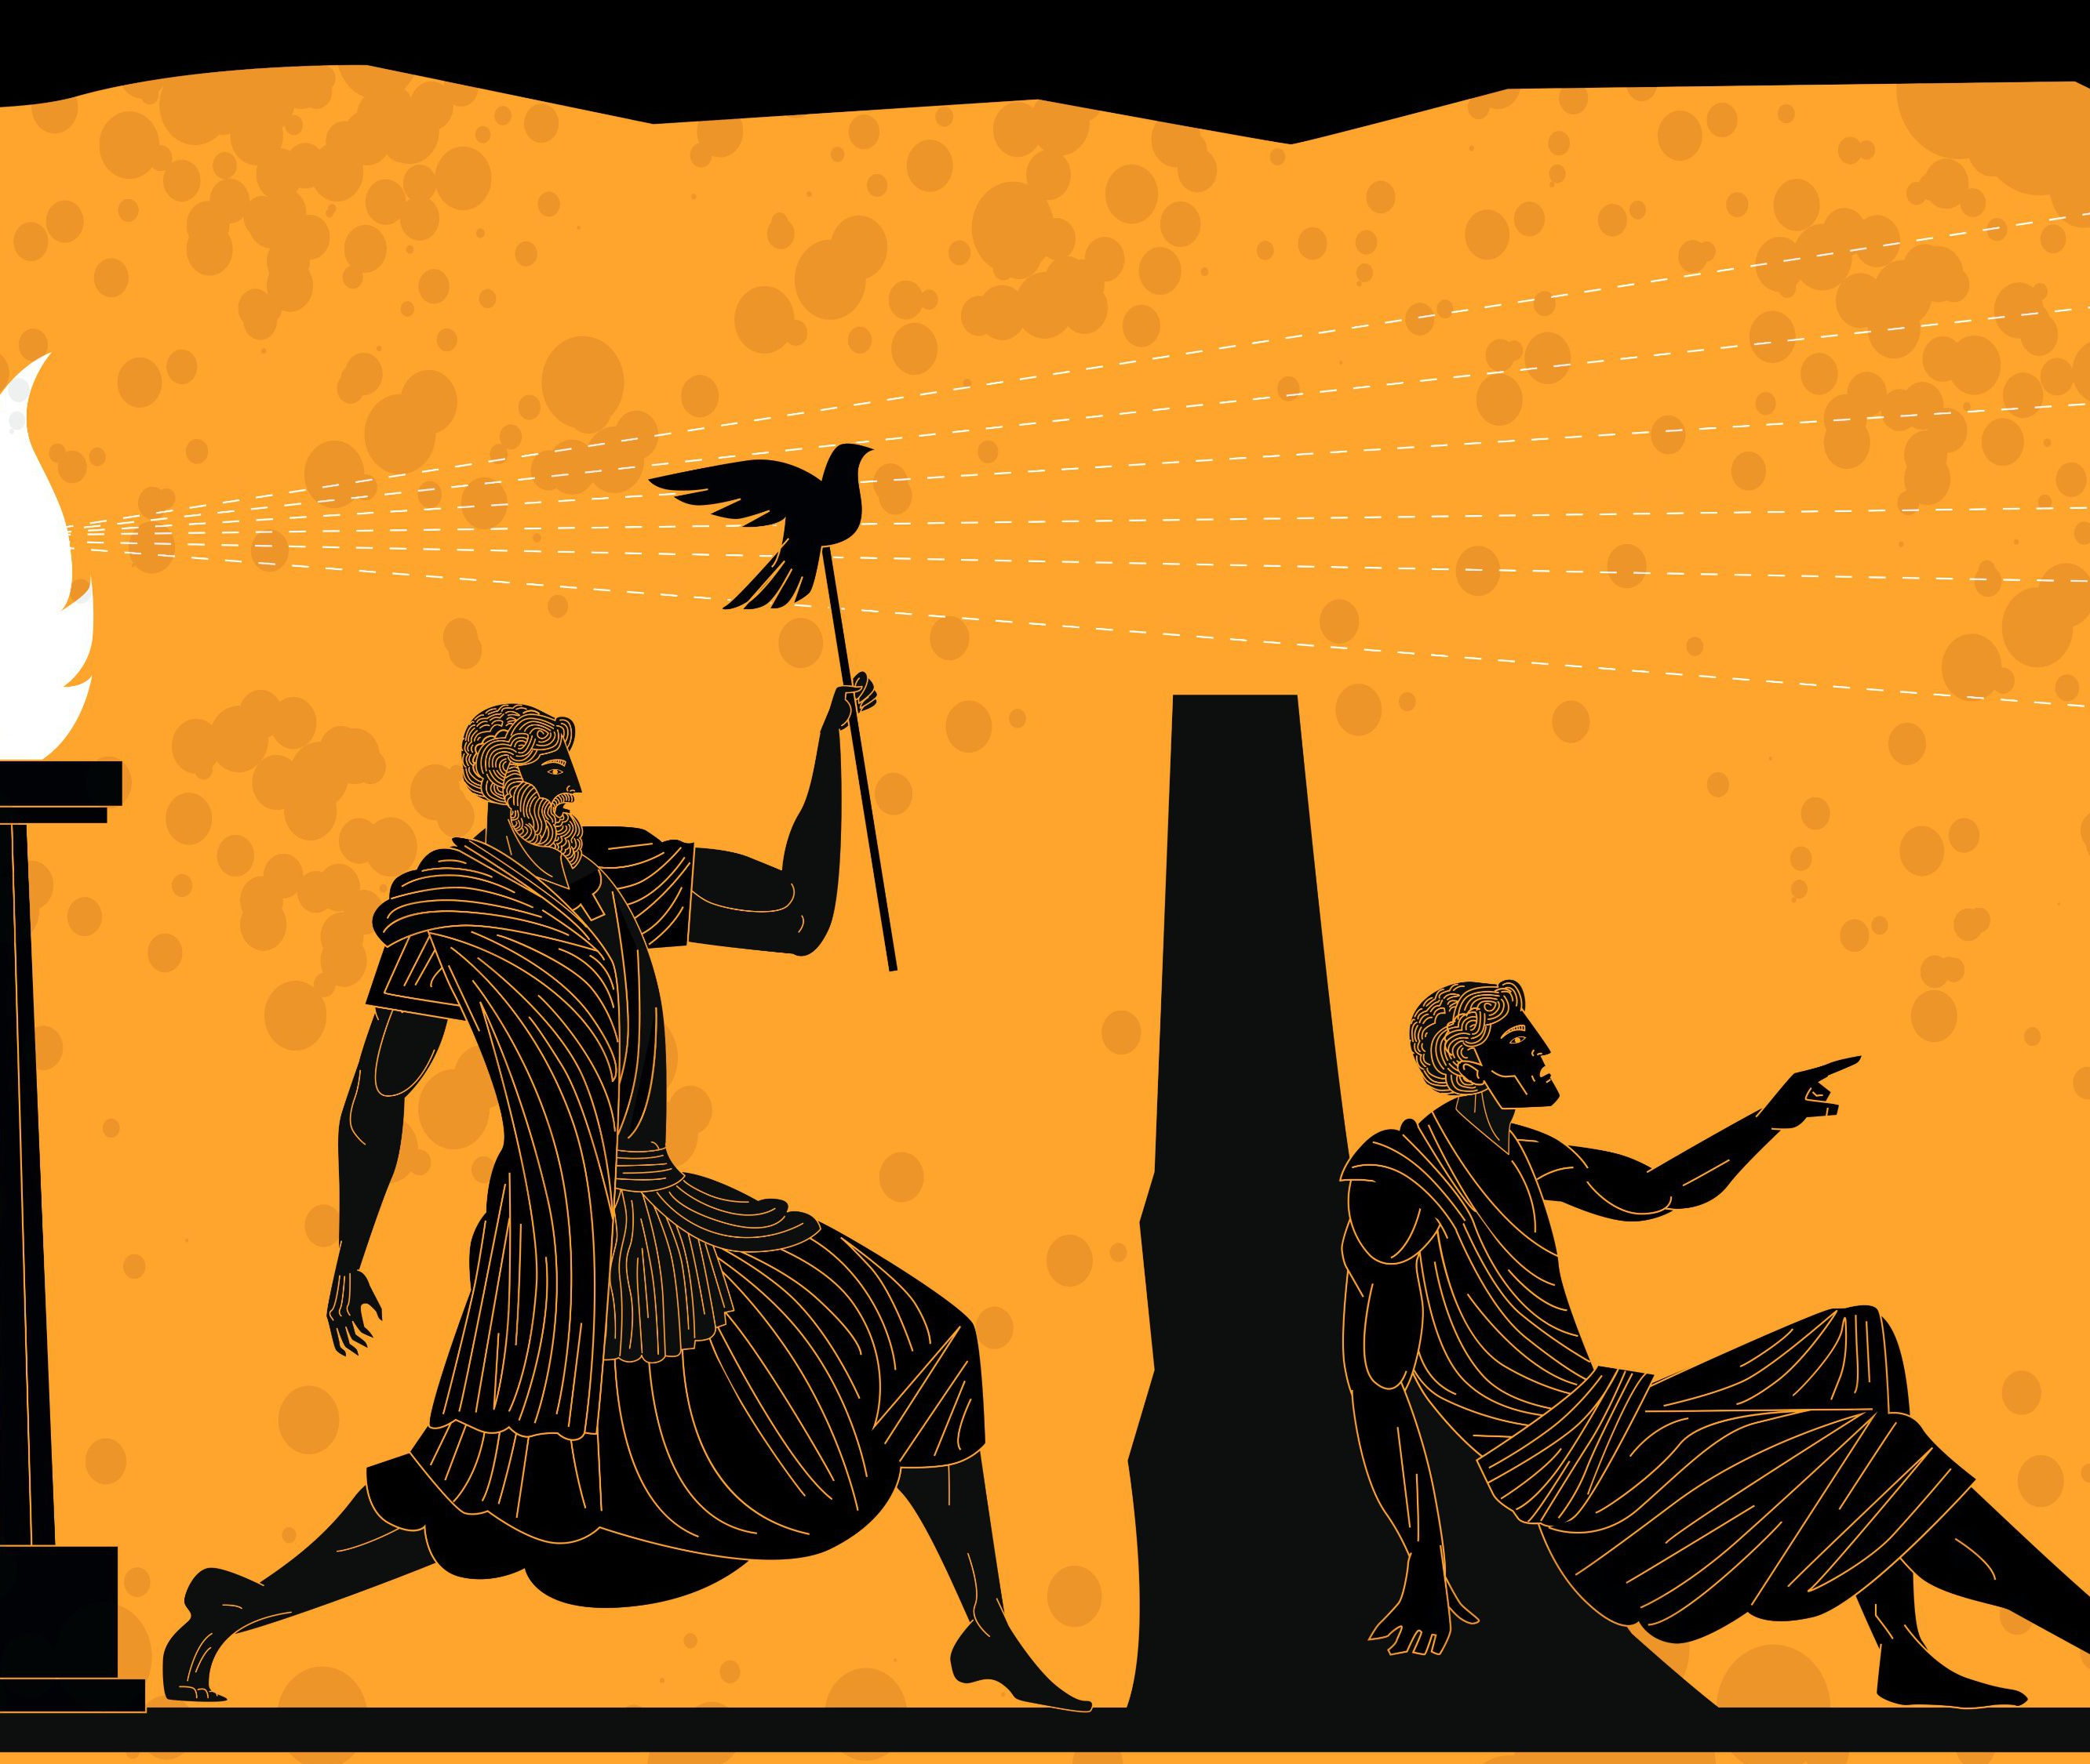
Notes:
[BRIEF COMMENTS]
Here are just a few of the stories we have told in the past, and some we still tell today…
Cave paintings
Ancient Sumerian poems (Epic of Gilgamesh)
Ancient Babylon (Enuma Elish)
Ancient Hebrews (Gen 1-11)
The Ancient Greeks (their gods and Plato’s cave—the Matrix)
Rome’s mythological beginnings, like America’s
World Religions [folded mini-chart]
Judaism & Christianity - creation, fall, redemption, and resurrection
Scientism (science alone gives us truth); It’s a mystery why the universe began, but what is clear is that you must create your own meaning (which is usually whatever the dominate culture is telling you) and take solace in science and nature, which by the way will one day end in a big freeze, rip, or crunch! Neil DeGrasse Tyson (Cosmos): “Let there be no doubt that as they are currently practiced, there is no common ground between science and religion.”
The American Dream – me-centered, success-driven, making money, being important, expressing your individuality, about being noticed, it’s about immediate gratification, and isn’t real concerned about life beyond consuming and the rat-race. Therefore, we tend to either ignore the bigger questions of life (like “Who am I? Is there a God? Is God good? If so, why is there evil in the world? Where are things going?” and so forth) or we distract or medicate ourselves so we don’t have to deal with the existential crisis that this creates in our increasingly secular age.
So, we need a better story. One that can give us some answers and meaning but can also appreciate the mystery and wonder of life; a story that helps us love, forgive, heal, hope, and flourish as human beings; and one that is honest about who we are—about evil, sin and death—and that we cannot save ourselves. Not wishful thinking, but a true story that is rooted in history.
Is there a story like that? Yes. It’s the gospel story. But what is the gospel story? What is the story we tell as Christians? And more specifically, what does gospel story look like from a 30,000-foot view? Let’s look at that. But first, I’d like to address a common misunderstanding about the gospel story. [NEXT SLIDE]

Slide 9
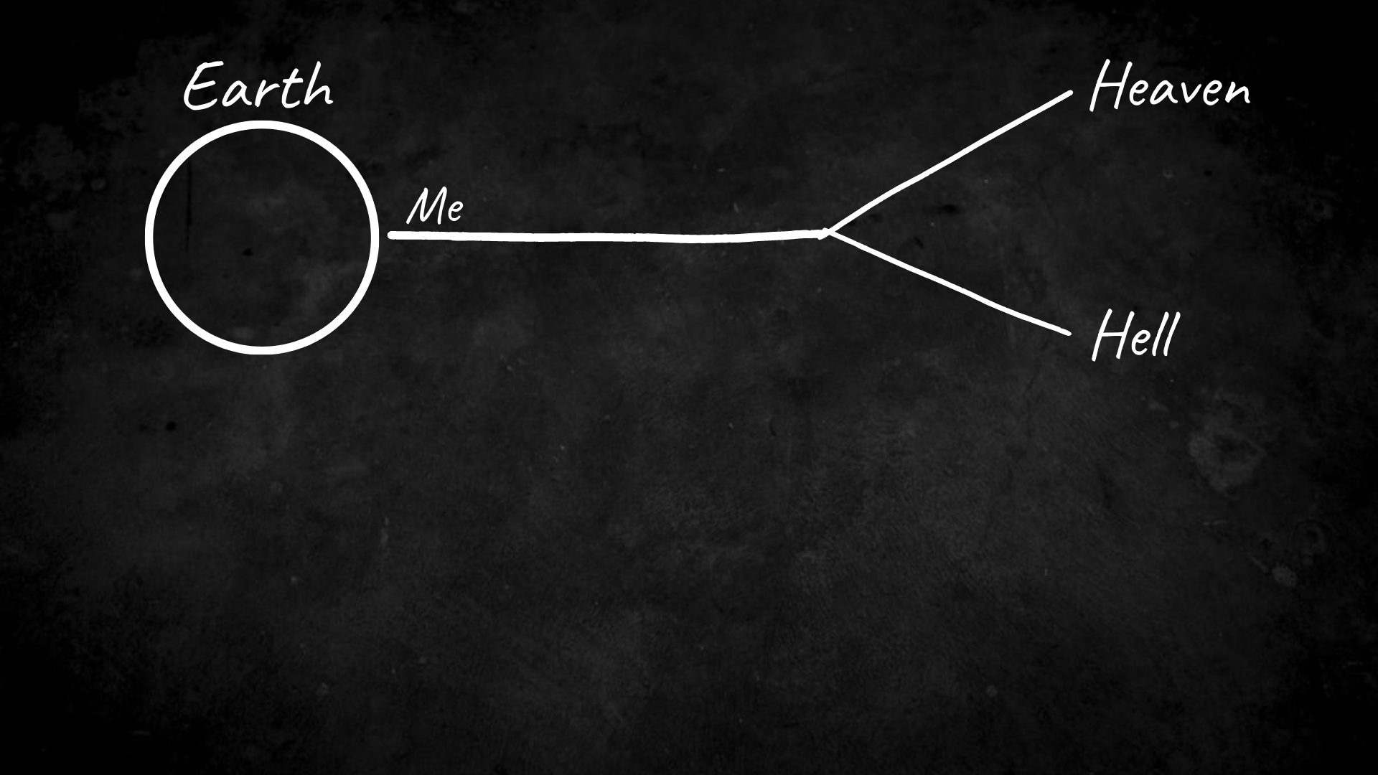
Notes:
[BRIEF COMMENTS]
This is the story your non-Christian neighbors think you believe.
You might be thinking, ”But that is what I believe.”
The problem with that is this: It’s not the biblical story and it doesn’t reflect the beliefs of Jesus and the gospel of the Kingdom.
So, if this isn’t the correct story, what is then? [NEXT SLIDE]

Slide 10
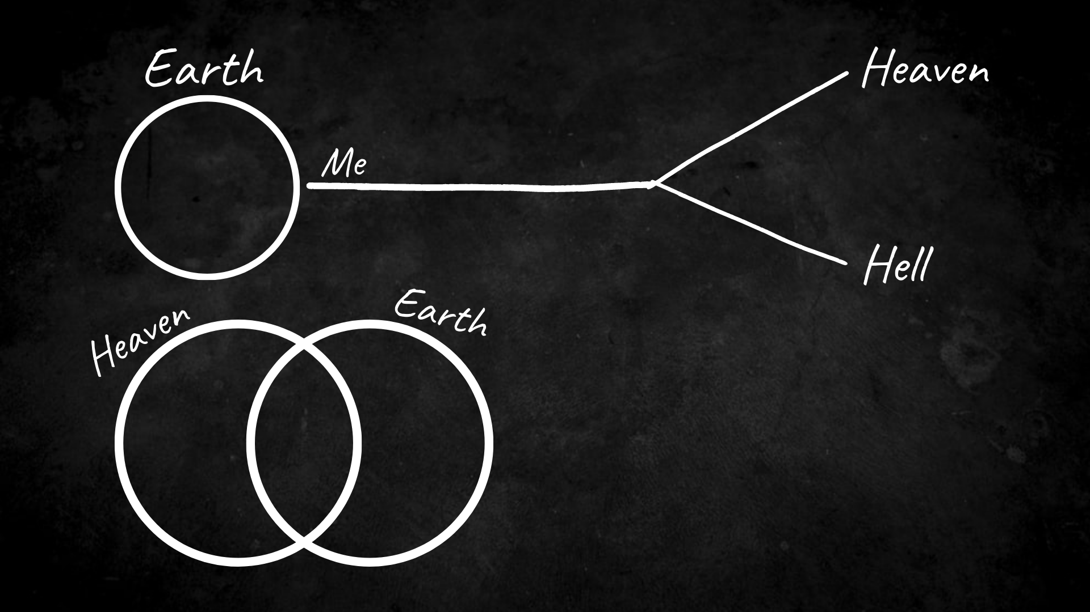
Notes:
[BRIEF COMMENTS]
God created two spaces, realms, or dimensions: God’s space (heaven) and our space (earth & the cosmos)
The spaces were shared more freely in the Garden of Eden
But sin tears these spaces apart and separates us from God (Gen 3)
Yet, these spaces still overlap and interlock: OT - Mt. Sinai, the tabernacle, and the temple
The temple (signifying the overlap) is destroyed
Isaiah says there will be a new heaven and earth—the marriage of these two spaces (Isa 65:17)
So, this is what God’s good future looks like… [NEXT SLIDE]

Slide 11
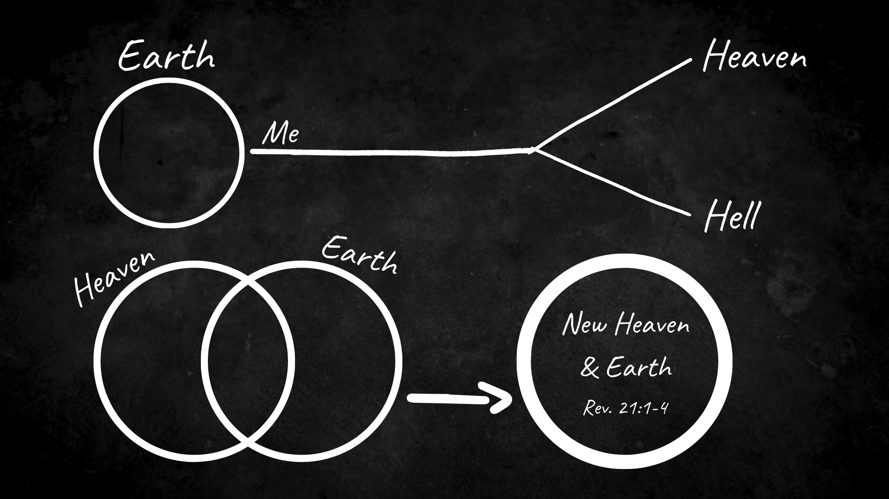
Notes:
[BRIEF COMMENTS]
And not only did Isaiah prophecy this future, so does John in Revelation 21:1-4
Yet, for the disciple John, he believes this because of what happened in Jesus, which I’ll get to in a minute…
But first, notice… God made heaven and earth. Genesis is very clear about that. But what about hell? Is there a hell? And if so, where did hell come from? And where does it fit in the story?
Well, we should begin by acknowledging that whatever hell is, it comes into the story later—after creation. And if you know your Bible, you should know that hell is first something that humans have created. [NEXT SLIDE]

Slide 12
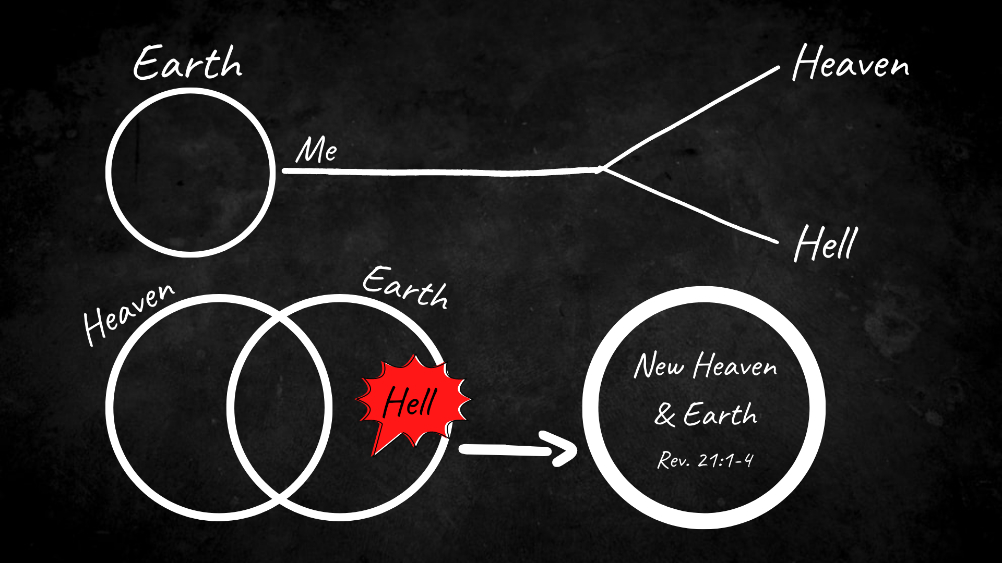
Notes:
[BRIEF COMMENTS]
How have we done this? (Gen 3-11; Romans 1:18-32; James 3:6)
So, hell is first a reality now. Whatever we might say about hell eternally, we first must recognize that hell is with us. It is here with us, and we created it by misusing human energy and freedom.
God hates hell. The story of the Bible is God wanting to heal his world and get the hell out of it!
So, Jesus comes onto the scene (in the story of Israel) and he confronts the powers of hell… [NEXT SLIDE]

Slide 13
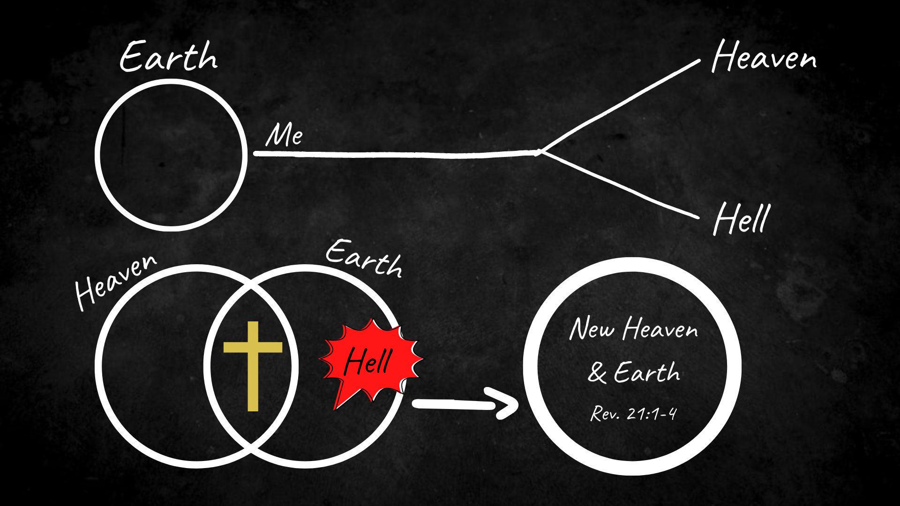
Notes:
[BRIEF COMMENTS]
He confronts the powers of sin and death (in you and in me), and he seeks to drive it out with the gospel of the Kingdom. Because Jesus (who is God in the flesh) hates hell. And he wants to get hell out of this world and the hell out of you. Folks, that’s good news! But it’s also hard to accept because it means that Jesus is coming after you with a scalpel—to cut out (to root out) all that is hellish and doesn’t reflect the life of heaven in you, if you will allow him to do that work as his disciple.
[THE STORY OF JESUS]
His incarnation– John 1:14, “The Word became flesh and made his dwelling among us. We have seen his glory, the glory of the one and only Son, who came from the Father, full of grace and truth.”
His life, teachings, and the coming Kingdom (with warnings of an eternal hell)
His death – hell exhausts its power on Jesus; Jesus takes our sin upon himself, restores us to relationship with God, and offers us new life; As Paul wrote in Colossians 1:19-20, ”For God was pleased to have all his fullness dwell in him, and through him to reconcile to himself all things, whether things on earth or things in heaven, by making peace through his blood, shed on the cross.”
His resurrection – “destroy this temple and I will rebuild it…” And the resurrection begins the movement and the marriage of God’s space and our space; the resurrected Jesus is evidence that God is doing and will do what he promised.
N.T. Wright, in his book, Surprised by Hope, writes: “Jesus's resurrection is the beginning of God's new project not to snatch people away from earth to heaven but to colonize earth with the life of heaven. That, after all, is what the Lord's Prayer is about.” Remember the words of Jesus. He prayed, “Thy Kingdom come, they will be done, on earth as it is in heaven.”
Therefore, Jesus says, repent and believe the good news. The Kingdom is coming! The spaces are on their way to becoming one. Thus, hell cannot remain. So, where will it go?
If you look at the last pages of the Bible, where and what is hell? We could put it like this. Hell is God’s monument (as C.S. Lewis once wrote) to human dignity and choice.
If someone refuses to return to their Creator… refuses be healed by the great physician… if someone rejects God’s salvation from death and disaster… if someone does not wish to live in God’s good future where Christ is Lord and king… then God will honor that decision. God will give them over to their choices. But what God will not do is continue to allow hell to ruin his good world. Which is why he plans to cast hell out forever. [NEXT SLIDE]

Slide 14
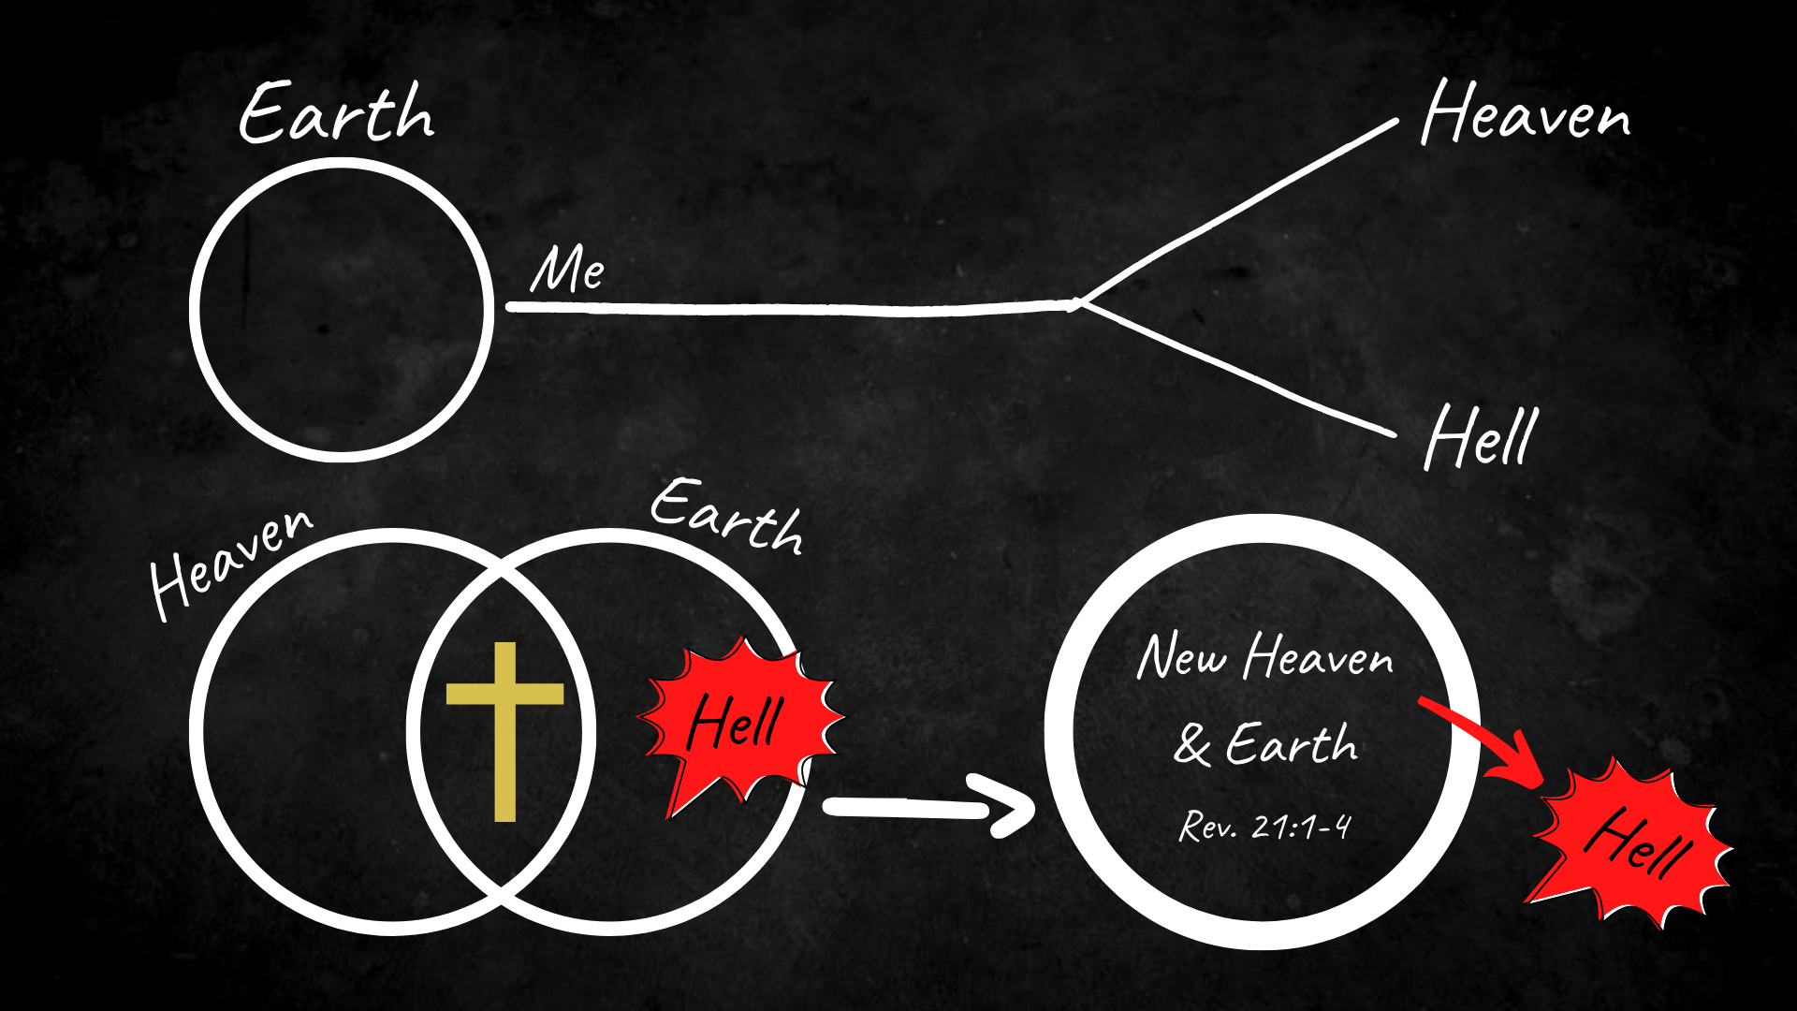
Notes:
[BRIEF COMMENTS]
Brothers and sisters, this is the gospel story. And when we accept this story and allow this story to intersect and impact every area of our life, we will begin to find (as the Apostle Paul said)… it is the “power of God unto salvation” (Rom 1:16).
For by this gospel we will discover who God is (what he is like), who we are (and our purpose), what God is doing about evil (and wants you to do about it), and shapes us by the hope of it—by a Kingdom imagination and the glorious expectation we can have in this life, even in the face of so much evil and the fear of death. This news is good because it changes everything.
But, as Jesus said, we must first repent of our way (with all the competing stories and liturgies of the world) and accept the good news of the Kingdom for ourselves, if we want to live life to the fullest and be assured of the life to come.
Therefore, let’s reflect and respond to these two questions together… [NEXT SLIDE]

Slide 15

Questions for reflection and response:
Gospel as Story

Slide 16
Questions for reflection and response:
What story am I living in today?
Gospel as Story

Slide 17
Questions for reflection and response:
What story am I living in today?
How can I live more fully into the gospel story?
Gospel as Story
Notes:
[BRIEF COMMENT ON EACH]
[CLOSING WORDS]
[CLOSING PRAYER (beautiful name - yours is the kingdom & the glory) – NEXT SLIDE]

