Slide 1

Notes:
This is the third Sunday in Lent and week 3 of our sermon series, Galatians: Faith Formation in Centered-Set Community.
We’re continuing to go chapter-by-chapter through Galatians, the very first epistle written by Paul in the New Testament, and we’re seeking to better understand his passionate letter to the churches in Galatia by reading it through the lens of bounded, fuzzy, and centered-set community.
Remember what those are… NEXT SLIDE]

Slide 2
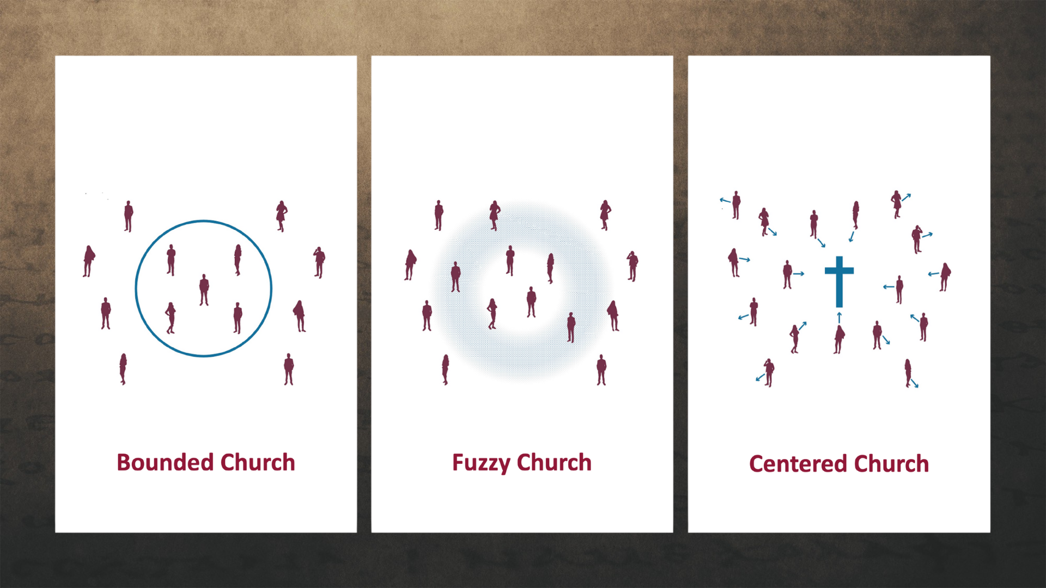
Notes:
A Bounded Church has a clear boundary line that is static and distinguishes who is in and who is out. The line generally consists of a list of correct beliefs and certain visible behaviors. A bounded church tends to create a sense of superiority and judgmentalism among its core members. And it hinders transparency and utilizes shame to motivate right behavior. Again, this is the sort of thinking that was threatening the Galatians and at the heart of why Paul is so concerned for them.
A Fuzzy Church is the opposite of the bounded church. It erases all lines and boundaries. The grounds for distinguishing who is in and out, as well as shaming and judging others, is gone, but the fuzziness about what they believe and who they are erodes the group’s sense of identity. Therefore, it lacks a sense of call to follow Christ, and it disregards discipleship and spiritual formation. It has a tendency toward blandness, low expectations, and it creates a new set of problems in the church.
A Centered Church discerns who belongs to the group by observing people’s relationship with the center—Jesus Christ. Do they desire to follow Jesus? Are they making decisions that reveal the orientation of their heart is to pursue and become more like Christ? That’s what this groups wants to do. And it’s their common direction that brings unity. In the centered church, there is space to struggle and fail because they believe that everyone is in process as they move closer to the center.
And I’ve been saying that this centered-set community is what Paul wants for the Galatians. And they can have it if they will embrace the gospel of God’s grace, which makes centered church possible.
If you’re just joining us, here is some background information on Galatians and a quick review of what we’ve looked at so far… [NEXT SLIDE]

Slide 3
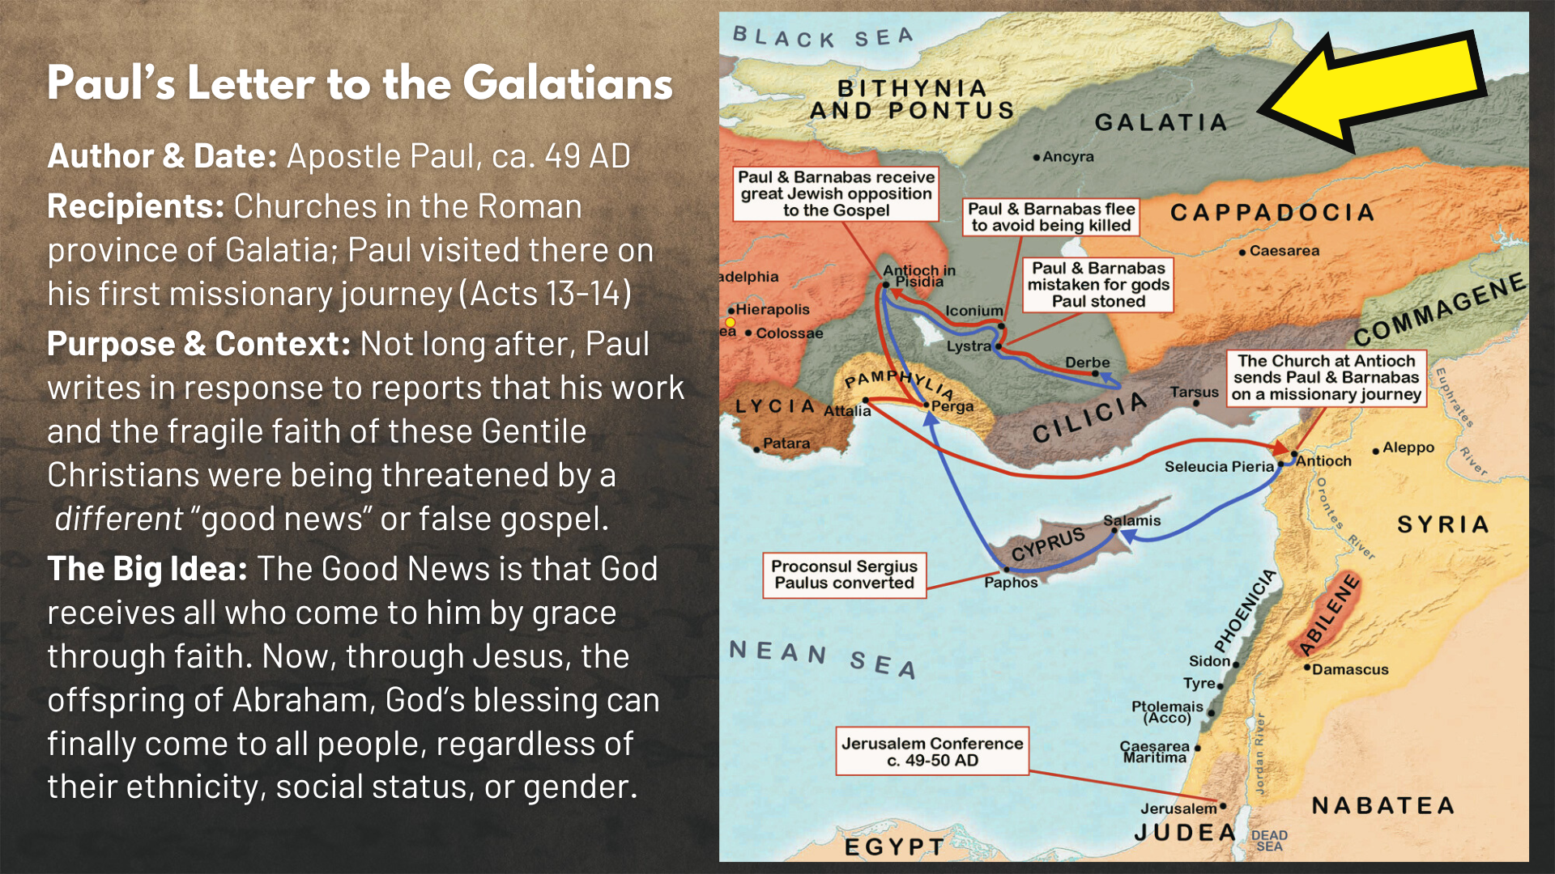
Notes:
In Acts 9, Saul of Tarsus, the zealous Pharisee who is hunting down Christians to arrest them and oversee their executions, meets the risen Jesus on the road to Damascus in a great light. Shortly after his conversion, Paul receives his calling to be the Apostle to the Gentiles. And after many years of rethinking his understanding of the Scriptures, how Christ fulfills the Law & the Prophets; and after meeting with some of his first disciples, and preaching locally, Paul eventually joins up with Barnabas (another Jewish believer) and they set off from Antioch on their first apostolic journey.
On that first journey they plant churches in the southern part of the province of Galata, which you can read about in Acts 13-14. And not long after that journey (around 49 AD), Paul writes to the Galatians in response to reports that his work and the fragile faith of these Gentile Christians were being undermined and threatened by the work of some “agitators” from Jerusalem leading them astray with a false gospel that required males to be circumcised and men and women to obey the Torah.
And these two gospels are very different… [NEXT SLIDE]

Slide 4
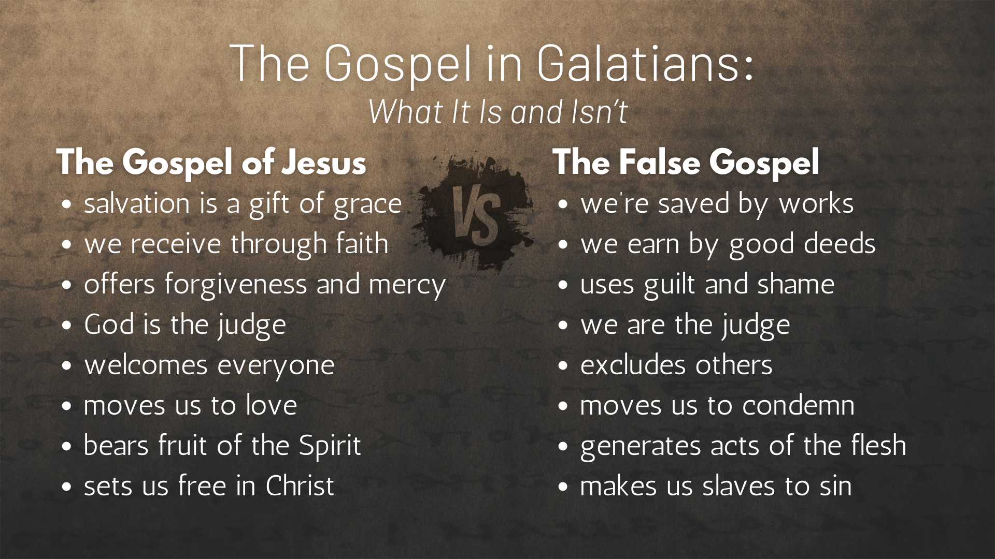
Notes:
[READ EACH POINT & COMMENT]
The Gospel of Jesus and then the False Gospel
And here is where we’ve been so far and where we’re going in this letter… [NEXT SLIDE]

Slide 5
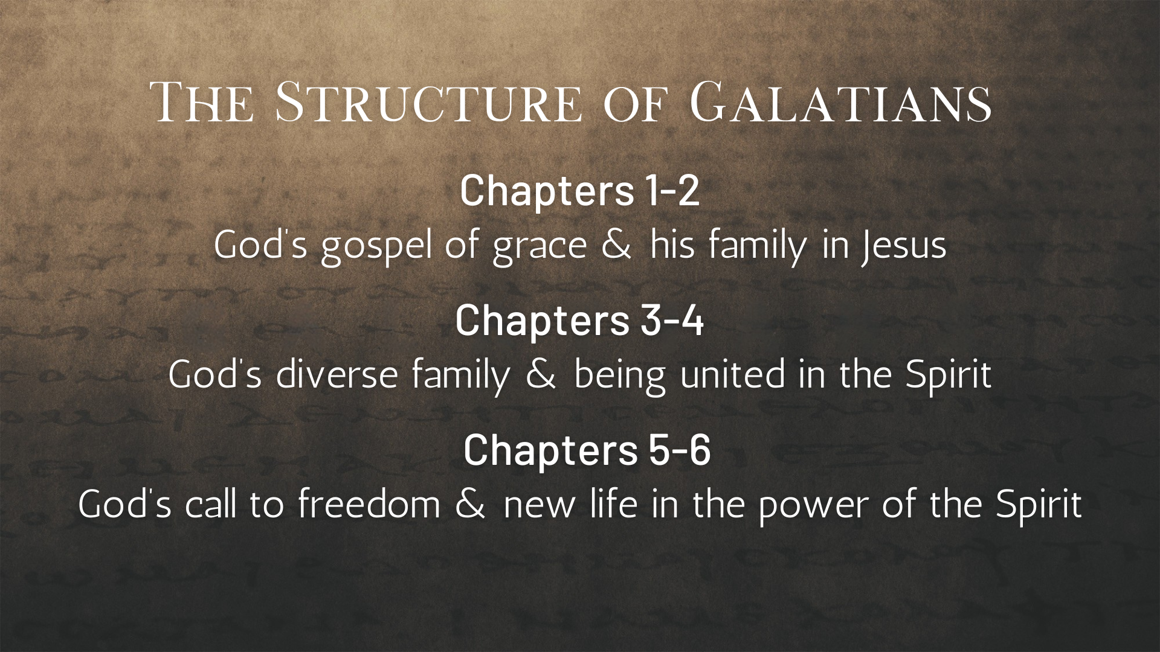
Notes:
In the first two chapters, we heard Paul’s frustration at how the Galatians have wandered away by listening to the false gospel as he unpacks God’s gospel of grace and shares how God desires a people (a family) where everyone who accepts Jesus through faith can participate in the Body of Christ and his coming kingdom.
Last week we heard Paul tell the Galatians that he had recently confronted Peter at Antioch because of Peter’s flipflopping faith. Remember, at first Peter shared table fellowship with the Gentile believers at Antioch, but then he stopped doing it once the bounded-thinking agitators from Jerusalem arrived. It’s likely at this point that Paul learned about how these “friends of James” from Jerusalem had been leading the Christians in Galatia away from the gospel of God’s grace.
Today we’re looking at chapter 3, which begins a new section of this letter that could be summed up as “God’s diverse family and being united in the Spirit.” [NEXT SLIDE]

Slide 6

Notes:
Paul is going to shift from his narrative and story-telling to laying out a series of arguments responding to what the bounded missionaries have likely said to the Galatians. He will explain the real purpose of the law, how the covenant with God works, and how all disciples of Jesus can become children of God through faith in Christ.
And all of this is in keeping with Paul’s efforts to encourage these believers to embrace the gospel of God’s grace and move away from bounded thinking to a centered-set practice of community.
Let’s jump right in now with Galatians chapter 3, beginning with verse 1… [NEXT SLIDE]

Slide 7
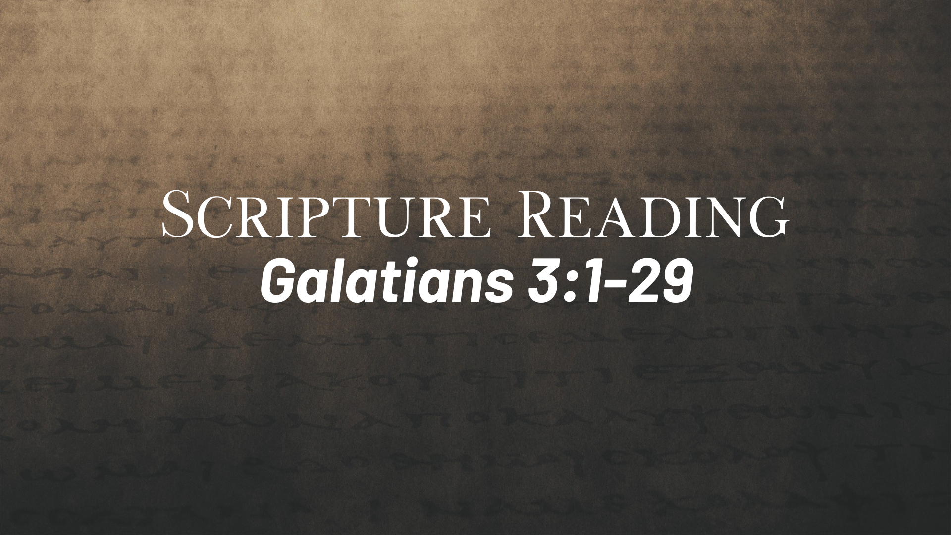
Notes:
[READ VERSE-BY-VERSE & COMMENT]
v. 1 – “foolish” or unwise; the opposite of sophia (wisdom); “bewitched” - led astray by evil or wicked arts; Paul is likening the bounded agitators to witches who have cast a spell on them!
v. 2 – Clearly, obeying the law had nothing to do with them becoming Christians
v. 3-4 – Was the Spirit and the gospel of God’s grace not enough?!
v. 5 – You’ve seen a lot of amazing things because of simple faith
v. 6-7 – Quotes Gen. 15:6 – Paul is pointing out that Abraham believed the promise that God gave him to make him a great nation, and God accepted his simple faith, long before the law of Moses.
v. 8-9 – Baker writes: “Paul did not promote a Christian Judaism like the Judaism of his past except for now including Gentiles. Rather, the “Israel” that the Galatian converts were brought into was an Israel whose history and identity had been radically reinterpreted and reconfigured by the cross and resurrection.” In other words, Jesus has reconstituted “Israel” to include all Jews and Gentiles who trust in his gospel of grace and follow his way of being human and of redeeming the world.
Verse 10… [NEXT SLIDE]

Slide 8
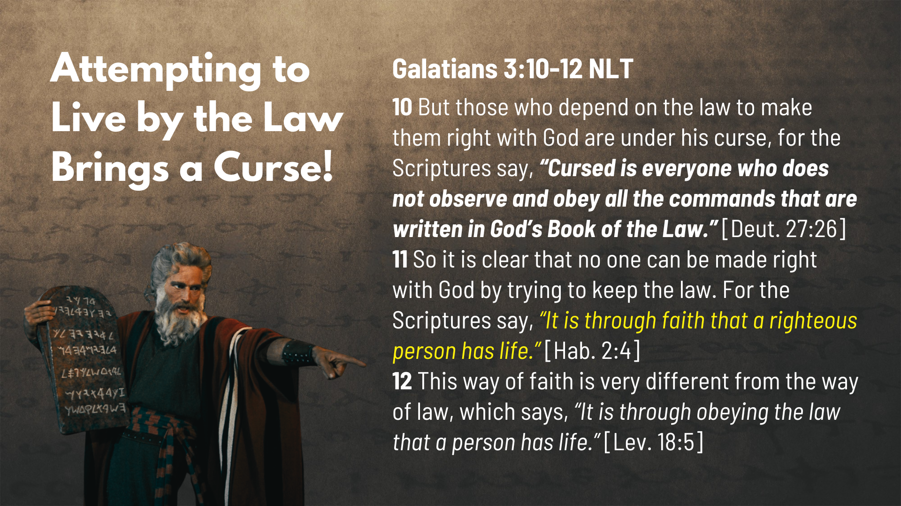
Notes:
[READ VERSE-BY-VERSE & COMMENT]
v. 10 – “curse” – full of divine wrath or punishment; we will experience the “curse” (a wrath that is built into creation) when we attempt to live by the law and judge others by it.
v. 11 – the OT prophets often helped Israel to look back and see God’s original intent and then to see past their failures, brokenness, and exile into God’s good future
v. 12 - ”the way of faith” is different because it leads to holiness without bounded thinking; “the way of faith” and the way of the gospel of God’s grace in Christ changes us from the inside-out.
Verse 13… [NEXT SLIDE]

Slide 9
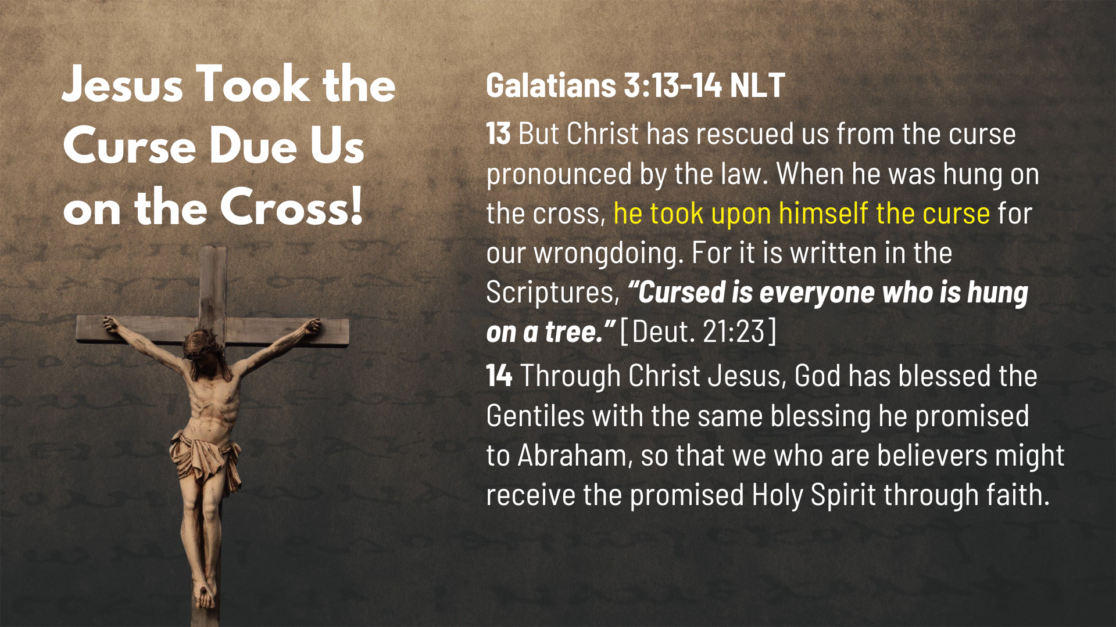
Notes:
[READ VERSE-BY-VERSE & COMMENT]
v. 13 – Listen carefully, folks. Jesus takes our place (there is substitution), and he receives the curse that was coming our way for failing to live up to God’s law; therefore, the divine “wrath” (which is built-into God’s creation) that our sins accrued, God the Father through his Son Jesus Christ took it upon himself on the cross. We sinned. We broke the rules. And WE were bringing death and hell down upon ourselves because of our transgressions, but Jesus willingly went to the cross and bore it himself. He did not protect us from an angry dad, or to ”satisfy” a sky-daddy’s bloodlust, but rather… he revealed a loving Father who was willing through God the Son to lay his own life down so that we can receive mercy, grace, and forgiveness; so that we can “glorify God and enjoy him forever.”
v. 14 – In other words, what Christ did on the cross and this gospel of grace that he establishes in his death and resurrection, is available to everyone through faith. And the Holy Spirit makes this possible.
Verse 15… [NEXT SLIDE]

Slide 10
Notes:
[READ & COMMENT ON VERSES 15-22]
[VERSE-BY-VERSE 23-25]
v. 23-24 – ”guardian” - paidagōgos (Latin: paedagogus) a guide and guardian of boys. Among the Greeks and Romans, the name was applied to trustworthy slaves who were charged with the duty of supervising the life and behavior of boys (particularly) and helping to shape their morals and values.
Generally speaking, because boys are seen as risk-takers and are happy to test boundaries, they weren’t allowed to even step out of the house without their paedagogus until they had become an adult; So, understand the analogy that Paul is making here… the Mosaic law is likened to a tutor or “guardian” because it makes us aware of God’s holiness and our sin, therefore, Paul is saying that the law is our paidagōgos into Christ, i.e. it prepares us for Christ and to live by faith.
v. 25 – ”the way of faith” as opposed to ”the way of the law”
We can sum up what Paul is saying about the Law of Moses this way… [NEXT SLIDE]

Slide 11
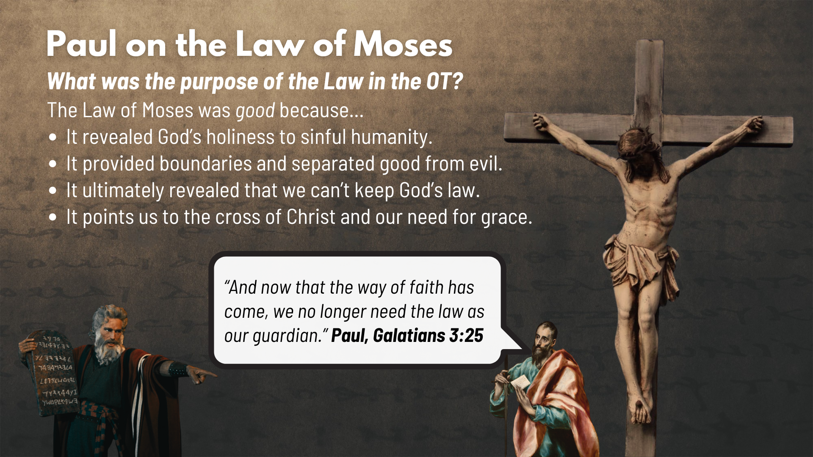
Notes:
[READ & COMMENT]
Paul is saying that God’s purpose for the law was good, but it is bounded people that use it to maintain bounded community; they misuse the law, thereby opposing the way of faith that welcomes everyone into a relationship with Christ and his family, the church.
Let’s now listen to Paul in the last few verses of chapter 3… [NEXT SLIDE]

Slide 12
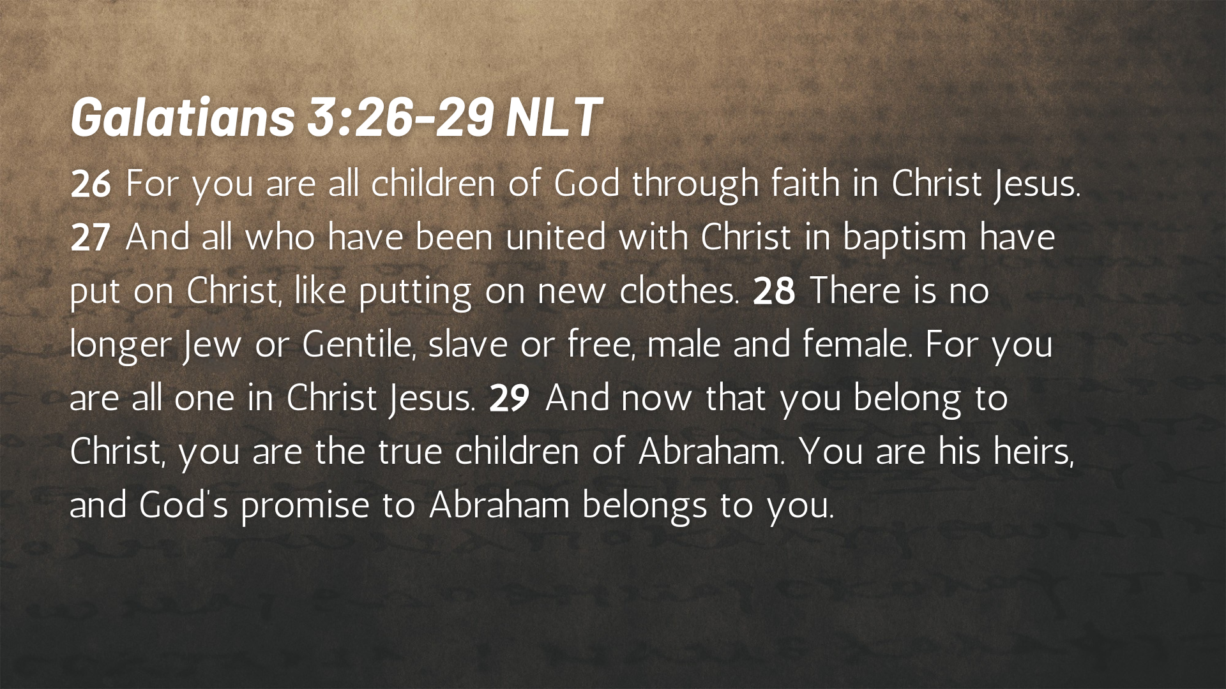
Notes:
[READ VERSE-BY-VERSE & COMMENT]
v. 26 – Is everyone a child of God? Not according to the Scriptures. Yes, we’re all made in God’s image (having inherent worth, dignity, and value), but to be ”adopted” into God’s family and join his redemptive purposes in the world only comes through faith in Christ Jesus.
v. 27 – “united with Christ in baptism” refers to the first step of obedience into Christian faith; baptism is the initiation; the rite of passage into Christ and his community; he wants them to recall their baptism; it’s their baptism which means God has accepted them by grace through faith.
v. 28 – Paul mentions the divisions that were evident among the Galatian churches, especially as it related to obeying the Torah and the false gospel being propagated by the bounded agitators; “one in Christ Jesus” means they belong to Christ and each other through faith alone.
v. 29 – “true children of Abraham” and “heirs” because of simple faith in Christ and nothing more
And it’s important to hear what Paul is saying in Galatians 3:28. This flies in the face of bounded thing. But it’s also not reflective of fuzzy thinking either. Listen to what Mark Baker writes in his commentary on Galatians… [NEXT SLIDE]

Slide 13
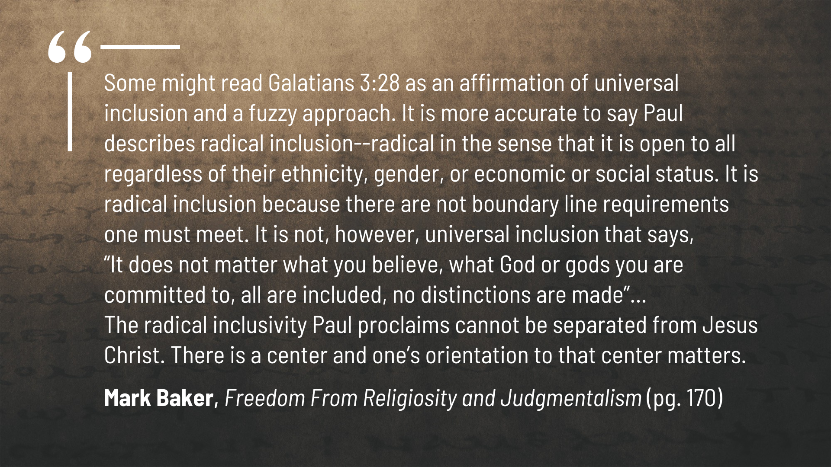
Notes:
[READ QUOTE & COMMENT]
What does this look like? Well, let’s bring Gal. 3:28 to our centered church image… [NEXT SLIDE]

Slide 14
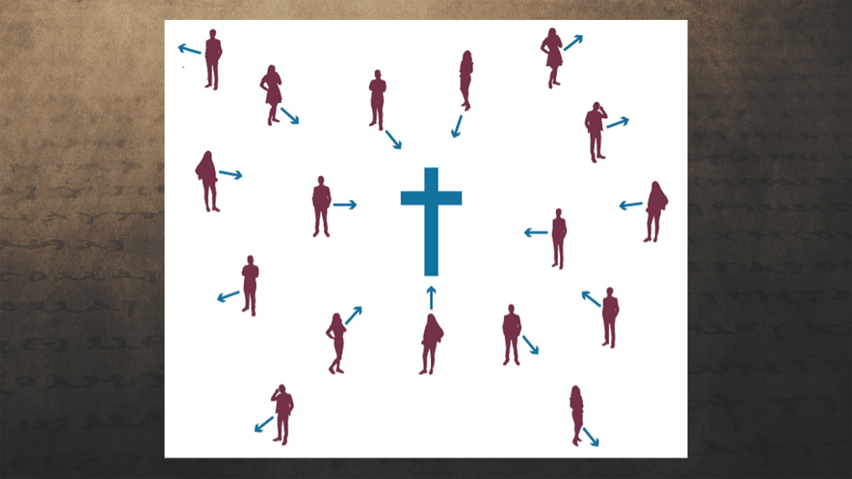
Notes:
[BRIEF COMMENTS ON CENTERED CHURCH]
So, how might we apply what we’ve been hearing. Here are some suggested takeaways… [NEXT SLIDE]

Slide 15
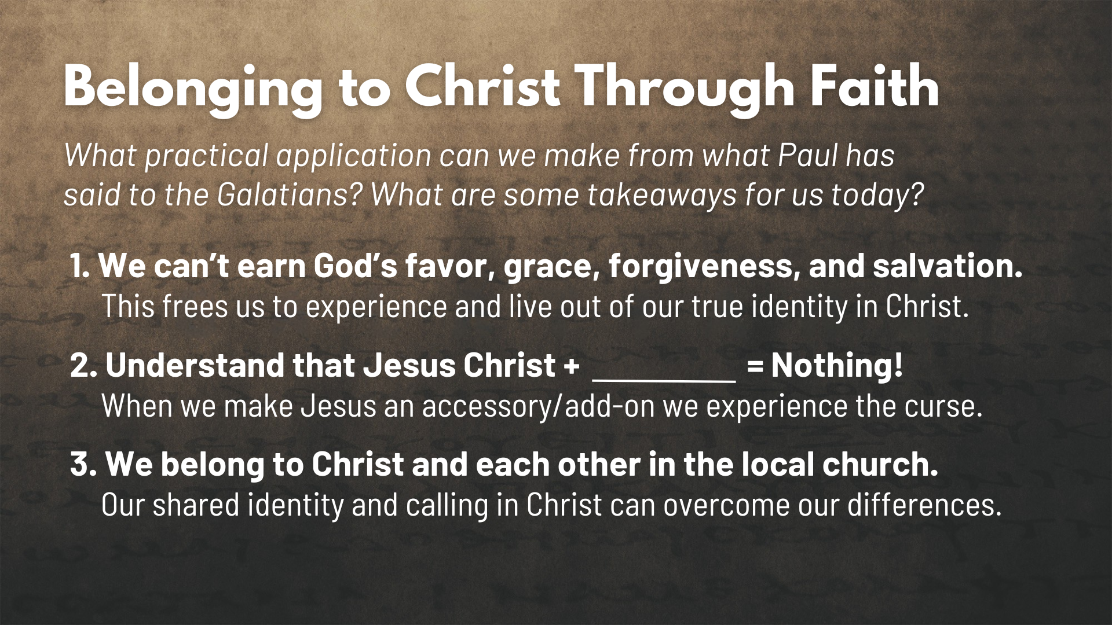
Notes:
[APPLICATION - READ EACH POINT & COMMENT]
1. We can’t earn God’s favor, grace, forgiveness, and salvation.
This frees us to experience and live out of our true identity in Christ.
2. Understand that Jesus Christ + ________ = Nothing!
When we make Jesus an accessory/add-on we experience the curse.
3. We belong to Christ and each other in the local church.
Our shared identity and calling in Christ can overcome our differences.
Finally, here are some questions to help us reflect and respond to the message… [NEXT SLIDE]

Slide 16

Notes:
Questions

Slide 17
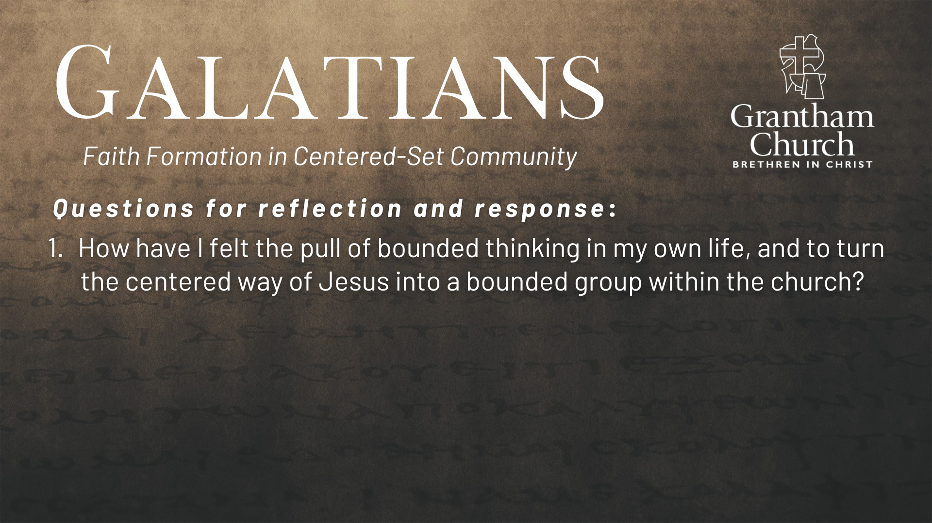

Slide 18
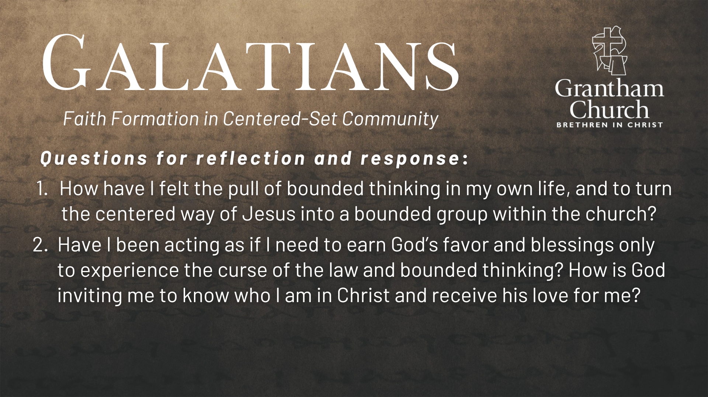

Slide 19
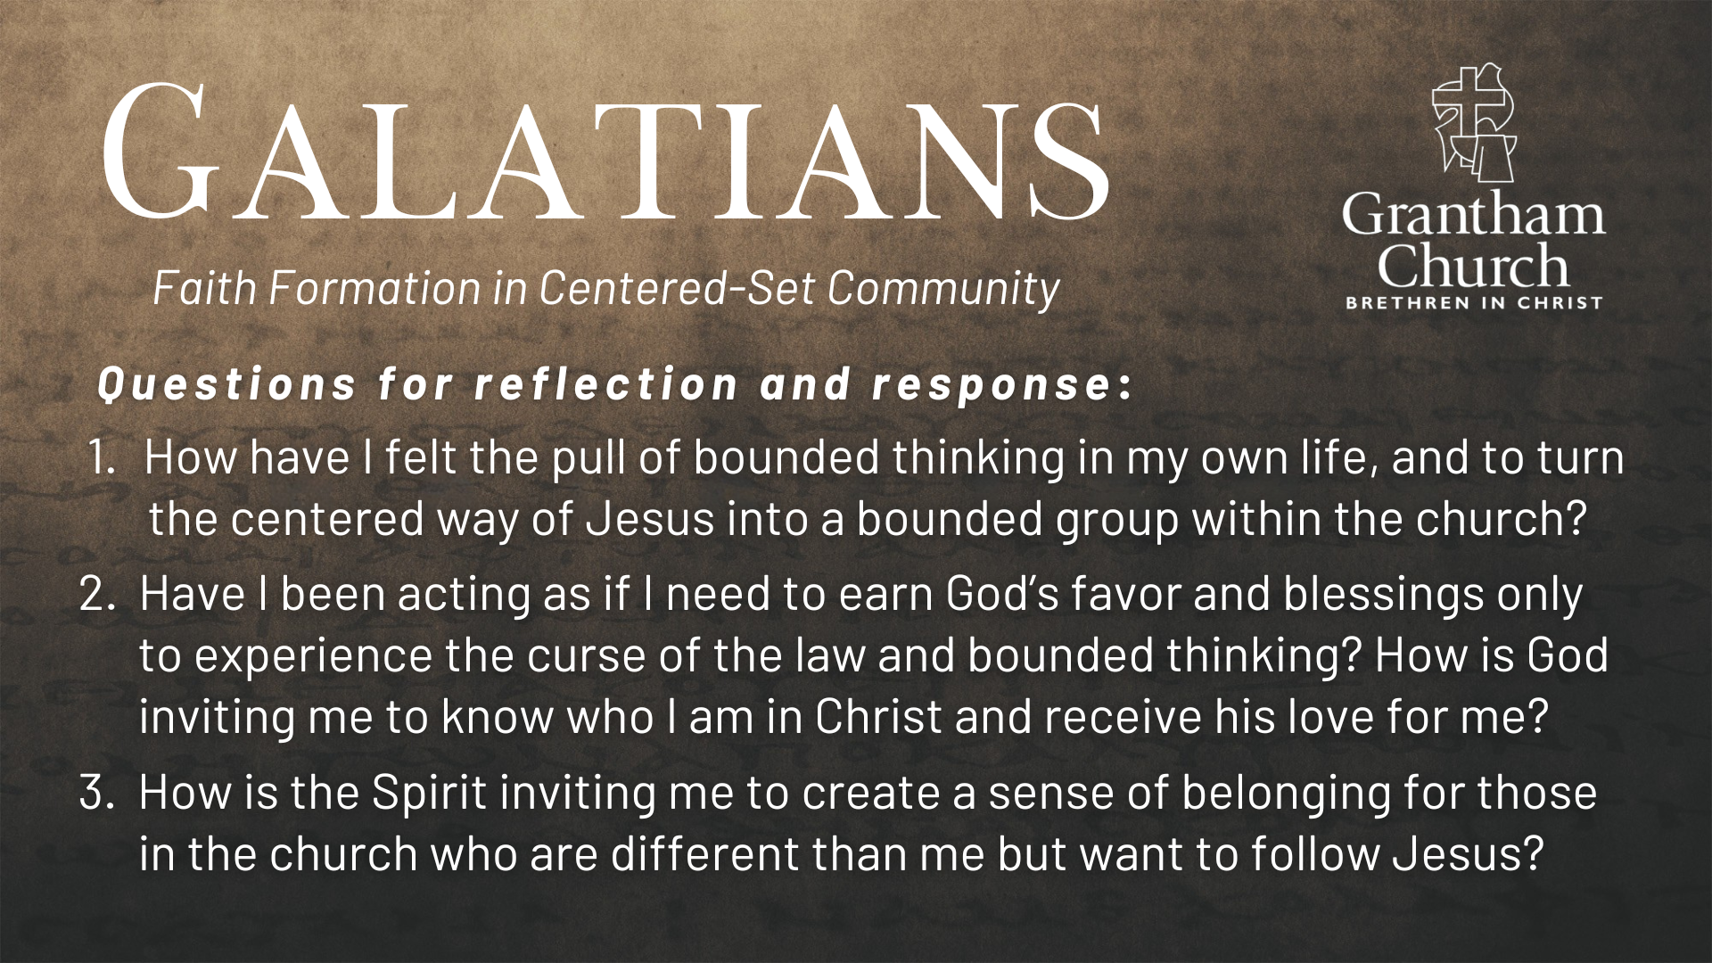
Notes:
[READ & BRIEF COMMENT ON EACH QUESTION]
How have I felt the pull of bounded thinking in my own life, and to turn the centered way of Jesus into a bounded group within the church?
Have I been acting as if I need to earn God’s favor and blessings on to experience the curse of the law and bounded thinking? How is God inviting me to know who I am in Christ and receive his love for me?
How is the Spirit inviting me to create a sense of belonging for those in the church who are different than me but want to follow Jesus?
[CLOSING WORDS]
Let’s pray… [NEXT SLIDE FOR CLOSING PRAYER]

Slide 20

Notes:
[CLOSING PRAYER]
Benediction
Brothers and sisters, we’ve been saved by grace through faith to be formed in Christ-centered community. May you only boast in the cross of our Lord Jesus Christ, for we have been freely given (not earned) Gods love and favor. Now let us go and extend that same gift of grace to others—in the church and in the world. In the name of the Father, and of the Son, and of the Holy Spirit. Amen.

