Slide 1
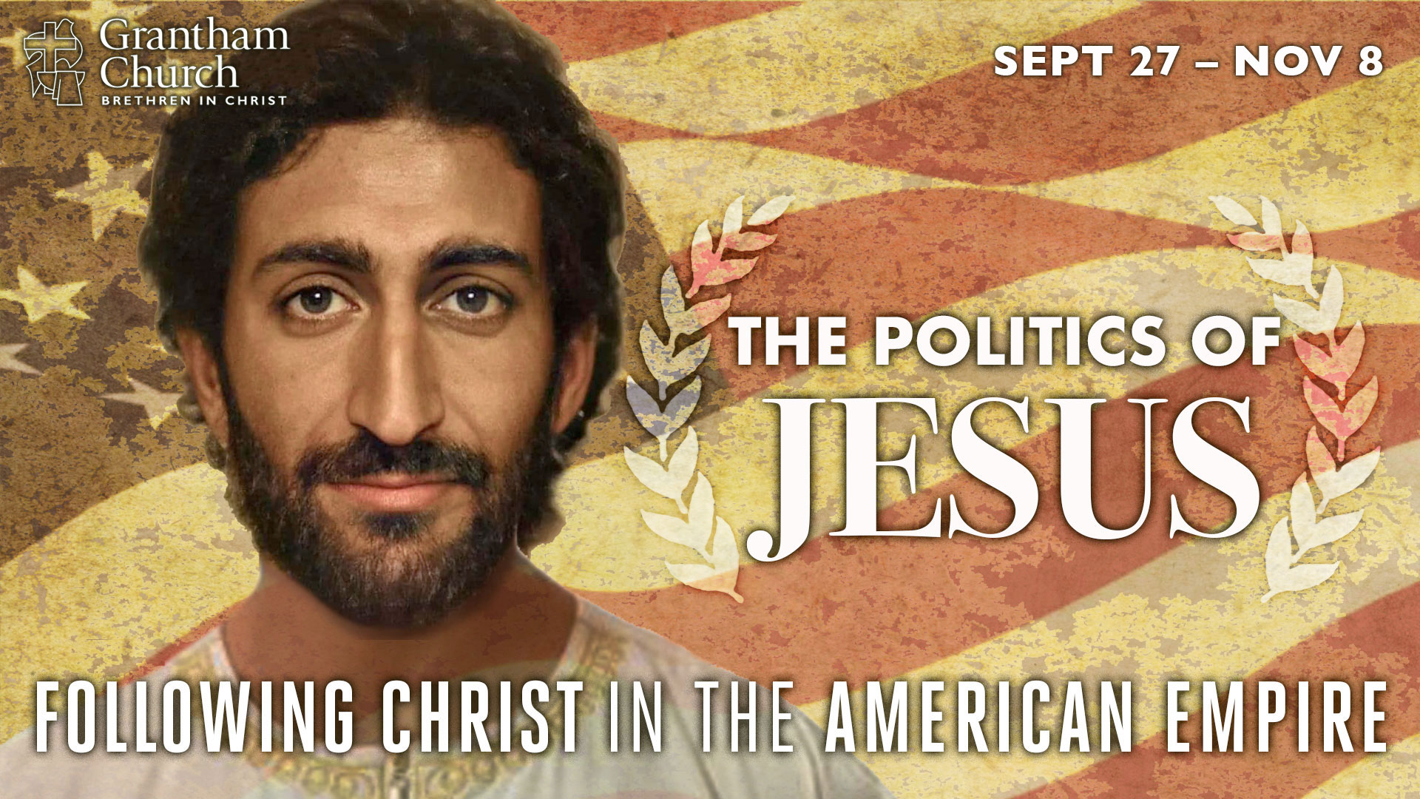
Notes:
Today we conclude our fall 2020 sermon series, The Politics of Jesus. A series that was designed to help us navigate the election season, to explore the political nature of the gospel, to rethink what we thought we knew about Jesus, and to allow the Messiah from Nazareth lead us to a more authentic expression of our faith, so that we might faithfully embody the life and teachings of Jesus.
And at the time of this recording, which is Friday afternoon (Nov 6th), we still don’t know the results of the presidential election, as ballots are still being counted. By the time you’re listening to this message, we may know whether Joe Biden is the new president of the United States, or if Donald Trump has extended his presidency for another four more years.
But regardless of the election outcome, I’ve prepared a message that speaks to what we do know. And that is this: (1) Jesus is Lord and (2) we have some major problems in this country. And those problems (as we can see by this close presidential race) will ultimately not be resolved through American politics in its current form, no matter who the president is and what political party gets the upper hand. So, what can we do? What should the church do now? And where might the Spirit be leading us to go from here?
I’ll say more about that and how I believe the church should respond a little bit later. But let’s begin by reflecting on what we’ve covered in this series before we land the plane (so to speak) and bring this series to a close. Here’s where we’ve been: [NEXT SLIDE]

Slide 2
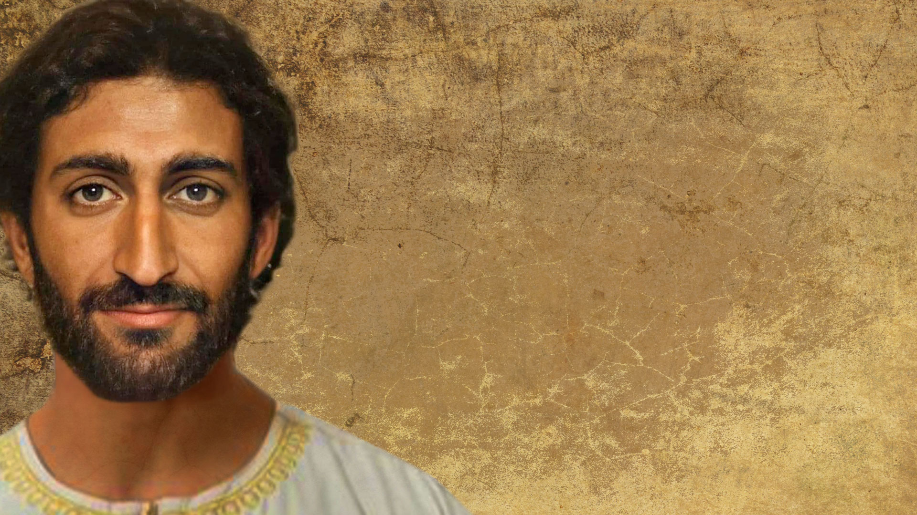
The Politics of Jesus
Church, We Have a Problem!
Jesus & the Third Way
The Inaugural Address of Jesus
The Patience & Empathy of Exiles
Might From the Margins
Jesus, You & the Voting Booth
Notes:
In the first message, Church, We Have a Problem!, we looked at how Jesus said that his disciples are to be known by their love, but unfortunately that isn’t the case today. Instead of living in love and trusting in cross-power, many Christians are lusting for political power and fighting culture wars. So I called us to remember who we are and to return to the way of Jesus
In the second message, Jesus & the Third Way, we saw how Jesus resisted the temptation to use worldly kingdom power to achieve the ends of the Father. He showed us that the Kingdom of God is about power-under, not power-over. And he called disciples with divergent political views to follow him and discover a “third” way to live within the empire. Therefore, I said that we need to pledge allegiance to Christ and trust in his way of changing the world.
In the third message, The Inaugural Address of Jesus, I invited us to see how as an incoming president reveals the things they intend to do when they come into power, Jesus does the same when he makes his royal announcement in Nazareth in Luke 4. But unfortunately, as Jesus saw in his hometown, not everyone desires his Kingdom. Because the Messianic agenda of Jesus is good news for those wanting a new world, but it’s bad news for those who aren’t willing to repent and let go of the old one.
And then in the fourth message, The Patience & Empathy of Exiles, I shared how the early church did not see themselves as the moral guardians of society or try to impose their will on the world. They had no political power—no vote—yet they turned the Roman Empire upside down. And they did it by faithfully living out the Messianic agenda of Jesus as citizens of the Kingdom. They weren’t in a hurry or in a panic. Instead, they lived as empathetic exiles and trusted God to work in his time.
In week 5, in a message entitled, Might From the Margins, guest speaker Dennis Edwards told us that if we want to see Jesus today, we don’t look to the powerful, we look to the powerless. The first Christians were among the powerless. So, who are the powerless today? Well, look around you. Who are the oppressed, forgotten, and exploited by the imperial system. Dennis said that it’s time to listen and learn from those in the margins, because they are the best teachers of what it means to be followers of Christ in the American Empire.
And then last week, in the sixth message of the series, Jesus, You & the Voting Booth, I said that it’s time for Christians in America to acknowledge that we’re living in a modern-day empire, and I gave some reasons why the US is more like Babylon or Rome than ancient Israel, and how the US is not a Christian nation. Instead, there is only one holy nation—the church. And as the church, as aliens and exiles on the earth, our civic conduct, our political life, should reflect the gospel of King Jesus, his Messianic agenda, and the beauty of his Kingdom.
Which brings us to the final installment in the series, a message I’ve entitled… Long Live King Jesus! [NEXT SLIDE]

Slide 3
The Politics of Jesus
Church, We Have a Problem!
Jesus & the Third Way
The Inaugural Address of Jesus
The Patience & Empathy of Exiles
Might From the Margins
Jesus, You & the Voting Booth
Long Live King Jesus!
Notes:
When we say “Jesus is King”… what do we mean? We need to give this some serious thought because American society has been so heavily influenced by Enlightenment thinking that we fail to recognize how it tends to kick God upstairs out of sight, out of the public square, and privatizes matters of faith, in order to keep religion separate from secular society, to keep Jesus in his place—i.e. in church services, in our private lives, and out of the real world.
And there are probably some of you who are thinking, “Yeah, like how they’ve kicked God out of the public schools, and how we can’t pray before football games.” No, that’s not what I’m talking about, and that shouldn’t be what concerns Christians living in a pagan, pluralistic nation—within an American empire. Instead, I’m referring to how we as Christ-followers have failed to understand and embrace the politically subversive nature of the gospel for ourselves. For example, many evangelicals have been far more concerned about the country keeping the veneer of Christianity but aren’t troubled by how we don’t really believe or apply the gospel of Christ to our own lives and living. We don’t see how we’ve made Jesus subservient to our American identity and worldview.
You see, most of us have been born into this way of compartmentalizing our lives so that we don’t see how this demonic assault on our faith has covertly undermined our Christian faith and made it impossible to experience the full impact of Christianity as a radical counter-cultural movement. It causes us to not see how truly revolutionary our faith is, and so the words we use about Jesus and our religion are stripped of their power, and the subversive impact of our language is lost (it’s never felt) because it doesn’t really mean anything.
So when we say, “Jesus is King”… if we’re honest, some folks are probably thinking, he’s king of my life in some “personal Lord and savior” sort of way—which I think can be a form of American individualism where Jesus is fortified within the walls of our own heart. He’s mine. And what I believe and how I live is none of your business. Essentially, I can believe in any version of Jesus I want. And so you don’t even see that the real Jesus isn’t king of your life, you are. And the American Jesus is just there to cheer you on.
Or when we say “Jesus is King” we might also mean in some future sense, when this world comes to an end, you know… later on when Christ returns. But, folks, the early church didn’t think that way. That’s not how they understood the gospel of Christ. Rather, they believed that God had really done something through Jesus that had real-world impact; that through Jesus… God was becoming King and that changed everything for them. They then conformed their lives and their thinking to this cosmic King Jesus.
Consider how this is presented in the New Testament: [NEXT SLIDE]

Slide 4

The Crowning of King Jesus
The angels heralded his royal birth (Lk 2:10)
Jesus was anointed by God in his baptism (Lk 3:21-22)
He defined his Kingship in his temptations (Lk 4:1-13)
He gave an inaugural address in Nazareth (Lk 4:14-30)
He gave us the Constitution of the Kingdom (Matt 5-7) & he embodied his Messianic agenda in his ministry
Jesus was hailed as King (Jn 12:12-19)
He was given a coronation (Jn 19:1-3)
He defeated his enemies (Lk 24:5-7; Col 2:15)
He ascended to the throne (Acts 1:10-11)
Notes:
[BRIEFLY COMMENT ON EACH]
So, Jesus’ crucifixion was his coronation, his resurrection was God’s approval, and his ascension is evidence that he is reigning and ruling now, not later… now! But how you might ask? It doesn’t look like Christ is Lord. I look out my window and I see a lot of crazy stuff, dark, evil things. But Jesus is Lord?
Yes, remember that Christ’s first coming is about bringing the Kingdom in the middle of the present evil age. These two ages overlap. It’s God’s bright future breaking into the darkness of this world. And so, like any warzone, we see small battles won here and there, we see glimpses of God’s Kingdom invading earth, we see slow advances, and sometimes major breakthroughs, as the struggle continues.
Wherever we see expressions of love, justice, mercy, and freedom for the captives; wherever we see forgiveness, repentance, reconciliation, and people denying their flesh to take up their cross; wherever we see baptisms, brokenness, and breakthroughs, we are seeing the Lordship of Jesus. Make no mistake about it, Jesus is Lord. He is reigning and ruling, and he commissions us to join this spiritual war effort. That’s how the early church saw it, and that’s what they were calling the world to recognize.
It’s what Paul had in mind when he said “Jesus Christ is Lord”… like he did with the Philippians. Let’s go back to where we began this series in Philippians chapter 2. Paul wrote: [NEXT SLIDE]

Slide 5
Philippians 2:5-8 NIV
⁵ In your relationships with one another, have the same mindset as Christ Jesus:
⁶ Who, being in very nature God, did not consider equality with God something to be used to his own advantage; ⁷ rather, he made himself nothing by taking the very nature of a servant, being made in human likeness. ⁸And being found in appearance as a man, he humbled himself by becoming obedient to death—even death on a cross!
Notes:
[BRIEF COMMENT]

Slide 6
Philippians 2:9-11 NIV
⁹ Therefore God exalted him to the highest place and gave him the name that is above every name, ¹⁰ that at the name of Jesus every knee should bow, in heaven and on earth and under the earth, ¹¹ and every tongue acknowledge that Jesus Christ is Lord, to the glory of God the Father.
Notes:
Now, Paul would have meant two things by this early creedal confession, Jesus Christ is Lord: (1) Jesus the Messiah is Yahweh in the flesh, i.e. Jesus is the incarnation of God. Paul is saying that the Lord of the Hebrew Scriptures and Jesus of Nazareth are the same; and (2) Since “Jesus Christ is Lord”… this means that Caesar is not.
As I’ve said before, the Roman Empire required the confession “Caesar is Lord” of their citizens, but Paul is saying, “No, you can’t say that because Jesus is Lord, not Caesar. No other person on the planet is worthy of your worship or allegiance but Christ. In other words, there is no God and Country. It’s God plus nothing. It’s just God, and this God has been fully revealed in Jesus, the One who created and sustains the world with his mighty right hand. The One who God the Father exalted to the throne and is worthy to be praised.
You know, I’ve said that the whole theocracy project was a failure. And it was. But do you know why? Because it only works when God is King of his people. And that is why Christ came to us the way that he did, and why we bow our knee and confess his Lordship. He ascended so that he might reign and rule from God’s throne in heaven. Or as Brian Zahnd has put it… [NEXT SLIDE]

Slide 7
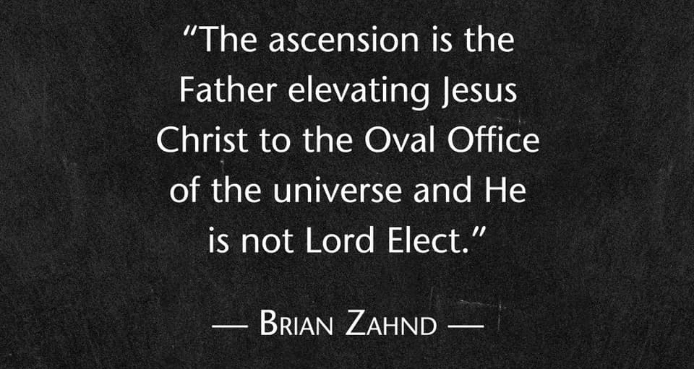
Notes:
Brothers and sisters, we do not make Jesus Lord. We didn’t vote him in and nobody is going to vote him out. He is Lord because the Father has said so. And his Lordship means, like a Master Chess Player, he will forever be moves ahead of his enemies. No matter how many towers of Babel we build, no matter how many times we raise arms against his will in the world, no matter how many mock his law and seek to glorify evil, the moral arc of his universe, though it may be long, bends toward justice. If you’re not hearing what I’m saying, let me be clear. The corporate capitalist and the greedy oligarchs of the world will not get the last word. The powerful and privileged elite who tap into our fears to gain our trust, who con us and woo us away from Jesus; those who exploit the poor and the weak, they will not get away with their crimes against heaven and earth. Listen church, those who glorify war, violence and sexual licentiousness, and use their freedom as a cover-up for evil will not enter the Kingdom of God.
Folks, it’s only a matter of time before the empire falls. For her sins have piled up to the doors of heaven and her refusal to repent ensures her eventual demise. So as John the Revelator records as a plea from heaven, “Come out of her, my people. Or you will be destroyed with her.” And how do we do that? How can we be saved from the wrath to come? Paul tells us in Romans 10:9-10. [NEXT SLIDE]

Slide 8
Paul, Romans 10:9-10 NIV
⁹ If you declare with your mouth, “Jesus is Lord,” and believe in your heart that God raised him from the dead, you will be saved. ¹⁰ For it is with your heart that you believe and are justified, and it is with your mouth that you profess your faith and are saved.
Notes:
[BRIEF COMMENT] – RETHINKING ROMANS 10:9-10
Listen to how this familiar passage reads in the VOICE translation: [NEXT SLIDE]

Slide 9
“So if you believe deep in your heart that God raised Jesus from the pit of death and if you voice your allegiance by confessing the truth that “Jesus is Lord,” then you will be saved! Belief begins in the heart and leads to a life that’s right with God; confession departs from our lips and brings eternal salvation.”
Paul, Romans 10:9-10 (VOICE)
Notes:
[BRIEF COMMENT]
In other words, Christianity is a way of life. It’s not about giving mental ascent to doctrines or just believing stuff that is totally disconnected to the way you live, the way you talk, the way you treat people, the way you post on social media, and the way you work for change in the world. Listen… if our lives don’t look like Christ (or at least reveal that we’re trying), then we should stop calling him Lord. Because he is either Lord or all or no Lord at all. He is either Lord of your thoughts and your mouth, or not. He is either Lord of your politics and your pocketbook, or he’s not. He is either Lord of your phone, your computer, and your tablet, or he’s not.
Folks, America waits to see a Church that has made Jesus Lord of everything. That’s when we gain street cred. That’s when we will have something to offer the world. You see, the Kingdom comes when we allow the Spirit to use us to be what only the Church can be for the world. We are called to be salt, light, to love God and neighbor, to strive for justice and be purveyors of mercy and grace, to forgive, to be a shining city on a hill, and agents of new creation. We are called to be bridge-builders, peacemakers, and ministers of reconciliation. Think about this. Who else can or will do that? Who else is going to embrace and embody the Messianic agenda?
That is why I say that we must untangle ourselves from partisan politics and idolatrous empire, from “us vs. them” thinking, and from trust in worldly kingdom power to solve all of our problems. The time has come for the Church in America to repent of civic religion, to stop fusing our faith with a political ideology (left or right), to resist the principalities and powers who undermine our calling and rob us of our witness and role in the world. We are his hands and feet. It’s time to wash them clean of our ignorance, of our denial, and of our complicity with America’s sins so that we can be the Body of Christ in a new century.
That’s what Teresa of Avila had in mind when she penned this words: [NEXT SLIDE]

Slide 10

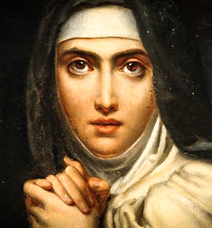
“Christ has no body now but yours. No hands, no feet on earth but yours. Yours are the eyes through which he looks compassion on this world. Yours are the feet with which he walks to do good. Yours are the hands through which he blesses all the world. Yours are the hands, yours are the feet, yours are the eyes, you are his body. Christ has no body now on earth but yours.”
Saint Teresa of Ávila
Notes:
Oh, church. We need a Kingdom imagination that models and casts a vision for what it looks like to live out the politics of Jesus as the early church did, and a desire for the unity and solidarity of Christ’s Table that is greater than our carnal desire to win, to grab hold of the horns of power, and to fight with the weapons of this world. For only a fresh vision of a Christianity that looks like Christ can heal the divisions in our churches and our country. And I believe if we will unite in our love for Christ and his Kingdom, God will use us.
Remember these words from Jesus as he prayed in his high priestly prayer: [NEXT SLIDE]

Slide 11
John 17:20-23 NIV
²⁰ “My prayer is not for them alone. I pray also for those who will believe in me through their message, ²¹ that all of them may be one, Father, just as you are in me and I am in you. May they also be in us so that the world may believe that you have sent me. ²² I have given them the glory that you gave me, that they may be one as we are one— ²³ I in them and you in me—so that they may be brought to complete unity. Then the world will know that you sent me and have loved them even as you have loved me.
Notes:
To my knowledge, the only other time that the gospel of John records Jesus saying something like this (when he says “by this the world will know”) is a few chapters earlier in John 13:34-35, when he gave his disciples a new commandment to love one another, which we began our series with. So hear what Jesus is saying… if we do not love each other with the love of Christ, and if we’re not united in that loyalty and love for King Christ, then the flock will scatter and the world will never be able to believe, nor will people see the power of the gospel put on display through the local church. But if we will choose to love like Christ, and seek the unity that he longs for among his people, then we can shine brightly in the darkness.
As I’ve reflected on this election over the past few days, I have concluded that the “us vs. them” (red/blue state) politics and allegiance to partisan ideologies are a threat to democracy. It is fueling and facilitating our societal divides. I’m convinced that this path will not lead to change, civility, common ground, or the common good. Yes, changes to the political system need to happen to address our many problems, but no form of government or politics will help us to heal and emerge from our deep division.
And I submit to you that followers of Jesus should be more concerned about this division and polarization than their candidate winning. That isn’t to say that voting and politicians don’t have real consequences, they do! But it is to draw our attention to what must be addressed if we want to preserve the very best about America, and most importantly, to follow Christ and be faithful to his Messianic agenda in the world.
Yes, we should be civically engaged and care for the least of these. We do not seek “unity“ while ignoring injustice and refusing to lift a finger. But hear me, the church must never turn away from Christ’s calling to change the world by first making disciples. We must disciple people into Jesus, into God‘s co-suffering love revealed on the cross. We must lead others to embrace transformative communal practices and liturgies of the church that are greater than the liturgies of empire. We must make disciples who know how to patiently listen and empathize, who are equipped to be peacemakers.
This is what Jesus wants us to do. But we can‘t go out trying to change the world if we‘re not being changed ourselves. And the good news is that if we will do that, if we will get serious about our own discipleship, well, Jesus put it in the DNA of the church to be change agents. As Stanley Hauerwas has said, “The church doesn’t have a social strategy, the church is a social stategy.” In other words, we are the divinely appointed vehicle that God sends out to turn the world upside-down.
And that doesn‘t preculde politics. As I‘ve said before, if you want to engage with the polis, if you feel called to work in government, in so far as you can faithfully obey the teachings of Jesus, try to do some good. Bad policies and laws hurt people. It even angers God. But none of us should be deceived by the allure of worldly kingdom politics. The allure is that politics is the best way (or even the only way) to make a difference in the world. Dear saints, this is simply not true, as most church growth and Spirit-led movements happend in places where Christianity had little to no political power.
So, if we‘re going to ever fully emerge from Constantine‘s long hold on the Church, we need a fresh vision and disciples who will faithfully follow Jesus in American empire. We need the entrepreneurs and the innovators, the poets and the prophets, the carpenters and custodians, the executives and the educators. We need the doctors and nurses, the counselors and caretakers, the artists and attornies; coaches and consultants, musicians and enternatiners. We need you all.
We need you and your gifts to help us chart a third way, to embody the teachings of Jesus, and communicate God‘s eternal purpose for the church—i.e. that people of every tribe, tongue, and nation would worship as one family, living out the Kingdom on the earth. But for that to happen, we must desire God‘s Kingdom far more than our own. We must agree there is a better way.
I like how Christena Cleveland put it in her book, Disunity in Christ: Uncovering the Hidden Forces that Keep Us Apart. She writes:

Slide 12
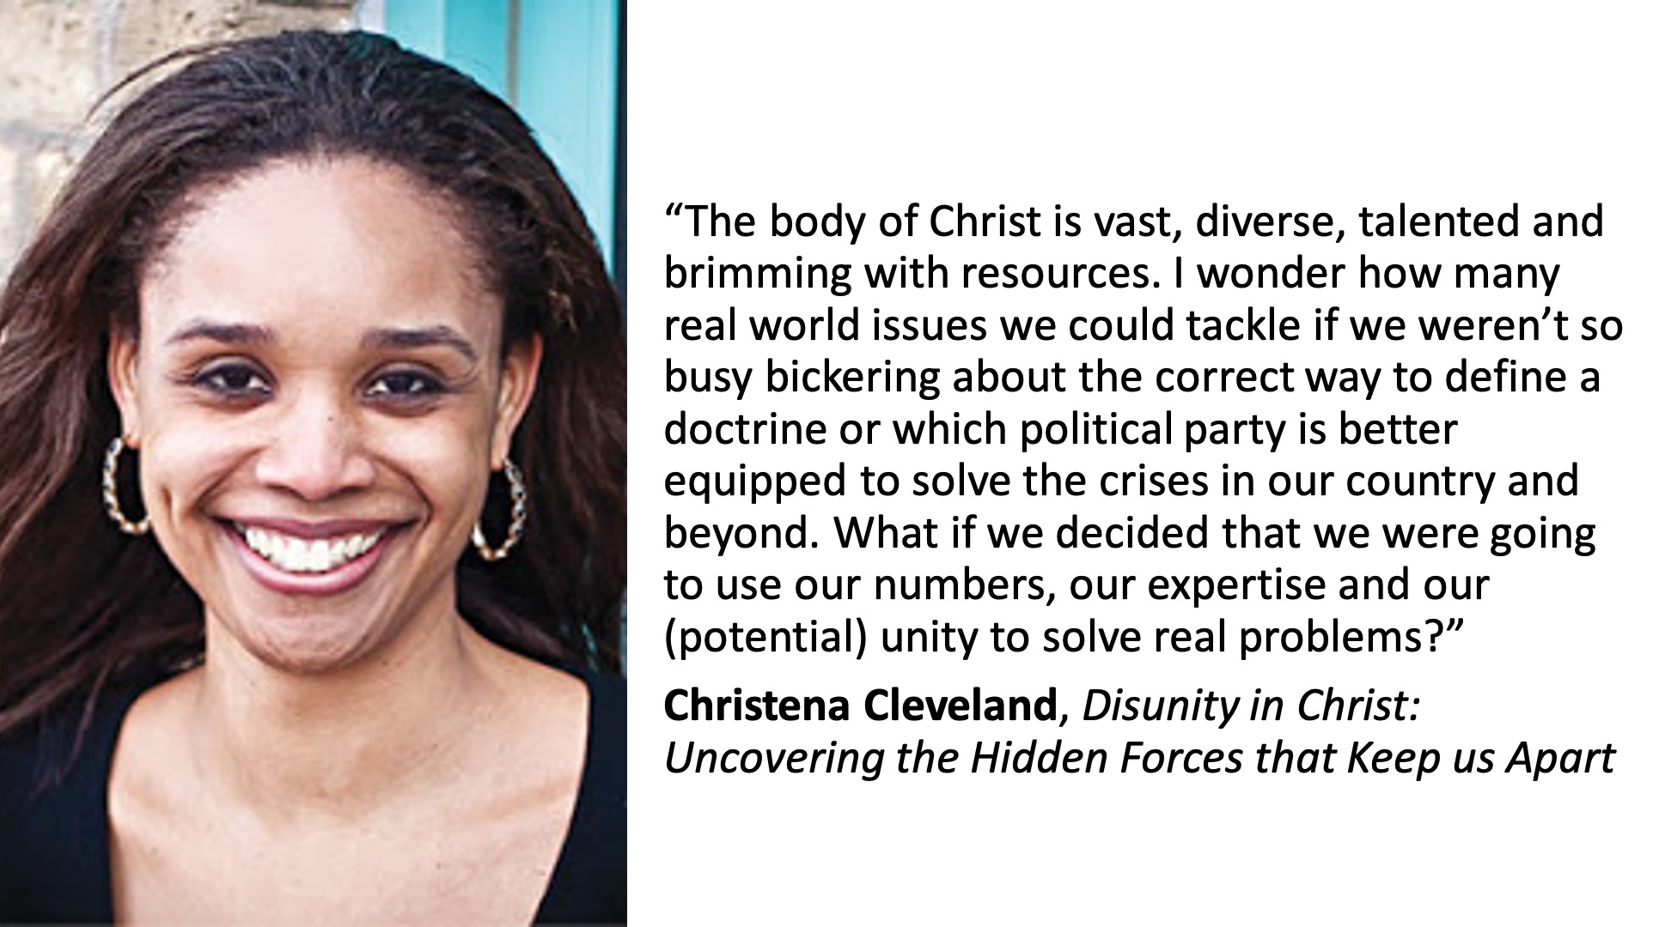
Notes:
I love that. The “what if” calls us to imagine what God can do, as Paul told the church in Ephesus. God can do infinitely more than we could ever ask or dream. And I say, if we’re going to be a part of a new reformation, if we’re going to join the Spirit in a non-violent, Jesus-loving, resistance movement in America, then we must rediscover what it means to call Jesus Lord together, to love as he loved, to live out his politics, and to be united with other disciples in seeing the Kingdom come. Amen?
Friends, I hope that this series has helped you during this challenging time. If you’ve been challenged, encouraged, inspired, or received some new insights into Christ, maybe you’ve decided to follow Jesus for the first time, I’d love to hear from you. And know this (more than anything else), it’s our greatest desire at Grantham Church that you would know the love, the forgiveness, the mercy, the grace, the beauty, and the hope that is found in Jesus. Salvation is found in no other. Which is why we declare together, “Long live King Jesus!”
Finally, I’d like to close out this series with this prayer and blessing that the Apostle Paul spoke over the church in Ephesus, which I referred to moments ago. Receive this with open hands and open hearts: [NEXT SLIDE]

Slide 13
Ephesians 3:16-19 NIV
¹⁶ I pray that out of his glorious riches he may strengthen you with power through his Spirit in your inner being, ¹⁷ so that Christ may dwell in your hearts through faith. And I pray that you, being rooted and established in love,¹⁸ may have power, together with all the Lord’s holy people, to grasp how wide and long and high and deep is the love of Christ, ¹⁹ and to know this love that surpasses knowledge—that you may be filled to the measure of all the fullness of God.
Notes:
[BRIEF COMMENTS]

Slide 14
Ephesians 3:20-21 NIV
²⁰ Now to him who is able to do immeasurably more than all we ask or imagine, according to his power that is at work within us, ²¹ to him be glory in the church and in Christ Jesus throughout all generations, for ever and ever! Amen.
Notes:
Amen, church.
And may God help us in days ahead as we embody the politics of Jesus and continue following Christ in the American Empire.

