Slide 1
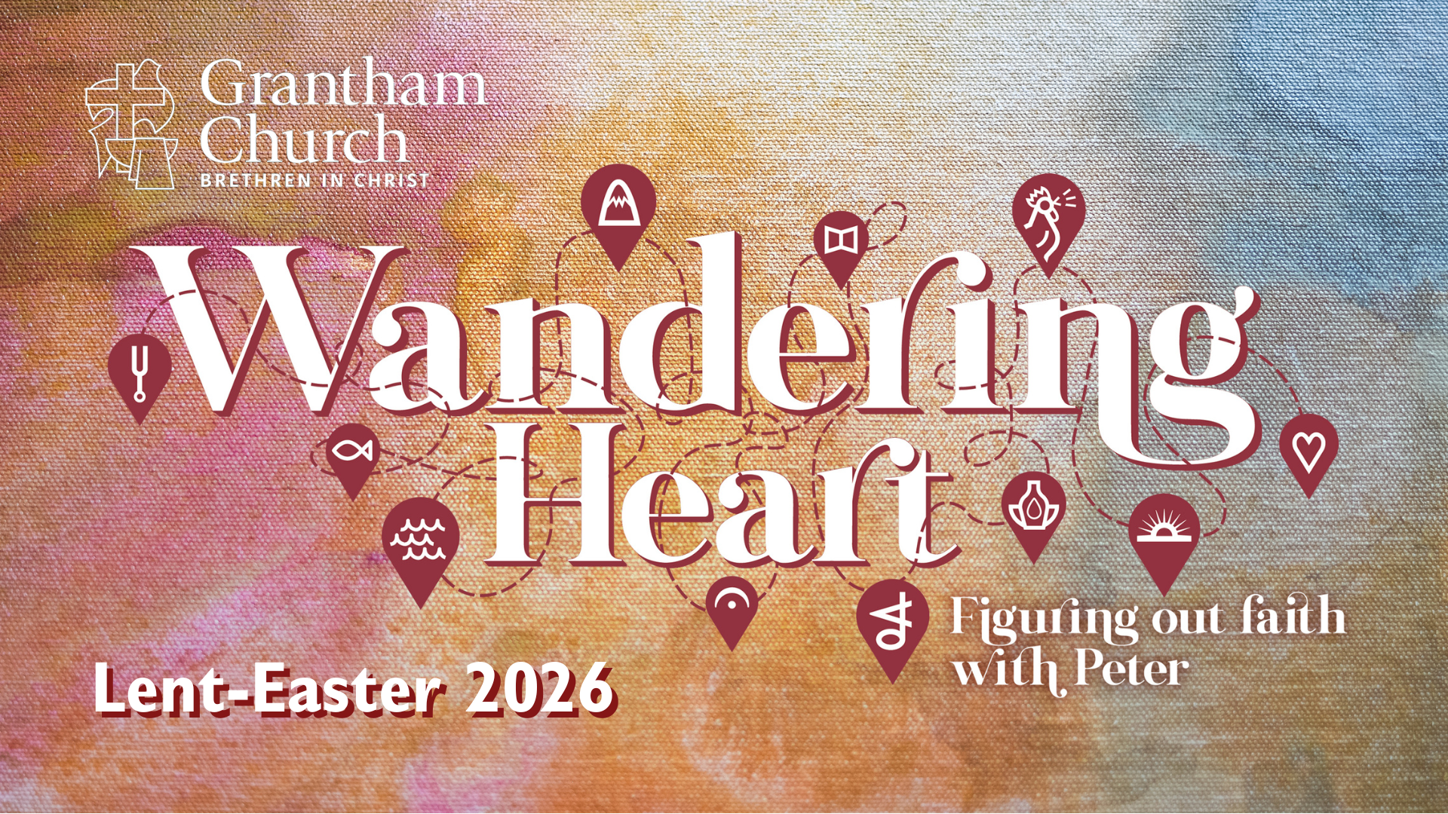
Notes:
[BRIEF WELCOME]
[INVITE CHILDREN TO STAGE]
[RECAP THE STORY OF PETER]
[GO TO NEXT SLIDE(S) AS I SHARE BRIEFLY ON EACH PICTURE]

Slide 2
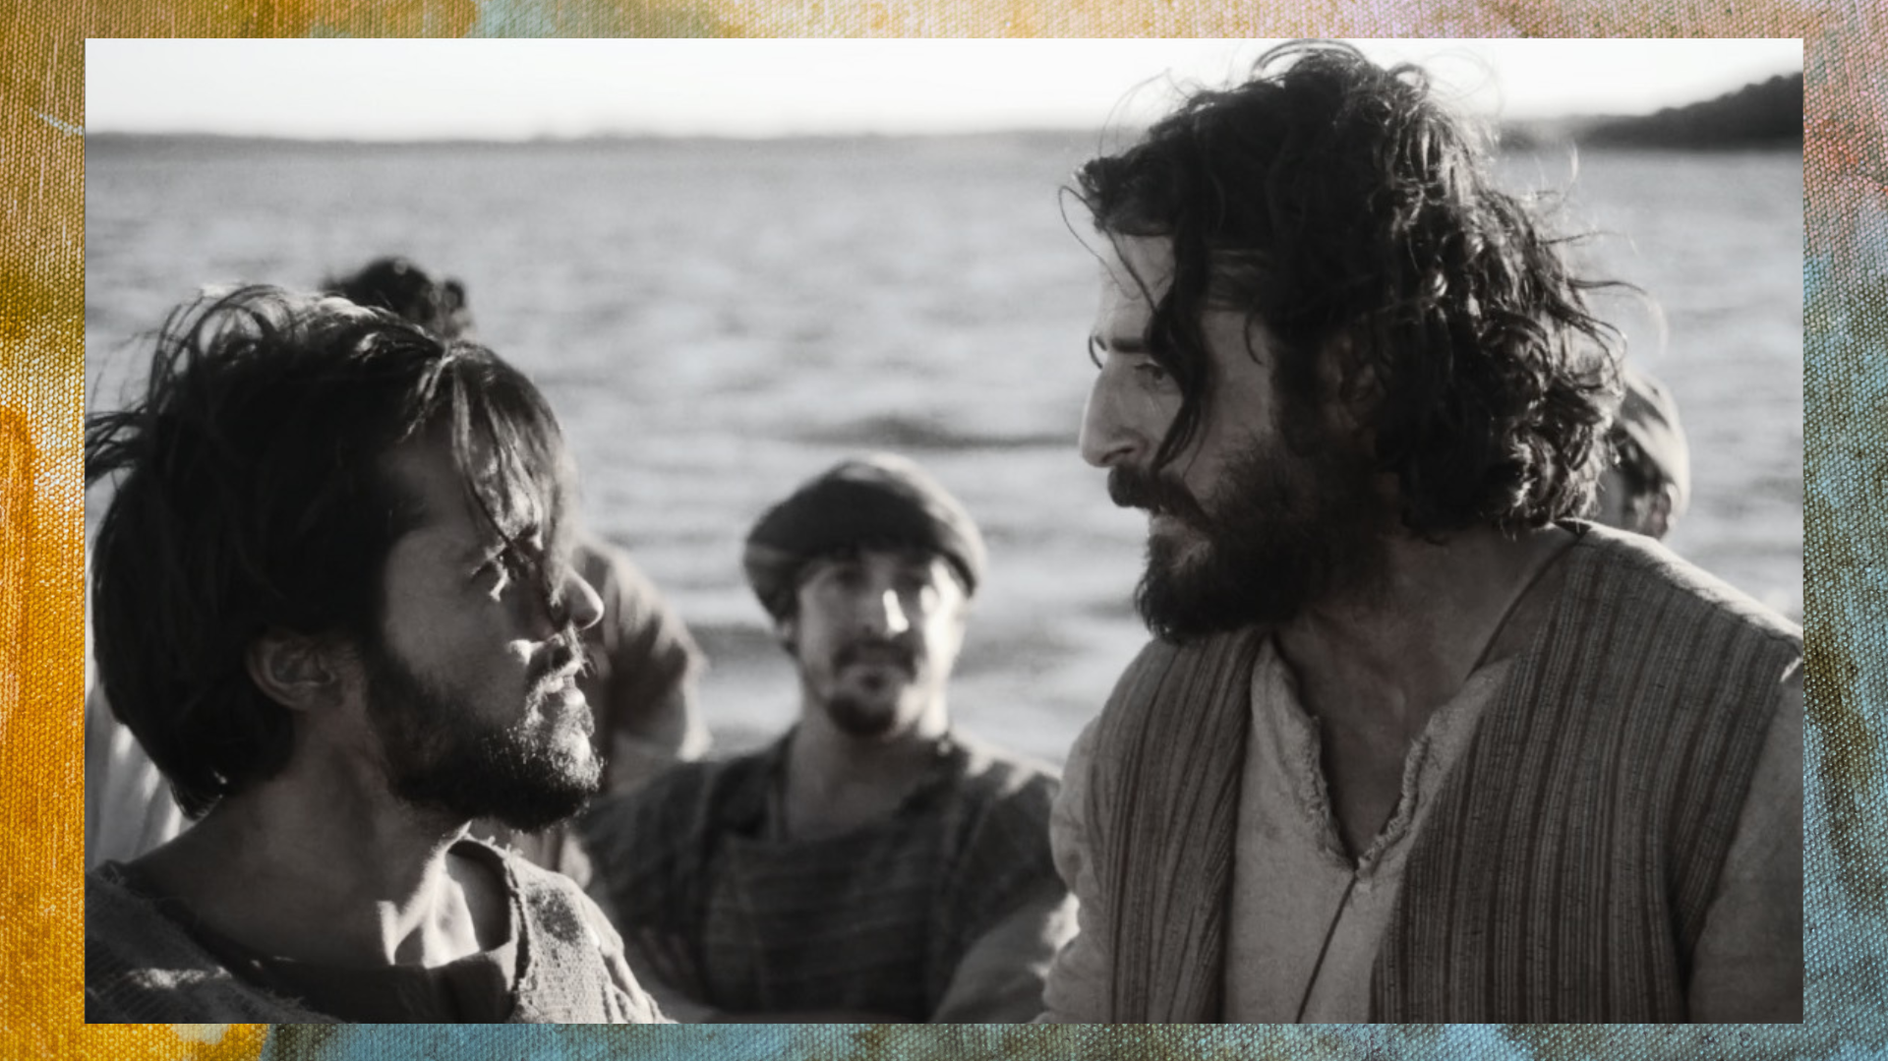
Notes:
[BRIEF WORD ABOUT JESUS CALLING PETER]
[NEXT SLIDE]

Slide 3
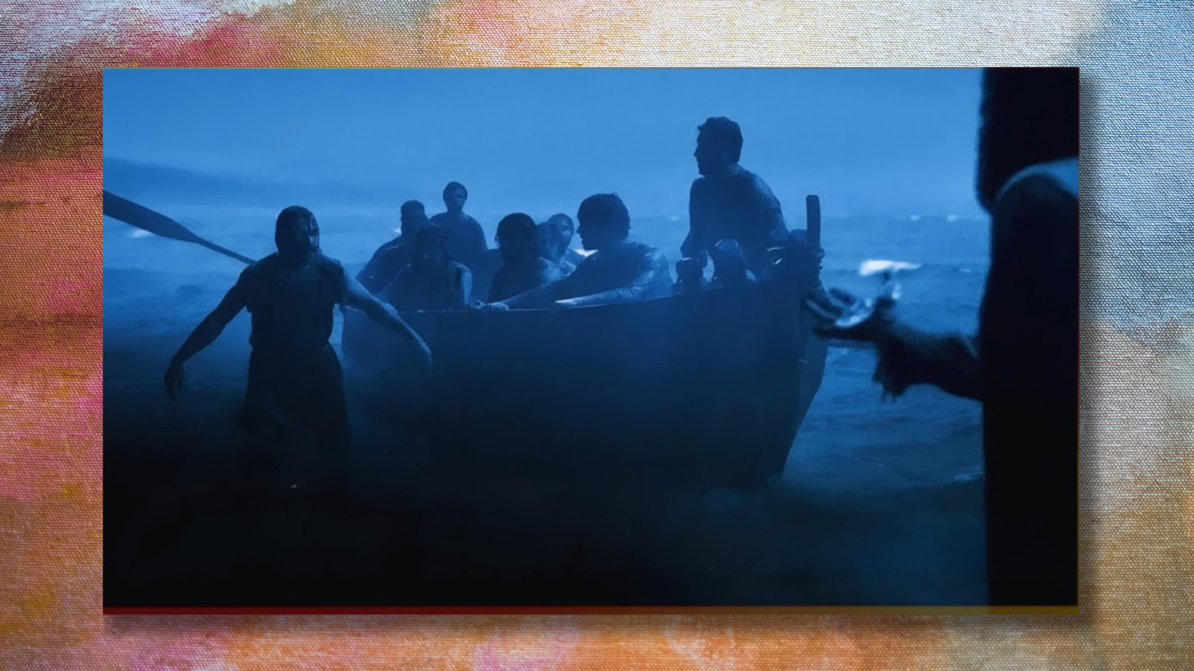
Notes:
[BRIEF WORD ABOUT PETER WALKING ON WATER]
[NEXT SLIDE]

Slide 4
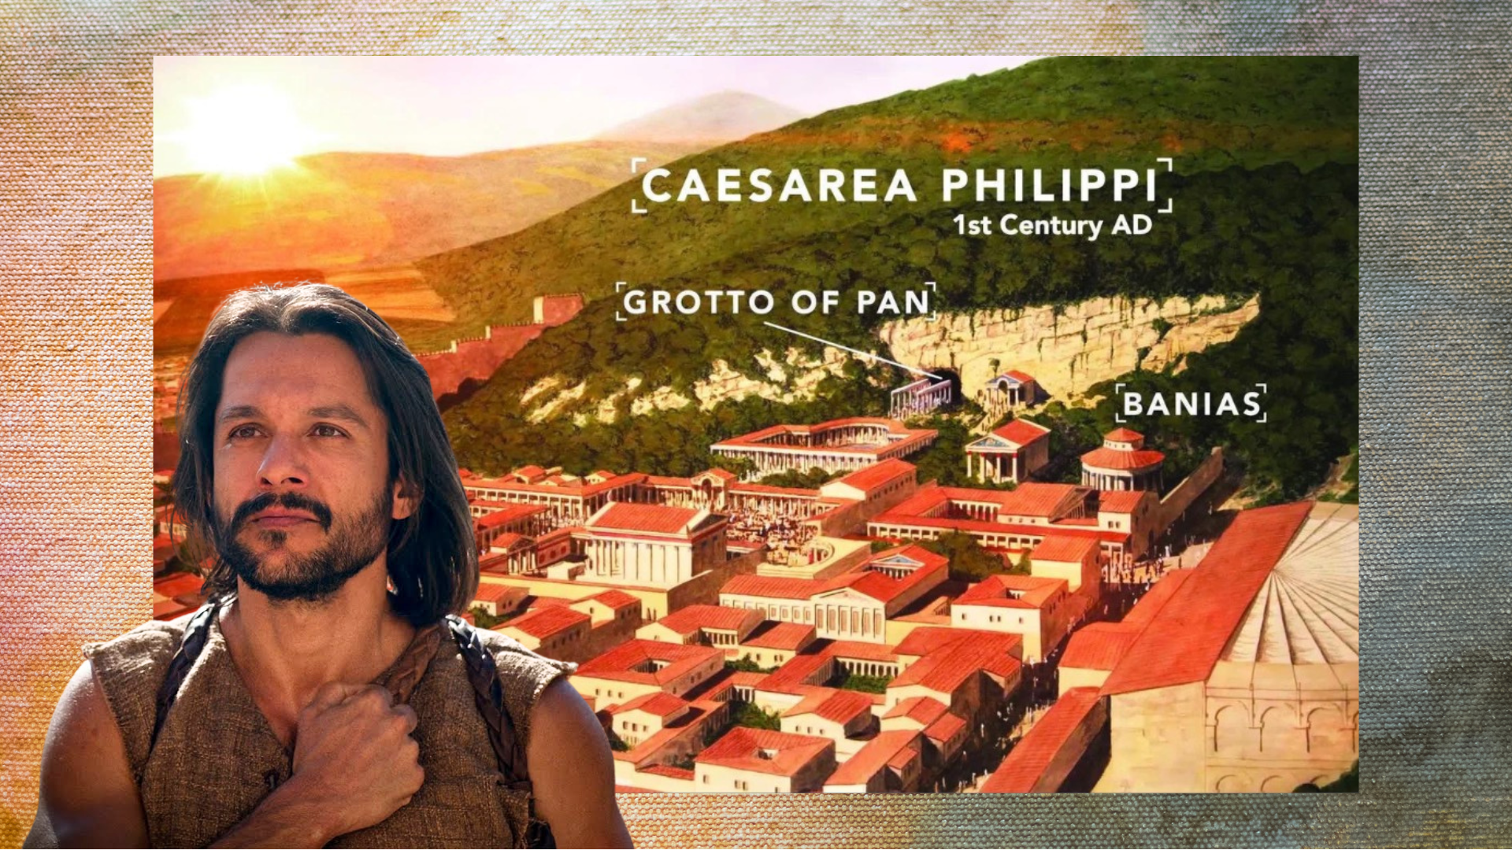
Notes:
[BRIEF WORD ABOUT PETER’S GREAT CONFESSION]
[NEXT SLIDE]

Slide 5
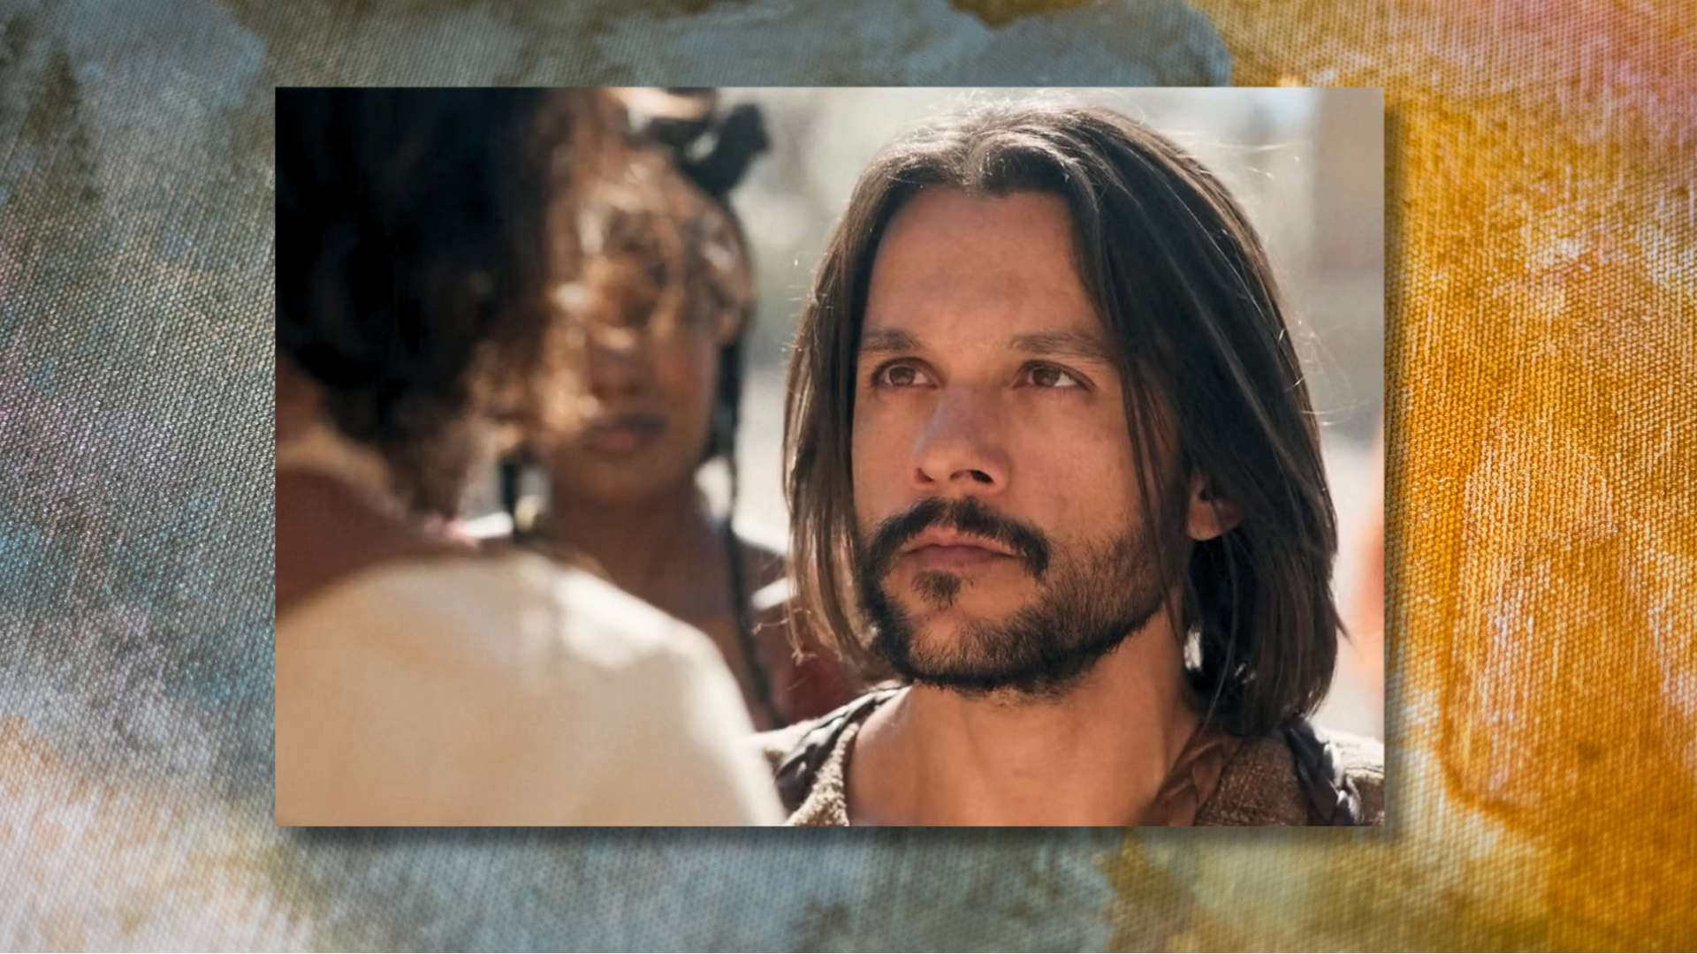
Notes:
[BRIEF WORD ABOUT JESUS REBUKING PETER]
[NEXT SLIDE]

Slide 6
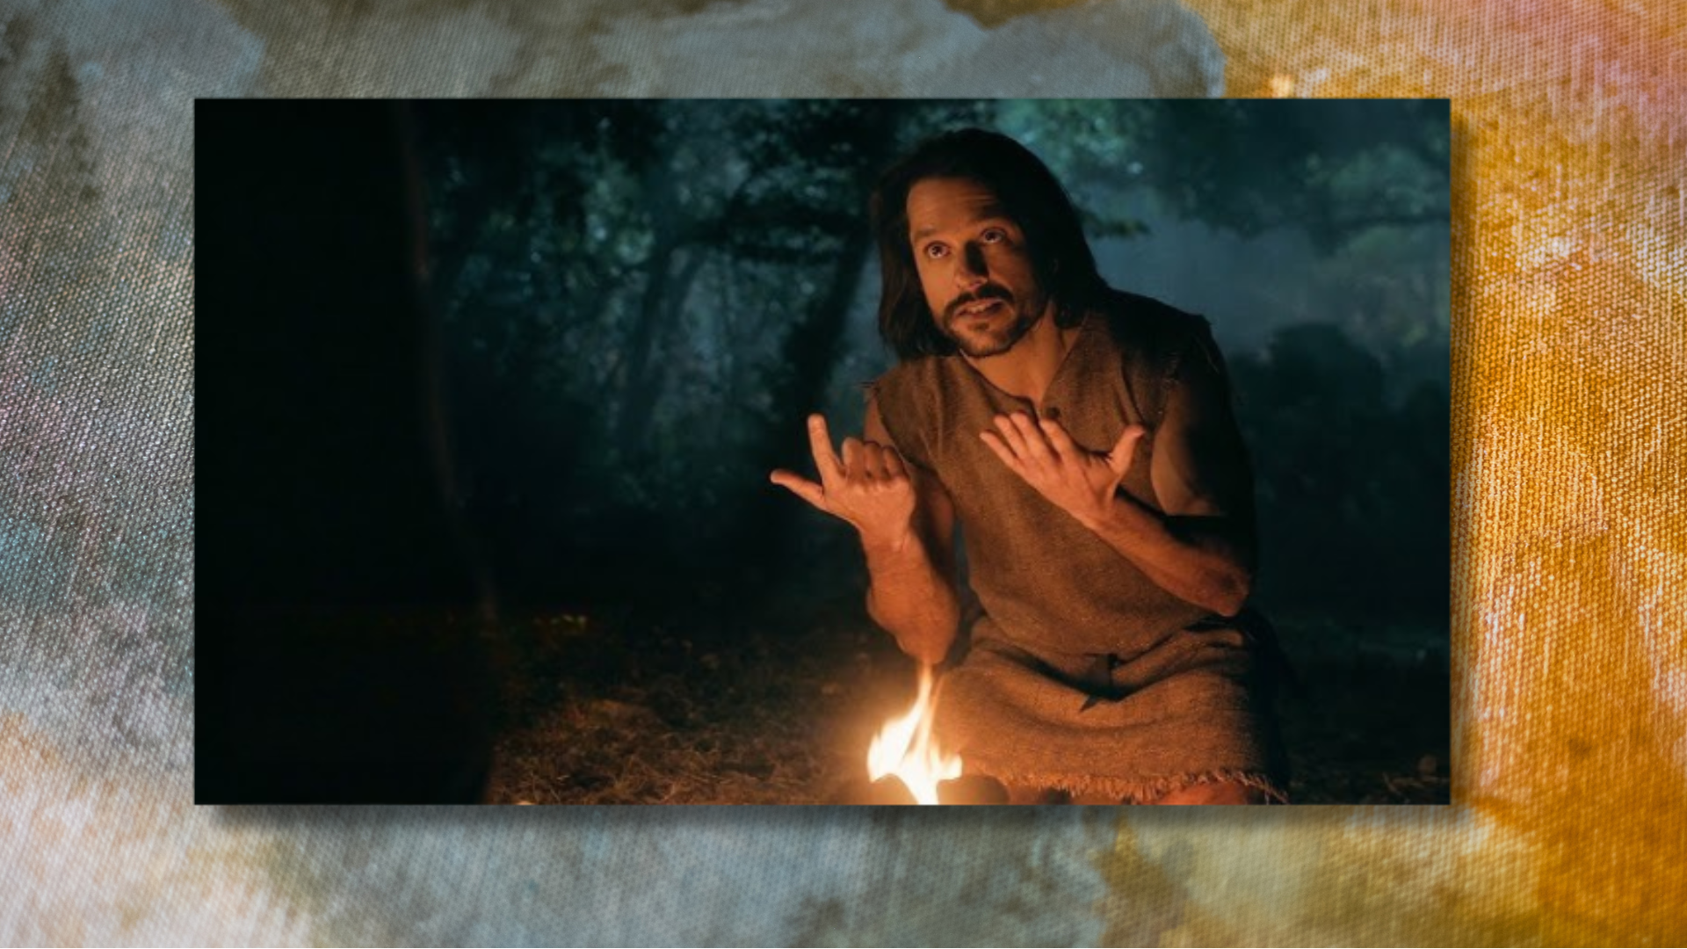
Notes:
[BRIEF WORD ABOUT PETER & FORGIVENESS]
That now brings us to Palm Sunday…
[INVITE CHILDREN TO WATCH THE VIDEO CLIP]

Slide 7
Notes:
[PLAY VIDEO]
[GO TO NEXT SLIDE AFTER VIDEO]

Slide 8
Notes:
[CLOSING WORD TO CHILDEN]
Wave palm branches when I say “Palm Sunday” in the sermon
[BRIEF PRAYER]
[GO TO NEXT SLIDE]

Slide 9
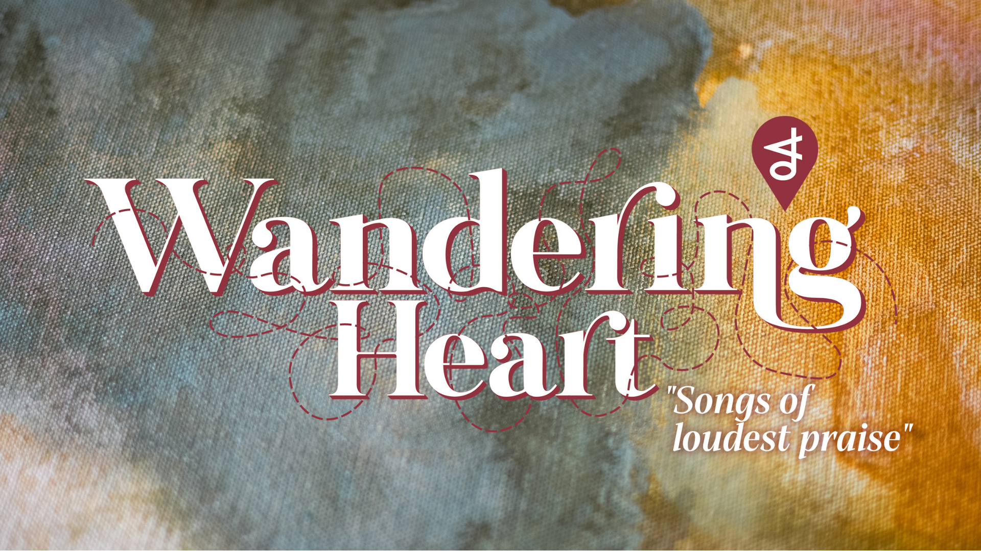
Notes:
Songs of Loudest Praise. If you’re taking notes, that is the title of the message today.
We began this series with Simon Peter’s abundant catch, and a charge to drop everything and follow. Peter has walked on water and clung to Jesus for rescue. He has pronounced his faith confidently and been told to get out of Jesus’ way. He has asked questions and learned about the expansiveness of grace. And now, the end is near. He walks into Jerusalem with Jesus and the rest of the disciples; through the crowds as they sing songs of loudest praise.
As we’re going to see this morning, Palm Sunday is filled with both awe and confusion—the crowds rightly celebrate Jesus as the Son of David yet misunderstand the kind of king and Messiah he has come to be for us. The disciples stand in the tension, hearing the shouts of victory while remembering Jesus’ words about suffering, sacrifice, and the cross.
What does it all mean? What did they think and feel? And how does it apply to us today? That’s what I’m inviting us to consider in this Palm Sunday sermon.
[BRIEF PRAYER] – [NEXT SLIDE]

Slide 10
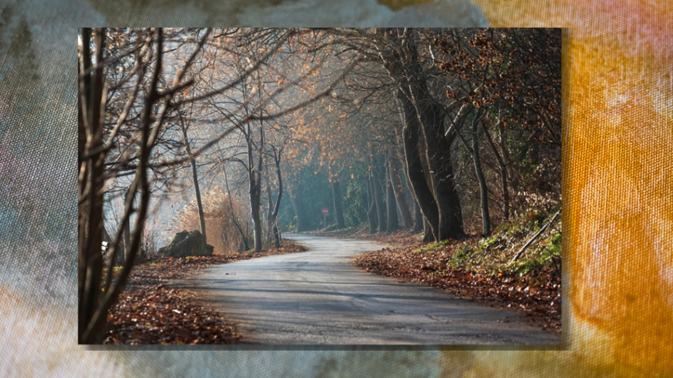
Notes:
A man was driving to an important event a couple hours away to an area of the state he wasn’t familiar with. He put his destination in the GPS and had the route all mapped out, ETA calculated, everything appeared to line up perfectly. And he set off. But about halfway there, his GPS suddenly rerouted him. “Turn right,” it said. What? That didn’t make sense. This wasn’t the way he had planned. But traffic was building ahead, so reluctantly, he followed the new directions. The road got narrower. Then rougher. Eventually, it didn’t even look like the kind of road that should lead anywhere important. He had a sinking feeling in his stomach.
At one point he actually said out loud, “There’s no way this is right.” And he may have said a few other choice words. He was frustrated. Confused. Second-guessing everything. But he kept going. And after several unexpected turns, the road opened up—and he arrived exactly where he needed to be… right on time. Later he found out there had been a major accident on the original route. If he had stayed on the path he trusted, he would have been stuck for hours—or worse. The route that didn’t make sense, was the one that actually got him there.
Palm Sunday feels like that moment. The crowds think they know the route: victory over the Romans, power to crush their enemies, a throne in Jerusalem. Even the disciples have their expectations mapped out. But in the back of their minds (certainly in Peter’s mind), they can hear Jesus’ shocking and confusing words… because he had been talking about something that just didn’t make sense to them: suffering, rejection, and being put to death. It feels like a detour. Like the wrong road. But what they can’t yet see… is that the way of the cross isn’t a mistake. It’s the only way the kingdom comes. It’s the way of the true Messiah.
So, let’s remember and reflect on what was really happening on Palm Sunday… [NEXT SLIDE]

Slide 11
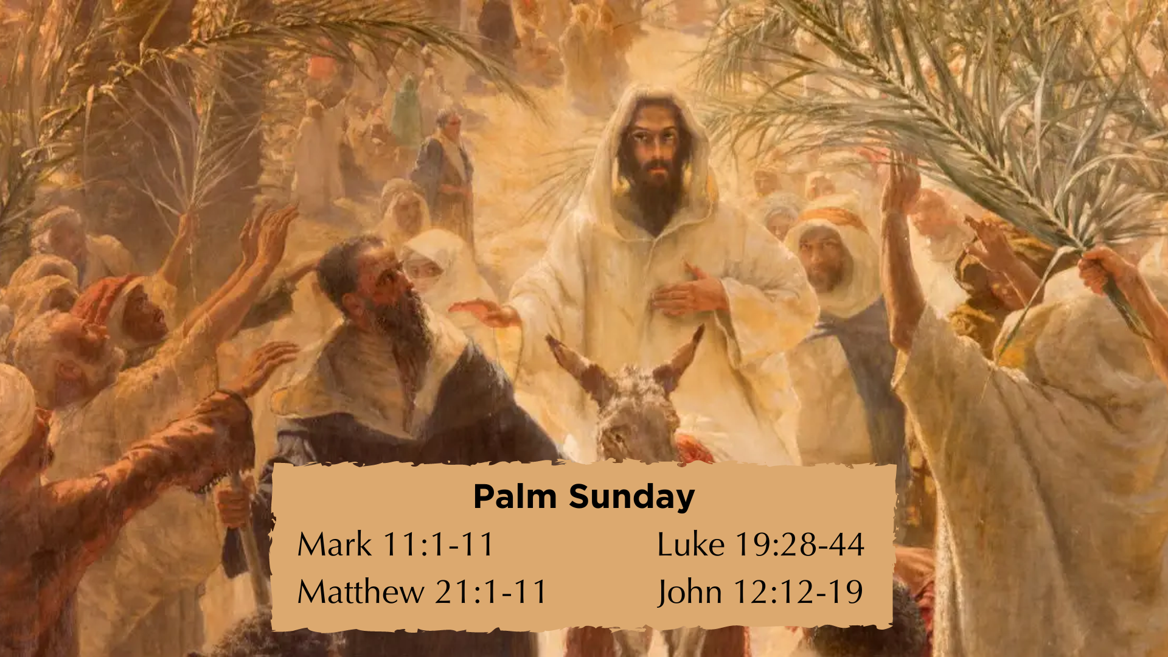
Notes:
Gospel references to Palm Sunday on the screen
Remember, a few days before the Passover, Jesus had been staying in Bethany, where he had raised Lazarus from the dead! Upon hearing this news, a large crowd comes to Jesus; knowing their intentions, Jesus plans his ”triumphal entry” into Jerusalem; the crowd that gathered in Bethany then follow Jesus as they intend to parade him into the city; and according to John 12:12-14, it appears that Jesus hopped on the donkey once he began to see the waving of palm branches and hearing the shouts of Hosanna.
Why the donkey? Jesus is fulfilling Zech. 9:9-10, but he is also making a statement!
Hosanna – is the Aramaic form of a two-part Hebrew word – Hosiah (help us) and the ending na, giving it a sense of urgency; “Save us now!” or “Please deliver us!”
And palm branches are being waved because they tap into Israel’s political memory and symbolize revolution and independence, going back 200 years to when the Jewish people, led by the Maccabees, revolted against the Seleucid empire. They hailed Judas Maccabeus as their new leader to the waving of palm branches.
The crowd is effectively saying: “This is the king who will restore Israel.” And from a first-century Jewish perspective, that meant: liberation from Rome; restoration of David’s throne; and national victory. But as we know, Jesus has come to fight a spiritual battle, to undo the powers of sin, death, and the devil, and to save us for the coming Kingdom.
So, consider the contrast with what Jesus is doing on Palm Sunday to what some scholars believe was happening on the same day on the other side of the city… [NEXT SLIDE]

Slide 12
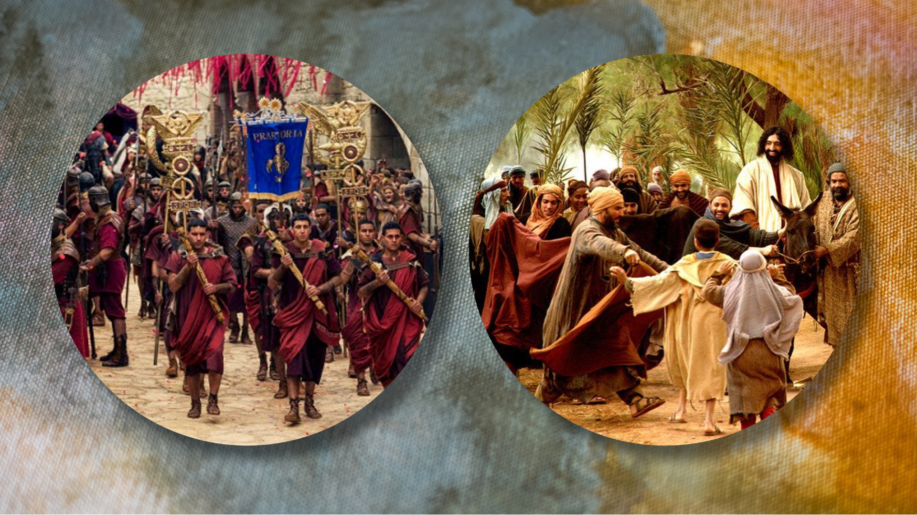
Notes:
As Jesus comes riding into Jerusalem from Bethany, over the Mount of Olives, through the eastern gate, it’s likely that the Roman governor Pontius Pilate is being paraded in through the north-western gate from Caesarea, where he lived most of the year. Pilate has come to Jerusalem for the Passover to discourage any revolutionary or “terrorist” activity during a high holy feast when the population of the city increased up 5 or 6 times its normal size (possibly 150-300,000 people).
And so, there are thousands upon thousands of people who would have witnessed or at least heard of the two processions. One reflective of military might and sword-power (Pilate riding in on a warhorse) and the other reflective of humble (honestly, quite comical) portrait of a peaceful Messiah (Jesus riding on a donkey). Which one do you want? What will you choose? A couple weeks ago we heard what Peter wanted. And Jesus rebuked him for it.
Remember, Peter, along with the other disciples, are hearing what Jesus is saying about his way being the way of the cross, that he is a suffering Messiah, but it’s just not fully registering with them. They don’t get it. Again, listen to what John writes… [NEXT SLIDE]

Slide 13
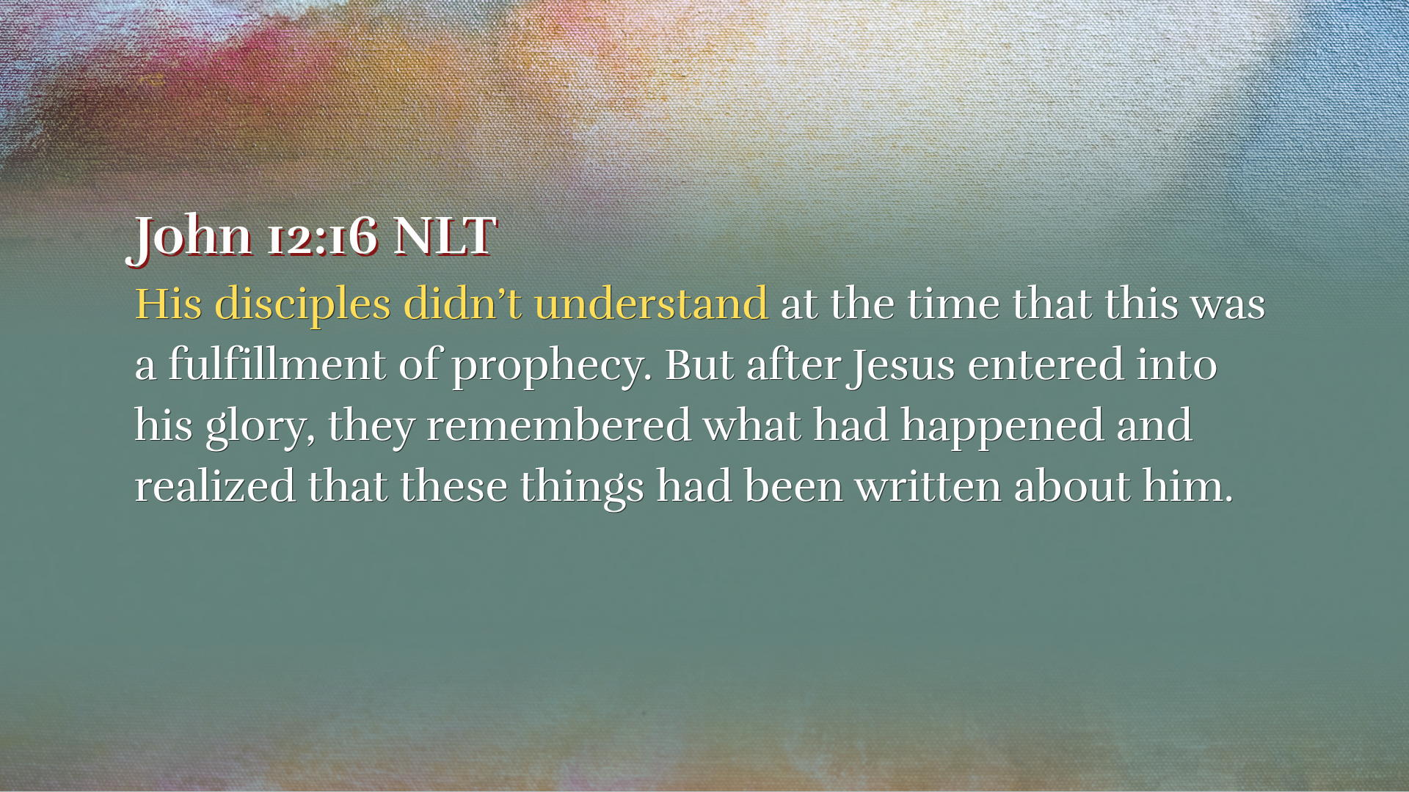
Notes:
[READ & COMMENT]
“prophecy” – the prince of peace and the suffering servant of Isaiah; the crucified Messiah of Psalm 22; and the king of shalom riding on a donkey in Zecheriah 9
“his glory” – his resurrected and glorified body
Isn’t that often how things work in life and in faith? As the saying goes, “hindsight is twenty-twenty.” But for now, we’re living in the already/not yet, we’re caught in the middle of the tension of knowing what Jesus said (believing that we’ve seen enough to know that it’s true), but we still get confused, lost in the mystery, trying to make sense of what is happening.
So… let’s put ourselves in the shoes of Simon Peter at this point in the story…

Slide 14
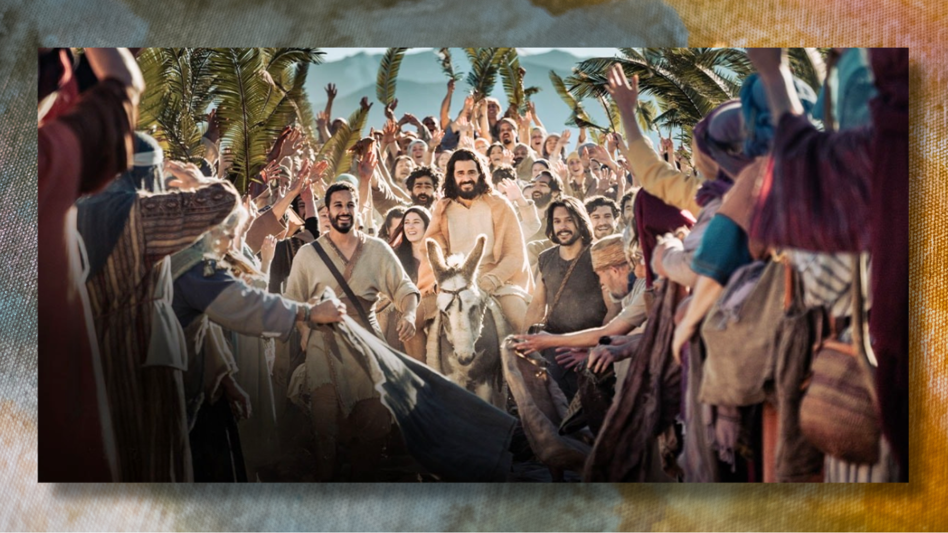
Notes:
Simon has made his great confession that Jesus is the Christ (the Messiah), the Son of the Living God, where Jesus gives him the name Peter—the rock. And the shortly after that, Jesus turns around and rebukes Peter for acting like the devil in his opposition of Jesus’ mission as a suffering, dying, and rising Messiah. He puts Peter in his place. So, at this point, Peter must be having a mix of feelings and emotions: he’s hurt, a bit angry, certainly confused… while also continuing to be amazed at what is unfolding. Imagine how it must have felt as he walks with Jesus through the crowds of people hailing him as the Son of David—Israel’s king and Messiah.
Maybe he feels some excitement to witness their praise. But he just can’t shake how Jesus recently rebuked him and spoke of taking up a cross. He must have been somewhat skeptical and afraid that someone might be trying to arrest or kill Jesus. Maybe Peter is hoping… wishing… that Jesus’ words will not come true. After all, Jesus’ words did seem puzzling (even cryptic) at times. Maybe Jesus didn’t mean that he would literally die. If he did that, how could he really be the Messiah? Understandably so, there just wasn’t a way at that time for Peter to make sense of everything that had led up to this moment, nor could he possibly anticipate what might happen next. Can you relate to those feelings?
These are the kinds of thoughts and feelings we will experience in our faith journey: doubt, uncertainty, frustration, confusion, bewilderment, cognitive dissonance, and more. And the reason is because we are finite human beings inhabiting 3 dimensions of space and a 4th dimension of time, which we can only understand linearly. But the Lord is infinite and not bound by those dimensions or our sense of time. Therefore, faith is required of us as we trust in an all-powerful, all-knowing God to sustain us, guide us, and deliver us.
Listen to what the author of Hebrews says in chapter 11… [NEXT SLIDE]

Slide 15
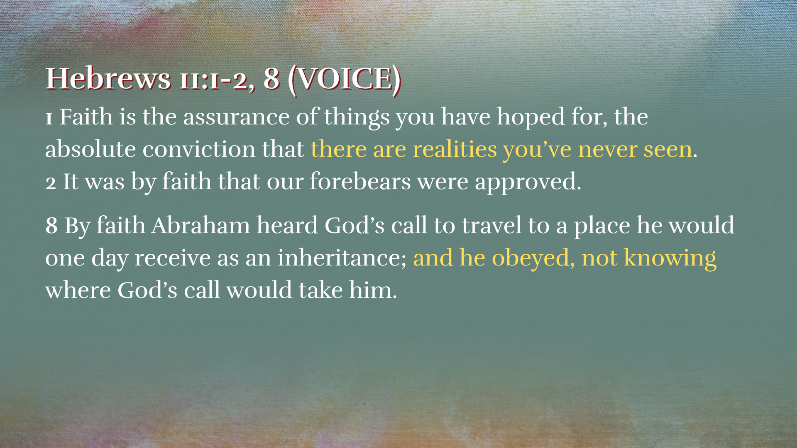
Notes:
[READ PASSAGE & COMMENT]
Brothers and sisters, faith is ultimately about trust… not crystal-clear clarity—it is obedience in uncertainty. And like Peter and the disciples entering Jerusalem, we often follow without full clarity. And, yeah, we may look back and say, “Man, was I wrong about some things.” But that’s OK. It’s all part of the journey of faith. The Lord meets us where we are and says, “Follow me.” And in his time, with our faithful participation, he gives us light upon light.
Look at this… even later in life, after he understood so much more than he did on Palm Sunday, Peter writes this about the simple mystery of faith in Jesus… [NEXT SLIDE]

Slide 16
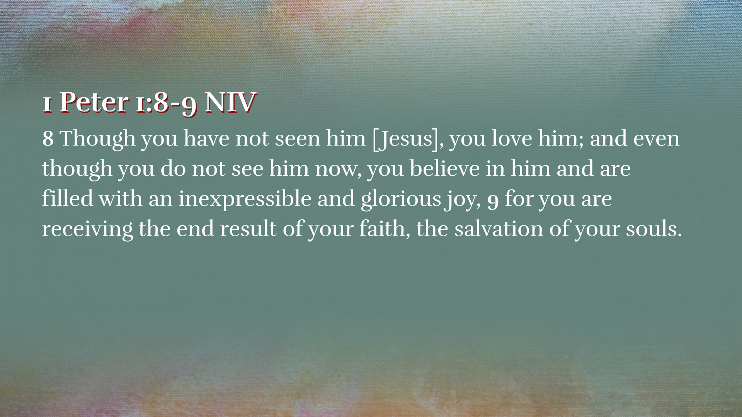
Notes:
[READ PASSAGE & COMMENT]
Peter is saying, “Keep going. You know Jesus is real; you know his claims are true; because his Spirit is at work within you—filling you with peace and joy and the ability to trust God. This is evidence that the Lord is loving you and leading you. Therefore, no matter what comes… don’t stop believing..” So, there you go. Peter said it long before Steve Perry sang it.
Finally, let’s go to our response question for today… [NEXT SLIDE]

Slide 17
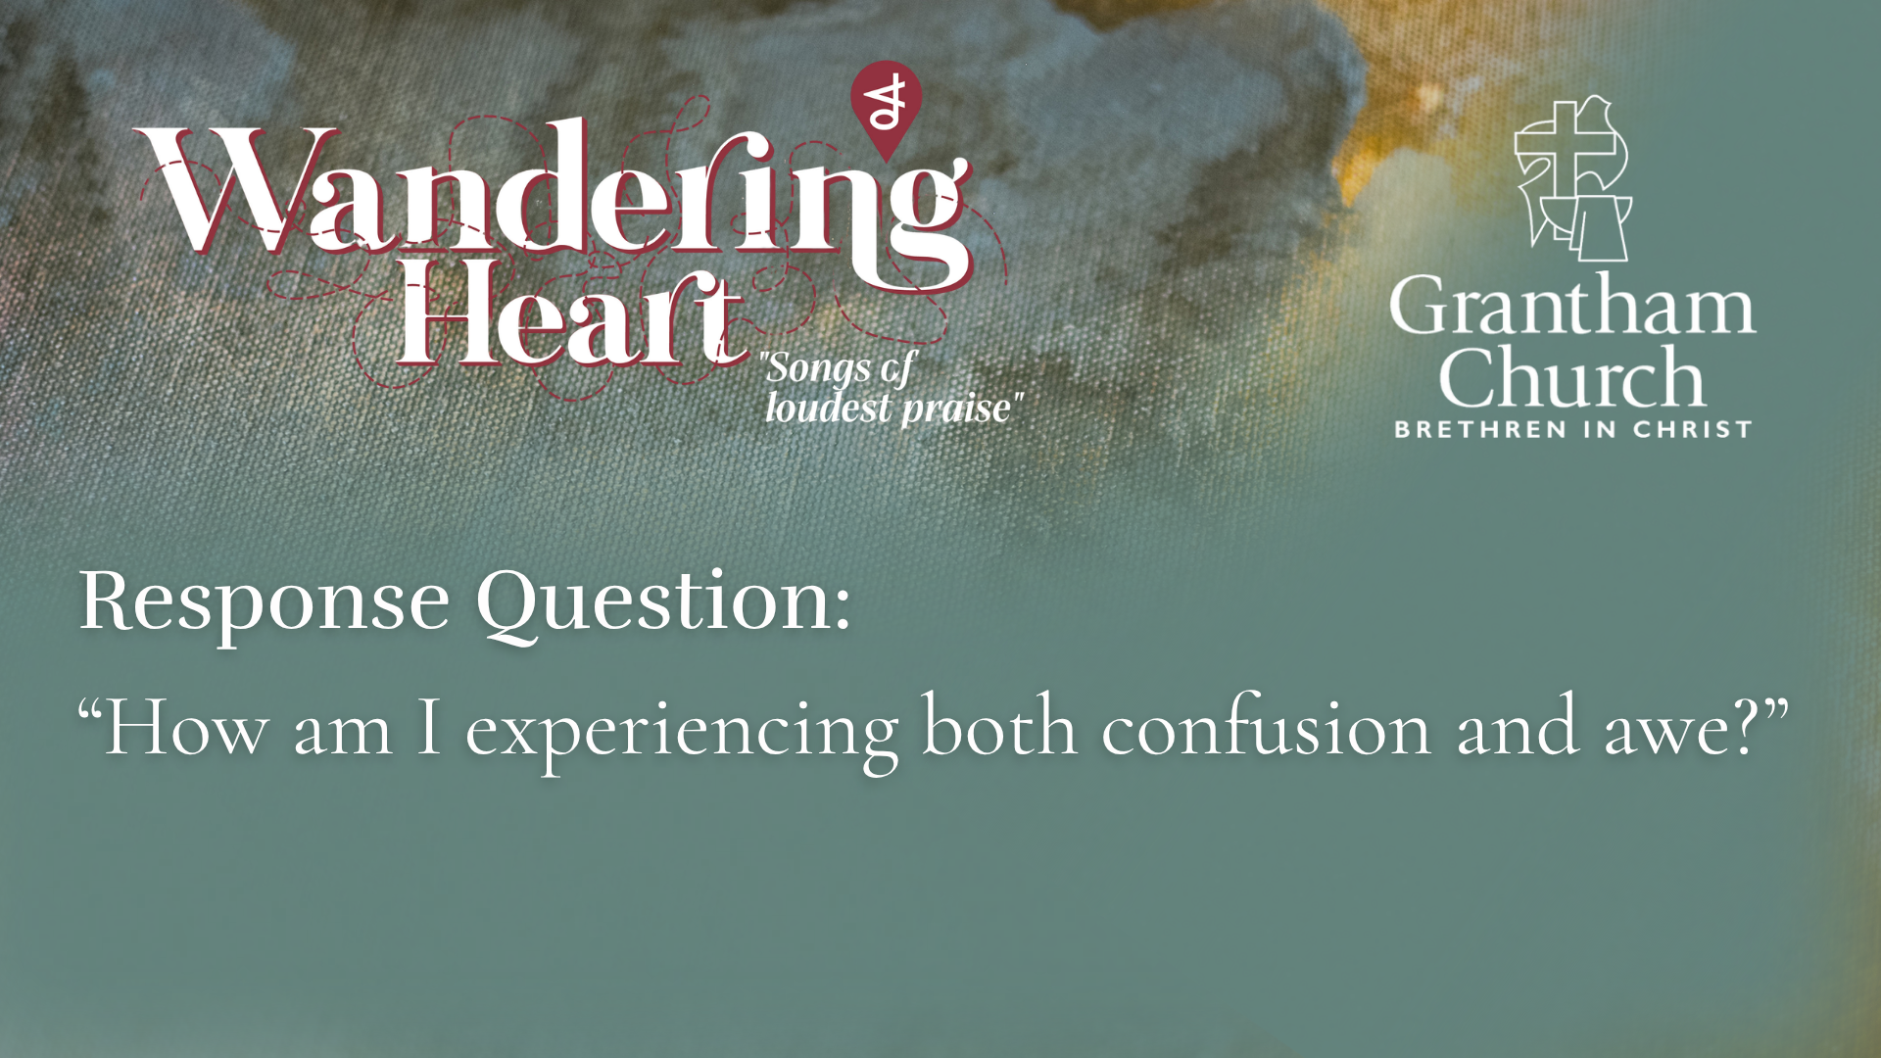
Notes:
Ask yourself… “How am I experiencing both confusion and awe?”
As you follow Jesus and are learning to trust him, how, like Peter, have you experienced the tension of both mystery and confusion, as well as awe and wonder?
Are you going through that right now in some way?
How is the Lord inviting you to trust him in the middle of this tension? And will you continue to offer songs of loudest praise despite the challenges and hardships you’re facing?
[CLOSING WORDS & PRAYER]
[GO TO NEXT SLIDE FOR PRAYER]

Slide 18
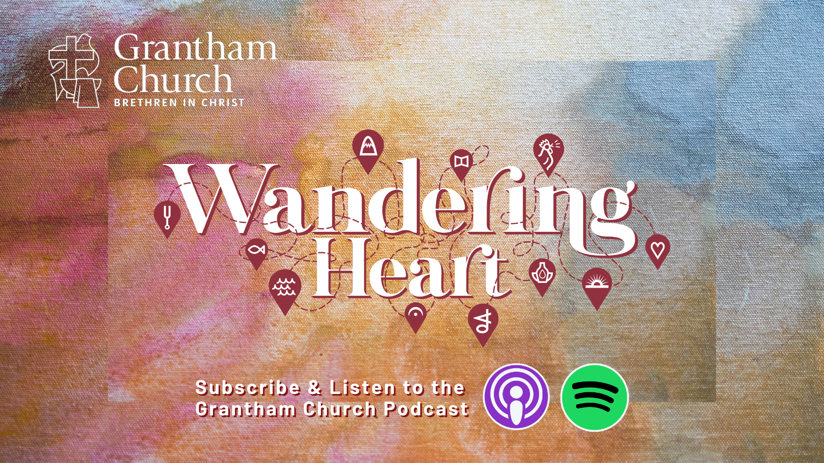
Notes:
[CLOSING PRAYER & SONG]
ANNOUNCEMENT: HOLY WEEK
Benediction
Beloved wanderer, as you leave this place,
may you carry your curious heart on your sleeve.
May you look for God in every face.
May you find the courage to get out of the boat,
to run to the tomb, and to speak of your faith.
And when the world falls apart,
may you hear God’s voice deep within,
saying, “Take heart, it is I, be not afraid.”
You are called. You are blessed.
In both your ups and your downs,
you always belong to God.
Go now in peace.
Go trusting that good news.
Amen.

