Slide 1


Slide 2
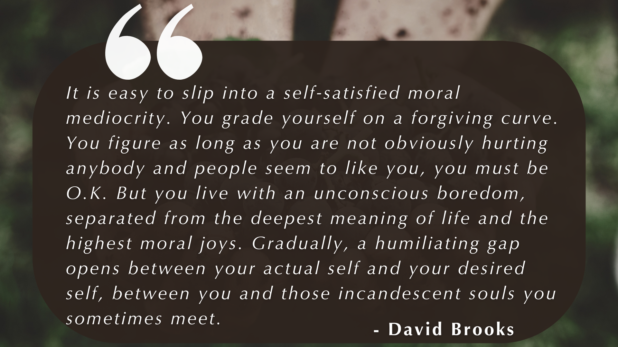

Slide 3


Slide 4

For in Christ Jesus neither circumcision nor uncircumcision has any value. The only thing that counts is faith expressing itself through love.
GALATIANS 5:6

Slide 5
For in Christ Jesus neither circumcision nor uncircumcision has any value. The only thing that counts is faith expressing itself through love.
GALATIANS 5:6
You, my brothers and sisters, were called to be free. But do not use your freedom to indulge the flesh; rather, serve one another humbly in love.
GALATIANS 5:13

Slide 6
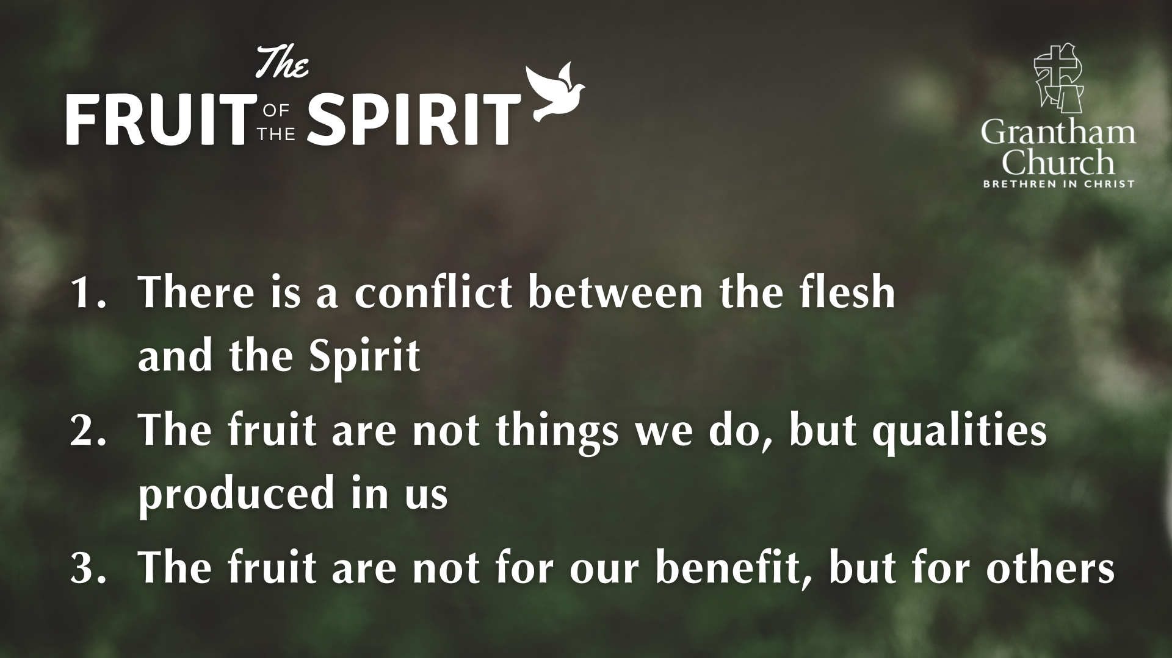

Slide 7
v. 6 - The only thing that counts is faith expressing itself through love.
v. 13 - But do not use your freedom to indulge the flesh; rather, serve one another humbly in love.

Slide 8
v. 6 - The only thing that counts is faith expressing itself through love.
v. 13 - But do not use your freedom to indulge the flesh; rather, serve one another humbly in love.
v. 14 - For the entire law is fulfilled in keeping this one command: “Love your neighbor as yourself.”

Slide 9
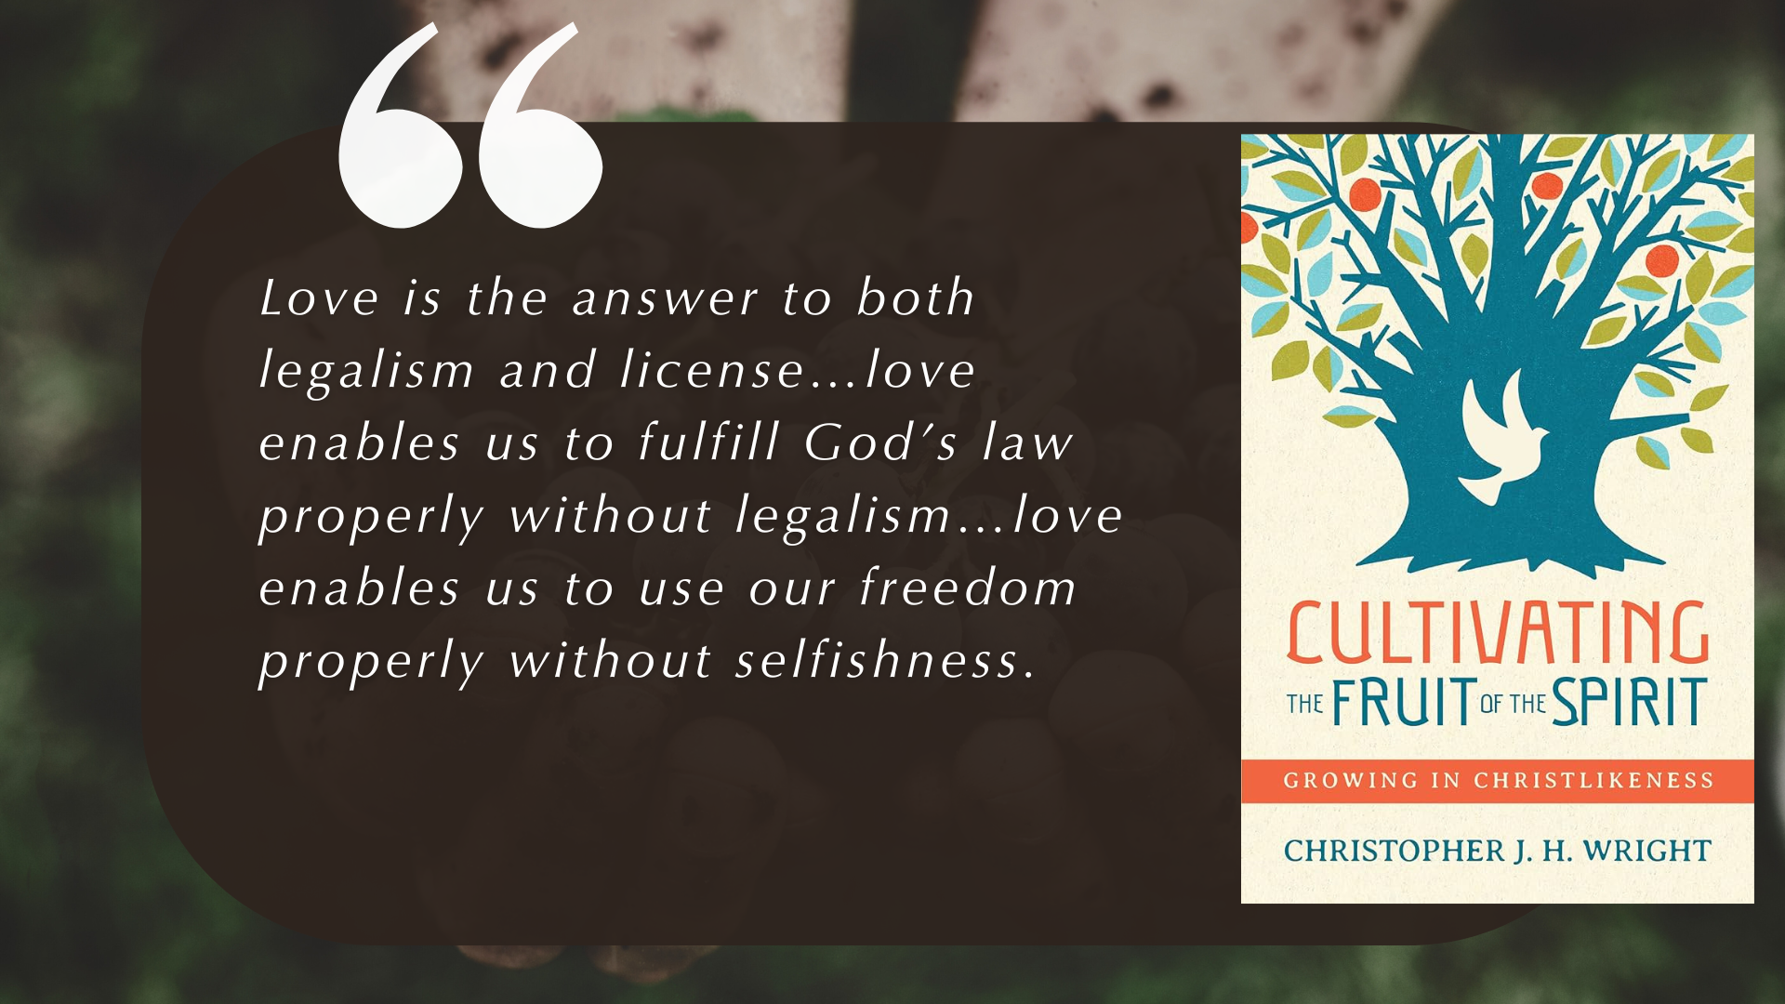

Slide 10
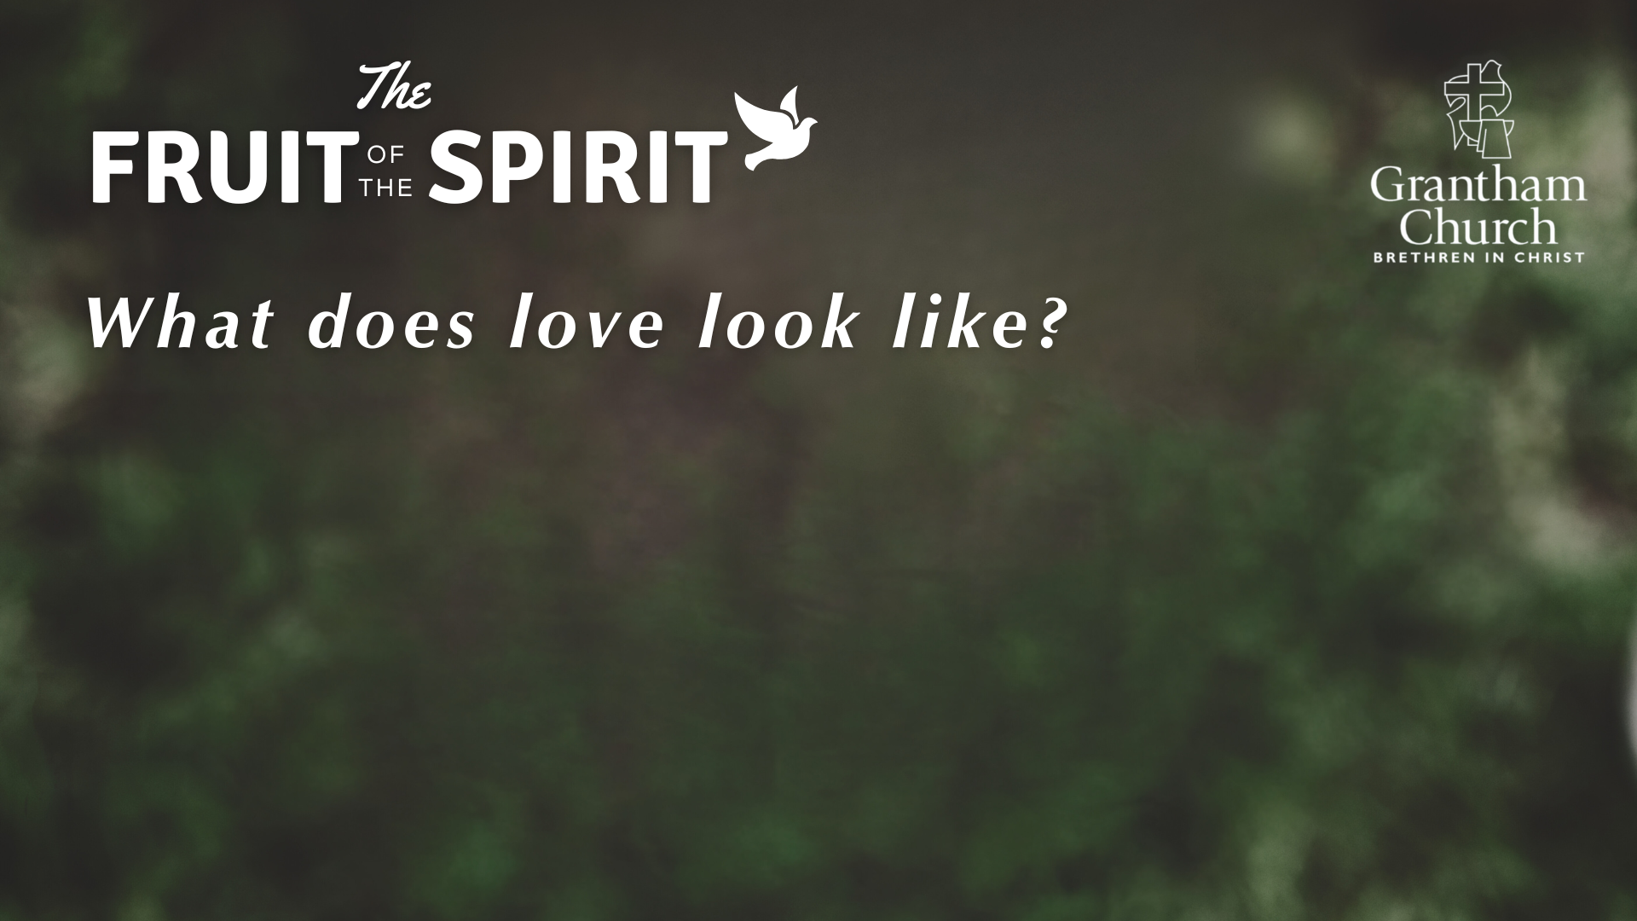

Slide 11
This is how we know what love is: Jesus Christ laid down his life for us. And we ought to lay down our lives for our brothers and sisters. If anyone has material possessions and sees a brother or sister in need but has no pity on them, how can the love of God be in that person? Dear children, let us not love with words or speech but with actions and in truth.
1 JOHN 3:16-18

Slide 13
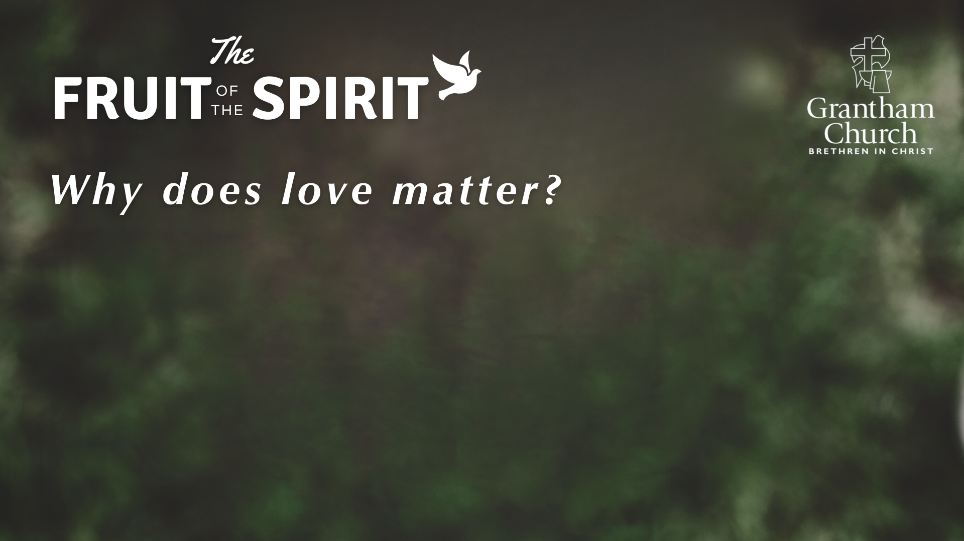

Slide 14
A new command I give you: Love one another. As I have loved you, so you must love one another. By this everyone will know that you are my disciples, if you love one another.
JOHN 13:34-35

Slide 15
A new command I give you: Love one another. As I have loved you, so you must love one another. By this everyone will know that you are my disciples, if you love one another.
JOHN 13:34-35
No one has ever seen God; but if we love one another, God lives in us and his love is made complete in us.
1 JOHN 4:12

Slide 17
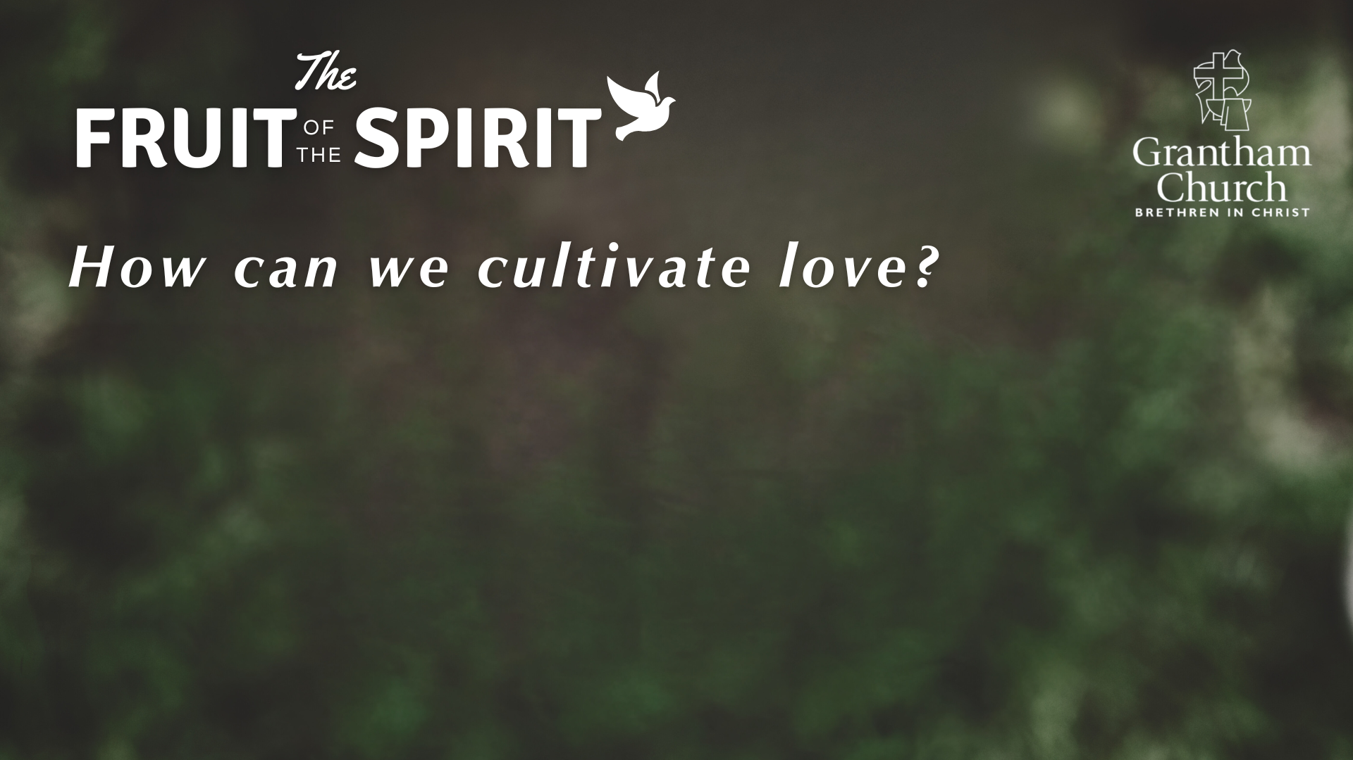
I am the vine; you are the branches. If you remain in me and I in you, you will bear much fruit; apart from me you can do nothing.
JOHN 15:5

Slide 18
Those who belong to Christ Jesus have crucified the flesh with its passions and desires. Since we live by the Spirit, let us keep in step with the Spirit.
GALATIANS 5:24-25

Slide 19
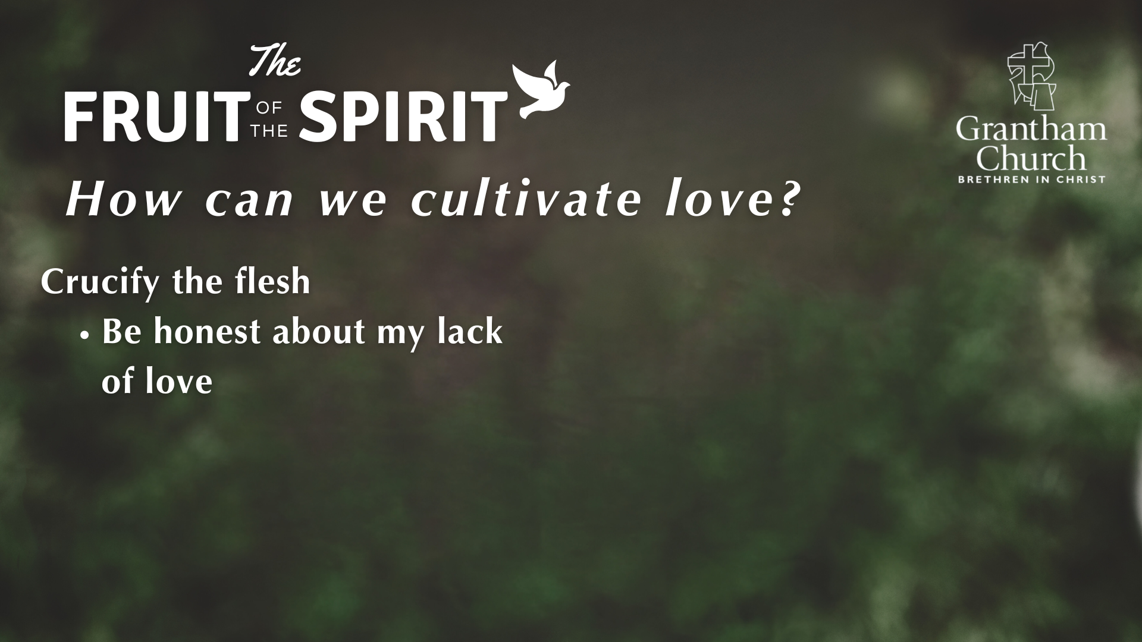

Slide 20
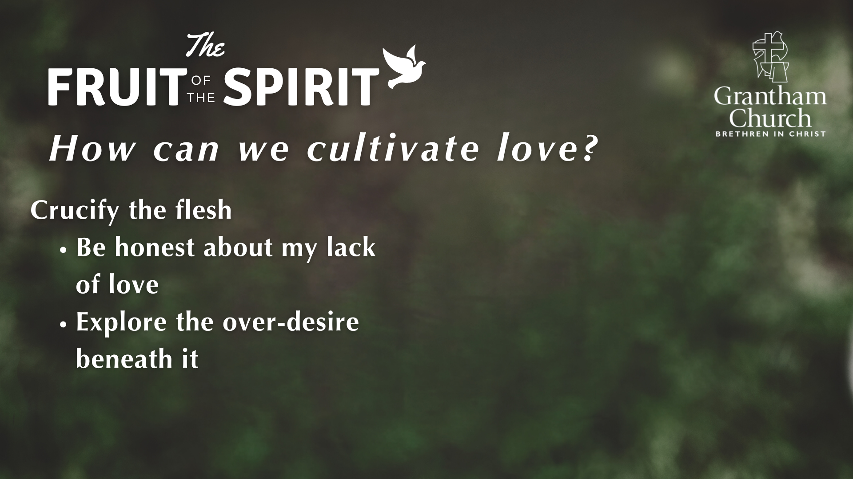

Slide 21
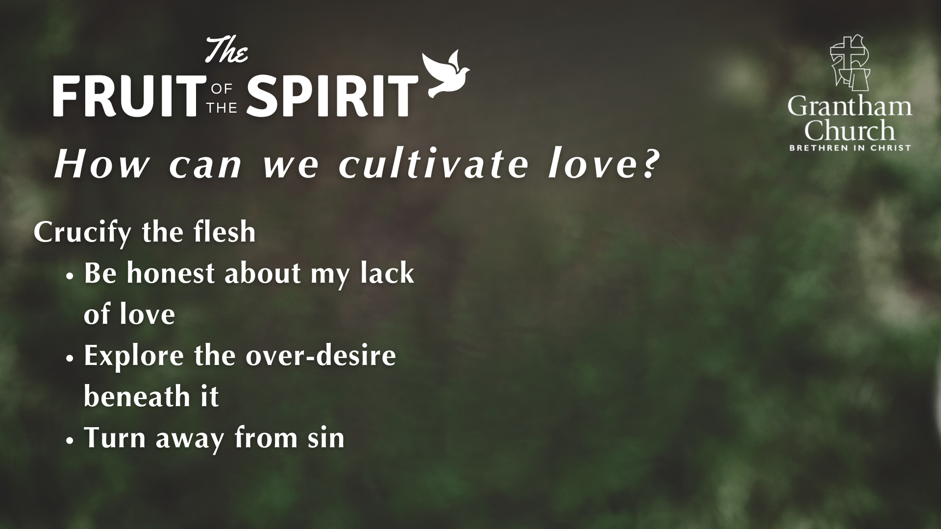

Slide 22
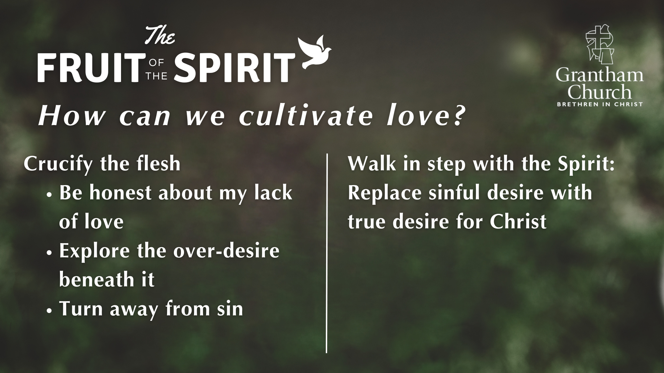

Slide 23
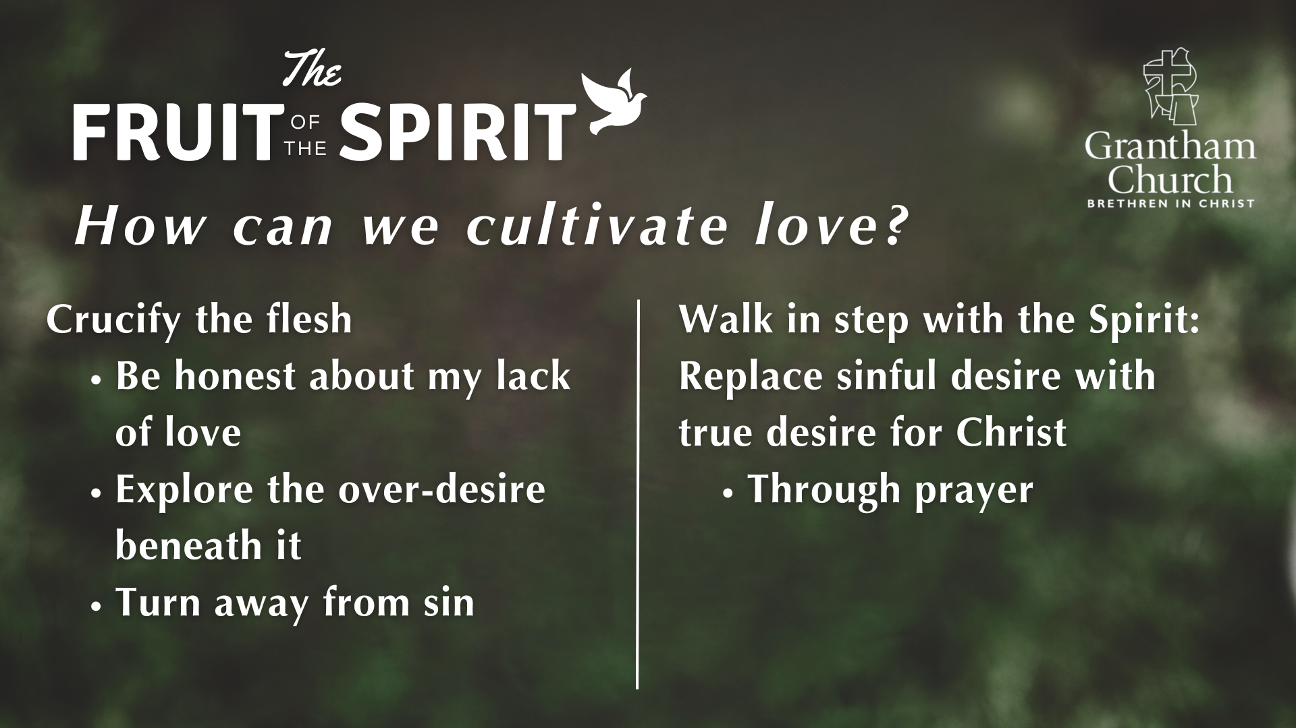

Slide 24
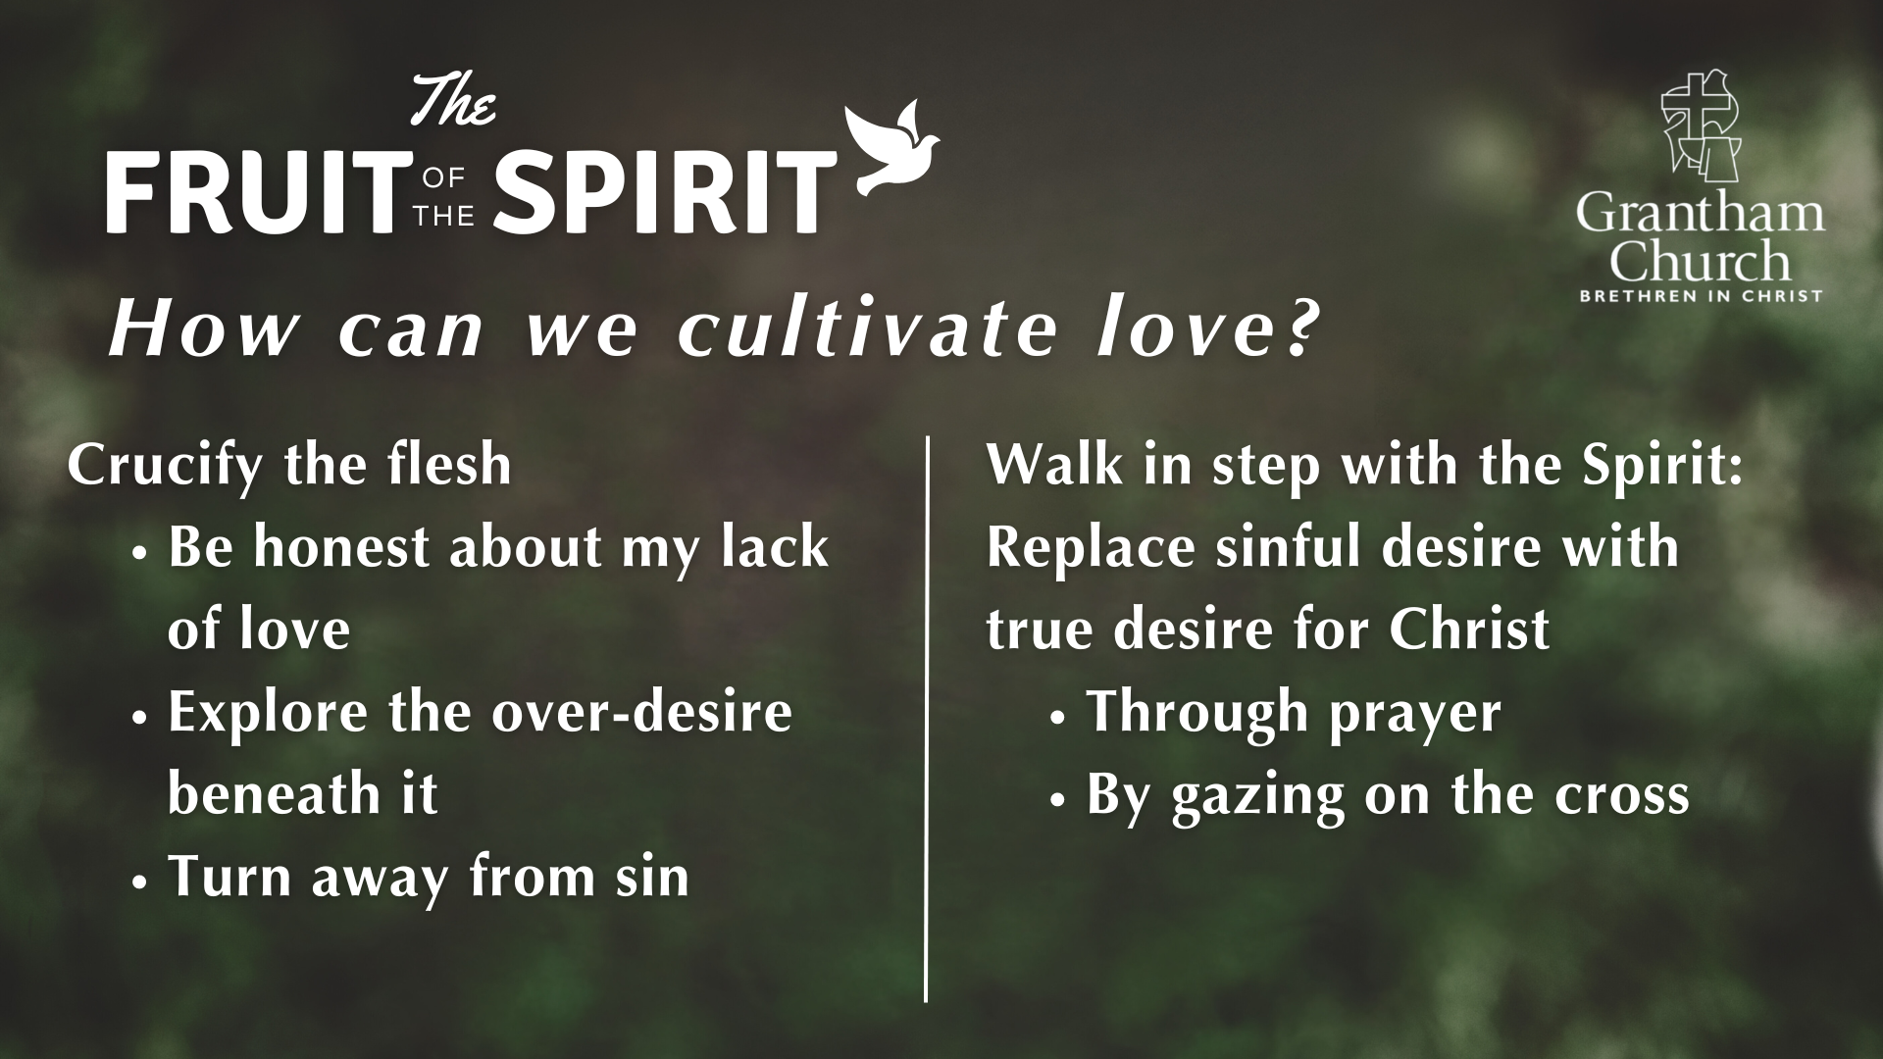

Slide 25
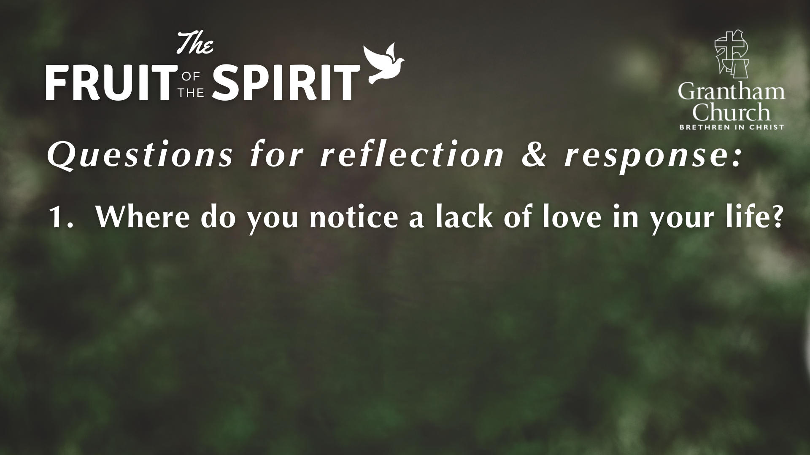

Slide 26
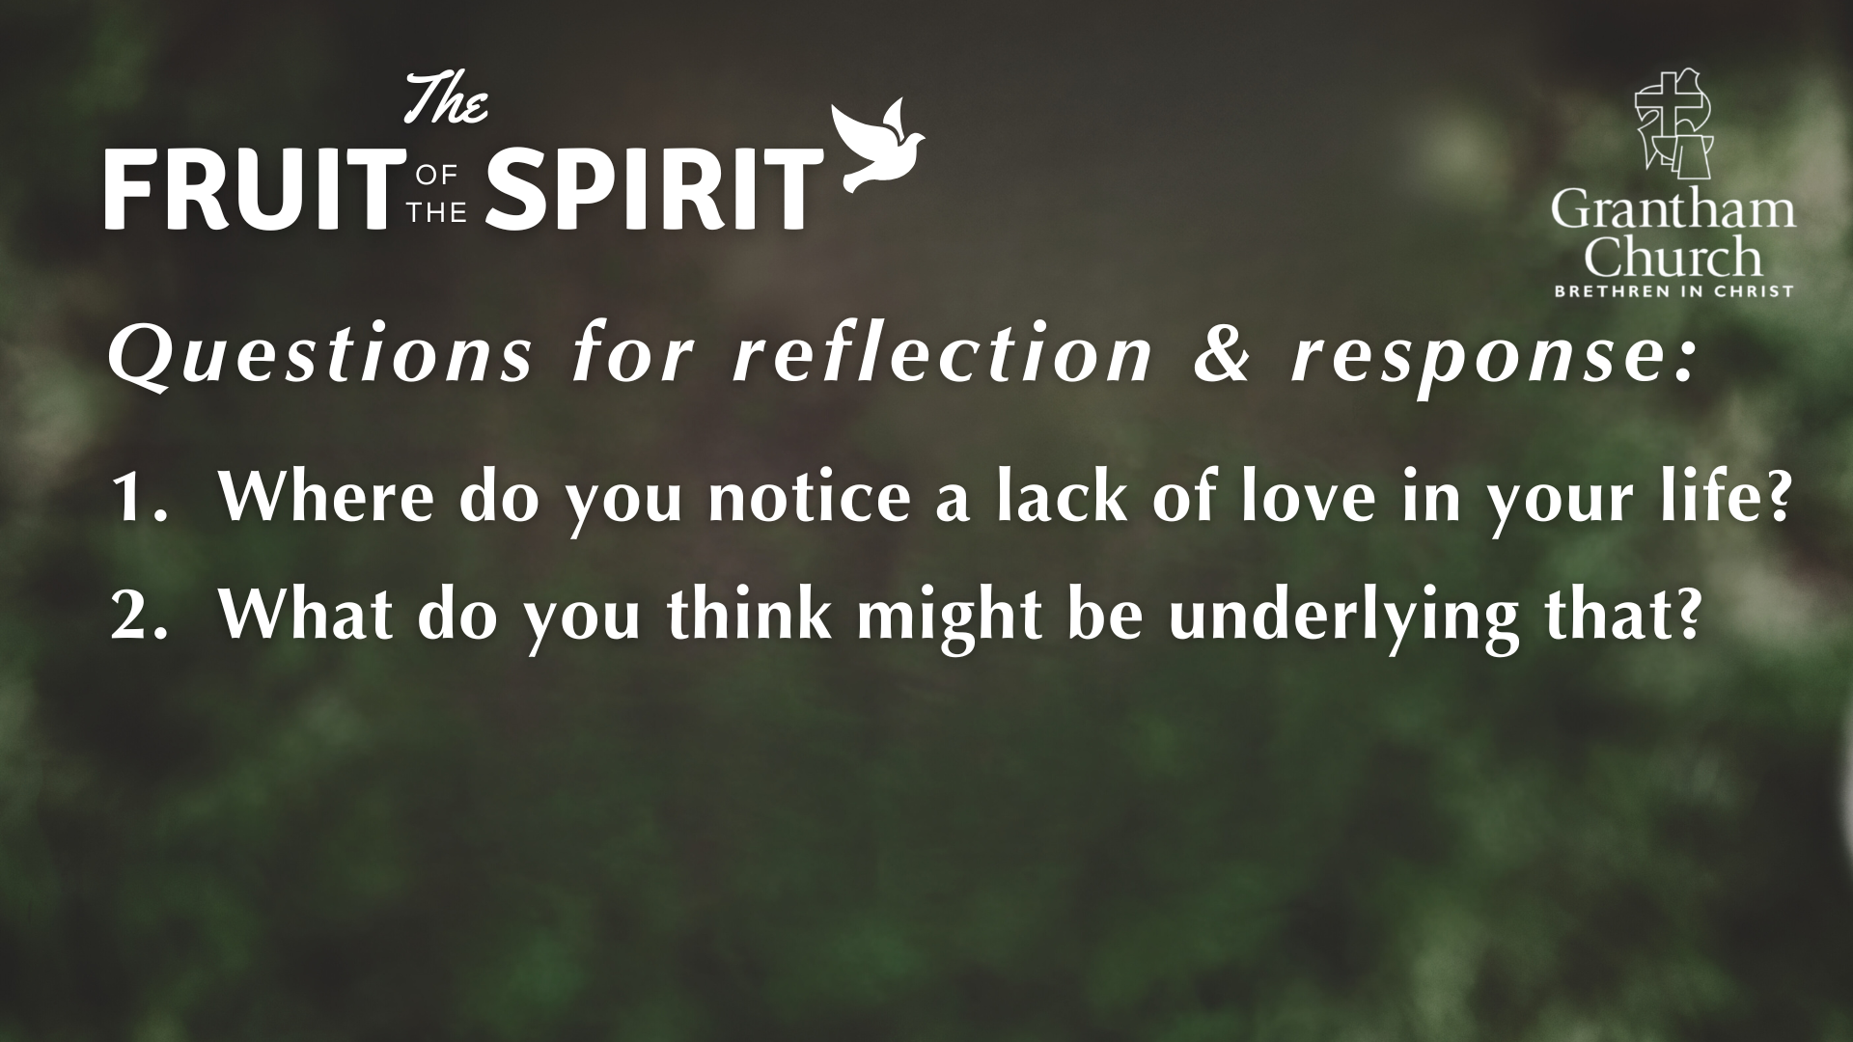

Slide 27
