Slide 1
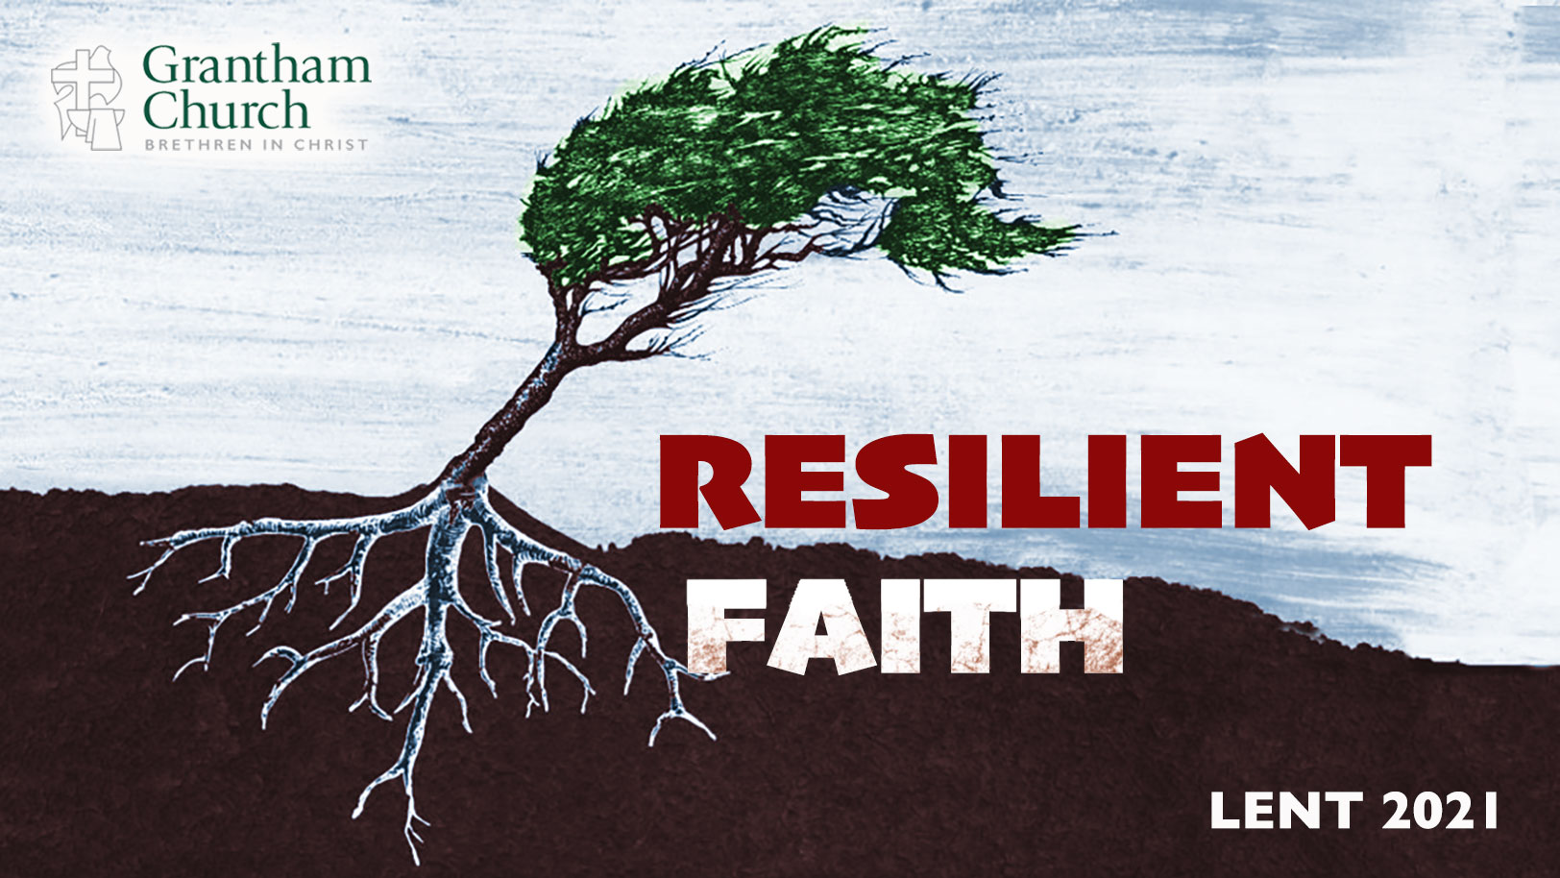
Notes:
This past Wednesday we entered into the season of Lent on the church calendar. If you’re not familiar with the liturgical calendar, Lent has nothing to do with that stuff that collects in your pockets or in your dryer vents at home. Instead, Lent is a 40-day period that begins on Ash Wednesday and ends on Holy Saturday, before Easter Sunday. It’s during this time that we remember Christ in the wilderness, where we journey with Jesus in a time of self-reflection, fasting, and repentance. It’s an opportunity for us to intentionally examine our own hearts, to deepen our faith, and to get all of our life from Christ and follow his calling on our lives.
So, this morning we are kicking off our Lent 2021 series, Resilient Faith. In this series we will be exploring what it looks like to deepen our trust in Christ and grow our faith to withstand the trials, challenges, and storms of life. It’s a series that I hope will encourage you during the ongoing pandemic as we invite you to develop the grit, adaptability, and resilience of our Lord Jesus.
What does in mean to be “resilient” and to develop a resilient faith? [NEXT SLIDE]

Slide 2
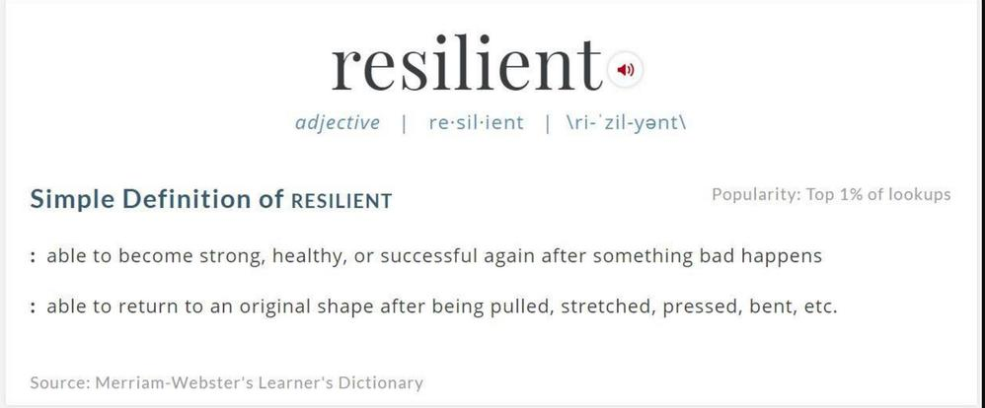
Notes:
And so, we’re talking about developing a “resilient” faith that is made strong through temptation and testing, through internal and external resistance, and by surviving the sabotage of the enemy–-a faith that doesn’t quit but perseveres; doesn’t blame others but takes responsibility; doesn’t get bitter but gets better; and isn’t stuck in the past but adapts and grows as the seasons change and God calls us forward into his good future.
And while the Scriptures don’t use the noun “resilience” or the adjective “resilient” to describe our faith, it does use similar words and phrases that get at the same idea when it describes the tested faith, the purging of faith, of being hard pressed on every side but not crushed, and speaks of pressing on, running the race, of persevering, enduring, and having a faith that is proved genuine.
So, what makes one resilient? Well, it only comes one way: through experiencing resistance. It comes through stress, change, challenges, trials, and even suffering. And it comes through allowing God to use those things to shape you, your character, and deepen your faith. Because he doesn’t just want us to survive in this world, but to thrive in the grace he gives us to overcome. [NEXT SLIDE]

Slide 3
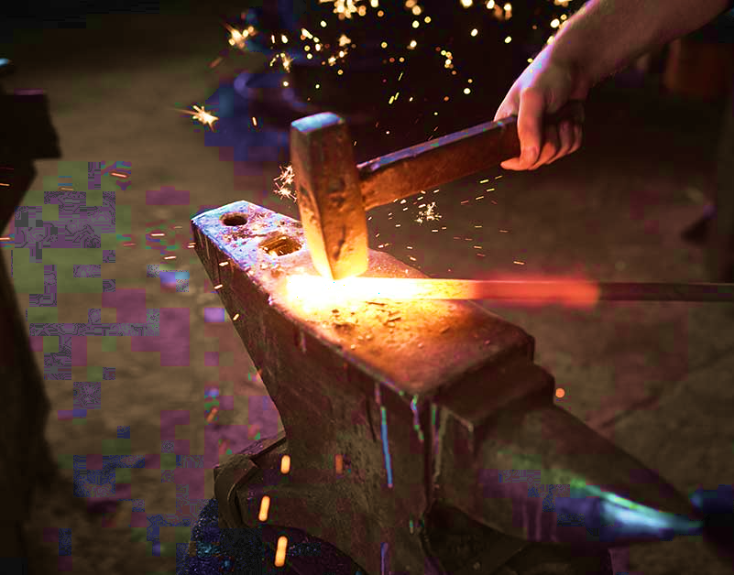
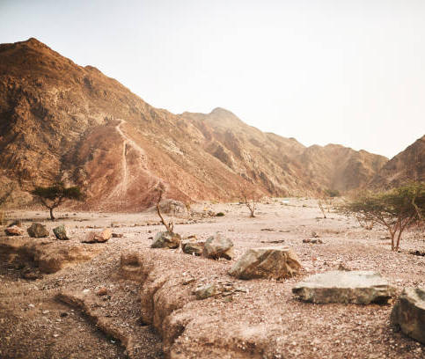
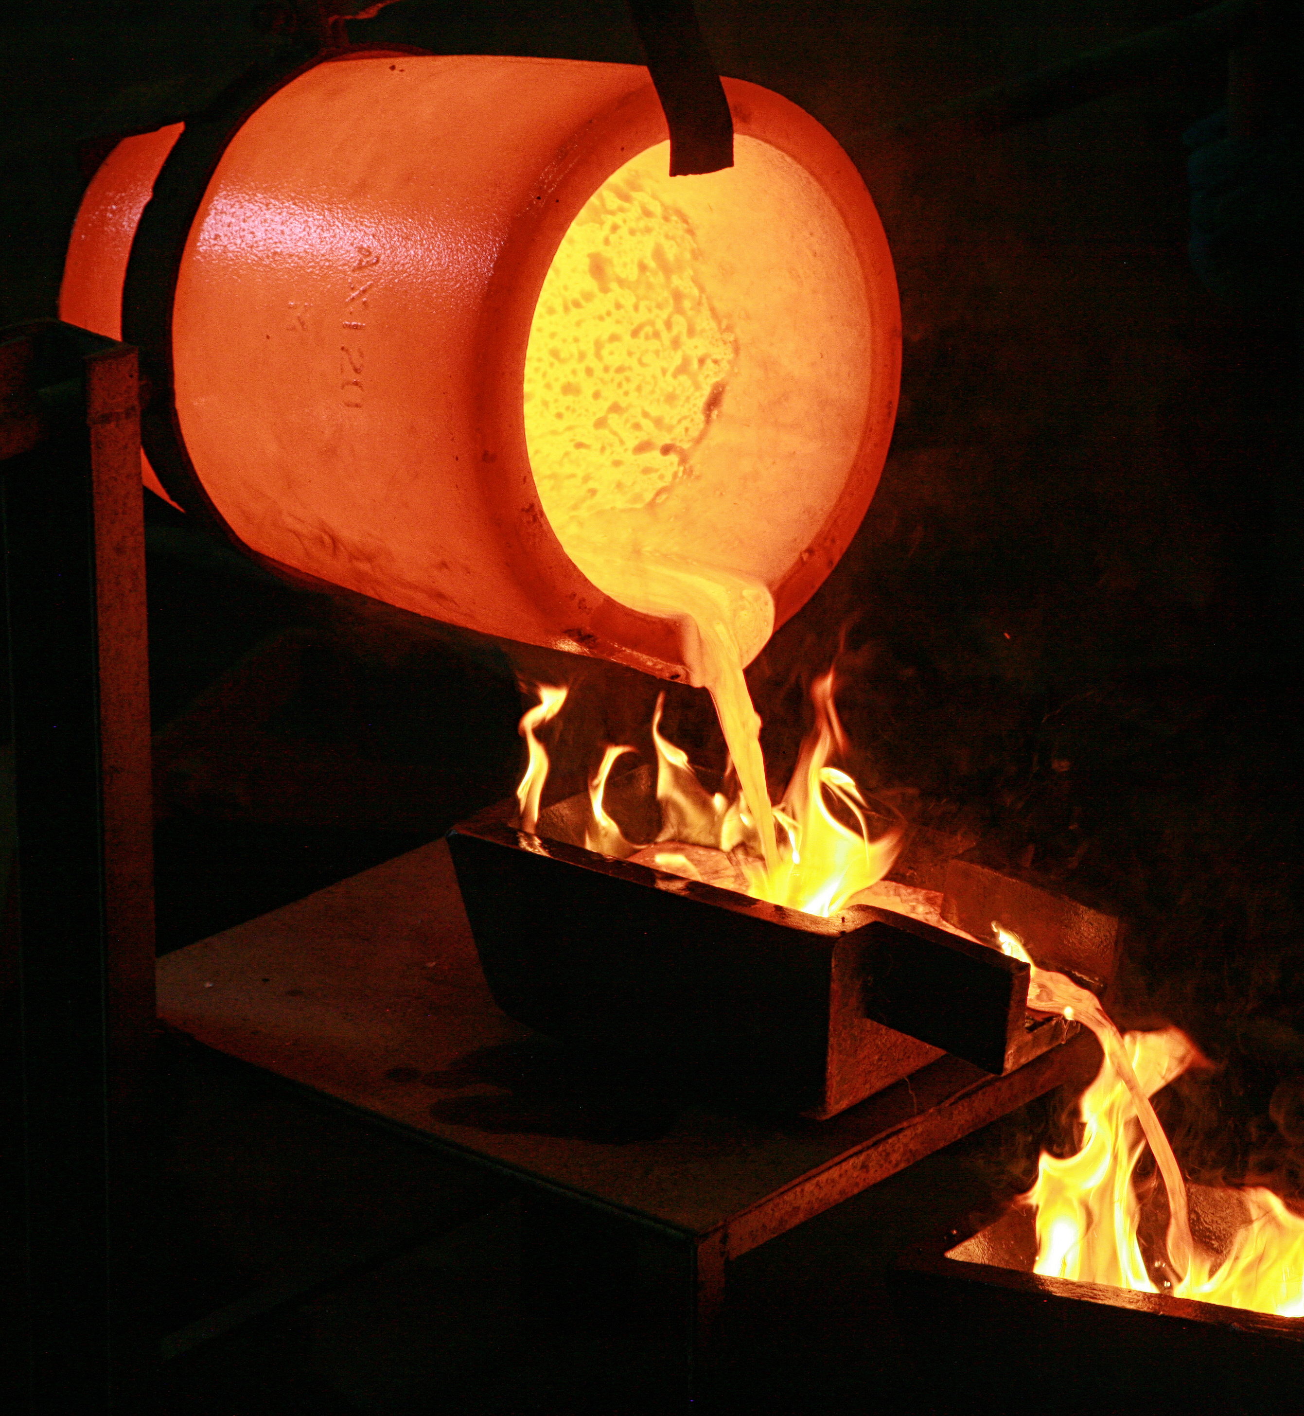
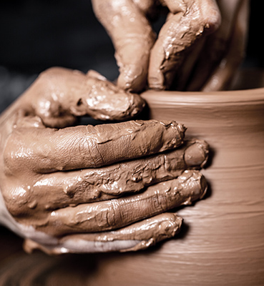
Notes:
[BRIEF COMMENTS]
There are biblical metaphors that ought to come to mind when thinking about how God shapes us and our faith through trials and hardships: like metallurgy (purifying gold), forging metals with fire (e.g. a hammer & anvil), or clay in the hands of the potter, and of course, the wilderness. Which is what Jesus experienced. And where the Lenten season begins.
All three synoptic gospels (i.e. Matthew, Mark, and Luke) record Jesus’ 40 days in the Judean wilderness. But Mark’s account is the shortest, and there are a couple of noticeable differences. Let’s take a look at Mark chapter 1, verses 9-13. [NEXT SLIDE]

Slide 4
Mark 1:9-13 NIV
⁹ At that time Jesus came from Nazareth in Galilee and was baptized by John in the Jordan. ¹⁰ Just as Jesus was coming up out of the water, he saw heaven being torn open and the Spirit descending on him like a dove. ¹¹ And a voice came from heaven: “You are my Son, whom I love; with you I am well pleased.” ¹² At once the Spirit sent him out into the wilderness, ¹³ and he was in the wilderness forty days, being tempted by Satan. He was with the wild animals, and angels attended him.
Notes:
Pay attention to the context:
Jesus has lived in obscurity for 30 years and has just been baptized (anointed by God)
His walk into the wilderness for 40 days is for several reasons: (1) Jesus embodies the story of Israel; (2) Jesus is being prepared for ministry; and (3) Jesus is deciding what kind of Messiah he will be.
Notice v.13 says he was wrestling with the powers of darkness (Satan & the wild animals)
Jesus knows that the trial comes before triumph
And look at this…
v.12 – “the Spirit sent him” – Gk, the Spirit “compelled” or “drove” Jesus into the desert. Matthew and Luke say that Jesus was led into the wilderness. But Mark’s language is stronger. He says that the Spirit drove Jesus. Why does Mark say this? Don’t misunderstand this. Mark doesn’t mean that the Spirit acted against Jesus’ own will, but rather that Jesus had surrendered to the Spirit that was now in control of Jesus’ messianic mission, impelling him forward with purpose. [NEXT SLIDE]

Slide 5
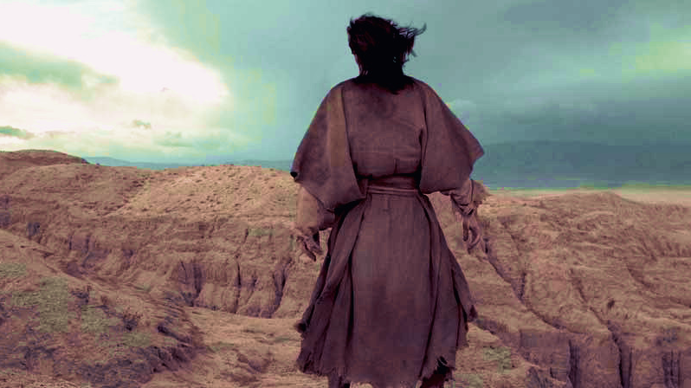
Notes:
Isn’t that so important? How much more difficult are our temptations and trials in our own wilderness if we believe that they are random events; if we don’t see that the Spirit is leading us, even driving us, forward at times? How much more painful and seemingly hopeless it can be when we can’t see the purpose of it all. How easy it is to say, “Why is this happening to me?” and ”What did I do to deserve this?” But Jesus didn’t do that. Because he knew the reason. He knew the purpose.
You see, Jesus knew who he was in the Father’s eyes. And Jesus knew that he had a specific calling on his life. That is why he didn’t come up out of the Jordan river and expect all rainbows and sunshine. He didn’t naively think ”I’m God’s chosen. I have his favor. Therefore, it’s all smooth sailing from here.” No, Jesus came up out of the baptismal waters seeing this very clearly. He has just been identified as the anointed one, God’s chosen servant.
And listen, folks, when God sets you apart to be a leader in any way, whether that’s being the Son of God, a pastor, a board member, a commission chair, or leading a team at your job, the attacks from the enemy will come. It comes with the territory. After all, we’re in a spiritual struggle between good and evil… in the church and in the world. And if you step forward to lead, you’ve just made yourself a target for the enemy and all the “wild animals” he employs and exploits.
Therefore, Jesus willingly goes with the compelling force of the Spirit into the wilderness to be tested and prepared for his vocation. Because it’s trial before triumph. For Jesus knows… good things are always on the other side of our trials and testing, if we will remember who we are, what God has called us to do, and submit to the Spirit’s work in our life.
James, the half-brother of Jesus, put it this way: [NEXT SLIDE]

Slide 6
James 1:2-4 NLT
² Dear brothers and sisters, when troubles of any kind come your way, consider it an opportunity for great joy. ³ For you know that when your faith is tested, your endurance has a chance to grow. ⁴ So let it grow, for when your endurance is fully developed, you will be perfect and complete, needing nothing.
Notes:
Let’s look at this verse-by-verse:
v. 2 – when troubles of any kind come your way,
not if, but when—troubles and trials are normal; drama has a key to your house!
we live in a society that wants comfort and avoids stress, trials, and problems, but we live in a world where human advancement and growth has always happened as a result of opposition and forces that fight against us and press down upon us, e.g. gravity and the ISS – a reminder that we require pressure to live as human beings
consider it an opportunity for great joy.
James challenges us to see trials through eternal lenses
Perspective that looks ahead to the end result, not on the immediate problem
James is asking, do you see your troubles as an opportunity for joy?
v. 3 – For you know that when your faith is tested,
“your faith” – your belief in Christ, in the Good News, in God’s goodness, and his ability to bring good out of evil, etc.
When that faith is “tested” you can grow, but how? The Greek word for “tested” is a term used in metallurgy – the impurities rise to the top and are scraped away– the dross is discarded
your endurance has a chance to grow (NIV: the testing of your faith produces perseverance – busting through stopping places)
endurance (meaning you see the need, carry the need, until there is none), this is characteristic of a person who is unmoved from their purpose and loyalty to faith and piety by even the greatest trials and sufferings
And let’s be clear, church. It’s not the suffering itself that is good, it’s about the good that can come from the suffering, if we will get our minds right about the opportunity it affords us to grow and develop a resilient faith.
v. 4 – So let it grow, for when your endurance is fully developed,
James is saying, don’t quit, don’t backdown, don’t backout, don’t pull out too soon and miss what can come if you’ll allow the Divine Metallurgist to purify you in the working out of your salvation. He says, you will be perfect and complete, needing nothing. Perfect – healthy, whole, and mature like Christ; able to rise above it all with the mind of Jesus.
That sounds a lot like what the Apostle Paul wrote in Romans 5:3-5. He said: [NEXT SLIDE]

Slide 7
Romans 5:3-5 NLT
³ We can rejoice, too, when we run into problems and trials, for we know that they help us develop endurance. ⁴ And endurance develops strength of character, and character strengthens our confident hope of salvation. ⁵ And this hope will not lead to disappointment. For we know how dearly God loves us, because he has given us the Holy Spirit to fill our hearts with his love.
Notes:
[BRIEF COMMENTS]
Your pastoral staff has certainly experienced the meaning of Paul’s words in the past 12 months. We’ve not only done a lot of hard work in our relationships and learning how to work together as a team, but, like many pastors during COVID, we’ve also been intentional in how God wants to grow each of us to be more resilient in our faith and in our leadership.
One way we’re doing that is by reading a book together and discussing it each week. Some of you may recall me mentioning the book Canoeing the Mountains in my message on Vision Sunday 2019. Well, the author, Tod Bolsinger, recently came out with another timely book called, Tempered Resilience: How Leaders Are Formed in the Crucible of Change.
Listen to these words from Tod about doing this hard but important work of growing a resilient faith: [NEXT SLIDE]

Slide 8
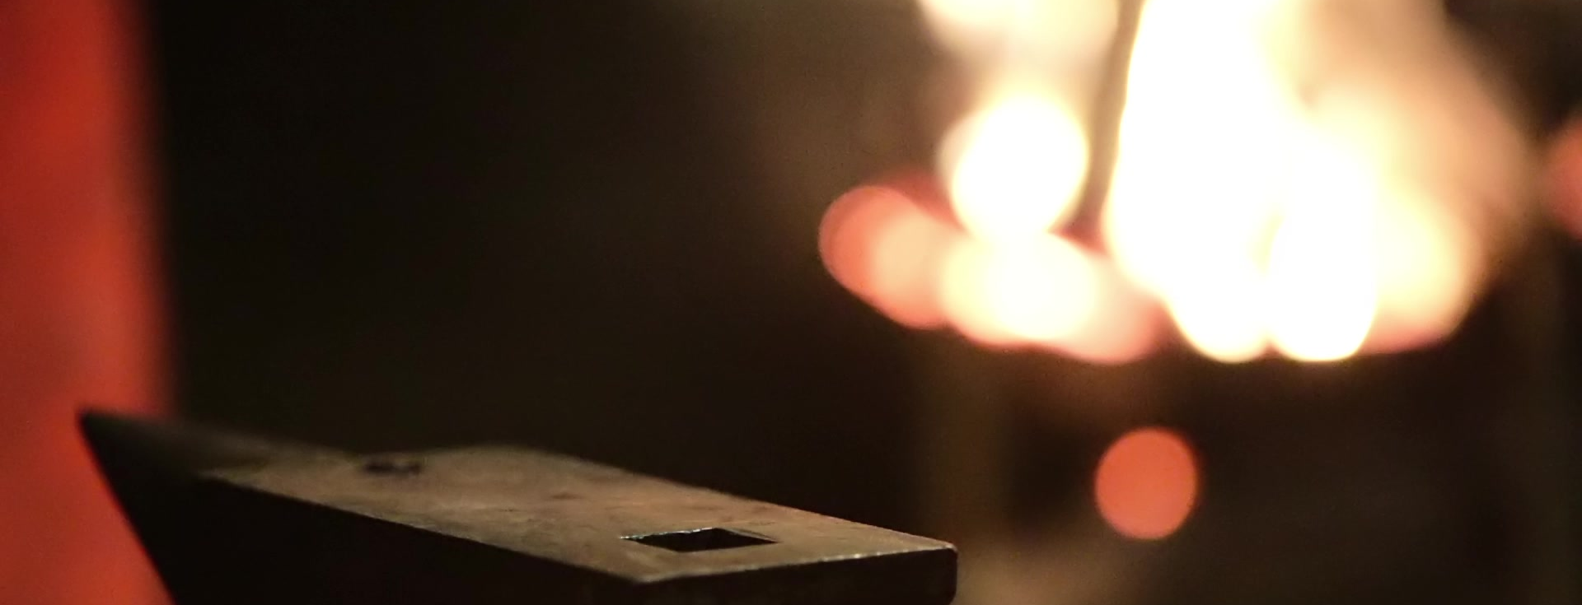

“Fire and anvil, Spirit and community are necessary but not alone. For the master Artisan uses anvil and fire with the hammer of hard blows—both crises we undergo and practices we undertake—to shape, strengthen, smooth, and shine us into something both beautiful and useful.”
Tod Bolsinger, Tempered Resilience
Notes:
Tod goes on to say… [NEXT SLIDE]

Slide 9
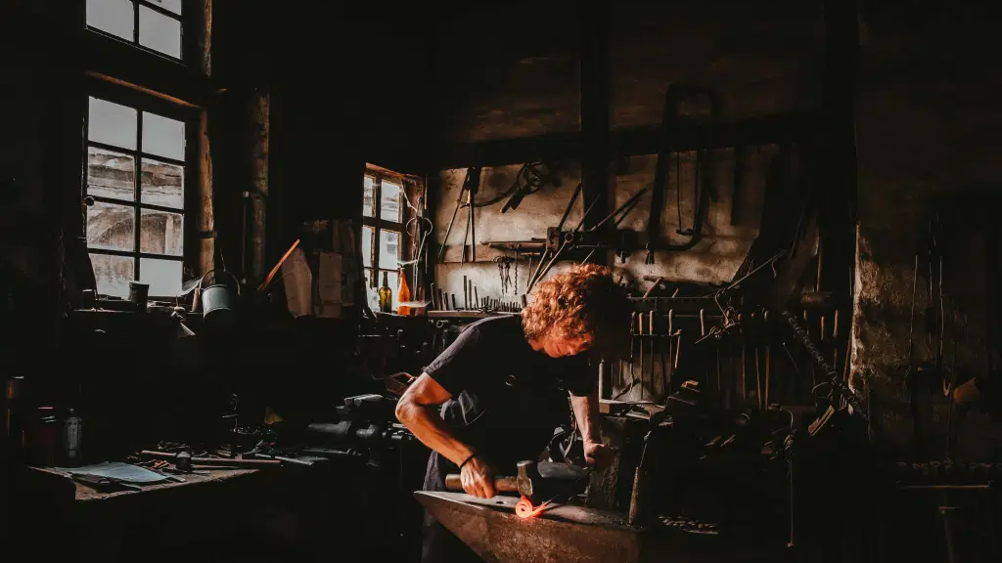
Notes:
“Without the Spirit, the hammer of life’s difficulties and tests would only scar and mar us. Without the anvil, the hammer would crush us to bits. But together fire, anvil and hammer, Spirit, community, and hardship used by the master Artisan, forge us into something stronger and more flexible, more useful and more beautiful than we could ever imagine.”
So, I suppose the question is, “Do you trust the Master Artisan with your trials?” Like Jesus, do you see your trials having purpose? That doesn’t mean that everything that happens to us was because God wanted it, but it does we can discover how wise God is and how capable he is to bring design, order, and purpose to our mess, if we will see the wilderness the way Jesus did.
Who doesn’t want that? I believe we all do. But we must of course be willing to let God do some sifting, some purifying, some chiseling, maybe some pounding, and, yes, the slow, gentle, careful forming of your soul on the Potter’s wheel. Will you submit to the process and look inward this Lent, and through this series? Will you commit to God’s way of creating a resilient faith? I hope that you’ll do that.
Finally, hear these hopeful words from the Apostle Peter: [NEXT SLIDE]

Slide 10
1 Peter 1:5-9 MSG
The Day is coming when you’ll have it all—life healed and whole. I know how great this makes you feel, even though you have to put up with every kind of aggravation in the meantime. Pure gold put in the fire comes out of it proved pure; genuine faith put through this suffering comes out proved genuine.

Slide 11
1 Peter 1:5-9 MSG
When Jesus wraps this all up, it’s your faith, not your gold, that God will have on display as evidence of his victory. You never saw him, yet you love him. You still don’t see him, yet you trust him—with laughter and singing. Because you kept on believing, you’ll get what you’re looking forward to: total salvation.
Notes:
[BRIEF COMMENT]

Slide 12
Notes:
As we conclude this message, I want to invite you to close your eyes and listen to these words from James 1:2-4 once again. And this time, hear them from Jesus to you.
James 1:2-4 (MSG) “Consider it a sheer gift, friends, when tests and challenges come at you from all sides. You know that under pressure, your faith-life is forced into the open and shows its true colors. So don’t try to get out of anything prematurely. Let it do its work so you become mature and well-developed, not deficient in any way.”
And now hear them again from the Lord (in a different translation) to us as a church family:
James 1:2-4 (VOICE) “Don’t run from tests and hardships, brothers and sisters. As difficult as they are, you will ultimately find joy in them; if you embrace them, your faith will blossom under pressure and teach you true patience as you endure. And true patience brought on by endurance will equip you to complete the long journey and cross the finish line—mature, complete, and wanting nothing.”
CLOSING PRAYER
Lord, we need you. Every hour, we need you. Thank you for your faithfulness to us in days past, for never leaving us nor forsaking us. Give us the strength to walk through the deserts of life. And help us to accept the trials of the wilderness that come in the strong winds, in the forge, in the hammer and the anvil, and in the potter’s hands, so that we might grow our roots down deep into you, develop resilience and grit, and overcome whatever trials we’re in, and whatever trials may come. We give it all to you. And we ask that you give it purpose and power, as we follow you each day, and wait to see how you will use it in our individual lives, and in the life of our church, for the glory of your Kingdom. Amen.

