Slide 1
Responding to Racism

Slide 2
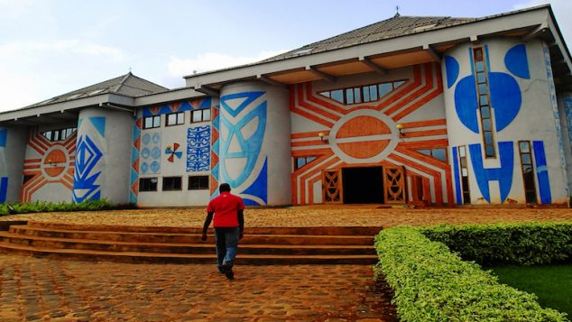
MCC is Addressing Systemic Racism
Dina Gonzalez-Piña
West Coast MCC Executive Director
January 24, 2021

Slide 3
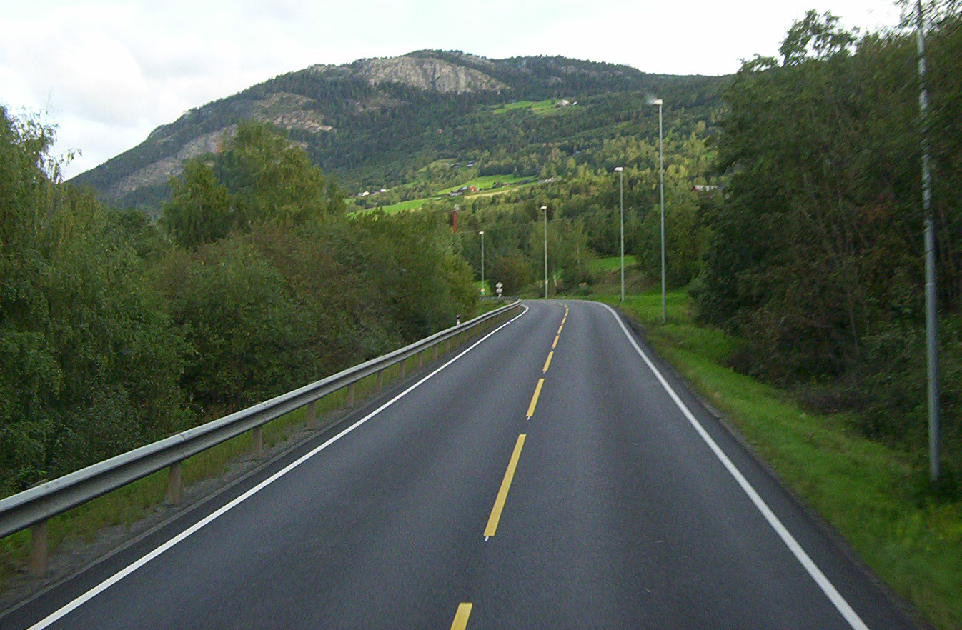
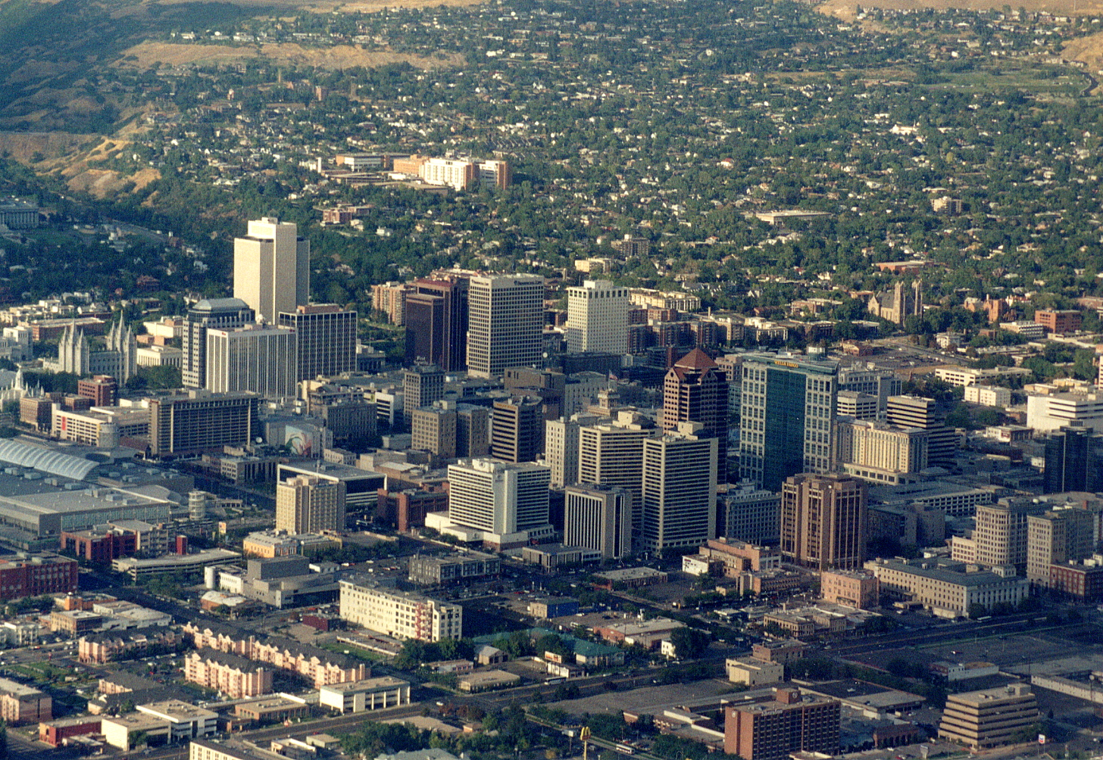
Our own journey…

Slide 4
MCC -Anti-Racism work
Rooted in BIBLICAL FOUNDATION-
    Its a Biblical Issue-
        Created in the Image of God- Gen 1:27
    It’s a Church Issue-
        Ministry of Reconciliation- 2 Cor. 5:18
    It’s a Missional Issue
        Every nations, all tribes, all people, all languages…Rev 7:9

Slide 5
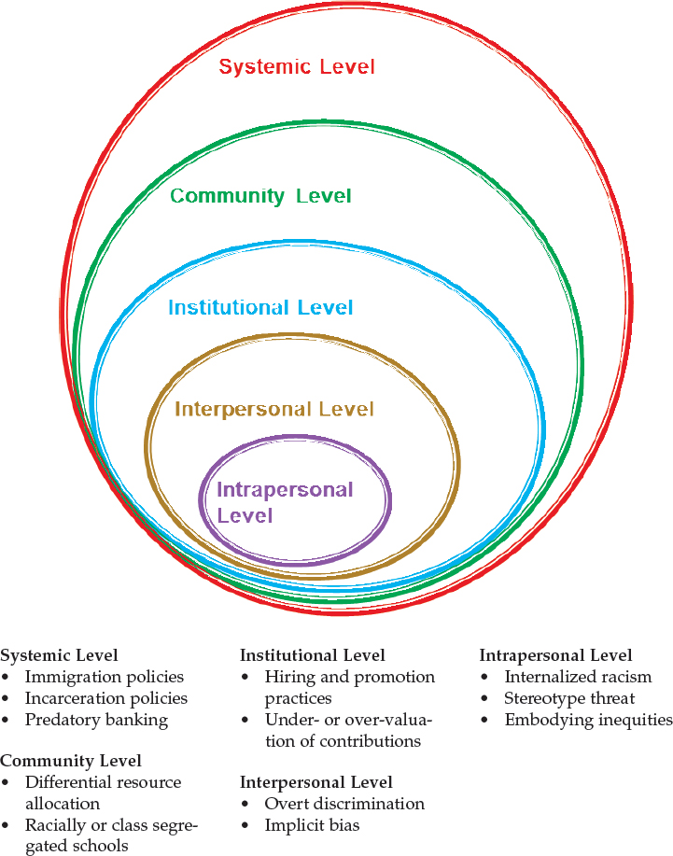
Levels of
Anti-racism work
Notes:
Video of kids- dolls

Slide 6
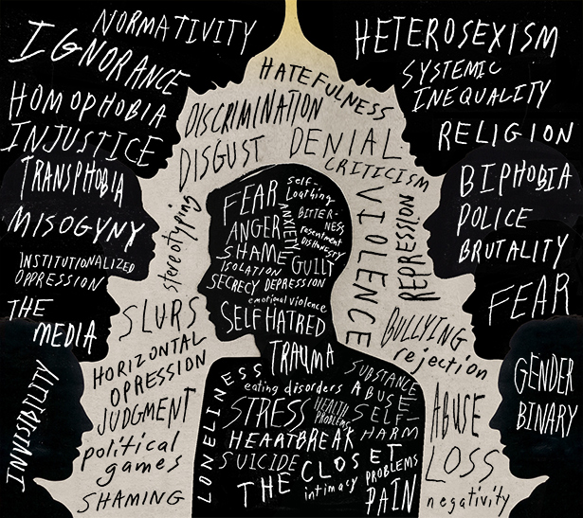
Intrapersonal Racism
Level 1 Intrapersonal Level: Intrapersonal racism is a way of seeing the internalized supremacy/racism that is the personal conscious or subconscious acceptance of the dominant society’s racist views, stereotypes and biases of racial and ethnic groups. It gives rise to patterns of thinking, feeling and behaving that result in discriminating, minimizing, criticizing, finding fault, invalidating, and hating others/oneself while simultaneously valuing the dominant culture.

Slide 7
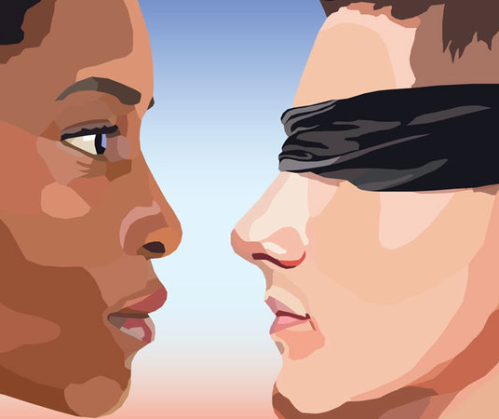
Interpersonal Racism
Level 2 Interpersonal Level: Individual racism refers to an individual's racist assumptions, beliefs or behaviors and can be conscious or unconscious. Interpersonal racism occurs between individuals. Once we bring our private beliefs into our interaction with others, racism is now in the interpersonal realm. It’s found in our practice of overt discrimination and implicit biases.

Slide 8
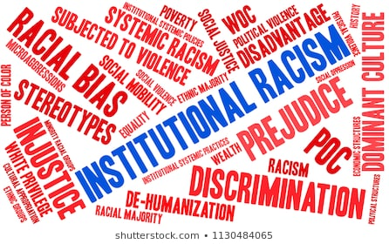
Institutional Racism
Level 3 Institutional Level: Institutional racism refers specifically to the ways in which institutional policies and practices create different outcomes for different racial groups. It is a pattern of social institutions—such as governmental organizations, schools, banks and courts of law—whose effect is to create advantages for whites and oppression and disadvantage for people from groups classified as people of color.

Slide 9
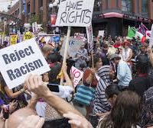
Community Racism
Level 4 Community Level: This is the system used to allocate resources and uphold inequalities based on race and amplifying disparities. An example is school segregation.

Slide 10
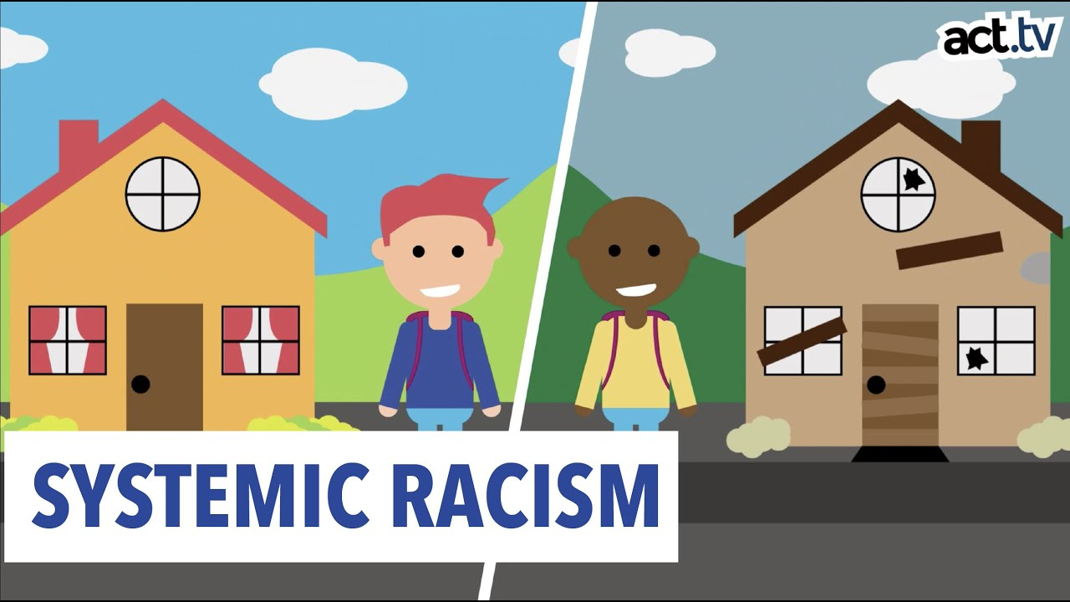
Systemic/ Structural Racism
Level 5 Systemic Level: Structural or systemic racism in the U.S. is the normalization and legitimization of an array of dynamics—historical, cultural, institutional and interpersonal—that routinely advantage whites while producing cumulative and chronic adverse outcomes for people of color. Structural racism encompasses the entire system of white domination, diffused and infused in all aspects of society including its history, culture, politics, economics and entire social fabric.

Slide 11
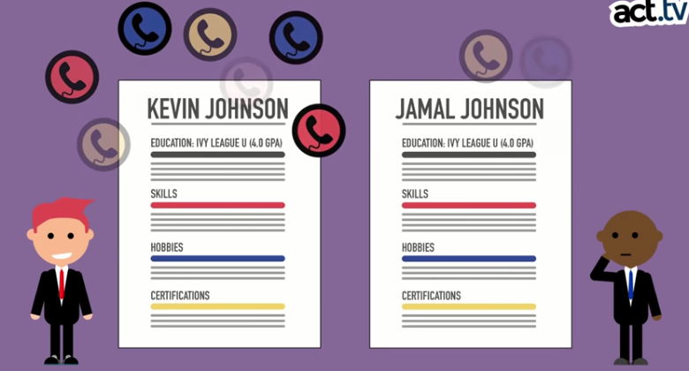
The cost of racism … on POC

Slide 12
Next Steps-
Advance your own journey by reading books, listening to podcasts and watching videos. Check out resources on MCC’s website here: https://mcccanada.ca/stories/resources-anti-racism-education. This includes reading authors from marginalized communities and being open to seeing the journey through a different lens.
Trouble I've Seen: Changing the Way the Church Views Racism, by Drew G.I. Hart
“What if all Christians listened to the stories of those on the racialized margins? How might the church be changed by the trouble they've seen?” In this enlightening book, Drew G.I. Hart examines how white faith leaders have turned a blind eye to racial injustice in North America. He urges white Christians to examine their institutions when it comes to racial equity and offers concrete practices for churches to seek solidarity with the oppressed.
White Awake: An Honest Look at What It Means to Be White, by Daniel Hill
“When white culture comes in contact with other cultures, it almost always wins.” After Daniel Hill was confronted by this reality, he began a journey of understanding his own identity. Hill urges us to address and confront racial and systemic injustices through seven stages of cultural awakening. This book will empower you to be an agent of reconciliation in our increasingly divided world.

Slide 13
2. Reach beyond your homogenous community and enter spaces with “mutual” engagement.
Invite speakers/preachers that have a different ethnic experience to share.
Move beyond resourcing old structures and see what God is doing in marginalized spaces.
Go on a prayer and fasting journey for God to reveal areas need to be decolonized.
Widen your circle to include people not from your ethnic group.
Practice radical hospitality.

Slide 14
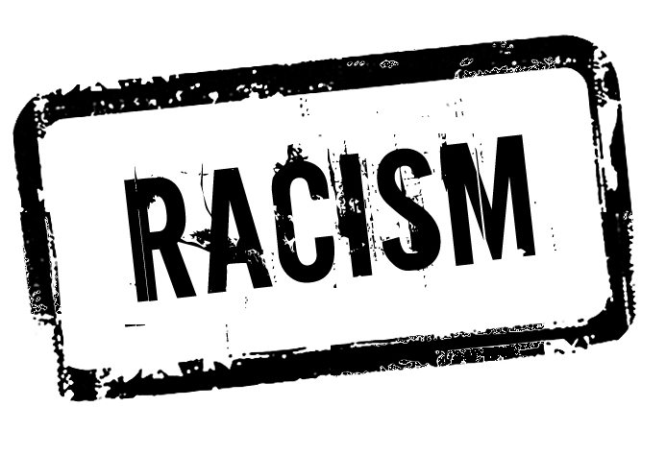
personal story
1) When were you first aware of race
2) Have you experienced or witness racism
This Photo by Unknown Author is licensed under CC BY-SA
This Photo by Unknown Author is licensed under CC BY-ND
This Photo by Unknown Author is licensed under CC BY-NC
Notes:
YOU Cannot respond to R unless you do your work of identifying it first.

Slide 15
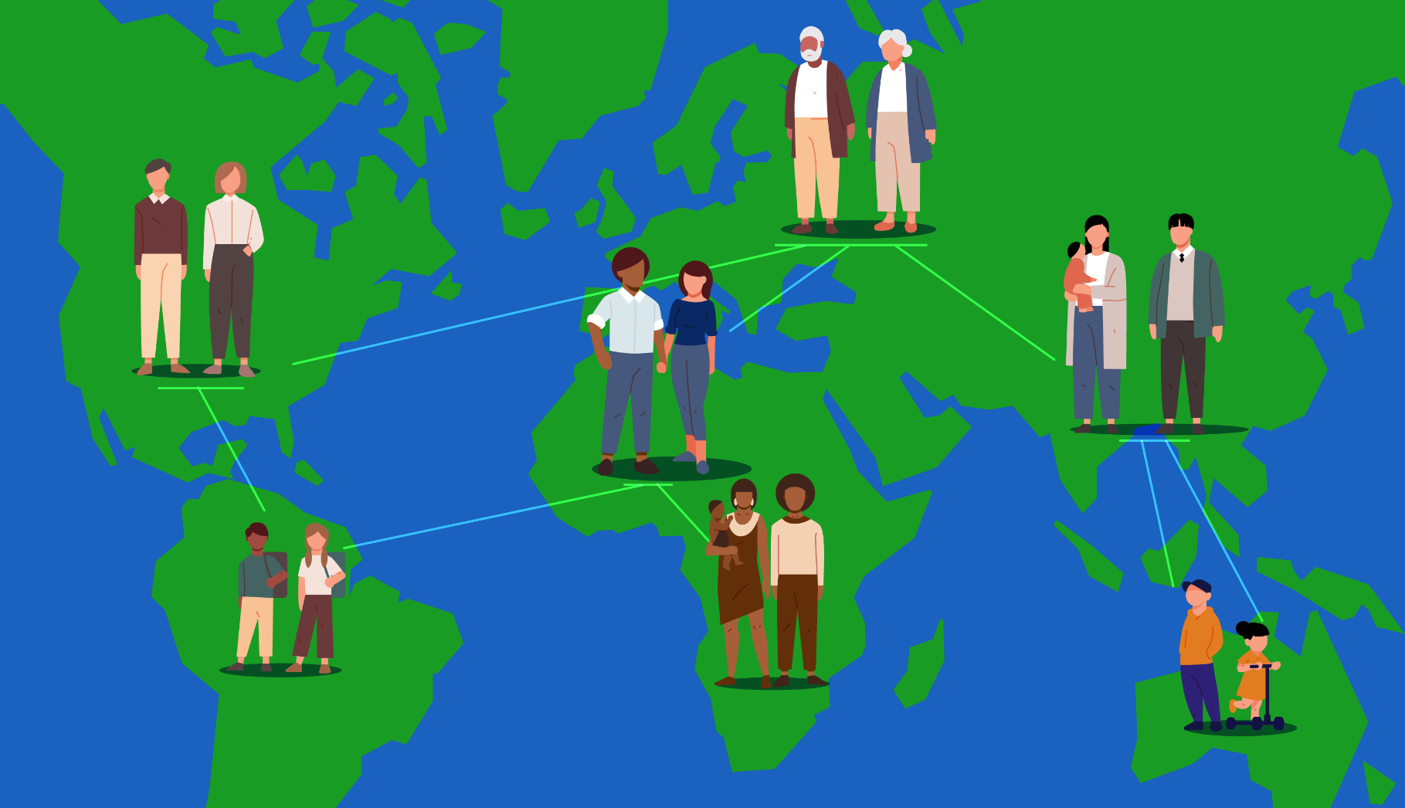
Do you know your own race history?

