Slide 1
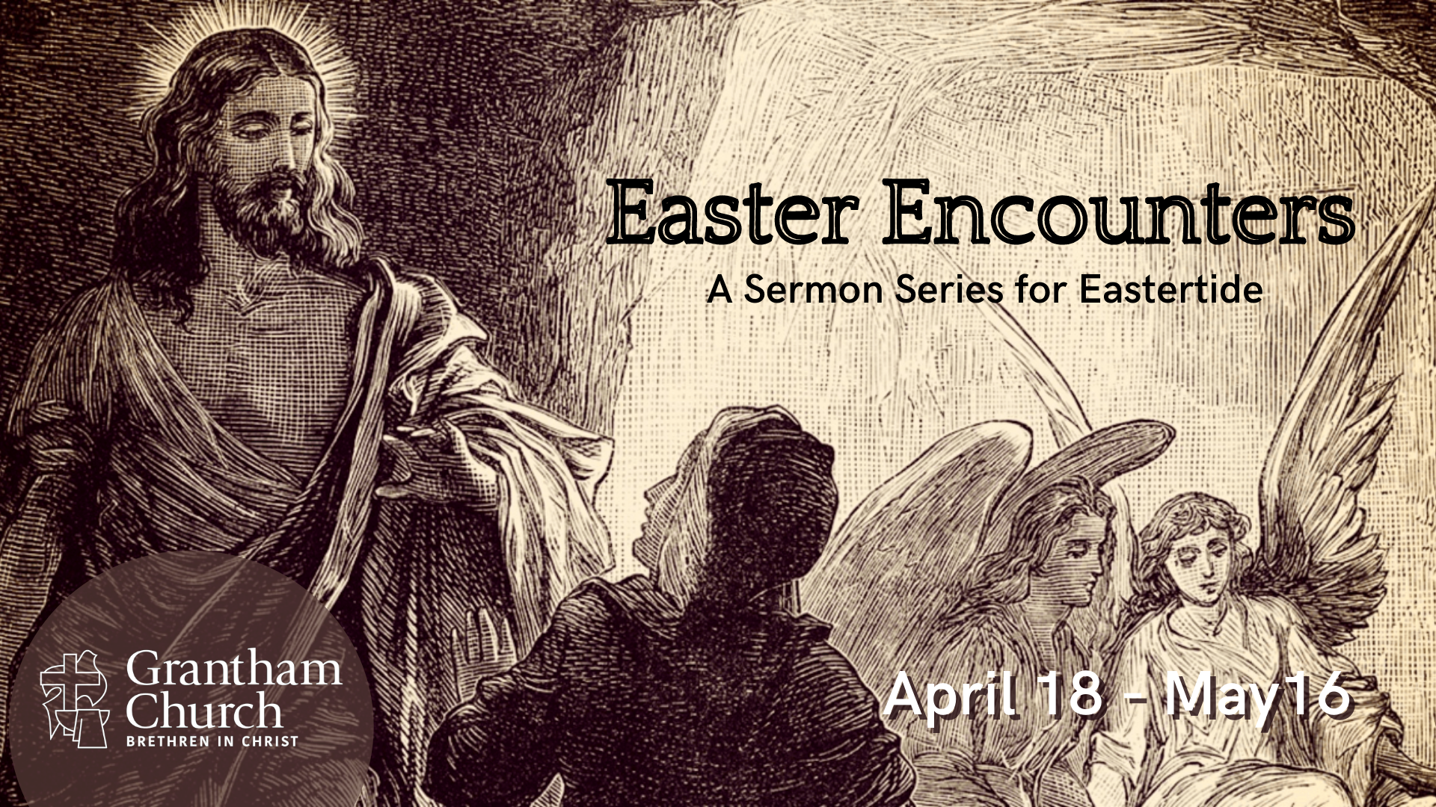
Notes:
This is the third week of our sermon series, Easter Encounters—A sermon series for Eastertide. If you’re just joining us, we have been looking at some of the experiences that the first disciples had with the risen Jesus. We began with Mary Magdalene’s Easter encounter at the empty tomb (and why it seems that Jesus appeared to her first). Last week we saw where Jesus catches up with two disciples on the road to Emmaus. For seven miles Jesus explained how the OT foretold that the Christ would suffer, die, and be raised from the dead, and he gave these two disciples a Christocentric understanding of the Scriptures before revealing himself at the table when he broke bread in their home.
And one of the lessons and theological truths that we saw in that episode was that the Lord doesn’t want his disciples to recognize him by sight anymore, but rather get used to encountering him in the Scriptures and in the Table, which I’d like to invite us to do this morning as we read from John 20, and explore that a bit, before we end our service with communion.
So, please turn in your Bibles… [NEXT SLIDE] to John 20:19-29 and stand with me as we read from our inspired Scriptures together. If you don’t have your Bible with you, you can simply listen as I read.

Slide 2
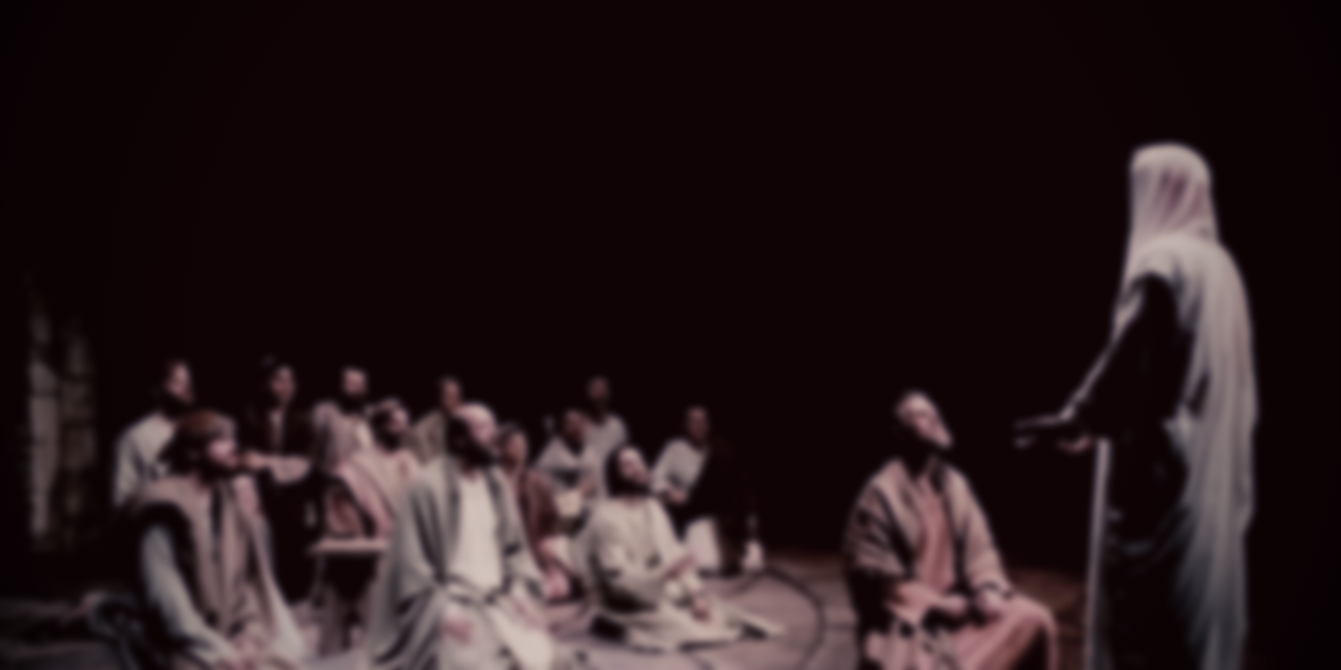

Scripture Reading
John 20:19-29 NIV
Notes:
[READ JOHN 20:19-29 NIV] – This is the Word of the Lord. Thanks be to God. You may be seated.
As sons of the Enlightenment and daughters of modernity, we can all appreciate the story of Thomas. Because like Thomas, we want empirical evidence. We want good rational reasons for believing that something is worth believing. We are products of the Enlightenment. We are rational, logical, thinking people. No matter how many of our friends believe something, we want to be convinced of the truth ourselves before we join the crowd. At least we think we all do that. So, we can relate to that.
Of course, we (unlike ancient Jews), seem to be unaware that there are plenty of things upon which we base our lives (deep convictions) which cannot be proven (e.g. how do you prove objective morals and values? how do you prove that we should all be treated with human dignity? How do you prove that God created the world and will one day redeem it? Or how do you prove historical claims?). Can you really “prove” anything? How do you know that you’re even really here this morning? But we have science! We are “people of science” and proven facts. Yeah, cause science has never been wrong before.
My point is this. For folks like Thomas in first century Palestine, I don’t think these disciples needed “proof” in the same way some skeptics demand it today. Because when it comes to the supernatural, we are far more skeptical (even arrogant) about what we think we know and understand than first century Jews. The didn’t believe in scientism. That’s because they were far more accepting of mystery and apt to believe that the God who made the universe can do some mind-blowing stuff.
So, for them, I submit to you that the resurrection of Jesus was more of a theological problem (Messiahs don’t die and rise again & the resurrection is a future event), more than it was a metaphysical problem, i.e., accepting that God could raise the dead. For them, it had more to do with their dashed hopes and expectations, and what it meant that Jesus was raised, than it was a question of God’s power. But nevertheless, don’t misunderstand me, the resurrection of Jesus was an enormous feat for the minds of these 11 disciples. No doubt, Easter defies everything all human beings have ever known about living and dying.
Therefore, let’s keep that in mind as we now go verse-by-verse through John 20:24-29 and consider what was really going on with Thomas and what takeaways are there to challenge and encourage us today. [NEXT SLIDE]

Slide 3
John 20:24-29 NIV
²⁴ Now Thomas (also known as Didymus), one of the Twelve, was not with the disciples when Jesus came.
²⁵ So the other disciples told him, “We have seen the Lord!” But he said to them, “Unless I see the nail marks in his hands and put my finger where the nails were, and put my hand into his side, I will not believe.”
Notes:
v. 24 - NLT - nicknamed “the twin”; Was Thomas a twin, or is this a literary device (i.e., we are Thomas’ twin)?
Now why was Thomas not with the other disciples? We don’t know. Maybe he was sad or angry that Jesus had died and it was all over. Maybe he was embarrassed that he fled like most of the other disciples. Maybe he wanted to grieve alone? Or maybe he wanted to sleep in for a change, run a marathon, or maybe his kids had baseball or soccer practice. Where was Thomas?
Remember, this is the same guy who in John 11:16 said, “Let us go with Jesus to Jerusalem, that we may die with him!” So, this shouldn’t be too surprising, I suppose. The most committed people often fall the hardest. You’ve seen this before, haven’t you? Maybe it’s happened to you, or you’ve witnessed it—when the most enthusiastic, radical followers fall into cynicism, doubt, disillusionment, even disbelief after they have been hurt, disappointed, duped, or feel they were misled. That’s Thomas.
Also, I think John may want us to see something here (just as Luke did with the two disciples on the road to Emmaus), and that is this: When you do not stay close and connected with the Lord’s people, you will miss things. If you leave or you’re not staying close to the Body of Christ, you will miss experiences that God may want to use to help you, grow you, and build your faith.
v. 25 – The scene that Thomas missed (which we read earlier) was also the same scene that Luke said that the two disciples from Emmaus had witnessed as well. Thomas wasn’t there and so it’s understandable that he has a hard time believing. I mean, we can certainly sympathize with Thomas. But still, here are 10 of his friends, other disciples of Jesus, all telling him that Jesus is alive, but he doesn’t believe it. Makes you wonder… what’s the biggest hurdle here: his anger or that Jesus is alive.
Anger? Why anger? Well, literally, in the Greek, Thomas says, unless I can “forcefully stick my finger” in his nail holes and “plunge my hand into his side, I will never ever believe.” There is a double negative there – never ever believe! This guy is upset. Are you getting the picture? He’s a smart guy. He won’t be bamboozled. He wants to see just as they saw, for sure. But I also think he’s having a hard time with it. He believed before and look what happened. And now they’re saying that Jesus appeared the one time he wasn’t with them. Well, that has to be even more upsetting.
Verse 26… [NEXT SLIDE]

Slide 4
²⁶ A week later his disciples were in the house again, and Thomas was with them. Though the doors were locked, Jesus came and stood among them and said, “Peace be with you!” ²⁷ Then he said to Thomas, “Put your finger here; see my hands. Reach out your hand and put it into my side. Stop doubting and believe.”
Notes:
v. 26a – Notice that Thomas—the one we have unfortunately called “doubting” Thomas—remained with the disciples. Now why is that significant? It’s significant because he didn’t call them a bunch of head cases and leave. Thomas stayed. He was upset. But he stayed. He had his doubts. But he stayed. He didn’t leave or miss another gathering. Because who knows, Jesus might show up and he doesn’t want to miss what he missed before. And this time he doesn’t. John says, “Though the doors were locked, Jesus came and stood among them and said, “Peace be with you!”
[A BRIEF WORD ABOUT JESUS’ RESURECTED BODY]
v. 27 - Jesus goes straight for Thomas. And it’s as if he had been listening in on the conversation 1 week earlier.
Rodney Whitacre in the IVP NT commentary writes this: “Faith throughout the Gospel is depicted as progressive, renewed in the face of each new revelation of Jesus. The other disciples have moved on to the next stage, but Thomas has not been able to. To not move on when Jesus calls us to do so is to shift into reverse and move away. Both believing and unbelieving are dynamic—we are growing in one direction or the other.” Whitacre says that “Jesus is challenging Thomas to move toward belief.” He writes, “Translated woodenly [verse 27] reads, “Stop becoming unbelieving and get on with becoming believing.”
I love this painting. Maybe you’ve seen it. [NEXT SLIDE]

Slide 5
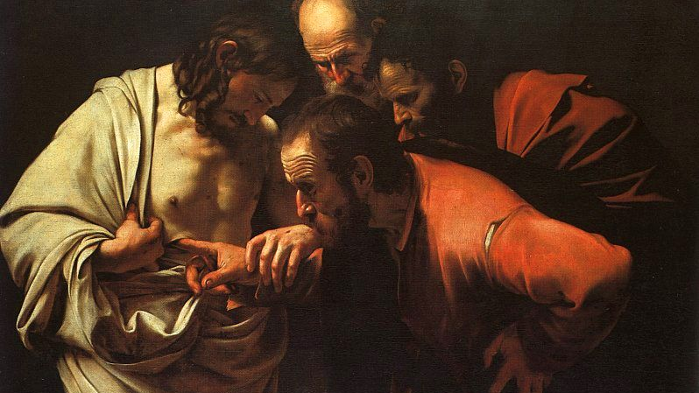
Notes:
This is the famous painting by Caravaggio. It’s called “the incredulity of Saint Thomas” (c. 1601–1602). Just gaze at that for a moment and be mindful of your feelings.
Folks, isn’t the Lord so accommodating? Think about what he did for Thomas. He didn’t have to do that. But he did because he loved Thomas, just like he loves his twin. And Jesus can still be accommodating if we will show up, if we will stay with his people, if we will bring our doubts to worship and remain committed to the church through all the seasons of life. If we will give him something to work with and not isolate ourselves and cut ourselves off from avenues of his grace.
You know, doubt doesn’t have to be a disaster. Doubts are a part of faith. In fact, you can’t have real faith without them. And truthfully, you can’t do much of anything without doubt as a constant companion. But we do need to hear this. There is a difference between honest doubts and making excuses for not believing and following Jesus. It’s true that some people just don’t want to let go of their anger, or let go of their desire to do whatever they want to do.
Let’s be honest, some people just don’t want to be responsible for the truth and repent or change, and so having doubts or being agnostic can be a way of avoiding repentance and obedience. Unfortunately, I’ve seen so many people do this.
[EXAMPLES]
A family member processing alone and then becoming agnostic
An author and friend wrestled with her doubts alone because she didn’t want to be convinced otherwise
So, sometimes, it’s not really about the evidence, it’s about not wanting to surrender to Christ. But then again, sometimes it is about the evidence, and we want to believe based on some good reasons, but we still have so many questions and can’t ever feel certain. And to those who view faith that way, I have good news for you. It’s not about arriving at a place of certainty. I like what Greg Boyd says in his book on doubt.
[NEXT SLIDE]

Slide 6
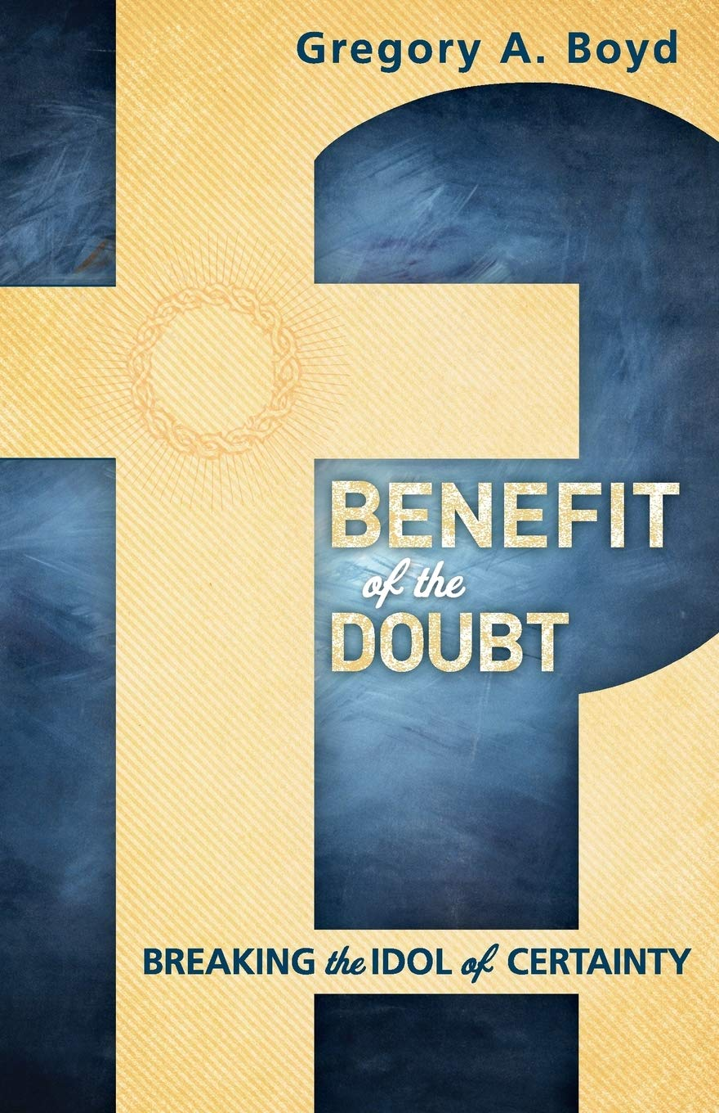
“While the certainty-seeking model of faith is psychological in nature, the biblical concept is covenantal. That is, while the former is focused on a person’s mental state, the latter is focused on how a person demonstrates a commitment by how they live.”
Greg Boyd, Benefit of the Doubt:
Breaking the Idol of Certainty
Notes:
Just as Thomas did. He had his doubts. But he still showed up. He had his doubts, but he was still living as a person of faith. He didn’t just follow Jesus with his mind, but also with his heart. Remember, he was with the disciples a week later. And this ought to speak to us this morning. Doubts will come, but we should work through those doubts like we would challenges in a relationship. We don’t abandon faith when it gets hard. Rather, we press on with those questions and press on through the challenges so that we can (in time) see the Lord and increase our faith.
That’s what Thomas did. And Jesus gave him an Easter encounter. Then look at how Thomas responded: [NEXT SLIDE]

Slide 7
²⁸ Thomas said to him, “My Lord and my God!”
²⁹ Then Jesus told him, “Because you have seen me, you have believed; blessed are those who have not seen and yet have believed.”
Notes:
v. 28 – Brothers and sisters, Thomas confesses what no other disciple had before. Thomas, according to John, is the first to recognize Jesus as God in the flesh. Which is climatic in John’s gospel when you consider where his gospel began. John 1:9-10 – “The true light that gives light to everyone was coming into the world. He was in the world, and though the world was made through him, the world did not recognize him.” And 1:18 – “No one has ever seen God, but the one and only Son, who is himself God and is in closest relationship with the Father, has made him known.”
Oh, but now that has all changed. Thomas has seen God. And he knows it. So check this out… Jesus invites Thomas to catch up with the others in their new stage of faith, and what does he do, he shoots past them and heads to the top of the class. He goes from being the biggest doubter to the biggest believer of them all. But just imagine if he had not been there.
v. 29 – Jesus isn’t scolding Thomas, but it’s obvious that he skips the commendation and thinks ahead to all of those (all of us) who will come after Thomas—his other “twin” if you will. You see, John includes these words of Jesus (a beatitude) for all those who will come after these first disciples and their Easter encounters. He is saying to us, there is a great blessing for those who can take the evidence they do have (short of seeing and touching the risen body of Jesus) and still believe.
And let’s be clear, the sort of “signs and wonders” that we often seek, as Thomas did, aren’t rejected here. But it’s important to understand that they will not always be available for us. And even when they are, as we can see throughout the gospels, they don’t in and of themselves guarantee faith in Christ. We often think they will, but people can and do explain them away. Therefore, Jesus invites us to believe on what evidence we have and receive the blessings that come from faith.
Finally, let’s consider some takeaways from Thomas’ encounter with Jesus:
[NEXT SLIDE]

Slide 8

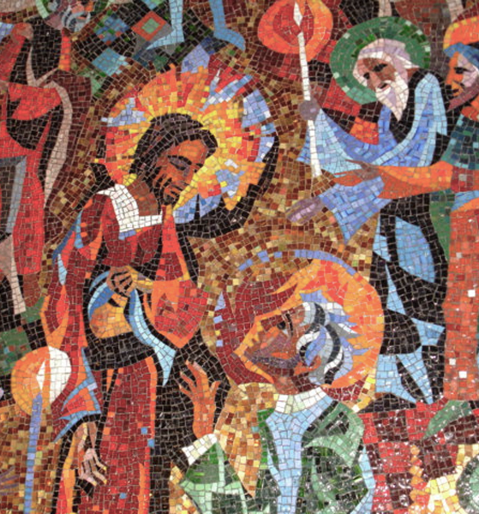
The Risen Jesus Appears to Thomas
What are some takeaways from Thomas’ encounter with Jesus?

Slide 9
The Risen Jesus Appears to Thomas
What are some takeaways from Thomas’ encounter with Jesus?
Be honest about your doubts.

Slide 10
The Risen Jesus Appears to Thomas
What are some takeaways from Thomas’ encounter with Jesus?
Be honest about your doubts.
Faith embraces mystery, so don’t make a big deal about your doubts. It’s normal.

Slide 11
The Risen Jesus Appears to Thomas
What are some takeaways from Thomas’ encounter with Jesus?
Be honest about your doubts.
Faith embraces mystery, so don’t make a big deal about your doubts. It’s normal.
Stay with the church, bring your doubts, and in time Jesus will reveal himself to you.
Notes:
[BRIEF COMMENTS ABOUT EACH POINT]
Be honest about your doubts. (a) Don’t deny them, and (b) ask yourself, are they the real issue?
2. In Matthew 28:17 when Jesus ascends to heaven (out of their sight), the Scripture says, “When they saw him, they worshiped him; but some doubted.” What did they doubt? It could have been anything because anything can be doubted. So, they doubted. But they will all still follow Jesus, receive the Spirit on Pentecost, and be a part an explosive Jesus movement.
3. A church that believes that faith is about trust in the person of Christ is not alarmed by questions. We welcome them. If you have questions and doubts. Fine. So do I. But we have more reason to believe it’s true. So let’s talk about it. Let’s continue to worship together and follow Jesus together, and trust that he will deepen our faith and guide us to truth.
Finally, may we receive the beatitude that Jesus gave us in John 20:29 – “blessed are those who have not seen and yet have believed.”
In that blessing is a promise, church. There is a reality and an experience of Christ that the world does not understand. And that’s because our faith is primarily a confession, not an explanation. While we may be able to explain a lot, which I believe Christian theology has done, we will always confess more than we can explain.
And for disciples of Jesus, that is enough.
Closing Prayer
Father, as the Apostle Peter wrote, we confess: “Though [we] have not seen him, [we] love him; and even though [we] do not see him now, [we] believe in him and are filled with an inexpressible and glorious joy, for [we] are receiving the end result of [our] faith, the salvation of [our] souls.” To that we say, Amen - we agree, Lord. But like Thomas, we often encounter doubt, and we find ourselves in need of an Easter encounter.
Therefore, we pray that you would come to us through your avenues of grace and meet us in the church, meet us in spiritual disciplines, meet us in the Scriptures, and meet us in the Table. So that we might see you for who you really are and say, “My Lord and my God!” For it’s in the name of the risen Jesus we pray, Amen.

Slide 12


