Slide 1
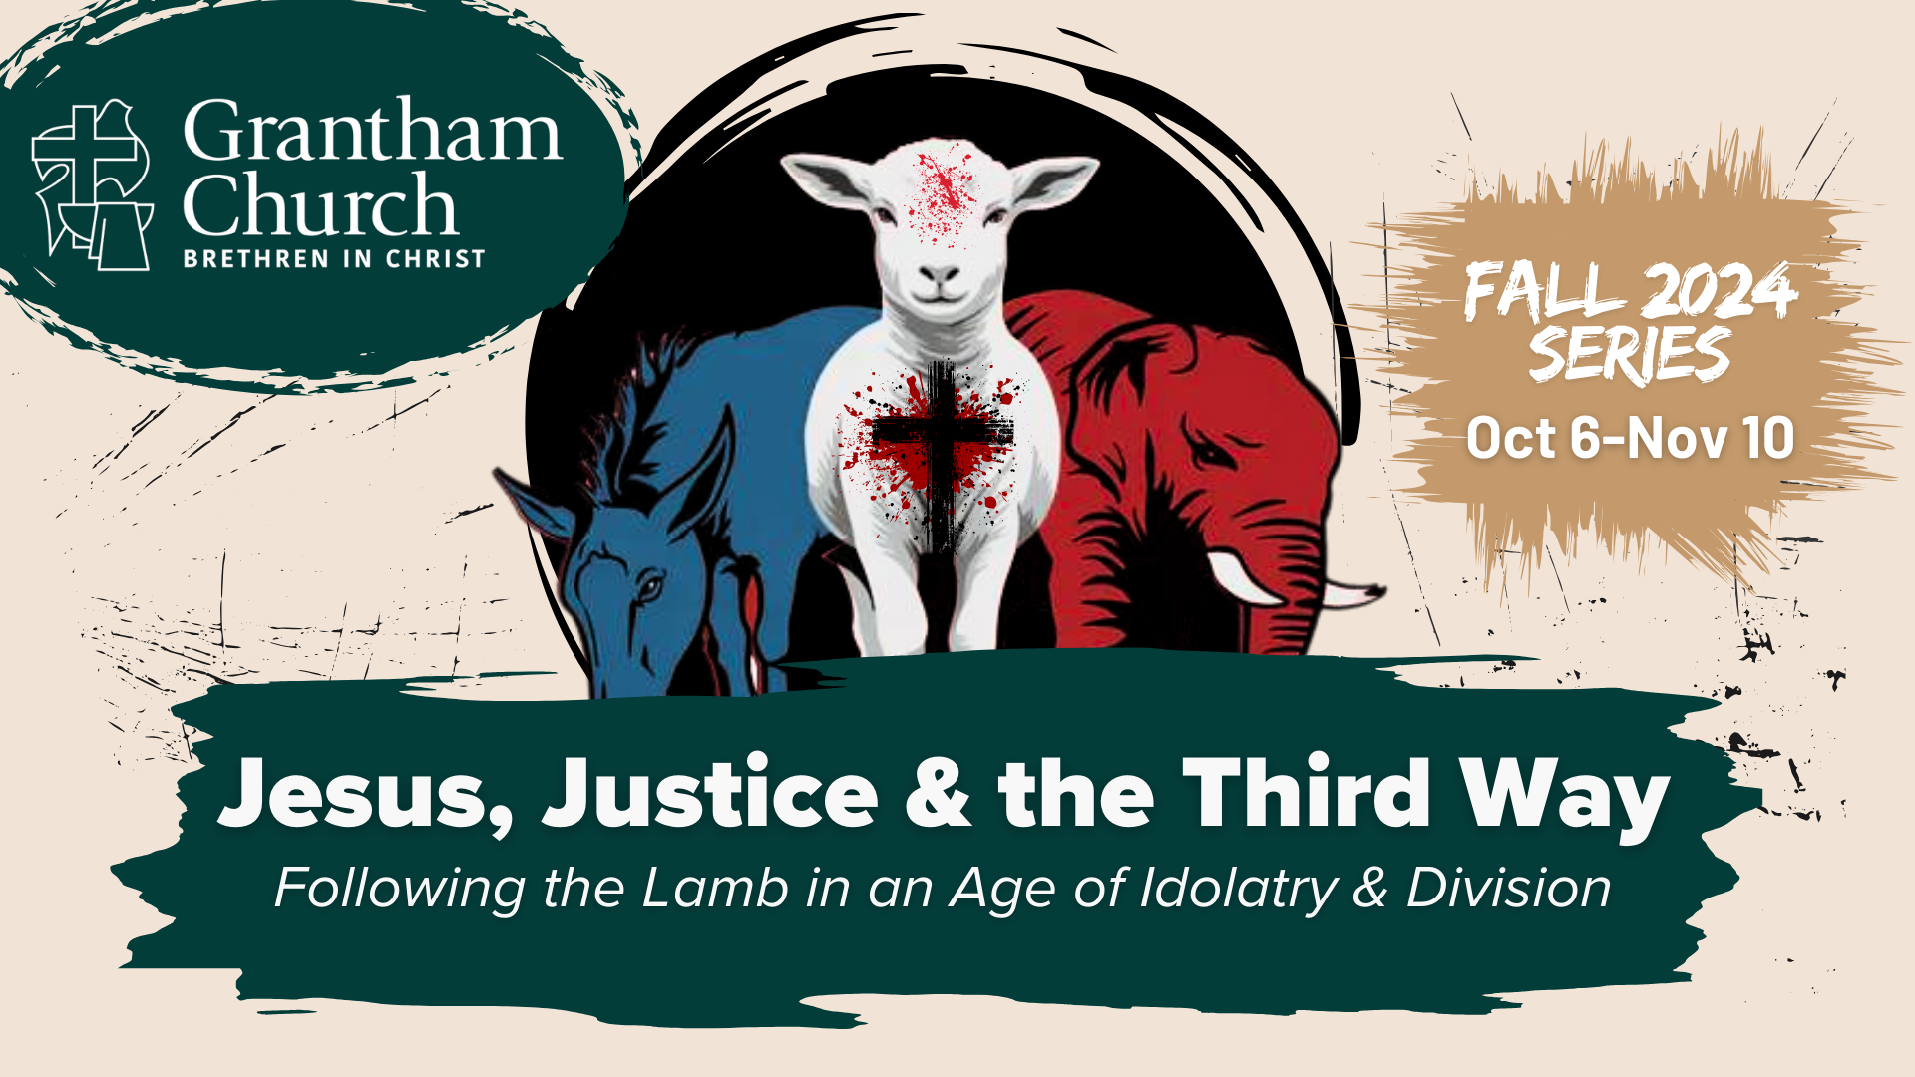
Notes:
Jesus, Justice & the Third Way: Following the Lamb in an Age of Idolatry & Division
Yes, it’s that time again. Here we are in the final stretch leading up to yet another polarizing and contentious presidential election in the US. And you might be wondering, where is the release valve for all the animosity, hate, and violence that has been growing in our country toward our political opponents? How can we turn away from the extremes and move toward hope, healing, and a better tomorrow? And according to Jesus, how can the Church be ministers of reconciliation to help curb injustice, political idolatry, and division? In this 6-week fall series, we will reflect on the political nature of the gospel and how we are to pledge allegiance to the Lamb—not the donkey or the elephant. We will examine Jesus’ posture and approach to political matters and see how he dealt with political parties, hot-button issues, and the “partisan mind” that fuels division.
And here is where we’re going each week in this series… [NEXT SLIDE]

Slide 2
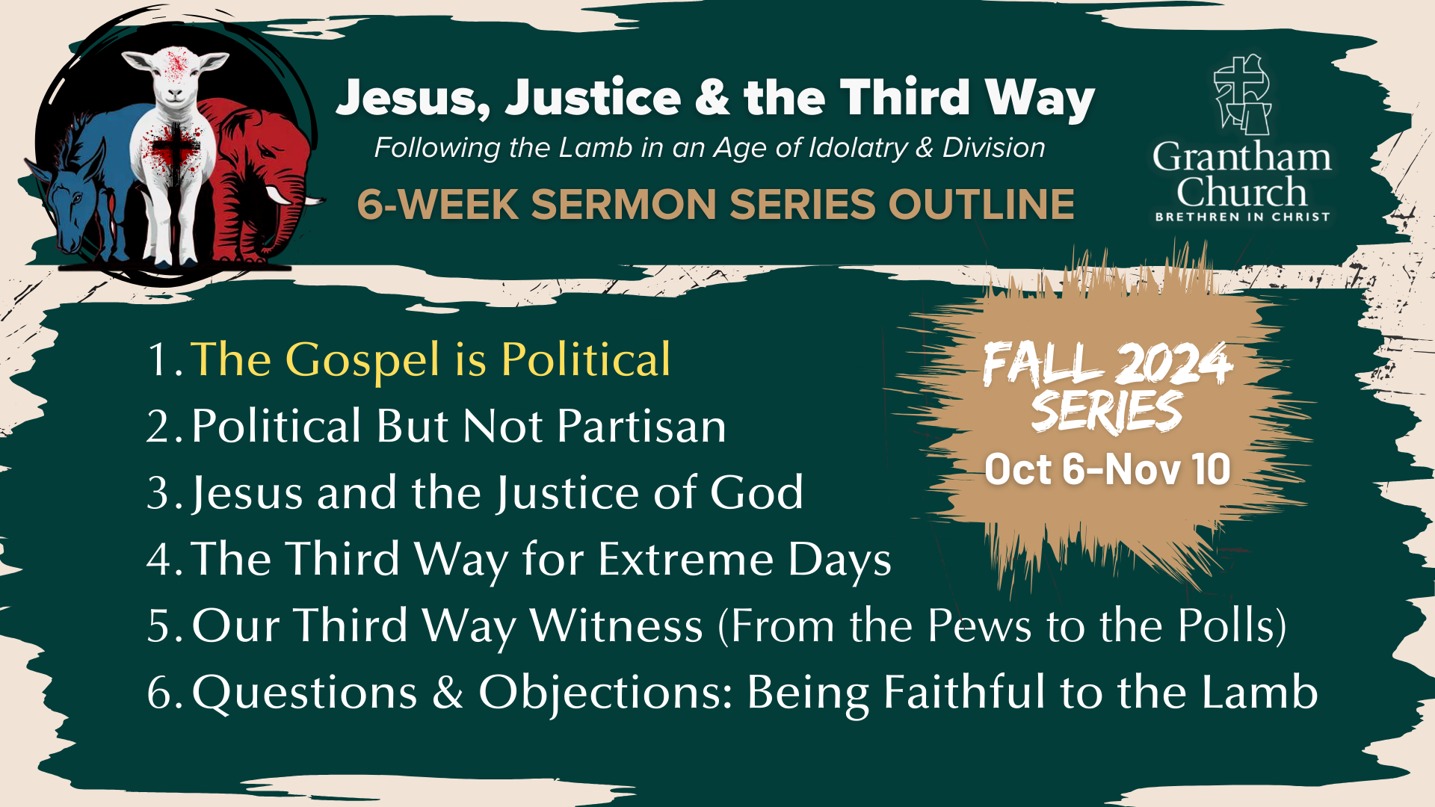
Notes:
[READ & COMMENT ON OUTLINE]
This series is an expansion of the short article we put out last year: Being Third Way at Grantham Church. That document is a response to the question: What does it mean to be Third Way?
You can find that question and a link to the PDF at our website under About, on the Language & Culture page.
This series builds on itself with each message, so it will help you to follow along every week—either in-person or through our podcast or YouTube channel.
Ultimately, I hope this series will challenge, encourage, and equip you to be faithful to Jesus in this election season and beyond. And if you think others might benefit from it in some way, please share it.
[BRIEF PRAYER]
I want to invite you to open your Bibles to the Gospel of John… [NEXT SLIDE]

Slide 3
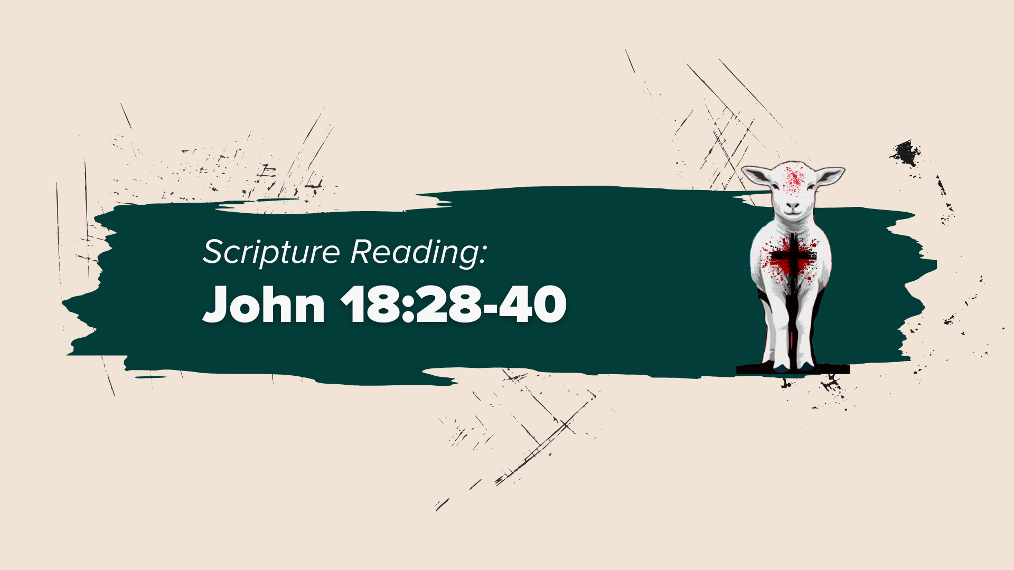
Notes:
[JOHN 18:28-40 - INVITE CONGREGATION TO STAND - READ SCRIPTURE]
I submit to you, as it’s quite clear from history, that the Enlightenment and modern Western society are responsible for forcing heaven and earth apart and driving a wedge between religion and politics—kicking God upstairs and into private and personal affairs so that the rich and powerful can go on running the world down here. This is the same framework that has taught us to scoff at miracles, to naturalize the supernatural, and given us “scientism” today.
And this construct of parsing out politics and religion, as well as separating faith and science (and philosophy for that matter), is a fairly recent invention in human history, and it’s not a view or practice supported by historic Christianity. According to Jesus and the New Testament, the gospel is political, and it has real-life implications. Therefore, they do not allow us to depoliticize the Scriptures and pretend it makes no political demands of us.
As we can see in his conversation with the Roman procurator, Pontius Pilate, Jesus (if understood correctly) is not denying the political nature (certainly the ramifications) of his gospel of the Kingdom. But rather, Jesus is telling Pilate that his Kingdom is not of this earth. Meaning: Christ’s Kingdom does not operate like the kingdoms of the world. Jesus is saying my Kingdom is not of this world, but it is for this world.
Listen to what scholars N.T. Wright and Michael Bird say in their new book… [NEXT SLIDE]

Slide 4
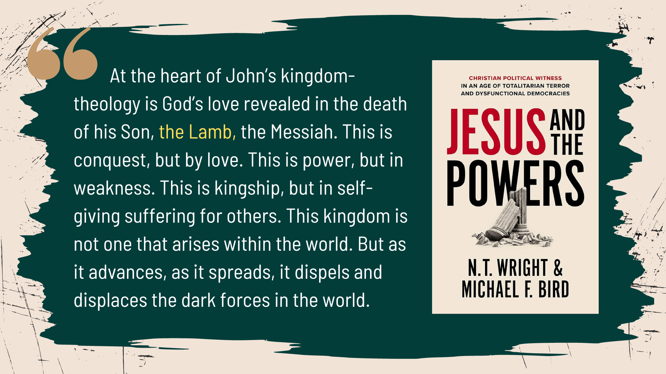
Notes:
[READ & COMMENT]
They go on to say… [NEXT SLIDE]

Slide 5
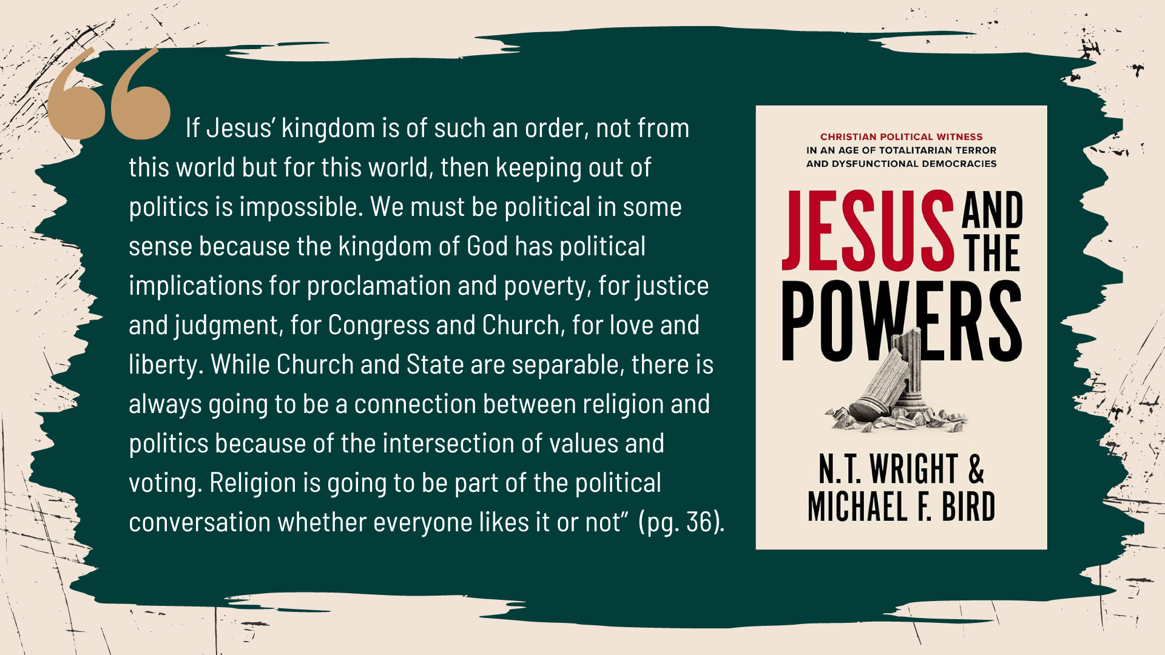
Notes:
[READ QUOTE & COMMENT]
In his book, The Righteous Mind, the American social psychologist, Jonathan Haidt, masterfully explains from a social and moral psychology perspective why that’s the case. But more on that later in the series.
OK. So, if you grew up like me, and you were taught to read the Bible apolitically, you probably need more than John 18 to be convinced that the gospel is political. Believe me, I get it. So, let’s give a bit more attention to the politically subversive nature of the gospel and begin to ponder some of its implications.
If you flip back to the Gospel of Mark and read his first sentence, it says: “The beginning of the good news about Jesus the Messiah, the Son of God…” Folks, his opening line is jam-packed with political language! The good news, Jesus the Messiah, the Son of God. And then he quotes a Messianic prophecy from Isaiah. Lest we forget that ”Messiah” is a divinely anointed leader with some political significance.
And then Mark says this… [NEXT SLIDE]

Slide 6
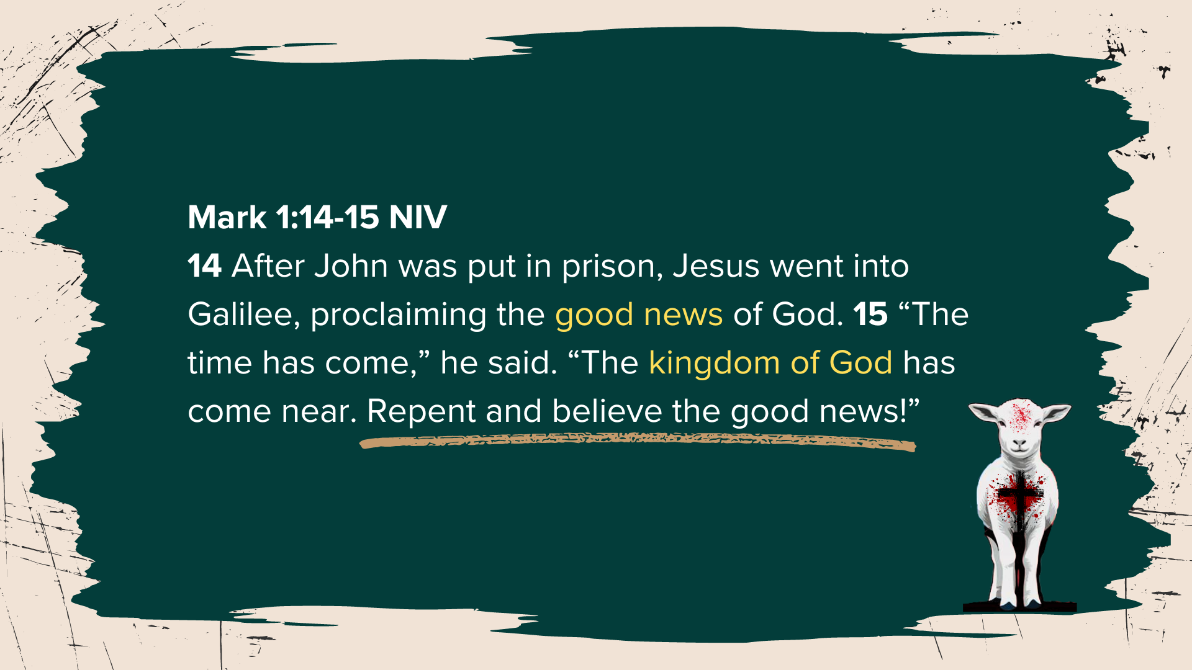
Notes:
[READ & COMMENT ON PASSAGE]
Notice, more political language; Jesus is essentially saying that he is the embodiment of the Kingdom
“Repent” (metanoia) – change, turn, do a 180, get your heart right; or put another way: Jesus is saying prepare yourself to receive what God is bringing through me and my gospel; not Caesar’s or anyone else’s promises of “I’m going to fix it” or “I’ll make us great again” or “I’m going to save us” if you will put your trust in me.
Rather, Jesus is issuing a call for people (his listeners then and his readers today) to give their loyalty and allegiance (their full trust) to him and his gospel of the Kingdom of God.
And this “gospel” wouldn’t be much of a threat to the Pilates and Pharisees of the world if it were merely a spiritual message with no political implications, would it? No, his Kingdom is not of this world, but it is for this world. Those who crucified him knew it. And it’s time for American evangelicals to know it.
If you were with us in this previous verse-by-verse study of Philippians, you will recall how the New Testament utilizes political language to communicate what God has done and is doing in Jesus… [NEXT SLIDE]

Slide 7
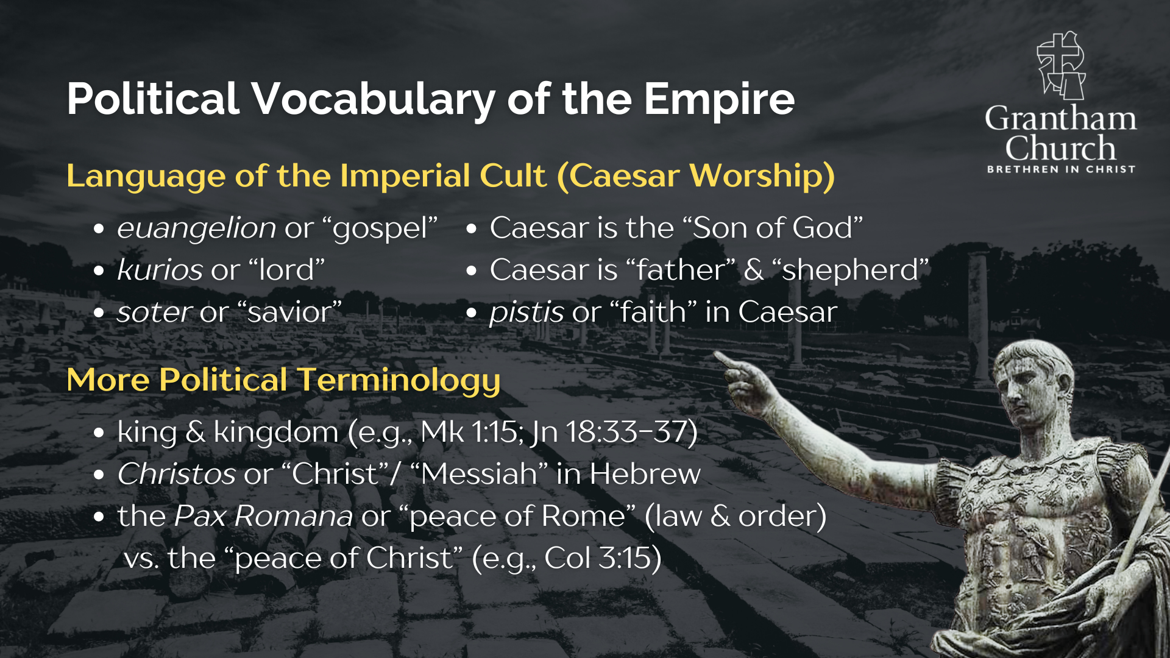
Notes:
[READ & COMMENT]
Language of the Imperial Cult
Other Political Terminology
So, Jesus and the early church clearly used political language to speak of the “politics of Jesus” and his Kingdom which (again) is not of this world, but it is for this world and has political implications on earth as it is in heaven. But what about the images and symbols of the empire? We also need to consider how icons and images were used in the first century to represent earthly powers and further imperial loyalty and allegiance.
Here are a handful of symbols used in the time of the NT… [NEXT SLIDE]

Slide 8
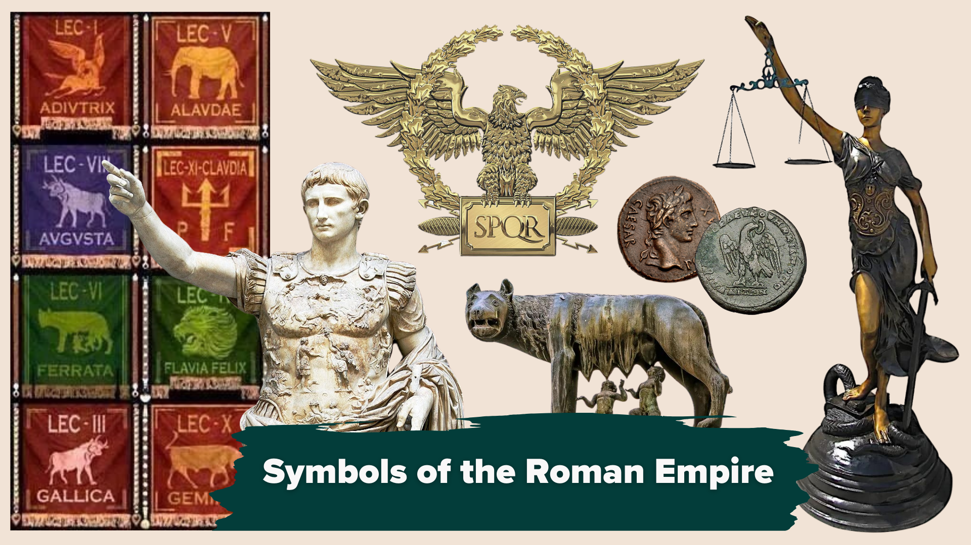
Notes:
[BRIEF COMMENTS ON SYMBOLS]
In dead center: the Roman eagle with SPQR
Below that: Romulus & Remus being suckled by a she wolf – part of the founding myth
Images of Caesar via statues and coins
Lady justice representing law & order – all to uphold the Pax Romana (the Peace of Rome)
There were even flags for the Roman legions, represented by various animals
These are just some of the images and symbols that would have been around in the time of Jesus. Each symbol with the idolatrous potential to lead a person to pledge their allegiance to the politics of empire. And in America, we’re not that different. The American empire has her own icons, images, and symbols, does it not? [NEXT SLIDE]

Slide 9
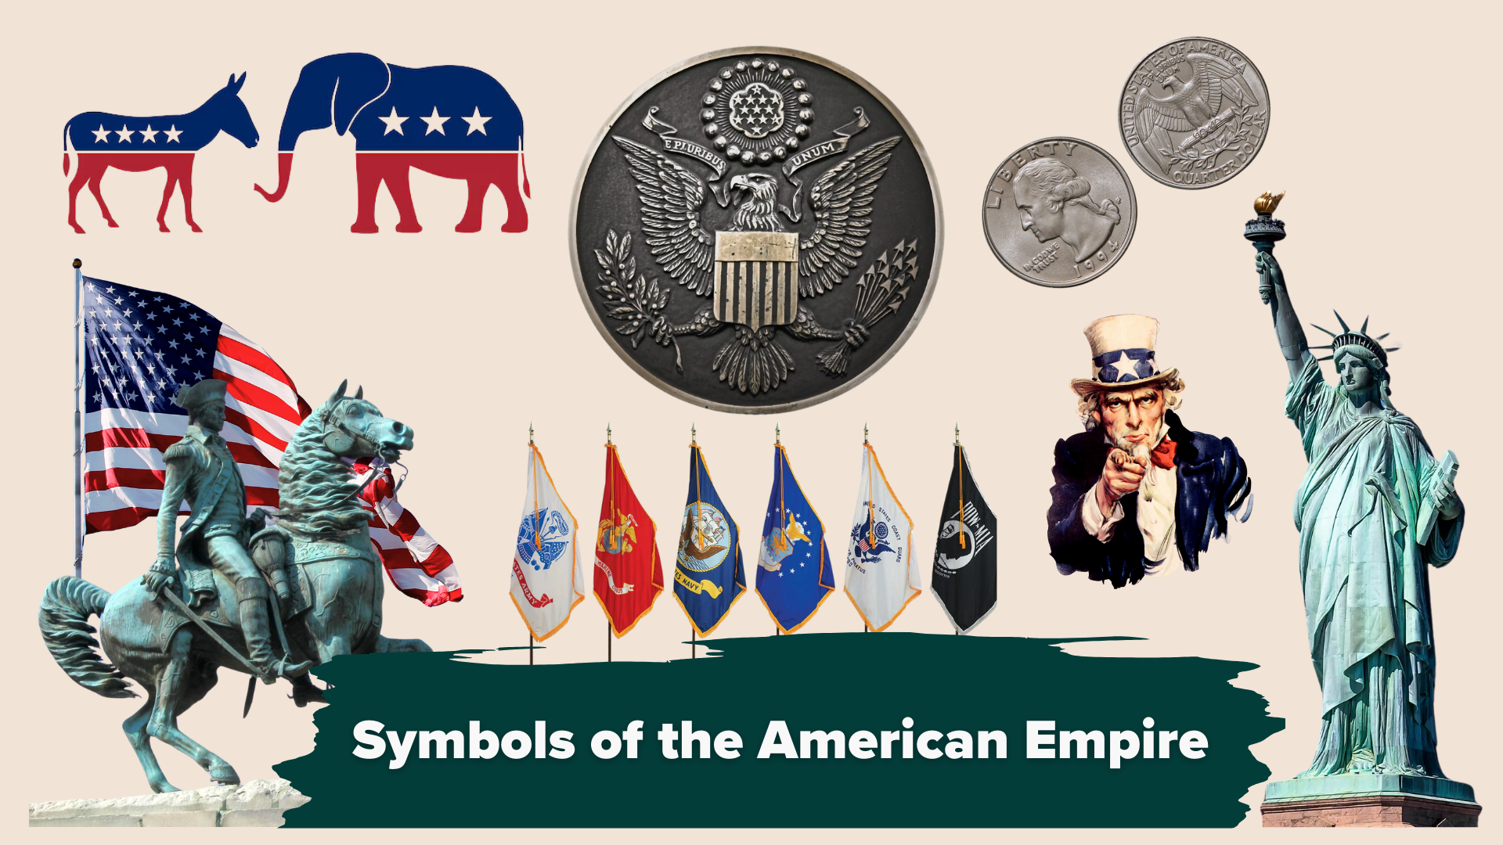
Notes:
[BRIEF COMMENTS ON SYMBOLS]
You may even notice some similarities…
In the center there: an American eagle with the Latin motto: E Pluribus Unum (out of many, one)
Then there is the American flag, which according to the flag code is to be treated like a living thing
There’s George Washington on horseback (the “father” of the country), his image is also on the quarter
We have flags representing the various branches of the US military
There’s the Statue of Liberty and Uncle Sam (who reminds us to give to government whatever is required)
And of course, the US represents her two major parties with a democratic donkey & a republican elephant
Now, let’s stop for a moment and reflect on these words from the Apostle Paul to the Philippians who (as we learned in the last series) lived in a Roman colony full of retired veterans and patriotic nationalists… [NEXT SLIDE]

Slide 10
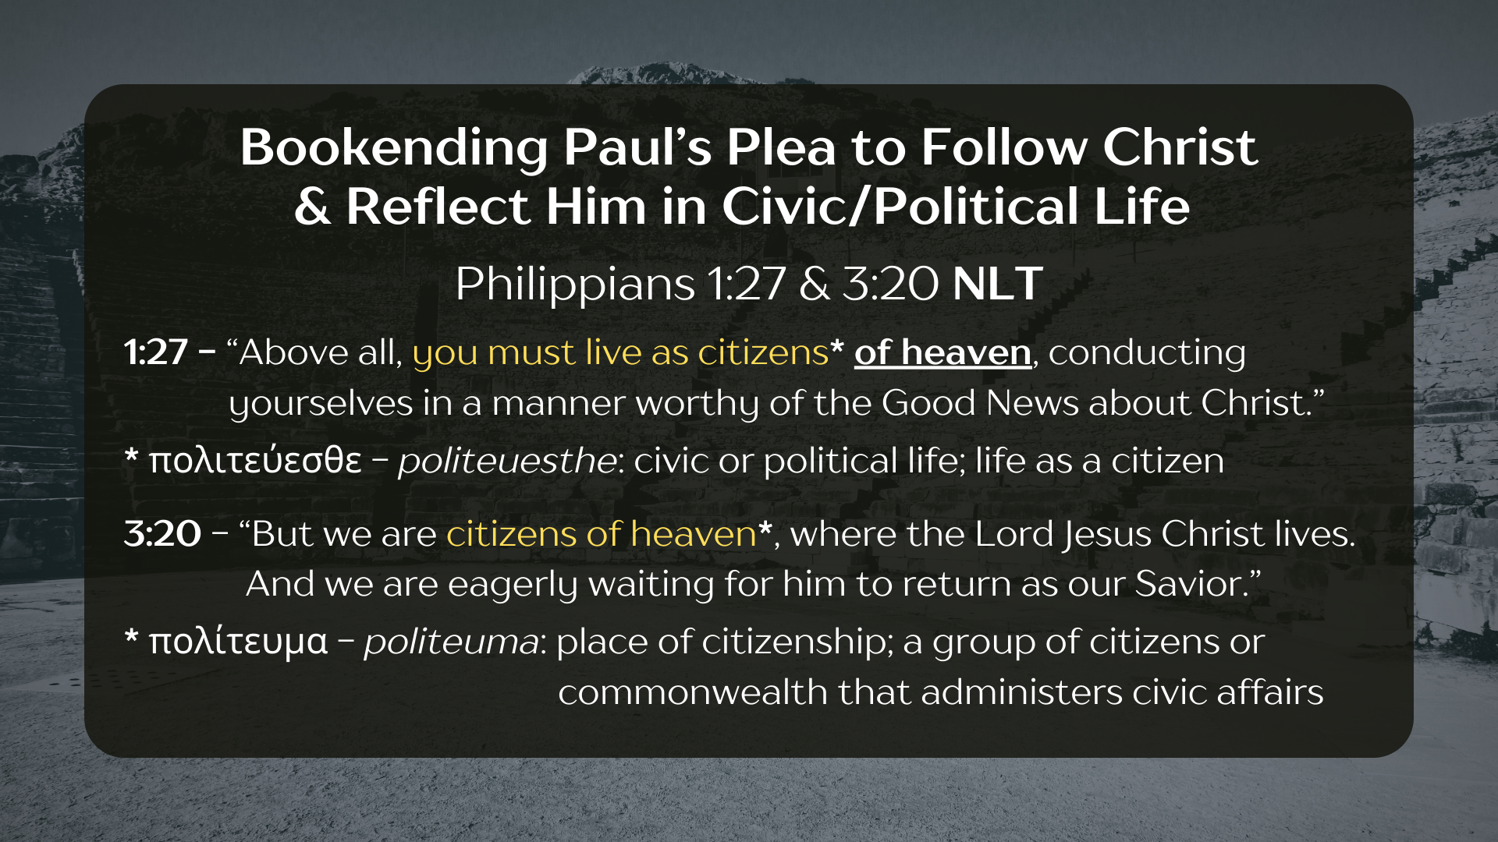
Notes:
[READ & COMMENT]
1:27 - Your political life should reflect your faith in the gospel of Jesus
3:20 - Our citizenship (our true identity) is in heaven, where Christ lives, reigns, and from where he will return
Therefore, if Jesus is to remain Lord of your life, a disciple must carefully navigate the idolatrous allure of empire, including its language and symbols (which represent certain ideologies and demands allegiance)
The early Christians understood this as they adopted political language to speak of Jesus and his good news. Yes, it is a gospel that involves the spiritual (Christ dying for your sins, being forgiven, being born again, etc.), but it also involved the real world and bringing about God’s Kingdom on the earth by worshipping Jesus, which at its core looks like radically loving God and our neighbor. And so, they not only adopted political language, they also created their own icons, images, and symbols to represent their faith in Christ and his rival Kingdom… [NEXT SLIDE]

Slide 11
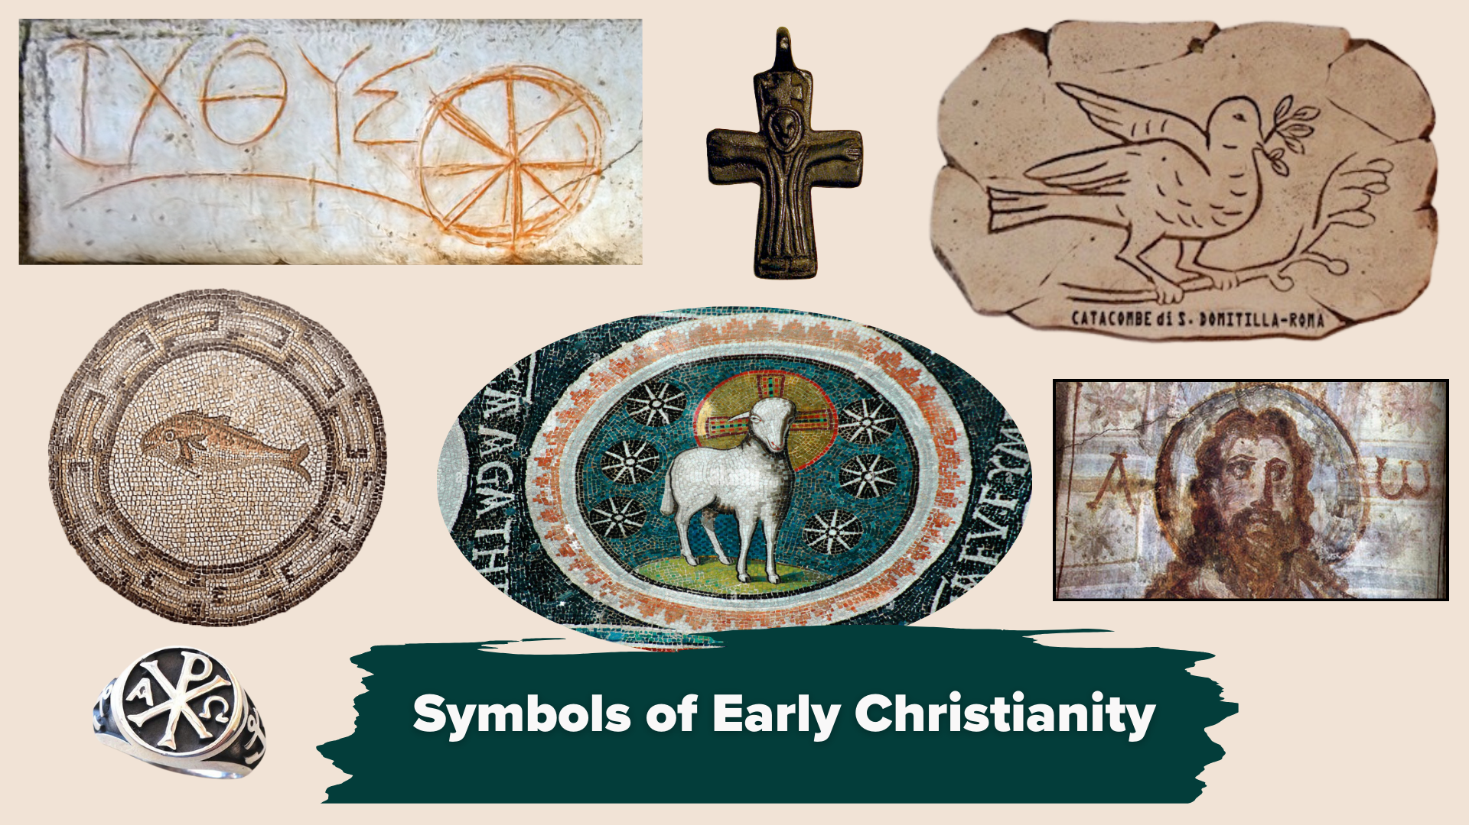
Notes:
[BRIEF COMMENTS ON SYMBOLS]
The cross was a central image, of course
But so was the dove – the Holy Spirit
And the fish because Jesus made us fishers of people (Fish in Greek is “Ichthus”; an acrostic – “Jesus Christ Son of God”); laid out in floor mosaics and etched in stone in the catacombs outside of Rome
There was also artwork that conveyed that Jesus is the Alpha & Omega, the beginning and the end
And then there was the image of the Lamb to symbolize Christ and the early Jesus movement
Why the image of a Lamb? Well, you might remember that John the Baptist told his disciples to follow Jesus with the words, “Behold, the Lamb of God, who takes away the sins of the world” – which points back to several OT references. But the image of the Lamb is featured most prominently in the Book of Revelation. [NEXT SLIDE]

Slide 12
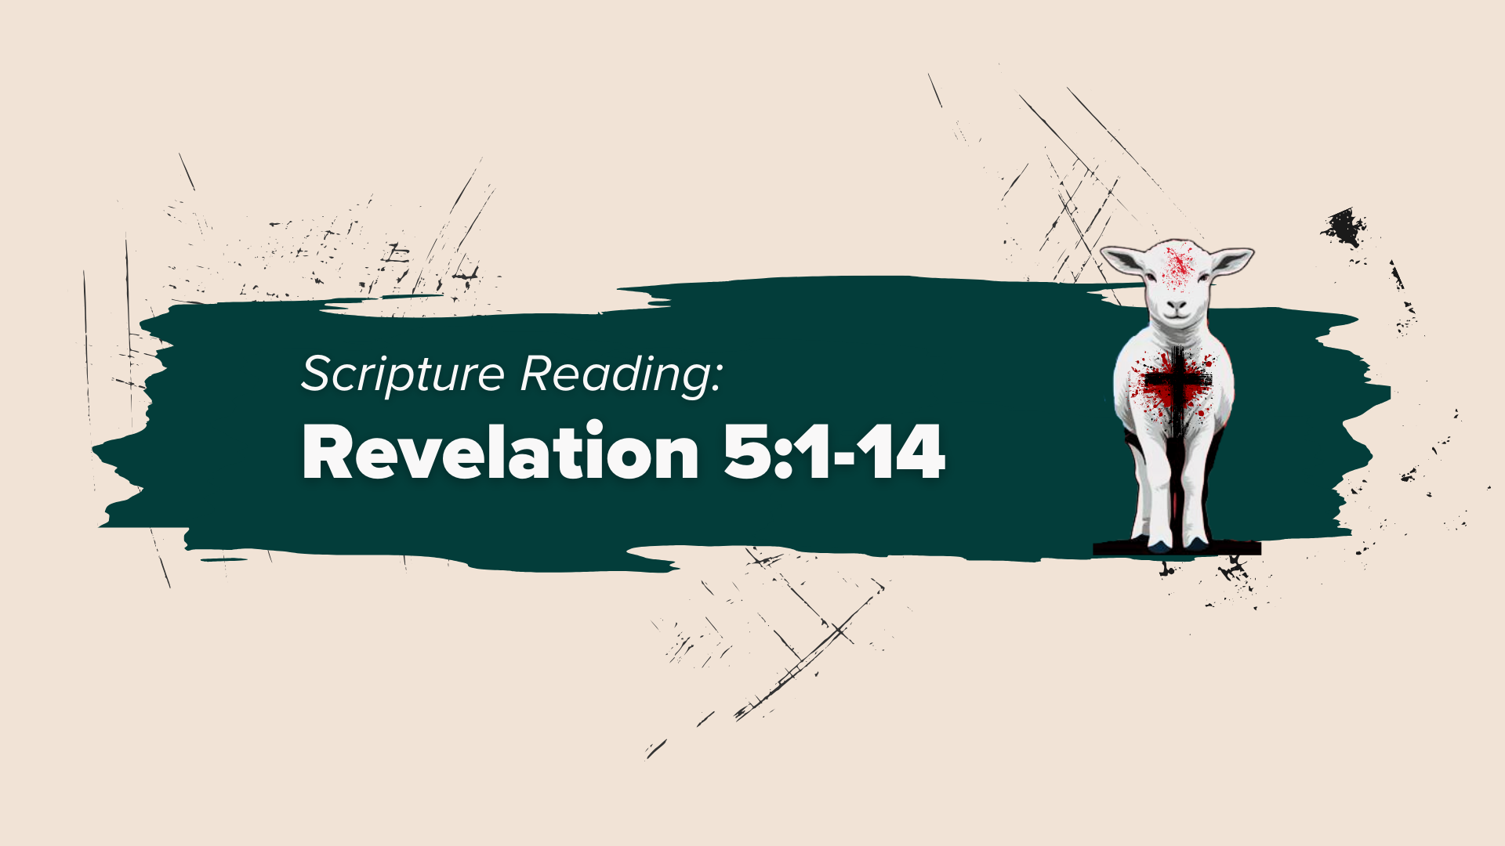
Notes:
You can go ahead and turn to Revelation 5 for our final Scripture reading. And as you’re turning there, let me briefly set the context. This revelation of Jesus to the apostle John may seem like a strange book to us. But to the early Christians, this apocalyptic vision of Christ and of the things to come was better than a Marvel movie. Revelation is a theo-political book. It’s a political tractate against the evils of empire. As Scot McKnight has said, “It’s apocalyptic literature that utilizes symbols and imagery to communicate a vision of what God is going to do in the world because of the injustice of the Roman empire.” And all future empires for that matter.
In Revelation 1-3, we read Jesus’ pastoral and prophetic words to seven churches in Asia Minor; each dealing with different issues, but all of them being called to remain faithful to Jesus amidst their challenges in a hostile culture. And then in Revelation 4 & 5, John describes the veil that separates heaven and earth being pulled back so that he can see inside God’s space: heaven; specifically, the throne room of God. He sees an amazing scene of worship, involving angels, people, and creatures. And he hears singing around the throne.
[READ REVELATION 5:1-14 & COMMENT]
Brothers and sisters, donkeys can kick and bite; elephants can run you over. But what can a slain little Lamb do? Well according to the Scriptures, the way of the sacrificial Lamb brings even the most wicked and powerful nations to their knees. The Lamb will someday bring an end to evil and injustice. In the meantime, may we recognize that the Lamb alone is worthy of our worship, loyalty, and allegiance. The Lamb holds the future. And as the Moravians like to say, “Our Lamb has conquered. Let us follow him.”
Real quick… here are some main takeaways to sum up this first message… [NEXT SLIDE]

Slide 13
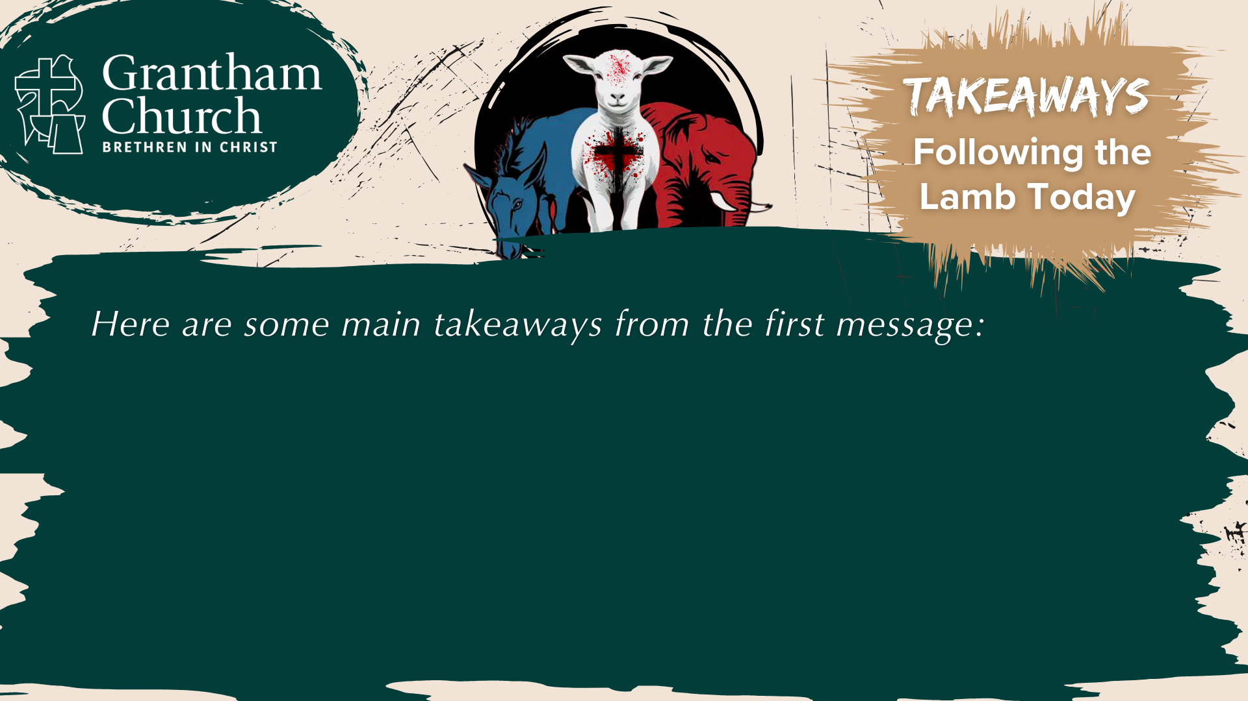
Notes:
In summary: Following the Lamb Today

Slide 14
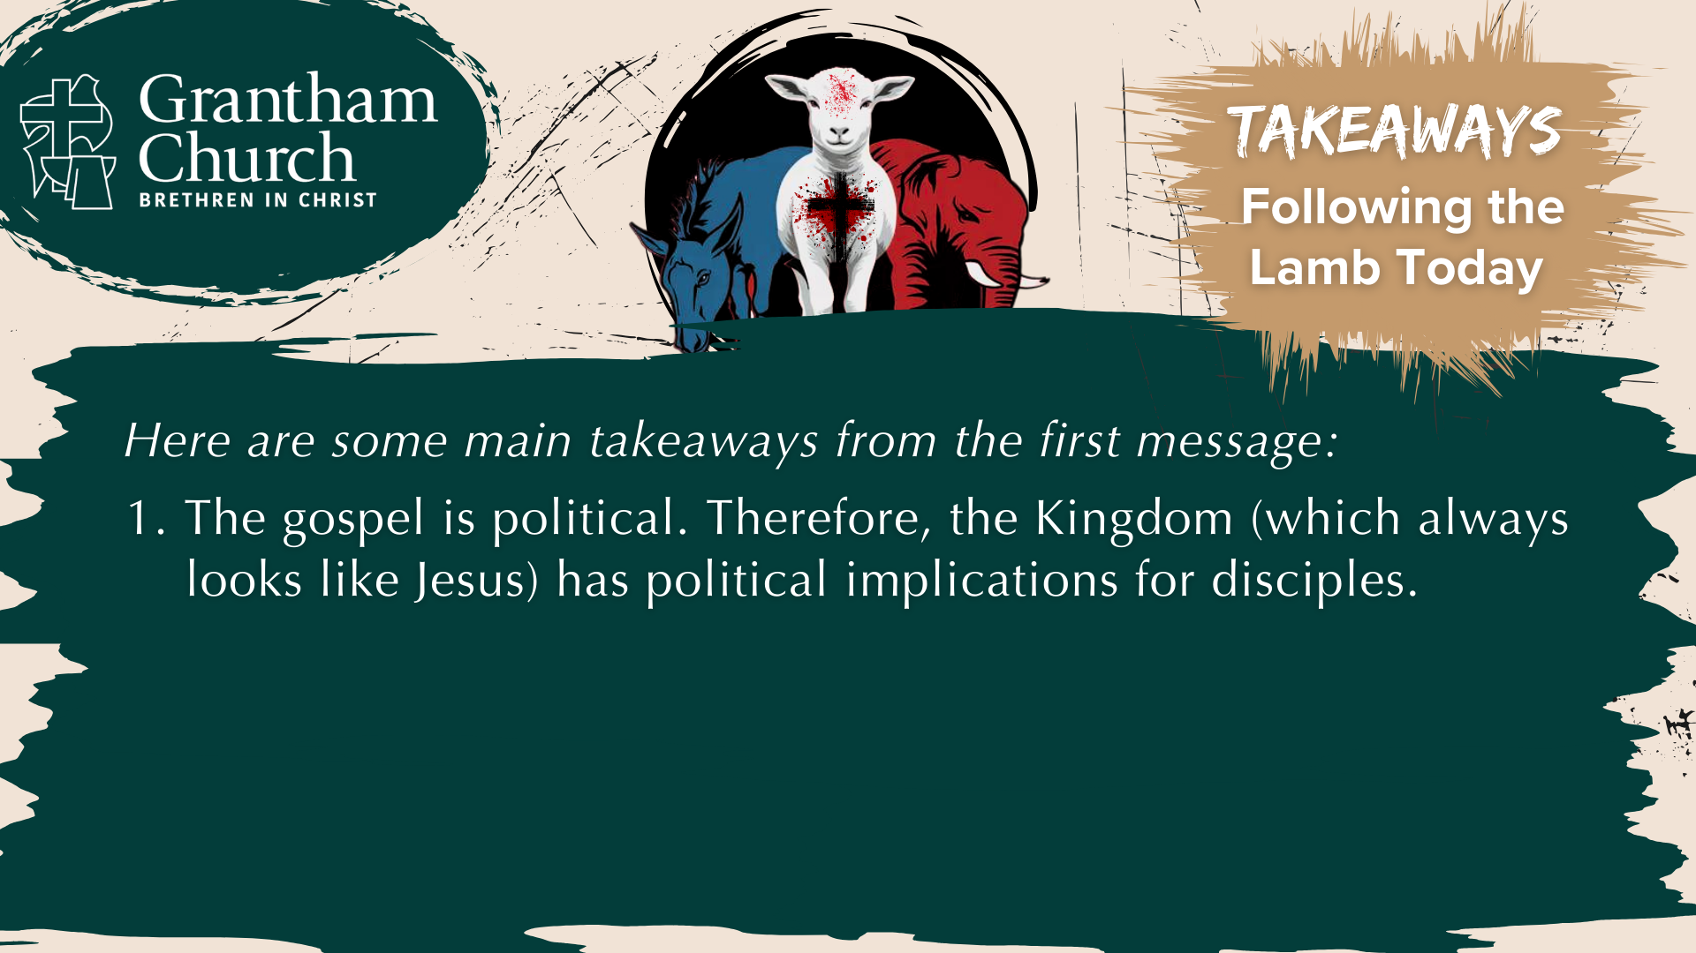
Notes:
In summary: Following the Lamb Today

Slide 15
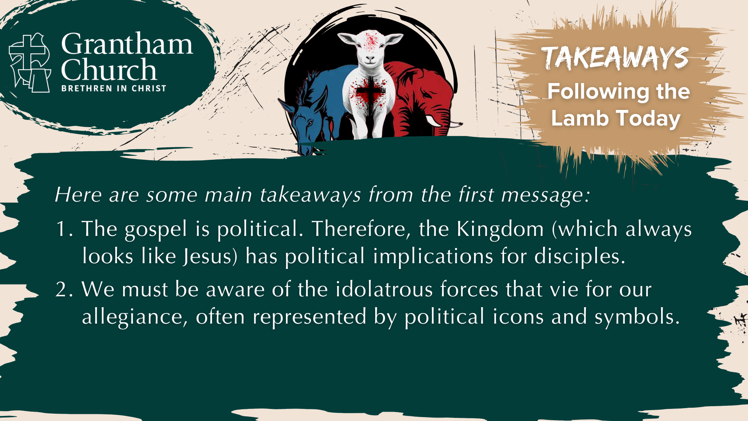
Notes:
In summary: Following the Lamb Today

Slide 16

Notes:
[READ & COMMEN ON EACH POINT]
The gospel is political. Therefore, the Kingdom (which always looks like Jesus) has political implications for disciples.
We must be aware of the idolatrous forces that vie for our allegiance, often represented by political icons and symbols.
The heavenly vision of Christ enthroned as a slain Lamb (rather that a ferocious beast) invites us to be Lamb-like as disciples.
And finally, here are some questions to help us reflect and respond to this first message together… [NEXT SLIDE]

Slide 17
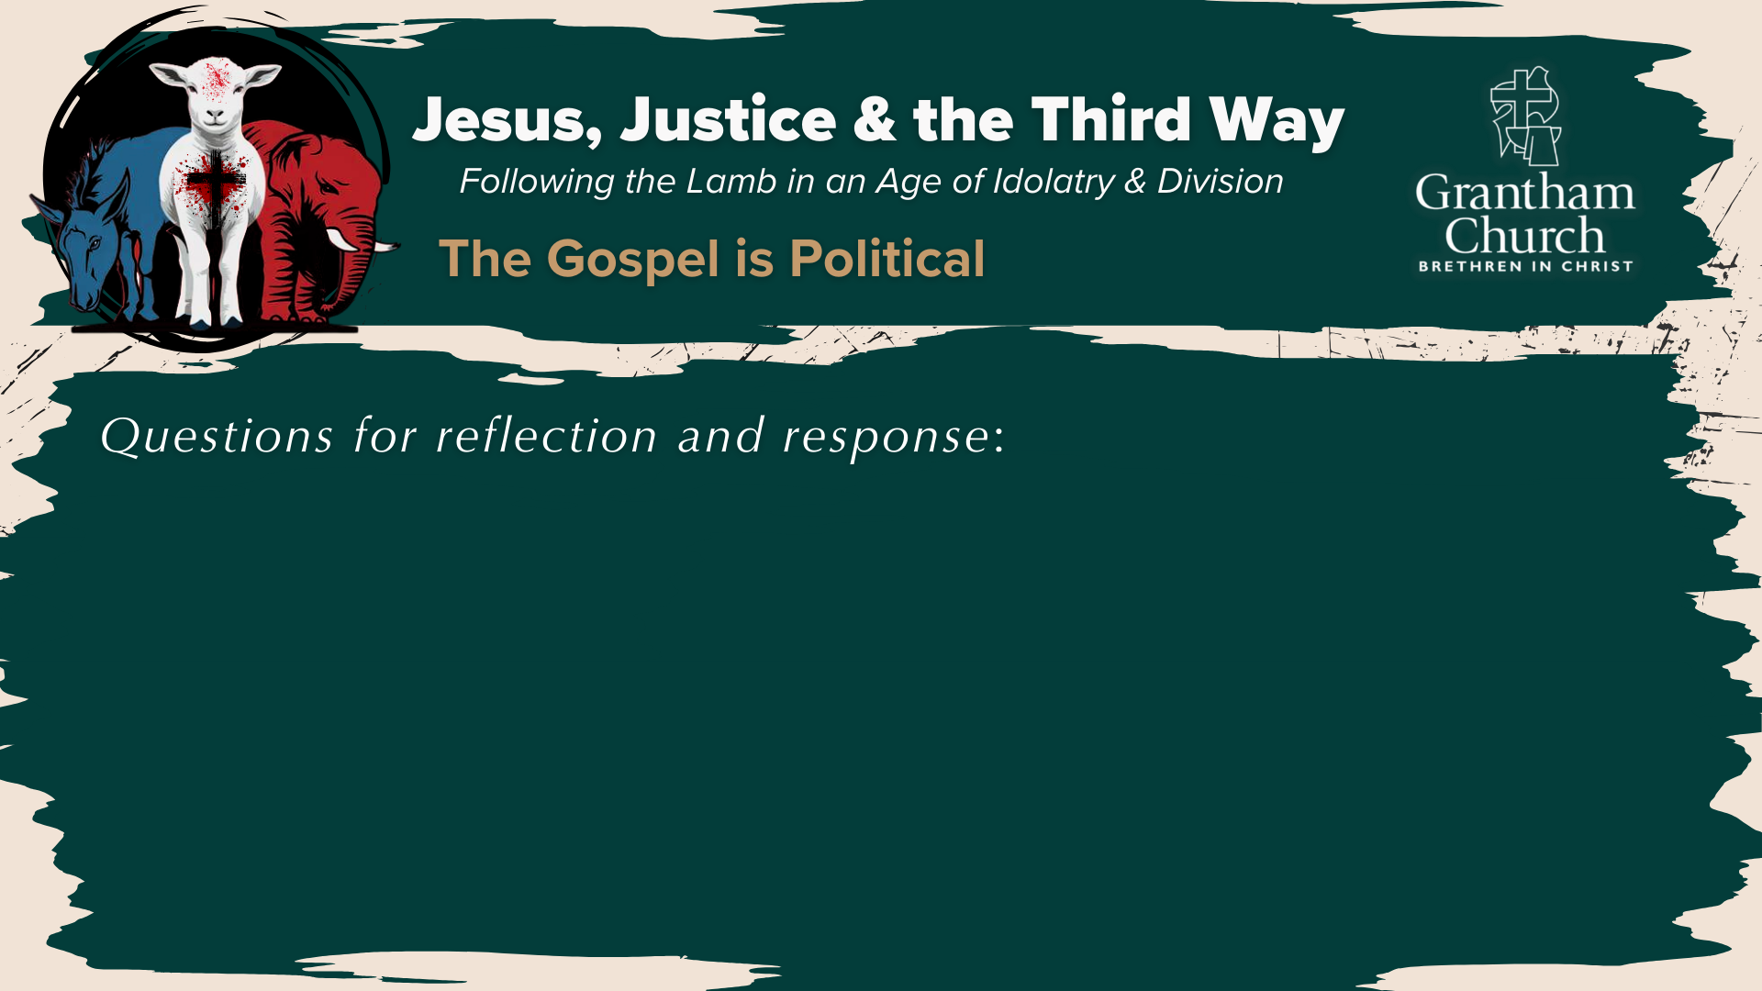

Slide 18
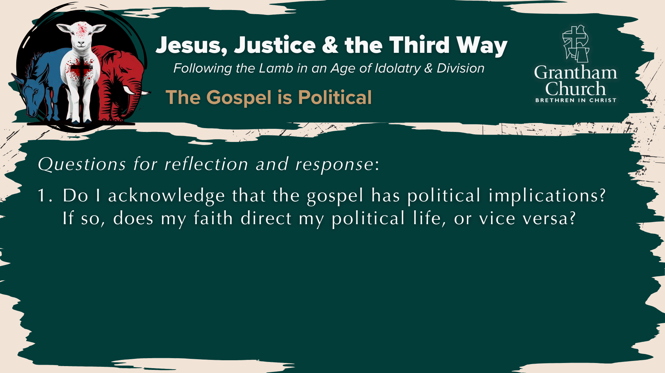

Slide 19


Slide 20

Notes:
[READ & BRIEF COMMENT ON EACH QUESTION]
Do I acknowledge that the gospel has political implications? If so, does my faith direct my political life, or vice versa?
Have I been aware of the idolatrous political forces at work in American society? What about in my own heart and mind?
How does the image of Christ as a slain Lamb (who conquered with love and by self-sacrifice) call me to Lamb-like living?
Let’s pray… [NEXT SLIDE]

Slide 21
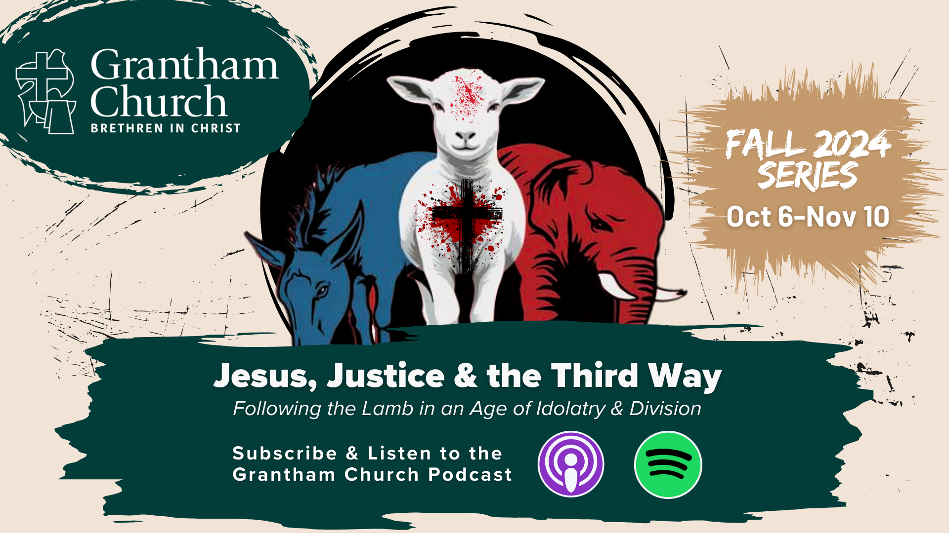
Notes:
[CLOSING PRAYER]
[APOSTLES’ CREED]
[COMMUNION]
PRAYER OF BLESSING FOR SEIBERTS]
[BRIEF WORD ABOUT THE BENEDICTION]
Benediction: Brothers and Sisters, the Lamb has conquered. Let us follow him. And may the God who looks like Jesus equip you with all you need to live for him in a world of competing loyalties and allegiances. In the name of the Father, the Son, and the Holy Spirit. Amen. Go in peace, church.

