Slide 1

Notes:
[BRIEF INTRO]
If you do a quick Google search on the word “generous”… you’re given this definition: “a person showing a readiness to give more of something, as money or time, than is strictly necessary or expected.”
When you think of a generous person in your life, who comes to mind? Think about that. Who is someone you see that has been generous with their time, talents, and treasure? And how have they influenced or blessed your life by their generosity?
Generosity is what the Apostle Paul had on his mind when writing… [NEXT SLIDE]

Slide 2
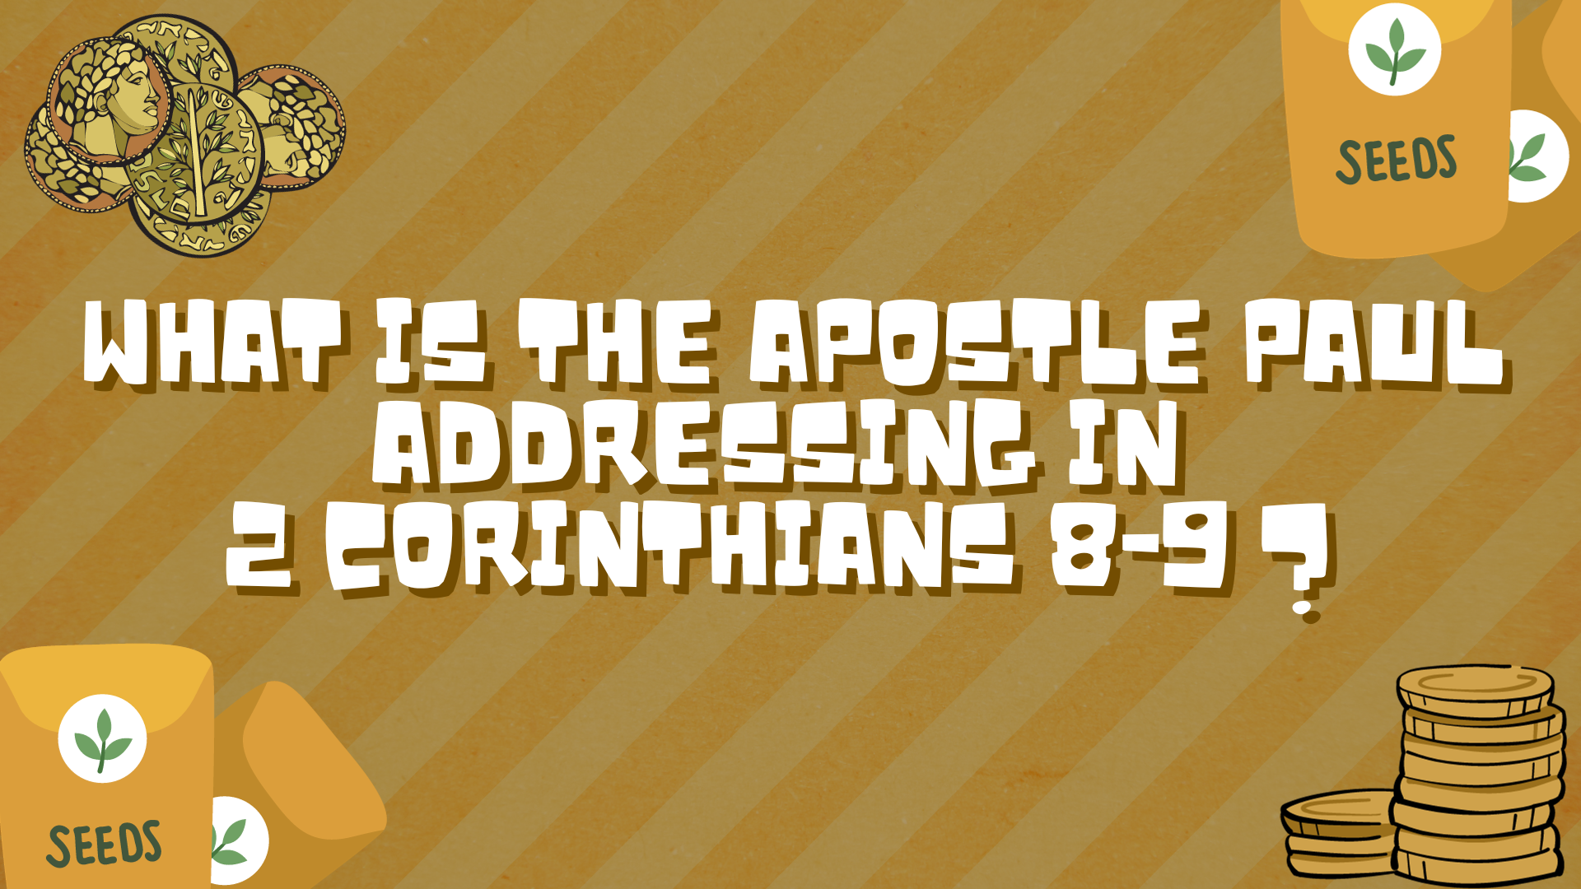
Notes:
[BRIEF COMMENTS ON THE CONTEXT]
Paul’s sends first letter because of problems; follows up with a “painful visit”
He sends a second letter written in anguish and tears (was lost); most repented
So, 2 Corinthians is written to assure them that he loves them and to encourage them to view life from a Kingdom perspective and inspire them to work out their faith in various ways.
One way to work out their faith is to fulfill their commitment to give what they said they would give to help the church in Jerusalem—to show unity and solidarity; Paul says he is sending Titus to collect their financial gift and ensure they give joyfully and not begrudgingly
It’s important to remember that Paul is writing to the church at Corinth, not to an individual. And it can be a challenge for a community of disciples to give generously together -- to freely scatter their gifts to the poor like seeds in a field -- to sow those seeds extravagantly, the seeds that God has entrusted to them as a congregation; to use their financial resources to bless others. But this is what Paul asks of them.
And for Paul, he anchors this call to be generous in the person and work of Jesus… [NEXT SLIDE]

Slide 3
“You know the generous grace of our Lord Jesus Christ. Though he was rich, yet for your sakes he became poor, so that by his poverty he could make you rich.”
Paul, 2 Corinthians 8:9 NLT
Notes:
[READ & COMMENT ON VERSE]
Notice the way rich and poor are being used
Our generosity is in response to the generosity of God
Listen to what Paul wrote to his young gentile co-worker in the faith, Titus. He reminded him of how we all once were, but because of the generosity of God we have been (and are being made) new in Christ… [NEXT SLIDE]

Slide 4
Titus 3:3-7 NIV
³ At one time we too were foolish, disobedient, deceived and enslaved by all kinds of passions and pleasures. We lived in malice and envy, being hated and hating one another. ⁴ But when the kindness and love of God our Savior appeared, ⁵ he saved us, not because of righteous things we had done, but because of his mercy. He saved us through the washing of rebirth and renewal by the Holy Spirit, ⁶ whom he poured out on us generously through Jesus Christ our Savior, ⁷ so that, having been justified by his grace, we might become heirs having the hope of eternal life.
Notes:
[READ VERSE & BRIEFLY COMMENT]
Paul no doubt wants his audience (as he does himself) to reflect on how generous God is with his mercy, grace, forgiveness, and love—how good and generous he is to provide for all our needs—so that it would inspire us to join him in sharing that same generosity with others, as we seek to embody his generous character and work out our faith as disciples.
Let’s go back now and look briefly at our main Scripture reading… [NEXT SLIDE]

Slide 5

Notes:
[NOTES VERSE-BY-VERSE]
v. 6 – sow a little you get back a little; sow a lot, you reap the reward
v. 7a – “decide in your heart” – the church acts out of the heart (generosity); you could think of it this way: they commit to a ministry budget together and they meet it with their generous giving
v. 7b – NIV: a “cheerful giver” – “cheerful” (hilaron/os – joyous, prompt or willing)
v. 8 – generosity is rewarded by God with needs being met and leftovers!
v. 9 – Paul quotes Psalm 112:9
v. 10 – God blesses your generosity by providing your needs and more
Remember what Jesus said in the Sermon on the Mount… [NEXT SLIDE]

Slide 6
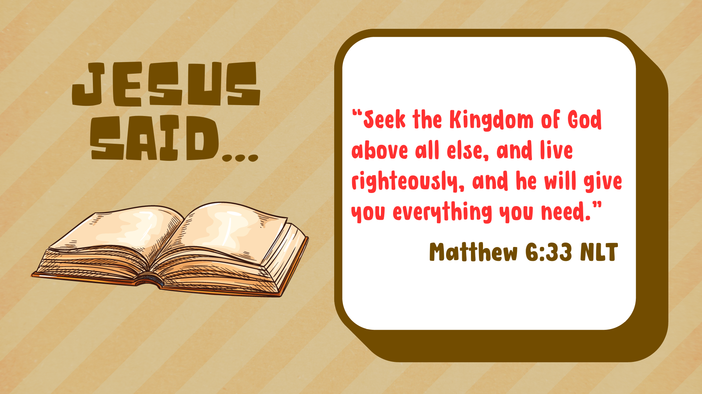
Notes:
[READ & COMMENT]
Of course, this way of living requires faith in the Father, doesn’t it? Trust that the Father will provide for you when you put the Kingdom first with your time, talents, and finances. Trust that when you make it a priority to organize your schedule and your pocketbook in a way that shows you value the gospel of the Kingdom above everything else, that the Lord will meet your needs and ensure that you’re able to continue being a blessing to others. Yes, it requires trust. But according to Jesus and the NT, this is the way we tap into the deeper Christian life.
[READ VERSES 11-15 & COMMENT]
Friends, this is how gospel ministry happens. This is not charity. It’s ministry aimed at not only meeting physical and socio-economic needs, but spiritual needs as well. It’s about people knowing the God who looks like Jesus. Listen to how one scholar captures what Paul is saying… [NEXT SLIDE]

Slide 7
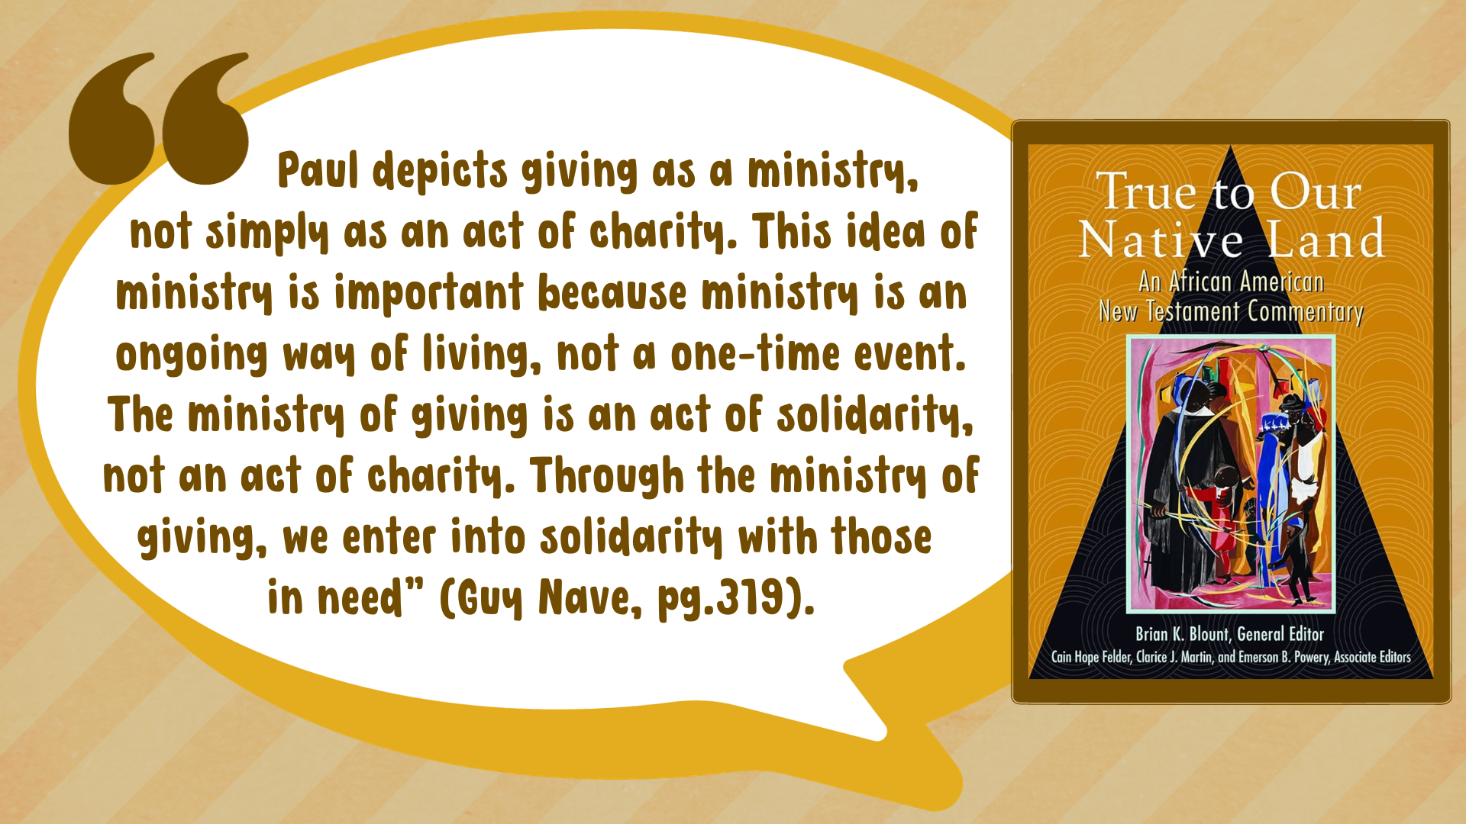
Notes:
[READ QUOTE & COMMENT]
Don’t miss this. When we choose to be generous and give of our time, talents, and treasure—when we make it a priority to give and bless others who are in need—we affirm their worth and we promote equity and security for others in and outside the church; we acknowledge (as Paul told the Corinthians) that there is one Body of Christ with one mission. And through our ministry of regular giving, our lives are mutually transformed by generosity.
So, let’s sum up what Paul is saying to us about being generous… [NEXT SLIDE]

Slide 8


Slide 9

Notes:
It’s who we are called to be.
Phil 2:7 - Christ “emptied himself” or “gave up his divine privileges”
Generosity is a sign that a church knows the gospel, knows who they are in Christ, and are determined to follow the self-emptying one and share in the very life of God. Giving is a spiritual discipline, an act of worship, but generosity is part of our character as disciples. It’s who we become in our baptism and who God calls us to be for the sake of the Kingdom.
It’s who we are called to be. And it’s also.. [NEXT SLIDE]

Slide 10
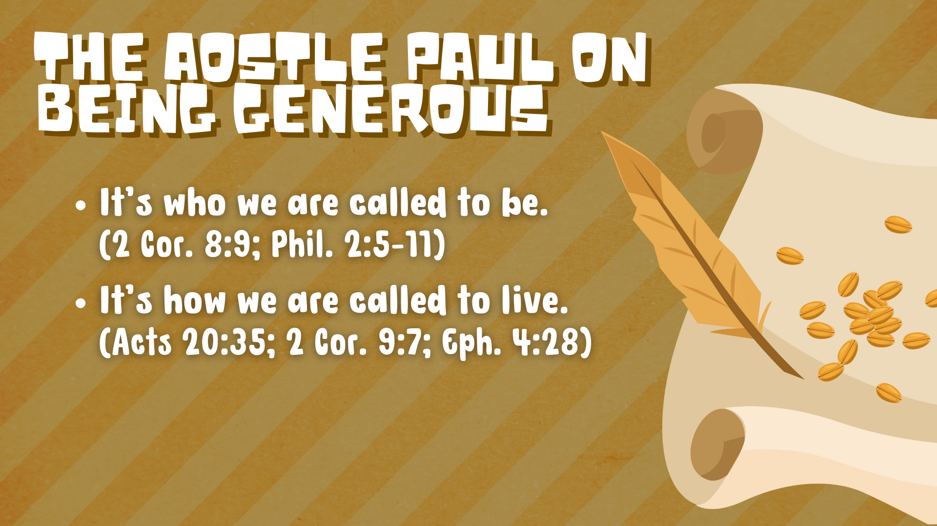
Notes:
How we are called to live.
Paul quotes Jesus in Acts 20:35 saying, “It’s more blessed to give than to receive.” Meaning, when we live with the Lord’s generosity, we experience more of God’s life. In Ephesians 4:28, Paul tells the saints to work (don’t just take), be helpful, and use what you earn to help others.
It’s who we are called to be. It’s how we are called to live. And lastly, Paul is saying… [NEXT SLIDE]

Slide 11
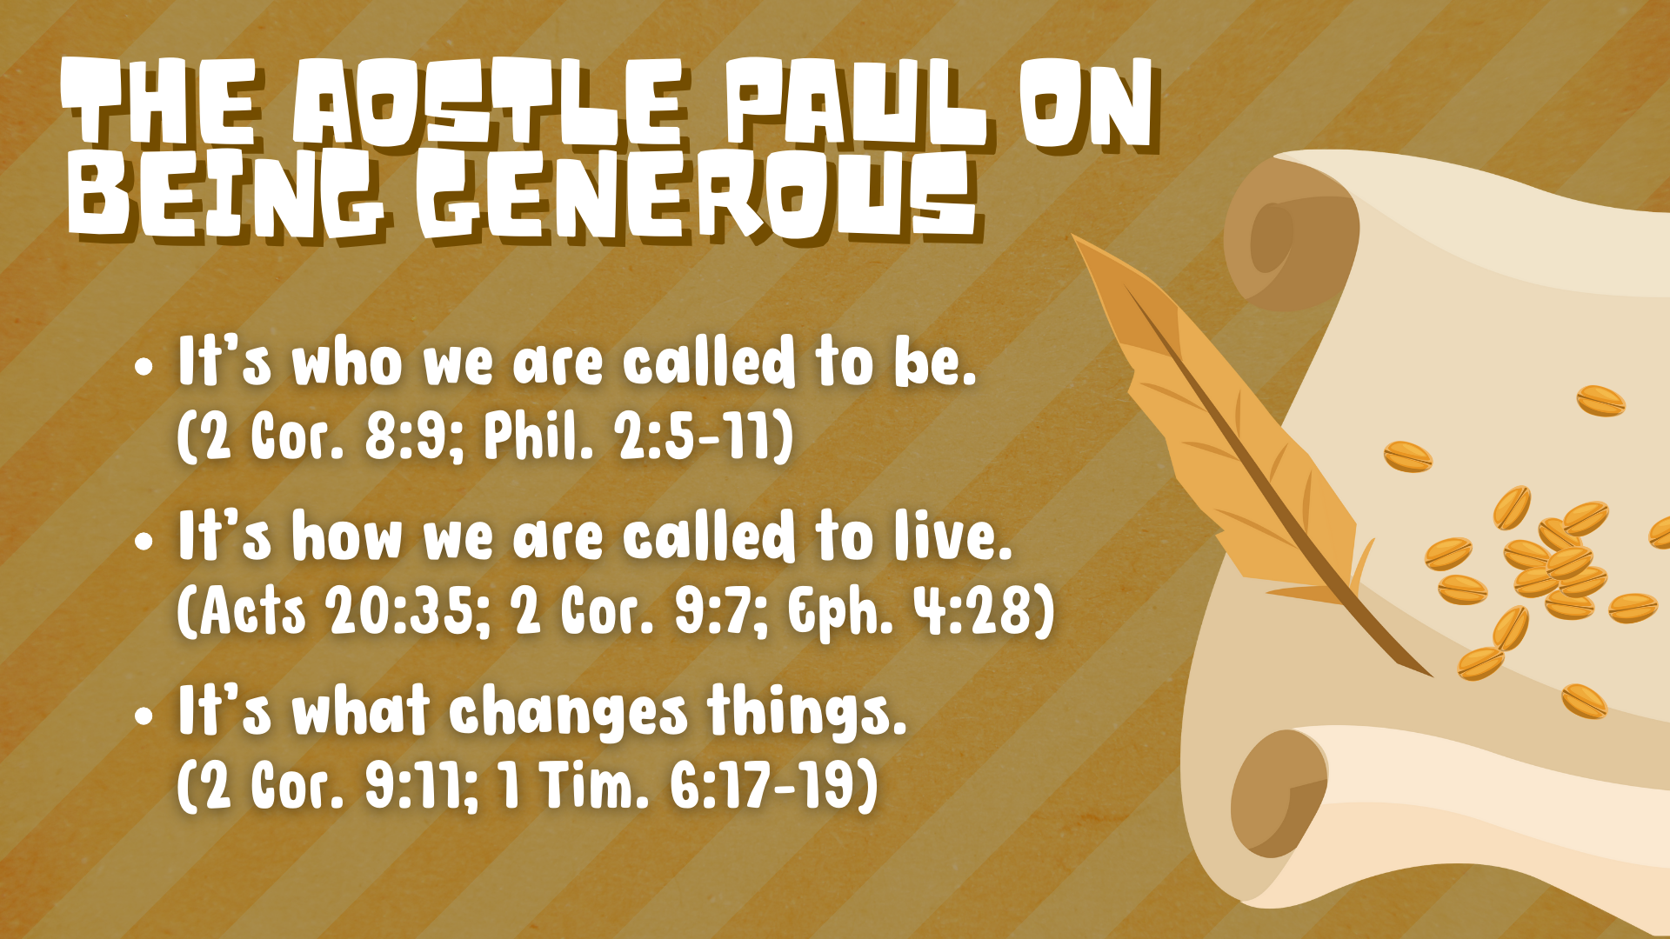
Notes:
It’s what changes things.
Brothers and sisters, money is not the root of all evil. In 1 Tim. 6:10, Paul said that the ”love of money” is the root of all evil. Even Jesus told a parable in Luke 12:16-21 that you should use your wealth to bless others, not spend or store away all the excess. Instead, invest it in the Kingdom! Use it for ministry.
That’s because money has “say so” in the Kingdom of God; it can influence, create, support, and sustain gospel ministry when we use it to further the mission of the church in the world. So, if something is important to you, you work it into your budget and you “put your money where your mouth is” so to speak. That means that we don’t give God and his mission the leftovers.
Rather, we give him the first-fruits and we prioritize ministry in and outside the church over other things that we don’t really need, and often don’t really matter in eternity. And this invitation to worship a generous God and be cheerful givers is how we work out our faith. After Paul spoke of the self-emptying, generous God in Philippians 2:5-11, he wrote this…[NEXT SLIDE]

Slide 12
Paul, Philippians 2:12-13 NRSV
“...work out your own salvation with fear and trembling; for it is God who is at work in you, enabling you both to will and to work for his good pleasure.”
Notes:
[READ & COMMENT]
Paul isn’t saying work for your salvation. He is saying work it out and live into who you are in Christ, how you’re called to live, and then live like this is how things really change in the Kingdom of God—by us having the same servant attitude and posture as the Lord Jesus.
And we don’t have to go at this alone. Paul says, God enables us by working with our desires and our efforts to bless the church and the world who needs Jesus. We simply need to align ourselves with his heart, generously sow our seeds, and call upon the Lord to send the rain.
You may remember, that’s what we invited our congregation to do through our breakthrough prayer. Will you pray this prayer with me? [NEXT SLIDE]

Slide 13

Notes:
[READ THE PRAYER ALOUD]
Finally, here are some questions to help us reflect and respond together… [NEXT SLIDE]

Slide 14


Slide 15


Slide 16


Slide 17

Notes:
[READ & COMMENT ON EACH QUESTION]
What would it look like for God to “open doors for greater ministry” at Grantham Church? What needs do you see in our church and in our community that we can meet if we call upon the Lord to move us in our spirit and mobilize us for his mission?
What is God saying to you about being more generous with your time, talents, and treasure? How is he calling you to give cheerfully to the work of the Lord? Is there someone you need to mentor or disciple? Is there a way that you can serve? Do you need to begin giving regularly to the church or increase your giving to help us carry out our mission & vision?
Will you prayerfully consider how the Spirit is inviting you to respond to his leading today?
Let’s take a moment of silence to listen and respond to God.
[NEXT SLIDE FOR CLOSING PRAYER]

Slide 18

Notes:
[CLOSING PRAYER]
Benediction
May the God who has generously poured out his grace upon your lives, move you to be generous with your time, talents, and treasure. As you leave this place and go out into the world, may your generosity be so extravagant that it leads others to the God who looks like Jesus. In the name of the Father who gave us his Son to be in us through the power of the Holy Spirit.
Go in peace, church, to love and serve the Lord. Amen.

