Slide 1
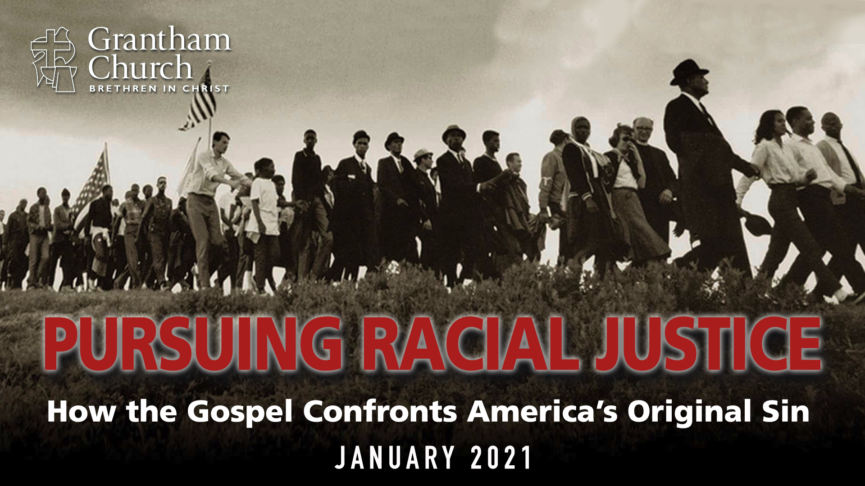
Notes:
Well, we made it through the first full week of 2021, and it wasn’t anything like what we had hoped it would be. For various reasons, I’m sure that it was just as challenging for you as it was for me and our staff. Except, let’s be honest, I’m the one that now must stand before you and our congregation and address it. I assure you that it’s no easy thing to do.
[MY ROLE AS A PASTOR]
My calling and role
Why it’s so hard
My desire for you (follow Jesus, embody the third way, and speak the truth in love)
So, let me say a few words about what happened in our country this past Wednesday… [NEXT SLIDE]

Slide 2
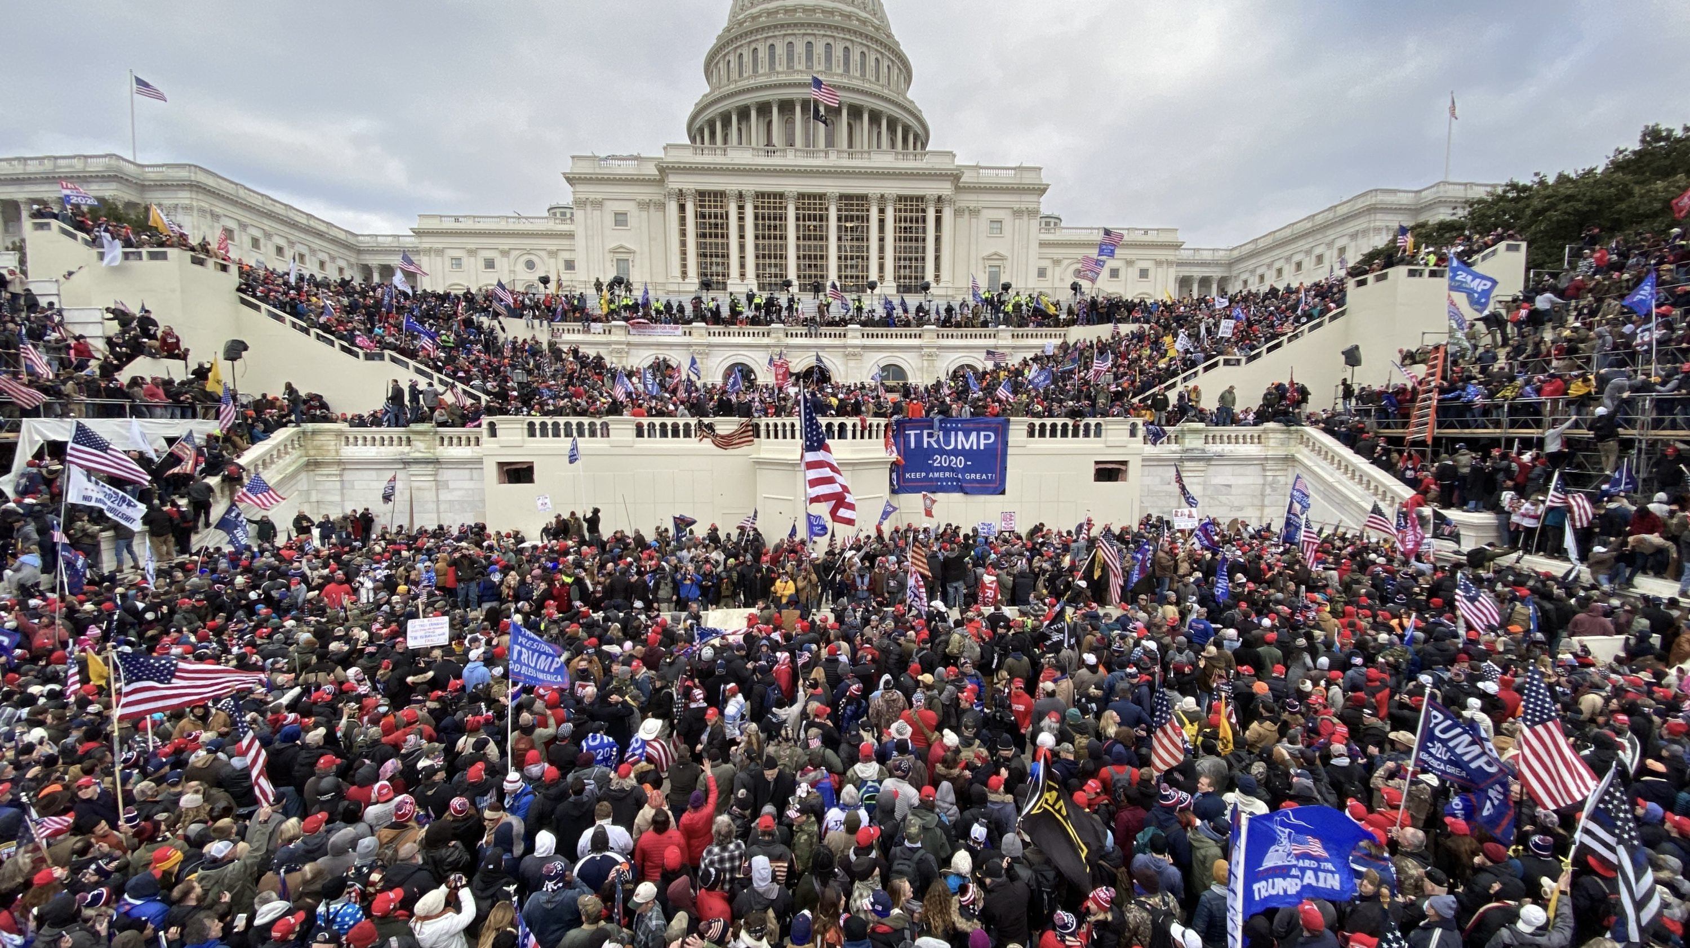
Notes:
There was a rally and protest held by Donald Trump on the day that the election results were being finalized in the senate
The protests eventually turned into a riot and insurrection – a mob broke into the Capitol building
In all 5 people have died, charges and arrests are happening as I record this message
I want to be clear about this: The insurrection at the U.S. Capitol on January 6th 2021 by radical right-wing Trump supporters wasn’t just about their belief that the election was fraudulent. It was also the culmination of Donald Trump’s presidency—one built upon fear, lies, scandals, conspiracy theories, violent rhetoric, bad religion, and white supremacy.
Take a look at this photo taken of one of the insurrectionists… [NEXT SLIDE]

Slide 3
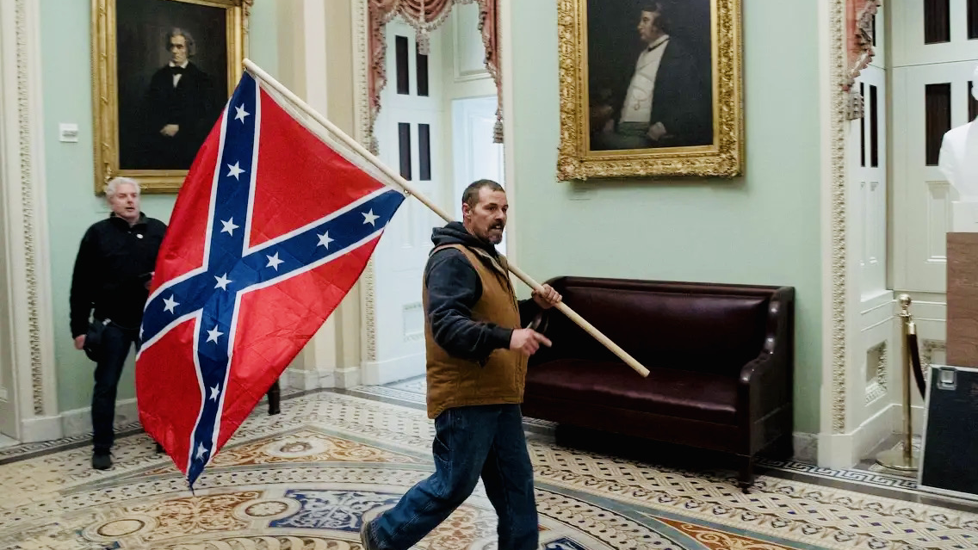
Notes:
America’s original sin – racism & white supremacy
It’s no secret that America was built upon the backs of African slaves (who were originally deemed by the US Constitution as three-fifths of a human being), as well as the genocide of Native American tribes.
Abolitionist movements arose in the 19th century, but because the US was founded upon violence, it resorted to violence to try and settle the matter: the Civil War (half a million died)
The North won the war, but that simply suppressed the racism and deep feelings of resentment in the South
Over the years we’ve seen the ongoing struggle for equality and the pursuit of racial justice. Racism and white supremacy continued through things like Jim Crow laws, the KKK (and other white supremacists' groups), segregation, redlining, the criminalization and mass incarceration of African Americans (allowed by the 13th Amendment), and seen in the many stories of police brutality in recent years. And it’s not hard to see the stark contrast between the militarized response to BLM protests and the unpreparedness and intentional withholding of national guard troops at the Capitol this past week.
Despite the progress made by the Civil Rights Movement of the 1960s and the outcries for racial justice today in light of George Floyd, Ahmaud Arbery, and Breonna Taylor, racism and white supremacy (America’s original sin) is still very much deeply ingrained in our society. [NEXT SLIDE]

Slide 4
Notes:
And that’s the purpose of our series, Pursuing Racial Justice: How the Gospel Confronts America’s Original Sin. As Christ-followers, we want to ask questions like, “What does the Gospel have to say about this? What should Christians do in response to racial injustice?”
I’d venture to say that most people in our congregation and those listening know that this is a problem, at least to some extent. The question of course is what do we do about it? How should we respond? Where do we go from here? That’s what this series is all about.
But if for some reason you’re still not convinced of the seriousness of this issue, and your open to learning more, our Peace and Social Justice Commission has created a suggested reading list to help educate and grow us in our understanding. You can find that list in the recent edition of our PeaceMatters Newsletter, which you can access at the peace and social justice page at granthamchurch.org. [NEXT SLIDE

Slide 5
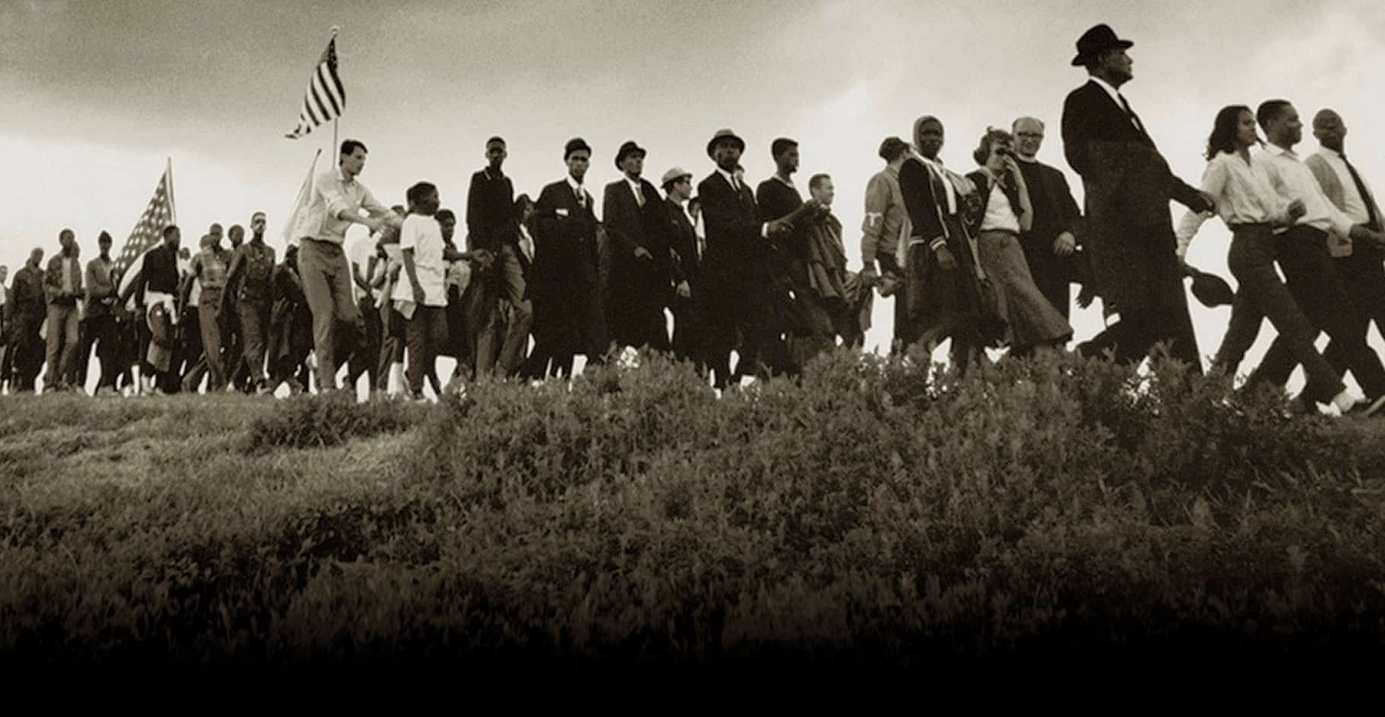

Pursuing Racial Justice
January 2021 Series Outline & Lineup
www.granthamchurch.org/peace-social-justice
Notes:
There you will also find the series outline and lineup. We have a lot of great speakers joining us virtually this year. Hank Johnson, Todd Allen, Greg Boyd, Dina Gonzalez-Pina (MCC), Dominque Gilliard, and Drew Hart.
[BRIEF PRAYER]

Slide 6
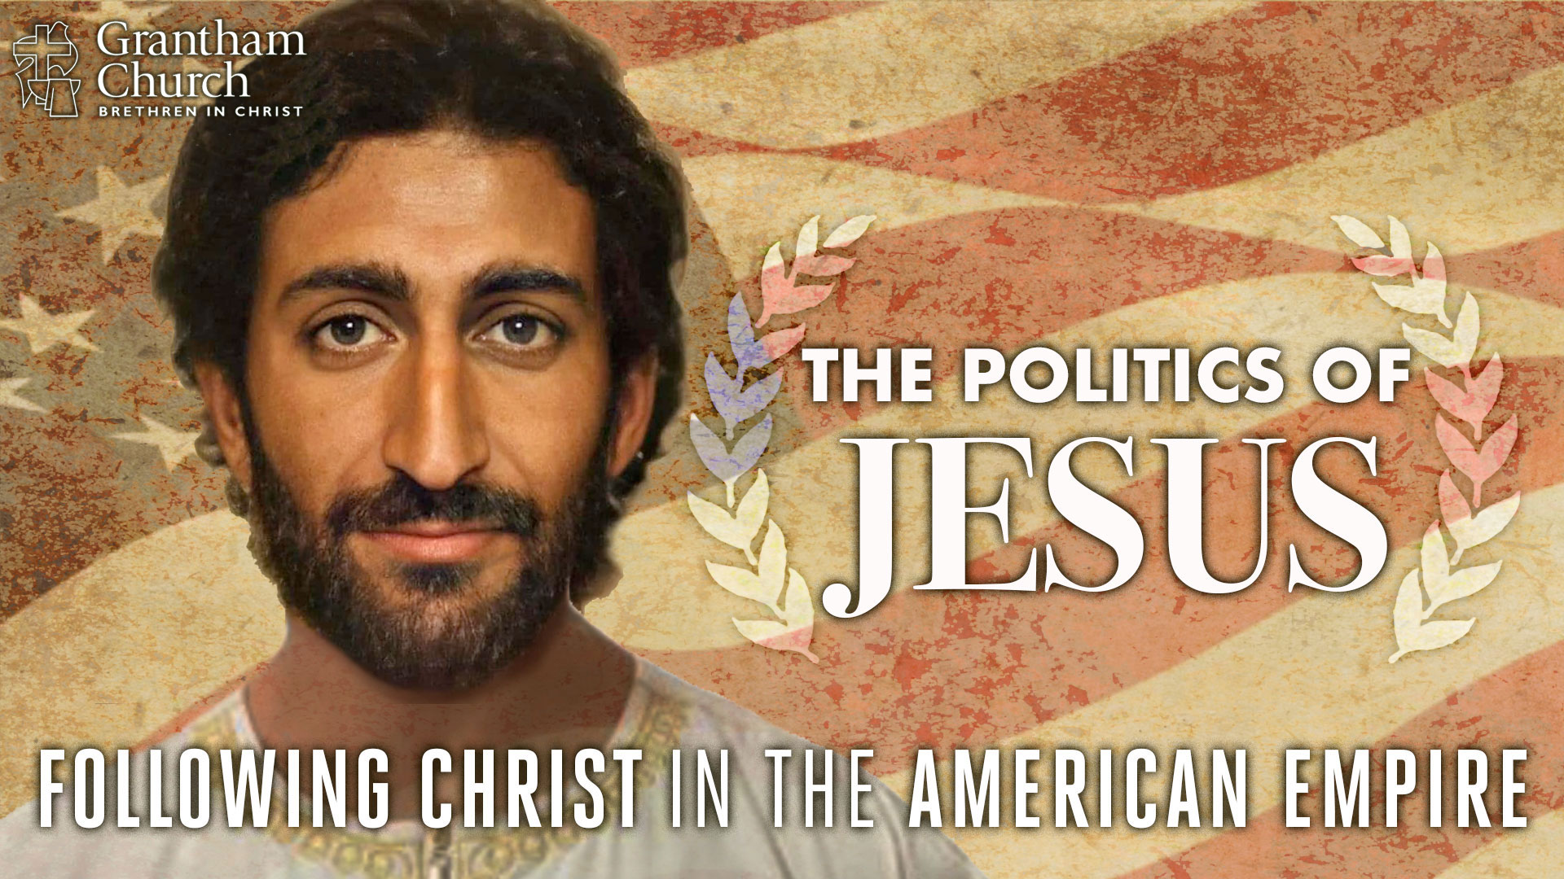
Notes:
Jesus, our Lord and Savior, was a Jew. He was not white. If you’ve been regularly engaged at Grantham, or you’ve been following our sermon podcast, you know that we did a series in the fall leading up to the election. It was called, The Politics of Jesus: Following Christ in the American Empire. [AI PHOTO OF JESUS]
Jesus was from a minority ethnic group (known historically as the Hebrews) who had a long history of slavery, exile, and oppression. And that oppression continued with the Roman Empire in the first century. The Jews were occupied by the Romans and exploited as as the outer rim and backwater of the empire. The term “Jew” itself would have likely been used by Romans in a derogatory way (e.g. Mexicans). Also, “King of the Jews” (Mk 15:26).
So, we can’t overlook how Jesus did not come from a powerful and privileged group of people. But instead, from an oppressed people, and he came for oppressed people everywhere. Therefore, it’s important to hear how the “good news” of Jesus is not just about the forgiveness of sins and inward spiritual change, it’s also about justice and setting the captives free. Which is why I’d like to begin our series by briefly showing us how racial justice is rooted in the gospel that Christ proclaimed, and how we too must pursue it together as a church. [NEXT SLIDE]

Slide 7
Luke 4:14-21 NIV – The Inaugural Address of Jesus
¹⁴ Jesus returned to Galilee in the power of the Spirit, and news about him spread through the whole countryside. ¹⁵ He was teaching in their synagogues, and everyone praised him.
¹⁶ He went to Nazareth, where he had been brought up, and on the Sabbath day he went into the synagogue, as was his custom. He stood up to read, ¹⁷ and the scroll of the prophet Isaiah was handed to him. Unrolling it, he found the place where it is written:
Notes:
[BRIEF COMMENTS]

Slide 8
Luke 4:14-21 NIV
¹⁸ “The Spirit of the Lord is on me,
because he has anointed me
to proclaim good news to the poor.
He has sent me to proclaim freedom for the prisoners
and recovery of sight for the blind,
to set the oppressed free,
¹⁹ to proclaim the year of the Lord’s favor.”
Notes:
[READ & COMMENT]
“the poor” refers to those living in poverty, but it also included those of lower social status, outsiders, the marginalized, the voiceless, and people living on the fringes; while it can include the poor in spirit, it most definitely refers to those who are physically poor. And we will see Jesus proclaiming good news to the poor and lifting them up from their plight all throughout the gospels.
“freedom for the prisoners” (NRSV - release to the captives) obviously the literal sense here is getting people out of jail (which is a good thing, particularly for the wrongly accused or those who have been unfairly sentenced), although we don’t see Jesus doing that in his ministry, it does happen later in Acts and will become the basis for abolition movements and prison reform throughout history. Praise God for that! But we should also notice that in Luke the “freedom for the prisoners” looks like setting people free from bondage to spiritual evil through exorcisms and healings. Afterall, you can set people free from a jail cell, but they can still live in their own private hell as a “free” person.
“recovery of sight for the blind” as you’ll recall, Jesus literally opened the eyes of blind people in the gospels, but we can also see how Jesus opens eyes in a spiritual sense for people to see the truth and come into his Kingdom, and for people like Nicodemus, to be born again. So, we shouldn’t make the mistake as post-Enlightenment Westerners of wanting to choose either a literal interpretation or a spiritual one. Instead, we need to hold them together. For Jesus and his Jewish audience, they both reflect the reality of God’s creation--we live in a physical/material world that is mysteriously connected to the spiritual realms and spiritual matters.
“to set the oppressed free” can apply to so many people and situations today (which we should do), but in the context they specifically would have thought of how the empire was oppressing and subjugating them, making them exiles and prisoners in their own land.
And then in verse 19 (Isaiah 61:2), Jesus reads, “the year of the Lord’s favor” – what’s that about? Well, this refers to the Jewish concept of the Jubilee year in Leviticus 25:8-10. And I say “concept” because there isn’t any historical evidence that Israel ever practiced it. That’s because Jubilee required that every 50 years debts be forgiven, slaves go free, that people stop charging interest on loans, that you treat each other with fairness, and make it possible that everyone receives what they need to live and be an equal, contributing member of society.
OT scholar Walter Brueggemann said that the Jubilee is about the ”rehabilitation of life out of impoverishment, powerlessness, and despair.” The idea behind Jubilee is that it’s the way a community in trouble can resolve and restore what is broken and run amok. And this vision of Jubilee, which offers profound hope for the disadvantaged and downtrodden, is understandably devastating to those who benefit from maintaining the status quo and keeping things the way they are--a system that has given them power and privilege over others. So, you can see why there isn’t any evidence that this was ever actually practiced. Yet, it reflects where God wants to take the world.
As one commentator writes, when understood literally, “the passage says the Christ is God’s servant who will bring to reality the longing and hope of the poor, the oppressed, and the imprisoned. The Christ will usher in the amnesty, the liberation, and the restoration associated with the proclamation of the year of Jubilee” (Fred Craddock, Luke pg.62). Sounds exciting, right? Well, not everyone likes the idea and how it applies, as we can see as the story unfolds in Nazareth.
Now, notice this. Jesus says he has come to “proclaim” or announce these things. Why is that important? [NEXT SLIDE]

Slide 9
Luke 4:14-21 NIV
²⁰ Then he rolled up the scroll, gave it back to the attendant and sat down. The eyes of everyone in the synagogue were fastened on him. ²¹ He began by saying to them, “Today this scripture is fulfilled in your hearing.”
Notes:
Everything is about to change. The Kingdom of God is coming. God is fulfilling his promises to Israel, and to the world.
When you see who Jesus was (and is) and understand his ministry as liberating the world from spiritual and earthly (i.e. social) bondage, it will expand your view of the gospel and transform the way you see what Christ is doing in the Gospels, and what he calls us to do as well. Once we’ve seriously considered the Jewishness of Jesus, that he was once a refugee to Egypt, that he was a religious Jew, that he was oppressed as a minority in his own land, we should then pay careful attention to the way he taught and the way he went to other oppressed people.
For example, let’s recall one of his most well-known parables and reflect on how radical it was within his own context. [NEXT SLIDE]

Slide 10
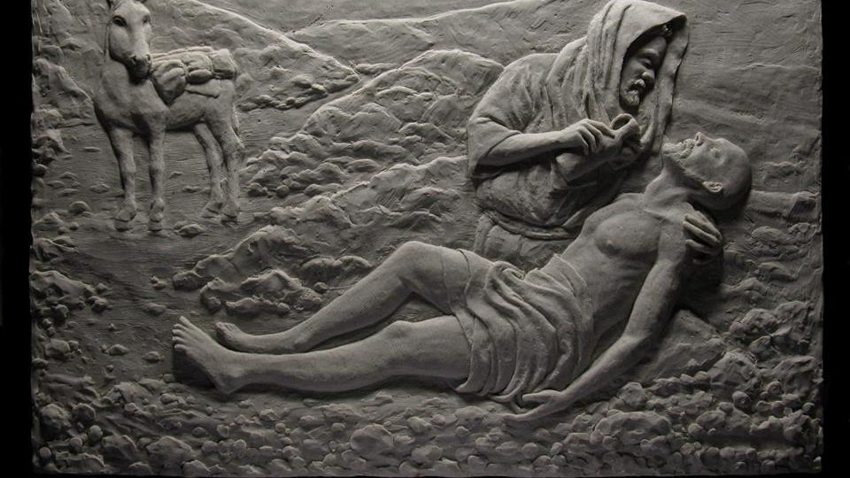

Who Is My Neighbor?
Luke 10:25-37
The Parable of the “Good” Samaritan
Notes:
Jesus said: “A man was going down from Jerusalem to Jericho, when he was attacked by robbers. They stripped him of his clothes, beat him and went away, leaving him half dead. ³¹ A priest happened to be going down the same road, and when he saw the man, he passed by on the other side. ³² So too, a Levite, when he came to the place and saw him, passed by on the other side. ³³ But a Samaritan, as he traveled, came where the man was; and when he saw him, he took pity on him. ³⁴ He went to him and bandaged his wounds, pouring on oil and wine. Then he put the man on his own donkey, brought him to an inn and took care of him. ³⁵ The next day he took out two denarii and gave them to the innkeeper. ‘Look after him,’ he said, ‘and when I return, I will reimburse you for any extra expense you may have.’³⁶ “Which of these three do you think was a neighbor to the man who fell into the hands of robbers?” ³⁷ The expert in the law replied, “The one who had mercy on him.” Jesus told him, “Go and do likewise.”
Jesus goes beyond the ethical responsibility of his readers; He challenges their ideas of ethnic superiority
Samaritans were despised – they were a mixed race, the offspring of Jews and Gentiles
In other words, Jesus is saying, we Jews are no better than the Samaritans.
And Jesus didn’t reveal his heart for pursuing racial and ethnic justice (and bridging and reconciling divides) simply through scandalous parables, but also by embodying his teachings and going directly to those who were considered by the Jews to be the real scum of the earth. [NEXT SLIDE]

Slide 11
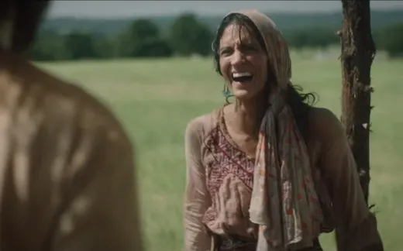
Gospel in Samaria
John 4:1-38
Jesus and the Samaritan woman at the well
Notes:
[BRIEF COMMENT]
John tells us that Jesus “had to go through Samaria” – Jews normally went around
He meets a woman getting water at a well at noon (not when women usually go)
In conversation, he tells her he knows why she is there by herself at noon – she has had multiple husbands
Nobody accepts her, but Jesus, a Jewish man, does
But Jesus isn’t looking for a date, he wants to let her in on a secret – He is the Messiah! And he can restore her.
In that exchange, Jesus says that all who worship God in spirit and in truth should do so as one people
The apostles return, but are confused. They would remain confused until after Jesus’ death and resurrection (e.g. calling fire from heaven).
But later they would understand, just as the Apostle Paul would understand…
[NEXT SLIDE]

Slide 12
There is no longer Jew or Gentile, slave or free, male and female. For you are all one in Christ Jesus.
Paul, Galatians 3:28 NLT
Notes:
[BRIEF COMMENT]
Jesus proclaimed the gospel that is good news for the poor, the prisoners, to the blind, and to those who are oppressed. He made it clear for us, as we can see in his life, teachings, and in the faith and practices of the early church, that treating others the way we want to be treated is God’s will; that lifting people up from their despair, becoming their allies, even using our power and privilege as we’re able, to free them from their bondage, is what it means to embody the good news and proclaim the coming Kingdom. And he not only calls us to do this, but also to sit, listen, and learn from the marginalized. As Dennis Edwards told last year, the marginalized are often the best teachers when it comes to knowing what it means to follow Jesus in the world today.
Therefore, as we embark on this journey through our Pursuing Racial Justice series, may we open to listening, learning, and living out what the Spirit is calling us to do, for such a time as this. [CLOSING PRAYER]

