Slide 1
Notes:
God has done exciting things in world missions in 2021, and before the sermon we have 4 highlights to share with you.

Slide 2
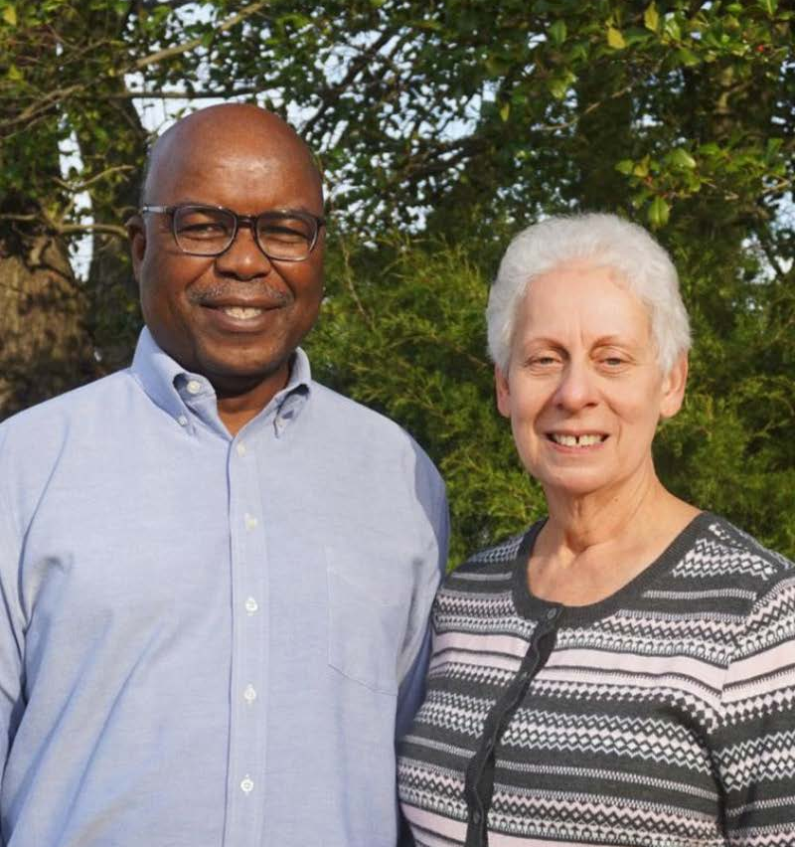
Donald and Karen Vundhla
Deployed in 2021 as
Regional Coordinators, serving the church in Zimbabwe, Zambia, Malawi and Mozambique.
Notes:
The Vundhla’s deployed to Southern Africa. Donald has significant training and experience in both theology and administration, Karen brings over 30 years of professional nursing experience. They both have prior experience in southern Africa, and are already making deep connections with the BIC church leaders across the region. Within the last few weeks they are able to travel into Mozambique, and this week they will be in Malawi.

Slide 3
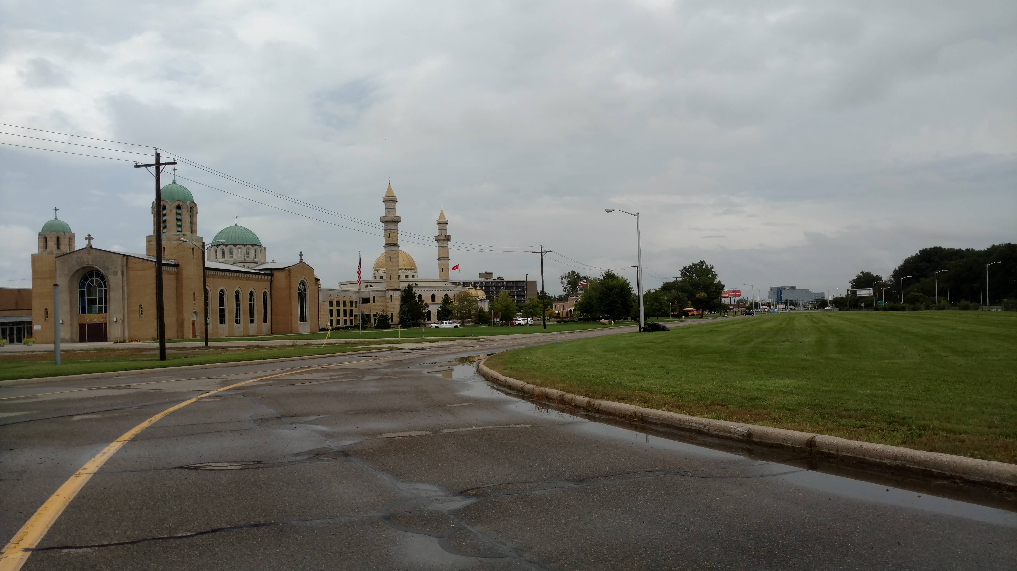
Notes:
Developing work in Dearborn Michigan – You could tell a story from your experience in Dearborn this summer.

Slide 4

Ongoing ministry in the Middle East to Syrian refugees
Notes:
Our family in the Middle East devotes more than 50% of their ministry to Syrian refugees living in their country. They are building relationships in multiple ways, supporting these families through compassion ministry, sharing gospel truth, and advocating for the protection of children.

Slide 5
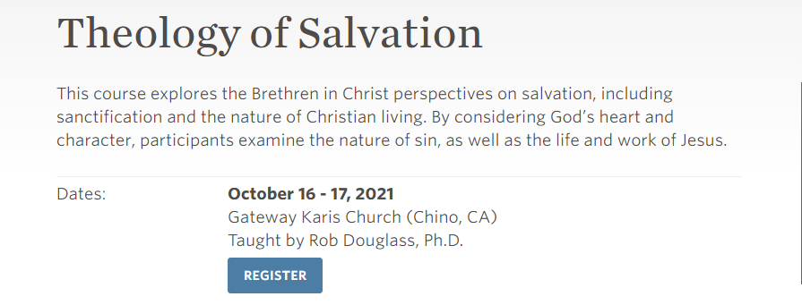
Notes:
Earlier this month we were able to help facilitate a gathering of developing church leaders. Chinese, South Korean, a representative of BIC Japan, and several American’s were able to come together for a core course at Gateway Karis church in southern California. The participants went away encouraged and hungry for more.

