Slide 1

Notes:
In 2018, the blog writer, Sabine Birdsong, wrote an article called “To Hell with Forgiveness Culture.” In it she declares that our culture has a “religious hangover from Christianity” that forces victims to forgive before they’re ready or feel guilty for not offering forgiveness. She says that for her, forgiveness can’t be offered freely, forgiveness must be earned. She writes not long after the #metoo movement really started growing and she’s is tapping into this question that I think many of us have: “Does forgiveness actually just negate justice and perpetuate abuse?”
One of the most central tenets of Christianity is the concept of forgiveness. Yet, we struggle with offering forgiveness, because we feel like the other person needs to express remorse for their actions and needs to demonstrate a desire to change, otherwise we’re just giving them free reign to hurt more people and not be held accountable. Well, today we’re looking at Jesus’ teaching on forgiveness. And it can be difficult to accept. But we’ll see in the Scriptures that forgiveness is not writing off the wrong that has been done, nor is it demanding a certain response from the perpetrator, but it’s an outgrowth of the mercy we’ve received. And, while forgiveness is not the same as justice, it is a necessary companion to it.

Slide 2

Notes:
We’re going to be looking today at Matthew 18, if you want to begin turning there.
We’ve been journeying with Peter this Lent and we reflected last week on the time Peter tries to rebuke Jesus when Jesus starts talking about how he will be killed, but Jesus rebukes Peter and puts him in his place. Jesus tells Peter he’s being a stumbling block when he’s only considering the human perspective and not God’s purposes. This was certainly a humbling experience for Peter. So, in this passage it seems like Peter is starting to learn about what it means to be the student. A student asks questions of the teacher. And this message today is entitled “teach me.”
Let’s pray – Lord, teach us the rhythms of your grace. Teach us about forgiveness. Teach us your ways. Our hearts are open to you. Amen.
We’re going to start in verse 21 and I won’t have you stand to read today because we’ll break up the passage a bit.

Slide 3
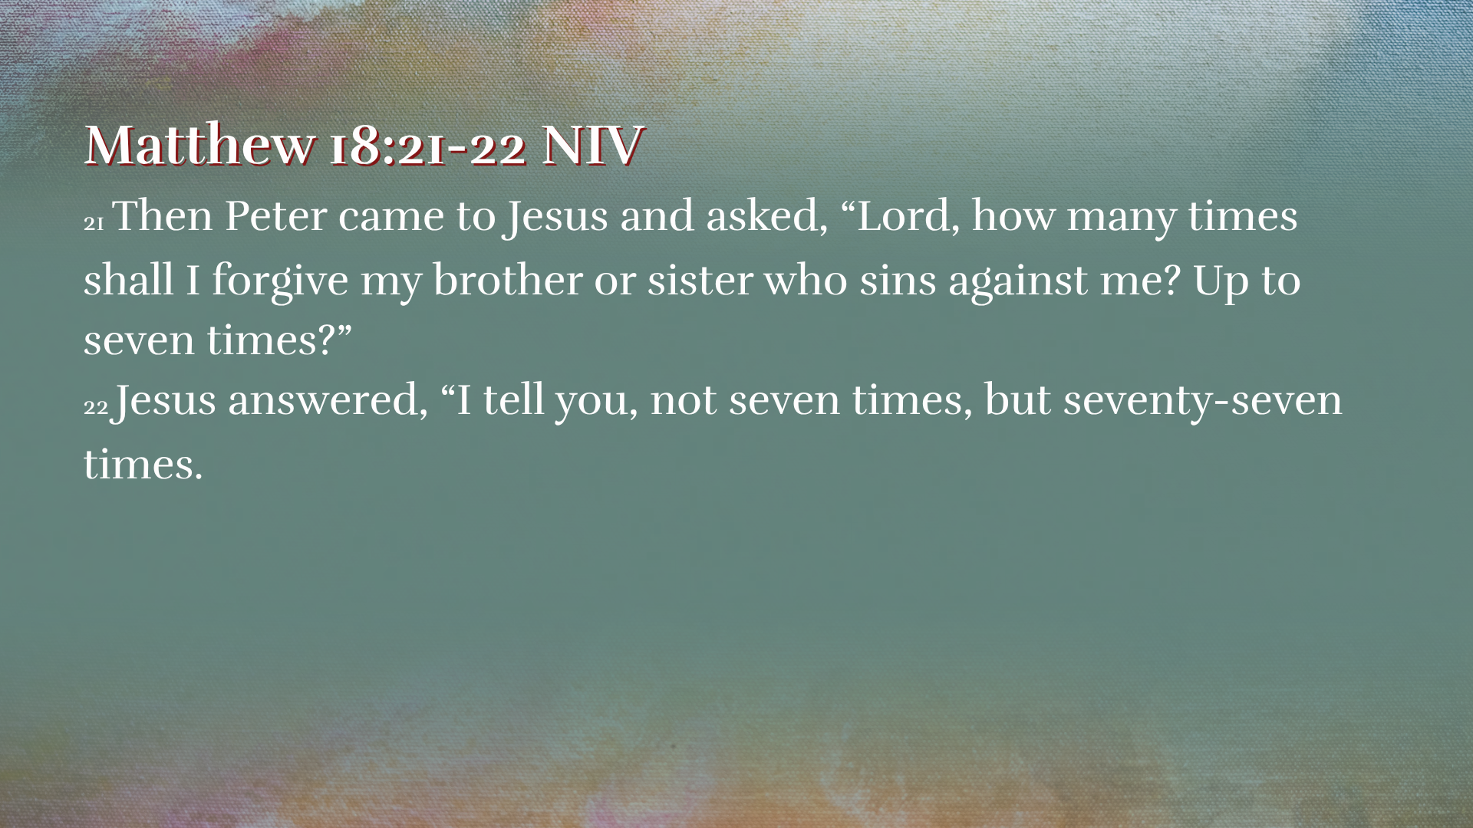
Notes:
READ Vv. 21-22
Peter’s curious, he wants to learn, but he also kind of still has that presumptuous quality where he thinks he knows the answer. The Rabbis of the day taught that a person should forgive up to three times, so Peter might be thinking he’s being pretty generous by extending that to seven. And seven is a good number of completion in the Bible. But Jesus responds and says, not seven, but seventy-seven or seventy times seven. The exact number is ambiguous in the Greek text, but the point is not to track the specific number of times you forgive. The idea Jesus is getting across is that his followers are to offer endless forgiveness. We are to forgive, even the same person, over and over and over again.
And this seems impossible for us to accomplish, right? Yeah, it is impossible in our own power. But – spoiler alert – we have a power within us that makes the impossible possible. So, let’s dig into this call to be people of infinite forgiveness.
Jesus’ most extensive teaching on forgiveness is not given as a lecture, but as a story, a parable. And in this parable, he relates sin to a debt. Let’s look at vv. 23-35

Slide 4

Notes:
READ 18:23-35
We’ll get to the final verses later, but let’s start at the beginning of the story. The first servant owed the king 10,000 “talents” is the word in the original language. One talent was equivalent to 20 years’ wages for a day laborer. 10,000 talents would be multiple lifetimes of work. It’s an impossible debt and when we recognize that, his plea looks kind of ridiculous. He asks the king to have patience and he’ll repay it, but there’s no way he could actually repay this debt. It’s like saying “I know I owe you 20 billion dollars. Let me repay you with $5 a day.” It’s an impossible debt. But what does the master do? He goes beyond what the servant even asks and he decides to cancel the debt. The servant owes nothing. And he’s released as a citizen of the kingdom. No hard feelings. No penalties. And we would expect this act of forgiveness to change the servant’s heart.
But, we see that it doesn’t. The amount his fellow servant owes is 100 denarii. One denarius was the daily wage of a day laborer. So, while this is still a lot – 100 days’ wages – it actually seems possible to pay back: little by little, work some extra jobs, get some people to help you out, take out a loan. It seems possible to pay back that amount. And the fellow servant has the same plea as the first servant: “be patient with me and I’ll pay it back.” But the first servant refuses and throws him into prison.
We’re shocked by this story, because we see so clearly the incongruity. We recognize this servant was forgiven an enormous debt and yet went on to demand repayment of a much smaller debt from his fellow servant.
And maybe what strikes us even more is when we recognize we’re just like the servant. Parables invite us to find who we relate to in the story. It’s obvious that the king in this story represents God and the servants represent us. This story presents the reality that we are in impossible debt to God. Simply as God’s creatures, created and sustained by him, we owe him our lives, we owe an incredible debt of gratitude and worship and devotion and obedience. And not only do we often ignore that or take advantage of it, but we actively turn away from God’s ways, we inflict harm on others, we pursue selfish gain, we put ourselves in the place of God as king and judge. We’re in an impossible debt. And we’re unable to repay it. All the good works we could possibly do would never suffice to balance our account.
So, we see the incongruity in the story, but we can sometimes miss it in our own live. We still live every day with a lack of kindness and generosity and forgiveness.
In a few moments we’ll look more closely at the last few verses of the parable and reflect more on that dynamic of receiving mercy but not giving it.
But first, I want us to notice that this story gives us some guidelines for forgiveness. As we think about the concern that forgiveness is just letting the other person off the hook, we can see that Biblical forgiveness is much deeper than a careless, dismissive “okay, it’s no big deal, let’s just move on” kind of attitude.

Slide 5
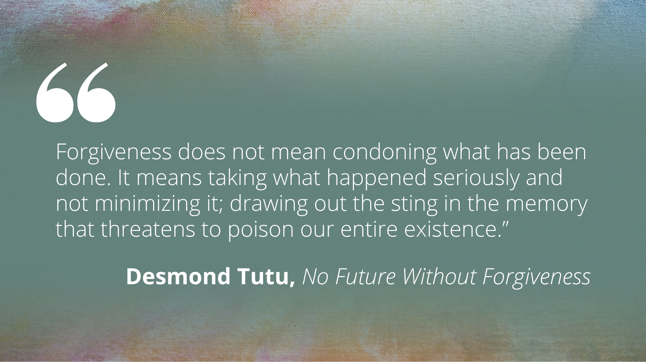
Notes:
Read quote
So, let’s look at this pattern of forgiveness Jesus outlines through the story:

Slide 6
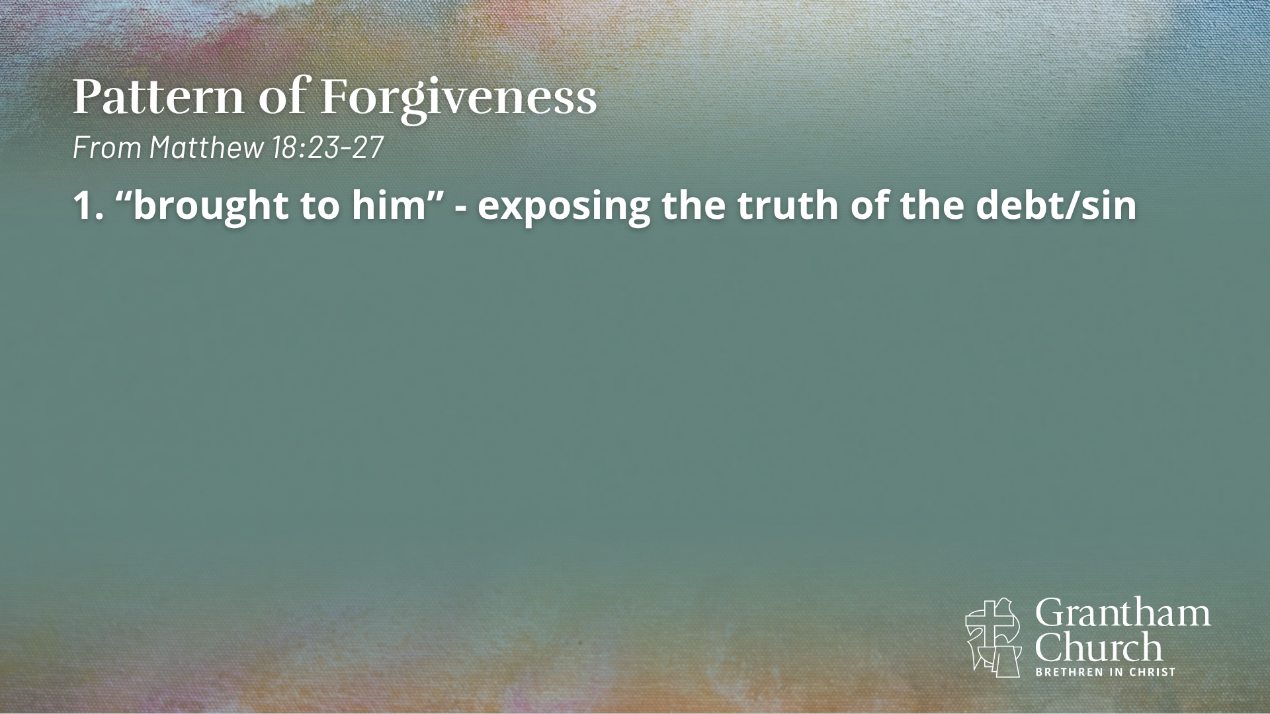
Notes:
First, the servant is “brought to” the king – the king doesn’t remain distant and just tell his courtpeople to go throw the servant in prison without giving an opportunity for understanding. He meets with him. And this is the exposing of the truth of the debt. [sometimes we don’t have the ability to meet with the person we need to forgive] He presents the reality – this is the debt, these are the consequences. And this creates space for understanding – for both parties. The servant understands the gravity of the debt, but the king can hear the servant’s explanation and understand his situation.

Slide 7
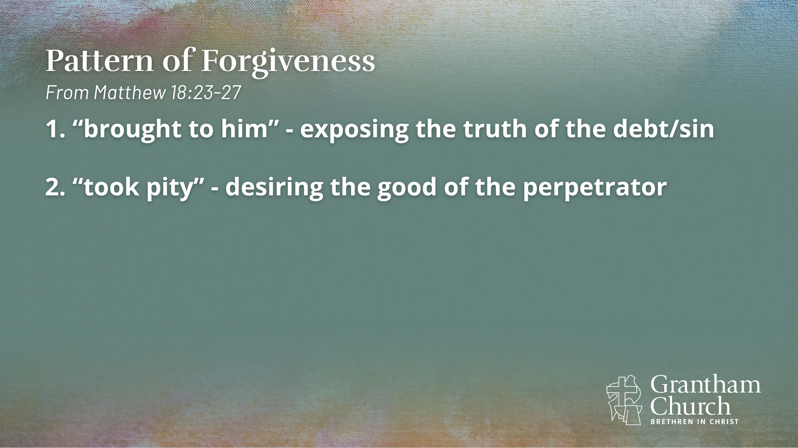
Notes:
And that leads to the second step toward forgiveness: the king “took pity” on the servant. He had compassion. He saw the humanity of this servant, heard his fears and worries. Maybe he recognized that this debt was probably the result of some deeper issues. And the king came to desire the good of the other.

Slide 8
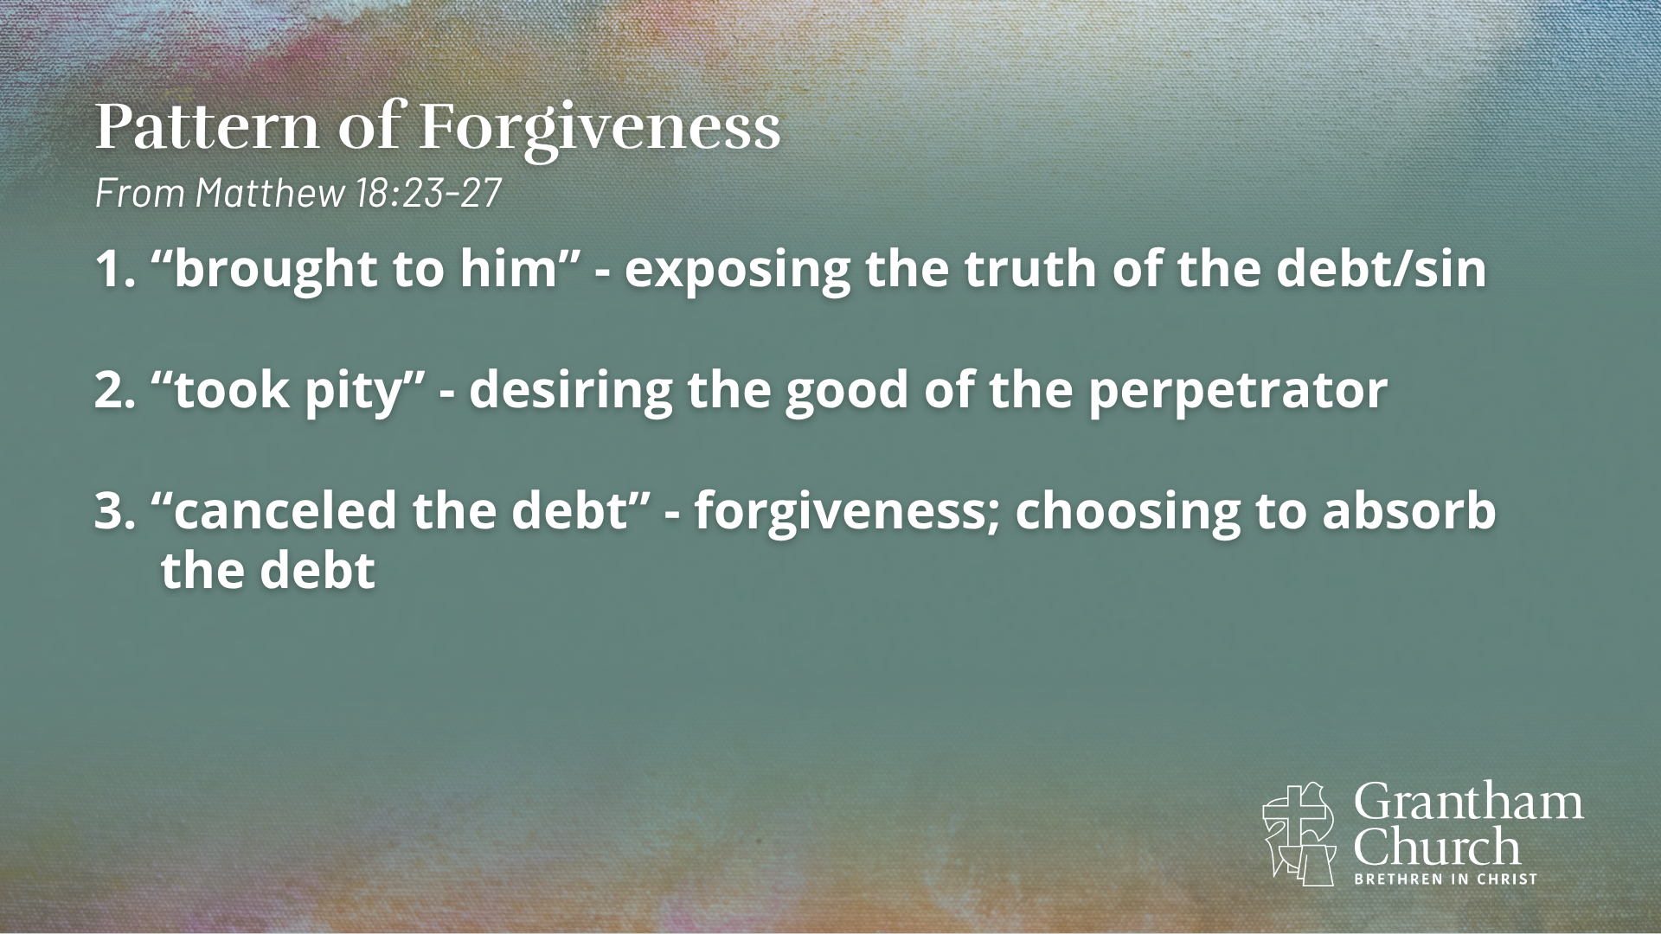
Notes:
And then he “canceled the debt.” This is the third step and this is the heart of forgiveness. The king refused to make the servant suffer for his wrong. And that didn’t make the debt go away. The debt still had to be dealt with, but the king was choosing to absorb it himself.
This is tough for us, right, because what if the debt we’re owed isn’t financial, but emotional, physical, spiritual – what does it looks like to absorb that debt? It means our resources – our joy, purpose, peace, wholeness has to come from somewhere else, right? Not from that person. The king absorbed the debt himself. He released his anger toward the servant and he forgave him.

Slide 9
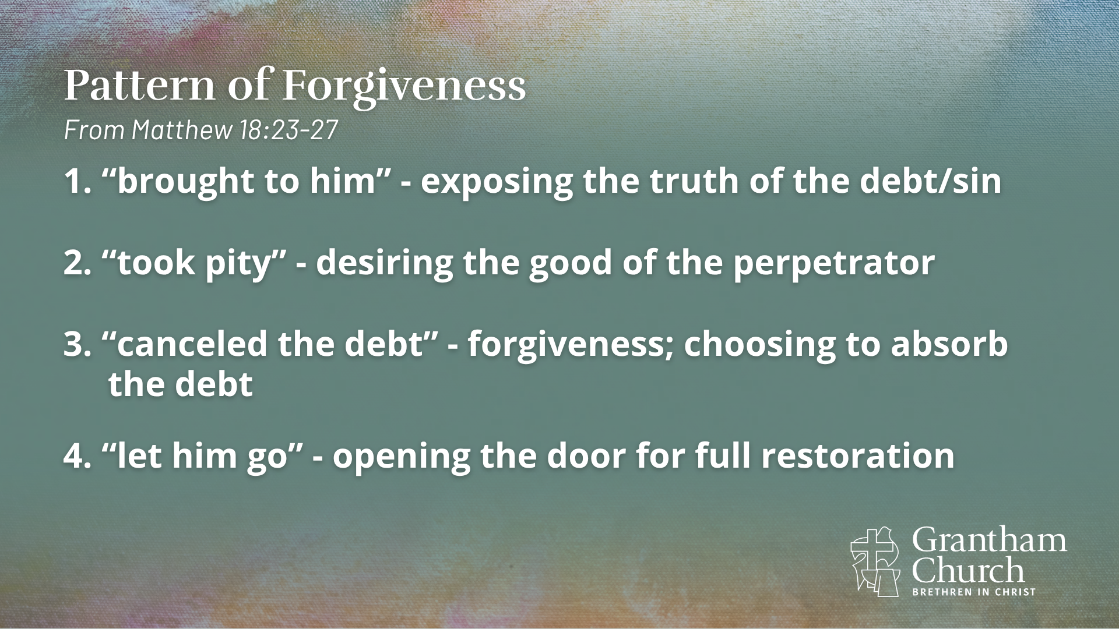
Notes:
And lastly he “let him go.” The servant was no longer indebted, but he was released as a citizen. This was opening the door for the relationship to be restored. But, that restoration at this point is up to the one being forgiven. In this parable, the servant doesn’t respond to the king’s kindness and so the relationship breaks down again.
ILLUSTRATION – I was reading this week a story from Terence Lester who founded Love Beyond Walls, which had a mobile makeover bus, which provided grooming resources to those who were unhoused in Atlanta. And there was a 27-year-old man named Jamil who had just earned his license from barbering school and he volunteered because his dad was unhoused and Jamil hadn’t seen him in 10 years and was hoping he might run into him through this outreach. Well, Jamil did meet his father and gave him a makeover on the streets. His dad didn’t know he had become a barber, but this encounter and Jamil’s forgiveness of his father who wasn’t there for 10 years, was a turning point for his father. He entered and graduated from a program, found work as a chef, and gained his own apartment. Forgiveness opened the door for further restoration.

Slide 10
Notes:
See, the thing about sin is that it destroys God’s shalom. Shalom is the Hebrew word used in the Bible that means peace, but more than that it means wholeness and completeness. It’s a state where nothing is broken or lacking, where everything and everyone is in right relationship with God and one another and within ourselves. But sin breaks that peace. It causes disintegration and deterioration at all levels. It causes breakdown between humans as we sin against each other, harming one another physically and emotionally. It causes breakdown within as we become bitter and resentful and selfish and lose integrity. And sin causes breakdown in our relationship with God. David in Psalm 51 after committing adultery cried out to God and said “Against you, you only, have I sinned and done what is evil in your sight.” He recognized that sin against another at its deepest level is sin against God as we turn away from him and pursue our own desires. And the Scriptures warn that sin is not contained if it doesn’t get dealt with. Sin is often referred to as a poison, something that grows and expands to cause further destruction and death.
So, sin doesn’t just affect the individual or even just the two who might be involved in an incident, but if it’s not dealt with it takes root and multiplies, affecting the whole community.
Earlier in Matthew 18 Jesus uses strong language to warn of the temptation to sin and says if your hand or foot or eye causes you to sin, cut it off and throw it away. It’s that serious. Sin’s got to be dealt with. That breakdown of shalom must be stopped. And that happens through forgiveness, which brings about healing and reconciliation and has the potential to produce further restoration.

Slide 11
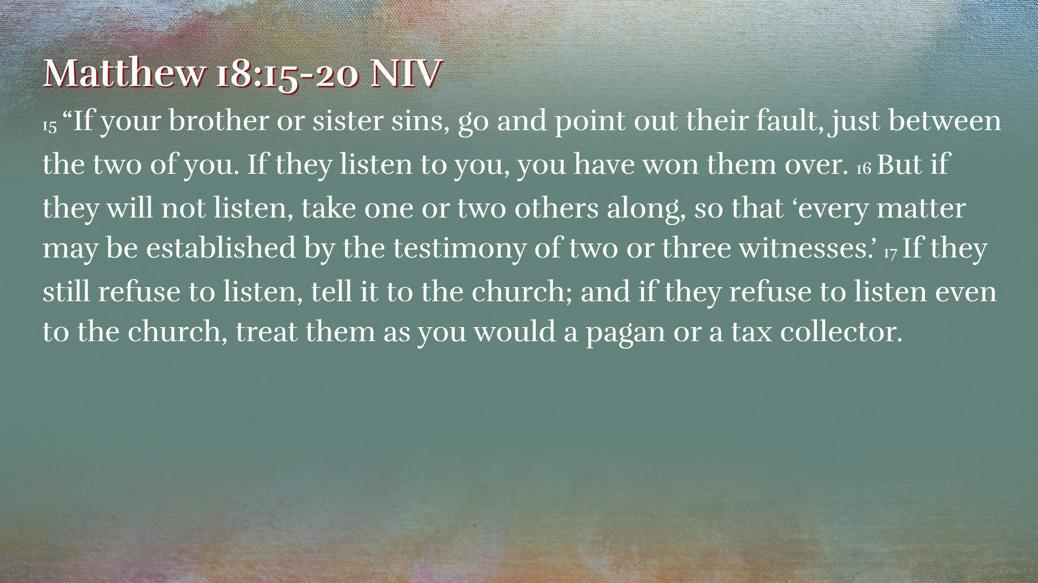
Notes:
And Jesus gives us the vision for restoration in verses 15-20. I’m putting the verses on the screen, but we don’t have time to look deep into these verses – there’s a lot we could say about that section – but one thing for us to notice is that the pursuit of restoration starts within the body of Christ. As we lovingly seek to address sin in the lives of our brothers and sisters we do so with concern for their relationship with God and with a longing for God’s shalom to be restored. The church is to be a microcosm of God’s shalom. So, this isn’t about proving someone did something wrong so we can kick them out of the church, but it’s about not letting sin fester and grow and cause more damage so that we can live in shalom with one another and extend that shalom into the world.
So, the process is you start by going directly to that person. Now, this isn’t to say that if a person is being abused that they are to put themselves in a position to experience more abuse. There’s more going on there and God’s heart is shalom, right, not further damage. So, we want to be wise in how we apply this. But in situations of ongoing sin as you’re able you start by going directly to that person. And that takes humility, on both sides, right? Hopefully the one acting in their sin has a teachable spirit willing to hear and understand the effects of their actions on the other. And hopefully the one seeking to expose the sin is humble enough to recognize there are ways they may be at fault with others and they want to understand what led the other person to this place. We seek to cultivate compassion.
But if necessary we get a couple other trusted brothers and sisters, maybe someone the other person would listen to try to help them see their need for repentance. Then as a last resort we bring in the broader church family to try to help the person see how their sin is affecting the whole community and to invite repentance and reconciliation.

Slide 12
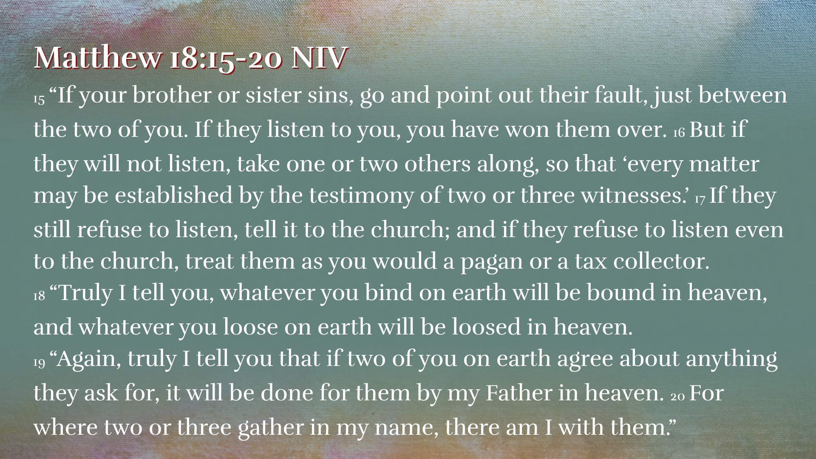
Notes:
God gives us the ability to open the door for others to step into God’s grace. And when we are united with God in bringing about his will for reconciliation and shalom, God is there reminding us of his presence and faithfulness and victory, spurring us on in that work of restoration. That’s what verses 19-20 are getting at. And we can trust that God will bring full restoration in his time.
ILLUSTRATION – shortly after I finished seminary, I was serving as the Office Administrator at a church in Massachusetts. And there was a brother in Christ, a member of our church who approached me one day to point out my sin…..
…changed my attitude and the way I engaged with others…I was humbled, but grateful
He had the courage and humility to point out my sin so it wouldn’t grow and expand and cause further breakdown in the body of Christ.

Slide 13

Notes:
And that’s the desired outcome. But as we go back to the parable, we see that because the servant didn’t allow the radical forgiveness from the king to change his heart and open him up to forgiving others, he didn’t receive the opportunity for restoration. He yielded to entitlement and bitterness and rage, a life of wickedness.
Remember this is a parable, there’s hyperbole, vivid imagery used. The consequence in v. 34 isn’t intended to define God as a brutalist who uses violent means to punish his people.
The servant subjected himself to this torture by betraying the grace of the king.
Every week in the Lord’s Prayer, we pray to God: “forgive us our sins as we forgive those who sin against us.” Many traditions say “forgive us our debts as we forgive our debtors.” Forgiveness by God and forgiveness of others are interdependent. If we can’t forgive others, have we really understood our need for forgiveness and the extent of God’s grace to us?

Slide 14
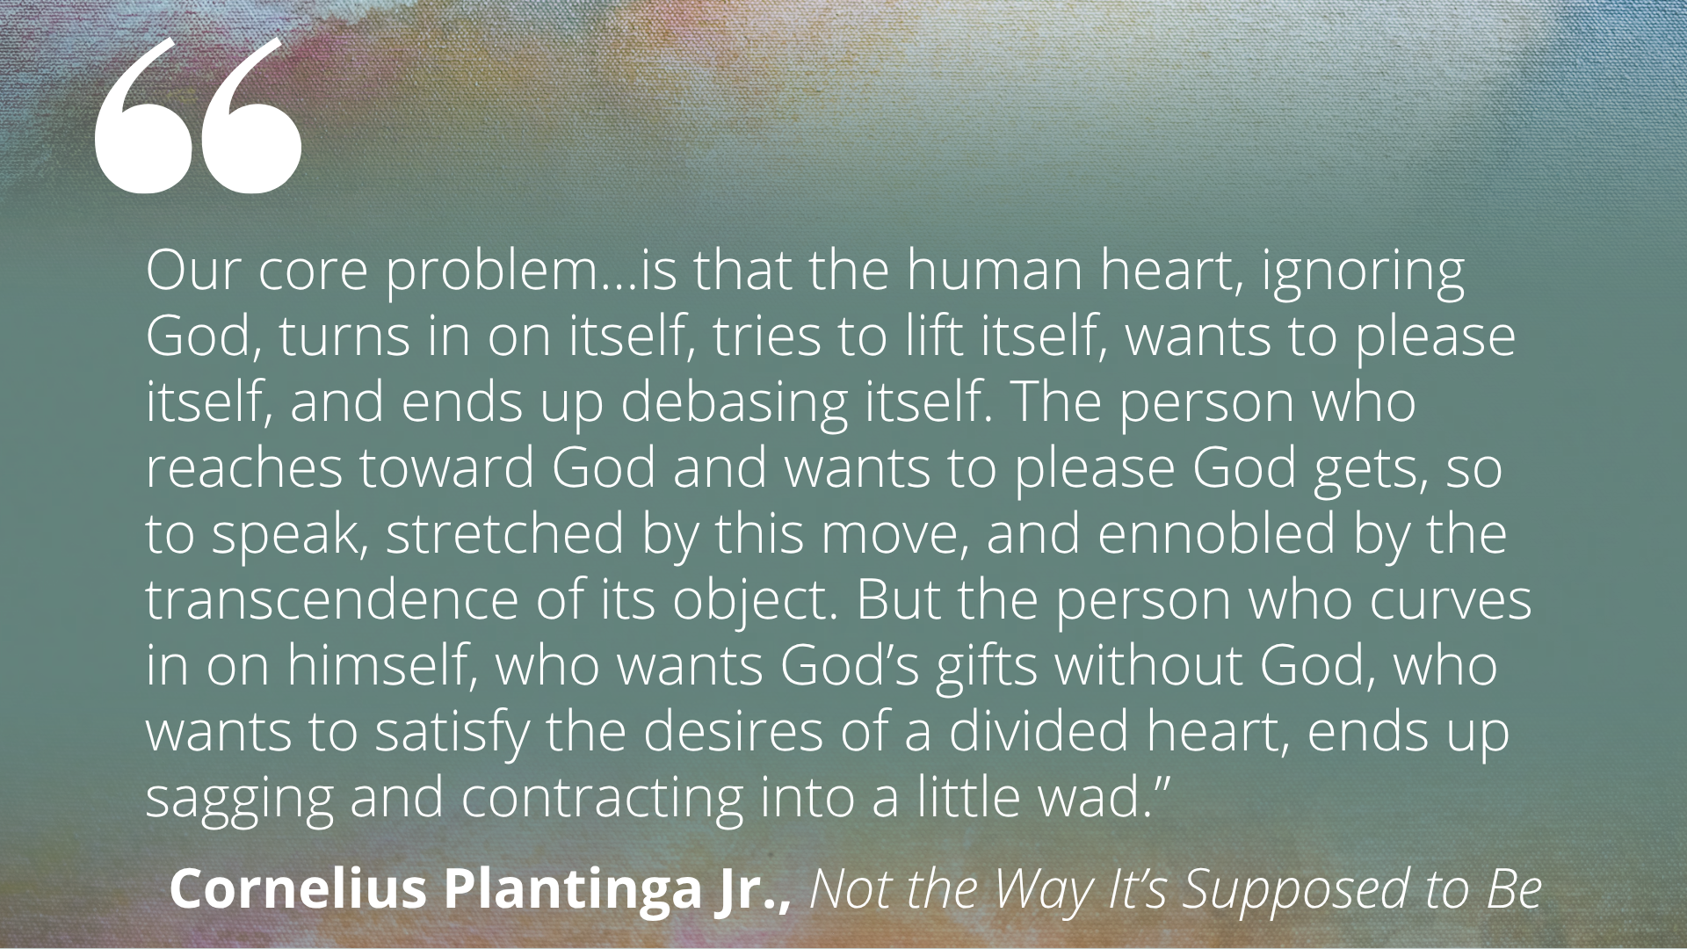
Notes:
Read quote
God has given us life and love and the potential for joy and flourishing. And we’ve all contributed to the corruption of God’s creation, so we owe him an immeasurable debt. But God in Christ has absorbed that debt. He’s offered us mercy if we’ll accept it. And when we receive it and we pursue what pleases God, it makes us better than we are and empowers us to do what is good and life-giving. But if we refuse it, we refuse his gift of life and give ourselves over to death. We can think our anger or resentment toward someone who has wronged us is really a punishment for them or a protection from them, but the old saying says “Resentment is like drinking poison and waiting for the other person to die.” Resentment ends up destroying us instead.

Slide 15
Notes:
ILLUSTRATION: Many of us are familiar with what happened in Nickel Mines, PA in 2006. A gunman shot ten children in an Amish schoolhouse, five of whom died, then he committed suicide. But instead of harboring resentment, the Amish community visited the killer’s immediate family and his parents, expressing sympathy for their loss and extending forgiveness to the murderer and his family. Their graciousness amazed many and led to calls for Americans to be more like that, more forgiving. But what enabled this community to forgive their enemy was because at the heart of their worship was a man who died for his enemies. Instead of following the selfish, entitled and retaliatory way of our culture (turning in on themselves), this Amish community followed the self-renouncing, forgiving way of our Lord (reaching up to the transcendent God).
See, in the parable, the servant is living at the mercy of the king, but acting like he’s the king and judge. But the thing that transforms a servant acting like a king, is seeing a king acting like a servant. Jesus came out of his judgment seat, put himself in the place of the accused, and went to the cross for our sake, bearing the weight of our sin. And this humbles us and moves us away from bitterness and anger and resentment because we know we’re at the mercy of God. But it empowers us to confront sin and injustice, knowing our deepest joy and hope is in Christ and he will bring ultimate restoration.
Forgiveness and justice come together on the cross. On the cross, sin and evil are not minimized – the gravity of them is realized as we watch the Son of God die. Jesus acts on behalf of the weak and oppressed and abused to overcome evil and uphold justice and free the enslaved. And we also hear the words of Jesus from the cross: “Father forgive them for they know not what they do.” Jesus doesn’t offer cheap grace (“oh, it’s okay, we’ll just move on”) or conditional grace (“I’ll forgive you if you show remorse”) or no grace not forgiving at all; Jesus offers costly grace. He absorbs the debt. And his resurrection promises that he will make all things right.
You know, when Peter first heard Jesus’ response to forgive infinitely, he mostly like couldn’t fully comprehend what Jesus was saying until he experienced the depth of God’s grace and forgiveness in his life. It wouldn’t be long after this before Peter deserts Jesus in his time of need and denies that he even knows Jesus. But, after that Peter will experience a transforming restoration.

Slide 16
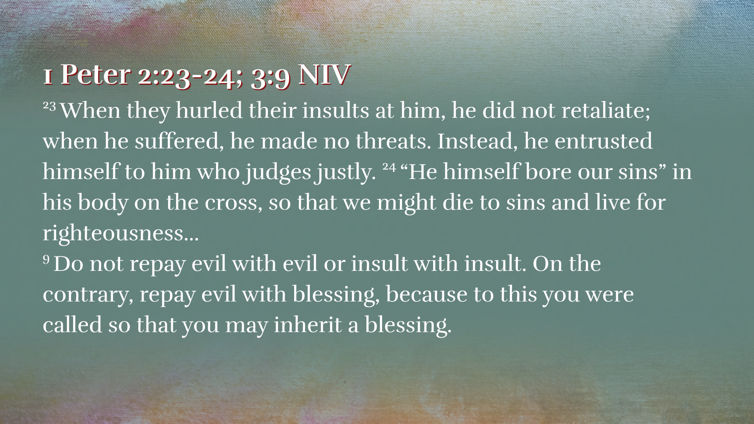
Notes:
Peter goes on to write this in one of his letters (READ verses)
Our power to forgive comes by way of the cross. Forgiveness is rarely easy or natural or quick. It may happen in phases. We may need the help of a friend or mentor or counselor. But forgiveness leads to healing. It frees us from resentment and opens the door for repair.
Rachel Denhollander is a former gymnast who was sexually assaulted multiple times by USA Gymnastics physician Larry Nassar. She was the first woman to publicly accuse Nassar of his abuse, leading hundreds of other women to come forward and share their stories. She’s a Christian and an advocate and she said this in the courtroom to the face of her abuser:

Slide 17
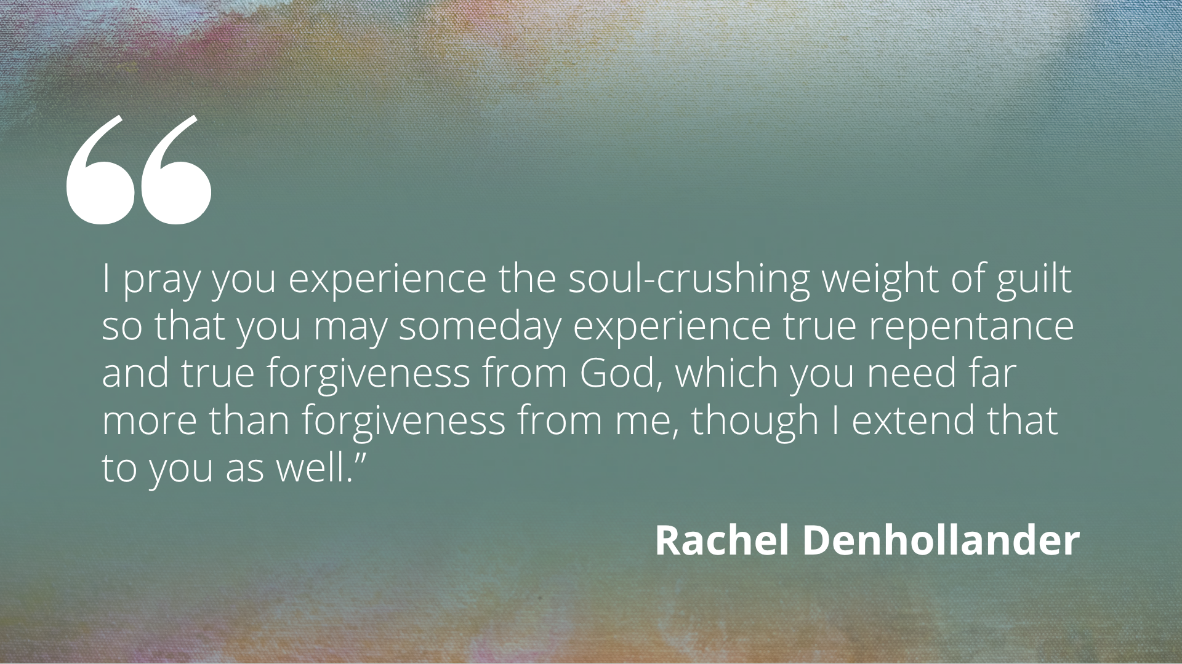
Notes:
Read quote
Forgiveness and justice coming together.

Slide 18
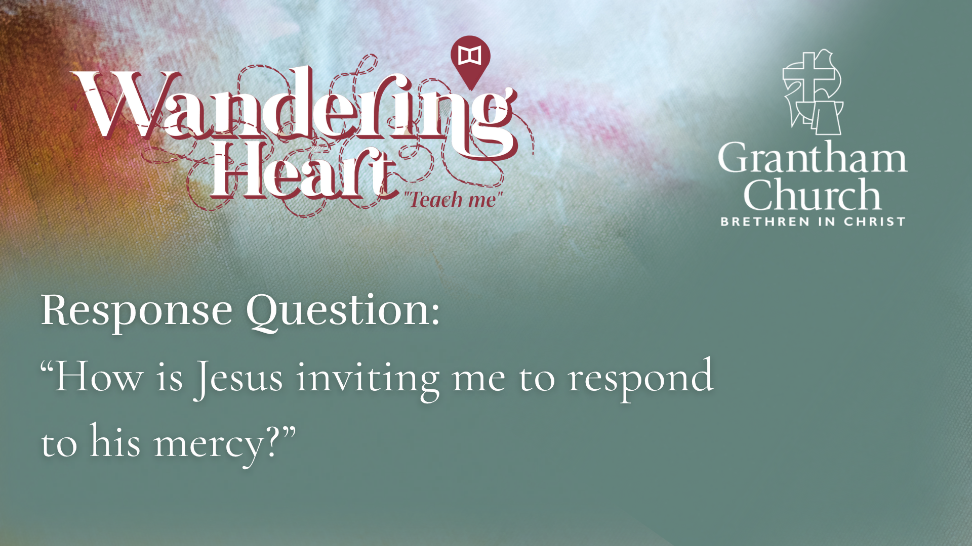
Notes:
Throughout this series we’ve been focusing on one response question each week. Today’s question is this: How is Jesus inviting me to respond to his mercy?
Think about God’s mercy. Think about the grace and forgiveness he offers through the cross. Have you received it? Have you let it change you? Is there a person or situation coming to mind where God might be compelling you to move toward forgiveness? What might that look like? Some of us may have really difficult and damaging experiences that God wants to work through with us. And for others, maybe there’s something that seems small that God is bringing to mind. Maybe it’s the seemingly insignificant grudge or someone who was rude to us or something bothering us. These little things can be like poison, festering and building and leading to greater destruction in you and in the community. So don’t ignore those things. Let’s take them to Jesus and receive his mercy.

Slide 19

Notes:
Pray

