Slide 1
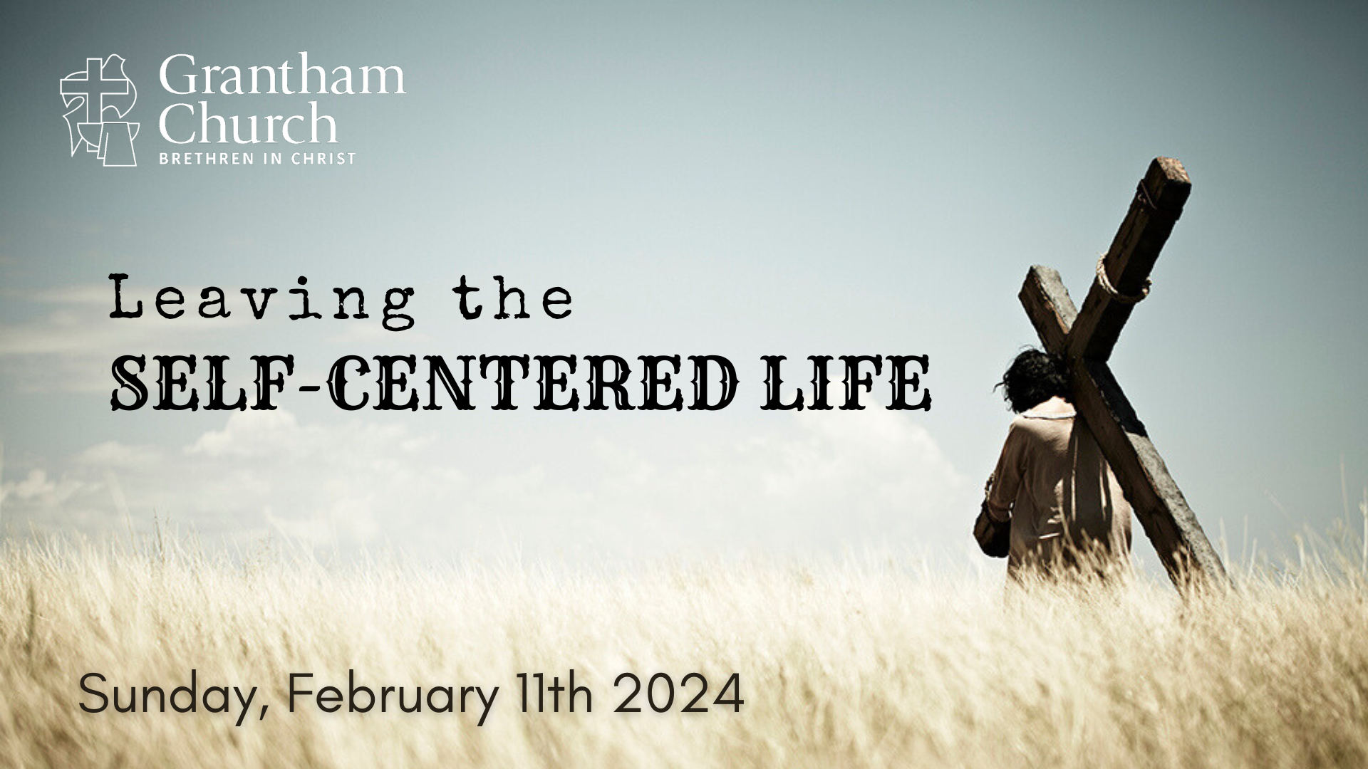
Notes:
[BRIEF INTRO]
This is the fourth and final week of addressing the results of an end-of-year congregational exercise where you said there were things you wanted to stop doing in 2024
So far, we’ve looked at winning the war on worry, work & rest in the way of Jesus, overcoming a critical and judgmental spirit… and this morning we’re addressing self-centeredness
It’s not hard to see that we live in a self-centered society that is making it increasingly difficult to listen well, to be patient and kind, to be empathetic, to want to help and serve others, and to discern the difference between facts and our feelings. What is happening in America? Why are we so self-centered? And what can we do to change course? So, this morning I’ll be inviting us to leave the self-centered life behind for a life that leads to true joy, peace, and freedom in Christ.
But before we go any further, let’s go to the Lord in prayer. [BRIEF PRAYER]
If you have a Bible, please open up to our main Scripture reading… [NEXT SLIDE]

Slide 2

Notes:
[INVITE CONGREGATION TO STAND FOR SCRIPTURE READING]
[READ PASSAGE]
“This is the Word of the Lord…. You may be seated.”
A week ago today was the 66th annual Grammy Awards. The Grammy Awards are regarded as the most prestigious and significant music awards in the world. To win a Grammy is considered one of the highest achievements that a musical artist can attain to in their career.
And without going into a lot of detail surrounding one of the acceptance speeches last Sunday evening, or even naming the person who said it (because it doesn’t matter who said it – it’s not about them or their music), let’s compare what we just read in Philippians 2 about the attitude and posture of Jesus with that of this quote from the award-winning artist… [NEXT SLIDE]

Slide 3
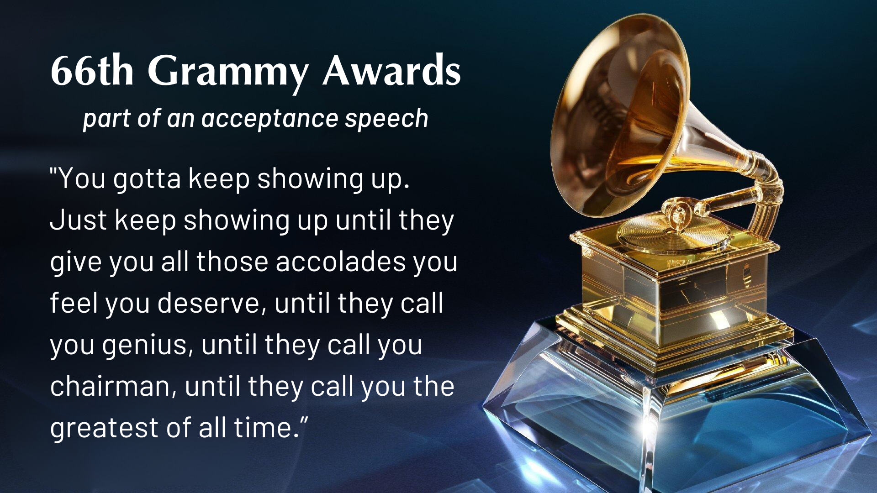
Notes:
This, along with the rest of the acceptance speech, has been praised all over the internet and in TV media as an “inspiring” speech. In context, the artist is actually “calling out” the judges for not making a better decision earlier in the show with who he thought deserved Album of the Year. And so, we have one very rich, famous, privileged person shaming judges on behalf of another rich, famous, privileged person, who by the way… that person he thought should have won is already the most awarded artist ever. But nevertheless, his words are praised. And we think this is wisdom.
This is where we are. And this is just a snapshot of the sort of celebrities and leaders that America idolizes, defends, applauds, and gets their ”wisdom” and life-coaching from. It’s about the attention, recognition, and accolades. It’s about what you feel that you deserve. Keep working hard… not because you enjoy it, not because you’re helping make the world a better place by sharing your gift, not because there is a God who wants us to live for his glory… no… none of that. You keep showing up because it’s about your ego, it’s about your title, it’s about what they will say when you’re gone. Why? Because it’s really all about you.
As disciples of Jesus, are we able to detect the error in this? And can we see that this is more evidence of our self-absorption and of individualism run amok in our country? You may recall a couple years ago I mentioned a book called… [NEXT SLIDE]

Slide 4

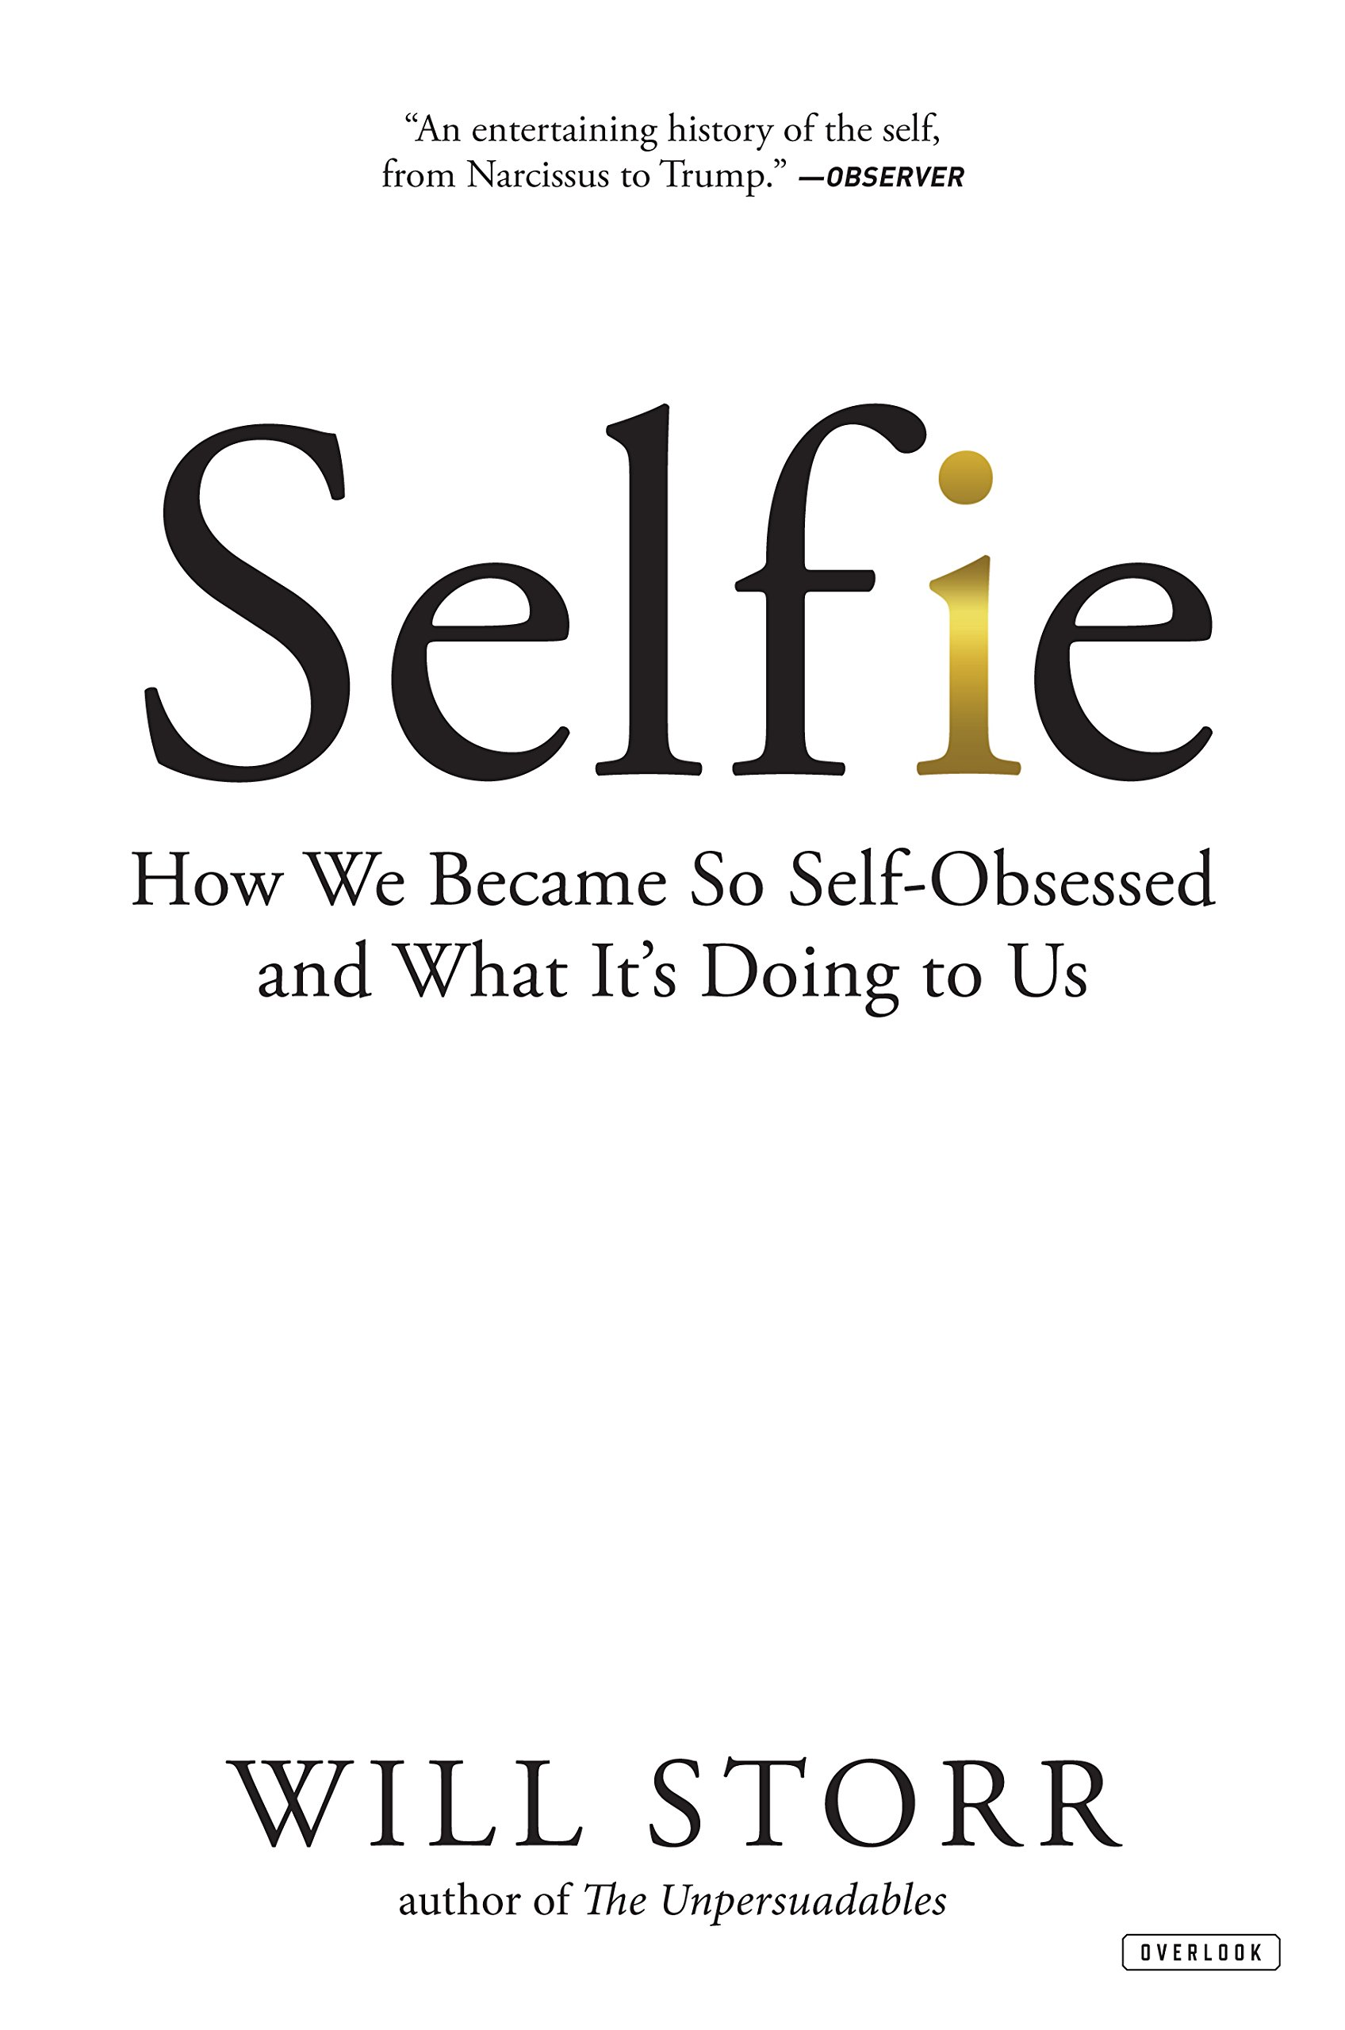
Notes:
Selfie: How We Became So Self-Obsessed and What It’s Doing to Us. In this book, the journalist and novelist Will Storr traces the history of individualism in the West and how we became such a self-absorbed nation. Until Ancient Greece (2,500 years ago), societies were collective in their thinking. But the geography of ancient Greece (i.e., many islands) impacted the Greek view of self, their psychology, their politics, and their economics—which then shaped all of Western thought, eventually the founding of our own country. So, rugged individualism (against a more collective, communal mindset) coupled with our own unique geography (isolating Americans from other nations, cultures, and ideas) set us on our current path.
And then, as Storr points out in his book, something happened in California in the 1980s that quickly backfired on us and has had some serious consequences. It was the “self-esteem” movement. After almost two millennia of the West being influenced by a Christian view of the self (that says that we are born sinners in need of a savior), some “me generation” hippies decided enough is enough. People don’t need to hear that they are “made in God’s image” but broken and not as they should be. That’s not helpful. It makes people feel bad and we want people to feel good about themselves.
And so, for the first time in human history, we say the reason that people misbehave and aren’t thriving isn’t because they think too much of themselves (which is what all other traditional cultures have said—i.e., hubris or pride was the root of all evil), but rather that we don’t think highly enough of ourselves. In fact, we all just need to see the “divine spark” in ourselves—that we’re all gods and goddesses.
Since then, the American collective conscience began to shift by positing that we’re all victims in some way and products of our biology, our upbringing, of evolution, and our environment (which notice… means that we no longer get to make moral judgments about people’s bad behavior). And so, we began to promote the idea that low self esteem is the reason for every social ill in American society (e.g., drug use, abuse, crime, etc.). Therefore, simply promoting a high self esteem was thought to be a social vaccine that would stimulate human health and productivity.
At the same time this is happening, we have the rise of neoliberalism in the 1980s, which meant deregulation, the dismantling of unions and protections for workers (gone are the days of trusting the company will take care of you for life), and essentially making one-to-one competition the defining characteristic of human relations. According to the American empire, human beings are just competitors and consumers. That’s it. And so, this pushes us further away from our neighbors, more toward hyper-individualism and an “every-man-for-himself” mentality. If you’re going to make it in this world, you better look out for yourself and do whatever you can to stand out and get ahead of the rest.
And where does this lead us? Well, we have found that hyper-individualism, stroking people’s egos, and not confessing our sins… partnered with secularism, neoliberalism, partisan politics, social media, and a smart phone with a self-facing camera… has led to the most self-obsessed, isolated, lonely, depressed, anxious, consumeristic, and exploitative culture on the planet.
And we have falsely believed that it’s through more self absorption (and getting what we feel that we deserve) that we will find life. But instead, as we all know, we keep coming up empty. Because that’s what happens when you try to find your identity, meaning, purpose, and your sense of self-worth in anything other than the Creator: you become a self-centered, self-absorbed, narcissistic, feelings-driven person with a God-complex. So, what insights do the Scriptures offer us… [NEXT SLIDE]

Slide 5
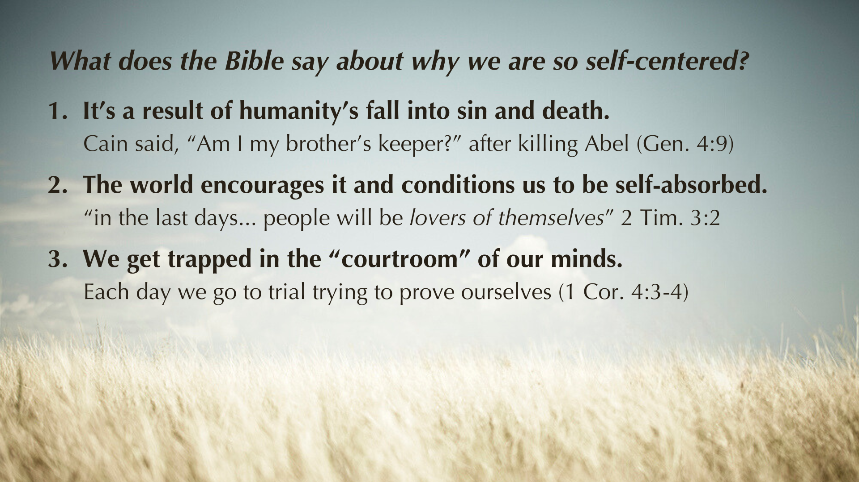
Notes:
[READ & BRIEF COMMENT ON EACH POINT]
It’s a result of humanity’s fall into sin and death.
Cain said, “Am I my brother’s keeper?” after killing Abel (Gen. 4:9)
2. The world encourages it and conditions us to be self-absorbed.
“in the last days... people will be lovers of themselves” 2 Tim. 3:2
3. We get trapped in the “courtroom” of our minds.
Each day we go to trial trying to prove ourselves (1 Cor. 4:3-4)
Listen to what Paul wrote to the Corinthians… [NEXT SLIDE]

Slide 6
Paul, 1 Corinthians 4:3-4 NIV
³ I care very little if I am judged by you or by any human court; indeed, I do not even judge myself.
⁴ My conscience is clear, but that does not make me innocent. It is the Lord who judges me.
Notes:
[READ PASSAGE & COMMENT]
Paul is saying I don’t care what you think, but you know what… I don’t care what I think. I have a low opinion of what you think about me, but I also have a low opinion of what I think about me. You see… Paul has disciplined himself to leave the courtroom of his mind. Now folks, that’s much different than the attitude many Americans have when they say, “I don’t really care what you think.” Which we often say just to protect our ego. And so, what happens is we go on living with thin skin and can’t receive any criticism. Therefore, we fail to listen or learn from what God may be saying to us through others, and we miss an opportunity to root our identity in the Lord himself. We miss the lesson that Paul had learned.
You see, here is the problem with trying to solve our ego problem in the way of the world. The world does not know how to heal low self-esteem (or self loathing & self-hatred) except with puffing ourselves up with pride. That is why I say don’t fall into the trap of high self-esteem or me-centered living. It’s a trap because (1) it’s still taking from the wrong tree; and (2) you can still feel good about yourself while believing something wrong or behaving badly. People do it all the time. Again, that’s why we need something more than the constant inflating and deflating of our ego with the temporary hot air of the world. Instead, we need our souls filled with something solid and life-giving. More specifically, to be given a new identity by being filled with more of Jesus. The Jesus who said this to his followers… [NEXT SLIDE]

Slide 7
Mark 8:34-35 NIV – The Way of the Cross
³⁴ Whoever wants to be my disciple must deny themselves and take up their cross and follow me. ³⁵ For whoever wants to save their life will lose it, but whoever loses their life for me and for the gospel will save it.
Notes:
[BRIEF COMMENTS]
v. 34 – “say no” to doing whatever you want (the easy road, the selfish way, the one that benefits you); “take up your cross” means there are sacrifices that need to be made to follow Christ. There is a cost, but it’s worth it!
v. 35 – Put another way: “For whoever wants to operate out of self-preservation and self-absorption will not truly live. But whoever follows in the Jesus way will discover real fulfillment and salvation.”
We know this, if we’re honest with ourselves. The natural state of the human self (the ego) is empty. It’s fragile and always feeling inadequate. So, it’s busy seeking to find meaning and purpose apart from God, or with God plus something else. That’s what the Tree of the Knowledge of Good and Evil was all about—us trying to find life apart from the one way we were created to receive it. And that’s why we must deny ourselves and walk in the new identity and purpose that Jesus offers us.
Remember what Paul wrote in Galatians chapter 2, verse 20… [NEXT SLIDE]

Slide 8
My old self has been crucified with Christ. It is no longer I who live, but Christ lives in me. So, I live in this earthly body by trusting in the Son of God, who loved me and gave himself for me.
Paul, Galatians 2:20 NLT
Notes:
[READ & COMMENT]
This is a divine reality, church. When you receive Christ as Lord, you are a new person. By the cross of Christ, you have come alive to God and received his very life in you. This means, as Paul said in Romans 8 verse 1, there is now no condemnation. The verdict is in: You’ve been forgiven and set free. You have God’s favor (not because of anything you’ve done) and so you can now live freely out of God’s mercy, grace, and love. You have nothing to earn and nothing to prove. You are freed to live a life of love and service to others.
But listen… you’ve believed lies for a long time. You’re made in God’s image but broken and not as you should be. You’re a sinner, but you have a savior. And the world won’t tell you that. Because you’ve been conditioned to believe differently by a self-obsessed culture. Your flesh will want to find another way. Don’t do it. Deny yourself as you follow Jesus and immerse yourself in this truth again and again and again—meditate on it, pray about it with friends, sing it in worship, hear it through the preaching of the Scriptures and live into it through the liturgies of the church.
And slowly but surely, you’ll be able to respond to the hurt feelings of your fragile ego with “I know who I am. I’m a son or daughter of the King.” And then, you’ll be able to let God fill your emptiness with the joy that comes by putting others first—by loving others when you just want to withhold that love, and by living for others when you don’t get what you feel that you deserve. Because we know that in the Kingdom, the way up is down; the way to wholeness is through selflessness, and the way to peace, joy, and freedom is through serving others. That’s the humble way of Jesus.
And as we’ve heard Rick Warren say before… [NEXT SLIDE]

Slide 9
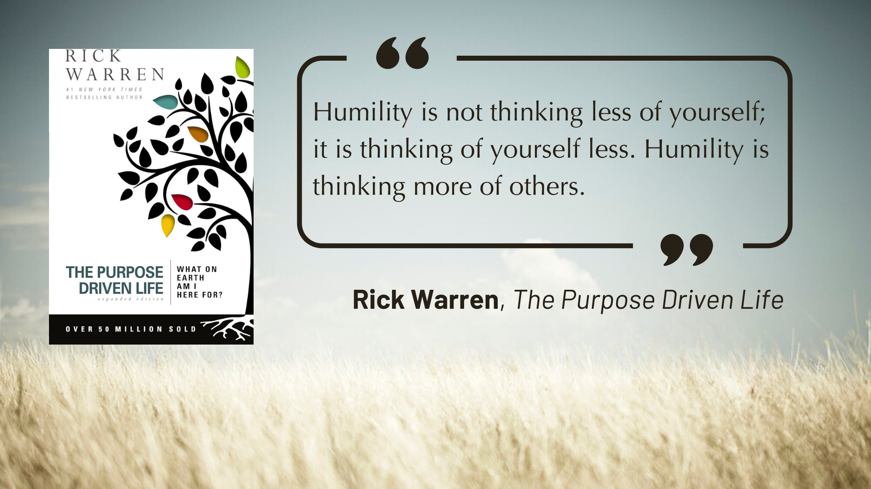
Notes:
[READ QUOTE & COMMENT]
So… how do we leave the self-centered life behind?
Let’s answer that and summarize the message in a few steps… [NEXT SLIDE]

Slide 10
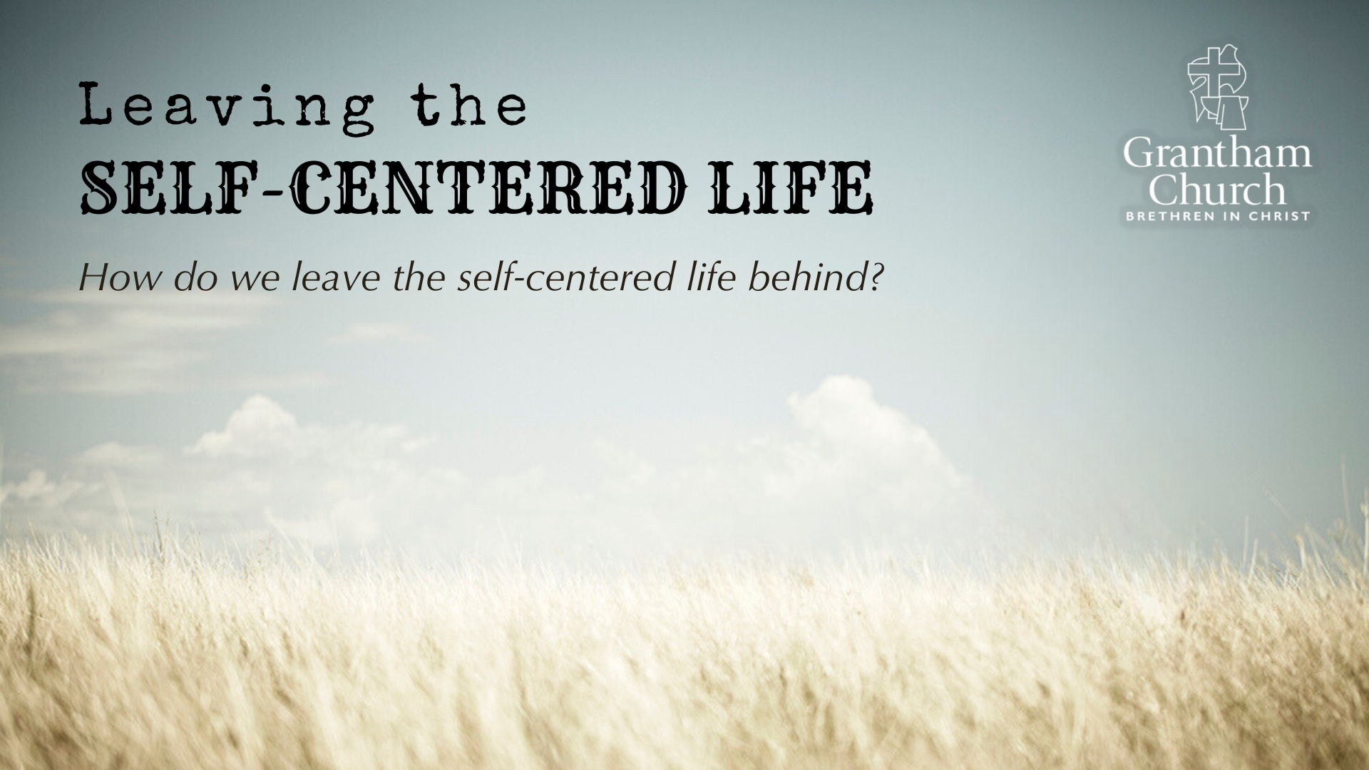

Slide 11
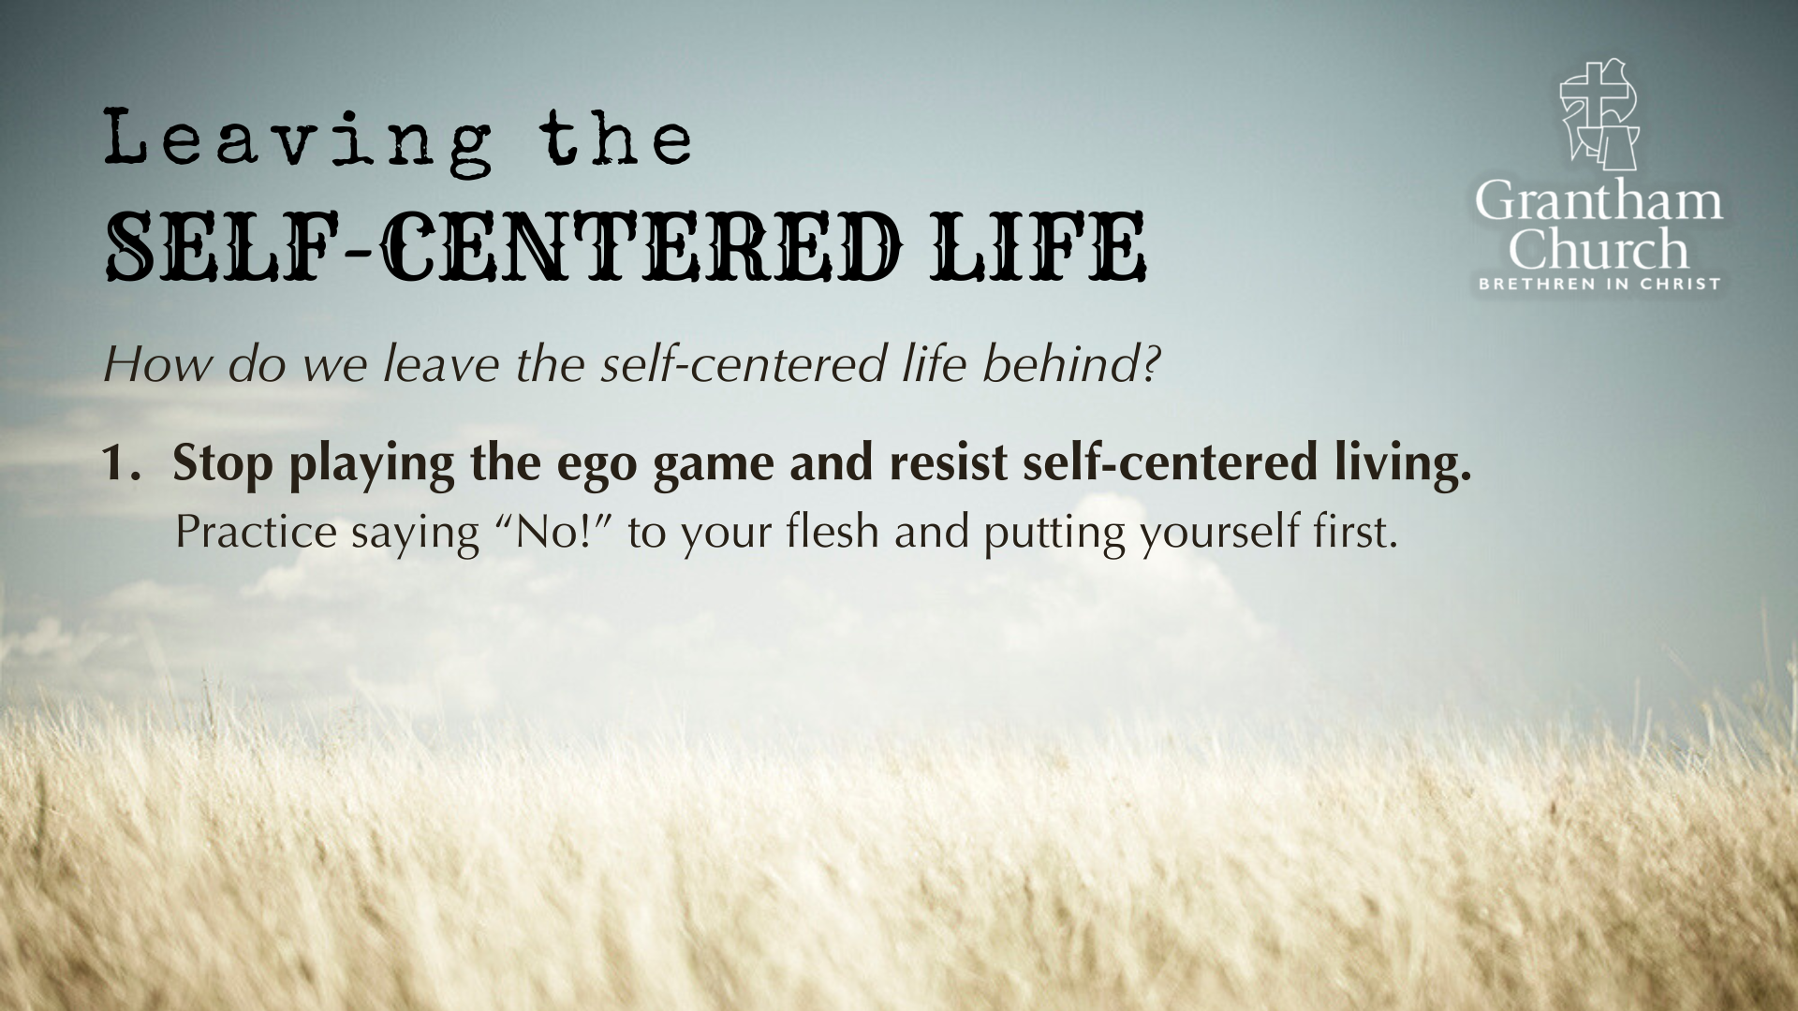

Slide 12
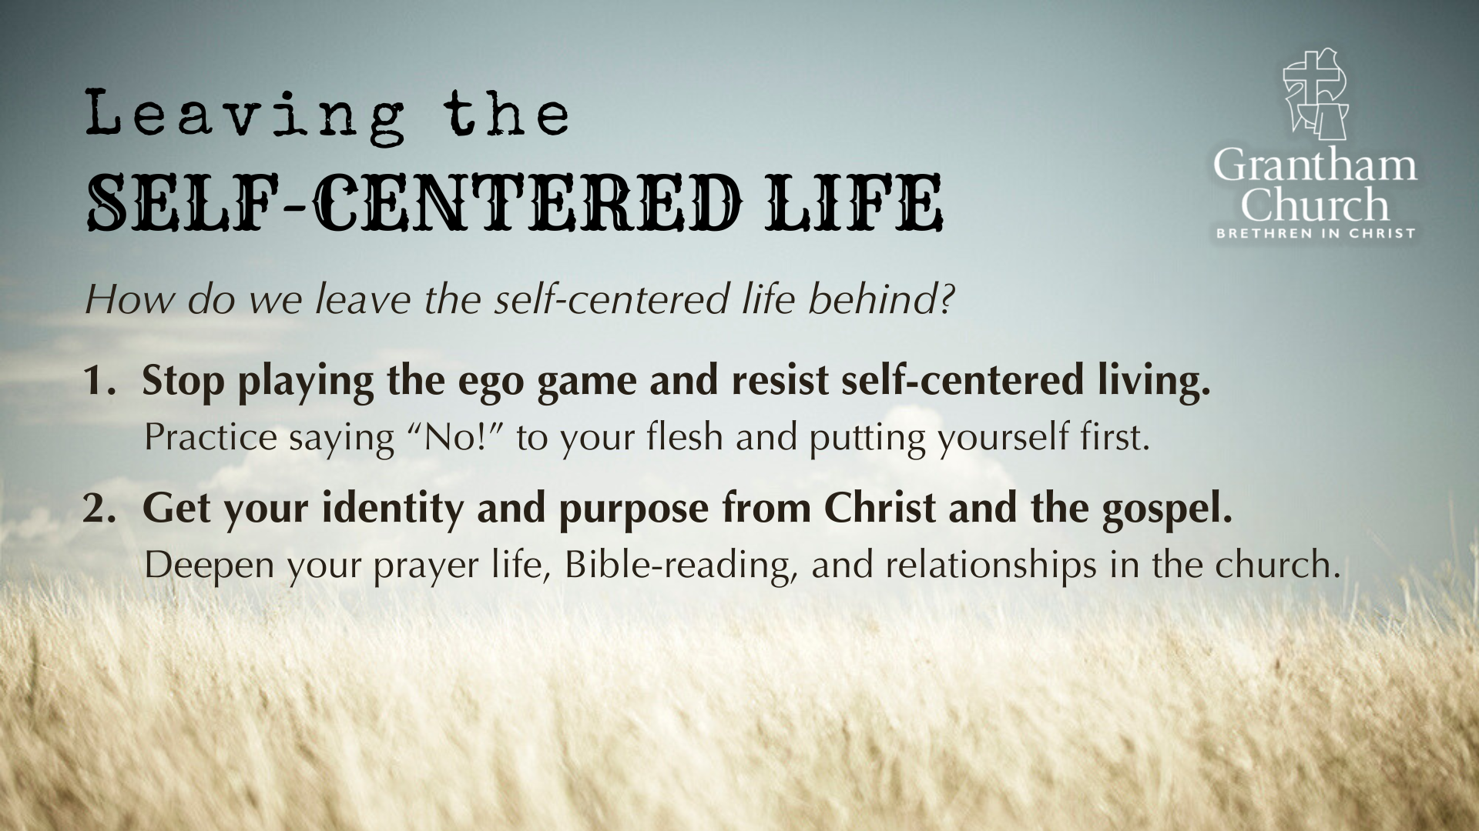

Slide 13
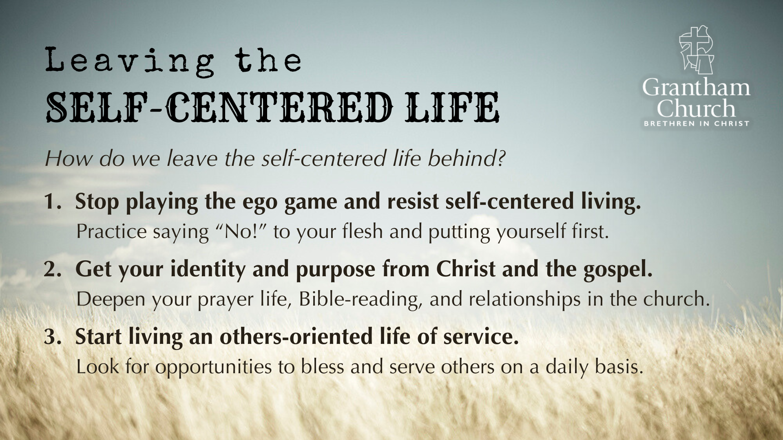
Notes:
[READ & BRIEF COMMENTS ON EACH POINT]
1. Stop playing the ego game and resist self-centered living.
Practice saying “No!” to your flesh and putting yourself first.
2. Get your identity and purpose from Christ and the gospel.
Deepen your prayer life, Bible-reading, and relationships in the church.
3. Start living an others-oriented life of service.
Look for opportunities to bless and serve others daily.
In Galatians, 5:13, Paul said, “You, my brothers and sisters, were called to be free. But do not use your freedom to indulge the flesh; rather, serve one another humbly in love.”
Finally, here are some questions to help us reflect and respond to what the Spirit is saying to us through this message this morning… [NEXT SLIDE]

Slide 14
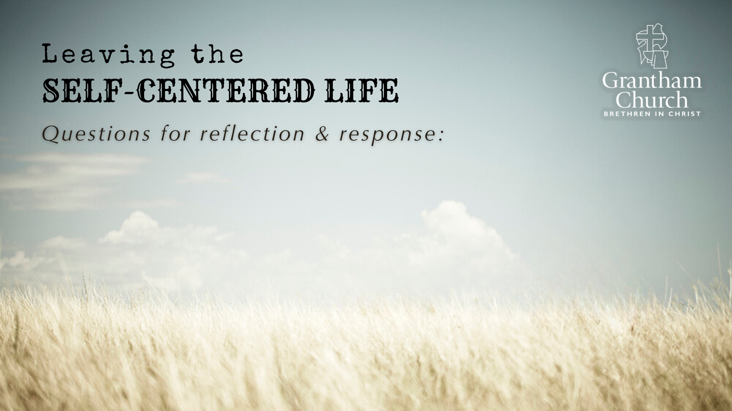

Slide 15
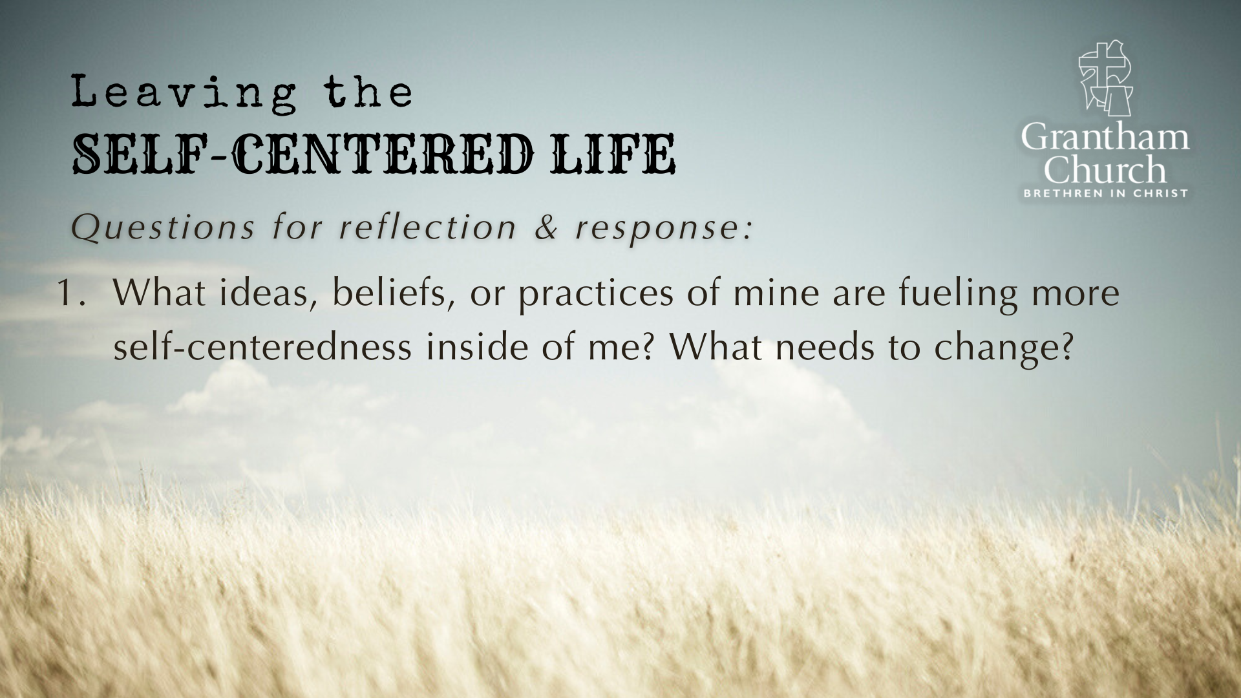

Slide 16
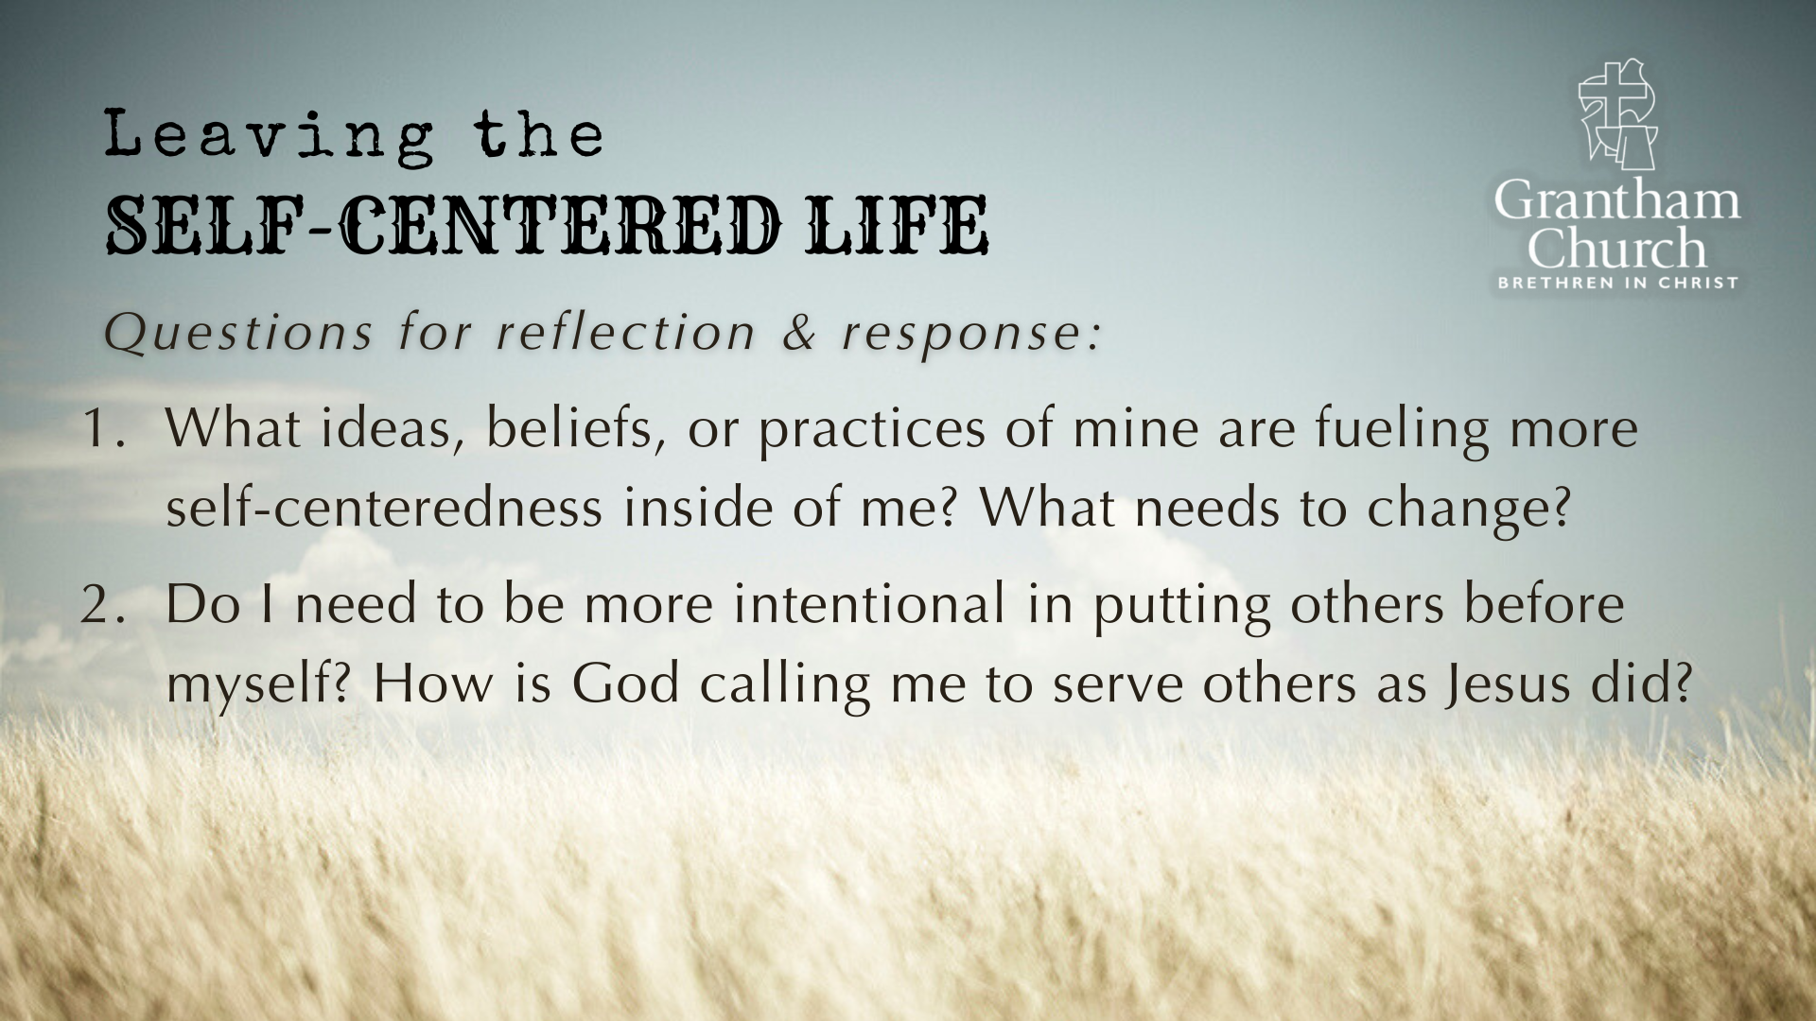

Slide 17
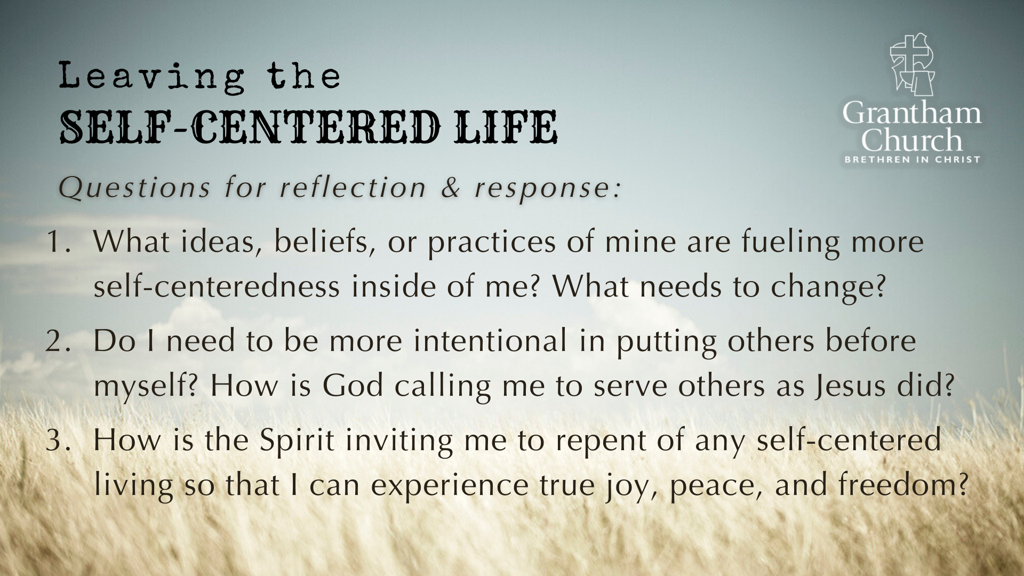
Notes:
[READ & COMMENT ON EACH QUESTION]
What ideas, beliefs, or practices of mine are fueling more self-centeredness inside of me? What needs to change?
Do I need to be more intentional in putting others before myself? How is God calling me to serve others as Jesus did?
How is the Spirit inviting me to repent of any self-centered living so that I can experience true joy, peace, and freedom?
Let’s pray… [NEXT SLIDE FOR CLOSING PRAYER]

Slide 18
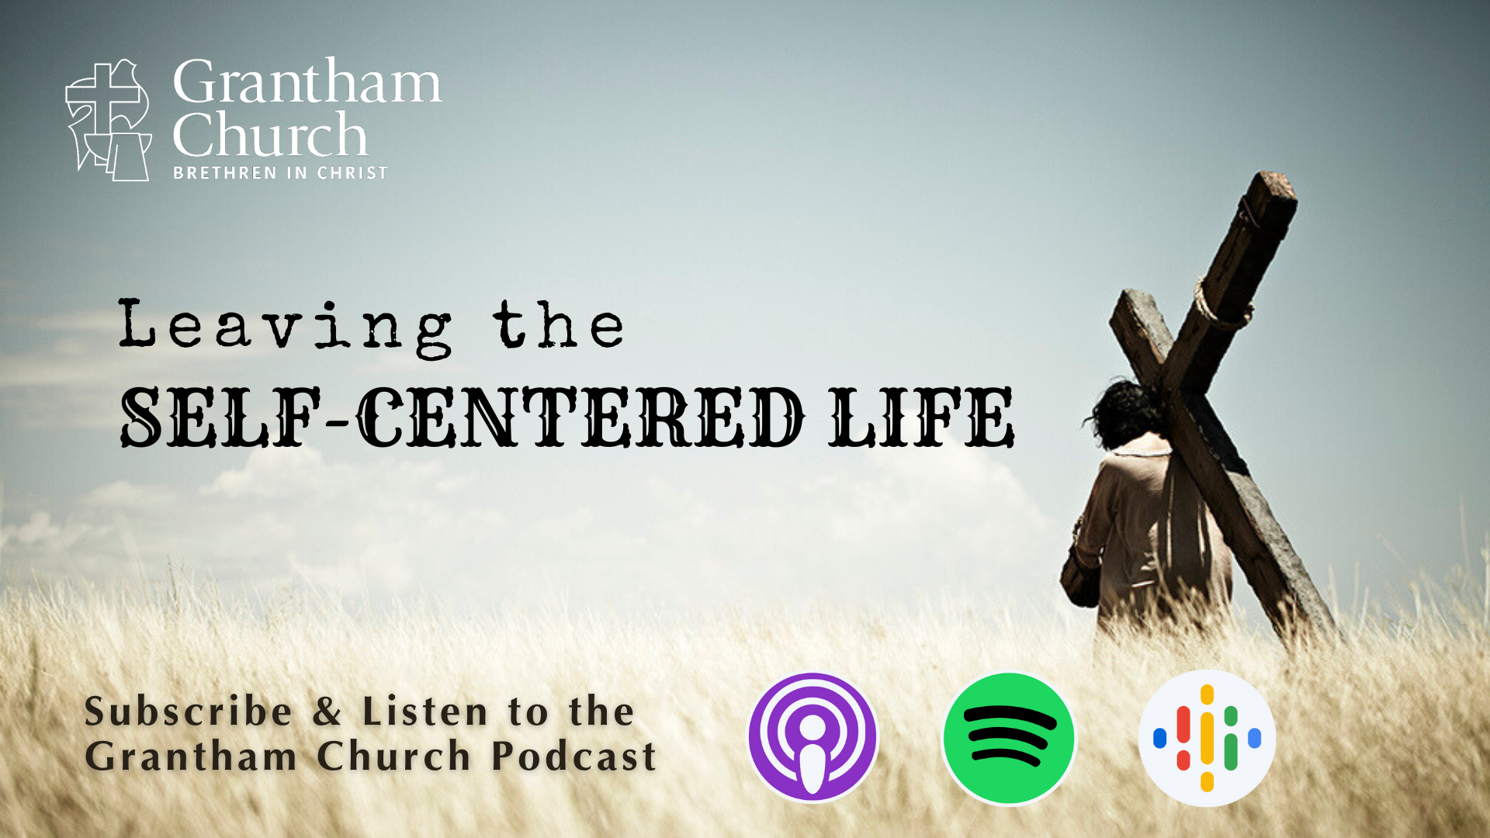
Notes:
[CLOSING PRAYER]
Benediction
In anxiety may you find peace
In sadness may you find comfort
In sickness may you find healing
In loneliness may you find community
In busyness may you find stillness
In listening may you find wisdom
In following may you find hope
And in the One who meets all our needs
May you find rest.

