Slide 1
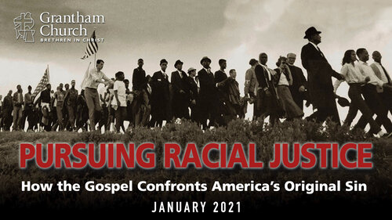

Slide 2

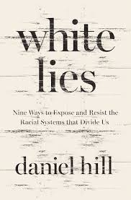
Race and the Church
“What we’re up against isn’t segregation. That’s a symptom of the disease. The disease is white supremacy. To love Jesus is to hate white supremacy.” – Daniel Hill

Slide 3
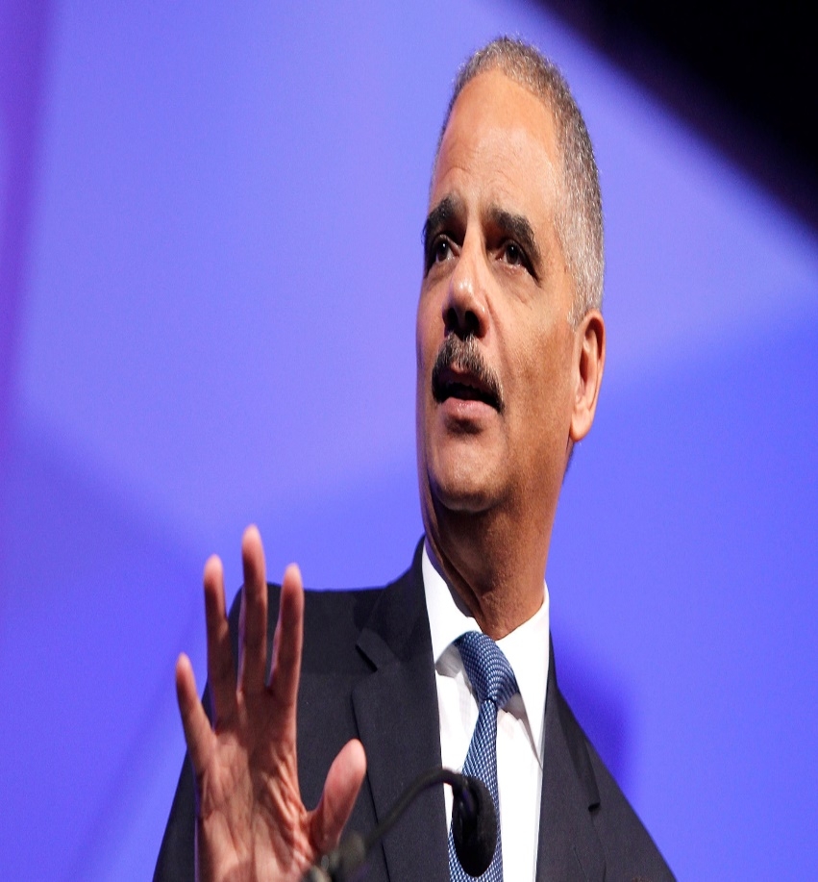
Can we talk?
“Though this nation has proudly thought of itself as an ethnic melting pot, in things racial we have always been and continue to be, in too many ways, essentially a nation of cowards.”
Former A.G. Eric Holder

Slide 4
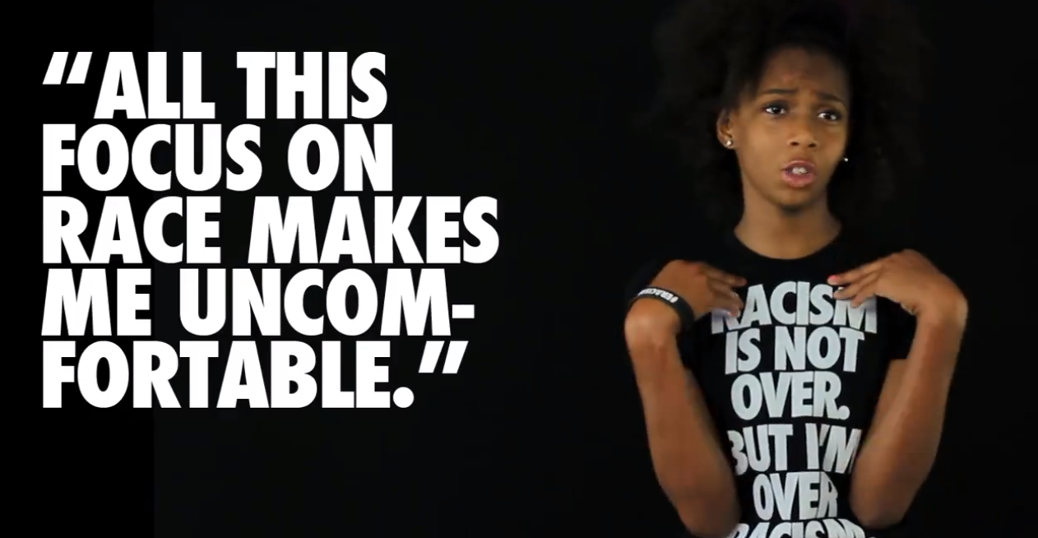
Race conversation starters
How have your life experiences shaped the way(s) you think about race? How would you characterize the state of race relations in the United States today? Why? What makes it easy to talk about race? Difficult?

Slide 5


Slide 6
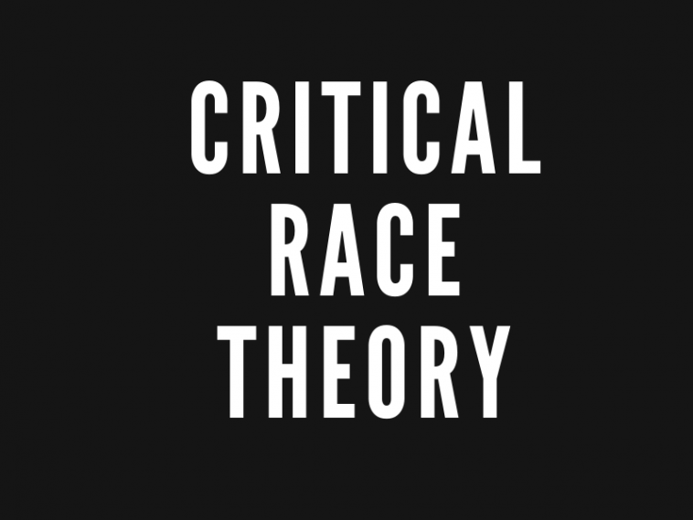
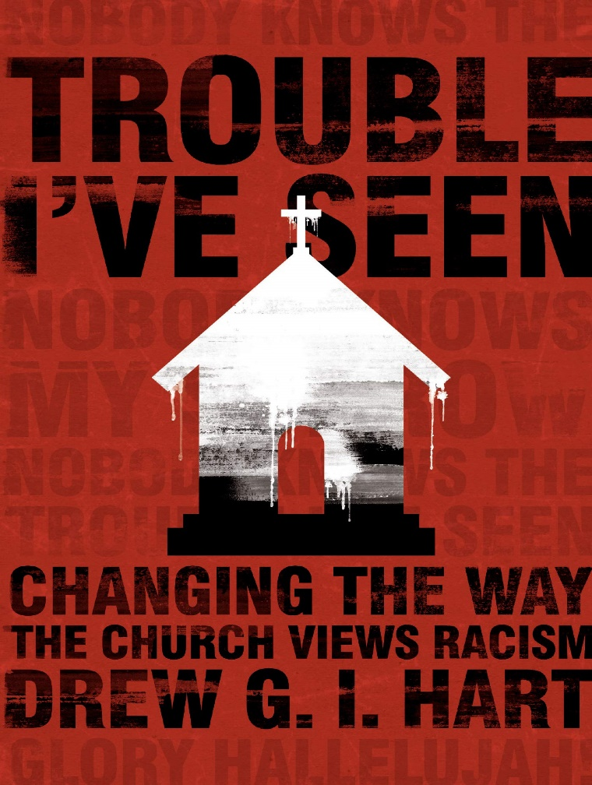
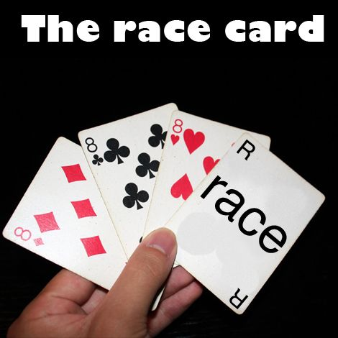
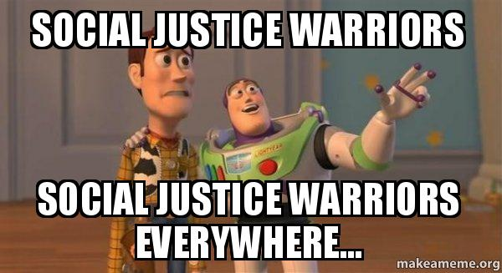
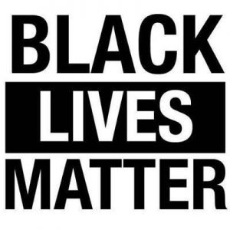
Race conversation stoppers
“We aren’t playing the race card; we are analyzing the racialized deck.”
Drew Hart

Slide 7
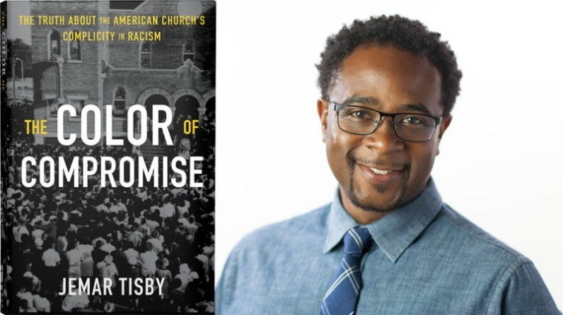
“History and Scripture teach us that there can be no reconciliation without repentance. There can be no repentance without confession. And there can be no confession without truth.”
-Jemar Tisby

Slide 8
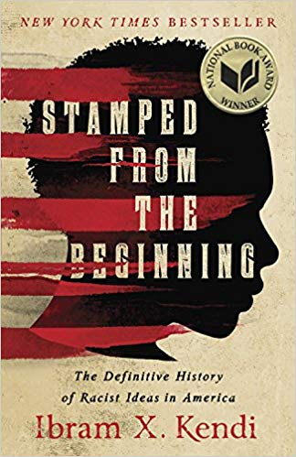
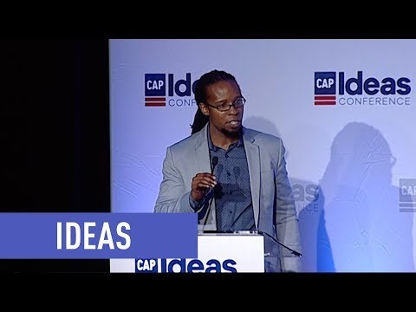
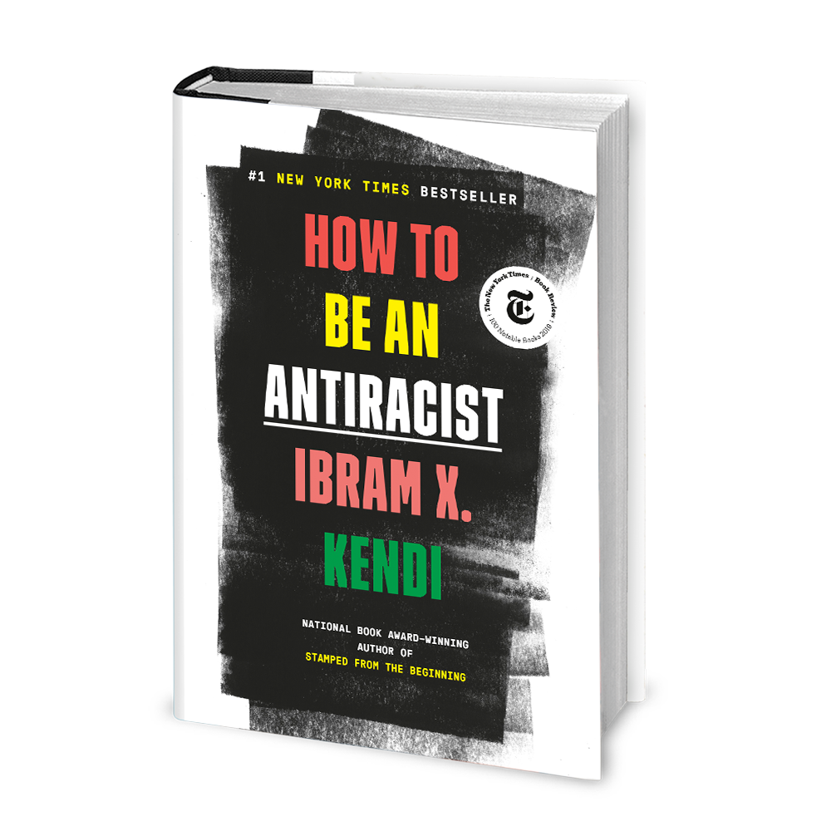
Creating a Story of Race

Slide 9
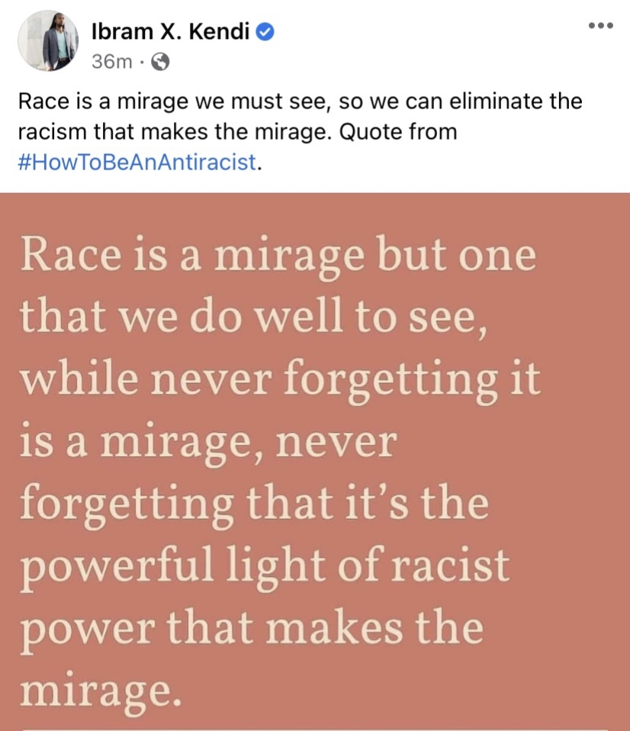
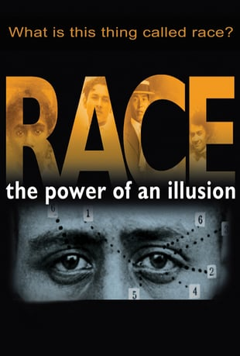
Notes:
“Commonly refers to certain physical similarities, such as skin color or eye shape, that are shared by a group of people and are used to mark or separate them from others.”

Slide 10
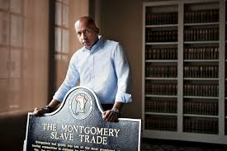
The narrative of racial difference
“We have committed ourselves in this country to silence about our history, to ignorance about our history, to denying our history. And that’s the first part of this relationship that has to be repaired. We’ve got to be willing now to talk honestly about who we are and how we got here.”
Bryan Stevenson

Slide 11
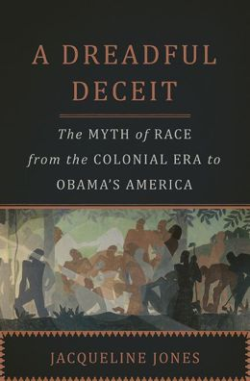
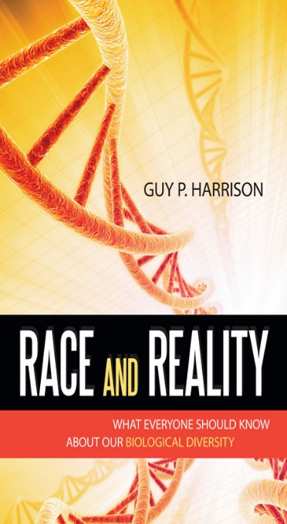
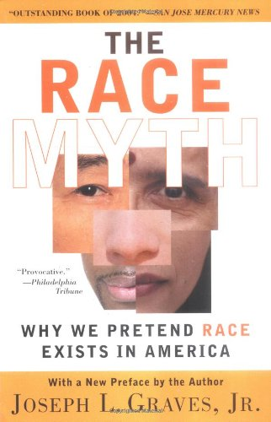
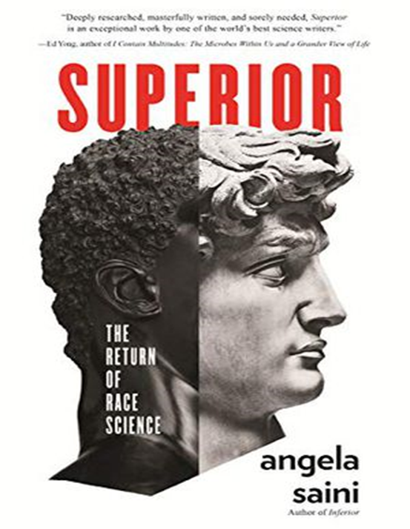
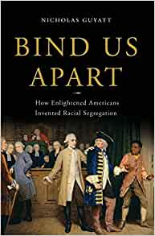
“Race belief rests upon a foundation of mistakes, lies, ignorance, pseudoscience, and delusion.”
Guy Harrison

Slide 12

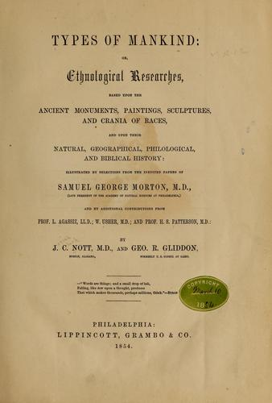
Pseudo-Science of Race
Notes:
Scientific racism is the use of ostensibly scientific or pseudo-scientific techniques and hypotheses to support or justify the belief in racial inferiority or racial superiority.

Slide 13
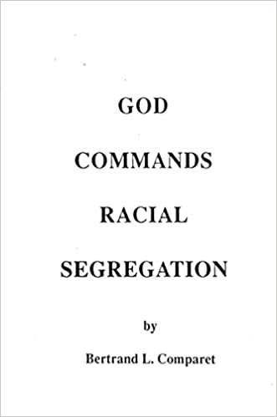
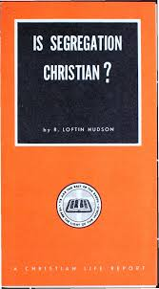
“If God Almighty had intended the two races to be equal, He would have so created them.”
Notes:
Birth of a Nation-DW Griffith
See: The Color of Compromise

Slide 14
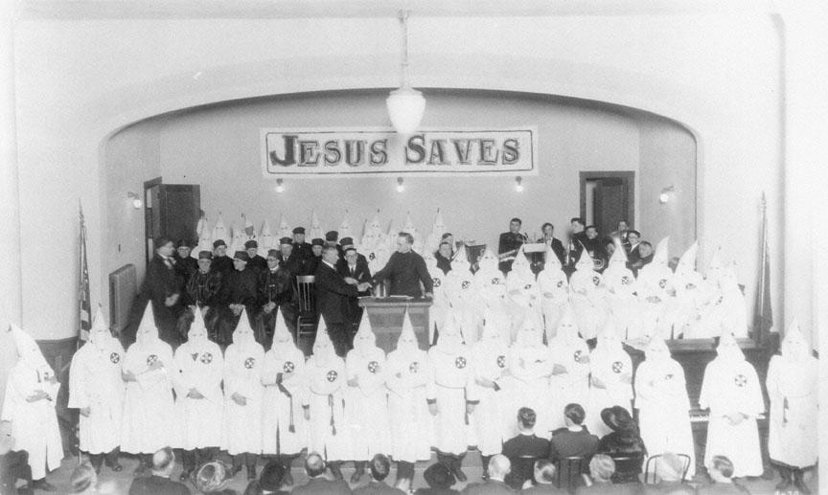

Slide 15
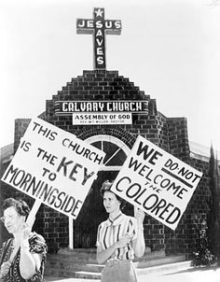
“God forgives murder and he forgives adultery. But he is very angry and he actually curses all who do integrate.”
-Anonymous

Slide 16
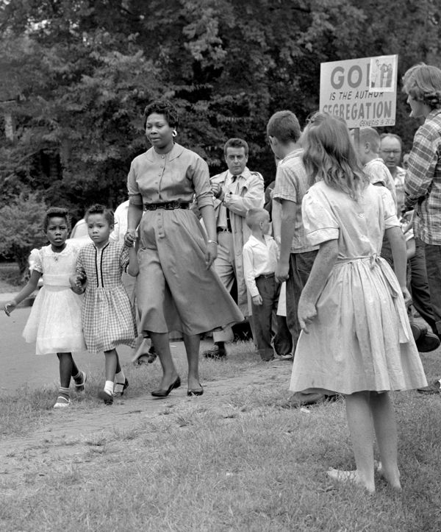

Slide 17
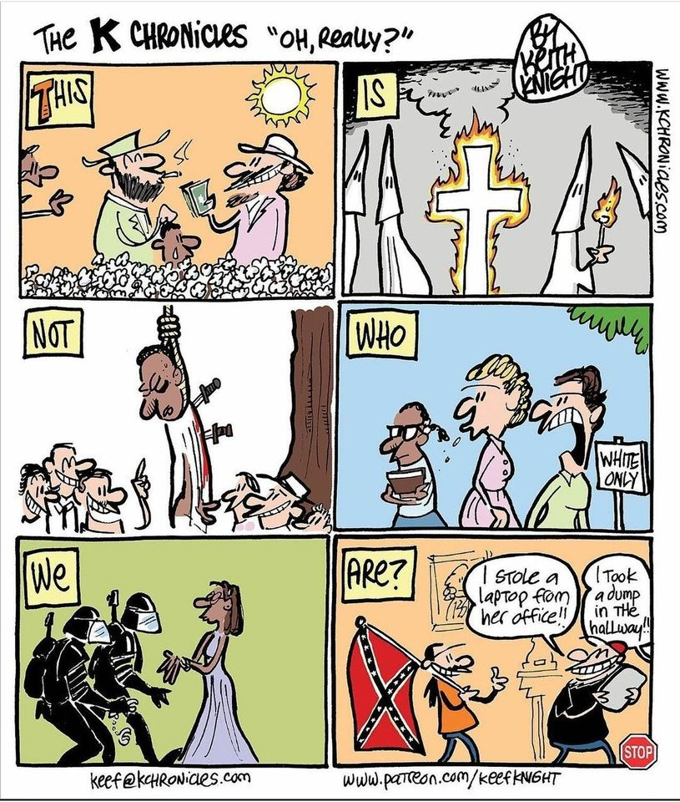

Slide 18
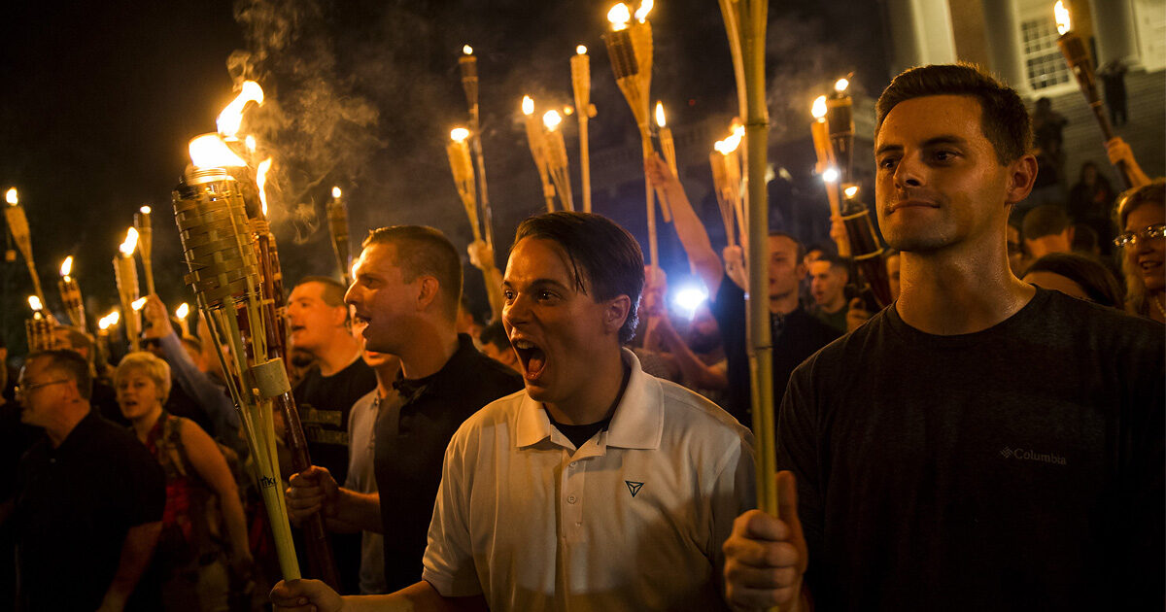

Slide 19
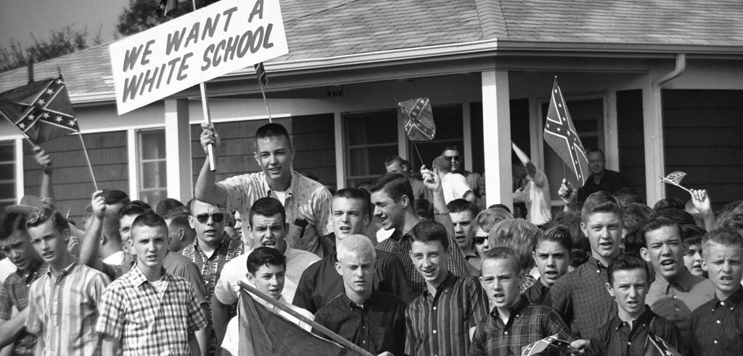

Slide 20
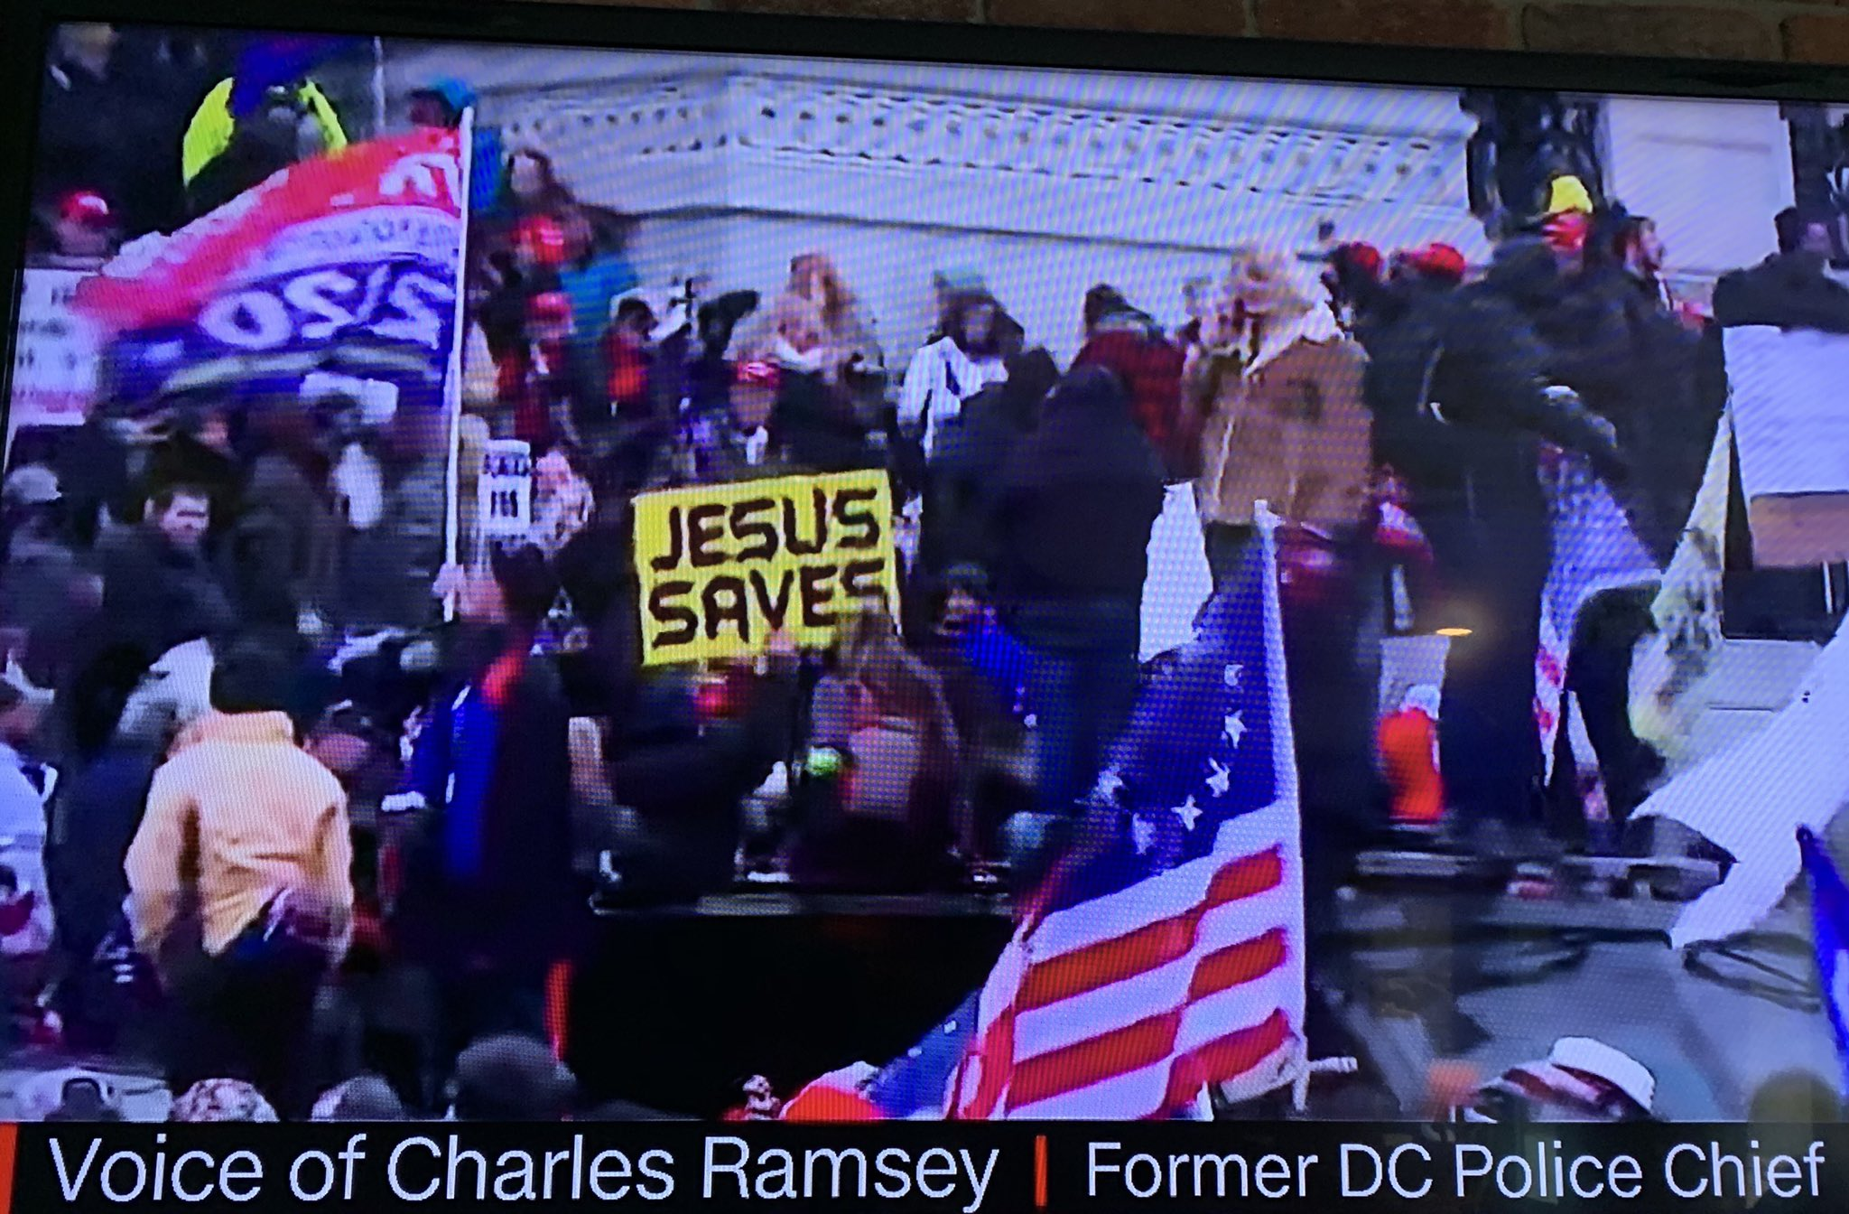
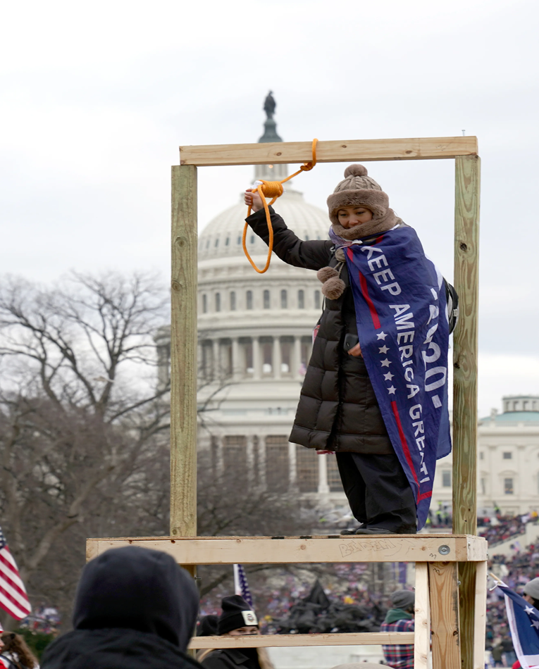
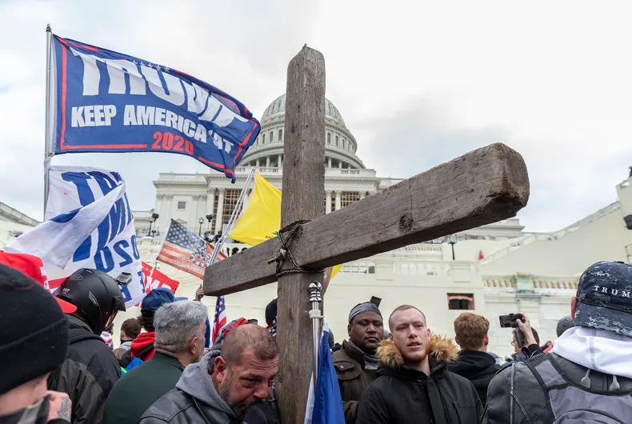
Notes:
Among the crowds last week were symbols and signs of “the faith”…echoes of an earlier era of white Christian nationalism.
TM Garrett’s response

Slide 21
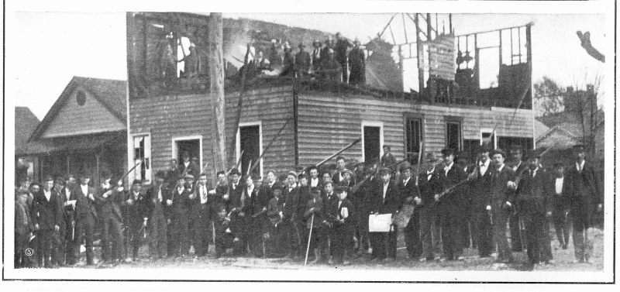
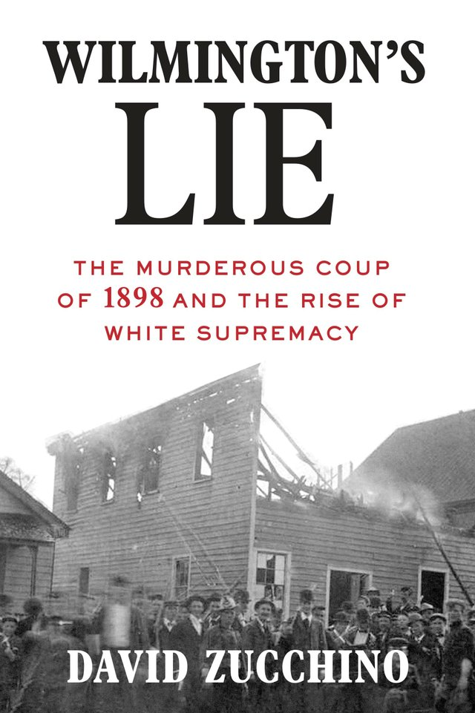
Notes:
he Wilmington insurrection of 1898, also known as the Wilmington massacre of 1898 or the Wilmington coup of 1898,^{[6]} was a mass riot and insurrection carried out by white supremacists in Wilmington, North Carolina, United States, on Thursday, November 10, 1898.^{[7]} Though the white press in Wilmington originally described the event as a race riot caused by Black people, as more facts were publicized over time, it came to be seen as a coup d'état, the violent overthrow of a duly elected government, by a group of white supremacists.
Multiple causes brought it about.^{[a]} The coup occurred after the state's white Southern Democrats conspired and led a mob of 2,000 white men to overthrow the legitimately elected local Fusionist government. They expelled opposition Black and white political leaders from the city, destroyed the property and businesses of Black citizens built up since the Civil War, including the only Black newspaper in the city, and killed an estimated 60 to more than 300 people.^{[2][3][4][5]} It has been described as the only incident of its kind in American history,^{[14][15]} because other incidents of late-Reconstruction Era violence did not result in the direct removal and replacement of elected officials by unelected individuals.
The Wilmington coup is considered a turning point in post-Reconstruction North Carolina politics. It initiated an era of more severe racial segregation and effective disenfranchisement of African Americans throughout the South, a shift which had been underway since the passage of a new constitution in Mississippi in 1890 which raised barriers to the registration of Black voters. Laura Edwards wrote in Democracy Betrayed (2000): "What happened in Wilmington became an affirmation of white supremacy not just in that one city, but in the South and in the nation as a whole", as it affirmed that invoking "whiteness" eclipsed the legal citizenship, individual rights, and equal protection under the law that Black Americans were guaranteed under the Fourteenth Amendment.[

Slide 22

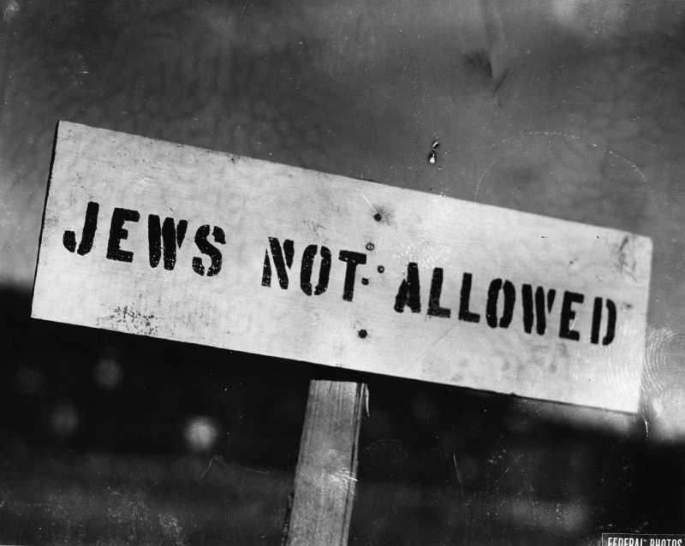
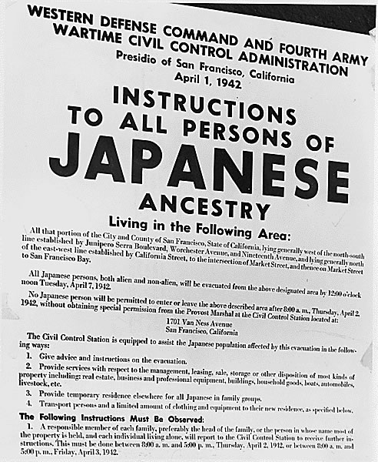
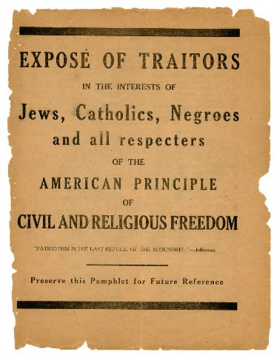
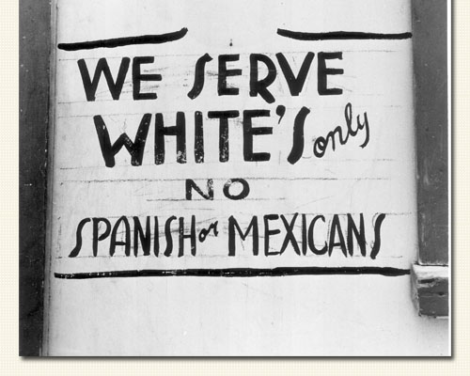

Slide 23
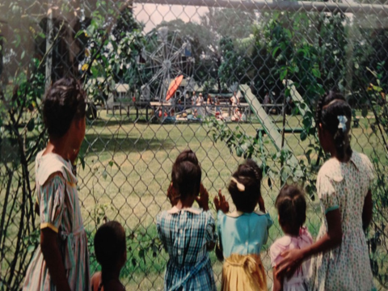

Slide 24
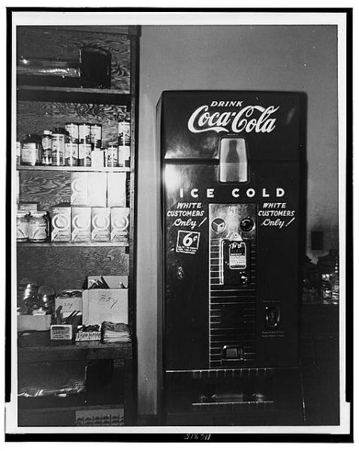
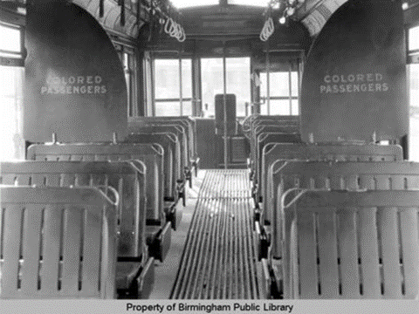

Slide 25
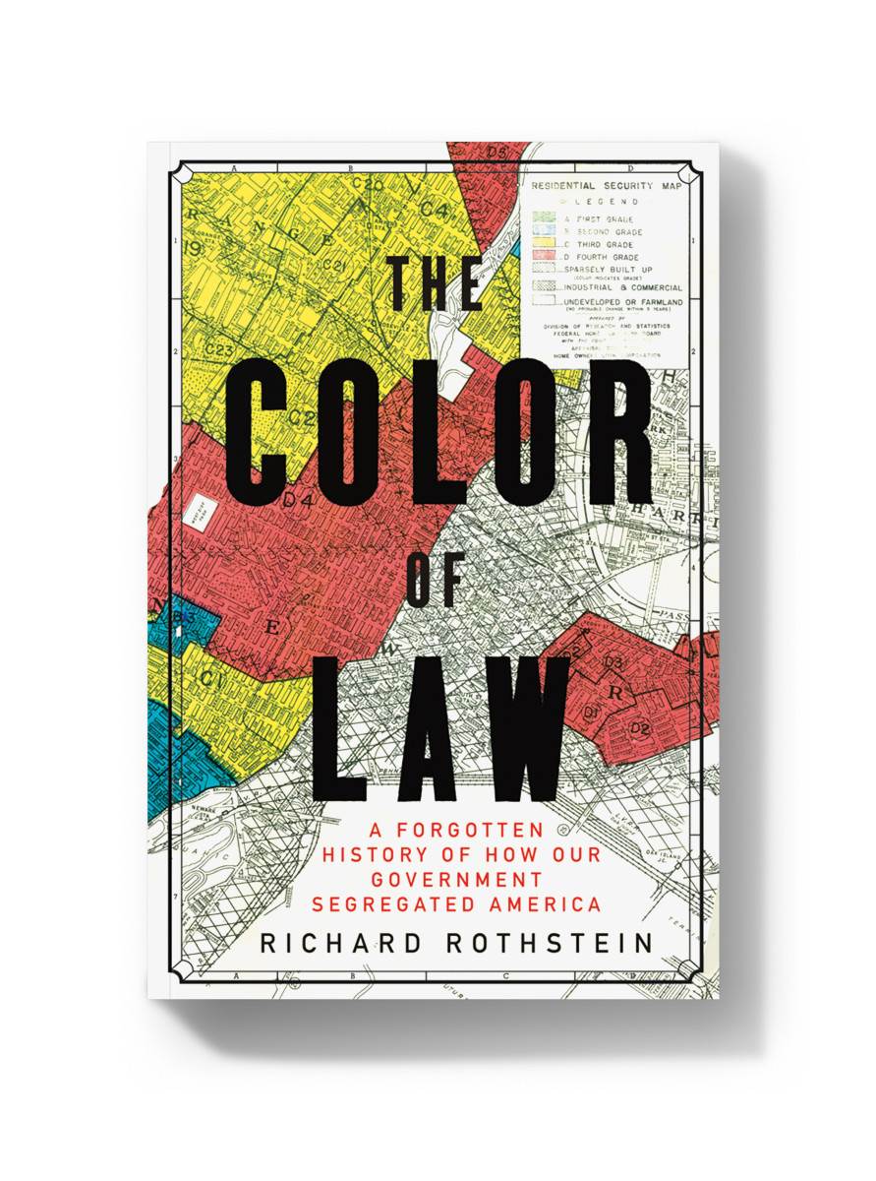
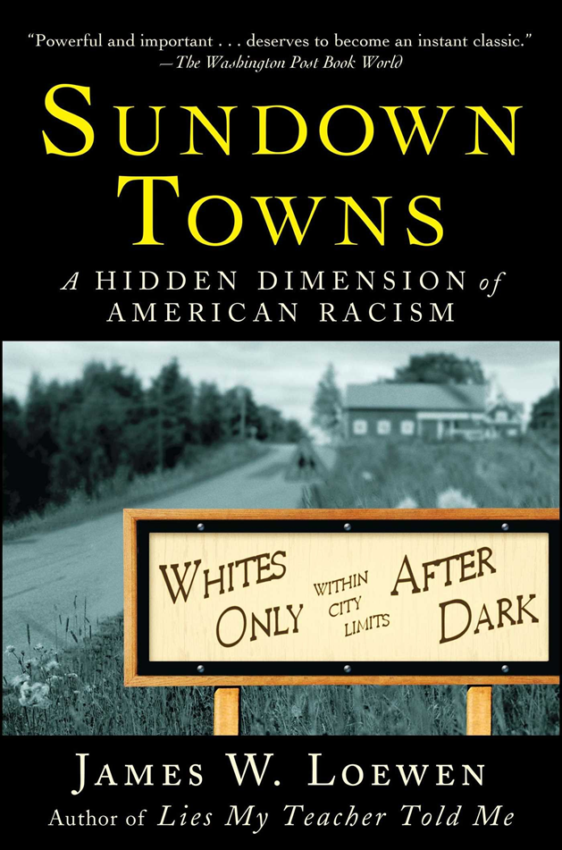
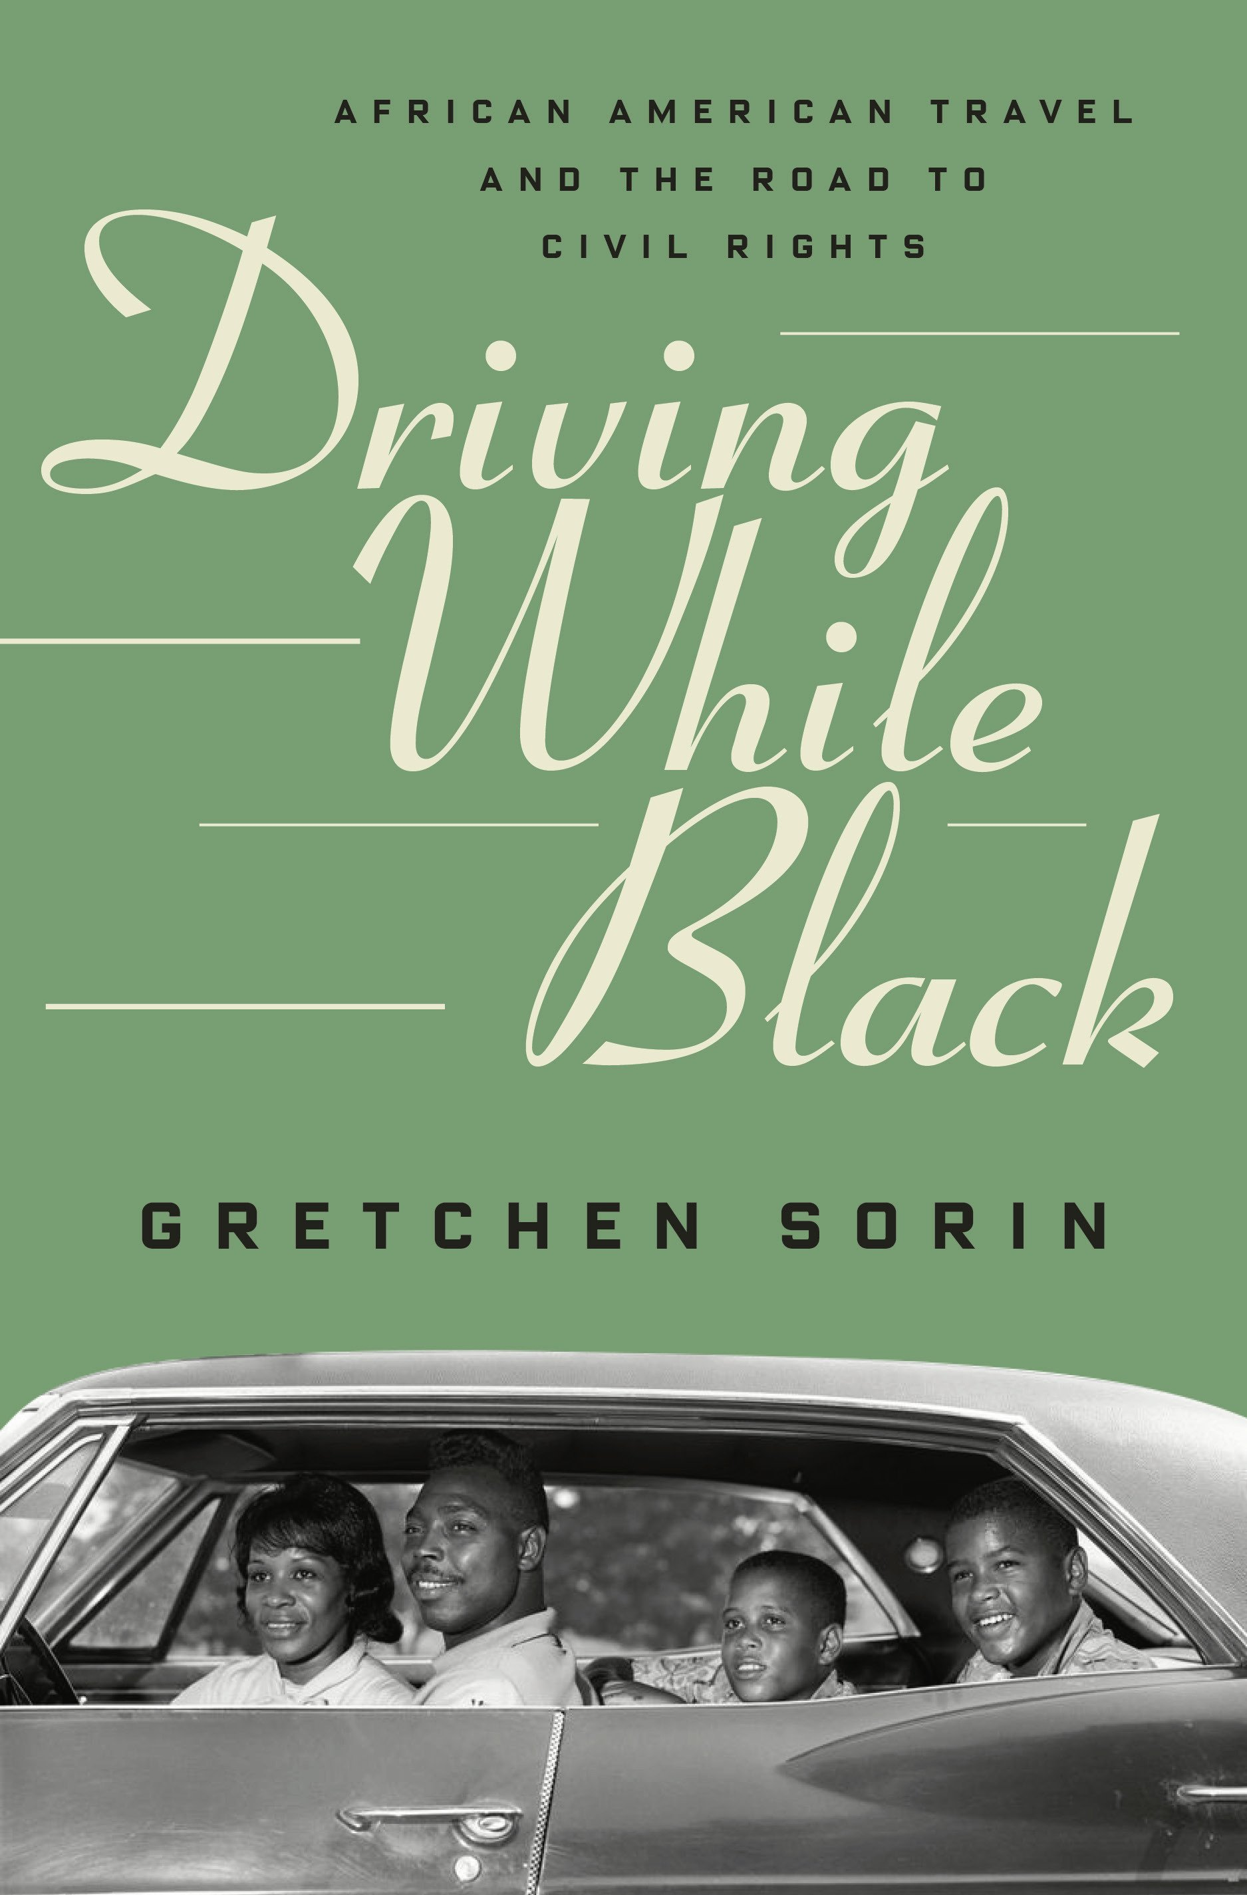
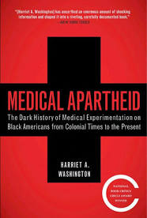
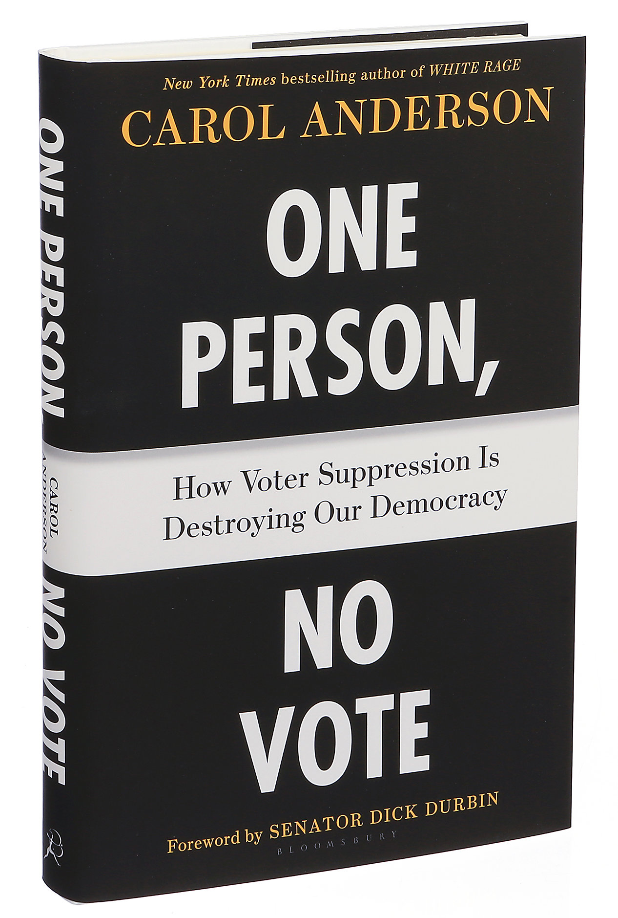
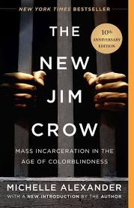
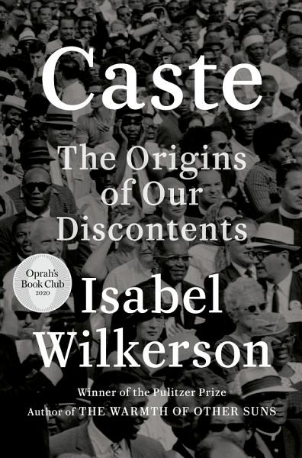
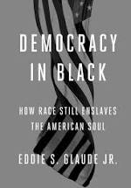

Legacies of jim crow
Notes:
“To get to a point where race won’t make a difference, we have to wrestle, first, with the difference that race makes.”
Michael Eric Dyson

Slide 26




Messages to the Church

Slide 27

No Regrets From Dylann Roof in Jailhouse Manifesto
“Negroes have lower IQs, lower impulse control, and higher testosterone levels in generals (sp). These three things alone are a recipe for violent behavior. And who is fighting for him? Who is fighting for these White people forced by economic circumstances to live among negroes? No one, but someone has to. I have to do it. You rape our women, and you’re taking over our country. And you have to go.”
Dylan Roof

Slide 28


“If anyone should be doing something about the racialized society and if anyone has the answers to the race problem it is Christians. Their religion calls for it, and their faith gives them the tools and moral force needed for change.”
-Emerson & Smith
Notes:
Not a matter of having the skill but one of having the will…

