Slide 1
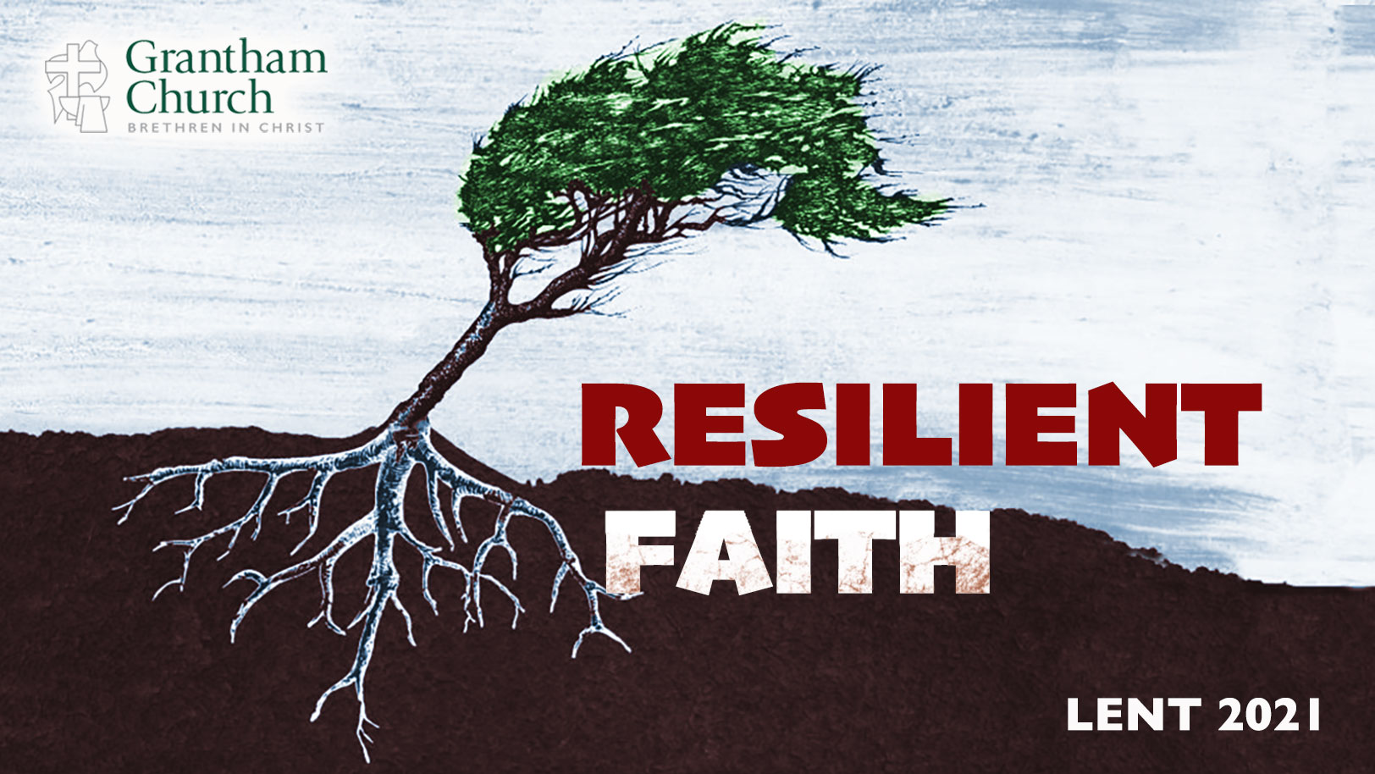
Notes:
Resilient Faith. If you’re just joining us, that’s the title of our Lent 2021 sermon series. In this series we have been exploring what it looks like to deepen our trust in Christ and grow our faith to withstand the trials, challenges, and storms of life; to develop the grit, adaptability, and resilience of our Lord Jesus.
For obvious reasons, we’ve created our Lenten series with this past year in mind. As we’ve all experienced in one form or another, the past 12 months have been jolting. It’s been sort of like CrossFit for the soul. “CrossFit”… that’s appropriate. Think about it. CrossFit is a strength and conditioning workout that is done at a high intensity level. It’s effective (and painful) because it’s all about “muscle confusion.”
The idea with that is if you quickly and repeatedly change your workout, you can shock your muscles and achieve better results—making you leaner, stronger, faster, etc. Basically, by stimulating and shocking the muscle, you break its training habit, or its automatic response to exercise. I experienced a version of this a few years ago when I did P90X for about 6 months.
But seriously, our trials, challenges, and suffering in life are a lot like that. And while it can be painful, it is often the way God does new things, shocks and strengthens our spiritual and religious muscles, and builds a faith that is more resilient and rooted in his love and good will for our lives, and our church.
So, we began our series by looking at some of the metaphors that the Scriptures use to describe how God shapes us and our faith through trials and hardships. Metaphors like metallurgy (purifying gold), forging metals with fire, clay in the hands of the potter, and the wilderness, which is what Jesus experienced out in the desert, and what we give attention to during Lent. Therefore, I invited us to see and embrace our own wilderness as an opportunity to build character, grow our endurance, and thrive on the other side.
And then last week we looked at how Jesus shows us that you can’t build resilient faith unless you learn to resist temptation and evil. I said that the New Testament reveals that we have three enemies that should be resisted: the world, our flesh, and the devil. And so, if we want to follow Jesus and grow in our walk, especially through difficult seasons, then we must engage in spiritual warfare through prayer.
Which brings us to today’s message, the third installment in our Resilient Faith series, a message I’ve entitled, The Necessity of Lament. [BRIEF PRAYER]
In reading the Old Testament, it’s easy to see that the Exodus and the wilderness period was no doubt the most formative event in the life of Israel. The Babylonian exile being the next big one. Certainly, both events were used to teach God’s people about himself, to clarify their calling and identity, and to shape their theology, their faith, and how they lived in the world.
But remember, that journey was full of ups and downs, twists and turns, faith and unbelief. In fact, the story of deliverance got off to a rough start. You’ll recall that Pharoah eventually agreed to release all of the Hebrew slaves after Yahweh had proved his power over the gods of Egypt. But not long into the exodus, the king of Egypt decides that he’s made a mistake and wants them back. So, he goes after them, and then God’s people find themselves trapped between Pharoah’s army and the Red Sea. [NEXT SLIDE]

Slide 2
Exodus 14:10-12 NIV
¹⁰ As Pharaoh approached, the Israelites looked up, and there were the Egyptians, marching after them. They were terrified and cried out to the Lord. ¹¹ They said to Moses, “Was it because there were no graves in Egypt that you brought us to the desert to die? What have you done to us by bringing us out of Egypt? ¹² Didn’t we say to you in Egypt, ‘Leave us alone; let us serve the Egyptians’? It would have been better for us to serve the Egyptians than to die in the desert!”
Notes:
[BRIEF COMMENTS]
What are your first thoughts when you read this passage?
Notice three things here: (1) how fear (even when the change is good or potentially good) distorts our view of the past; (2) you can be comfortable in your captivity when see what it will require to escape it; and (3) this is the beginning of a pattern of grumbling and faithless complaints
We know that grumbling and complaining aren’t good things. They’re not the sort of thing worshippers of God and followers of Jesus ought to be doing; whether you’re reading about the constant whining and unbelief of the Hebrews in Exodus, or you’re reading Paul in Philippians. [NEXT SLIDE]

Slide 3
Paul, Philippians 2:12-14 NIV
¹² Therefore, my dear friends, as you have always obeyed—not only in my presence, but now much more in my absence—continue to work out your salvation with fear and trembling, ¹³ for it is God who works in you to will and to act in order to fulfill his good purpose. ¹⁴ Do everything without grumbling or arguing, ¹⁵ so that you may become blameless and pure, “children of God without fault in a warped and crooked generation.”
Notes:
Look at verse 15. Paul is quoting Deut. 32:5, which is from Moses’ song about the disbelieving generation that didn’t live to see the promised land. You’ll recall that they had to wander around in the wilderness until their kids (who didn’t remember Egypt, who weren’t trapped in old ways of thinking, and who had cultivated a faith in the wilderness that prepared them for a new season) were ready to inherit the land.
And it’s this wilderness that Jesus is symbolically re-living as he embodies Israel his 40-days in the desert. [NEXT SLIDE]

Slide 4
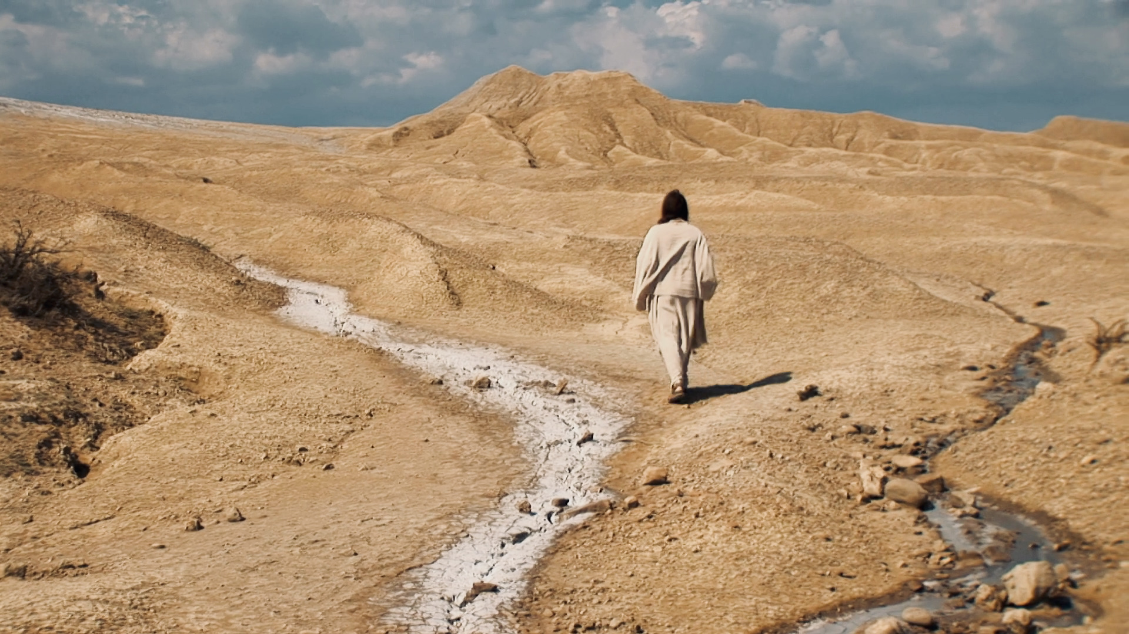
Notes:
That’s how we must see what Jesus is doing in the Judean wilderness. But instead of repeating the mistakes of God’s people (with their faithless whining, grumbling, and demanding signs and miracles), Jesus becomes the faithful Israelite—the one who gets from the wilderness what is to be gotten so that he can become the sort of Messiah the Father has called him to be and lead others to the promised land.
Therefore, as Israel passed through the waters of the Red Sea, Jesus passed through the baptismal waters of the Jordan. Except Jesus, unlike Israel, would resist temptation and build a resilient faith that enabled him to carry out a 3-year ministry before dying on the cross—which is when Jesus finally voices his own complaints to God the Father. And he does so by quoting from Psalm 22, verse 1. [NEXT SLIDE]

Slide 5
“My God, my God, why have you abandoned me? Why are you so far away when I groan for help?”
Psalm 22:1 NLT
Jesus’ lament from the cross
– Matt 27:46; Mark 15:34
Notes:
Psalm 22 is known as a lament psalm. Lament psalms make up forty percent of the book of Psalms. There are other laments throughout Scripture, most heavily in books like Job, Jeremiah, and Lamentations. But the book of Psalms is the prayer and songbook for Jews, and so this is where Jesus goes to express his own feelings of abandonment in what was his greatest moment of darkness and despair.
And this is important to note. When Jews quoted the first verse of a psalm, they were evoking the entire passage. Pay attention then to the flow of Psalm 22, and the rhythm of a biblical lament.
Confession of trust: ³ Yet you are enthroned as the Holy One; you are the one Israel praises.^{[c]} ⁴ In you our ancestors put their trust; they trusted and you delivered them. ⁵ To you they cried out and were saved; in you they trusted and were not put to shame.
Petition:
¹¹ Do not be far from me, for trouble is near and there is no one to help.
Vow of praise:
²² I will declare your name to my people; in the assembly I will praise you.
View of the future hope and end goal:
²⁷ All the ends of the earth will remember and turn to the Lord, and all the families of the nations will bow down before him, ²⁸ for dominion belongs to the Lord and he rules over the nations.
Don’t miss this, church. In Jesus’ darkest moments, while he certainly voiced his complaint and revealed the depth of despair he felt upon the cross, he also trusted the Father, called upon the Father for help, praised the Father for his faithfulness, and expressed a hope in what was to come. Which is why, as the author of Hebrews wrote, it was “for the joy set before him he endured the cross” (Heb12:2).
This is true lament. Listen to what Soong-Chan Rah writes in his book, Prophetic Lament:

Slide 6
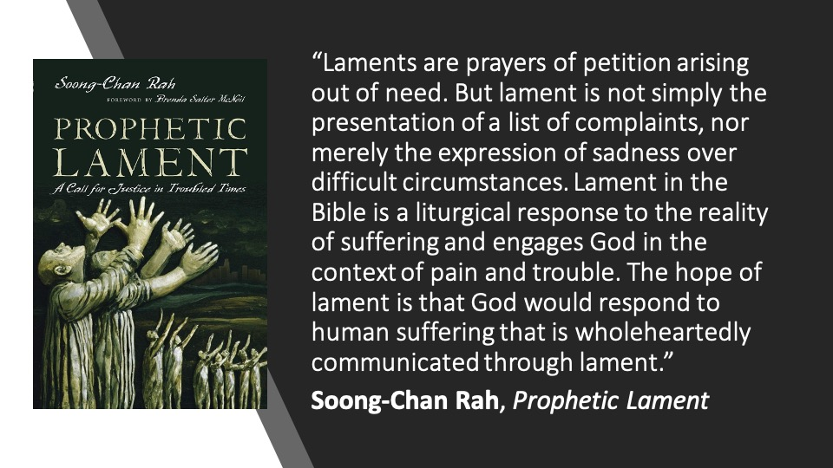
Notes:
If we’re honest, many of us avoid lament. Lamenting feels like acknowledging defeat. And that just doesn’t fit the American spirit of triumphalism that we’re taught, which of course leaves no room for holding grief and celebration together. So, we either want to live in one ditch or the other. Because we live in a culture that doesn’t understand the value of grieving and lamenting, and how it enables us to be fully human.
And unfortunately, the church hasn’t led the way very well because we have often succumbed to that spirit. We have failed to hear Jesus say, “rejoice with those who rejoice” and “mourn with those who mourn.” So, we don’t lament properly, and it leads to all kinds of spiritual malformation, and sometimes depression. In fact, I think it’s a lack of biblical lamentation that leads a church to either be down in the dumps and cynical all the time (since there is no shortage of injustices in the world), or want to ignore the suffering of the world and just sing happy songs, preach happy sermons, and think happy thoughts all the time. They are both extremes. And neither of them reflect the gospel and our biblical hope. Therefore, we need to practice lament. Psalm 13 is a classic lament psalm. Let’s use this psalm as an example of what healthy lament looks like, and how it can build resilient faith. [NEXT SLIDE]

Slide 7
Psalm 13:1-2 NIV
¹ How long, Lord? Will you forget me forever? How long will you hide your face from me? ² How long must I wrestle with my thoughts and day after day have sorrow in my heart? How long will my enemy triumph over me?
Notes:
Listen to how the psalmist pours out the depths of his despair in a faith-filled complaint to God. He feels forgotten by God. It’s the image of a broken relationship—of separation and distance. “Where are you?” There is pain. There is sorrow. There is loss. And no end in sight. And the enemy seems to be winning.
Verse 3… [NEXT SLIDE]

Slide 8
Psalm 13:3-4 NIV
³ Look on me and answer, Lord my God. Give light to my eyes, or I will sleep in death, ⁴ and my enemy will say, “I have overcome him,” and my foes will rejoice when I fall.
Notes:
In these two verses, the writer protests how God appears to be managing the world—overlooking his faithful ones. “Look at me! Speak! It’s now or never, God. Help me, or I will die from this pain!” Hear the indignation, anger, and the feeling of being unfairly treated. All of these feelings are bubbling up within the psalmist. This is a plea for help. Folks, this isn’t disrespectful. This is honesty. And it is representative of the real struggle of faith in a world full of competing wills, full of rebellious sinful human beings, as well as spiritual attacks from the enemy.
And notice, he expresses them to God (not to those who he feels has wronged him) because he believes God is the one who can do something about it. You see, because a lament is about asking God to bring about change. A lament is not just about venting our feelings, nor does it stop with complaint or accusation against God. If it did, how would it be any different than those lobbed by the Accuser who came to God about Job. Yes, be honest, but also remember who you’re talking to and exercise your faith.
As we will see now, the psalm doesn’t end in despair. If it did, it wouldn’t be a true lament.
Verse 5… [NEXT SLIDE]

Slide 9
Psalm 13:5-6 NIV
⁵ But I trust in your unfailing love; my heart rejoices in your salvation. ⁶ I will sing the Lord’s praise, for he has been good to me.
Notes:
Did you see what happened? Faith entered the picture between verse 4 and verse 5. And we have no reason to believe that the writer’s circumstances have changed. Yet, something enables the psalmist to say, “I trust you. You’re loving. You’ve saved me once; you’ll save me again.”
You see, church. A true lament speaks to God as the Divine Therapist. And by the end of the session, we can say, “I’ve done what you asked me to do. I spilled my guts. I told you what I’m really thinking and feeling. And I believe those things are now in good hands because I believe you’re a good God. You will listen, and you will love me. And it’s because of your love that I keep bringing these complaints to you, that I will keep singing your praises, and that I will remember how good you’ve been to me.”
You see, folks, biblical lament concludes on a note of confidence and hope, trust and joy. And in this pattern, we see a pattern for our own lives. We must lament properly and sufficiently, allowing the time needed to grieve.
However, if grieving is all that we do, and we never emerge and grow in cooperation with the Spirit… and we never experience and express confidence, hope, trust, and joy… then we are not expressing faith. We have instead joined ranks with “the warped and crooked (unbelieving) generation” that died in the desert because of their stubborn refusal to change, adapt, move on, and believe in God’s good future. And it’s in that story that we hear the invitation: What will it be? Who will you be, church?
To sum up why lament is necessary, and why we need it to develop a resilient faith, let’s think of it this way: [NEXT SLIDE]

Slide 10
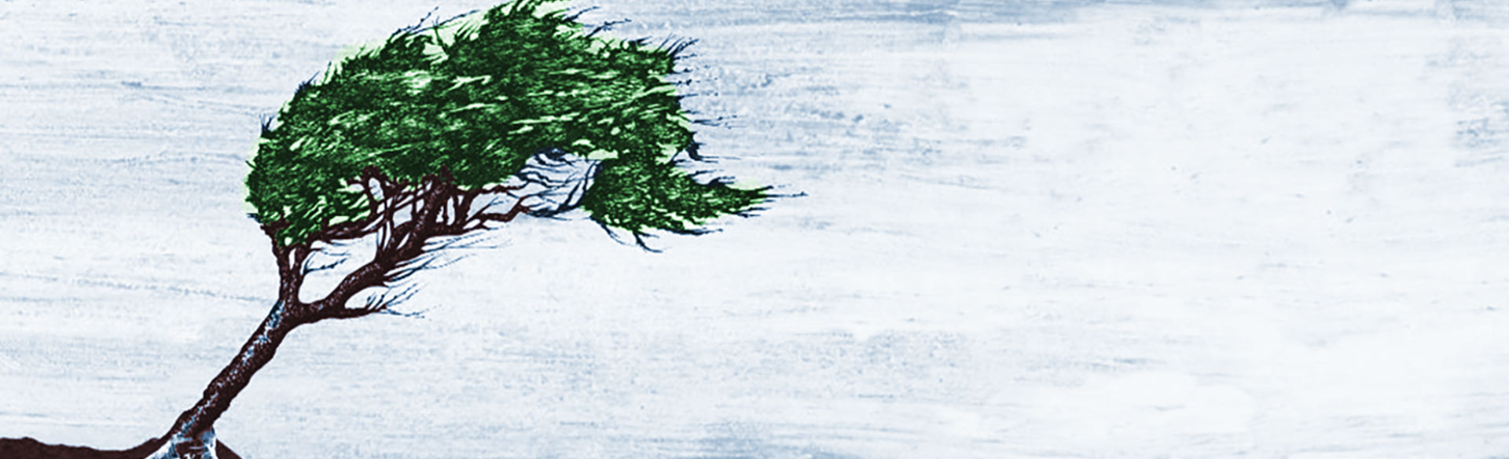
The Necessity of Lament
We need to practice lament if we’re going to develop a resilient faith. Why?

Slide 11
The Necessity of Lament
We need to practice lament if we’re going to develop a resilient faith. Why?
Lament says, “This isn’t right.”
Notes:
[BRIEF COMMENTS]
God desires raw honesty – How are you feeling? Stop yapping to your neighbors and tell him.
Lament, say “this isn’t right” and be truthful. Because if we fail to recognize what’s wrong, broken, and unjust, we can’t ever hope to find healing and be a part of God’s ministry of healing to this world
#2 … [NEXT SLIDE]

Slide 12
The Necessity of Lament
We need to practice lament if we’re going to develop a resilient faith. Why?
Lament says, “This isn’t right.”
Lament says, “This hurts, but I’m not quitting.”
Notes:
[BRIEF COMMENTSS]
Lamenters talk to God because ultimately the problem can only be worked out in dialogue with God
So, rather than taking a time out or abandoning ship, we lament
Consider this: When you feel like you’re in exile, you have three choices: give up, give in, or lament
Lastly, #3… [NEXT SLIDE]

Slide 13
The Necessity of Lament
We need to practice lament if we’re going to develop a resilient faith. Why?
Lament says, “This isn’t right.”
Lament says, “This hurts, but I’m not quitting.”
Lament says, “God, I/we need your help.”
Notes:
[BRIEF COMMENTS]
Lament shows that we recognize our need for God’s help
Lament allows God to meet us where we are and deliver us
I’m reminded of a scene from one of my favorite TV shows. [NEXT SLIDE]

Slide 14
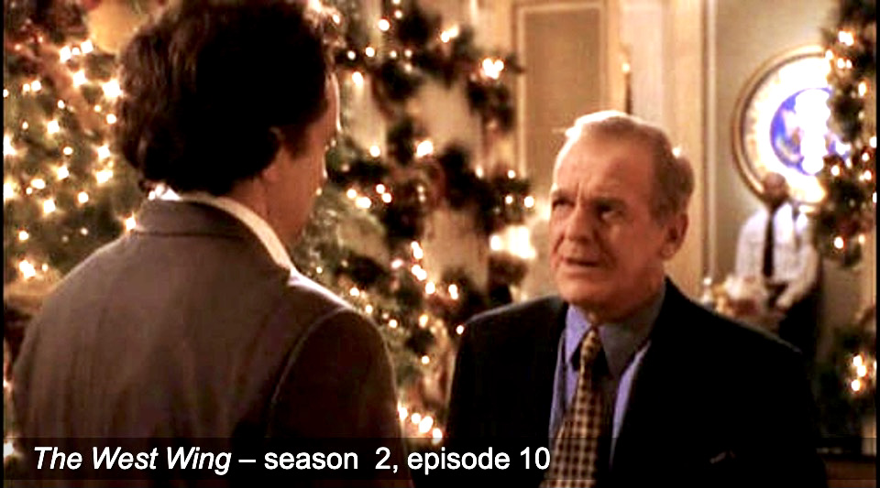
Notes:
Some of you may be familiar with the show, The West Wing. In one memorable episode, White House chief of staff Leo McGarry reaches out to his deputy, Josh Lyman, who is struggling with PTSD. And Leo tells him a parable:
He says, “This guy’s walking down the street when he falls down a hole. The walls are so steep he can’t get out. A doctor passes by, and the guy shouts up, “Hey, you! Can you help me out?” The doctor writes a prescription and throws it down in the hole and moves on. Then a priest comes along, and the guy shouts, “Father, I’m down in this hole. Can you help me out?” The priest writes out a prayer, throws it down in the hole, and moves on. Then a friend walks by. “Hey, Joe, it’s me! Can you help me out?” And the friend jumps in the hole. The guy says, “Are you stupid? Now we’re both down here.” The friend says, “Yeah, but I’ve been down here before, and I know the way out.””
When I first heard Leo share this parable, I immediately thought of Jesus. That is Jesus. Jesus is the one who slides down in the hole and says, “I’ve been down here before, and I know the way out.” And then I thought of this passage from Hebrews chapter 2, beginning with verse 14. [NEXT SLIDE]

Slide 15
Hebrews 2:14-15 NLT
¹⁴ Because God’s children are human beings—made of flesh and blood—the Son also became flesh and blood. For only as a human being could he die, and only by dying could he break the power of the devil, who had the power of death. ¹⁵ Only in this way could he set free all who have lived their lives as slaves to the fear of dying.
Notes:
[BRIEF COMMENT]
Verse 17… [NEXT SLIDE]

Slide 16
Hebrews 2:17-18 NLT
¹⁷ Therefore, it was necessary for him to be made in every respect like us, his brothers and sisters, so that he could be our merciful and faithful High Priest before God. Then he could offer a sacrifice that would take away the sins of the people. ¹⁸ Since he himself has gone through suffering and testing, he is able to help us when we are being tested.
Notes:
[BRIEF COMMENT]
Finally, as I begin to conclude this message… [NEXT SLIDE]

Slide 17
Notes:
I want to invite you to ask yourself:
“What do I need to lament in order to develop a more resilient faith?”
With what things from this past year do you need to say:
“This isn’t right.”
“This hurts, but I’m not quitting.”
And… ”God, I need your help.”
With those things in mind, I want to invite you to express your lament to God in response to the hearing of his word this morning. Let’s do that in a responsive reading of Psalm 13.
[NEXT SLIDE] – Psalm 13

