Slide 1

Notes:
[BRIEF INTRO]
This is week 7 of our 8-week series on Philippians: Cruciformed Community & Our Civic Witness. Each week we have been going verse-by-verse through Philippians—one of the most politically subversive books in the NT—as Paul shares how these early Christians ought to think and live in a city that is committed to the empire. He wants their civic and political life within Philippi to reflect Christ and the gospel of his Kingdom.
Which means they can expect resistance to their faith from their Roman neighbors, as two kingdoms collide with their opposing beliefs and values. Paul had experienced this himself when he planted the church in Philippi in 52 AD, as recorded in Acts 16… [NEXT SLIDE]

Slide 2
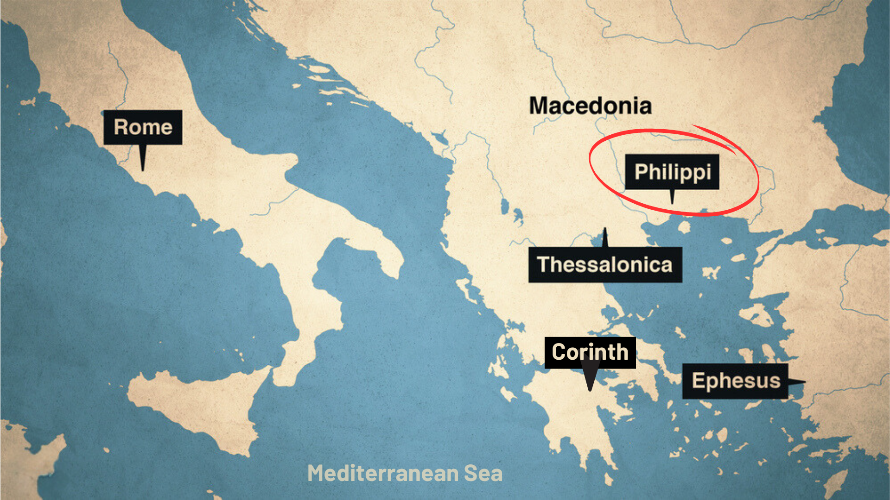
Notes:
And then about 10 years later (62 AD), Paul writes to the Philippian church from Rome, where he is being kept under house arrest, awaiting his trial before the emperor Nero. The Philippians are concerned for Paul. So, they sent Epaphroditus from Philippi to Paul (and Timothy, his co-worker) to help him and then bring word back about how he is doing.
Therefore, the letter to the Philippians is Paul’s response to those concerns, as well as his reminders of what the gospel means for how they are to follow Jesus in an idolatrous city that demanded of its citizens what these early Christians could not give.
Remember… [NEXT SLIDE]

Slide 3
Notes:
[BRIEF COMMENTS]
Philippi was an affluent Roman colony of 10,000 people; it’s full of retired Roman military veterans and patriotic nationalists who are fiercely loyal to empire. They have a special status with Caesar, and they will not tolerate any competing “good news” or rival “Lord”
And there were strong societal and cultural forces that pressured the city’s inhabitants (citizen status or not) to express their patriotism publicly, and an expectation that all Philippians would respect and uphold Roman values and virtues
So, these cultural forces would have impacted every aspect of life: social, political, religious, and economic; and to go against the dominant cultural current was to draw negative attention to yourself, which is what was happening to the church in Philippi
But despite their circumstances, they are trying to stay the course; Paul believes in them and wants to inspire them to remain faithful to Jesus, no matter what happens
It’s important that we keep in mind the flow of Paul’s letter to the Philippians and the content of his message so far… [NEXT SLIDE]

Slide 4
Notes:
[BRIEF COMMENTS]
[NEXT SLIDE]

Slide 5
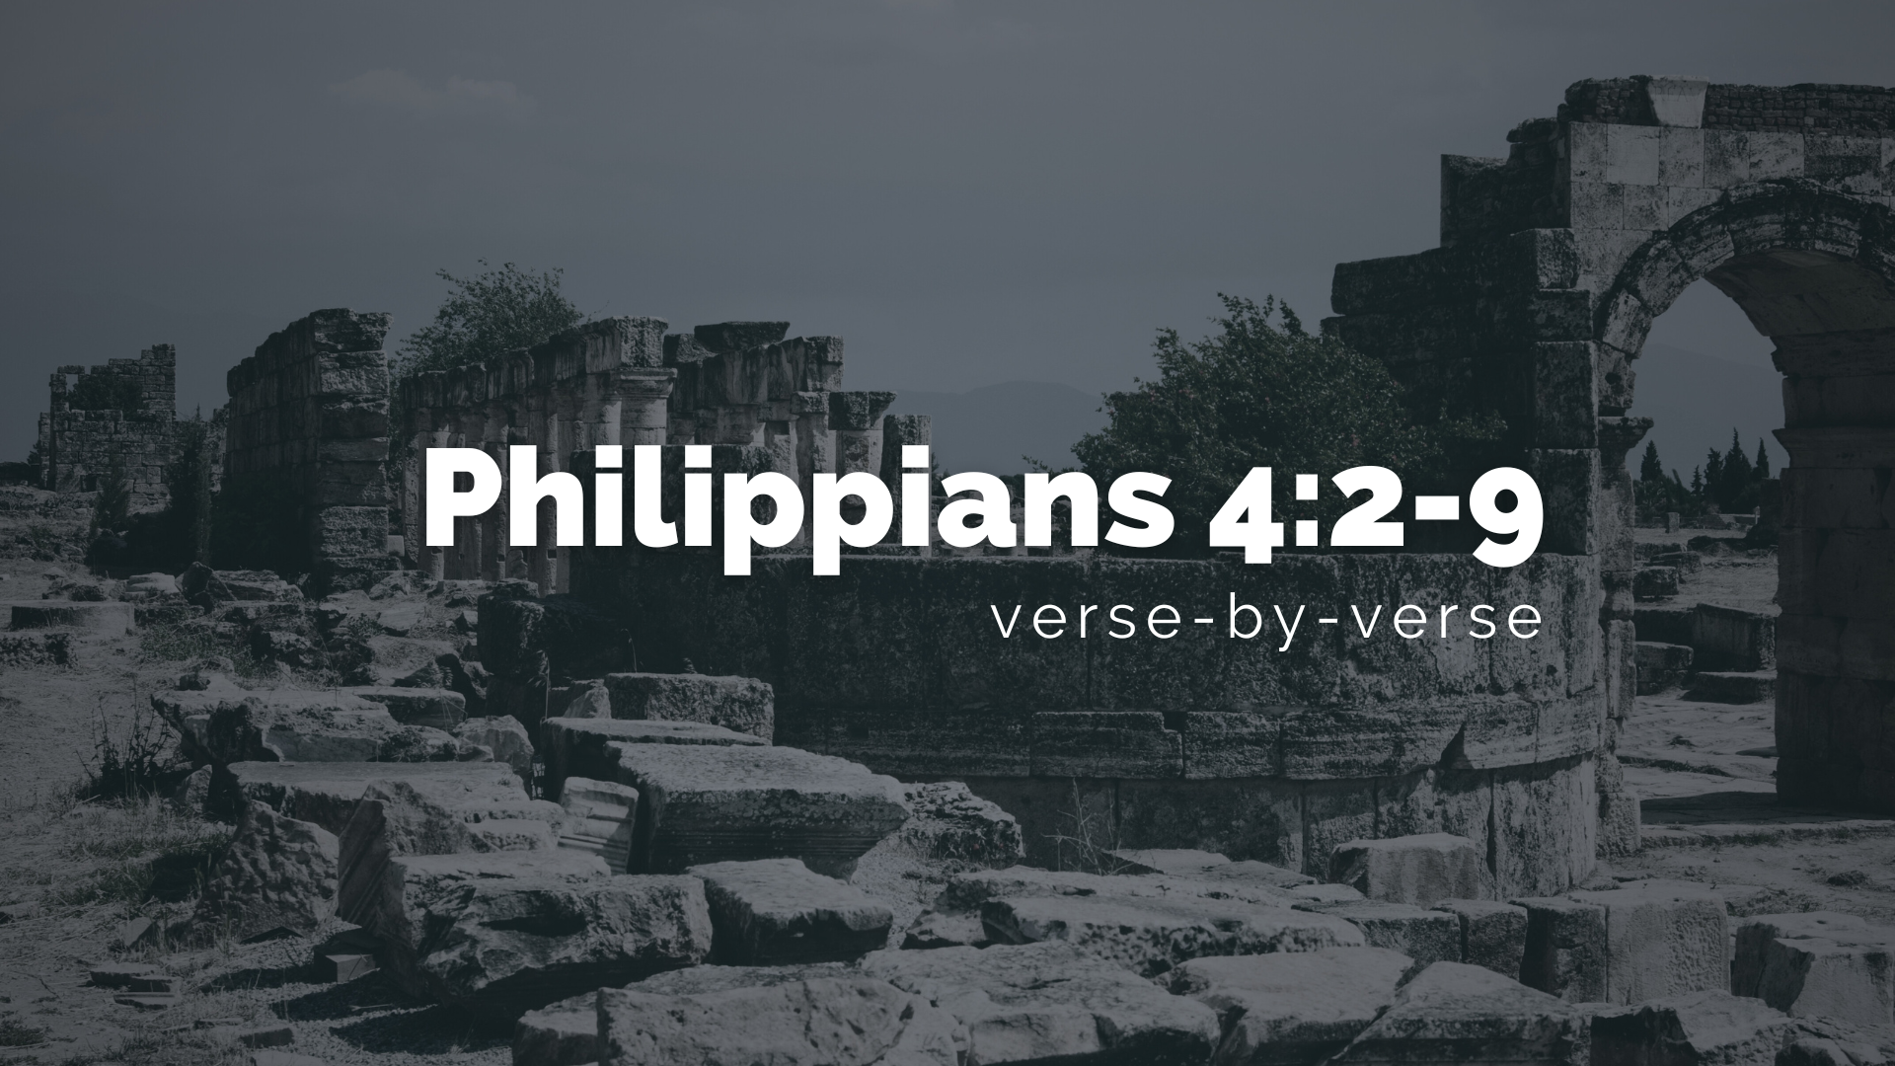
Notes:
[BRIEF COMMENTS]
[NEXT SLIDE]

Slide 6
1 Peter 3:14-16 NIV
¹⁴ But even if you should suffer for what is right, you are blessed. “Do not fear their threats; do not be frightened.” ¹⁵ But in your hearts revere Christ as Lord. Always be prepared to give an answer to everyone who asks you to give the reason for the hope that you have. But do this with gentleness and respect, ¹⁶ keeping a clear conscience, so that those who speak maliciously against your good behavior in Christ may be ashamed of their slander .
Notes:
[READ & COMMENT ON PASSAGE]
[NEXT SLIDE]

Slide 7
Notes:
[BRIEF COMMENTS]
[NEXT SLIDE]

Slide 8
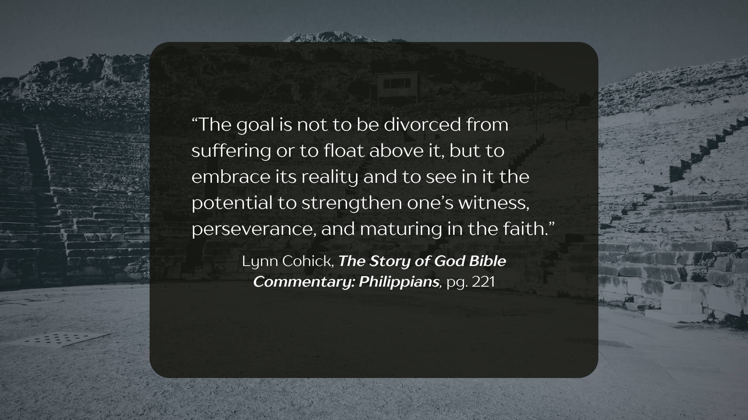
Notes:
[BRIEF COMMENTS]
[NEXT SLIDE]

Slide 9
Notes:
[BRIEF COMMENTS]
[NEXT SLIDE]

Slide 10
Notes:
[BRIEF COMMENTS]
[NEXT SLIDE]

Slide 11
Notes:
[READ QUOTE & COMMENT]
[NEXT SLIDE]

Slide 12
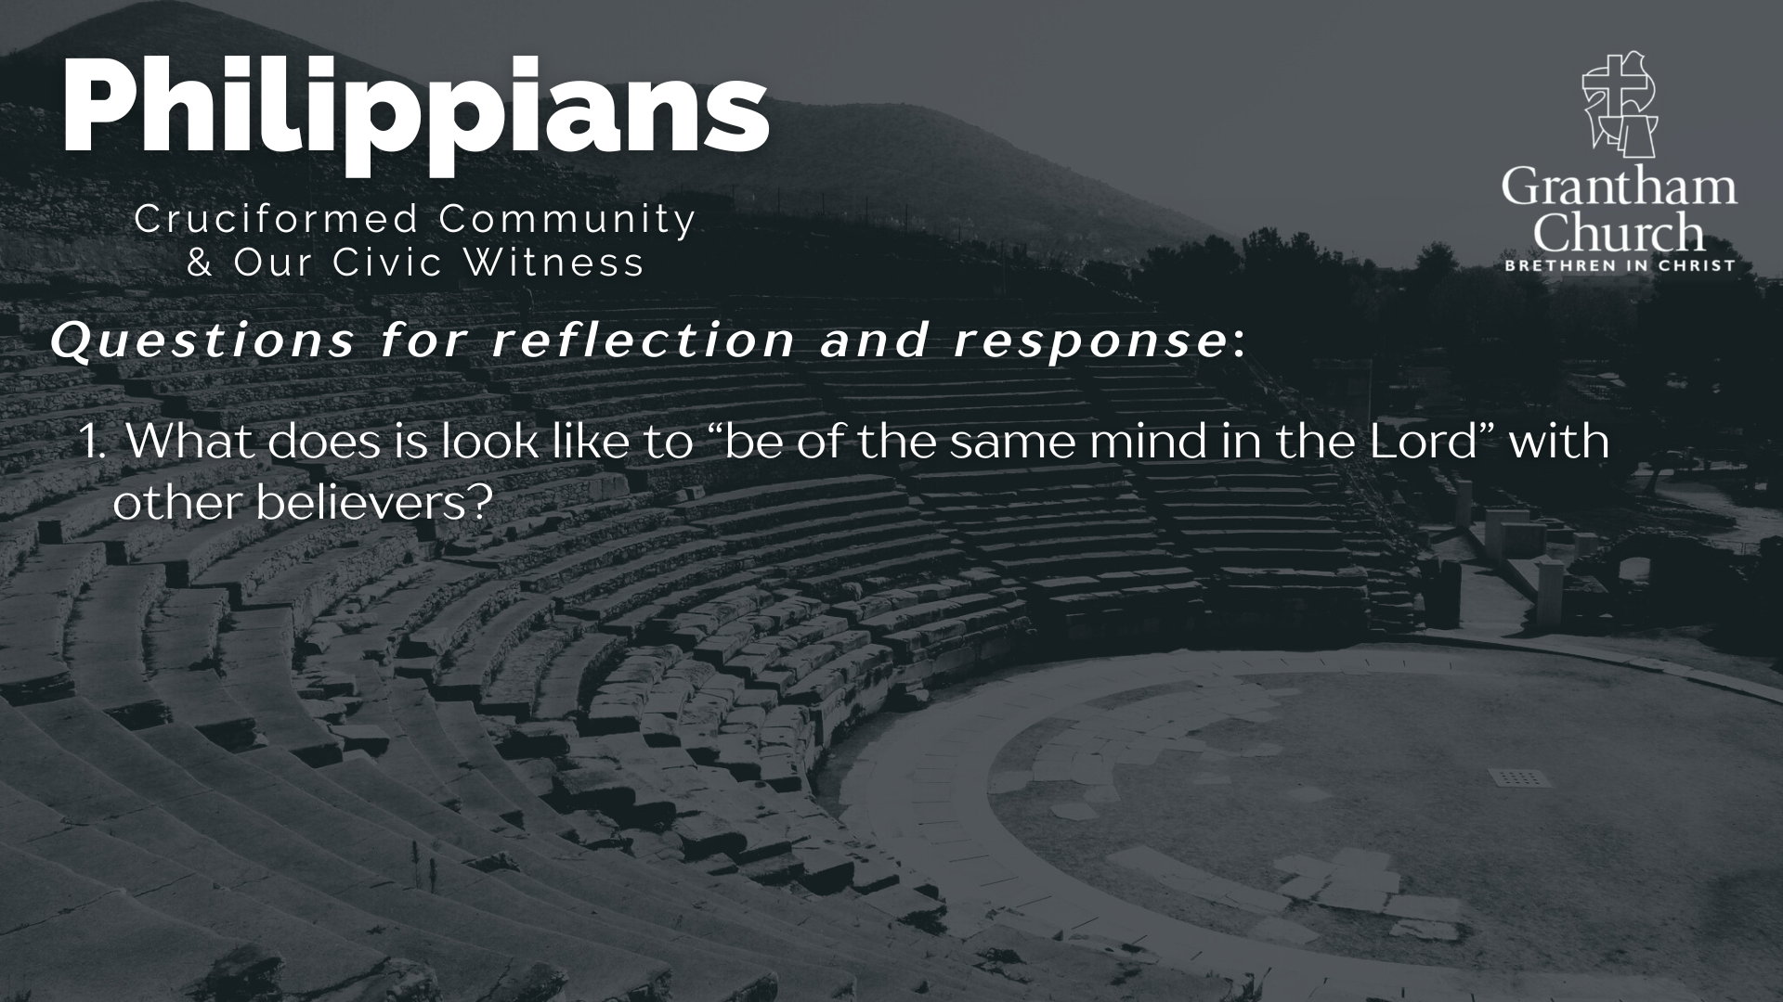

Slide 13
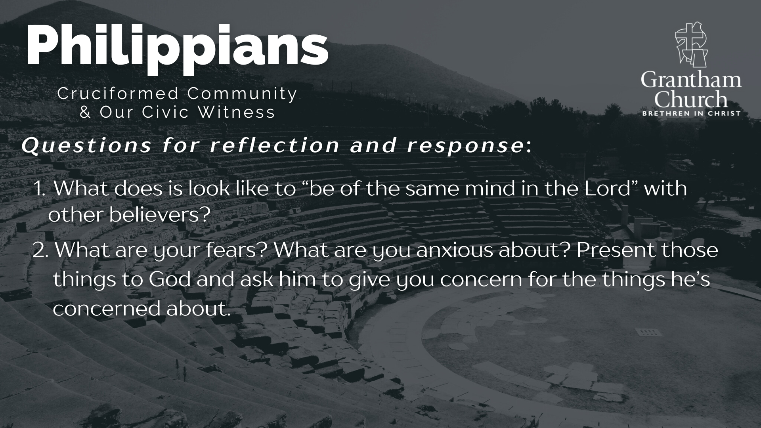

Slide 14


Slide 15
Notes:
[READ & BRIEF COMMENT ON EACH QUESTION]
[NEXT SLIDE]

Slide 16

Notes:
[CLOSING PRAYER]
Benediction
May the God who looks like Jesus lead you to faithfully follow him in a world that needs to hear and see the Gospel of Jesus Christ. And may the grace and peace of the Lord Jesus comfort and sustain you as a witness of his coming Kingdom. Amen.

