Slide 1
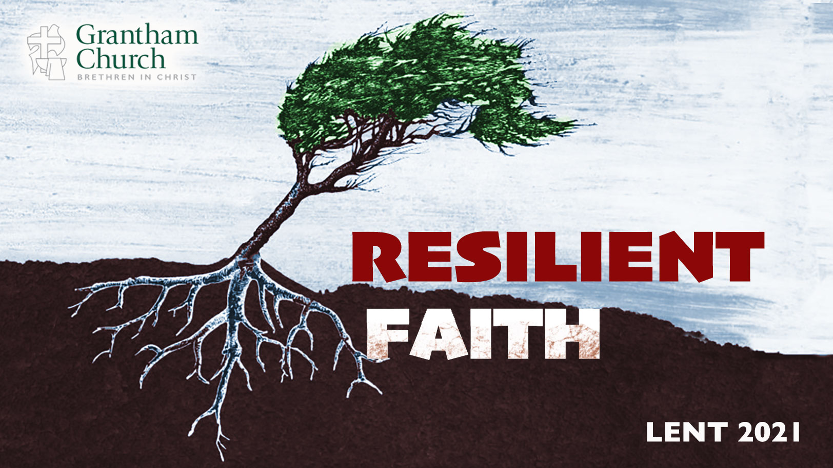
Notes:
Resilient Faith. If you’re just joining us, that’s the title of our 6-week Lenten sermon series. This is message 4 of 6 in our series that aims to deepen our trust in Christ and grow our faith to withstand the trials, challenges, and storms of life; to develop the grit, adaptability, and resilience of our Lord Jesus.
We began our series by looking at some of the metaphors that the Scriptures use to describe how God shapes us and our faith through trials and hardships. With that, I invited us to see and embrace our own wilderness as an opportunity to build character, grow our endurance, and thrive on the other side.
And then two weeks ago we looked at how Jesus shows us that you can’t build resilient faith unless you learn to resist temptation and evil. Resistance builds resistance. In that message I challenged us to view prayer, like Jesus and the Apostles, as a weapon for resisting spiritual darkness. We have to fight in this way if we’re going to overcome our flesh, the world, and the devil.
And then last week I shared a message called, The Necessity of Lament. I said that this life is full of trials and troubles. And if we don’t acknowledge what is wrong and learn how to properly lament, we will grow to be spiritually malformed. So, we must lament by saying (1) This isn’t right; (2) This hurts, but I’m not quitting; and (3) God, I need your help. I hope you found that sermon helpful. And I hope that we will continue to practice lament together whenever the need arises.
All of that brings us to the next installment, a message I’ve entitled, Know Who You Are. And let me just say, I think this may be the most important message that disciples of Jesus need to hear. I think that will become clear as we move along today. So, if you would, I’d encourage you to take some notes (if that’s helpful) and really tune in to the voice of the Spirit this morning. [BRIEF PRAYER]
Anyone ever experienced amnesia? I’ve never personally experienced it, but I can imagine how troubling that would be. [MY GRANDFATHER]
Thankfully, my Papa didn’t forget who he was. That would have been even more frightening, to be sure. Just ask Jason Bourne. [NEXT SLIDE]

Slide 2
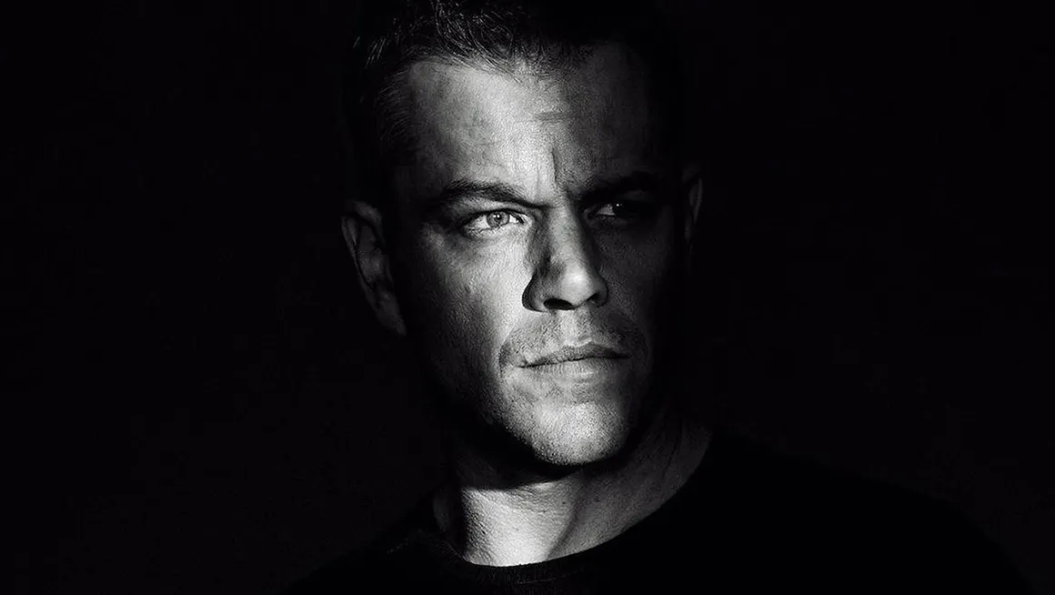
Notes:
As many of you may know, the Bourne movies are a series of action thriller films based on the character Jason Bourne, a CIA assassin suffering from dissociative amnesia who must figure out who he is, how it is that he has James Bond like reflexes, how it is that he can guess your weight, and tell you all of the license plates numbers out in the parking lot; and why people want him dead. You could say that Jason Bourne definitely shows “resiliency” in seeking to discover his identity. And he will stop at nothing to get the answers he’s looking for. And if you threaten his life, he will beat you down with a rolled-up magazine or a ballpoint pen. And, of course, not have a clue how he is doing it.
The Jason Bourne story, much like our own lives, is driven by the question: “Who am I?” It’s a question that we all ask in one form or another. That’s why I know that today’s message is relevant to all of us. Every single one of us. Which has much to do with why I think it’s one of the most important. That’s because your identity (knowing who you are) is absolutely essential to the health and flourishing of human beings. Because, like Jason Bourne, you can’t ever find peace, purpose, and rest in your soul until you know who you are and align yourself to the truth, and live into that truth as God created you to do. Which bring us back to Jesus in the wilderness. Let’s begin our Scripture reading with Mark 1, verses 9-13. [NEXT SLIDE]

Slide 3
Mark 1:9-13 NIV
⁹ At that time Jesus came from Nazareth in Galilee and was baptized by John in the Jordan. ¹⁰ Just as Jesus was coming up out of the water, he saw heaven being torn open and the Spirit descending on him like a dove.
Notes:
[BRIEF COMMENT]
“heaven being torn open” – indicates what is known as a theophany, a revelation
The Greek word for “being torn” is “skidzo”; the only other time it’s used is when Mark describes the tearing of the temple curtain in chapter 15, verse 38. In other words, this event is a divine breakthrough.
The dove is symbolic of the Spirit coming to rest on Jesus; an anointing by God
Verse 11… [NEXT SLIDE]

Slide 4
¹¹ And a voice came from heaven: “You are my Son, whom I love; with you I am well pleased.”
Notes:
Brothers and sisters, don’t miss what is happening here. Think about this. Jesus has done nothing publicly significant or noteworthy up to this point. He hasn’t healed anyone. He hasn’t told a parable. He hasn’t preached a sermon. He hasn’t performed a miracle. Up to this point, Jesus, son of Mary and Joseph, from the podunk town of Nazareth, has lived a simple (but faithful) life of obscurity for about 30 years of his life.
And then one day he walks into the Jordan to be baptized by his cousin John, and these words come from the Father in heaven: “You are my Son, whom I love; with you I am well pleased.” Why is that important?
It’s important because it says that God’s favor and our worth is not dependent upon anything we’ve done or will do. It’s important because Jesus is about to begin his ministry from a place of affirmation, of security, of belonging, and of acceptance. He doesn’t need to prove anything. The Father’s love isn’t dependent upon that. Jesus doesn’t need to earn the Father’s favor. He already has it.
And because of that, he doesn’t need everyone to like him, to like his sermons, to agree with him, or for others to meet his emotional needs. While some of those things are nice and helpful, Jesus will get his life from the Father, not from anything in this world. You see, church. This is important because these words of favor (an affirmation of the Lord’s identity and calling) are what Jesus hears right before he goes into the wilderness. Verse 12… [NEXT SLIDE]

Slide 5
¹² At once the Spirit sent him out into the wilderness, ¹³ and he was in the wilderness forty days, being tempted by Satan. He was with the wild animals, and angels attended him.
Notes:
So, what is the wilderness all about? Is it not ultimately about the testing of one’s identity?
Jo Saxton,(author & speaker) says this… [NEXT SLIDE]

Slide 6

“The wilderness can test your identity to the breaking point. It’s where the authenticity of your purpose is challenged to its core. The pressure and pain of the experience strips away pretension and reveals what is truly happening inside.”
Jo Saxton
Notes:
And if you’re paying attention, your hardships and trials do this, especially in the darkest of times. They eventually uncover and expose us, and invite us to ask the most basic question of all: Who am I?
As we can see with Jesus in the wilderness, the testing that comes from the harsh terrain of the world can bring about the temptations and the doubts that the enemy then seeks to exploit by calling our identity into question. Remember, the Father said to Jesus, “You are my Son, whom I love; with you I am well pleased.” But then the testing comes in the wilderness. And out slithers the tempter, saying… [NEXT SLIDE]

Slide 7
The tempter came to him and said, “If you are the Son of God…”
Matthew 4:3 NIV
Notes:
[BRIEF COMMENT]
And this wasn’t a new tactic. It was an old one. In fact, what is happening here with Jesus in the wilderness looks a lot like a scene we’re all familiar with from the book of Genesis, chapter 3. [NEXT SLIDE]

Slide 8
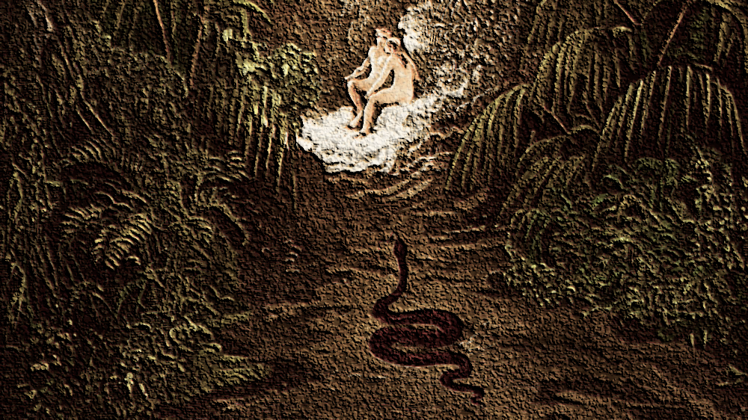
Notes:
You’ll recall in the Garden of Eden that the tempter is described as coming to the first human pair in the form of a crafty serpent, which is interesting since in the ancient world the serpent was a symbol of wisdom. Think about that. So, you’re an ancient reader reading along and think, “Oh, something good is about to happen.” No, plot twist! The serpent sneaks up on Eve, who is all alone, and who didn’t hear God’s command for herself, and the tempter says, “Did God really say, ‘You must not eat from any tree in the garden’?”
Notice, the tempter wants to sow seeds of doubt about God’s word, and that eventually leads to a sinister invitation to doubt God’s character—which is where our identity is founded. And because of Adam and Eve’s choice to sin, they experience an identity crisis, and what the Bible calls “the flesh” was born.
[NEXT SLIDE] So, follow this:

Slide 9
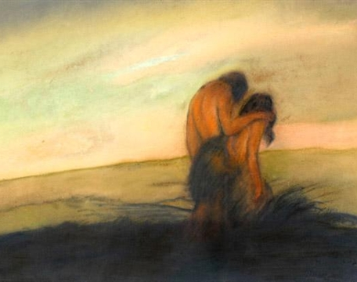
Identity Crisis
An identity of “flesh” began in Eden and the “pattern of this world” seeks to maintain/conform us to a false identity.

Slide 10
Identity Crisis
An identity of “flesh” began in Eden and the “pattern of this world” seeks to maintain/conform us to a false identity.
Lie 1: You can do better than God

Slide 11
Identity Crisis
An identity of “flesh” began in Eden and the “pattern of this world” seeks to maintain/conform us to a false identity.
Lie 1: You can do better than God
Lie 2: You can live without God

Slide 12
Identity Crisis
An identity of “flesh” began in Eden and the “pattern of this world” seeks to maintain/conform us to a false identity.
Lie 1: You can do better than God
Lie 2: You can live without God
Lie 3: You can be your own god (save yourself)
Notes:
[BRIEF COMMENT ON EACH LIE]
So, let’s not go down that road. Instead, we need to know what the Bible says is true about us. Let’s think biblically and theologically about this so we can truly understand what Christ has done for us, and how we can know who we are (our true identity) according to the gospel.
Here is what the Scriptures teach about human beings—the bigger picture:
[NEXT SLIDE]

Slide 13

What the Bible Says About You

Slide 14
What the Bible Says About You
The first humans sinned and experienced shame, emptiness, and enmity between God and others

Slide 15
What the Bible Says About You
The first humans sinned and experienced shame, emptiness, and enmity between God and others
We are made in God’s image but broken and not as we should be; not everything is as God intends

Slide 16
What the Bible Says About You
The first humans sinned and experienced shame, emptiness, and enmity between God and others
We are made in God’s image but broken and not as we should be; not everything is as God intends
Therefore, we are all born into “flesh” and a world that has been impacted by the Fall/rebellion

Slide 17
What the Bible Says About You
The first humans sinned and experienced shame, emptiness, and enmity between God and others
We are made in God’s image but broken and not as we should be; not everything is as God intends
Therefore, we are all born into “flesh” and a world that has been impacted by the Fall/rebellion
God sent Christ to free us from the flesh and the Fall by giving us a new identity (saint, not sinner)
Notes:
[BRIEF COMMENT ON EACH]
I can’t think of a better passage on our new identity and this new life that Christ offers than in Romans chapter 8, verses 1-17. If you have your Bible, read along there with me. Or just listen as a I read.
[NEXT SLIDE]

Slide 18
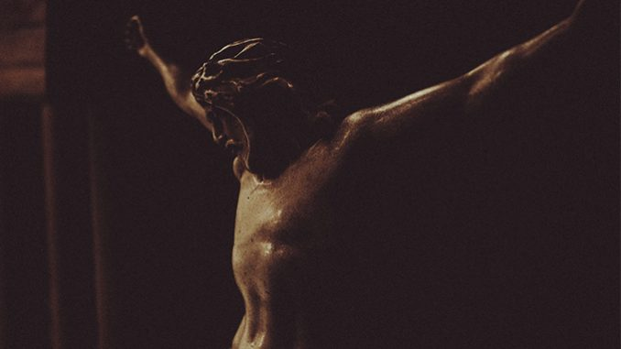
Romans 8:1-17 NIV
Notes:
[READ & BRIEFLY COMMENT ON PASSAGE]
But that’s not all the Apostle Paul has to say about it. [NEXT SLIDE]

Slide 19
“My old self has been crucified with Christ. It is no longer I who live, but Christ lives in me. So I live in this earthly body by trusting in the Son of God, who loved me and gave himself for me.”
Paul, Galatians 2:20 NLT
Notes:
[BRIEF COMMENT ON PASSAGE]
If anyone knows this, Paul does. You are not the worst thing you’ve ever done.
And like Jason Bourne, once you realize who you are at your worst (as Jason did at the end of the first movie, and as Saul of Tarsus did on the road to Damascus), you can say, “I don’t want to do this anymore.” You can choose to say, I don’t want to be the old self, the sinner, the killer. Instead, I want a new identity and a new life. And so, I receive again and again what Christ as done for me.
That’s how Paul can write this to the messed-up Corinthian church: [NEXT SLIDE]

Slide 20
Paul, 2 Corinthians 5:15-17 NLT
¹⁵ He died for everyone so that those who receive his new life will no longer live for themselves. Instead, they will live for Christ, who died and was raised for them.

Slide 21
¹⁶ So we have stopped evaluating others from a human point of view. At one time we thought of Christ merely from a human point of view. How differently we know him now! ¹⁷ This means that anyone who belongs to Christ has become a new person. The old life is gone; a new life has begun!
Notes:
Now, it may be that there is someone listening to this message about our identity in Christ for the first time. But chances are, you’ve heard it lots of times, but you keep forgetting it. So, for many of us, the wilderness comes and God wants to use it to remind you of who you are, and where you ought to get your life from.
It makes me think of another movie called 50 First Dates. [NEXT SLIDE]

Slide 22

Notes:
50 First Dates is a romantic comedy starring Adam Sandler and Drew Barrymore. Barrymore’s character, Lucy, has short-term memory loss due to an accident and she can’t remember anything that happened the day before. Which means, she doesn’t remember the man who loves her. So, Henry, played by Sandler, has to help her remember everyday who she is and how they met, as he attempts to woo her again and again.
We need those reminders, don’t we? We too need to become aware of the one who created us for himself, who loves us, and wants us to know who we are in him. How do we do this when it seems that we so quickly forget? And when, as the pastor and hymn-writer Robert Robinson put it, we’re so prone to wander.
Here are a few things I’d like to suggest that we do: [NEXT SLIDE]

Slide 23
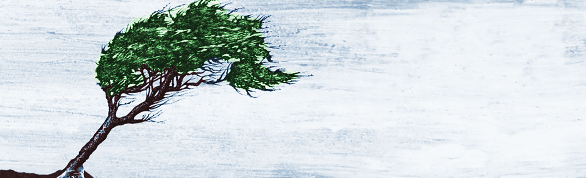
Know Who You Are
We can root our identity in Christ by…

Slide 24
Know Who You Are
We can root our identity in Christ by…
Meditating on the God revealed in Jesus
Notes:
As A.W. Tozer said, “What comes into our minds when we think about God is the most important thing about us.” So, what comes into your mind? Chances are, for many of us, our portrait of God has been shaped by all kinds of people and ideas that don’t reflect Christ. Therefore, we have to be intentional in constantly aligning and realigning our thoughts about God to be consistent with the God revealed in Jesus.
And we can do that by regularly reading and reflecting on the gospels, practicing imaginative prayer, listening to music, reading books, or listening to podcasts that are meant to reframe your portrait of God. Whatever it is, whatever you do. Do something. Otherwise, competing portraits and the lies of the tempter will find their way into your mind and your heart and lead you away from the God who looks like Jesus. And that’s a problem because we see ourselves most clearly when we see God for who he is in Christ.
The second thing we can do… [NEXT SLIDE]

Slide 25
Know Who You Are
We can root our identity in Christ by…
Meditating on the God revealed in Jesus
Practicing sabbath (rhythms of work & rest)
Notes:
This one can be really difficult for some of us. Particularly for leaders. But setting aside a day to rest reminds us that we are human beings, not human doings. You are not what you do. You are not your work. And as God would tell Israel, you’re no longer slaves in Egypt. So don’t live like it.
Partake of the blessing of sabbath and get your life back. Let sabbath reset your heart to the things of God. Let it open up space for you to remember who you are–you are loved by God for being you (his child, co-heirs with Christ), not for what you do. Amen?
And a third thing we can do to root our identity in Christ… [NEXT SLIDE]

Slide 26
Know Who You Are
We can root our identity in Christ by…
Meditating on the God revealed in Jesus
Practicing sabbath (rhythms of work & rest)
Allowing the wilderness to (re)shape you
Notes:
As I said earlier, the wilderness has a way of exposing what’s happening on the inside, especially the stuff that doesn’t reflect Christ and needs to be repented of if we’re going to grow in our faith. So let it. Allow the wilderness to shape and chisel off all that doesn’t reflect your new identity as a follower of Jesus.
And I should probably say this. Don’t compare yourself to others in this pursuit of holiness. As I heard one psychologist put it: “Compare yourself to who you were yesterday, not to who someone else is today.” In other words, work on your own growth. You take responsibility for you and leave others to God.
Finally, let’s close with these questions for refection and response: [NEXT SLIDE]

Slide 27
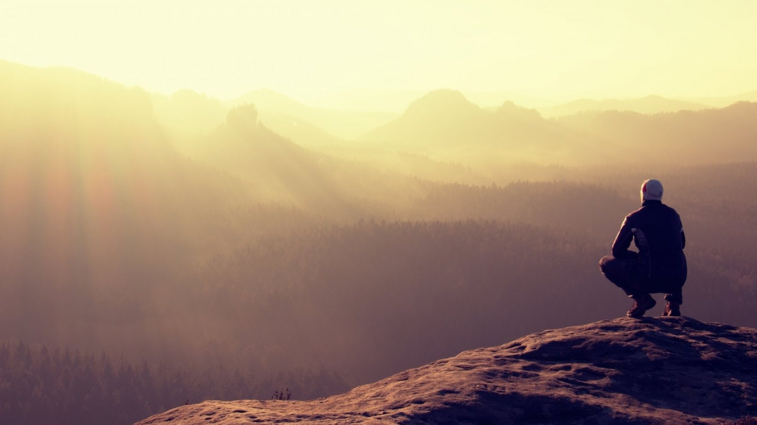
Questions for reflection and response:

Slide 28
Questions for reflection and response:
Who are what is shaping your identity on a regular basis? Are the voices that you listen to pointing you to Christ?

Slide 29
Questions for reflection and response:
Who are what is shaping your identity on a regular basis? Are the voices that you listen to pointing you to Christ?
Does your view of yourself reflect what the Bible says? If not, what needs to change? What needs to be healed?

Slide 30
Questions for reflection and response:
Who are what is shaping your identity on a regular basis? Are the voices that you listen to pointing you to Christ?
Does your view of yourself reflect what the Bible says? If not, what needs to change? What needs to be healed?
In what way is the Spirit inviting you to know who you are in Christ and grow a more resilient faith in the wilderness?
Notes:
[READ QUESTIONS]
Closing Prayer
Father, we want to know who we are in Christ. We need more than just words. We need those words to be accompanied by a real experience in our soul—to feel your favor and the peace and freedom that comes from being loved by you. As we reflect on what we’ve heard, and as we prepare to receive communion together, we pray that your Spirit would move in us to confess our sins and believe in your grace—the grace that says we’re forgiven, that we can change, and that we can live into our purpose as your children. Thank you, Lord, for making that possible. Bless us now as we remember who we are at your table. Amen.

