Slide 1


Slide 2

But the fruit of the Spirit is love, joy, peace, patience, kindness, goodness, faithfulness, gentleness, and self-control.
GALATIANS 5:22-23

Slide 3
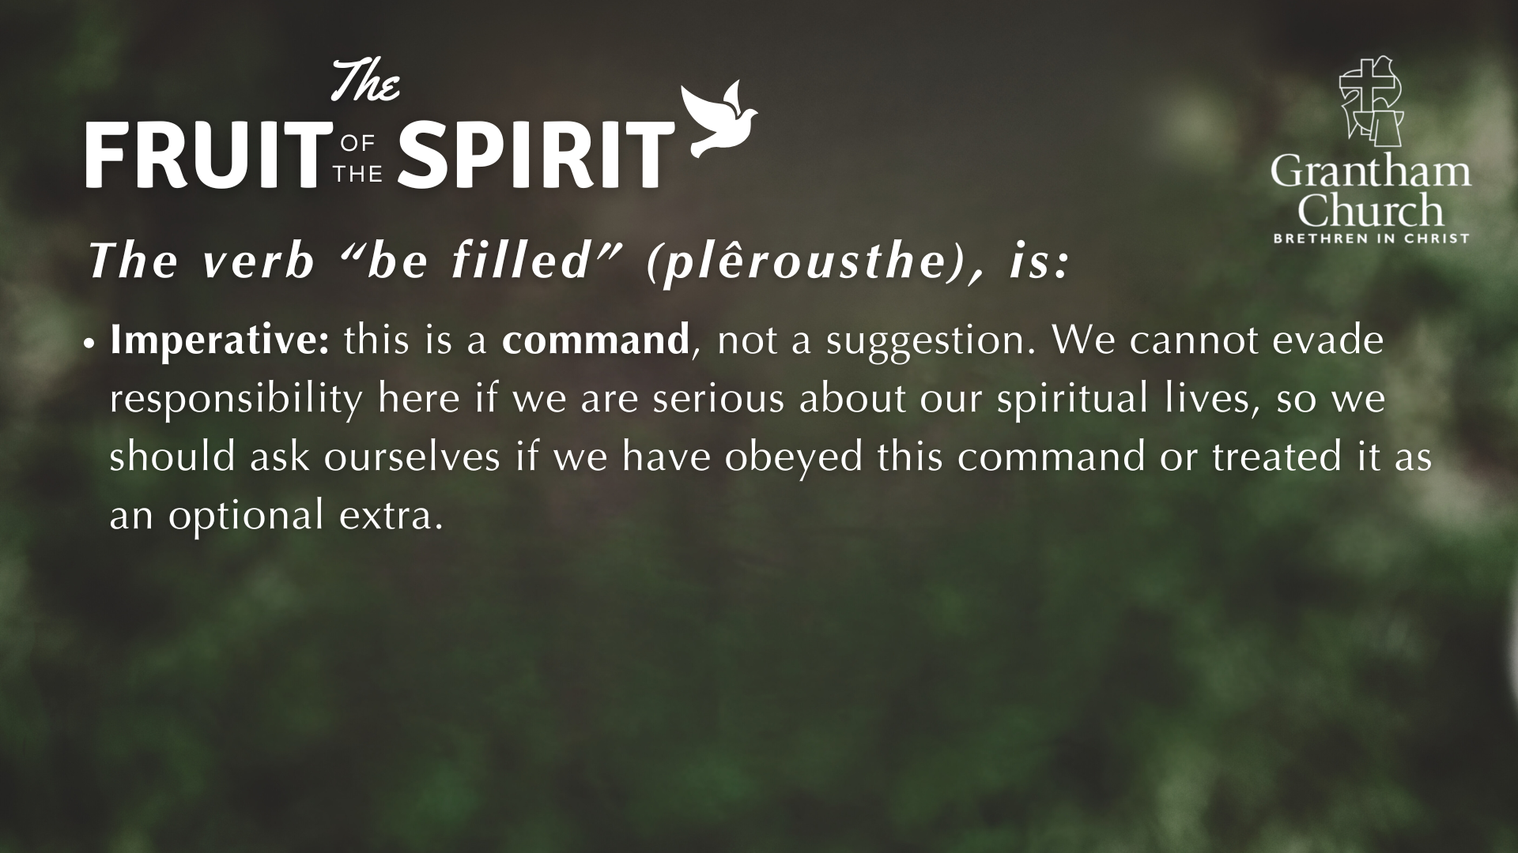

Slide 4
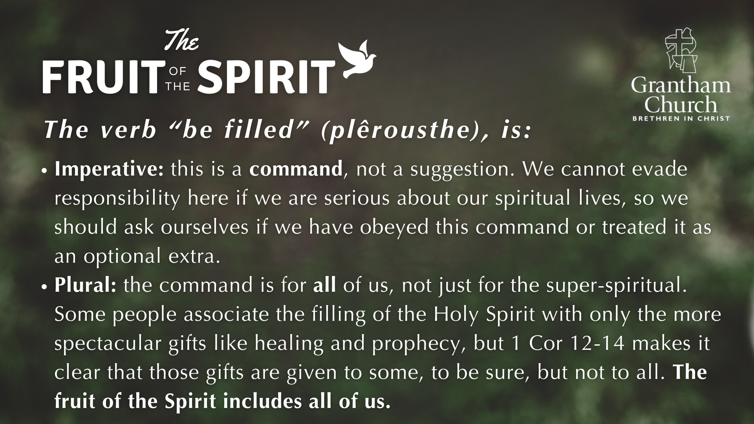

Slide 5
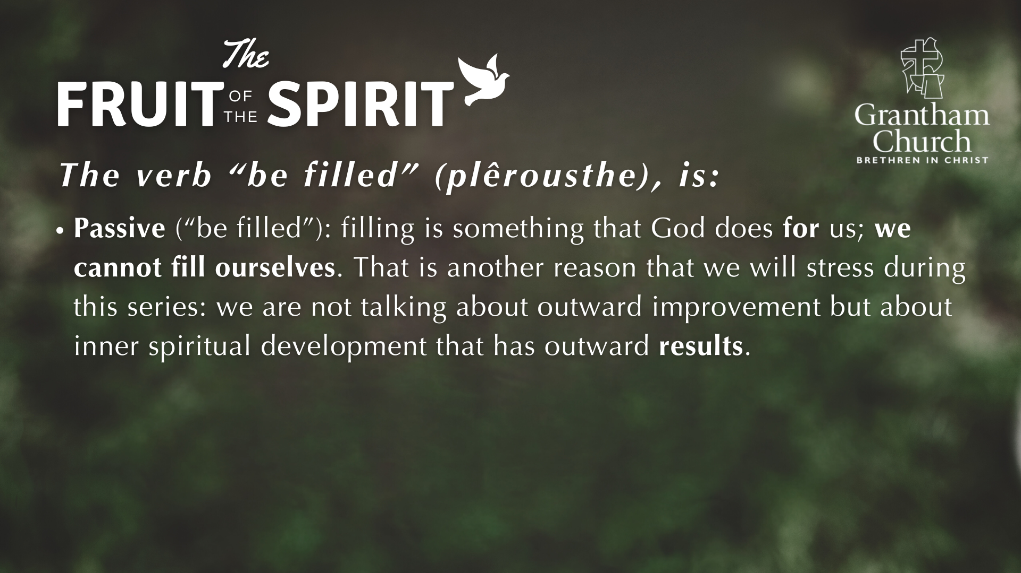

Slide 6
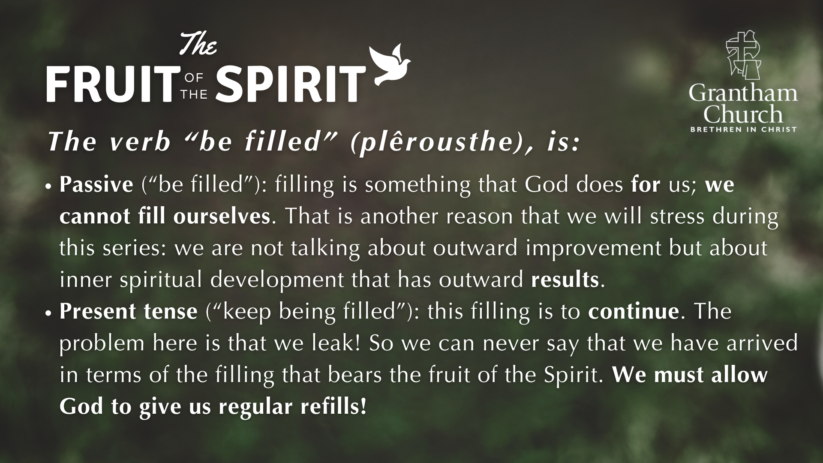

Slide 7
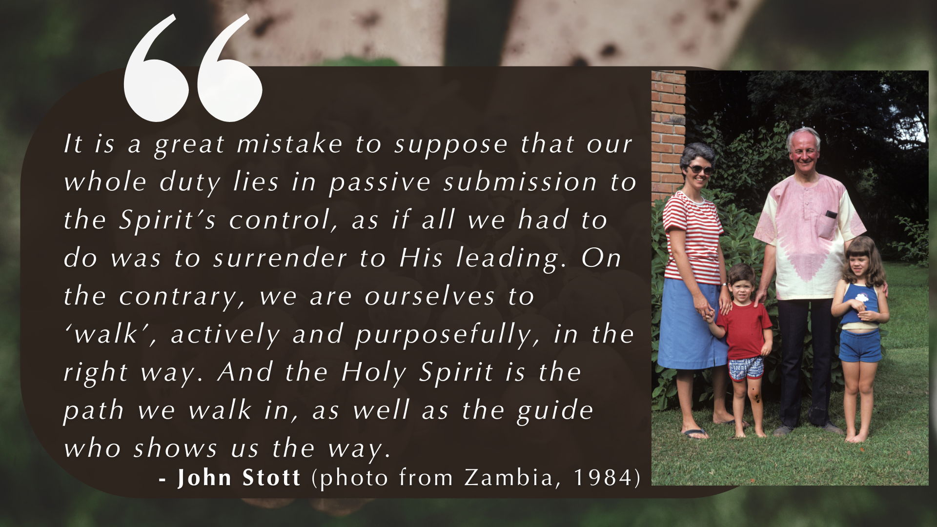

Slide 8
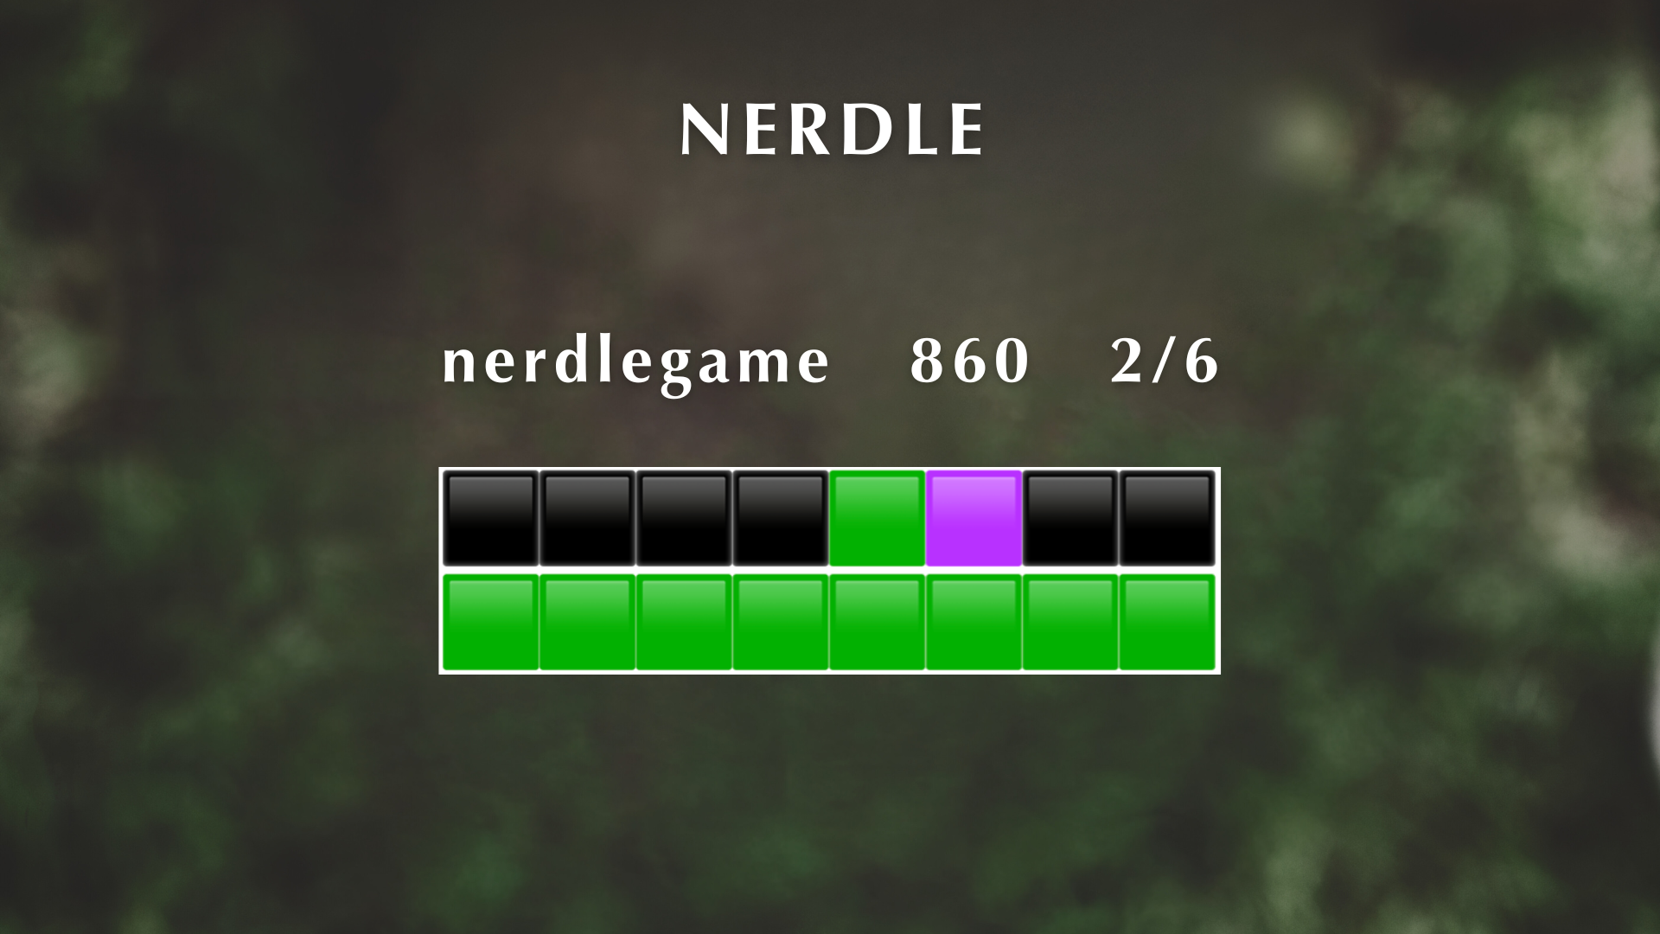

Slide 9
1 Oh, what joy for those whose disobedience is forgiven, whose sin is put out of sight! 2 Yes, what joy for those whose record the LORD has cleared of guilt, whose lives are lived in complete honesty! … 11 So rejoice in the LORD and be glad, all you who obey him! Shout for joy, all you whose hearts are pure!
PSALM 32:1-2, 11 (NLT)

Slide 10
3 For I know my transgressions, and my sin is always before me. 4 Against you, you only, have I sinned and done what is evil in your sight … 8 Let me hear joy and gladness; let the bones you have crushed rejoice…. 12 Restore to me the joy of your salvation and grant me a willing spirit, to sustain me.
PSALM 51:3-4, 8, 12

Slide 11
MATTHEW 2:10 (the Magi, or “wise men”)
When they saw the star, they were overjoyed.
εχαρησαν χαραν μεγαλην σφοδρα
echarêsan charan megalên sphodra
They rejoiced joy great very much

Slide 12
11 Blessed are you when people insult you, persecute you and falsely say all kinds of evil against you because of me. 12 Rejoice and be glad, because great is your reward in heaven, for in the same way they persecuted the prophets who were before you.
MATTHEW 5:11-12

Slide 13
So you have sorrow now, but I will see you again; then you will rejoice, and no one can rob you of that joy.
JOHN 16:22 (Jesus to his disciples)

Slide 14
So you have sorrow now, but I will see you again; then you will rejoice, and no one can rob you of that joy.
JOHN 16:22 (Jesus to his disciples)
Because of the joy awaiting him [Jesus], he endured the cross, disregarding its shame. Now he is seated in the place of honor beside God’s throne.
HEBREWS 12:2

Slide 15
2 Consider it pure joy, my brothers and sisters, whenever you face trials of many kinds,
3 because you know that the testing of your faith produces perseverance. 4 Let perseverance finish its work so that you may be mature and complete, not lacking anything.
JAMES 1:2-4 (NIV)

Slide 16
2 Consider it pure joy, my brothers and sisters, whenever you face trials of many kinds,
3 because you know that the testing of your faith produces perseverance. 4 Let perseverance finish its work so that you may be mature and complete, not lacking anything.
JAMES 1:2-4 (NIV)
…when troubles of any kind come your way, consider it an opportunity for great joy.
JAMES 1:2 (NLT)

Slide 17
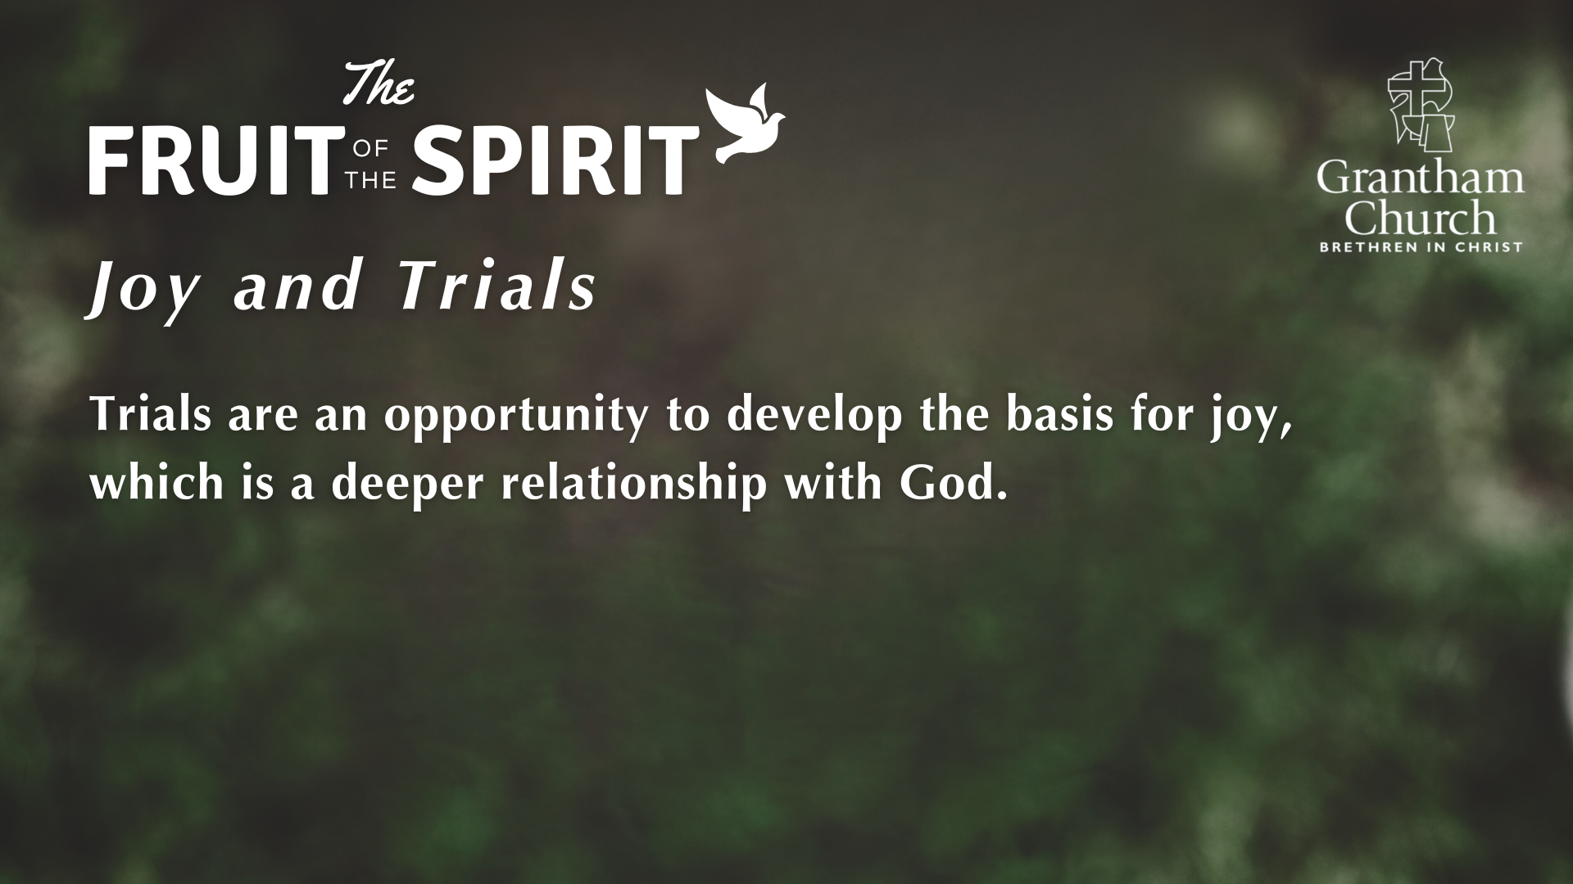

Slide 18
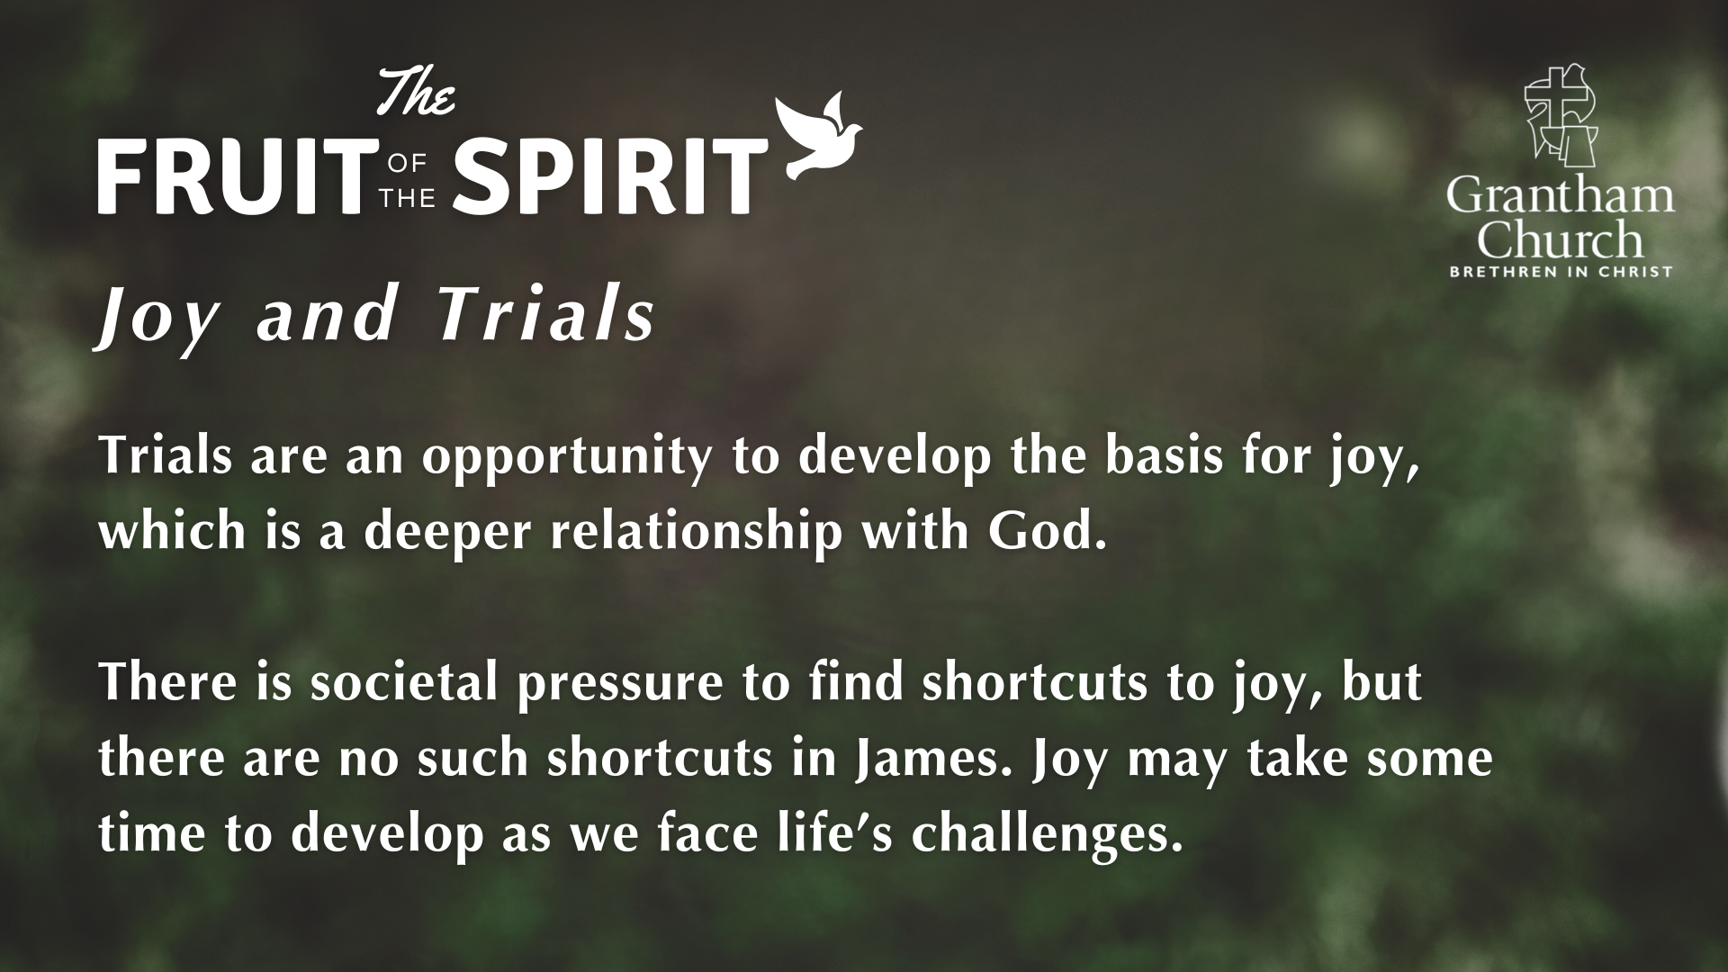

Slide 19
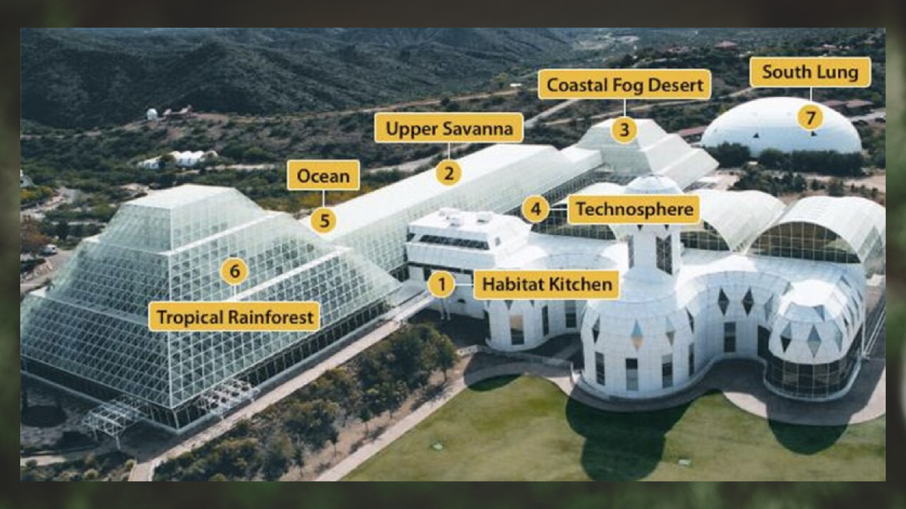

Slide 20
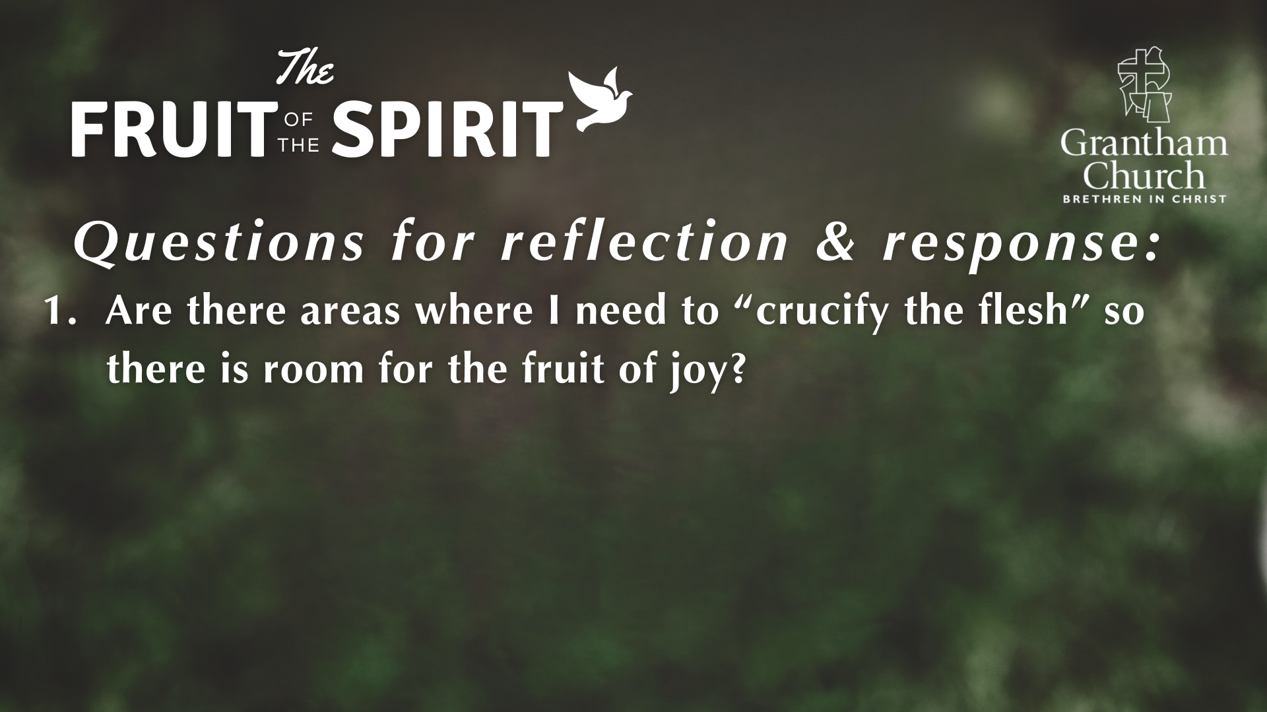

Slide 21
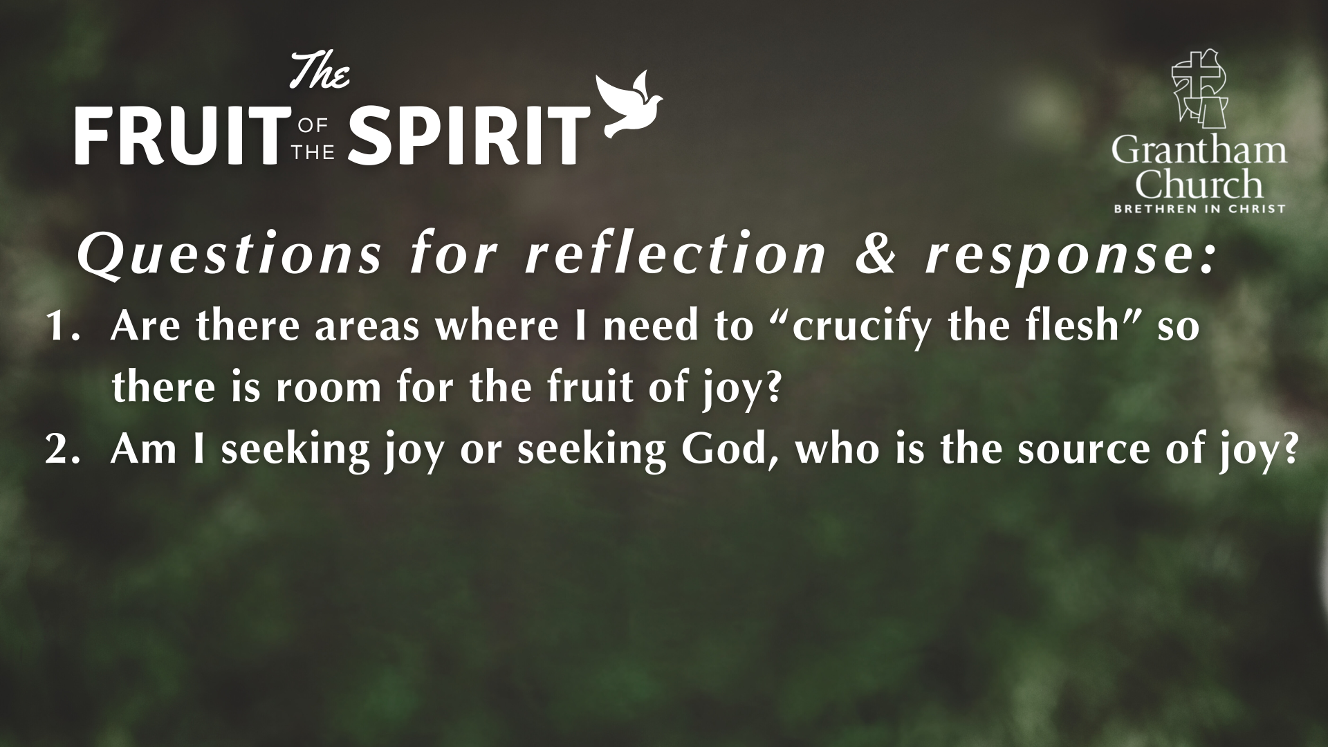

Slide 22
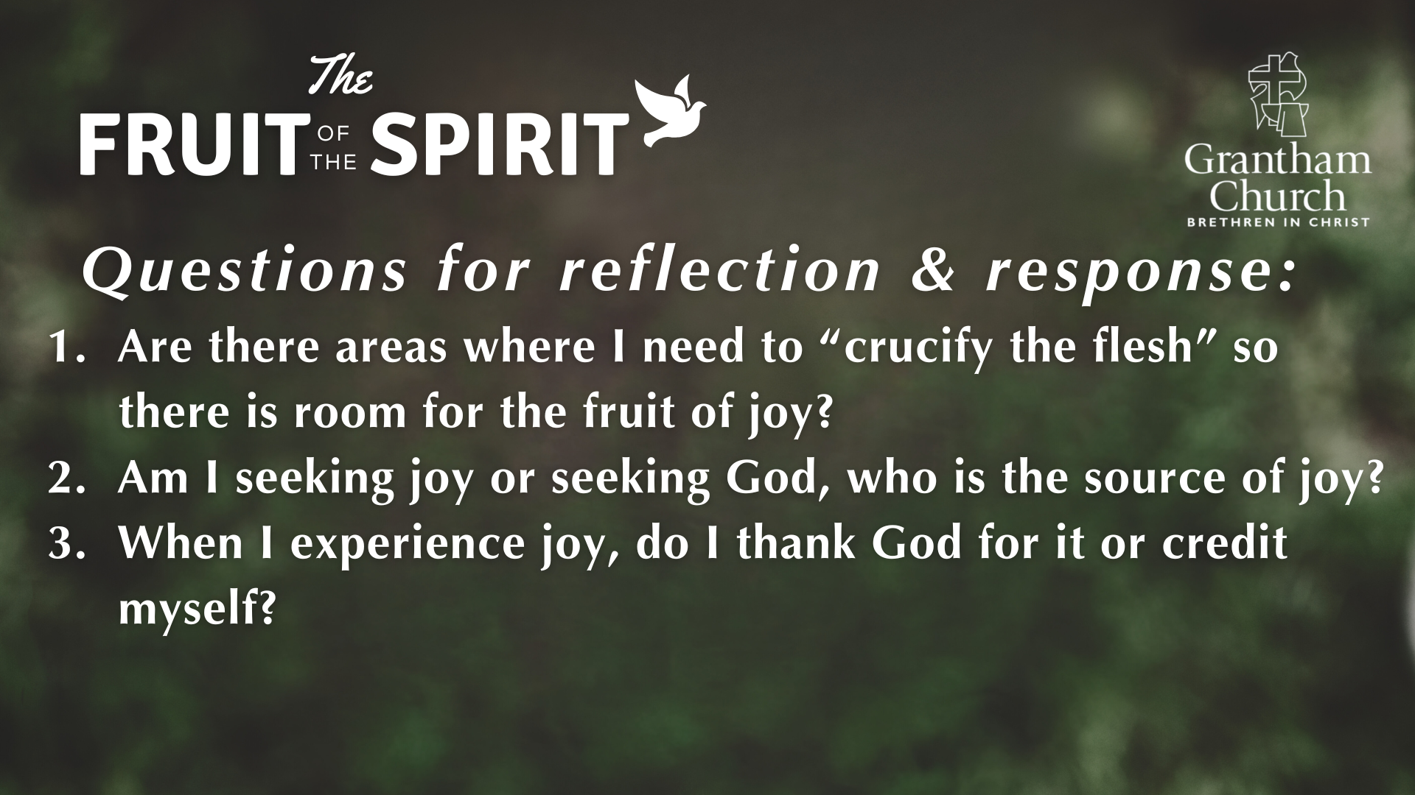

Slide 23
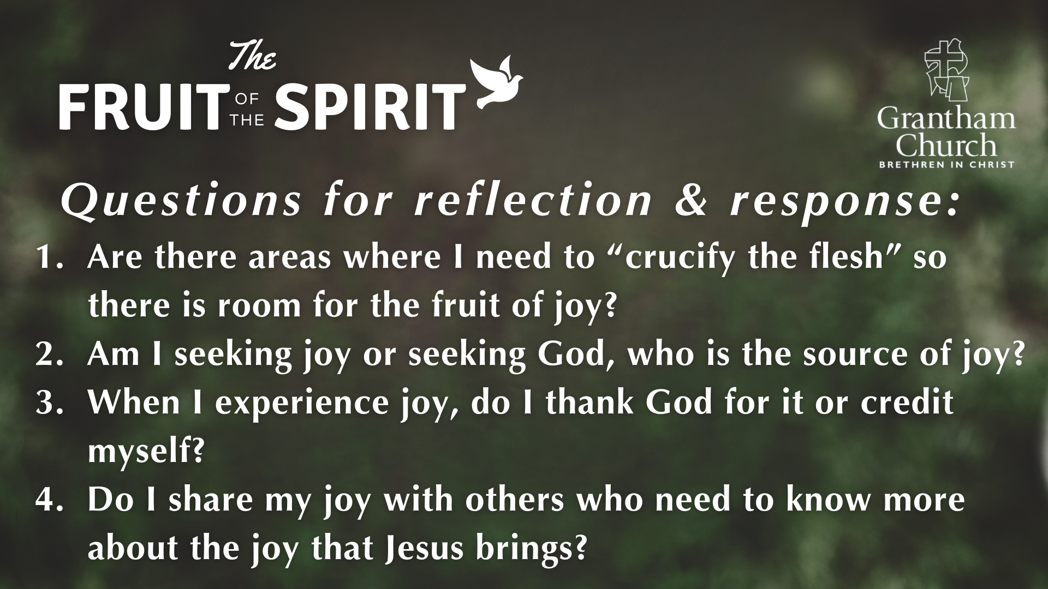

Slide 24
Don’t be dejected and sad, for the joy of the LORD is your strength.
NEHEMIAH 8:10 (NLT)

Slide 25
¹⁷ Even though the fig trees have no blossoms,
and there are no grapes on the vines;
even though the olive crop fails,
and the fields lie empty and barren;
even though the flocks die in the fields,
and the cattle barns are empty,
¹⁸ yet I will rejoice in the Lord!
I will be joyful in the God of my salvation!
HABAKKUK 3:17-19 (NLT)

Slide 26


