Slide 1

Notes:
[BRIEF INTRO – CONCLUDING PRAYER SERIES]
In this 3-part mini-series, we’ve been focusing on the need to enter into corporate prayer as a congregation. I began by reminding us that all throughout the Scriptures and church history, every spiritual awakening and renewal was founded on intense, corporate, Kingdom-centered prayer. So, prayer must be about more than our own spiritual and physical needs. That view of prayer is too small.
In addition to those things, we must see prayer as our cry for more of the Kingdom, which is what it looks like when God’s will is being done on the earth, and that will and Kingdom always looks like Jesus.
And as we saw last week, this “cry for the Kingdom” involves using prayer as a way of revolting against spiritual evil. For if we don’t see that we are in a battle between human, angelic, and demonic wills, then we cannot and will not be about the Kingdom-coming ministry of Jesus.
This brings us to the final message in our series, where I’d like us to reflect on what God is able to do when we humble ourselves, acknowledge our need for divine intervention, and pray for an in-breaking of the Kingdom.
And then I’m going to share with you a corporate prayer that I’m inviting our congregation to pray together this fall, as we seek a renewal, an awakening, and an outpouring of the Spirit—here at Grantham, but also for the Church in America.
[BRIEF PRAYER – NEXT SLIDE]

Slide 2

Scripture Reading
Mark 6:6-13, 30-52 NIV
Notes:
[INVITATION TO STAND FOR SCRIPTURE READING]
[READ MARK 6:6-13, 30-52]
This is the word of the Lord. Thanks be to God
You may be seated. [NEXT SLIDE]

Slide 3
Notes:
[BRIEF COMMENTS ON PASSAGE]
Summary – Jesus sends them out, feeds the 5,000, and saves them!
The OT imagery is thick (e.g., ”remote” place, the multitudes, Jesus as shepherd, they’re hungry—God miraculously provides, a miracle on the sea, etc.)
So, what do we learn from this story? How does it apply to us? Let’s consider some of the things being communicated in this story… [NEXT SLIDE]

Slide 4
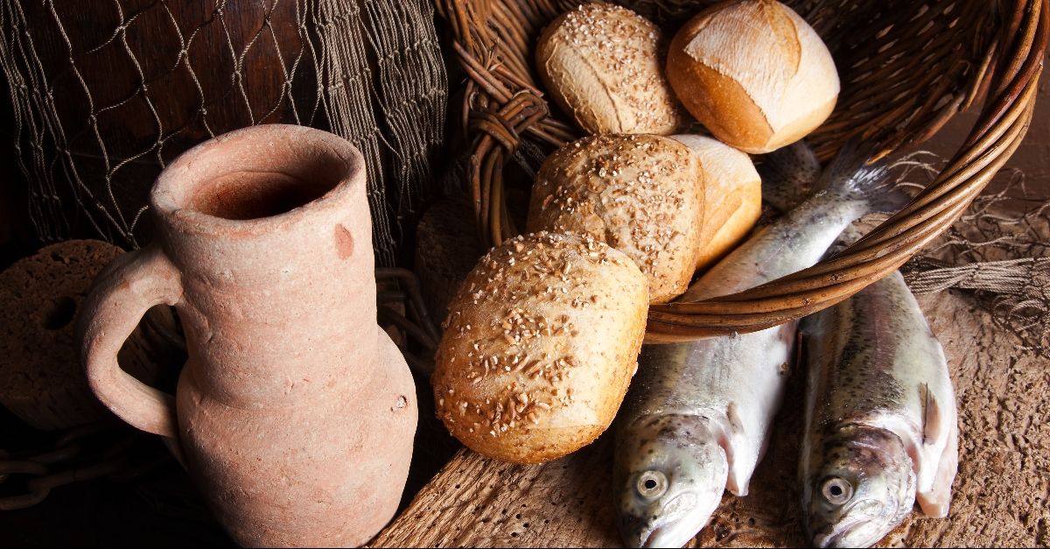
Mark 6:6-13, 30-52 – Making Application
What do we learn from this story? How does it apply to us?

Slide 5
Mark 6:6-13, 30-52 – Making Application
What do we learn from this story? How does it apply to us?
We’re called to live by faith and trust in God’s provision and power.

Slide 6
Mark 6:6-13, 30-52 – Making Application
What do we learn from this story? How does it apply to us?
We’re called to live by faith and trust in God’s provision and power.
Jesus wants to increase our faith and for us to grow in our dependency upon him with each passing event.

Slide 7
Mark 6:6-13, 30-52 – Making Application
What do we learn from this story? How does it apply to us?
We’re called to live by faith and trust in God’s provision and power.
Jesus wants to increase our faith and for us to grow in our dependency upon him with each passing event.
God can take the little we have and multiply it with faith.

Slide 8
Mark 6:6-13, 30-52 – Making Application
What do we learn from this story? How does it apply to us?
We’re called to live by faith and trust in God’s provision and power.
Jesus wants to increase our faith and for us to grow in our dependency upon him with each passing event.
God can take the little we have and multiply it with faith.
In the midst of the storm, remember the miracle in your basket!

Slide 9
Mark 6:6-13, 30-52 – Making Application
What do we learn from this story? How does it apply to us?
We’re called to live by faith and trust in God’s provision and power.
Jesus wants to increase our faith and for us to grow in our dependency upon him with each passing event.
God can take the little we have and multiply it with faith.
In the midst of the storm, remember the miracle in your basket!
Prayer is how we access and release God’s blessings—our prayers can be cries for heaven to break through into our situation.
Notes:
[BRIEF COMMENTS ON EACH]
We are called to live by faith and trust in God’s provision & power. - Don’t let your doubts, your reasoning, and your fears rule you - Don’t make excuses (“But God…”); your “but” isn’t greater than God
Jesus wants to increase our faith and for us to grow in our dependency upon him with each passing event. - Every situation, event, and trial is an opportunity to grow, because the depth of your faith will determine reality the of the Kingdom in you and around you
God can take the little we have and multiply it with faith. - 5 loaves and 2 fish is enough for God to feed the multitudes; will you give it to him (John 6 - a young boy offers up his lunch)
In the midst of the storm, remember the miracle in your basket! - The disciples saw the power of God before, the evidence was in their boat - What is in your basket? Hear Jesus say, “Remember what I’ve done before and who I am. I’m greater than these challenges. I’m greater than the storm.”
Prayer is how we access and release God’s blessings—our prayers can be cries for heaven to break through into our situation. - Jesus took their small offering and prayed for divine intervention—for heaven to serve on earth what was lacking and in short supply
And that’s what prayer can do if we will cry out for more of the Kingdom. Think back to the prayer Jesus taught his disciples to pray… [NEXT SLIDE]

Slide 10
Matthew 6:9-10 NIV
This, then, is how you should pray:
Our Father in heaven, hallowed be your name, your kingdom come, your will be done, on earth as it is in heaven…
Notes:
[BRIEF COMMENTS]
First, notice it’s a corporate prayer—”Our Father…”
Also, it’s about heaven coming to earth, and it’s about God’s will being done
The phrase “your will be done” literally in the Greek says “your will come into existence” or “break through” into human history.
Don’t miss this, church. Jesus sees this collective prayer as a cry to God for the in-breaking of his Kingdom in the middle of our present evil age. And he was teaching his disciples to pray with this in view as they embodied his teachings and mission.
That’s why in her book Open Road, Sue Nilson Kibbey writes: [NEXT SLIDE]

Slide 11
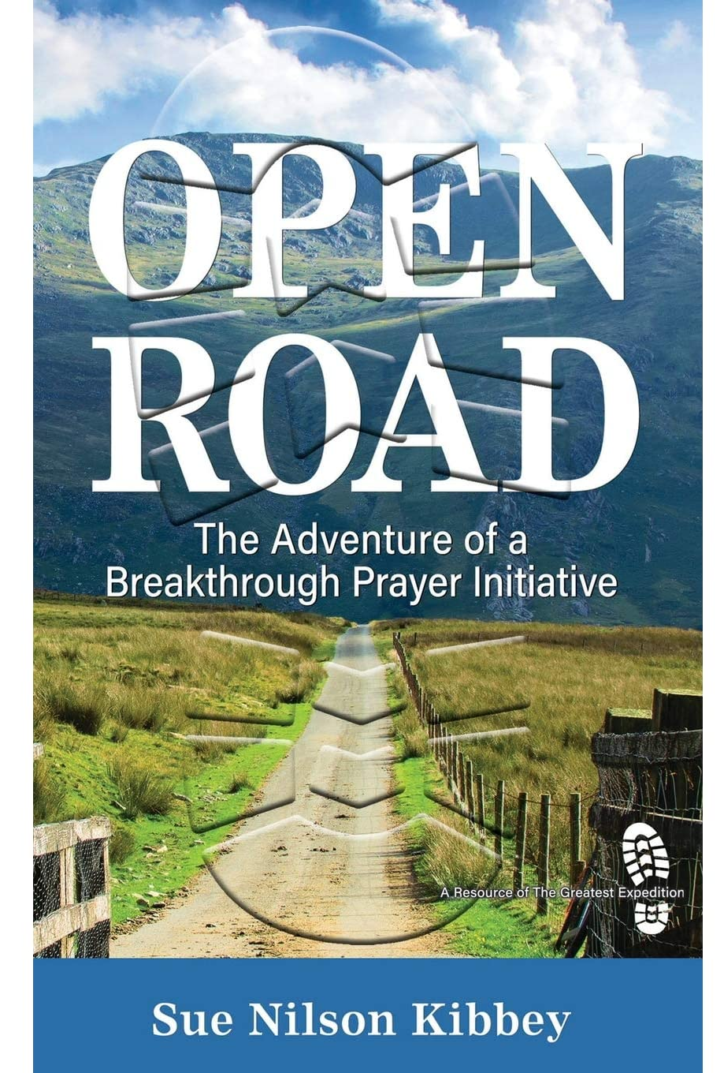
“Jesus’ followers grasped that doing ministry and good works via their own human ideas and expertise wasn’t enough. When Jesus taught them to add prayer asking God to break through miraculously anew, they began to look expectantly for the Almighty God to do in and through them what they had never imagined on their own and certainly couldn’t accomplish themselves.”
Notes:
[BRIEF COMMENTS]
This is what it means to cry out for the Kingdom in solidarity with the church.
And why do we need to cry out together?
Our personal challenges
Our church challenges
Our country is in trouble
The world is lost without Jesus
That’s why it’s time to join together as a church family and voice a collective cry for more of the Kingdom. And as Sue suggests in her book, create a “breakthrough” prayer that our congregation can begin praying regularly. So, that’s what we’ve done, and what I want to share with you now.
Here is Grantham’s breakthrough prayer… [NEXT SLIDE]

Slide 12
Grantham’s Breakthrough Prayer
Father,
We cry out for more of your Kingdom in and through Grantham Church! Please break through our darkness, free us from our bondage, and open doors for greater ministry. Fill us with your Spirit and empower us by your grace, and we will surrender and faithfully follow Jesus in fulfilling your gospel mission. Amen.
Notes:
[READ & COMMENT]
Real quick… let me say a few words about each line of this prayer. [NEXT SLIDE]

Slide 13
Grantham’s Breakthrough Prayer
Father,
We cry out for more of your Kingdom in and through Grantham Church! Please break through our darkness, free us from our bondage, and open doors for greater ministry. Fill us with your Spirit and empower us by your grace, and we will surrender and faithfully follow Jesus in fulfilling your gospel mission. Amen.
Notes:
[BRIEF COMMENT]

Slide 14
Grantham’s Breakthrough Prayer
Father,
We cry out for more of your Kingdom in and through Grantham Church! Please break through our darkness, free us from our bondage, and open doors for greater ministry. Fill us with your Spirit and empower us by your grace, and we will surrender and faithfully follow Jesus in fulfilling your gospel mission. Amen.
Notes:
[BRIEF COMMENT]

Slide 15
Grantham’s Breakthrough Prayer
Father,
We cry out for more of your Kingdom in and through Grantham Church! Please break through our darkness, free us from our bondage, and open doors for greater ministry. Fill us with your Spirit and empower us by your grace, and we will surrender and faithfully follow Jesus in fulfilling your gospel mission. Amen.
Notes:
[BRIEF COMMENT]

Slide 16
Grantham’s Breakthrough Prayer
Father,
We cry out for more of your Kingdom in and through Grantham Church! Please break through our darkness, free us from our bondage, and open doors for greater ministry. Fill us with your Spirit and empower us by your grace, and we will surrender and faithfully follow Jesus in fulfilling your gospel mission. Amen.
Notes:
[BRIEF COMMENT]
So, what are we doing with this prayer? Well, here are several ways… [NEXT SLIDE]

Slide 17
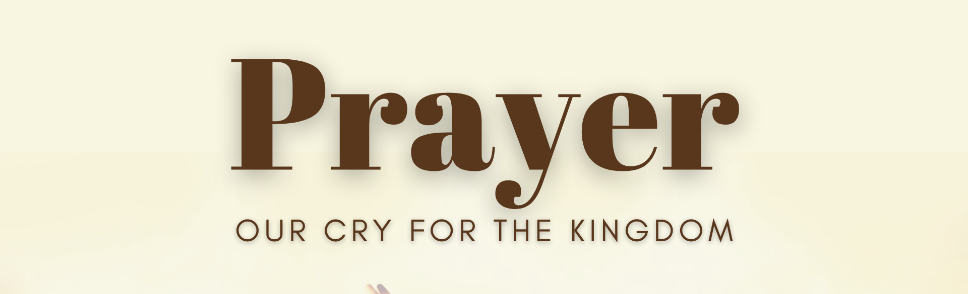
How you can join with our congregation in corporately praying Grantham’s Breakthrough Prayer:

Slide 18
How you can join with our congregation in corporately praying Grantham’s Breakthrough Prayer:
Include the prayer in your own regular rhythms of prayer.

Slide 19
How you can join with our congregation in corporately praying Grantham’s Breakthrough Prayer:
Include the prayer in your own regular rhythms of prayer.
Set a timer (on your phone) to pray at a certain time of day.

Slide 20
How you can join with our congregation in corporately praying Grantham’s Breakthrough Prayer:
Include the prayer in your own regular rhythms of prayer.
Set a timer (on your phone) to pray at a certain time of day.
Pray the prayer at all church group gatherings & meetings.
Notes:
[BRIEF COMMENT ON EACH]
While we are planning to include Grantham’s Breakthrough Prayer in most worship services this fall, I want to strongly encourage you to decide how you want to incorporate this into your religious rhythms and routines. Will you do that?
We will even help you… [PRINTED RAYER CARDS]
Here it is again. [NEXT SLIDE]
This time, please join me in saying the breakthrough prayer as we close out this series and prepare to receive communion together.

Slide 21
Grantham’s Breakthrough Prayer
Father,
We cry out for more of your Kingdom in and through Grantham Church! Please break through our darkness, free us from our bondage, and open doors for greater ministry. Fill us with your Spirit and empower us by your grace, and we will surrender and faithfully follow Jesus in fulfilling your gospel mission. Amen.
Notes:
[LEAD CONGREGATION IN BREAKTHROUGH PRAYER]
[CLOSING WORDS]
[CLOSING PRAYER LEADING TO COMMUNION]
Father, as you fed Israel with manna in the wilderness, you fed the multitudes through your Son, Jesus; and you are still feeding us today through your word and through your Table. You are the true bread of heaven. Without you, there is no life. Without you, we can do nothing. Feed us now. Give life to our souls; break through into our darkness, shine the light of your love and favor on your people, and bring renewal and awakening to your Church. Let this begin with us at Grantham Church.
Lord, hear our cry for more of the Kingdom. Build your Kingdom here. Make possible what seems impossible to us, as we consider all of our needs, and so many uncertainties about the future. Still, we trust you—your character and your power. Help us not to waste this time by living in fear, cynicism, anger, and apathy. May we respond to the voice of your Spirit calling, “Repent and return to me.” May we be broken over our sins and know that in you is forgiveness and new life.
So, God, bring us to a place of confession and total surrender. Give us a hunger for more of you. Restore to us the joy of our salvation. Reignite a passion for Christ and the gospel, and help us to see the lostness of our world and the urgency of this hour. Do this so that your will would be done in us, your Church, and the world.
And as we partake of communion this morning, let this Table be a tangible reminder that you will reconcile, renew, and restore all things. You will establish your Kingdom on the earth. And we are being included in that gospel mission. So, we thank you for the joy and the promise, Jesus. And we say that all the glory is yours in this life and in the age to come. Meet us now in the bread and cup. For it’s in your holy and precious name that we pray. Amen.

