Slide 1
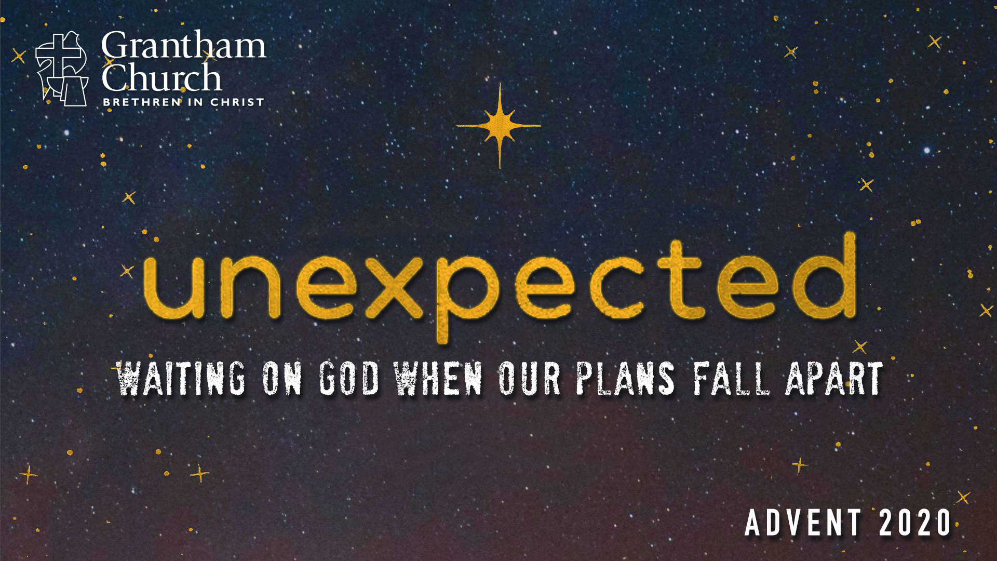
Notes:
What do we do when the unexpected happens? How do we respond when our world is rocked? The Bible is full of stories where people experienced God through unexpected events—biblical characters whose ideas about God and their plans for the future were challenged and disrupted, yet they were surprised by God’s faithfulness, mercy, and love after a period of waiting. What can these stories teach us?
That’s our focus for our Advent 2020 series, Unexpected: Waiting on God When Our Plans Fall Apart. This Advent we are going to look at four different stories, and the biblical characters involved in those stories, and see how God might use them to shine light into our own situation and circumstances in 2020. And I’ll tell you where we’re going each week.
In this first message (today), we’re going to reflect on the story of Abraham and Sarah (where the biblical story of faith and redemption begins), next week we will look at the life of Joseph (who was betrayed by his brothers and went from prison to the palace), week three we will consider the lessons and the wisdom we can learn from Job and his trials, and then the Sunday before Christmas we will conclude the series with the unexpected events in Mary and Joseph’s life, which culminates in the birth of the Messiah.
Folks, we’ve had a challenging year, and it’s not over yet. So, I hope you will join us for this timely 4-part series. And let’s open up our hearts to what the Spirit wants to say to us about God, about ourselves, and about how we should live as people of faith amid the unexpected.
Let’s begin then with our first story, the story of Abraham and Sarah. I want to start by reading from Genesis 12, but let me give you a little context first. The biblical book of Genesis is a book of origins. It begins with God creating the world, of him creating humankind in his image, and making us stewards and caretakers of his good creation. But we mess it up. In Genesis 3 we see sin enter the Garden when Adam and Eve listen to the lies of the serpent and give in to temptation. They eat from the forbidden tree. And from there things only get worse. Things get bad.
They get so bad that eventually there is a flood that wipes out the wicked, allowing humanity to begin again. But it’s not long and the people of the earth forget God. In fact, they think they are gods themselves. And this is represented by them building the tower of Babel in Genesis 11, which is portrayed as a collective arrogance and rebellion against God. But this time God doesn’t use a flood to sort it out. Instead, he uses the scattering of people throughout the earth into different tribes, ethnic groups, and languages to accomplish his will and move forward with his plan to redeem the world.
And that plan begins with Abram, later to be known as Abraham—the Father of our faith. We’re told at the end of Genesis 11 that Abram is from the land of Ur, which was in the region of the Tigris and Euphrates rivers in the Middle East. God has his eye on Abram. And for whatever reason (maybe it was Abram’s disillusionment with his gods, a yearning for something more, or his heart simply being ripe for faith), God sets apart Abram to kick off his divine plan to birth a nation that Yahweh could reveal himself, his character, his power, his covenant faithfulness, his love and his desire to redeem the whole world, which will ultimately come in the person of Jesus Christ.
So, that brings us to Genesis chapter 12, where the story of Abraham begins. Let’s look at that together: [NEXT SLIDE]

Slide 2
Genesis 12:1-5 NRSV
¹ Now the Lord said to Abram, “Go from your country and your kindred and your father’s house to the land that I will show you. ² I will make of you a great nation, and I will bless you, and make your name great, so that you will be a blessing. ³ I will bless those who bless you, and the one who curses you I will curse; and in you all the families of the earth shall be blessed.”
Notes:
So, God wants to bless, rescue, and restore the whole world through Abraham and his family. Which is why the entire Old Testament focuses on this family through the nation of Israel.
Verse 4. [NEXT SLIDE]

Slide 3
⁴ So Abram went, as the Lord had told him; and Lot went with him. Abram was seventy-five years old when he departed from Haran. ⁵ Abram took his wife Sarai and his brother’s son Lot, and all the possessions that they had gathered, and the persons whom they had acquired in Haran; and they set forth to go to the land of Canaan.
Notes:
[BRIEF COMMENT ON VERSES]
Canaan, of course, is what is known as ”the promised land” later on in the Exodus story. This is the land that God will eventually give to the Hebrew people where the kingdom of Israel will be established. But at this point in the story, Canaan is occupied by another tribe, the Canaanites. So, until God gives him the land, Abram (who must wait) will pitch his tent in the Negev, which is the southern most part of Canaan, a less populated, desert-like region.
And then later in chapter 12 we learn that there is a severe famine in the land and so Abram goes down to Egypt. [NEXT SLIDE]

Slide 4
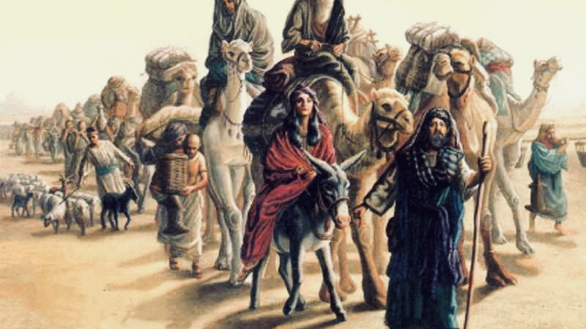
Notes:
The Scripture tells us that not once but twice in the story Abram, for fear of his own life, will lie to kings and say that his wife is his sister, so they don’t kill him and take her because of her beauty. Of course, he can convince them of this because his wife, Sarai, has still not bore him any children. And let me just say that I think it’s important for us to recognize that Abraham, like most characters in the Bible, is not perfect. Yet, God will graciously work with imperfection and reward our faith and determination to follow him. We should be glad about that. Because we’re not perfect either.
As the story goes on (about 10 years later), Abram begins to grow impatient when waiting for God’s promise. Afterall, God said that he would make him a great nation and give him a land for his family. So, he says to God, “Hey, if you don’t do something, I’ll have to adopt my servant and build this nation through him.” And then in Genesis 15, verse 4 and 5… [NEXT SLIDE]

Slide 5
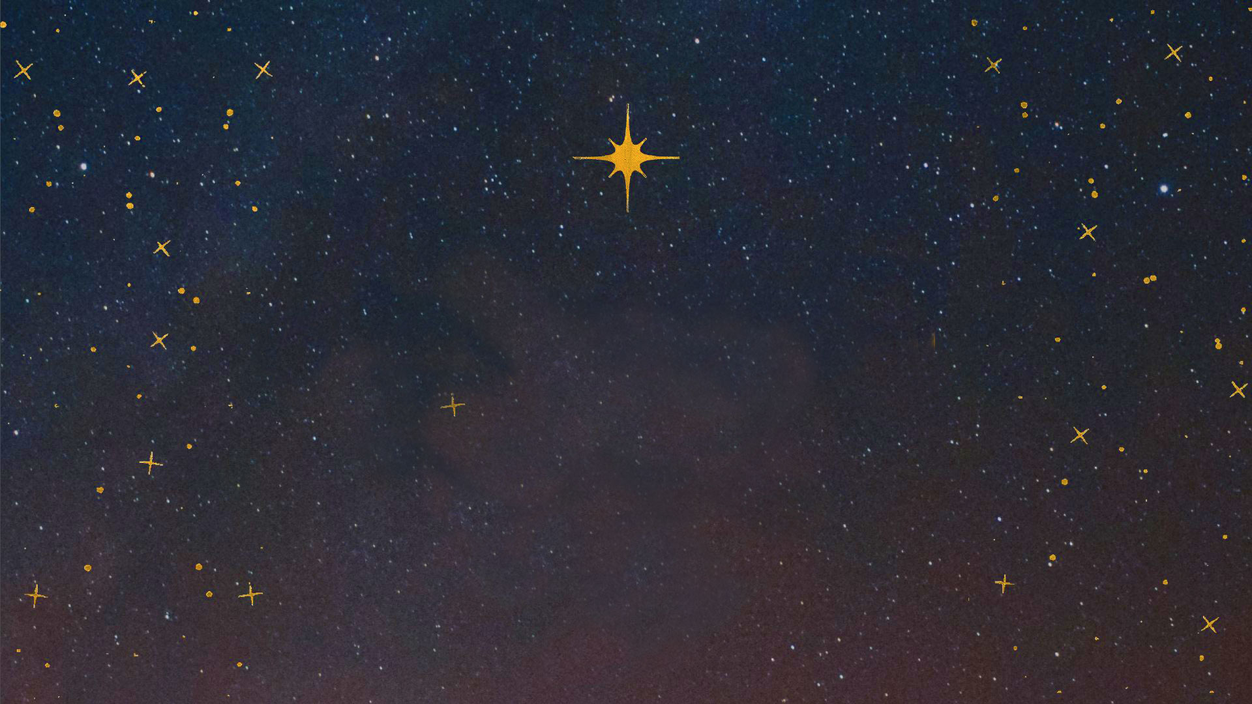
Genesis 15:4-5 NLT
⁴ Then the Lord said to him, “No, your servant will not be your heir, for you will have a son of your own who will be your heir.” ⁵ Then the Lord took Abram outside and said to him, “Look up into the sky and count the stars if you can. That’s how many descendants you will have!”
Notes:
What a beautiful promise. God made this covenant with Abram and he says that he is going to keep his end of the deal. God will prove that he is faithful. OK, but when? That’s what Abram wants to know. And like Abram, that’s what we’d like to know. ”Lord, I hear you saying this will happen, but when? What else? Can you give me more?” But nothing. Silence. Abram and Sarai must wait. But they don’t want to wait.
Now Sarai begins to grow impatient. I mean she’s old, really old (beyond her child-bearing years), and not getting any younger. So, she decides to take matters into her own hands. She’s going to try and make something happen. Now, you can look at this as a lack of faith in God, or you can see it the way I think most of us see things like this: God told me this was going to happen, so I’m going to help him along. Besides, maybe he is waiting on me to do something. So, what does she do? Do you know this story? Listen to Genesis 16:1-4. [NEXT SLIDE]

Slide 6
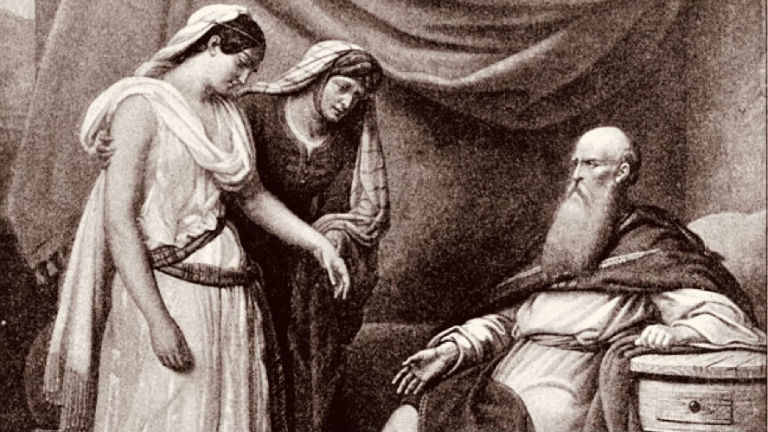
Notes:
Genesis 16:1-4 NIV
¹ Now Sarai, Abram’s wife, had borne him no children. But she had an Egyptian slave named Hagar; ² so she said to Abram, “The Lord has kept me from having children. Go, sleep with my slave; perhaps I can build a family through her.” Abram agreed to what Sarai said. ³ So after Abram had been living in Canaan ten years, Sarai his wife took her Egyptian slave Hagar and gave her to her husband to be his wife. ⁴ He slept with Hagar, and she conceived.
[BRIEF COMMENTS ON PASSAGE] – Surrogacy
Problem solved, right? Not even close. Because they refused to wait and trust in God to act on their behalf, they’ve created another problem. Now, Sarai and Hagar will both despise each other. Ishmael will be born. And a feud will begin between families that will last for generations.
When reading this story we see how God continues to bail Abraham out, just as he will do time and time again through the whole biblical story. Even though these fallible human beings keep making a mess of things (as we will see through the OT story), God is a committed lover to them. He is true to the covenant agreement he has made. Which we see God formalize with Abram in Genesis 17 through circumcision, as a sign that his offspring would be blessed. And then he changes Abram’s name to Abraham, and Sarai to Sarah. A marker that something new has begun.
And then it finally happens. Listen as I read Genesis 21:1-5… [NEXT SLIDE]

Slide 7
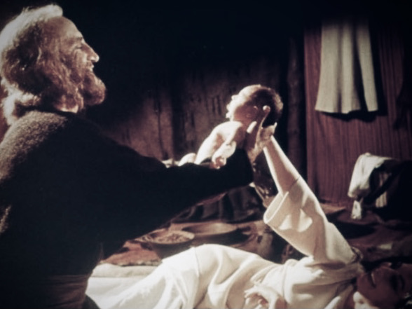
Notes:
Genesis 21:1-5 NIV
¹ Now the Lord was gracious to Sarah as he had said, and the Lord did for Sarah what he had promised. ² Sarah became pregnant and bore a son to Abraham in his old age, at the very time God had promised him. ³ Abraham gave the name Isaac to the son Sarah bore him. ⁴ When his son Isaac was eight days old, Abraham circumcised him, as God commanded him. ⁵ Abraham was a hundred years old when his son Isaac was born to him.
Wow! It finally happened. And that’s it. Abraham’s faith paid off, his faith proved genuine, and that God is faithful. End of story, right? No. There is one more big test that comes some years later. We’re not entirely sure how old Isaac was at this point, but one thing is for sure, what happens next was totally unexpected. We’re not sure why God chose to do it this way, but a somewhat miraculous, certainly unusual birth wasn’t enough to build a nation or solidify Abraham’s faith in God. God would need to test Abraham in order to see if his faith was truly legit, and hopefully to inspire generations to come.
Take a look at Genesis 22. [NEXT SLIDE]

Slide 8
Genesis 22:1-2 NIV
¹ Some time later God tested Abraham. He said to him, “Abraham!”
“Here I am,” he replied.
² Then God said, “Take your son, your only son, whom you love—Isaac—and go to the region of Moriah. Sacrifice him there as a burnt offering on a mountain I will show you.”
Notes:
What is happening here? Why is God commanding Abraham to do this? It’s no doubt a troubling thing for God to ask a father to do (offer his son up as a human sacrifice), even if it is a test! Which is why some Jews in the intertestamental period proposed that Abraham may not have actually heard the voice of God, but was instead misled by the Evil One and then God stepped in to stop it. But let’s go with what the text says. On top of this being a dark command, remember that Isaac is proof of God’s faithfulness and the way be which God’s promise to Abraham is to be fulfilled. So, why this request?
And notice, it’s most striking that Abraham doesn’t question or ague with God. He just obeys. However, there is reason to believe that Abraham does see this as a test, at least he thinks that it is possible. A few verses later we read that Abraham has begun the religious journey to what would later be the Temple Mount to make a sacrifice with his son Isaac, something they’d apparently done before. On the way, Isaac asks, “Father, where is the lamb for the burnt offering?” And Abraham replies, “God himself will provide the lamb, my son.” Is that his way of deceiving his unsuspecting boy, or does it reflect Abraham’s sincere belief that God would not actually expect him to do this. You see, it’s not just about God’s promise. It’s about his character.
And remember, human sacrifice wasn’t uncommon in the ANE. In fact, the Canaanites (who lived in the land) practiced the ritualistic killing of their children in order to appease a deity. So, while the thought of it would have been gut-wrenching to Abraham, he heard of his neighbors doing this all the time. Maybe God was like the gods of the Canaanites, or maybe he’s not. Listen as I pick up with Genesis 22 verse 9. [NEXT SLIDE]

Slide 9
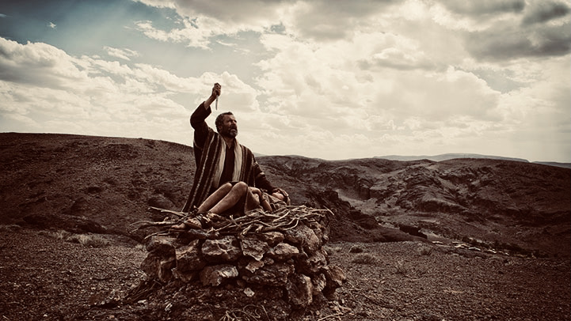
Notes:
⁹ When they reached the place God had told him about, Abraham built an altar there and arranged the wood on it. He bound his son Isaac and laid him on the altar, on top of the wood. ¹⁰ Then he reached out his hand and took the knife to slay his son. ¹¹ But the angel of the Lord called out to him from heaven, “Abraham! Abraham!” “Here I am,” he replied. ¹² “Do not lay a hand on the boy,” he said. “Do not do anything to him. Now I know that you fear God, because you have not withheld from me your son, your only son.”
What a traumatic experience this would have been. Something Abraham and Isaac would never forget. And if they were to tell Sarah, something she would never forgive Abraham for. So, why would God test Abraham like this? Brothers and sisters, I don’t know. I don’t know why God allows us to undergo what James calls the trials and tribulations that test our faith. I don’t know why God sometimes asks us to do things that don’t make a lot of sense. I don’t know why (or maybe I should say I mostly don’t like) God working in our lives this way. But I do know this. The tests are not for us to fail. God wants us to succeed that we would both know that our faith is genuine, that we become more like Christ, and that we’re ready for the next world.
And to be clear about Genesis 22, God doesn’t want the killing, and he doesn’t do the killing. He provides the Lamb. As he reveals in Christ, he makes a way out for us. He pours out his grace on our lives and stays committed to his covenant and commitment to us as a loving Father. Now God knows that Abraham’s faith is genuine. And now Abraham knows that God is unlike all other gods. This God—the one true God—is gracious, faithful, and good. Verse 15… [NEXT SLIDE]

Slide 10
Genesis 22:15-18 NIV
¹⁵ The angel of the Lord called to Abraham from heaven a second time ¹⁶ and said, “I swear by myself, declares the Lord, that because you have done this and have not withheld your son, your only son, ¹⁷ I will surely bless you and make your descendants as numerous as the stars in the sky and as the sand on the seashore. Your descendants will take possession of the cities of their enemies, ¹⁸ and through your offspring all nations on earth will be blessed, because you have obeyed me.”
Notes:
[BRIEF COMMENTS ABOUT PASSAGE]
In preparing this message, I thought about the unexpected in my life, and the times I’ve had to wait on God. This year has certainly been full of the unexpected and I’ve undoubtedly had to wait on God. And like a lot of pastors right now, I’ve even felt like quitting a few times, if I’m honest.
But like Abraham, I was also reminded of my own calling and how long I had to wait to see some of God’s promises fulfilled. Some of you know, I felt a clear call into vocational ministry when I was in middle school. I vividly recall seeing myself doing the things I’m doing now. I felt I was given these images and visions of me speaking before large crowds of people, and God confirmed that those things were from him many times through the years, even as I still waited on them to come to pass.
I also remember that by the time I was in college I was growing impatient. I wanted to speed things up and I tried a few times to make things happen. I practically begged older leaders to be my mentors, going through most of my 20s without anyone really investing in me. I spent about 7 years in youth ministry, only for that season to end with me feeling disillusioned and cynical about the church. For the first time I began doubting what I had heard from God. I was shaken to my core, but I decided to draw closer to God through it, and I never stopped believing in the church.
This led to a 7-year wilderness and rebuilding period. 7 years of resting, re-learning, and rethinking what I thought I knew before I returned to vocational ministry and pastored my first church. Think about that folks. It was almost 20 years after my first initial visions and calling that I began to receive what God had promised. I had to wait quite a while. I had to trust God—that this crooked road full of unexpected twists and turns would arrive at the destination he had revealed to me. And this call to trust God is still in effect today. For all of us. That’s why this series is all about.
And so to help us reflect on each story in this series, I want us think about three questions: What does this story teach us about God, about ourselves, and about how we should live in light of the truths found within the story? I’ll help us to do that, but please allow the Spirit to show you more and connect the dots in your own life. Let’s do that now with the story of Abraham and Sarah. [NEXT SLIDE]

Slide 11
unexpected Advent 1 Reflection – What does this story teach us?
About God?
About ourselves?
About how we should live?
Notes:
[BRIEF COMMENT ON EACH]
[CLOSING PRAYER]

Slide 12
unexpected Advent 1 Reflection – What does this story teach us?
About God? He meets us where we are and he works with our messy lives.
About ourselves?
About how we should live?
Notes:
[BRIEF COMMENT ON EACH]
[CLOSING PRAYER]

Slide 13
unexpected Advent 1 Reflection – What does this story teach us?
About God? He meets us where we are and he works with our messy lives.
About ourselves? Our thinking is often too small and we’re not willing to wait on God.
About how we should live?
Notes:
[BRIEF COMMENT ON EACH]
[CLOSING PRAYER]

Slide 14
unexpected Advent 1 Reflection – What does this story teach us?
About God? He meets us where we are and he works with our messy lives.
About ourselves? Our thinking is often too small and we’re not willing to wait on God.
About how we should live? We must cultivate a deep trust in God and expect the unexpected.
Notes:
[BRIEF COMMENT ON EACH]
[CLOSING PRAYER]

