Slide 1

Notes:
[BRIEF INTRO]
Week 3 of our 8-week study of the book of Philippians
Two weeks ago, we began our series by giving attention to the opening of Paul’s letter (1:1-11); right away we read of Paul’s love for Christ and his affection for the church in Philippi; we also picked up on themes and concepts that Paul will address in the rest of his letter
Last Sunday we looked at chapter 1, verses 12-26, where Paul encouraged the Philippian Christians to see their own sufferings in light of the gospel and the Kingdom that is coming in Christ, just as Paul sees his own sufferings and the possibility that he might be executed in Rome
Again, Paul is writing from Rome while under house arrest, as he awaits a court date with the Roman emperor, Nero. Epaphroditus, a brother from Philippi (mentioned later in chapter 2), has come to Paul to check on and support him, and report on how the Philippian believers are doing and relay the questions they have for him. Remember where Philippi is in the Roman world… [NEXT SLIDE]

Slide 2
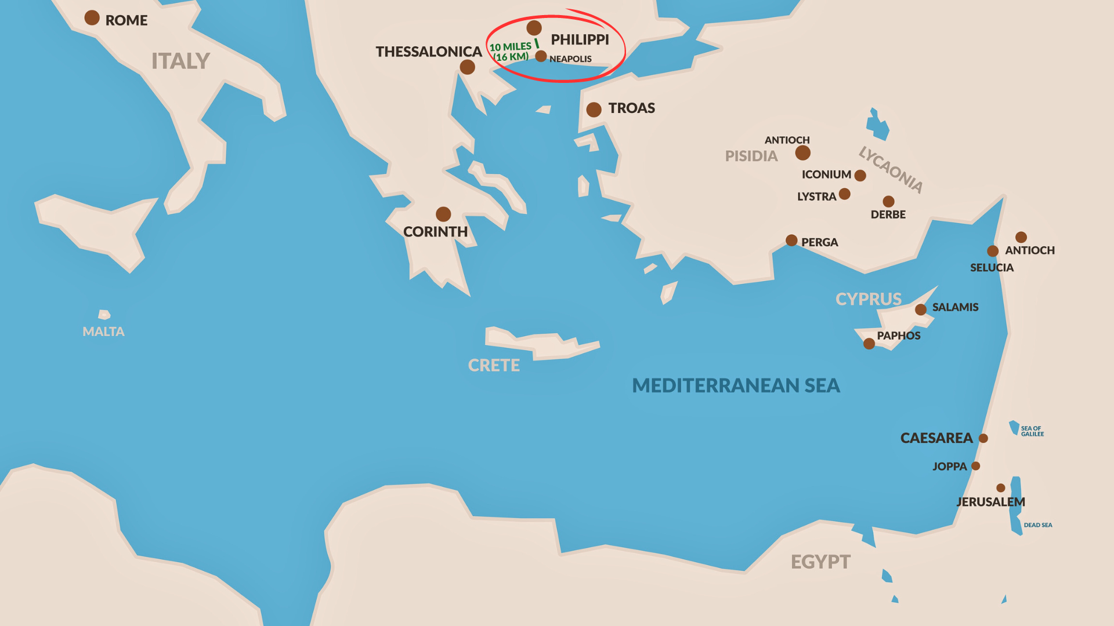
Notes:
[BRIEF COMMENTS]
Philippi was located in Macedonia, a region in northern Greece; Paul first went into Macedonia and planted the church in Philippi about 52 AD with the first convert, a wealthy woman named Lydia
Philippi is 800 miles from Rome and along a major Roman road and trade route of the empire, which gave quick and easy access to Philippi and helped to fuel its local economy
Each week I’ve been reminding us of some critical background information on the city, its makeup, demographics, and the context in which the church in Philippi is living… [NEXT SLIDE]

Slide 3
Notes:
[BRIEF COMMENTS]
Philippi was an affluent Roman colony of 10,000 people; it’s full of retired veterans and patriotic nationalists. It’s like a miniature Rome, with its temples, Roman forum, and large outdoor amphitheater. It was an exemplar of loyalty to Caesar and fealty to Roman law and order
Only about 40% of the population are Roman citizens, the rest were Gentiles lacking citizenship. There appears to be little to no Jews in Philippi, which makes sense when you consider that this is one of the last places an orthodox Jew would want to live; knowing its nationalist fervor.
In fact, it’s believed that the Roman citizens of Philippi worked hard to demonstrate proper honor and fidelity toward Rome so that Roman power might be directed in beneficial ways toward their community. How this worked was that cities of the empire vied with one another to express their loyalty and allegiance to Rome in hopes of gaining advantages that only Caesar could bestow. Fierce competition for imperial favor meant elaborate building programs, special embassies to Rome, and a whole series of honors—temples, priests, games, statues, sacrifices, and decrees.
Therefore, the leading citizens of Philippi would seek honors for themselves and enhanced status in their city by sponsoring the various mechanisms of emperor worship, which first began with Caesar Augustus. Participation in the “imperial cult” was an immediate way in which city leaders could show such loyalty. So, this loyalty resulted not only in gains to the leading citizens (their prosperity and reputation), but to the entire city as well. Which is why they did not tolerate any disruption of this social and political system that ensured continued wealth for the elite and reinforcement of the status quo. And that is what the gospel of Jesus and the early Christian movement was: a disruption and threat to oppressive systems of power where the rich get richer, and the poor get poorer.
Just consider how the language of empire was adopted by early Christians to challenge, rival, even subvert, the narrative of a glorious Roman empire where Caesar is Lord… [NEXT SLIDE]

Slide 4
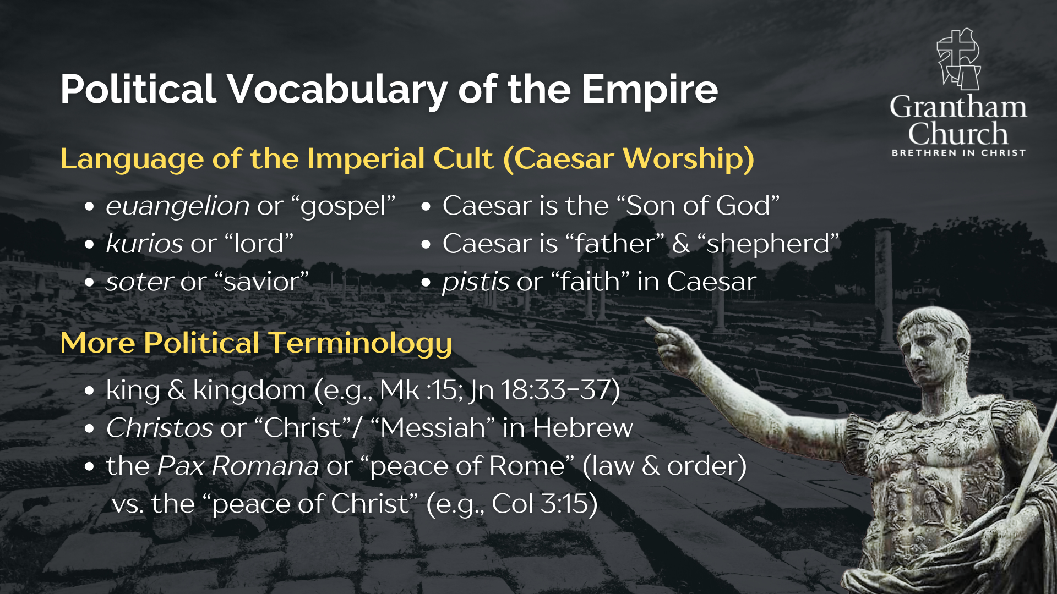
Notes:
[READ SLIDE & COMMENT]
And it’s not just the subversive language that leads to opposition, but it is likely that the Philippians were suffering at the hands of the wider civic community due to their withdrawal from the traditional Greco-Roman cults, especially from the imperial cult. Because they confessed “Jesus is Lord” (and therefore, Caesar is not), the Philippian believers refused to demonstrate their loyalty to Rome in the prescribed manner of emperor worship. Such a refusal would have been seen as a threat to community well being and relations with Rome. Economic sanctions, strained social relations, and even censure from local authorities were likely consequences of the Philippian believers` commitment to Christ and his good news. Their refusal to conform to socio-political and cultural norms would have been a great offense to the Roman way of life. Of course, all of it done in love and in obedience to Jesus.
In a small way, to help us understand the Philippian plight, it would be like sitting during the national anthem at a Texas rodeo… or not holding your hand over your heart and pledging allegiance in a patriotic ceremony here in PA. It may not be illegal, but you go ahead and try it and see what happens. Then you’ll get a little taste of what the Philippian believers would have endured for confessing “Jesus is Lord” and that his kingdom is greater than the Roman one, or the American one, for that matter.
You see… a big problem in the American church is that we have tended to separate and compartmentalize religion and politics as if they are two totally different spheres. But in the first century, and for most of human history, there wasn’t a dividing line between the two. And so, we can no longer afford to read the New Testament in an apolitical or de-politicized way. Because when we do that, we strip the gospel of Jesus Christ of its subversive nature and its power to change lives and American society. The early Christians knew better. Listen to what Preston Sprinkle writes… [NEXT SLIDE]

Slide 5
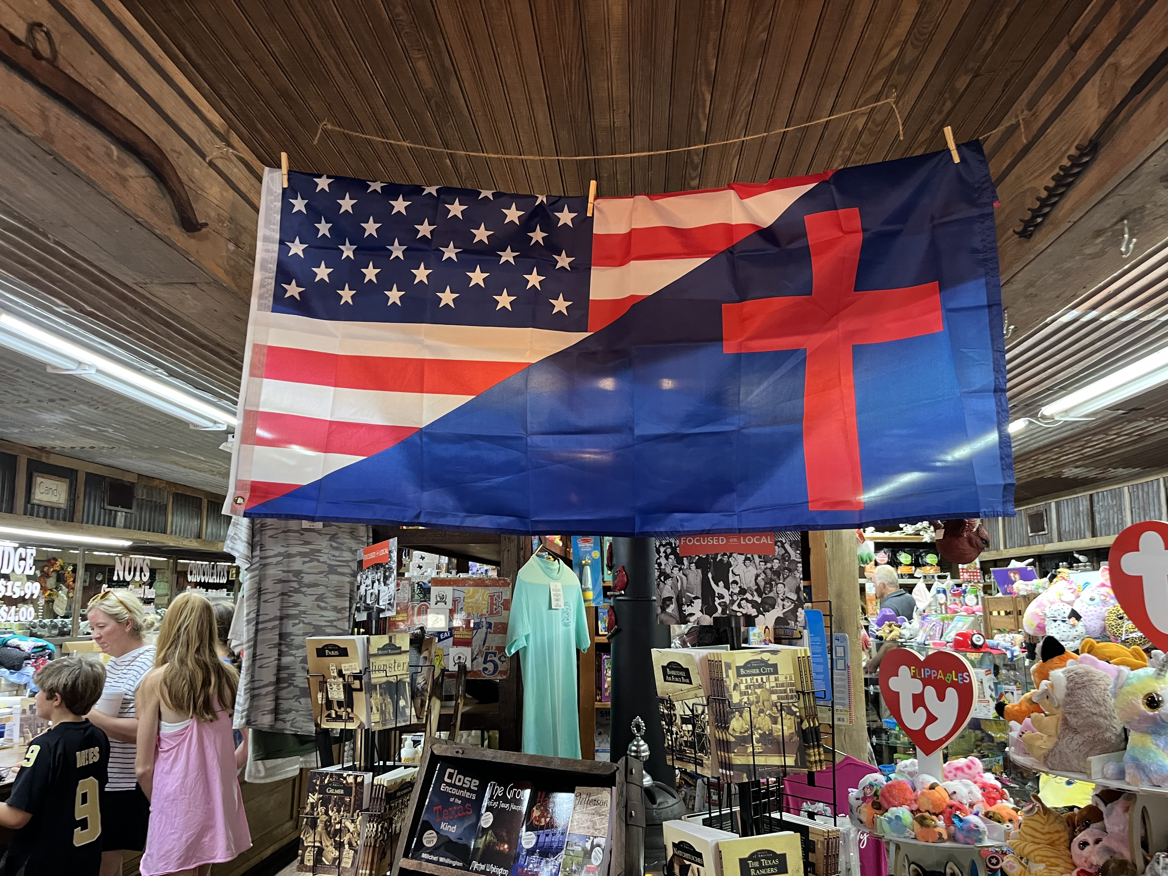

Slide 6
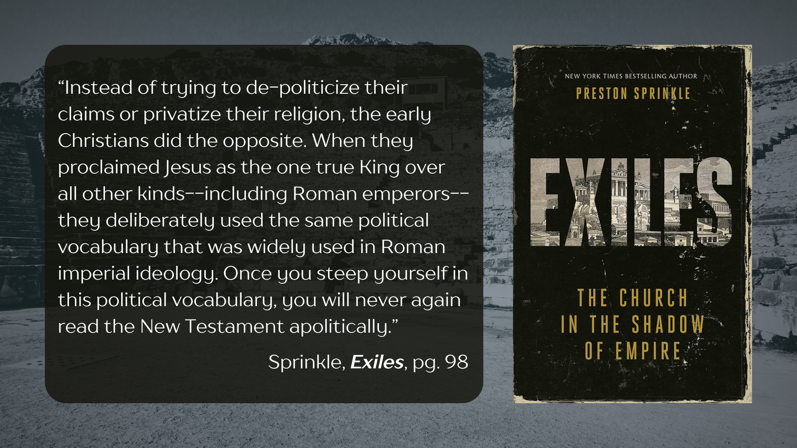
Notes:
[READ QUOTE & COMMENT]
And so, let’s now open up to Paul’s subversive letter as we go verse-by-verse through Philippians chapter 1, verses 27 through chapter 2, verse 4… [NEXT SLIDE]

Slide 7
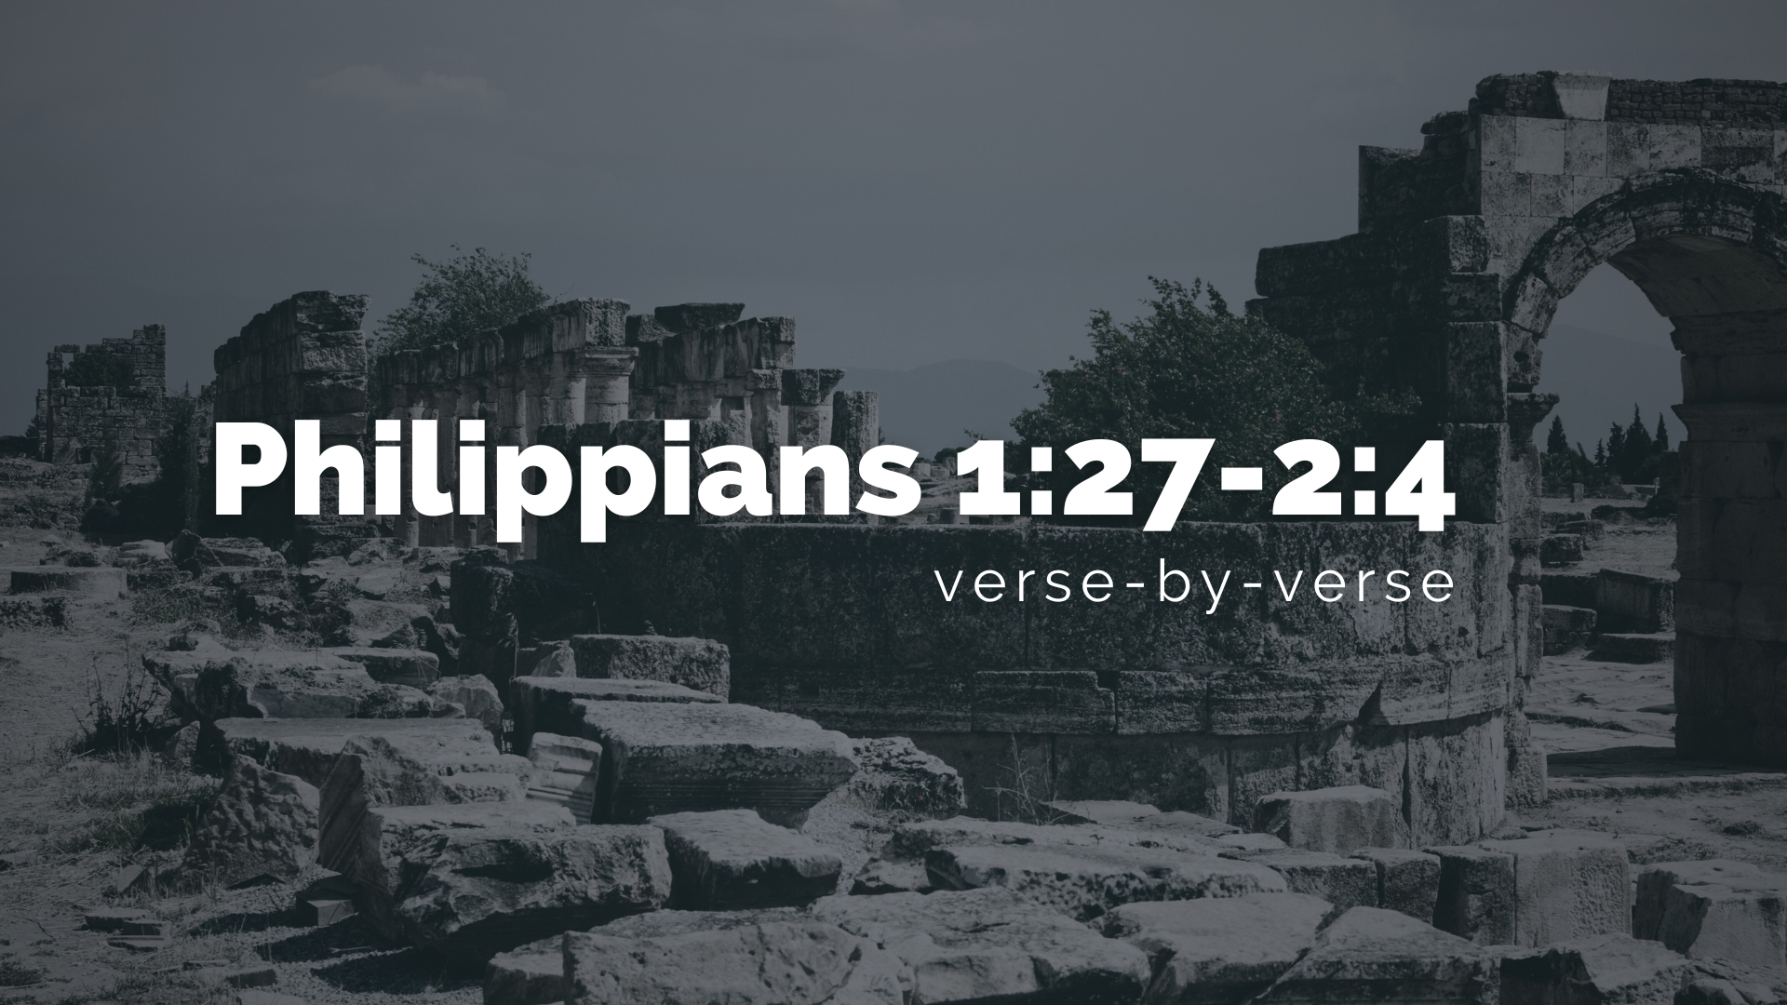
Notes:
I’m reading from the New Living Translation.
[READ & COMMENT ON PASSAGE VERSE-BY-VERSE]
v. 27 – this is a key verse in Paul’s letter; and it’s an imperative or command from Paul
Let’s look closely at this verse and break it down… [NEXT SLIDE]

Slide 8
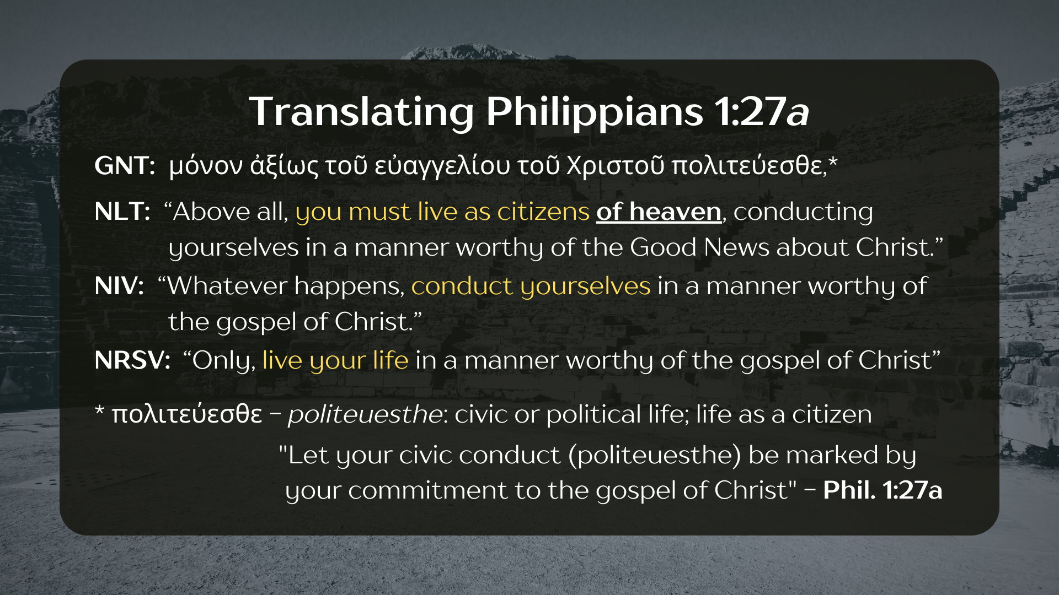
Notes:
[COMMENT ON EACH TRANSLATION OF THE VERSE]
Philippians 1:27-3:21 is one literary unit; it’s bookended with language of citizenship
So, in the coming verses Paul will sketch out what our citizen life should look like
Let’s keep reading the rest of verse 27… [NEXT SLIDE]

Slide 9
Notes:
[READ & COMMENT ON EACH VERSE]
v. 27b – NIV: “stand firm in one Spirit” (also used in 4:1); the imagery here is being firmly secured on the deck of a ship that is being rocked by wind and waves; it is the Holy Spirit (as we pursue him together) that becomes the glue that holds us together; our unity is secured by the Spirit; ”striving together” the Greek says with “one mind” or purpose; that purpose being founded on Christ and our faith in his gospel; the imagery here is one of a race; we might think of a three-legged race! So, clearly, the opposition they face in Philippi has threatened their unity in Christ.
v. 28 – NIV: “don’t be frightened” by your enemies; the verb “to fear” can be used to describe a herd of stampeding horses, going wild and out of control in a panic; Paul is saying that we should not be spooked and act in a fearful panic when our lives and the gospel (our beliefs, our values, our hope) is threatened by those who are enemies of the cross of Christ; then our lack of fear and panic will “be a sign” of the overthrow of evil and that Christ’s victory is sure and certain; in other words, our enemies reveal their guilt by persecuting the righteous children of God, as well as the path that leads to their own destruction. And broad is that path, Jesus once told us. But narrow is the road to life.
v. 29 – NT scholar Lynn Cohick says: “Paul writes that God gave to the Philippians two things: belief in Christ and suffering for Christ… lest we imagine that faith in Christ is merely intellectual acceptance of cold facts, Paul conjoins faith and suffering in his picture of the Christian life.” For Paul, our suffering has a redemptive quality when we submit our lives to Christ and live for his glory and honor. And it’s something to be expected in a fallen world. But because of the death and resurrection of Jesus, it will not get the last word. And as he will mention several times in this letter, Christ will come again to right the wrongs and sort it all out. All we must do is believe and persevere as we embody that belief.
v. 30 – Paul simply reminds them that he is in this with them. They are not alone.
2:1-2 – In other words: Does Christ really have power for you? Does the good news of his love comfort you? Are your own hearts softened by his mercy and grace toward you? Well, Paul says “make my joy complete” (imagery: fill up his cup) and fight for unity in the face of division and polarization; work hard to maintain an authentic Jesus community because it is your civic witness. The world is watching!
v. 3-4 – Don’t operate out of the flesh and be self-centered; don’t parrot the narcissism of the culture, don’t seek glory for yourself. Be humble and put others first. And don’t just think about what is good for you, think about what will bless others. That is how we conduct ourselves in a manner worthy of the gospel of Christ. And that is how we resist the scattering forces of evil in our midst.
Again, Lynn Cohick writes… [NEXT SLIDE]

Slide 10
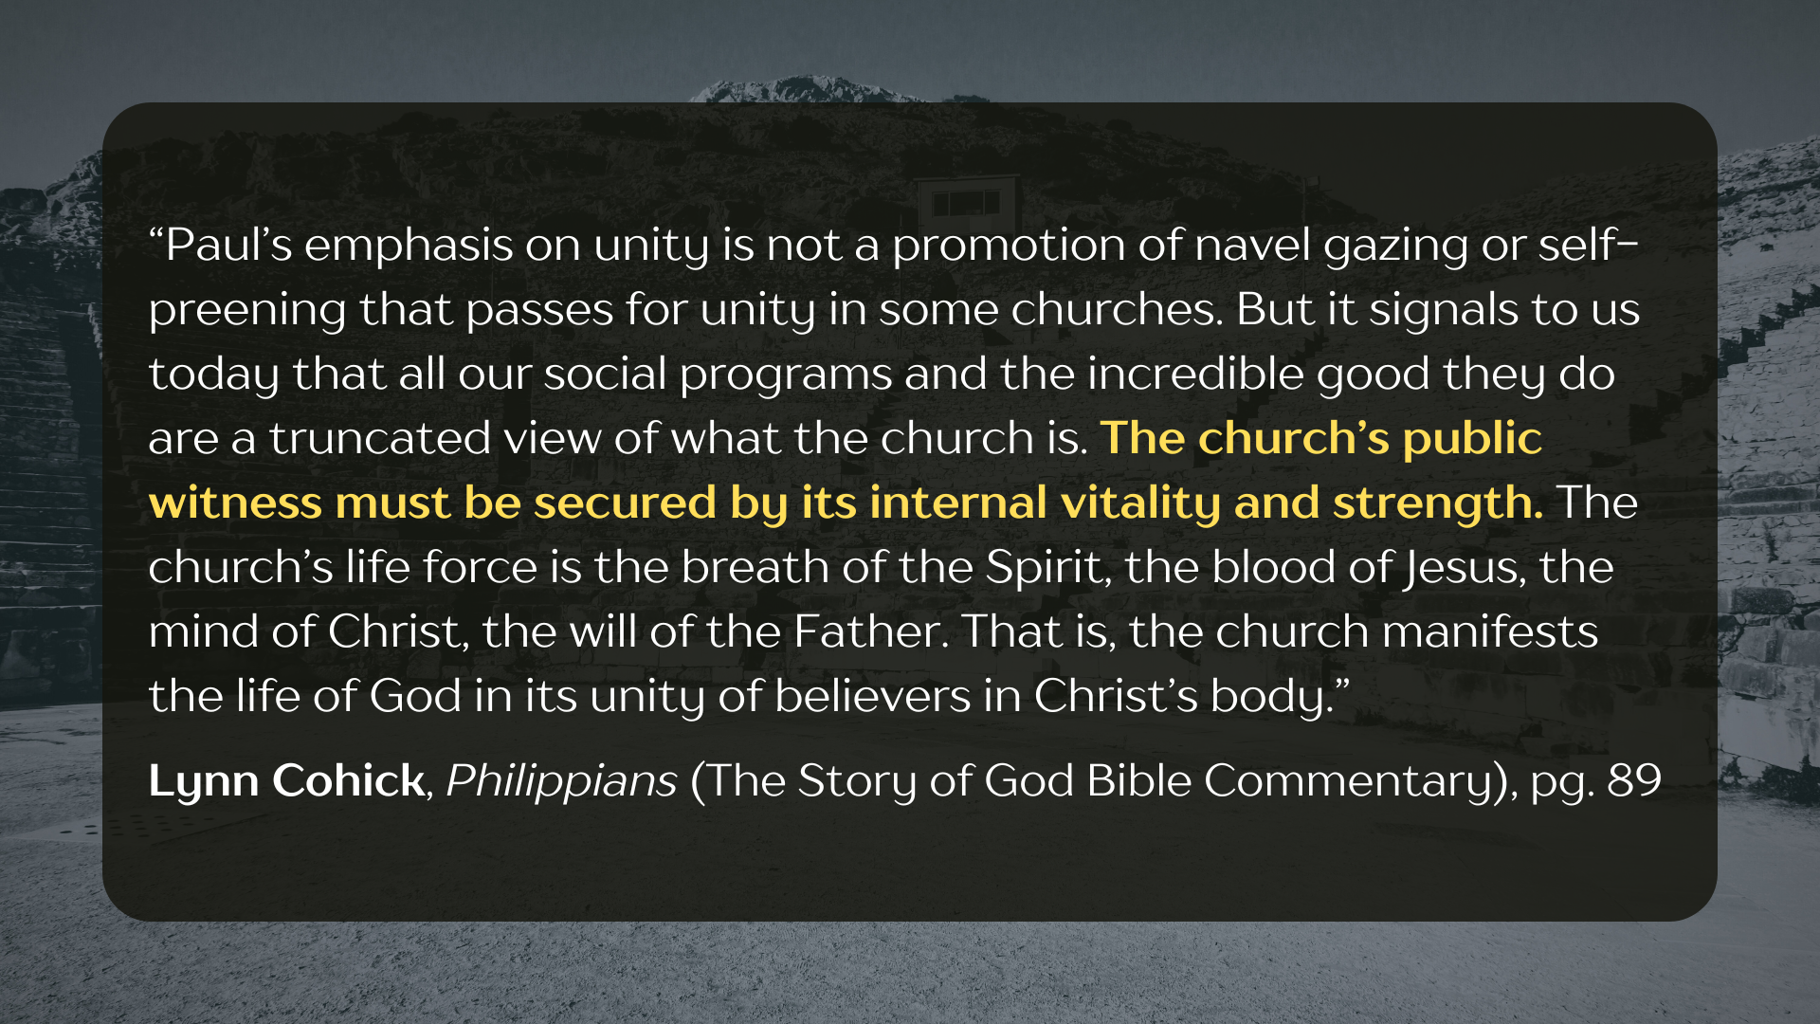
Notes:
[READ & COMMENT]
Before we look at some reflection questions, here is summary of what we’ve heard from the Spirit through the Apostle Paul today… [NEXT SLIDE]

Slide 11
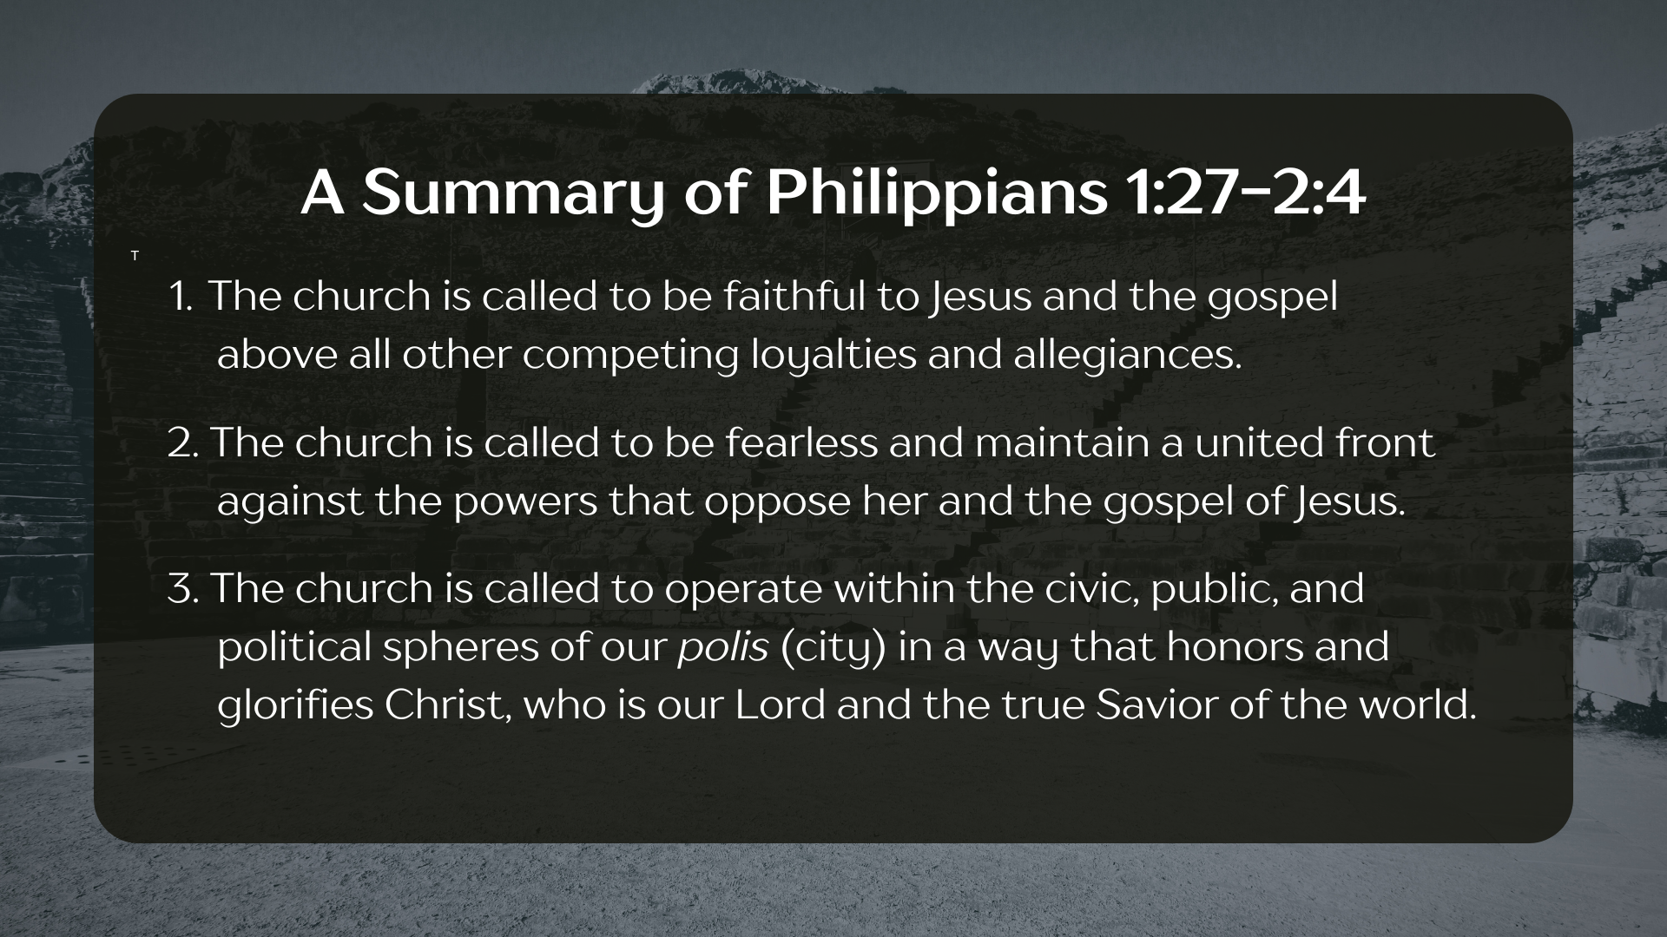
Notes:
[BRIEF COMMENTS]
The church is called to be faithful to Jesus and the gospel above all other competing loyalties and allegiances.
The church is called to be fearless and maintain a united front against the powers that oppose her and the gospel of Jesus.
The church is called to operate within the civic, public, and political spheres of our polis (city) in a way that honors and glorifies Christ, who is our Lord and the true Savior of the world.
Finally, here are some questions to help us reflect and respond to the Lord together… [NEXT SLIDE]

Slide 12
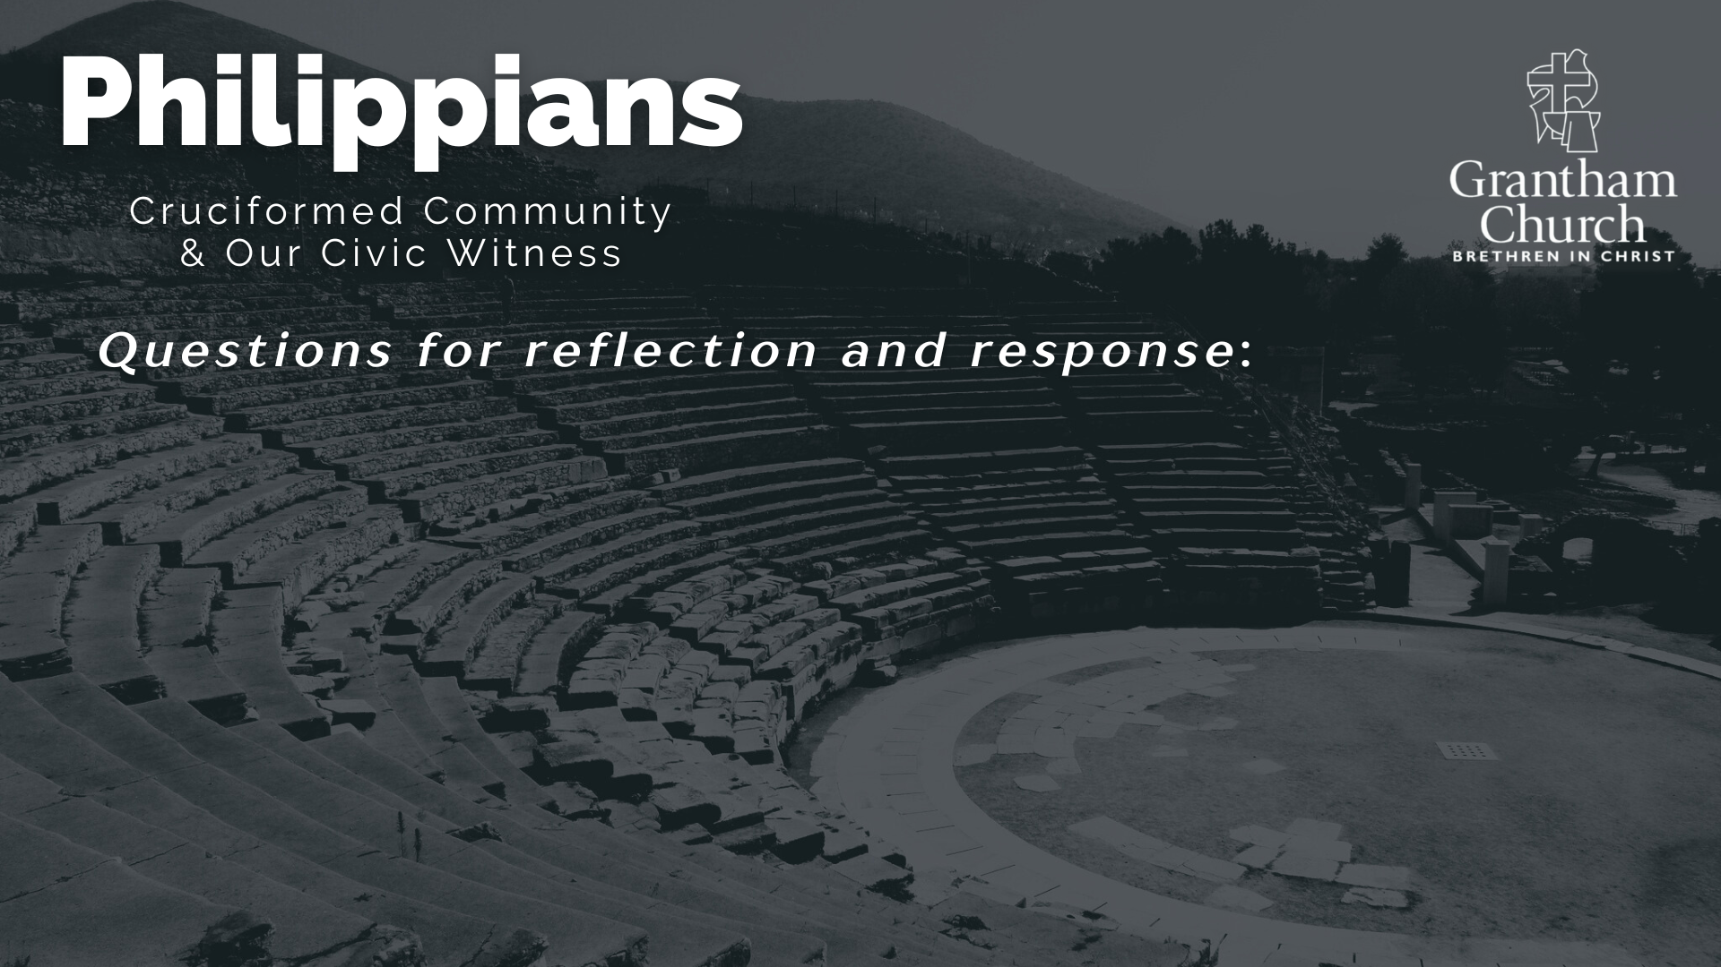

Slide 13
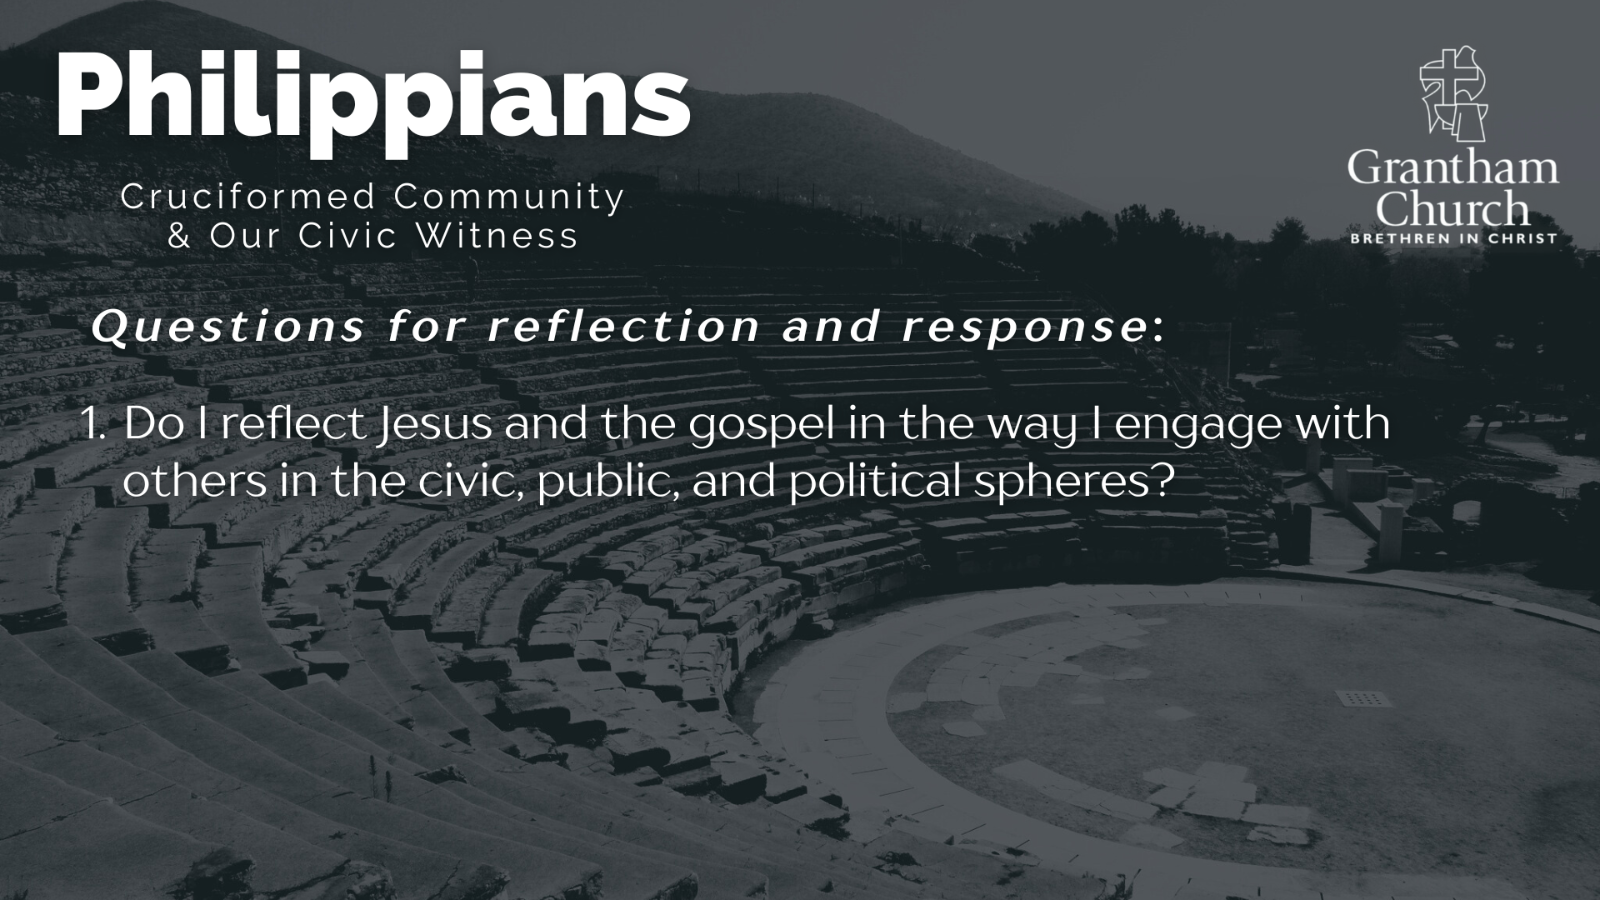

Slide 14
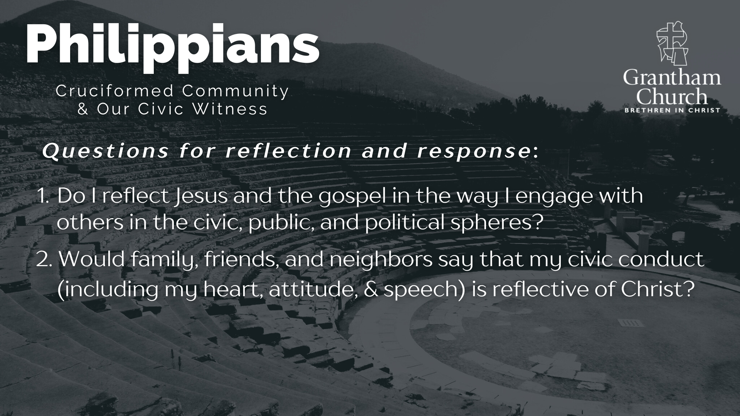

Slide 15
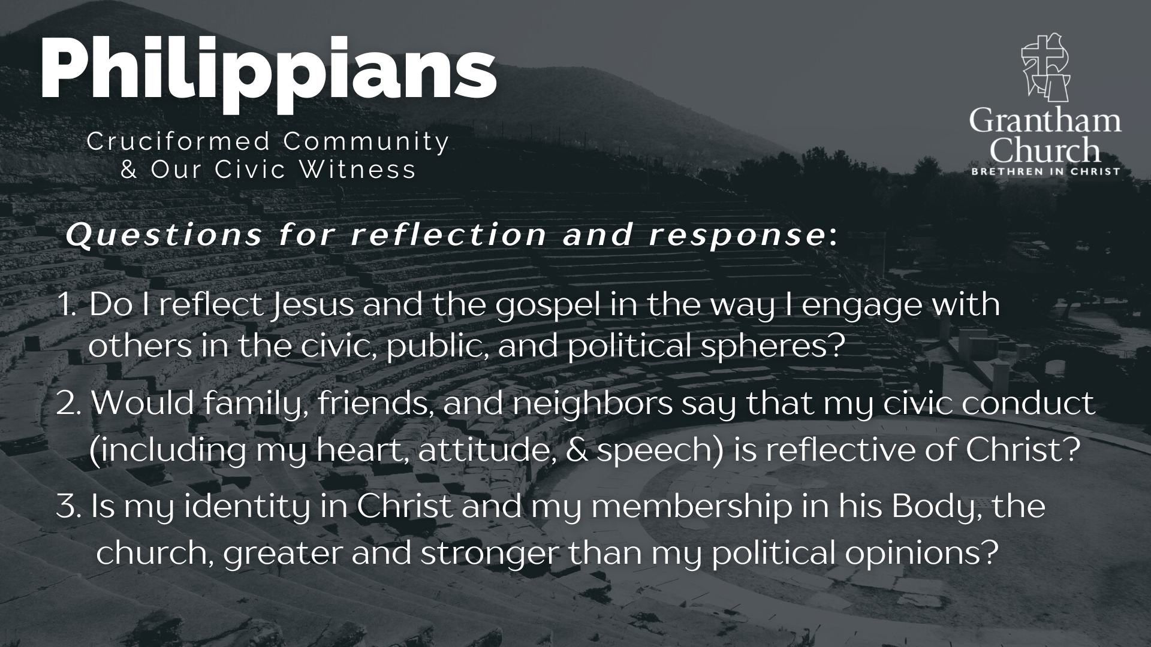
Notes:
[READ & BRIEF COMMENT ON EACH QUESTION]
Do I reflect Jesus and the gospel in the way I engage with others in the civic, public, and political spheres?
Would family, friends, and neighbors say that my civic conduct (including my heart, attitude, & speech) is reflective of Christ?
Is my identity in Christ and my membership in his Body, the church, greater and stronger than my political opinions?
Let’s pray… [NEXT SLIDE]

Slide 16

Notes:
[CLOSING PRAYER]
Benediction
May the God who looks like Jesus lead you to faithfully follow him in a world that needs to hear and see the Gospel of Jesus Christ. And may the grace and peace of the Lord Jesus comfort and sustain you as a witness of his coming Kingdom. Amen.

