Slide 1

Notes:
[BRIEF INTRO]
Week 2 of our 8-week study of the book of Philippians
Last week we began our series by giving attention to the opening of Paul’s letter (1:1-11); we could easily see his love for Christ and his affection for the church in Philippi; we also picked up on themes and concepts that Paul will address in the rest of his letter
If you missed last Sunday, or you just appreciate brief summaries, I showed this map of the mediterranean and Roman world… [NEXT SLIDE]

Slide 2
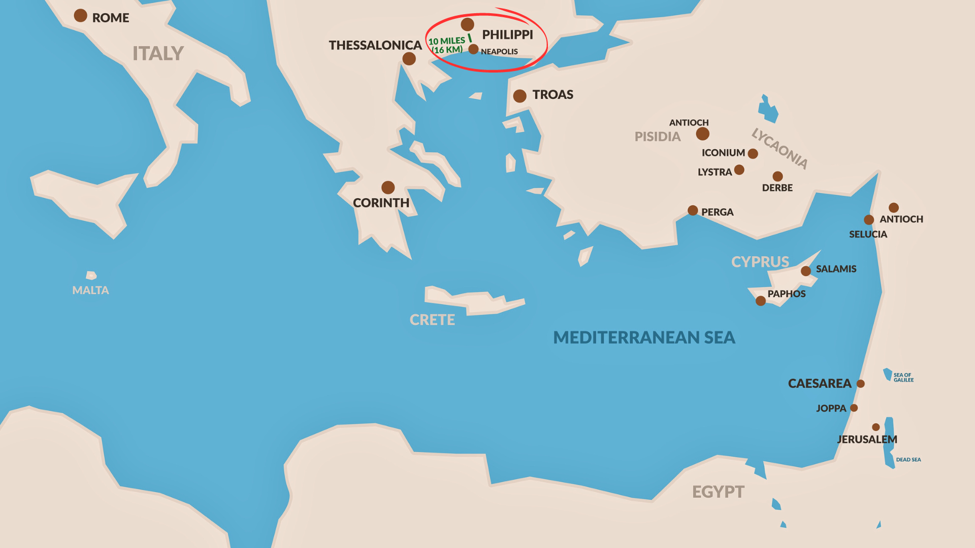
Notes:
[BRIEF COMMENTS]
Philippi was located in Macedonia, a region in northern Greece; Paul went into Macedonia between 50-52 AD in response to a dream of a man asking Paul to come and help them
Philippi is a port city; 800 miles from Rome; over 1,400 miles from Jerusalem
It is along a major trade route in the Roman empire, which would have helped to fuel the diversity and commerce of Philippi
Last week I shared some background and noteworthy facts about the city… [NEXT SLIDE]

Slide 3
Notes:
[BRIEF COMMENTS]
Philippi was a Roman colony; full of retired veterans and patriotic nationalists. The city was like a mini-Rome, with its temples, Roman forum, and large outdoor amphitheater.
It’s a fairly well-to-do Roman colony of around 10.000 people, with only about 40% of the population being Roman, the rest were Gentiles lacking citizenship. And we know there weren’t many Jews because there wasn’t a synagogue in Philippi
As recorded in Acts 16, Paul instead finds God-fearers (including many women) praying down by the river and he shares the gospel with them; a wealthy business owner named Lydia accepts Paul’s message and the church in Philippi is born
And again, because the city is so fiercely committed to her nationalism, the church in Philippi (as we will continue to see throughout this series) will experience the same sort of treatment that Paul received when he preached the gospel there, and when his allegiance to Christ led him to cast out an evil spirit from a slave girl; disrupting the local economy.
But the church in Philippi will continue to grow after Paul leaves, despite their faithful insistence that “Christ is Lord”, not Caesar; and their unwillingness to go along with the ways of empire: idolatry, greed, violence, exploitation of the poor, disregard for foreigners and non-Romans, etc.
So, it’s about 10 years later and Paul is now living under house arrest in Rome awaiting his court date with the emperor Nero… [NEXT SLIDE]

Slide 4
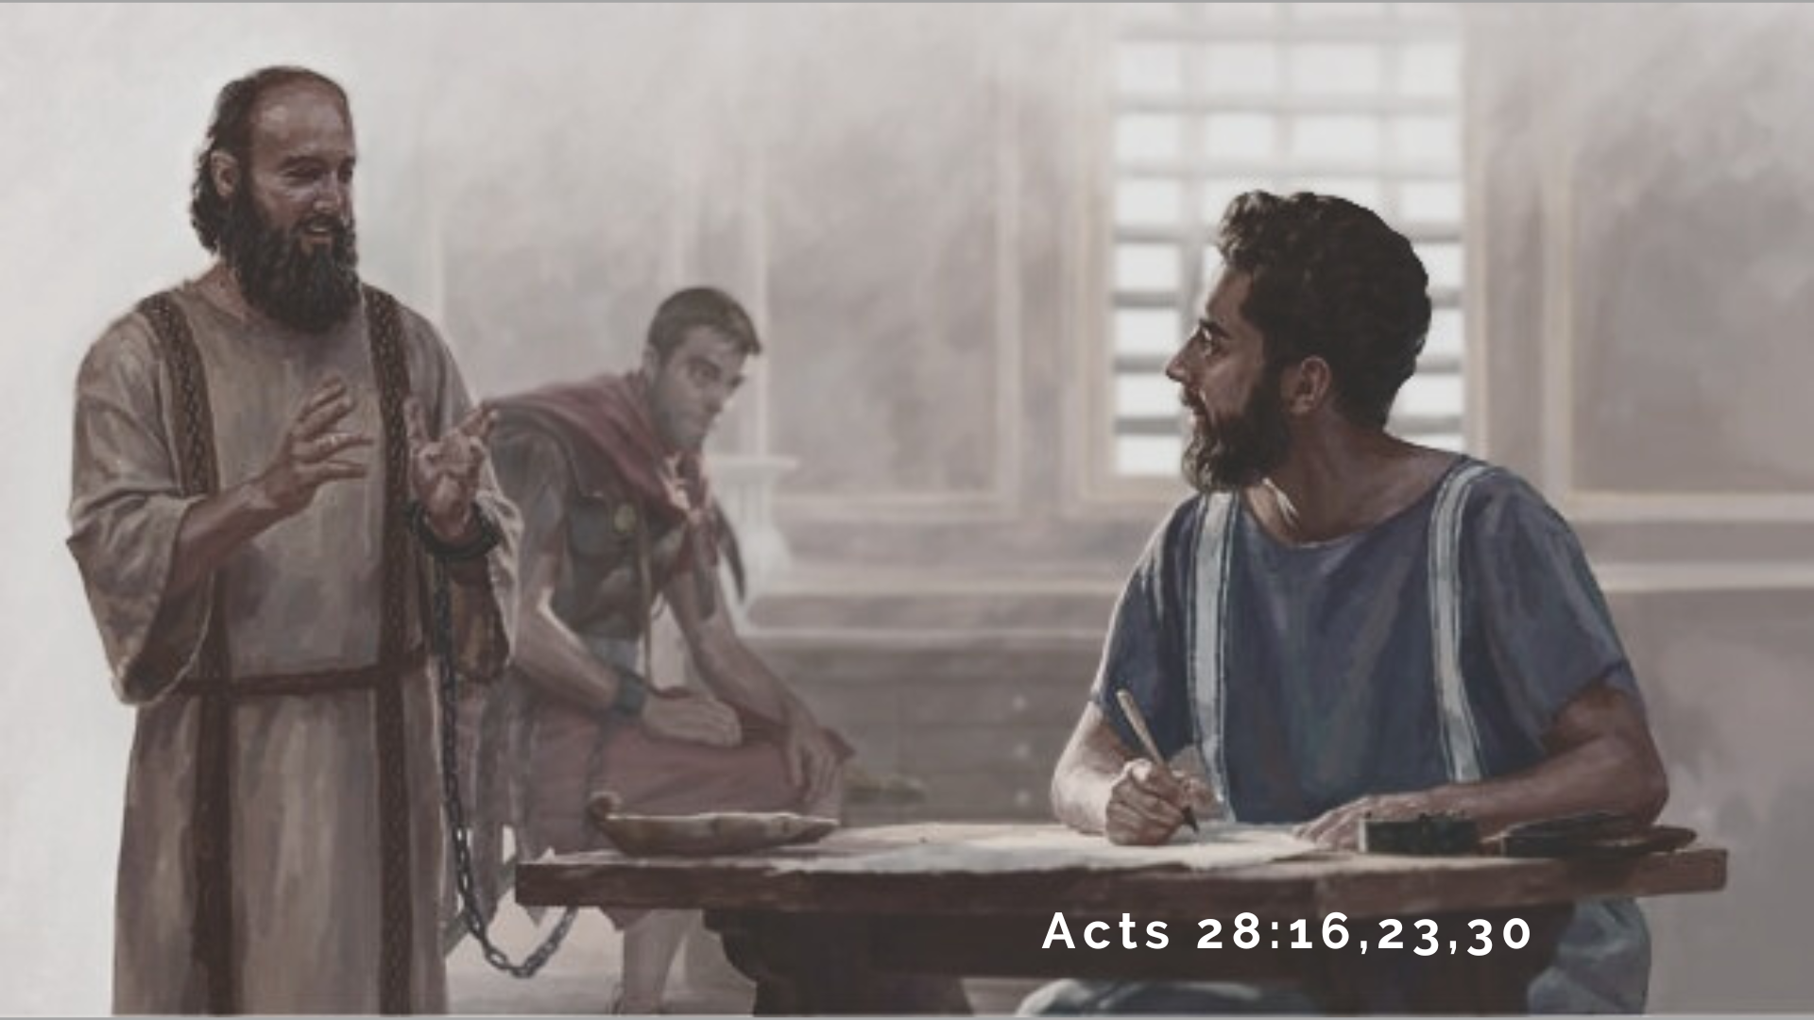
Notes:
From an earthly perspective, things don’t look too good for Paul; which is why the Philippians were concerned for Paul and his future. And so, he and his student Timothy write the next section of his letter to address those concerns and to help the Philippian Christians see his situation through Kingdom lenses and put their own sufferings and hardships in gospel perspective.
Let’s now turn to our main passage of Scripture this morning, and go verse-by-verse through Philippians chapter 1, verses 12-26… [NEXT SLIDE]

Slide 5
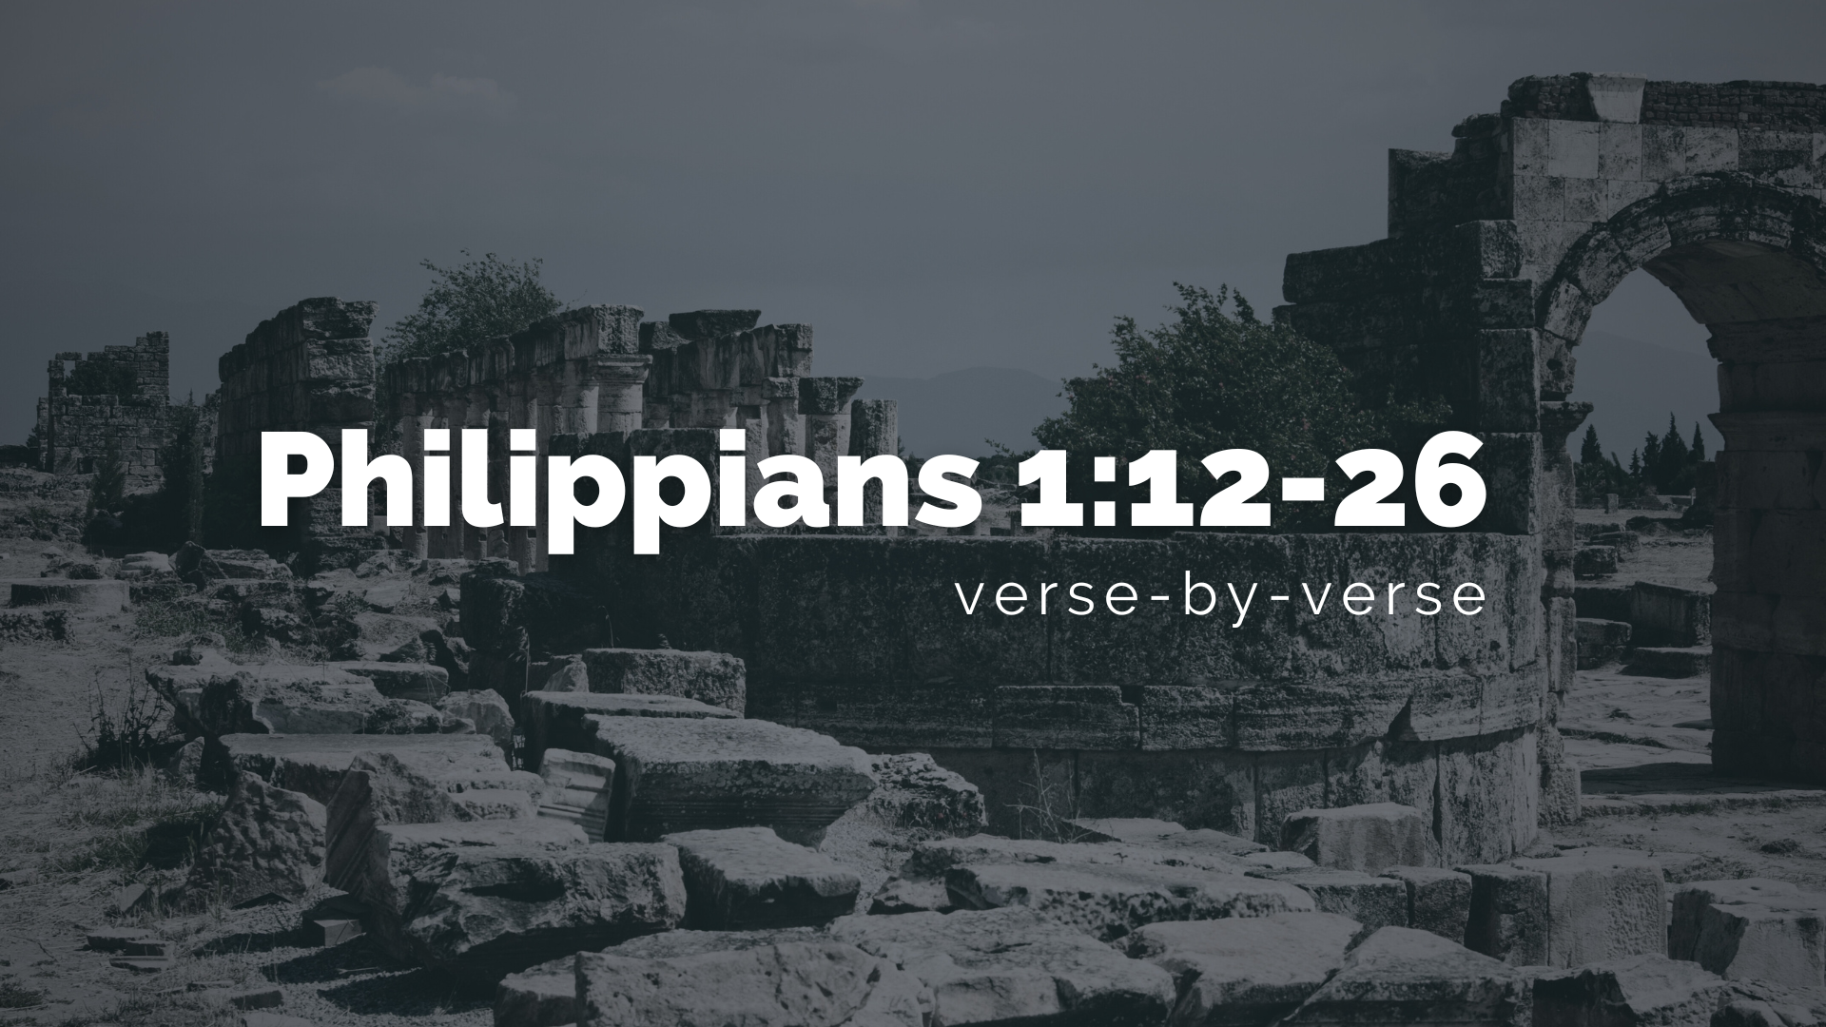
Notes:
I’m reading from the New Living Translation.
[READ & COMMENT ON PASSAGE VERSE-BY-VERSE]
v. 12 – “everything that has happened to me” – his arrest in Jerusalem, his trials while being taken to Rome, and now being held in custody (under house arrest) and awaiting an audience with the emperor, Nero; “has helped to spread” NIV: “served to advance the gospel”; GK: “progress” – a military term for soldiers advancing through hard terrain by means of removing barriers.
In other words, Paul, ignoring his own mistreatment and discomfort, sees the gospel progressing and the Kingdom advancing, even though it would appear that things are really bad for him. Paul rejoices because the good news about Jesus is reaching the ”oval office” of the Roman empire. And what could be more exciting than that!
But let’s be clear on what this “gospel” or good news means in his first century context… [NEXT SLIDE]

Slide 6
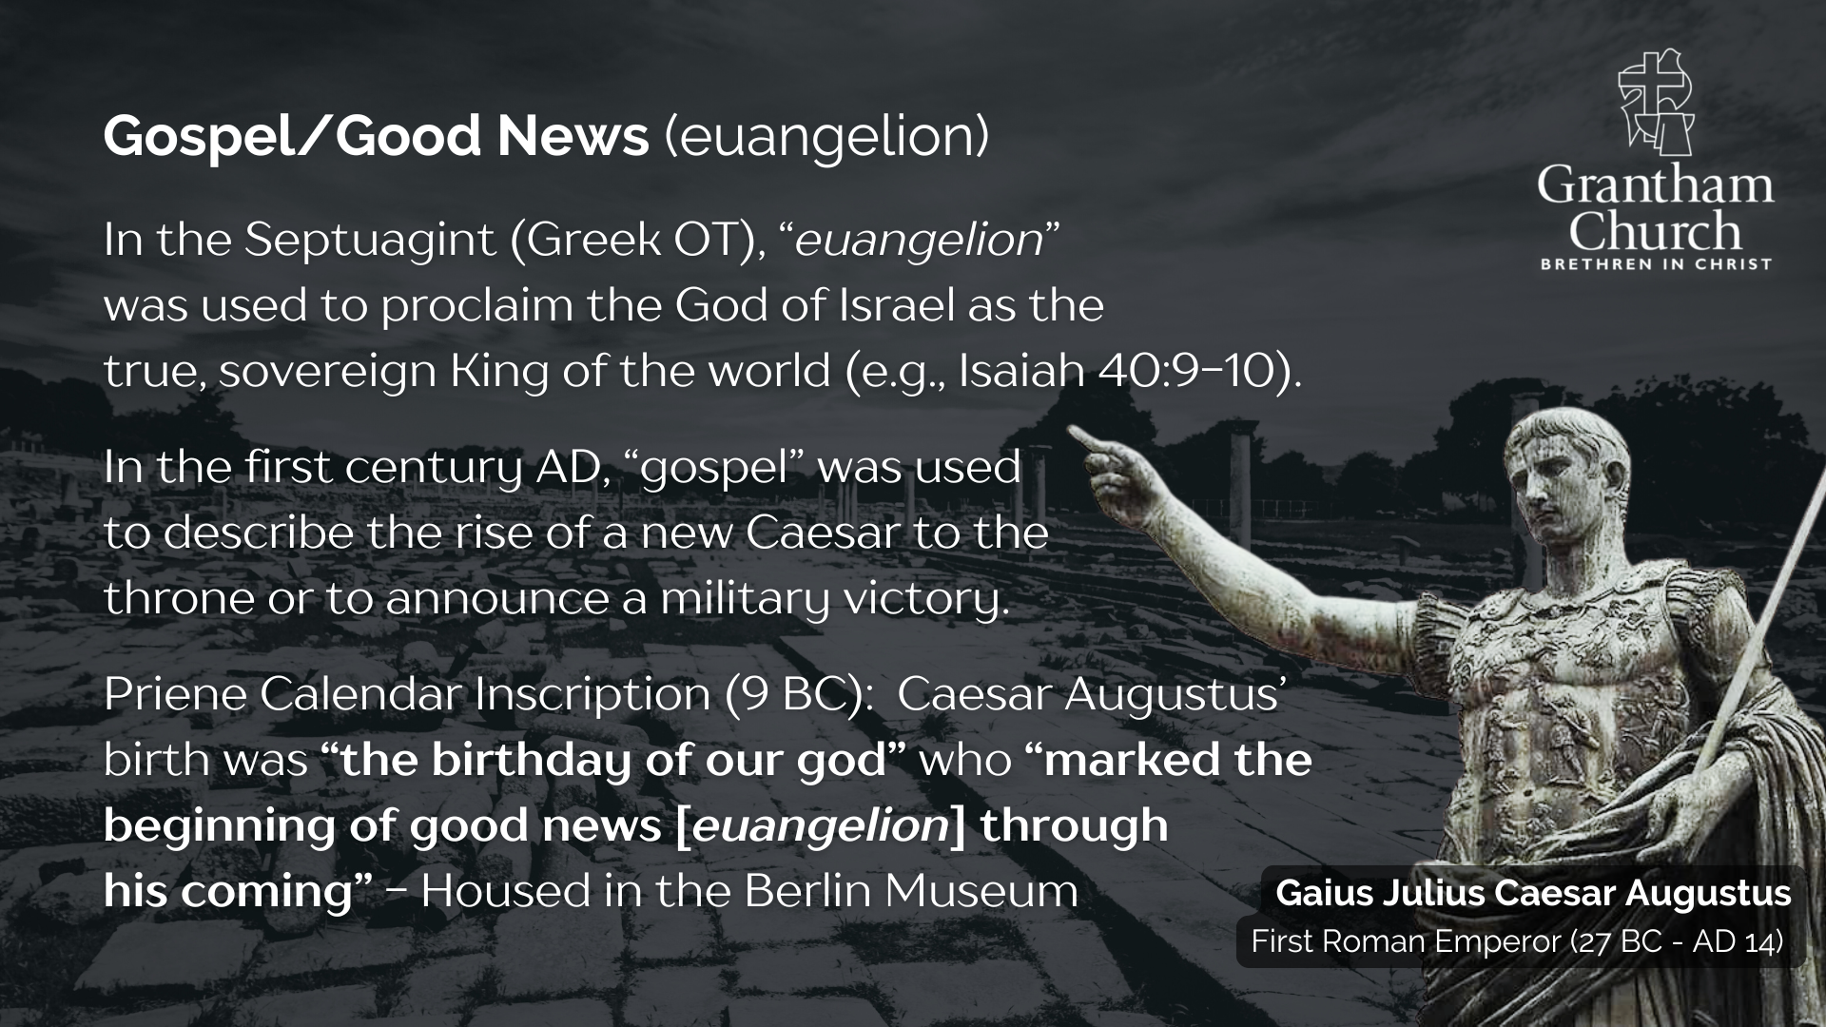
Notes:
In the Septuagint (Greek OT), “euangelion” was used to proclaim the God of Israel as the true, sovereign King of the world. For example, Isaiah 40:9-10 says: “You who bring good news to Zion, go up on a high mountain. You who bring good news to Jerusalem, lift up your voice with a shout, lift it up, do not be afraid; say to the towns of Judah, “Here is your God!” See, the Sovereign Lord comes with power, and he rules with a mighty arm. See, his reward is with him, and his recompense accompanies him.”
In the first century AD (the time of the New Testament), “gospel” or euangelion was used to describe the rise of a new Caesar to the throne or to announce a military victory. In the late 19th century, the Priene Calendar Inscription (from 9 BC) was discovered. It says that Caesar Augustus’ birth was “the birthday of our god” who “marked the beginning of good news [euangelion] through his coming.” So, again, consider the subversive nature of the angels heralding the birth of Jesus in Luke’s gospel with the words, “Fear not: for, behold, I bring you good tidings (good news) of great joy, which shall be to all people” (Lk 2:10).
It’s subversive you see because the “good news” of Jesus is a rival gospel to the good news of Caesar and to any ”good news” or authoritative claim of the world. Here is how we have been more broadly defining the gospel at Grantham Church… [NEXT SLIDE]

Slide 7
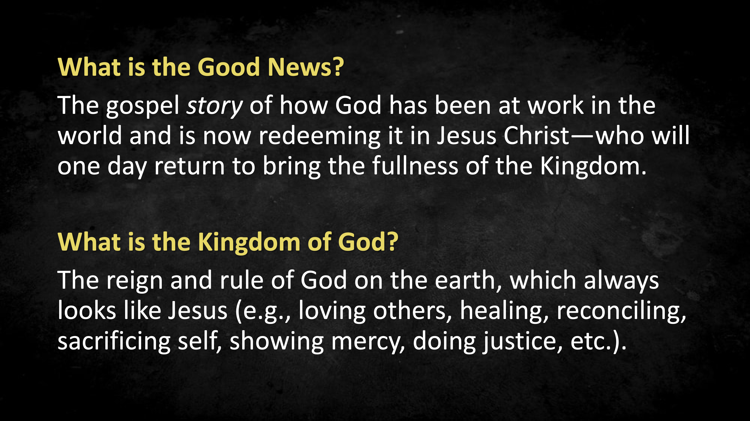
Notes:
The “good news” story of how God has been at work in the world in ages past and is now redeeming it in Jesus Christ, who will someday return to bring the fullness of the Kingdom. The gospel is God’s gift of grace, forgiveness, and redemption in Jesus. We are “saved” and believe in the gospel when we confess Christ as Savior and Lord and welcome the Kingdom of God.
And what is the Kingdom of God? It is the reign and rule of God on the earth, which always looks like Jesus (e.g., loving God, loving neighbors, loving enemies, healing, restoring, reconciling, self-sacrifice, Spirit-filled living, giving to the poor and needy, peacemaking, showing mercy, doing justice, etc.). We have also been communicating the story and power of the good news through this image… [NEXT SLIDE]

Slide 8
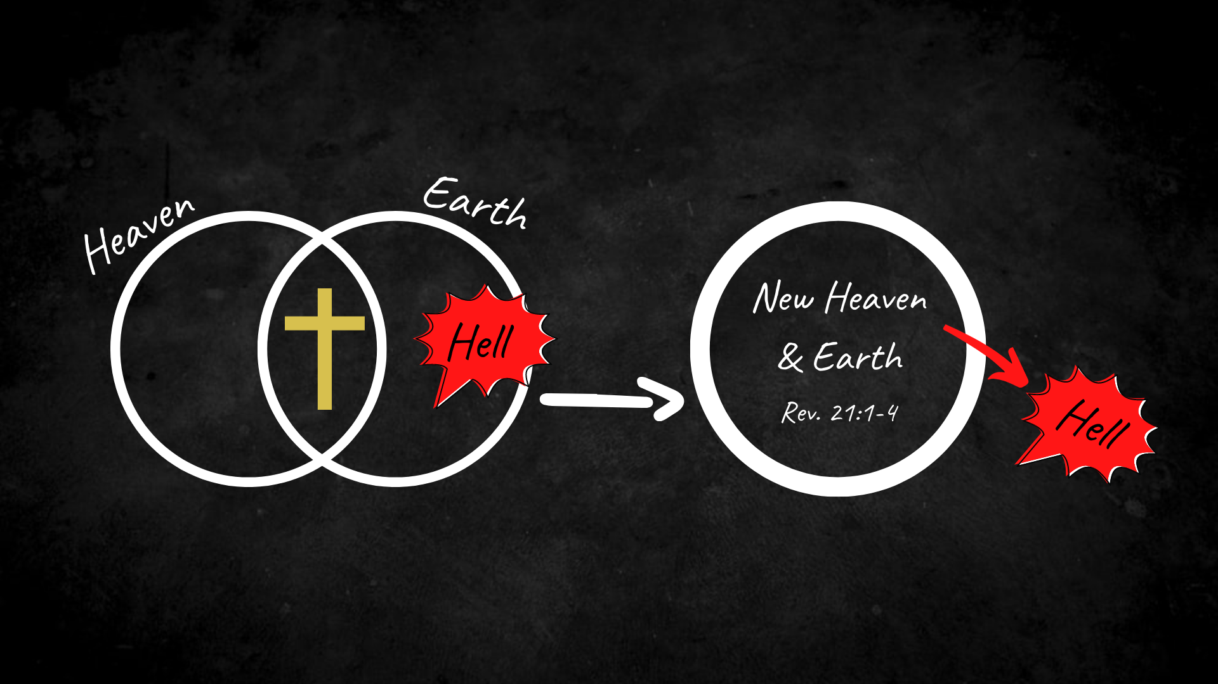
Notes:
[BRIEF COMMENTS]
Jesus is the embodiment of the good news. It’s through his life, death, and resurrection that we know who God is, that God loves us, and has a design for us and all of creation. It’s through Jesus that we make sense of the world… past, present, and future.
As the image depicts, it’s through Jesus that heaven and earth are coming together. His resurrection body is both a picture and the reality of God’s space and our space coming together. Sin, death, the devil (and all of the principalities and powers), and hell itself are being (and will be) judged. They will be cast out once and for all upon his return to bring the fullness of the Kingdom.
It’s then that we shall see what Isaiah and the book of Revelation calls the New Heaven and New Earth; when all who believe will undergo a transformation of their bodies (in the same way Jesus was transformed), and all things will be made new.
My friends, this is the gospel that Paul says is progressing, advancing, and spreading. Now back to Philippians chapter 1, verse 13… [NEXT SLIDE]

Slide 9
Notes:
[READ & COMMENT ON PASSAGE VERSE-BY-VERSE]
v. 13 – “the whole palace guard” (praetoria) or praetorian guard. They are the elite solders, a combination of the secret service and navy seals, who were first commissioned by Caesar Augustus to protect the emperor and act on his behalf in service to the emperor; Paul is telling the Philippian believers that the entire praetorian guard in Rome has heard the good news about Jesus because of his imprisonment.
v. 14 – the believers in Rome are inspired and emboldened by Paul’s fearlessness, his joy, and his gospel perspective of his trials as he advances the gospel into the heart of the empire
[READ VERSES 15-24 & COMMENT]
Notice that Paul is expressing his inner feelings. He says, ”I’m torn between living and dying.” He wants to be with Christ, but still he wants to remain on the earth to further the gospel and be a blessing to the Philippians, as well as other believers. And he is even willing to suffer and go through hard times (even enduring more pain from other followers of Jesus) because he sees that it is worth it in the end.
Listen to how Paul expressed this sentiment to the Colossian believers… [NEXT SLIDE]

Slide 10
“I am glad when I suffer for you in my body, for I am participating in the sufferings of Christ that continue for his body, the church.”
Paul, Colossians 1:24 NLT
Notes:
[READ & COMMENT]
Church, don’t miss the invitation here to see our own sufferings as participation in the sufferings of Christ in a fallen world. Our trials and tribulations (even those that may seem to have nothing to do with advancing the gospel) are in a real sense identifying Christians with Jesus and are part of our sharing in his life, ministry, and death… and someday in the future, his resurrection.
Back to our final two verses in this section… [NEXT SLIDE]

Slide 11
Notes:
[READ & COMMENT ON LAST TWO VERSES]
Even though Paul will never leave Rome… as he will be executed for the gospel of Jesus Christ… he knew that “to live is Christ and to die is gain”; he knew that he was in a “win-win” situation. And he trusted that whatever happened to him, or happens to us, God will use it for our good and the good of the church who are his agents of new creation and are seeking to advance the euangelion of God.
Remember what Paul wrote to the church in Rome a few years before his arrival there… [NEXT SLIDE]

Slide 12
“And we know that all things work together for good, for those who love God, and are called according to his purpose.”
Paul, Romans 8:28 NRSV
Notes:
[READ & COMMENT]
And before that he said, “I consider that our present sufferings are not worth comparing with the glory that will be revealed in us” as he reminds us that before a baby is born there is pain; before something new can come, the old things must die; and God in his sovereignty, wisdom, and power is able to take our mess, our pain, our suffering, our “chains”… and bring forth new life… moving us one step closer to Christ.
Finally, here are some questions to help us reflect and respond to the message the Lord is speaking to us… [NEXT SLIDE]

Slide 13
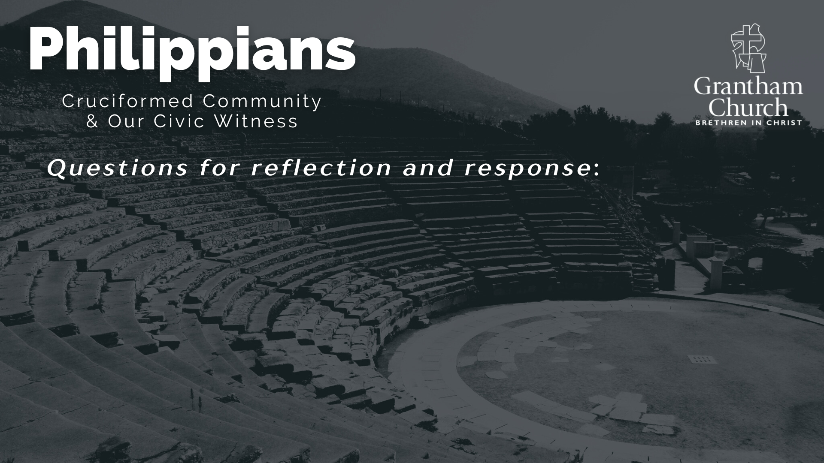

Slide 14
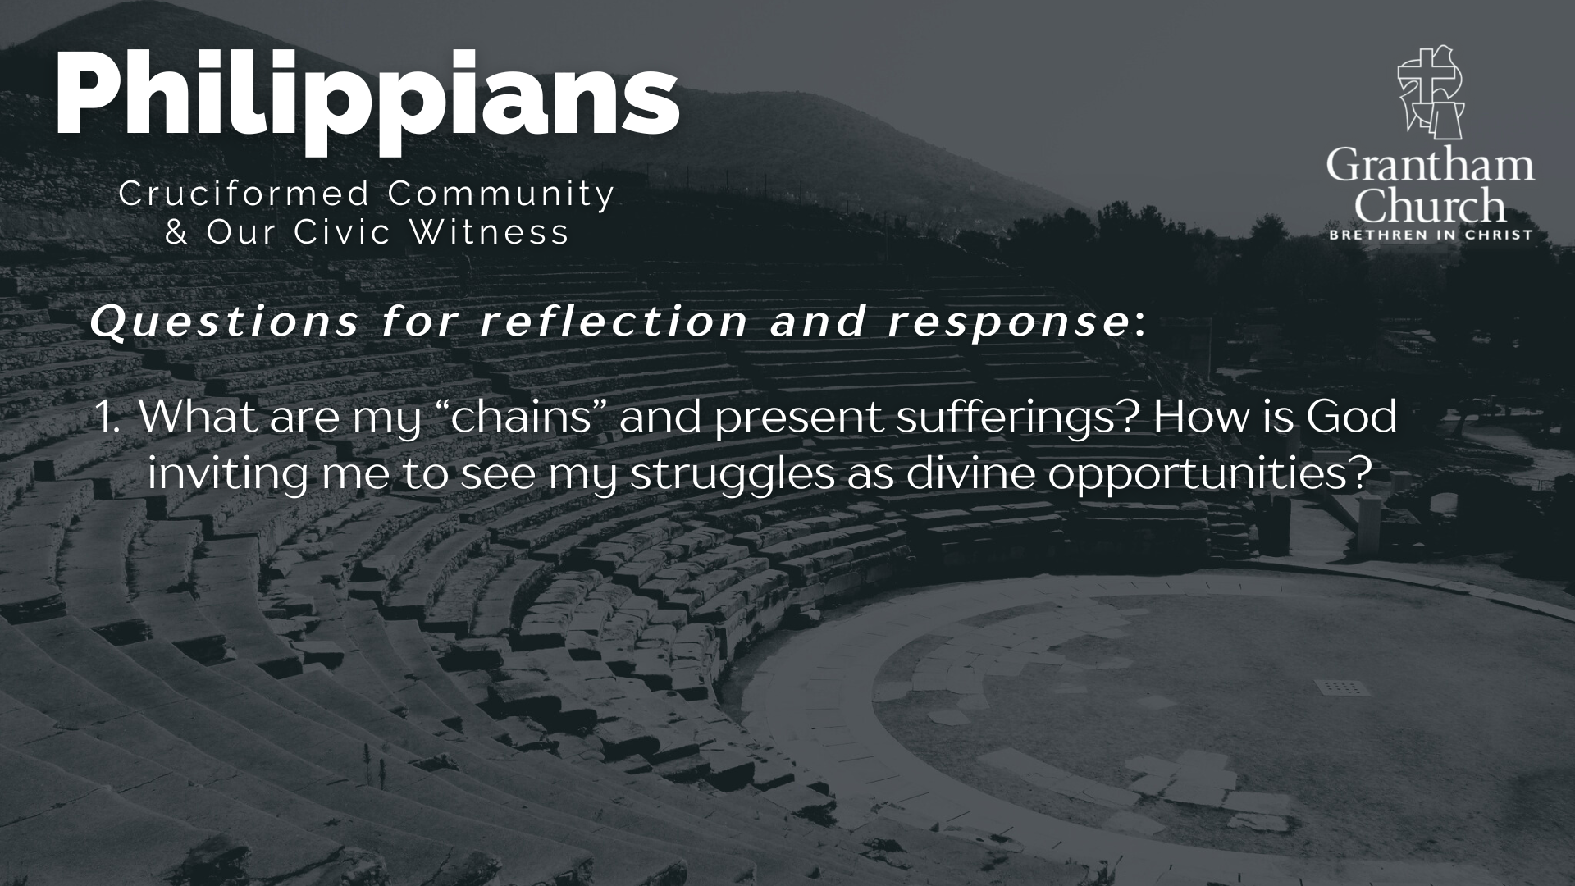

Slide 15
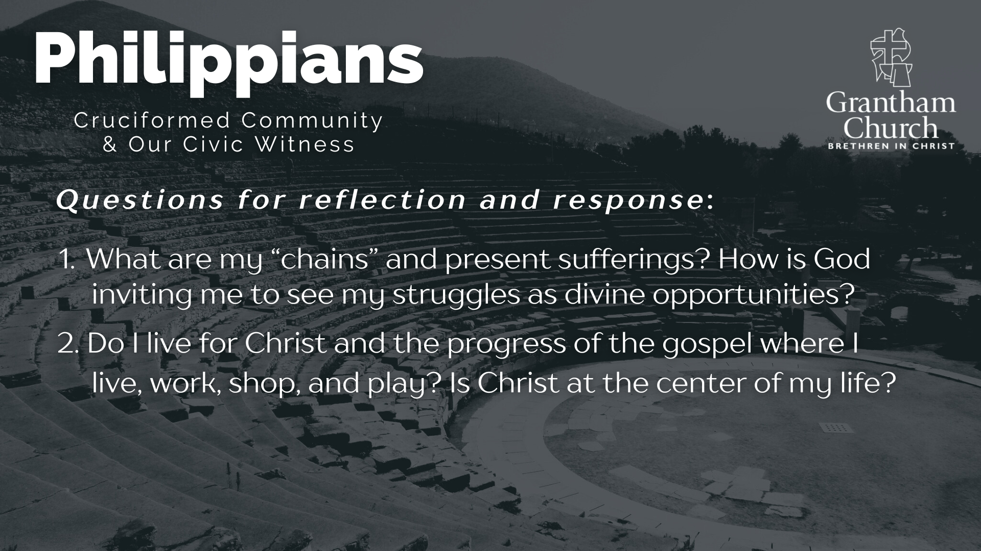

Slide 16
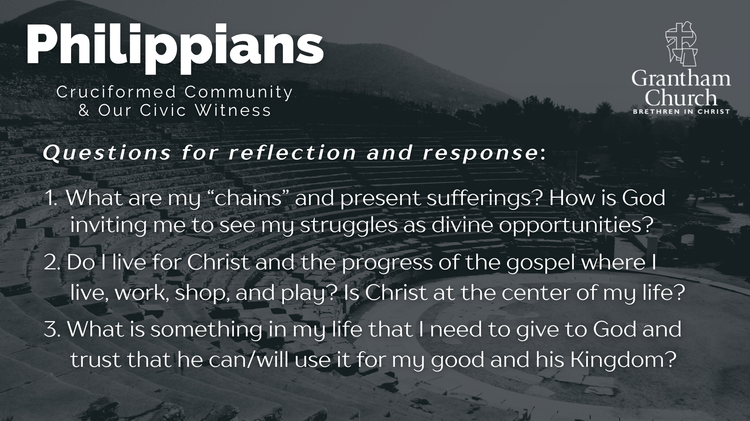
Notes:
[READ & BRIEF COMMENT ON EACH QUESTION]
What are my “chains” and present sufferings? How is God inviting me to see my struggles as divine opportunities?
Do I live for Christ and the progress of the gospel where I live, work, shop, and play? Is Christ at the center of my life?
What is something in my life that I need to give to God and trust that he can/will use it for my good and his Kingdom?
Let’s pray… [NEXT SLIDE]

Slide 17

Notes:
[CLOSING PRAYER]
Benediction
May the God who looks like Jesus lead you to faithfully follow him in a world that needs to hear and see the Gospel of Jesus Christ. And may the grace and peace of the Lord Jesus comfort and sustain you as a witness of his coming Kingdom. Amen.

