Slide 1

Notes:
[BRIEF INTRO] – Meals with Jesus
We are looking at table scenes with Jesus in the Gospel of Luke.
And we are exploring the blessings that God provides when we experience his radical hospitality and accept his challenge to open our lives to others around the table.
Last Sunday – “Discovering Grace” (Luke 5:27-32)
Today we are in Luke 7, as we discover the way to God’s Kingdom community... [NEXT SLIDE]

Slide 2

Notes:
Sermon Focus: Jesus was once invited to the home of a religious leader who prided himself in being separate from sinners. The guests were expecting good food, pleasurable company, and some stimulating conversation with the edgy rabbi from Nazareth. But when a notorious sinner showed up uninvited, things got really awkward.
Please open your Bibles to Luke 7:36-50… [NEXT SLIDE]

Slide 3

Notes:
[READ THE PASSAGE] – This is the word of the Lord – “Thanks be to God”
[UNPACK VERSE-BY-VERSE]
v. 36 – This Pharisee wants Jesus to be his special guest
v. 37 – a “certain immoral woman” or “lived a sinful life” (NIV)
v. 38 – she barges in uninvited and expresses her hospitality
Here is an artistic representation of that scene… [NEXT SLIDE]

Slide 4
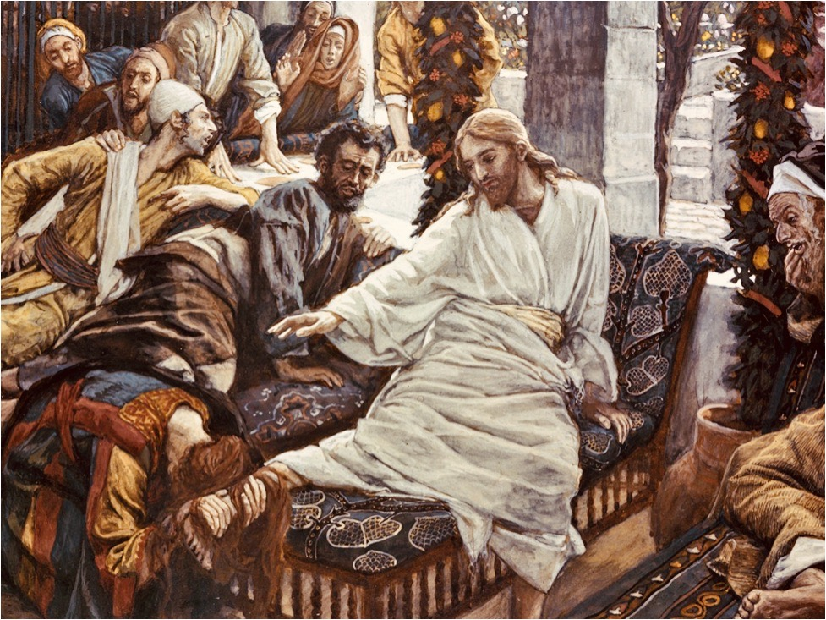
Notes:
[COMMENT VERSE-BY-VERSE, CONT.]
Verses 39-50
Let’s consider now some “Table Takeaways” from this story… [NEXT SLIDE]

Slide 5


Slide 6
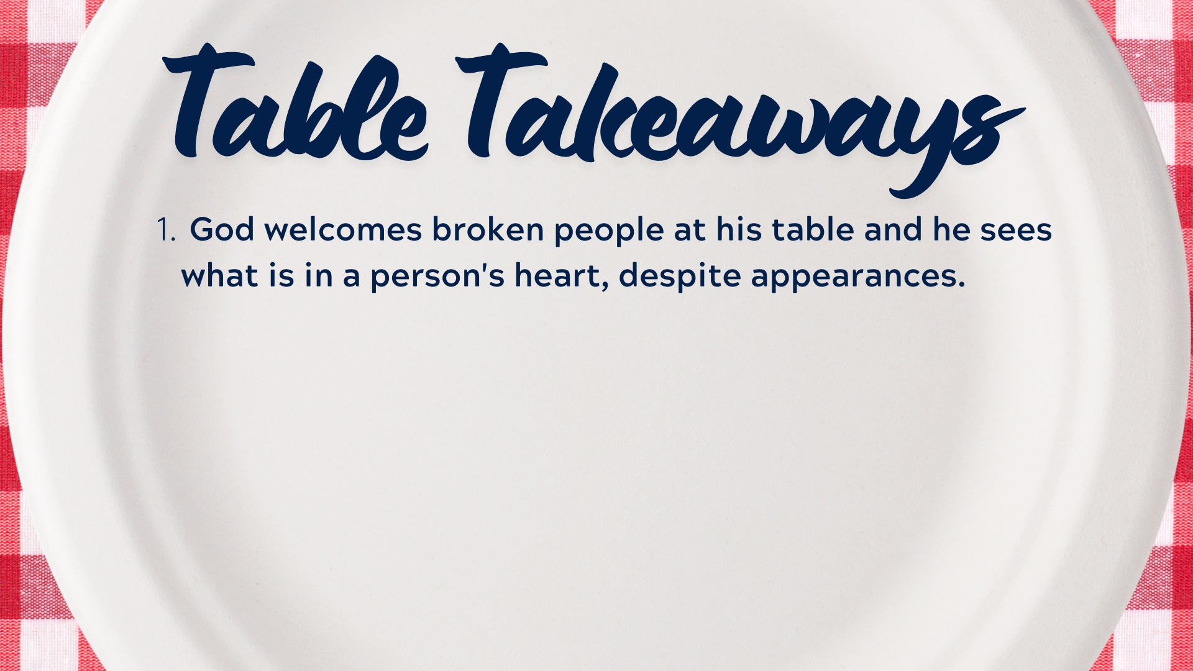
Notes:
[BRIEF COMMENT]
Don’t miss this: God embraces sinners and the messiness we all bring
Think about what this might mean for who you invite to your table and who might show up unannounced or uninvited and make things awkward and uncomfortable for everyone.
A humorous example of this would be from the movie… [NEXT SLIDE]

Slide 7
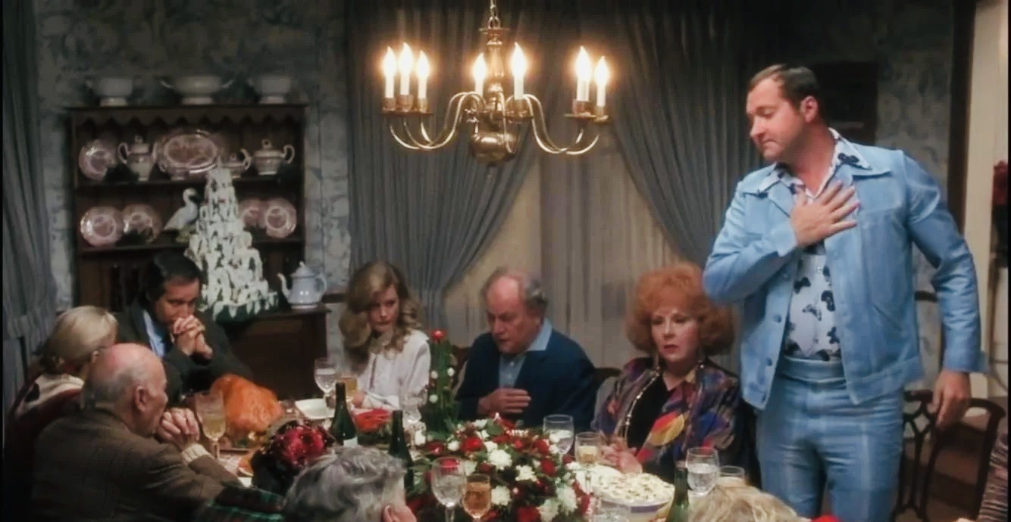
Notes:
[BRIEF COMMENT]
Cousin Eddie is annoying, gross, has a low IQ, and has poor taste in clothing
However, in Clark Griswold’s own words, Eddie’s “heart is bigger than his brain”
He proved it by kidnapping Clark’s boss for cutting out Christmas bonus’
So, regardless of the awkwardness (even what seems offensive), the Lord invites us to see a person with different eyes, in order to love and accept them as he does.
Number 2… [NEXT SLIDE]

Slide 8
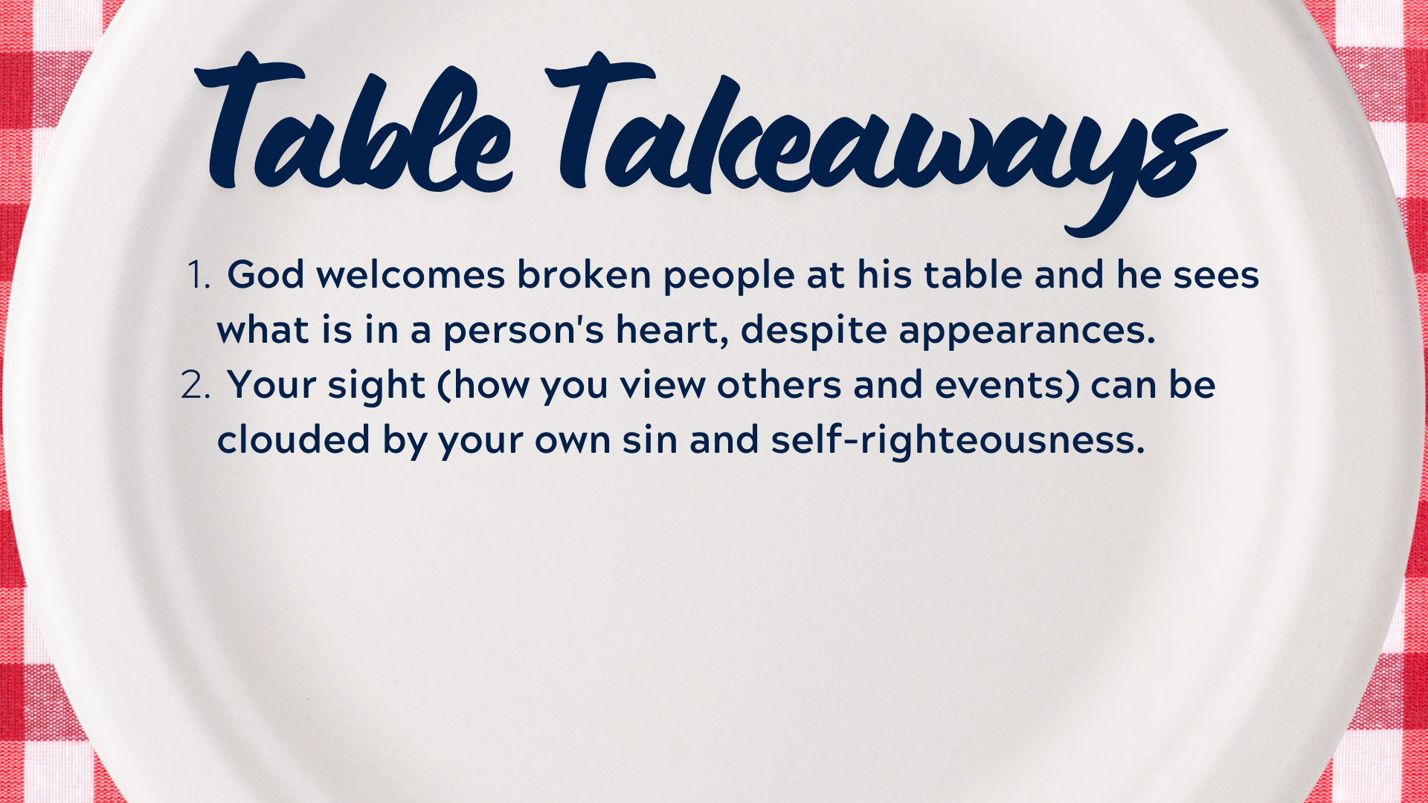
Notes:
[BRIEF COMMENT]
Don’t be like Simon, the Pharisee. Check your own heart.
Be careful not to make assumptions or project your own junk onto others.
Number 3… [NEXT SLIDE]

Slide 9
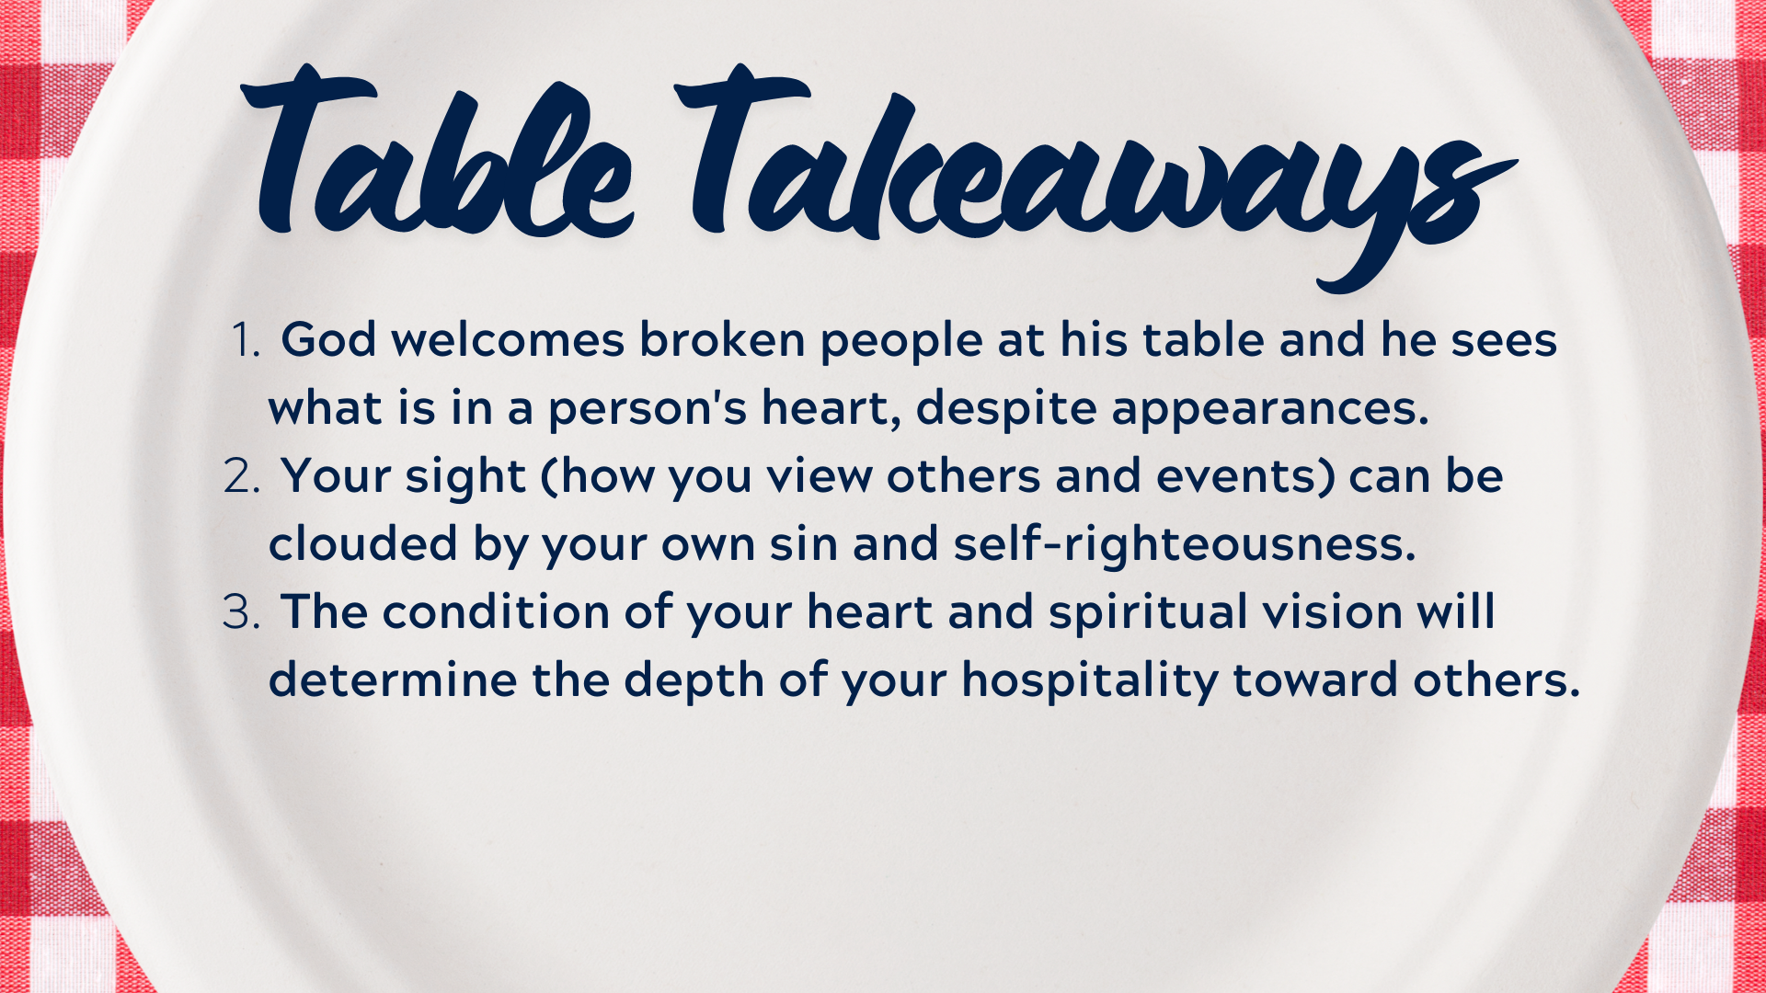
Notes:
[BRIEF COMMENT]
If you’re not very hospitable, and you’re not able to look past your own judgmental thoughts and feelings about a person, it says more about you than them.
So, let’s be willing to let the Lord have our heart and eyes
Number 4… [NEXT SLIDE]

Slide 10
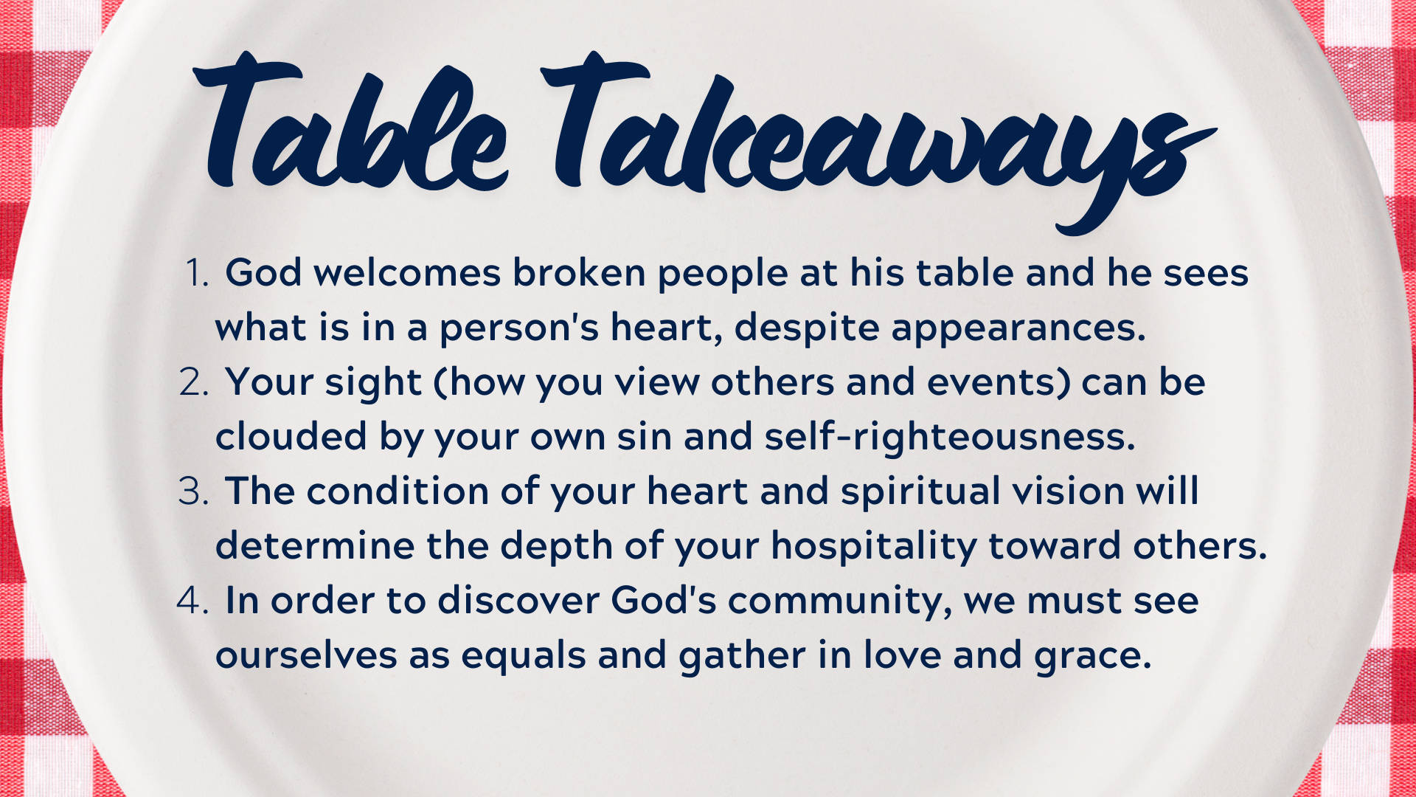
Notes:
[BRIEF COMMENT]
Jesus not only accepts the sinful woman, he simultaneously declares her equal with the men at the table. We see this in how he disregards Jewish customs.
For in the Godhead, we see this sort of equality and submission, one to another.
Take a look at this iconic painting of the Trinity from Russian artist, Andrei Rublev… [NEXT SLIDE]

Slide 11
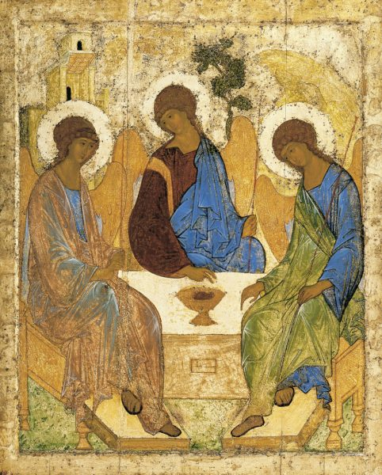
The Trinity
Andrei Rublev
15th century
Notes:
[BRIEF COMMENT]
The Trinity – 3 persons, but 1 God
Different functions, but equally God; mutually submitted (no subordination)
The Father (the Lover), the Son (the Beloved), the Spirit (the love shared between them)
Within God himself, there is perfect community; and God created us in his image
And notice, the artist depicts the Trinity at a table
And lastly, number 5… [NEXT SLIDE]

Slide 13
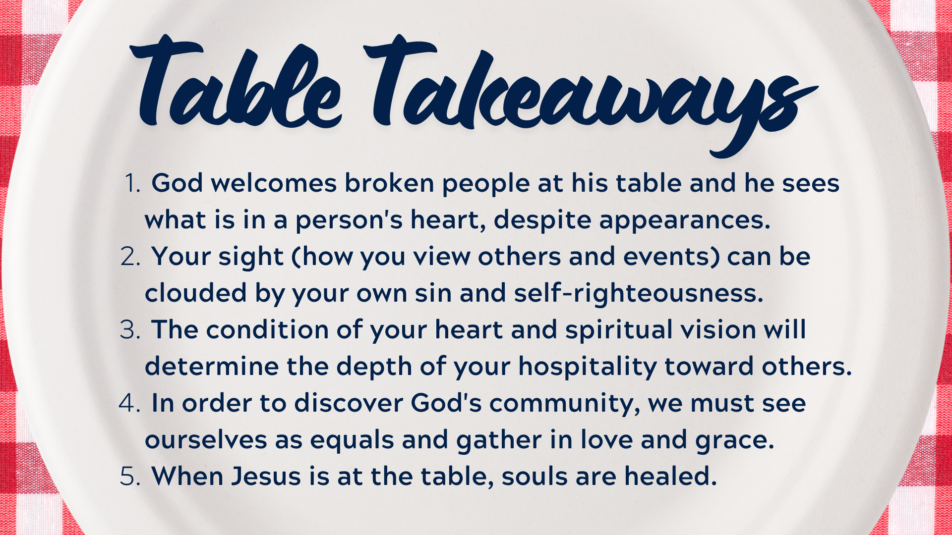
Notes:
[BRIEF COMMENT}
When we set the table for Jesus (and allow him to be present), it’s not just eating that we are gathered for, it is for divine community, for relationships, and for soul care.
Remember what Jesus said to the woman: “Your sins are forgiven.” “Your faith has saved you; go in peace.” What words of blessing can we give to those at our table? Think about this, church. Eating at the table (whether it be with your family or with the church, your neighbor or a stranger) ought to be a picture and embodiment of the gospel—a tangible expression of God’s love, forgiveness, and healing.
What would that look like in your home? What would that look like as you invite others into your home, to discover community at your table? We are inviting you to do that at some point in this series. You can plan that out, or you can be more spontaneous (e.g., Homer and Mildred Kraybill). I encourage you to do whatever the Spirit leads.
Finally, here are some questions for reflection and response… [NEXT SLIDE]

Slide 14

Questions for reflection and response:

Slide 15
Questions for reflection and response:
How does the table story in Luke 7:36-50 speak to you?

Slide 16
Questions for reflection and response:
How does the table story in Luke 7:36-50 speak to you?
How is the Spirit inviting you to respond to this message?
Notes:
[BRIEF COMMENTS]
How does the table story in Luke 7:36-50 speak to you?
How is the Spirit inviting you to respond to this message?
[CLOSING WORDS & PRAYER]

