Slide 1

Notes:
[BRIEF INTRO]
This is the third message in our series – Fear Not! The phrase ”Fear not!” or “Do not be afraid!” are used a lot in the Bible, and they’re the first words from the angels to Zechariah, Mary, and the shepherds in the opening of the Gospel of Luke.
In the first message, Fear Not! God Hears Your Prayers, we reflected on the interaction that the angel had with the priest Zechariah. We were reminded of how God hears our prayers, and while many years may go by, the Lord is able to act on our behalf if we will believe and remain faithful to him in the waiting.
In last week’s message, Fear Not! God’s Favor is Unmerited, we read about Mary’s encounter with the angel Gabriel who said she would conceive a child by the power of the Holy Spirit and give birth to the promised Messiah. We saw how simple faithfulness, humility, and a willingness to trust God enables us to experience more of his mercy, grace, and favor in our lives. It may not be through an angel that God shows up in your life, but the Lord will most certainly reveal himself to you in one way or another when you embody Mary’s attitude and posture.
And in today’s message, Fear Not! You Have a Part to Play, we’re going to read about the role of the shepherds in this good news story and reflect on what it means that God would include these men in the birth narrative of Jesus.
If you have your Bibles, please open up to… [NEXT SLIDE]

Slide 2
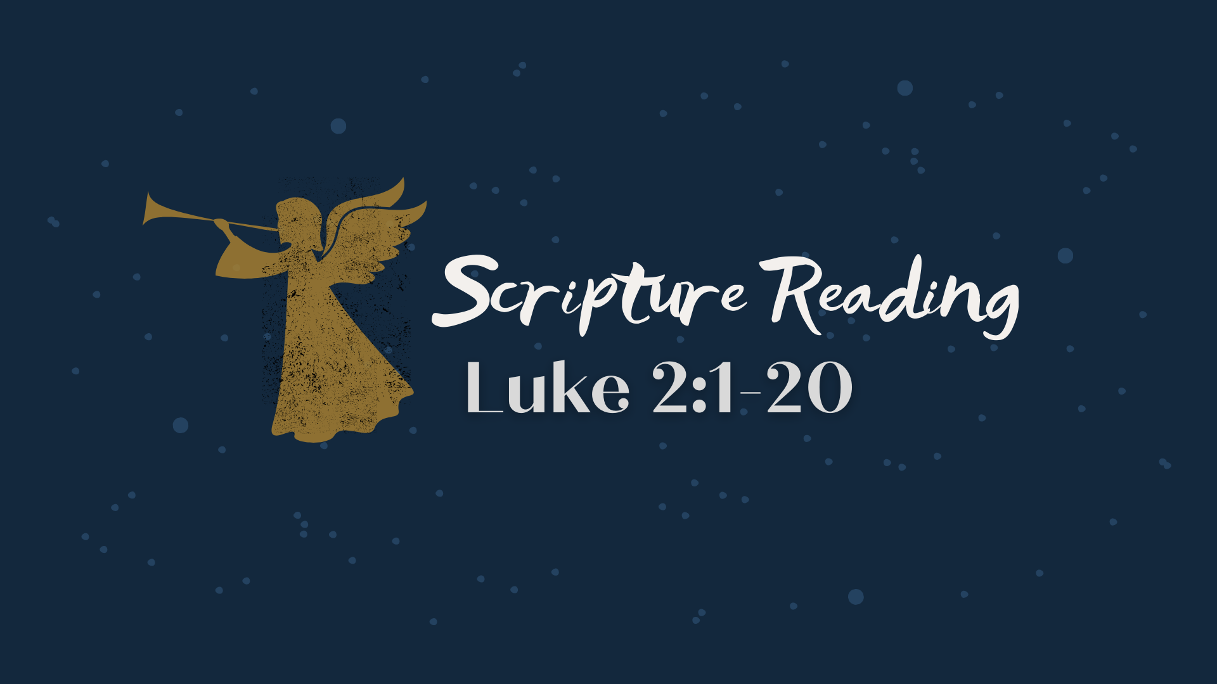
Notes:
[LUKE 2:1-20 NLT - CONGREGATION STAND - READ SCRIPTURE]
This is the word of the Lord. Thanks be to God.
We’ve all likely been in situations as a child—either on the playground, gym class, or on the sandlot—where two teams where being chosen to play a game of some kind… and we may have experienced what it’s like to watch all the other kids being picked… until we’re the last person standing there… NEXT SLIDE]

Slide 3

Notes:
[BRIEF COMMENTS]
Do you know that feeling?
Have you ever watched this happen to someone else?
Our main characters today—the shepherds in the birth story of Jesus—know what that is like. Having one of the lowest occupations in the ancient world, they were accustomed to being overlooked. Before we return to the passage we just read and go verse-by-verse… let’s consider the significance of the shepherds… [NEXT SLIDE]

Slide 4
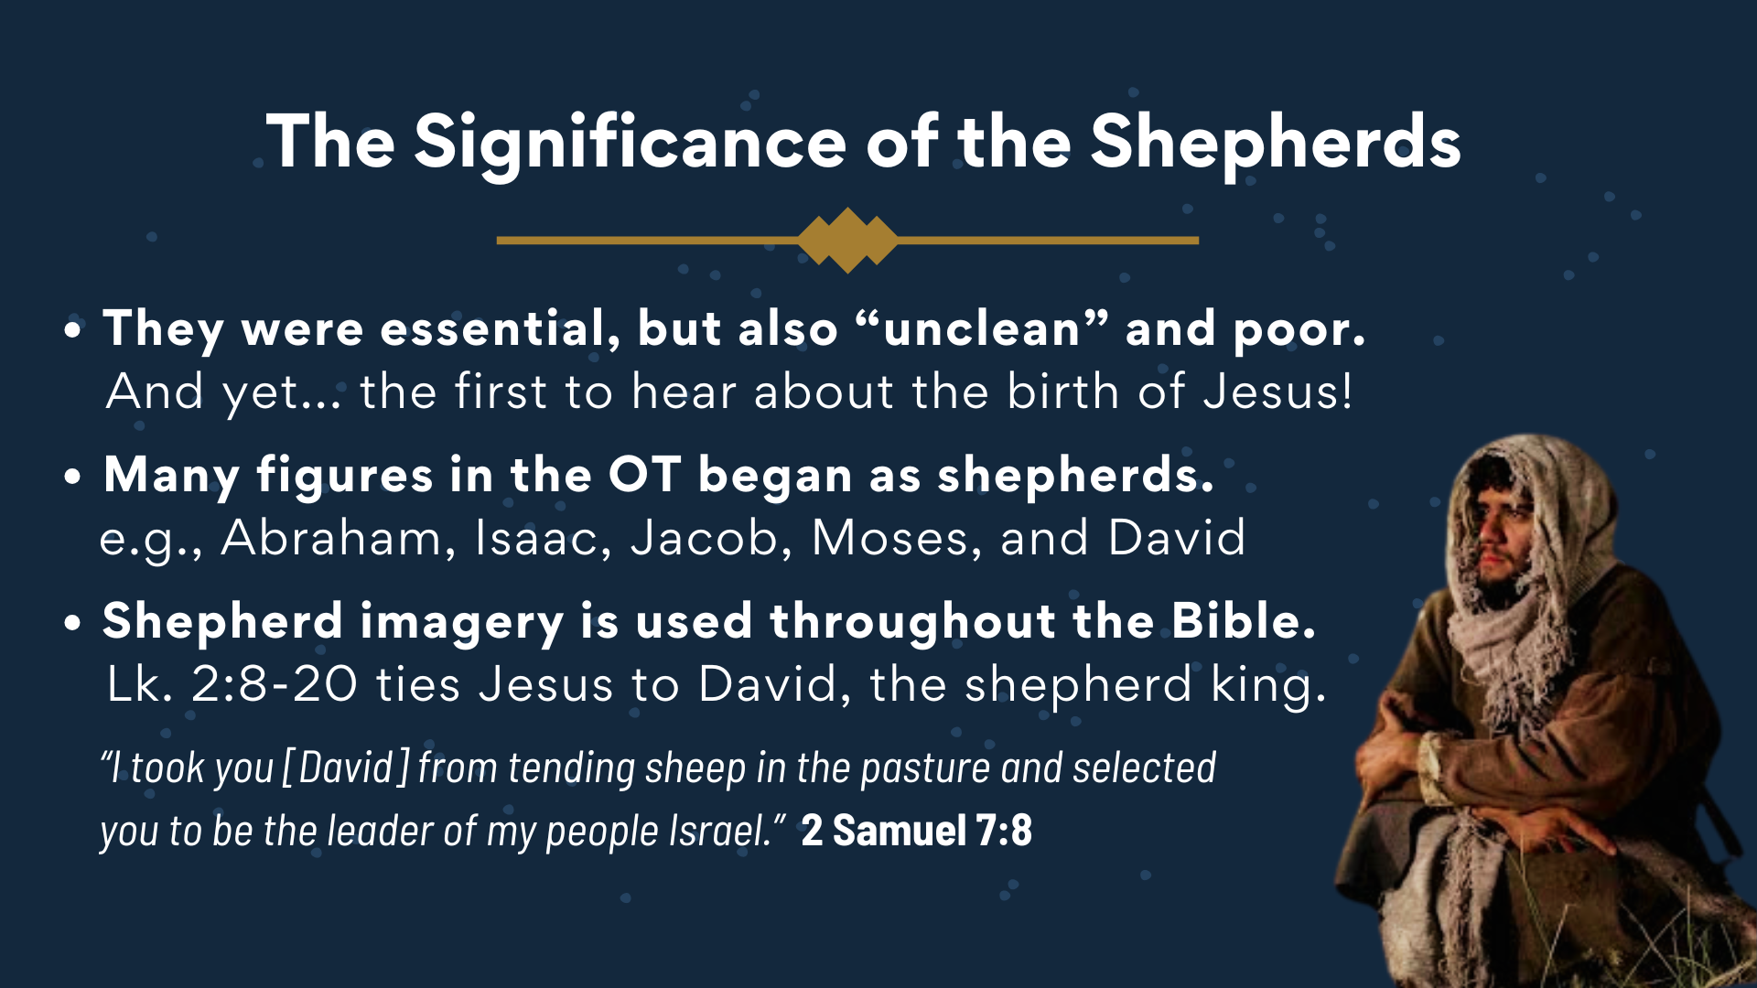
Notes:
[BRIEF COMMENTS ON EACH POINT]
They were essential, but also “unclean” and poor. And yet... the first to hear about the birth of Jesus!
Many figures in the OT began as shepherds.
e.g., Abraham, Isaac, Jacob, Moses, and David
Shepherd imagery is used throughout the Bible. Lk. 2:8-20 ties Jesus to David, the shepherd king.
In 2 Samuel 7:8, we read: “I took you [David] from tending sheep in the pasture and selected you to be the leader of my people Israel.” So, as we saw last week, God is in the business of using the most improbable people to carry out his plan; and to include those, like the young shepherd David, who was forgotten or left out when the prophet comes to visit so he can bless God’s anointed for a divine commission.
Let’s now return to the Scripture and go verse-by-verse… [NEXT SLIDE]

Slide 5
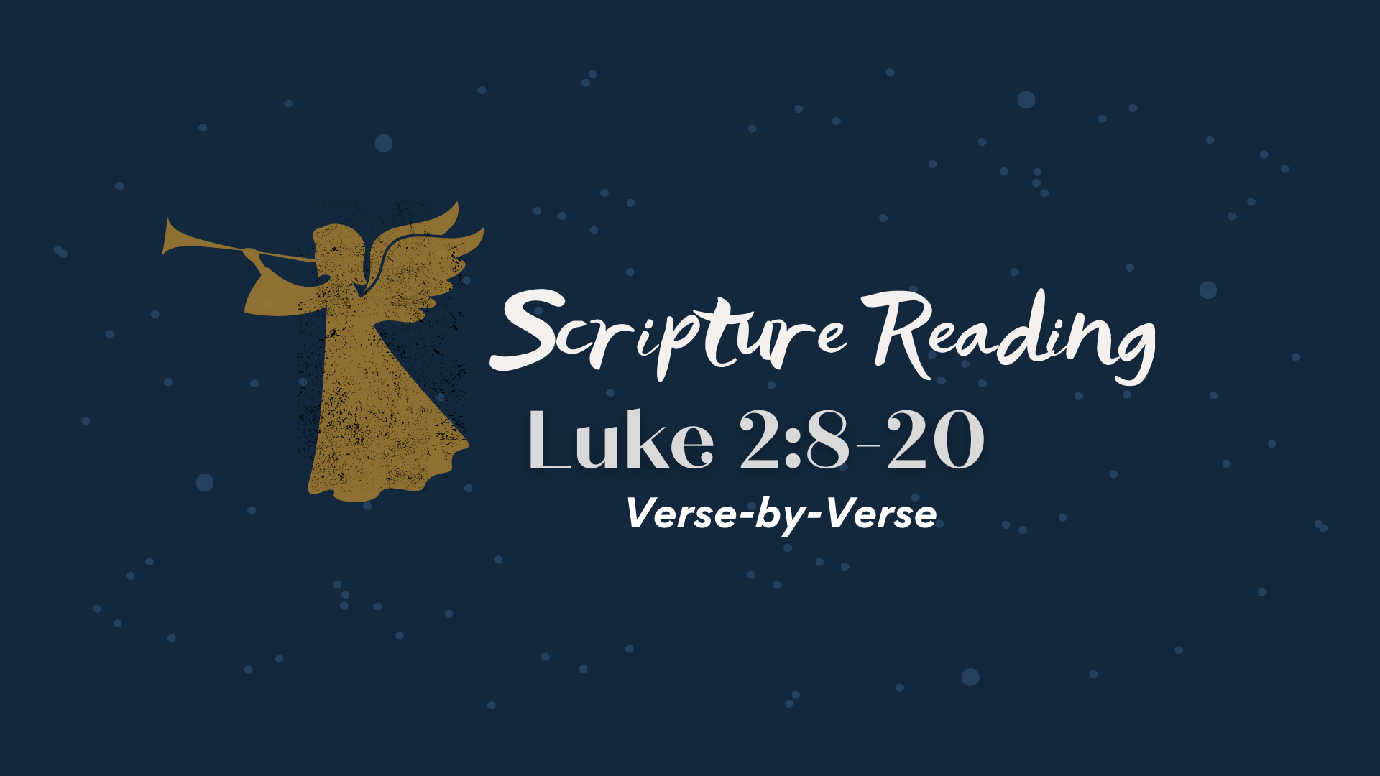
Notes:
[READ VERSE-BY-VERSE & COMMENT]
v. 8 – the shepherds are vigilant and on the lookout
v. 9 - ἐφοβήθησαν φόβον μέγαν – lit., put to flight by terrifying (to scare away), they were full of great fear! The shepherds are scared out of their minds. Or as we sing in the Christmas carol, “Silent night, holy night. Shepherds quake… at the sight.”
Verse 10… “But the angel reassured them… [NEXT SLIDE]

Slide 6
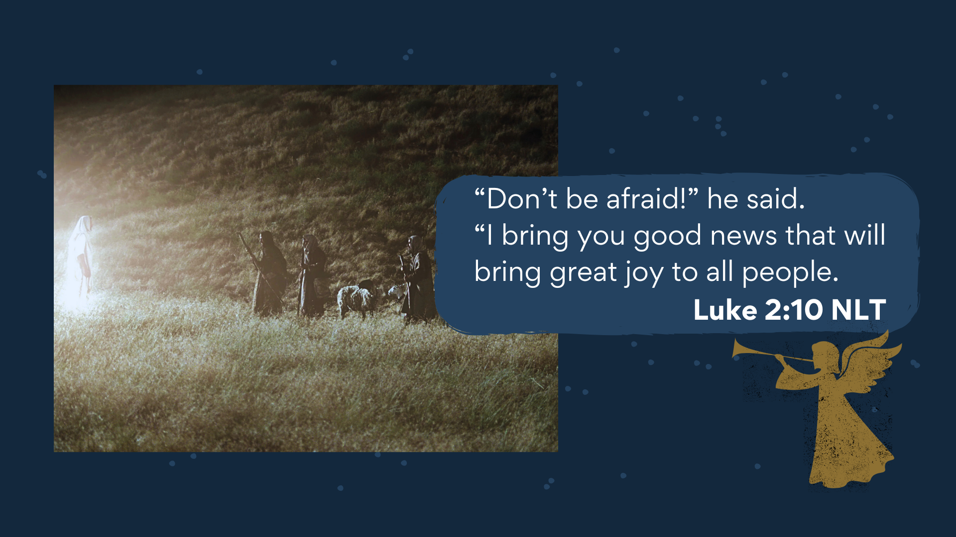
Notes:
[READ & COMMENT VERSE-BY-VERSE, VERSES 10-20]
v. 10 – lit. “Fear not!”; “good news” (euangellion); God wants to replace their “great fear” with “great joy”; and this is for all people!
v. 11 – the promised Messiah has been born, and they are the first to hear about it!
v. 12 – “lying in a manger” – not your typical birthing room
Verse 13… [NEXT SLIDE]

Slide 7
Notes:
v. 13 – “the armies of heaven” - NIV: “a great company of the heavenly host”; lit., “troops of angels” appeared, but they presented themselves more like a choir
v. 14 – “glory to the Most High God”
v. 15 – the natural response to hearing ”good news” is to follow-up on it (learn, see more) and then share it with others
v. 16 – How did they find them? “lying in the manger”
v. 17-18 – “astonished” or ”amazed” or “marveled” (no words, just in awe)
v. 19 – NIV: “pondered them in her heart” (lit. “revolve in the mind/heart”)
v. 20 – when you’ve witnessed the glory of God, you naturally return it
Brothers and sisters, the announcement of Jesus’ birth to shepherds is quite significant when you stop to consider its implications and what it says about God and the part we all play in his plan. On top of the fact that the Son of God is not born in an opulent palace, but rather in a stable for animals… you have the first people being told what has happened are those who are usually the last to know anything; clearly communicating that Jesus has come for everyone.
In Matthew’s Gospel, he tells us that the Magi or well-to-do pagan astrologers from the East arrive after the shepherds. In the movie, the Nativity Story, when they meet with King Herod, they tell him they were following a star or a sign in the sky that they believed indicated that a King or “Messiah” had been born…[NEXT SLIDE]

Slide 8
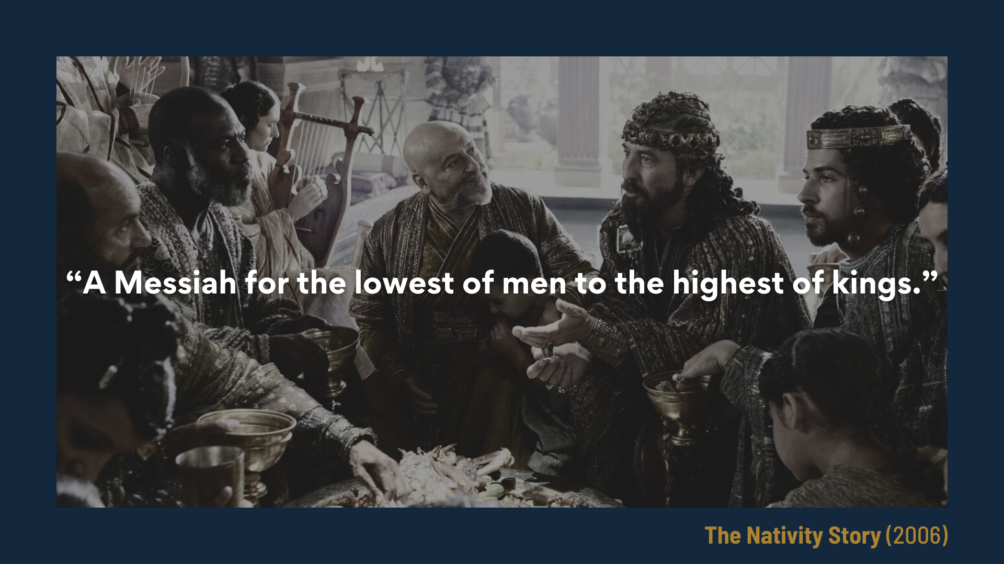
Notes:
They tell him that they had come to see ”a Messiah for the lowest of men to the highest of kings.” Which of course, provokes Herod to order the slaughter of all the firstborn boys of Bethlehem. But not before these pagan foreigners are able to see the baby Jesus and share their gifts of gold, frankincense, and myrrh.
So, think about what this story means for each one of us, as well as those who are “the least of these”—the overlooked, the left out, the forgotten, and the outsiders. Think about what it all says about the God who would come to us in this way.
Listen to what the Apostle Paul wrote… [NEXT SLIDE]

Slide 9
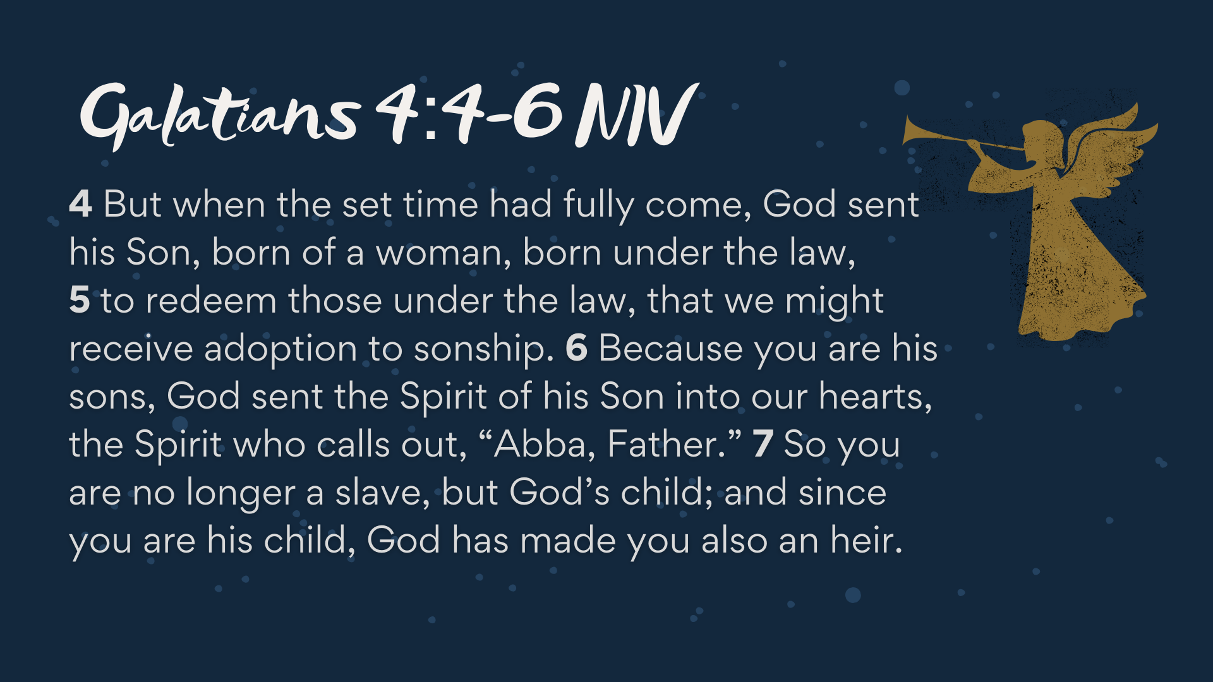
Notes:
[READ PASSAGE & COMMENT]​
“the set time” for God to enact his plan
We have been adopted into his care, to receive all rights and privileges of being a full-blooded son or daughter! We all get to call him Abba or “Daddy”
And then in Ephesians… [NEXT SLIDE]

Slide 10
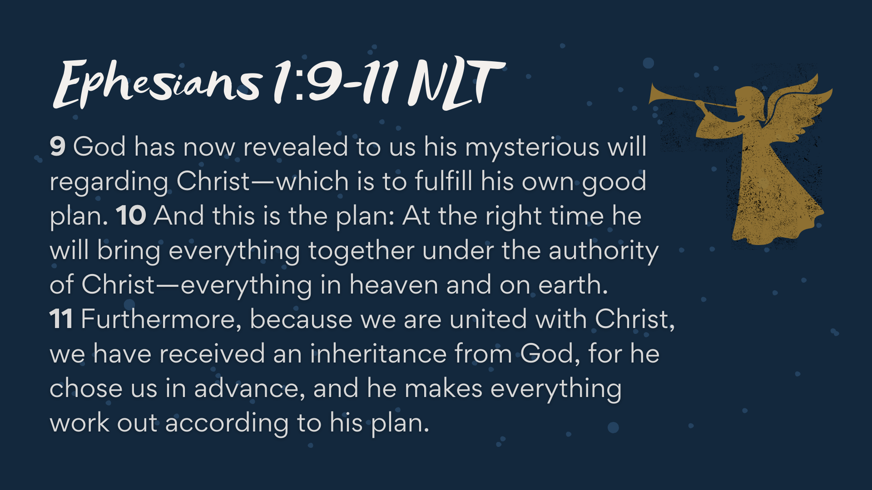
Notes:
[READ PASSAGE & COMMENT]​
Once again… “at the right (or set) time”
We all have been brought into his family and are part of his story
My friends, the shepherds were included and it says to all of us that those who will respond in faith to his good news get included as well… [NEXT SLIDE]

Slide 11

Notes:
You are invited into God’s story! We are in that great theatrical production of God’s creation, of humanity’s fall, and of God’s saving work in Jesus. And each of us have a part to play. What is your part? Like the shepherds, your part may get thrusted upon you by God’s grace. Or like the Magi, you intentionally seek it out and discover it. But regardless, we have some say-so and decision-making power to decide how we live our lives and whether we engage with the divine program.
[MY EXPERIENCE IN THEATER]
There are different jobs and functions
Sometimes you get to choose; other times you are chosen
But… Fear Not! You Have a Part to Play
Finally, here are some questions for reflection and to help us respond to the voice of the Lord together… [NEXT SLIDE]

Slide 12
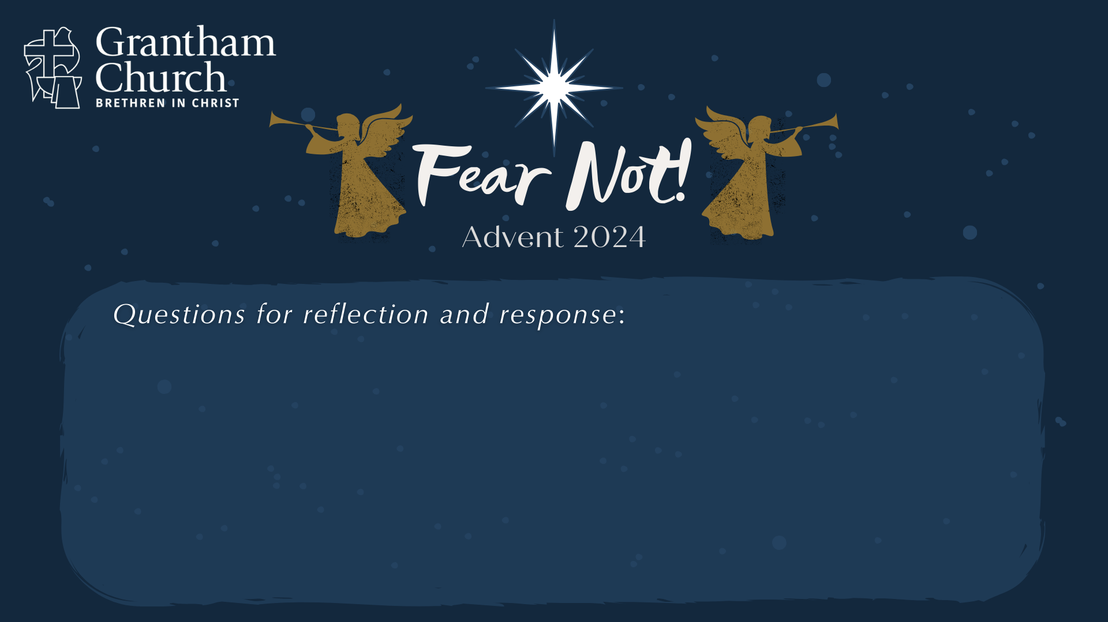

Slide 13
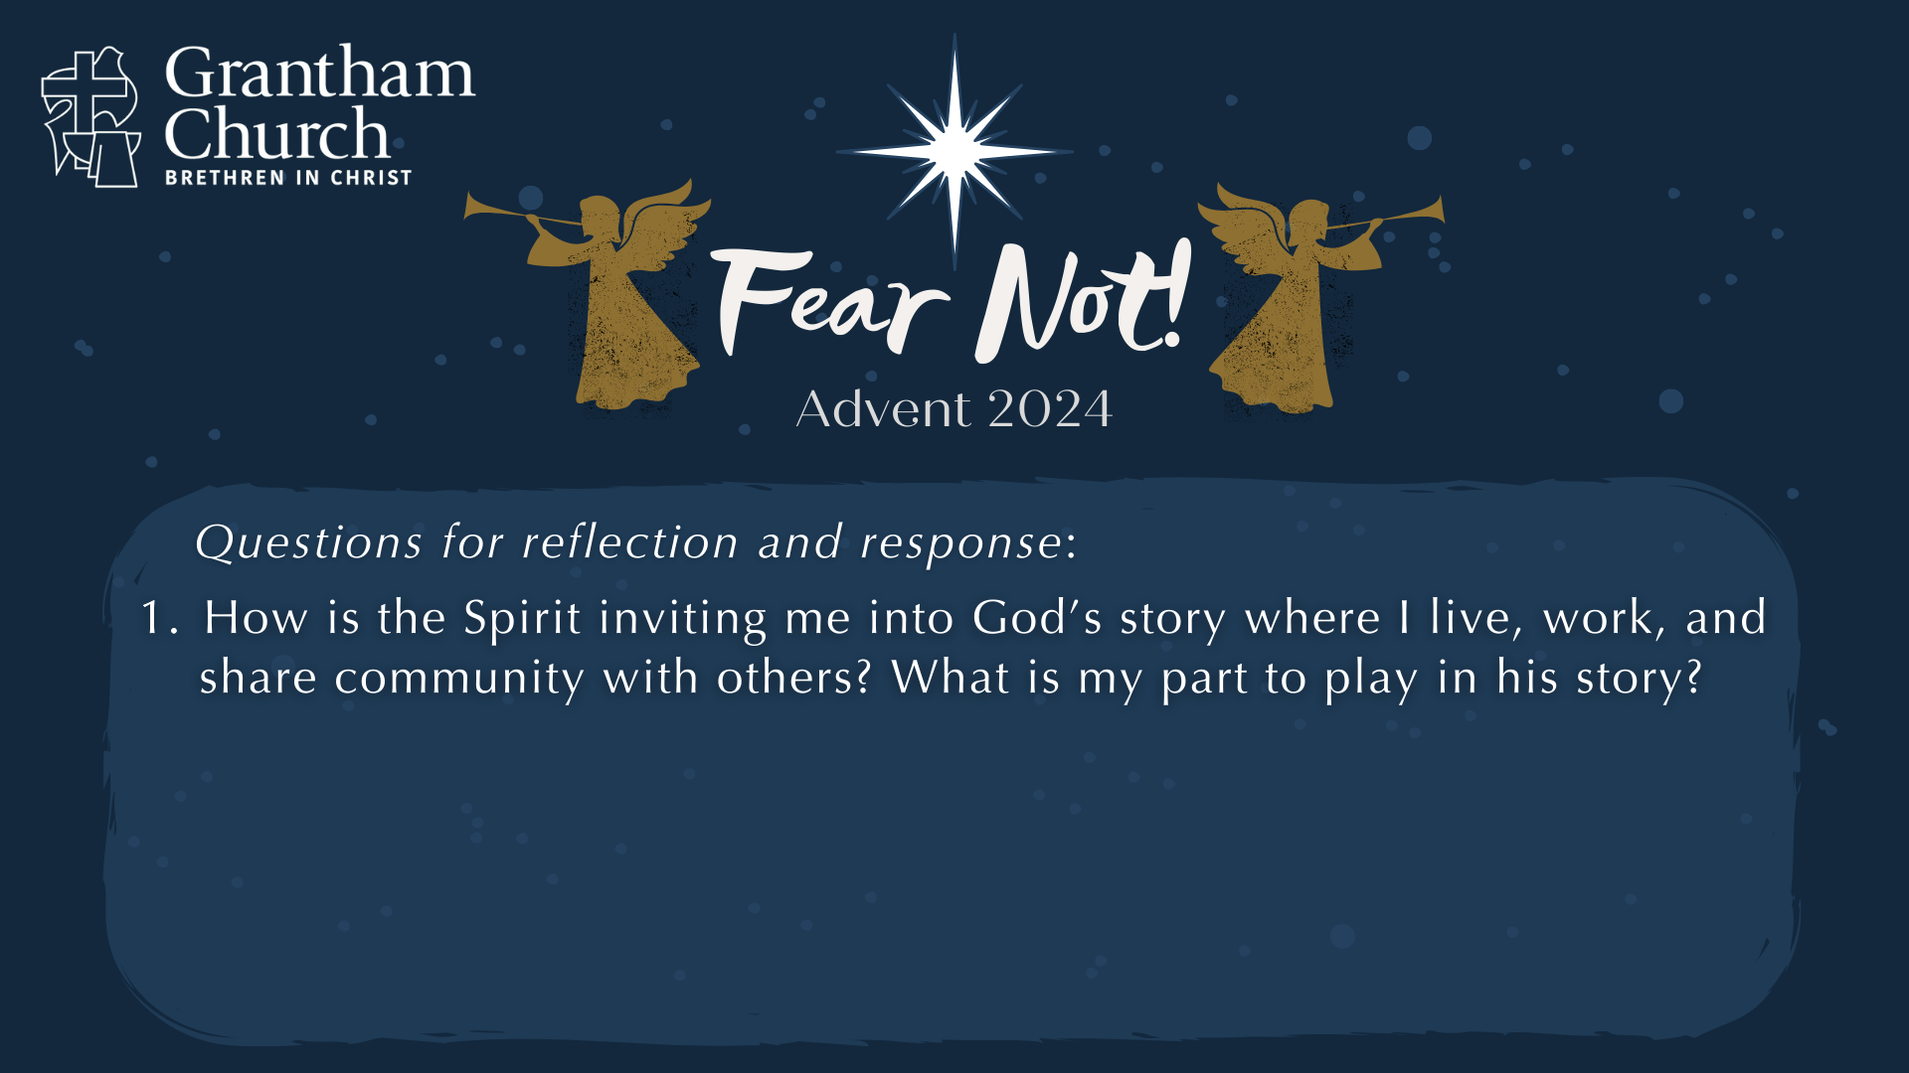

Slide 14
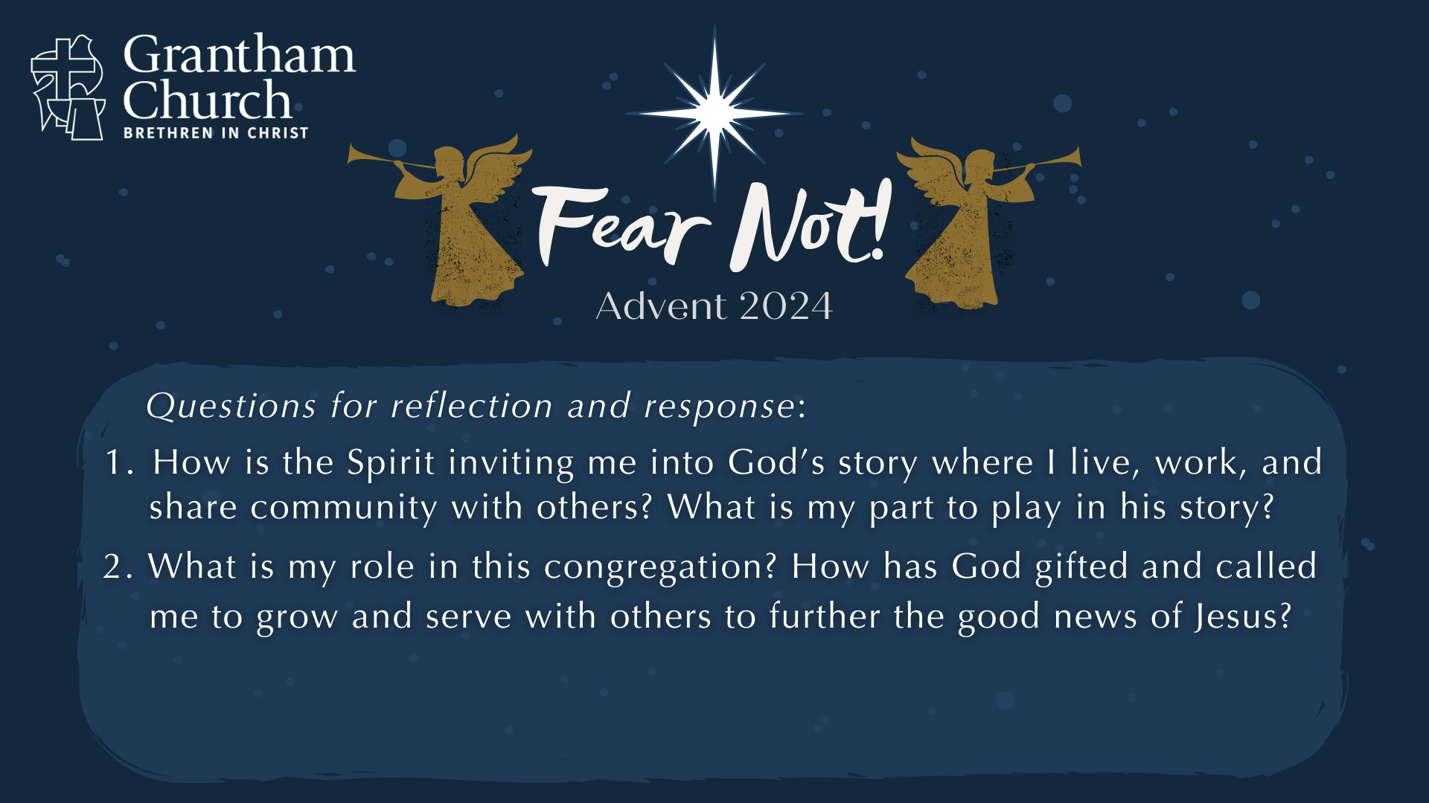

Slide 15
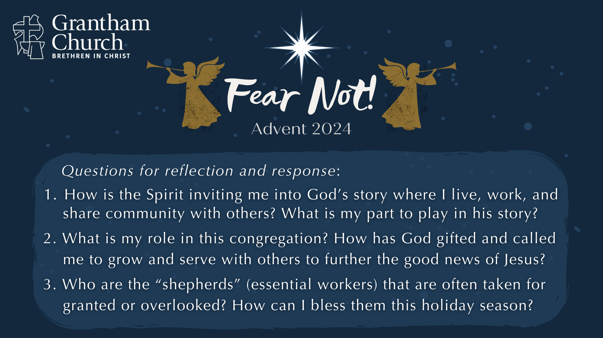
Notes:
[READ QUESTIONS & COMMENT]
How is the Spirit inviting me into God’s story where I live, work, and share community with others? What is my part to play in his story?
What is my role in this congregation? How has God gifted and called me to grow and serve with others to further the good news of Jesus?
3. Who are the “shepherds” (essential workers) that are often taken for granted or
overlooked? How can I bless them this holiday season?
[FINAL WORDS]
[GO TO NEXT SLIDE DURING CLOSING PRAYER]

Slide 16

Notes:
[CLOSING PRAYER]
Benediction:
Brothers and sisters, fear not! You have a part to play. As you wait upon the Lord and anticipate Christmas, may you be filled with his peace, surrounded by his presence, and empowered by his Spirit. Go in peace, church, to love and serve the Lord. Amen.

