Slide 1

Notes:
[BRIEF INTRO]
Welcome
2nd Sunday of our winter series
Foundations is a 4-week sermon series that calls us to address the spiritual foundations of our life in Christ. We are looking at how the gospel challenges us to commit to following Jesus together, which involves regular rhythms of prayer, reading and reflecting on the Scripture, and deepening relationships.
Last Sunday Pastor Melissa began our Foundations series with an excellent message, The Call to Discipleship. As Melissa shared, if we’re going to live into God’s best for us and apply the gospel to our lives, then we must place Jesus at the center, prioritize our faith over idols, and take up our cross and follow him. She said that the grace God gives us to follow Jesus as committed disciples isn’t an “add-on” to our lives, it’s the main thing. And while this calling isn’t easy, it is the surest way to know God’s peace, freedom, mercy, grace, and love—life to the fullest (Jesus said)—it’s what we were created for.
And so, when we answer the call to discipleship, we commit to some basic spiritual practices and religious routines that help orient our hearts to God and allow us to hear his voice. Prayer is the primary way by which we abide in the Lord, experience his presence and power, discern his will, and stay rooted in his love. Therefore, this morning I’ll be challenging us to honestly examine the state of our praying life, and I’ll be specifically inviting us to develop a conversational relationship with God.
Would you grab a Bible and turn to… [NEXT SLIDE]

Slide 2
Scripture Reading
1 Samuel 3:1-10 NLT
Matthew 6:5-13 NLT
Notes:
[INVITATION TO STAND FOR SCRIPTURE READING]
[READ 1 SAMUEL 3:1-10 & MATTHEW 6:5-13 NLT]
This is the word of the Lord. Thanks be to God
You may be seated. [NEXT SLIDE]

Slide 3

Notes:
[READ INTRO TO BOOK]
And that is why we must start with the call to prayer…. [NEXT SLIDE]

Slide 4
“I am the good shepherd; I know my sheep and my sheep know me... My sheep listen to my voice; I know them, and they follow me.”
John 10:14, 27 NIV
Notes:
[BRIEF COMMENT ON PASSAGE]
And I think whether you believe we can hear from God (and know the shepherd’s voice) or not, is really all about your worldview. Let’s think about this for a moment… [NEXT SLIDE]

Slide 5
Your Theological Worldview
Impacts Your Idea of “Relationship” and Prayer
Who is God? Where is God? And what difference does it make?
Pantheism – “God is everything, everything is God”; prayer is about getting in tune with self and nature – being “one with the Universe” (e.g., Greek mythology, Native American religions, etc. )
Deism – God is a distant deity who created and then stepped away; therefore, prayer calls across a void in times of need/trouble and for national or tribal blessings (e.g., the US Founding Fathers, etc.)
Christian Theism – God is transcendent, but also present in his creation (heaven & earth); God is knowable and is revealed in Jesus; therefore, prayer is “spiritual” communication, were God (Spirit) touches our spirit
Notes:
[BRIEF COMMENT ON EACH]
But we should recognize that prayer encompasses more than simply “communicating” with God. It is also about communing and relating to a loving God—who the Bible says is the divine Creator that has a will and a purpose for the world, including your own life.
As the prophet Samuel discovered when he was a boy. [NEXT SLIDE]

Slide 6
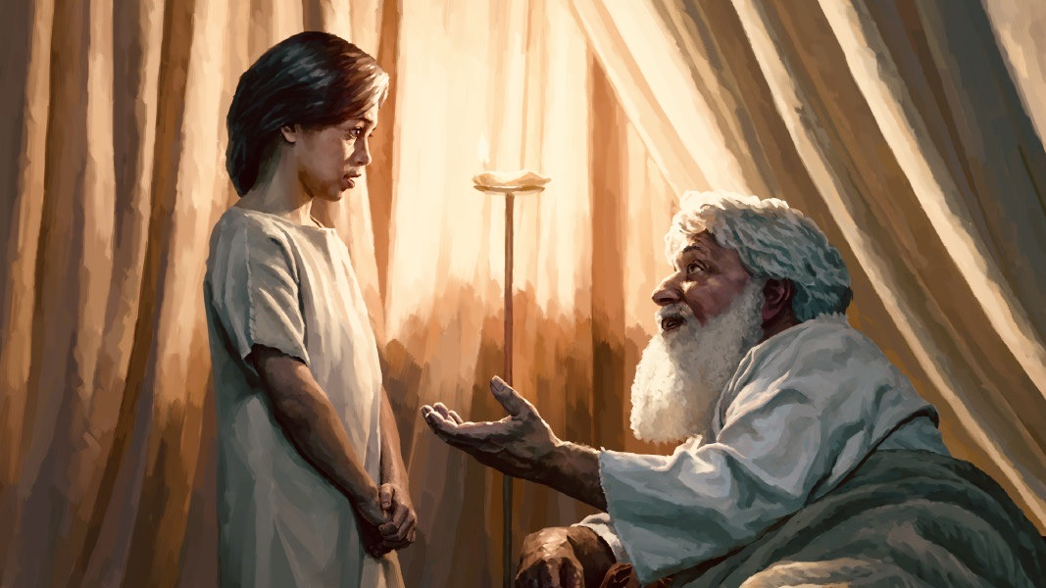
1 Samuel 3:1-10 – Samuel learns to hear from God
Notes:
[SUMMARY & CONTEXT OF 1 SAMUEL 3:1-10]
At the end of the period of the Judges (before Israel had her first king)…
Samuel was dedicated to God and his service in the tabernacle by his mother, Hannah.
The Bible says that hearing a word from God was rare at that time, yet Samuel hears
Samuel thinks the priest Eli is calling him, but they both discover it’s God
After the third time, Eli tells Samuel… “Oh, you’re hearing from God” and Eli guides him
Eli helps Samuel in how to hear and respond to God in conversation: ”Speak, Lord…”
Was this voice audible? Possibly. And while it’s certainly possible for God to speak to us audibly, or speak to us through dreams and visions… [NEXT SLIDE]

Slide 7
Biblical Ways God Can Speak to Us
According to the Bible, here are common ways that God speaks:
God speaks to us directly in an inward way.
(e.g., Abraham, Moses, the Prophets, Jesus, Paul, etc.)
2. God speaks to us through the Holy Scriptures.
(e.g., Josiah, Jesus, Peter, Paul, Ethiopian Eunuch, etc.)
3. God speaks to us through other people.
(e.g., Nathan to David, Ananias to Saul (Paul), Peter to
Cornelius, Paul to the Athenian philosophers, etc.)
Notes:
[BRIEF COMMENT ON EACH]
So… at this point, let me ask you a few questions… [NEXT SLIDE]

Slide 8
Are you listening for God’s voice?
Are you awake to what He’s doing around you?
Are you able to hear his voice within you?
Notes:
[BRIEF COMMENT]
And if you’re not, or you’re unsure about where to start, I’d like to suggest slowing down and intentionally creating some space for the Lord to speak to you. As the psalmist wrote… [NEXT SLIDE]

Slide 9
“Be still, and know that I am God.”
Psalm 46:10 NIV
Notes:
[BRIEF COMMENT ON PASSAGE]
Certainly, God can break through our busy lives and all of the noise. He can appear in a burning bush, as he did with Moses, he can knock us off of our horse, as he did Saul of Tarsus. But I have found that isn’t normally how God speaks. Instead, it’s (as the Scriptures say) through a still small voice, that God comes to us. It’s with a divine whisper through our own thoughts that the Spirit of God most often speaks to us. And being alone and embracing solitude (even boredom) helps us to do that.
I recently experienced this on a hike… [NEXT SLIDE]

Slide 10
The Posture of a Listening Servant
If we want to hear God speak, we must be listening. What is the posture of a listening disciple of Jesus?
Our heart and mind must be open to hearing from God
We need to be humble, believing, dependent & surrendered
It requires cultivating your spiritual capacity to hear God’s voice in solitude, and in your everyday activities
We allow space for God to speak to us when we pray
Notes:
[BRIEF COMMENT ON EACH]
More recently, here are a few tools that I have found helpful in creating regular quiet times for being still, reaching out to God (spirit to Spirit), and opening myself up to hearing from him. [NEXT SLIDE]

Slide 11

Questions for reflection and response:
How is your prayer life? Do you have set times that you pray?
When you pray, are you allowing space for God to speak to you?
How is the Spirit prompting you to respond to this message?
Notes:
[BRIEF COMMENT ON EACH]
[CLOSING WORDS]
[CLOSING PRAYER]

