Slide 1
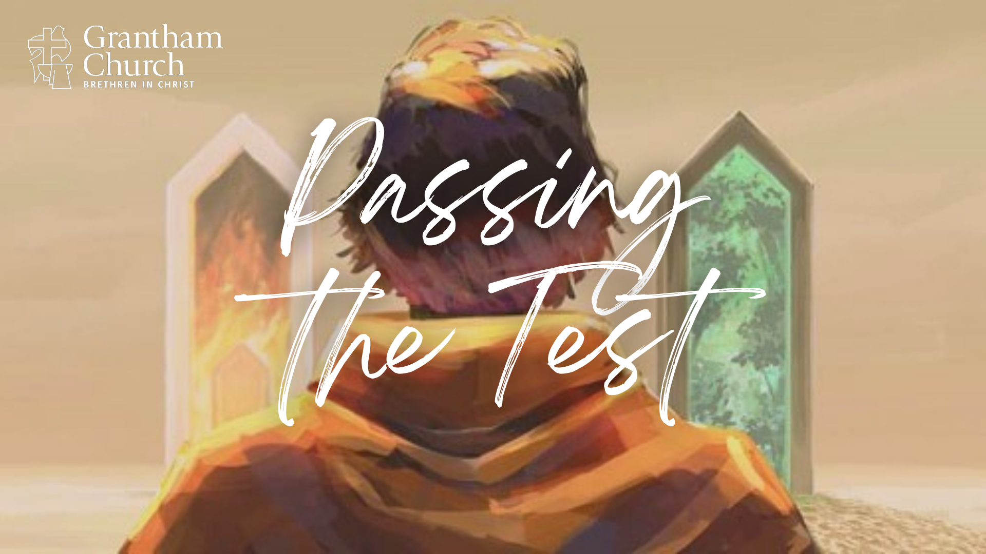
Notes:
[BRIEF INTRO]
Greetings
Passing the Test – Life is full of trials that test our faith. We live in a broken world and not everything is as God intends. Bad things happen and challenges come. But ultimately, God wants to bring good out of our trials and for us to see them as opportunities to deepen our faith in him. Therefore, I want to encourage us this morning to view our trials as tests that God uses to increase our awareness of his love, faithfulness, and provision, which will then lead us to live into the fullness of life and freedom that Jesus offers us in the gospel.
Would you please grab a Bible and turn to… [NEXT SLIDE]

Slide 2
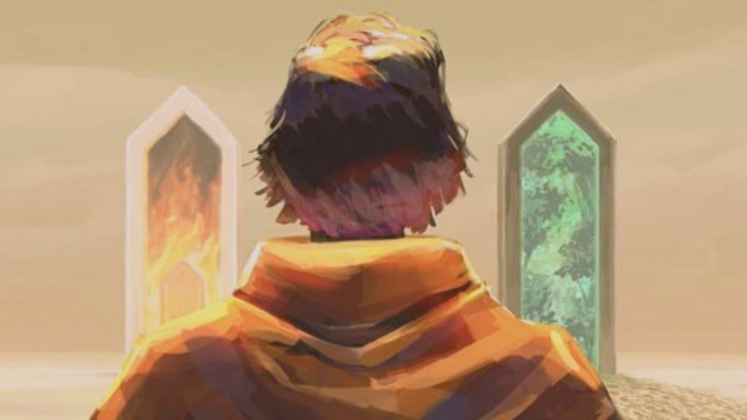
Scripture Reading
Genesis 22:1-18 NLT
Notes:
[INVITATION TO STAND FOR SCRIPTURE READING]
[READ GENESIS 22:1-18 NLT]
This is the word of the Lord. Thanks be to God
You may be seated. [NEXT SLIDE]

Slide 3
Notes:
[A FEW WORDS ABOUT THE PASSAGE]
A troubling text to be sure, especially a cursory reading of it
The ANE context is important–God meets people where they are
The larger biblical story is important (progressive revelation)—Jesus reveals God—and it’s important to read the OT through a Christocentric or “cruciformed” lens
And of course, paying attention to the immediate context helps
So, let’s begin by looking more closely at our main Scripture reading… [NEXT SLIDE]

Slide 4
Genesis 22:1-2 NLT
¹ Some time later, God tested Abraham’s faith. “Abraham!” God called.
“Yes,” he replied. “Here I am.”
² “Take your son, your only son—yes, Isaac, whom you love so much—and go to the land of Moriah. Go and sacrifice him as a burnt offering on one of the mountains, which I will show you.”
Notes:
[BRIEF COMMENTS VERSE-BY-VERSE]
v. 1 – In Gen 12 God called Abram to leave his land, his family, and his religion; he shows great faith throughout his life, but was by no means perfect (e.g., twice claims Sara is his sister, he sleeps with his wife’s servant Hagar, etc.); in their old age, Isaac is born—a fulfillment of God’s promise to Abraham that he would grow his family into a nation.
v. 2 – Isaac is a young boy (under the age of 12); Mt. Moriah, believed to be where the temple in Jerusalem was later built, but at this time is in the land of the Canaanites Why is that important to know? Because child sacrifice (particularly the firstborn) would have been fairly common at that time, and so it seems (at first) that Yahweh may be like other Canaanite gods afterall. Of course, we can’t help but wonder, how Abraham received this message. Did he hear correctly? Was this the voice of God? The text certainly reads that way.
Verse 3… [NEXT SLIDE]

Slide 5
³ The next morning Abraham got up early. He saddled his donkey and took two of his servants with him, along with his son, Isaac. Then he chopped wood for a fire for a burnt offering and set out for the place God had told him about. ⁴ On the third day of their journey, Abraham looked up and saw the place in the distance. ⁵ “Stay here with the donkey,” Abraham told the servants. “The boy and I will travel a little farther. We will worship there, and then we will come right back.”
Notes:
v. 3 – Where is Sara? Does she know what’s going on? And imagine what is going through Abraham’s mind as he chops wood, unaware that God is testing him.
v. 4 – Three days to wrestle with what he believes God has said to him!
v. 5 – Is he lying so as not to alarm anyone (he has certainly lied before), or does Abraham believe deep down that God is not like other pagan deities and therefore wouldn’t possibly have him go through with the nightmarish act of sacrificing his little boy?
Verse 6… [NEXT SLIDE]

Slide 6
⁶ So Abraham placed the wood for the burnt offering on Isaac’s shoulders, while he himself carried the fire and the knife. As the two of them walked on together, ⁷ Isaac turned to Abraham and said, “Father?”
“Yes, my son?” Abraham replied.
“We have the fire and the wood,” the boy said, “but where is the sheep for the burnt offering?”
⁸ “God will provide a sheep for the burnt offering, my son,” Abraham answered. And they both walked on together.
Notes:
v. 6 – we shouldn’t miss the parallel here of the son carrying wood for the offering up a hill to be a sacrifice for sins as a show of faithfulness to God on the altar
v. 7 – folks, this is just gut-wrenching
v. 8 – if it was unclear in verse 5, surely, we can see that Abraham in verse 8 sounds like a man that believes it is inconsistent with God’s character and contrary to his covenant that he would command and then expect this to play out. But doubts must be there, or this wouldn’t be a real test.
Now simply listen as I continue to read verses 9-12… [NEXT SLIDE]

Slide 7
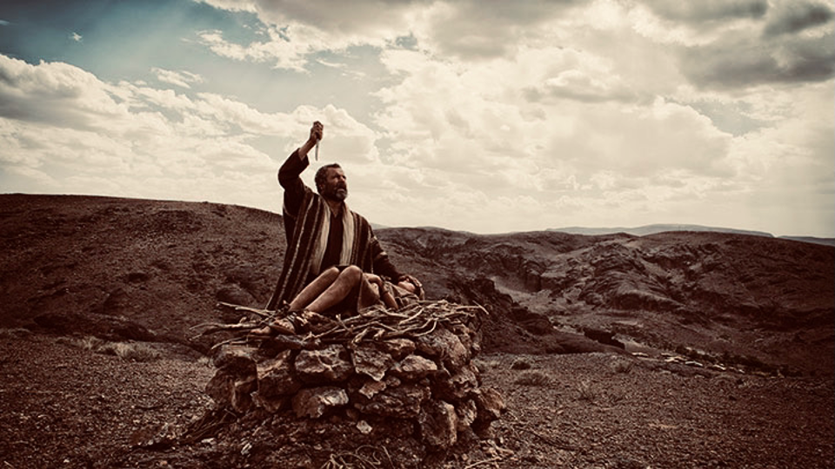
Notes:
⁹ When they reached the place God had told him about, Abraham built an altar there and arranged the wood on it. He bound his son Isaac and laid him on the altar, on top of the wood. ¹⁰ Then he reached out his hand and took the knife to slay his son.
¹¹ But the angel of the Lord called out to him from heaven, “Abraham! Abraham!” “Here I am,” he replied. ¹² “Do not lay a hand on the boy,” he said. “Do not do anything to him. Now I know that you fear God, because you have not withheld from me your son, your only son.”
My friends, as a father myself, I can think of no greater test than this. But before we think more deeply about this as a “test of faith” and the tests that are before us this morning, I want to try and help us see what I believe is really going on in Genesis 22 (that we can accept this as inspired Scripture) and why God has stooped so low in this story, even taking on the appearance of a monstrous deity putting Abraham through a horrific ordeal. [NEXT SLIDE]

Slide 8
Notes:
[BRIEF COMMENTS]
Did you notice that Abraham wasn’t surprised or shocked at God’s command? Why would he not object? He objected to the judgment coming to Sodom and Gomorrah.
Again, child sacrifice was common. Abraham saw it in Ur and in the land of Canaan. Maybe God would eventually ask that of him. This likely was a fear of Abraham’s.
And I believe that God knew the fear that lingered within Abraham: “What if God is like the other gods?” Remember, Abraham is still getting to know Yahweh. And he is doubting God’s character and covenant. Therefore, the Lord’s strategy is to have him face his fear and overcome it, much like “flooding” or “implosion” therapy.
Therefore, in dramatic fashion, God does something in this test that will no doubt create a theological and emotional imprint on Abraham’s soul and increase his faith in Yahweh. After this test, Abraham’s view of Yahweh will be forever changed, and he will be set free from his fallen projections and misconceptions of God. Listen what Greg Boyd says about God’s strategy in his book, Crucifixion of the Warrior God… [NEXT SLIDE]

Slide 9
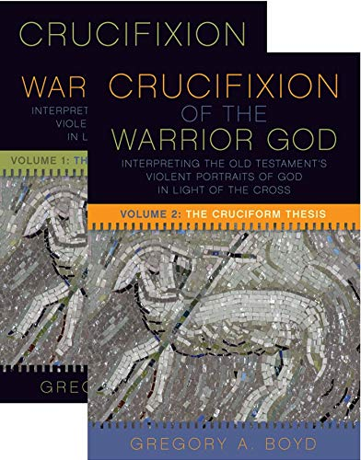
“I submit that as a means of finally freeing Abraham from every remnant of this cursed ANE view of divinity and to convince Abraham that he is a God who would never demand child sacrifices, God stooped to temporarily bear Abraham’s sinful and culturally conditioned suspicions about his character and to therefore momentarily take on an appearance that seemed to confirm these suspicions. And he did this precisely so he could finally free Abraham from every last vestige of his pagan view of divinity while at the same time discerning the depth of his commitment to him.”
Greg Boyd, Crucifixion of the Warrior God (Vol. 2: The Cruciform Thesis), pg.1292
Notes:
[BRIEF COMMENTS]
For Abraham, this is an emotional purging of any lingering remnants of a pagan portrait of God, something he would never forget, nor would his descendants.
This brings about a major paradigm shift not only in Abraham’s understanding about God, this is also a new revelation to humanity about who God is and what he is like. The true God does not require child sacrifice, for he himself provides the sacrifice.
And of course, we see God stooping to this same level when the Father sends the Son in the likeness of sinful humanity, taking on the appearance of a criminal and dying a criminal’s death on a cross, so that he might be the perfect lamb of God who takes away the sins of the world. [NEXT SLIDE]

Slide 10
Notes:
And so, this test of Abraham, it wasn’t just to see if he would obey God and be faithful to his commands. It goes much deeper than that, just as it does with us all. More than simply obeying his word and passing the test, God wants to correct our misconceptions of him… away from the God who looks like the gods of our own making; away from the God we want to hide from, or the God who might “take” our loved ones, or the God who is out to get us or bring evil upon us… away from the God who can’t be trusted in the dark times.
Church, this is how God reconciles us to himself. Jesus on the cross is the quintessential expression of God’s love for you and the world. And as you come to this God who looks like Jesus, and receive his love and forgiveness (over and over again in your life), you will be reconciled. You will be free.
And ultimately, this is what is behind every test that we’re facing. Do we believe that God loves us, and will we trust him to see us through? Because he wants to make himself known, deepen our faith in him, and see us pass the test. He wants this for us because it leads to a greater awareness of his love and frees us from our bondage to the hell that lingers in our lives—irregardless if it’s something of our own doing or something beyond our control.
So, consider these things when you hear these words from James… [NEXT SLIDE]

Slide 11
James 1:2-4, 12 NLT
² Dear brothers and sisters, when troubles of any kind come your way, consider it an opportunity for great joy. ³ For you know that when your faith is tested, your endurance has a chance to grow. ⁴ So let it grow, for when your endurance is fully developed, you will be perfect and complete, needing nothing.
¹² God blesses those who patiently endure testing and temptation. Afterward they will receive the crown of life that God has promised to those who love him.
Notes:
[BRIEF COMMENTS ON PASSAGE]
And don’t forget, that Jesus was also tested and showed us what submission to the Father looks like as he prayed in the garden before his arrest… [NEXT SLIDE]

Slide 12
“My Father! If this cup cannot be taken away unless I drink it, your will be done.”
Matthew 26:42 NLT
Notes:
[BRIEF COMMENT ON PASSAGE]
Look and learn from Jesus. Jesus submitted to God in his greatest test and believed that he would be vindicated and ultimately raised. Because God always brings good out of evil. I think that’s what the Apostle Paul had in mind in Romans 8 when he wrote… [NEXT SLIDE]

Slide 13
“We are confident that God is able to orchestrate everything to work toward something good and beautiful when we love Him and accept His invitation to live according to His plan.”
Paul, Romans 8:28 (VOICE)
Notes:
[BRIEF COMMENT ON PASSAGE]
Folks, this is the good news, the gospel of God. The invitation is to believe it and live it today.
Before we close with some questions for reflection and response, let’s watch this short video from the BibleProject, as I think it will help you to put your test (whatever you’re going through right now) into perspective. And maybe… just maybe… you will hear the Lord speak to you.
Let’s watch this together…. [GO TO VIDEO]

Slide 14
Notes:
[PLAY VIDEO – 6 min]
[GO IMMEDIATELY TO NEXT SLIDE AFTER VIDEO]

Slide 15
Reflection & Response
Notes:
[BRIEF COMMENT ON EACH]
[CLOSING WORDS]
[CLOSING PRAYER]

Slide 16
Reflection & Response
What trials are you experiencing in this season of your life?
Notes:
[BRIEF COMMENT ON EACH]
[CLOSING WORDS]
[CLOSING PRAYER]

Slide 17
Reflection & Response
What trials are you experiencing in this season of your life?
Have you been viewing your challenges as a test, as an opportunity to grow your faith?
Notes:
[BRIEF COMMENT ON EACH]
[CLOSING WORDS]
[CLOSING PRAYER]

Slide 18
Reflection & Response
What trials are you experiencing in this season of your life?
Have you been viewing your challenges as a test, as an opportunity to grow your faith?
How is the Spirit inviting you to see God differently, to trust him, and respond in faith to his voice?
Notes:
[BRIEF COMMENT ON EACH]
[CLOSING WORDS]
[CLOSING PRAYER] – “Lord, we need you…”

