Slide 1

Notes:
[BRIEF INTRO]
The Scriptures tell us that God’s heart is that all would come to know him in all his glory. His plan for accomplishing that mission is to work through disciples who make disciples. God wants us to share his heart in proclaiming the good news of Jesus in word and deed to every man, woman, and child that we encounter in life. And so, this 5-week “We the Church” series is intended to stir our imagination for what Jesus can do through us if we will join his Kingdom mission and respond to his calling on our lives to reach others with the gospel.
Each week we will watch a quick intro video to the message (like the one you just saw) from someone connected with Christ Together, a national organization that helps churches rally around Christ and the gospel, and also partner with other churches in our area to fulfill that mission. Will Plitt and Christ Together have been coaching and giving guidance to the Capital Region Gospel Partnership, which is a growing collective of churches here in the greater Harrisburg area who are seeking to unite around God’s mission to reach those around us with the good news about Jesus.
Why are we doing this series that’s been created by Christ Together? Well, you may recall The Disciple Survey we took in Fall 2023. Your responses revealed that the most significant area where there is room for growth and a desire to grow among at Grantham Church is in intentionally passing on our faith to others. And we believe that this series will challenge and encourage us to reflect on how we have been transformed by Christ, where God has placed us and who he has put in our lives, and what it looks like to extend the good news to others within our own circles of influence. Pastor Melissa and I have been talking about this series since early 2024, and so we’re excited that we now get to share it with you in the coming weeks. And for many of you, you’ll get to go even deeper with your small groups.
We begin our series today with a message called, One Church, One Mission, with a focus on unity… [NEXT SLIDE]

Slide 2

Notes:
[BRIEF PRAYER]
Earlier in the service you heard Macy read our main Scripture reading for today: Jesus’ words in the gospel of John chapter 17… [NEXT SLIDE]

Slide 3
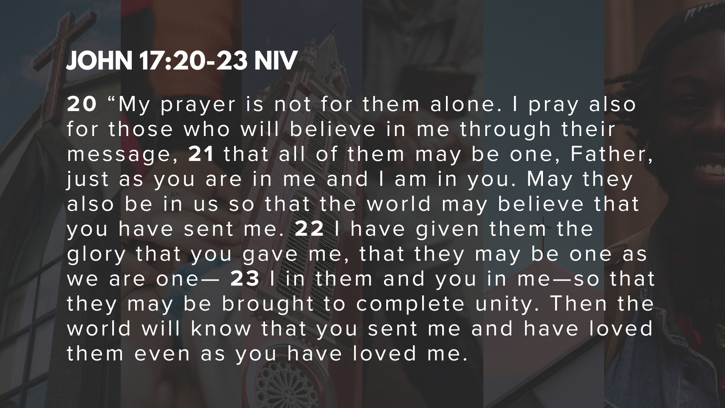
Notes:
[EXPLAIN THE CONTEXT]
[READ & COMMENT VERSE-BY-VERSE]
Listen to what our Lord is saying. The mission of reaching others with the good news of Jesus is accomplished primarily through the unity of believers around the gospel. But you might be thinking… if unity is that important, why are there so many denominations? And how should we think (or what should we do) about the many divisions in the Body of Christ?
In his book… [NEXT SLIDE]

Slide 4
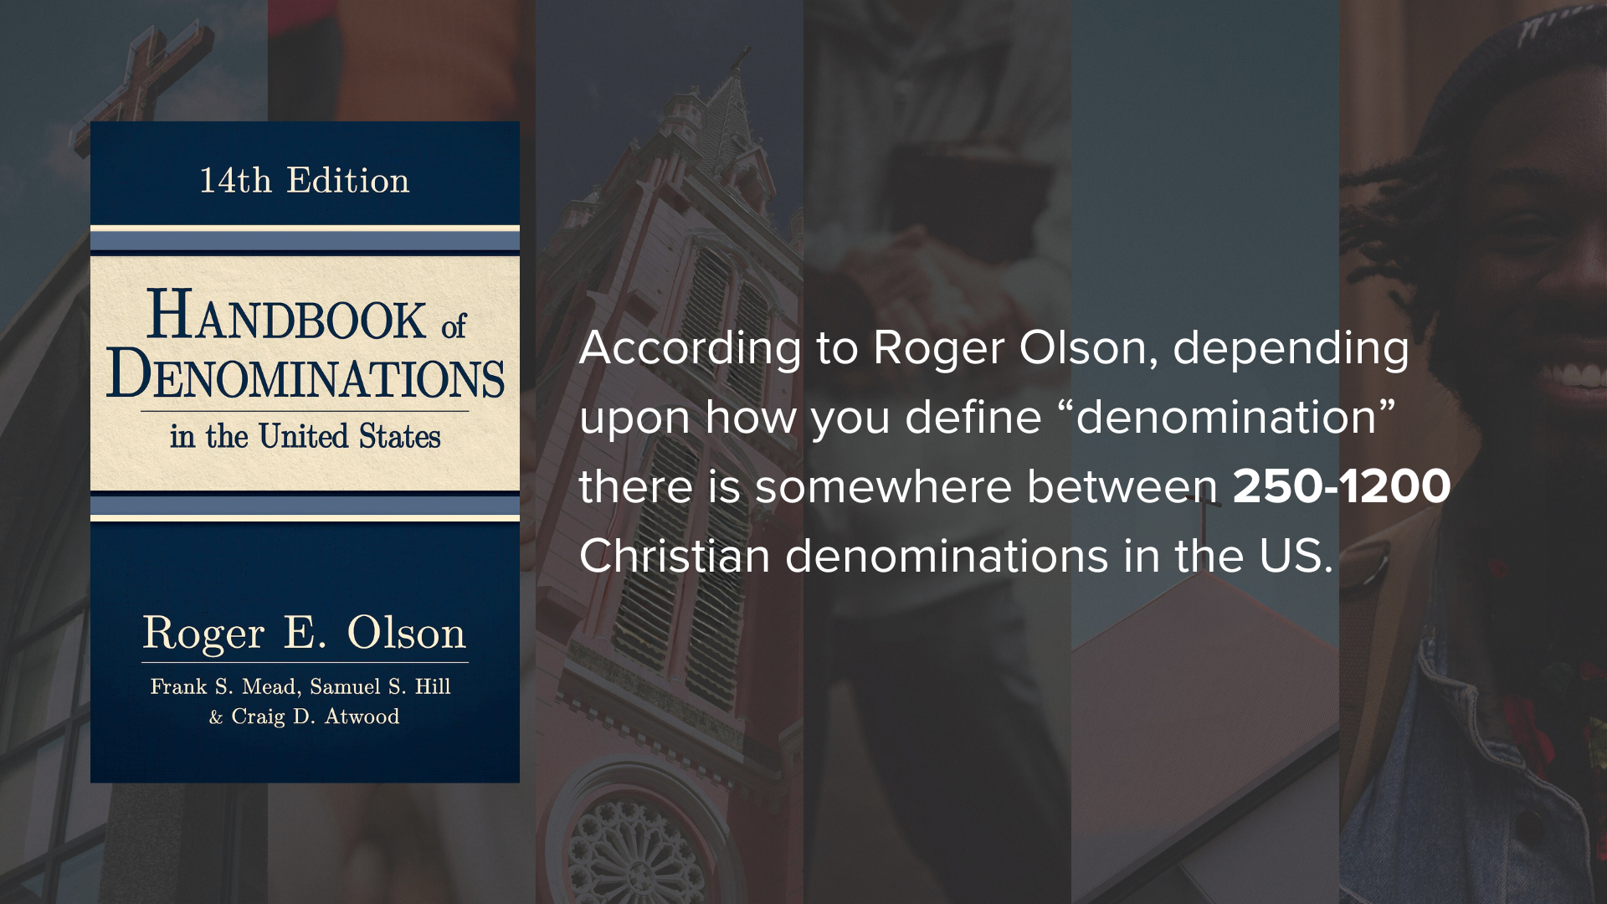
Notes:
Handbook of Denominations in the United States, historical theologian, Roger Olson, says depending upon how you define “denomination” there is somewhere between 250-1,200 Christian denominations in the U.S. And of course, far more than that globally.
So, what are we to make of this?
Well, first off, don’t forget that disagreements and the “division of labor” (to put it more generously) goes all the way back to the first century. Take a look with me real quick to the book of Acts… [NEXT SLIDE]

Slide 5
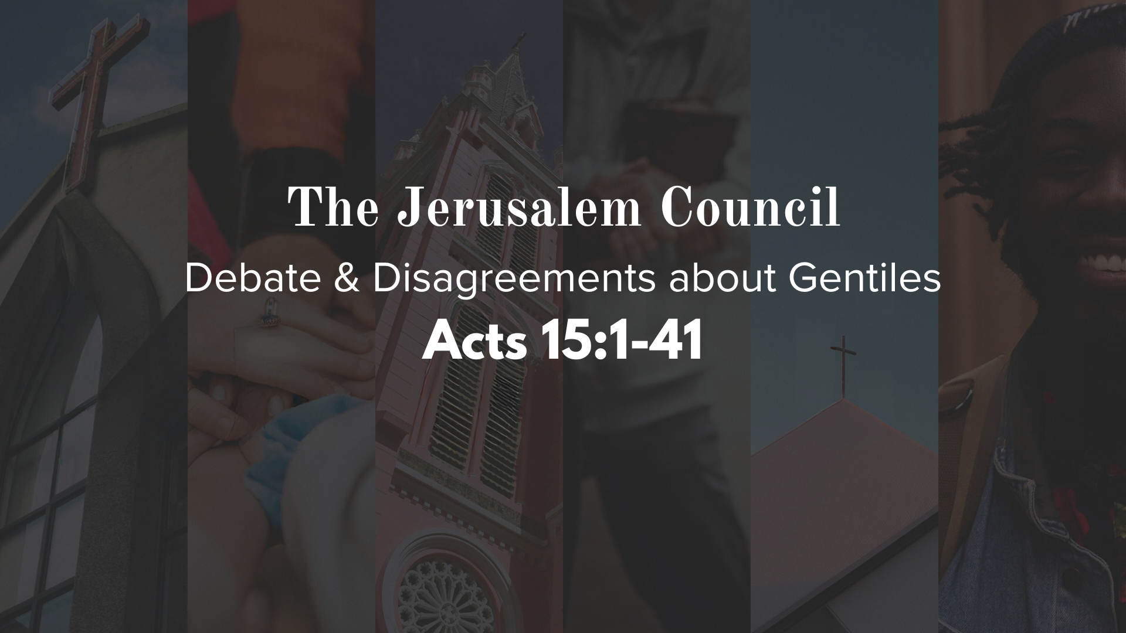
Notes:
[BRIEF COMMENTS ON ACTS 15]
Debate about Gentile inclusion: How much of Jewish law and customs should they obey?
Compromise is reached, but ultimately leads to a Jewish and Gentile Church
And by the end of Acts 15, Paul is splitting ways with Barnabas over John Mark
And from there we continue to see disagreements and different expressions of the Church down through the history of Christianity. Of course, the church never diversified more than she did beginning in the 16th century with the Protestant Reformation.
And where are we today? [NEXT SLIDE]

Slide 6
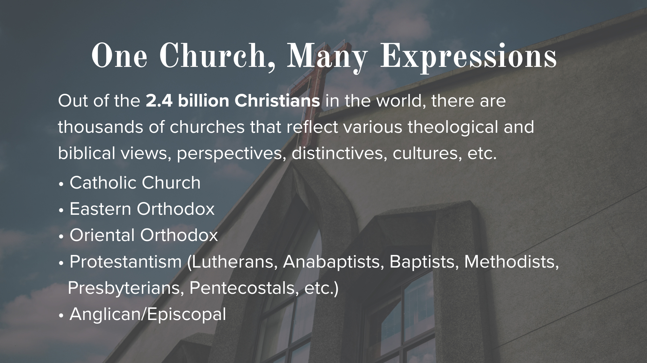
Notes:
[READ & COMMENT]
Now what brings about all these changes or divisions in the church? Well, it’s much more complex than what you might think…
Theological & doctrinal disputes – (e.g. sovereignty vs. free will, modes of baptism, meaning of communion, etc.)
Biblical authority - is the Bible inspired and relevant for us today (Yes, but which parts?); what about traditions/church councils
Biblical interpretation – differences over the Bible and how should we live in the world
Church polity – leadership structures and decision-making
Language/geography/culture
Renewal movements & responses to changing times
Let’s use our concentric circles image to help visually with why there are so many different denominations within Christianity: [NEXT SLIDE]

Slide 7
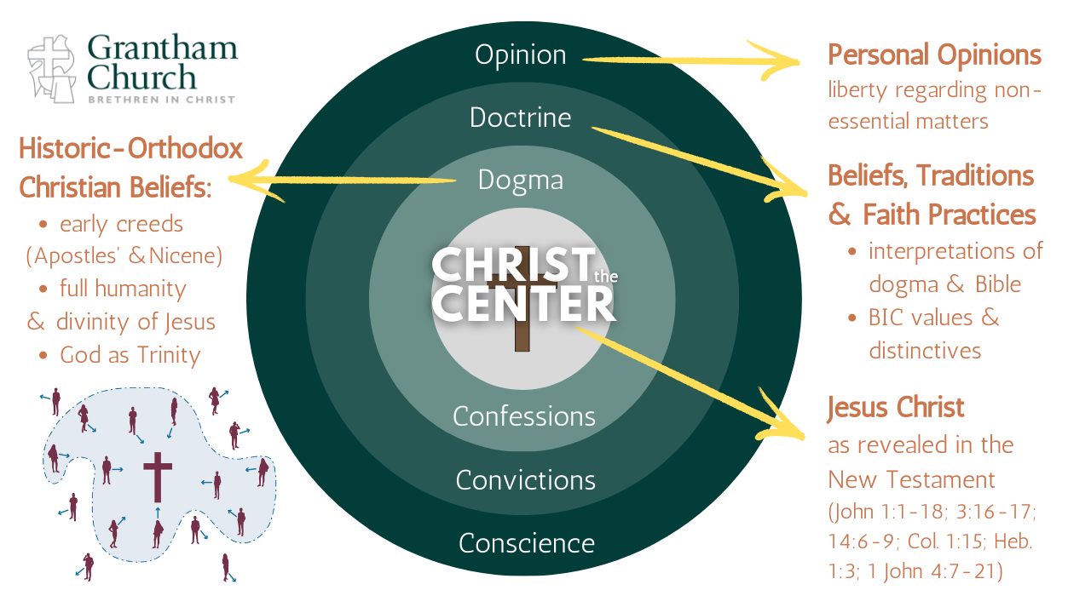
Notes:
[BRIEF COMMENTS ON GRAPHIC]
Within the realm of historic, orthodox Christianity, denominations are often the result of brothers and sisters disagreeing on secondary issues, though not always. And consider this… while many divisions are prompted by disagreement, we’ve seen how the Spirit uses new and fresh expressions to bring renewal (i.e. fresh wind & fire) to propel the gospel forward through the Body of Christ.
Therefore, all those who claim to be Christians ought to be united around Christ and his gospel, which we profess in the Apostles Creed. But we should also keep in mind that there is a big difference in unity and uniformity. Think about this…
1. Christian unity is not necessarily institutional unity.
2. A one world-wide institutional unity in the church would require a great level of uniformity.
So, what about unity among diversity? What if instead of seeing a fractured body we saw a colorful tapestry? Seeing the Spirit working in various ways through the Body of Christ, despite our errors and shortcomings. God displays his beauty and his glory in creation through different “kinds” of things. Why not in the church too?
If we look at it in this way, I think we can see some benefits of denominations... [NEXT SLIDE]

Slide 8
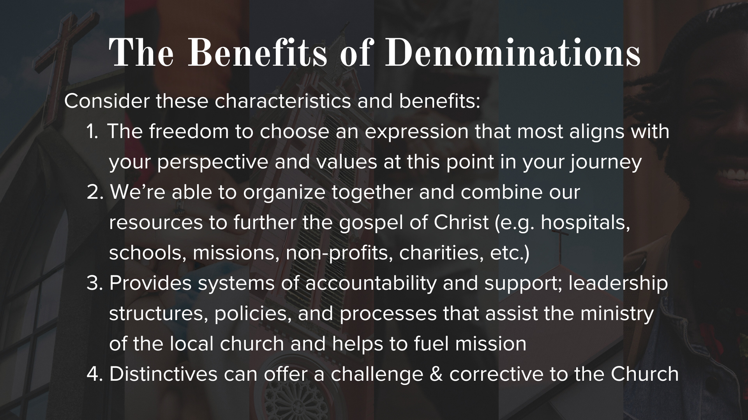
Notes:
[READ & COMMENT ON EACH POINT]
But there are certainly pitfalls that we must be aware of… [NEXT SLIDE]

Slide 9
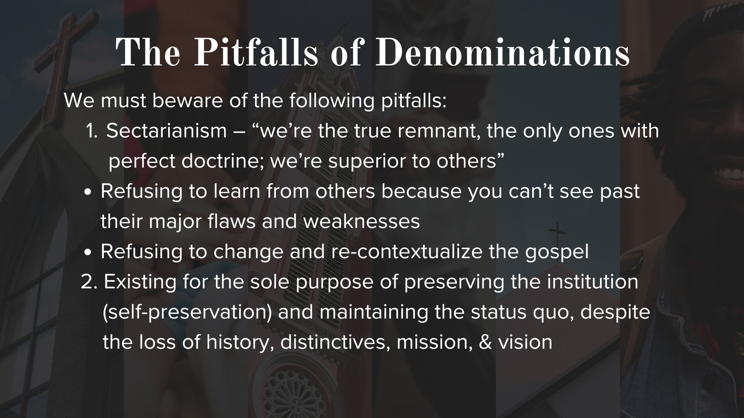
Notes:
[READ & COMMENT ON EACH POINT]
And you might be thinking to yourself, “Ugh. With these pitfalls and the downside of denominations, I don’t want to be a part of one.”
Well, consider this. Those who seek to escape denominations usually end up either creating new denominations or forming ”networks” that are essentially new denominations (or they gradually become that). Why? Because we all eventually realize that local churches can’t do this alone. We must cooperate with other like-minded believers to share God’s heart for people and carry out the great commission set forth by Jesus in Matthew 28:18-20.
And that’s a good thing. It’s a good thing to know who we are, why we’re uniquely different (if we are), and use that to meet the needs around us, to impact those within our sphere of influence, that other churches and denominations may not be able to reach. And to also challenges each other. That’s what I believe God wants to do with our differences. There are different churches for different people, having specific tasks to meet different needs around them. And no single church or denomination can fully capture and embody God’s heart.
Therefore, we must listen to the call of Jesus to be one… [NEXT SLIDE]

Slide 10
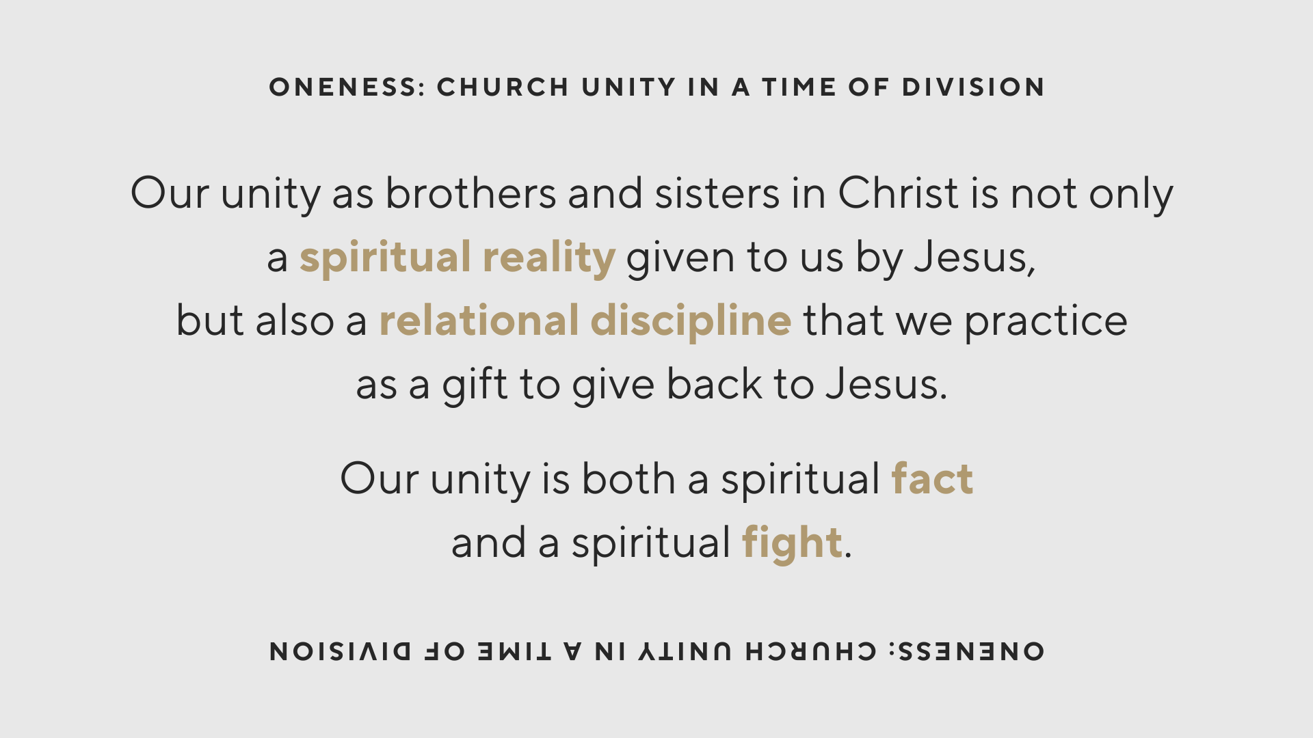
Notes:
[READ & COMMENT]
The relational discipline we probably understand the most, i.e., unity takes effort. But it’s the “spiritual reality” that we first need to sit with so we can understand its implications
The spiritual reality – our experience might fool us, but the reality is established in a higher dimension than our senses, e.g., being married, yet far from home. So, the question is: “Despite how I might feel in the moment and the distance that may exist between the bride and bridegroom, will I live according to the truth and the spiritual reality that exists by a sacred covenant, or not?” God is inviting us into unity as a spiritual reality.
Therefore, our unity is both a spiritual fact and a spiritual fight. In Ephesians 2:14-16, Paul said that Christ broke down the walls of hostility that separate us. That’s a fact. And it’s a fight because we struggle against demonic and human forces that seek to scatter and divide us. In Ephesians 4:1-6, Paul tells us to make “every effort” to keep the unity of the Spirit. And in Romans 15:5-7, he says that we should fight passionately for oneness.
Again, we are one church with one mission… [NEXT SLIDE]

Slide 11
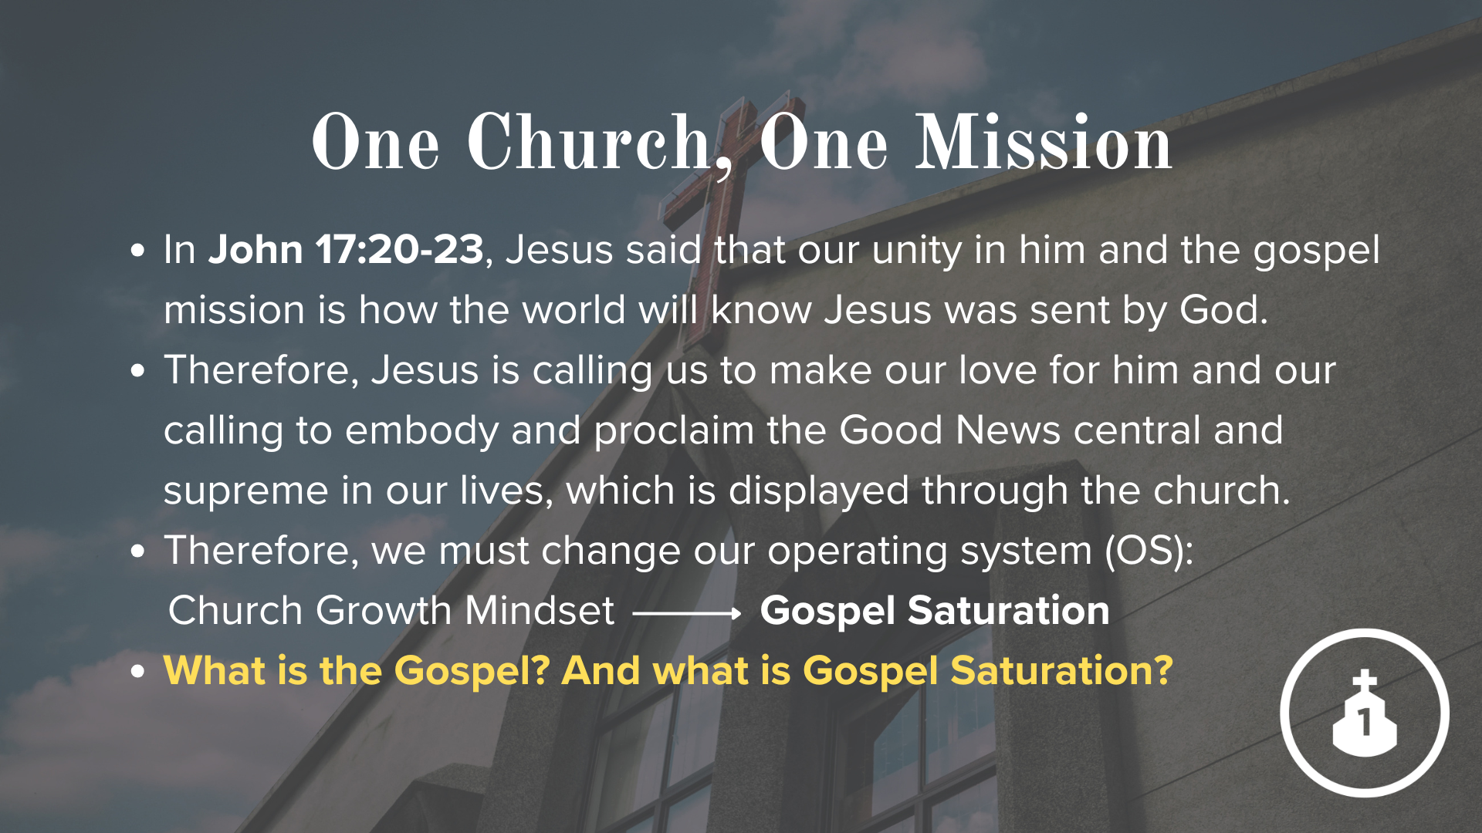
Notes:
[READ EACH POINT & COMMENT]
First, we’ve defined the gospel this way at Grantham Church… [NEXT SLIDE]

Slide 12
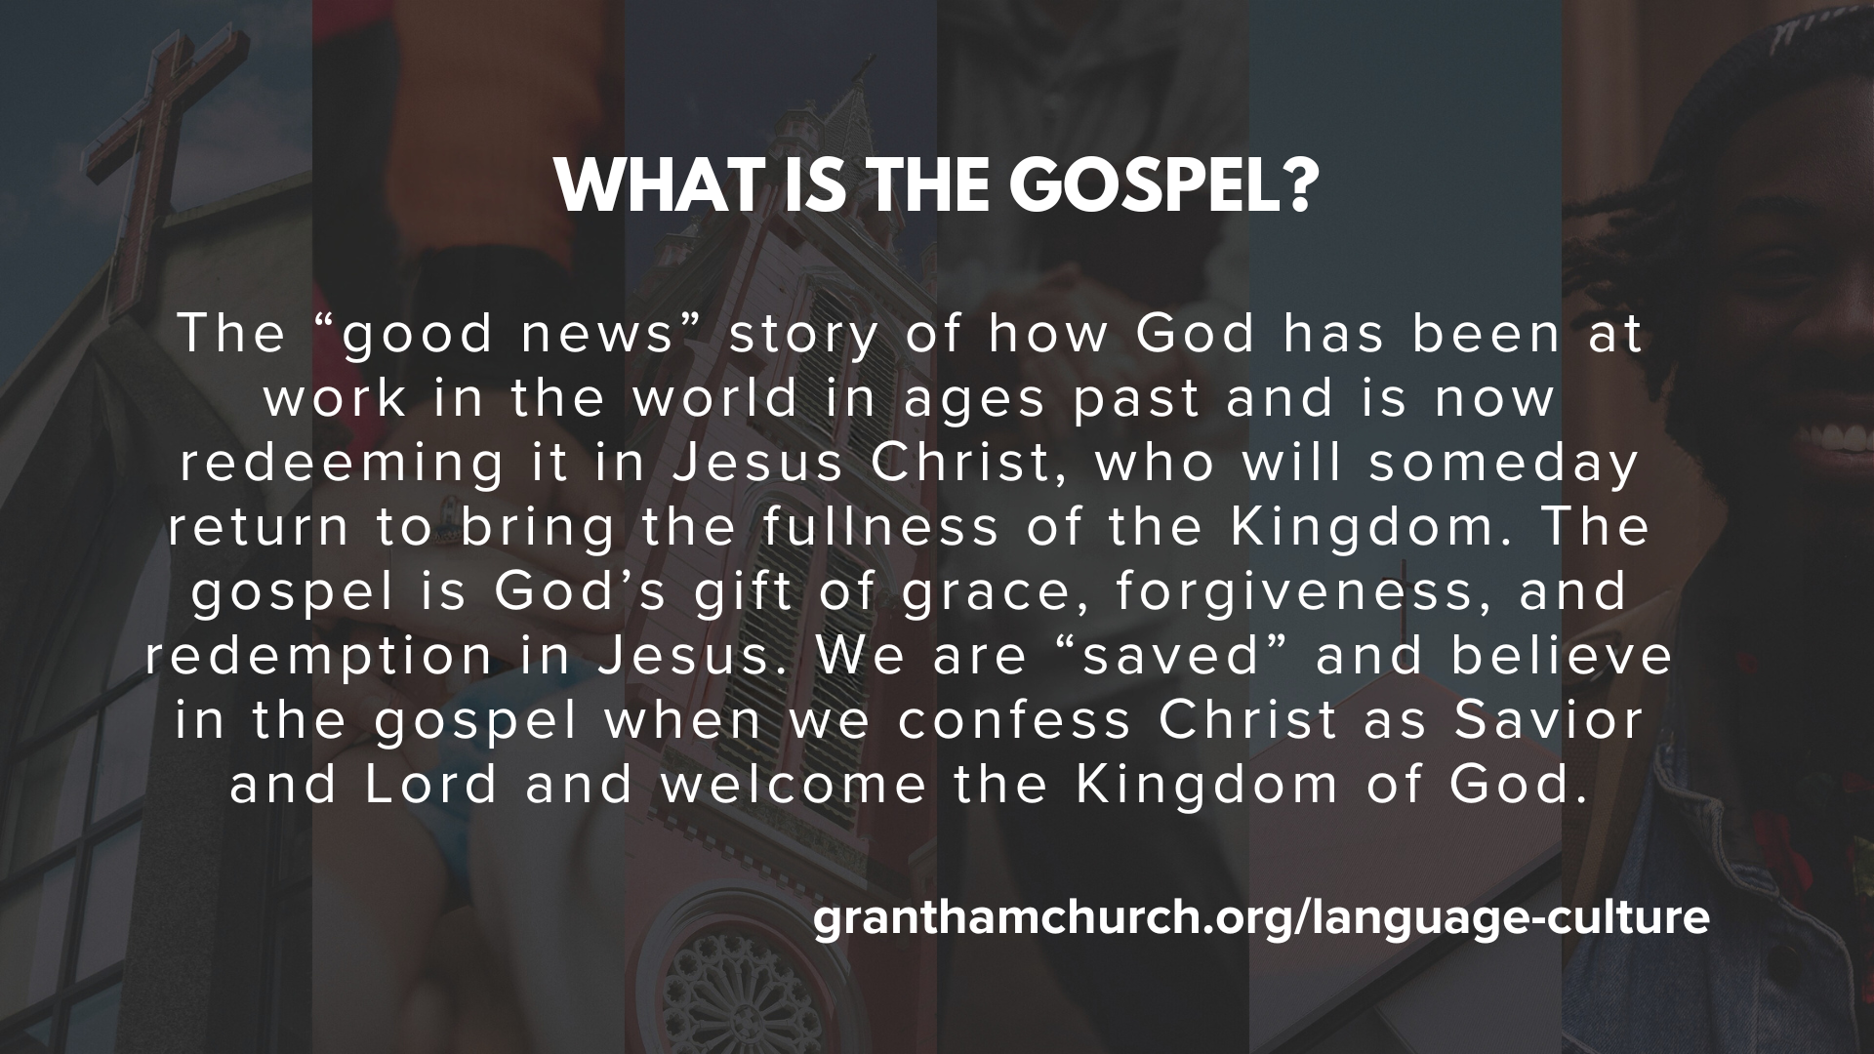
Notes:
[READ DEFINITION & COMMENT]
The gospel is for you; to bring forgiveness, healing, and transformation
But the gospel is also for others (e.g., our family, friends, neighbors, enemies)
And the gospel is about the renewal of all creation
You may remember this image I’ve used to communicate this… [NEXT SLIDE]

Slide 13
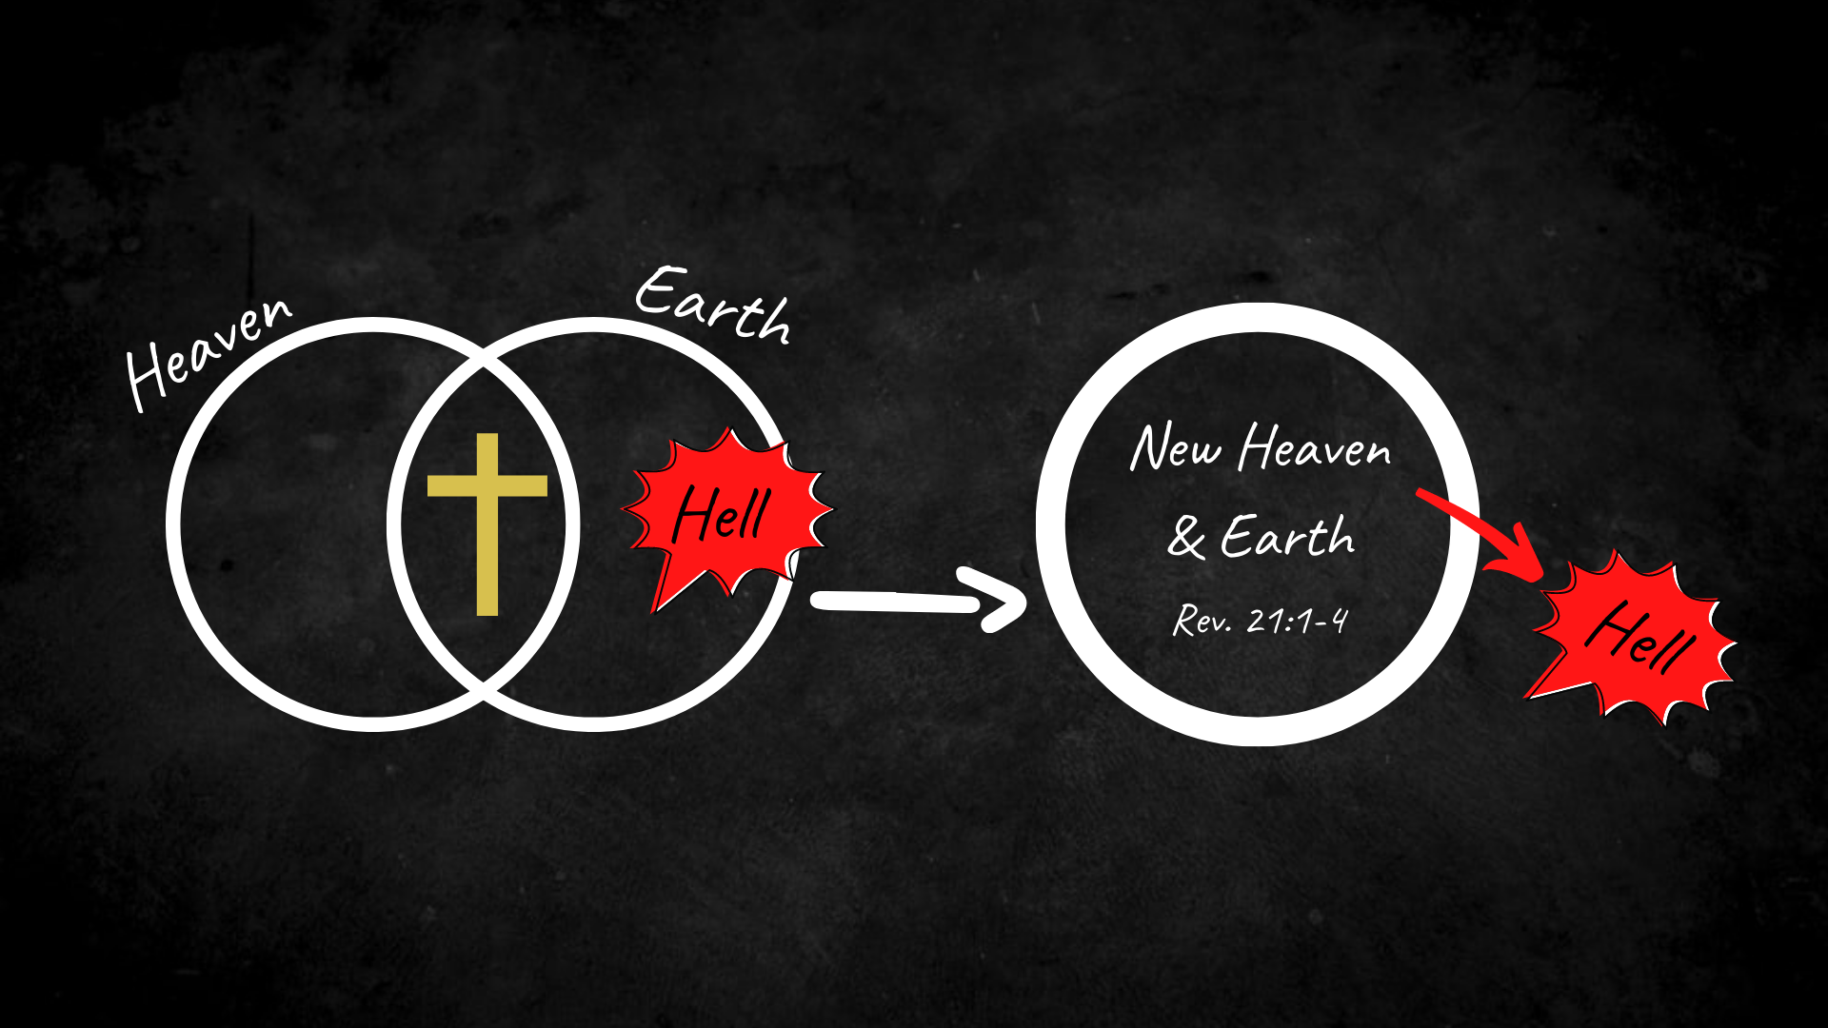
Notes:
[EXPLAIN IMAGE]
Heaven and earth are two interlocking planes of existence; heaven (spiritual dimension) is God’s space, and earth is our space; they are coming together in Jesus; Jesus’s death and resurrection are uniting heaven and earth; his resurrected body is the proof!
In that process, Jesus has declared that death and hell have lost its power and is coming to an end; and Jesus promises to cast the hell out of earth and out of you and me
And the gospel proclaims that Christ will someday return and bring about a new glorious reality; a resurrected cosmos; a new heaven and earth; where God’s perfect reign and rule will be known in us and death and hell will be cast out forever; they will be no more.
So, the purpose of the WE THE CHURCH initiative is to mobilize all of God’s people to embody and proclaim this Good News for the gospel saturation of our region. What is gospel saturation? [NEXT SLIDE]

Slide 14
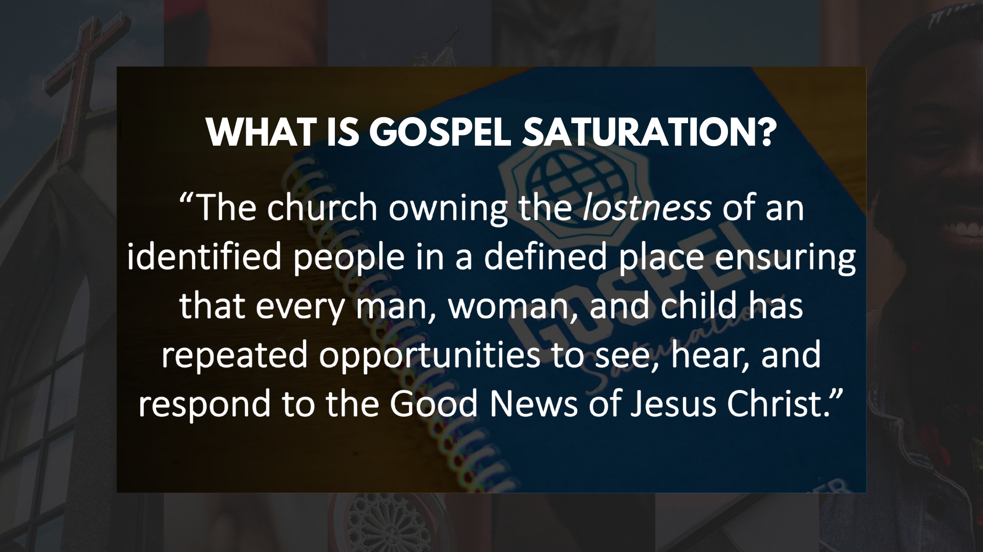
Notes:
It is the process of helping each disciple understand their role as ambassadors of the good news where they live, learn, work and play. It is the church—the Body of Christ—owning the lostness of the people who live in our area so that every man, woman, and child has repeated opportunities to see, hear, and respond to the Good News of Jesus Christ.
This is our mission. This is what we are called to as disciples of Jesus.
Listen to what the risen Jesus said to his disciples after he appeared to them in the locked upper room… [NEXT SLIDE]

Slide 15
John 20:19-23 NLT
¹⁹ That Sunday evening the disciples were meeting behind locked doors because they were afraid of the Jewish leaders. Suddenly, Jesus was standing there among them! “Peace be with you,” he said. ²⁰ As he spoke, he showed them the wounds in his hands and his side. They were filled with joy when they saw the Lord! ²¹ Again he said, “Peace be with you. As the Father has sent me, so I am sending you.” ²² Then he breathed on them and said, “Receive the Holy Spirit. ²³ If you forgive anyone’s sins, they are forgiven. If you do not forgive them, they are not forgiven.”
Notes:
[READ HIGHLIGHTED SCRIPTURE & COMMENT]
My friends, just as Jesus sent those first disciples into the world to be his hands and feet, to embody and proclaim what Christ has done and where things are going, he also, with power from the Spirit, commissions us as one Church to make disciples who make disciples; to tell the world that God loves them; that there is hope for the hopeless; peace and forgiveness; and that in the end God will set the world to rights and make all things new.
Do you believe this? Church, do you believe this? Amen. Then let us together be one Church with one mission. For the glory of God and the healing of our world.
Finally, here are some questions to help us reflect and respond together… [NEXT SLIDE]

Slide 16

Notes:
Questions

Slide 17
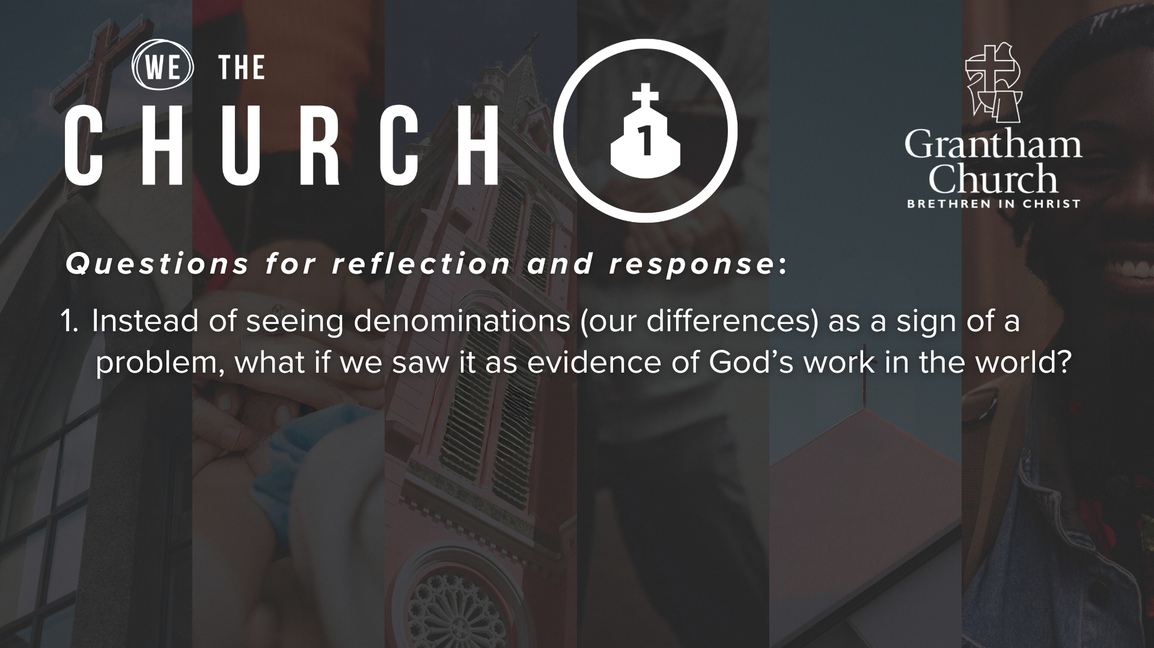

Slide 18
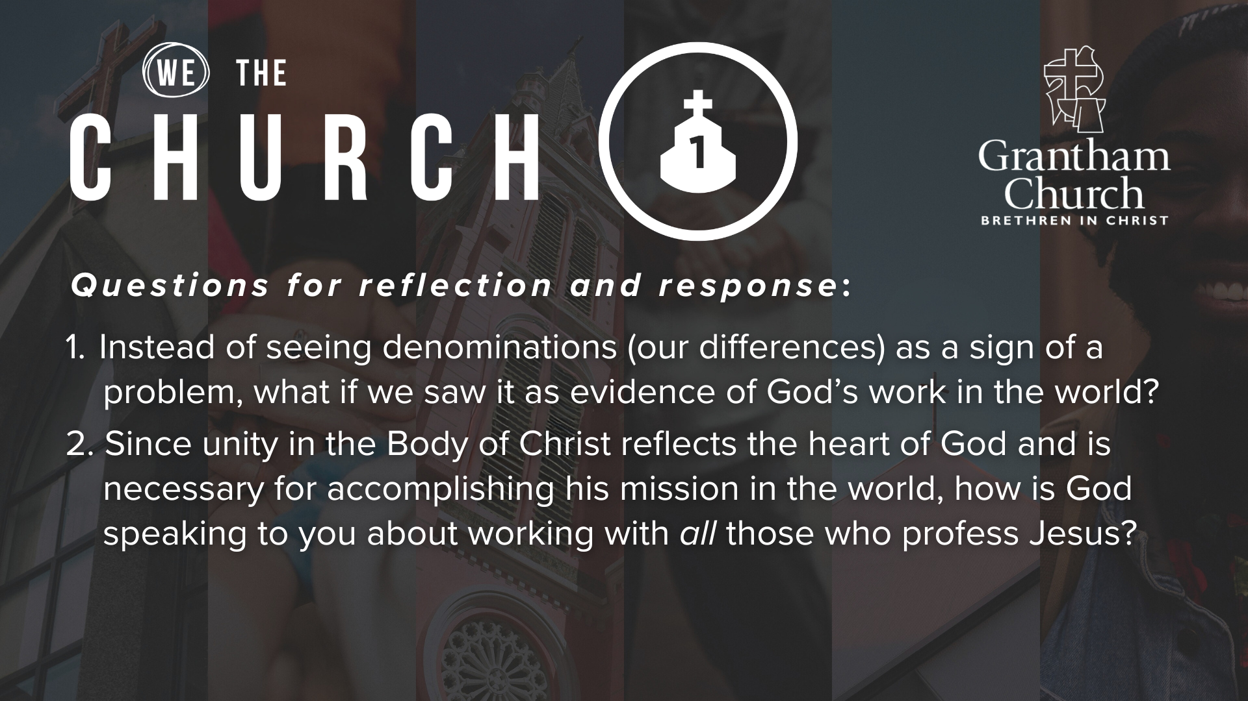

Slide 19
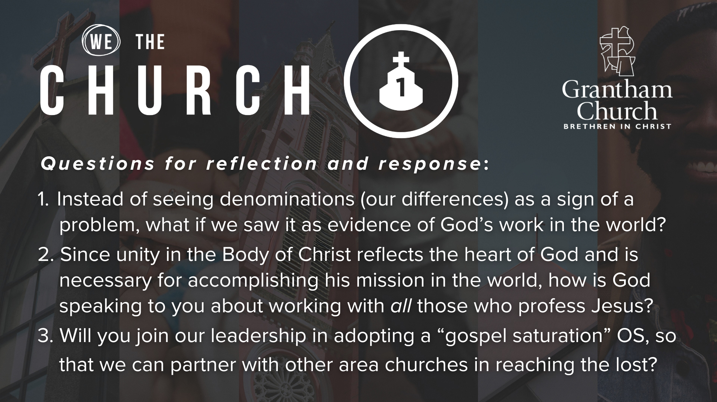
Notes:
[READ & BRIEF COMMENT ON EACH QUESTION]
[CLOSING WORDS]
Brothers and sisters, I know folks in the room have varied experiences and attempts towards unity and doing great things for God. Some of you have had hurtful church experiences and maybe you’ve even experienced a church split. I know that pain runs deep, so you are full of hesitations. I get that. Others of you have dreamt for years of the possibility of transformative unity in this congregation and among other congregations in our area, so you are full of hope. So, with the Lord’s help, let’s imagine together…
What if we became the answer to Jesus’ prayer?
What if unity became a reality at Grantham and other churches in our region?
What if we conspired together to link arms with other believers for the purpose of seeing our neighbors and enemies come to believe in Jesus as their rescuer?
What if we joined with other believers in our neighborhoods to do prayer walks together?
What if we used our homes to host those who are far from Jesus as a way of building relationships so that we could share the good news of Jesus with them?
What if we found those most hurting or in transition and decided to serve them together because we know how much we have been served by Jesus?
What if we fed the hungry and clothed the poor with other Christians with whom we have the gospel in common, even if we don’t agree with each other on everything else?
There is nothing more invigorating to our faith and to the growth of the church than seeing others come to faith in Jesus. And as we’ve heard this morning, THE way that primarily happens is through the unity of God’s people around the mission of God.
Let’s pray… [NEXT SLIDE FOR CLOSING PRAYER]

Slide 20
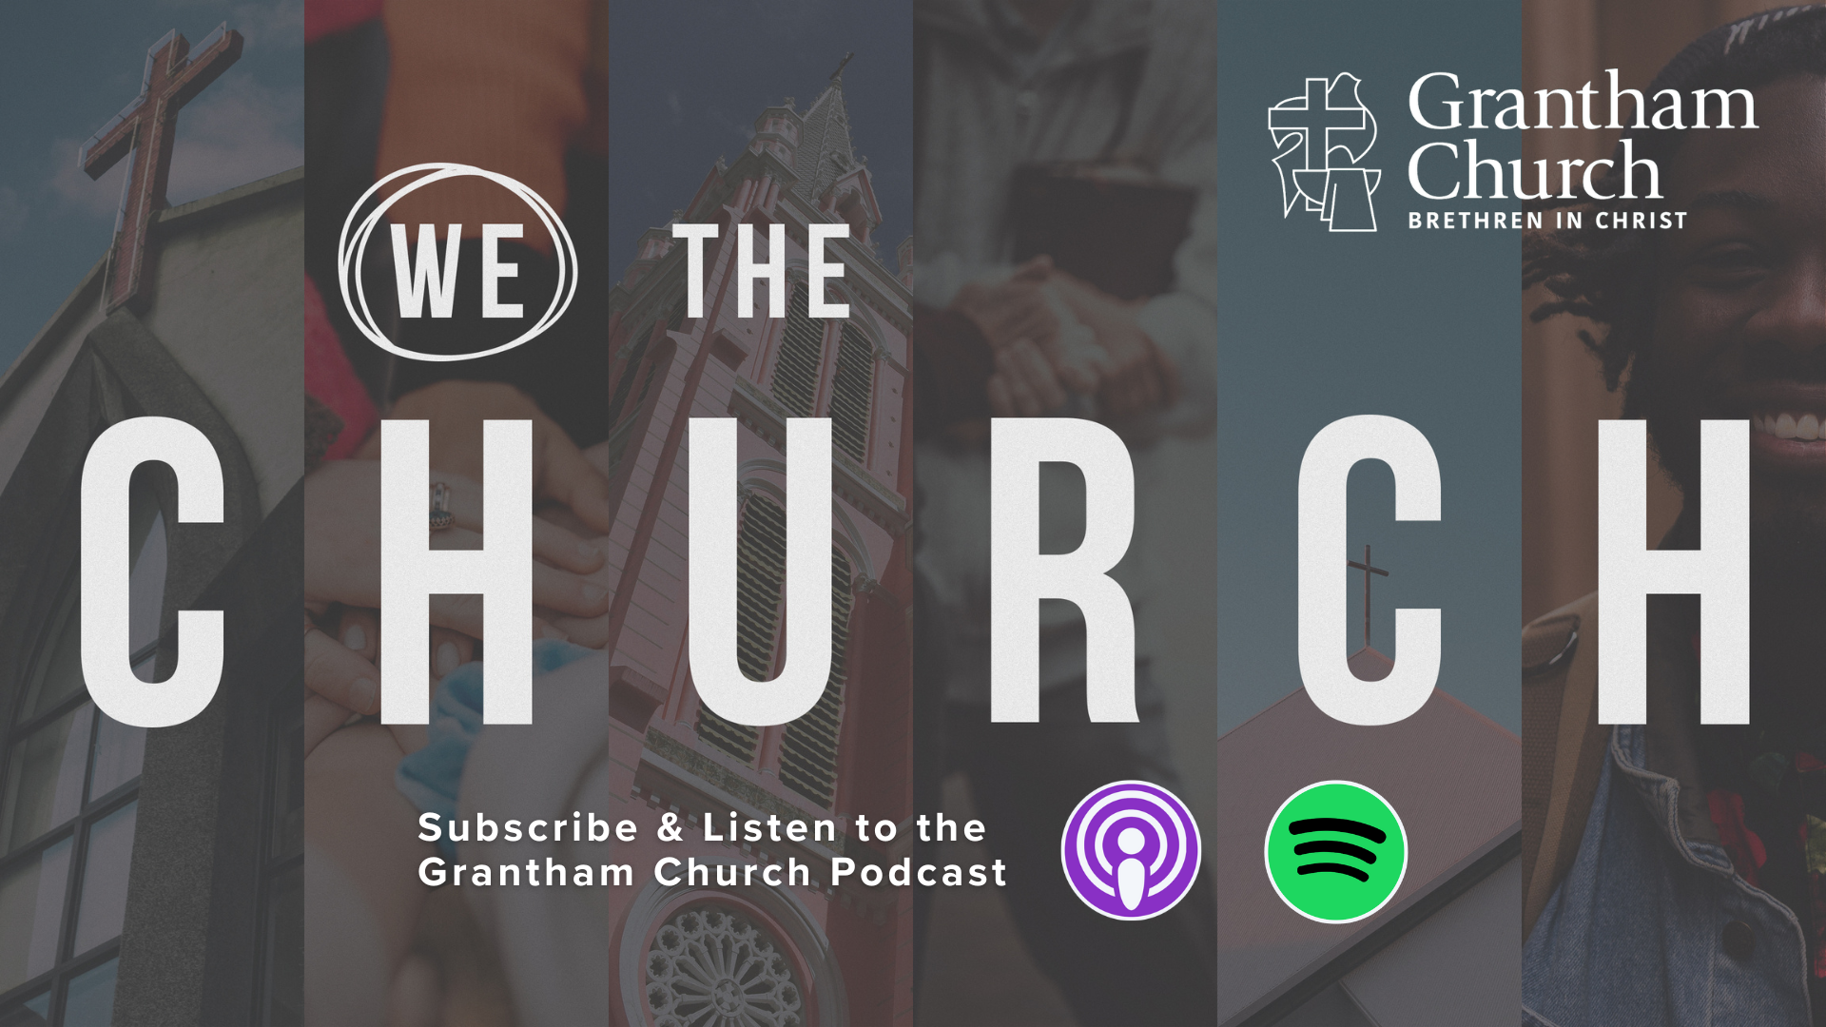
Notes:
[CLOSING PRAYER]
[APOSTLES’ CREED]
[COMMUNION]
Benediction

