Slide 1

Notes:
He is Risen!
[BRIEF WELCOME]
If you’re just joining us this morning, for the past 6 weeks, we have been in a Lent-to-Easter sermon series called, Wandering Heart: Figuring out faith with Peter—looking at the ups and downs in Peter’s walk with Jesus, highlighting certain moments in his journey that we can learn from and apply to our own..
For each step in Peter’s journey… [NEXT SLIDE]

Slide 2

Notes:
… we have selected a phrase from the hymn, Come Thou Fount, and we’ve sought to bind our wandering hearts to God. As you can see on the screen and in the art behind me, each icon corresponds to a significant moment in Peter’s faith journey.
Simon Peter is such a relatable character. His life isn’t polished and his journey isn’t a straight path. He wants to do good. He aspires to be a leader. And he shows great faith at times. But he often gets it wrong. And so, ultimately, it’s in Peter’s story that we’re reminded that God loves imperfect people—in fact, that’s precisely who God claims and calls.
As we can see when Jesus first called Simon, the fisherman… [NEXT SLIDE]

Slide 3
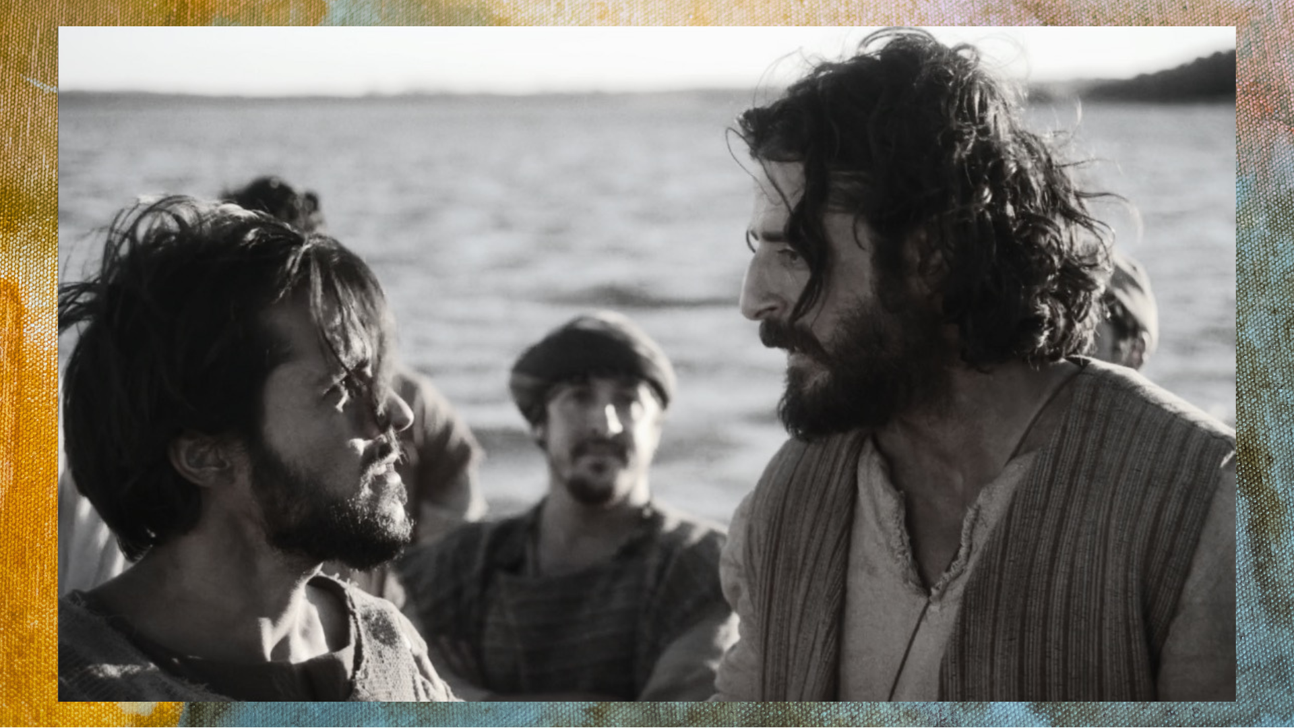
Notes:
After rabbi Jesus uses Simon’s boat to preach from to the people along the shore, he then tells Simon and his friends to go back out into deeper water and cast their nets again. Simon is reluctant (since he assumes he knows how to fish better than Jesus), but he does it anyway.
And after a miraculous catch so great that it almost sinks the boat, Simon falls down in front of Jesus and acknowledges that he is a sinful man not worthy of being a disciple. Of course, this isn’t a surprise to Jesus. He knows Simon better than Simon knows himself. But it doesn’t matter. Jesus calls him. And Simon follows.
In the next episode, Jesus sends the disciples across the Sea of Galilee and a storm comes… [NEXT SLIDE]

Slide 4
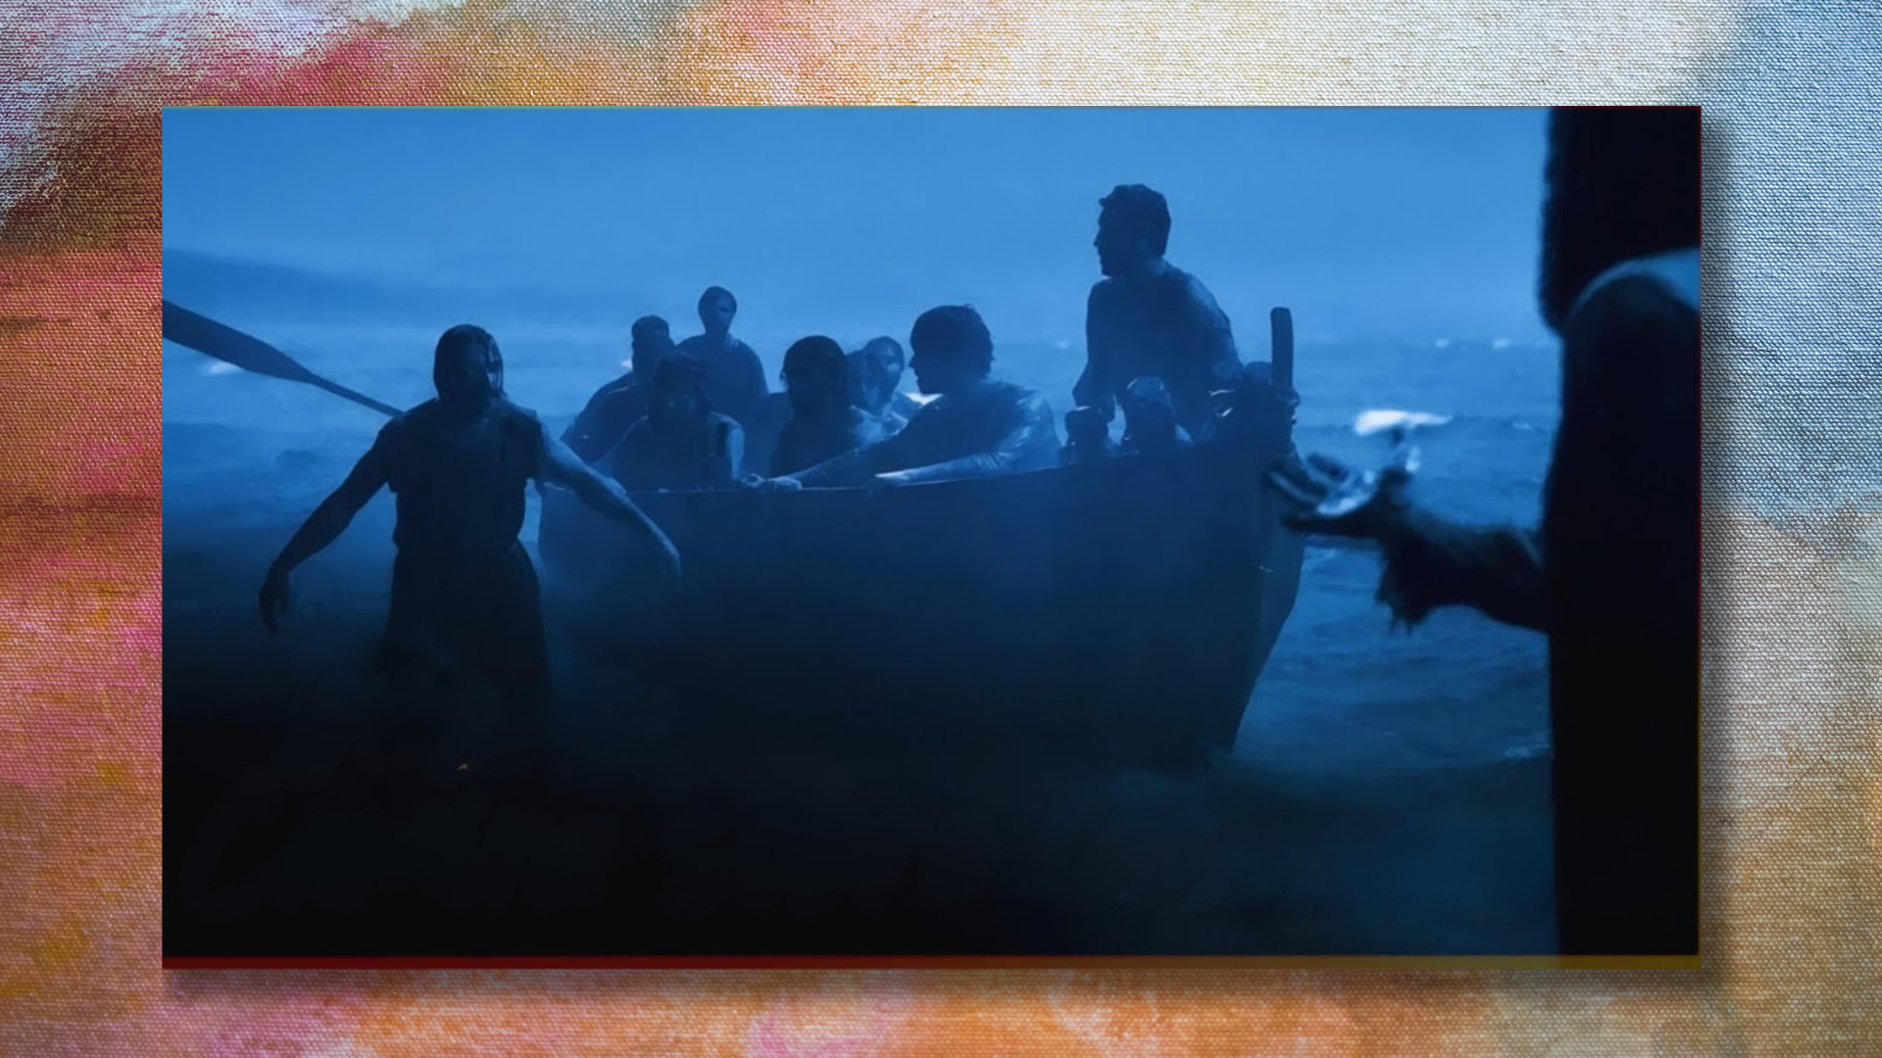
Notes:
And Jesus comes to them on the water. The disciples are afraid. They think Jesus is a ghost at first, but then Simon, who is fully aware of the dangers of being caught in a storm (and of how water works), recognizes Jesus and asks his Master to call him out of the boat so he can walk on the water too. Afterall, good disciples are supposed to do what their rabbi does.
Simon does OK for a few steps, until he takes his eyes off Jesus and begins to sink. Jesus reaches down and saves Simon. And that day Simon learned how important it is not to let his fear get the better of him and that, if he had more faith, he could do the impossible with Jesus.
And then in Matthew 16, Jesus takes his disciples… [NEXT SLIDE]

Slide 5

Notes:
To Caeserea Philippi—to the northern most part of Galilee in Gentile territory. Jesus stands at the base of a mountain that many believed was where angels fell from heaven in the great cosmic rebellion, and at the mouth of a cave some thought to be the gates of hades.
Jesus asks them. “What are people saying about me? Who do they say that I am?” And after several names are thrown out (believing Jesus to be like a prophet of the OT), Jesus says, “Who do you say that I am?” And then Simon speaks up and says, “You are the Christ, the Son of the Living God.” That is when Jesus first accepts the title of Messiah and then gives Simon his new name, Peter (the rock), because of his courageous confession.
But this mountain top experience doesn’t last long… [NEXT SLIDE]

Slide 6
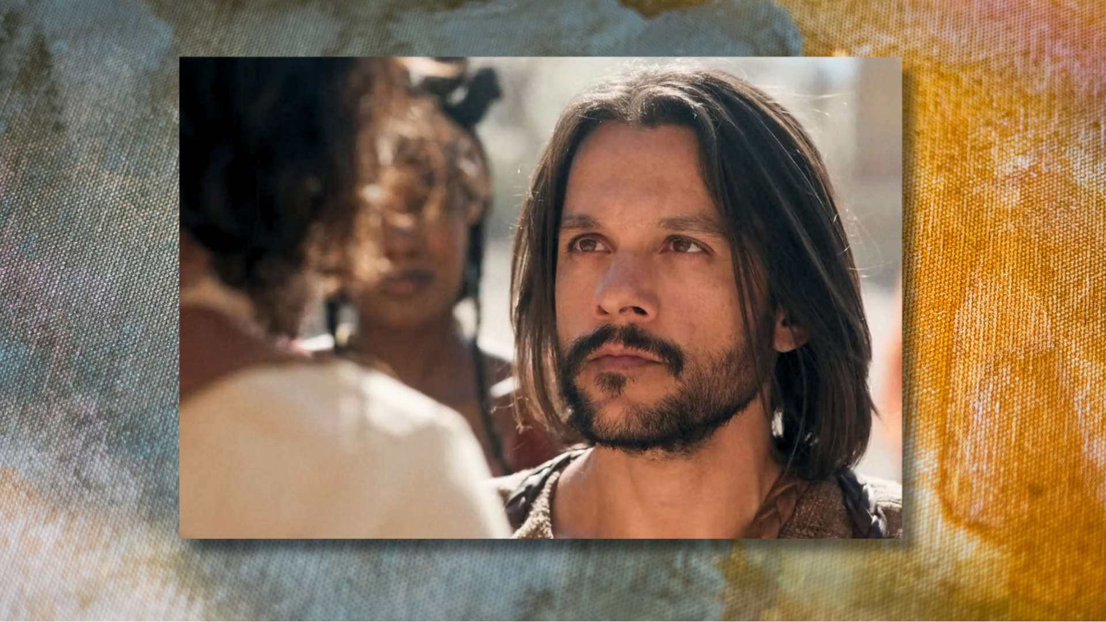
Notes:
In the very next episode in Matthew 16, Jesus tells his disciples that he must go to Jerusalem and suffer many things at the hands of the elders, the chief priests and the teachers of the law, and that he must be killed and on the third day be raised to life. And Peter isn’t having any of it. He pulls his Master aside and tells Jesus that he will never allow this to happen.
That is when Jesus rebukes Peter and tells him that he is being used by Satan at that moment to derail his salvific mission; to stop the Lord from doing what he came to do. Just as the devil had tempted the Lord in the wilderness, Peter is in this instance being a scandalon--a small rock to cause Jesus to stumble.
So, Jesus puts Peter in his place—”get behind me, Satan” (adversary)—and reminds him that there is only one Teacher; that Peter is merely the student. And as you can imagine, from this point on… Peter seems to live with some inner turmoil, uncertainty, and frustration.
Next, the gospel of Matthew tells us that Peter goes to Jesus… [NEXT SLIDE]

Slide 7
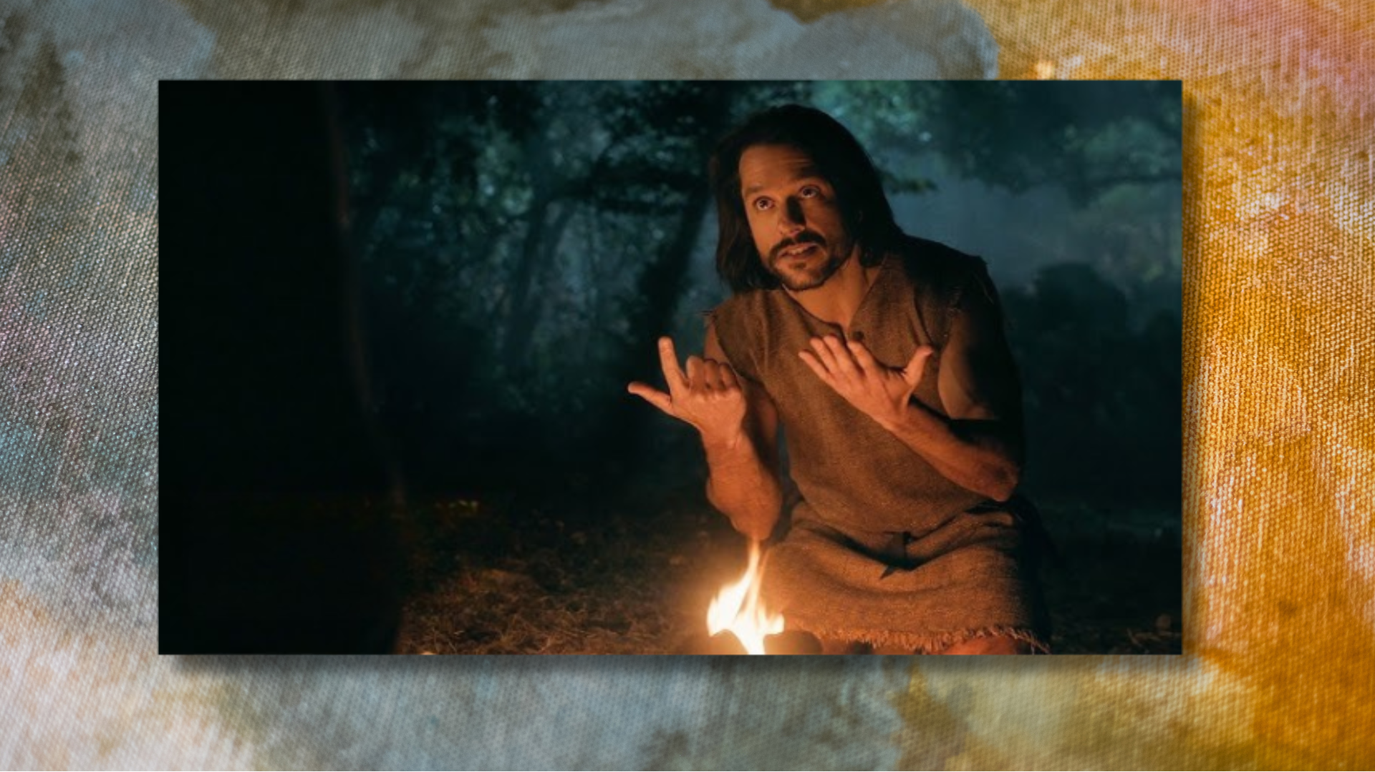
Notes:
And asks him, “How many times must I forgive someone who has wronged me?” And Peter answers his own question with what he no doubt believed was a spiritual response: “Should I forgive them seven times?” And Jesus essentially says, “No, you must be willing to offer people forgiveness forever.” Was Peter struggling to forgive someone? Was it one of the other disciples… maybe Matthew—the tax collector—from Peter’s fishing village?
We’re not sure. But we can easily imagine what was happening in Peter’s heart after that conversation with Jesus… a build-up of even more frustration.
And then last week, we were invited to imagine what Simon Peter might have felt on Palm Sunday… [NEXT SLIDE]

Slide 8
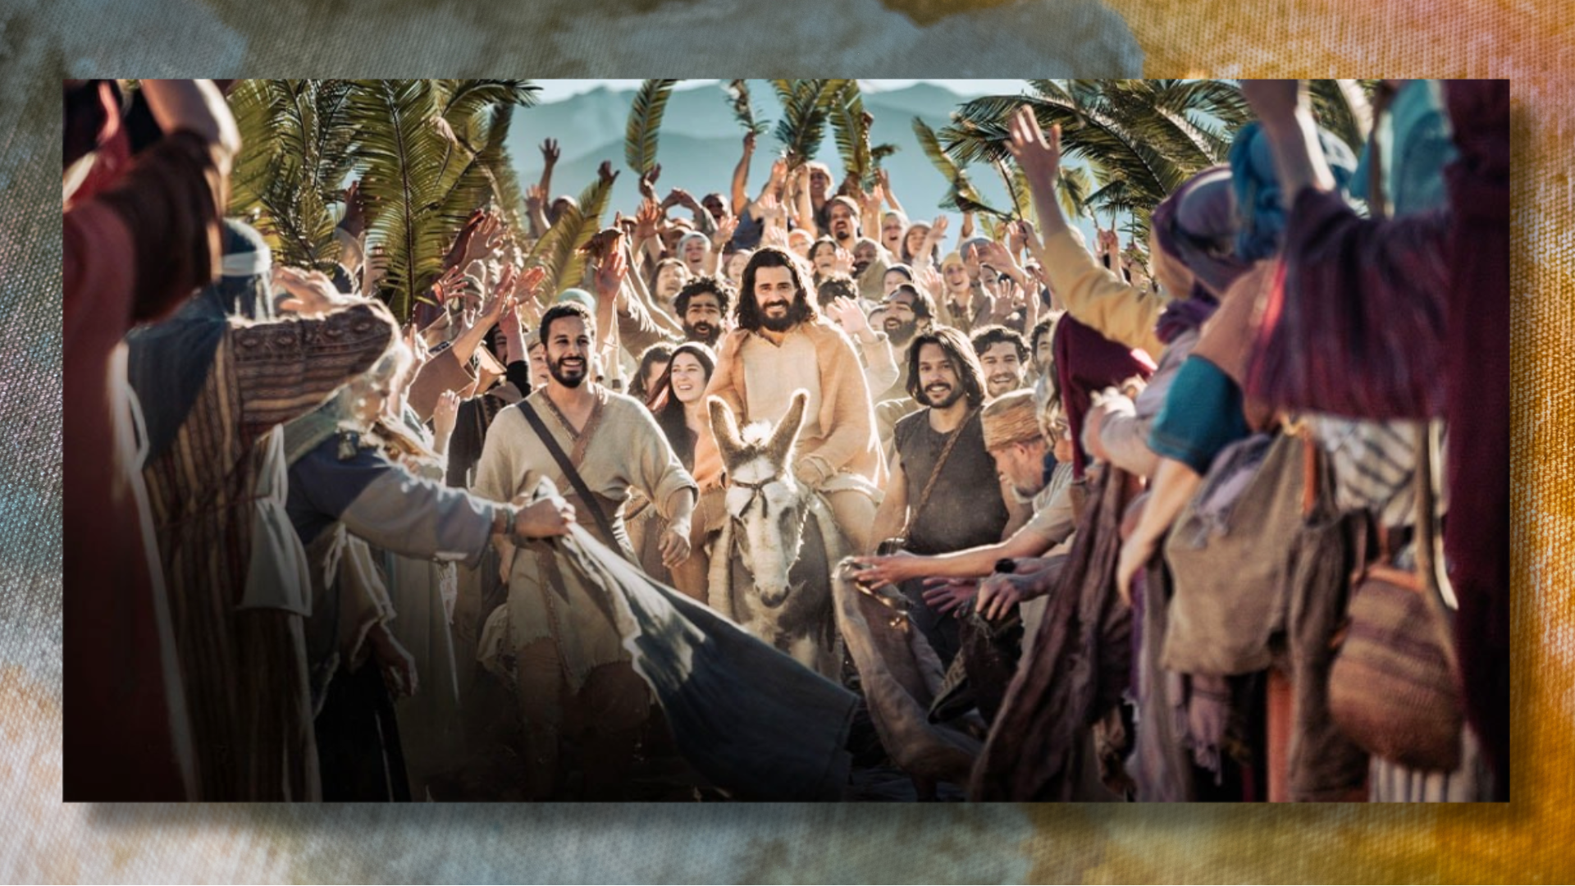
Notes:
On the day when Pontius Pilate rode into Jerusalem to keep the peace during Passover, Jesus stages a protest with some prophetic theater. He rides in on a donkey; fulfilling prophecy and also making a statement: he is a King with a peaceable kingdom not of this world.
The disciples, including Peter, are filled with both awe and confusion—the crowds rightly celebrate Jesus as the Son of David yet don’t understand what is about to happen. The disciples stand in the tension, hearing the shouts of victory while remembering Jesus’ words about suffering, sacrifice, and the cross. Therefore, we imagined what Peter might have felt; caught up in the thrill of the triumphant entry, hoping that maybe he had misunderstood Jesus, but unable to shake the Lord’s words about his coming death.
And then after a long week in the city… seeing the Lord clear the temple, hearing him debate with the religious leaders, and seeing his Master’s head anointed with an expensive perfume in Bethany, the disciples are in the Upper Room sharing what we call the Last Supper, and, once again, Peter challenges Jesus… [NEXT SLIDE]

Slide 9
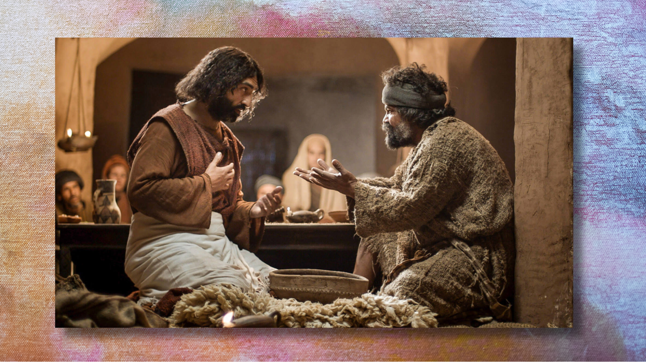
Notes:
”Lord, you’re not going to wash my feet. I can’t let you do it. I should be washing your feet.” And Jesus tells him, “Unless I wash your feet, you can’t belong to me as a disciple.” Peter, as had happened many times before, didn’t understand what Jesus was doing. In one last act of humility and service, Jesus was showing Peter and the other disciples what God is like, what leadership is like, what serving looks like, and what love looks like.
Which looks a lot different than striking off someone’s ear, which Peter will do later that evening in the garden when temple guards come to arrest Jesus. While it may have been motivated by his devotion to Jesus, it was also more evidence that Peter had not fully embraced the way of Jesus. And so, after Jesus rebukes Peter one last time by telling him to put away his sword, the Lord is arrested and taken into custody… [NEXT SLIDE]

Slide 10
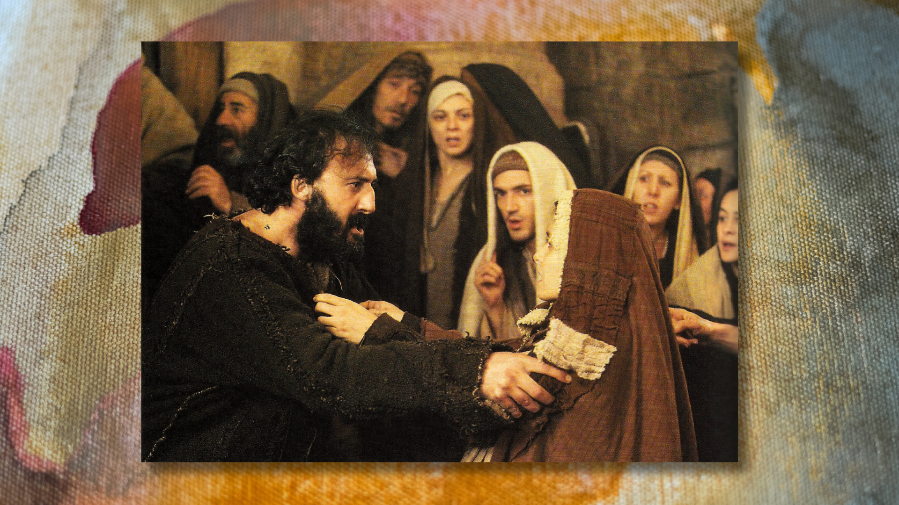
Notes:
While Jesus was on trial, Peter managed to gain access to the courtyard and observe what was taking place. And that was when he was recognized by people in the crowd who were there warming themselves by the fire. Just as Jesus said it would happen… when asked if Peter was one of those disciples of Jesus of Nazareth… Peter denied it. Three times he denied knowing his rabbi, his Master, and his Lord.
And on the third denial, the gospel of John tells us, “Suddenly, Jesus’ words flashed through Peter’s mind: “Before the rooster crows, you will deny three times that you even know me.” And he went away, weeping bitterly.” Therefore, Peter was not there when Jesus died—he was crying and hiding in shame.
And he remained hidden behind a locked door until the Third Day. [NEXT SLIDE]

Slide 11

Notes:
Which brings us to Easter Sunday… when everything changed for Peter.
And when everything changed for us…
[PLAY VIDEO]

Slide 12
Notes:
[PLAY VIDEO – PETER RUNS TO THE EMPTY TOMB]
[GO TO NEXT SLIDE AFTER VIDEO]

Slide 13
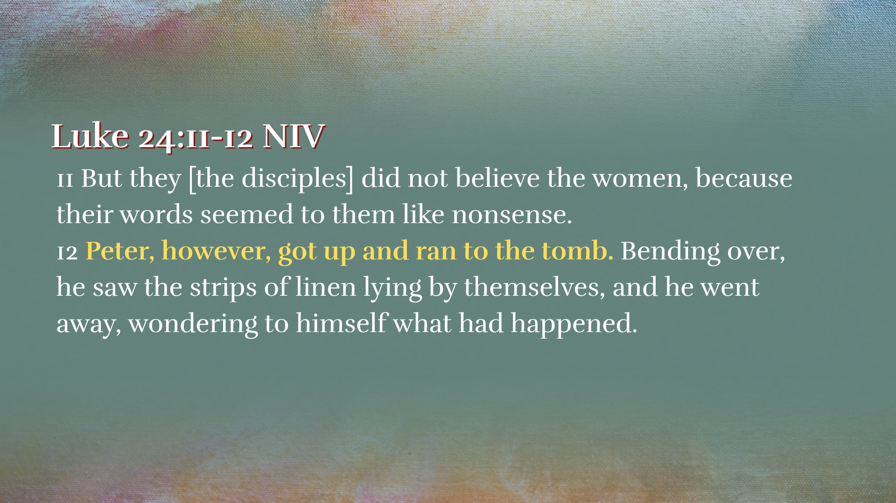
Notes:
[READ & COMMENT]
v. 11 – To the disciples, the women’s report sounded like “nonsense” (a tall tale, a made-up fantasy, or a pile of garbage) because:
it clashed with their theology (resurrection)
contradicted their recent experience (crucifixion)
and came through a socially discounted source (women)
v. 12 – Even though the report seemed like nonsense, Peter still goes. Why? Because something in him is stirred: curiosity, uncertainty, maybe even a fragile hope. Afterall, the tomb was heavily guarded. The massive stone looked like it was knocked over, the ropes look like they just burst, the grave clothes were left behind. This is a puzzling scene. He doesn’t believe (not yet)—but he can’t ignore it either. Luke says, “he went away, wondering to himself”… in other words, there was bewilderment, deep puzzlement, trying to make sense of something that doesn’t yet fit. Peter is not yet in full belief. That will come soon enough. But for the moment, he is in between: not dismissing it entirely, but not yet understanding it.
Remember… [NEXT SLIDE]

Slide 14
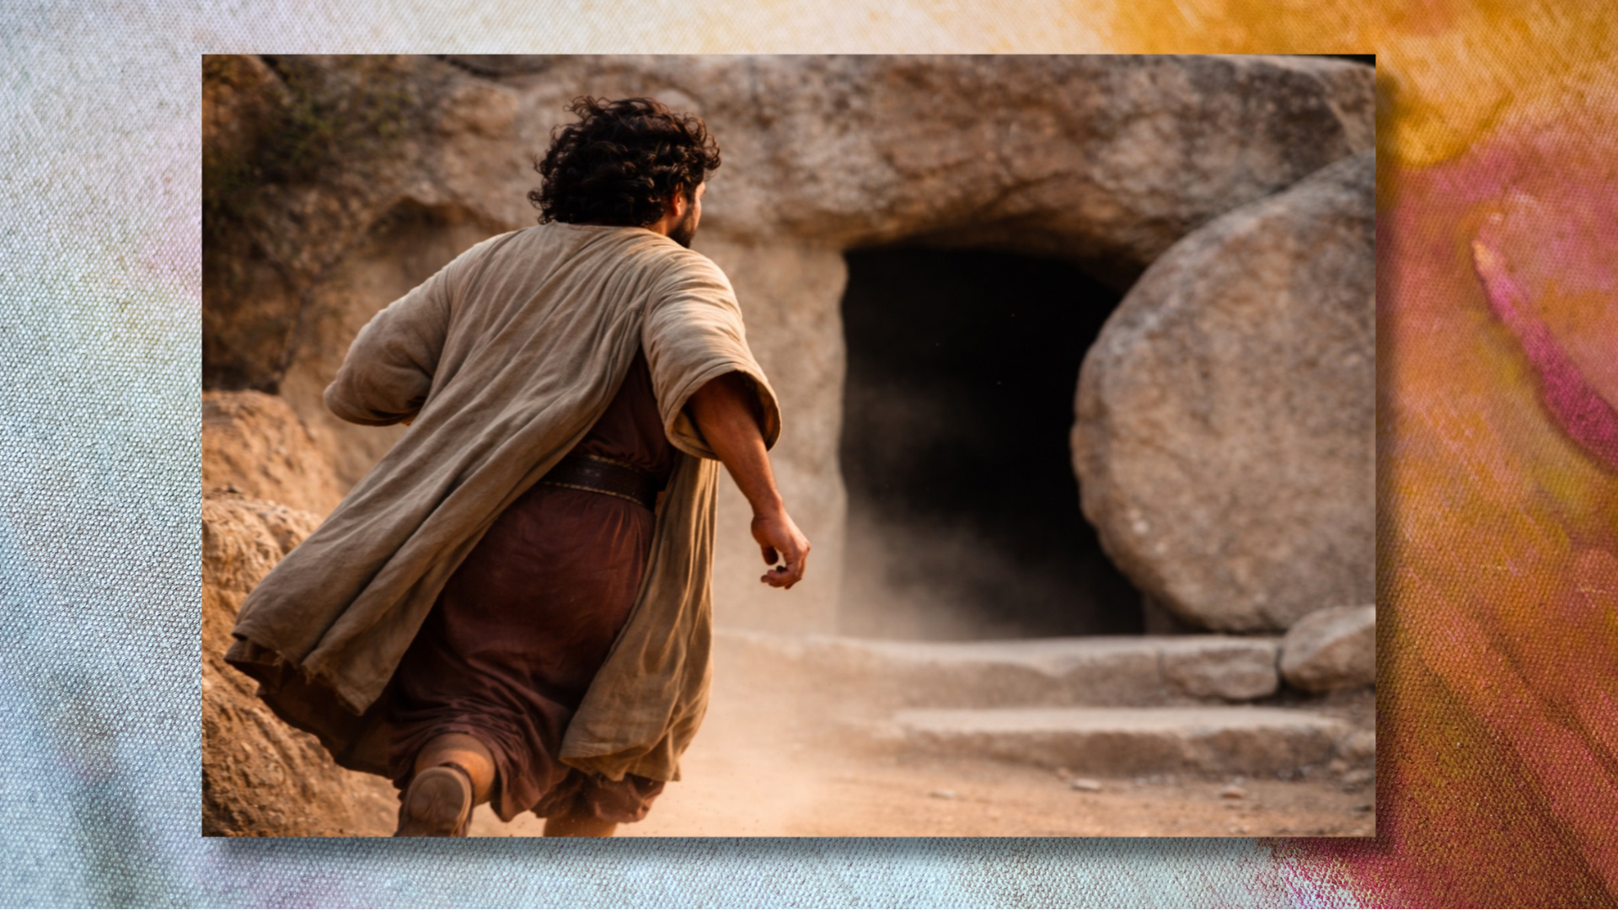
Notes:
Peter is still carrying the weight of his denial, his abandonment of Jesus, and his shame. He is still confused about Jesus’ death; now confronted with an empty tomb. He’s asking, in effect: “What does this mean?” “Could it possibly be true?” But he doesn’t yet have the answers.
The resurrection didn’t immediately produce confident faith—it first produced confusion. The disciples didn’t reject the message because they were stubborn, but because it didn’t fit anything they thought was possible. And yet Peter runs to the tomb anyway—caught between doubt and hope, wondering if what sounds impossible might actually be true.
[NEXT SLIDE]

Slide 15
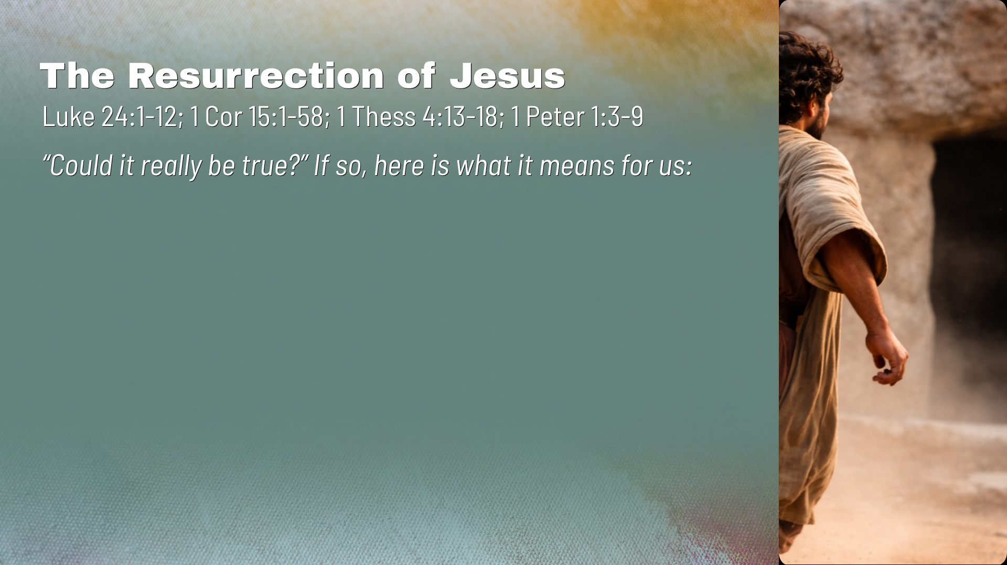

Slide 16
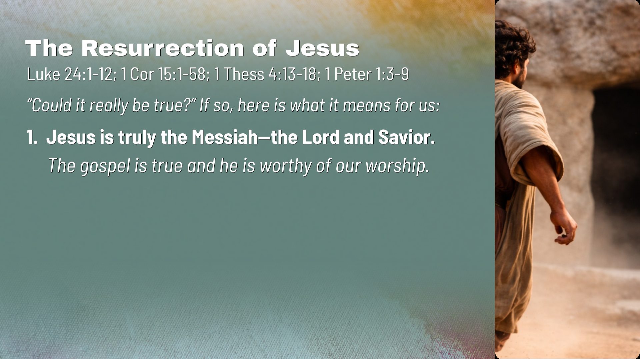

Slide 17
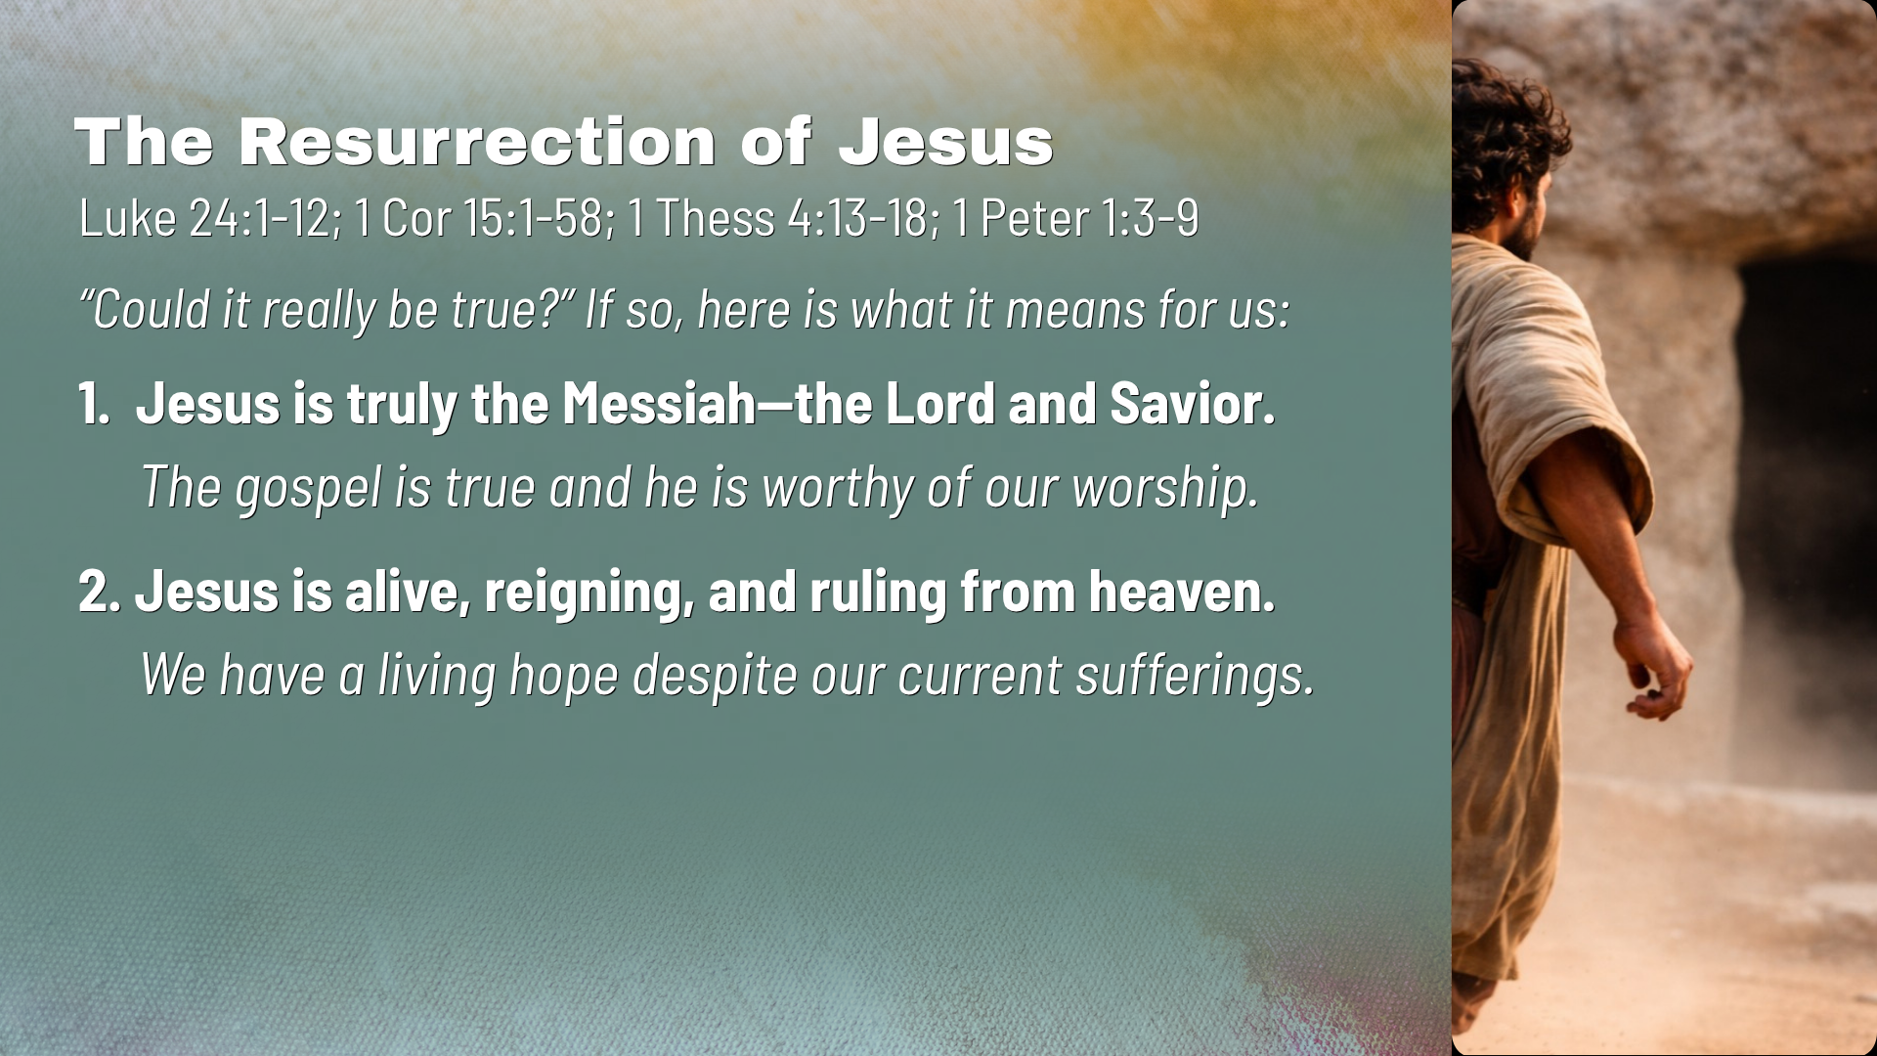

Slide 18
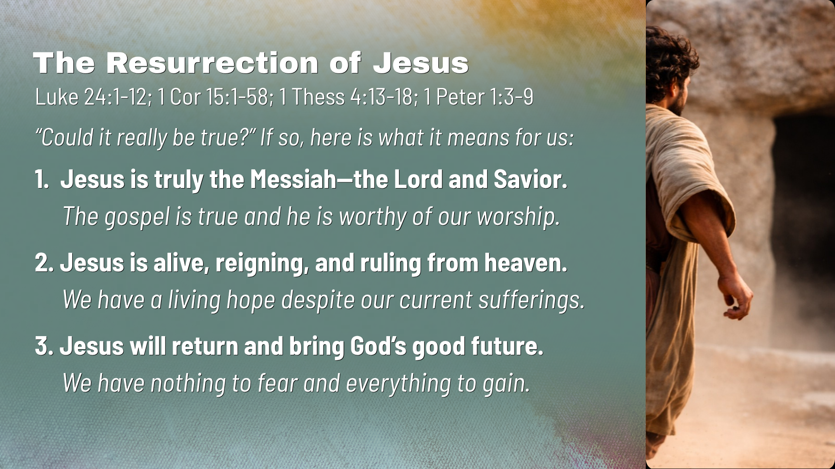
Notes:
[READ & COMMENT ON EACH POINT]
Jesus is truly the Messiah—the Lord and Savior. The gospel is true and he is worthy of our worship.
Jesus is alive, reigning, and ruling from heaven. We have a living hope despite our current sufferings. Peter shows us that we can always begin again. We can add an “and” when we think our stories have come to an end.
Jesus will return and bring God’s good future. We have nothing to fear and everything to gain.
[CLOSING WORDS & PRAYER]
[GO TO NEXT SLIDE FOR PRAYER]

Slide 19
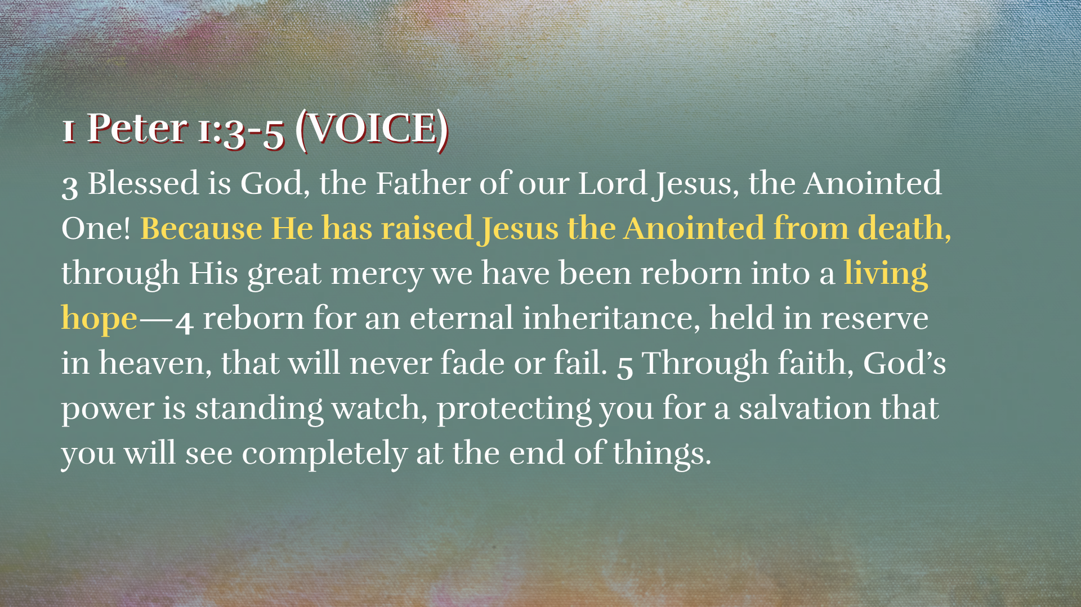
Notes:
[READ & COMMENT]
[NEXT SLIDE]

Slide 20
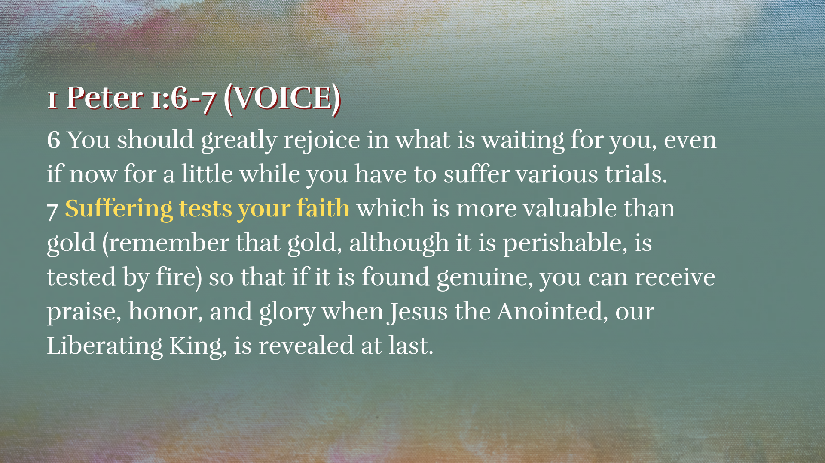
Notes:
[READ & COMMENT]
[NEXT SLIDE]

Slide 21

Notes:
[CLOSING PRAYER]

