Slide 1
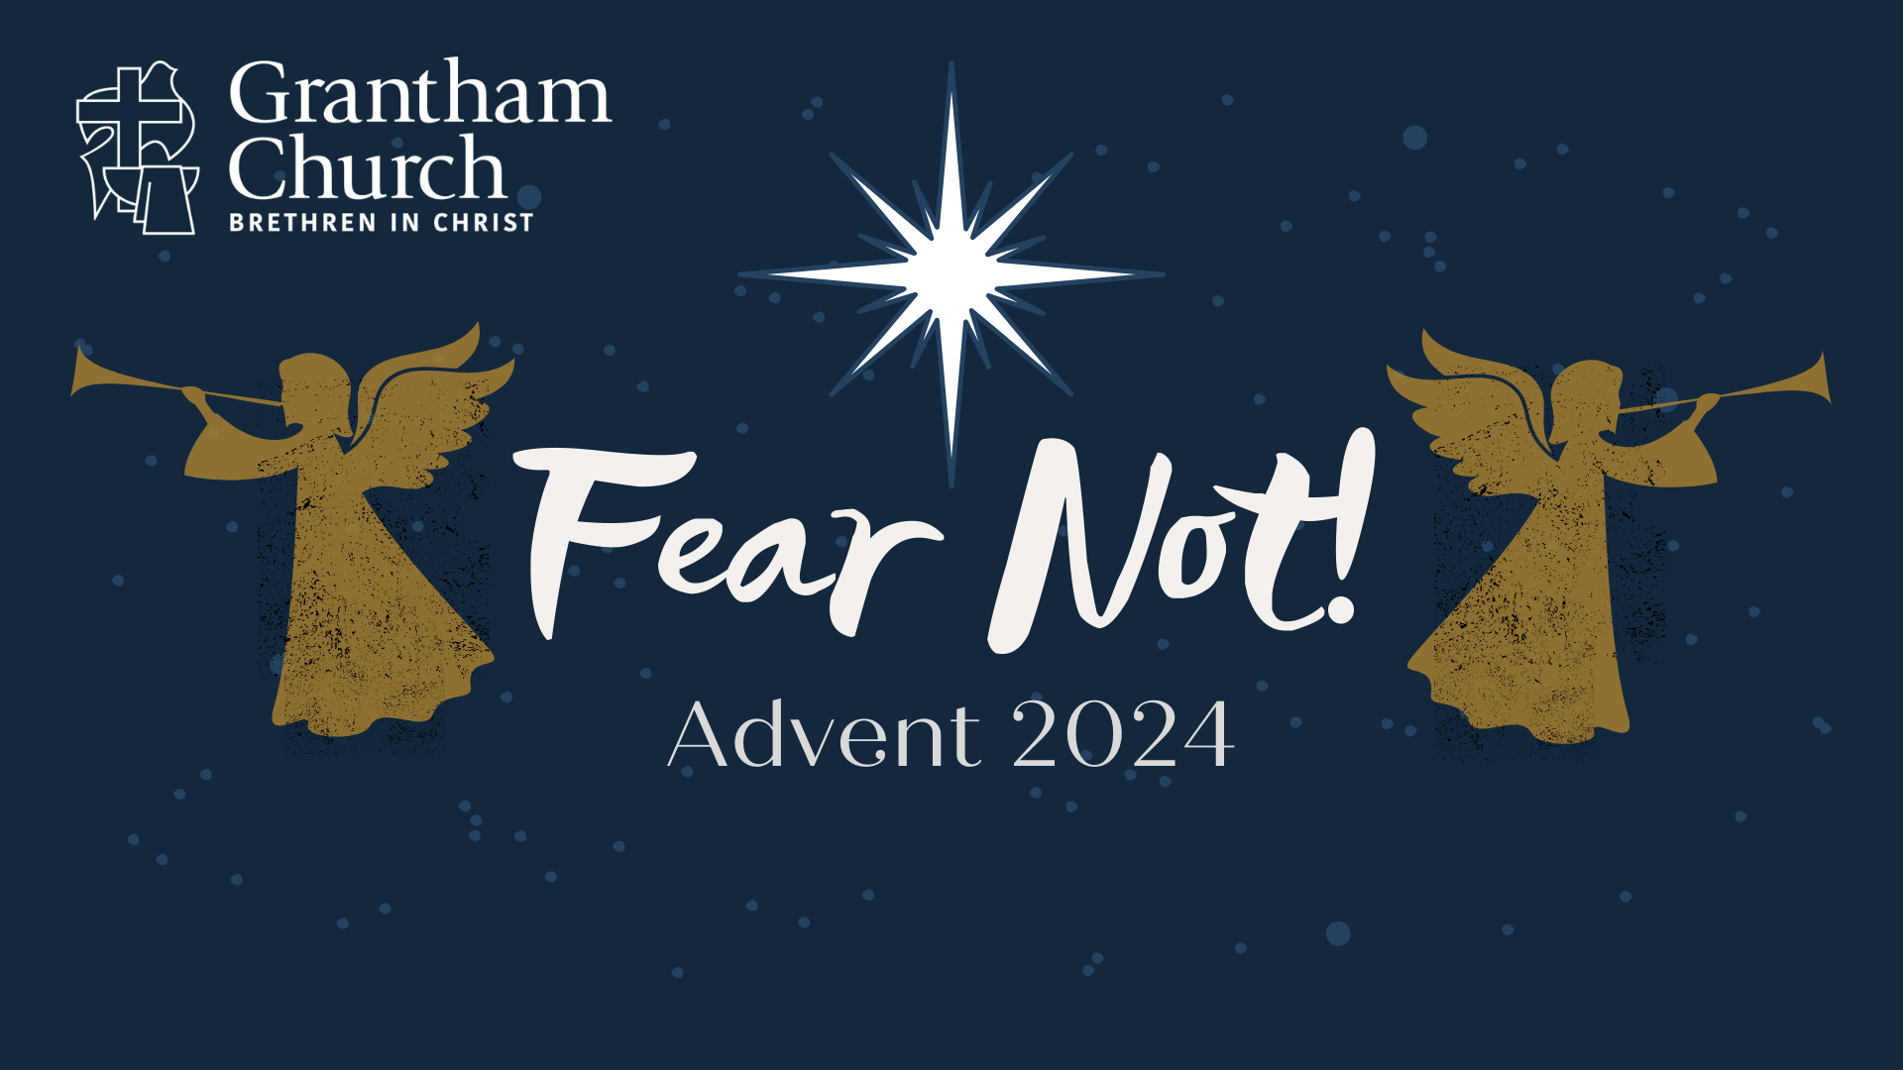
Notes:
[BRIEF INTRO]
This morning, we begin our Advent series – Fear Not!
”Fear not!” or “Do not be afraid!” is one of the most oft-repeated phrases in the entire Bible. And these are the first words from the angels to Zechariah, Mary, and the shepherds in the opening of the Gospel of Luke. And those words are not just for them. We need to hear these comforting words from those heavenly messengers, for their words and their meaning are echoing down through the ages to reach us where we are today. In this 3-part mini-series, we’re going to reflect on these three gospel encounters and find encouragement in how the Lord recognizes our fears on earth and responds to them in his great wisdom and loving kindness.
If you have your Bibles, please open up to… [NEXT SLIDE]

Slide 2
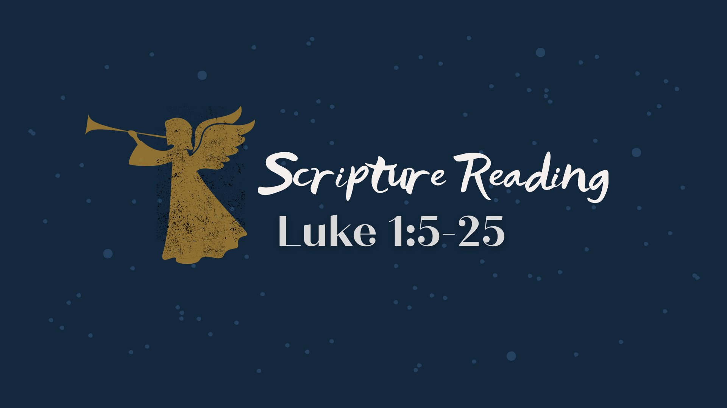
Notes:
[LUKE 1:5-25 NLT - CONGREGATION STAND - READ SCRIPTURE]
This is the word of the Lord. Thanks be to God. You may be seated.
In Luke’s Gospel, the story of Zechariah and Elizabeth comes before Mary and Joseph’s story; and these stories begin with God doing the impossible; He makes a way where there seems to be no way; and he reveals his wisdom and power through two faithful couples. As we just read, Zechariah is from the priestly tribe of Aaron. He and his wife, Elizabeth, were faithful followers of God and careful to obey the Law and practices of Judaism. And we know that by the first century there were several thousand priests in Israel. They were organized in 24 divisions; each were allocated 2 weeks of Temple duties in the year; and priests who offered incense were chosen by lot (similar to casting dice), and so it’s possible that this is the first time that Zechariah has ever had the honor of going into the Temple to perform this sacred task of burning incense, which symbolized the prayers of the people of Israel rising up to God in heaven.
And when Zechariah is performing this task, he quickly realizes that he is not alone. An angel appears, and Zechariah is startled and griped with fear… [NEXT SLIDE]

Slide 3
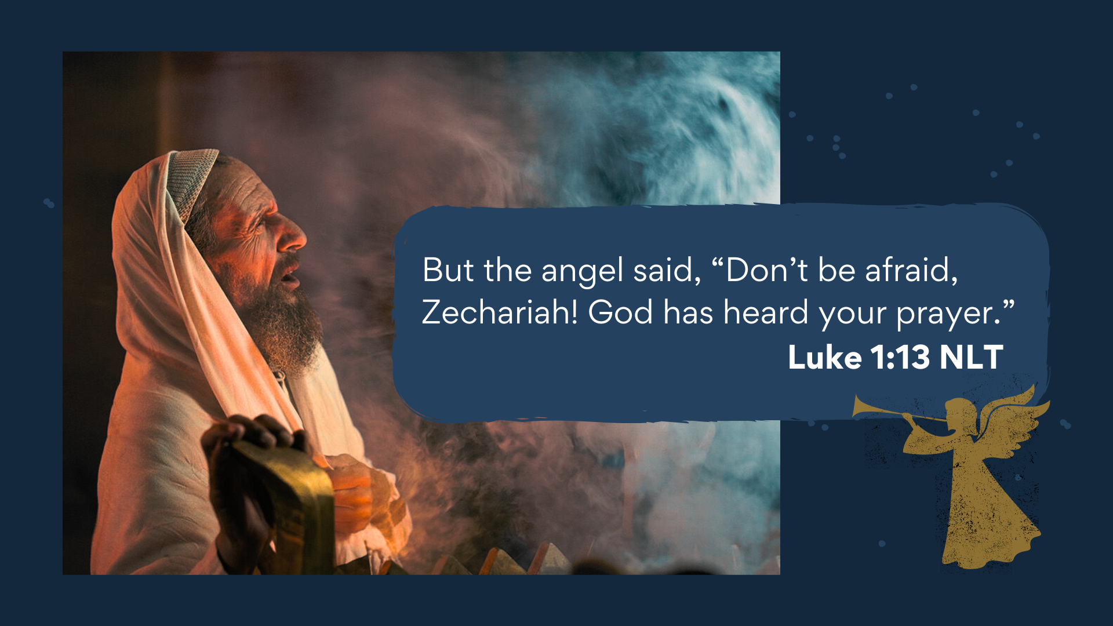
Notes:
[READ VERSE & COMMENT]
Now, first, I think it’s necessary for me to say something about the appearance of angels in these stories. From a biblical perspective, just as there are free-willed agents on earth, there are also free-willed beings in the heavenly realms. This is the worldview of the Scriptures. But we shouldn’t think that it’s somehow commonplace for someone to see or interact with an angel, for each time it occurs in the Bible people are overwhelmed with fear because they know that something out of the ordinary is happening; they can tell right away that they are not human. And while this is how Luke highlights divine communication—via these angelic messengers—it’s not the only way in which God communicates (e.g., dreams, visions, signs, the Scriptures, experiences in worship, etc.). So, Zechariah is just as shocked as you would expect him to be!
So, as Zechariah is offering up the incense (the prayers of the people), the angel Gabriel appears and assures Zechariah that his own prayer has been heard. Now, was this a prayer he had just prayed while offering up the incense, or was it a prayer he had prayed long ago and had given up on it being answered? We’re not sure. But we do know that he and his wife are beyond child-bearing years. And despite the promise of the angel that God is making a way for them to have a child, Zechariah is skeptical and doubts what he hears. Now, aren’t you glad that God doesn’t hear Zechariah’s skepticism and doubt and say, “You know what… just forget it.” No, he doesn’t do that to Zechariah, nor does he do that to us. However, Zechariah’s lack of faith will have consequences, as it does with us. His lack of faith means the loss of his voice.
And it’s not that God doesn’t appreciate brutal honesty. He does. He welcomes it. But even after we’ve shared our fears, our pain, our anger, our anxiety, and our doubts with God, we can still express faith in God’s wisdom, character, and power to deliver us. For example, listen to the raw and authentic words of David in Psalm 6… [NEXT SLIDE]

Slide 4

Notes:
[READ PASSAGE & COMMENT]
We can’t help but notice the authenticity in David’s prayer, which seems to be in response to an unanswered prayer or expressing desperation at having to wait so long for God to do something. But we should also pay careful attention to how the prayer ends… not in fear, but in faith; not in hopelessness, but in trust in a loving God to do what only he can do.
Jesus himself prayed with this sort of passion and emotion. Listen to what the author of Hebrews says in chapter 5, verses 7-8… [NEXT SLIDE]

Slide 5
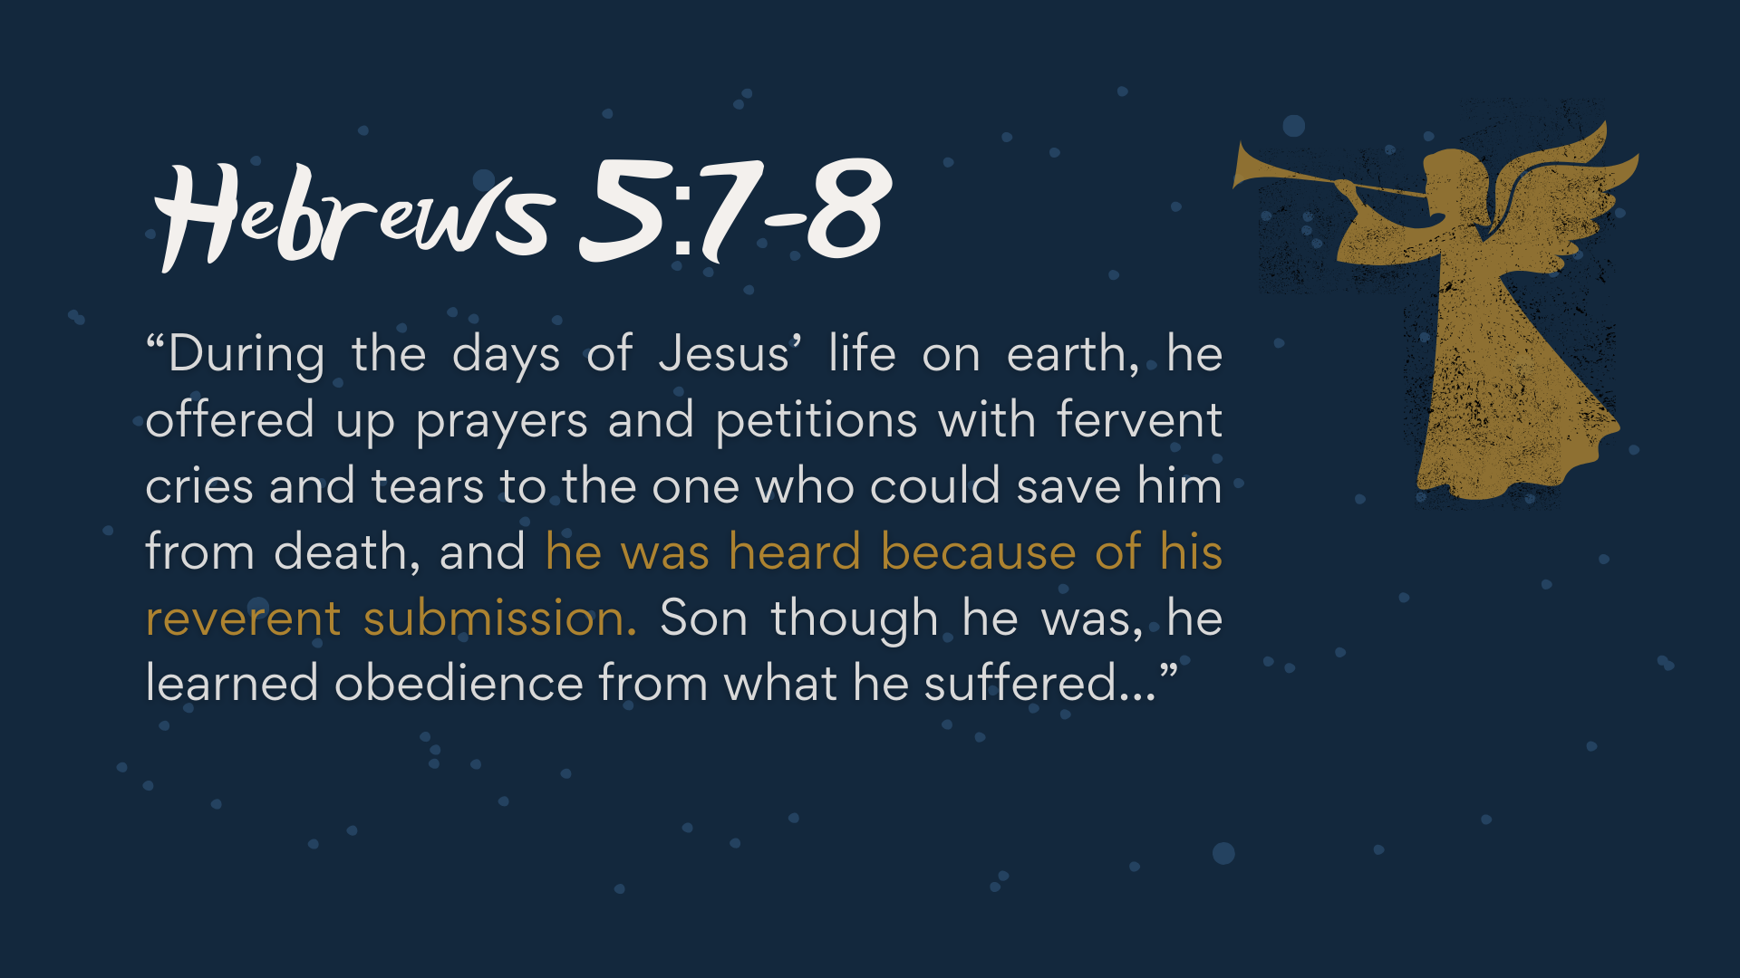
Notes:
[READ PASSAGE & COMMENT]
Let’s reflect a bit on this verse:
Why did Jesus pray? – He was fully God, but he was also fully human
What did Jesus pray? – Matt. 6:9-13 “they kingdom come; thy will be done”
The Lord’s Prayer presupposes that God doesn’t always get his way!
So, what is the point of prayer? – To know God and to partner with him
Of course, we often don’t see the results of our prayers
“he was heard… because of his reverent submission”
Did the Father hear his prayers? Did he save him from death?
“reverent submission” – Jesus submitted his life to God the Father
What is submission to God? Let’s think about that a moment… [NEXT SLIDE]

Slide 6
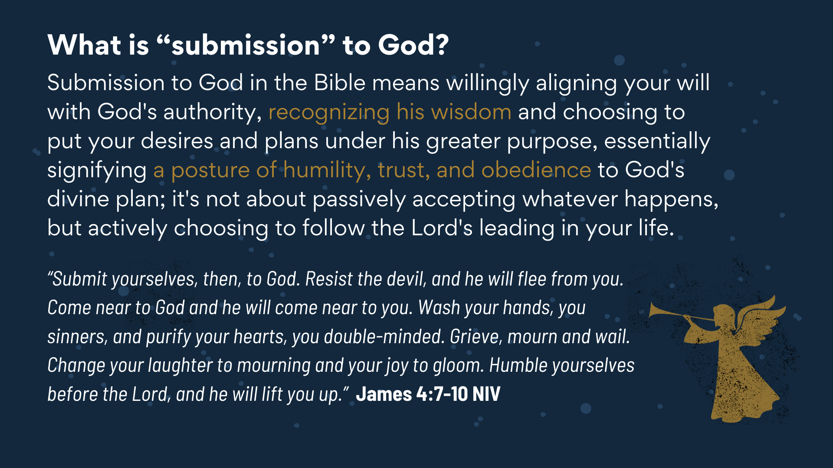
Notes:
[READ SLIDE & COMMENT]
Now… don’t miss the sentence, “Resist the devil, and he will flee from you.” Resistance to our real spiritual enemy is key in faithfully submitting to God.
Remember what Paul said in Ephesians… [NEXT SLIDE]

Slide 7
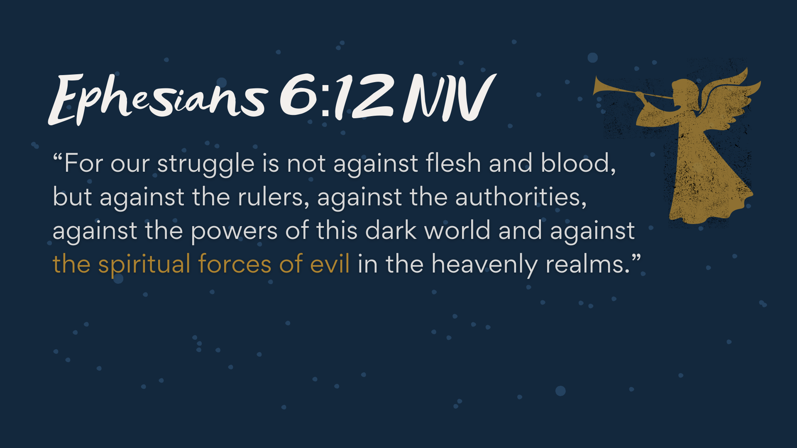
Notes:
[READ & COMMENT]​
The real battle is spiritual. Therefore, our weapons must be spiritual as well.​ That’s what Paul meant in 2 Corinthians 10:3-4, “For though we live in the world, we do not wage war as the world does. The weapons we fight with are not the weapons of the world. On the contrary, they have divine power to demolish strongholds.”​
​
As I’ve said before, I know how this sounds to some people. It can sound crazy. That’s because an increasing number of Westerners embrace scientism—the idea that the hard sciences alone can answer our questions, solve our mysteries, and provide the only real knowledge of reality.
But if we’re honest, it’s just another version of fundamentalism. It’s arrogant, narrow-minded, and as Greg Boyd reminds us, it totally disregards the worldview and perspectives of all those not living in the West. In his book, God at War, Boyd writes… [NEXT SLIDE]

Slide 8
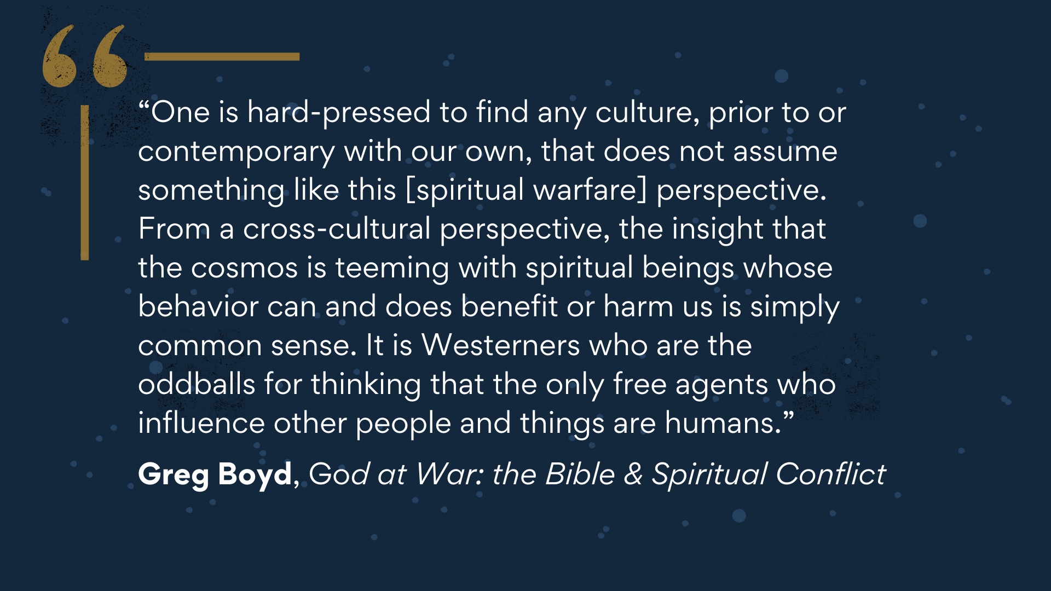
Notes:
[READ QUOTE & COMMENT]​
Folks, we can’t afford to deny this aspect of reality if we’re going to join God in the cosmic struggle. If we’re going to see prayer as our cry for the Kingdom and as the way we fight as Christians, then we need to accept the NT worldview (that there is a battle of human and angelic wills) and live into more of an awareness of this truth in our prayer life.​ While I certainly encourage contemplation, meditative prayers, breath prayers, and the like… if intercessory prayer is not a regular part of your prayer life, I submit to you that are not participating in the cosmic battle of good over evil; and you are forfeiting your calling to engage in the fight.
​
And it may be that by accepting this truth that you discover what has been missing in your prayer life… and has too often kept you from praying like it matters. Of course, there may be other things that aren’t helping your prayer life. So, let’s think about that for a few minutes… [NEXT SLIDE]

Slide 9
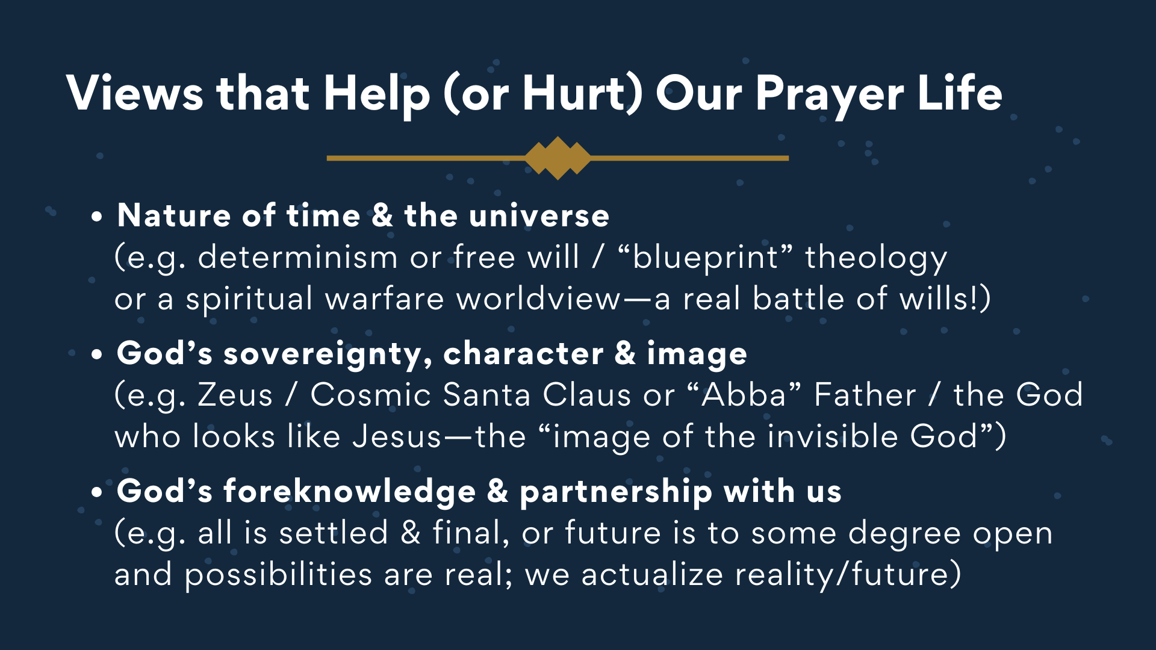
Notes:
[BRIEF COMMENTS ON EACH POINT]​
Determinism – “everything happens for a reason” or ”prayer doesn’t change God…”
God’s character – Does God look like Jesus or Zeus or Santa Claus?
God’s foreknowledge – Does God see only one future, or multiple futures?
​
My friends, I submit to you that we live in a world where God has given us a certain amount of freedom and “say-so” to actualize his good future through our decisions, and particularly through our prayers, where we say “yes” to the Kingdom and become conduits of his grace and avenues for actualizing his will around us—where we partner with God in bringing heaven to earth.​
​
That’s what the Methodist missionary E. Stanley Jones had in mind when he wrote… [NEXT SLIDE]

Slide 10
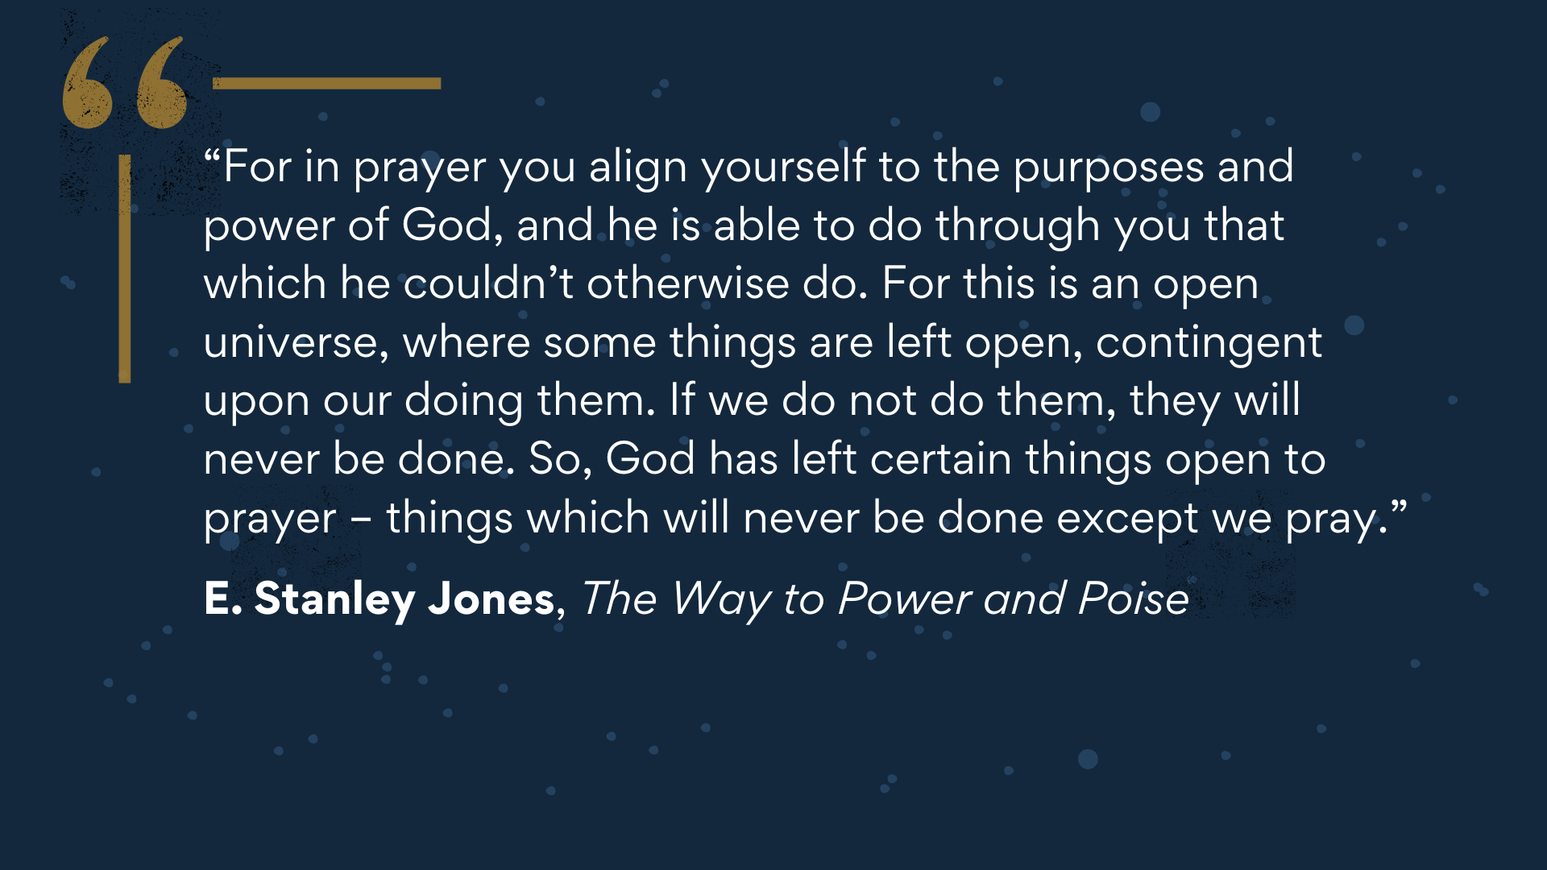
Notes:
[READ QUOTE & COMMENT]
Which is why we need to hear this encouraging reminder from James… [NEXT SLIDE]

Slide 11
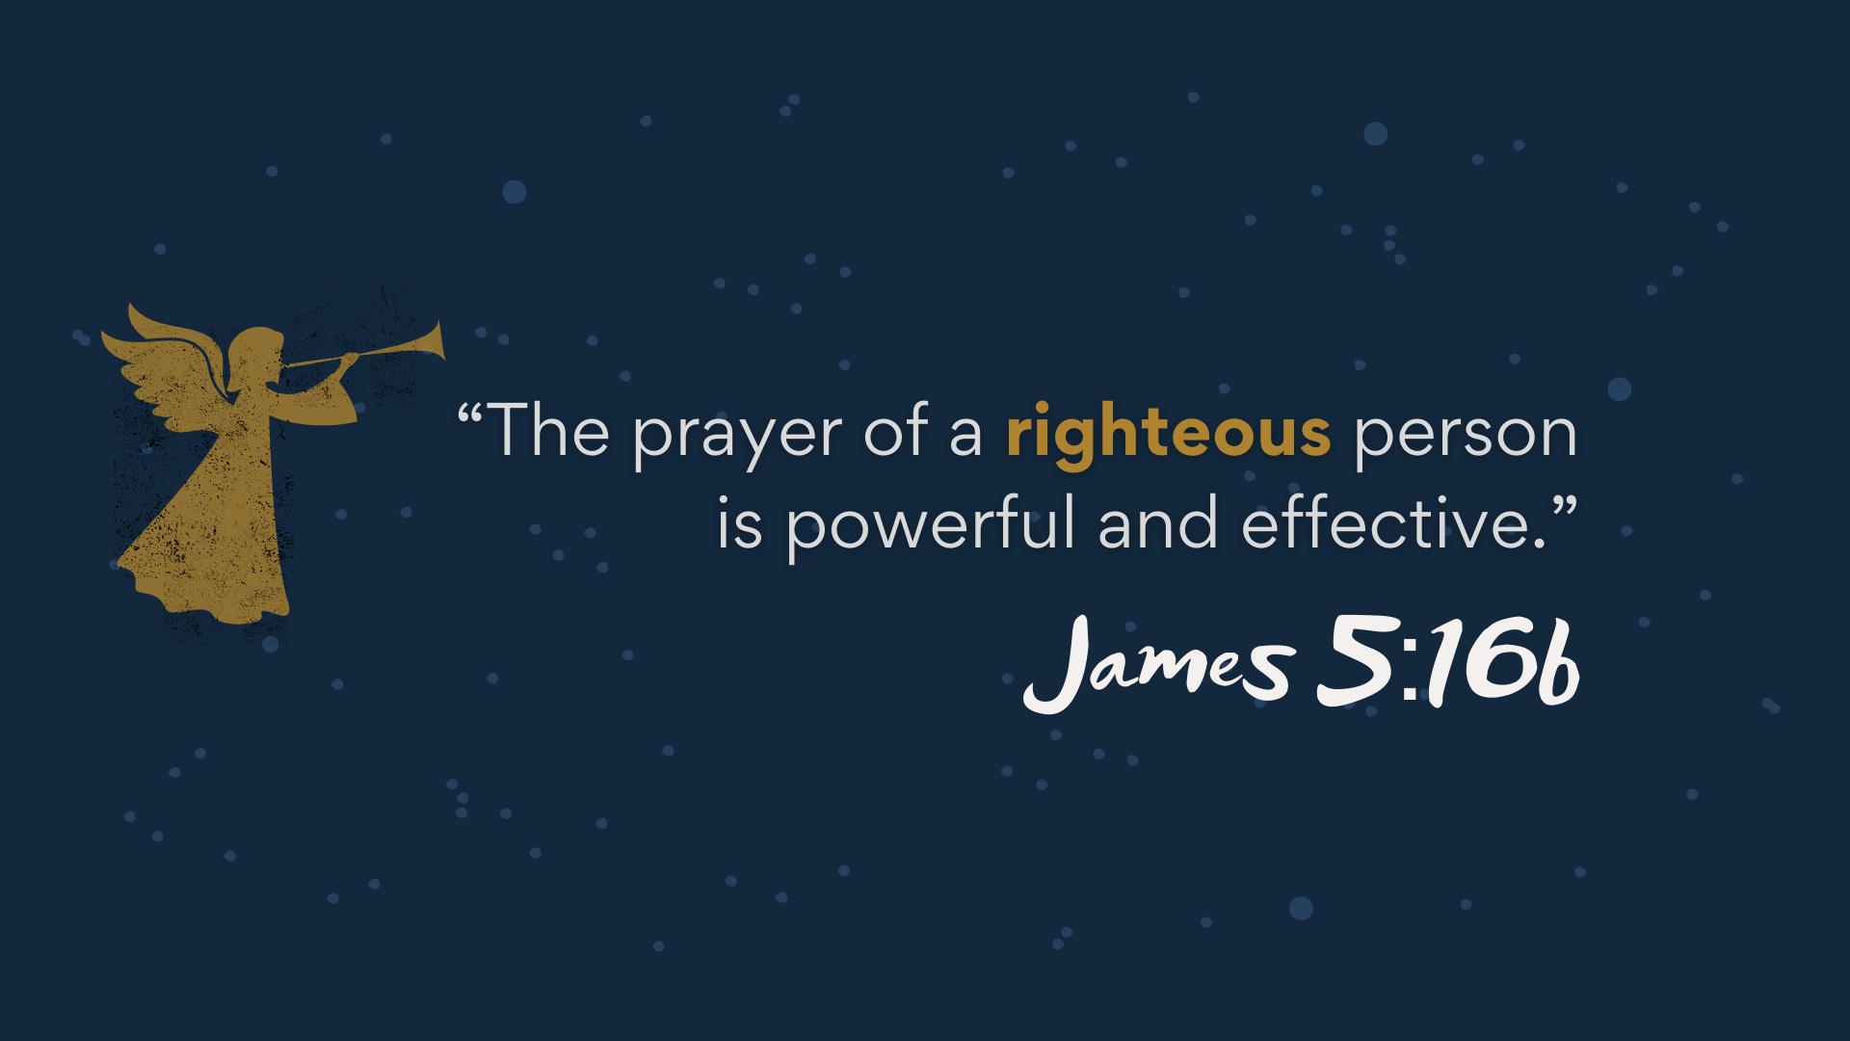
Notes:
[READ & COMMENT]
Who is righteous? Well, a "righteous person" is someone who lives according to God's will. It’s someone who seeks to live a life of honesty, integrity, justice, and faithfulness. It’s someone who is submitting to God. That is what makes our prayers particularly powerful and effective, because we are aligned with God's desires. A “righteous person” isn’t a completely sinless person, but rather a believer who strives to live in faithful submission and reliance upon God.
Remember that old familiar Proverb… [NEXT SLIDE]

Slide 12
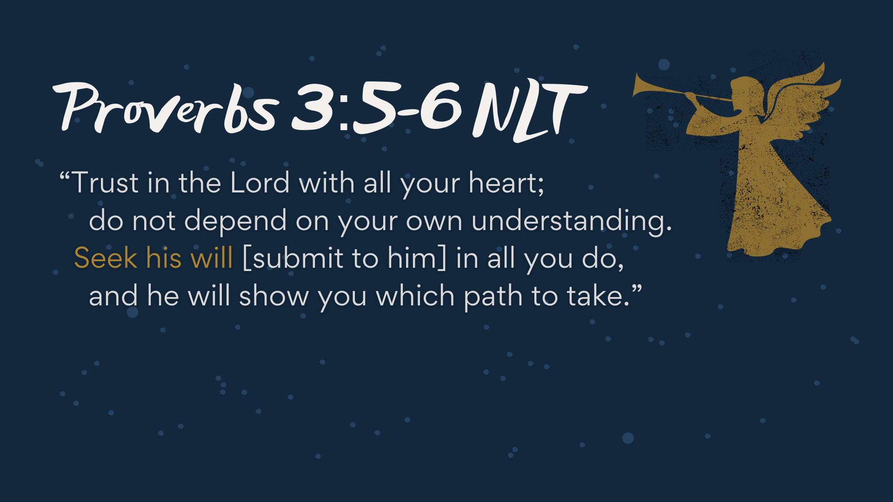
Notes:
[READ PASSAGE & COMMENT]
This is a call not to rely upon yourself (your own strength, wisdom, and understanding) but to rely upon God in prayer, and to trust that he love us and hears us when we pray
Therefore, we must resist the evil one and all of the forces that keep us from praying
[BRIEF STORY: MY RECENT MEETING WITH TWO ETHIOPIAN COUPLES]
Church, may God help us to overcome the forces that keep us from folded hands and bended knees, so that we might trust in the only One who can save, deliver, and heal this world. For it’s this God that reminds us in Advent… to pray, to work, and to wait upon the Lord.
Finally, here are some questions to help us reflect and respond to God’s voice… [NEXT SLIDE]

Slide 13
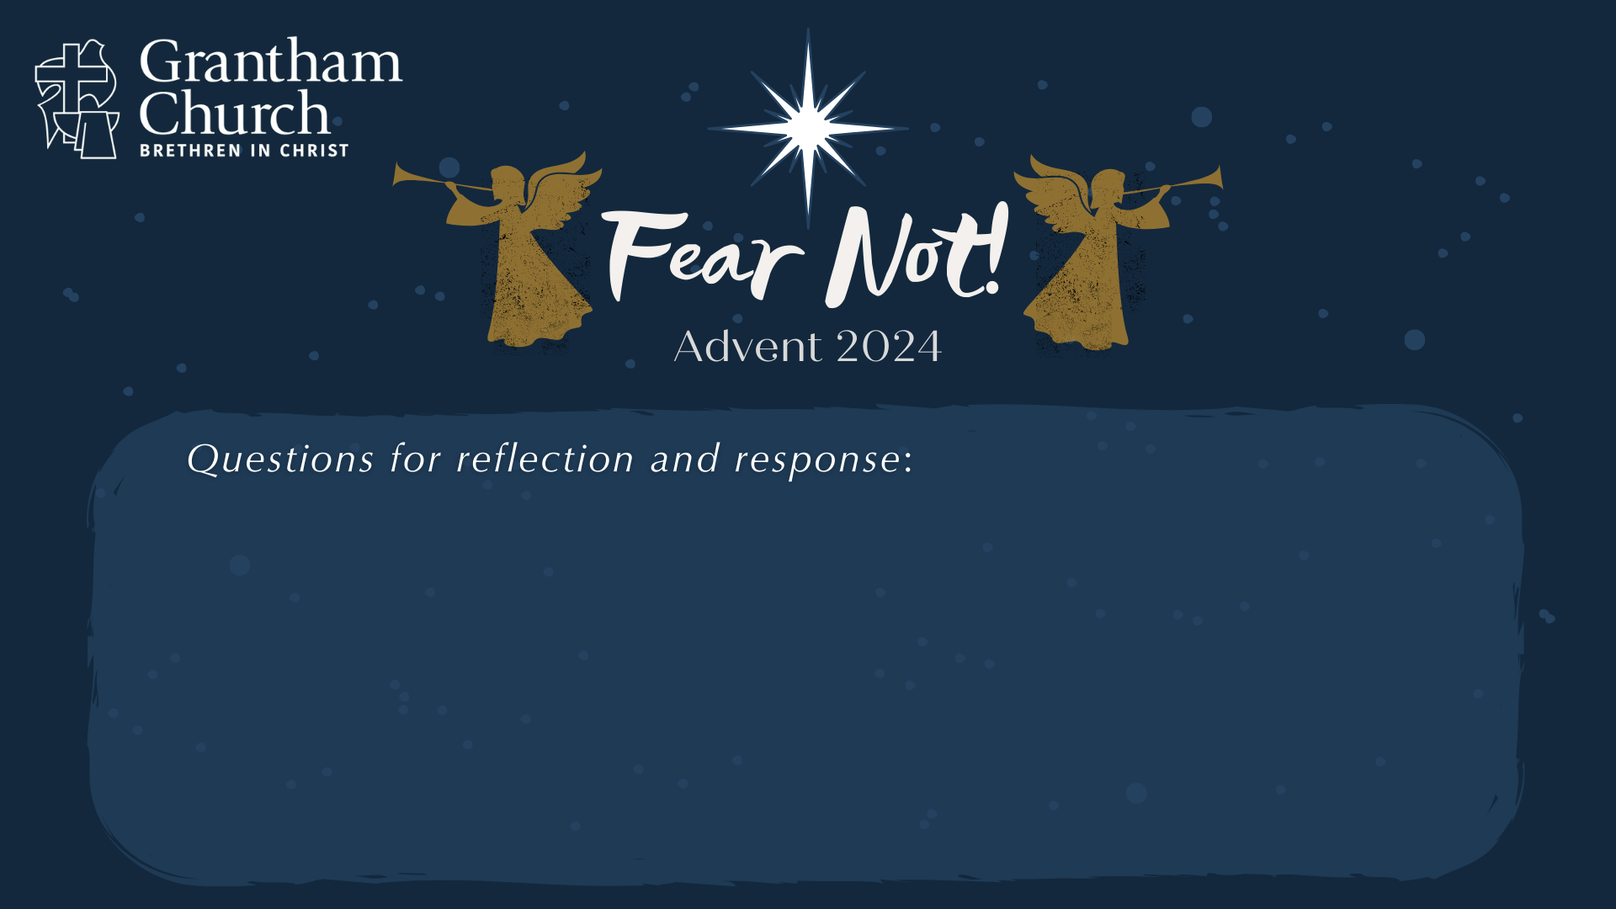

Slide 14
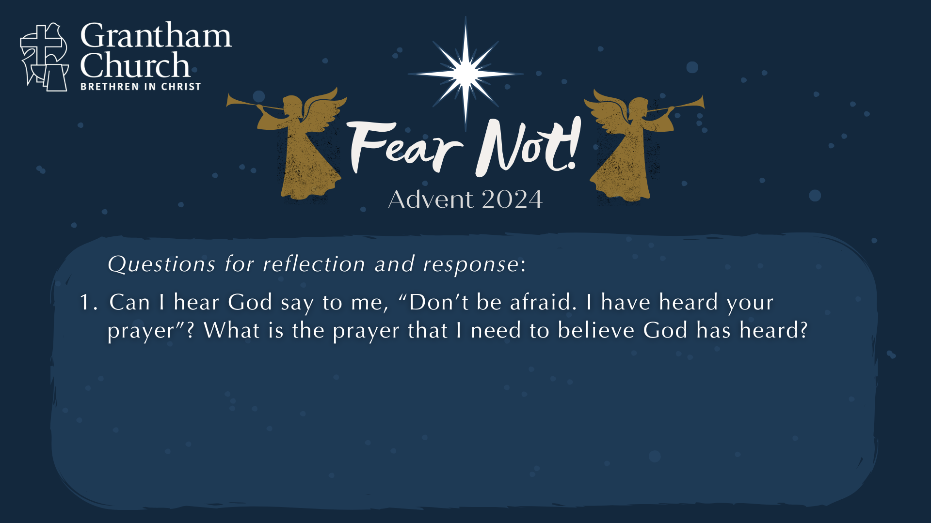

Slide 15
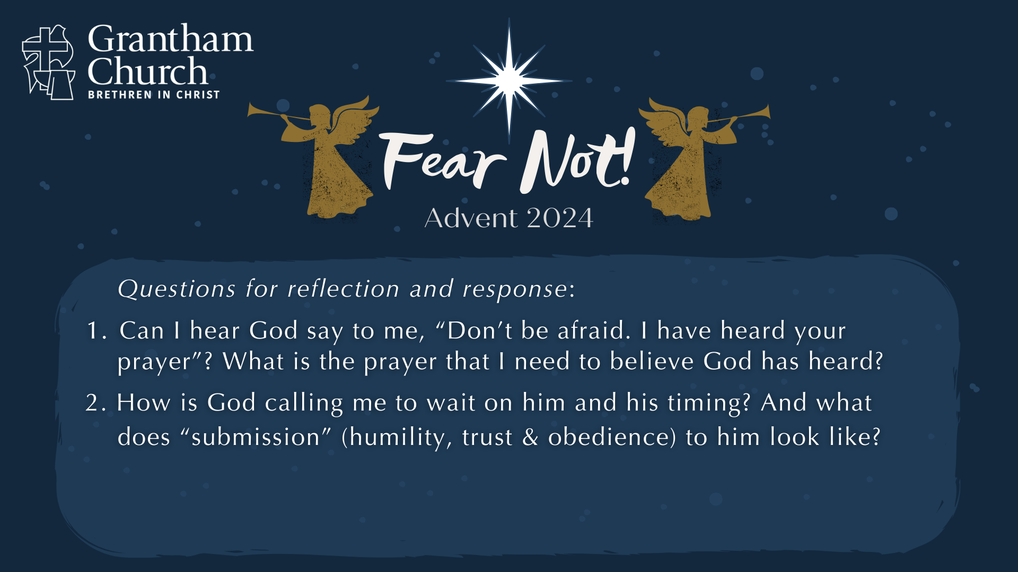

Slide 16
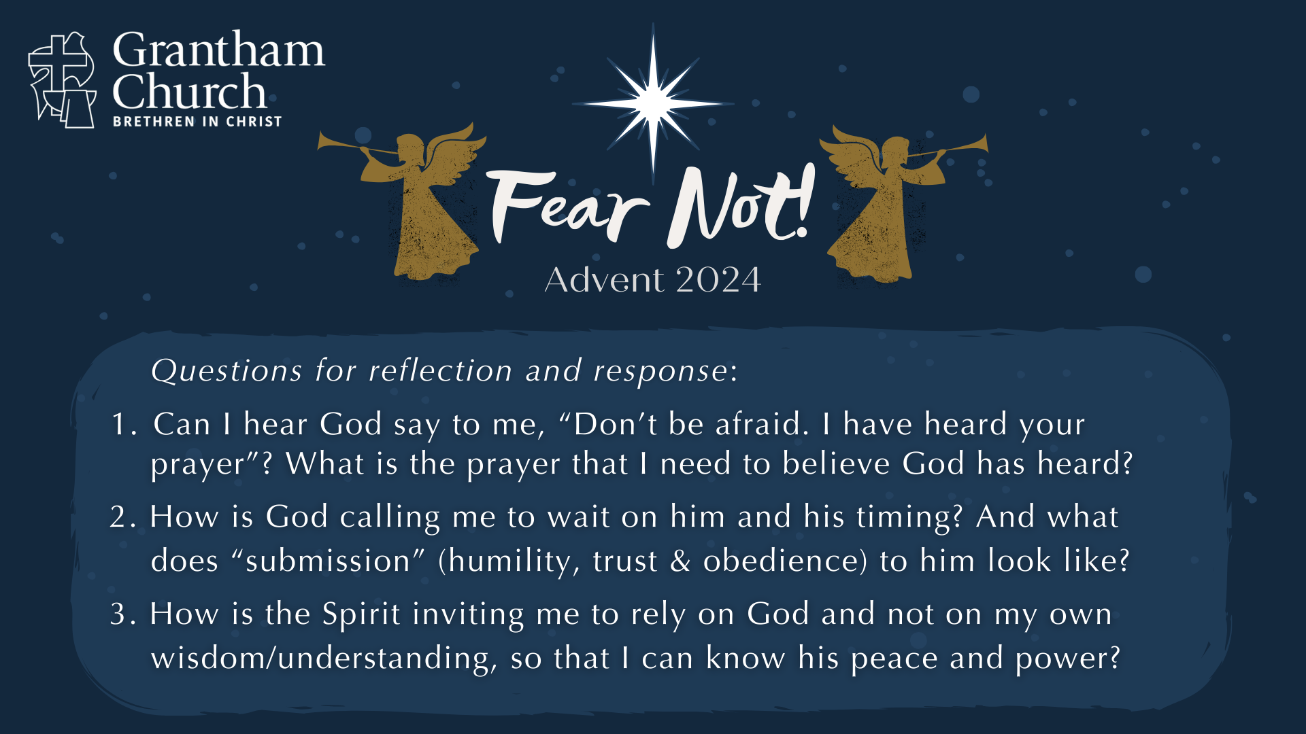
Notes:
[READ QUESTIONS & COMMENT]
Can I hear God say to me, “Don’t be afraid. I have heard your prayer”? What is the prayer that I need to believe God has heard?
How is God calling me to wait on him and his timing? And what does “submission” (humility, trust & obedience) to him look like?
How is the Spirit inviting me to rely on God and not on my own wisdom and understanding, so that I can know his peace and power… so that his perfect love can cast out fear?
[FINAL WORDS]
[GO TO NEXT SLIDE DURING CLOSING PRAYER]

Slide 17
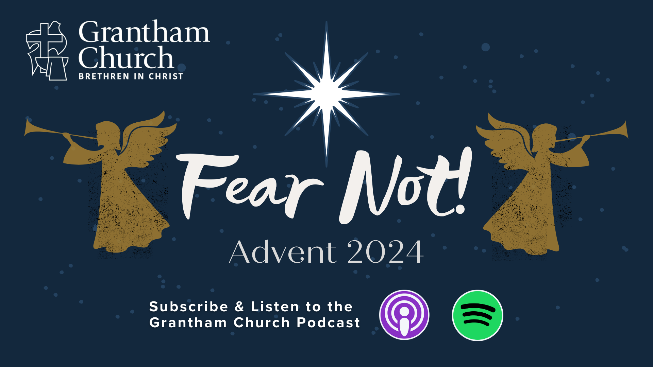
Notes:
[CLOSING PRAYER]
[APOSTLES’ CREED]
[COMMUNION]
Benediction:
Brothers and sisters… Fear not! God hears your prayers. As you wait upon him this Advent season, may you be filled with his peace, surrounded by his presence, and empowered by his Spirit. Go in peace, church, to love and serve the Lord. Amen.

