Slide 1


Slide 2


Slide 3


Slide 4


Slide 5


Slide 6

⁶ Now Joseph was well-built and handsome ⁷ and after a while his master’s wife took notice of Joseph and said, “Come to bed with me!”
⁸ But he refused. “With me in charge,” he told her, “my master does not concern himself with anything in the house; everything he owns he has entrusted to my care. ⁹ No one is greater in this house than I am. My master has withheld nothing from me except you, because you are his wife. How then could I do such a wicked thing and sin against God?” ¹⁰ And though she spoke to Joseph day after day, he refused to go to bed with her or even be with her.
¹¹ One day he went into the house to attend to his duties, and none of the household servants was inside. ¹² She caught him by his cloak and said, “Come to bed with me!” But he left his cloak in her hand and ran out of the house.
GENESIS 39:6-12

Slide 7
¹ In the spring, at the time when kings go off to war, David sent Joab out with the king’s men and the whole Israelite army. They destroyed the Ammonites and besieged Rabbah. But David remained in Jerusalem.
² One evening David got up from his bed and walked around on the roof of the palace. From the roof he saw a woman bathing. The woman was very beautiful, ³ and David sent someone to find out about her. The man said, “She is Bathsheba, the daughter of Eliam and the wife of Uriah the Hittite.” ⁴ Then David sent messengers to get her. She came to him, and he slept with her.
2 SAMUEL 11:1-4

Slide 8
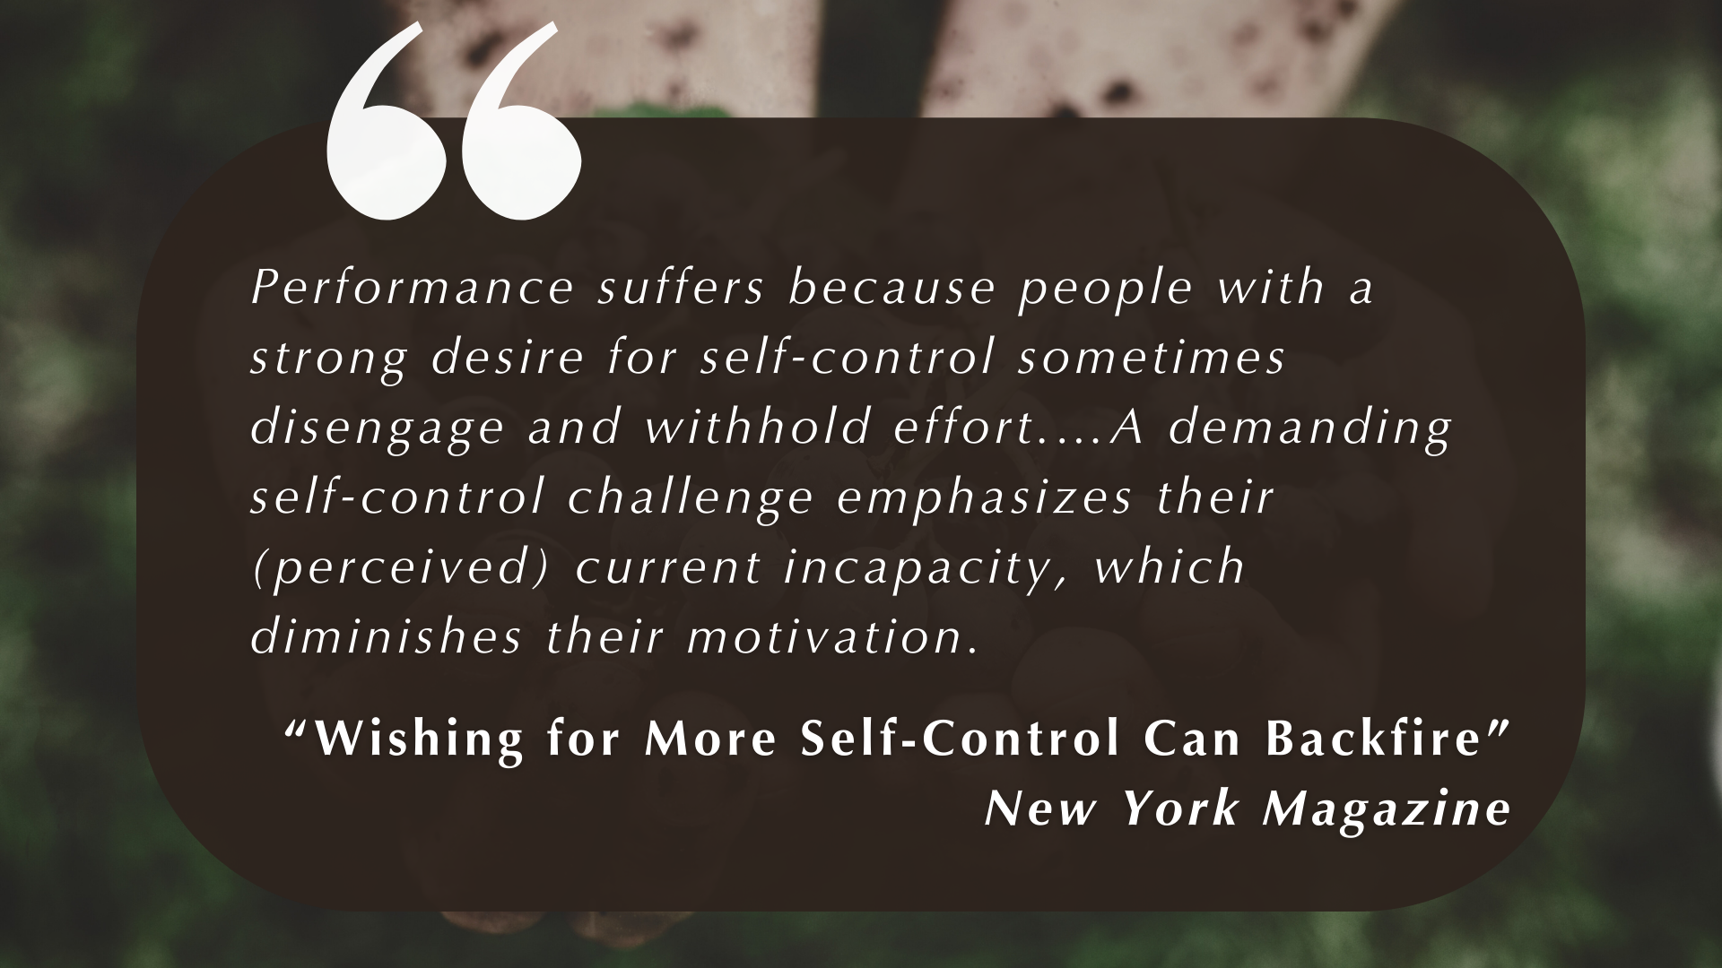

Slide 9
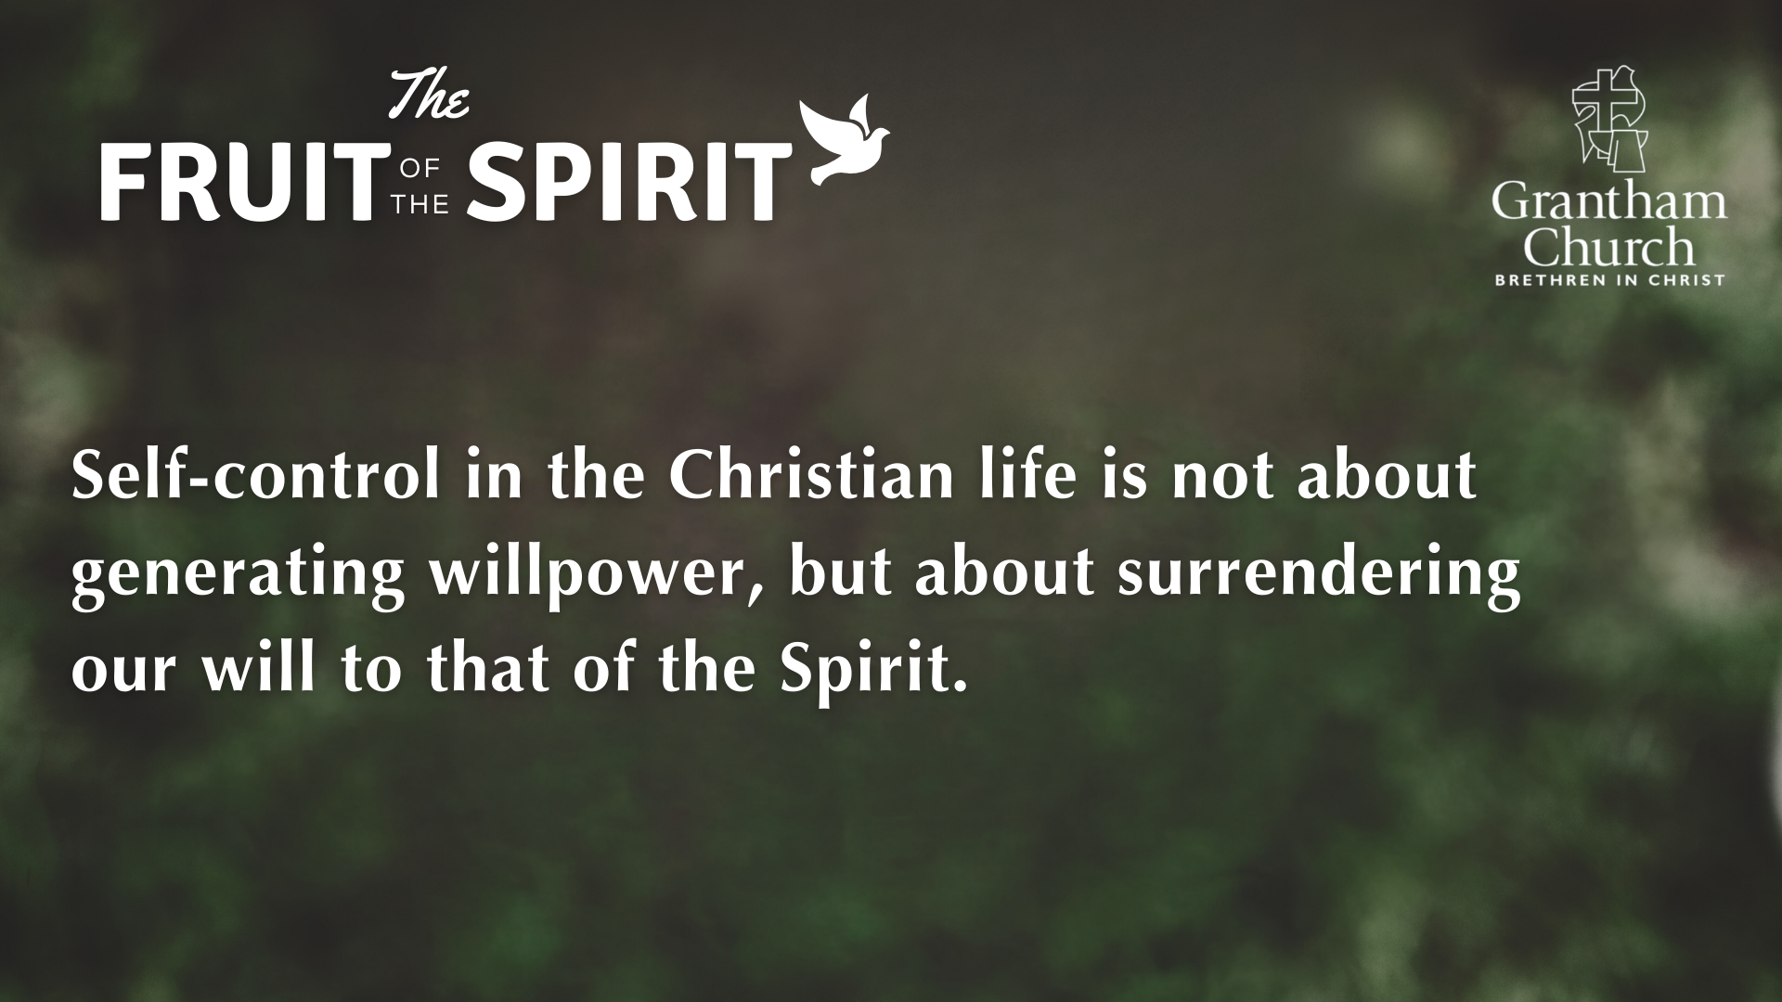

Slide 10
GALATIANS 5:25
Since we live by the Spirit, let us keep in step with the Spirit. (NIV)
If the Spirit is the source of our life, let the Spirit also direct our course. (NEB)

Slide 11
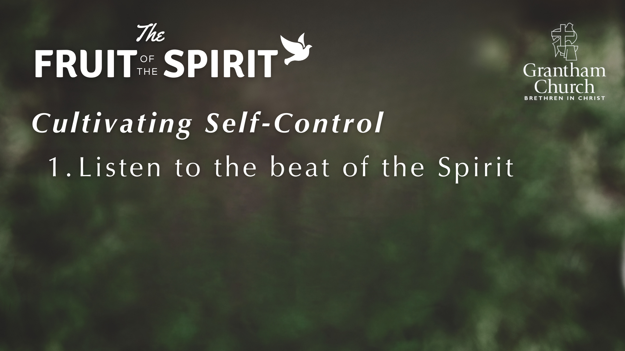

Slide 12
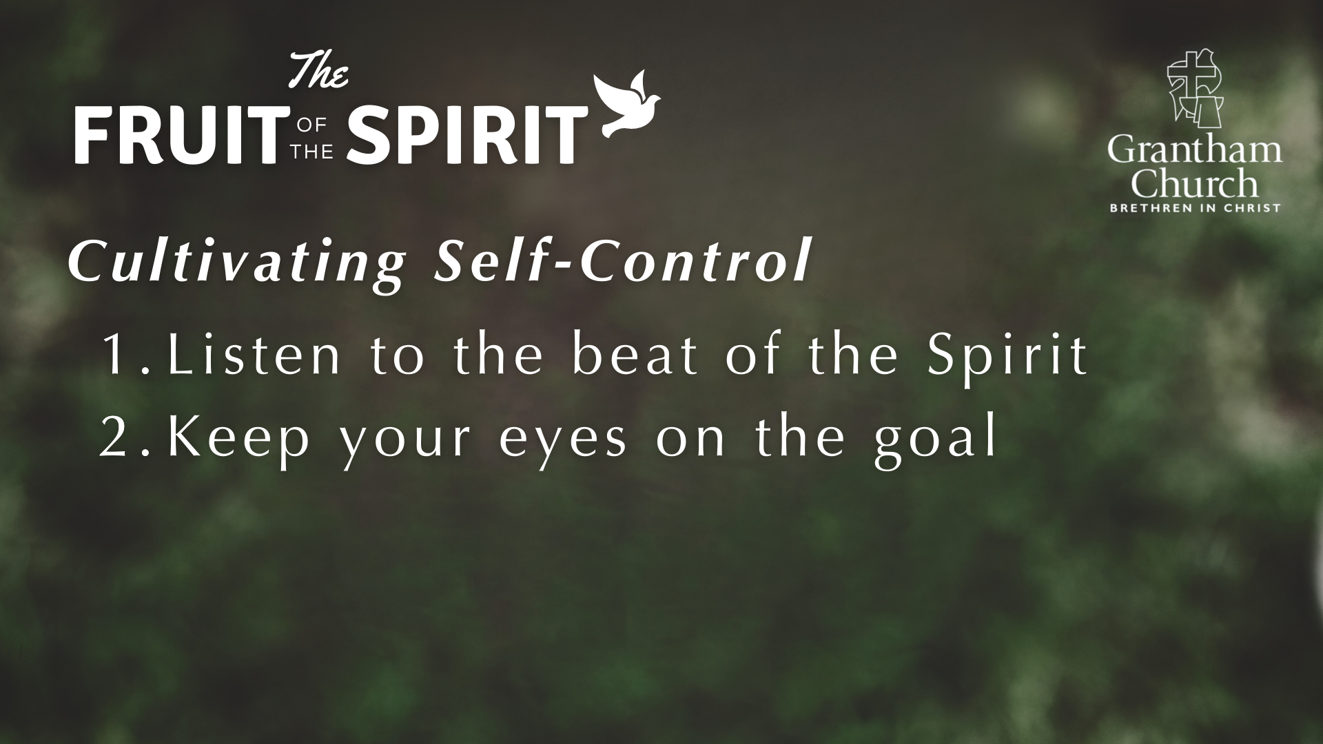

Slide 13
²⁴ Do you not know that in a race all the runners run, but only one gets the prize? Run in such a way as to get the prize. ²⁵ Everyone who competes in the games goes into strict training. They do it to get a crown that will not last, but we do it to get a crown that will last forever.
²⁶ Therefore I do not run like someone running aimlessly; I do not fight like a boxer beating the air. ²⁷ No, I strike a blow to my body and make it my slave so that after I have preached to others, I myself will not be disqualified for the prize.
1 CORINTHIANS 9:24-27

Slide 14
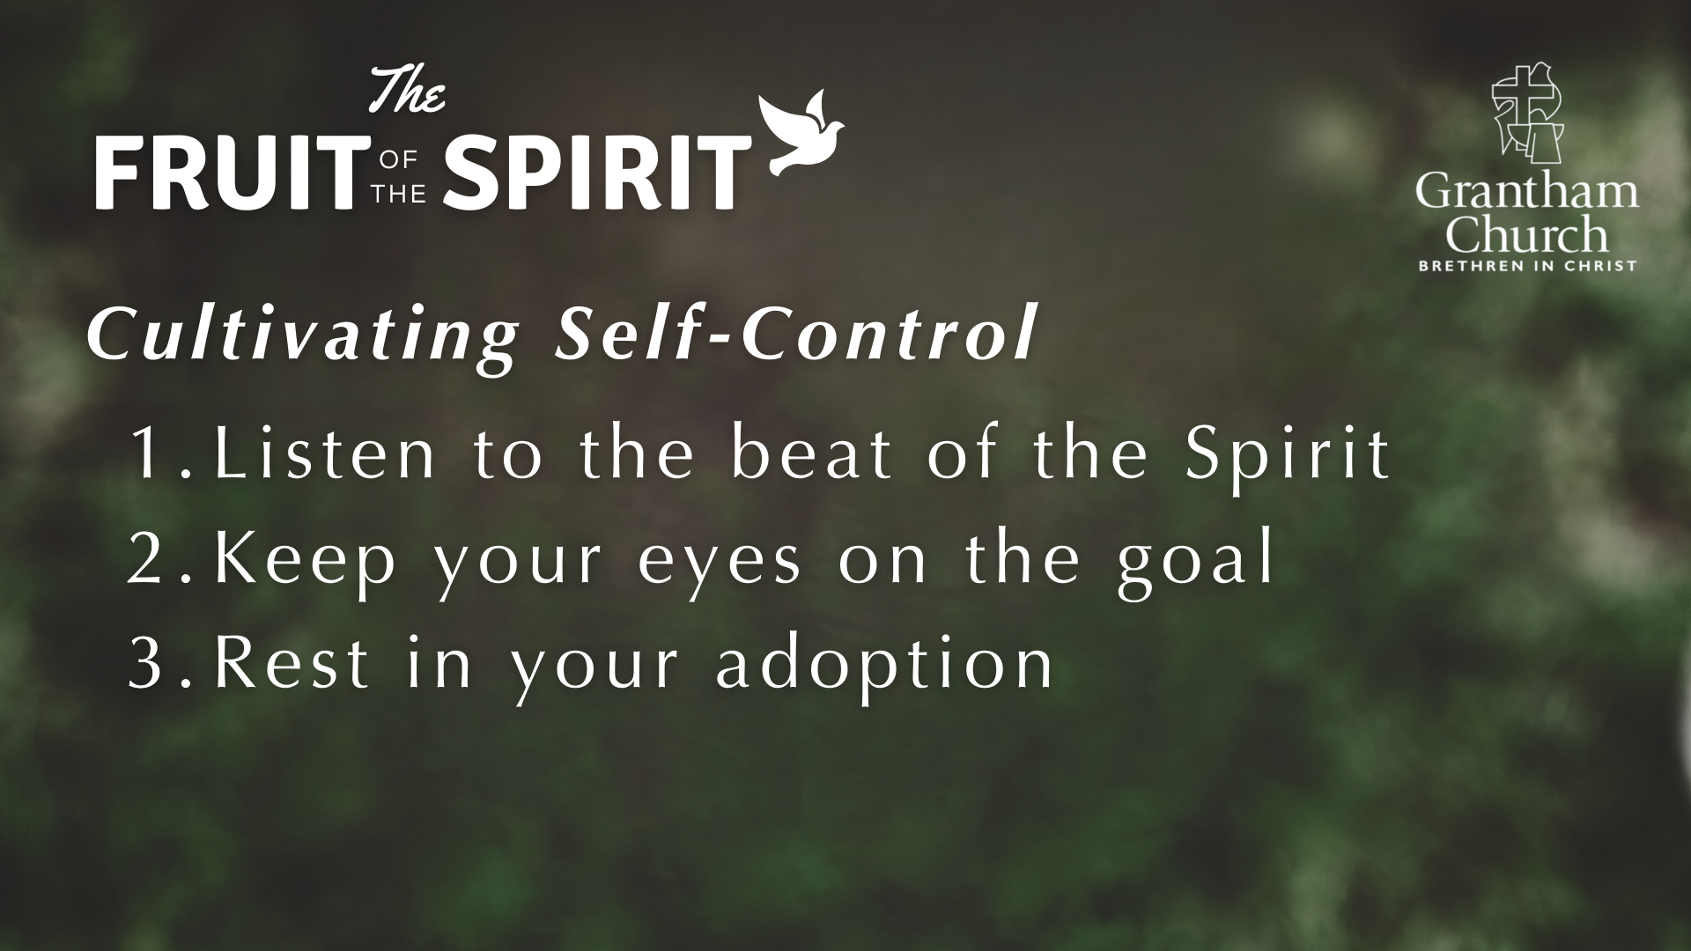

Slide 15
¹⁴ For those who are led by the Spirit of God are the children of God. ¹⁵ The Spirit you received does not make you slaves, so that you live in fear again; rather, the Spirit you received brought about your adoption to sonship. And by him we cry, “Abba, Father.” ¹⁶ The Spirit himself testifies with our spirit that we are God’s children. ¹⁷ Now if we are children, then we are heirs—heirs of God and co-heirs with Christ, if indeed we share in his sufferings in order that we may also share in his glory.
ROMANS 8:14-17

Slide 16
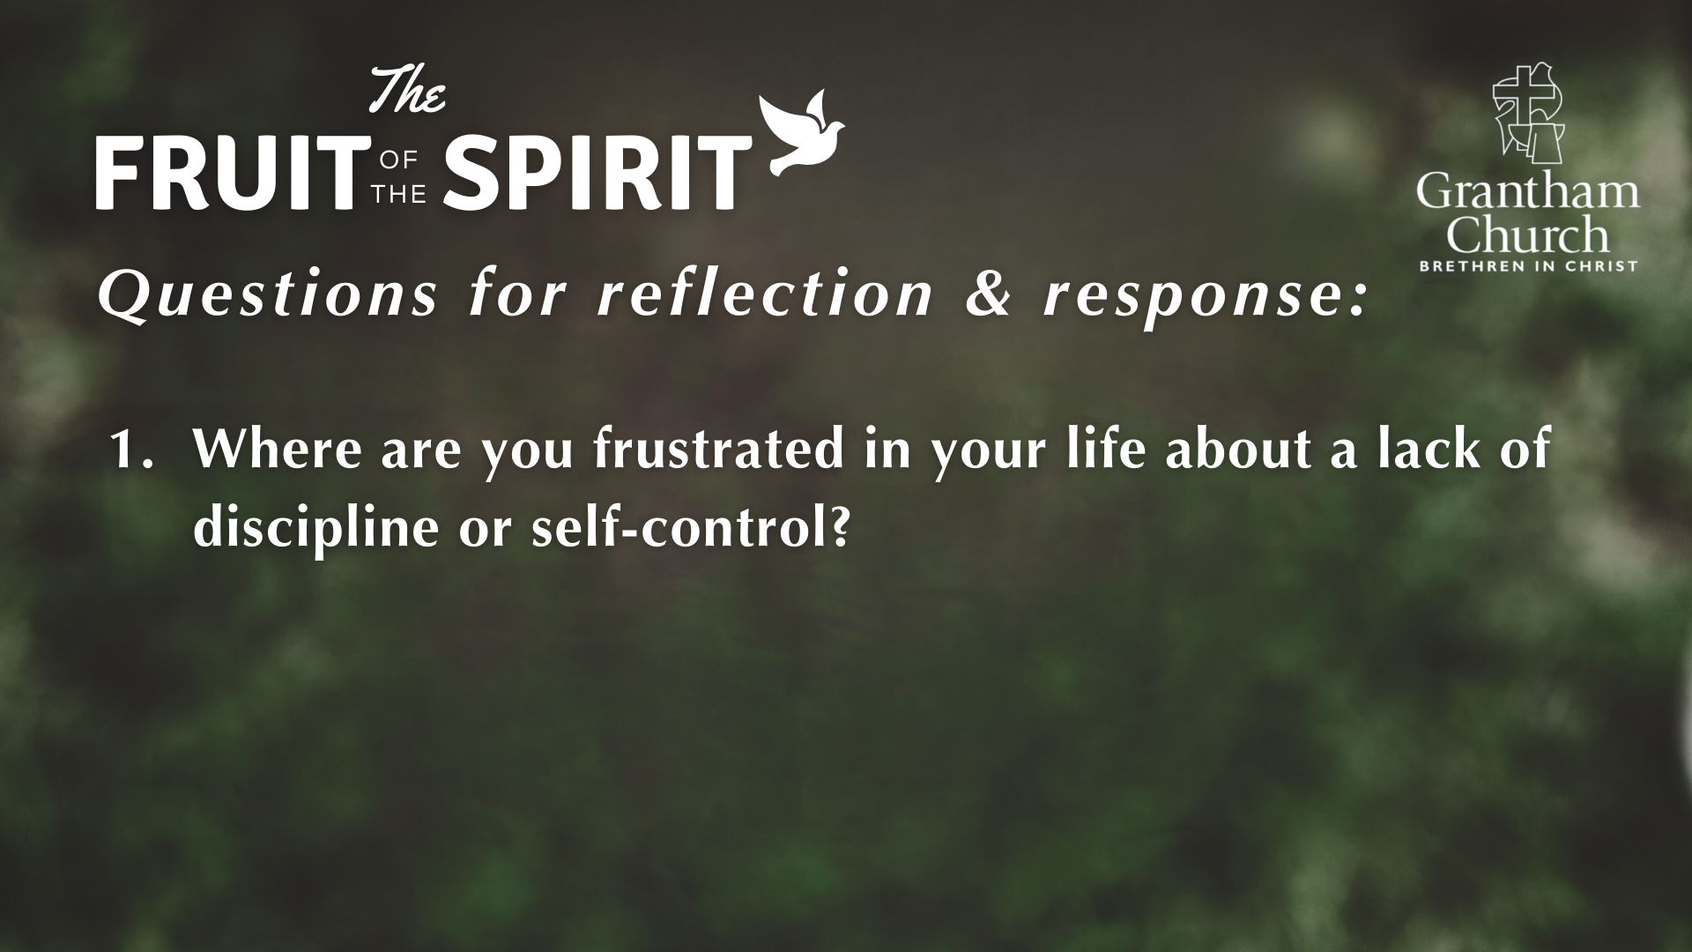

Slide 17
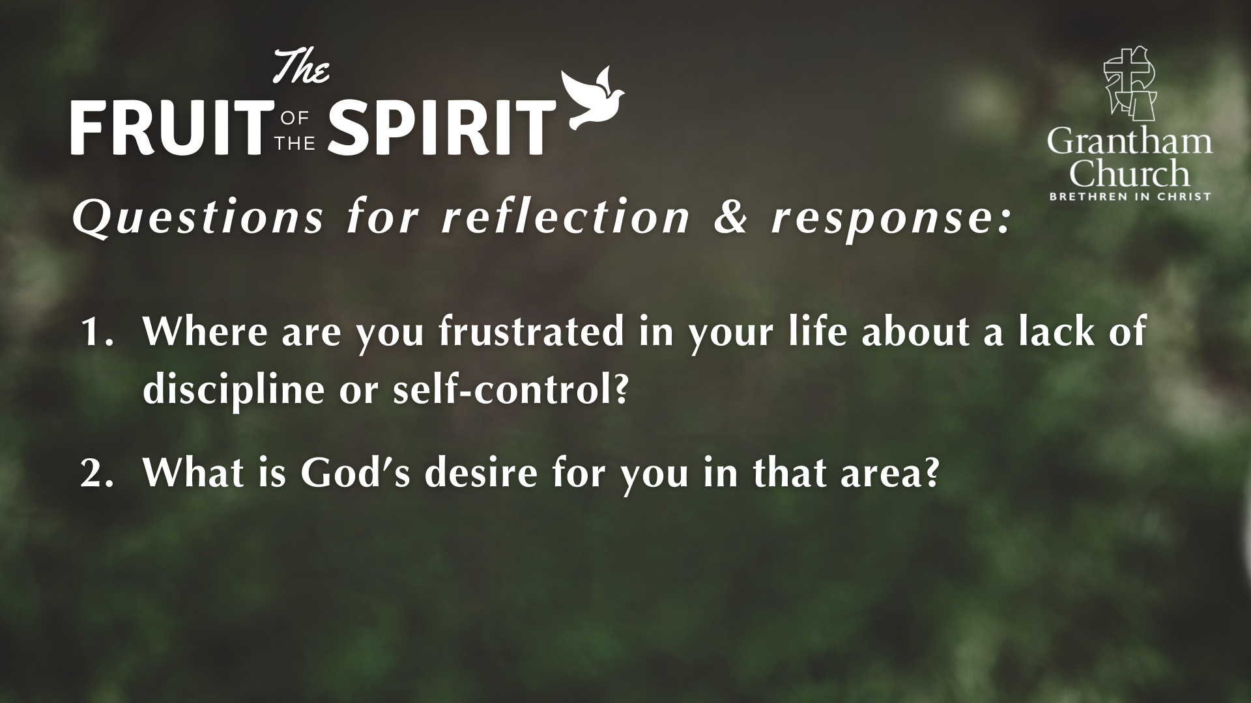

Slide 18
