Slide 1


Slide 2


Slide 3

Scripture Reading
Luke 3:1-18 NIV

Slide 4
Preparing the Way Requires
Repentance

Slide 5
Good News!
You are more sinful and broken than you ever dared believe…

Slide 6
Good News!
You are more sinful and broken than you ever dared believe…
but you are more deeply loved than you ever dared imagine.

Slide 8
Preparing the Way Requires
Repentance
Reform

Slide 9
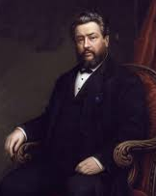
“If you know God offers you his salvation freely, and that there is nothing to do but to accept the perfect righteousness of his Son, then you can feed the hungry and clothe the naked just for the love of God and for the love of people. But if you think you are getting salvation in return for these deeds, then it is yourselves you are feeding, yourselves you are clothing.”
- Charles Spurgeon

Slide 11
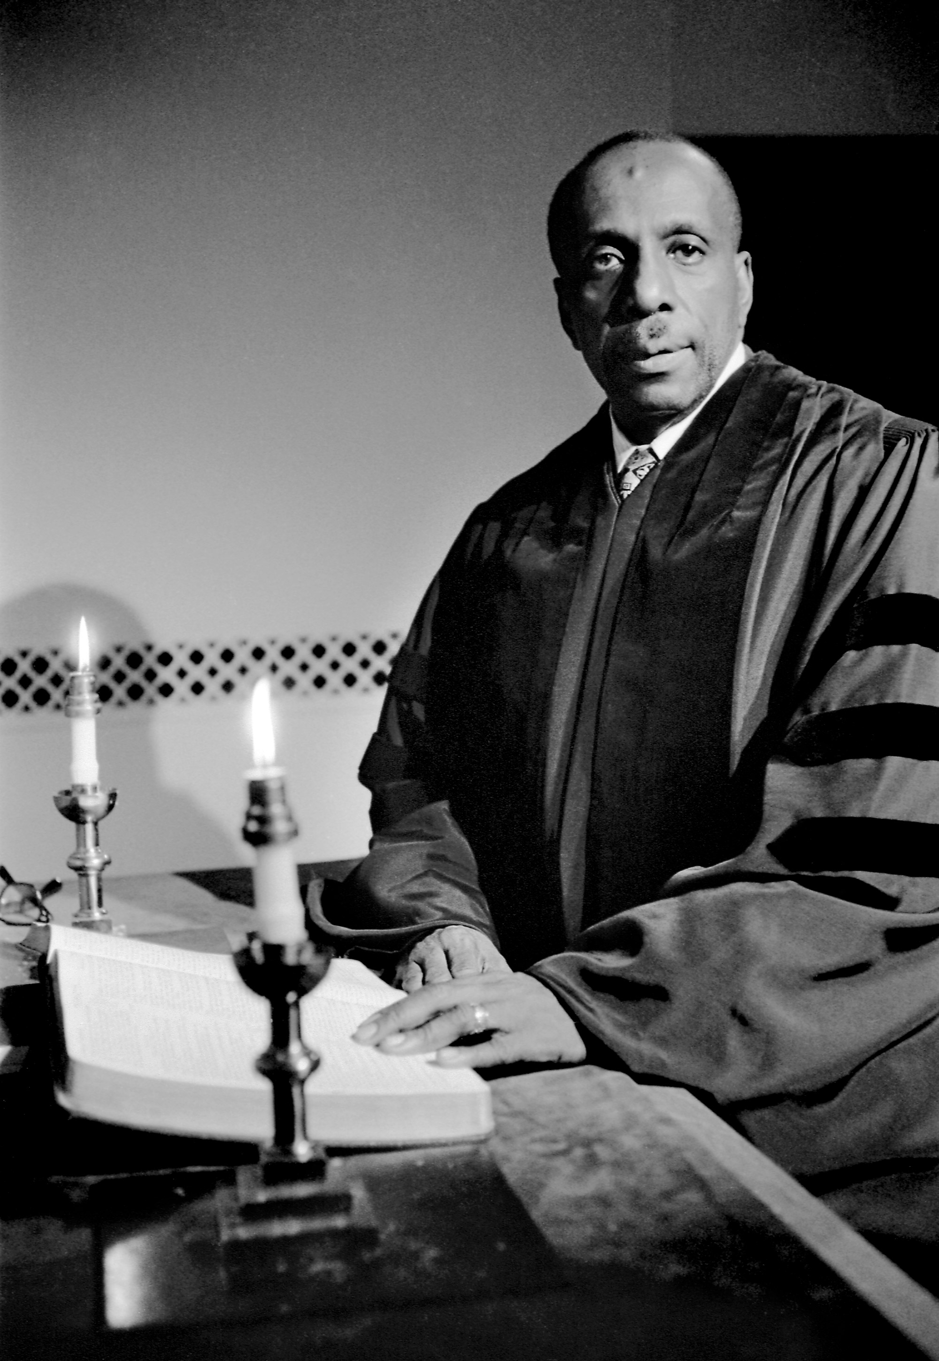
The Work of Christmas
When the song of the angels is stilled,
When the star in the sky is gone,
When the kings and princes are home,
When the shepherds are back with their flock,
The work of Christmas begins:
To find the lost,
To heal the broken,
To feed the hungry,
To release the prisoner,
To rebuild the nations,
To bring peace among others,
To make music in the heart.
Howard Thurman

