Slide 1

Notes:
[BRIEF INTRO]
Sermon Title: The Peace of God for the People of God
Please open your Bibles to the NT book of Philippians… [NEXT SLIDE]

Slide 2

Notes:
[INVITE CONGREGATION TO STAND FOR READING]
[READ THE PASSAGE]
Quick search on the internet…
Nearly 50 million Americans are living with a serious mental disorder today, anxiety disorders are the most common.
These numbers have risen dramatically in the past 2 years with no signs of slowing
Recent statistical reporting is showing record levels of stress and anxiety due to the pandemic, inflation, shipping delays, gun violence, the war in Ukraine, the January 6th hearing, Supreme Court decisions, ongoing culture wars, for Christians—the acceleration of secularism. Then there are rapid changes to societal norms, technology, climate change, increasing political polarization, global uncertainty… and the list goes on! If you weren’t stressed already, you probably are now, right?
That’s why I believe the Spirit wanted me to remind us this morning of the peace we have in Christ… [NEXT SLIDE]

Slide 3
John 14:27 NIV
“Peace I leave with you; my peace I give you. I do not give to you as the world gives. Do not let your hearts be troubled and do not be afraid.”
Notes:
The verse in context
I think it’s fair to say that most folks want peace today. Lots of folks want peace, but on their terms.
Even the evil emperor in Star Wars believed in peace: “Once more the Sith will rule the galaxy and we shall have peace.”
Clearly, how we seek to achieve peace varies (e.g., money, materialism, sex, status, power, or force lightening, etc.)
But Jesus’ peace comes to us and is made known on the earth much differently; it doesn’t come by giving in to our flesh, always getting what we want, or acting out of our hate and anger, using force (even violence) to get at peace. It does not and will not ever come about by living out of our amygdala (fight or flight). No, it doesn’t come through fear!
Remember what the Bible says in 1 John 4:18: “Where God’s love is, there is no fear, because God’s perfect love drives out fear.” And so, we want to know the God who is love and experience this love that drives out fear and enables us to access God’s peace. For it’s this peace that God wants to give us, not only for our own health and flourishing, but also so that we might be makers and givers of his peace in the world. It’s one way we are to be salt and light in the world, as Jesus said in Matthew 5.
And so, as we consider where we are as followers of Jesus today, living in an American empire—a modern-day Babylon or Rome—I believe we can find words of challenge and of comfort to us through Paul’s letter to the Philippians. [NEXT SLIDE]

Slide 4

Notes:
[BRIEF COMMENTS ON PHILIPPIANS]
Philippi was a Roman colony in ancient Macedonia – 10,000 people
Largely inhabited by retired Roman soldiers and other Roman nationalists
There were about 35 pagan deities worshipped there, including the cult of the divine Augustus
Paul had been in Philippi before with Silas – Acts 16 (Lydia, the slave girl, Paul is beaten, thrown in jail)
So, Paul was aware of the political nature of the city – which shows in his letter, as it’s full of politically subversive language (e.g., Christ, savior, gospel, civic life (politeuesthe), citizenship (politeuma) and using the phrase “Jesus is Lord” – every knee will bow!
And of course, Paul will say a few things about the “peace” of God in juxtaposition to the Pax Romana
The Philippian church is a healthy congregation (they recently gave a financial gift to help Paul in prison, likely in Ephesus where he was writing from), but they are facing hardships and experiencing anxiety because of their faith in Jesus, who they said is a rival king with a rival kingdom. Therefore, the Roman nationalists in Philippi are hostile toward them, and so Paul writes to thank them for their financial gift and then encourage them to persevere in following the example of Jesus.
Here are some specific ways that Paul encourages them, as he wants them to know the peace of God in Christ… [NEXT SLIDE]

Slide 5


Slide 6


Slide 7
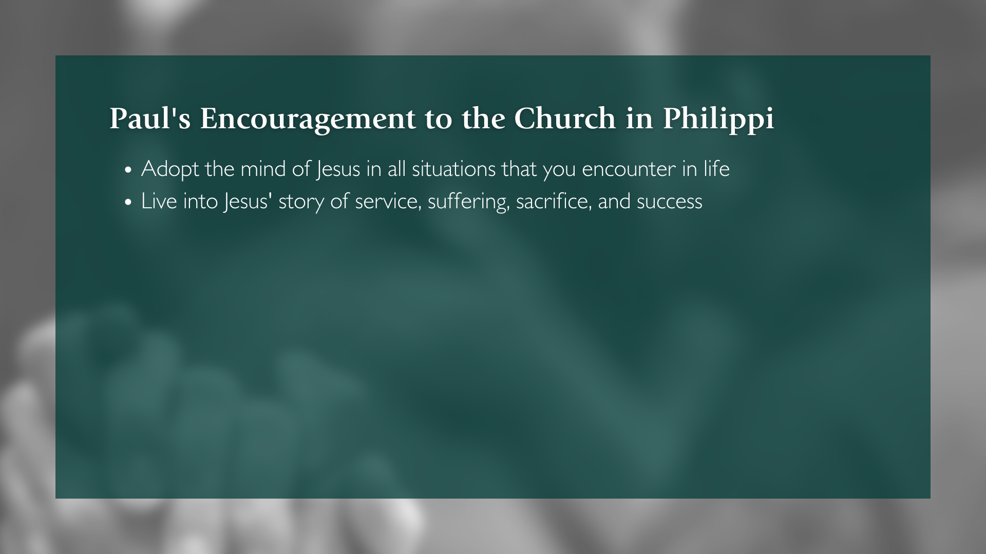

Slide 8
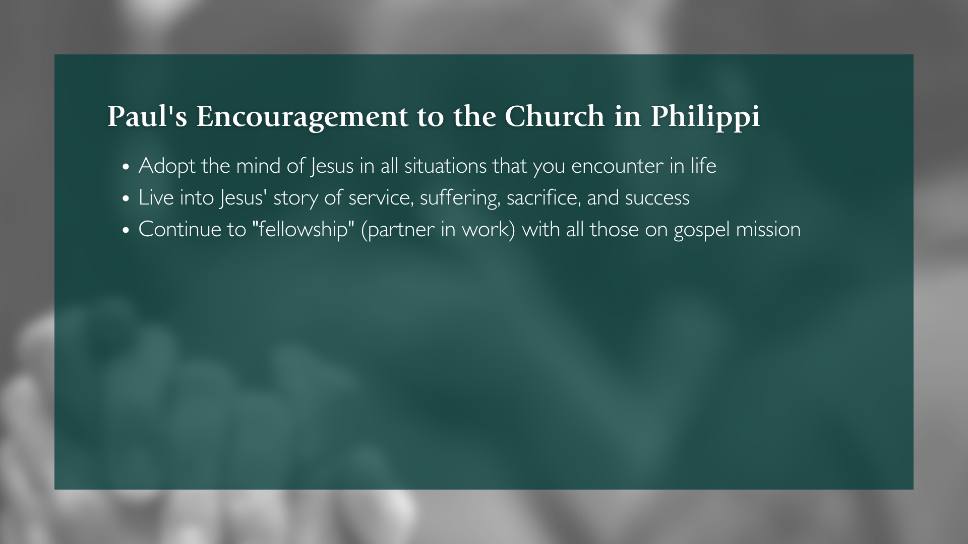

Slide 9
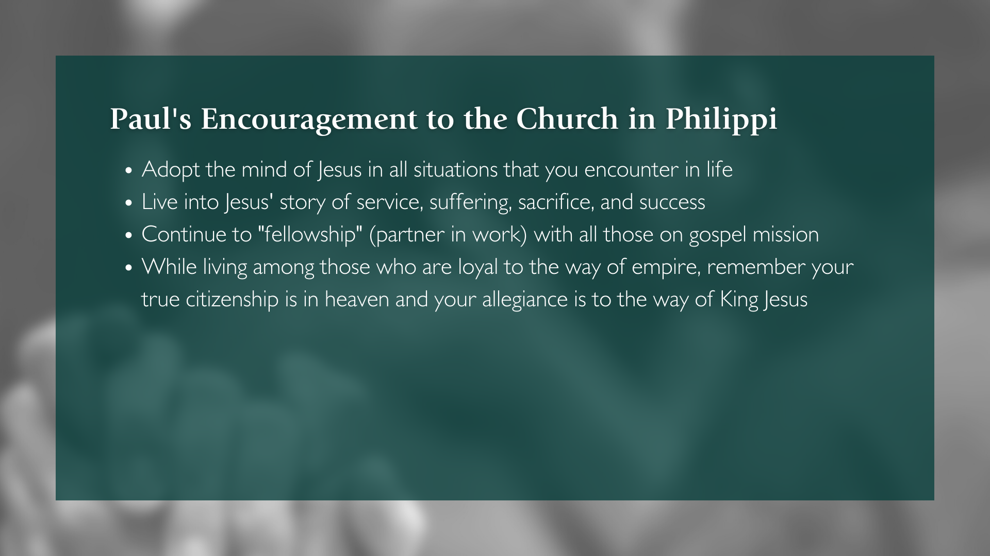

Slide 10


Slide 11


Slide 12

Notes:
[BRIEF COMMENTS ON EACH POINT]
Let’s hear Paul again in Philippians 4:6-9, this time from the Message…. [NEXT SLIDE]

Slide 13
Paul, Philippians 4:6-9 MSG
⁶ Don’t fret or worry. Instead of worrying, pray. Let petitions and praises shape your worries into prayers, letting God know your concerns. ⁷ Before you know it, a sense of God’s wholeness, everything coming together for good, will come and settle you down. It’s wonderful what happens when Christ displaces worry at the center of your life.
Notes:
[READ & COMMENT BRIEFLY]
v. 6 – Paul knows we will worry, so we must be intentional with our thoughts – “take them captive” (2 Cor. 10:5)
v. 7 – “a sense of God’s wholeness” – the idea of “Shalom” (Hb-peace) – complete or whole stone with no cracks, or a wall with no gaps; the core idea: life is complex, full of moving parts, relationships, etc., so any misalignment leads to a lack of shalom/peace.
Verse 8… [NEXT SLIDE]

Slide 14
⁸ Summing it all up, friends, I’d say you’ll do best by filling your minds and meditating on things true, noble, reputable, authentic, compelling, gracious—the best, not the worst; the beautiful, not the ugly; things to praise, not things to curse. ⁹ Put into practice what you learned from me, what you heard and saw and realized. Do that, and God, who makes everything work together, will work you into his most excellent harmonies.
Notes:
[READ & BRIEF COMMENTS]
v. 8 – What are you focused on? Through what lens are you seeing the world?
v. 9 – What have they learned from Paul? The dude is writing from prison!
“who makes everything work together” is getting at this idea of God’s peace
OK. So, you may be thinking… “I get it. We’re supposed to be at peace. God wants me to know his peace, the peace that Jesus gives and the way that Jesus gives it.” And Pastor David, “I hear Paul saying that we need to get control of our thoughts. But how do I do that? How can I access God’s peace this way? Can you give me some practical steps or ideas?”
Yes, I can. I’m really glad that you asked. Here are some ways we can… [NEXT SLIDE]

Slide 15
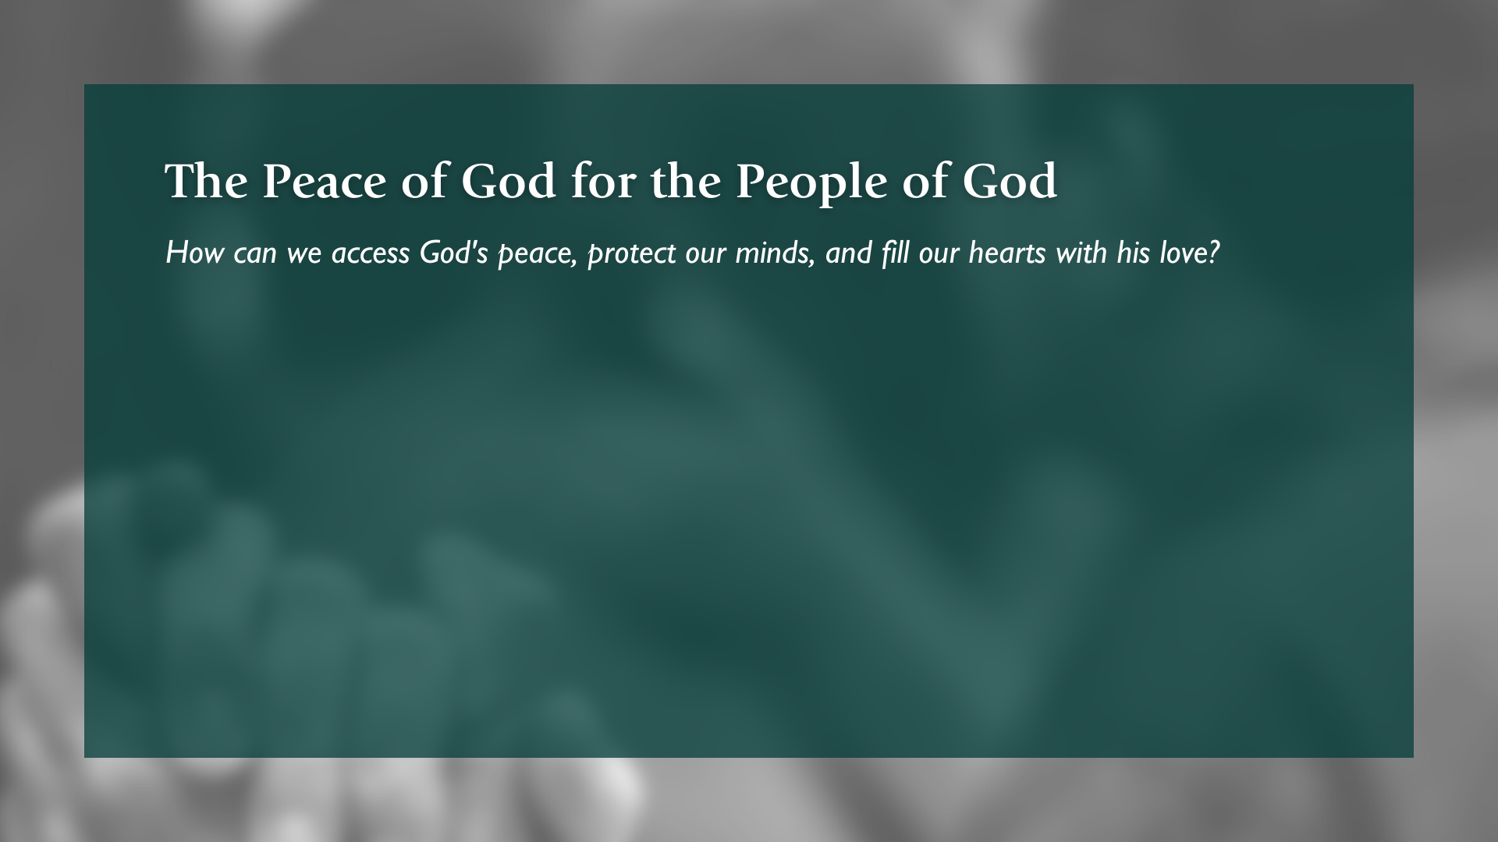

Slide 16
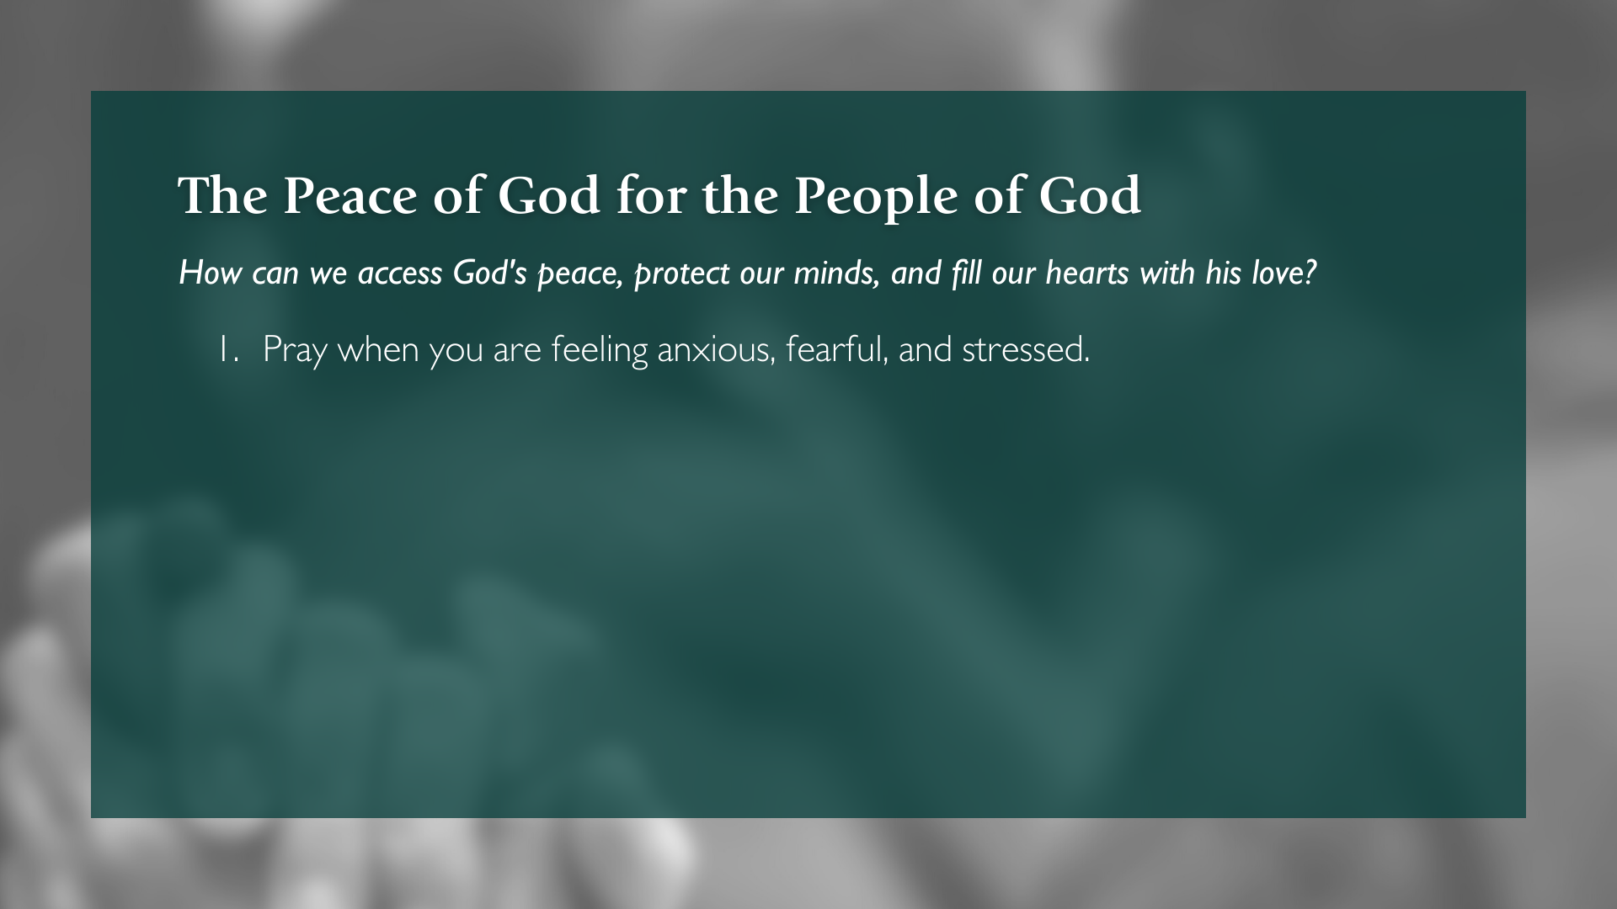

Slide 17
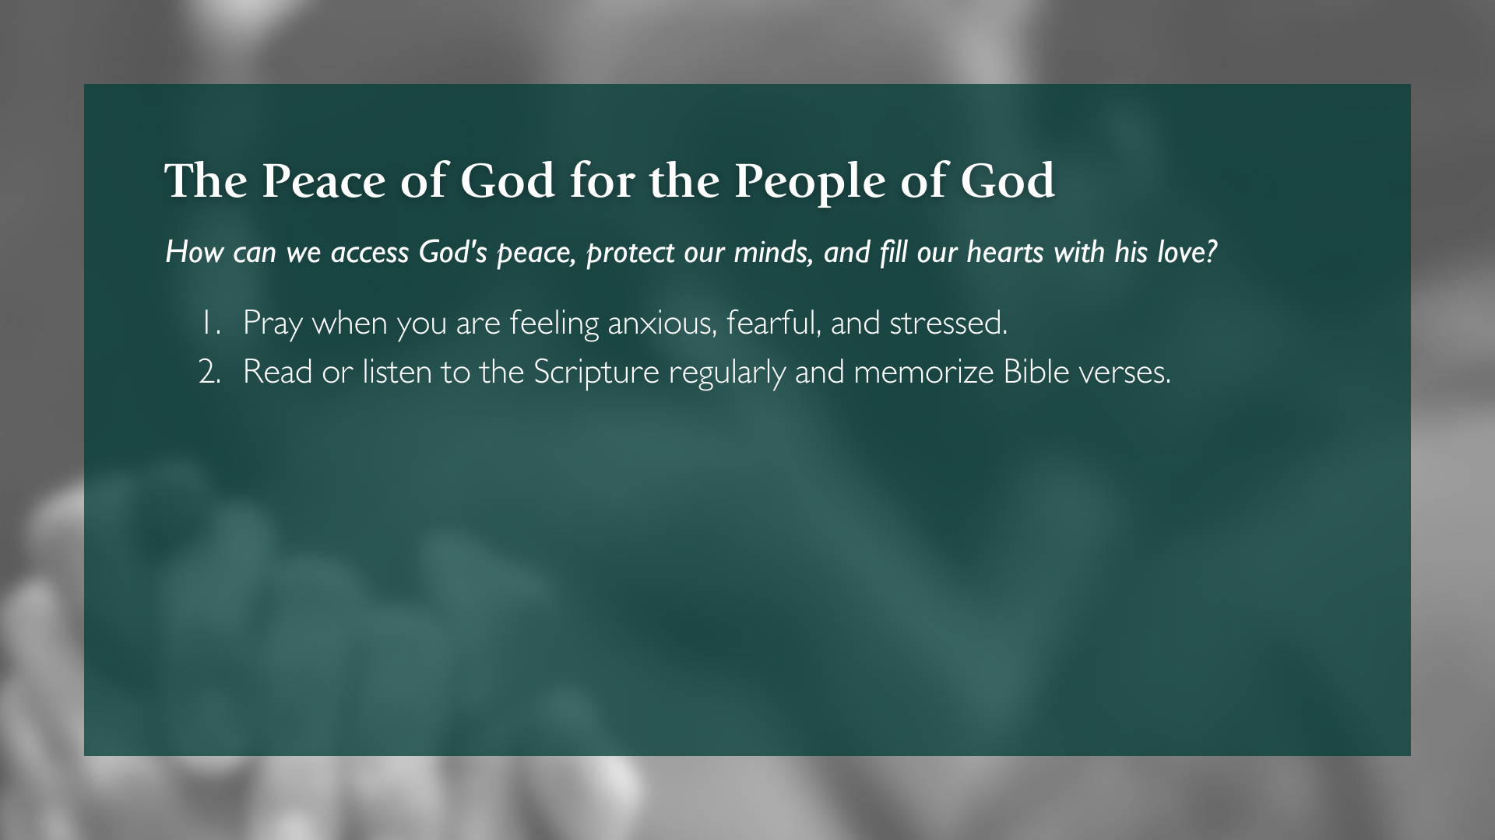

Slide 18
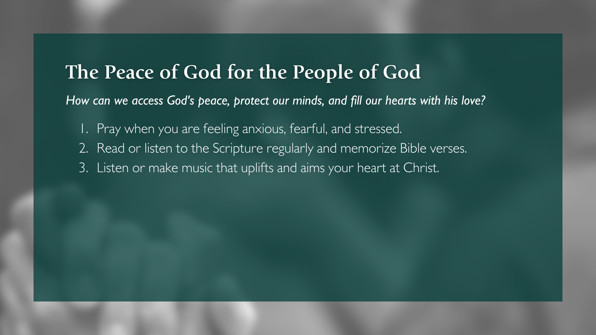

Slide 19
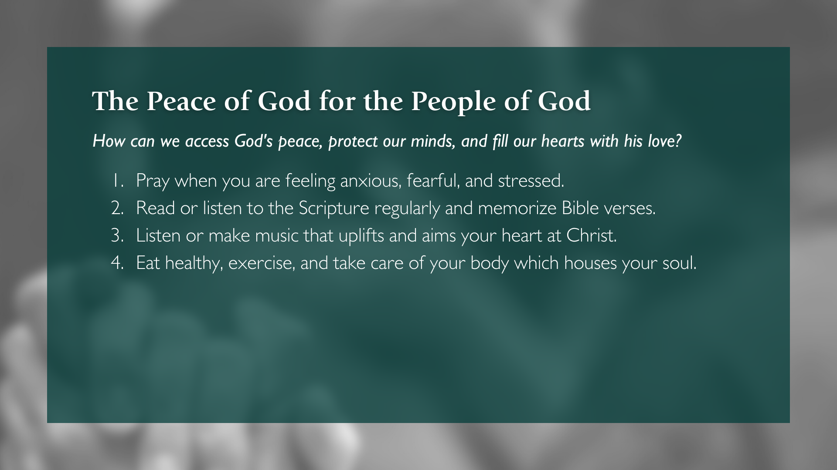

Slide 20
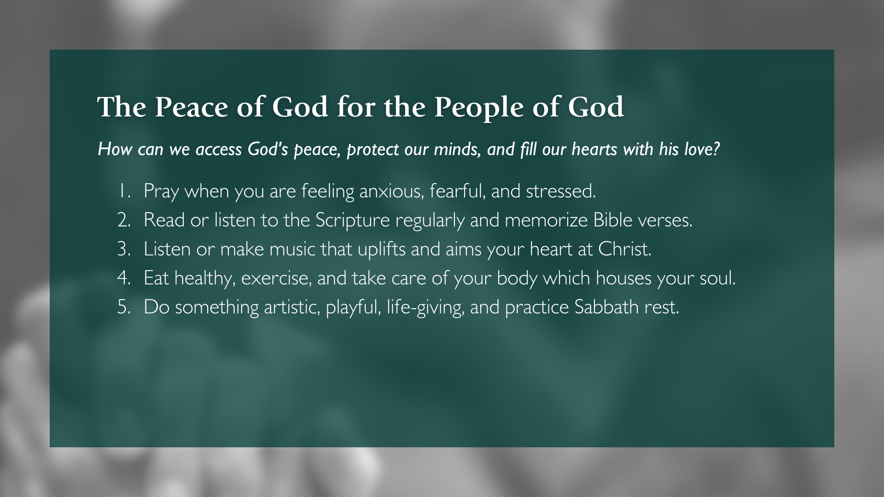

Slide 21
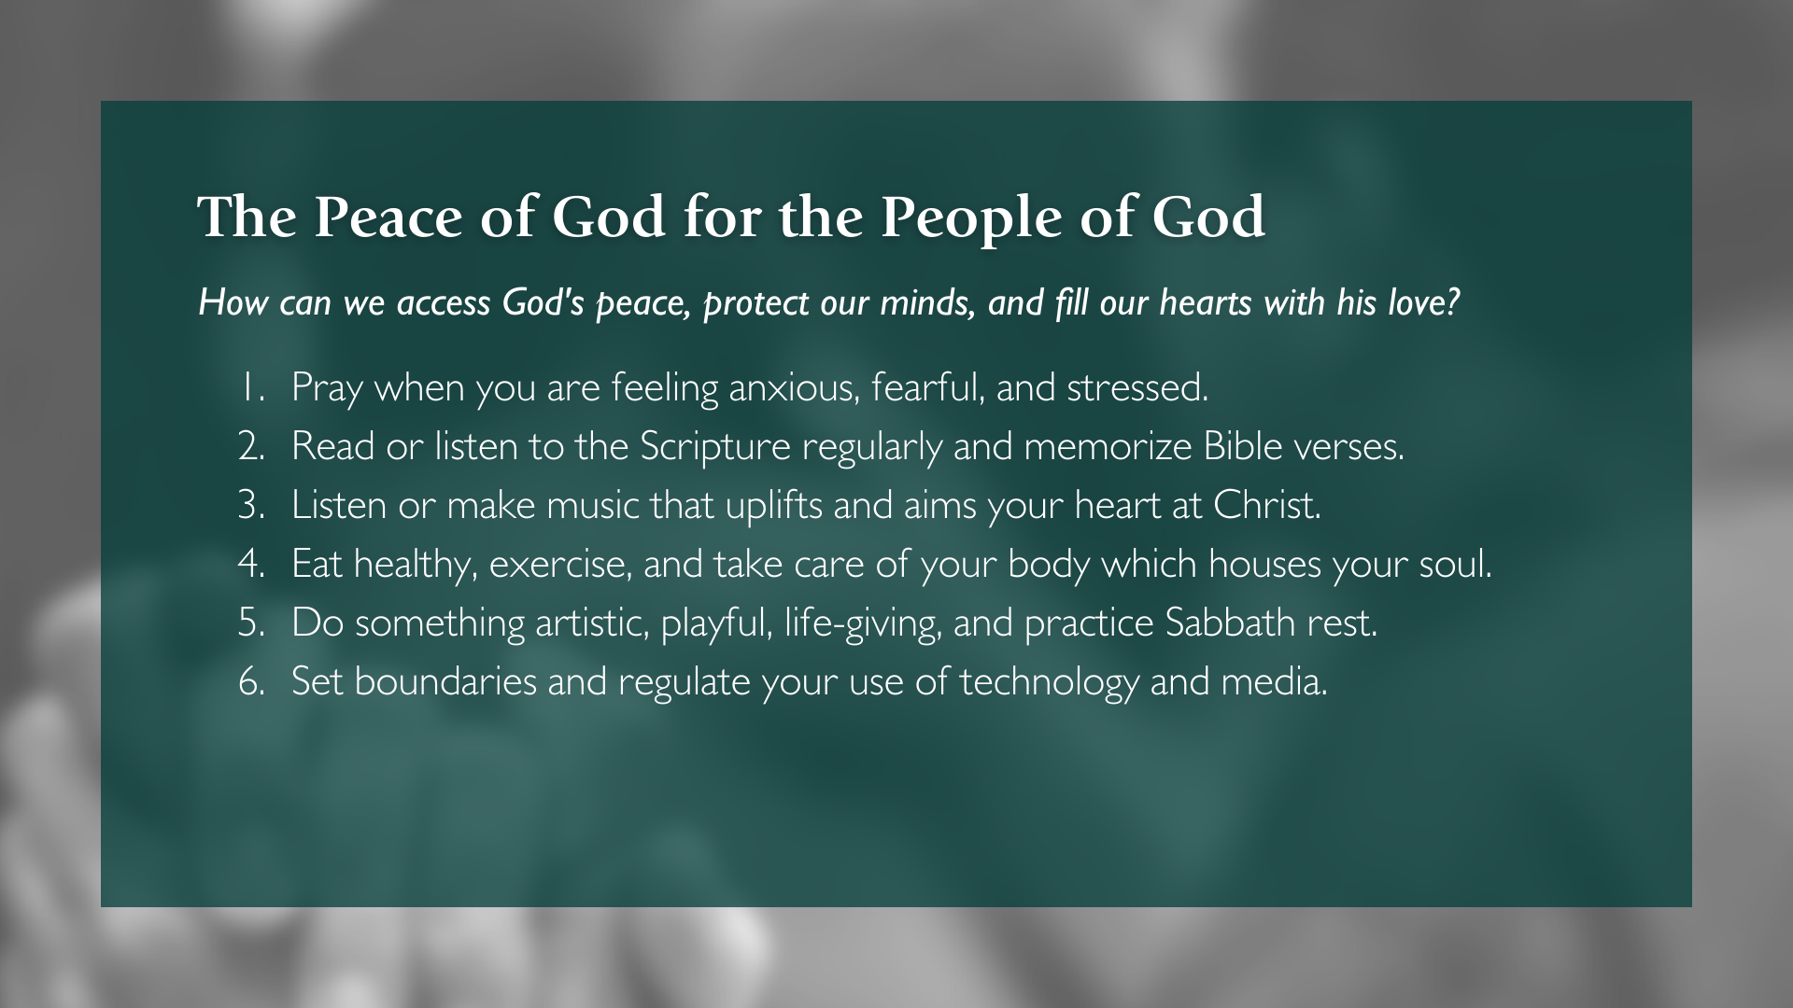

Slide 22
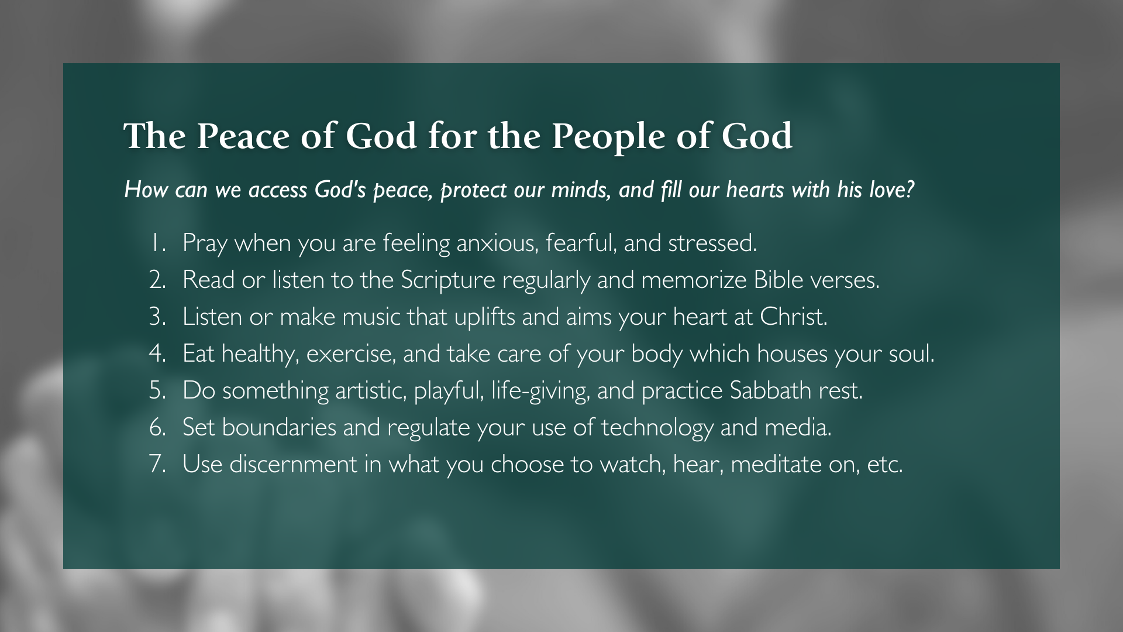
Notes:
[BRIEF COMMENTS ON EACH POINT]
Brothers and sisters, we can do this. Through the Spirit that raised Jesus from the dead, we can win over worry. We can experience God’s peace no matter our circumstances. It’s all a matter of our lenses and our willingness to discover and express the fruit of peace in our lives as growing disciples. Let us do what is within our own power, and then trust God with that which is beyond our control. Only then can we know the peace of God that transcends all understanding and show others the way of real peace in the world.
Finally, listen to what Paul says toward the end of his letter to the Philippians, a passage that will be familiar to many of you… [NEXT SLIDE]

Slide 23
Paul, Philippians 4:12-13 NIV
¹² I know what it is to be in need, and I know what it is to have plenty. I have learned the secret of being content in any and every situation, whether well fed or hungry, whether living in plenty or in want.
¹³ I can do all this through him who gives me strength.
Notes:
[READ & BRIEFLY COMMENT]
v. 12 – Notice, Paul’s contentment reveals a deep level of peace that is available to all of us
v. 13 – “all this” or “all things” is specifically referring to our ability to do the things that God has called us to do, no matter the situation and circumstance. It is only through Christ that we can be who he has called us to be and overcome life’s hardships, come what may
Like the apostle Paul, may we believe this so that we might be comforted and encouraged until Christ comes again to set establish his Kingdom forever, to right the wrongs, to heal what is broken, and to make all things new. Amen? To help us reflect and respond to what the Spirit is saying to us through this message, here are a few guiding questions… [NEXT SLIDE]

Slide 24
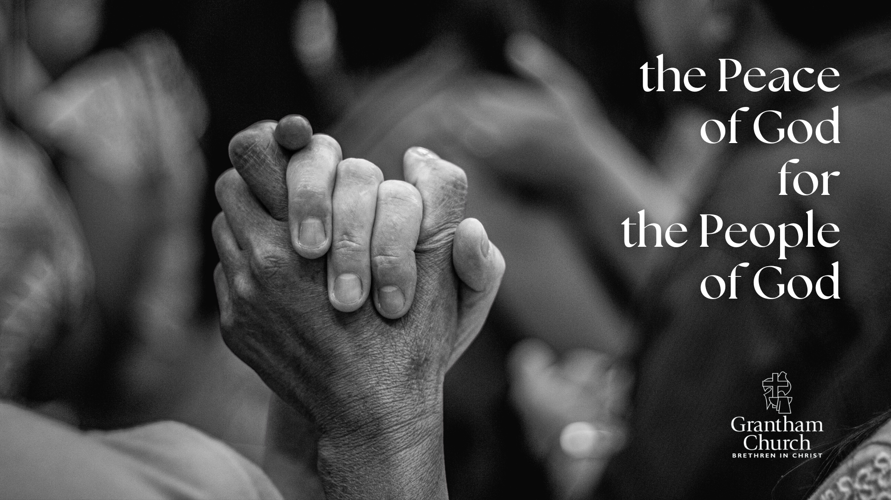
Questions for reflection and response:

Slide 25
Questions for reflection and response:
Where are you lacking the peace of God in your life? How are you feeling anxious, stressed, fearful, etc.?

Slide 26
Questions for reflection and response:
Where are you lacking the peace of God in your life? How are you feeling anxious, stressed, fearful, etc.?
Instead of dwelling on the trouble in your heart and mind, and in the world today, how can you be intentional in giving your worries and fears to God?

Slide 27
Questions for reflection and response:
Where are you lacking the peace of God in your life? How are you feeling anxious, stressed, fearful, etc.?
Instead of dwelling on the trouble in your heart and mind, and in the world today, how can you be intentional in giving your worries and fears to God?
How is the Spirit inviting you to access God’s peace, protect your mind, and fill your heart and mind with his love?
Notes:
[BRIEF COMMENT ON EACH QUESTION]
[CLOSING WORDS]
[NEXT SLIDE FOR CLOSING PRAYER]

