Slide 1
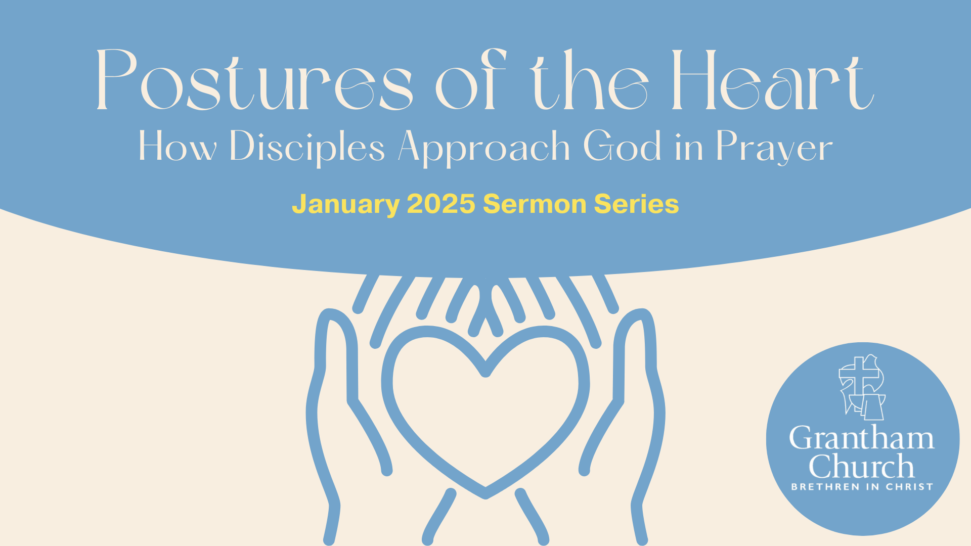
Notes:
[BRIEF INTRO]
This is message 3 in our 3-part January sermon series – Postures of the Heart: How Disciples Approach God in Prayer
Melissa, our Discipleship Pastor, began our series by inviting us to consider the importance of approaching God with reverence and humility, so that we can see ourselves rightly before a holy God, receive his grace, and respond with repentance and submission to his will. And then last Sunday, our guest speaker, Renee Blanchard, shared about how we have the privilege to approach God with confidence because of who we are in Christ. When we understand God’s power and embrace our true identity, we are empowered to pray boldly.
Which brings us to today’s message, The Posture of Trust: Praying with Authenticity. Please grab your Bible and open up to the first of several primary Scripture texts we will be looking at this morning… [NEXT SLIDE]

Slide 2
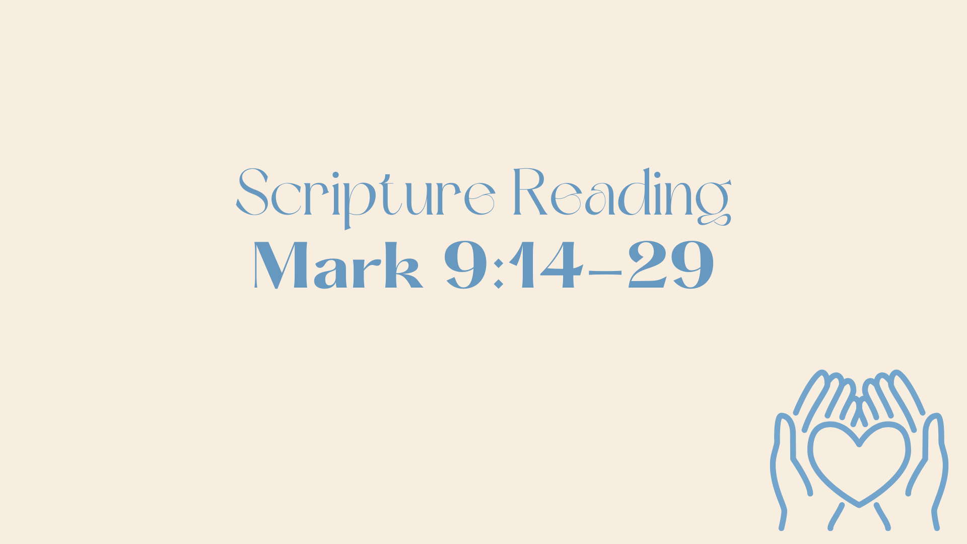
Notes:
[MARK 9:14-29 NLT - CONGREGATION STAND - READ SCRIPTURE]
“This is the word of the Lord… Thanks be to God.” You may be seated.
[QUICK VERSE-BY-VERSE EXPOSITION OF THE TEXT]
v. 23 – “If I can?” The man doubts Jesus because of his experience with the disciples
v. 24 – “I do believe. But help me overcome my unbelief!”
v. 29 – “This kind can be cast out only by prayer.”
This episode in Mark stresses and highlights some important theological truths for us. First off, the spiritual realm is real and we need God’s help to cast out the darkness. Second, while some of Jesus’ disciples (i.e., the church) may disappoint you, Jesus will not. And thirdly, despite our doubts, through faith (trust) and prayer, everything is possible with God.
And of course, we should always be mindful of what the gospel writers are revealing about the character, person, and portrait of God that we see in Jesus. Because our portrait of God will make or break our faith. I, like many of you, know this from personal experience… [NEXT SLIDE]

Slide 3
Notes:
Most of you know my story… I grew up in a conservative Southern Baptist Church in East Texas. In some ways it was fundamentalist, though I can point to other churches that were far more so. Like many of us, understanding my religious upbringing and worldview started to come into focus in college, and, at first, I was upset by the more troubling aspects of that upbringing, e.g. seeing through the legalism, the hypocrisy, the disregard for context in the Scriptures, and not allowing Christ to show us what God is really like.
But having said that, I don’t want you to think that it was all bad, or that I’m not extremely thankful for my parents having me in church as a child. I’m eternally grateful for the good memories, the positive influences, and a grounding in faith, despite the junk along the way. Because the truth is, none of us can escape the junk. My own kids will learn some things from Lanna and I that they will need to rethink and relearn in order to better follow Christ in their generation, if they continue to make our faith their own, which I hope and pray they do.
So please hear that. I say that for all of us here, and for any family members who might be listening to this through our podcast. I love my family and I’m thankful for them. But most of all, I’m thankful for a God who can use every experience for our good. Amen?
Having said that, I want to tell you that while I take full responsibility for my teenage rebellion, I think that there were certain things going on in my life that led me to want to distance myself from God and the church. For me, it had much to do with the portrait of God that I was being shown through the overall experience of my family and the church. And specifically, through the men in my life. What do I mean?
Well, it was a non-existent relationship with my dad, it was the fire and brimstone preaching and the psychological-certainty model of faith, it was the Pharisaical approach to moral issues and matters of conscience, it was seeing that most of the men I knew were overbearing, hot-tempered, and wanted to lay down rules without any relationship, from the preacher to the baseball coach. And for a hormonal teenager that wanted to know he is loved without condition, that wanted to be affirmed and valued for who he was, it was all too much to bear, especially when you project all of those experiences onto God and he becomes a cosmic projection of dad, grandpa, and the coaches who shamed me when I made an error on the ballfield. Maybe some of you can relate.
You see, I was told plenty of times that God loved me, that Jesus wanted to be my ”personal” Lord and savior, and I believed that and do think I had some real personal experiences. But what won out over what I was told and taught was the portrait of God that was produced through my family, church, and other authority figures in my life over those first 16-17 years. This had shaped my thinking and set me up to rebel against it.
And that’s why I talk about this repeatedly with conviction. And it’s why I like to share this quote from the pastor and theologian, A.W Tozer… [NEXT SLIDE]

Slide 4
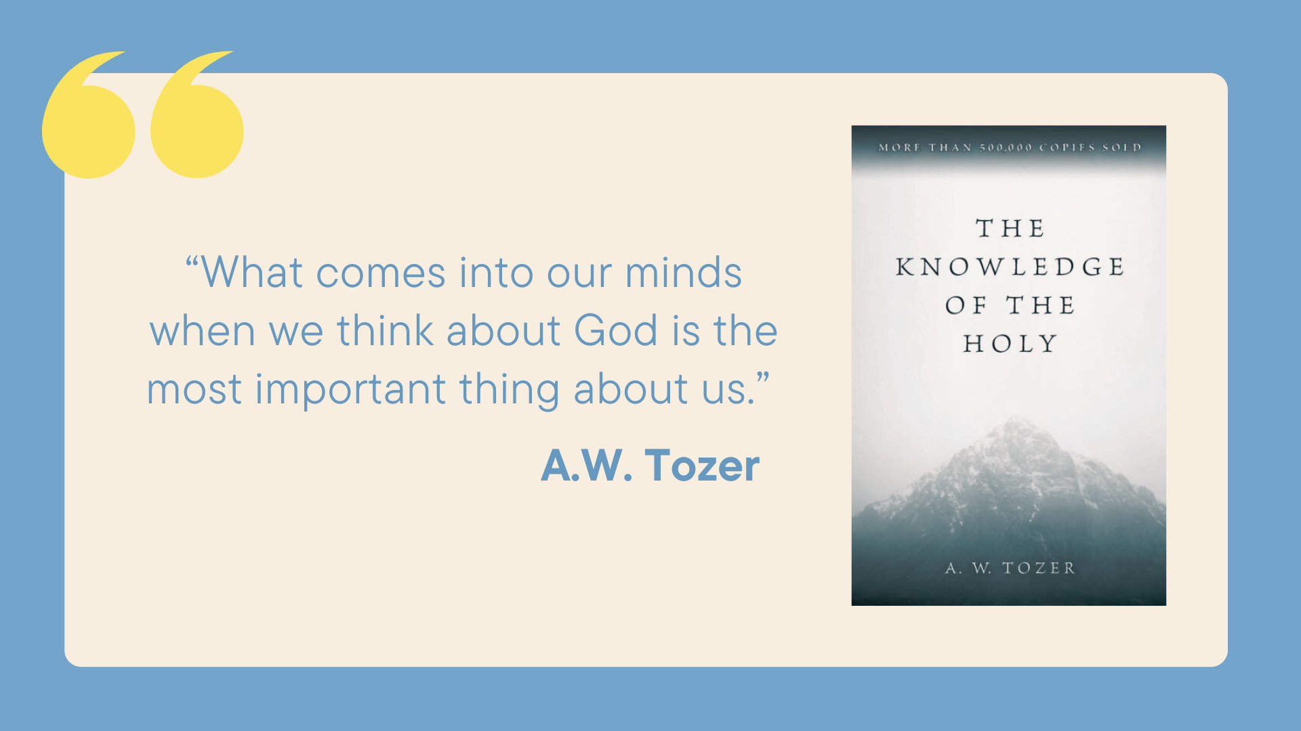
Notes:
[READ QUOTE & COMMENT]
And as much as we hear about God being love, and the Christian teaching that Jesus shows us what God is like, many people in America, even in the church, form thoughts about God from various competing portraits and concepts that do not look like Jesus. Here is some compelling evidence for that.
I’ve mentioned this book before… [NEXT SLIDE]

Slide 5
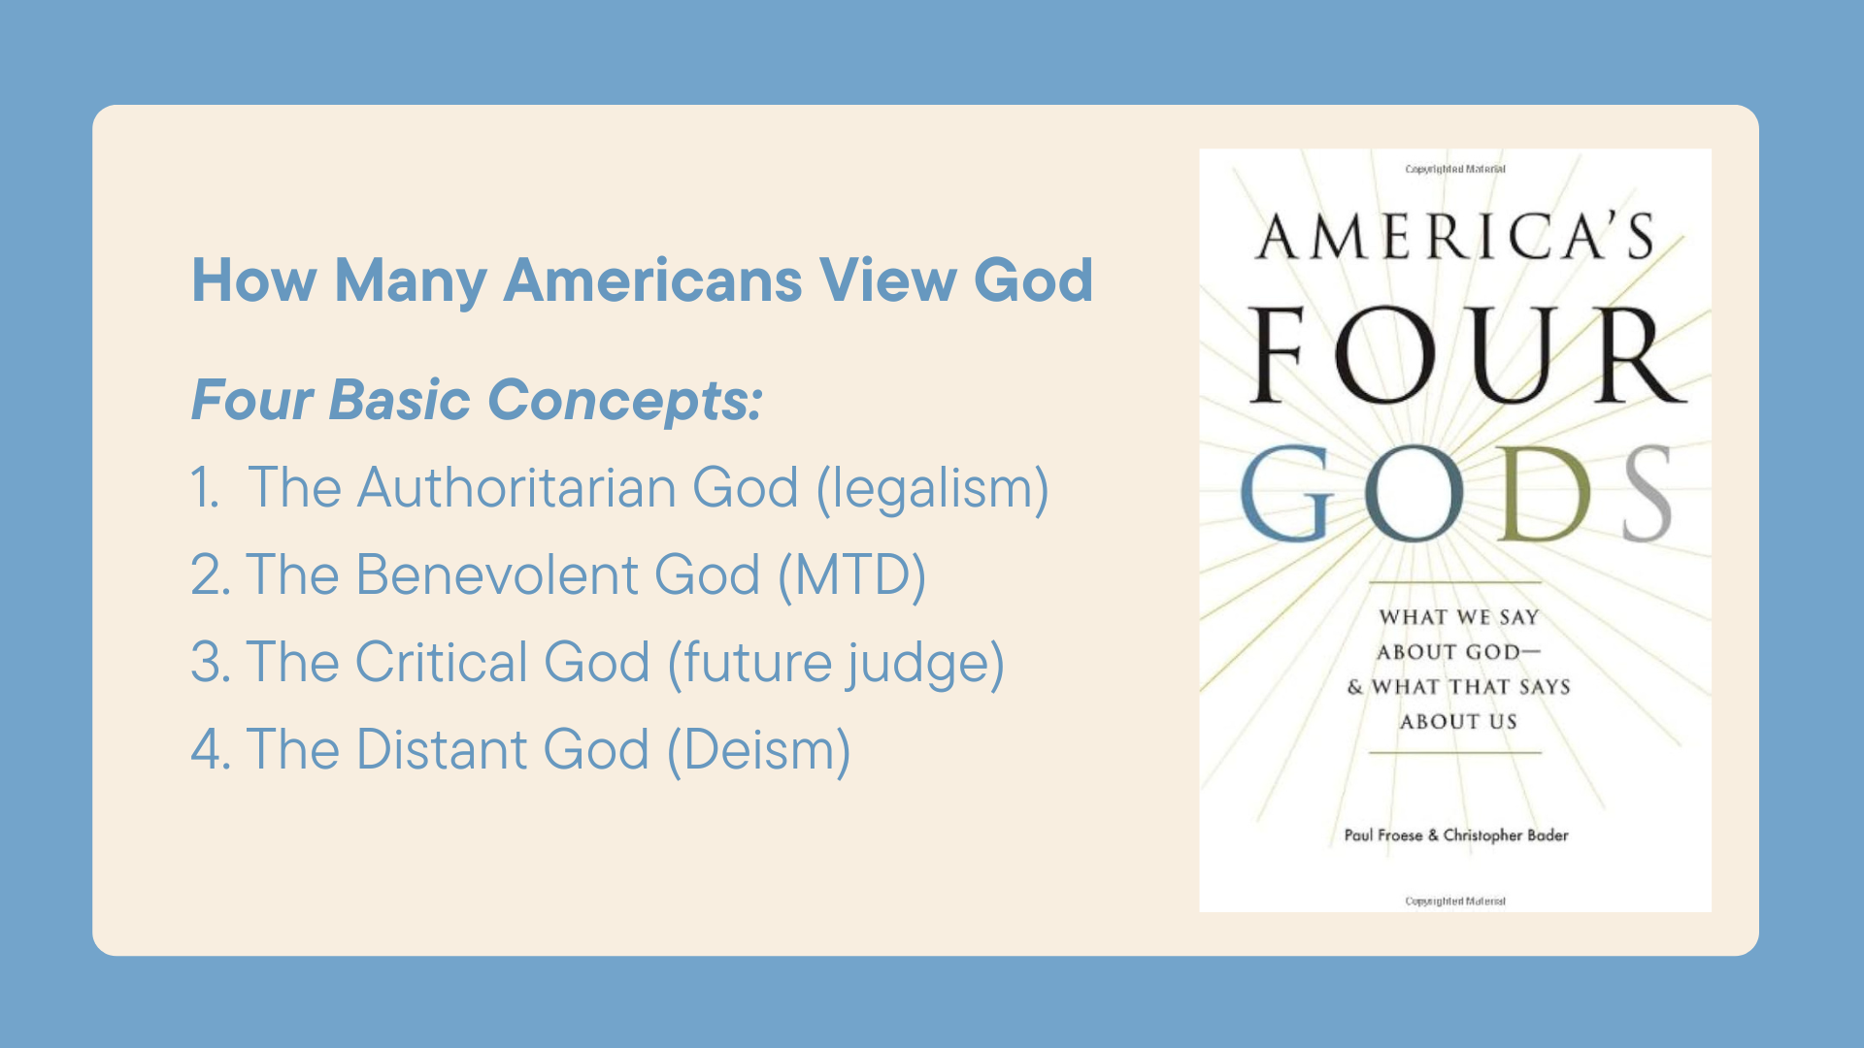
Notes:
About 10 years ago, two Baylor sociologists, Paul Froese and Christopher Bader, set out to get America’s thoughts about God. They share their findings in their book, “America’s Four Gods: What We Say About God & What That Says About Us,”
They found that while 95% of Americans believe in God, we apparently have vastly different conceptions of the divine and the role God plays in our daily lives. As a result of their research, they divide these images into four basic concepts. I’ve listed these four ideas, but I’m going to add a few extra thoughts based on my own observations about these concepts.
1. The Authoritarian God: In this view God is like a drill-sergeant father; He is a God of control to be feared. He’s engaged as a positive force in the world but he’s also as a judge of the behaviors of humankind. So, you best not step out of line, or else.
2. The Benevolent God: This God is mainly a God of love and force for good in the world. He’s a being who answers the prayers of individuals and comforts the suffering. A rising number of Americans are accepting this view, which is certainly good in one respect, but as the sociologist Christian Smith has pointed out, much of American culture today is embracing what he calls a Moral Therapeutic Deism, where God just wants you to try and live a decent life, be happy, and not be burdened with any religious obligations or demands from on high, certainly not from a God-man claiming to be the only way to the Father.
Then there is #3 The Critical God: In this perspective, God is less likely to be concerned with every moment and situation in the lives of individuals, instead, he will save his work for when it comes to pronouncing judgments in the next life. The authors point out that this seems to be a popular image among the poor and oppressed. Of course, we can find this critical God concept in our well-to-do families and churches as well.
And finally, there is #4 The Distant God, where the supreme being is a cosmic force that sets the laws of nature in motion, but does not get involved in day-to-day events or movements. We have historically called this Deism. It was extremely popular at the time of the Founding Fathers, during the time of the Enlightenment. Of course, I think we still find variations of this today, sometimes this one concept is lurking in all of these four views which these sociologists have outlined for us.
So, whether you completely agree that these concepts should be divided up in this way, or that any of these fully capture the God we see in Jesus, what is most telling, and something we should pay attention to, is how we see this connection between how we think about God and the way we think about ourselves, the way we treat others, as well as the way we see things like morality, politics, and prayer.
The authors of Four Gods find that how people view God is one of the strongest predictors of a range of social and moral attitudes. They are saying, when you find out a person’s image of God, you can tell far more about that person and why they think and do what they do, than knowing the individual’s religion or denomination, or what local church they attend.
For example, while you might attend a theologically and politically liberal Mainline church, if you have an Authoritarian view of God, you’re far more likely to vote for a fascist president or believe the idea that God is burning up the LA area because of the sins of Hollywood, than a Southern Baptist who has come alive to the revelation that God looks like Jesus.
So, our concept of God says a lot about us. Because what we think about God determines how we see ourselves and how we treat our neighbors and our enemies. If fact, how we see everything is shaped by our view of God. And as I’ve pointed out recently, our view of God and of reality will impact our prayers. Our understanding of God will help or hurt our prayer life… [NEXT SLIDE]

Slide 6
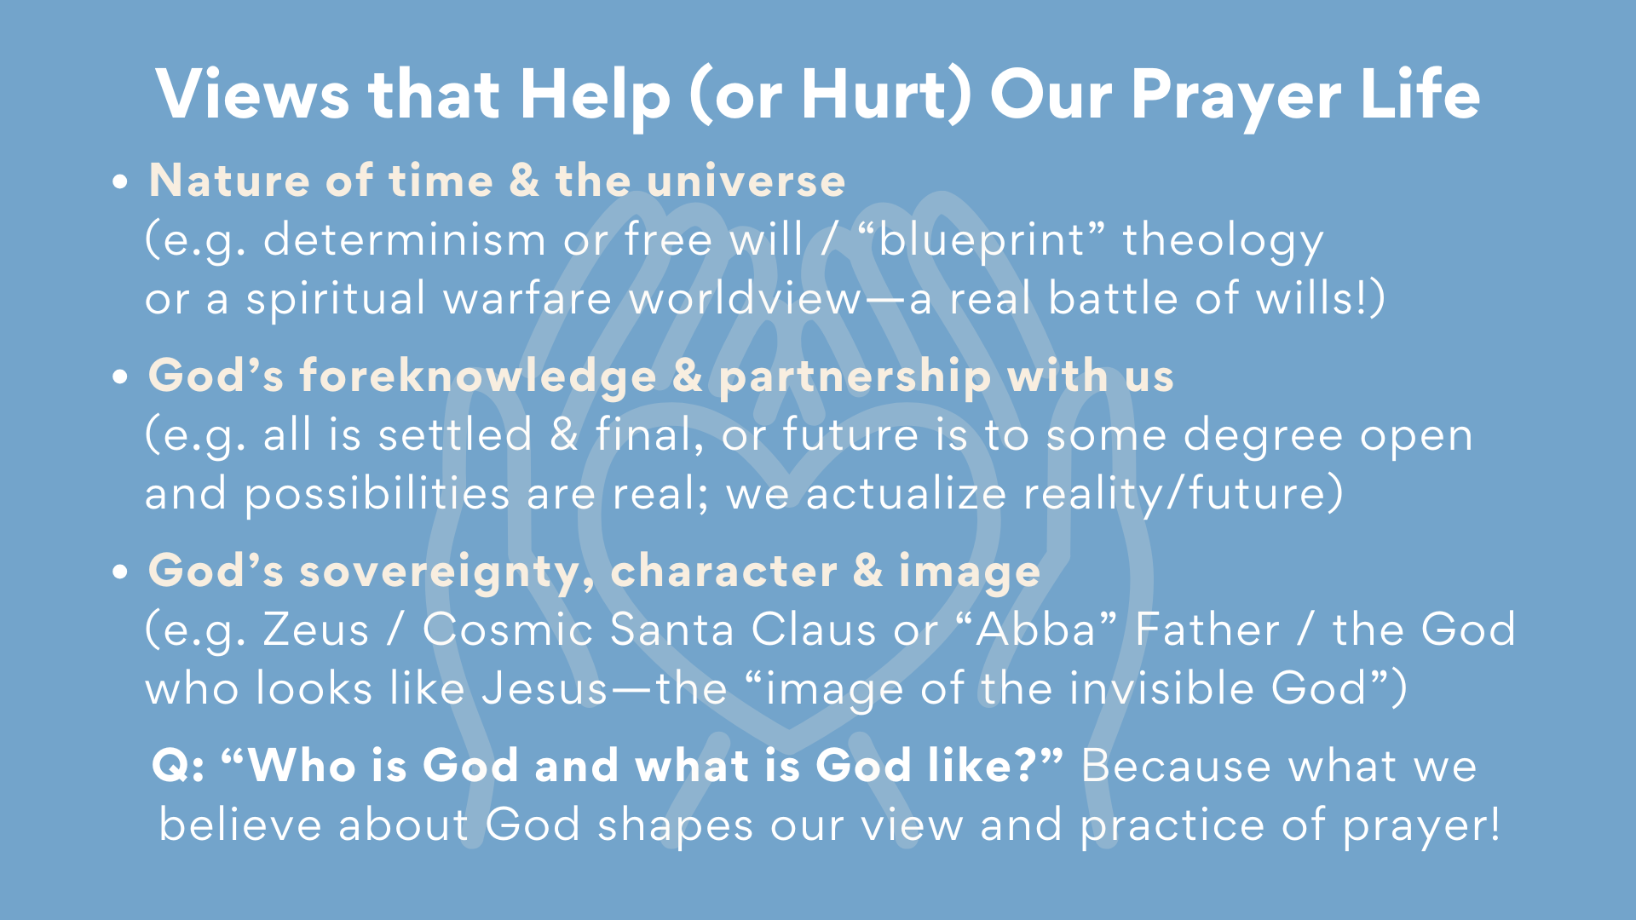
Notes:
[READ & COMMENT ON EACH POINT]
Nature of time & the universe ​
(e.g. determinism or free will / “blueprint” theology or a spiritual warfare worldview—a real battle of wills!)
​
God’s foreknowledge & partnership with us​
(e.g. all is settled & final, or future is to some degree open
and possibilities are real; we actualize reality/future)
God’s sovereignty, character & image ​
(e.g. Zeus / Cosmic Santa Claus or “Abba” Father / the God
who looks like Jesus—the “image of the invisible God”)
Question: “Who is God and what is God like?” Because, again, what we believe about God shapes our view and practice of prayer!
Therefore, we want to allow Jesus to reveal God the Father to us so that we can adopt a posture of trust as praying disciples… [NEXT SLIDE]

Slide 7
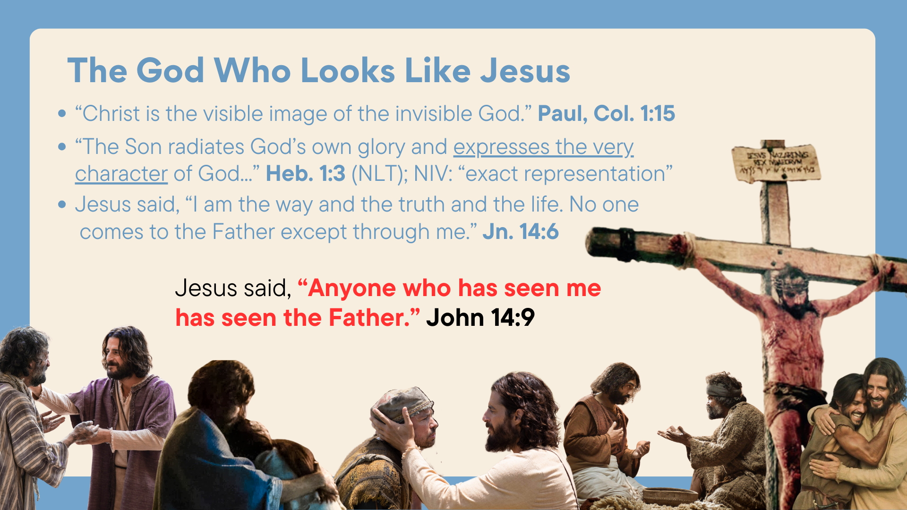
Notes:
[READ & COMMENT]
“Christ is the visible image of the invisible God.” Paul, Col. 1:15
“The Son radiates God’s own glory and expresses the very character of God...” Heb. 1:3 (NLT); NIV: Jesus is the “exact representation” of God
Jesus said, “I am the way and the truth and the life. No one comes to the Father except through me.” Jn. 14:6
Jesus said, “Anyone who has seen me has seen the Father.” John 14:9
And so now… let’s listen to what Jesus says about the posture of trust in prayer… [NEXT SLIDE]

Slide 8
Matthew 7:7-11 NIV
⁷ “Ask and it will be given to you; seek and you will find; knock and the door will be opened to you. ⁸ For everyone who asks receives; the one who seeks finds; and to the one who knocks, the door will be opened.
Notes:
[READ SCRIPTURE & COMMENT]
What are we asking, seeking, and knocking for here? As Scot McKnight says, “Jesus wasn’t naïve; this is part of Jesus’ exaggerated rhetoric, and Jesus knew that his own disciples prayed and didn’t get what they wanted.” And maybe it’s because, as James said, we ask for selfish gain or personal pleasure, not out of real need or to build the Kingdom.
In his commentary on Matthew, N.T. Wright says, “For most of us, the problem is not that we are too eager to ask for the wrong things. The problem is that we are not eager enough to ask for the right things.”
And McKnight goes on to say that Jesus’ point is this: “his disciples are to go to God, ask him, and expect him to respond. Why does he need to say this? Because the disciples are wondering if God will answer their prayers. Thus, 7:7-8 isn’t a promise that everything everyone asks will be given. Instead, it is addressing doubting disciples who need to be assured that God indeed loves them and that they can trust God.”
Why can we trust God? Because he looks like Jesus. And listen to what this Jesus goes on to say in verses 9-11 about why we can trust in the goodness of God… [NEXT SLIDE]

Slide 9
⁹ “Which of you, if your son asks for bread, will give him a stone? ¹⁰ Or if he asks for a fish, will give him a snake? ¹¹ If you, then, though you are evil, know how to give good gifts to your children, how much more will your Father in heaven give good gifts to those who ask him!
Notes:
[READ & COMMENT]
If we are his children, what does this say about…
Our requests – some are granted some are not (God is sovereign & wise)
His character – like a good parent, he will give good gifts and bless us
And so, knowing that this is the God who hears our prayers, we should feel free to come to him as we are and share our hearts through authentic prayers and petitions.
For example, listen to David—the ”man after God’s own heart”—be his authentic self in this recorded prayer found in Psalm chapter 13… [NEXT SLIDE]

Slide 10

Notes:
[READ SCRIPTURE & COMMENT]
David prays with authenticity; pouring out his heart!
David concludes his prayer and song with trust in God’s character
Let’s sum up the message in this way. Based on what we’ve heard today, what does a posture of trust look like in our prayer life? [NEXT SLIDE]

Slide 11
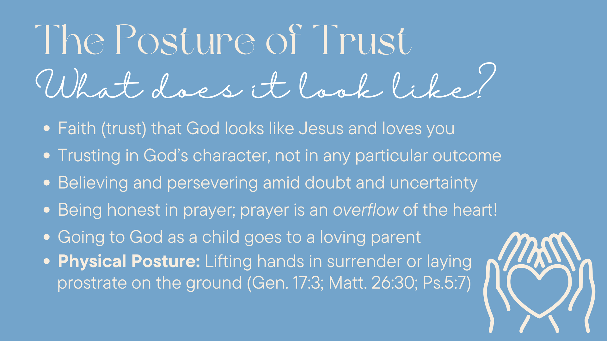
Notes:
[READ & COMMENT ON EACH POINT]
Faith (trust) that God looks like Jesus and loves you *The original temptation was to cast doubt on God’s character!
Trusting in God’s character, not in any particular outcome
Believing and persevering amid doubt and uncertainty
Being honest in prayer; prayer is an overflow of the heart!
Going to God as a child goes to a loving parent
Physical Posture: Lifting hands in surrender or laying prostrate (or bowing) on the ground (Gen. 17:3; Matt. 26:30; Ps.5:7)
Finally, here are some questions to help us reflect on what we’ve heard and respond to the Spirit together… [NEXT SLIDE]

Slide 12
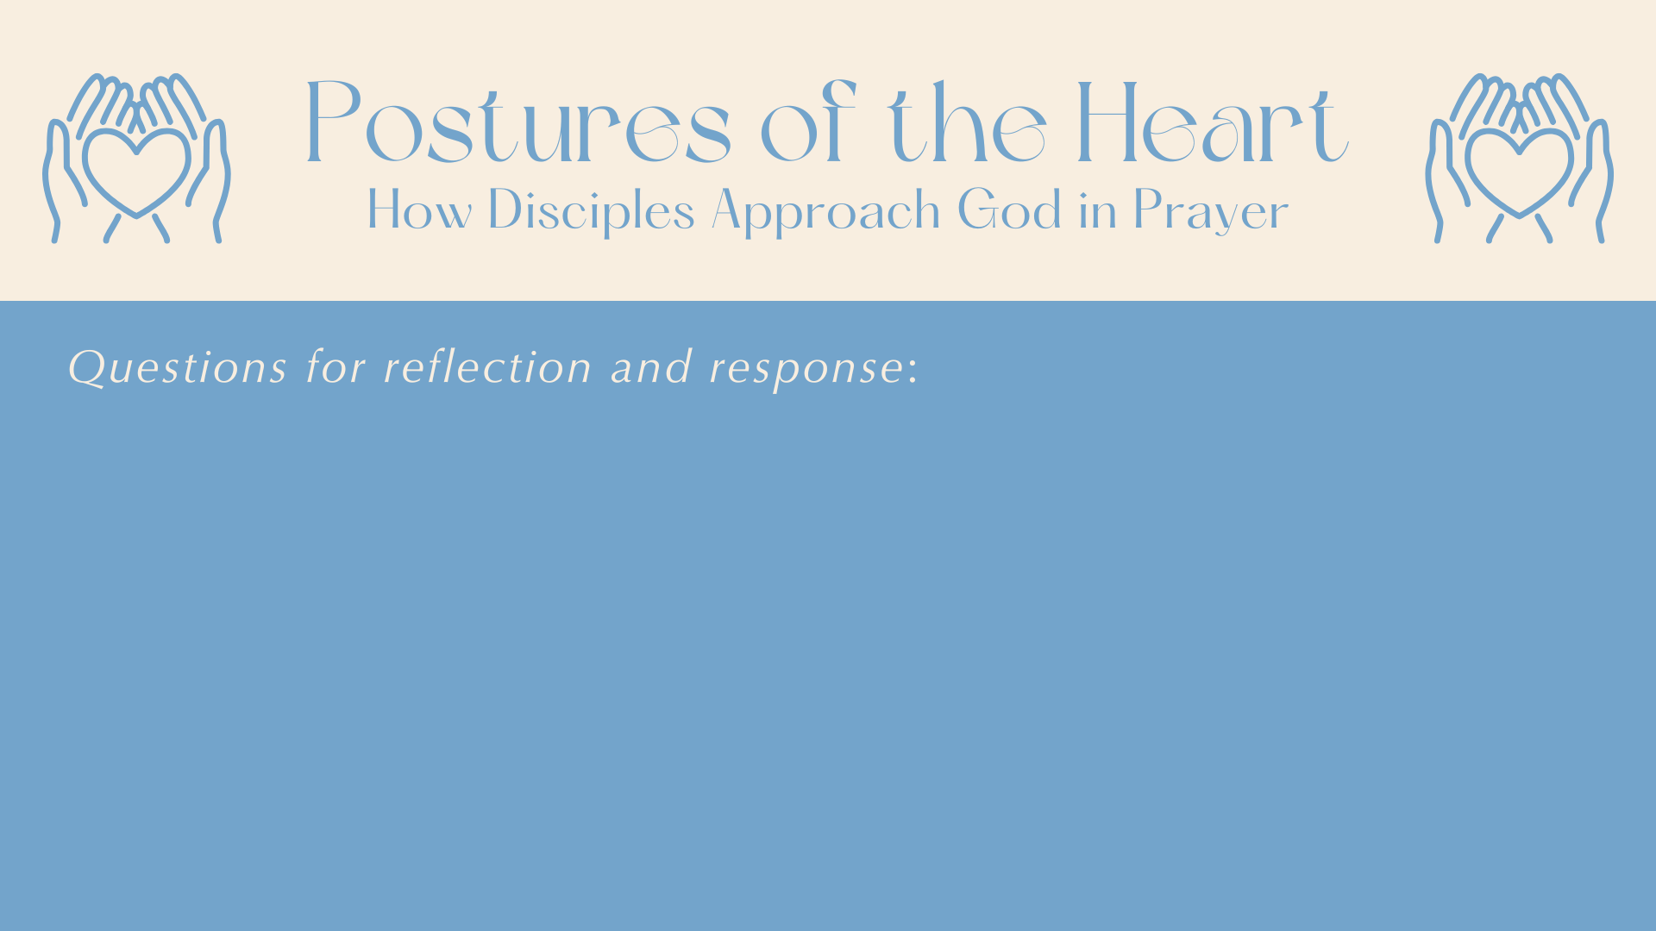

Slide 13
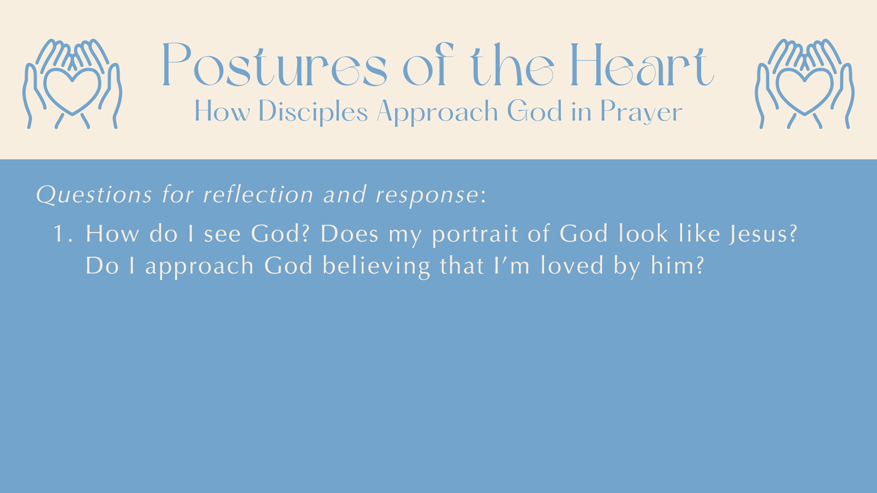

Slide 14
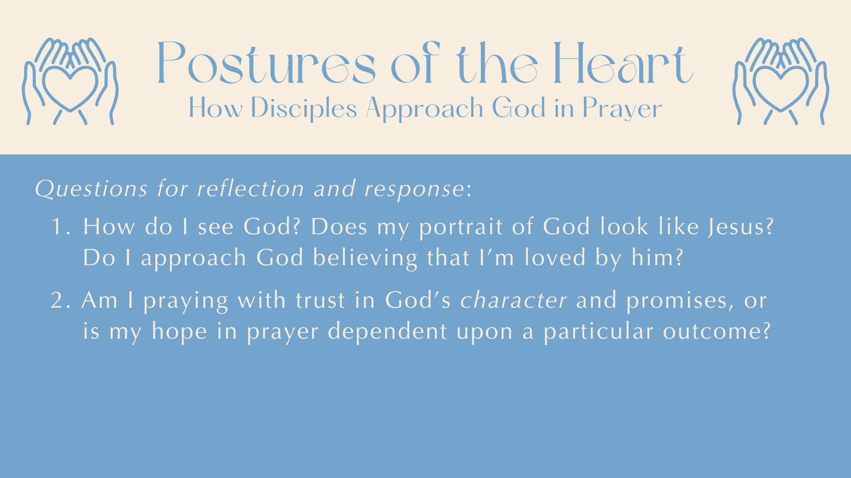

Slide 15
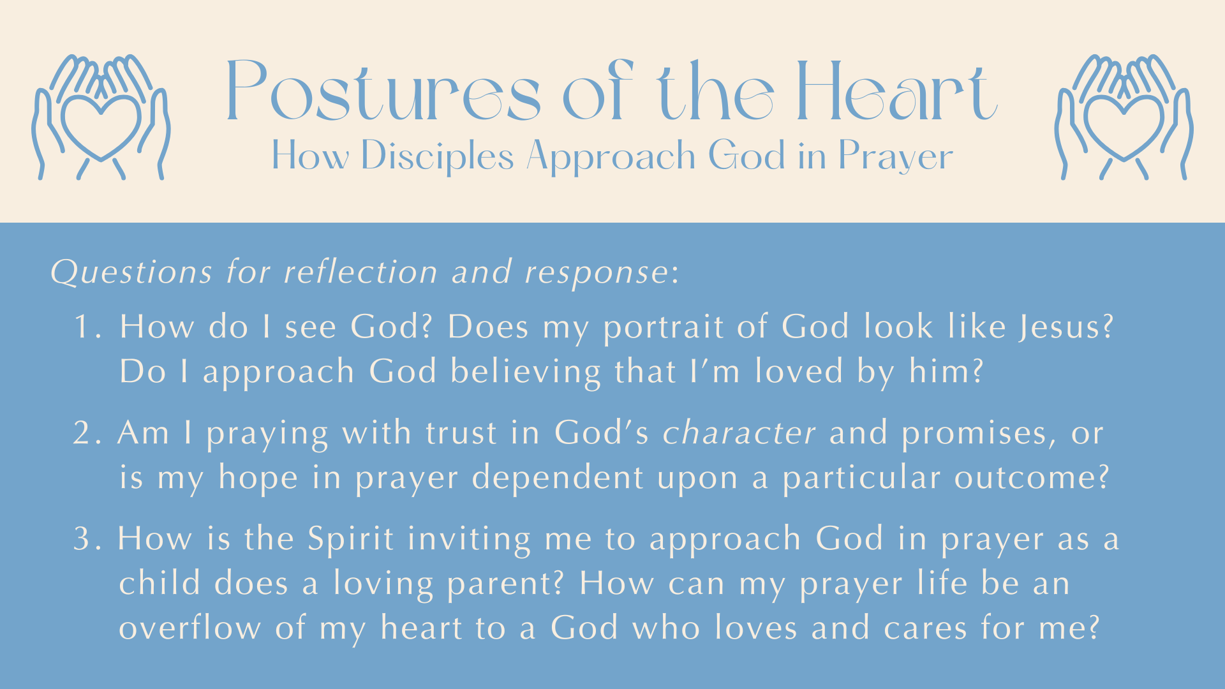
Notes:
[READ & BRIEF COMMENT ON EACH QUESTION]
How do I see God? Does my portrait of God look like Jesus?
Do I approach God believing that I’m loved by him?
2. Am I praying with trust in God’s character and promises, or
is my hope in prayer dependent upon a particular outcome?
3. How is the Spirit inviting me to approach God in prayer as a
child does a loving parent? How can my prayer life be an
overflow of my heart to a God who loves and cares for me?
Let’s pray… [NEXT SLIDE FOR CLOSING PRAYER]

Slide 16

Notes:
[CLOSING PRAYER]
“Father, open our eyes this morning. God, open our minds and our hearts to receive the truth about who you are and what you’re really like. There are so many competing portraits. So, Holy Spirit, give us the power to cast aside those thoughts and images of you that do not look like your love expressed in Jesus. Help us to see you as you are, that we might see ourselves as we are, so we can then see others the way you see them. And God, that we might learn to trust you more; that we would come to you as little children to a loving Father or Mother. We confess, Lord, that we need you. And so, we open ourselves up to you now. Speak to us and draw us closer to yourself in prayer. For your glory and our growth.
In the name of the Father, and of the Son, and of the Holy Spirit we pray, Amen.”
[RESPONSE SONGS]
Benediction
Brothers and sisters, let us be ever mindful of our great need for God. And let us by faith draw near to the God who looks like Jesus, as we approach our heavenly Father as his beloved children. Ask… and you will receive. Seek… and you will find. Knock… and the door will be opened. Now as you go out into the world, may the grace of the Lord Jesus Christ, and the love of the Father, and the fellowship of the Holy Spirit be with you all.
Go in peace, church, to love and serve the Lord.

