Slide 1
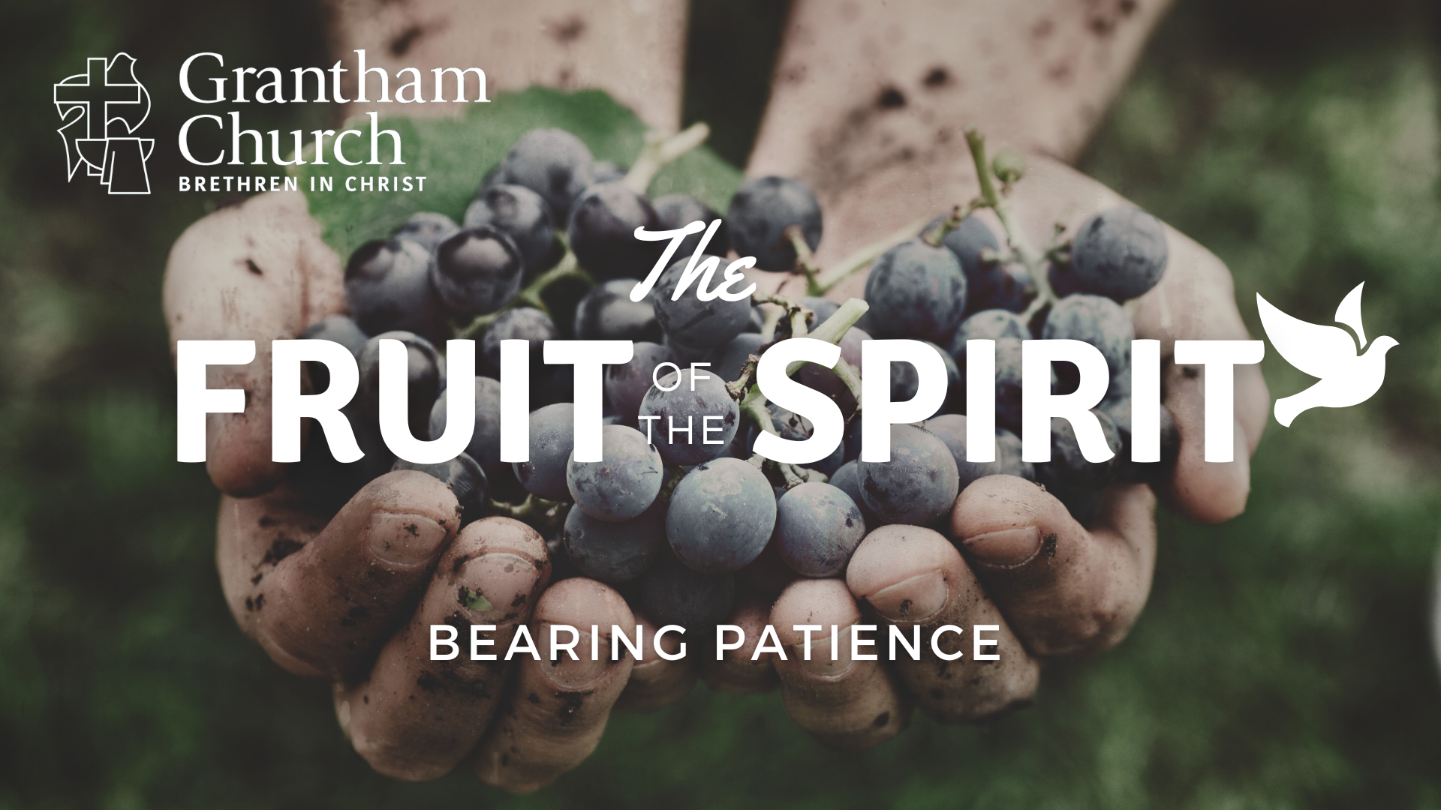

Slide 2

But the fruit of the Spirit is love, joy, peace, patience, kindness, goodness, faithfulness, gentleness, and self-control. Against such things there is no law.
GALATIANS 5:22-23

Slide 4
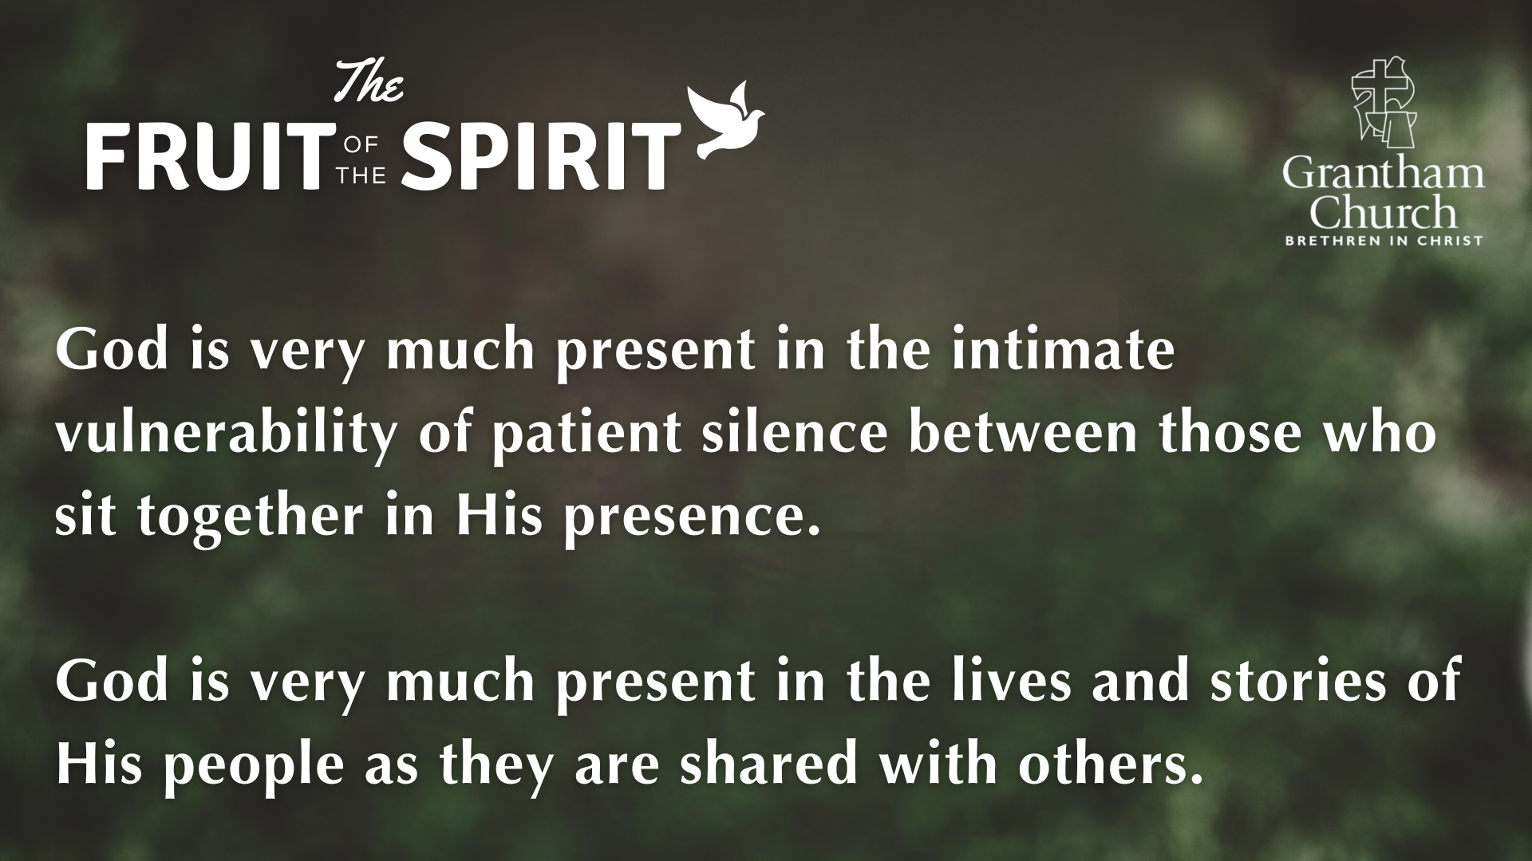

Slide 6
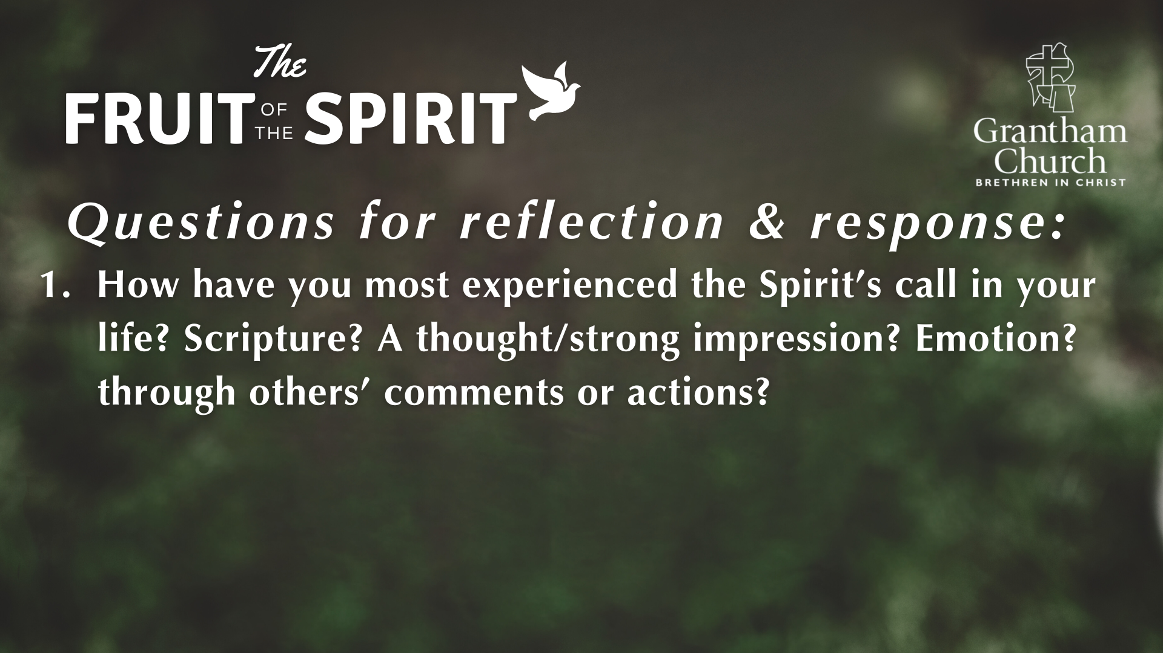

Slide 7
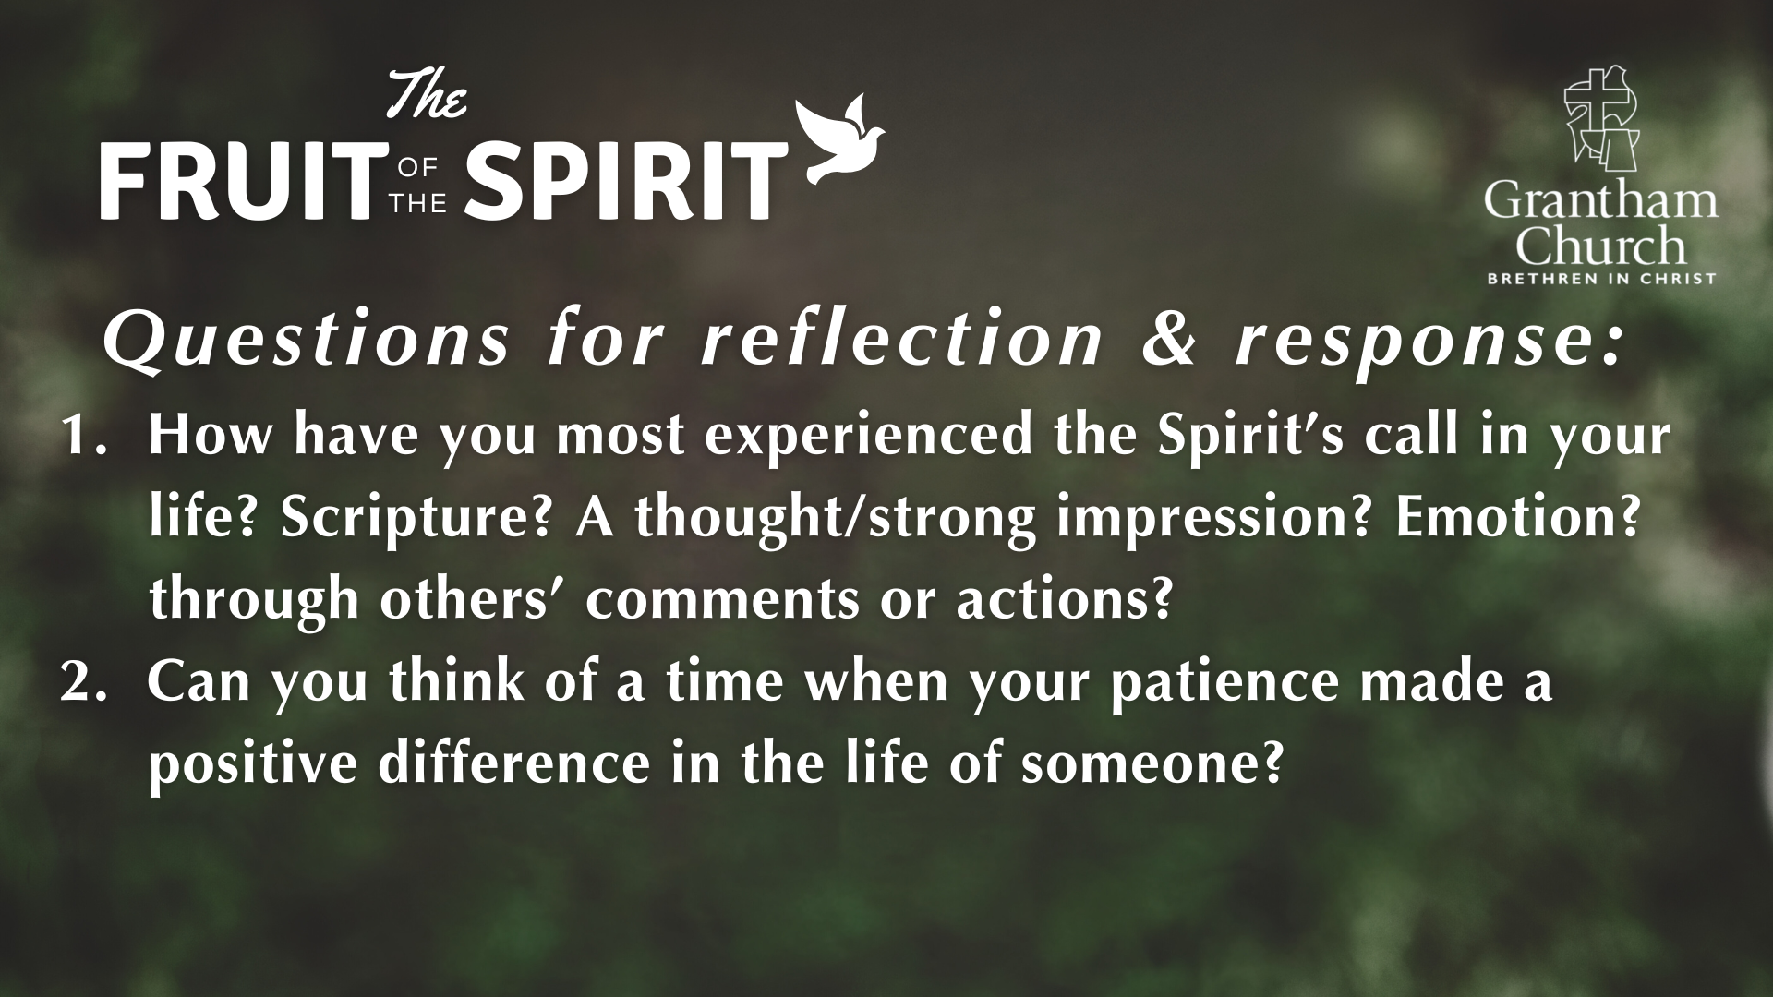

Slide 8
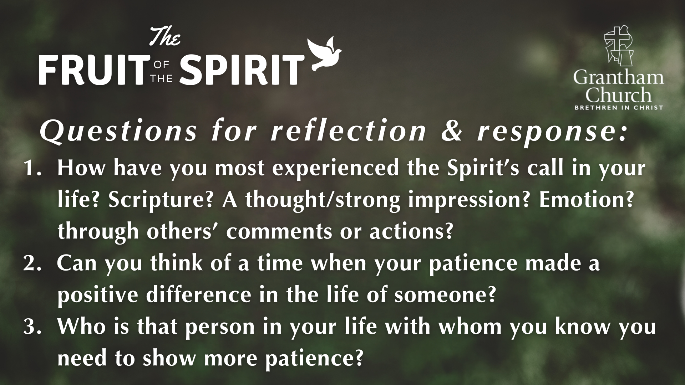

Slide 9


