Slide 1

Notes:
[BRIEF INTRO]
Welcome/Greeting
Lent to Easter series – Waging Peace: A Journey with Jesus Through Holy Week – At the beginning of Holy Week, Jesus looked out over Jerusalem and cried aloud, “If only you knew the things that make for peace.” And then Jesus spends each day confronting injustice, calling out oppressors, and contending for peace. How did he do this? What did that look like? That’s what we’re giving attention to each week in this series as we discover anew why Jesus is called the Prince of Peace, and what it looks like when we are waging peace like him.
This series is based on Jason Porterfield’s book… [NEXT SLIDE]

Slide 2

Notes:
Fight Like Jesus: How Jesus Waged Peace Throughout Holy Week, published by Herald Press (2022). Remember, if you’d like to go deeper, you can purchase the book and follow along. And you can use our small group discussion questions posted each week with the sermon at our website and podcast. Also, those questions can be used at home with your family as well.
If you’re just joining us, we began our Holy Week journey with Palm Sunday. We reflected on the meaning of Jesus riding into Jerusalem on a donkey to the waving of palm branches during Passover, a Jewish holiday that commemorated God’s delivering of his people from oppression and bondage. And through tears, we heard Jesus cry aloud over his people’s failure to accept him for who he truly is and embrace his way of bringing about the peace (the shalom) of God.
Last Sunday we looked at Holy Monday. We learned that, according to Mark’s gospel, Jesus looked around the temple at the end of Palm Sunday and had an evening to think about his next move. And with everyone closely watching this popular and controversial rabbi, the next day Jesus goes into the temple using some prophetic theater, confronting the evil and injustice there in the court of the Gentiles. No violence, just a wicker whip to shoo out animals. And after he flips over the money-changing tables, he quotes from two OT prophets to indicate its meaning.
It’s now day three of Holy Week… [NEXT SLIDE]

Slide 3

Notes:
Holy Tuesday. What do you know about what happened on Holy Tuesday? I’m guessing, for most of us, probably not much. We often just give attention to Palm Sunday and then jump straight to Maundy Thursday, Good Friday, and Easter. Or honestly, many Christians just leap straight from Palm Sunday to Easter Sunday, and we end up diminishing the significance of the cross and the empty tomb. And we really don’t want to do that. Because the gospel writers did not rush us through Holy Week. In fact, the dialogue on Tuesday is quite extensive.
After Jesus cleared the temple on Monday, surprisingly, he returned there the next day to teach and challenge the hypocrisy of the religious leaders that are now seeking for a way to arrest him. And while it might seem suicidal for Jesus to go back to the temple, the site was filled with his supporters; it was actually a safe place for Jesus. Still the religious leaders will try to trap Jesus with their baited questions and attempt to get the crowds to turn against him. But as we will see today, they fail at doing that. Instead, Jesus tricks them into entrapping themselves.
So, in this third message of our series, I’m going to invite us not to overlook the words of Jesus on Holy Tuesday so that we can adopt his approach to waging peace when our enemies try to entrap us, and so we will know what to do when we, like his first disciples, are facing difficult and trying days ahead. If you’re taking notes, this message is entitled, Traps, Truth-Telling & Traitors.
[BRIEF PRAYER]
As I said earlier, Jesus engages in a lot of conversation on Holy Tuesday… [NEXT SLIDE]

Slide 4
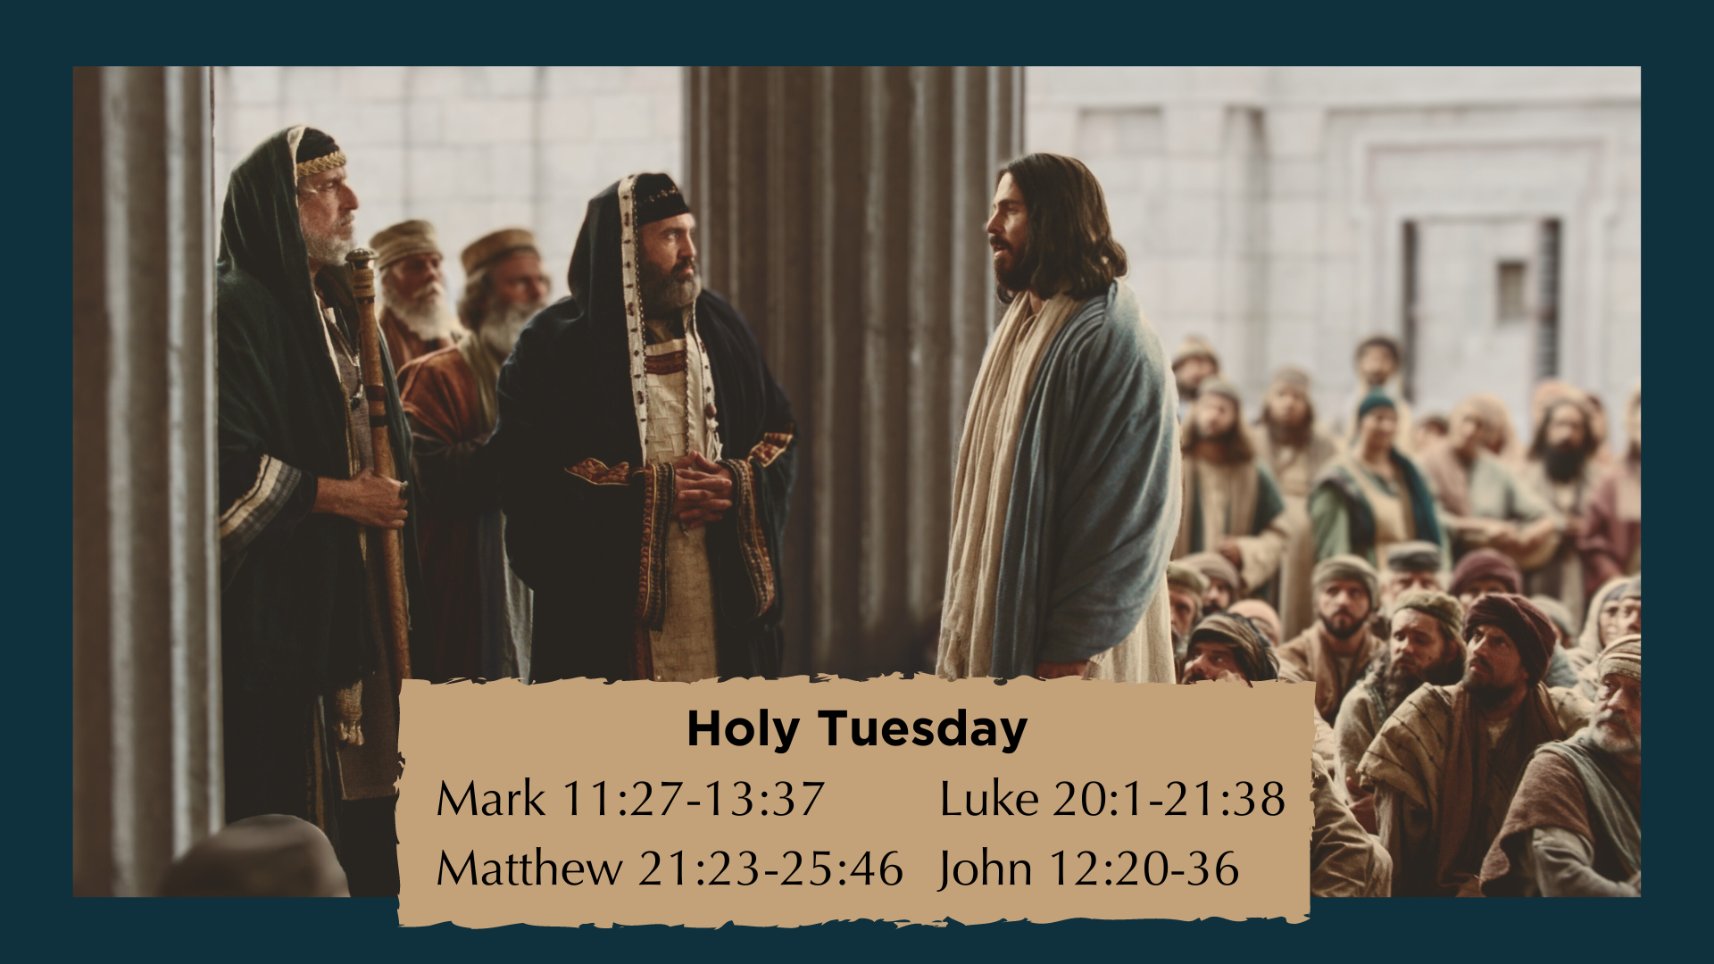
Notes:
[BRIEF COMMENTS]
The synoptic Gospels (Matthew, Mark & Luke) contain the bulk of it
We need to understand at this point: Jesus has strengthened approval from the crowds because of his “decommercializing” the temple, but it has put his enemies in a panic!
What were their concerns? Jesus’ teachings; many think he’s the Messiah; and Rome!
Therefore, they need to find a way to discredit Jesus and turn the crowds against him
And they think they can do it, as Jesus comes back to the temple again (in his mind) to wage peace. Holy Tuesday can be divided up into three separate acts… [NEXT SLIDE]

Slide 5
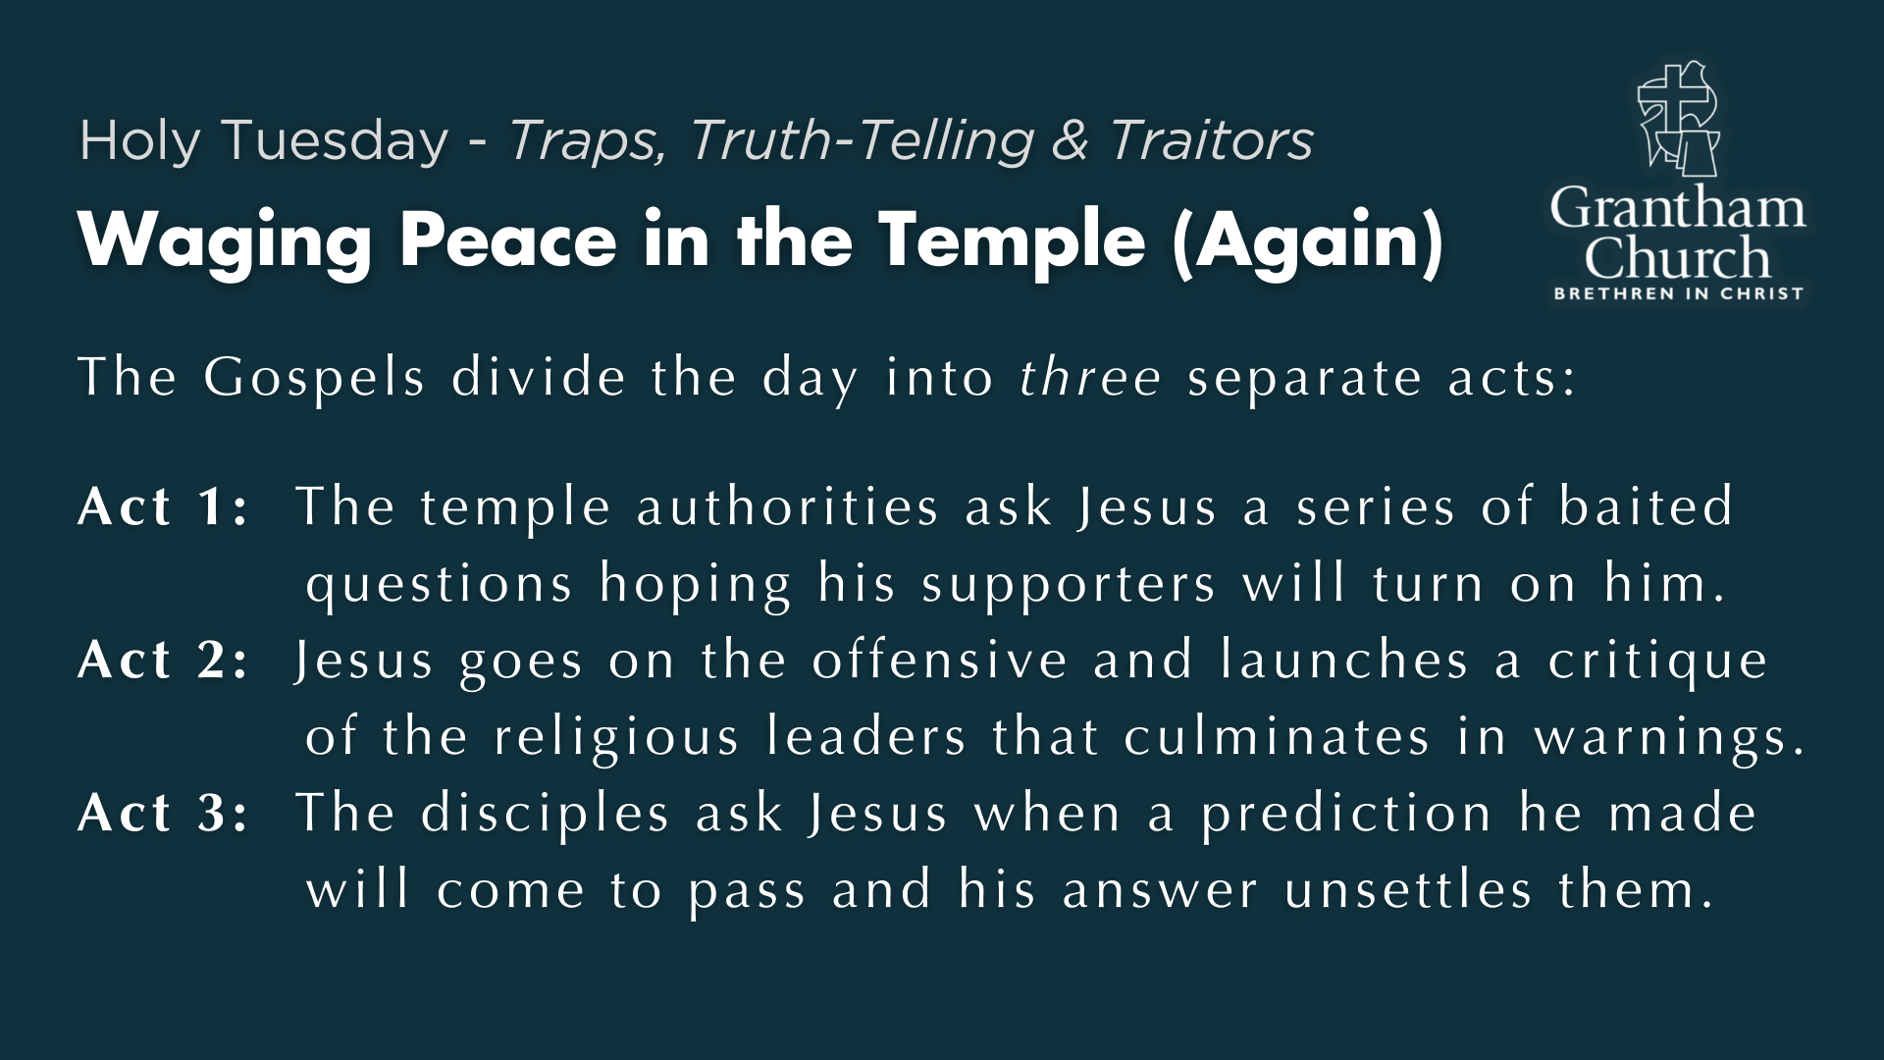
Notes:
[READ & BRIEF COMMENTS]
Act 1: The temple authorities ask Jesus a series of baited
questions hoping his supporters will turn on him.
Act 2: Jesus goes on the offensive and launches a critique
of the religious leaders that culminates in “woes” or warnings.
Act 3: The disciples ask Jesus when a prediction he made
about the temple will come to pass; his answer will unsettle them.
And because there is a lot that is said on Tuesday, we’re just going to focus on three texts, one from each act of the day. So, let’s begin with the second baited question that the religious leaders asked Jesus: [NEXT SLIDE]

Slide 6
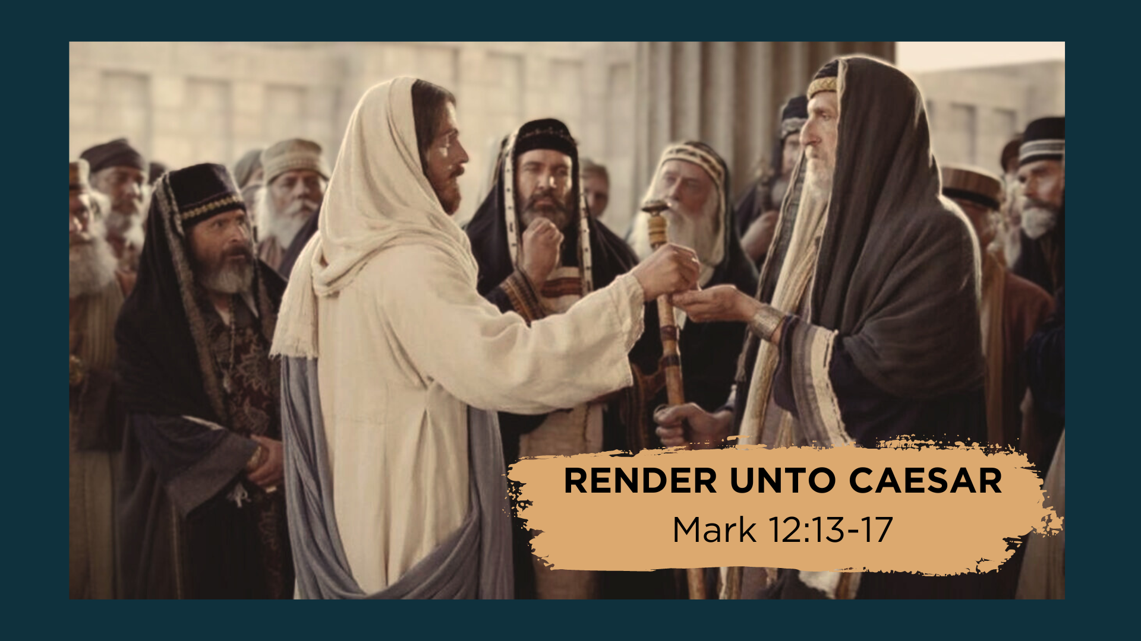
Notes:
Please open your Bibles to Mark 12:13-17.
[SET THE CONTEXT BEFORE READING]
First century hot button issues (e.g., debates about divorce, capital punishment, theological debates about the future resurrection of the dead, and paying taxes) – the temptation for Jesus was to weigh in on the paying taxes debate and polarize the people further
Two groups: pay or don’t pay. Pay: because it’s Rome, the elite benefited from them; others were scared of them. Don’t Pay: It’s idolatrous and we’re supporting them! The trap was a good one: If he says yes, he will alienate the crowds; if he says no, he could be arrested.
[READ THE PASSAGE]
Yeah they were amazed. Jesus just smoothly avoided a trap and did a mic drop on his enemies. He says, ”Give to Caesar what is Caesar’s (his face is on the coin, well give it back to him), but then give to God what is God’s (meaning, everything else belongs to him).” Jesus dumbfounds his audience and evades being pigeon-holed and being forced into their worldly kingdom categories and debates. Jesus chooses a way out of this very political predicament. He says, you‘re thinking about this all wrong. And if you‘d follow me, you‘d eventually see that.
We call this being “Third Way” at Grantham Church. And this Third Way approach and posture is rooted in Jesus himself. It is not a strategy to win debates or avoid doing hard things; it is a conviction grounded in Christ that there is a better way. Therefore, it is necessary that we see how Christ embodied the Third Way by the pattern he left for us in the Gospels. [NEXT SLIDE]

Slide 7
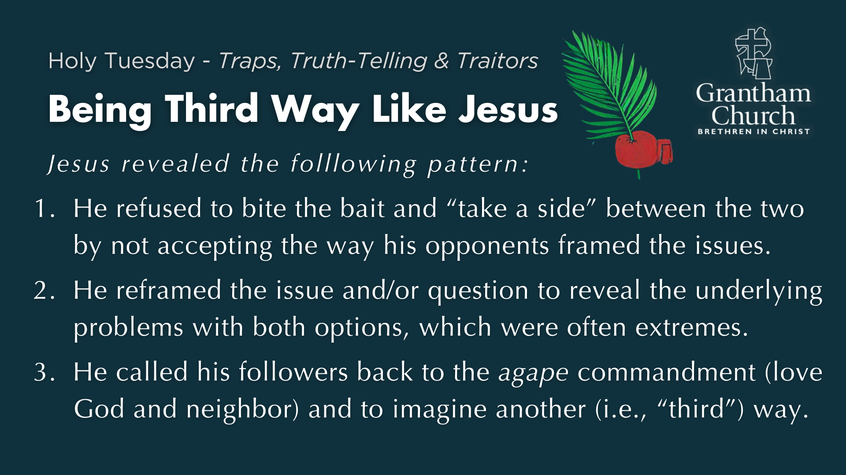
Notes:
When asked to weigh in and choose between two polarizing political and religious options, Jesus revealed the following pattern on several different occasions:
He refused to bite the bait and “take a side” between the two by not accepting the way his opponents framed the issues.
He reframed the issue or question to reveal the underlying problems with both options, which were often extreme positions that harmed someone.
He called his followers back to the agape commandment (love God and neighbor) and to imagine another (i.e., “third”) way.
Again, we can see this in Jesus’ response to many issues: the Roman occupation debate, the inheritance debate, the capital punishment debate, the divorce debate, and of course, in the debate about paying taxes. I reference all of these in our Being a Third Way Church doc.
Did Jesus side with the oppressed and marginalized? Yes. Did Jesus “take sides” and fully align himself with the agendas of a religious or political party, tribal group, or faction? No, he did not. And if there were ever a time to heed the words and example of Jesus, it is now. Folks, Jesus can help us settle our debates (particularly within the church) if our questions are sincere and not simply attempts to trap people, make them look stupid, or defend and justify ourselves.
Let’s move on to Act 2, and our second Scripture reading… [NEXT SLIDE]

Slide 8
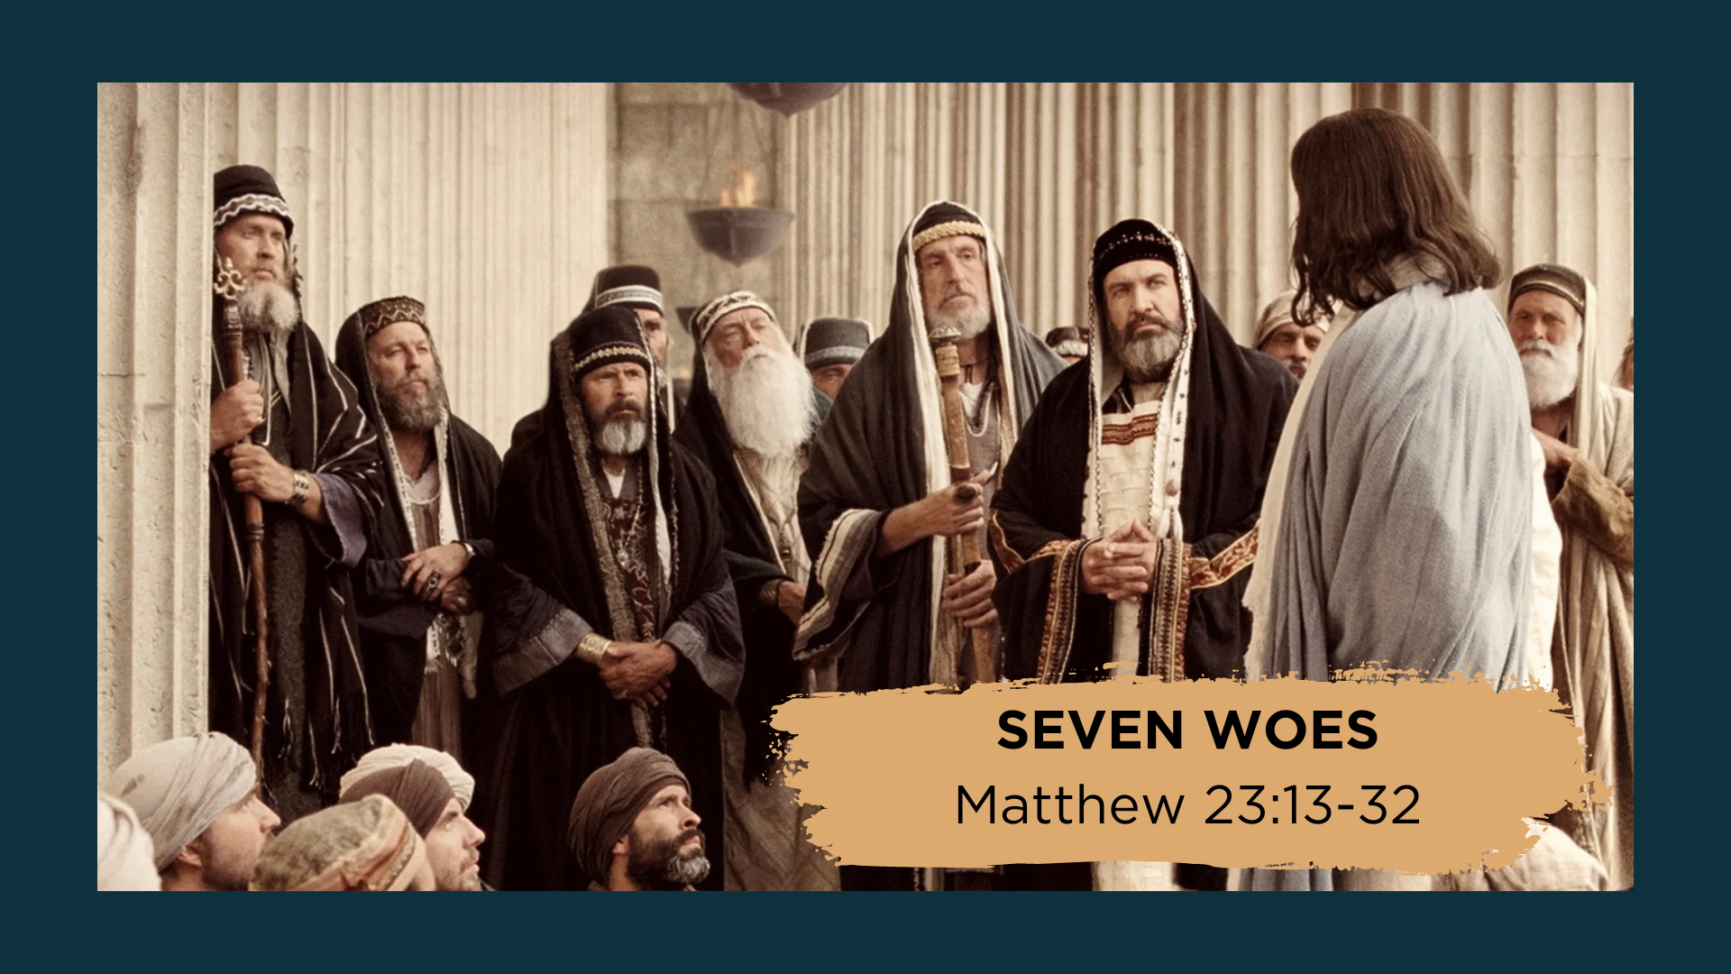
Notes:
For the sake of time, we’re not going to read the entire passage. But let’s look at a few verses so we can hear Jesus’ critique and seven warnings to the religious leaders.
[READ VERSES & COMMENT]
”Woe” is an exclamation of sorrow and grief; Jesus is not intending to demonize these people; he is calling them to repentance
Keep in mind the power dynamic here: Jesus’ critique comes from below; they have the power to kill him… and they will eventually see that it happens
As strong as his language is, the Lord’s woes and warnings should be viewed as a parental plea to do what is right, rather than an angry outburst meant to condemn
After this strong rebuke in front of a large audience, Jesus will leave the temple never to return; and from there he exits with his disciples
Which brings us to Act 3. For our final section from Tuesday, here is a passage from… [NEXT SLIDE]

Slide 9
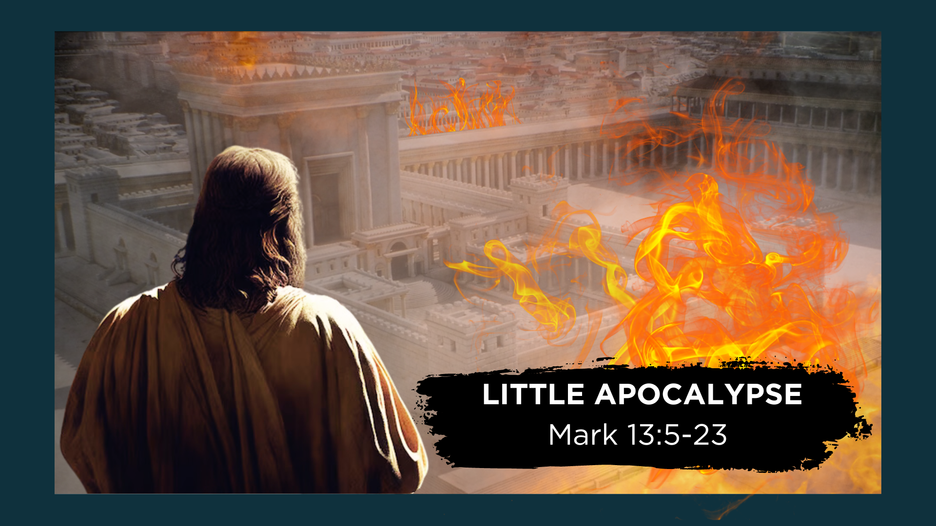
Notes:
Mark 13:5-23. Jesus is leaving the temple and his disciples, likely feeling that their Master had just scored a huge win by showing up the religious leaders and putting them in their place, take notice in their celebration of the magnificent and impressive architecture of the temple. “Teacher, take a look at these stones in the wall. Wow!” And they were huge. Archaeologists have unearthed stones 77ft long, 9ft high, and 10ft wide.
And so, they weren’t prepared for Jesus’ answer. He tells them, ”Yes, look at these great buildings. But it will all be completely demolished. Not one stone will be left on top of another!” Jesus is predicting the future destruction of the temple, which is no small thing. And then when they get to the Mt. of Olives, a nice resting place halfway back to their lodging in Bethany, his disciples ask, “When will this happen? And what will be the signs of its fulfillment?” Jesus will give a lengthy answer warning them of a tragic future. Unfortunately, they can expect false Messiahs, suffering, and betrayal. This is not how the disciples envisioned the day ending.
[BRIEF COMMENTS]
In the immediate context, Jesus is predicting the fall of Jerusalem (e.g., Matt. 24-25)
While he wasn’t talking about the end of the world, it would have seemed that way to them
I still think these sobering words of Jesus can apply to us, specifically his call to be awake, alert, and ready for hard times; And when they come, we should not join in on the violence
And then at the end of Holy Tuesday, Jesus’ final remarks of the day to his disciples are recorded in Matthew chapter 25. Jesus says, when the Son of Man comes in his glory to bring the kingdom in all its fullness… [NEXT SLIDE]

Slide 10
Matthew 25:34-36 NIV – Final Words of Holy Tuesday
³⁴ “Then the King will say to those on his right, ‘Come, you who are blessed by my Father; take your inheritance, the kingdom prepared for you since the creation of the world.
³⁵ For I was hungry, and you gave me something to eat, I was thirsty, and you gave me something to drink, I was a stranger and you invited me in, ³⁶ I needed clothes, and you clothed me, I was sick, and you looked after me, I was in prison, and you came to visit me.’
Notes:
[READ PASSAGE]
Stanley Hauerwas said that Jesus specified, “the work necessary to sustain those who watch” [those who are awake to him, his words, and what is to come; those who are committed to his way of waging peace]. It is the sustaining work of peacemaking and benevolence, the “work of giving food to the hungry and drink to the thirsty, welcoming the stranger, clothing the naked, caring for the sick, and visiting those in prison” that we are called. No matter what comes.
Put another way, Jason Porterfield writes… [NEXT SLIDE]

Slide 11
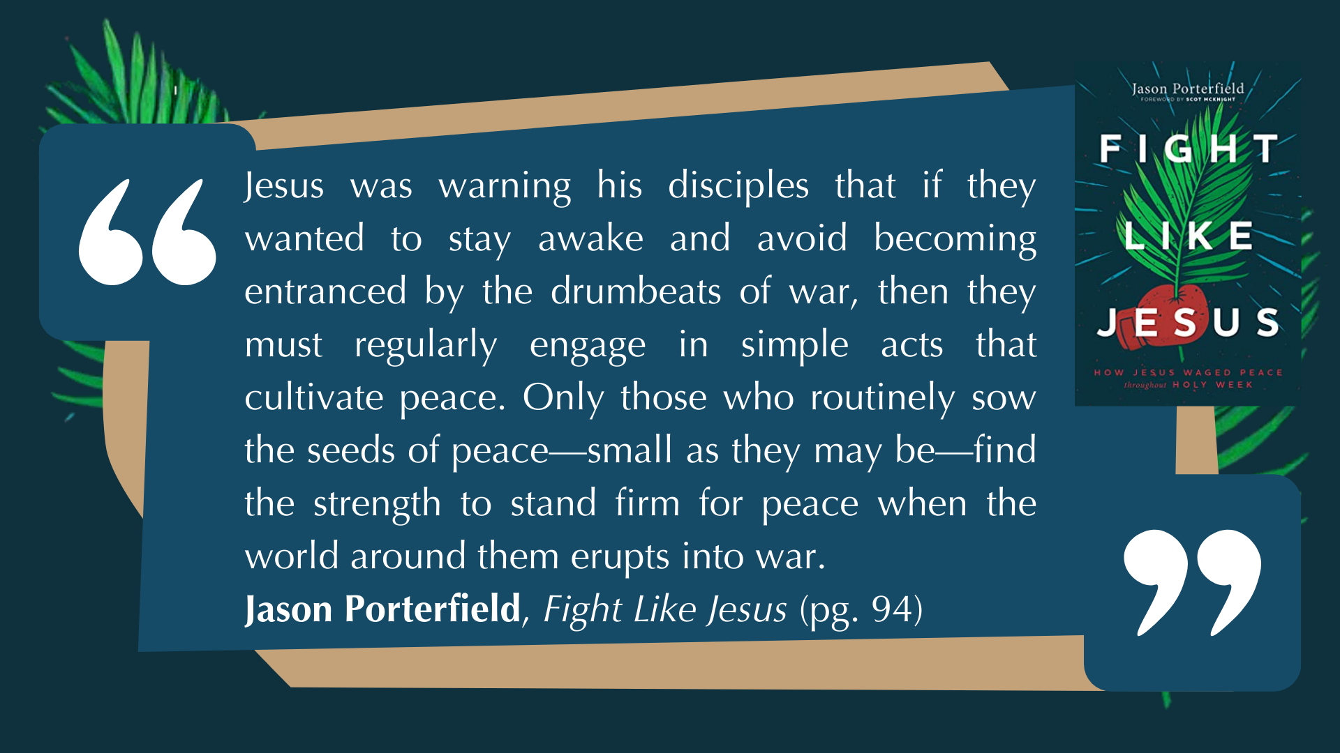
Notes:
[READ & BRIEF COMMENTS]
Real quick… here are the three “lessons in peacemaking” for Holy Tuesday… [NEXT SLIDE]

Slide 12


Slide 13


Slide 14


Slide 15

Notes:
[READ & BRIEF COMMENT ON EACH LESSON]
Lesson 1: Christlike peacemakers recognize no human law as valid if it conflicts with God’s non-violent love.
Lesson 2: Christlike peacemakers speak truth to power and listen with humility when such truth is spoken to them.
Lesson 3: Christlike peacemakers break the cycle of violence by routinely engaging in small acts of radical love.
Before we close with some questions, let’s end the teaching portion with these words from Jesus… [NEXT SLIDE]

Slide 16
Matt 5:38-45 NIV – Breaking the Cycle of Hate & Violence
³⁸ “You have heard that it was said, ‘Eye for eye, and tooth for tooth.’³⁹ But I tell you, do not resist an evil person. If anyone slaps you on the right cheek, turn to them the other cheek also. ⁴⁰ And if anyone wants to sue you and take your shirt, hand over your coat as well. ⁴¹ If anyone forces you to go one mile, go with them two miles. ⁴² Give to the one who asks you, and do not turn away from the one who wants to borrow from you. ⁴³ “You have heard that it was said, ‘Love your neighbor and hate your enemy.’ ⁴⁴ But I tell you, love your enemies and pray for those who persecute you, ⁴⁵ that you may be children of your Father in heaven.
Notes:
[READ & BRIEF COMMENTS]
v. 39 – “resist” means to oppose in kind; tit-for-tat; to violently resist
In Romans 13:2, Paul uses the same word: “whoever rebels (violently resists) the authority…”
Notice, Jesus uses three different examples of how we can radically love our enemies, each act is intended to expose the oppressor and persecutor by waging peace
Jesus is saying to us this morning, you want to break the cycle of evil and violence? You want to call out and expose evildoers and those who oppress you? Then stop playing their eye-for-eye, tooth-for-tooth, tit-for-tat game. Embody and introduce love, mercy, and grace into the equation, even when it is necessary to speak truth to power and call people to repentance. Imagine a Third Way. And trust in my way of waging peace and overcoming evil with good.
Finally, here are some questions for personal reflection and to help us respond to what the Spirit is saying to us through the message… [NEXT SLIDE]

Slide 17


Slide 18


Slide 19


Slide 20

Notes:
[READ & COMMENT ON EACH QUESTION]
Have I been “taking the bait” on questions meant to trap and polarize? Do I believe that Jesus can reveal a Third Way?
How do I need to “speak truth to power” in the way of Jesus but also listen with humility when truth is spoken to me?
Am I trusting in small acts of radical love to break the cycle of evil/violence (i.e., turning cheeks & going the extra mile)?
Let’s pray… [NEXT SLIDE FOR CLOSING PRAYER]

Slide 21

Notes:
[INVITE SERVERS & WELCOME CHILDREN BACK]
[CONFESS APOSTLES’ CREED] & [COMMUNION LITURGY]
Series Benediction – adapted from a “Franciscan Benediction”
May God bless you with discomfort…
Discomfort at easy answers, half-truths and superficial relationships,
Discomfort, so that you will hunger and thirst for righteousness.
May God bless you with anger…
Anger at injustice, oppression, and exploitation of people,
Anger, so that you will work for God’s Kingdom vision of shalom.
May God bless you with tears…
Tears to shed for those who suffer pain, rejection, starvation and war,
Tears, so that you will reach out to comfort them
And turn their pain into joy.
And may God bless you with foolishness…
Foolishness to believe that through the Spirit you can live like Jesus,
Foolishness, so that you will do what others claim cannot be done. Amen.
Grantham Church, go in peace… to love and serve the Lord.

