Slide 1

Notes:
[BRIEF WELCOME & INTRO]
This morning we are continuing our series, The Last Things – a 7-week sermon series on the future of all things. This is the fourth message in the series.
Remember the ”last things” comes from… [NEXT SLIDE]

Slide 2
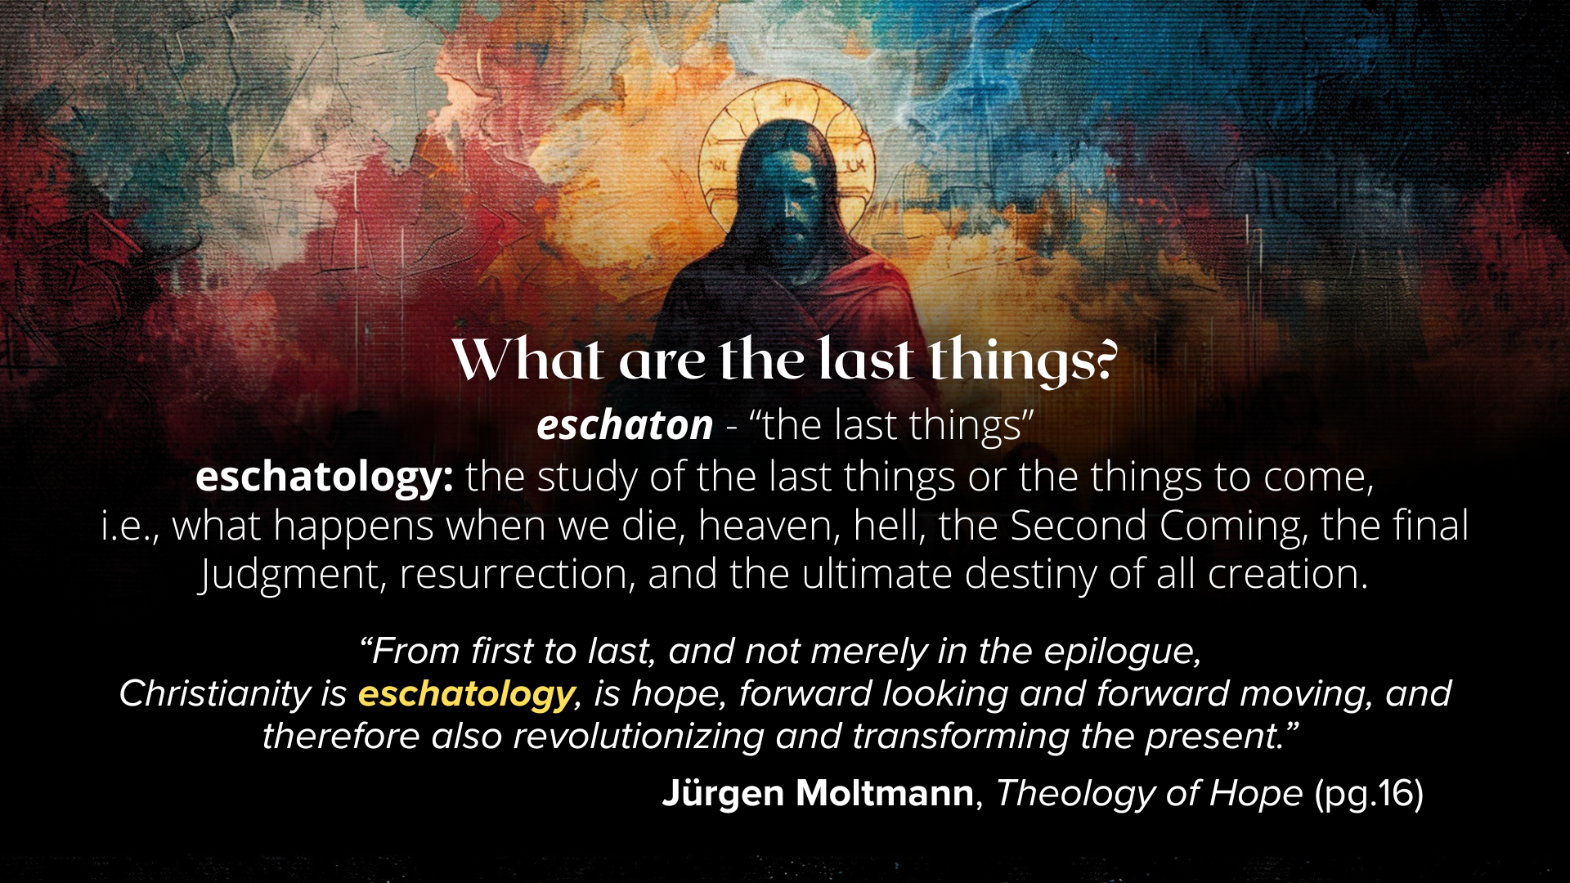
Notes:
[READ SLIDE & COMMENT]
And as I’ve been saying, our knowledge of the future ought to deepen our trust in God in times of fear and uncertainty, ground us in the Christian hope, and help us to live in light of the last things. Because knowing where everything is going and that God is guiding all of human history to its divinely intended goal should help us keep all of life in perspective.
And here is where the New Testament tells us everything is going… [NEXT SLIDE]

Slide 3
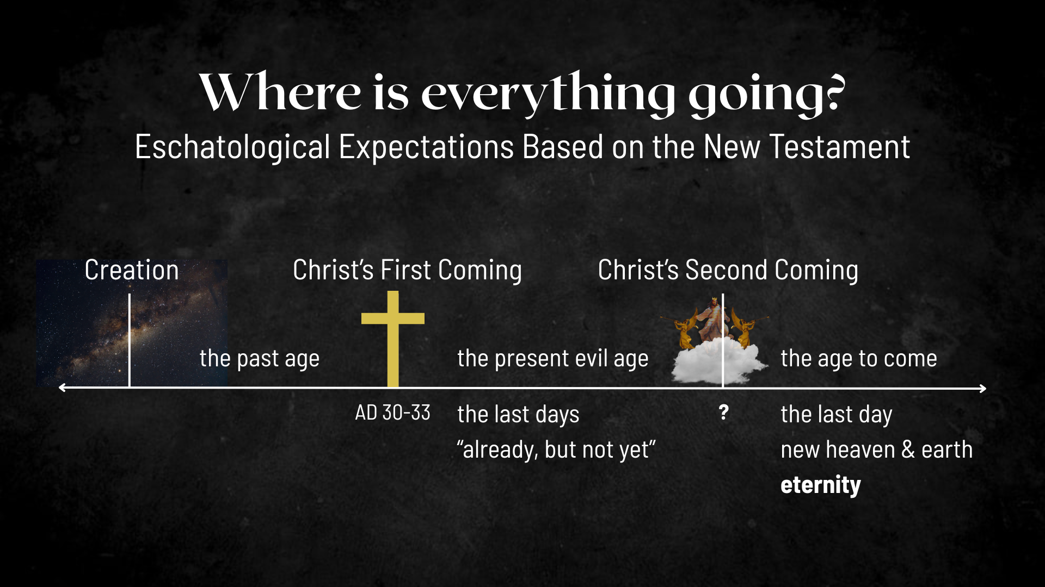
Notes:
[EXPLAIN IMAGE – CREATION TO ETERNITY]
Jesus’ first coming split our historical timeline (the past age & the present evil age)
So, according to the Scriptures, since the life, death, and resurrection of Christ, we’re living in the “last days”; we live in the ”already, but not yet” of the Kingdom of God; the decisive battle has been won, the victory is certain, and the future is secure.
And when Christ returns a second time, the “age to come” will be realized; this is when God raises the dead, brings heaven to earth and we enter the “age to come” or eternity.
We began our series a few weeks ago with the message… [NEXT SLIDE]

Slide 4
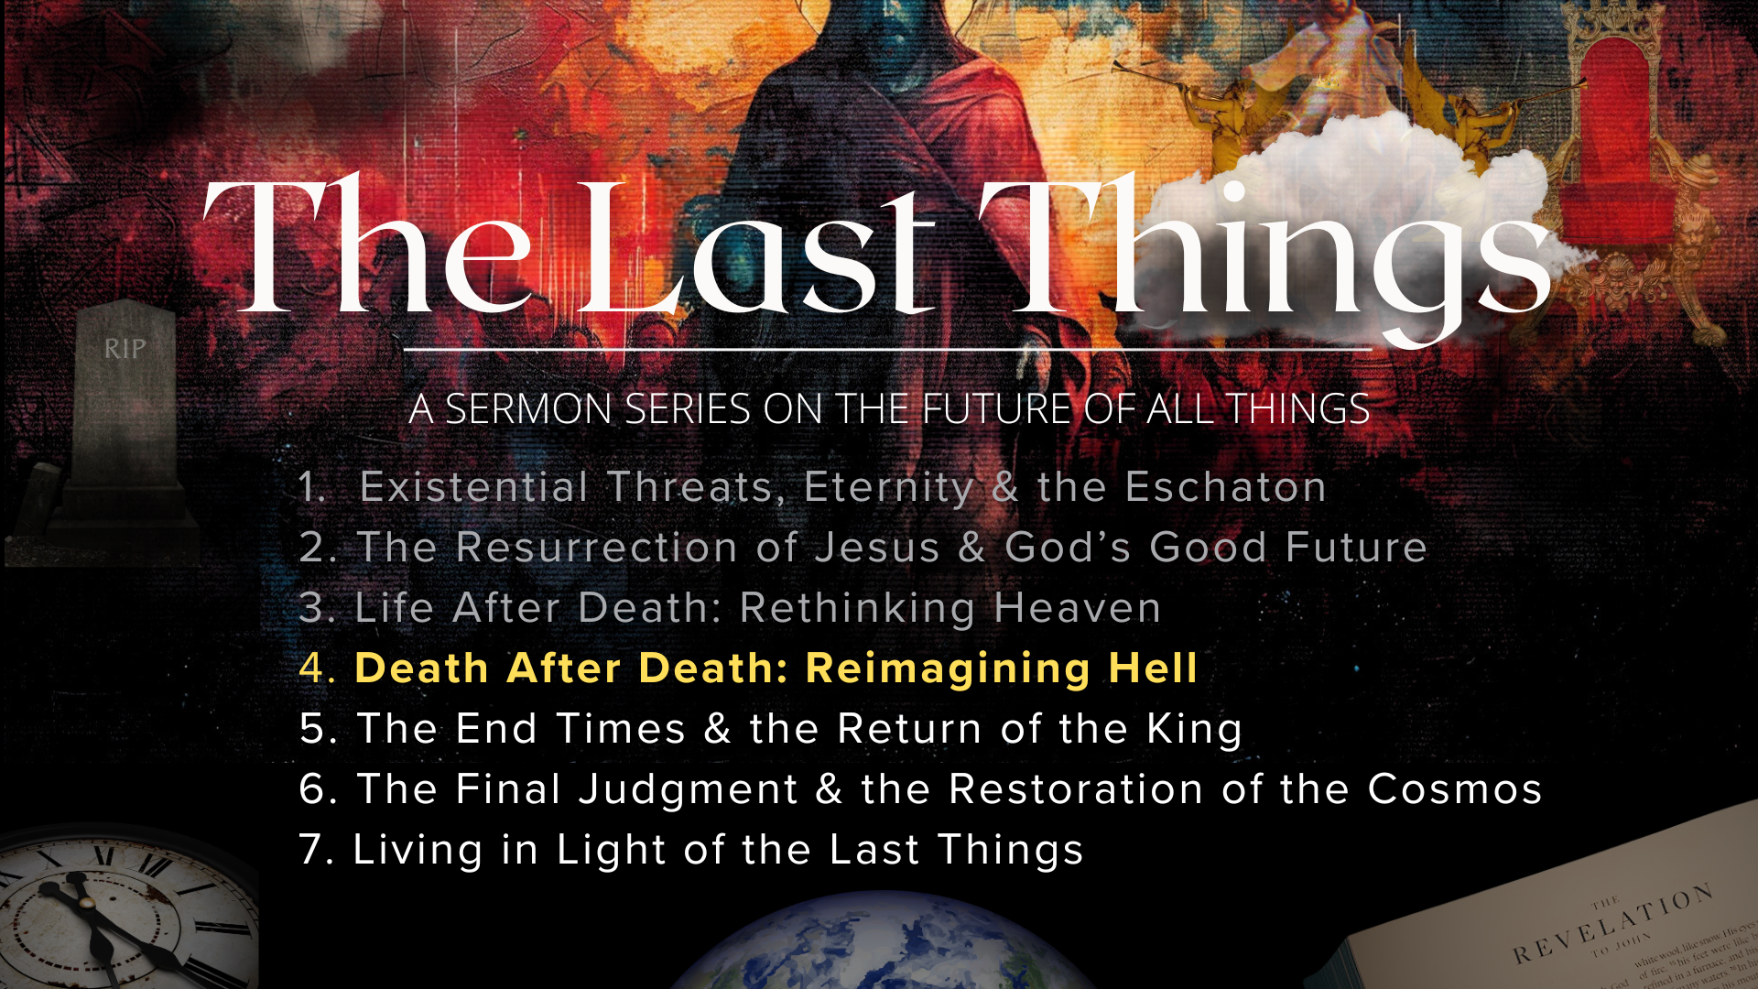
Notes:
Existential Threats, Eternity & the Eschaton - In the intro of the series, I invited us to adopt an eternal perspective, build our lives upon God’s story, and deepen our trust in his power to guide history to its divinely intended goal.
In the second message, The Resurrection of Jesus & God’s Good Future, we looked at how the resurrection of Jesus changed everything, we reflected on Paul’s words in 1 Corinthians 15 on resurrection as the Christian hope and what we mean when we say we believe in the future resurrection and where God is taking all of creation.
Then in last week’s message, Life After Death, Rethinking Heaven, I invited us to rethink what Jesus and the New Testament tell us about what happens when we die in Christ. We saw how “heaven” (as a present reality or dimension) is not the same as the future new heaven and earth, and why that matters. And once again, we saw how resurrection is the Christian hope, as we long for God to renew us as unified persons made up of spirit, soul, and body, and bring heaven to earth and finally make all things new.
And so, to be clear, the Bible tells us that when we die as believers we can say with confidence that we will be with Jesus in what he called “paradise” (to the thief on the cross) as our souls consciously rest in that spiritual realm and wait for God to someday merge heaven with earth and resurrect his people for that new reality. And that is also the time when sin, death, and hell are cast out forever. Which brings us to today’s message… [NEXT SLIDE]

Slide 5
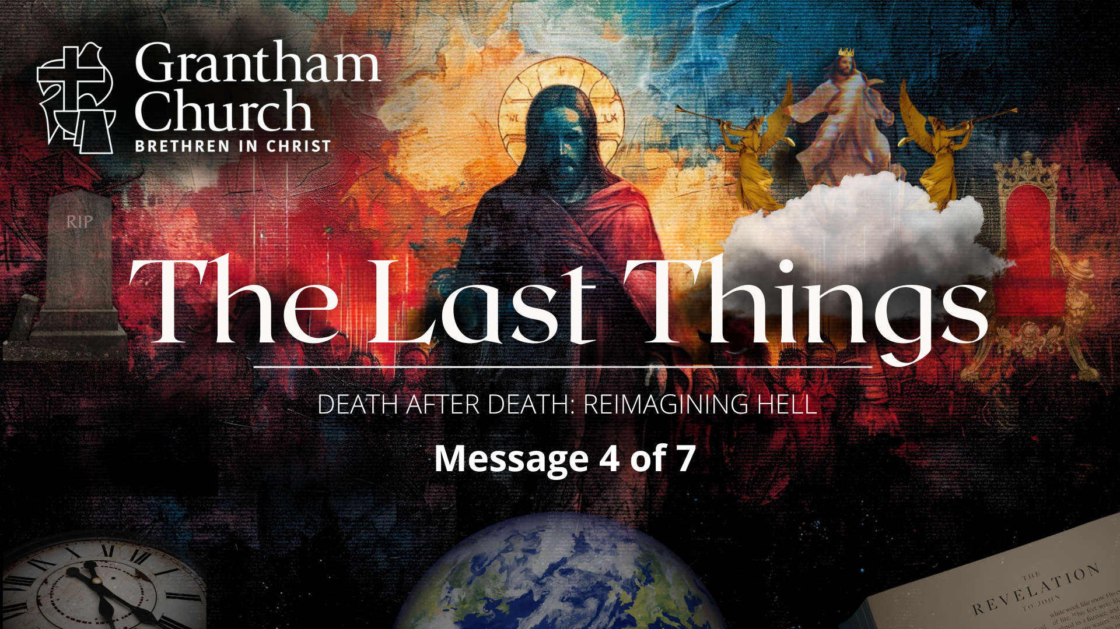
Notes:
Death After Death: Reimagining Hell.
In this fourth sermon, we’re going to see that Jesus spoke frequently about there being terrible consequences for those who refuse him and his Kingdom. We will look at some of the history of hell and the metaphors that Jesus used to describe an eternal punishment for those who reject God, spurn his love, and live for themselves. Along the way, I’ll try to answer some questions that often arise. And most importantly, I will invite us to align our thoughts about hell with the God who looks like Jesus.
[BRIEF DISCLAIMER]
There are different interpretations of hell (then and now)
I will share my view (beyond what the BIC states); you don’t have to agree with me
While not a pleasant topic, it’s not one we can afford to ignore; (1) we need to heed Jesus’ warnings about it; and (2) because whatever we say about hell says something about God.
There are reasons why I’ve waited to address this topic: (1) I wanted to build trust; (2) because fear of hell has been used as a weapon and caused a lot of harm; and (3) it often distorts our portrait and understanding of God, depending on how it is taught.
So, let’s pray before we go any further. [BRIEF PRAYER]
Last week I talked about the serious studies that are being done today on near-death experiences.1 in 25 people (about 13 million Americans) have had an NDE. And I mentioned that not all of those experiences are of heaven… [NEXT SLIDE]

Slide 6
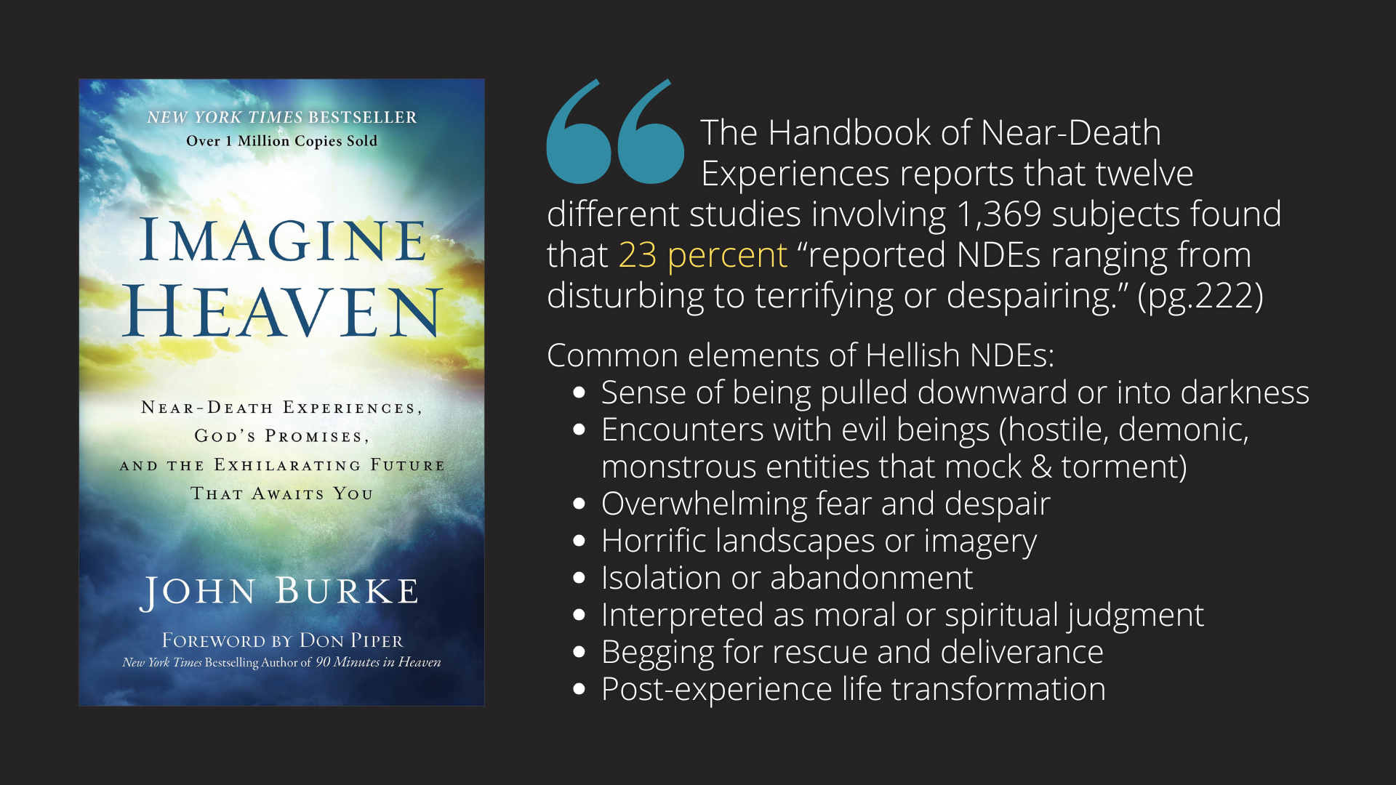
Notes:
In his book, Imagine Heaven (which I highly recommend), John Burke writes that, “The Handbook of Near-Death Experiences reports that twelve different studies involving 1,369 subjects found that 23 percent “reported NDEs ranging from disturbing to terrifying or despairing.” (pg.222)
Here are some common elements of Hellish NDEs:
Sense of being pulled downward or into darkness
Encounters with evil beings (hostile, demonic, monstrous entities that mock & torment)
Overwhelming fear and despair
Horrific landscapes or imagery
Isolation or abandonment
Interpreted as moral or spiritual judgment
Begging for rescue and deliverance
Post-experience life transformation
[READ 2 STORIES, PGS. 228-229]
So, what does the Bible say about eternal punishment? Here is some biblical background and history of hell… [NEXT SLIDE]

Slide 7
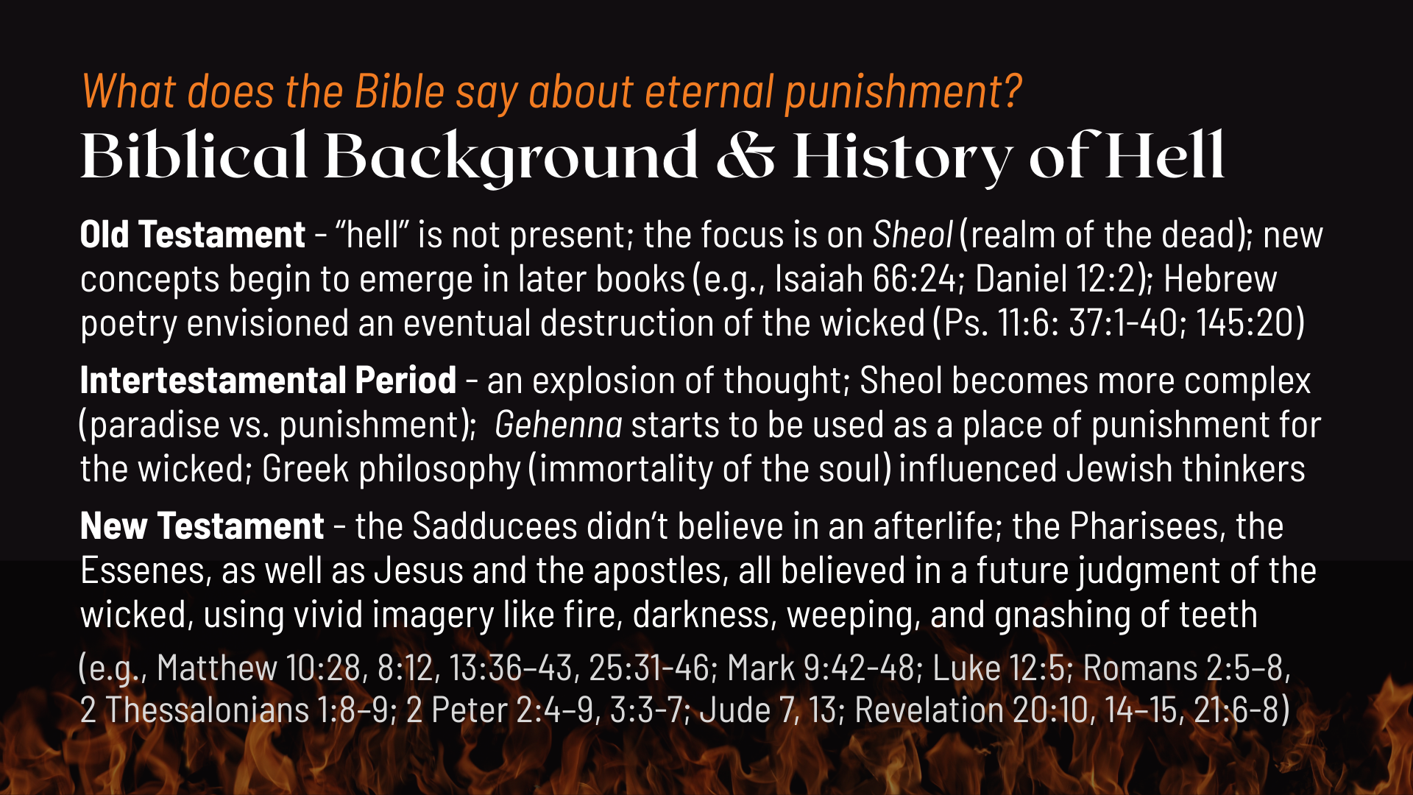
Notes:
Old Testament - “hell” is not present; the focus is on Sheol (realm of the dead); new concepts begin to emerge in later books (e.g., Isaiah 66:24; Daniel 12:2); Hebrew poetry envisioned an eventual destruction of the wicked (Ps. 11:6: 37:1-40; 145:20); The psalmist says, the wicked will vanish away “like smoke” (Ps.37:20) and “like a dream when one awakes” (Ps. 78:10). They will ”not be remembered” (Ps. 9:6) and “shall be as though they had never been” (Ob.16).
Intertestamental Period – an explosion of thought, which we can read about in the Apocrypha, Pseudepigrapha, and Dead Sea Scrolls; Sheol becomes more complex (paradise vs. punishment); Gehenna starts to be used as a place of punishment for the wicked; Greek philosophy and Hellenistic thinking influenced Jewish thinkers (e.g., immortality of the soul).
New Testament – it’s interesting to note that the Sadducees didn’t believe in an afterlife; the Pharisees, the Essenes, as well as Jesus and the apostles, all believed in a future judgment of the wicked, using vivid imagery like fire, darkness, weeping, and gnashing of teeth.
The Pharisees believed in a literal hell where folks would be tormented day and night without a real death. However, Jesus painted a picture of a judgment for the unbeliever, like the poets of the Old Testament, that I don’t believe should be interpreted literally. Let’s take a closer look at the words and metaphors that Jesus used… [NEXT SLIDE]

Slide 8
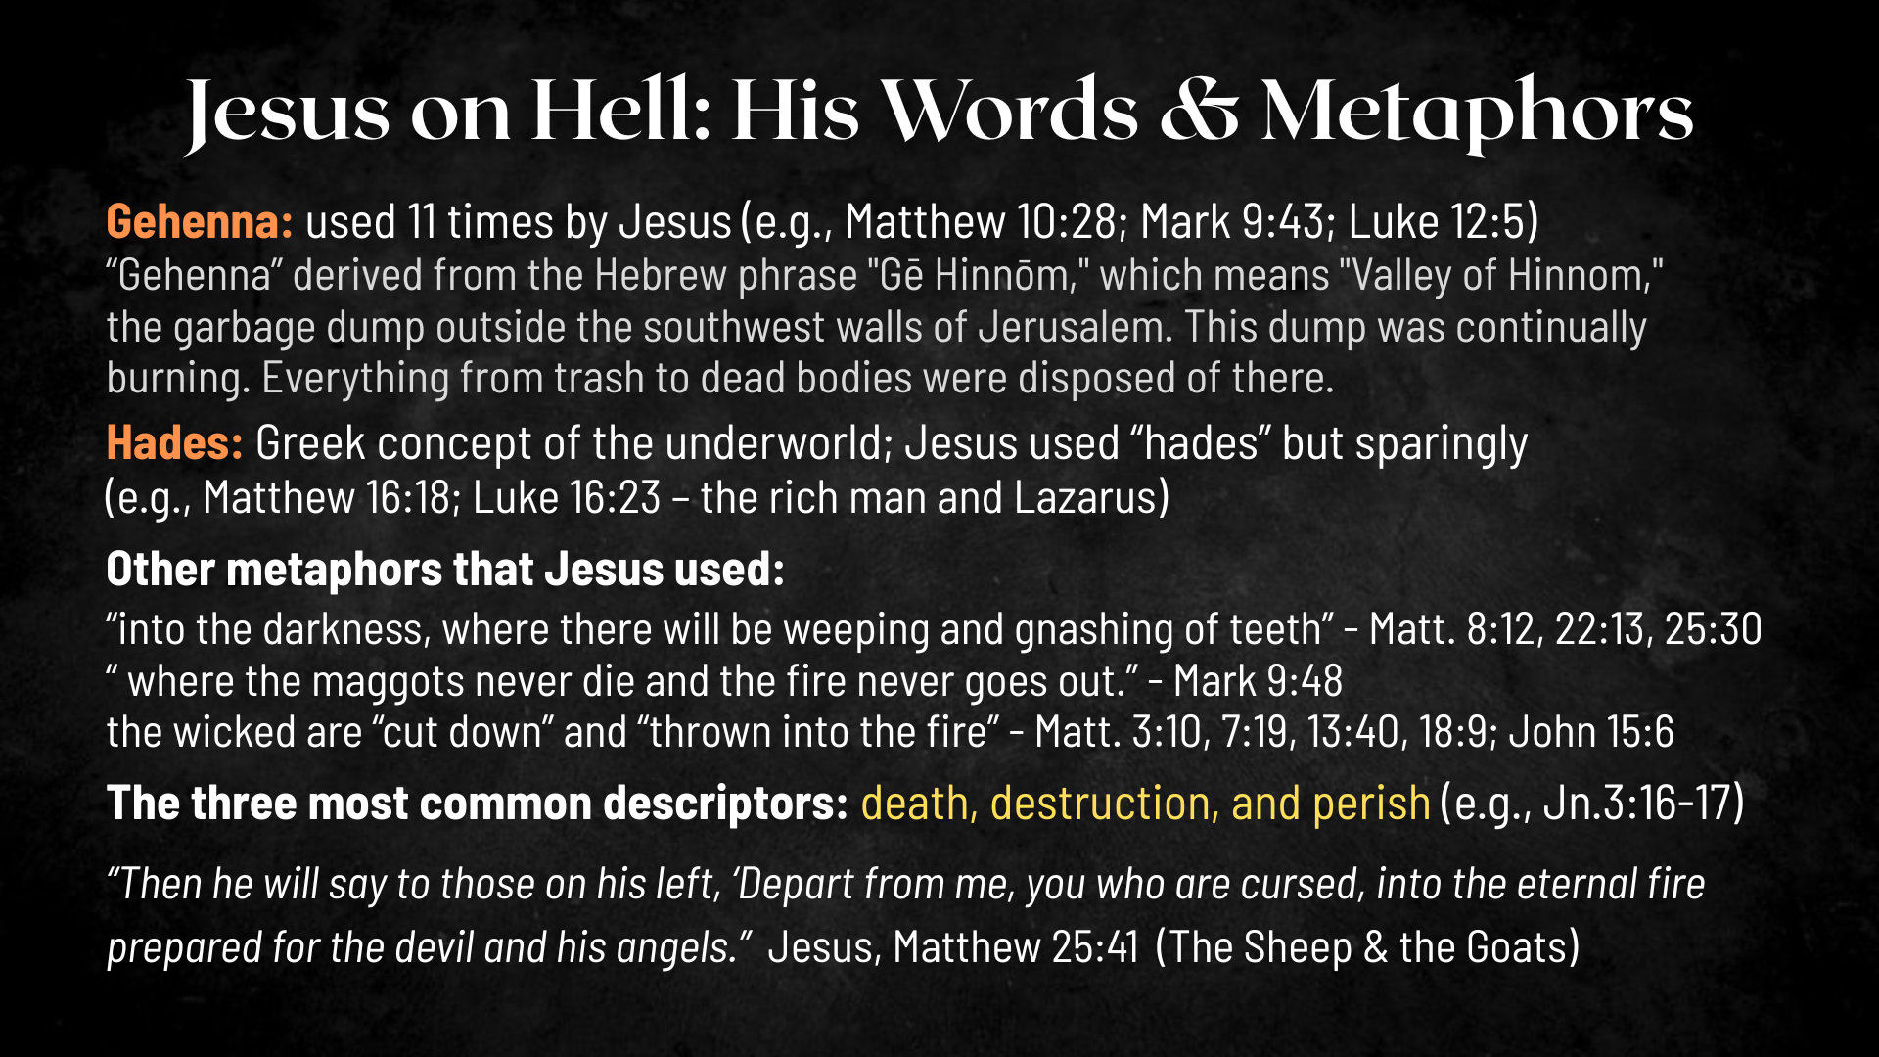
Notes:
The word “Gehenna” is translated as “hell” in the Gospels. It’s used 11 times by Jesus in the Gospels. Gehenna was the name of the Valley of Hinnom; the garbage dump outside the southwest walls of Jerusalem. It was also once the site of child sacrifice to Moloch in the days of Ahaz and Manasseh. This dump was continually burning. Everything from trash to dead bodies were disposed of there. The trash was consumed but the fire continued to burn as the smoke rose forever without end, just as hell is described in Revelation 14:11.
Jesus uses Gehenna to speak symbolically of the judgment of God. His metaphors would have undoubtedly spoken of a horrible judgment for those who did not accept God’s salvation. But it would indeed be misguided to hear Jesus describing a literal hell where there are worms, fire, and darkness all at the same time (Mk. 9:48). The point is… worms and fire speak of a complete and total destruction. And darkness is the absence of God, who is light.
It’s worth noting that Jesus uses “Gehenna” when speaking to the Pharisees, but he uses “Hades” when in Gentile territory. The Gentiles would have been familiar with this term. Hades was known as the Greek god of the underworld; the place of the dead. Jesus says to those that reject him, “you will be brought down to Hades” (i.e. grave, land of the dead). He even uses Hades in his parable of the rich man and Lazarus (Lk. 16:19-31).
Jesus uses the parable to warn that ignoring the needy and rejecting God’s revealed truth leads to irreversible judgment—so repentance must happen now, while there’s still time. He is not trying to describe the furniture of heaven and the temperature of hell, or that people in paradise can see or talk to people in hell. The point of the parable is to show the finality of the matter, not describe for the listeners a literal description of hell. Think of parables like jokes, in that when you’re listening to a joke it is important that you get the punch-line of that joke and not be distracted by the details leading up to that punch-line. It is the same in this parable told by Jesus. He is telling us that a person can reach a state that is beyond the life sustaining power of God, so don’t be like the selfish, greedy, indifferent rich man.
And I propose a better understanding of the adjective aionios (i.e. “eternal”). Eternal judgment does not speak of duration, but of consequence or result. The judgment is final—it is done. The Scripture also declares an “eternal redemption” and an “eternal salvation” that we would never take to mean that God will forever be saving and redeeming us. In the same way, “eternal” describes the far-reaching consequence of this judgment. The “eternal” nature of the matter is not that these things will be happening forever (never-ending), but that the results will never end. The results are “eternal” because they proceed and are final in the Age to Come. So, when the Bible speaks of eternal punishment, judgment, and destruction, it means to say that there is no end to the result. It can’t be reversed, as the results are final.
And if we take Jesus’ parable in Luke 16:19-31 literally, should we then assume that we too shall see our loved ones being eternally tortured and crying out for mercy? “Sorry, Charlie! Uh, I guess I should have witnessed to you more?” How could heaven, or the new heaven and earth, be glorious? This even causes a problem for those who are our enemies. For our love for them will be perfected upon resurrection. There is plenty of reason that we should question this interpretation, which goes back to Dante’s Inferno and other medieval concoctions of hell that have been propagated throughout church history.
[COMMENT ON THE OTHER METAPHORS]
Let’s consider now the main schools of thought when it comes to understanding hell as a final judgment against the wicked… [NEXT SLIDE]

Slide 9
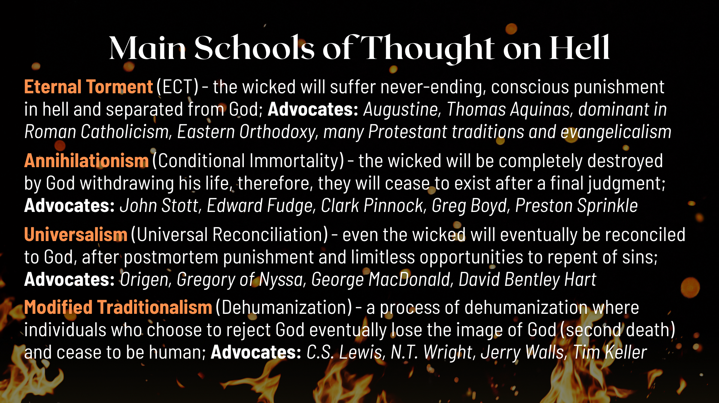
Notes:
[READ SLIDE & COMMENT]
NOTES:
Modified Traditionalism:
In his book, The Great Divorce, C.S. Lewis wrote: “There are only two kinds of people in the end: those who say to God, ‘Thy will be done,’ and those to whom God says, in the end, ‘Thy will be done.’ All that are in hell, choose it. Without that self-choice there could be no hell.” And in The Reason for God, Tim Keller said, “Hell is simply one’s freely chosen identity apart from God on a trajectory into eternity.”
[MY VIEW AT THE PRESENT]
And so, listen to these sobering words from Jesus in Matthew 10:28… [NEXT SLIDE]

Slide 10
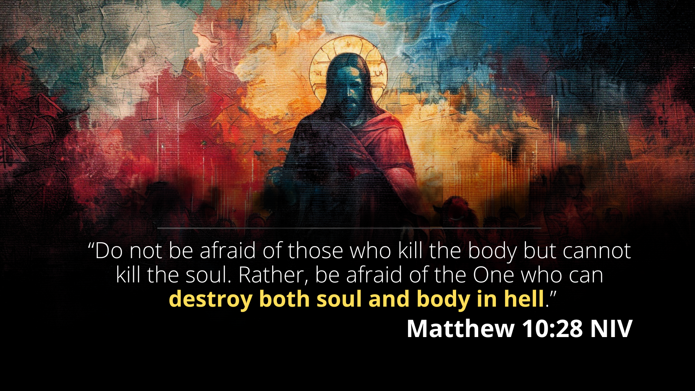
Notes:
[READ & COMMENT]
Regardless of what your view of hell might be—even though I think one or two are more plausible and reflective of Scripture and the God who looks like Jesus—it’s still a troubling reality for those who choose to walk away from the One who made them and offers them eternal life.
Because, no matter how you look at it, there is no getting around the fact that Jesus himself speaks of a destruction of the soul and body in a state of being that ends in death, i.e., a death after death.
After the apostle John shares his vision of the New Jerusalem coming from heaven to earth in Revelation 21, he records Jesus saying this… [NEXT SLIDE]

Slide 11
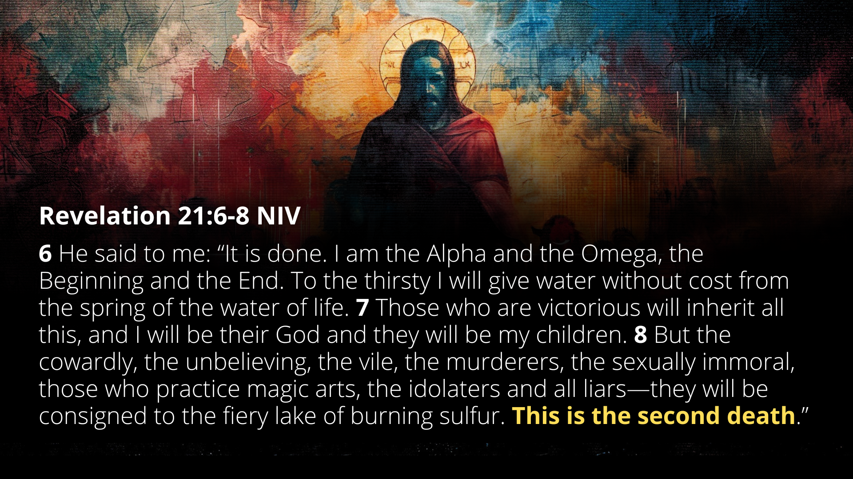
Notes:
[READ & COMMENT]
My friends, this how God is ridding his creation of all that doesn’t conform to his will and glory. So now, bring this understanding to this image… [NEXT SLIDE]

Slide 12
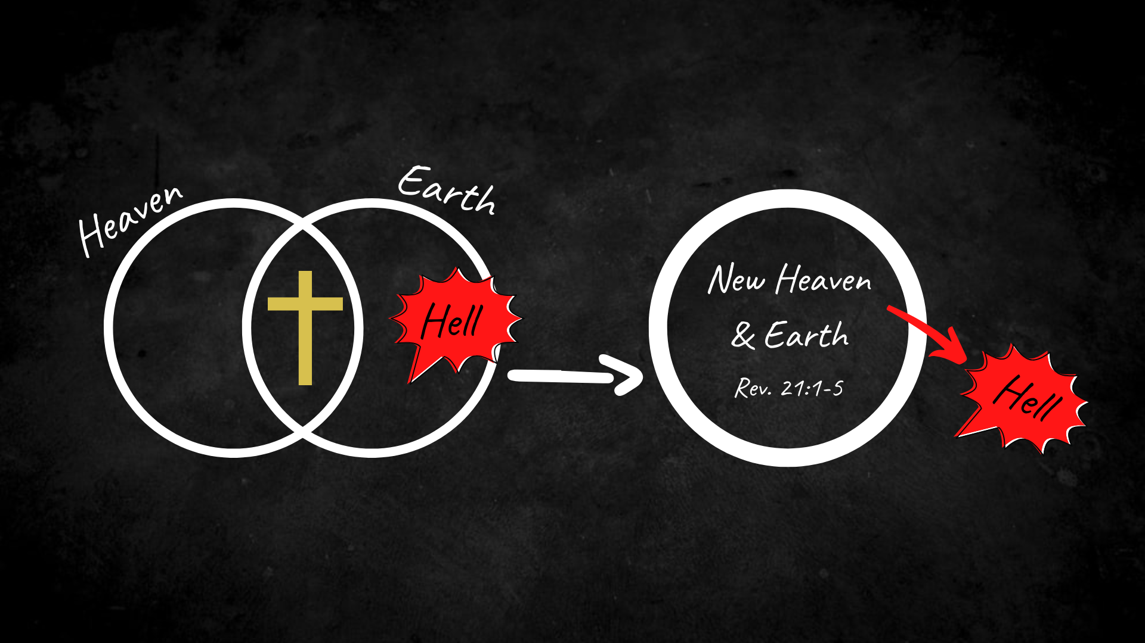
Notes:
[BRIEF COMMENTS]
Church, the earth is the Lord’s and everything in it. And so, he wants to get the hell out of you, the hell out of earth, and drive it out of his good creation once and for all. Therefore, that is what he is doing through the good news of Christ—his death and resurrection. And that’s what he will do someday when the Lord returns to set the world to rights; which is how we know where everything is going.
Let’s sum up the message with some takeaways and suggested application… [NEXT SLIDE]

Slide 13
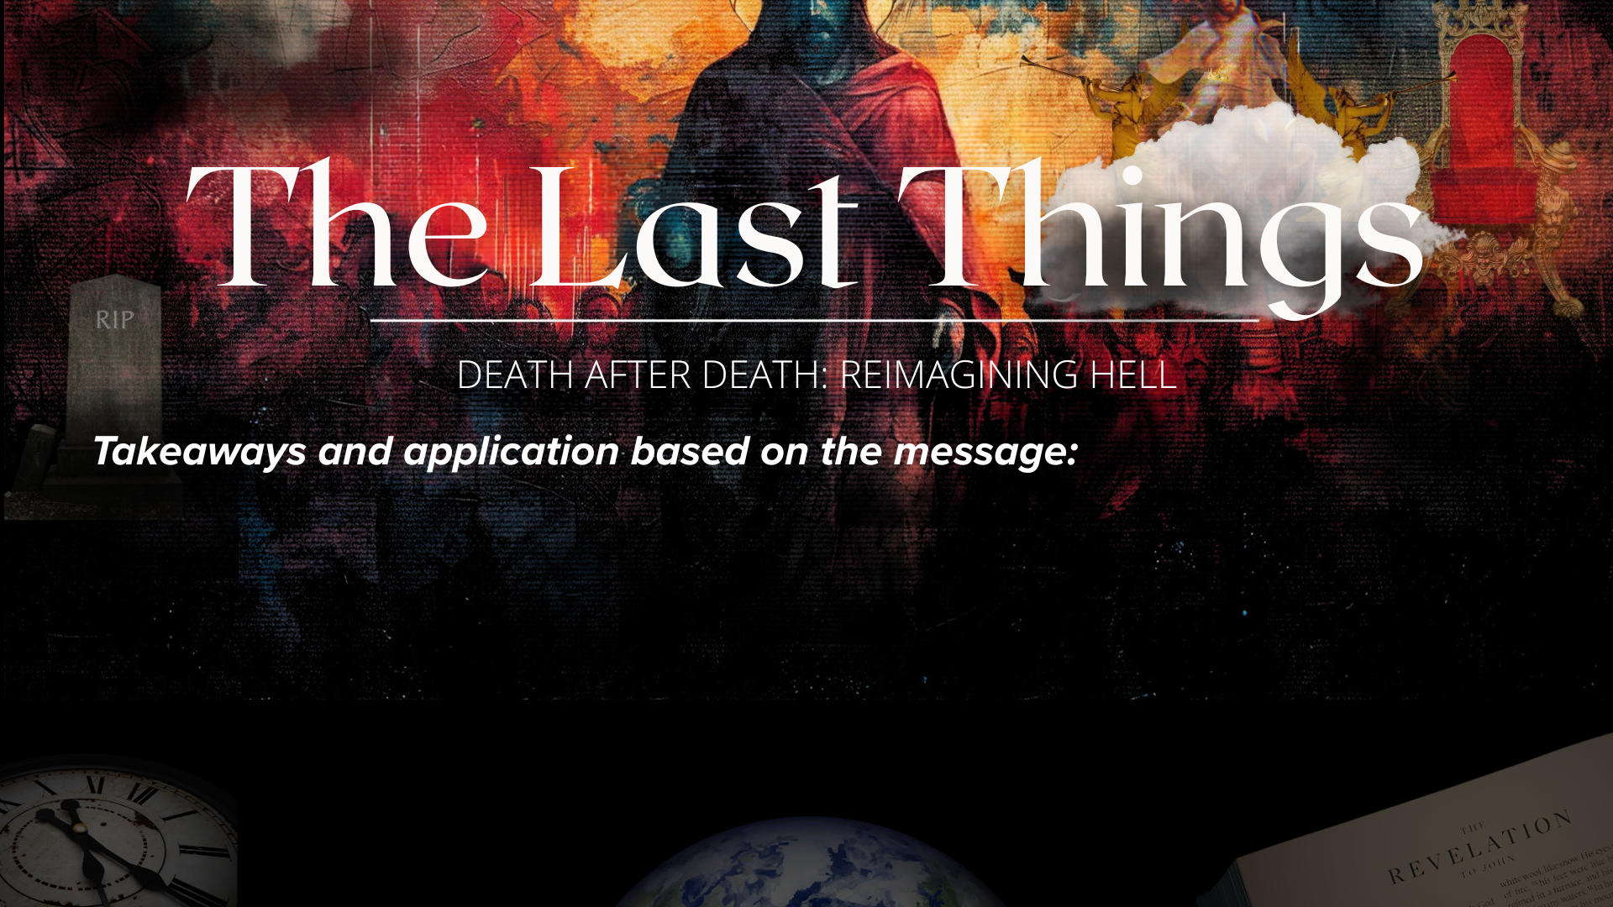

Slide 14
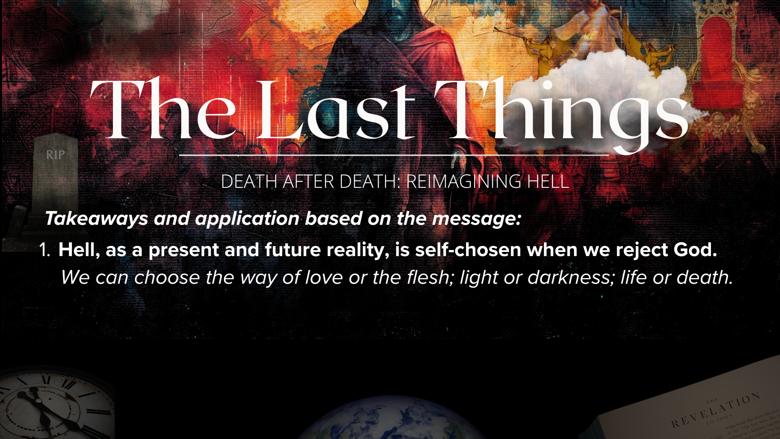

Slide 15
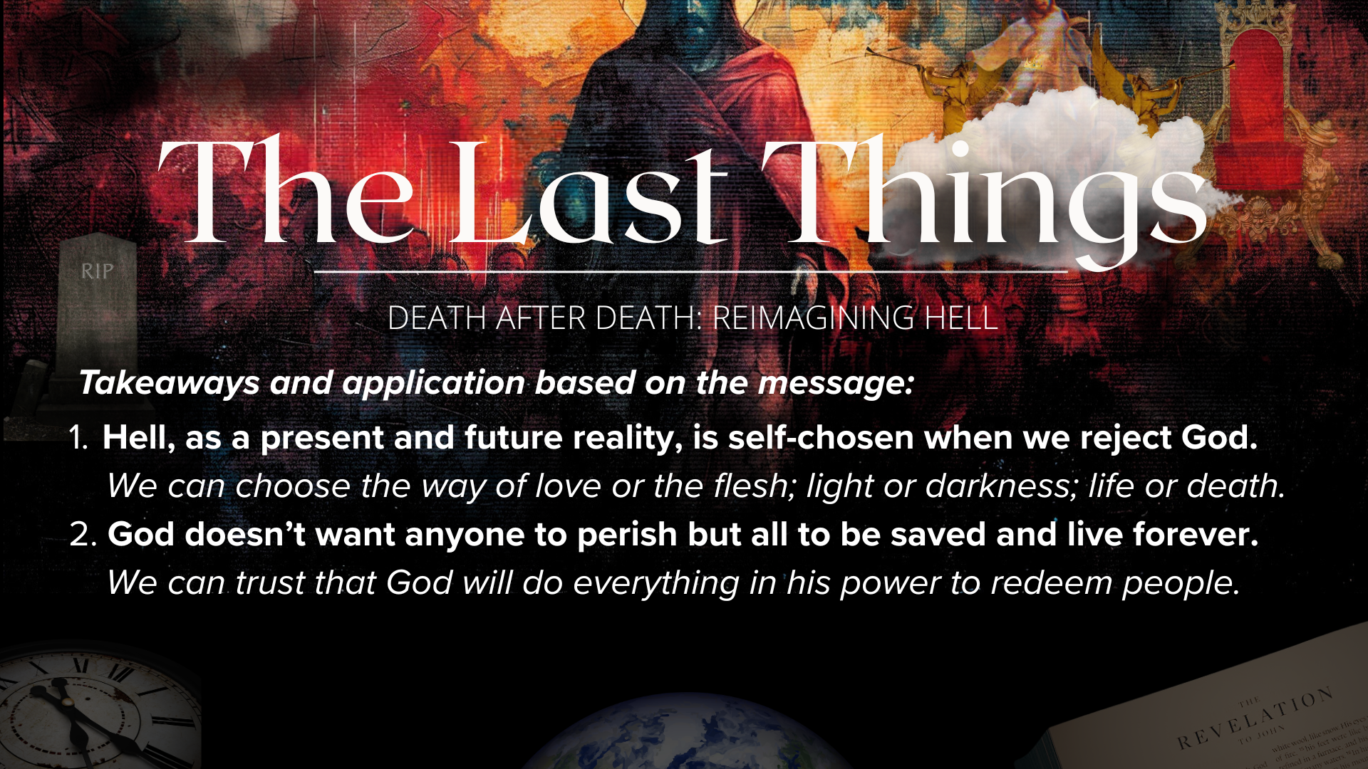

Slide 16
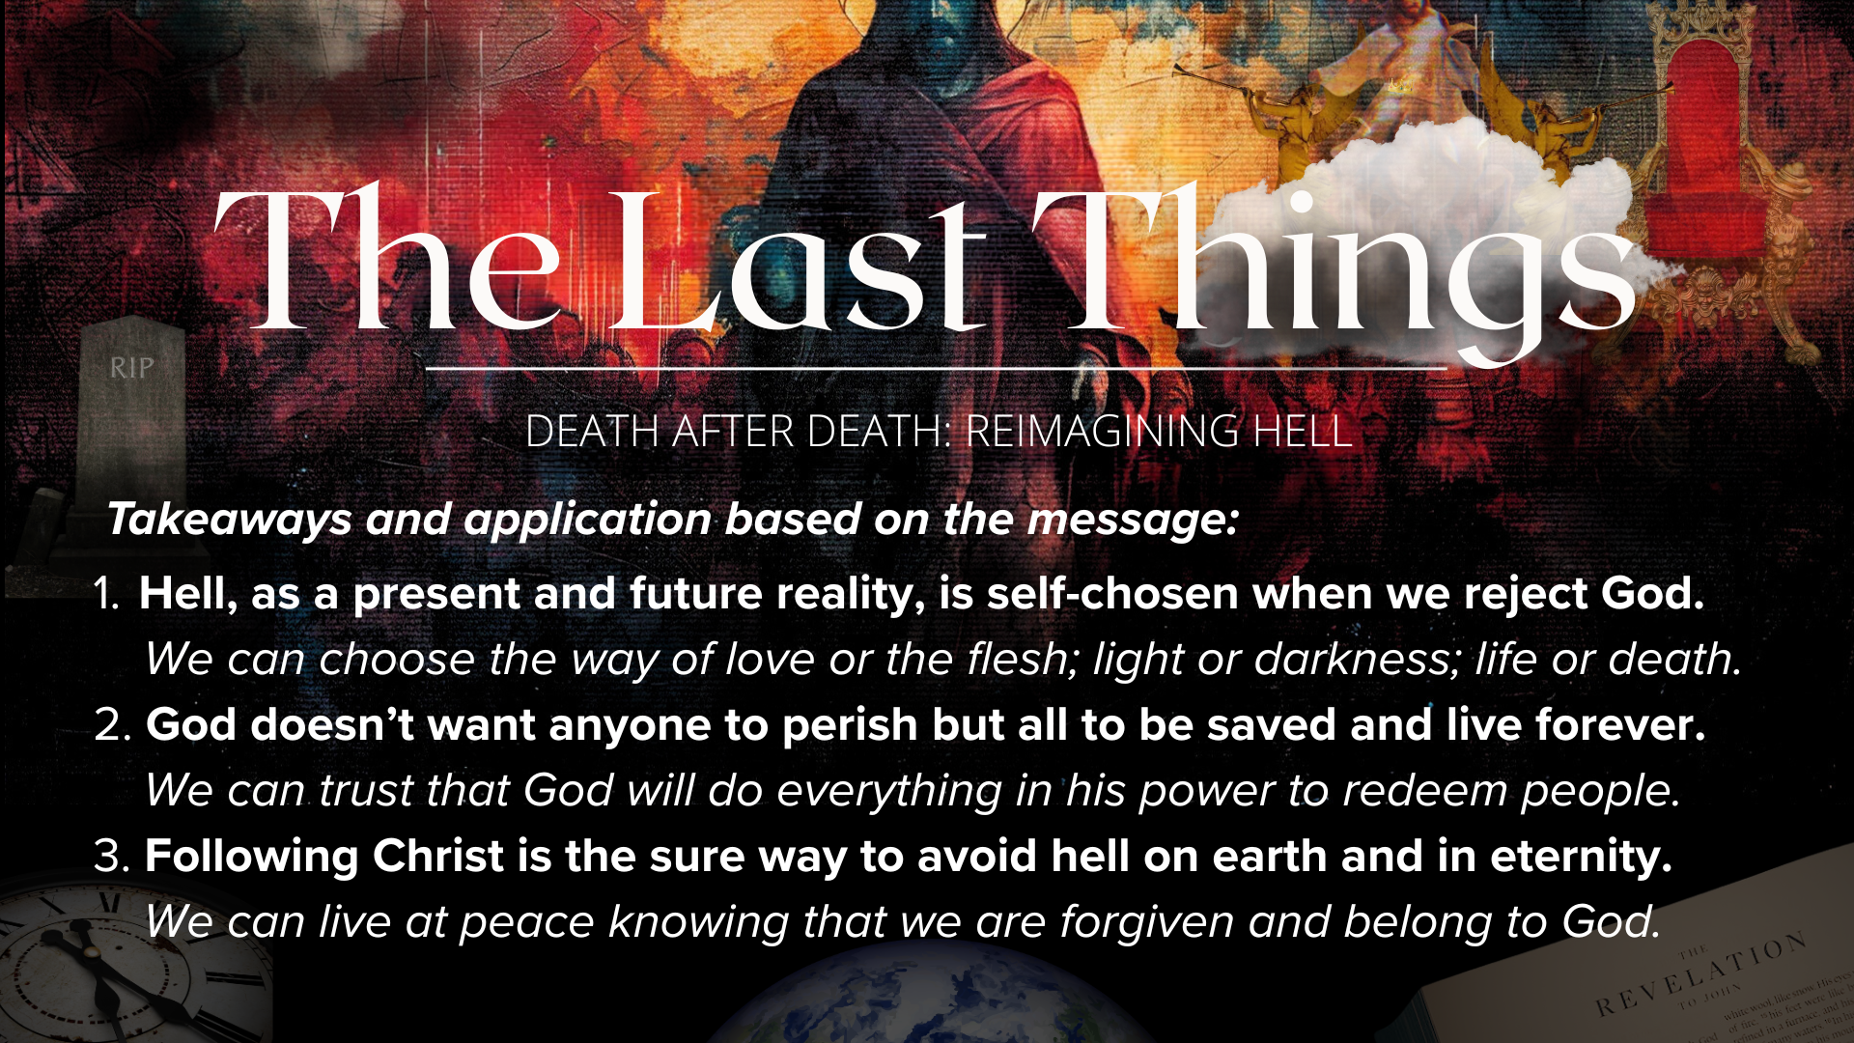
Notes:
[READ & COMMENT ON EACH TAKEAWAY]
Hell, as a present and future reality, is self-chosen when we reject God.
“The gates of hell are locked on the inside.” C.S. Lewis, The Problem of Pain
We can choose the way of love or the flesh; light or darkness; life or death.
God doesn’t want anyone to perish but all to be saved and live forever.
(2 Peter 3:9 “doesn’t’ want anyone to perish but everyone to come to repentance” and 1 Timothy 2:4 “all to be saved and come to a knowledge of the truth”)
Therefore, we can trust that God will do everything in his power to redeem people.
Following Christ is the sure way to avoid hell on earth and in eternity.
John 3:16 - “For God so loved the world that he gave his one and only Son, that whoever believes in him shall not perish but have eternal life.” And in John 5:24, Jesus said: “Very truly I tell you, whoever hears my word and believes him who sent me has eternal life and will not be judged but has crossed over from death to life.”
Friends, if we’ve given Christ our life and are following him, then we can live at peace knowing that we are forgiven and that we belong to God.
And finally, here are some questions to help us reflect and respond… [NEXT SLIDE]

Slide 17
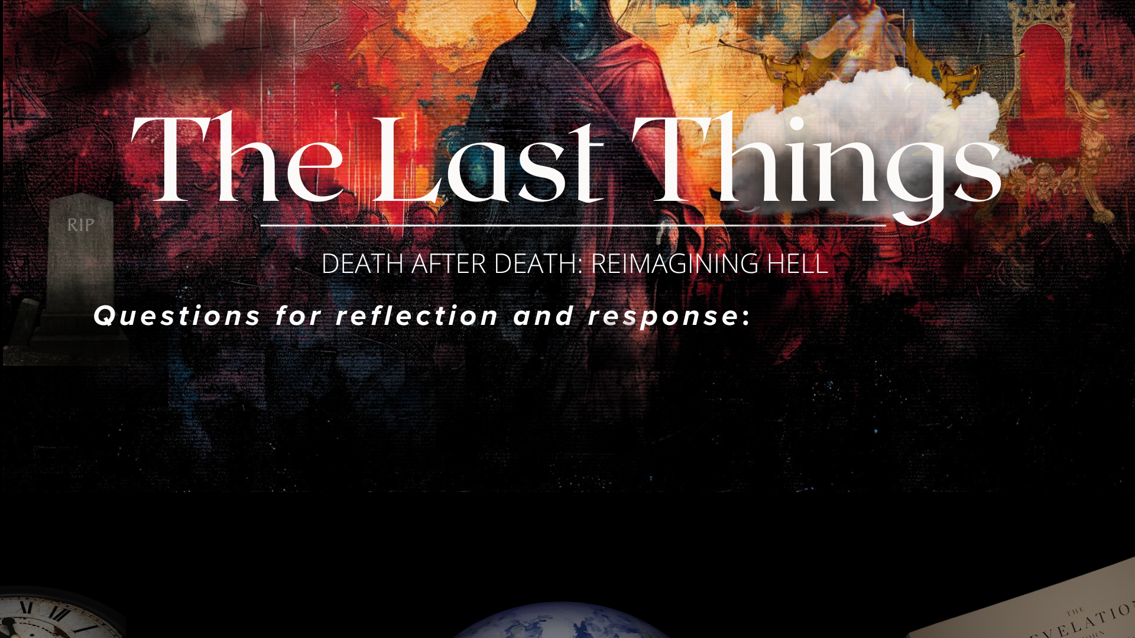

Slide 18
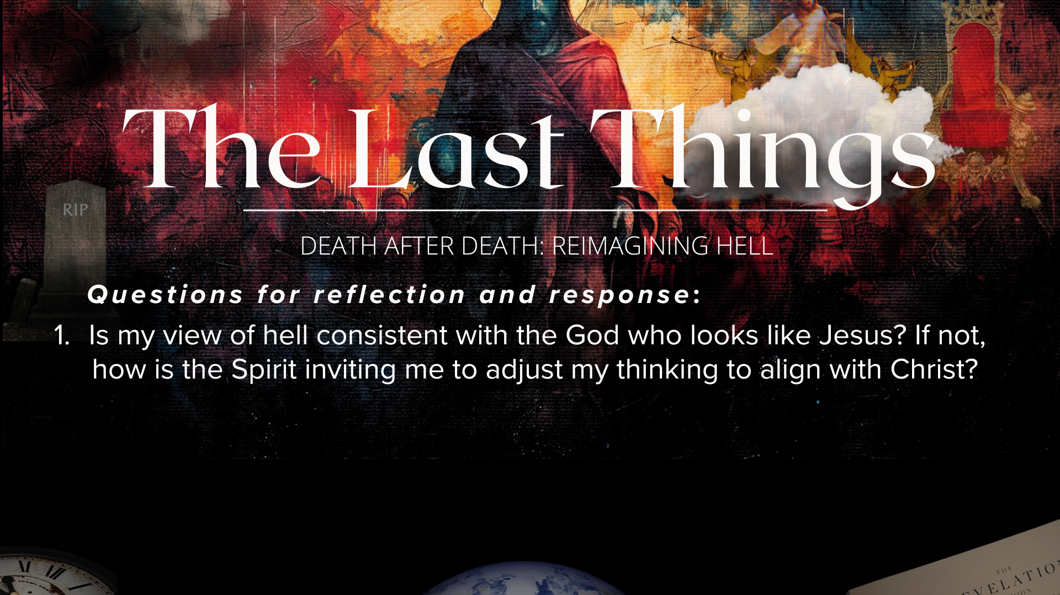

Slide 19
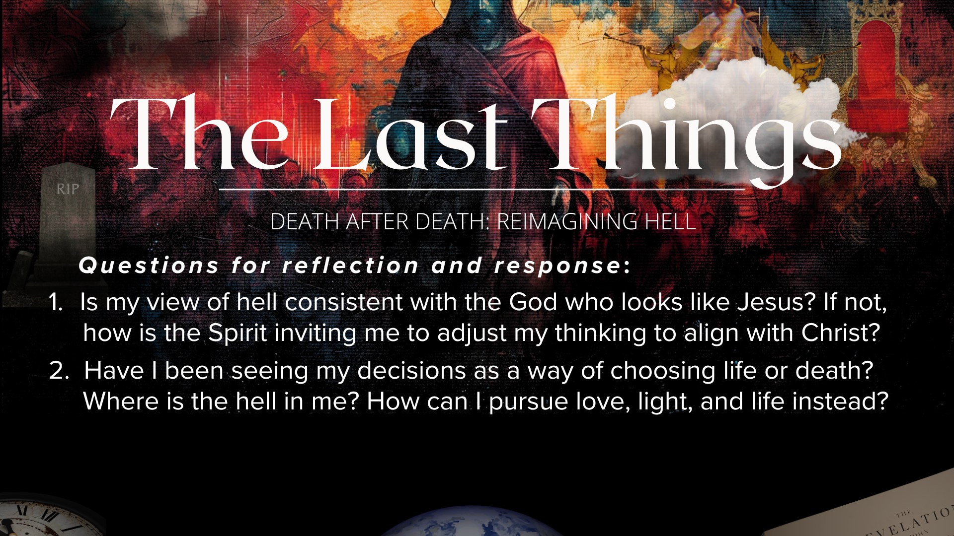

Slide 20
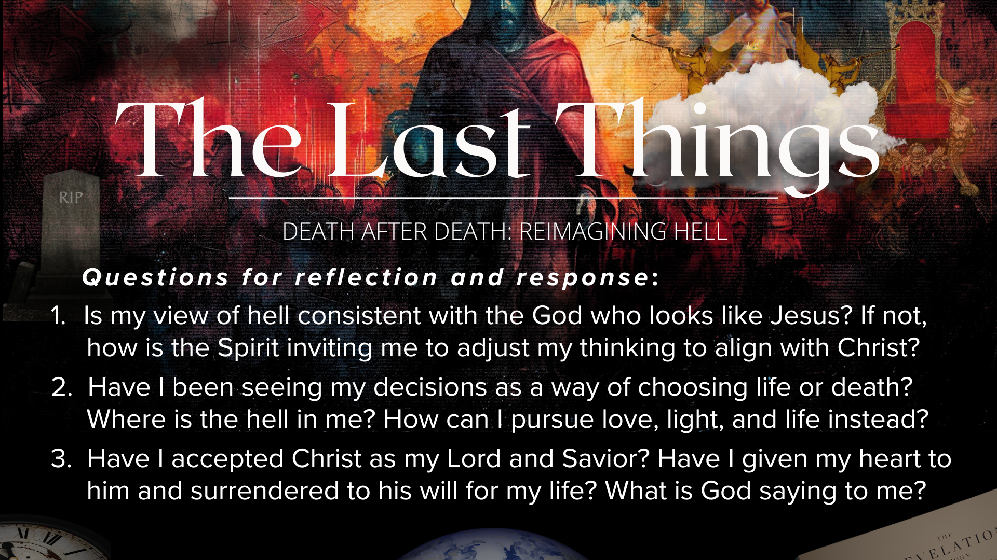
Notes:
[READ & BRIEF COMMENT ON EACH QUESTION]
Is my view of hell consistent with the God who looks like Jesus? If not, how is the Spirit inviting me to adjust my thinking to align with Christ?
Have I been seeing my decisions as a way of choosing life or death? Where is the hell in me? How can I pursue love, light, and life instead?
Have I accepted Christ as my Lord and Savior? Have I given my heart to him and surrendered to his will for my life? What is God saying to me?
Brothers and sisters, it’s not the Lord’s desire that anyone ever perish. It’s also not His desire to choose life for us. He has placed before us two paths: the way of life and of death. And through the incarnation He has broke into human history to show us His great love and make a way for abundant life. Jesus said that all are invited to the great banquet, but, unfortunately, not all RSVP (Matt. 22:8-9).
So, remember the words of Jesus who said, “I am the resurrection and the life. He who believes in me will live, even though he dies; and whoever lives and believes in me will never die. Do you believe this?”
Let’s pray… [NEXT SLIDE FOR CLOSING PRAYER]

Slide 21

Notes:
[CLOSING PRAYER]
[CLOSING SONG]
Benediction
Church, may our sovereign God fill you with peace as you look to the future with faith, not fear. May the promise of resurrection and eternal life anchor your soul in times of uncertainty and give you hope. And may you live in light of the last things with confidence that Christ will return and bring heaven to earth. Until we gather again, go in peace to love and serve the Lord. Amen.

