Slide 1

Notes:
[BRIEF INTRO]
Welcome
Week 2 in a 7-week fall sermon series – The Gospel of the Kingdom
Jesus said, “The kingdom of God has come near. Repent and believe the good news!” But what is this gospel of the kingdom? And how do we partner with God as believers and carriers of his good news? In this series we are exploring the redemptive story of God and what it looks like when we encounter the original good news of Jesus, and then how it ought to impact the world around us when we are living out the gospel through the local church.
Last Sunday I defined “good news” and “kingdom of God” this way: [NEXT SLIDE]

Slide 2
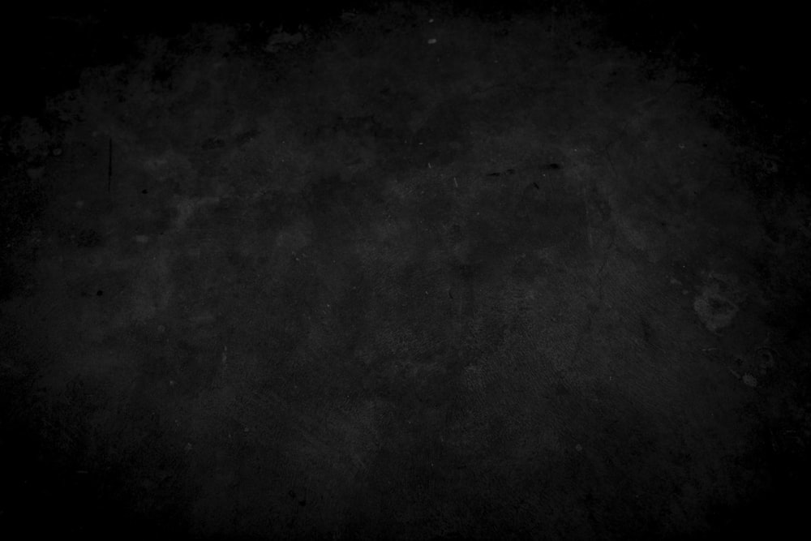
What is the Good News?
The gospel story of how God has been at work in the world and is now redeeming it in Jesus Christ—who will one day return to bring the fullness of the Kingdom.
What is the Kingdom of God?
The reign and rule of God on the earth, which always looks like Jesus (e.g., loving others, healing, reconciling, sacrificing self, showing mercy, doing justice, etc.).
Notes:
[READ GOOD NEWS DEFINITION]
To be even more specific, it encompasses…
The story of Israel—the OT (the larger biblical story)
The story of Jesus the Messiah (his life, teachings, death, resurrection & ascension)
The story of what Jesus continues to do through his Church (as we anticipate his return)
[READ KINGDOM OF GOD DEFINITION]
The kingdom is already, but not yet—we live in the overlap of the ages
Heaven is coming to earth; God’s space and our space will be joined in Christ’ return
Last week I illustrated the larger good news story this way… [NEXT SLIDE]

Slide 3
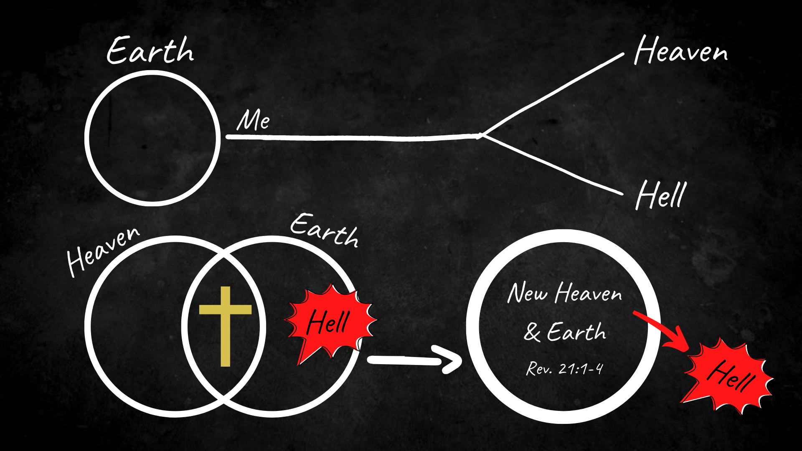
Notes:
[BRIEF COMMENTS ON IMAGE]
TOP: The popular modern version of the story is full of partial truths and distortions
BOTTOM: God intends to consummate heaven and earth, and rid the cosmos of hell (sin & death)
Getting this story right matters!
- it’s true to the original good news and Christian hope
- our portrait of God is shaped by the story we tell
- a reductionist gospel doesn’t lead to disciples
- our beliefs about the future impacts the present
So, the things we believe matter because those beliefs are connected to action (or inaction) and to discipleship. We should desire that our actions and our beliefs align because that is biblical faith—faith that saves. Amen?
And that brings us to today’s message… [NEXT SLIDE]

Slide 4

Notes:
[BRIEF COMMENTS]
It’s critical that we understand the gospel as story and then embrace historic Christian beliefs about Jesus. These beliefs not only ensure that we are faithful to the original good news, but (as I said) they impact the way we live and respond to God’s coming kingdom. Therefore, this morning I want to help us see why our beliefs about Jesus matter and how the good news changes everything. And then in the last part of this message I’d like to come back to the gospel as story and visualize what it means to accept the good news about Jesus.
But before we do that… please join me in a quick prayer.
[BRIEF PRAYER & NEXT SLIDE]

Slide 5
Scripture Reading
1 Corinthians 15:1-8, 20-28 NIV
Notes:
[READ & EXPOUND ON THE SCRIPTURE]
[VERSE-BY-VERSE]
So, let’s come back to the gospel as story and think of these gospel truths from within the story. And I’d like to tell the story a little differently this time around, in hopes of making it ever more clear for us. [NEXT SLIDE]

Slide 6
The Gospel in Chairs
Notes:
[ILLUSTRATE THE TWO VERSIONS OF THE GOSPEL]
The modern, legal, western view
The ancient, restorative, eastern (more biblical) view
[THE MAJOR DIFFERENCES]
In the first version, God needs to punish in order to forgive
In the second (more ancient) version, humanity needs to be reconciled to God, not God to humanity (Paul said, “God was in Christ reconciling the world to himself” 2 Cor 5:19)
* And notice, God never turns away from sinful humanity, he confronts us with his love
Also, in the restorative view, you never pit God the Father against his Son (Jesus doesn’t need to “satisfy” the Father’s wrath, he doesn’t change or placate the Father, but he rather reveals the Father)
The good news is that God is like Jesus. He has always been like Jesus. There has never been a time when God was not like Jesus. We haven’t always known this, but we do now. So… take this understanding of the gospel and hear afresh these familiar words of Jesus… [NEXT SLIDE]

Slide 7
Jesus, John 3:16-18 NIV
¹⁶ For God so loved the world that he gave his one and only Son, that whoever believes in him shall not perish but have eternal life. ¹⁷ For God did not send his Son into the world to condemn the world, but to save the world through him. ¹⁸ Whoever believes in him is not condemned, but whoever does not believe stands condemned already because they have not believed in the name of God’s one and only Son.
Notes:
[READ & BRIEF COMMENTS]
So, what must someone do to be saved? In Acts 2:38, the apostle Peter said… [NEXT SLIDE]

Slide 8
“Repent and be baptized, every one of you, in the name of Jesus Christ for the forgiveness of your sins. And you will receive the gift of the Holy Spirit.”
Acts 2:38 NIV
Notes:
[READ & BRIEF COMMENTS]
And then the apostle Paul said this… [NEXT SLIDE]

Slide 9
Paul, Romans 10:9-10 NIV
⁹ If you declare with your mouth, “Jesus is Lord,” and believe in your heart that God raised him from the dead, you will be saved. ¹⁰ For it is with your heart that you believe and are justified, and it is with your mouth that you profess your faith and are saved.
Notes:
[READ & BRIEF COMMENTS]
And then in Ephesians 2:8-9, Paul wrote…

Slide 10
“For it is by grace you have been saved, through faith—and this is not from yourselves, it is the gift of God—not by works, so that no one can boast.”
Paul, Ephesians 2:8-9 NIV
Notes:
[READ & BRIEF COMMENTS]
Finally, let’s reflect on what we’ve heard this morning and respond as the Spirit leads… [NEXT SLIDE]

Slide 11

Questions for reflection and response:
Gospel Truths

Slide 12
Questions for reflection and response:
Have you accepted these gospel truths?
Gospel Truths

Slide 13
Questions for reflection and response:
Have you accepted these gospel truths?
How is God inviting you to respond today?
Gospel Truths
Notes:
[BRIEF COMMENT ON EACH]
[CLOSING WORDS]
[CLOSING PRAYER – NEXT SLIDE]

