Slide 1

Notes:
[BRIEF INTRO]
Welcome
Recognize Bishop Heather Beaty
This is my last message before going on sabbatical. So, this morning I’m going to preach and then toward the end I’ll give some insights into what I’ll be doing when I’m gone, respond to some of your questions, and then Heather will come and share a few words before a sending prayer.
Please open your Bibles to the Gospel of Matthew… [NEXT SLIDE]

Slide 2
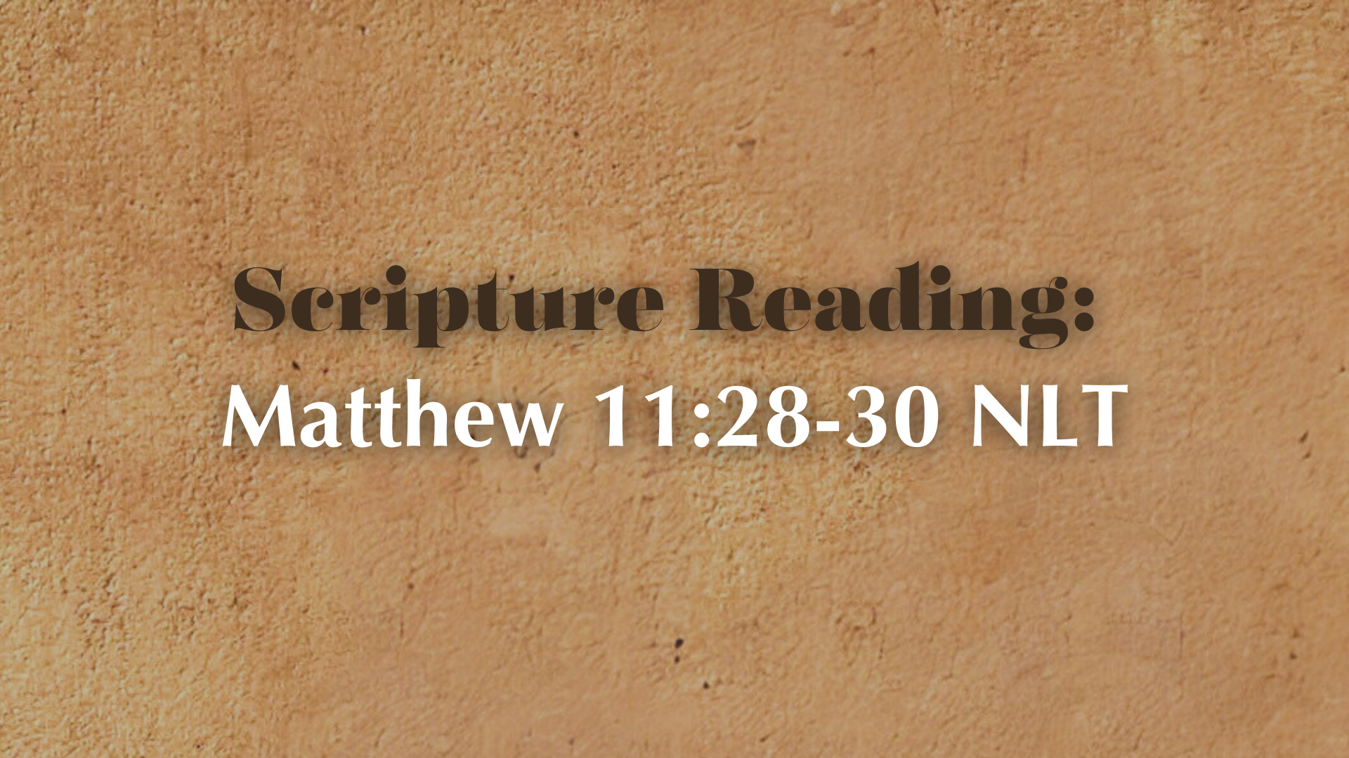
Notes:
[INVITE CHURCH TO STAND & READ] – “This is the Word of the Lord. Thanks be to God.”
You may be seated… [NEXT SLIDE]

Slide 3
Notes:
[BRIEF COMMENTS]
Some of you will recall that I once shared there there is a pattern in my life of hardship, challenge, or transition every 7 years: 1999 - repentance; 2006 - left vocational ministry & my denomination; 2013 - returned to vocational ministry and left Texas; 2020 - the most difficult year or my life; leading and growing through conflict and a global pandemic.
All of these events were moments when I was confronted with the words of Jesus in Matthew 11:28-30 - “Come to me, all you who are weary and burdened, and I will give you rest. Take my yoke upon you and learn from me, for I am gentle and humble in heart, and you will find rest for your souls. For my yoke is easy and my burden is light.”
If you’re like me… you at times might experience a sort of cognitive dissonance with this. Maybe you’ve wondered, “Really, Lord? Your yoke is easy? Your burden is light? Because I feel like I’m drowning here. I feel like I’m being crushed by the weight of it all.”
But over time, I’ve come to realize, while being a disciple in the way of Jesus, and particularly being a pastor today, isn’t easy, Jesus has never been the one to add dead weight and soul-crushing pressure to my journey; instead, He has been the one to help me lift it and navigate whatever comes as a result of my own sin, of living in a fallen world, and being opposed by the devil.
So, let’s look more closely at what Jesus said in Matthew 11:28-30 and unpack his meaning so we can receive his words and apply them to our lives… [NEXT SLIDE]

Slide 4
Matthew 11:28-30 NIV
²⁸ “Come to me, all you who are weary and burdened, and I will give you rest. ²⁹ Take my yoke upon you and learn from me, for I am gentle and humble in heart, and you will find rest for your souls. ³⁰ For my yoke is easy and my burden is light.”
Notes:
[READ EACH VERSE & COMMENT]
v. 28 – “Come to me” – while the words are quite obvious in their meaning, we can just as easily move right past them and miss the intentionality and free will that the Lord is asking us to exercise. He says, “Come to me”… i.e., we must make a decision of the will to pursue Jesus when we are anxious, weary, and heavy-laden with all manner of things, e.g., cares of the world, mental distress, depression, exhaustion, worn out from sensory overload and the demands on our time, etc. etc.
Jesus says, “Come to me, bring all of the stuff that is weighing you down, and I will give you rest.” The word for rest in the Greek means refreshment, a ceasing from movement or labor to recover strength; it is the Greek equivalent of the Hebrew word Shabbat, or sabbath. After all, Jesus said he is Lord of the Sabbath. So, while taking a day off is good for you, and a subversive act in Caesar’s world, it is not enough in and of itself. What we need is the kind of rest that can only be found in Jesus Christ.
v. 29 – Take my “yoke” upon you. We will come back to “yoke” in just a minute. And “learn” from me, Jesus says. The word for “learn” here is the same root of the Greek word for “disciple” (i.e., a learner). Don’t miss that. This is an invitation into discipleship. Come to me and learn from me. Listen to that. Jesus knows something we don’t know. He has something we don’t have. He has experienced life (because he is life itself) which we don’t have without him but can have if we will learn from him. And more than learning some interesting facts and information, or even uncovering the mysteries of the universe, or answering life’s most perplexing questions, Jesus offers himself. And it’s by his meekness, his gentle nature, his humble heart, his merciful and gracious reception of sinners, that we are wooed and ushered into his rest. It’s by experiencing who he is that we can find rest for our souls.
v. 30 – “For my yoke is easy and my burden is light.” What is a yoke? I thought it would help us all (and not just the younger folks in the room) to see a real yoke. Seth, will you please bring out the yoke?
[BRIEF COMMENTS ON THE YOKE]
Here is a picture of what this kind of yoke looks like on livestock… [NEXT SLIDE]

Slide 5
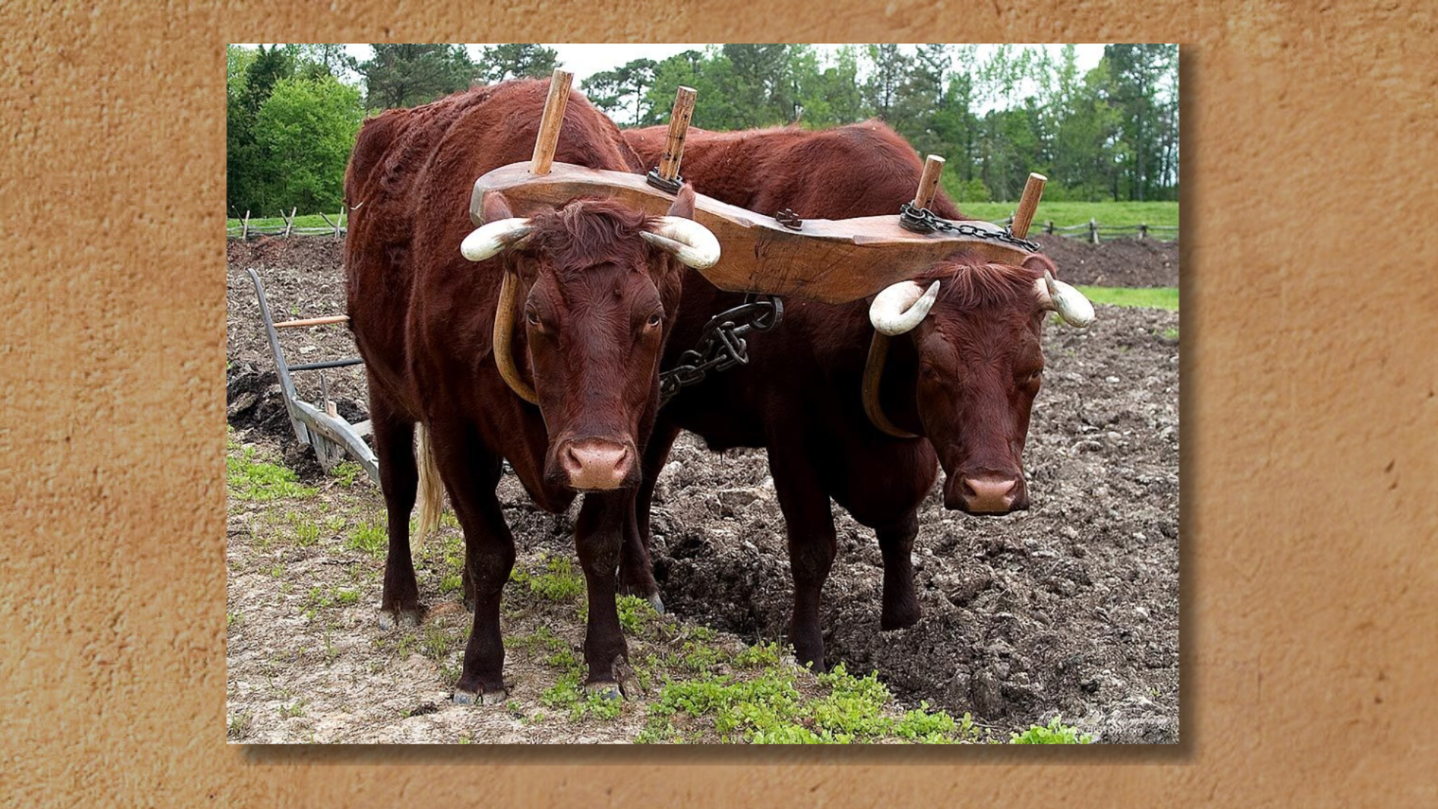
Notes:
[READ & COMMENT]
What does Jesus mean by take my yoke upon you? I think there are a few layers of meaning here. Think about this with me.
First, notice, there are two in the yoke—paired up and working together. Jesus is trying to convey the partnership that exists between the disciple (the learner) and the Master.
And so, this would certainly communicate that his yoke is easy and his burden is light because you’re not having to carry it on your own. He is with you; if not carrying the bulk of the weight himself.
But there was another kind of yoke in the first century and one that is still used in some places today. It’s a yoke specifically made for humans to carry things… [NEXT SLIDE]

Slide 6

Notes:
[READ & COMMENT]
A shoulder yoke allows you to carry heavy buckets full of various things; helps to distribute the weight equally across the shoulders and back
It’s possible that Jesus has this yoke in mind as well, as he uses a well-known image as a metaphor for following him in a world full of hard, uncomfortable yokes and heavy burdens
And a couple things worth pointing out here is that yokes were often thought of negatively. Leviticus 26:13 states that God delivered his people from a “yoke of slavery” to Egyptian servitude. Even Jewish rabbis referred to the Law of Moses as a yoke, but a necessary burden (they said) that leads to a wise life. Yet, Jesus says “take my yoke” upon you, not that of the Law, not that of slavery, not that which crushes you; But my yoke, which feels better on you and is better for you. It’s what you were made for.
Of course, we also can’t help but see the connection to the “yoke” which Jesus himself bore. And my friends, his yoke wasn’t for carrying buckets of water. It was for carrying the weight of our sins… [NEXT SLIDE]

Slide 7
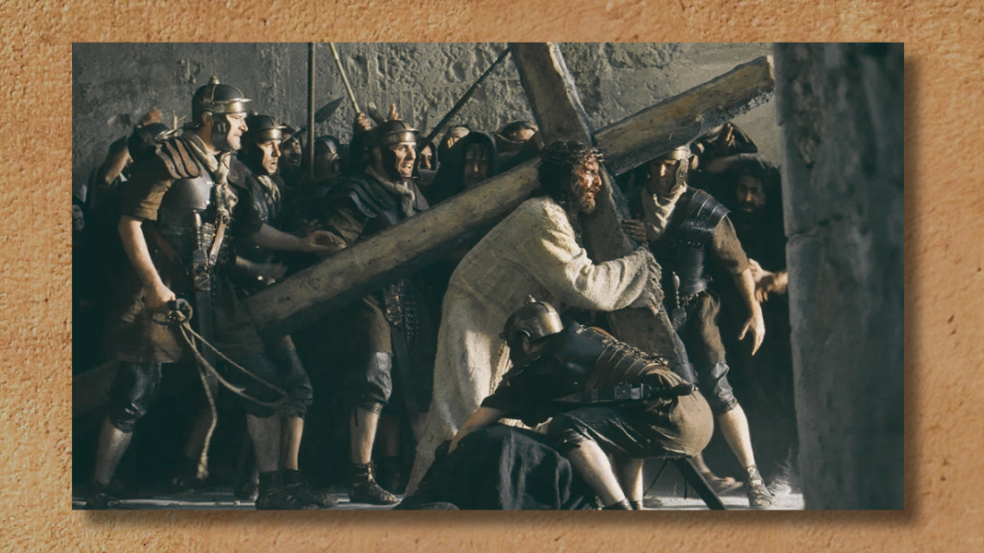
Notes:
Yes, the final layer of meaning here is that ”my yoke” which Jesus is referring to is the crossbeam which he carried across his back for our sake. And this is the wisdom of God for those who have eyes to see and ears to hear what Jesus means. When he says, “take my yoke upon you” he does in fact mean that we are to take up our cross and follow him in hardship and suffering. But he also means to say that he has gone before us carrying the greatest weight of all. And that this feat wasn’t just for winning a future victory, but for overcoming sin and the powers of hell in your life right now.
Someday you and I will be fully delivered, and the weariness and burdens will be completely eradicated. But for now, he invites us to yoke ourselves to him, to carry your cross, and be changed by knowing him; thereby entering his rest, regardless of what may come and whatever trial or tribulation awaits us. We can enter his rest.
So, what does that look like in our everyday lives? What are some ways that we can find rest in Jesus? [NEXT SLIDE]

Slide 8
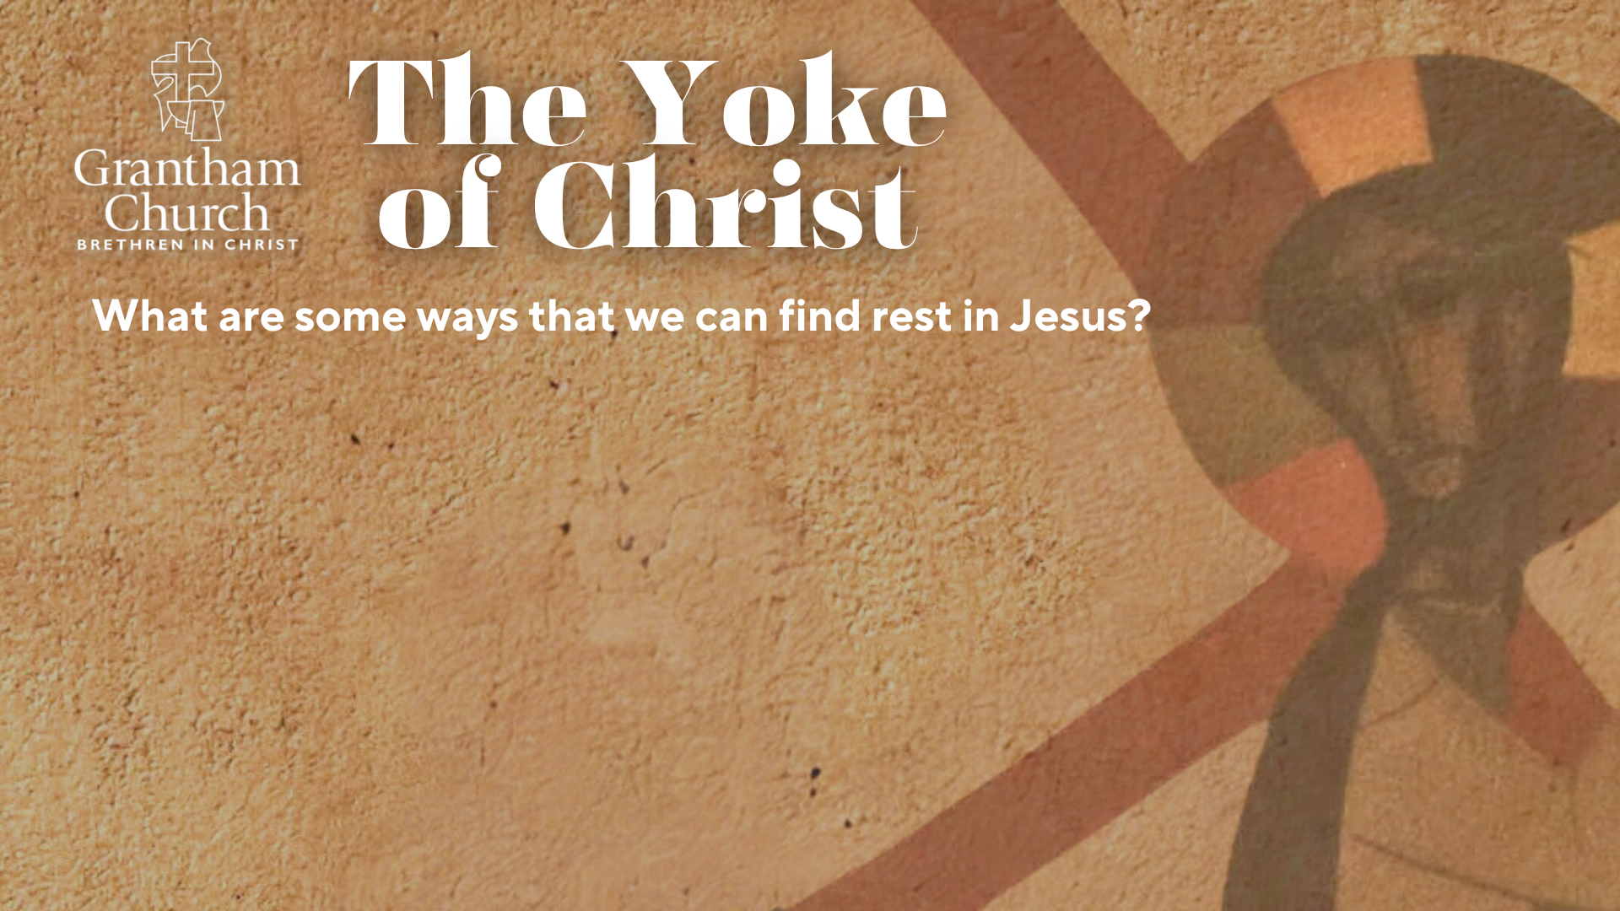

Slide 9
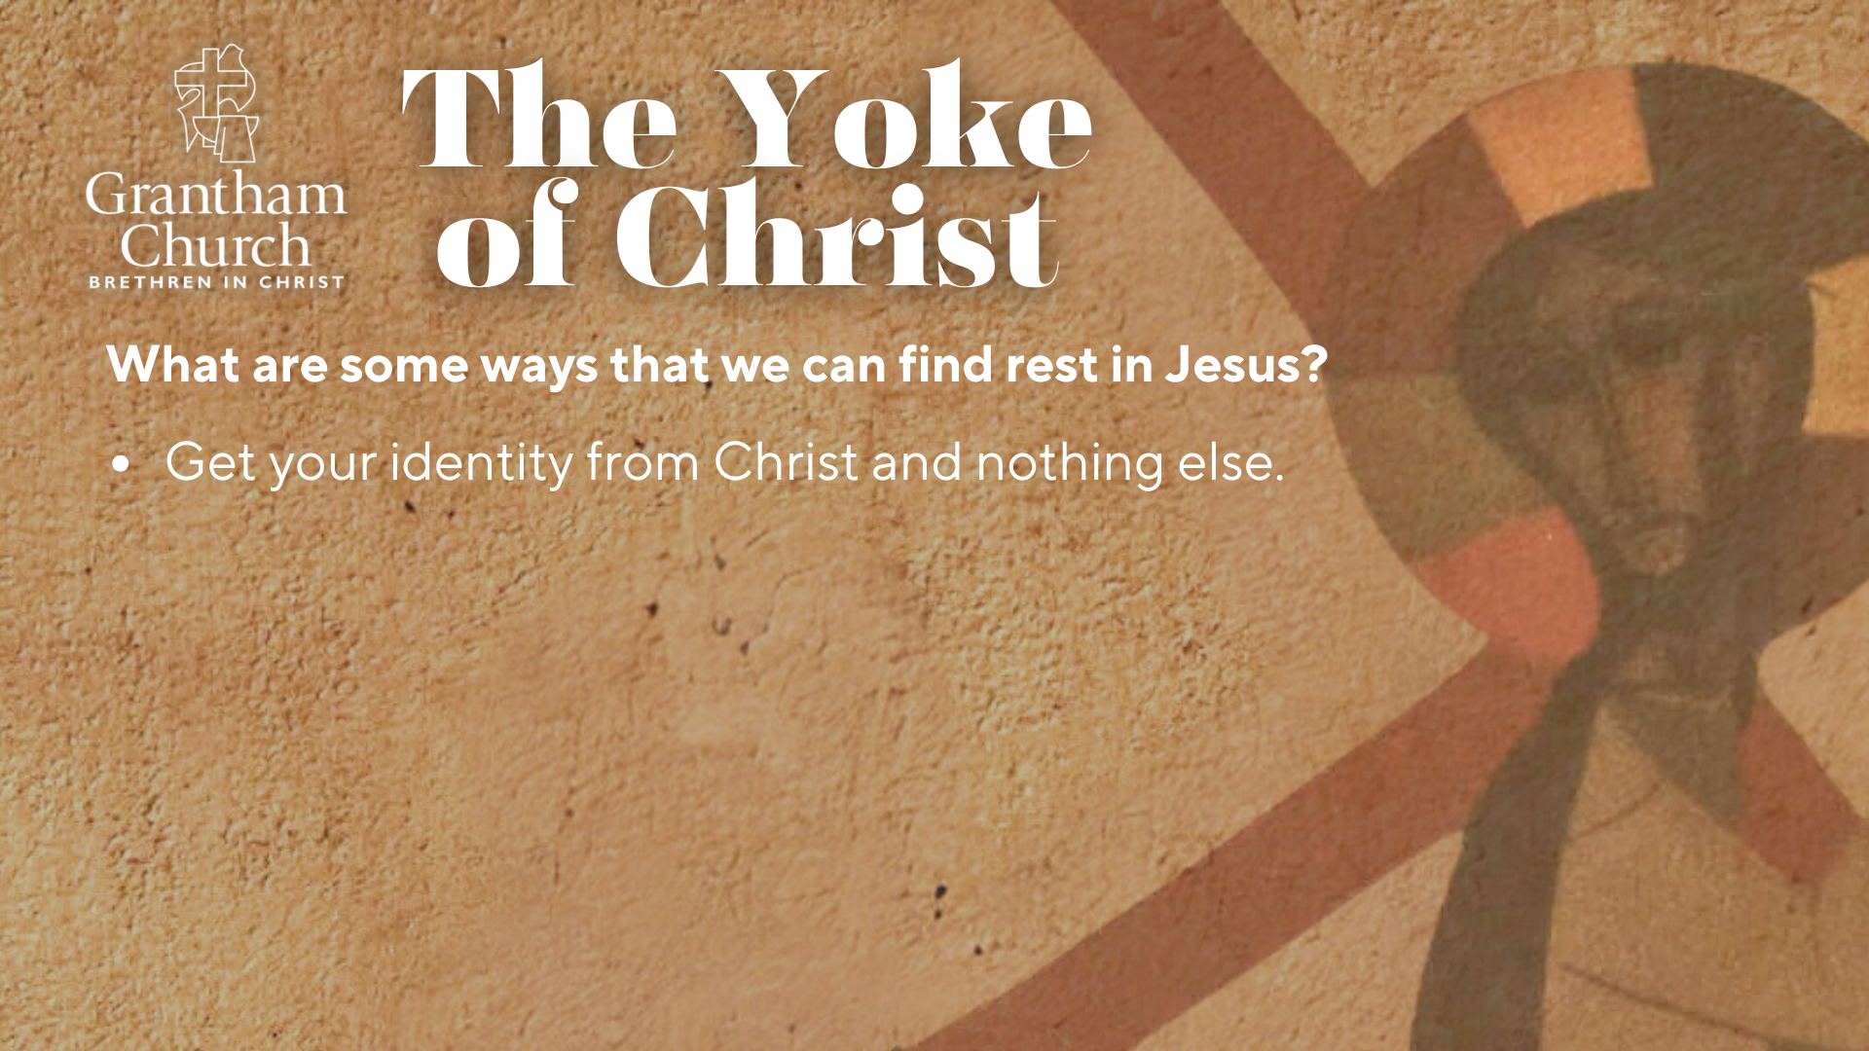

Slide 10
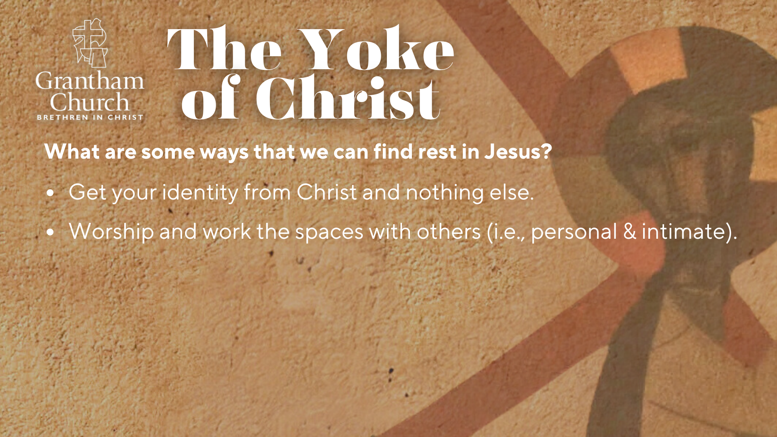

Slide 11
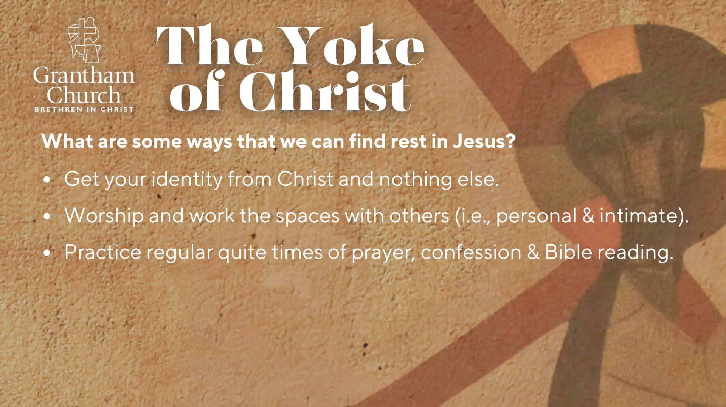

Slide 12
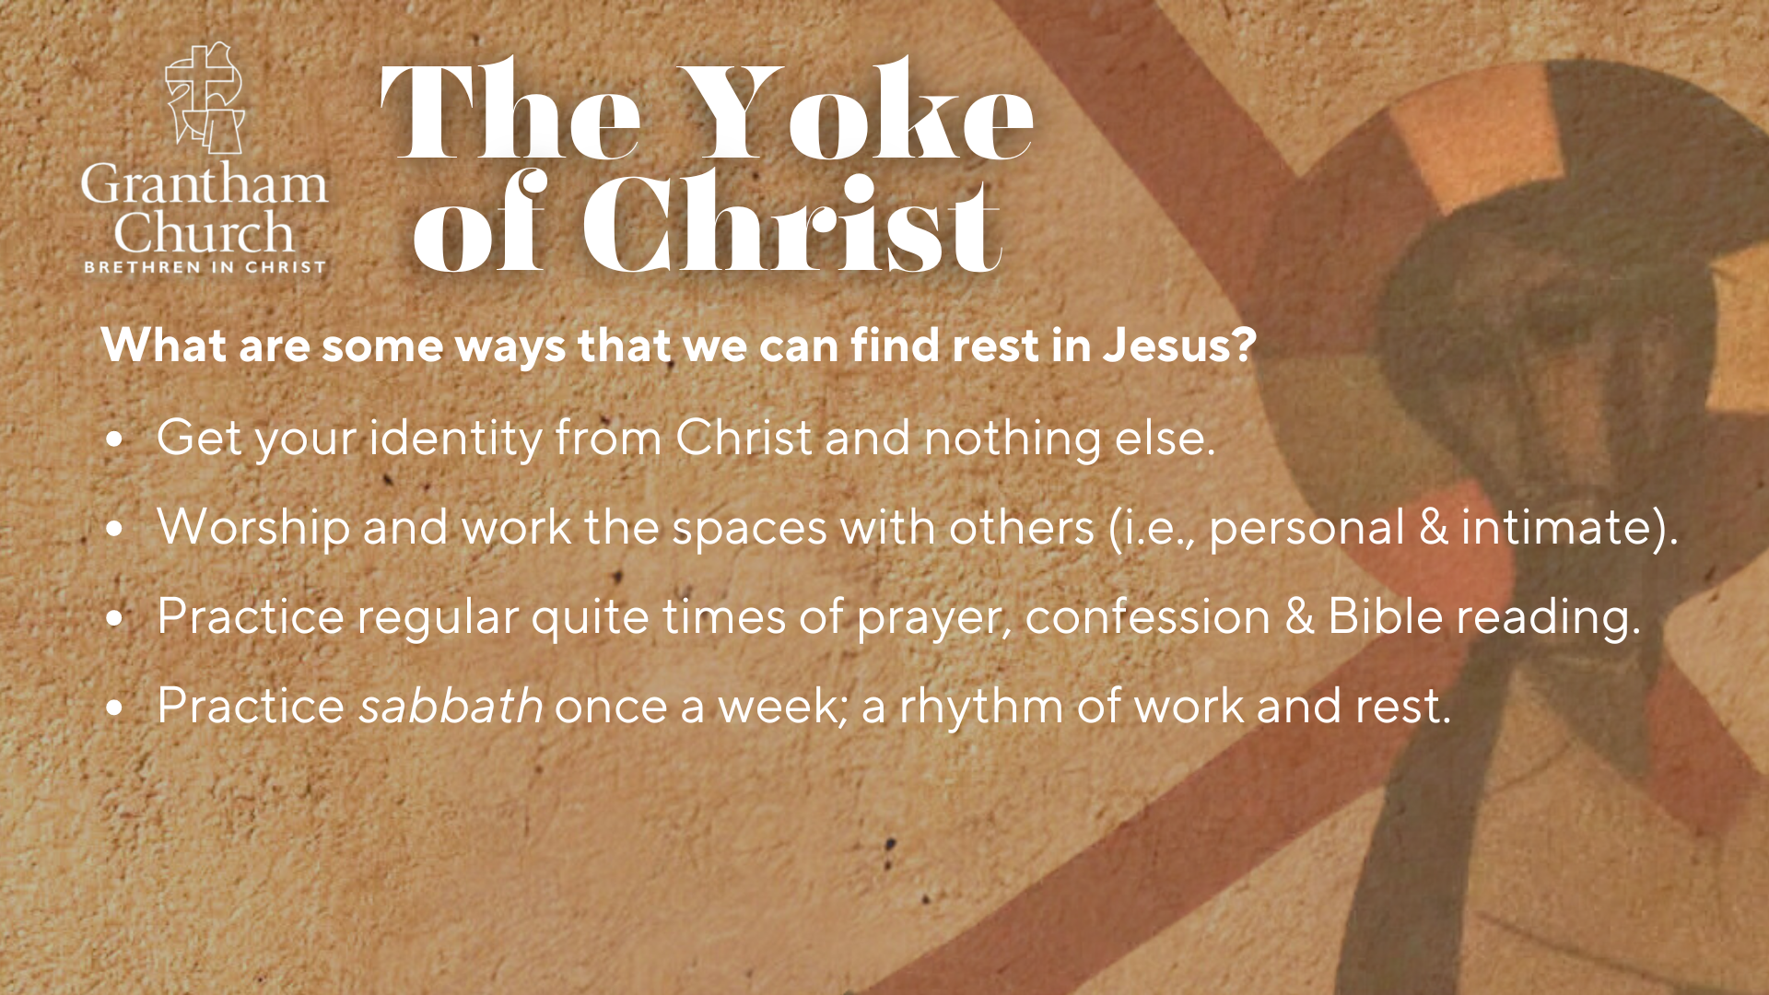

Slide 13
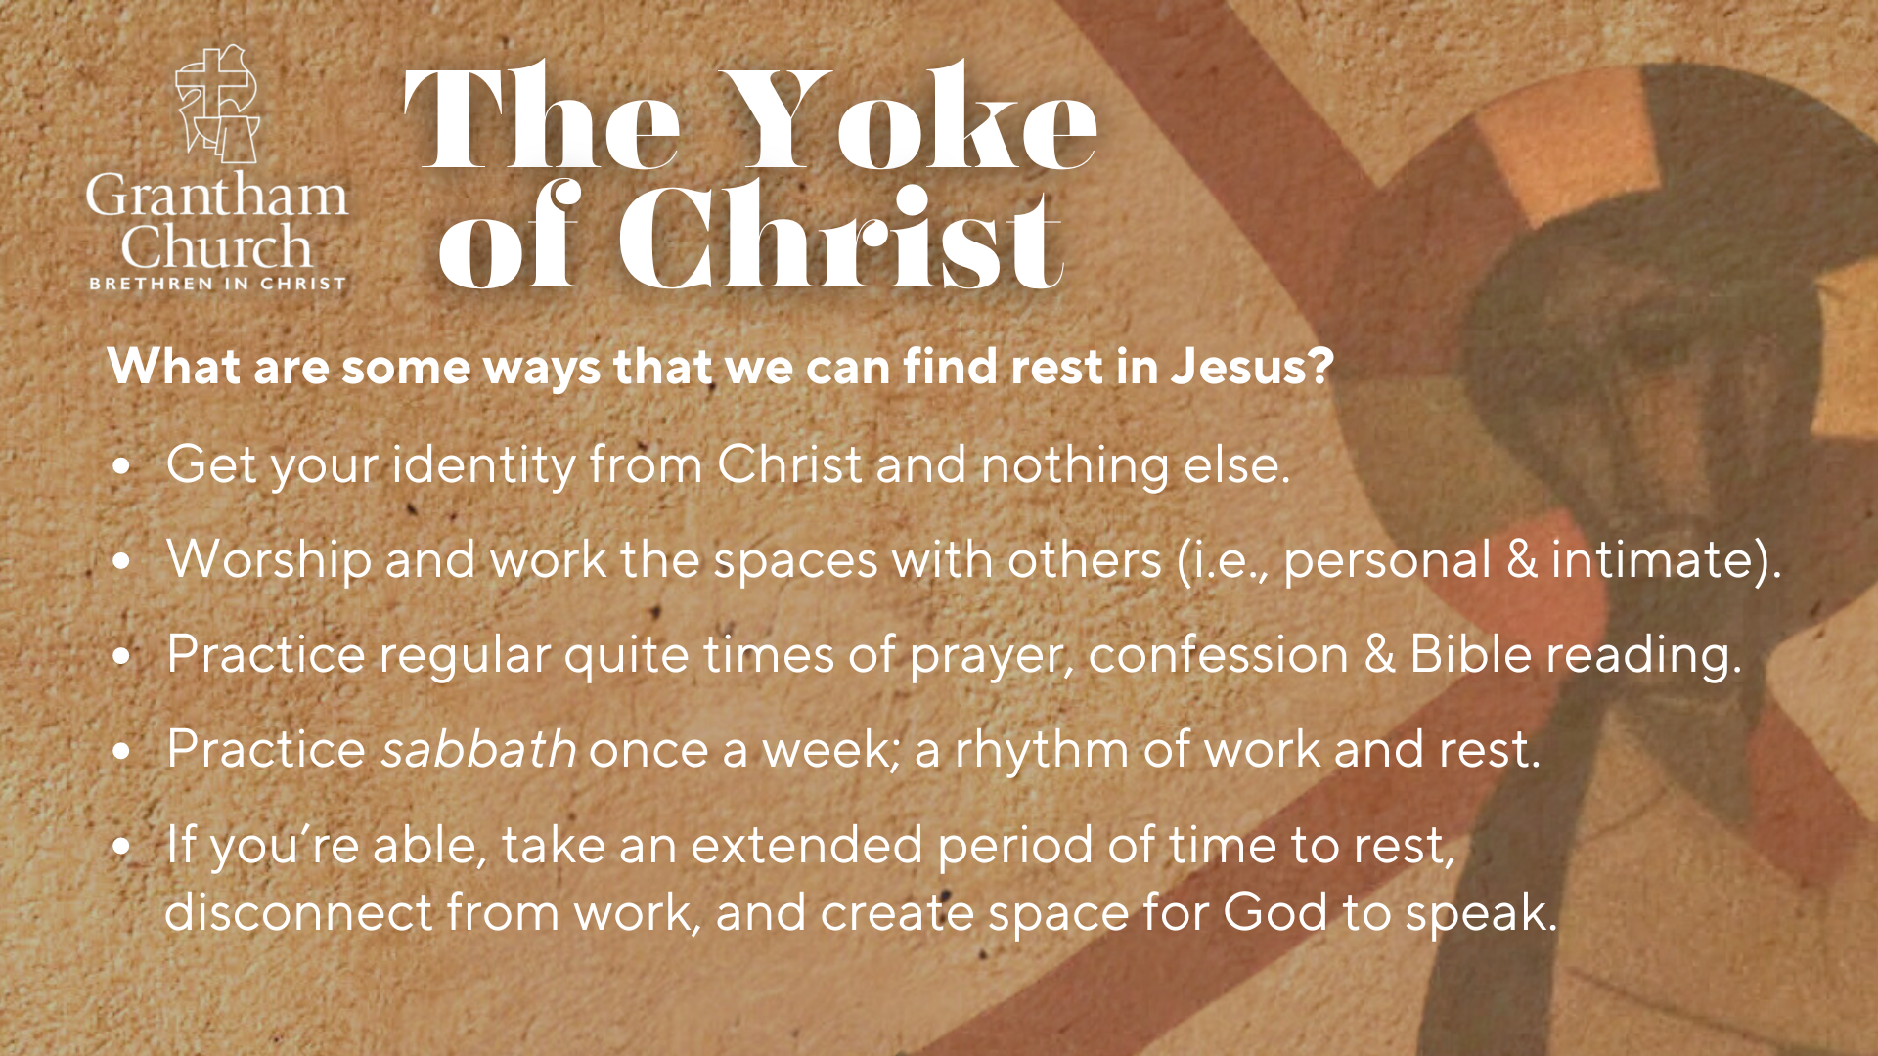
Notes:
[READ & BRIEF COMMENT ON EACH POINT]
Get your identity from Christ and nothing else.
Worship and work the spaces with others (i.e., personal & intimate).
Practice regular quite times of prayer, confession & Bible reading.
Practice sabbath once a week; find a healthy rhythm of work and rest to sustain you.
Hebrews 4:9-10 – “There remains, then, a Sabbath-rest for the people of God; for anyone who enters God’s rest also rests from their works, just as God did from his.”
If you’re able, take an extended sabbath to rest, to disconnect from work (that is identity-forming), and to create space for creativity, new ideas, clarity, discernment, and for God to speak to you.
It’s because of your kindness and love for me that you’re allowing me to do that, not only for my sake, but for yours as well… [NEXT SLIDE]

Slide 14
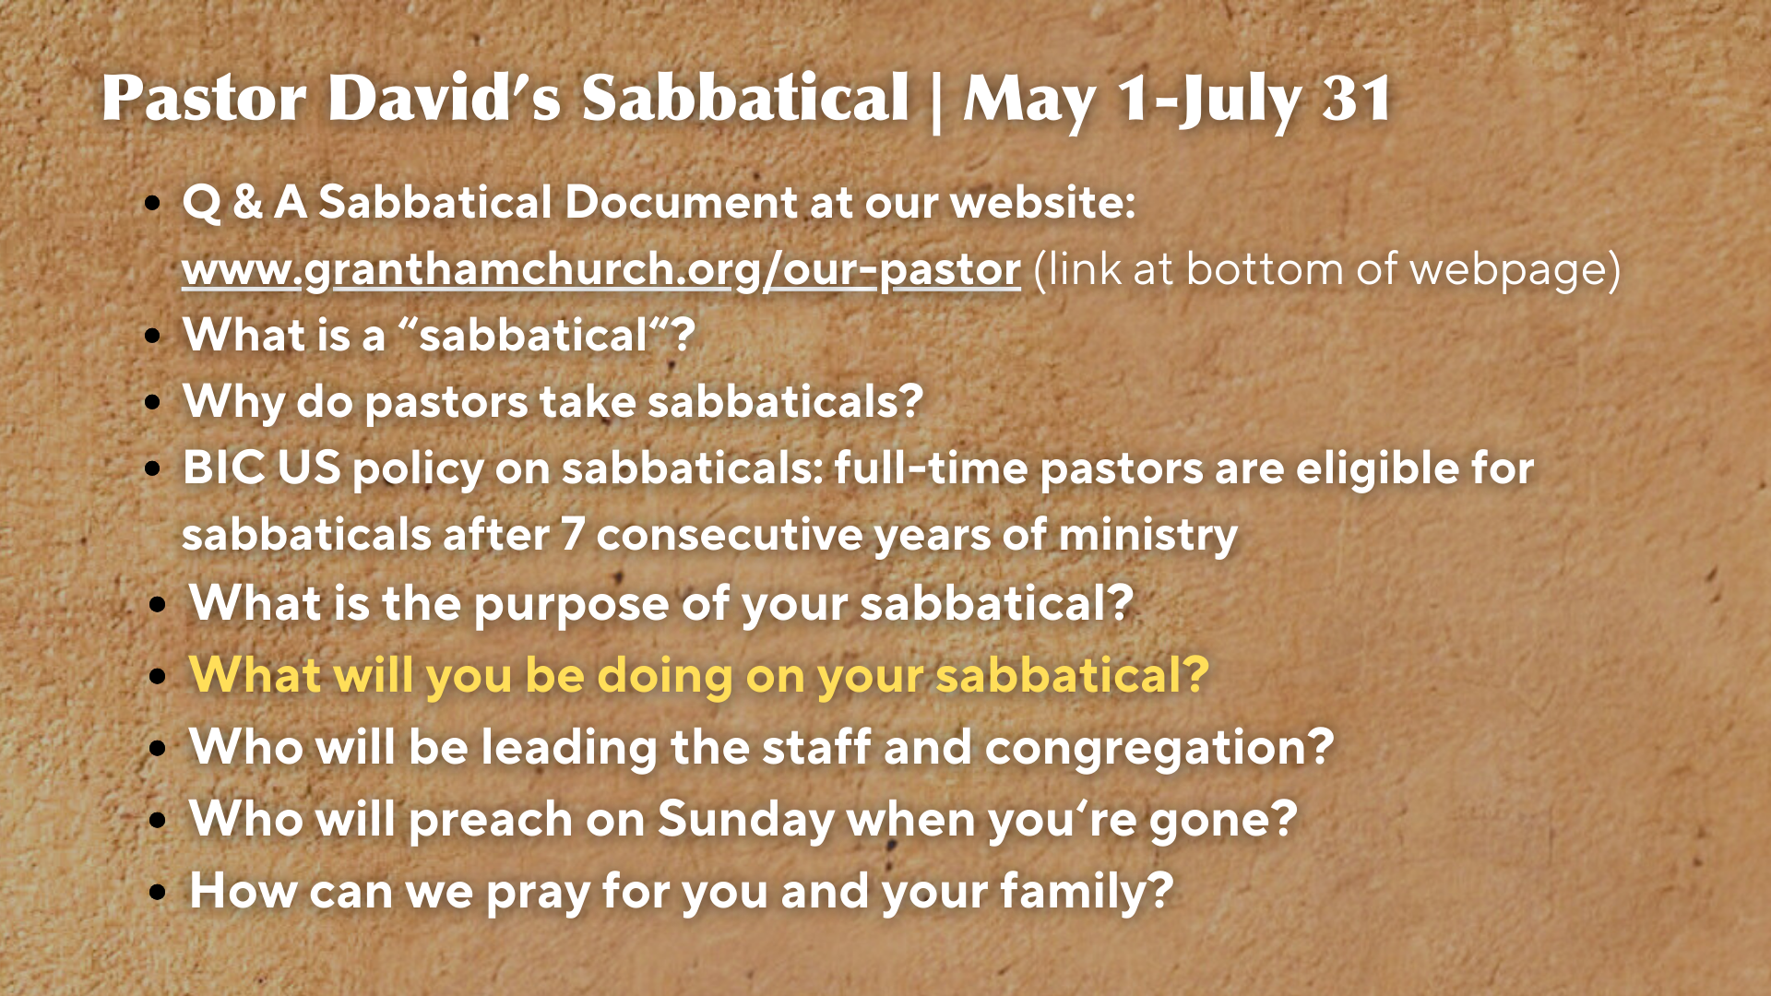
Notes:
Q&A Sabbatical Document on the church website
What is a “sabbatical”? The primary purpose of a sabbatical is for a prolonged season of self-care and sabbath rest. In the Christian tradition, it is for devoting a period of time to personal reflection, renewal, and rest. Typically, sabbaticals are 1-6 months long, with 3 being standard practice.
Why do pastors take sabbaticals? Pastoral work is extremely stressful, and a lack of physical and spiritual rest is especially hazardous to the effectiveness of pastoral ministry. Of course, many people work hard and have stressful jobs, but pastors carry a responsibility that is greater than most occupations. Due to current technology, we are easily accessible to hundreds of people. Also, we are held to the highest standard of mental, physical, emotional, and spiritual health. Rightly so. The work of a pastor is sacred. After hours of study each week, we minister through the preaching of the Scriptures in worship (upwards of 350 sermons since 2016; avg.15hrs. of prep = 5,250 hrs; 218 days in study!). Also, we marry, bury, and baptize. We give counsel, cry with others, and confront sin. We not only carry the burdens of our own families, but we also carry the stress and burdens of dozens within the church. In addition, pastors are highly visible and always on call. And we’re easy targets for the frustrations and criticisms of others. As spiritual caretakers and shepherds of the church, pastors are also targeted by spiritual evil. The challenges that come with this work never ends. And so, when pastors aren’t healthy, it impacts our family, the staff, and the entire congregation. Without proper rest and soul care, pastors face an increasing risk of burnout. Therefore, it is wise to be proactive and for pastors to take sabbaticals.
The BIC recommends sabbaticals; full-time pastors are eligible after 7 consecutive years of ministry
What is the purpose of your sabbatical? While some pastors or academics may use their time to write a book, begin doctoral work, or travel to Europe, my sabbatical is primarily designed to be a time of personal rest and renewal. Overall, my first 7 (almost 8) years at Grantham have been a real blessing to me and my family. But there have also been some difficult days, especially through 2020-2021. And now that these challenges are behind us, and the church is in a healthy place, I feel that it’s time to cease from pastoral ministry, reflect, rest, and know the easiness of the Lord’s yoke.
What will you be doing on your sabbatical? I will be sleeping more, praying more, reading more, and listening to music more. I will work around the house, in the garden, go on hikes, journal, and read my Bible for the sole purpose of meeting with God. I will also continue to meet with my spiritual director throughout my sabbatical. I have 3 trips planned: (1) LA; (2) Texas; and (3) Cincinnati.
Who will be leading the staff and congregation? Pastor Melissa will serve as the acting Senior Pastor. And of course, our Care Teams ministry will continue meeting needs that arise.
Who will preach on Sunday when you’re gone? Pastor Melissa will preach some, but also other members of our congregation. We are blessed to be able to cover the pulpit with our own people.
How can we pray for you and your family? You can pray that God would help me to enter into his rest and experience his easy yoke. Pray for clarity and discernment in my calling and for the next season of ministry. And pray that God would protect my family and this time would be peaceful. Before I leave, I’m planning to send Tom George some prayer requests for the prayer chain.
Finally, here are some questions for you… to help us all reflect and respond to the Lord together…[NEXT SLIDE]

Slide 15


Slide 16
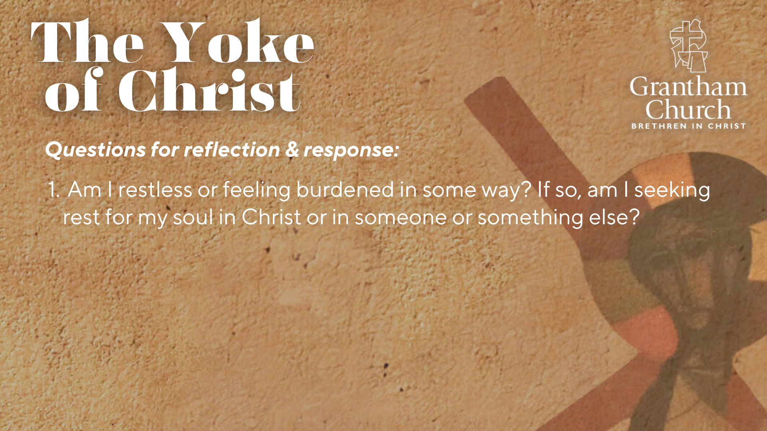

Slide 17
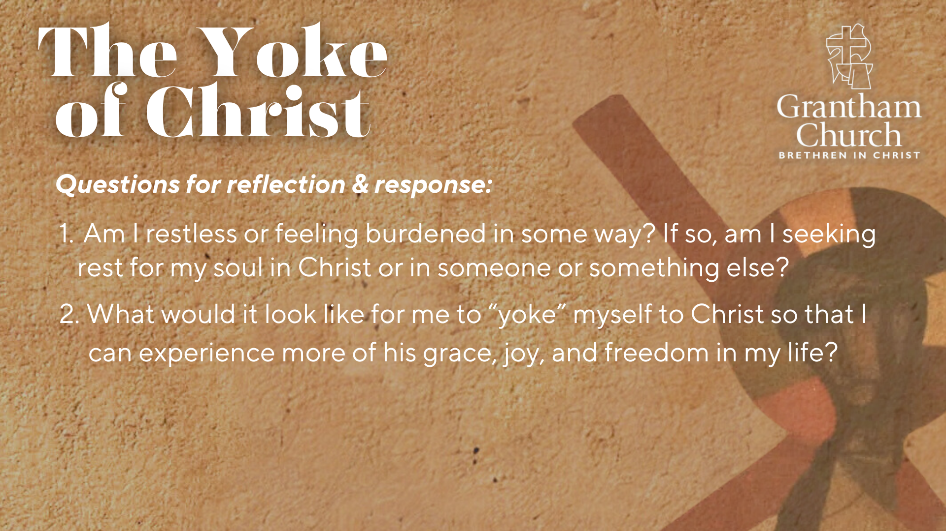

Slide 18
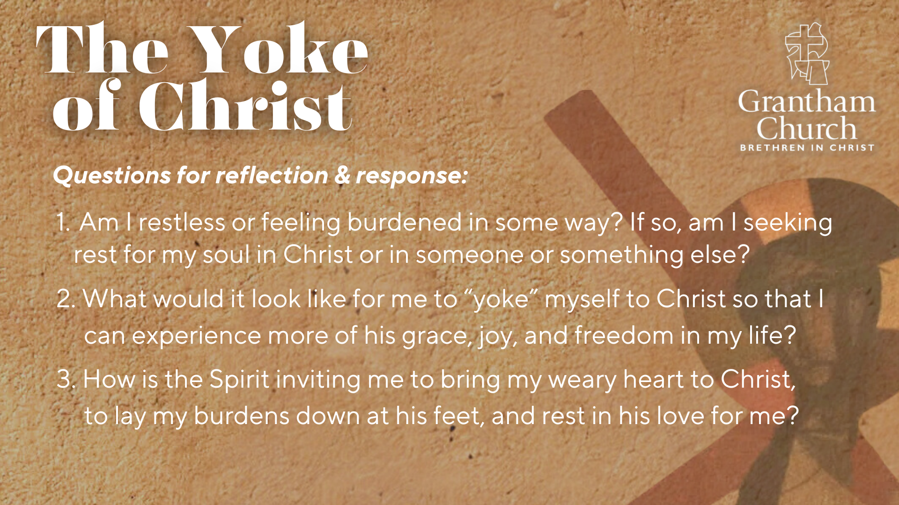
Notes:
[READ & BRIEF COMMENT ON EACH QUESTION]
Am I restless or feeling burdened in some way? If so, am I seeking rest for my soul in Christ or in someone or something else?
What would it look like for me to “yoke” myself to Christ so that I can experience more of his grace, joy, and freedom in my life?
How is the Spirit inviting me to bring my weary heart to Christ, to lay my burdens down at his feet, and rest in his love for me?
Before we close in prayer and hear from our Bishop Heather Beaty, let’s listen again to the words of Jesus in Matthew 11:28-30. This time from the Message… [NEXT SLIDE]

Slide 19
Matthew 11:28-30 MSG
“Are you tired? Worn out? Burned out on religion? Come to me. Get away with me and you’ll recover your life. I’ll show you how to take a real rest. Walk with me and work with me—watch how I do it. ﻿Learn the unforced rhythms of grace. I won’t lay anything heavy or ill-fitting on you. Keep company with me and you’ll learn to live freely and lightly.”
Notes:
[READ & FINAL WORDS]
Let’s pray… [NEXT SLIDE]

Slide 20

Notes:
[CLOSING PRAYER]
[BISHOP HEATHER BEATY]
[BLESSING & SENDING PRAYER]
[BLESSING SONG]
Benediction
Grantham Church, as you worship with this congregation, and as you now go out into the world, may you choose love, mercy, and forgiveness over fear, anger, and hate. May you stay centered and guided by the God who looks like Jesus. And may you be on guard against the scattering forces of the evil one, as we make every effort to keep the unity of the Spirit. In the name of the Father, Son, and Holy Spirit, go in peace, church, to love and serve the Lord. Amen.

