Slide 1

Notes:
[BRIEF INTRO]
Last Sunday I shared the first of a two-part message on God’s mercy and grace
First message: Mercy Triumphs Over Judgment
Today’s message: Grace Empowers the Weak & Humble
Here is how I’ve defined mercy and grace… [NEXT SLIDE]

Slide 2


Mercy & Grace – Related But Different
Mercy is about forgiveness and pardon—
not getting the punishment we deserve.
Grace is about blessing and empowerment—
getting good things we don’t deserve.
Notes:
[BRIEF COMMENT]
Can you recall a time when you experienced God’s mercy and grace in an unforgettable way?
[Personal Examples]
Returning to Christ and repenting of my sin – my prodigal story
Meeting Lanna and getting married
Other moments and seasons; the overall story of my life
What about you? I encourage you to share your experiences and observations.
This is the God that we serve—a God of mercy and grace. And we see this (and can know this about God), through the Scriptures, and ultimately through the person of Christ. Turn with me to the gospel of John… [NEXT SLIDE]

Slide 3
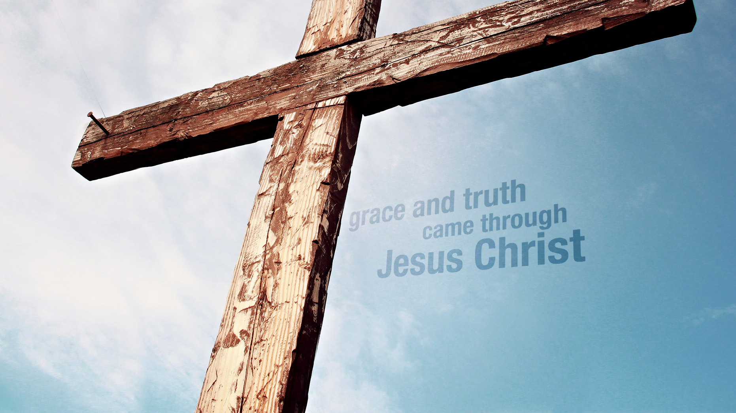
John 1:1-18 NIV
Notes:
[READ SCRIPTURE & COMMENT]
The word “grace” is only found 4 times in the gospels; all in John’s prologue
Jesus never used the word grace, but his life was the embodiment of it
Jesus was the grace of God in flesh and walking in sandals
His ministry, his message (including his stories and parables), and miracles were expressions of grace (e.g., in John’s gospel -- water to wine, the woman at the well, healing the royal official’s son, healing the lame man at the pool of Bethesda, feeding the five thousand, or pardoning the woman caught in adultery.
You’re likely familiar with that story. Let’s look at that. [NEXT SLIDE]

Slide 4
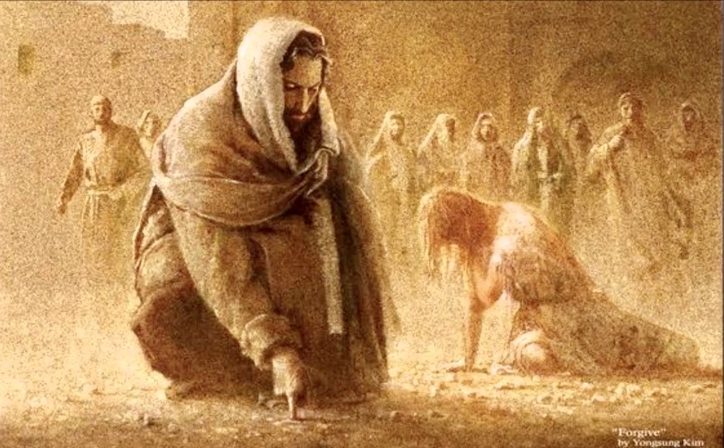
John 8:1-11 NIV
Notes:
[READ SCRIPTURE & COMMENT]
Jesus does something scandalous for a rabbi in the first century to do. He sets aside the Law of Moses (with its demands for retributive justice and punishment) and he extends mercy and grace to someone who is clearly guilty. And of course, this is most upsetting to the temple leaders and the religious establishment of the day.
Last Sunday I mentioned how Jesus challenged the Law and judgment mindset on multiple occasions. A classic example is when he says this in Matthew 5:38-39.
“You have heard that it was said, ‘Eye for eye, and tooth for tooth.’ But I tell you, do not resist an evil person. If anyone slaps you on the right cheek, turn to them the other cheek also.”
[BRIEF COMMENTS]
Leviticus 24:19-20 – “Anyone who injures their neighbor is to be injured in the same manner: fracture for fracture, eye for eye, tooth for tooth.” And the law is affirmed again in Deuteronomy 19:21.
So, the Law of Moses had a purpose for a time, but now in Christ we’re being given a new life for a new law. That’s what he meant when he said he come not to abolish the Law but to fulfill it. It is the way of restorative justice, the way of reconciliation, the way of healing, renewal, and peace. It’s the way of mercy and grace.
And it’s not surprising that this way was immediately misunderstood and condemned by the religious leaders. Even the first apostles had a hard time with it. You’ll recall when the apostle Paul began preaching the gospel of grace to the Gentiles, the Jerusalem church and the Judaizers balked at it. [NEXT SLIDE]

Slide 5
Paul, Romans 6:1-4 NIV
¹ What shall we say, then? Shall we go on sinning so that grace may increase? ² By no means! We are those who have died to sin; how can we live in it any longer? ³ Or don’t you know that all of us who were baptized into Christ Jesus were baptized into his death? ⁴ We were therefore buried with him through baptism into death in order that, just as Christ was raised from the dead through the glory of the Father, we too may live a new life.
Notes:
[READ & COMMENT]
Paul is saying that grace isn’t a license to sin or permission to be lackadaisical about holiness; rather, grace is about enabling and empowering us to live freely and follow Christ out of joy; to release us from the burden of our sin, guilt, and shame. That is what this “new life” is all about.
Yes, we will continue to struggle against sin, as Paul says in the next chapter (Rom 7), but it no longer should define us. We are no longer slaves to it. Yes, we are sinners, but we are called to be saints; to work out our salvation and become like Christ. So, what are you doing with the grace that God is giving you?
Church, let’s be careful not to embrace a cheap and powerless grace, for ourselves or in the church. Some of you may know that’s what Dietrich Bonhoeffer called it. [NEXT SLIDE]

Slide 6
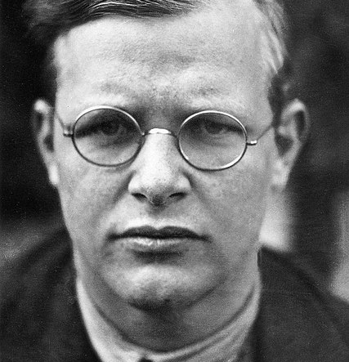
“Cheap grace is the preaching of forgiveness without repentance, baptism without church discipline, communion without confession, absolution without personal confession. Cheap grace is grace without discipleship, grace without the cross, grace without Jesus Christ living and incarnate.”
Dietrich Bonhoeffer,
The Cost of Discipleship
Notes:
[BRIEF COMMENT]
Cheap grace is not real grace. Real grace—God’s grace—is the costly grace of Christ on the cross—the grace that empowers us to confess, repent, and live as disciples of Jesus, and then extend that grace to others.
Now back to Paul and his gospel of grace. [NEXT SLIDE]

Slide 7
Paul, 2 Corinthians 12:6-10 NIV
⁶ Even if I should choose to boast, I would not be a fool, because I would be speaking the truth. But I refrain, so no one will think more of me than is warranted by what I do or say, ⁷ or because of these surpassingly great revelations. Therefore, in order to keep me from becoming conceited, I was given a thorn in my flesh, a messenger of Satan, to torment me. ⁸ Three times I pleaded with the Lord to take it away from me.
Notes:
[SET CONTEXT, READ SCRIPTURE & COMMENT]
Verse 9… [NEXT SLIDE]

Slide 8
⁹ But he said to me, “My grace is sufficient for you,
for my power is made perfect in weakness.”
Therefore, I will boast all the more gladly about my weaknesses, so that Christ’s power may rest on me.
¹⁰ That is why, for Christ’s sake, I delight in weaknesses, in insults, in hardships, in persecutions, in difficulties. For when I am weak, then I am strong.
Notes:
[READ & COMMENT]
The power in weakness paradox
It’s about God-dependency not self-dependency
Real strength is not seen in a Samson, but in Jesus
We must recognize our weaknesses and humble ourselves
Remember what James said in his epistle of wisdom… [NEXT SLIDE]

Slide 9
And he gives grace generously. As the Scriptures say,
“God opposes the proud
but gives grace to the humble.”
James 4:6 NLT
Notes:
[BRIEF COMMENT]
Who are the proud? What does it look like to be prideful?
If we want access to God’s grace (which we need to follow Jesus, to be a healthy congregation, and to impact our neighbors through gospel living), then it starts by humbling ourselves
So then, let’s consider what it would look like to be a grace-filled church—a community of grace. And to help us better understand what Christ is calling us to as his people, let’s contrast a community of grace with what it looks like to be a community of performance. [NEXT SLIDE]

Slide 10
Community of Performance or Community of Grace?
Community of Performance
Community of Grace
The leaders appear “sorted”
The community appears polished and in need of nothing
Identity is found in performance
Failure is devastating
Conflict is suppressed or ignored
Actions are driven by duty
The focus is on belief & behavior
(looking good on the outside)
The leaders are vulnerable
The community is messy and
honest about its shortcomings
Identity is found in Christ
Failure is a part of growth
Conflict is addressed with grace
Actions are driven by joy
The focus is on affections of the heart
(with a strong view of sin and grace)
Notes:
[BRIEF COMMENTS]
And this focus being on the affections of the heart must begin with our own. Richard Foster (the author of Celebration of Discipline) put it this way: “Everyone thinks of changing the world, but where, oh where, are those who think of changing themselves?”
Or in the words of the great urban philosopher Ice Cube, “You betta check yo self before you wreck yo self.”
So, let’s be honest about how we’re doing with recognizing our need for God’s mercy and grace this morning; as individual disciples and as a congregation. Because as the apostle Peter said, “it’s time for judgment to begin with the house of God.” Let it begin with us, Grantham Church. [NEXT SLIDE]

Slide 11
Notes:
[CLOSING PRAYER]
Lead into communion – the Table of Grace

