Slide 1

Notes:
[BRIEF INTRO]
Welcome
3rd Sunday of our winter series
Foundations is a 4-week sermon series that calls us to address the spiritual foundations of our life in Christ. We are looking at how the gospel challenges us to commit to following Jesus together, which involves regular rhythms of prayer, reading and reflecting on the Scripture, and deepening relationships.
In the first Sunday of the series, Pastor Melissa shared about The Call to Discipleship. She said that discipleship, the work of the gospel and being intentional about our spiritual growth, can’t simply be an “add-on” to our busy lives, rather, it’s the main thing. That message was an invitation to place Christ at the center and be about deepening your faith here at Grantham.
And so, when we answer the call to discipleship, we commit to some basic spiritual practices and religious rhythms that help orient our hearts to God, allow us to hear his voice, and experience him personally. Which is what I invited us to do last Sunday, i.e., see prayer as the primary way by which we abide in the Lord, experience his presence and power, discern his will, and stay rooted in his love; this is where our identity and purpose is discovered.
That then brings us to today’s message on the place of Scripture in building the foundations of our faith and how to use the Bible to know God and, by the power of the Holy Spirit, meet the risen Jesus—the One who shows us what God is like and has always been like, the One who loves you and offers us his mercy and grace today. And it’s this Jesus that I pray you will encounter and experience through this message. [BRIEF PRAYER]
[BRIEF COMMENTS BEFORE VIDEO – CHINESE SEMINARIANS]
Let’s watch this short clip together… [NEXT SLIDE]

Slide 2

Notes:
[GO TO NEXT SLIDE IMMEDIATELY FOLLOWING THE VIDEO]

Slide 3

Notes:
[BRIEF COMMENTS ON VIDEO]
As followers of Jesus, do we have a love and appreciation for the Scriptures like the believers in the video clip we just saw? If not, why do you think that is?
What might be the reasons for our apathy, our disinterest, and/or simple neglect?
Whatever the reasons… I believe we can all do something about it.
I recently read Brian Zahnd’s timely new book… [NEXT SLIDE]

Slide 4
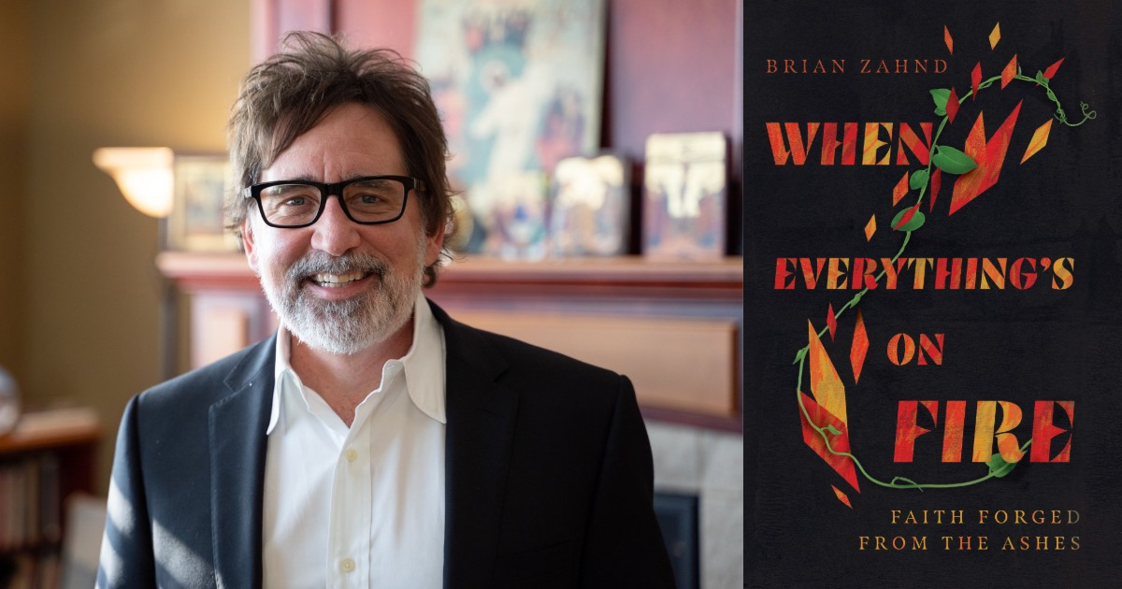
Notes:
[BRIEF COMMENTS ON THE BOOK]
Description on back of book: “In an age of secularism, skepticism, and cynicism, our worldviews have been shaken. Various solutions exist―some double down on certainty, while others deconstruct their faith until there is nothing left at all. But Brian Zahnd offers a third way: what is needed is not a demolition but instead a renovation of faith.
Written with personal and pastoral experience, Zahnd extends an invitation to move beyond the crisis of faith toward the journey of reconstruction. As the world rapidly changes in ways that feel incompatible with Christianity, When Everything's on Fire provides much-needed hope. A stronger, more confident faith is possible when it is grounded in the beauty and truth of Christ. Zahnd permits us to risk the journey of deconstruction so that God can forge something more beautiful in its place.”
And for some of us, that means re-encountering the Scriptures in a way that not only accepts the inspired imperfections of the sacred text (revealing what it looks like when God accommodates himself to sinful humanity), but also moves us beyond a fundamentalist reading, and a modernist critical reading, so we can use the Bible to touch the divine.
In chapter 10, Brian begins by saying the “20th century French philosopher Paul Ricoeur coined the term “second naivete” to express the possibility of a return to innocence after having once passed through the purging flames of critical thought.” And (Zahnd says) this should resonate with many Christians who have gone through (or are going through) some form of deconstruction or been steeped in critical thinking for so long you’re not experiencing God through the text.
Zahnd says that when we apply the grace of second naivete to how we read the Bible, we can think of 3 stages: a literal reading, an analytical reading, and then a mystical reading. He says, “A second naivete reading of the Bible is not going back, it’s not amnesia, it’s not willful ignorance but a new appreciation for the divine genius at work in these inspired stories.”
And while it was a different time, far removed from the Biblical criticism of the 20th cent, King Josiah believed it was divine inspiration and genius at work in the Scripture when he brought about his sweeping reforms in the OT. [NEXT SLIDE]

Slide 5
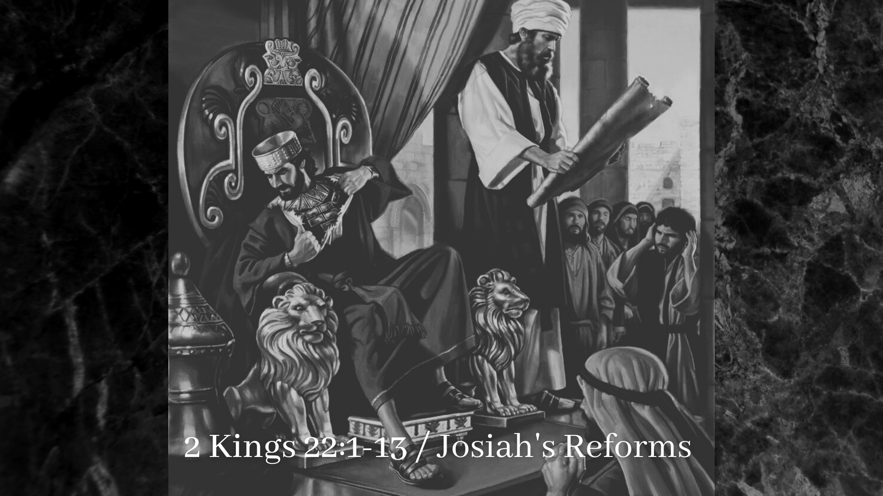
Notes:
[THE STORY OF KING JOSIAH]
621 BC – the kingdom of Judah (Jerusalem) remained, 100 years after fall of Israel
Josiah became king at 8 years old; after his wicked father (Amon) was assassinated
Ever since his grandfather (Manasseh), Judah was under a cloud of spiritual darkness
The spiritual depravity of God’s people – worshipping idols, sexual immorality, etc.
At about 26 years old, Josiah has the Temple renovated – the Book of the Law found!
A call for a revival of Yahweh worship and a return to taking the Scripture seriously
Josiah has all idols removed from sacred places—throws the Asherah pole (phallic symbol used to worship Baal) in the Kidron Valley to be burned and desecrates the altar in the Valley of Hinnom (Gehenna), so there would be no more child sacrifice
His reign and reforms lasted 31 years before things began to fall apart, and in less than 3 decades, Babylon would come and carry off what was left of Judah into exile in 587 BC
[THE SCRIBES & PHARISEES]
They believed that Rome (yet another empire!) ruled over them for lack of obedience to the Law; if God’s people would all become serious students of the Scriptures, honor the covenant and obey the LORD, the Messiah would arrive on the scene, take the throne ,and God’s judgment would finally fall on their enemies—the Kingdom would come!
And while Jesus certainly shared their love for the Scriptures, and a passion for holiness, he not only differed on their interpretations and application of the Law, but he believed they were missing the point and the purpose of the Scriptures, thus missing God entirely.
Listen to what Jesus said… [NEXT SLIDE]

Slide 6
“You study the Scriptures diligently because you think that in them you have eternal life. These are the very Scriptures that testify about me, yet you refuse to come to me to have life.”
John 5:39-40 NIV
Notes:
[BRIEF COMMENT ON PASSAGE]
Jesus is first speaking of how the OT points to him
This is reason for a Jesus-centered “cruciformed” hermeneutic of the OT
But Jesus is also putting himself in God’s position
Jesus is inviting us to know and experience him in the Scriptures
Again, Brian Zahnd writes this in his book… [NEXT SLIDE]

Slide 7

“The Bible contains a lot of information, but the true purpose of the Bible is not to be an encyclopedia of God facts; rather it is to be a portal for engagement with God. This means that Scripture and prayer should go hand in hand. If all we do is read the Bible, we’ve not yet understood the spiritual purpose of our sacred text.”
pg. 146
Notes:
[BRIEF COMMENT]
There are various ways to devotionally and prayerfully engage with the Scriptures. For example… [NEXT SLIDE]

Slide 8
Various Methods of Devotional Reading
Daily Devotionals – a few verses, a short reading, prayer (e.g., 365 days, men’s, women’s, seasonal, etc.)
Daily Office – liturgical format that includes a Psalm and Bible reading, silence, written prayers, etc. (e.g., Seeking God’s Face: Praying with the Bible Through the Year)
Book of Common Prayer – liturgical format includes Scripture, written prayers (morning & evening), songs, etc. (e.g., Common Prayer: A Liturgy for Ordinary Radicals)
Lectio Divina – ancient practice (3rd cent) of prayerfully reading Scripture and listening with the “ears of the heart”
Notes:
[BRIEF COMMENT ON EACH POINT]
Last week I showed you three free apps that are all inspired by Lectio Divina… [NEXT SLIDE]

Slide 9

Notes:
[PRAY AS YOU GO]
At their website, they describe the app this way: Pray As You Go is a daily prayer session, designed to go with you wherever you go, to help you pray whenever you find time, but particularly while travelling to and from work, study, etc. It is not a 'Thought for the Day', a sermon or a bible-study, but rather a framework for your own prayer. Lasting between ten and thirteen minutes, it combines music, scripture and some questions for reflection.
Our aim is to help you to:
become more aware of God's presence in your life
listen to and reflect on God's word
grow in your relationship with God
The style of prayer is based on Ignatian Spirituality.
And then there is Lectio 365… [NEXT SLIDE]

Slide 10

Notes:
[LECTIO 365 DEVOTIONAL APP]
You can read it, listen to it, or both!
There is a morning and evening devotion (the evening one serves like the Examen for the day. It is great for going to sleep!)
The app teaches you to PRAY: P:ause to be still R:ejoice with a Psalm and R:eflect on Scripture A:sk for God’s help Y:ield to His will in your life.
And as I said last week, they recently released Lectio for Families… [NEXT SLIDE]

Slide 11

Notes:
[LECTIO FOR FAMILIES]
The Lectio for Families app has been designed for families with children aged between 7-11 years old, but may be suitable for those who are younger and slightly older too!
It features daily Bible readings, a weekly memory verse, engaging questions to pause and talk about, and prompts for reflection and prayer.
The app can be downloaded by parents and caregivers onto a mobile device. You can then choose to either listen to the audio content together, or you can read it as you pass the device to each other.
If you listen to the audio, the background music is engaging, the speakers are mostly British, and the Scripture is read by other children.
You can also find some other helpful resources at 24-7prayer.com
Again, these three apps were inspired by Lectio Divina… [NEXT SLIDE]

Slide 12
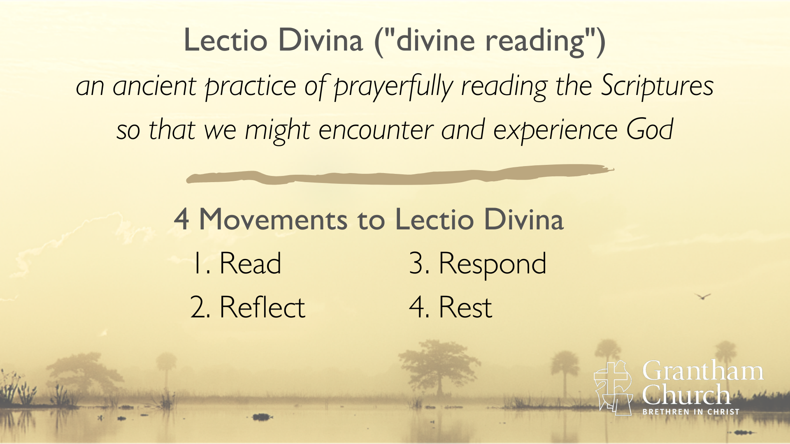
Notes:
[BRIEF COMMENTS]
You can find slight variations of this (e.g., Latin words, how many times you read the Scripture in these 4 movements, and a 5th stage: action).
We’re going to practice Lectio this morning with two readings of the Scripture
Here is what happens with each movement… [NEXT SLIDE]

Slide 13
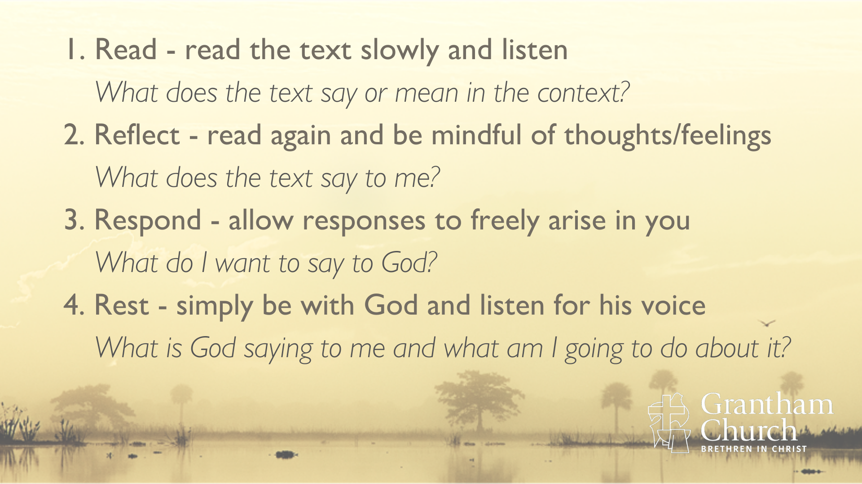
Notes:
[BRIEF COMMENT ON EACH]
And so… here is what Lectio looks like in practice… [NEXT SLIDE]

Slide 14
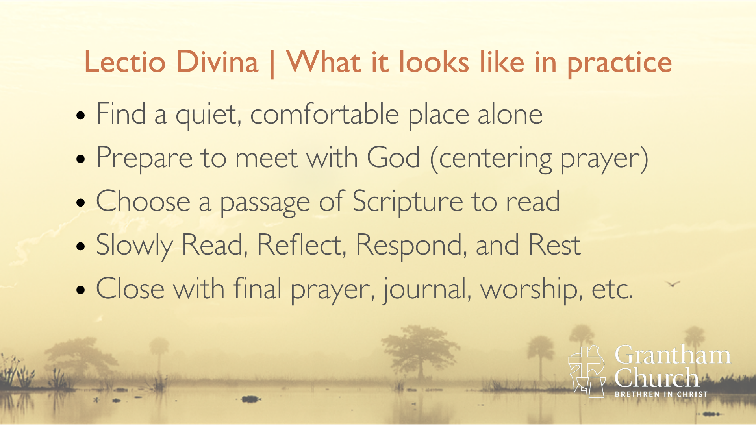
Notes:
[BRIEF COMMENT ON EACH]
And notice how with Lectio Divina we are really beginning and ending with rest… [NEXT SLIDE]

Slide 15
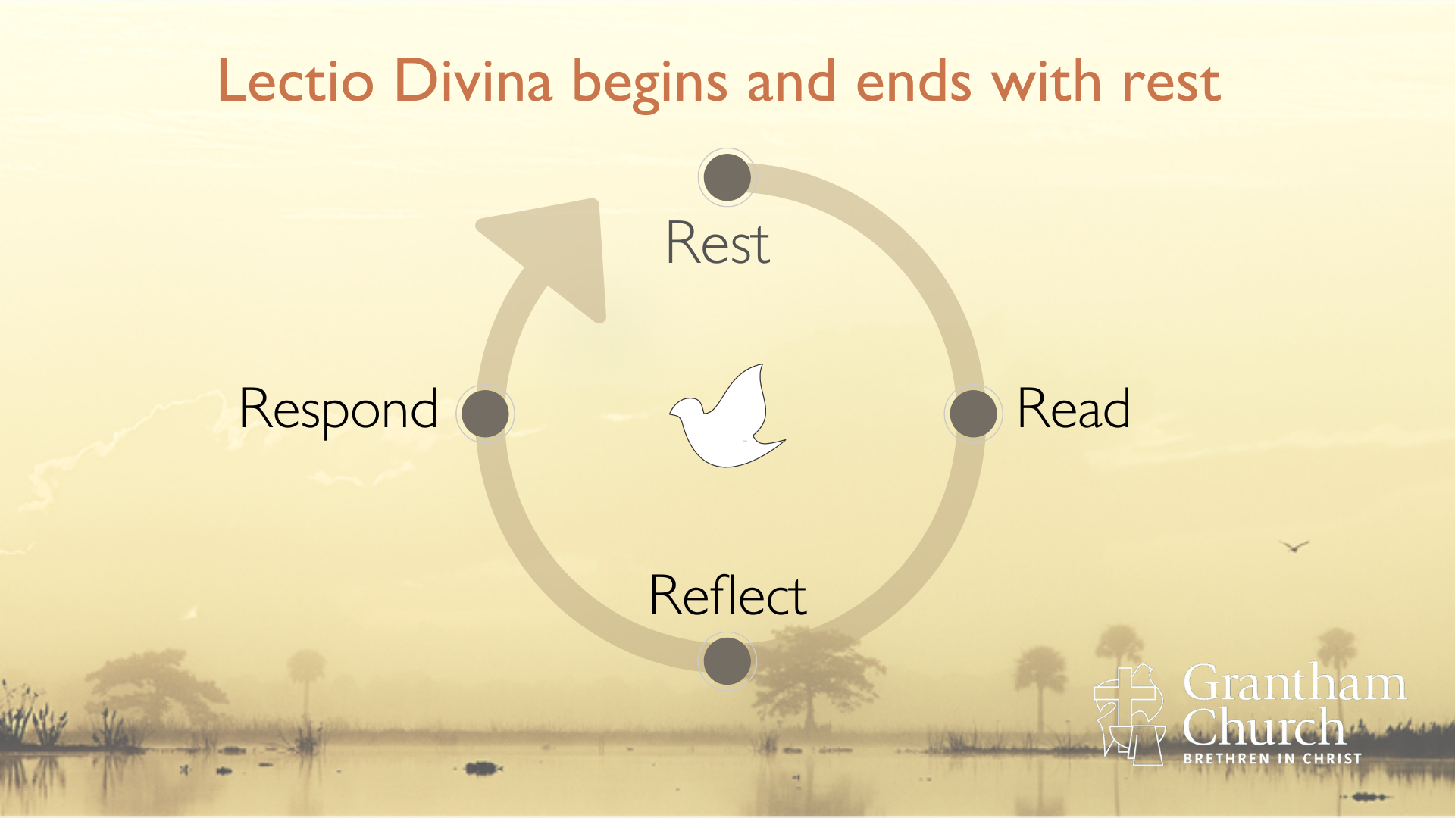
Notes:
[BRIEF COMMENT]
So, I’d now like to guide us through a session of Lectio Divina using a passage that we had in our Foundations Bible Reading plan from this past week.
Please grab a Bible… [NEXT SLIDE]

Slide 16
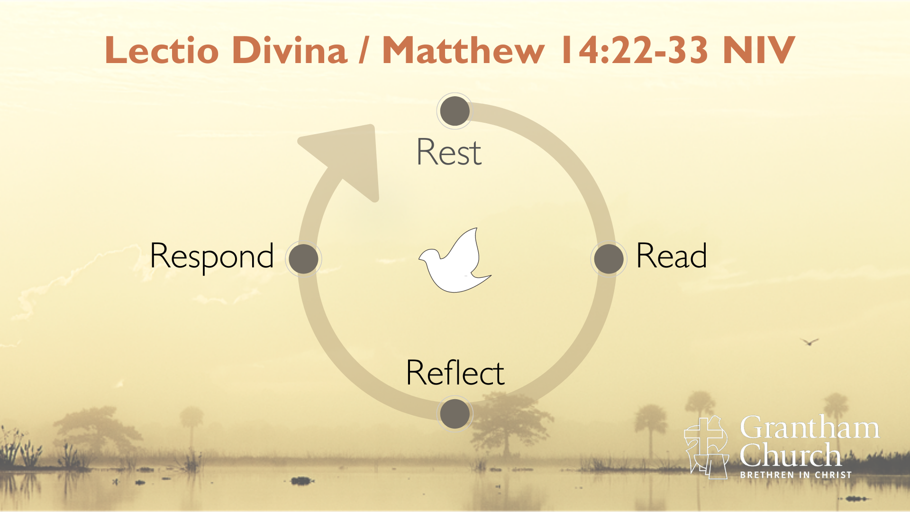
Notes:
[BRIEF INSTRUCTIONS]
Prepare and Center
“As I enter prayer now, I pause to be still, to take slow deep breathes; to re-center my scattered senses upon the presence of God.” Continue breathing and focus on Christ, welcome the Spirit into this moment.
“Jesus, light of the world, as I follow You today, would You illuminate the darkness within me and around me. Show me Your presence and Your path as I welcome the light of life.”
Read
Our passage for today’s Lectio Divina is from the gospel of Matthew chapter 14, verses 22-33. We are reading and reflecting on the time Jesus walked on water and met his scared disciples caught in the storm. I will read the passage aloud as we take in the story together.
[READ MATTHEW 14:22-33 ALOUD]
Now I invite you to read the passage to yourself quietly. This time, when a word or phrase strikes you. Pause for a moment and rest with it. Let it speak to you. Pay attention to the feelings that arise in you as you read. Let’s begin.
[READ PASSAGE AGAIN QUIETLY]
Respond
Prayer is our response to God’s words through the Scriptures. It is a dialogue with God that comes from our hearts. First, take a few moments to share with God the thoughts, questions, feelings, or requests that you have that our text is birthed in you. And then… allow him to speak to you through your own thoughts. What is he saying to you? Talk to him now. [wait 1 minute]
Rest
Now, brothers and sisters, rest in the stillness of God’s presence. As you return to your deep breathing, receive his transforming embrace. Know that you are loved and forgiven. You are not alone. And in this relationship, know that words are not always necessary. So, now rest in his presence. Be still, and know that he is God. [wait 15 seconds]
Closing
Finally, as we close in prayer… let’s put our hand on our heart. Father God, fill us with your love. Help us to love You, and everything that you’ve made. Let’s point to our eyes. Lord Jesus, help us to believe that you are with us in the storm. Help us to see you, and to see others the way that you see them too. And now let’s point to our ears. Holy Spirit, help us to hear you, and give us courage to trust you and do what you say.
And all of God’s people said, Amen. [NEXT SLIDE]

