Slide 1

Notes:
”One Church. Many Expressions. One Mission.”
This is the fourth week of our 5-week sermon series, We the Church. The purpose of the WE THE CHURCH initiative is to mobilize us as God’s people to see that our primary calling is to testify and embody the good news of Jesus to our neighbors, which requires that we partner with other churches in this gospel mission to those who live in our community and region. But to do that, we first need to have a clear understanding of the gospel.
Again, here is a definition of the gospel that we use at Grantham Church… [NEXT SLIDE]

Slide 2
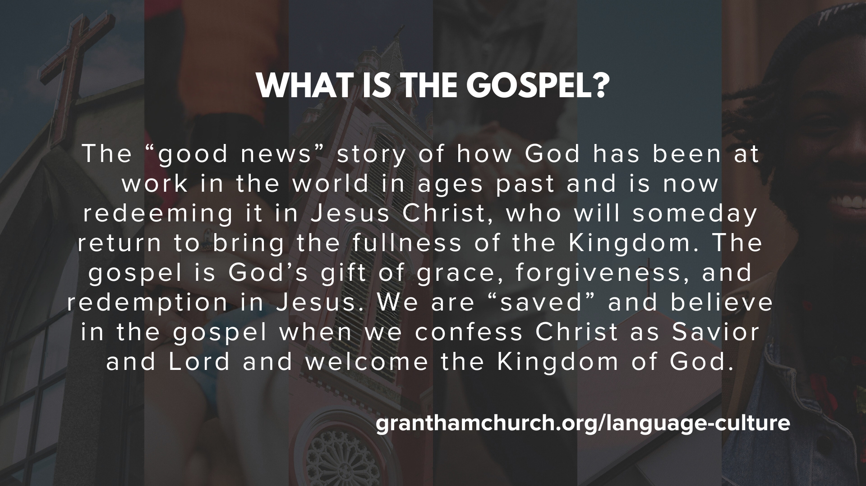
Notes:
[READ DEFINITION & COMMENT]
The gospel is for you; to bring forgiveness, healing, and transformation
But the gospel is also for others (e.g., our family, friends, neighbors, enemies)
Also, the gospel is about the renewal of all creation when Christ returns; Jesus doesn’t just save souls, he is interested in saving bodies, nations, and redeeming the world.
In other words, the Kingdom is coming to earth (It’s Jesus’ vision of the future and it’s what his resurrection means for us); and Jesus will bring it in its fullness when he returns.
In the meantime, we are seeking to become like Jesus as his disciples, and we’re called by Jesus to tell others about him, because he is the only one who can change us, our communities, our country, and save our world from death and destruction.
And so, that’s the gospel. What then is gospel saturation?… [NEXT SLIDE]

Slide 3
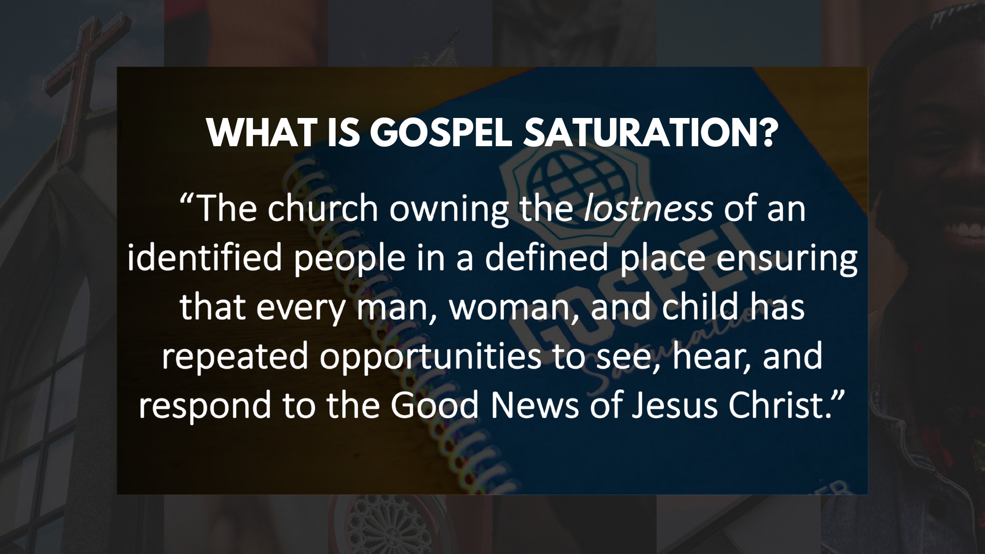
Notes:
It’s the process of helping each disciple understand our role as ambassadors of the good news where we live, learn, work, and play so that every person has repeated opportunities to see, hear, and respond to the good news of Jesus Christ.
But if we’re going to catch this vision and be about this mission, we have to shift from a “church growth” mindset (where it’s all about our congregation) to a “gospel saturation” OS or operating system. If you’ve ever changed operating systems on your computer, you know that there can and will be some adjustments and new things to learn. And when it comes to changing a church’s OS, it means that we adopt and adapt to Jesus’ grand vision of joining together with the larger Body of Christ to fulfill the Great Commission.
That is why we began our series with the message, One Church, One Mission, with a focus on unity… [NEXT SLIDE]

Slide 4
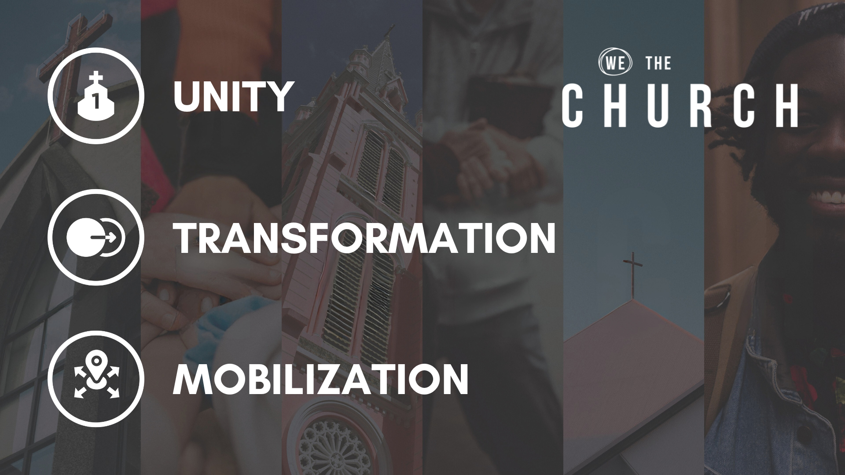
Notes:
UNITY – In that first message, we heard Jesus pray in John 17 that the world will know that the Son was sent by the Father through our oneness and shared calling in his mission. And so, while there may be many churches in a geographical location, Jesus calls us all to recognize his Lordship and take responsibility for those who live in our city and region.
TRANSFORMATION – The purpose of the gospel is to transform individuals who embody the character and competencies of Jesus. The inevitable result will be the transformation of our community because we will desire nothing more than to see others experience the same kind of life-giving change. So, we want to move from consumers to carriers of the gospel.
MOBILIZATION – Pastor Melissa shared how we need to shift from a “Sunday-centric” church mission revolving around a “come and hear” theology to an “every day-centric” mission revolving around a “go and tell” theology, where every disciple takes
the gospel with them where they live and work in community with others.
Which brings us to today’s focus on… [NEXT SLIDE]

Slide 5

Notes:
Collaboration. That because gospel saturation of a geography is only possible when Christians of different backgrounds see collaboration as a necessity, not just a nicety. And so, this morning we will be challenged to shift from isolated individuals and churches who focus on their own uniqueness and differences to churches who collaborate by seeing that they share the gospel and a geographical location in common.
And I’m excited that Pastor Mike Leonzo from Living Water Community Church in Harrisburg will be joining me a little later for a conversation in this message called, Church Together.
[BRIEF PRAYER]
Please turn with me to Romans chapter 16… [NEXT SLIDE]

Slide 6
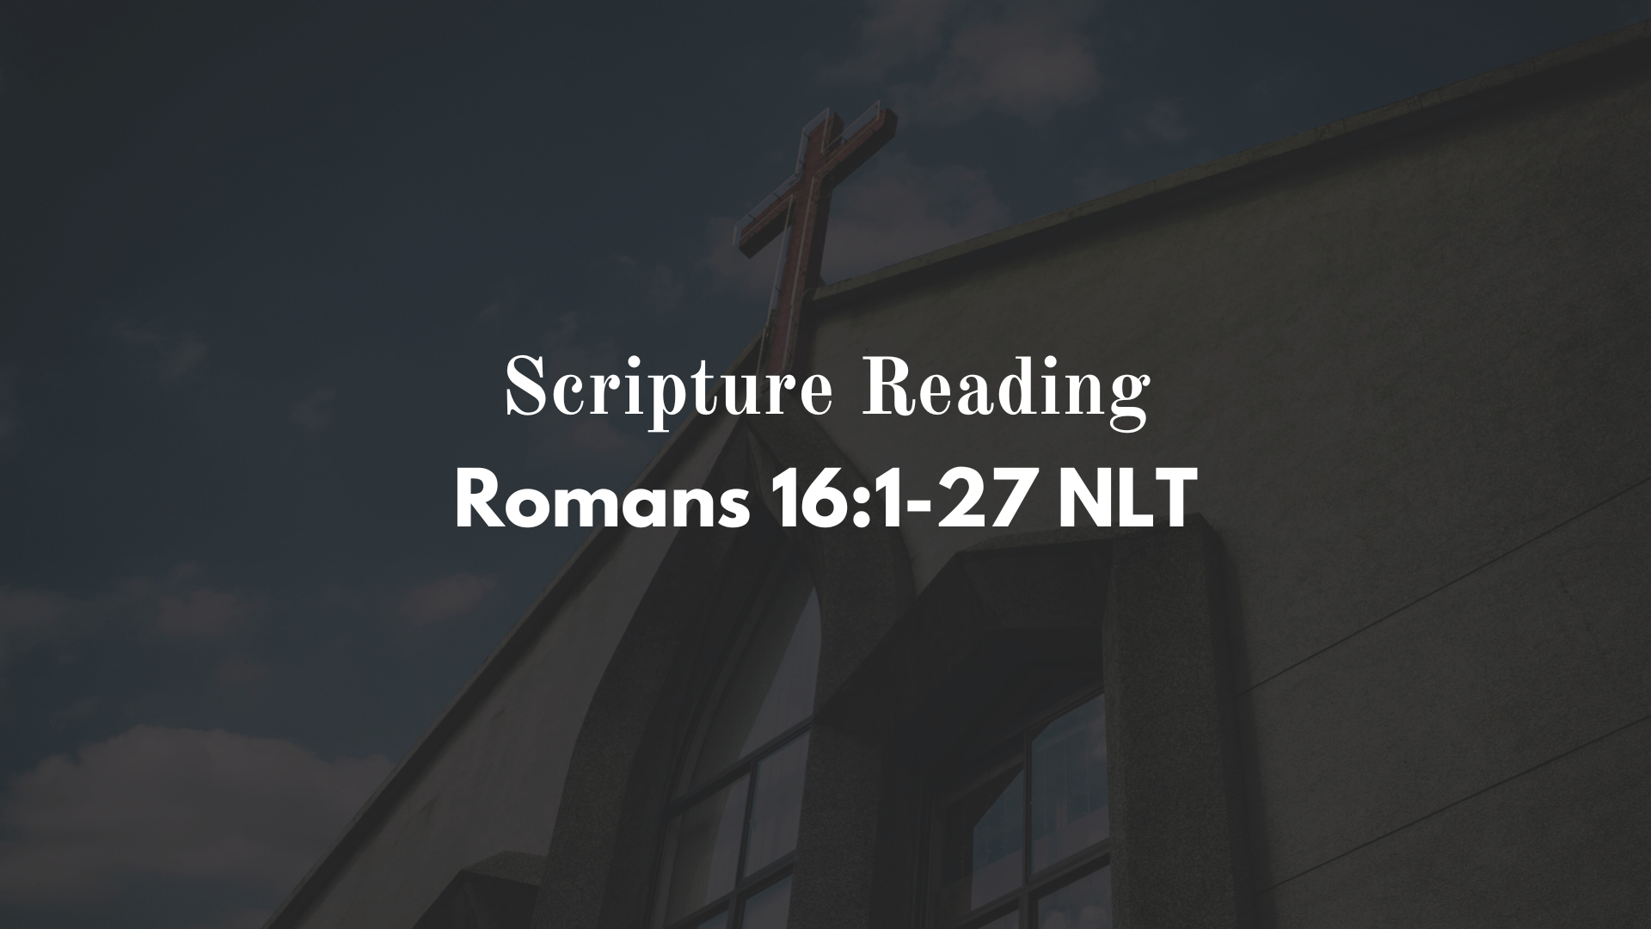
Notes:
In the book of Romans, Paul writes to Christians in Rome and unpacks the gospel and its implications for disciples of Jesus. Rome was the capital of the Empire and the world’s political, religious, social, and economic center. Rome was a cosmopolitan city open to the entire world and full of people with an endless diversity of skin color, culture, professions and languages. And this was also reflected in the Church of Rome; having a dynamic mixture of Jews, Gentiles, slaves, free people, men, women, Roman citizens, and world travelers. As Paul preached in the eastern part of the empire, he went first to the key cities—Jerusalem, Antioch in Syria, Philippi, Corinth, Athens, Ephesus. Along the way he met many believers who eventually ended up in Rome. And this diversity of people can be seen in the final chapter of Romans, where Paul mentions many of them by name in a final greeting.
[READ ROMANS 16:1-16]
Don’t miss what Paul is doing here. He specifically mentions 37 different people. 8 of them are his current co-workers not in Rome. 29 of them are part of the church in Rome. It is a mixture of men and women. Interestingly, he mentions twice as many men but commends twice as many women. Five house churches are specified. Singles and married couples are mentioned. Some are young; some are old. Siblings are mentioned. Mentors and mentees. Authors, scribes, readers, speakers, city workers, accountants and other professions are represented. Large house owners, renters and those who need lodging provided for them. Those who hold positions of church leadership and those who attend are both on this list. Personal friends and distant acquaintances. Jews and Gentiles alike are mentioned. Former prisoners with a rap sheet and those well respected in the culture. Poor people, rich people, business owners and migrant workers. And no one spiritual gift is prioritized over another.
And then in verses 17-20, Paul writes… [NEXT SLIDE]

Slide 7
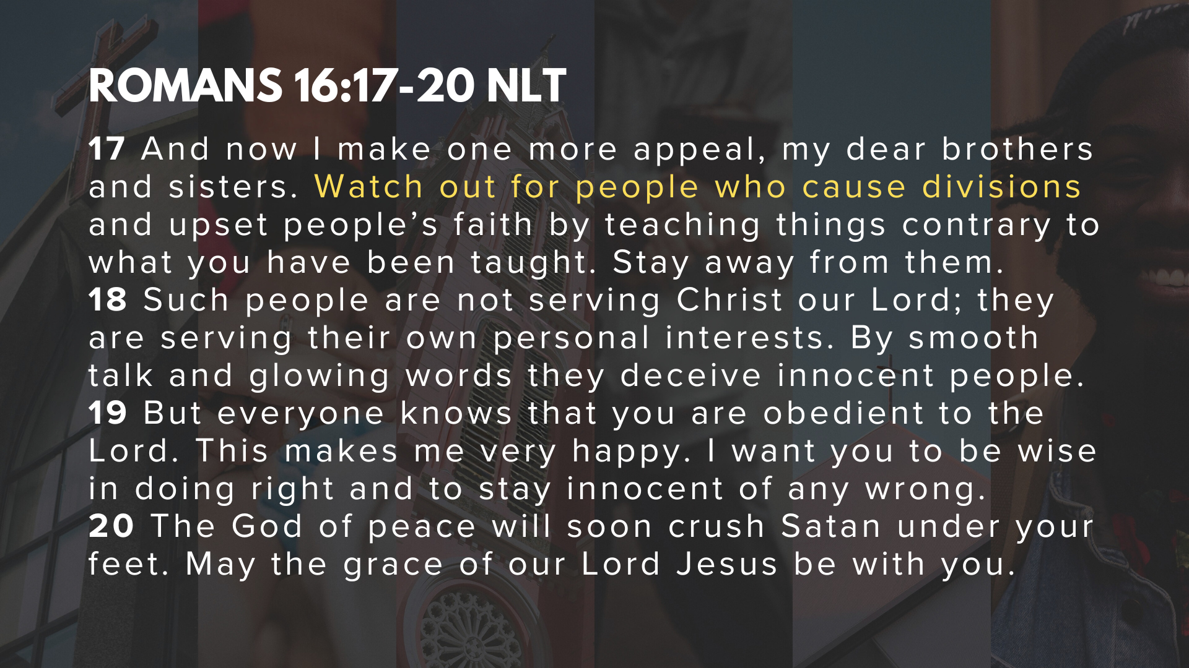
Notes:
[READ ROMANS 16:17-20 & COMMENT]
My friends, we can easily make the argument that the point of greeting these 37 people, and the entire chapter for that matter, is to encourage collaboration around one goal: the mission of the gospel going forward through the churches in Rome! And while their diversity and their differences could potentially be a problem, we instead see unity and hear a call from Paul for these believers to remain united in Christ as they each do their part.
That reminds me of the body metaphor that Paul used with the Corinthians, which not only applies to individual congregations, but also to the Church in any given region… [NEXT SLIDE]

Slide 8
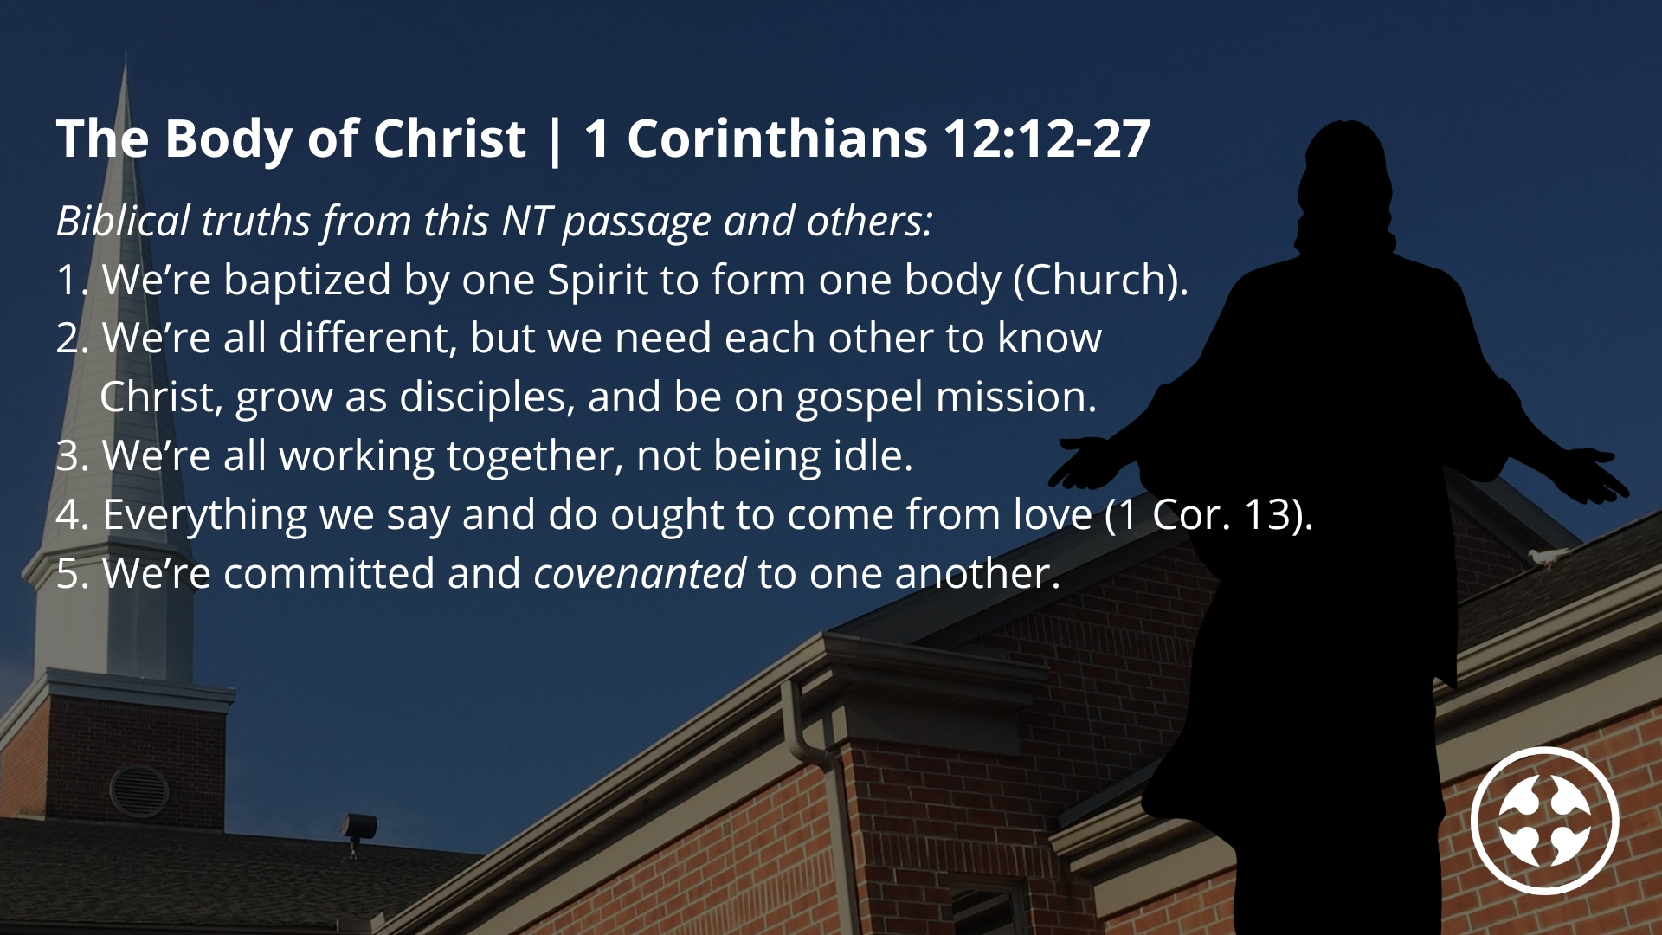
Notes:
Paul said that the Body of Christ (the church) has many members or parts, like your own body. Each part has a role to play. Christ is the head, and we make up the rest of that body. I think this can apply to individual Christians, as well as churches in one city and region.
And so, the New Testament teaches:
1. We’re baptized by one Spirit to form one body (Church).
2. We’re all different, but we need each other to know Christ, grow as disciples, and be on gospel mission. And so…
3. We’re all working together, not being idle.
4. Everything we say and do ought to come from love (1 Cor. 13).
5. We’re committed and covenanted to one another; we all partake of the same Table.
But what about our differences? And how do we challenge and then partner with other churches who disagrees with us on a doctrine, core value, or distinctive?
[SHARE P&SJ COMMISSION CONVO]
And I was reminded of a story we heard on the Civil Rights Bus Tour a couple years ago… [NEXT SLIDE]

Slide 9
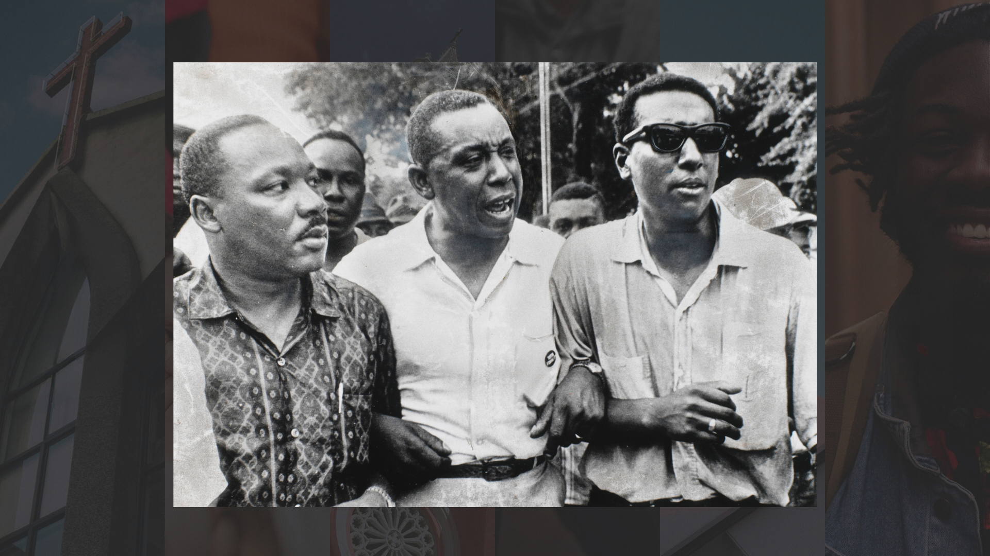
Notes:
[STORY: MLK & STOKELY CARMICHAEL]
Collaboration is possible with those in whom we disagree. And true collaboration and lasting change occurs when God’s people partner with different expressions of His Church for the mission of God, for gospel saturation. THE church is greater than A church. And here’s the interesting piece: When God’s people are going after the mission together as one Church in our city and our region, the byproduct is a unity that can’t be ignored.
This is what Jesus prayed and is trying to tell us in John 17… [NEXT SLIDE]

Slide 10
John 17:20-23 NIV
²⁰ “My prayer is not for them alone. I pray also for those who will believe in me through their message, ²¹ that all of them may be one, Father, just as you are in me and I am in you. May they also be in us so that the world may believe that you have sent me. ²² I have given them the glory that you gave me, that they may be one as we are one— ²³ I in them and you in me—so that they may be brought to complete unity. Then the world will know that you sent me and have loved them even as you have loved me.
Notes:
[READ SCRIPTURE & COMMENT]
Brothers and sisters, the only power great enough to sustain lasting collaboration is found in the Spirit through a shared commitment to reaching our communities with the good news of Jesus. And we are seeking to embody that through the Capital Region Gospel Partnership.
Together, we and other Gospel-centered congregations are seeking to ensure that every person in our region has repeated opportunities to see, hear, and respond to the good news of Jesus Christ. For over a year now, we have been doing that through monthly prayer meetings in our building, using teaching material that helps us shift our OS, as well as other small gatherings, and most recently, the printing of our regional prayer guide.
And those who have been most consistently engaged with us have been:
West Shore Free Church
Immanuel Alliance Church
Mechanicsburg Brethren in Christ
LCBC (Mechanicsburg campus)
Mike Holland and the LAE congregation in York Springs
Living Water Community Church in Harrisburg
And so that we can all get a glimpse of this partnership at work, and that a shared love of Christ and the gospel is greater than our differences, I’ve invited Living Water’s lead pastor, and my friend, Mike Leonzo, to join us today for a conversation.
Would you please welcome Pastor Mike to the stage? [NEXT SLIDE]

Slide 11
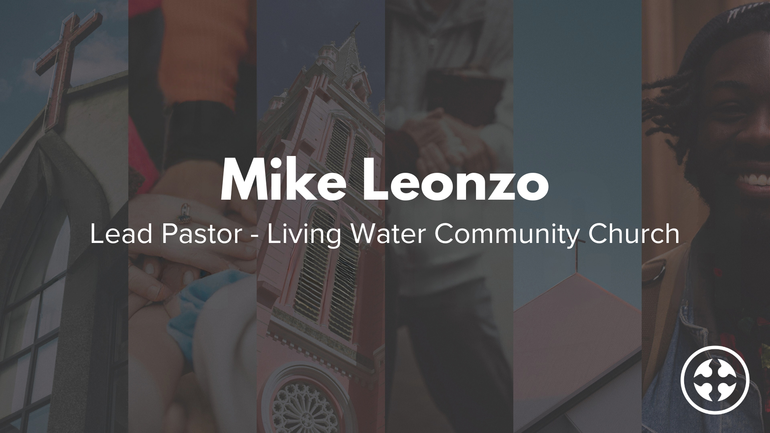
Notes:
[QUESTIONS & CONVERSATION WITH MIKE]
Mike, tell us a little about yourself. Wife? Kids? Hobbies?
You planted Living Water? When and how did that happen?
What is Living Water’s mission and vision? What’s unique about you?
Are you aware of any theological differences between Living Water and other churches in the Capital Region Gospel Partnership?
Why are you and Living Water part of CRGP? How can we collaborate?
[THANK MIKE & GO TO QUESTIONS]
Finally, here are some questions to help us reflect and respond together… [NEXT SLIDE]

Slide 12

Notes:
Questions

Slide 13
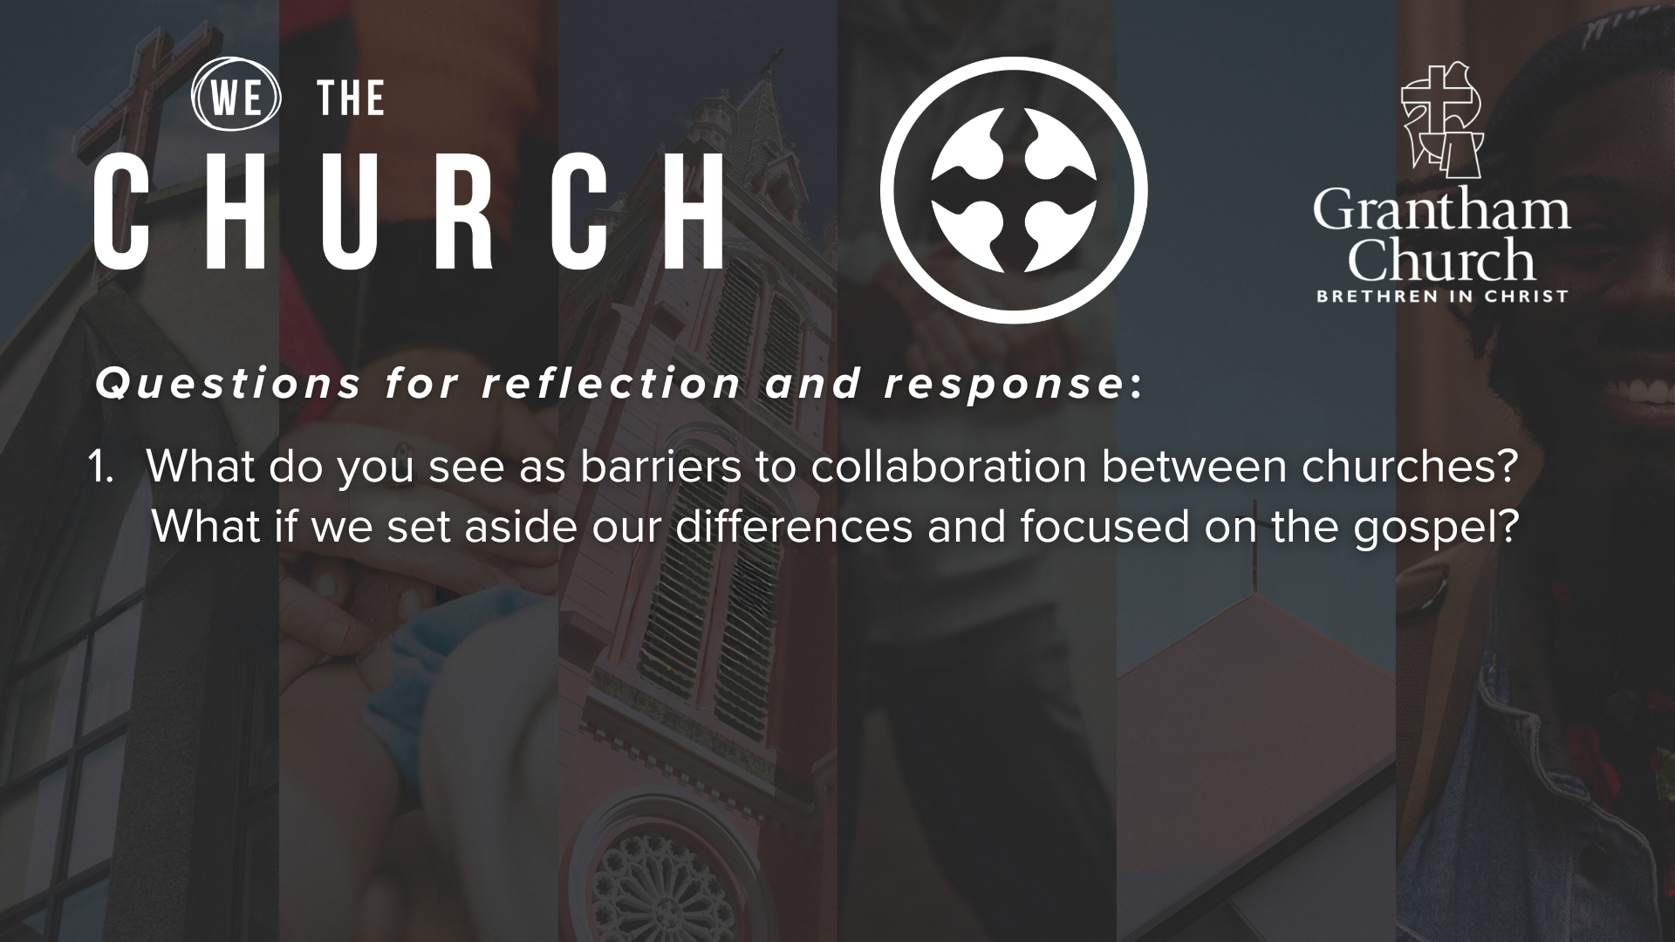

Slide 14
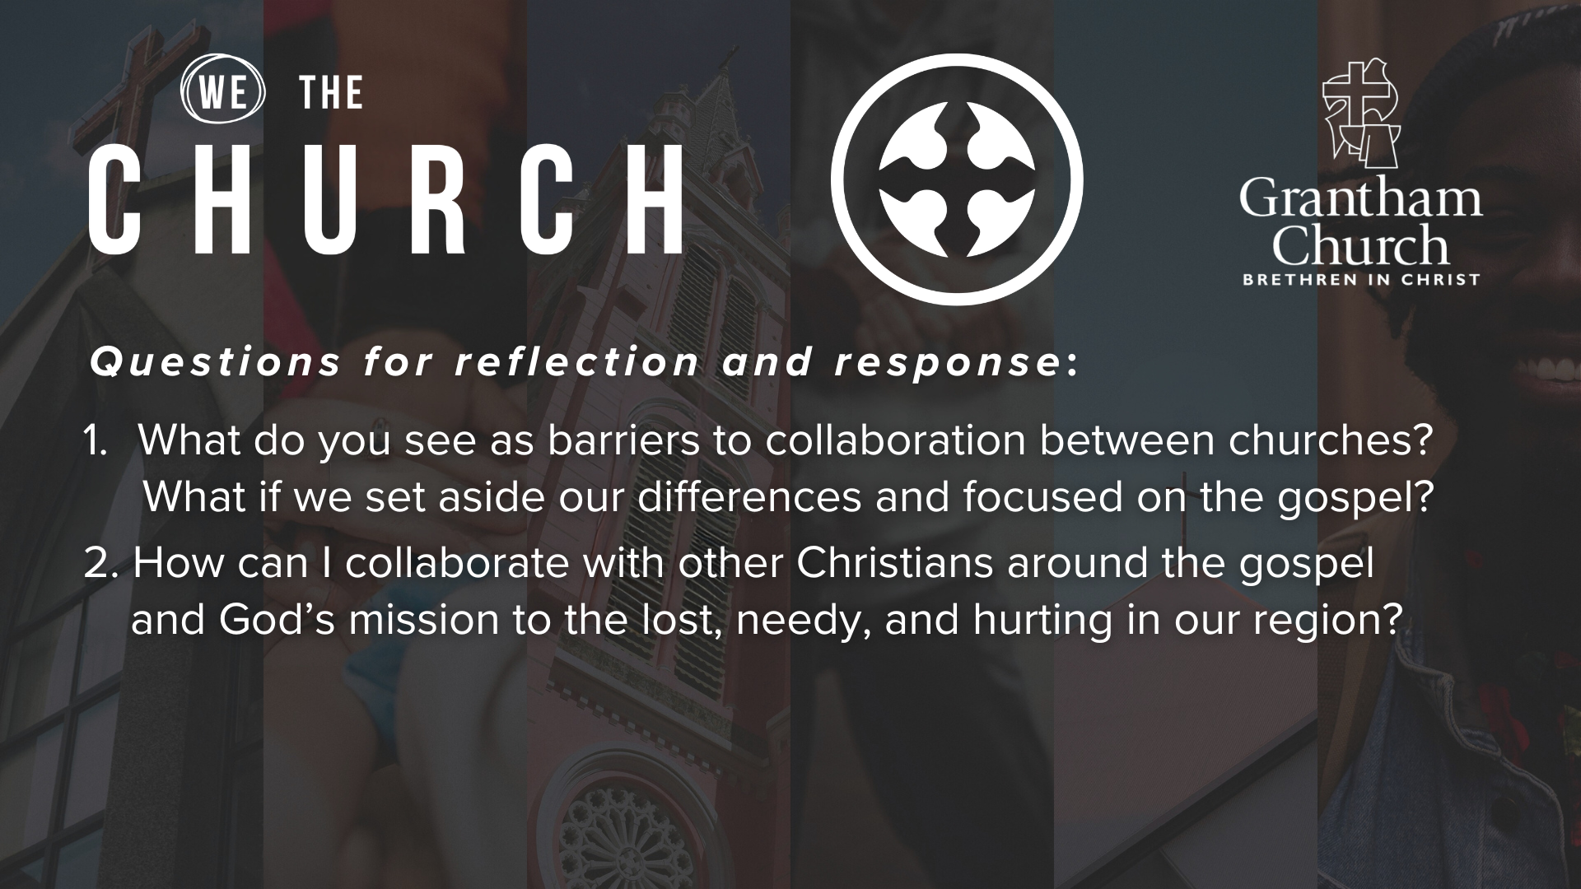

Slide 15
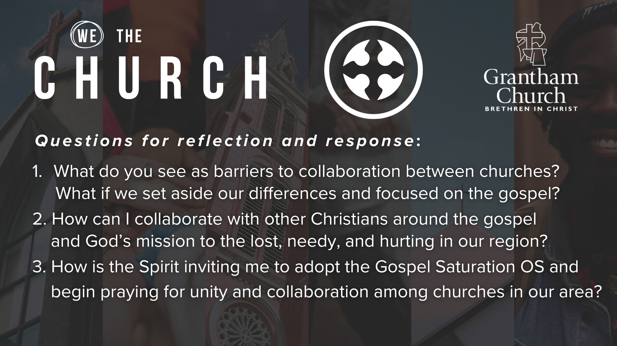
Notes:
[READ & BRIEF COMMENT ON EACH QUESTION]
What do you see as barriers to collaboration between churches? What if we set aside our differences and focused on the gospel?
How can I collaborate with other Christians around the gospel and God’s mission to the lost, needy, and hurting in our region?
How is the Spirit inviting me to adopt the Gospel Saturation OS and begin praying for unity and collaboration among churches in our area?
[CLOSING WORDS]
[NEXT SLIDE FOR CLOSING PRAYER]

Slide 16

Notes:
[CLOSING PRAYER]
[RESPONSE SONG]
ANNOUNCEMENT – ART GALLERY RECEPTION RIGHT AFTER THE SERVICE IN A1
As many of you know, Molly Shortridge lost both her parents (Becky & Bill Probst) last year, and as she cleaned out a house full of treasures, it was clear that she had uncovered a story —the evidence of a family tradition of creativity and artistic expression, art in various forms from at least three generations in Molly‘s family. Therefore, we want to invite you to meet Molly and appreciate the beauty in the paintings, drawings, PA Dutch folk furniture, handmade dolls, carved wooden birds, and very fine needlework.
Benediction
Brothers and sisters, God wants us to share his heart by embodying and proclaiming the good news of Jesus to every person that we encounter in life. Therefore, let us go into the world and make disciples who make disciples. May the Holy Spirit empower you to carry out the mission we’ve been give to lead others to the God who looks like Jesus. In the name of the Father, and the Son, and the Holy Spirit. Amen.

