Slide 1
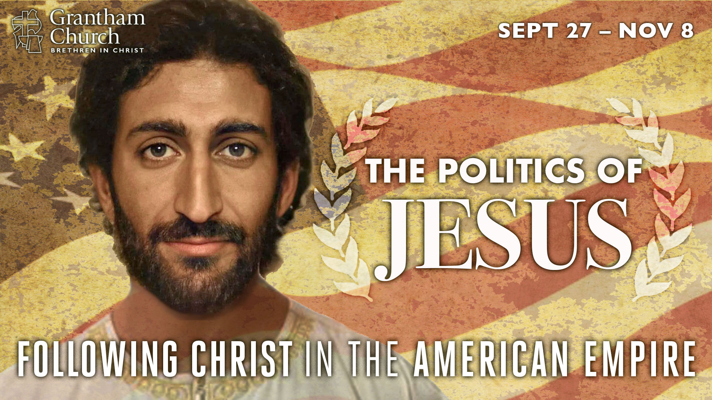
Notes:
This is the third message in our fall sermon series: The Politics of Jesus: Following Christ in the American Empire. In this series we want to give serious thought to what it looks like to embrace the agenda of Jesus and embody his way of radical love, as we seek to navigate this election season by letting the Messiah from Nazareth lead us, and show us what it means to be faithful to God in these tumultuous times.
We began the series two weeks ago by reflecting on how Jesus said that his disciples are to be known by their love. I said that judging by the church’s reputation in America, and the behavior that we’re observing among many Christians in this country (both conservatives and progressives), something is definitely amiss with the church’s witness today. So, I called us to remember who we are, and invited us to return to the way of Jesus, the way of love, not of trusting in political power and winning with the weapons of the world.
And then last week we saw how Jesus resisted the temptation to use worldly kingdom power to advance his Kingdom on the earth. Jesus showed us that the Kingdom of God is about power-under, not power-over. And he called disciples with divergent political views to set aside their opinions in order to follow him and discover a “third” way to live within the empire. As followers of Christ living in a polarized nation today, we so desperately need to embrace what Jesus has taught and modeled for us. Like I said, if we don’t do it, no one else will.
Which brings us to today’s message, which I’ve entitled, The Inaugural Address of Jesus. And what we’re going to see today may very well be something you’ve never noticed before. You see, just like an incoming president reveals the things they intend to do when they come into power on inauguration day, Jesus does the same when he makes his royal announcement in Nazareth. But unfortunately, as we will see in this message, not everyone desires his Kingdom. Some people like things the way they are.
So whether you’re watching at home or listening to our podcast, I want to invite you to open up your heart and mind to the things of the Spirit—to the voice of Jesus—and let’s ask God to help us do whatever is necessary to follow Christ in a world of competing idols and allegiances. Please, join me now in a quick prayer of submission to God’s will for our lives. [BRIEF PRAYER]

Slide 2
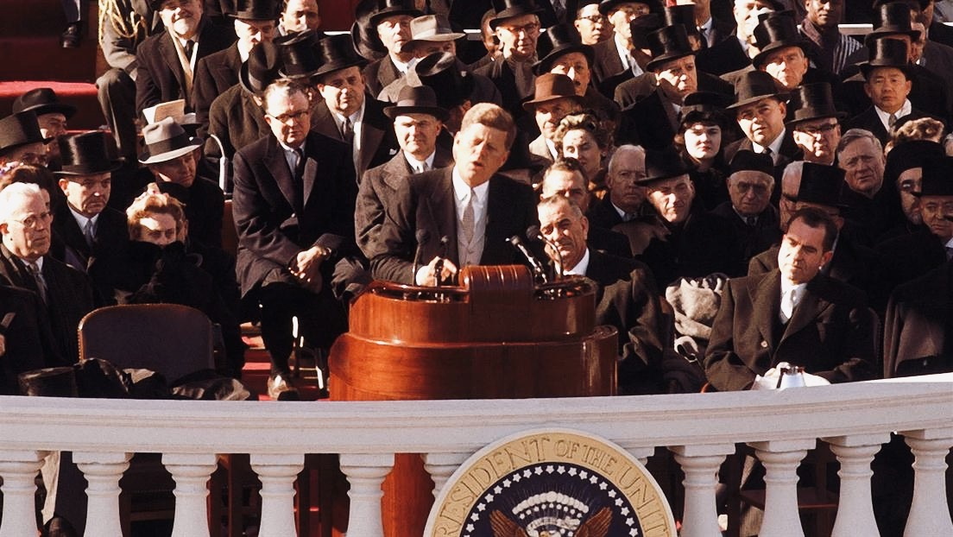
Notes:
"Ask not what your country can do for you, but what you can do for your country.” Have you heard those words before? Who said that? And when and where were those words spoken? Some of you know this. Those famous words were spoken by John F. Kennedy, the 35th president of the United States, on January 20, 1961 in his inaugural address.
As you know, every four years we have a national election and on Inauguration Day the president (in JFK’s case, a newly elected president) delivers a speech that informs the nation of their intentions as a leader, what their administration will seek to accomplish during their term, and sometimes what they intend to do in the first 100 days of being in office.
In the US, inaugural addresses are often used to unite the country and share a hopeful vision for the future. Incoming presidents usually seek to inspire the nation, garner support for their agenda, even attempt to win over those who aren’t sure of their abilities (or those who flat out disagree with them), and then assure the country (and the world) why they will be better off with them in power.
And you might not know this, but Jesus did something similar in Luke 4:14-30, following his temptations in the Judean wilderness. And we need to seriously consider the politically subversive nature of what’s happening in the gospels. As I said before, if we will see the baptism of Jesus as his public “anointing” as the Messiah—God’s promised King coming to power—and his temptations as the way Jesus decided what kind of Messiah and King he would be, then we can certainly see how in the very next episode in Luke’s gospel, Jesus gives us insights into his own self-understanding, what his intentions are as God’s appointed leader, and what his Kingdom will look like.
Let’s look at that together. Luke chapter 4, beginning with verse 14. [NEXT SLIDE]

Slide 3
Luke 4:14-30 NIV – The Inaugural Address of Jesus
¹⁴ Jesus returned to Galilee in the power of the Spirit, and news about him spread through the whole countryside. ¹⁵ He was teaching in their synagogues, and everyone praised him.
¹⁶ He went to Nazareth, where he had been brought up, and on the Sabbath day he went into the synagogue, as was his custom. He stood up to read, ¹⁷ and the scroll of the prophet Isaiah was handed to him. Unrolling it, he found the place where it is written:
Notes:
¹⁴ Jesus returned to Galilee in the power of the Spirit, and news about him spread through the whole countryside. Think about this. The Spirit came on Jesus at his baptism (represented by the dove), and now after having resisted the devil, deciding what kind of Messiah he is going to be, and having already begun his teaching and healing ministry, Jesus returns full of the Spirit to where he grew up. The word was out, and people were loving his campaign. He wasn’t just kissing babies, he was healing them. Know what I mean?
¹⁵ He was teaching in their synagogues, and everyone praised him. Check it out. Jesus was growing in popularity and folks weren’t even entirely sure who he was and where he stood on the hot-button issues of his day. But it was exciting, for sure.
¹⁶ He went to Nazareth, where he had been brought up, and on the Sabbath day he went into the synagogue, as was his custom.
Let me give you some background information here. So, the Jewish Sabbath is on Saturday, and notice that Jesus religiously attended the local synagogue. It’s helpful to know that synagogues first began during the Babylonian exile as a way of continuing devotion and worship of Yahweh when they didn’t have the Temple and were far removed from Jerusalem. As a result of their captivity, synagogues became the center of religious and civic life for Jewish communities post-exile. They not only served as a place of worship, they were also a school, a community center, and a place for administering justice. And unlike the Temple, they are not led by priests. Instead, the synagogue was led by Jewish laymen. And since the Torah was a central focus of their worship, Pharisees often provided oversight of the synagogue.
So Jesus goes to the synagogue in Nazareth, where he would have grown up in worship, and likely because of his growing reputation, and because he was a local boy back in town, Jesus is invited as a distinguished visitor to read Scripture and share a brief homily and interpretation of the Scripture. It’s very likely that the text would have been chosen for him in advance, according to synagogue practice. Which means there are two readings in worship: first, a reading from the Law, and then a reading from the Prophets.
Jesus is given the second reading, so the first reading had already taken place. What was the first reading? Well, some scholars believe the text associated with what Jesus is going to read is from Deuteronomy 30. Here is what two familiar verses in that chapter (19-20) say: “This day I call the heavens and the earth as witnesses against you that I have set before you life and death, blessings and curses. Now choose life, so that you and your children may live and that you may love the Lord your God, listen to his voice, and hold fast to him.”
Assuming that’s what was read, Luke says in verse 17 that the synagogue leader or attendant then hands Jesus the scroll of Isaiah. This would have been a really long scroll without chapters or verses. Luke says, Unrolling it, he found the place where it is written: That place in our Bible is Isaiah 61, verses 1 and 2. Here is what Jesus read: [NEXT SLIDE]

Slide 4
Luke 4:14-30 NIV
¹⁸ “The Spirit of the Lord is on me, because he has anointed me to proclaim good news to the poor. He has sent me to proclaim freedom for the prisoners and recovery of sight for the blind, to set the oppressed free, ¹⁹ to proclaim the year of the Lord’s favor.”
Notes:
I’d like us to give attention to each line here, but first, we need to notice that this passage from Isaiah is located within the literary unit of Isaiah 60-63. And in those chapters, Isaiah is describing Yahweh’s salvation and deliverance, that God will bring all nations unto himself, and that a specific person will announce the good news of God’s Kingdom coming; eventually leading to Yahweh overcoming Israel’s enemies. So, for some time this passage in Isaiah was thought to be Messianic and pointing to God’s good future for Israel.
[READ EACH LINE & COMMENT]
“the poor” refers to those living in poverty, but it also included those of lower social status, outsiders, the marginalized, the voiceless, and people living on the fringes; while it can include the poor in spirit, it most definitely refers to those who are physically poor. And we will see Jesus proclaiming good news to the poor and lifting them up from their plight all throughout the gospels.
“freedom for the prisoners” (NRSV - release to the captives) obviously the literal sense here is getting people out of jail (which is a good thing, particularly for the wrongly accused or those who have been unfairly sentenced), although we don’t see Jesus doing that in his ministry, it does happen later in Acts and will become the basis for abolition movements and prison reform throughout history. Praise God for that! But we should also notice that in Luke the “freedom for the prisoners” looks like setting people free from bondage to spiritual evil through exorcisms and healings. Afterall, you can set people free from a jail cell, but they can still live in their own private hell as a “free” person.
“recovery of sight for the blind” as you’ll recall, Jesus literally opened the eyes of blind people in the gospels, but we can also see how Jesus opens eyes in a spiritual sense for people to see the truth and come into his Kingdom, and for people like Nicodemus, to be born again. So, we shouldn’t make the mistake as post-Enlightenment Westerners of wanting to choose either a literal interpretation or a spiritual one. Instead, we need to hold them together. For Jesus and his Jewish audience, they both reflect the reality of God’s creation--we live in a physical/material world that is mysteriously connected to the spiritual realms and spiritual matters.
“to set the oppressed free” can apply to so many people and situations today (which we should do), but in the context they specifically would have thought of how the empire was oppressing and subjugating them, making them exiles and prisoners in their own land. And then in verse 19 (Isaiah 61:2), Jesus reads, “the year of the Lord’s favor” – what’s that about? Well, this refers to the Jewish concept of the Jubilee year in Leviticus 25:8-10. And I say “concept” because there isn’t any historical evidence that Israel ever practiced it. That’s because Jubilee required that every 50 years debts be forgiven, slaves go free, that people stop charging interest on loans, that you treat each other with fairness, and make it possible that everyone receives what they need to live and be an equal, contributing member of society.
OT scholar Walter Brueggemann said that the Jubilee is about the ”rehabilitation of life out of impoverishment, powerlessness, and despair.” The idea behind Jubilee is that it’s the way a community in trouble can resolve and restore what is broken and run amok. And this vision of Jubilee, which offers profound hope for the disadvantaged and downtrodden, is understandably devastating to those who benefit from maintaining the status quo and keeping things the way they are--a system that has given them power and privilege over others. So, you can see why there isn’t any evidence that this was ever actually practiced. Yet, it reflects where God wants to take the world.
As one commentator writes, when understood literally, “the passage says the Christ is God’s servant who will bring to reality the longing and hope of the poor, the oppressed, and the imprisoned. The Christ will usher in the amnesty, the liberation, and the restoration associated with the proclamation of the year of Jubilee” (Fred Craddock, Luke pg.62). Sounds exciting, right? Well, not everyone likes the idea and how it applies, as we will see in this passage.
Now, I should also point out something that I believe is critical to Jesus’ own self-understanding, how he views God the Father, and how he views his mission. We can see here what Jesus read from Isaiah 61:1-2, but pay careful attention to what he didn’t read. Because Jesus stops reading in the middle of verse 2. Here is what would have come next: [NEXT SLIDE]

Slide 5
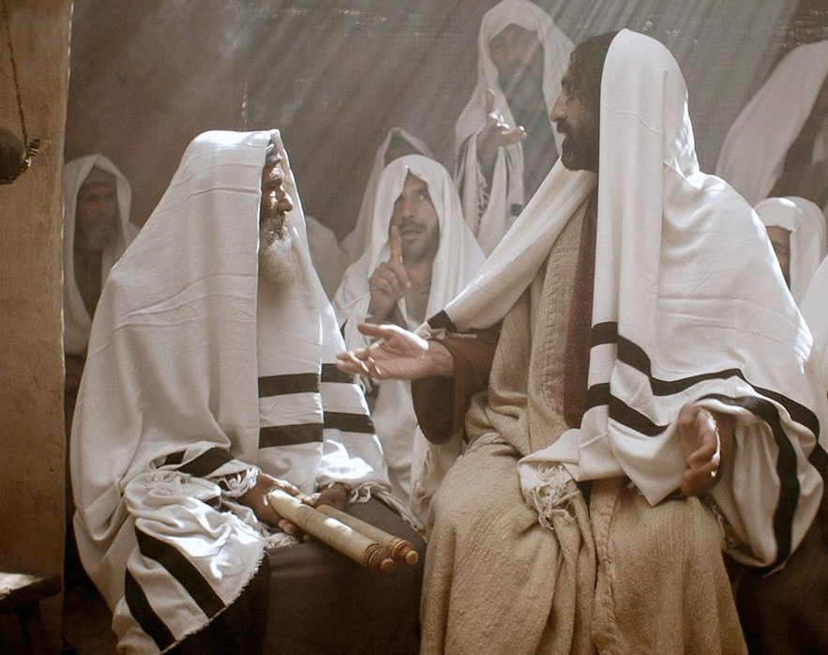
Isaiah 61:2 NIV
“to proclaim the year of the Lord’s favor and the day of vengeance of our God”
Notes:
Now, why would Jesus do that? Why would Jesus not finish reading the verse that speaks of God’s vengeance on his enemies? Some will immediately say, “Well, it’s because Jesus came first to show us love and die for our sins.” Afterall, in John 3:17, Jesus said that God didn’t send his Son into the world to condemn the world, but to save the world. And while I agree that Jesus came to show us love, die for our sins, to save not to condemn, I want to submit to you that this is what God is actually like, what he has always been like, and will always be like.
Which means that we are the ones who have misunderstood how his wrath and “vengeance” works, we are the ones who have projected our own sinfulness and ideas of justice onto God, wanting him to operate more like sinful humanity, and so we, like James and John (the Sons of Thunder) want God to call down fire from heaven and destroy our enemies. But for Jesus, he isn’t going to be that kind of Messiah, because the Father isn’t that kind of God. And this isn’t going to sit well with the folks in Nazareth. Look what happens next. Verse 20. [NEXT SLIDE]

Slide 6
Luke 4:14-30 NIV
²⁰ Then he rolled up the scroll, gave it back to the attendant and sat down. The eyes of everyone in the synagogue were fastened on him. ²¹ He began by saying to them, “Today this scripture is fulfilled in your hearing.”
Notes:
²⁰ Then he rolled up the scroll, gave it back to the attendant and sat down. The eyes of everyone in the synagogue were fastened on him. Notice, Jesus sat down to teach, which was the custom in Judaism. And he would have sat in what they called “the seat of Moses” symbolizing the authority of the speaker. And you can imagine the suspense here. You likely could have heard a pin drop. What’s Jesus going to say? And he speaks, he says: “Today this scripture is fulfilled in your hearing.” (GASP!) What?! Oh no he didn’t.
In Luke’s gospel, apart from his reading of Scripture, “Today” is the first word Jesus utters in his public ministry. Emphasizing the “already” nature of the Kingdom age. In other words, Jesus is saying, I’m the Messiah and the Kingdom (which I embody) is coming now through me. I’m about to do all of these things which you have read about for centuries and that you have been anticipating and longing for your whole lives.
And look what happens next. In v.22 Luke says at first ”all spoke well of him” literally means “they bore witness to him”; i.e. their initial impression was favorable, and they can’t believe this is the same Jesus who grew up in their village. But their response, ”Isn’t this Joseph’s son?” makes us think of the saying, “familiarity breeds contempt.” Because you see, their proximity to Jesus and their feelings of privilege (being the villagers who watched Jesus grow up) are going to make it impossible for them to hear his words and embrace his mission. They want Jesus to do the miraculous things they’ve heard that he has done in Capernaum (his new home and base for ministry), but they don’t want to hear his claims or hear about his vision of the Kingdom of God.
And likely having expected this response, Jesus reminds them that prophets were never welcomed by their own people (by their hometown). He then goes on to give them two examples, Elijah and Elisha, OT prophets who used their miraculous powers to bless and benefit outsiders, and in one case, heal the Gentile commander of the enemy army. So, catch this, Jesus has not only jolted them by not reading all of verse 2, and then shocked them with “Today this scripture is fulfilled in your hearing,” he now lays on them more than they can handle with his seemingly unpatriotic (anti-Israel sounding) words. How dare he!
And then this happens. [NEXT SLIDE]

Slide 7
Luke 4:14-30 NIV²⁸
²⁸ All the people in the synagogue were furious when they heard this. ²⁹ They got up, drove him out of the town, and took him to the brow of the hill on which the town was built, in order to throw him off the cliff. ³⁰ But he walked right through the crowd and went on his way. All the people in the synagogue were furious
Notes:
It goes without saying that throwing someone of a cliff is out of the ordinary in Judaism. Stoning would have been the prescribed way of judging a blasphemer. So clearly what Luke wants us to see is the mob mentality that takes over and drives the townsfolk to violence. They are so furious and filled with rage that they forget all about the diapers they changed when Jesus was in the nursery, they have forgotten about how he was always such a well-behaved, well-mannered child, and that recently he has become Nazareth’s claim to fame. None of that matters. In their minds, Jesus is a heretic, dreamer, and blasphemer, and deserving of a violent death in the name of saving their nation.
But somehow in the midst of their fury, Jesus (still operating in the power of the Spirit), walks right through the hostile crowd, and for what we can tell, never returns to Nazareth. Folks, if you’ve never stopped to think about it before, imagine the hurt and the pain that Jesus must have felt to be rejected in this way. But this of course is the road Jesus has chosen as Messiah. He understands that some people don’t want his good news, because they like things the way they are, and it’s too much to rethink what you thought you knew and to repent.
And that’s how the crowd responded to Jesus’ inaugural address. But he didn’t let this stop him from proclaiming the Kingdom and living out his Messianic agenda. As we can see from the gospels, Jesus acts on everything he said he had come to do in his reading of Isaiah. He delivered on his promises for a period of about 3 years. And somewhere in his short ministry, he gives us what some scholars have called the “Constitution of the Kingdom.” We know it as the Sermon on the Mount. [NEXT SLIDE]

Slide 8
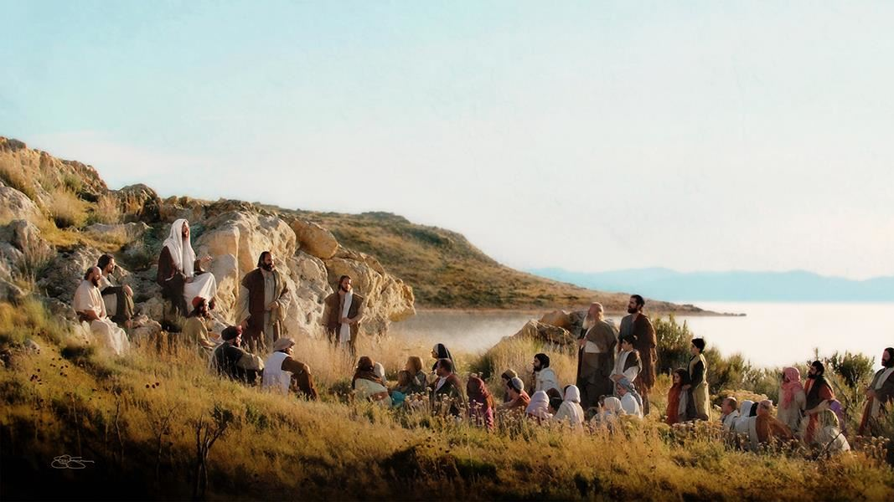
The Sermon on the Mount – The Kingdom Constitution Matthew chapters 5-7 & Luke 6:17-49
Notes:
So much to what Jesus was doing wasn’t only politically subversive, it was also reminiscent or alluded to something that occurred in the life of Israel. In the case of the Sermon on the Mount, Jesus goes up on a mountain to give us his law of the Kingdom. Just as Moses gave Israel the old covenant law on Mt. Sinai, Jesus gives the new covenant law on the Mount of Beatitudes. And what Jesus teaches us there is what it looks like to live under his Lordship; what it looks like to embrace his Messianic agenda and apply it to our lives.
But we shouldn’t see the sermon as a list of rules and requirements, but rather a description of the society of Jesus; his Kingdom community. When we read Matthew 5-7, we can see that this community is driven by a love of God and our neighbors, including our enemies; a community known for our passionate pursuit of righteousness and justice; known for loving and telling the truth (with no need to swear on a Bible to prove it); known for lovingly turning the other cheek in order to expose the shameful acts of evildoers; a community known for rooting out our anger and lust, for being faithful to our spouses, known for giving to the poor, for being spiritual and religious without hypocrisy, for being content and not materialistic and greedy, for not being a people who worry, but being a non-anxious presence; a Kingdom community known not for being judgmental, but identified by our radical inclusive love that points people and leads others to the narrow road that leads to life.
If you’ve not read the Sermon on the Mount in a while, I encourage you to go and read it. Slowly. The sermon begins with what we call the Beatitudes. And we should understand the beatitudes, like the rest of the Sermon on the Mount, as an explanation and description of what it looks like to love God and love your neighbor as your self, which Jesus said is how the Kingdom can be summed up. And so when Jesus says “Blessed are” (e.g. blessed are the poor in spirit, blessed are those who mourn, blessed are the merciful) this blessedness has meaning for the present as well as the future; Jesus is saying, my Kingdom is good news to these people; it’s “happiness for those” people – yet the happiness of the beatitudes isn’t about feeling good, it’s about being good and living like Jesus. It’s blessings for those who choose to follow him.
And ultimately, Jesus blesses three kinds of people in the Beatitudes:
Those who are poor, marginalized, and forgotten
Those who hunger and thirst for what is right, fair, and just
Those who create and work for peace in all its forms
And this is how King Jesus is remaking the world. This is how he rules and reigns; this is how his Kingdom comes. As N.T. Wright has said, “The ‘Beatitudes’ are Jesus’ [political] agenda for kingdom-people... when God wants to change the world, he doesn’t send in the tanks. He sends in the meek, the mourners, those who are hungry and thirsty for God’s justice, the peacemakers, and so on.” I love that!
And Warren Carter (a historical Jesus scholar) said it this way: “In the beatitudes, Jesus has the disciples imagine a different world, a different identity for themselves, a different set of practices, a different relationship to the status quo. Why imagine? Not because it is impossible. Not because it is escapist. Not because it is fantasy. But because it begins to counter patterns imbibed from the culture of the imperial world.”
You see, church, in the greatest sermon ever preached, Jesus is casting a vision for how his church can be a “city on a hill” and, as he said, the “light of the world.” Those words don’t describe America or any other nation or empire on the earth. It describes his Body—a new humanity—which transcends all borders, boundaries, and lines on a map. As Jesus says at the end of his sermon, this is how we build our house on a rock; we build it on the rock of his teachings and upon the constitution of the Kingdom of God.
But… we get to choose. He sets before us life or death; Kingdom or empire; the new way or the old way. So, will we turn our eyes to the hill or to the mount? Where does our help come from? Does it come from what politicians do in Washington, or does it come from what God in Christ did on the cross? Folks, the biggest choice you’ll ever make isn’t your decision on November 3rd (though it’s pretty important), but rather it’s whether you will follow Jesus, accept his agenda and its implications for how you live. Again, let’s soak it up and take it in together: [NEXT SLIDE]

Slide 9
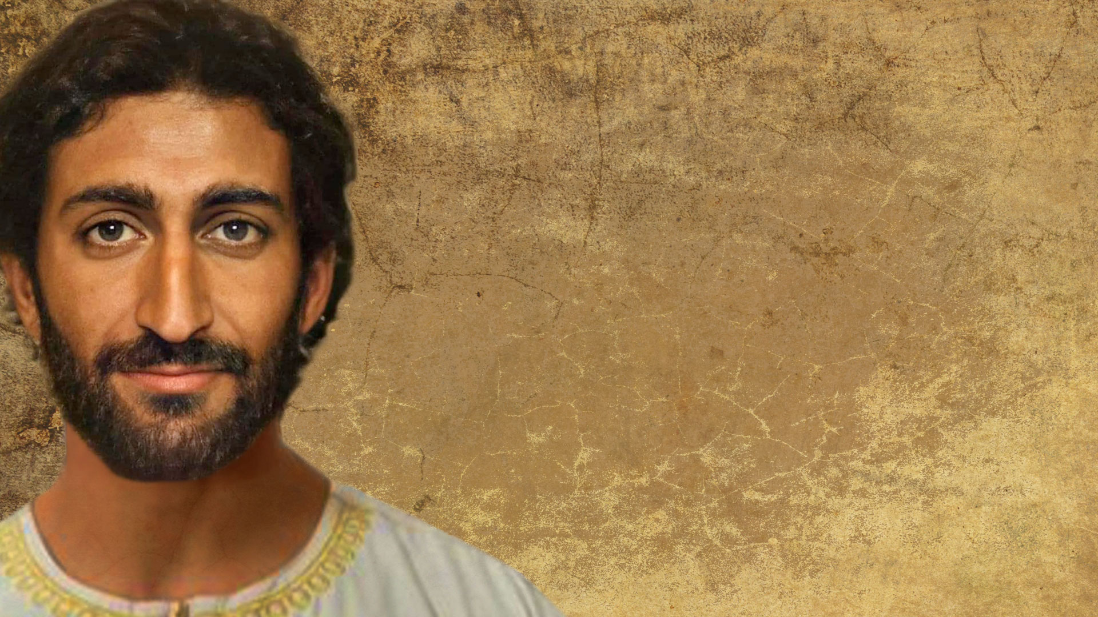
The Messianic Agenda of Jesus
Forgiveness of sins and crippling debt
Blessings for the spiritually destitute; help for the helpless, the poor, outsiders, etc.
Compassion for the broken-hearted
Healing physical and spiritual wounds—opening the eyes of the blind!
Deliverance from spiritual evil and from oppressive systems of abuse and injustice
Rewards for the merciful, for those who love their enemies, for peacemakers, and for those persecuted for Jesus’ sake
Notes:
[READ & BRIEFLY COMMENT]
Brothers and sisters, as I’m sure you can see, while the Messianic agenda of Jesus is good news for those wanting a new world, it’s bad news for those who aren’t willing to repent and let go of the old one. Because the truth is this: if you’re the kind of person that has been oppressed and exploited by the empire—you see your need for forgiveness, compassion, mercy, healing, deliverance, and so forth; you see your need for the salvation that Jesus brings—then accepting the Messianic agenda is a bit easier for you. You probably even welcome it.
But if you see yourself as self-reliant and self-sufficient, and you’re OK with your spiritual situation; if you’re benefiting from the power and privilege of maintain the status quo, and benefiting from greed and crony capitalism; if you’re disconnected from the marginalized and disenfranchised; if you don’t actually know people who can’t get a job (or enough jobs), people who depend upon food stamps, and you’ve never experienced the effects of racism, sexism, poverty, and bigotry, then you’re probably not going to like or desire Christ’s Kingdom. Because Jesus cares about all of that. He’s not just interested in souls, he’s interested in bodies, and bringing the righteousness and justice of the Kingdom into the present evil age.
But if we’re going to get on board with that, whoever we are, it’s going to require repentance. That’s what Jesus said: [NEXT SLIDE]

Slide 10
“The time promised by God has come at last!” he announced. “The Kingdom of God is near! Repent of your sins and believe the Good News!” Jesus, Mark 1:15 NLT
Notes:
Church, please hear me. The good news is so much bigger than “accept Jesus so you can have your sins forgiven and die and go to heaven” escaping the earth and leaving it to burn – in fact, that alone is a distortion of the gospel message. Never did Jesus or the rest of the NT speak about saying a prayer so you can go to heaven when you die. The gospel of the NT has always been about heaven coming to earth. Which means that the gospel is wholistic. It’s about freeing the spirit, soul, and body. It’s about the Kingdom of God being realized on this planet. It’s about God getting his way in the world, which looks like the Messianic agenda expressed in Jesus’ inaugural address and through the Sermon on the Mount.
But again, to welcome and experience the power of this in our lives, we all must repent, i.e. change our thinking, turn around, and give up on our way, the old way, the world’s way, and let the Messiah from Nazareth lead us to the kind of peace and freedom found only in the Kingdom. I’s hard, I know. It’s hard to repent. But it reminds me of what Dietrich Bonhoeffer said in his classic book, Discipleship. He said, “The command of Jesus is hard, unutterably hard, for those who try to resist it. But for those who willingly submit, the yoke is easy, and the burden is light.”

Slide 11
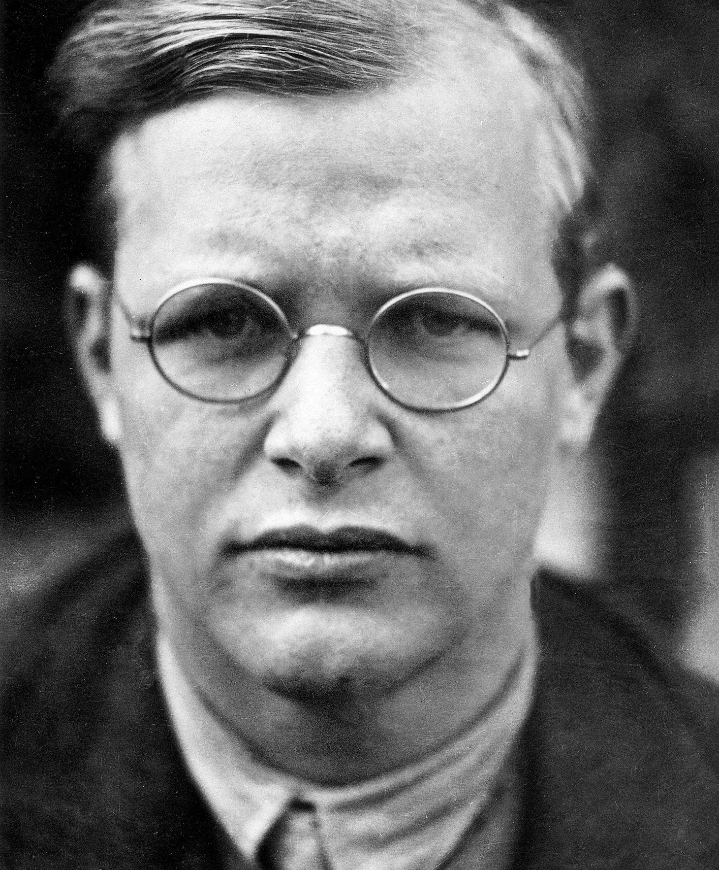
“The command of Jesus is hard, unutterably hard, for those who try to resist it. But for those who willingly submit, the yoke is easy, and the burden is light.”
Dietrich Bonhoeffer
Notes:
Finally, we come to a time of invitation and response. Here are a few ways that we can embrace the agenda of Jesus: [NEXT SLIDE]

Slide 12

Invitation & Response
Steps to embracing the agenda of Jesus:
Notes:
[BRIEF COMMENTS ON EACH POINT]
Again, as Bonhoeffer said, the command of Jesus is hard when we resist, but when we obey, that’s when get to experience the life of the Kingdom—the abundant life that Jesus so desperately wants to give us.
As we close in prayer, please join me in asking that God would give us hearts that are willing to obey, so that we can follow King Jesus and welcome more of his Kingdom in our lives, in our church, in our country, and in our world. Let’s pray…
[CLOSING PRAYER]

Slide 13
Invitation & Response
Steps to embracing the agenda of Jesus:
Begin by acknowledging where your priorities do not align with those that Jesus taught and lived.
Notes:
[BRIEF COMMENTS ON EACH POINT]
Again, as Bonhoeffer said, the command of Jesus is hard when we resist, but when we obey, that’s when get to experience the life of the Kingdom—the abundant life that Jesus so desperately wants to give us.
As we close in prayer, please join me in asking that God would give us hearts that are willing to obey, so that we can follow King Jesus and welcome more of his Kingdom in our lives, in our church, in our country, and in our world. Let’s pray…
[CLOSING PRAYER]

Slide 14
Invitation & Response
Steps to embracing the agenda of Jesus:
Begin by acknowledging where your priorities do not align with those that Jesus taught and lived.
Be honest and confess how the Jesus of the gospels doesn’t always agree with you.
Notes:
[BRIEF COMMENTS ON EACH POINT]
Again, as Bonhoeffer said, the command of Jesus is hard when we resist, but when we obey, that’s when get to experience the life of the Kingdom—the abundant life that Jesus so desperately wants to give us.
As we close in prayer, please join me in asking that God would give us hearts that are willing to obey, so that we can follow King Jesus and welcome more of his Kingdom in our lives, in our church, in our country, and in our world. Let’s pray…
[CLOSING PRAYER]

Slide 15
Invitation & Response
Steps to embracing the agenda of Jesus:
Begin by acknowledging where your priorities do not align with those that Jesus taught and lived.
Be honest and confess how the Jesus of the gospels doesn’t always agree with you.
Repent of the attitudes, beliefs, and behaviors that conflict with Jesus.
Notes:
[BRIEF COMMENTS ON EACH POINT]
Again, as Bonhoeffer said, the command of Jesus is hard when we resist, but when we obey, that’s when get to experience the life of the Kingdom—the abundant life that Jesus so desperately wants to give us.
As we close in prayer, please join me in asking that God would give us hearts that are willing to obey, so that we can follow King Jesus and welcome more of his Kingdom in our lives, in our church, in our country, and in our world. Let’s pray…
[CLOSING PRAYER]

Slide 16
Invitation & Response
Steps to embracing the agenda of Jesus:
Begin by acknowledging where your priorities do not align with those that Jesus taught and lived.
Be honest and confess how the Jesus of the gospels doesn’t always agree with you.
Repent of the attitudes, beliefs, and behaviors that conflict with Jesus.
Put Jesus’ words into action.
Notes:
[BRIEF COMMENTS ON EACH POINT]
Again, as Bonhoeffer said, the command of Jesus is hard when we resist, but when we obey, that’s when get to experience the life of the Kingdom—the abundant life that Jesus so desperately wants to give us.
As we close in prayer, please join me in asking that God would give us hearts that are willing to obey, so that we can follow King Jesus and welcome more of his Kingdom in our lives, in our church, in our country, and in our world. Let’s pray…
[CLOSING PRAYER]

