Slide 1
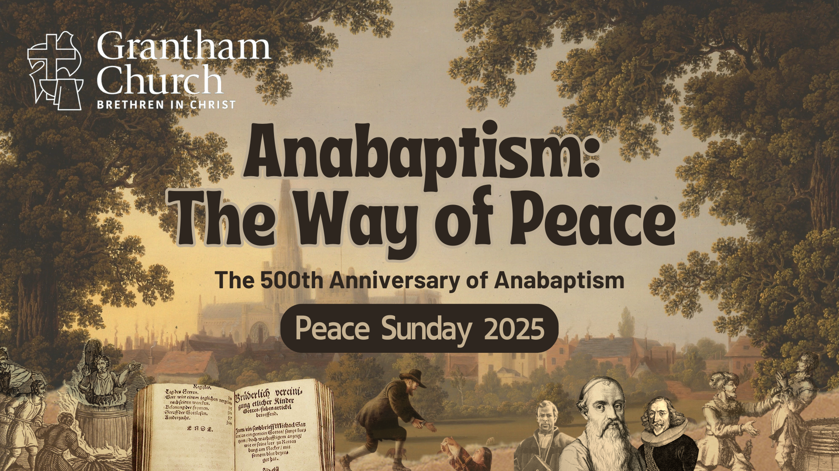

Slide 2
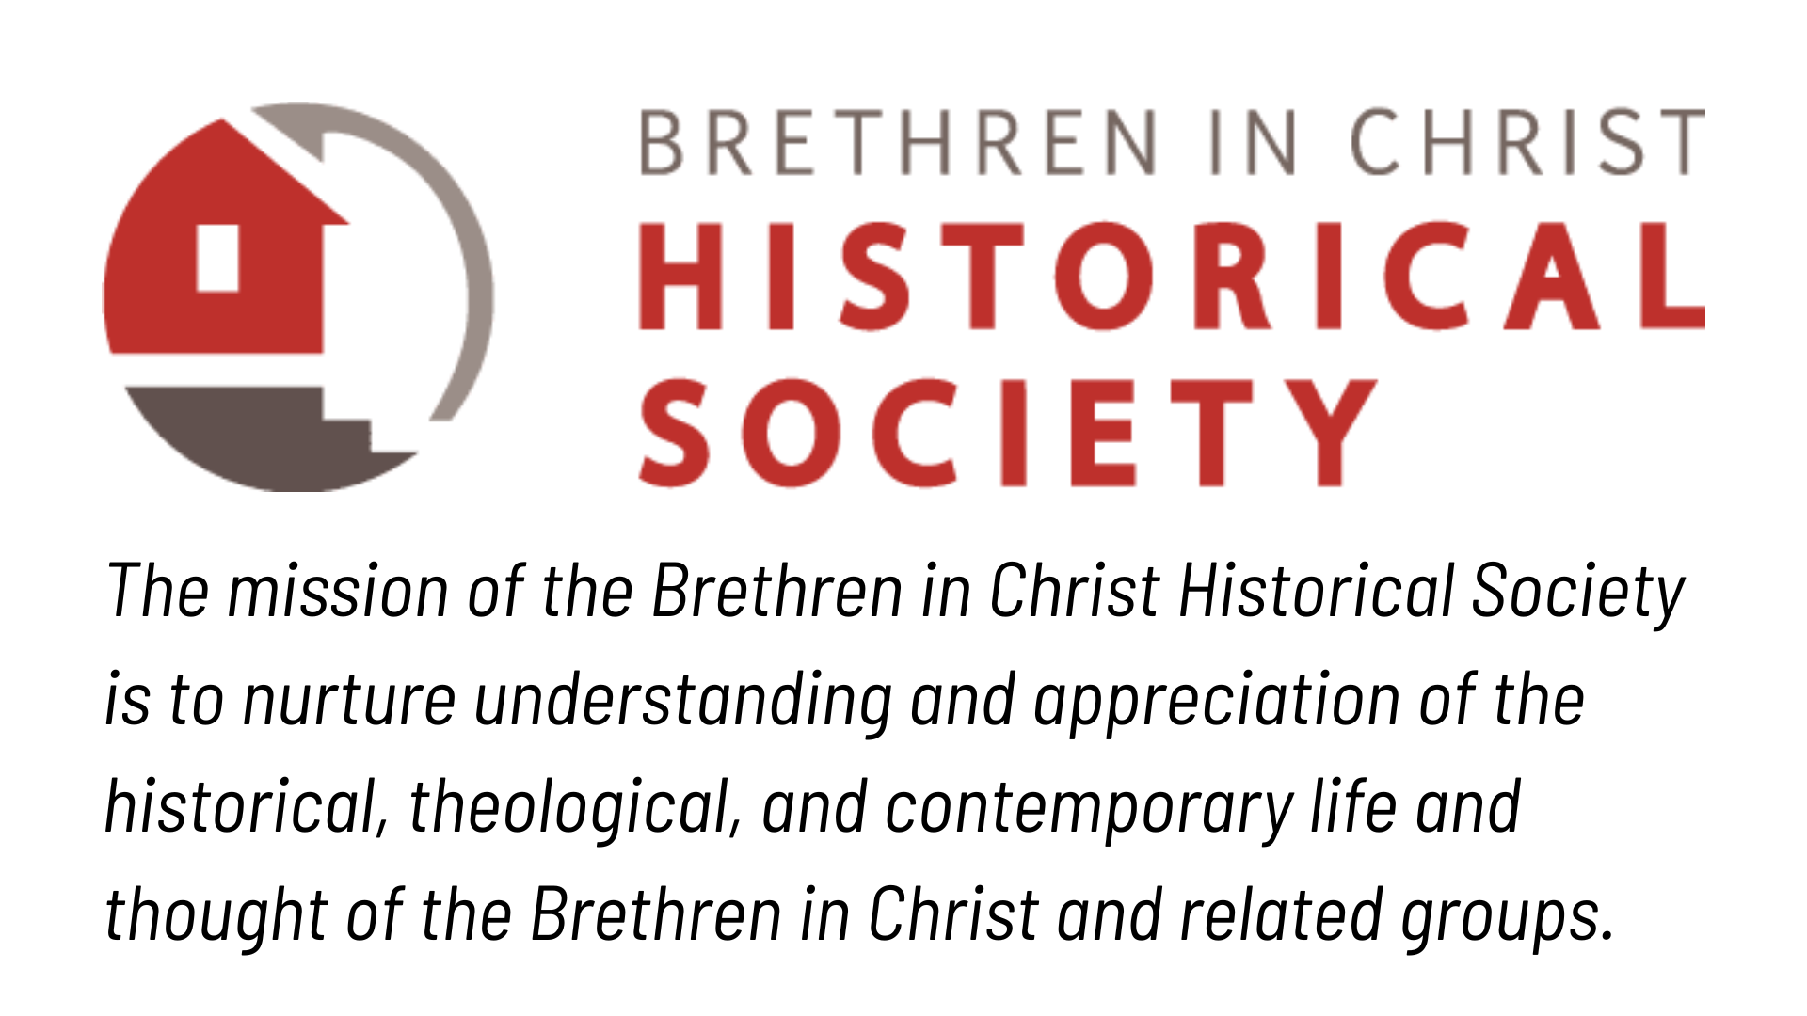

www.bic-history.org

Slide 3


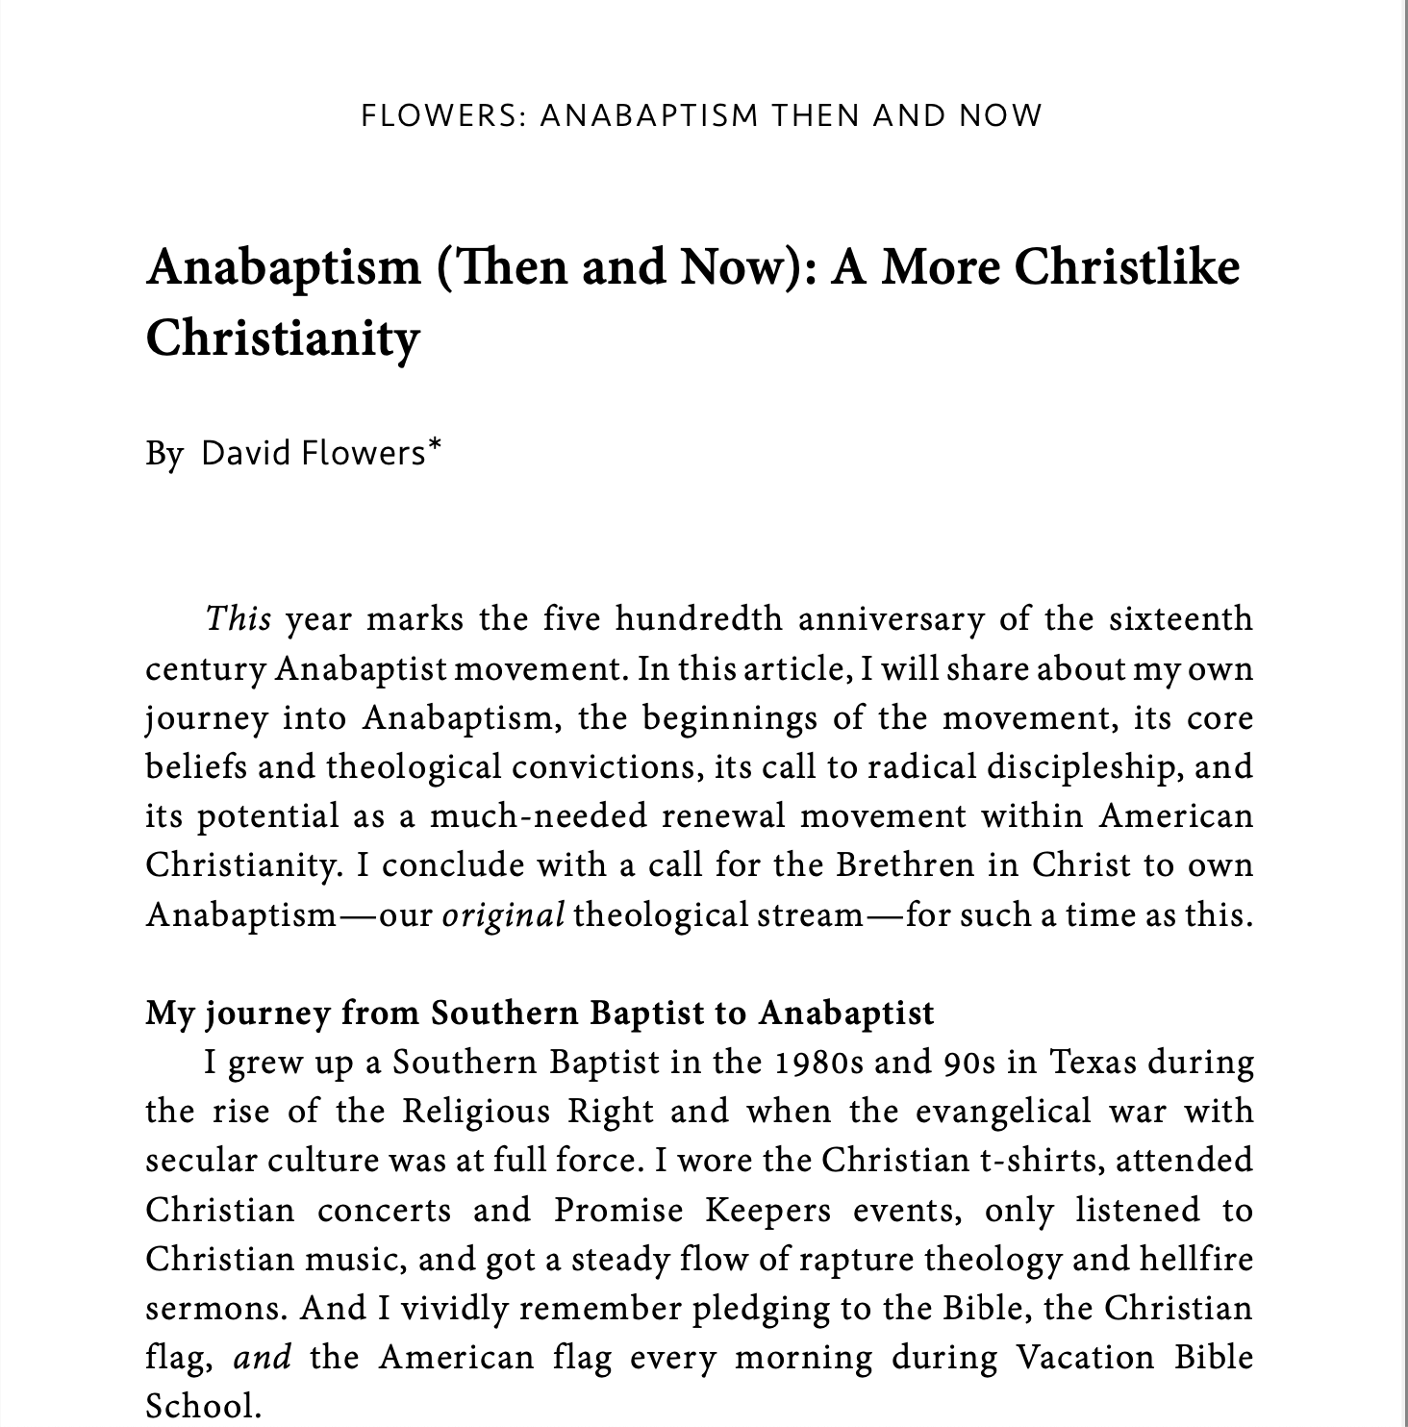

Slide 4


Anabaptism (Then & Now): A More Christlike Christianity
Pastor David Flowers, MTS
Senior Pastor - Grantham Church
Notes:
I’ll be summarizing the content in the article and hitting the highlights, though I do want to read small portions of it along the way.
In the article, I share about my own journey into Anabaptism, the beginnings of the movement, its core beliefs and theological convictions, its call to radical discipleship, and its potential as a much-needed renewal movement within American Christianity. And then I conclude with a call for the Brethren in Christ to own Anabaptism—our original theological stream—for such a time as this.

Slide 5
My Journey from Southern Baptist to Anabaptist
Notes:
[READ ARTICLE PGS. 3-9]

Slide 6
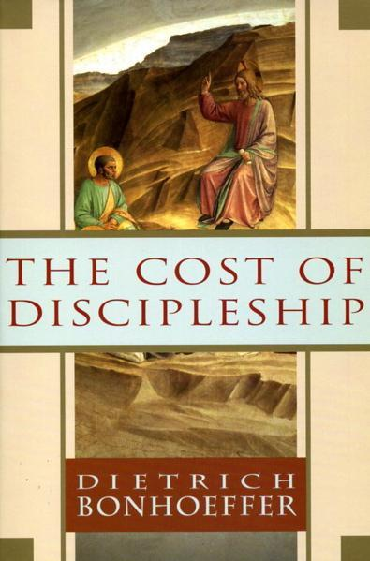





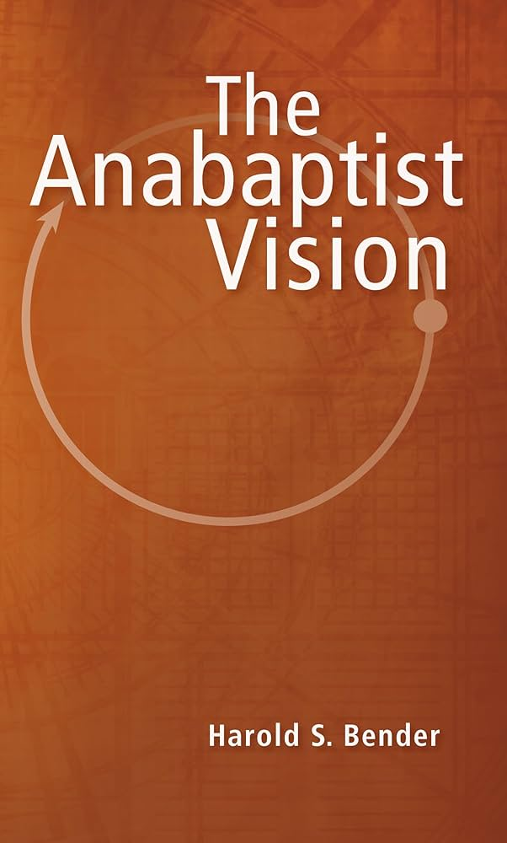



Notes:
[Books that influenced me toward Anabaptism]
Comment briefly on each book
PDFs of Verduin and Hoover’s books can be found online
[NEXT SLIDE]

Slide 7


Slide 8
Anabaptism: How the Movement Began
Notes:
So, what is Anabaptism and how did it begin? [NEXT SLIDE]

Slide 9
The Birth of Anabaptism
Oct 31, 1517 – Martin Luther (95 Theses)
1521 – Luther stands trial at Diet of Worms
1522 – Ulrich Zwingli leads Swiss reform, but three of his students aren’t satisfied with that reform
Jan 21, 1525 – Conrad Grebel re-baptizes George Blaurock in Zurich, Switzerland (i.e. “Swiss Brethren”) “Ana-baptism” is born!
1527 – Schleitheim Confession (Anabaptist Creed)
Notes:
[COMMENT ON TIMELINE]
And after these young men re-baptize one another, just shortly after the start of the 16th century Reformation, the Anabaptists grow to become a scattered and diverse group of separatists. Beginning with the self-identified “Swiss Brethren”, these men and women called for a “radical reformation” of the church that went far beyond the reform movements known as Protestantism.
For example, the early Anabaptists rejected infant baptism as a civil rite, which denied the church’s relationship to the state, and called for strict adherence to the teachings of Jesus (e.g. loving enemies, washing feet, abstaining from oaths, etc.)—a life of discipleship which follows a believer’s baptism.
And since it appeared they were being baptized a second time, their opponents called them Ana-baptists (re-baptizers). These radicals claimed that Protestants only wanted a “half-way” reform because they refused to put down the sword and follow Christ in non-violence and peaceful living. They posited that the Reformers only rested in grace, but did not walk in resurrection life. Obeying Christ is the evidence of a changed life, they would say, so how can we not take Jesus’ words and example seriously? To not follow Jesus in this way, only goes to show how much a person is clinging to his or her old life, and the old world, which Jesus has forever changed.
And here is what the Schleitheim Confession addressed… [NEXT SLIDE]

Slide 10
Schleitheim Confession (1527)
The first Anabaptist confession addressed the following:
Baptism (rejected infant baptism; “believer’s baptism” only; created clear separation between the Church & the State)
The Ban (excommunication for the unrepentant)
Breaking of Bread (only the baptized can take communion)
Separation from Evil (no fellowship with the wicked)
Pastors in the Church (to be honored but held accountable)
The Sword (actively practice peace & non-violence)
Oaths (Jesus prohibited swearing & oath-taking)
*The Sermon on the Mount (Matt. 5-7) was central for Anabaptists!
Notes:
[READ & COMMENT ON EACH POINT]
For the Anabaptists, they had an apocalyptic worldview. And they believed there is (as John’s gospel tells us) a spiritual battle between good and evil—the forces of darkness against God and his agents of light. And part of understanding this battle is to understand what the Scriptures reveal about the kingdom of God vs. the kingdoms of the world… [NEXT SLIDE]

Slide 11

Notes:
[READ & BRIEF COMMENTS]
Examples from the Old Testament
Examples from the New Testament
Therefore, we can see from the Scriptures that while human governments are currently a part of the world as we know it, even necessary for the present evil age (e.g., Romans 13), they are easily corruptible and used by the enemy to fuel human systems of injustice, greed, war, violence, and exploit the vulnerable, oppress minorities, and sometimes persecute the church.
At some point in the future, when Christ brings the fullness of his Kingdom upon the earth, these kingdoms will be no more. But until then, the Anabaptists said we must recognize their temporary nature, and their susceptibility to corruption and idolatry, as we seek to navigate the political landscape today as citizens of heaven. And so, we must recognize that there are Two Kingdoms and that are allegiance is to one and not the other… [NEXT SLIDE]

Slide 12
Two Kingdoms Theology & Apocalypticism
Kingdoms of the World
Ruler: Jesus said that Satan is the “ruler (arche) of this world” (Jn 12:31; 14:30; 16:11); “god of this age” and “prince of the power of the air” (2 Cor 4:4; Eph 2:2); he is the one who “deceives the nations” (Rev 13:14).
Methods: exercises power-over people (law), wields “the power of the sword” (war & violence), operates by intimidation and force, seeks to control the behavior of others.
Purpose: originated because of sin and rebellion; in spite of its corruption, God uses it to keep law and order in a fallen world where sin reigns in human beings (Rom 13:1-5).
Notes:
[READ & COMMENT]
Therefore, it’s not all that surprising that the Anabaptists denounced the Roman emperor Constantine as “the great dragon” for fusing the cross and the sword in the 4th century, which set the church on a course of power and privilege, as if the Kingdom had finally come to earth through a Christian empire. So, the early Anabaptists called for a restoration of NT belief and practice, to reflect a God and a Kingdom that looks like Jesus. [NEXT SLIDE]

Slide 13
Two Kingdoms Theology, cont.
Kingdom of God
Ruler: Jesus Christ is “King” of kings (1 Tim 6:15; Rev 19:16) and “Lord” of all (Acts 10:36); maker of heaven and earth (Col 1:16); “judge” over all creation (Rom 2:16; 2 Tim 4:1); he is the full embodiment of the Kingdom of God.
Methods: exercises power-under people (love), wields the sword of the Spirit, operates in gentleness and grace, seeks to transform hearts by the Spirit; always looks like Jesus!
Purpose: that God would reign and rule the cosmos through Jesus, his Son; he invites all of creation to share in the mysterious Kingdom that is already/but not yet.
Notes:
[READ & COMMENT]
In addition to their Two Kingdoms theology... [NEXT SLIDE]

Slide 14
The Anabaptist View of
Scripture & Authority
Notes:
…is the radical way in which they viewed the Bible and the aim of Scripture. [NEXT SLIDE]

Slide 15
On Whose Authority?
The Protestant reformers challenged the authority of Roman Catholic traditions, Church Councils, and the power of the Pope.
“Sola Scriptura” (Only Scripture) is infallible guide to faith & practice of Christians.
Problem: Doctrinal differences & disagreements over interpretations fracture Protestantism. Bible is read as a flat book to support practices that contradict the life and teachings of Jesus.
Notes:
[READ & COMMENT]
The Anabaptists essentially said that Christendom was missing the whole point of the Scriptures… revealing Jesus Christ as the God-man who reframes our understanding of Scripture and calls us to follow him. Listen to what Peter Hoover writes in his book… [NEXT SLIDE]

Slide 16
The Word Became Flesh… Not Ink
“The Anabaptists had infinitely more than sola scriptura. They had community with Christ. And they were not “people of the book.” They were “people of the Man.” The Anabaptists did not read in the Gospels that the Word was made paper and ink. They read that “the Word became flesh and dwelt among us, and we beheld his glory, the glory as of the only begotten of the Father, full of grace and truth.”
Peter Hoover, The Secret of the Strength (p.72)
Notes:
[READ & COMMENT]
So, for the Anabaptists, Christ is the hermeneutical key… [NEXT SLIDE]

Slide 17
Christ as Hermeneutical Key
The Anabaptists believed Christ revealed the
fullness of God; God is like Jesus—the Word made flesh!
The NT reveals the new covenant, superseding the OT
The life & teachings of Jesus have supremacy
over our interpretations of Scripture (e.g. OT & Epistles).
“The holy writings are valuable for those who use them right. But their misuse is the source of
all heresy and unbelief.” Heinz Kraut (1536)
Notes:
[READ & COMMENT]
And in Jesus’ own words… [NEXT SLIDE]

Slide 18
John 5:39-40 NIV
“You study the Scriptures diligently because you think that in them you have eternal life. These are the very Scriptures that testify about me, yet you refuse to come to me to have life.”
Notes:
[READ & COMMENT]
You can hear the commitment to the centrality of Christ in the Scriptures in the words of Menno Simons… [NEXT SLIDE]

Slide 19
“Beware of all innovations and teachings that
do not come from the Word of Christ and his
apostles... Point to Christ and his Word at all
times. Let all those who would introduce
anything more than what Christ teaches in his
Word be anathema. For no other foundation
can a man lay than that of Jesus Christ.”
Menno Simons (1557)
Notes:
[READ & COMMENT]
anathema – be cursed or driven out; expulsion
So… you can sum up an Anabaptist reading and interpretation of Scripture like this… [NEXT SLIDE]

Slide 20
Anabaptist Interpretive Method
Everyone can & should interpret responsibly.
Biblical interpretation is a community practice.
Interpretation is for practical application.
Interpretation must happen in light of the life, teaching, death, and resurrection of Jesus.
Transformation & discipleship is the ultimate goal of all Bible reading & interpretation.
Notes:
[READ & COMMENT]
And of course, all these ideas, beliefs, and practices undermined the very foundations of Christendom (i.e. church militant and triumphant), and made the Anabaptist enemies of both Protestants and Catholics who held to the power of the sword… [NEXT SLIDE]

Slide 21

Baptism by Blood & Fire:
Anabaptist Martyrdom
Notes:
And as a result, many Anabaptists were martyred during the 16th century… [NEXT SLIDE]

Slide 22
Baptism by Blood & Fire
Catholics and Protestants see Anabaptist movement made up of “perverted sects” with eccentric individuals, “unbelievably stubborn” and “wildly obstinate” heretics worthy of death.
“These miserable fanatics have no other goal than to put everything into disorder...They reveal themselves to be the enemies of God and of the human race...” John Calvin
“My struggle with the old church (Catholicism) was child’s play compared to my struggle with the Anabaptists.” Ulrich Zwingli
“For think what disaster would ensue if children were not baptized? Besides this the Anabaptists separate themselves from the Churches... we conclude that the stubborn must be put to death.” Martin Luther (pamphlet of 1536)
Notes:
[READ & COMMENT]
And now hear the words of a few of the first Anabaptists… [NEXT SLIDE]

Slide 23
Baptism by Blood & Fire
“Do not worry about the authorities. Just do what God has told you to do.” Conrad Grebel (1525)
“They threatened us with bonds, then with fire and the sword. But in all this I surrendered myself completely into the will of the Lord, together with all my brothers and with my wife, and prepared myself to die for his testimony.” Michael Sattler (1527)
“We would rather suffer our bodies to be burned, drowned, racked or tortured, whatever you may wish to do with them, and we would rather be whipped, banished, or driven away, or robbed of our goods, than show any disobedience contrary to the Word of God.” Hans van Overdam (1551)
Notes:
[READ & COMMENT]
Once again... Peter Hoover writes… [NEXT SLIDE]

Slide 24
“Following Christ, for the Anabaptists, was much more
than obeying his commandments. It was much more than
confessing him publicly or being willing to die for him. It
was knowing Christ, and living like the first disciples in full
community with him.” The words of Paul in Philippians
3:10 stated distinctly the goal of the Anabaptists: “I want to know Christ, and the power of his resurrection, and the fellowship of sharing in his sufferings, becoming like him in his death, and so, somehow, to attain to the resurrection from the dead.”
Peter Hoover, The Secret of the Strength (p.27)
Notes:
[READ & COMMENT]
A well-known story is Anabaptist circles today is the story of Dirk Willems… [NEXT SLIDE]

Slide 25
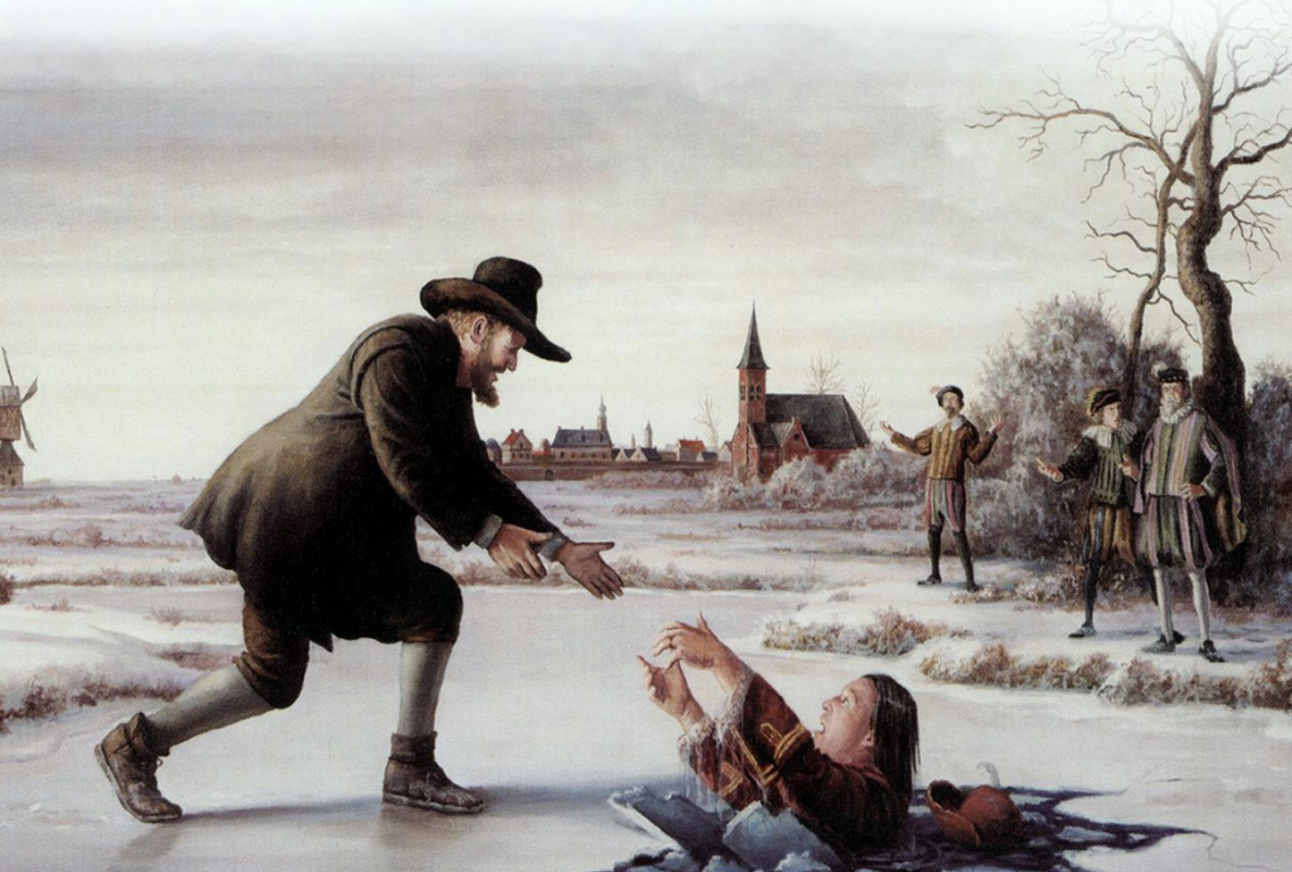
Dirk Willems (1569)
Notes:
Dirk Willems was re-baptized as an Anabaptist; he was arrested; then escaped from prison. As he was fleeing, the guard chasing him fell through the ice of a frozen pond; And yet, despite this act of love, Willems was rearrested, tortured, and burned at the stake on a windy day in May 1569. His screams could be heard from miles away in neighboring towns. The violent hostility from their persecutors only increased as the impact of their witness grew. John Longhurst writes, “It is estimated that between 4,000 and 5,000 Anabaptists were executed during the Reformation years, although the true number is uncertain.” These men and women gave their lives for Christ and the gospel, for they did not love their lives even unto death (Rev. 12:11). We must remember and honor their legacy of faith and sacrifice.
The willingness of Anabaptists to die for their faith reflects their commitment to… [NEXT SLIDE]

Slide 26
Radical Discipleship &
The Anabaptist Vision
Notes:
Radical discipleship, which is at the heart of the Anabaptist vision of Christ’s call and commission.
Listen to what Stuart Murray wrote in his book… [NEXT SLIDE]

Slide 27
“The Christendom era has bequeathed a form of Christianity that has marginalized, spiritualized, domesticated, and emasculated Jesus. The teaching of Jesus is watered-down, privatized, and explained away. Jesus is worshipped as a remote kingly figure or a romanticized personal savior. In many churches (especially those emerging from the Reformation), Paul's writings are prioritized over the Gospel accounts of the life of Jesus. And in many Christian traditions, ethical guidelines derived from the Old Testament or pagan philosophy trump Jesus' call to discipleship.”
Stuart Murray, The Naked Anabaptist (p.55-56)
Notes:
[READ & COMMENT]
And in his classic essay, Harold Bender said… [NEXT SLIDE]

Slide 28
“The Anabaptist vison included three major points of emphasis; first, a new conception of the essence of Christianity as discipleship; second, a new conception of the church as brotherhood [community]; and third, a new ethic of love and nonresistance.”
Harold S. Bender, The Anabaptist Vision
Notes:
[READ QUOTE]
And the early Anabaptists saw this discipleship involving the inner work of transformation (becoming more like Christ) as well as what we might call “social justice” or caring for the least of these. Listen to this well-known quote from Menno Simons…

Slide 29
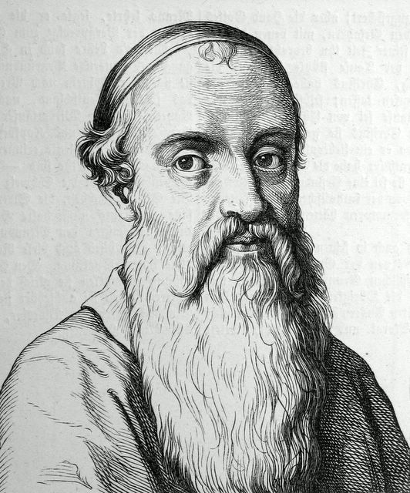
“True evangelical faith, cannot lie dormant, it clothes the naked, it feeds the hungry, it comforts the sorrowful, it shelters the destitute, it serves those that harm it, it binds up that which is wounded, it has become all things to all creatures.”
Menno Simons
Notes:
[READ QUOTE]
And now let’s turn our attention to the Anabaptist beginnings of the Brethren in Christ… [NEXT SLIDE]

Slide 30
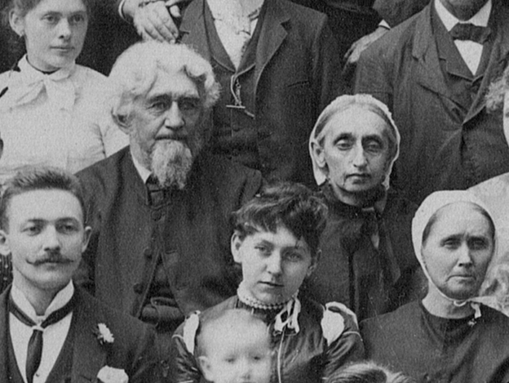
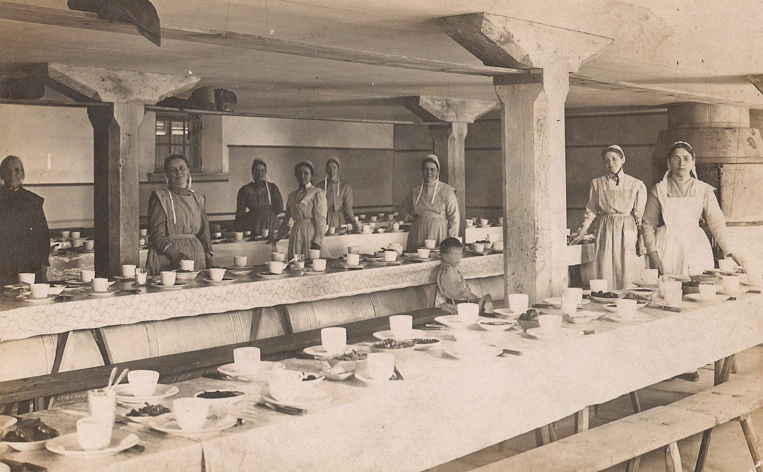
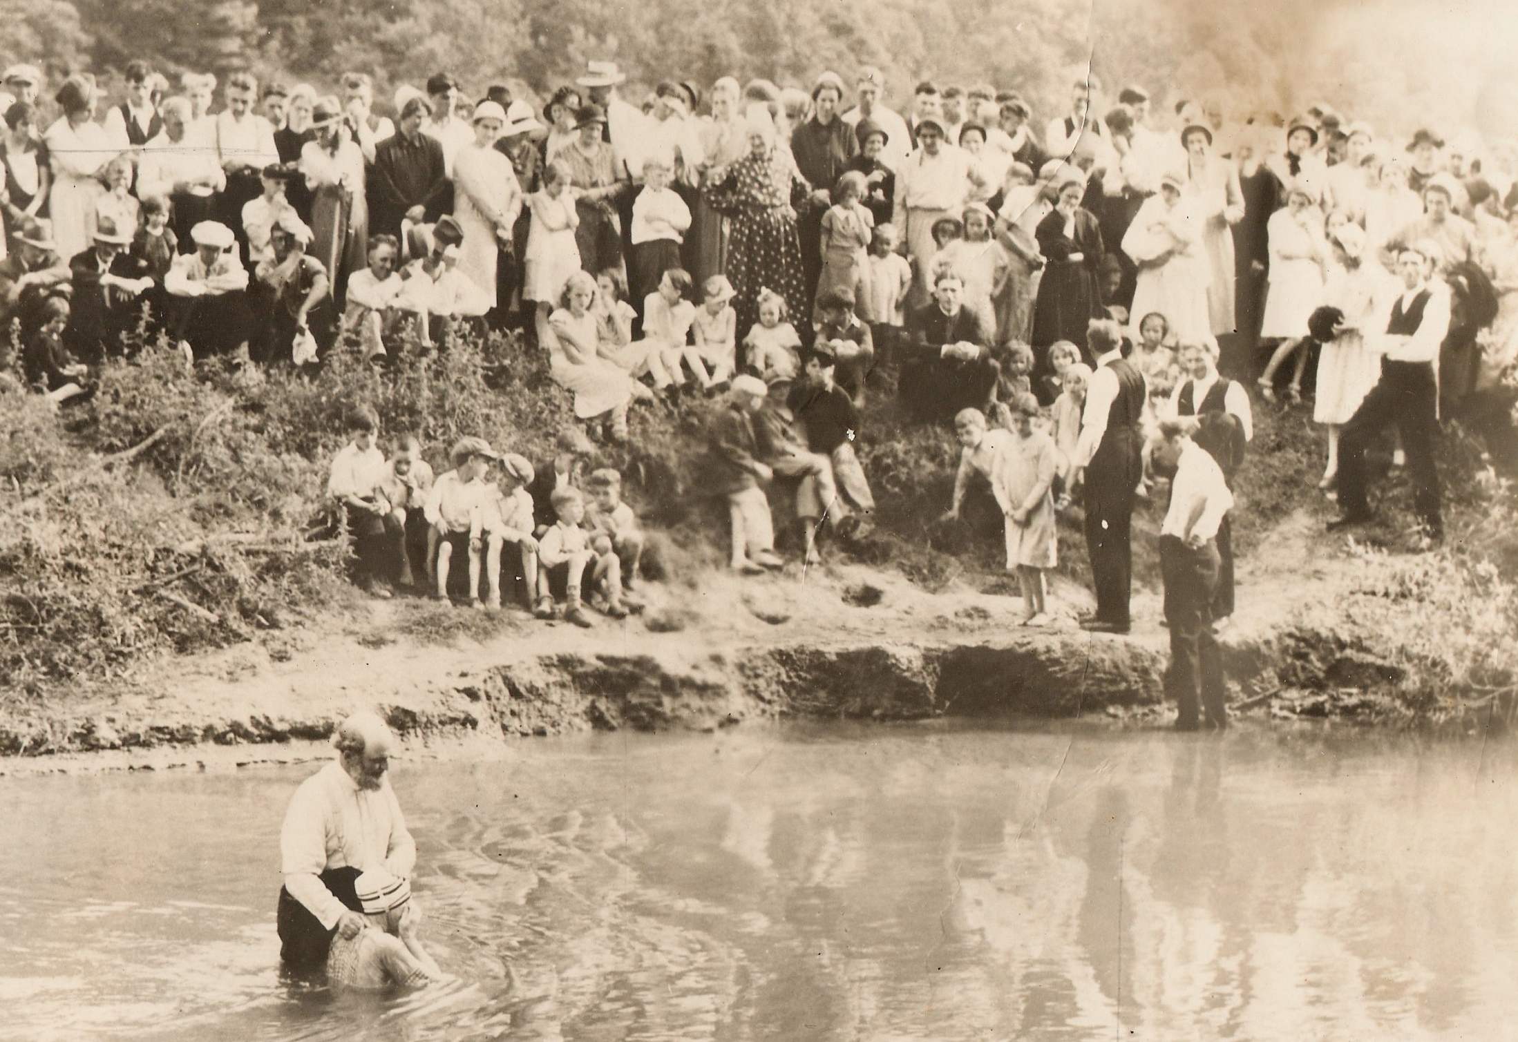
Anabaptism Then:
The Original Stream of the Brethren in Christ
Notes:
We are accustomed in the BIC to refer to the theological traditions that have shaped us as “streams” merging together. More on that in a few minutes… [NEXT SLIDE]

Slide 31
Anabaptism & the Brethren in Christ
A timeline of Anabaptism leading to the founding of the BIC:
1531: Menno Simons embraces Anabaptism
1644: Anabaptists, specifically Dutch Mennonites, arrive in North America
1681: William Penn’s colony becomes a refuge for Anabaptists and other religious outcasts and dissidents seeking to freely live out their faith
1683: Dutch Mennonites established the first permanent congregation of Anabaptists in North America in the Germantown area near Philadelphia
1775-1788: The “River Brethren” of Lancaster County, PA become a denomination when they encountered Pietism; they changed their name to “Brethren in Christ” later in the nineteenth century (1861-65)
1885-1910: The Brethren in Christ embraced the pietism of Wesleyanism
Notes:
[READ & COMMENT ON TIMELINE]
[READ ARTICLE PGS. 27-28]
[READ PG. 29]
BIC historian Luke Keefer wrote… [NEXT SLIDE]

Slide 32
As Brethren in Christ historian Luke Keefer Jr. noted:
“I maintain that the introduction of the third stream of Wesleyanism neither destroyed the initial synthesis of Anabaptism and Pietism nor won at the expense of either of the first two streams. It found acceptance in the denomination by coming to terms with our Anabaptist heritage.”
Luke Keefer Jr., “The Three Streams of Our Heritage: Separate or Parts of a Whole?” Brethren in Christ History and Life, 19, no. 1 (April 1996): 26-63.
Notes:
[READ & COMMENT]
So, it wasn’t until the introduction of Evangelicalism into the life of the church in the middle of the twentieth century that we began to see the eroding of the original stream of the Brethren in Christ… [NEXT SLIDE]

Slide 33
Evangelicalism & the Brethren in Christ: The Slow Erosion of Our Anabaptist Heritage
Notes:
[READ & COMMENT]
Evangelicalism, a worldwide interdenominational movement within Protestant Christianity, emphasizes evangelism, a personal relationship with Jesus Christ, and the authority of the Bible. And as the neo-Evangelicalism of the 1940s and 1950s was picking up steam and was attractive to our declining denomination, many leaders believed the Brethren in Christ were too rigid, legalistic, and dying from biblical literalism, largely perceived to be born of our Anabaptist heritage. [NEXT SLIDE]

Slide 34
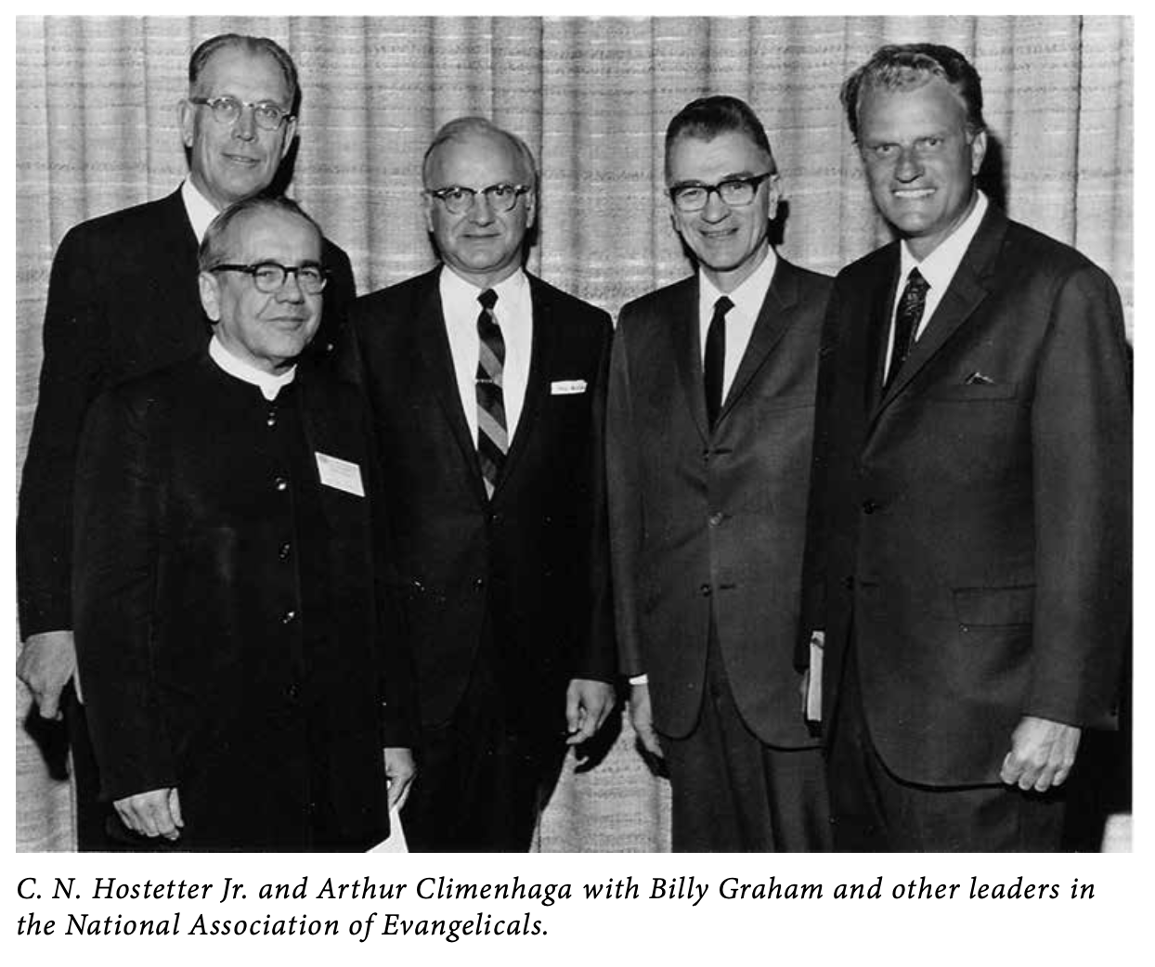
Notes:
[READ ARTICLE PGS. 30-32]
[NEXT SLIDE – ALDERFER QUOTE]

Slide 35
“As American life was identified with Main Evangelicalism
and the Brethren in Christ became more and more associated
with that Evangelicalism, . . . the Brethren drew closer to
American political life and American culture and the old lines
of separation between the kingdoms became less. Anabaptism
was increasingly becoming a burden to the Brethren in Christ.”
Owen Alderfer, “ Anabaptism as a ‘Burden’ for the Brethren in Christ” in Reflections on a Heritage, 110. First published in Within the Perfection of Christ: Essays on Peace and the Nature of the Church, ed. Terry Brensinger and E. Morris Sider (Evangel Press and the Brethren in Christ Historical Society, 1990).
Notes:
[READ & COMMENT]
I’m going to hop, skip, and jump over this next section… [NEXT SLIDE]

Slide 36
Anabaptism Now:
Convictions for a Church in American Exile

Slide 37
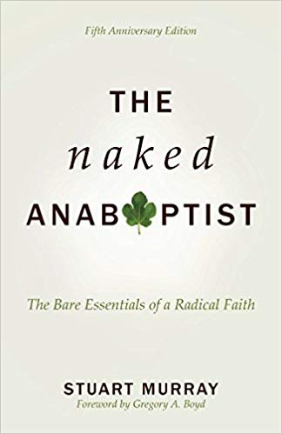


Notes:
[BRIEF COMMENTS ON BOOKS]
A brief excerpt of my story can be found in The Naked Anabaptist
Here is a look at Anabaptists today… [NEXT SLIDE]

Slide 38
Anabaptists Today
1. Descendants and outgrowth of early Anabaptists:
Mennonites, Amish, Hutterites, Mennonite Brethren, Church of the Brethren, River Brethren, and the Brethren in Christ (circa 1775)
2. Denominations, groups, and networks inspired by Anabaptism:
Bruderhof movement, some Baptists, the Anabaptist Mennonite Network, Urban Expression, and the Jesus Collective
3. Neo-Anabaptists throughout many Christian traditions:
Christians who belong to other church traditions, but accept and acknowledge the influence of Anabaptism on their faith and living.
Notes:
[READ & COMMENT]
It is important to point out what Stuart Murray says in his book… [NEXT SLIDE]

Slide 39
“The Anabaptist tradition has never been uniform. From the earliest years there were different emphases and divergent practices. Anabaptists today will interpret the Anabaptist vision in ways that make sense in our various cultures and contexts. But there are foundational insights, deep convictions, and enduring values that have shaped this tradition, for which the first Anabaptists were willing to die, and which all who accept the label “Anabaptist” recognize and want to embody.”
Stuart Murray, The Naked Anabaptist (p.159)
Notes:
[READ & COMMENT]
And here are seven core convictions of Anabaptists as laid out in… [NEXT SLIDE]

Slide 40
Core Convictions of Anabaptism Today
Expounded upon in The Naked Anabaptist by Stuart Murray
Jesus is our example, teacher, friend, redeemer, and Lord.
Jesus is the focal point of God’s written revelation.
Western culture is emerging from the Christendom era, which seriously distorted the gospel and left us ill-equipped for mission.
The association of the church with status, wealth, and force is inappropriate for disciples and damages our witness.
Churches are called to be baptized communities of discipleship and mission; intergenerational, mutual accountability & multi-voiced.
Spirituality & economics are inter-connected; we’re committed to finding ways to live simply, share generously, & do justice/care for creation.
Peace is at the heart of the gospel; we are peacemakers committed to finding non-violent alternatives in the church, society, and nations.

Slide 41
Owning Our Anabaptist Heritage:
An Invitation to the Brethren in Christ U.S.
Notes:
[READ ARTICLE PGS. 35-36]
[NEXT SLIDE FOR BIC TREE ILLUSTRATION]

Slide 42
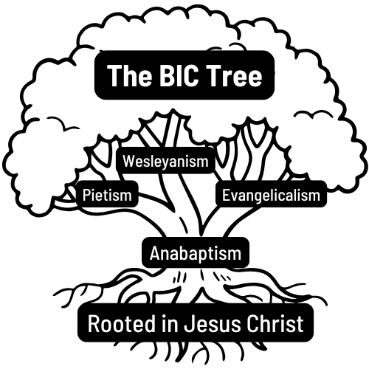
Notes:
[EXPLAIN IMAGE]
[CLOSING WORDS & QUESTIONS - NEXT SLIDE]

Slide 43
Questions & Response | Group Discussion
What encourages you and/or do you find most compelling about historic Anabaptism? What do you find most “Christ-like” about it?
What do you find most challenging about Anabaptism to your own walk and why?
How might our embrace of Anabaptism at Grantham, and within the BIC, help the cause of Christ and the mission of the church today?

Slide 44


