Slide 1


Slide 2


Slide 3
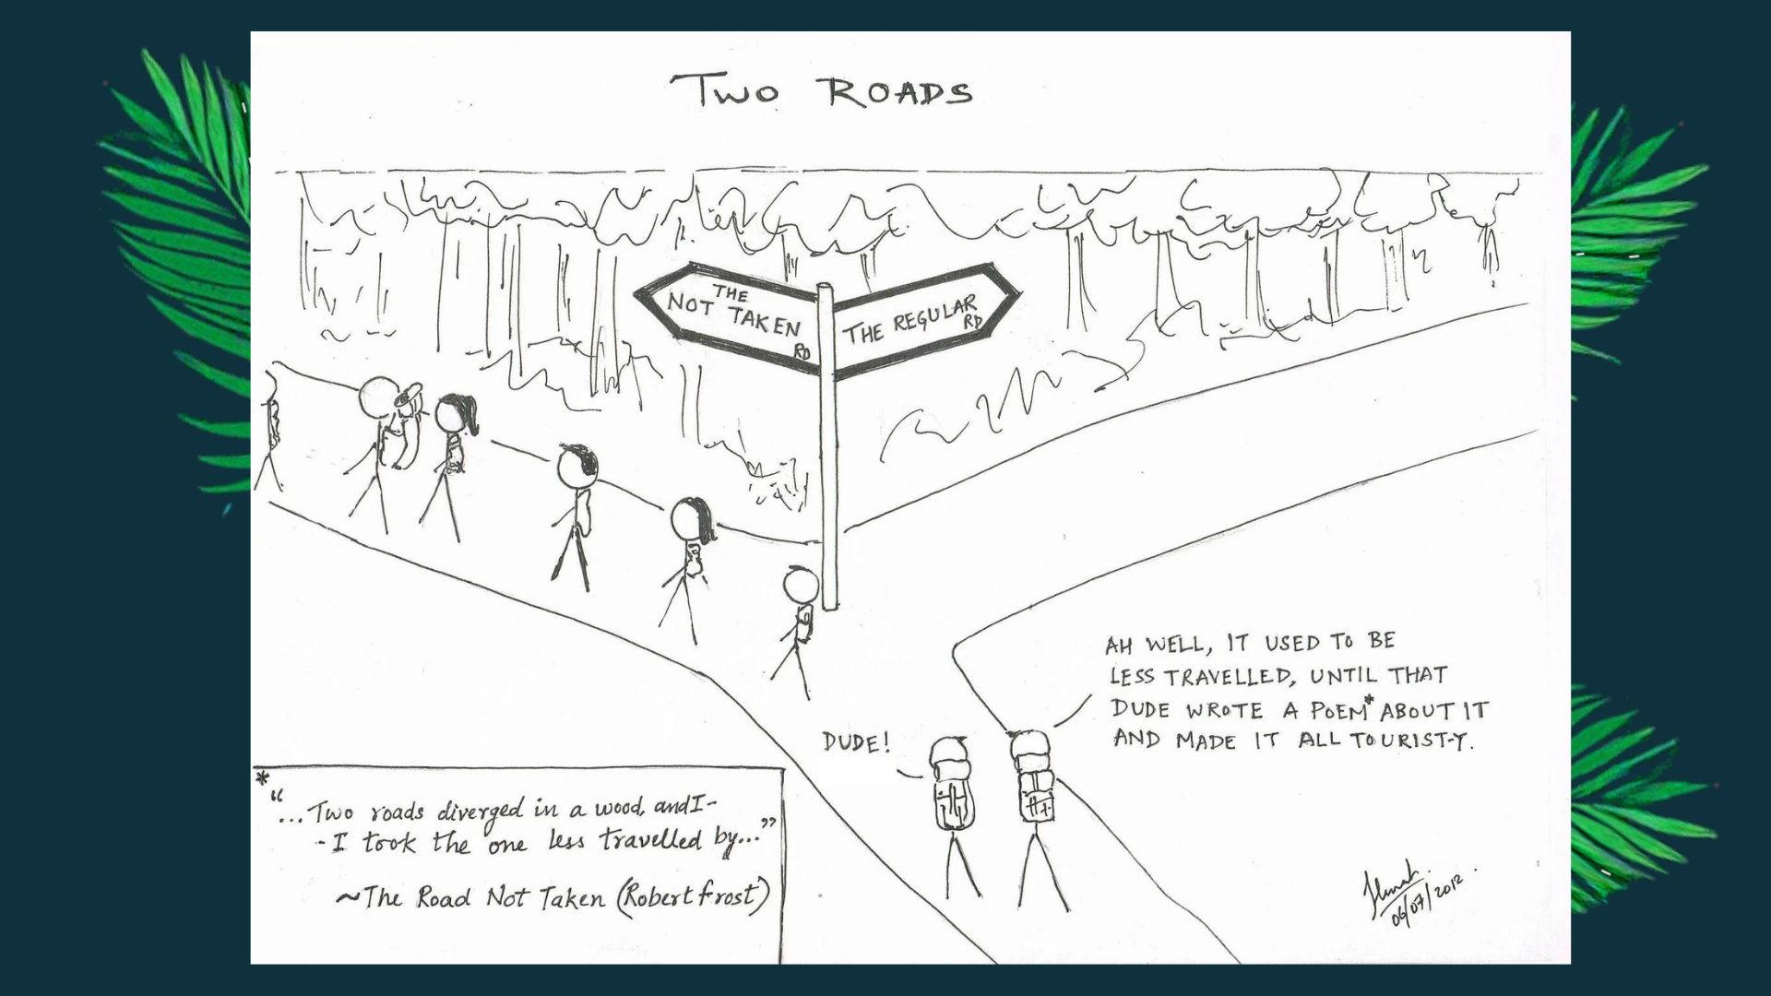

Slide 4


Slide 5
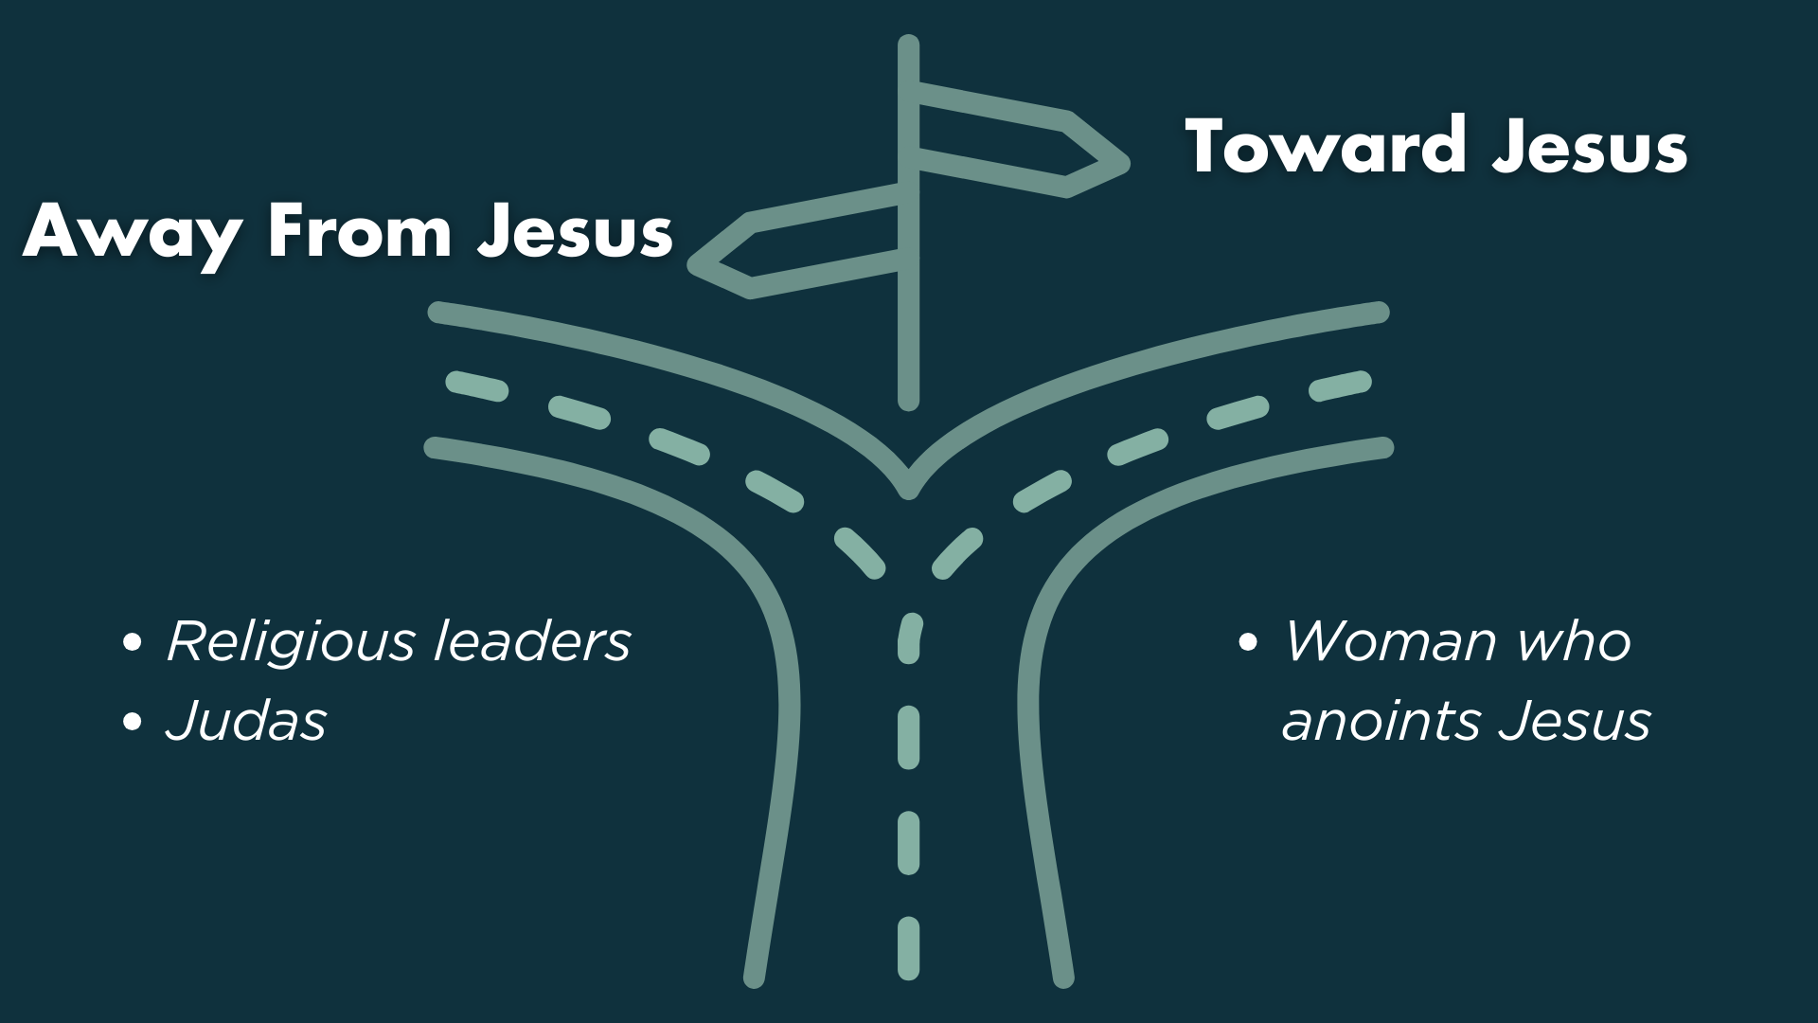

Slide 6


Slide 7
John 11:47b-48 NIV
⁴⁷ “…Here is this man performing many signs. ⁴⁸ If we let him go on like this, everyone will believe in him, and then the Romans will come and take away both our temple and our nation.”

Slide 9
John 11:50 NIV – words of Caiaphas, Jewish high priest
“You do not realize that it is better for you that one man die for the people than that the whole nation perish.”

Slide 11


Slide 12
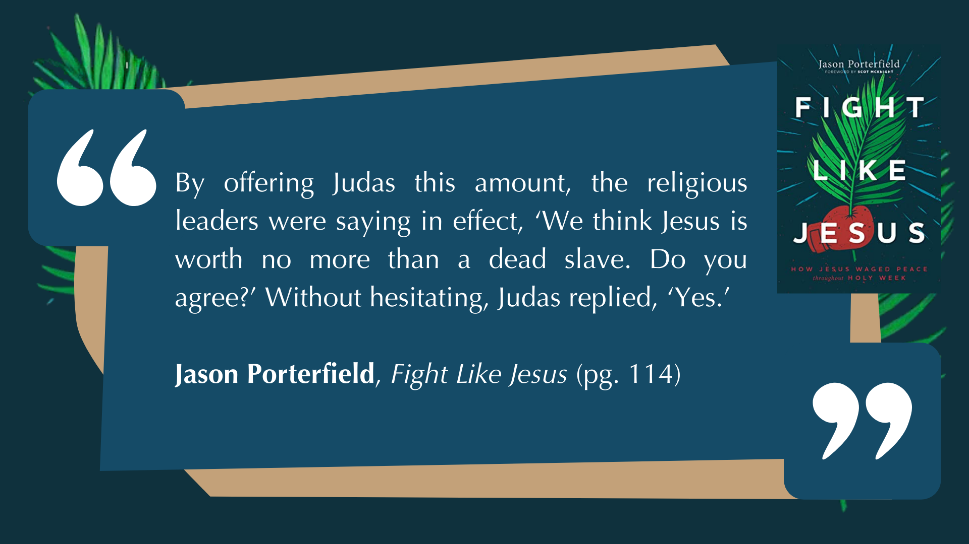

Slide 15
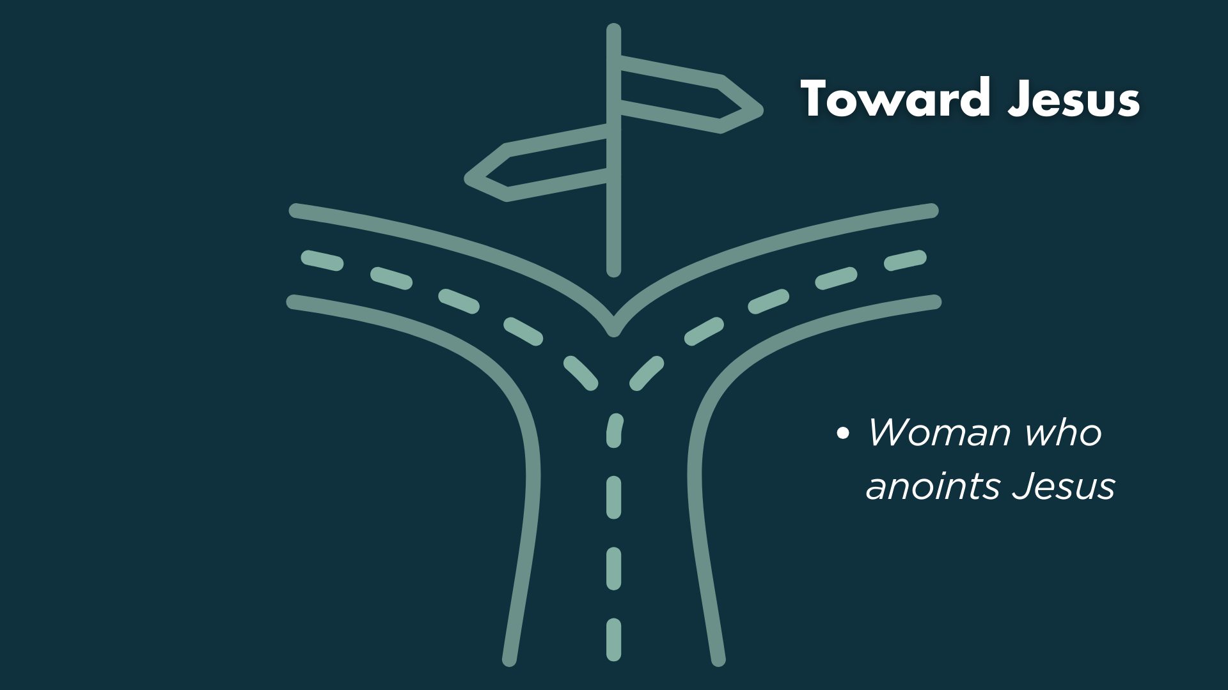

Slide 16
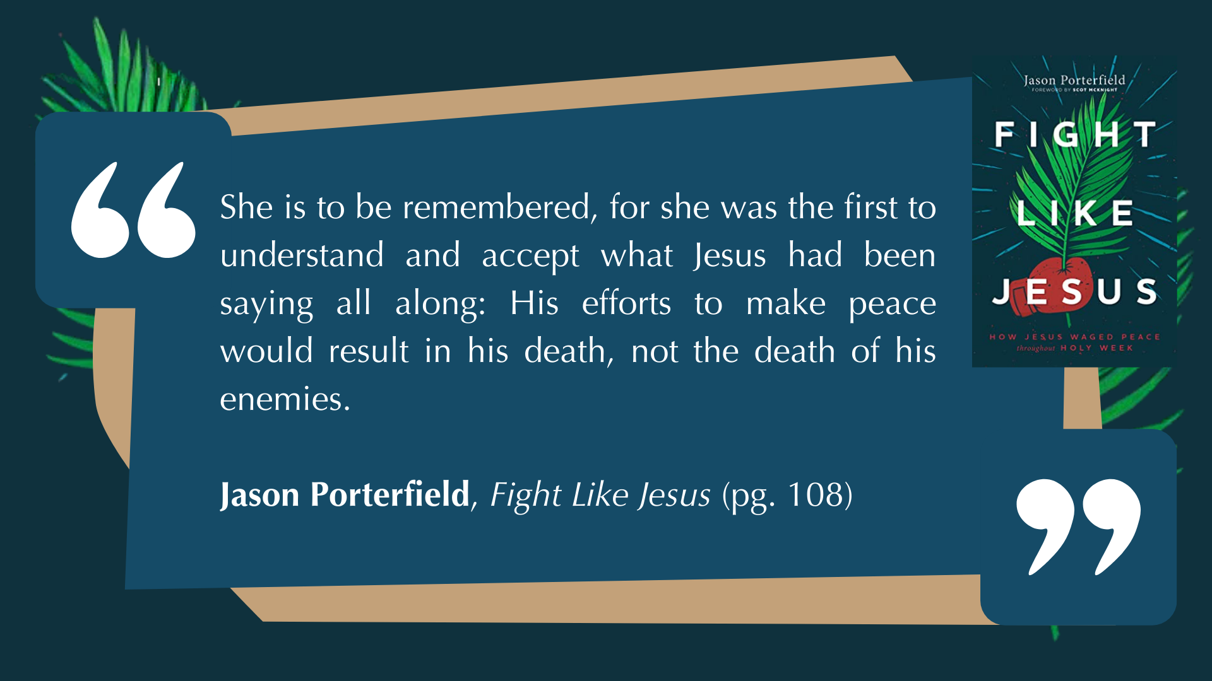

Slide 18


Slide 19


Slide 20


Slide 21


Slide 22


Slide 23


Slide 25


