Slide 1

Notes:
[BRIEF WORD ABOUT PASTOR DAVE’S SABBATICAL]
As most of you know, I took my first sabbatical this past summer. In the BIC, full-time pastors are eligible for a sabbatical after 7 consecutive years of service in one congregation; Pastor Dave is in his 7th year here at Grantham. And so, after 15 years of worship ministry within the church, we have the opportunity to bless Dave with time to rest from the demands of ministry and to complete the first semester of his counseling internship, which is a requirement in the Master of Arts in Counseling program at Messiah. The skills that Dave is acquiring will help him in his pastoral care work here at Grantham and also allow him to offer professional counseling in the future. Pastor Dave’s sabbatical is from Jan.6-April 6; and he has prepared the Worship Commission to help us lead our worship services during that time, so things will continue to operate smoothly. If you have any questions, or you’d like to show your support of Dave, please feel free to reach out to him before Jan 6. And please pray for him and his family.
[RETURN BACK TO OUR ADVENT SERIES]
This is the second message in our series – Fear Not!
”Fear not!” or “Do not be afraid!” is one of the most oft-repeated phrases in the entire Bible. And these are the first words from the angels to Zechariah, Mary, and the shepherds in the opening of the Gospel of Luke. And those words are not just for them. They are for us as well. We need to hear these comforting words from those heavenly messengers, for their words and their meaning are echoing down through time to us today. In the first message, Fear Not! God Hears Your Prayers, we reflected on the interaction that the angel had with the priest Zechariah. In today’s message, we’re looking at what is known as The Annunciation, when the angel Gabriel tells Mary that she will conceive a child by the power of the Holy Spirit and be the mother to the Messiah, the Son of God.
If you have your Bibles, please open up to… [NEXT SLIDE]

Slide 2
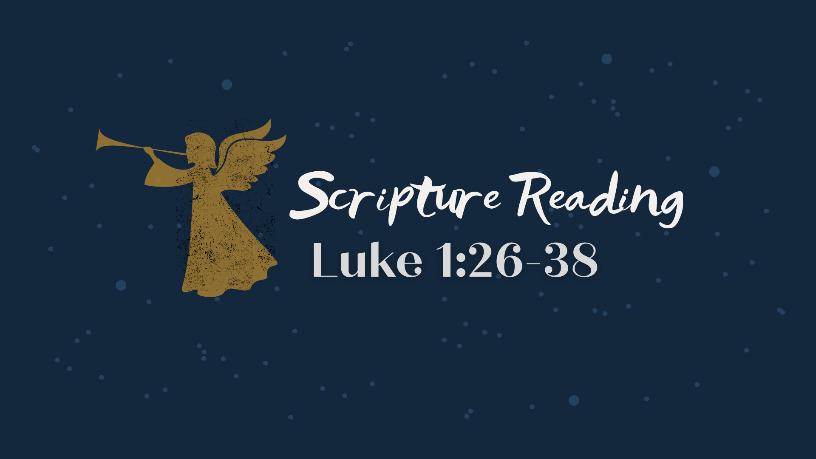
Notes:
[LUKE 1:26-38 NLT - CONGREGATION STAND - READ SCRIPTURE]
This is the word of the Lord. Thanks be to God.
[BRIEF PRAYER] You may be seated.
There is no getting around it… the story we just read can be challenging to many of us living in a materialist world where the priests of scientism would have us believe the only thing that exists is the observable universe, the laws of physics, and that which can be tested and proved.
So, just as I spoke to the existence of “angels” in the first message, let me begin this message by addressing the seemingly impossible notion of the virgin birth, which I submit to you is no small theological matter. Here are some common objections that I’d like to briefly respond to… [NEXT SLIDE]

Slide 3
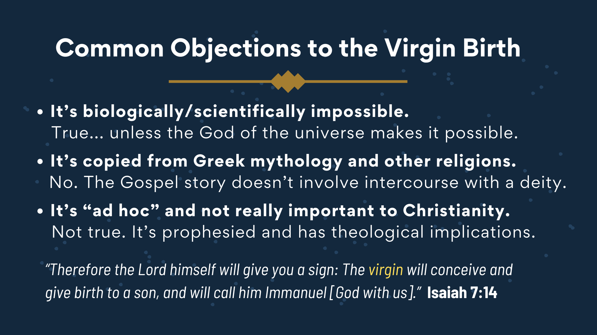
Notes:
[COMMENT ON EACH POINT]
It’s biologically/scientifically impossible. True... unless the God of the universe makes it possible. ​
​It’s copied from Greek mythology and other religions.​ ​
No. The Gospel story doesn’t involve intercourse with a deity.
It’s “ad hoc” and not really important to Christianity.
Not true. It’s prophesied and has theological implications.
Isaiah 7:14 says, “Therefore the Lord himself will give you a sign: The virgin will conceive and give birth to a son, and will call him Immanuel [God with us].”
So, it is an important part of the story and our theology. Which is why we testify to our belief in the virgin birth each month when we confess the Apostles’ Creed… [NEXT SLIDE]

Slide 4
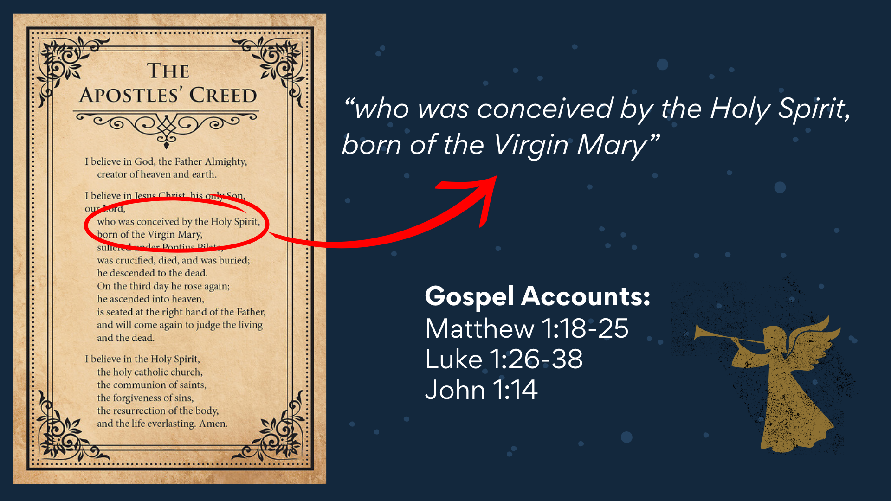
Notes:
[BRIEF COMMENTS]
“I believe in God, the Father Almighty, creator of heaven and earth. I believe in Jesus Christ his only Son, our Lord… who was conceived by the Holy Spirit, born of the Virgin Mary…”
And this part of the gospel story is told not only in Luke 1:26-38, but also in Matthew 1:18-25. And then summed up in John 1:14 with the one-liner: “The Word became flesh…”
Let’s also consider some theological implications of the virgin birth… [NEXT SLIDE]

Slide 5
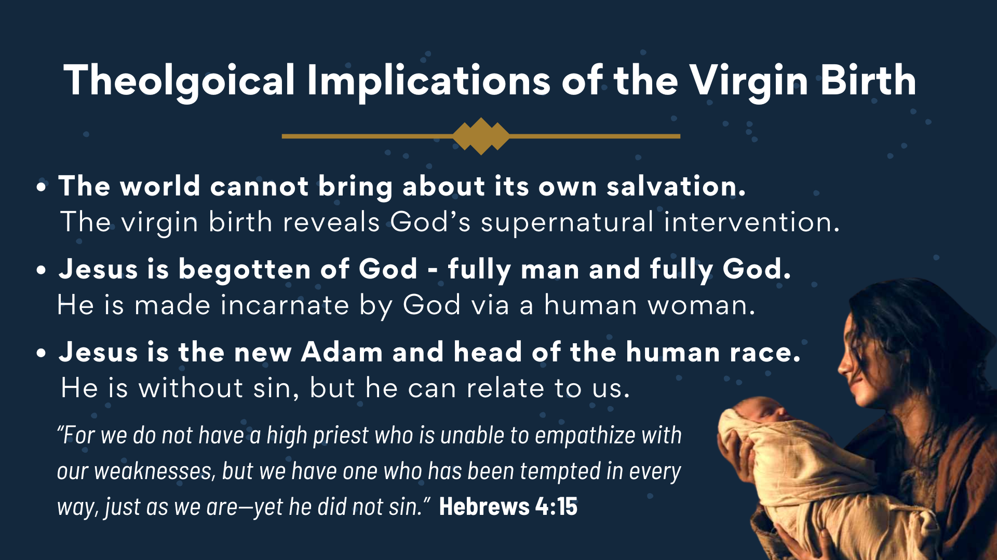
Notes:
[COMMENT ON EACH POINT]
The world cannot bring about its own salvation.
The virgin birth reveals God’s supernatural intervention.
Jesus is begotten of God - fully man and fully God.​
He is made incarnate by God via a human woman.
Jesus is the new Adam and head of the human race.
He is without sin, but he knows its affects and can relate to us.
As the author of Hebrews writes: “For we do not have a high priest who is unable to empathize with our weaknesses, but we have one who has been tempted in every way, just as we are—yet he did not sin.” And 1 John 3:5 says, “And you know that Jesus came to take away our sins, and there is no sin in him.” This happened through his being begotten of God (born from above) and in his willful submission to the Father. Though he could have sinned, he was without sin.
Therefore, the virgin birth was necessary. Matthew and Luke state it as a fact, and it has theological implications for us. Also, it shouldn’t surprise us from the beginning to the end of his time on the earth, that the life of Jesus was evidently miraculous and reveals God’s divine intervention into the natural world. Scholar R.T. France writes… [NEXT SLIDE]

Slide 6
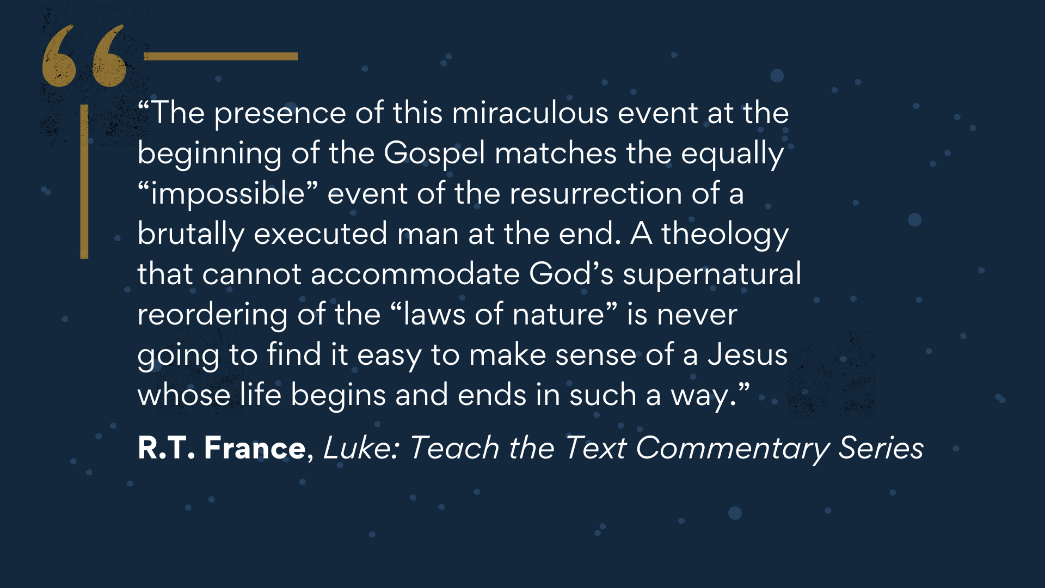
Notes:
[READ & COMMENT]
But still… if you do struggle with the miraculous, I totally understand and can certainly empathize with you. So, if that’s the case and you’d like to study and reflect more deeply on the topic, please reach out to me. I’d be happy to talk about it or share some helpful resources with you.
Let’s go back to our primary Scripture reading and go verse-by-verse… [NEXT SLIDE]

Slide 7
Notes:
[READ VERSE-BY-VERSE, VERSES 26-29 & COMMENT]
And then verse 30… [NEXT SLIDE]

Slide 8
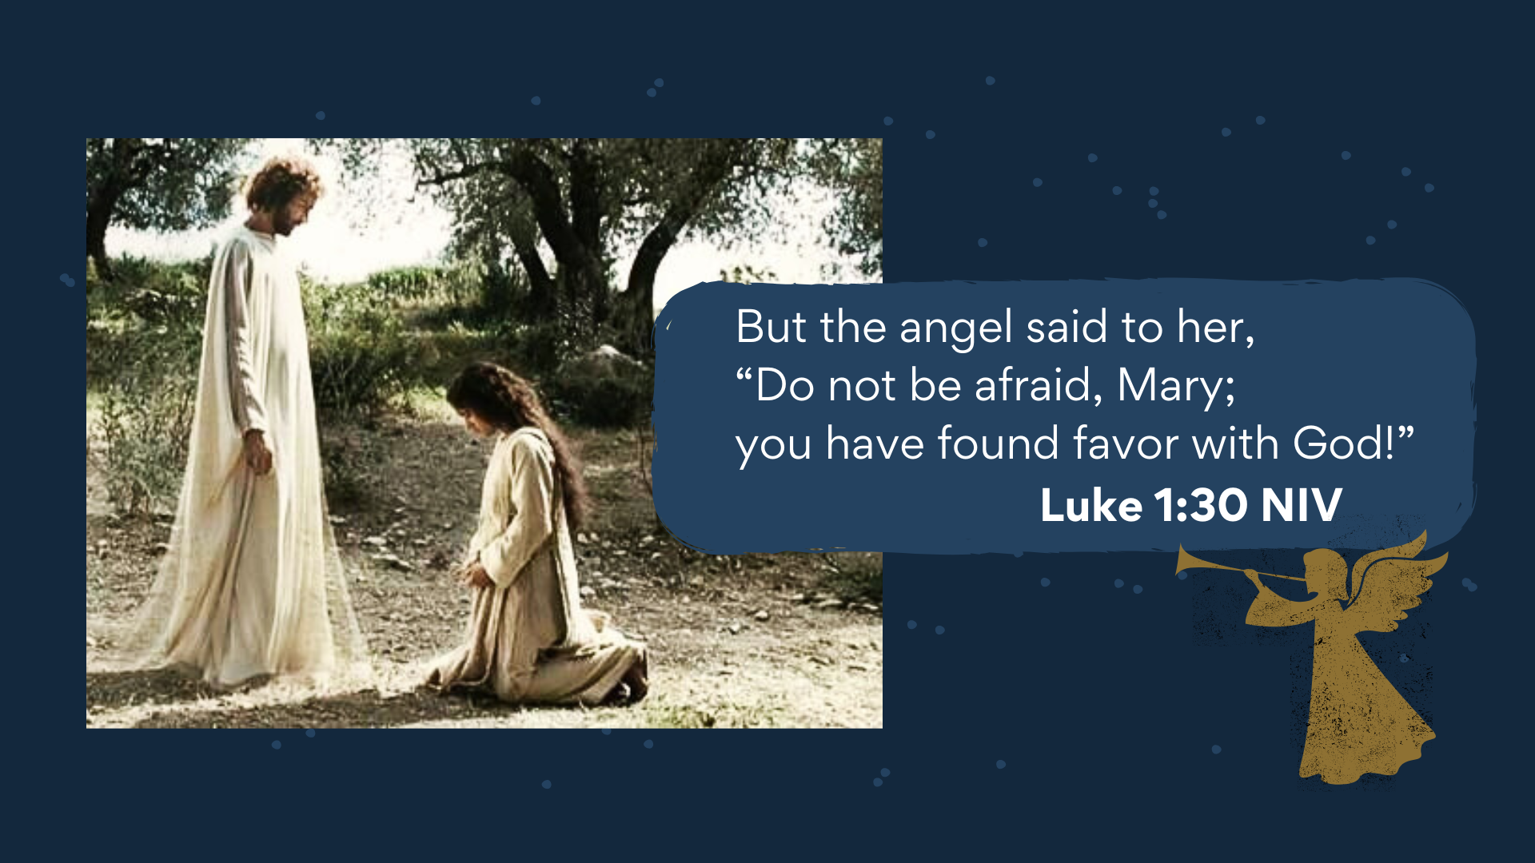
Notes:
[READ & COMMENT VERSE-BY-VERSE, VERSES 30-38]
Once again, we see in Mary a submissive spirit to whatever God wants for her life. Remember what we said about “submission” to God in the previous message… [NEXT SLIDE]

Slide 9
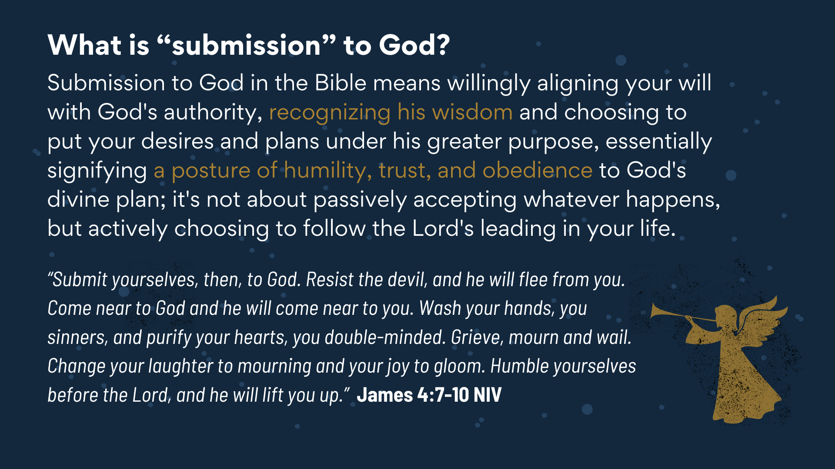
Notes:
[READ SLIDE & COMMENT]
And so, don’t miss the posture and pattern here. Why is Mary favored by God? Well, her story does show her to be thoughtful, obedient, believing, and devoted to Jewish law and piety. But, as the NT scholar Fred Craddock points out, none of these qualities is given as the reason God’s favor rested on her. Ultimately, that reason is wrapped up in the mysterious purposes of God. However, we can see that her character, her posture of humility, her trust, and obedience, allows her to know and experience the favor of God on her life, and it positions her to be used mightily by God for his plan and purposes.
Think about this. Proverbs 3:34 says… [NEXT SLIDE]

Slide 10

Notes:
[READ VERSE & COMMENT]
Friends, it appears that humility has a great deal to do with discovering how God really feels about each of us. Humility sort of unlocks the door (if you will) to the reality of knowing God’s grace and favor upon each of us. We all know how often our pride, our ego, and our refusal to deny our flesh and submit to his ways can create unhealth, and a lack of peace and direction in our lives; how it walls us off from experiencing God’s grace, favor, and blessings.
It’s one reason Paul stresses this point in that familiar passage in Ephesians… [NEXT SLIDE]

Slide 11
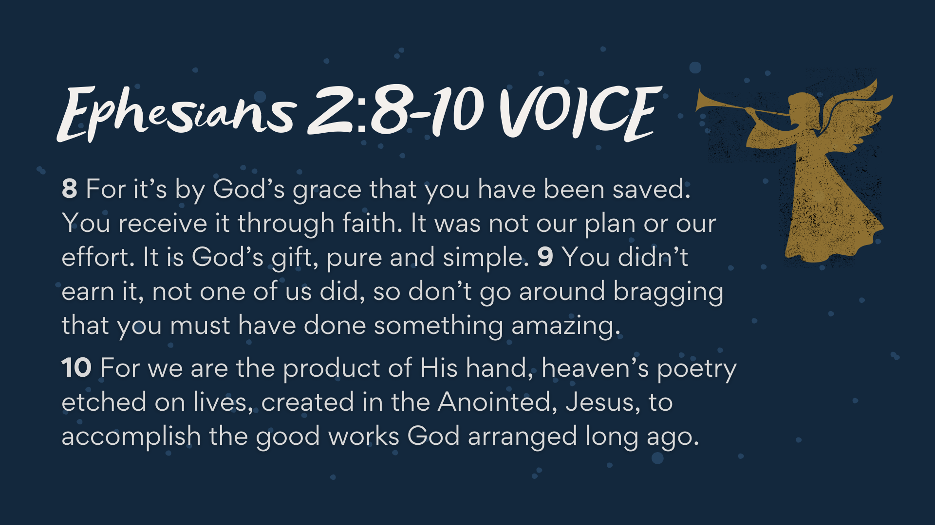
Notes:
[READ PASSAGE & COMMENT]​
Ephesians 2:8-10 is really the go to passage for making this point: you and I don’t earn God’s grace or favor. Rather, it’s bestowed upon us because of God’s love and mercy. And the way for you to receive it, to know it, and experience it in your life… is to acknowledge your own sinfulness and spiritual need for God; to humble yourself as a person in need of his unmerited favor. And then good works and fruit of the Spirit will come as a result of having experienced it.
And what does humility and the humble spirit look like… [NEXT SLIDE]

Slide 12
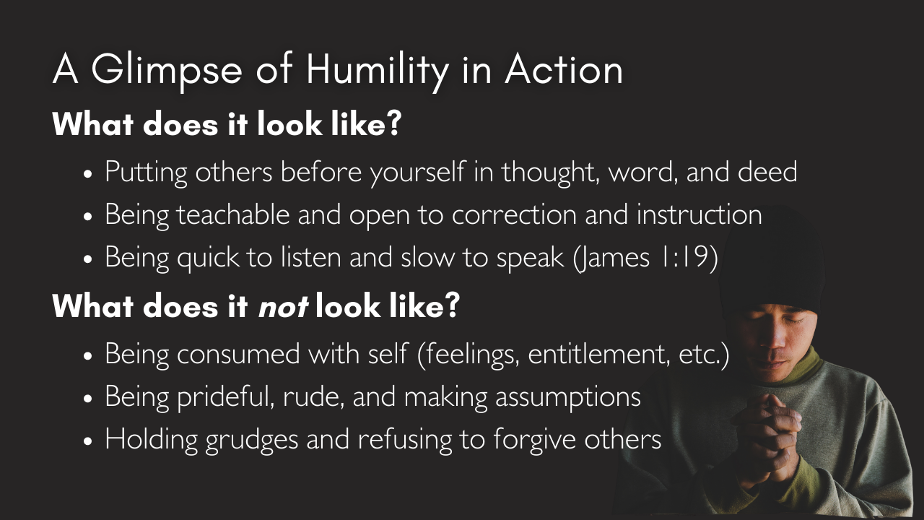
Notes:
[READ & BRIEFLY COMMENT ON EACH POINT]
So, let’s reflect on the beauty, the mystery, and the wonder of this scene one more time… [NEXT SLIDE]

Slide 13
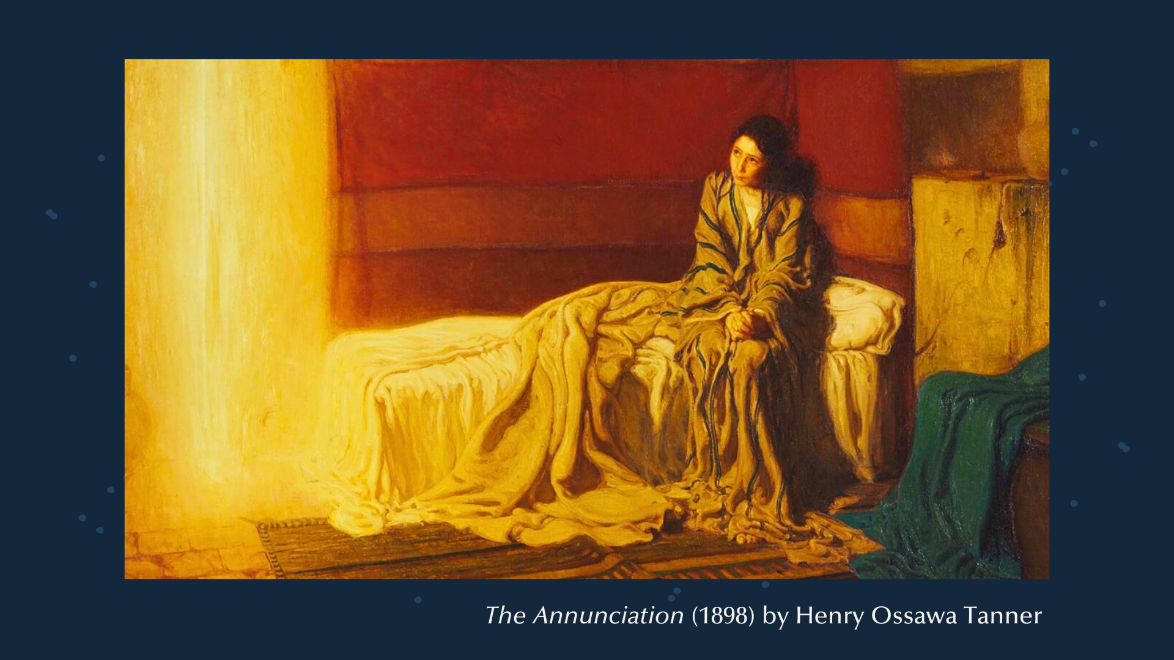
Notes:
A young woman… a faithful follower of Yahweh… she is simple, teachable, humble, and submissive to God. She is betrothed to be married, living an ordinary life, when an angel comes to her and says, “Fear Not! You have found favor with God.” He then tells Mary that she will conceive and give birth to the Son of God by the power of the Holy Spirit.
She wonders how this is possible. She is mystified at how God will accomplish it. But she listens, receives the news, and puts her faith into action. She then experiences the grace and favor of God. It’s not just a theological concept to Mary. It’s now a lived reality. And her willingness to be an open vessel, a servant of the Most High, will lead to blessings for all who believe.
Now, brothers and sisters, what does this good news to a young peasant girl from a backwater village say about God’s favor and his ways of blessing the humble?
Once again… R.T. France writes… [NEXT SLIDE]

Slide 14
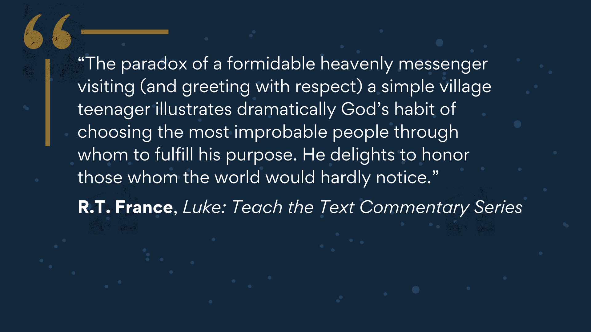
Notes:
[READ QUOTE & COMMENT]​
And this should bring to mind what Paul wrote to the Corinthians… [NEXT SLIDE]

Slide 15
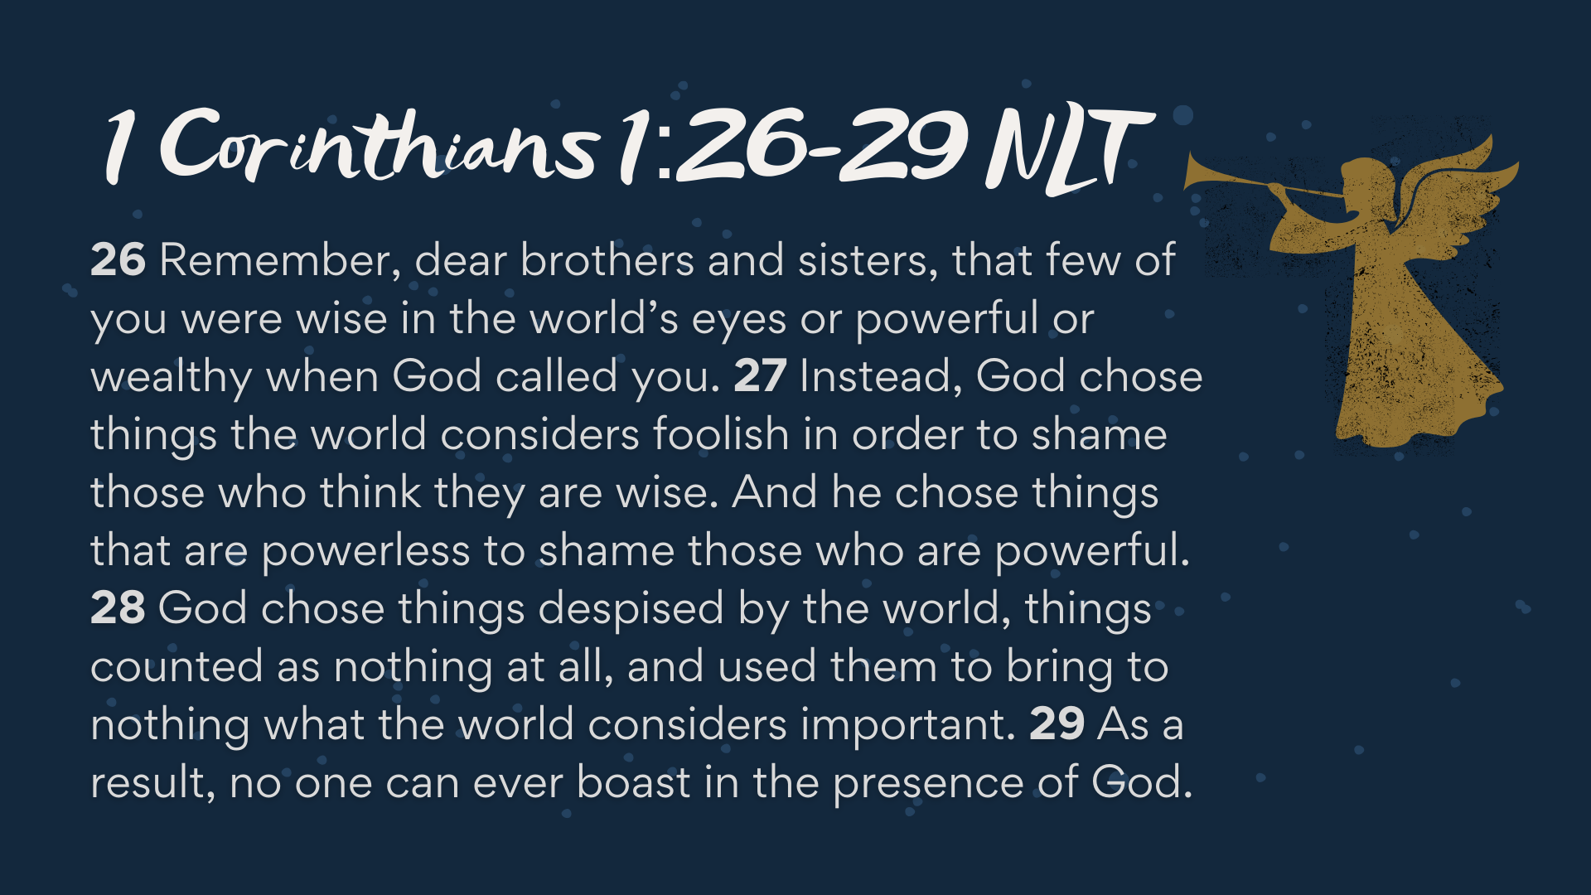
Notes:
[READ PASSAGE & COMMENT]
Finally, here are some questions for reflection and to help us respond together… [NEXT SLIDE]

Slide 16
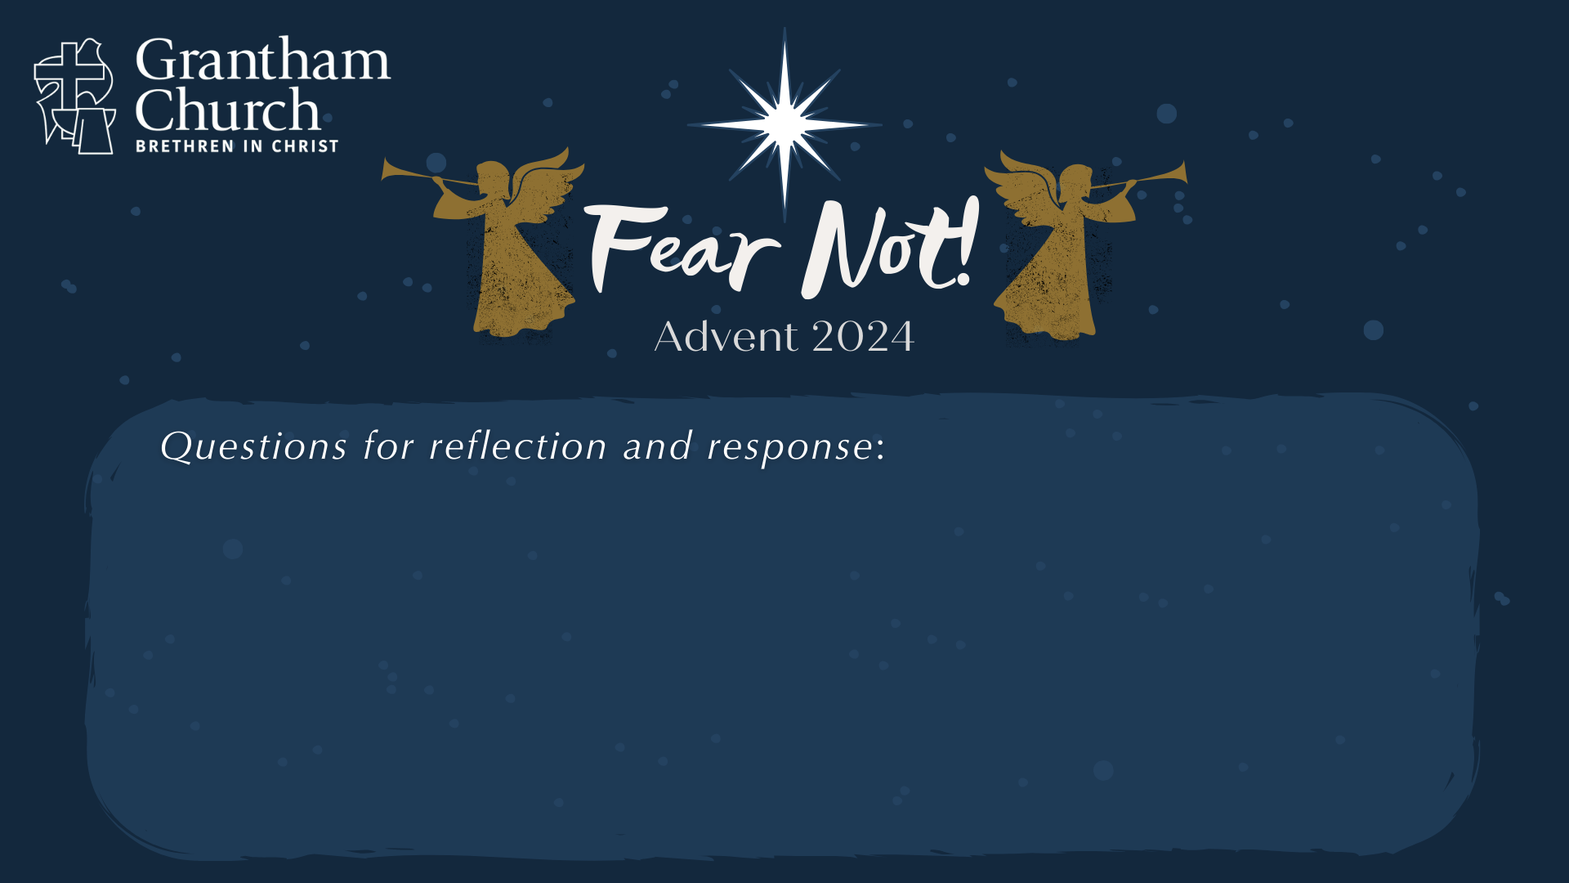

Slide 17
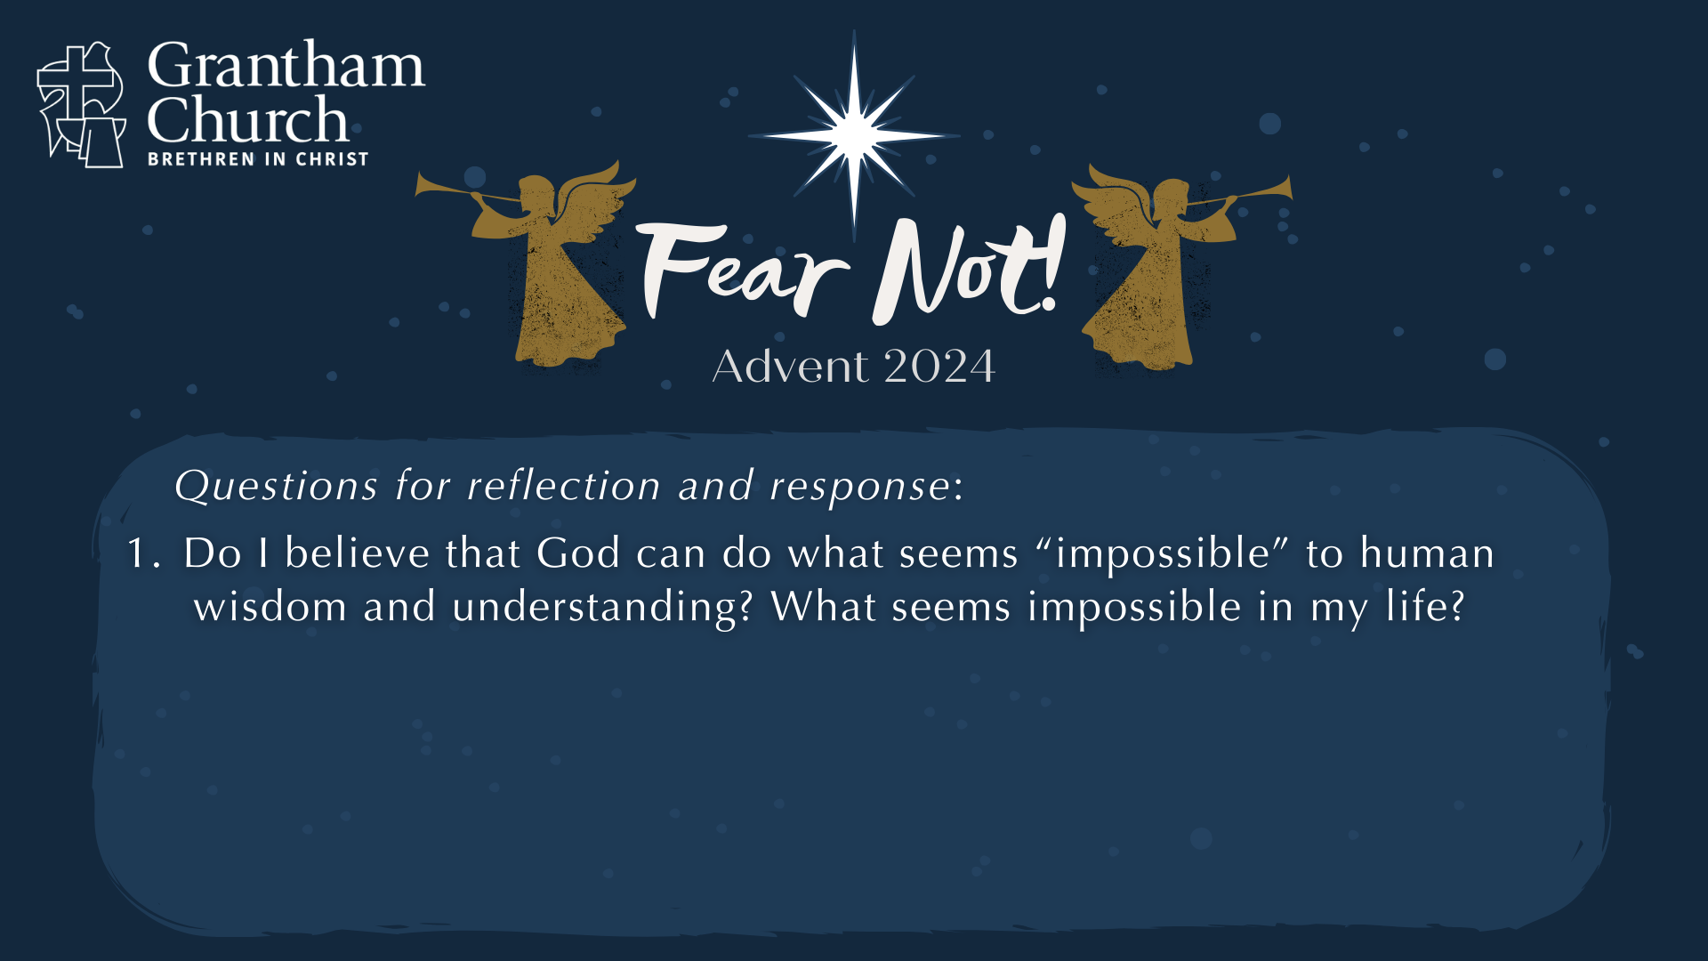

Slide 18
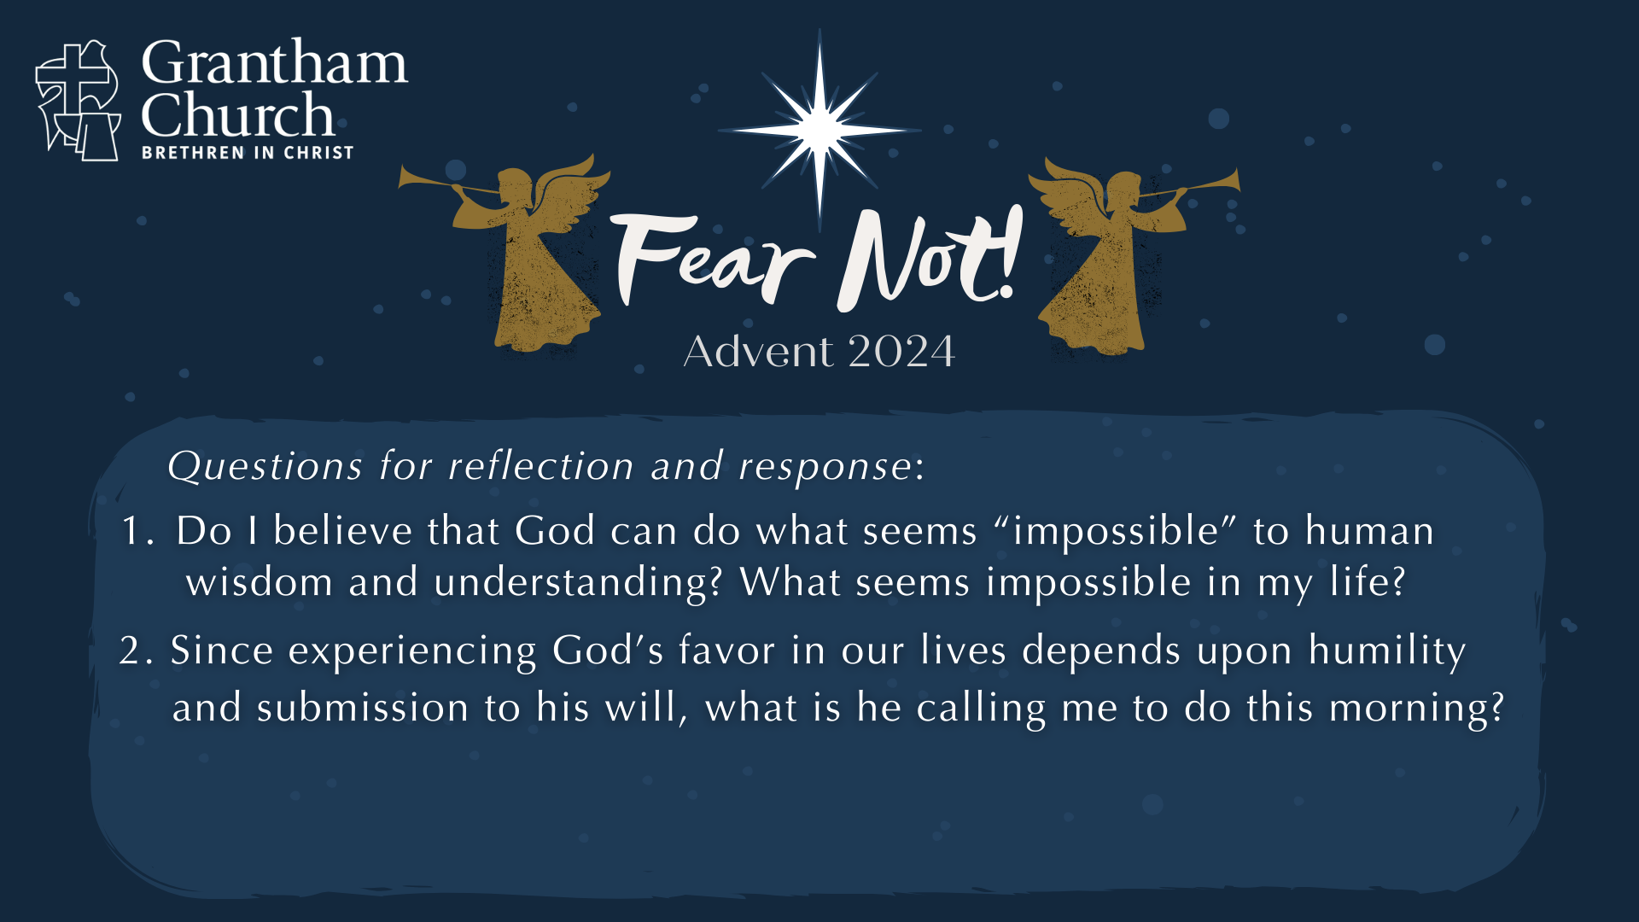

Slide 19
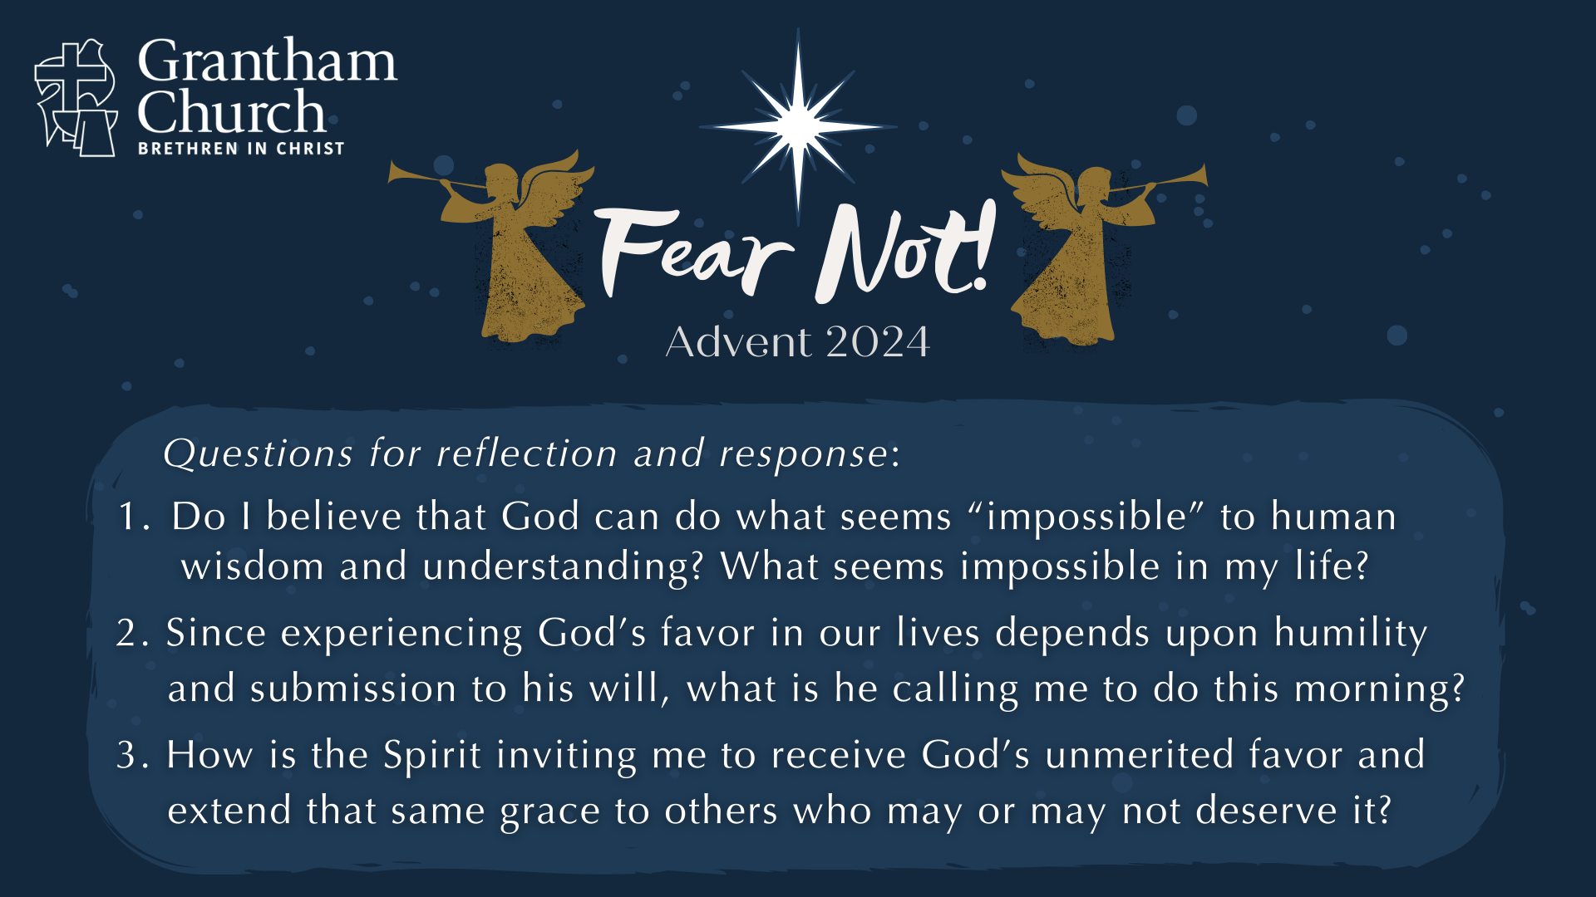
Notes:
[READ QUESTIONS & COMMENT]
Do I believe that God can do what seems “impossible” to human wisdom and understanding? What seems impossible in my life?
Since experiencing God’s favor in our lives depends upon humility and submission to his will, what is he calling me to do this morning?
How is the Spirit inviting me to receive God’s unmerited favor and extend that same grace to others who may or may not deserve it?
[FINAL WORDS]
[GO TO NEXT SLIDE DURING CLOSING PRAYER]

Slide 20

Notes:
[CLOSING PRAYER]
Benediction:
Brothers and sisters… Fear not! God’s favor is unmerited. As you wait upon him this Advent season, may you be filled with his peace, surrounded by his presence, and empowered by his Spirit. Go in peace, church, to love and serve the Lord. Amen.

