Slide 1


Slide 2
Technology has turned neighbors into strangers.
As a people commissioned by God to “go therefore and make disciples of all nations” (Matthew 28:19),
trends toward isolation and away from real, face-to-face friendship should trouble us.
Relationships are the highways for loving the lost, sharing the good news, and making disciples.

Slide 3
John 20: 19-22 – A sent people
On the evening of that first day of the week, when the disciples were together, with the doors locked for fear of the Jewish leaders, Jesus came and stood among them and said, “Peace be with you!” After he said this, he showed them his hands and side. The disciples were overjoyed when they saw the Lord.
AGAIN Jesus said, “Peace be with you! As the Father has sent me, I am sending you.” And with that he breathed on them and said, “Receive the Holy Spirit.”

Slide 4
MISSION
Comes from the Latin word missiō meaning
“a sending, sending away, dispatching, release”
“The total redemptive purpose of God
to establish his kingdom.”
-Avery WIllis (author and missiologist)

Slide 5
2 Corinthians 5:20 – Ambassadors for Christ
We are therefore Christ’s ambassadors, as though God were making his appeal through us. We implore you on Christ’s behalf: Be reconciled to God.

Slide 6
We can live generously because of what we have received in Christ!
You, my brothers and sisters, were called to be free. But do not use your freedom to indulge the flesh; rather, serve one another humbly in love. For the entire law is fulfilled in keeping this one command: “Love your neighbor as yourself.” -Galatians 5:13-14
Freely you have received; freely give. -Matthew 10:8

Slide 7
The first message to your international neighbors should be:
“Welcome. I see you. You belong here.”
Then, pursue deeper
relationship through:
Examine your perspective and priorities:
How can you take steps towards them, possibly sacrificing your own ideals and comforts, rather than expecting them to conform in all ways to your culture and norms?
intentionality
generosity
persistence
consistency
humility

Slide 8
Short-Term Opportunities (1-2 week commitment)
International:
Bogotá, Colombia - June 2024
Athens, Greece - Fall 2024
United States:
Dearborn, MI - July/Aug. 2024
*Applications due March 2024
For more information and to apply: bicus.org/missions

Slide 9
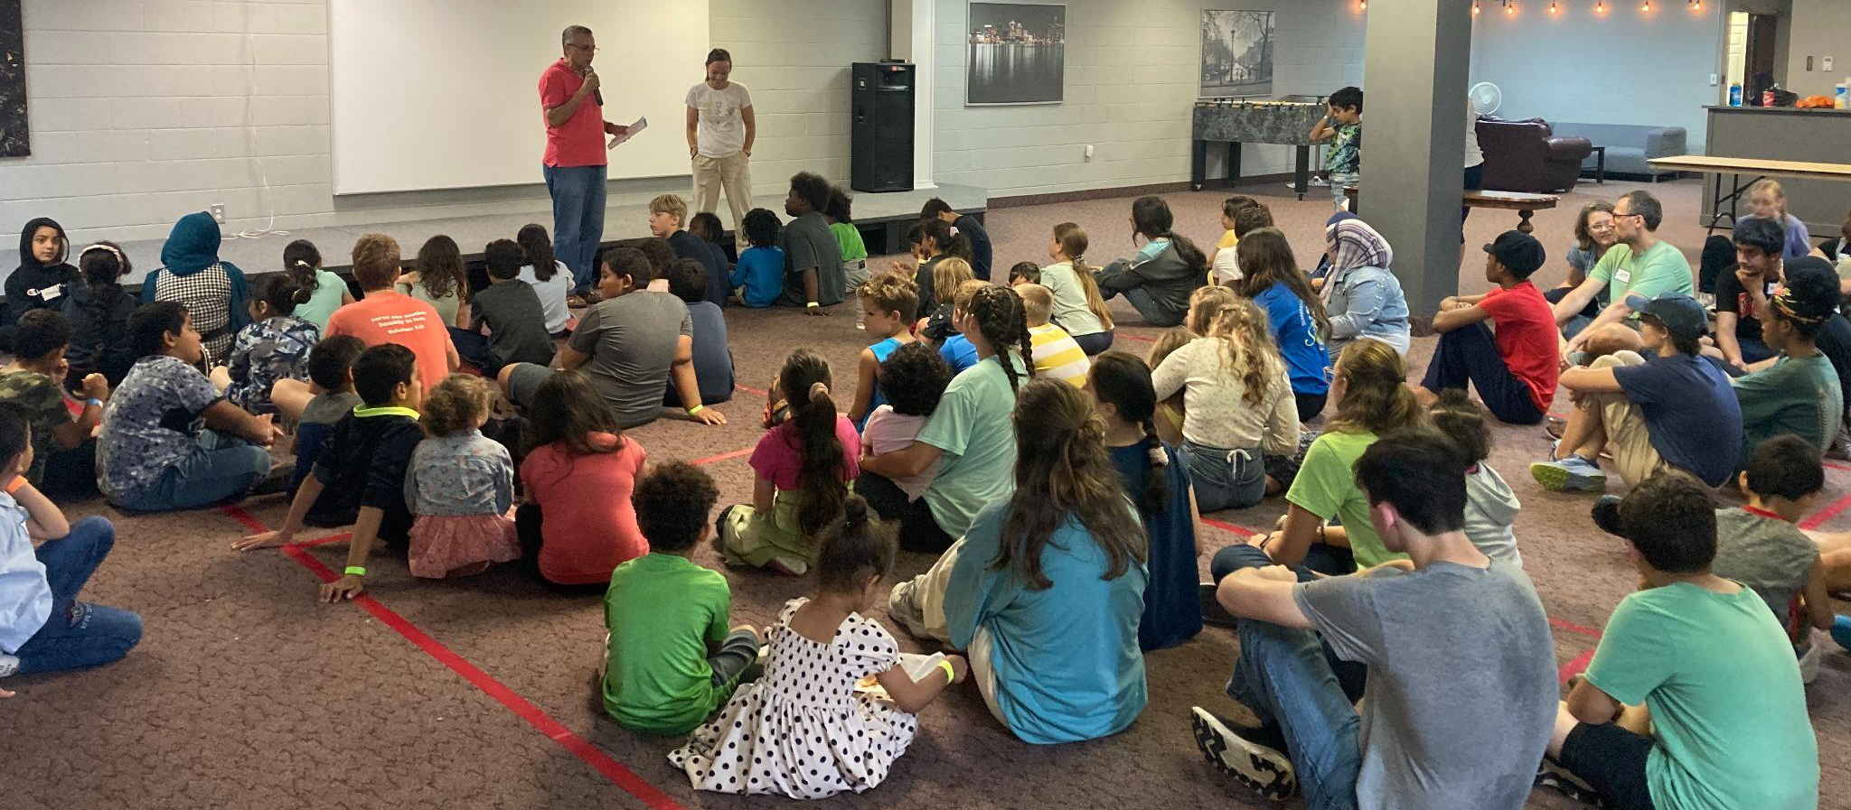
Dearborn Trip 2023

Slide 10
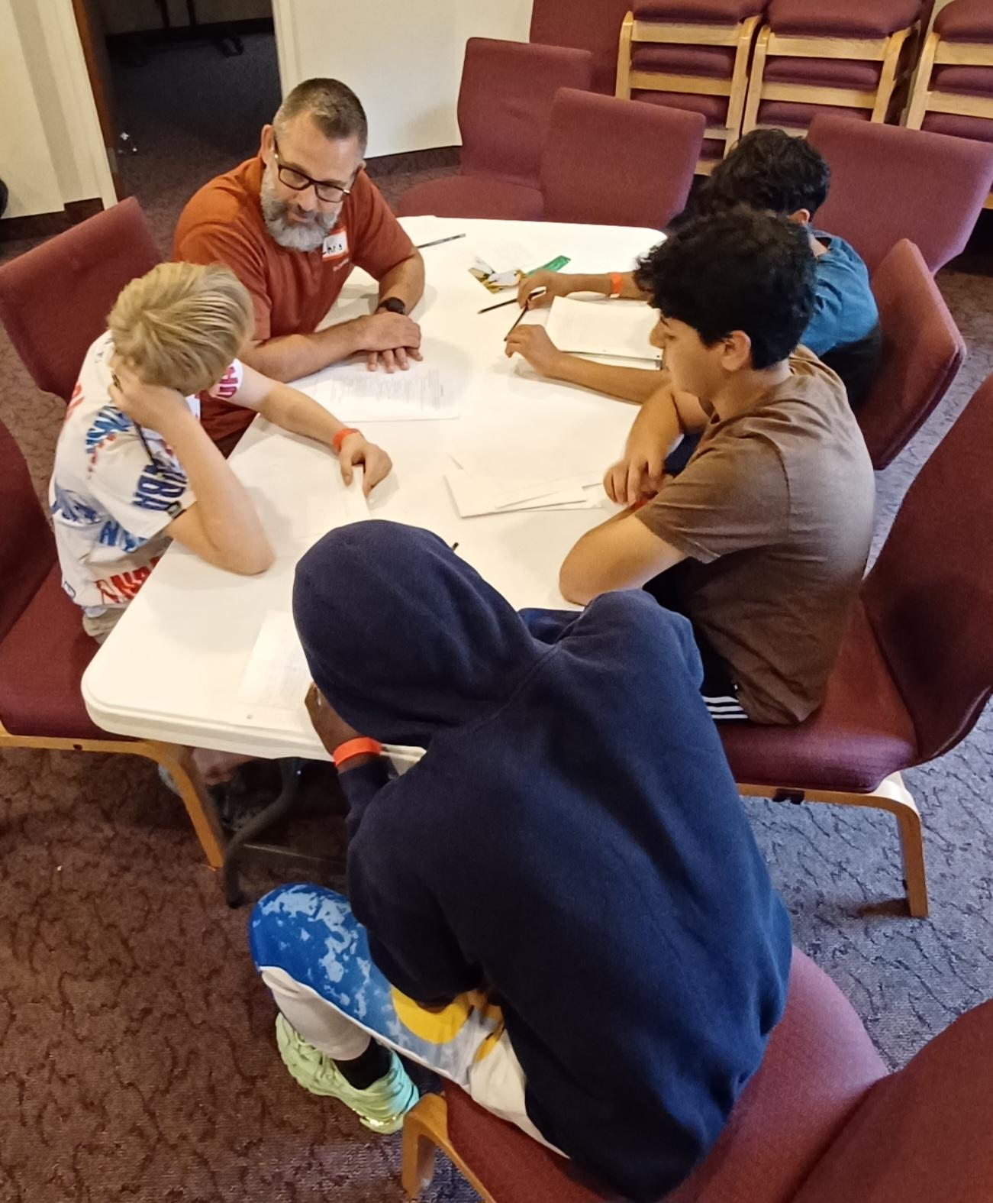
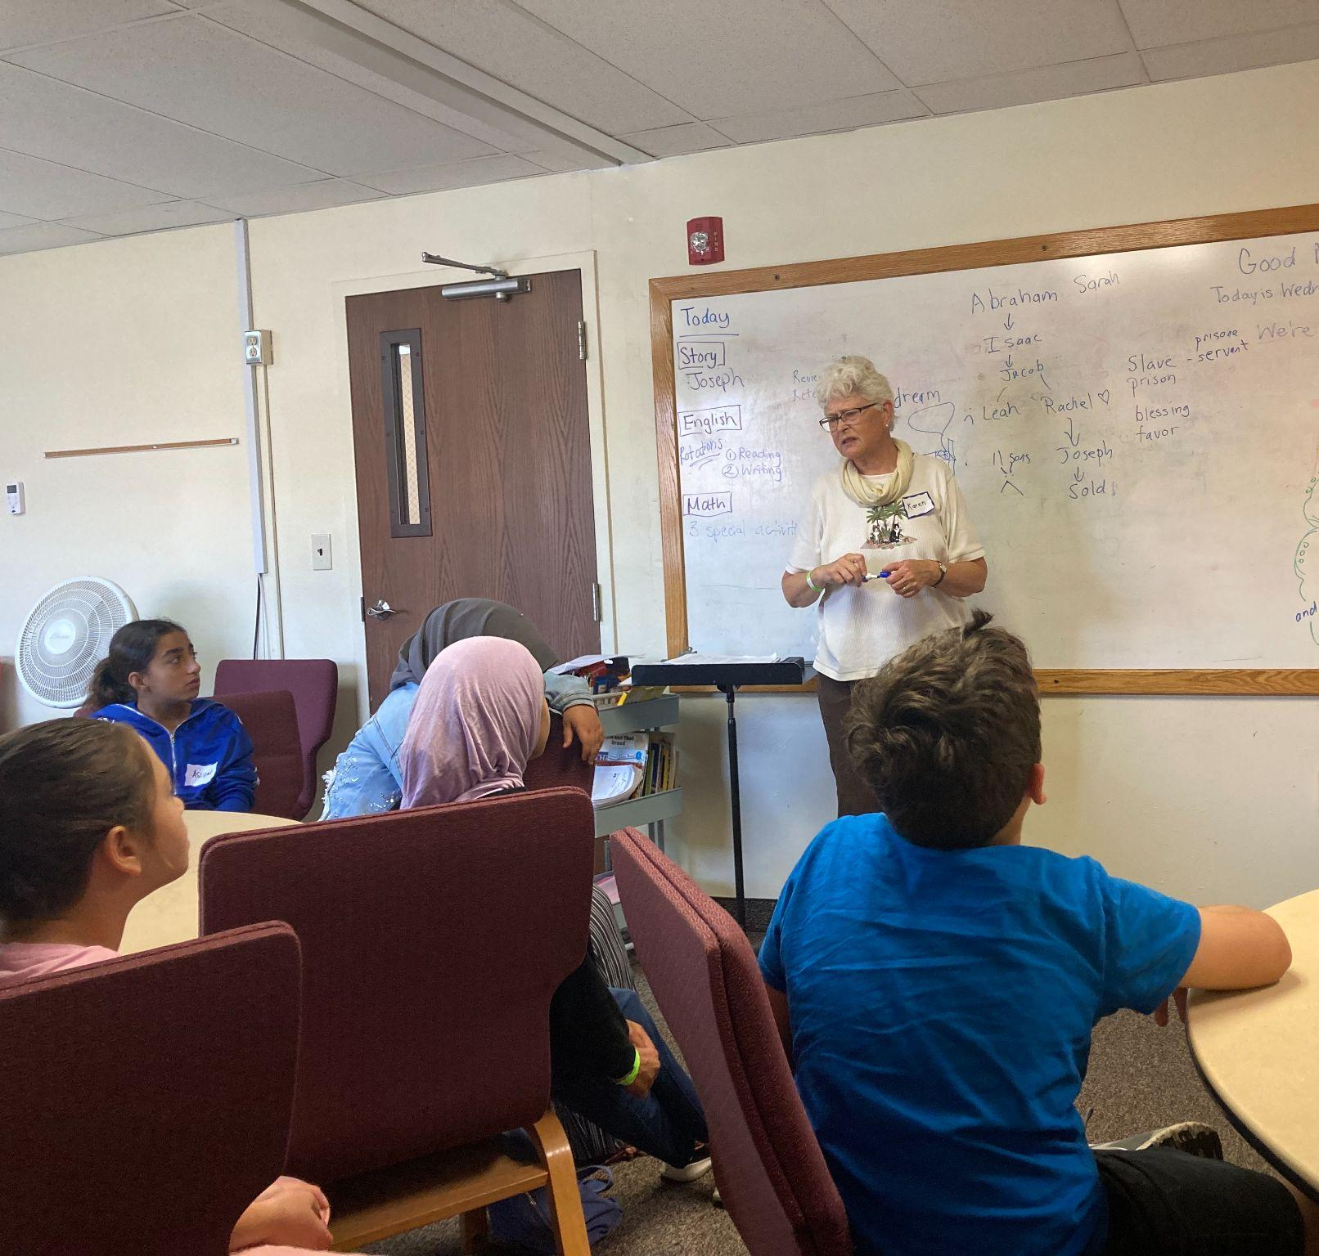
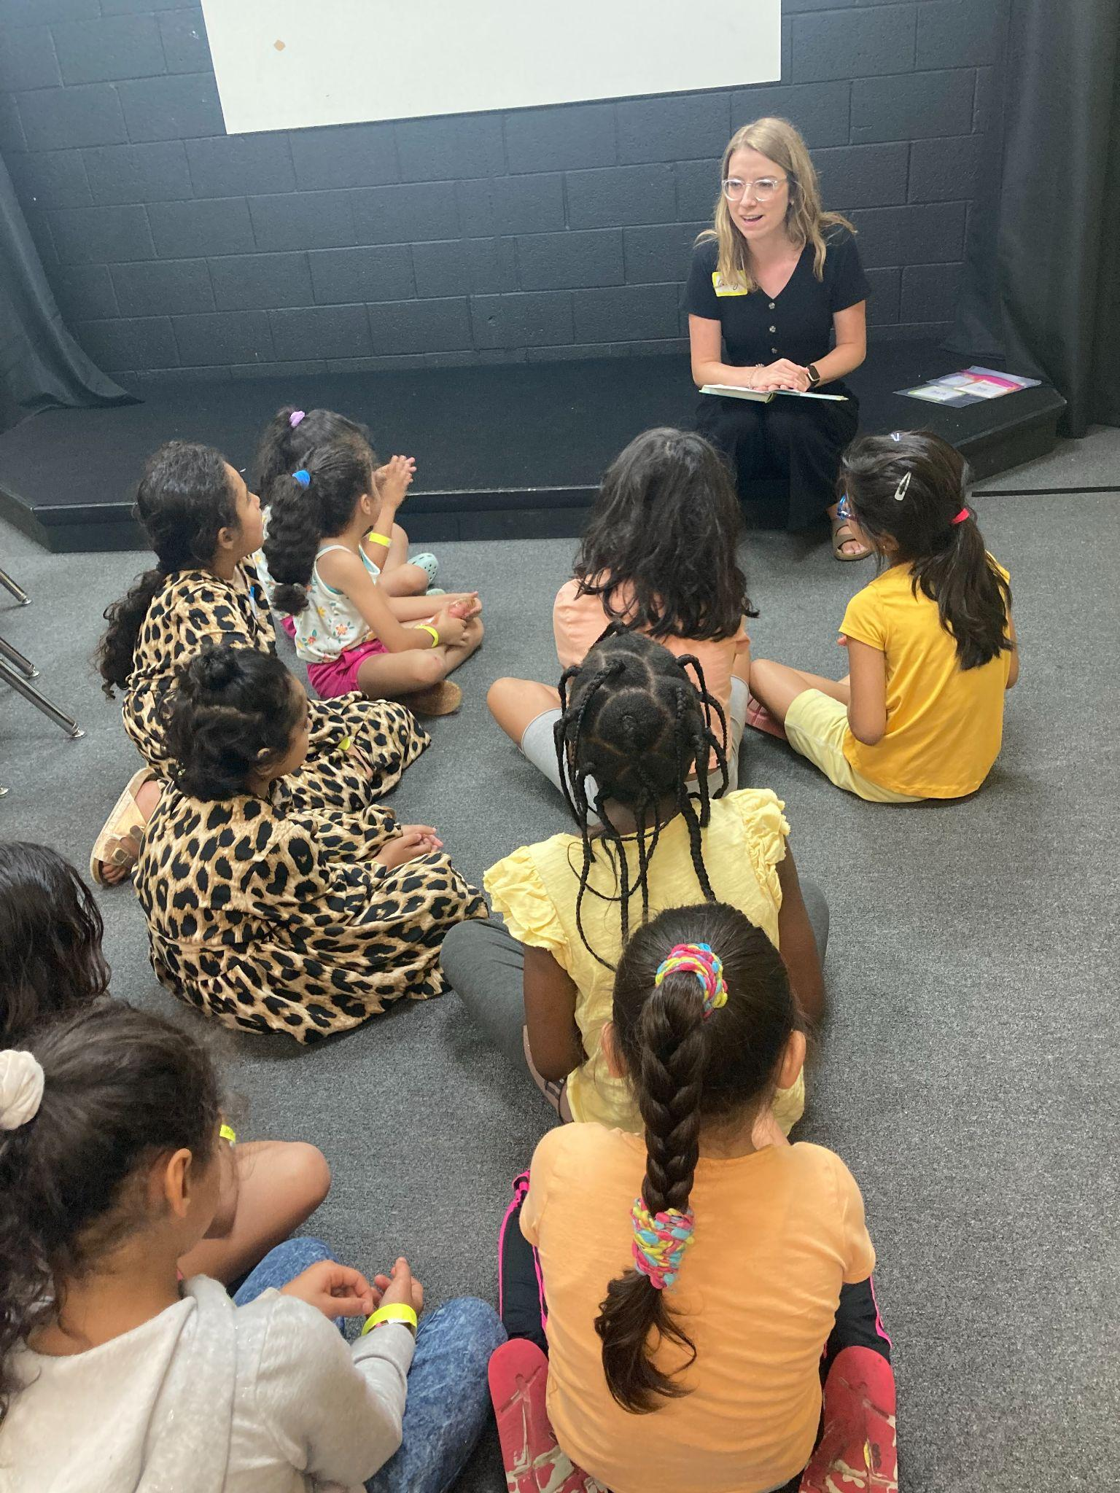
Dearborn Trip 2023

Slide 11
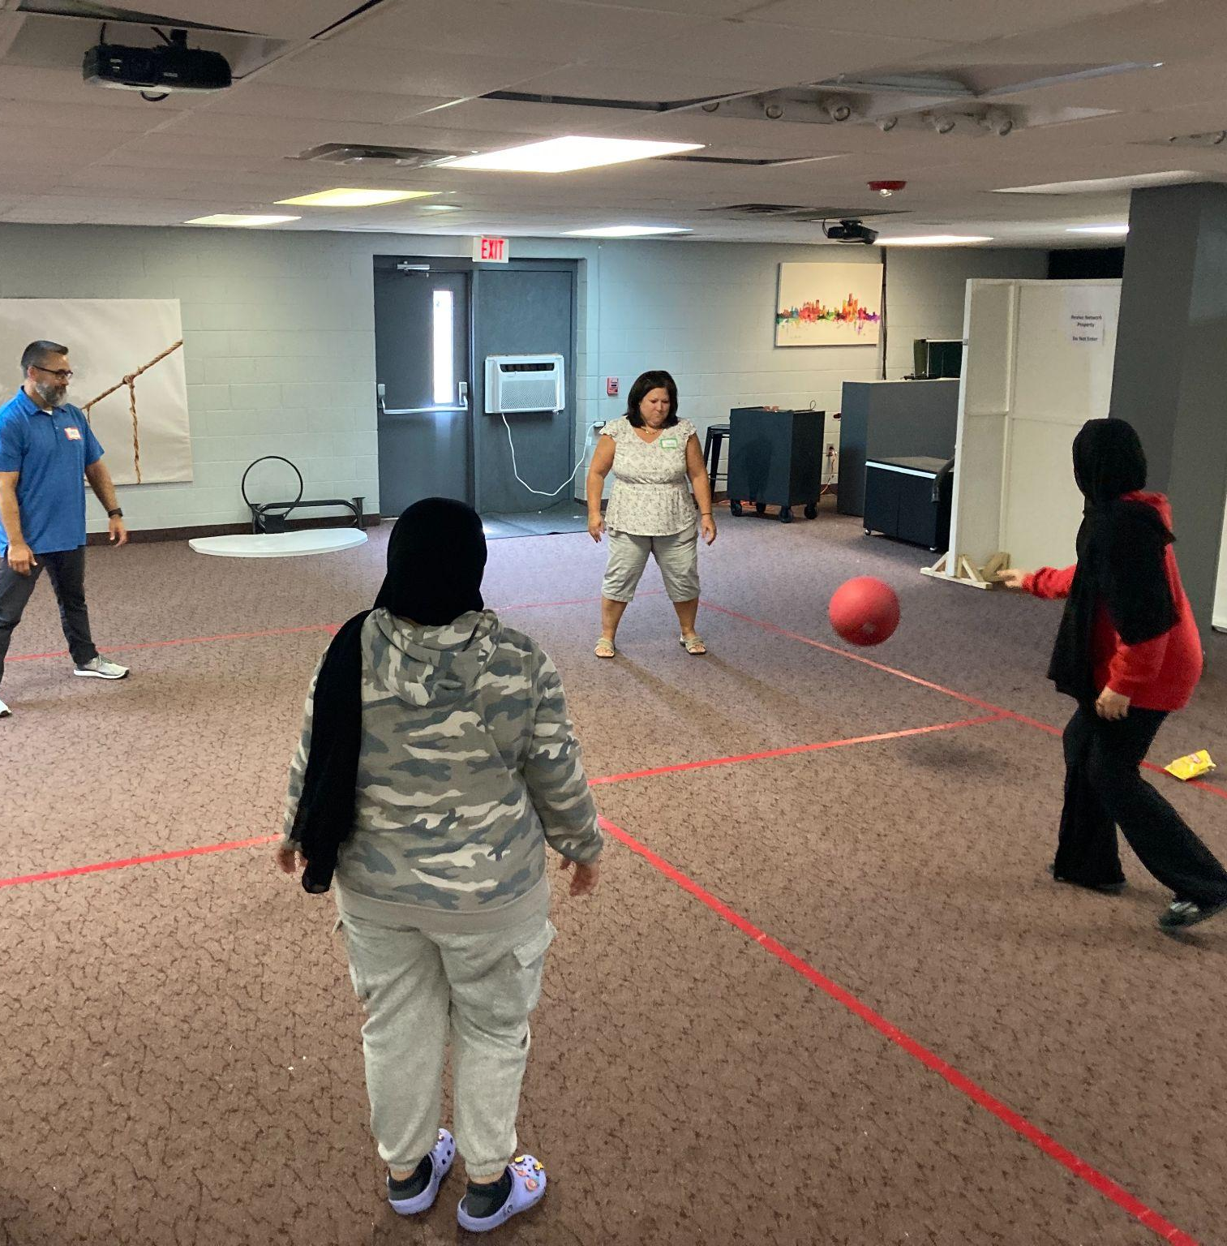
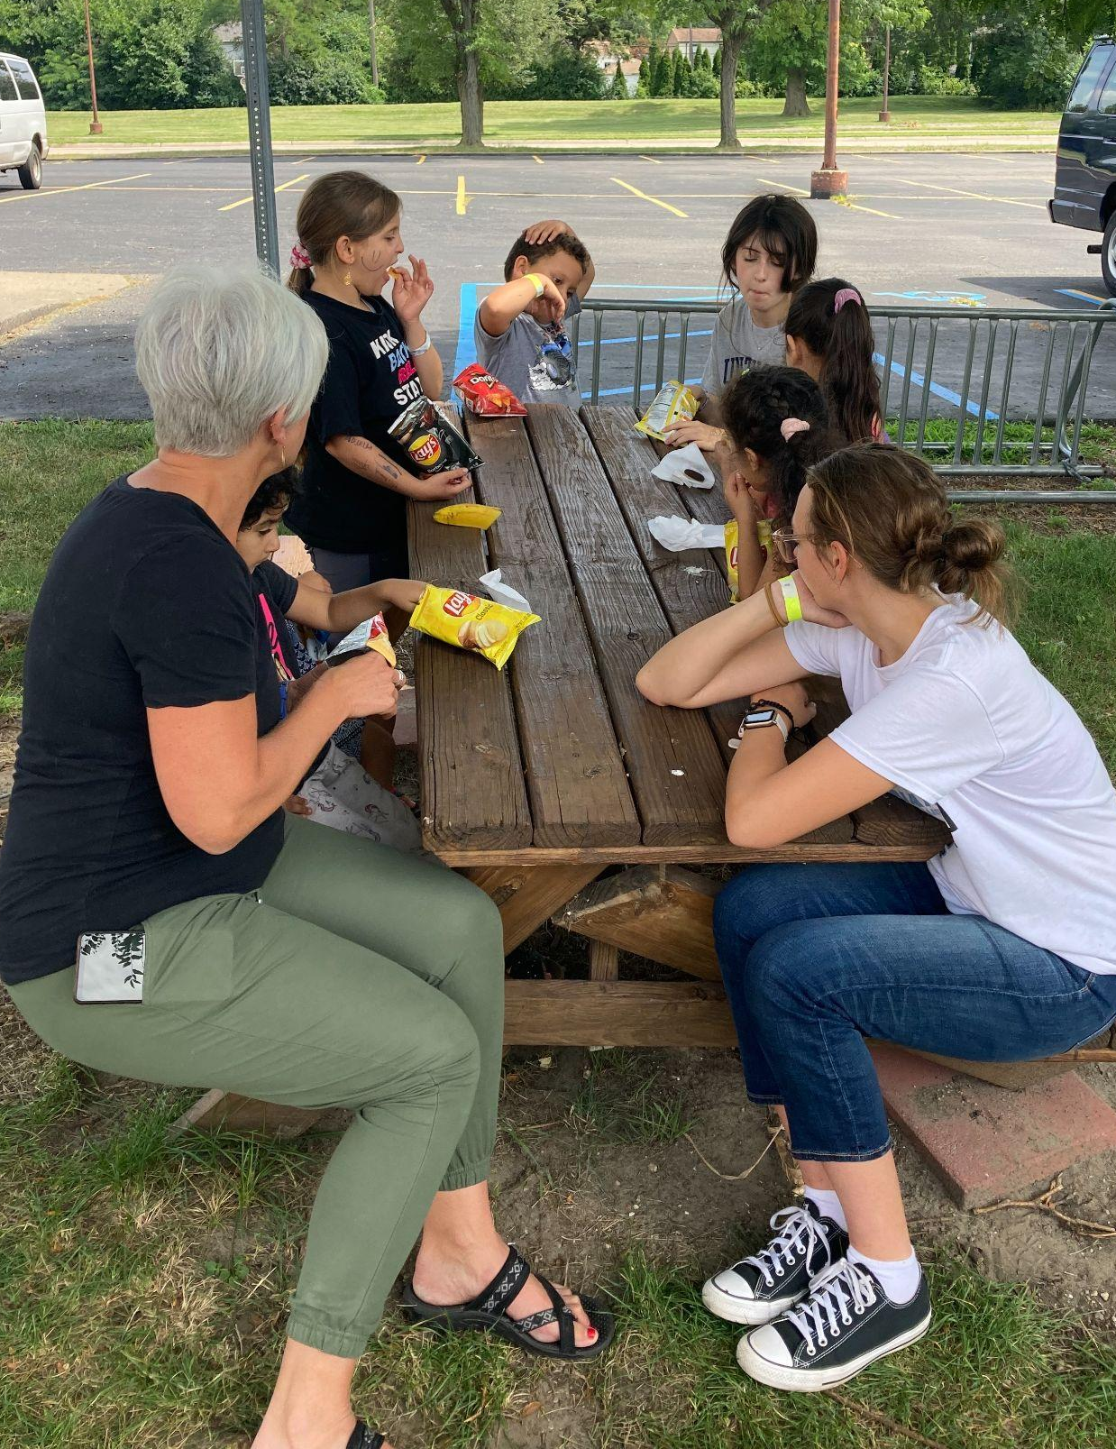
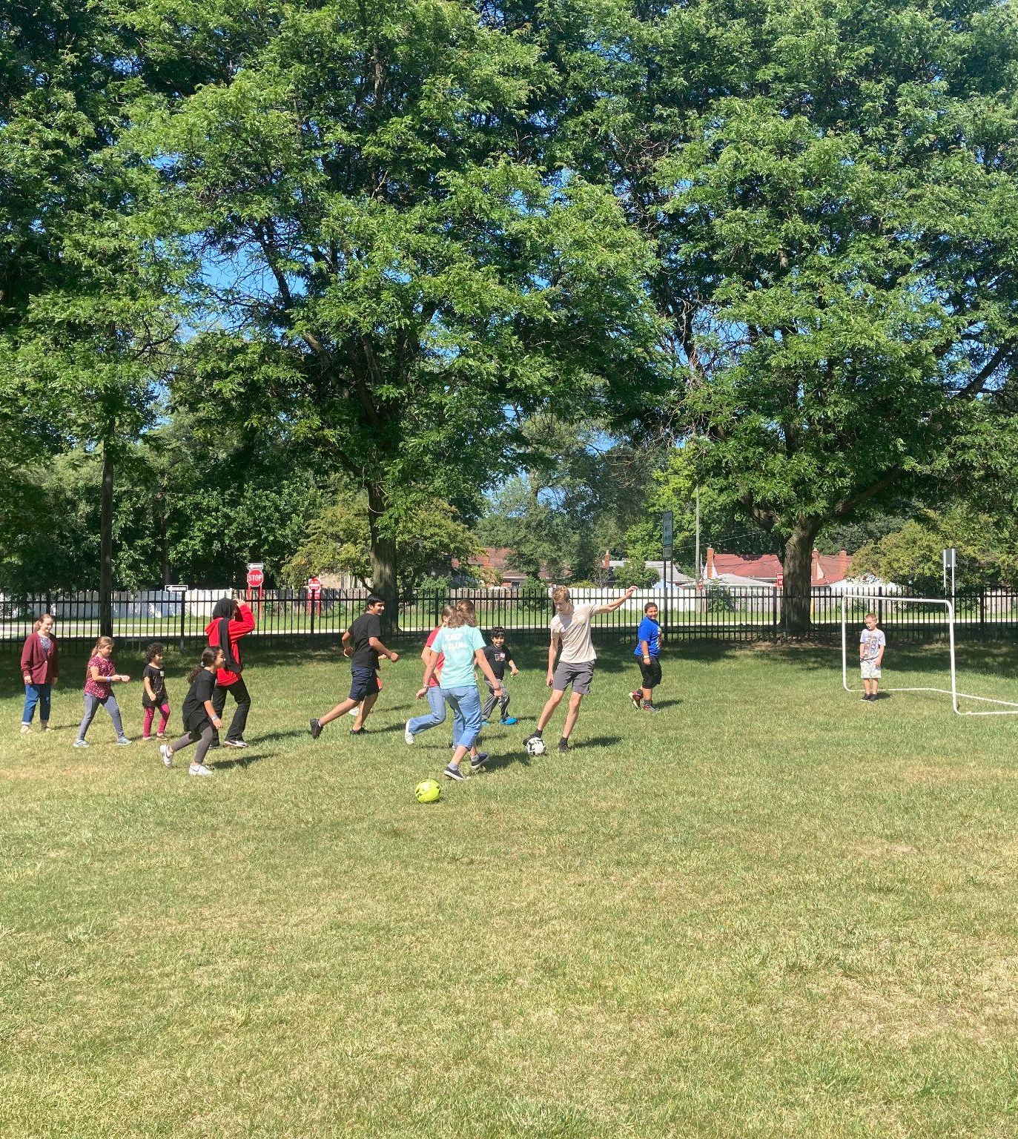
Dearborn Trip 2023

Slide 12
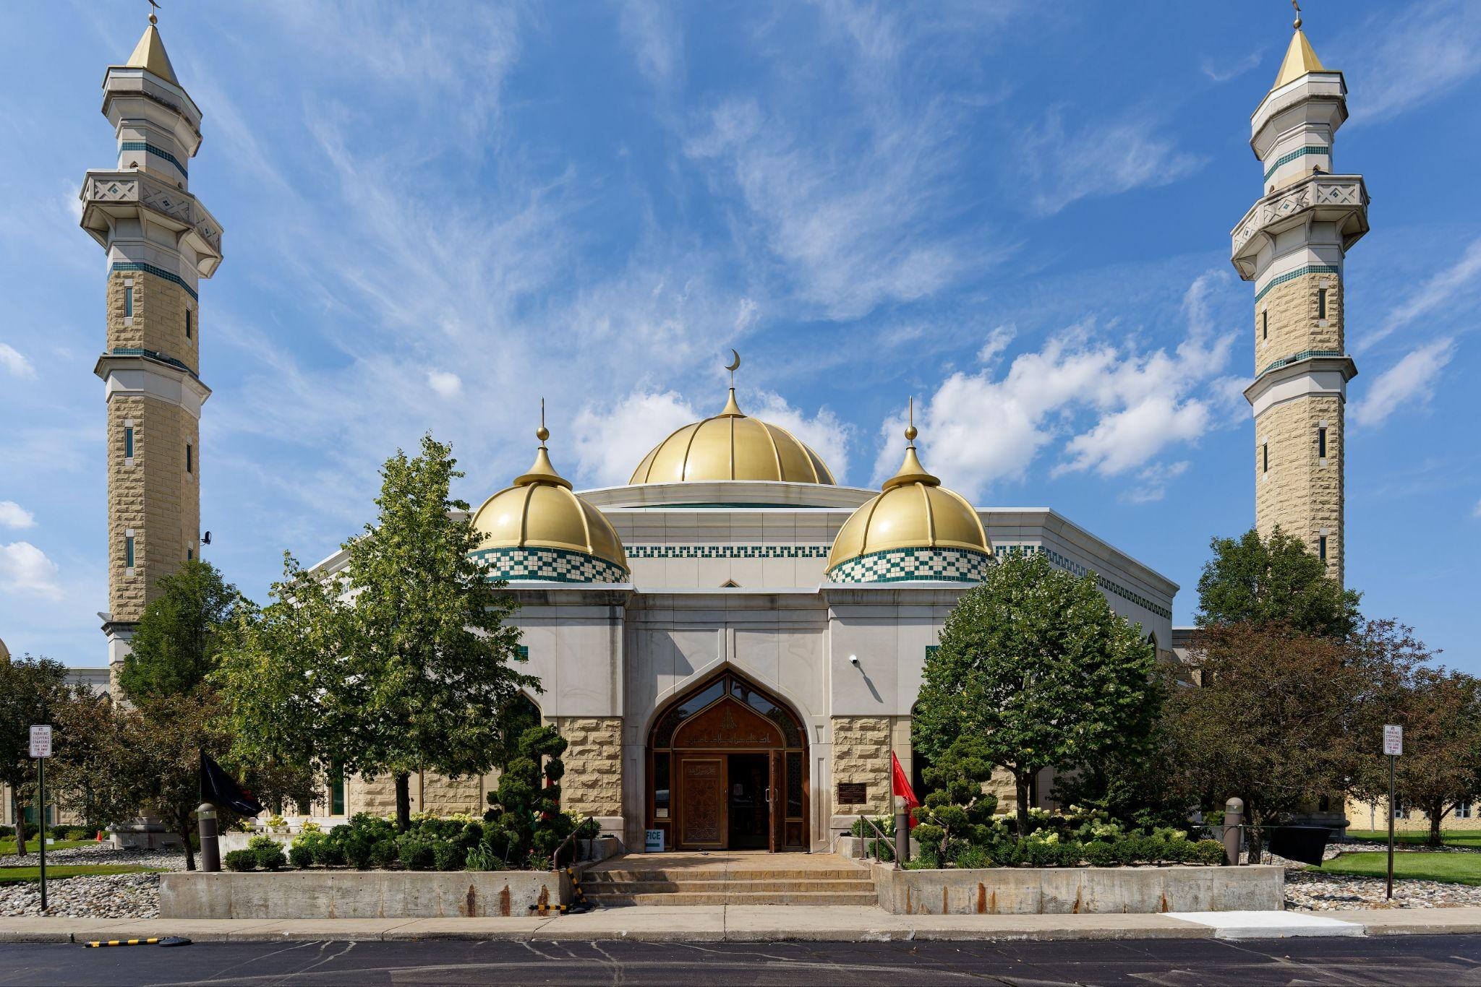
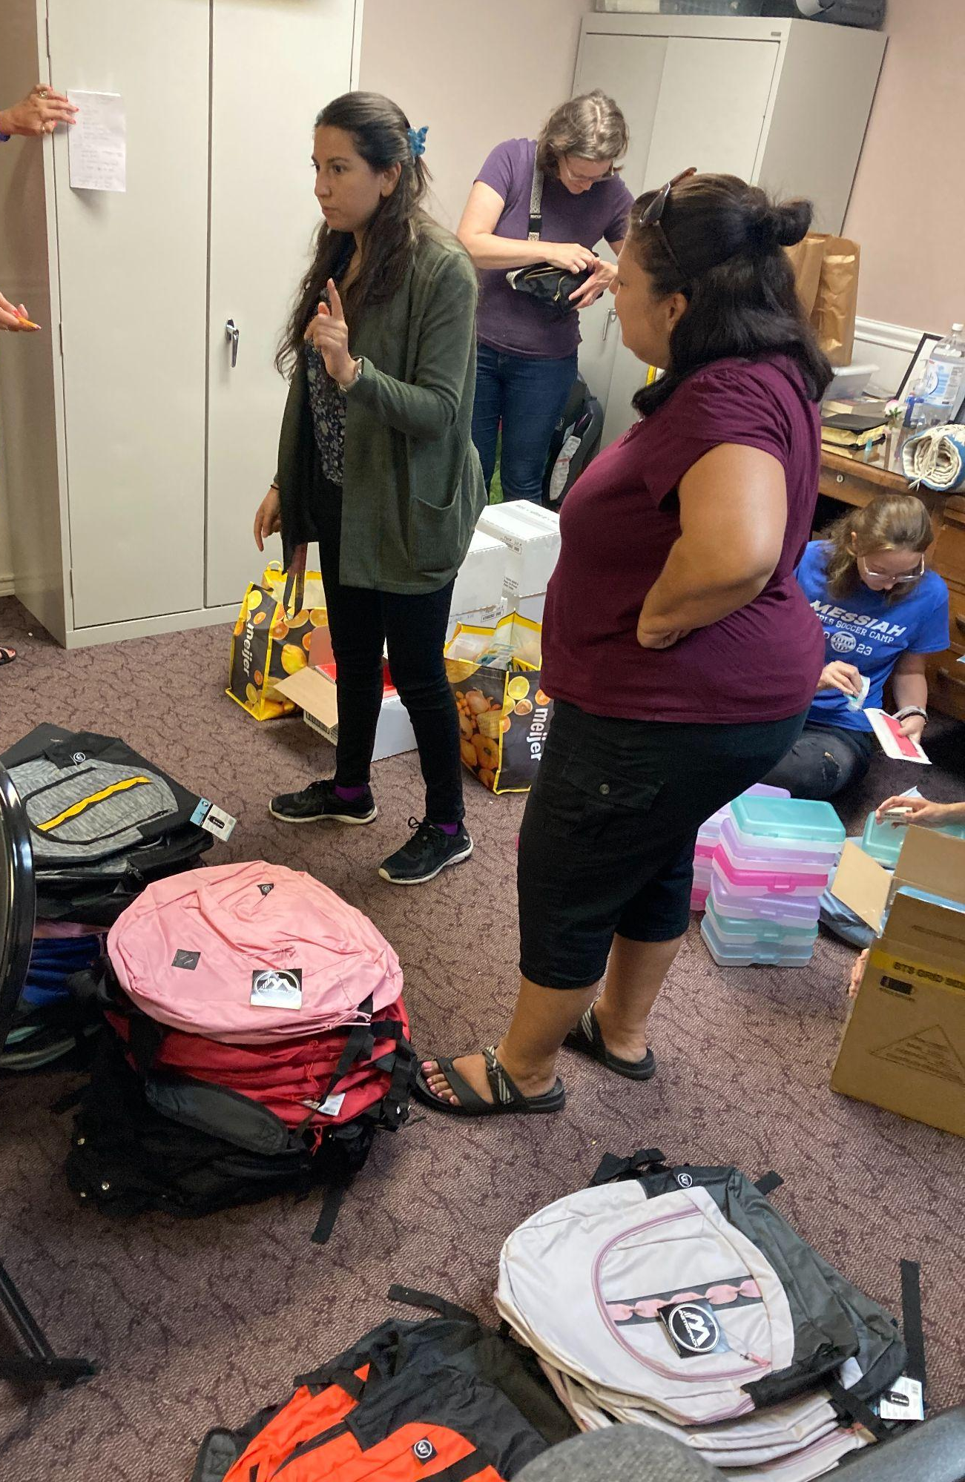
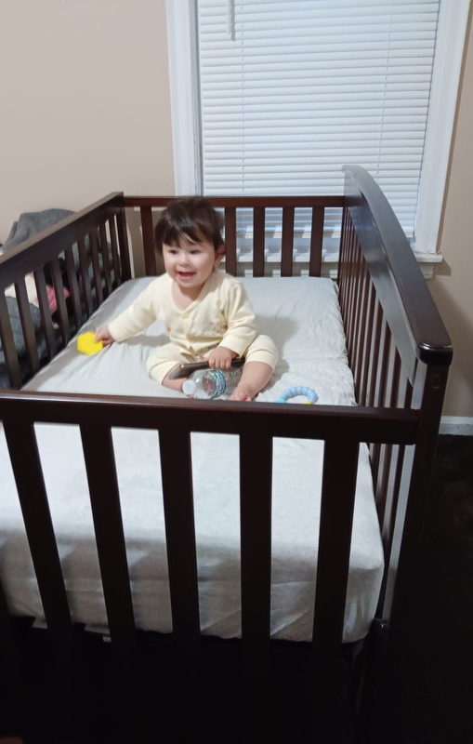
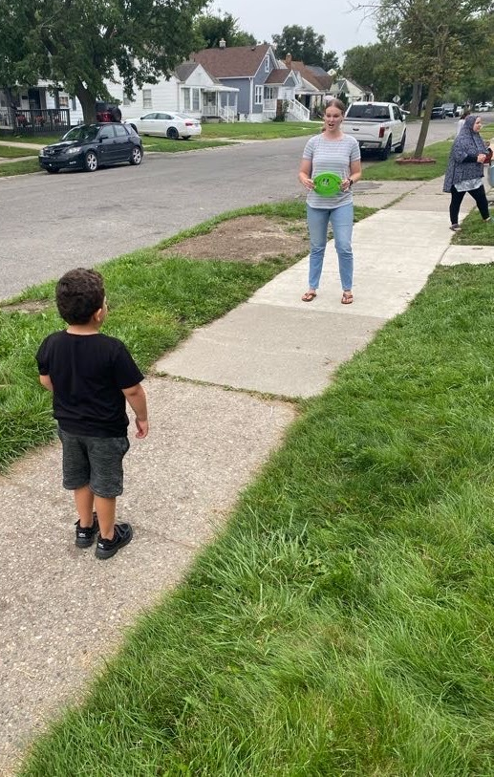
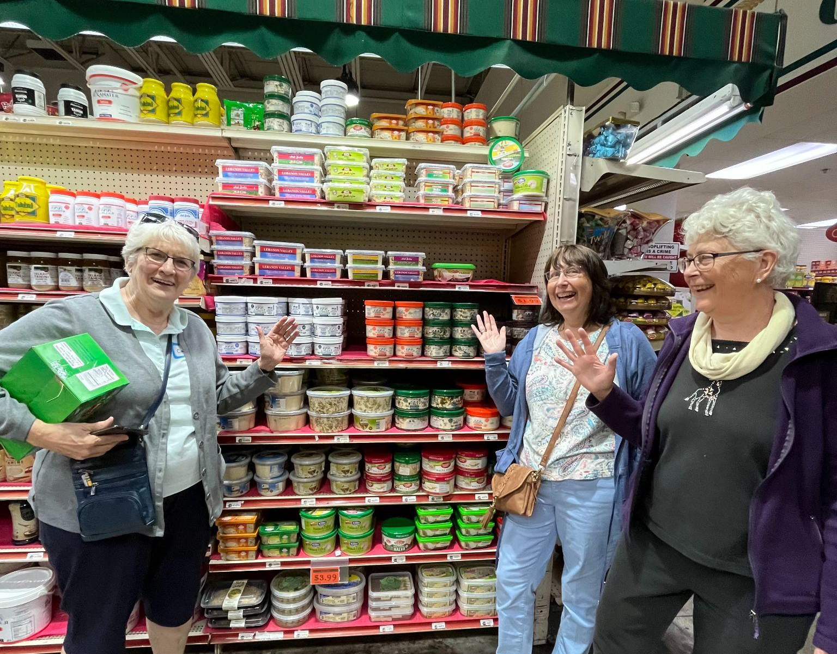
Dearborn Trip 2023

Slide 13
After this I looked, and there was a vast multitude from every nation, tribe, people, and language, which no one could number, standing before the throne and before the Lamb. They were robed in white with palm branches in their hands. And they cried out in a loud voice: “Salvation belongs to our God, who is seated on the throne, and to the Lamb!”
-Revelation 7:9–10

Slide 14
Questions for reflection and response:
What can I do today to move from spiritual consumer to missional co-laborer?

Slide 15
Questions for reflection and response:
What can I do today to move from spiritual consumer to missional co-laborer?
What in my life or heart might I need to set aside or surrender in order to do this?

Slide 16
Questions for reflection and response:
What can I do today to move from spiritual consumer to missional co-laborer?
What in my life or heart might I need to set aside or surrender in order to do this?
Which neighbor do I want to start praying for and pursuing opportunity for relationship with?

Slide 17


