Slide 1
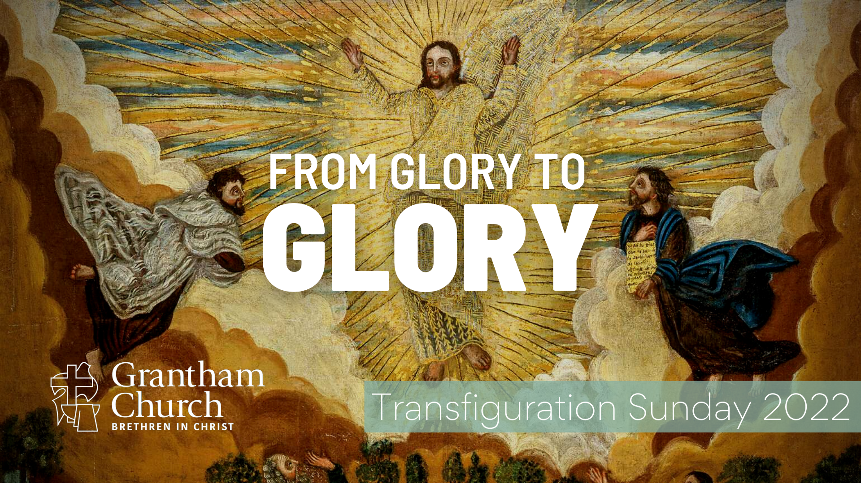
Notes:
[BRIEF INTRO]
Greetings
Transfiguration Sunday on the liturgical church calendar
Please take your Bible and turn to… [NEXT SLIDE]

Slide 2
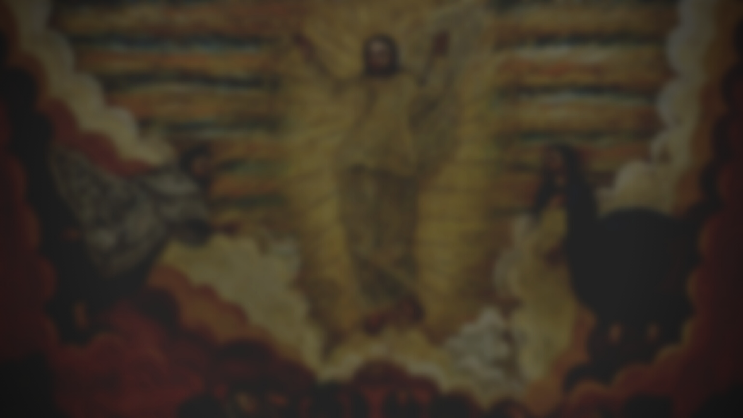
Scripture Reading
Luke 9:28-36 NLT
Notes:
[INVITATION TO STAND FOR SCRIPTURE READING]
[READ LUKE 9:28-36 NLT]
This is the word of the Lord. Thanks be to God
You may be seated. [NEXT SLIDE]

Slide 3
Notes:
[BRIEF COMMENTS]
Sermon title: From Glory to Glory
Message summary in your bulletin: The transfiguration of Jesus is one of the most neglected gospel stories within Western Christianity. While a surface reading of the story might seem strange and confusing, we can’t afford to miss its significance and the implications it has for Christ’s identity, his supremacy over all things, and for our own spiritual growth.
Listen to this quote from Dorothy Lee, professor of New Testament at Trinity College in Melbourne, an Anglican priest and author… [NEXT SLIDE]

Slide 4

“Western Christianity in many places is struggling for survival against a deadly secularism that smothers any sense of transcendence or mystery, too much of which has penetrated its own ranks. The Church needs to regain the vision of Christ on the mountain, the light in which we see light, the echo of the divine voice acclaiming Jesus the beloved Son—the biblical symbolism of a majestic, incarnate, crucified God as the only source of hope for the transfiguring of a disfigured world.”
Notes:
[READ AND BRIEF COMMENT]
Embracing mystery, mysticism, and that there is more than meets the eye
Even in a world that embraced mystery, the NT authors understood what they were saying
Listen to what Peter writes in his second epistle about the disciples’ reporting of some pretty spectacular things they witnessed, including the mountain-top experience in Luke 9… [NEXT SLIDE]

Slide 5
2 Peter 1:16-18 NRSV
¹⁶ For we did not follow cleverly devised myths when we made known to you the power and coming of our Lord Jesus Christ, but we had been eyewitnesses of his majesty. ¹⁷ For he received honor and glory from God the Father when that voice was conveyed to him by the Majestic Glory, saying, “This is my Son, my Beloved, with whom I am well pleased.” ¹⁸ We ourselves heard this voice come from heaven, while we were with him on the holy mountain.
Notes:
[READ & COMMENT ON PASSAGE]
So, with your Bibles open to Luke 9, I’d like to summarize what is happening in our main Scripture text for this morning, and look more closely at the context, symbolism, and meaning of the passage so that we might hear the voice of God to us and respond in faith to the Spirit’s promptings. [NEXT SLIDE]

Slide 6
The Transfiguration of Jesus: Context, Symbolism & Multi-Layered Meaning
Notes:
[BRIEF COMMENT ON EACH POINT]

Slide 7
The Transfiguration of Jesus: Context, Symbolism & Multi-Layered Meaning
The literary unit and the immediate context of Luke 9:18-43. (1) begins with Jesus’ question about his own identity; (2) Jesus redefines Messiah after Peter’s confession and then predicts his death; (3) God “lifts the veil” to reveal Jesus’ true identity; and (4) Jesus comes down the mountain to a faithless people.
Notes:
[BRIEF COMMENT ON EACH POINT]

Slide 8
The Transfiguration of Jesus: Context, Symbolism & Multi-Layered Meaning
The literary unit and the immediate context of Luke 9:18-43. (1) begins with Jesus’ question about his own identity; (2) Jesus redefines Messiah after Peter’s confession and then predicts his death; (3) God “lifts the veil” to reveal Jesus’ true identity; and (4) Jesus comes down the mountain to a faithless people.
Old Testament background, imagery, symbols, and fulfillment. (1) mountain-top experience; (2) clouds; (3) witnesses; (4) the Law & the Prophets; (5) the one greater has come!—Dt 18:15; (6) a new ”exodus”; (7) the glory of God revealed—Ex 34:29-35.
Notes:
[COMMENT ON EACH POINT]
The literary unit and the immediate context of Luke 9:18-43.
Old Testament background, imagery, symbols, and fulfillment.
The apostle Paul uses this OT scene with Moses on Mt. Sinai and the transfiguration of Christ in his attempts to explain why some don’t believe in Jesus, how we’re able to first believe, but also how we can continue to grow in our faith by gazing upon the glory of Christ. Let’s go to… [NEXT SLIDE]

Slide 9
Scripture Reading
2 Corinthians 3:7-4:6 NLT
Notes:
[READ & COMMENT ON PASSAGE]
So, let’s consider some key takeaways and implications of this message… [NEXT SLIDE]

Slide 10
Takeaways & Implications for Spiritual Growth

Slide 11
Takeaways & Implications for Spiritual Growth
Jesus is not simply a prophet, teacher, and miracle worker. He is the promised Messiah, the Son of Man and God in the flesh.

Slide 12
Takeaways & Implications for Spiritual Growth
Jesus is not simply a prophet, teacher, and miracle worker. He is the promised Messiah, the Son of Man and God in the flesh.
Jesus is the fulfillment of the Law & Prophets; He established a new covenant on the cross and leads us out of spiritual bondage.

Slide 13
Takeaways & Implications for Spiritual Growth
Jesus is not simply a prophet, teacher, and miracle worker. He is the promised Messiah, the Son of Man and God in the flesh.
Jesus is the fulfillment of the Law & Prophets; He established a new covenant on the cross and leads us out of spiritual bondage.
The Old Testament should be interpreted through a Jesus (cruciformed) lens and used to show Christ as the fulfillment.

Slide 14
Takeaways & Implications for Spiritual Growth
Jesus is not simply a prophet, teacher, and miracle worker. He is the promised Messiah, the Son of Man and God in the flesh.
Jesus is the fulfillment of the Law & Prophets; He established a new covenant on the cross and leads us out of spiritual bondage.
The Old Testament should be interpreted through a Jesus (cruciformed) lens and used to show Christ as the fulfillment.
The glory of God revealed in Jesus happened during prayer.

Slide 15
Takeaways & Implications for Spiritual Growth
Jesus is not simply a prophet, teacher, and miracle worker. He is the promised Messiah, the Son of Man and God in the flesh.
Jesus is the fulfillment of the Law & Prophets; He established a new covenant on the cross and leads us out of spiritual bondage.
The Old Testament should be interpreted through a Jesus (cruciformed) lens and used to show Christ as the fulfillment.
The glory of God revealed in Jesus happened during prayer.
There is a greater knowing of Jesus beyond facts, theology and doctrines. We’re called to move “from glory to glory” in our faith.
Notes:
[BRIEF COMMENT ON EACH]
That’s what the author of Hebrews had in mind when they wrote… [NEXT SLIDE]

Slide 16

Hebrews 6:1-3 MSG
So come on, let’s leave the preschool fingerpainting exercises on Christ and get on with the grand work of art. Grow up in Christ. The basic foundational truths are in place: turning your back on “salvation by self-help” and turning in trust toward God; baptismal instructions; laying on of hands; resurrection of the dead; eternal judgment. God helping us, we’ll stay true to all that. But there’s so much more. Let’s get on with it!
Notes:
[READ & BRIEF COMMENT]
Finally, here are some questions to help us reflect and respond to what we’ve heard… [NEXT SLIDE]

Slide 17
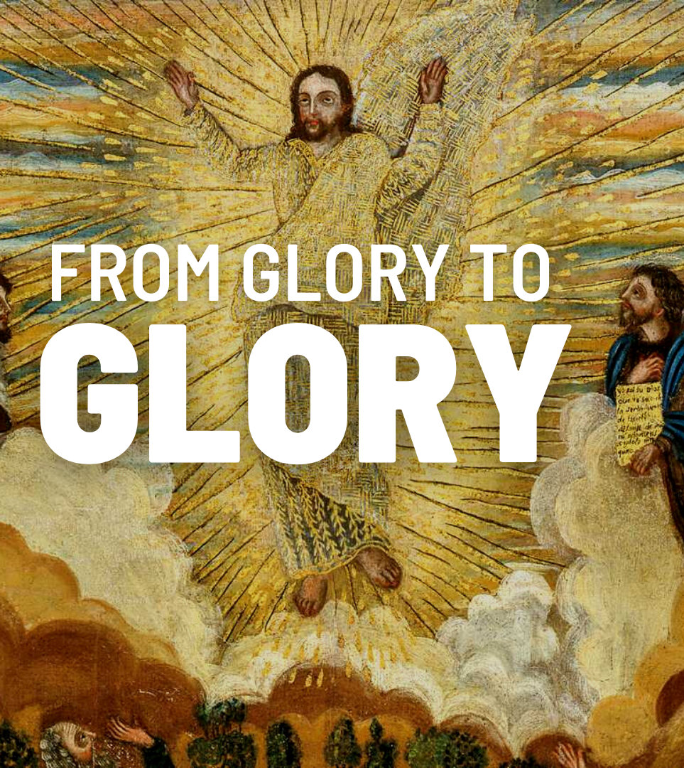
Questions for reflection and response:

Slide 18
Questions for reflection and response:
The Father said, “This is my Son, whom I have chosen; listen to him.” How might you need to listen to what Jesus says over other competing or contrary voices in your life?

Slide 19
Questions for reflection and response:
The Father said, “This is my Son, whom I have chosen; listen to him.” How might you need to listen to what Jesus says over other competing or contrary voices in your life?
Instead of simply gaining more head-knowledge, how might the Spirit be inviting you to know the living Jesus more deeply in a relational way?

Slide 20
Questions for reflection and response:
The Father said, “This is my Son, whom I have chosen; listen to him.” How might you need to listen to what Jesus says over other competing or contrary voices in your life?
Instead of simply gaining more head-knowledge, how might the Spirit be inviting you to know the living Jesus more deeply in a relational way?
What next steps do you need to take to move “from glory to glory” with Jesus and fully live into the gospel?
Notes:
[BRIEF COMMENT ON EACH]
[CLOSING WORDS]
[GO TO FINAL SLIDE DURING CLOSING PRAYER]

