Slide 1
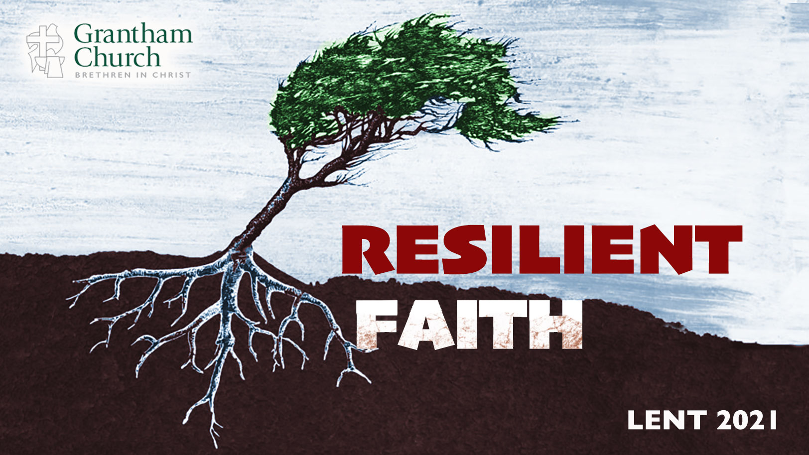
Notes:
It’s Palm Sunday, which means this is the final Sunday of Lent. As most of you know, for the past 6 weeks we have been in our Lenten series, Resilient Faith.
In this series we have looked at how God wants to use the wilderness to shape our character and our faith, if we will partner with him in that work. We have seen how we must resist evil and temptation if we’re going to overcome hardships and live into God’s best for us. We have also reflected on the necessity of biblical lament in building resilient faith and how important it is to know who you are in Christ if we’re going to trust God and grow in the wilderness.
And then last week week we saw how being humble and teachable is essential to getting what is to be gotten from the wilderness. Otherwise, pride and arrogance will harden us to the lessons that God wants to teach us. That’s why we said it’s the humble hearts that grow.
Which brings us to the final sermon in our 6-week series, a message I’ve entitled… [NEXT SLIDE]

Slide 2
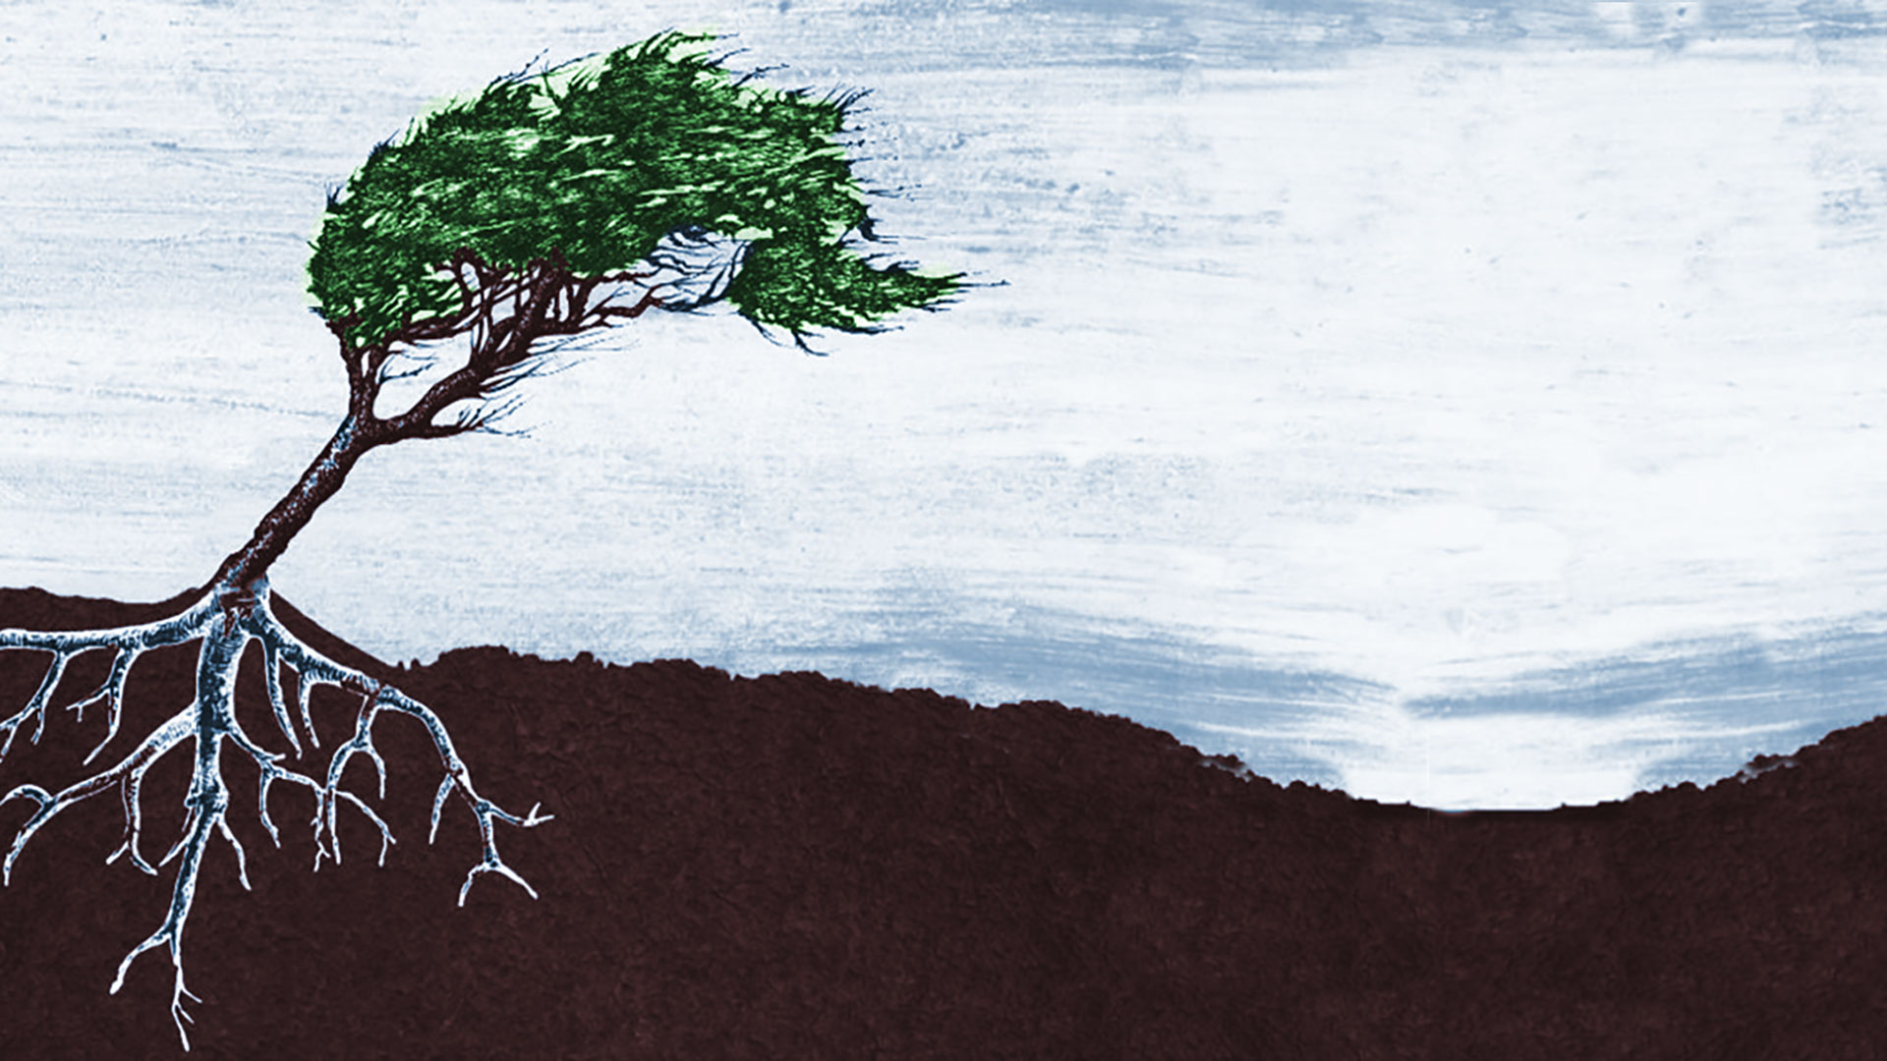
Determination + Adaptation = Resilience
Notes:
I’d like to close our series this morning thinking about how determined disciples (i.e., who know who they are and understand their calling) who are willing to adapt and change, are those who develop resilient faith. They are the ones who will grow in the wilderness, survive the sabotage, and thrive on the other side of the trials they are experiencing.
And this equation… “Determination + Adaptation = Resilience” communicates that truth.
[BRIEF PRAYER]
Once again, it is Palm Sunday… [NEXT SLIDE]

Slide 3
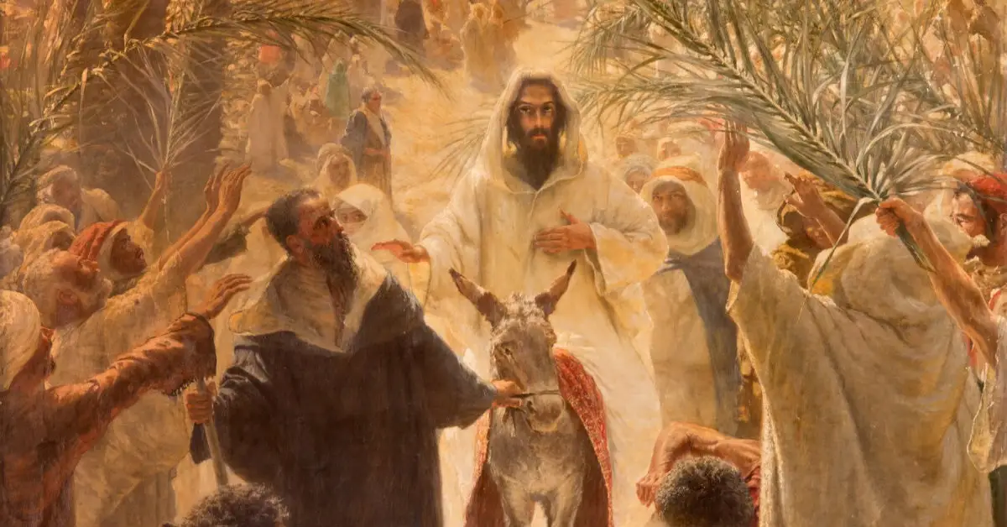

Mark 11:1-11
Matthew 21:1-11
Luke 10:28-44
John 12:12-14
Palm Sunday
Notes:
And earlier in the service you heard Mark’s telling of what is known as Jesus’ triumphal entry. You can find a version of this story in each of the four gospels. So, what is going on here? What is this event all about? And why do we remember it on the church calendar?
It’s because this day marks the beginning of the end for Jesus’ life and ministry. He has been to Jerusalem many times before, but this will be the last time. After three years of healings, exorcisms, preaching, teaching, and challenging the political and religious leaders of his day, he now enters his final week on the earth. Jesus is loved by some (even thought to be the long-awaited Messiah), but he is hated by others, as he was thought to be a threat to Judaism, to the ruling order, and to the peace of Rome.
And Jesus knows this. In fact, the gospels tell us that he knows he is coming to Jerusalem to die. And it’s as if Jesus has it all planned out—how he arrives, what he will do, what he will say, and how he will lay down his life as a ransom and be the scapegoat for all our sins.
And as we see on Palm Sunday, Jesus has come creative ideas and prophetic theater in mind for the crowds—outside the city and later in the temple. So, he begins by riding into Jerusalem, not on a conquering warhorse, but on a donkey. Yet, people still hail him as the Messiah, the Son of David. They express this belief in their chant (Hosanna – “save us!” Son of David), but also in laying their cloaks on the road and waving palm branches.
The waving of palm branches was something the Jews did 200 years earlier, after what is known as the Maccabean revolt when the Jewish people threw off the rule of the Seleucid Empire, which was left over from divided lands of Alexander the Great. The Jewish people were free until the Romans began their occupation about 65 years before Jesus was born. So, in other words, they are hoping that Jesus will free them once again. And he will free people, just not in the way they thought he would.
That’s because Jesus was not what anyone expected a Messiah to be. As we saw in his temptations (by rejecting worldly kingdom power) and we can hear in his parables on the Kingdom and his teachings on loving our enemies, Jesus did not come to establish the Kingdom of God by trusting in power-over, but rather by embracing power-under and calvary-like love. And ultimately, he revealed the power of this co-suffering love (a love that can actually change hearts and minds) by dying on the cross for our sins.
And notice, despite the difficulties that Jesus faced in trying to persuade his closest followers of his identity and his vision for the Kingdom, and despite the suffering that he would have to endure as he confronted the unjust systems of both temple and empire, Jesus’ determination is obvious to anyone who reads the gospels. He wasn’t stopping, he wouldn’t be deterred, and he wouldn’t be knocked off course—not by the devil in the wilderness, not by the Pharisees in the synagogues, not by his friend Peter who said, “we won’t let you go” nor by Pilate who said, “Don’t you know I have the power to crucify you?” Still, Jesus kept going.
And this was all very puzzling to his disciples. What is he saying? What does he mean “the Son of Man must suffer and die” in order to defeat evil? Why is he doing this? Afterall, what good can he do if he’s dead? What kind of Messiah is that? What kind of Kingdom is that? And like so many things that Jesus said and did, his disciples met Jesus’ determination with some level of misunderstanding and confusion. Which is why there were several times Jesus said something like this… [NEXT SLIDE]

Slide 4
“You do not realize now what I am doing, but later you will understand.”
Jesus, John 13:7 NIV
Notes:
You may recall that Jesus said this after he had shared the Last Supper with his disciples, as he was playing the role of a servant and washing their feet. They couldn’t believe it. Peter even tried to stop him. And Jesus said, “You’ll get this later, guys. You’ll understand later on.”
And if you continue to read the New Testament with the book of Acts and onward, you can see that Jesus’ determination and his patience (even trusting that the Spirit would grow his disciples when he was gone), eventually pays off. They eventually understand. [NEXT SLIDE]

Slide 5
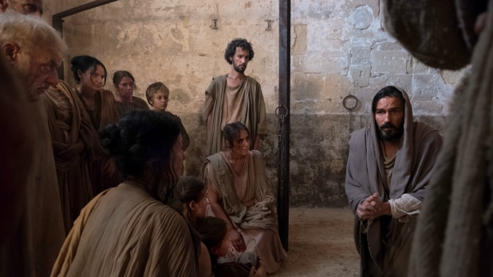
Notes:
Post-resurrection, the Holy Spirit will empower the disciples and the early church to have the same sort of determination of identity and purpose, as well as the ability to adjust once they realized what needed to change in their thinking, and the fortitude to adapt to the shifting culture around them so that the church could grow, and the gospel of the Kingdom could be known in their communities and ultimately the world. Folks, this is resilience! And it’s why the early church thrived despite the opposition that she faced.
You know, the Apostle Paul is the epitome of this. I think this former Pharisee and persecutor of Christians embodies the early church’s willingness to change, adapt, and press on with a Kingdom vision and carry-on Christ’s call to make disciples. Just look at the mindset that Paul had as it’s reflected in his words to the house church in Corinth: [NEXT SLIDE]

Slide 6
I have become all things to all people so that by all possible means I might save some. I do all this for the sake of the gospel, that I may share in its blessings.
Paul, 1 Corinthians 9:22-23 NIV
Notes:
Don’t miss what Paul is communicating, church. This isn’t simply about his approach to evangelism. This is reflective of Paul’s attitude; his determination and his willingness to adjust his thinking and adapt to the world around him. This has implications for us as individual disciples, as well as implications for us as a congregation of disciples on mission together.
So, let’s consider how this mindset fueled the growth of the first disciples and led to a Jesus movement that may be best described as a wildfire of the Holy Spirit. [NEXT SLIDE]

Slide 7
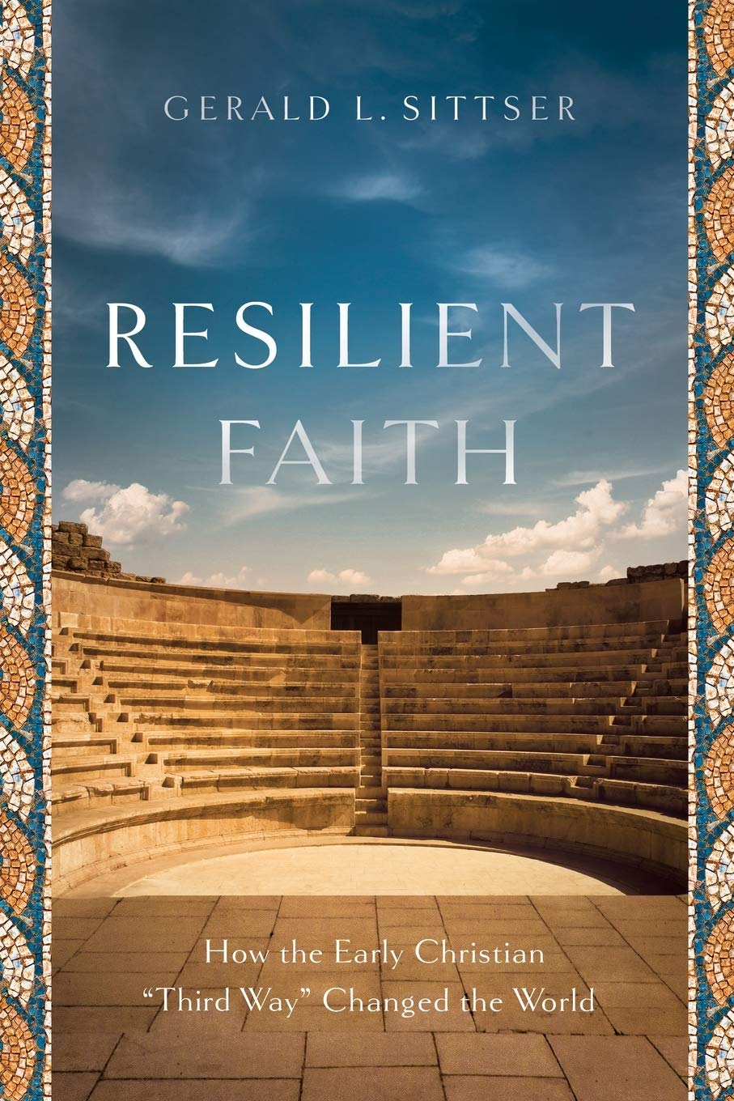
The Resilient Faith of the Early Church

Slide 8
The Resilient Faith of the Early Church
They created a “third way” (race) or new family through the church community.

Slide 9
The Resilient Faith of the Early Church
They created a “third way” (race) or new family through the church community.
They had to improvise and learn to be creative and resourceful with less.

Slide 10
The Resilient Faith of the Early Church
They created a “third way” (race) or new family through the church community.
They had to improvise and learn to be creative and resourceful with less.
They embraced liturgical worship and counter-cultural practices that helped them live into the redemptive story.

Slide 11
The Resilient Faith of the Early Church
They created a “third way” (race) or new family through the church community.
They had to improvise and learn to be creative and resourceful with less.
They embraced liturgical worship and counter-cultural practices that helped them live into the redemptive story.
They thrived by patiently making disciples and putting their faith openly on display.
Notes:
In his book, Resilient Faith: How the Early Christian “Third Way” Changed the World, professor of theology at Whitworth University, Gerald Sittser, makes the case that it was the resilient faith of the early church that led to the explosive growth of Christianity, and its Kingdom impact on the empire. And he says, we need to look back at the example of the early church so we can move forward with resilience in a post-Christian, increasingly secular, American empire today.
Here are a few takeaways from his book. Sittser says:
They created a “third way” (race) or new family through the church community.
- Confessing “Jesus is Lord” impacted their daily, moral, and political decisions.
- They were alert to the extremes within society and avoided them.
- Their living challenged and subverted the mainstream of society and culture (e.g. values, their sexual ethics, their view of women, the elderly, the widows, the entire social order).
- They did this through house churches (personal spaces)
- They saw themselves as a “nation within a nation”
They had to improvise and learn to be creative and resourceful with less.
- They were an illegal religion; they had no buildings
- They had no social standing or political power—no special privileges
- They were mostly poor and shared their resources
- They found a way to make a little do a lot, because they we’re fully committed
They embraced liturgical worship and counter-cultural practices that helped them live into the redemptive story.
- They gave themselves to the formative power of worship; it wasn’t just about getting information; it was about adopting meaningful religious practices at home—developing practices that became habits or “second nature” to their church community.
- By immersing themselves in God’s redemptive story and purposes culminating in Jesus, and by embodying that story through meaningful liturgies that countered the world’s liturgies, the early disciples became a transformational force.
They thrived by patiently making disciples and putting their faith openly on display.
- Sittser writes, “discipleship is not for a few special Christians but for all Christians, not an option but an expectation, not an addition to conversion but an essential feature of conversion.” It’s clear to us that the early church raised the bar, they didn’t lower it.
- Just as Alan Krieder said in his book, The Patient Ferment of the Early Church, the key to their success was the slow, patient, catechizing and formation of serious disciples.
And it’s these components of their faith and their discipleship that enabled them to adapt and grow, despite the godlessness of the empire and the daily threats to their wellbeing as followers of the crucified and risen Jesus. It makes me think of this quote: [NEXT SLIDE]

Slide 12
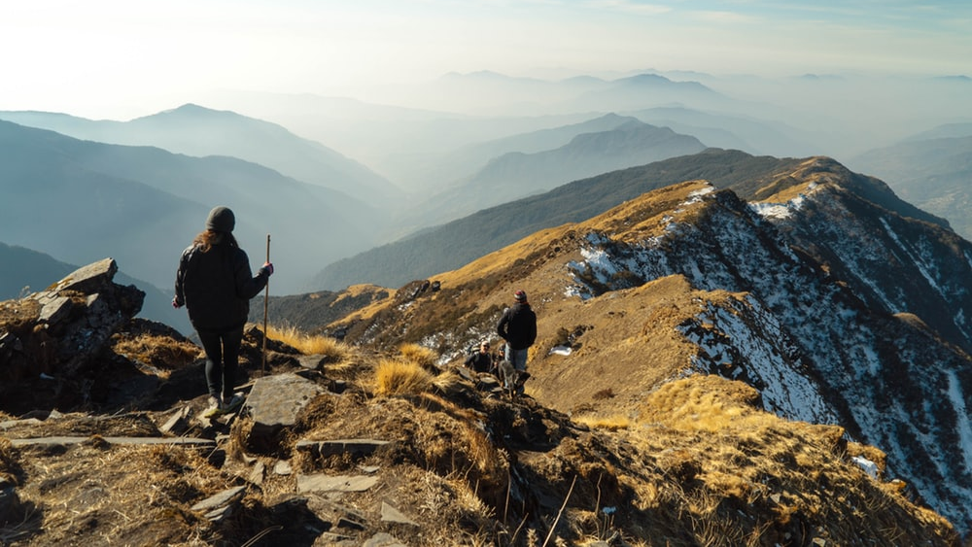
“It is not the most intellectual of the species that survives; it is not the strongest that survives; but the species that survives is the one that is able best to adapt and adjust to the changing environment in which it finds itself.”
Leon C. Megginson
Notes:
And I believe that is where we find ourselves in 2021, living in a pluralistic, post-modern American society where the pandemic has accelerated post-Christendom and the widening gap between authentic Christian values & virtues and the alure of secular humanism.
And while that might be unnerving to many of us, we should view these changes as an opportunity for God to purge the church, as Jesus did in his own ministry after saying hard things—separating the nominal Christians from the true disciples—and then bring about a fresh new authentic expression of a church that leads others to the God who looks like Jesus.
But before that can happen, we must come to terms with where we are, what has happened, and if we’re going to press on and discover new life on the other side of it all. It makes me think of the movie, Gravity… [NEXT SLIDE]

Slide 13

Notes:
starring Sandra Bullock and George Clooney. Bullock, the main character, plays a scientist (Dr. Ryan Stone) who is recruited by NASA for a special mission to work on the Hubble telescope orbiting the planet. During a spacewalk, Mission Control in Houston warns the space shuttle’s crew about a rapidly-expanding cloud of space debris (accidentally caused by the Russians after they shot down a defunct spy satellite) and order the crew to return to Earth immediately. But before the astronauts can return to the shuttle, high-speed debris strikes the shuttle and the Hubble, destroying them, and sending Dr. Stone and Kowalski tumbling through space.
The rest of the movie is about them fighting to survive and return home. But the real focus of the story is Dr. Stone’s own inner struggle, as you learn that she had recently experienced the loss of a child, and that she really wasn’t living, nor did she know if she wanted to continue living. It’s an intense movie with stunning visuals, with an even greater story—the story of a woman who decides that she must grieve and let go so that she can experience a new birth and learn to live again. If you’ve not seen it, I recommend you watch it.
So, what are we saying? Take a look at this quote from business leader, Ronald Heifetz. [NEXT SLIDE]

Slide 14
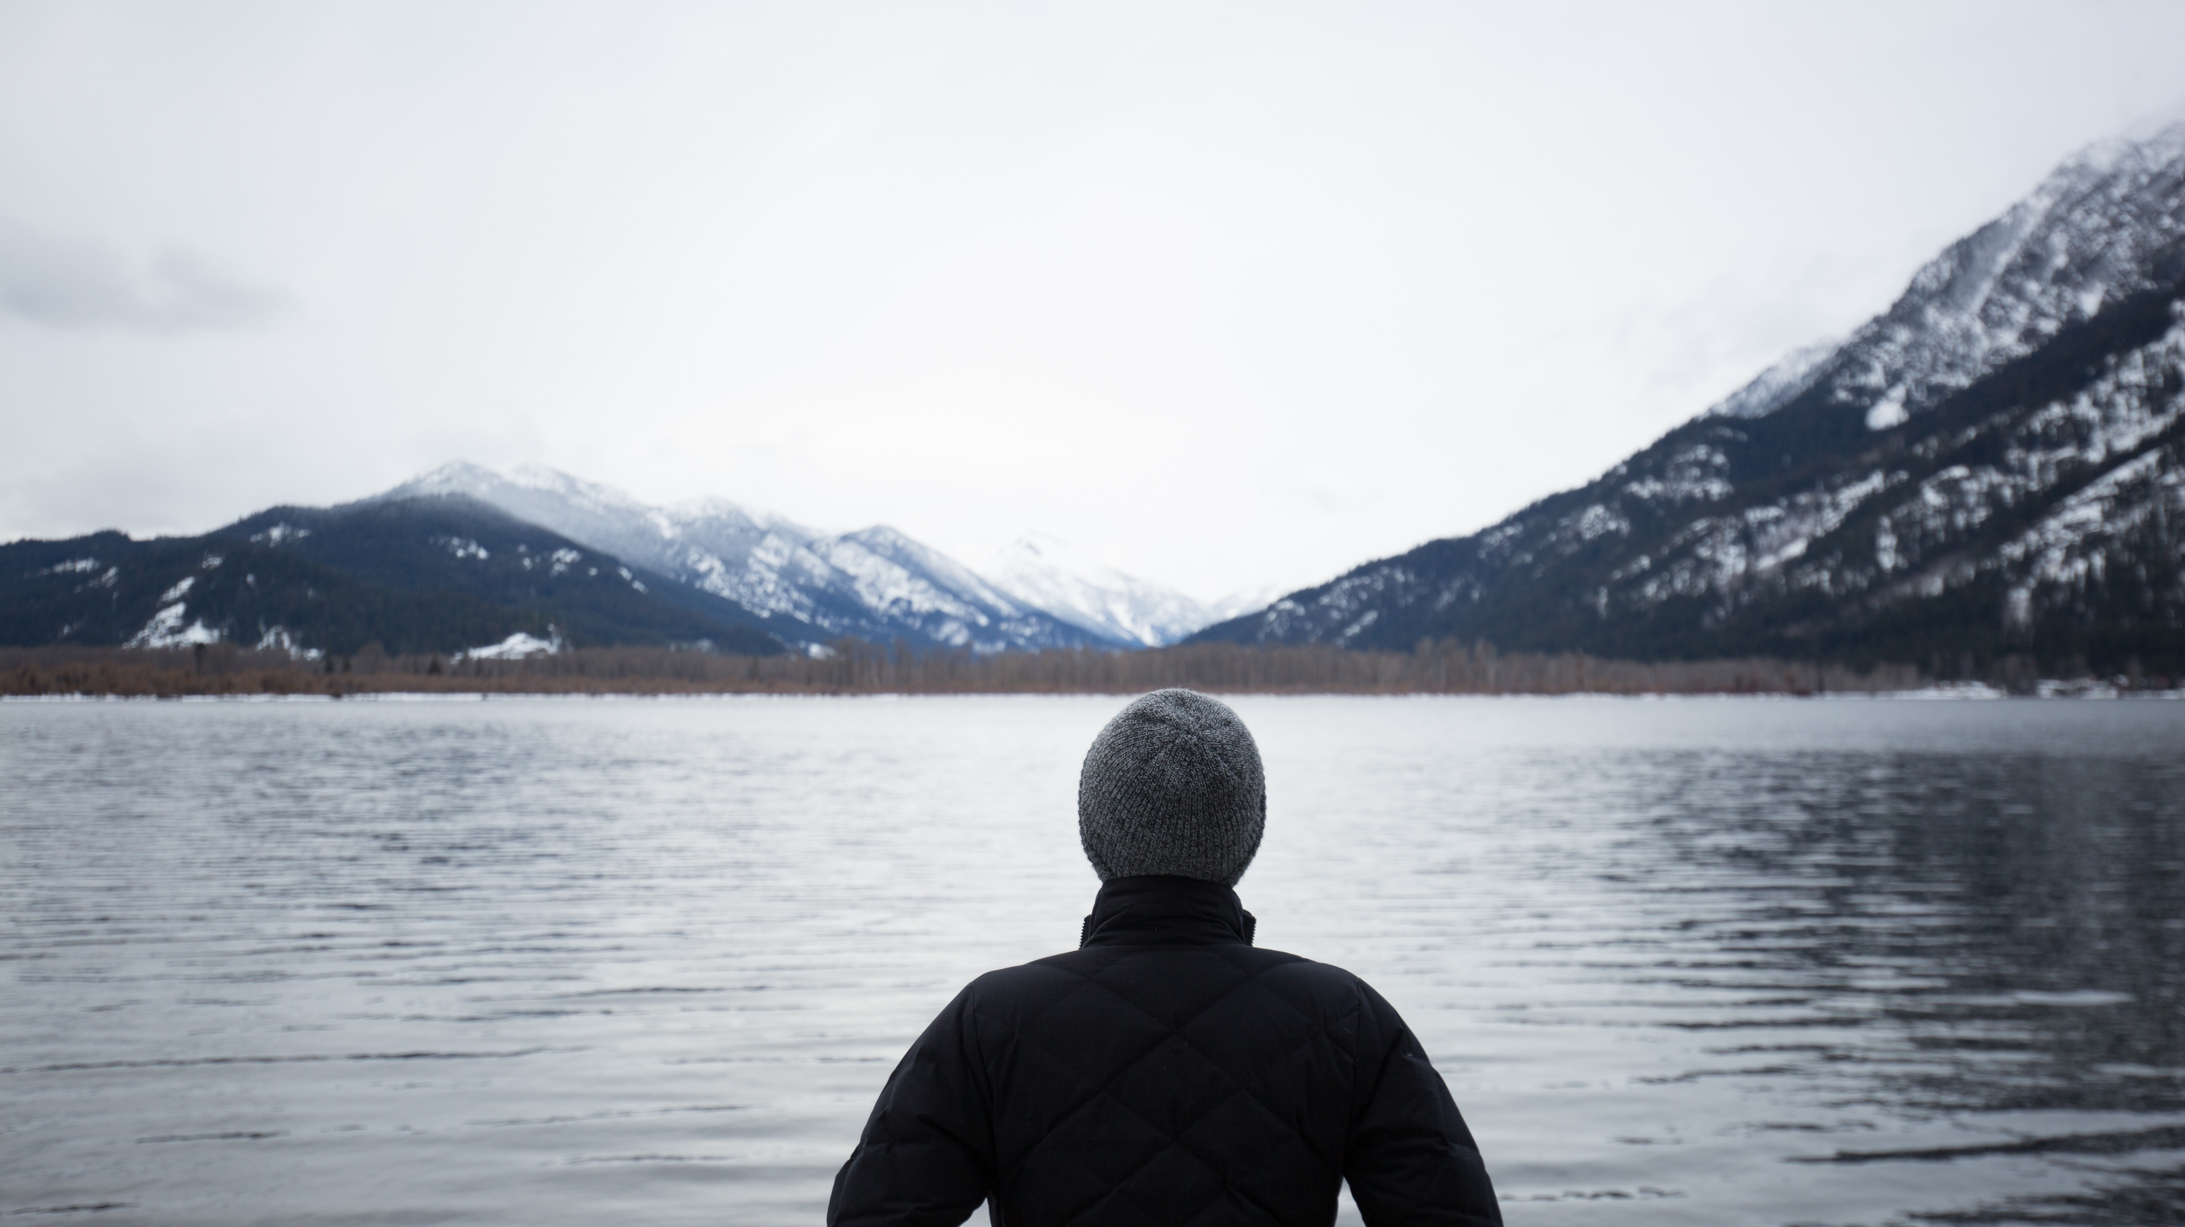
“People do not resist change, per se. People resist loss.”
Ronald Heifetz
Notes:
What’s so hard about change? Ron Heifetz says that it’s disappointment and loss. For some of us, we’ve experienced a great deal of disappointment and loss this year, and maybe at some point in the past. And because of that, it’s hard to let go and move on.
For others, it’s the fear of further loss—something that hasn’t happened yet but is bound to happen at some point. So, we cling to the past or we cling to the present, afraid of what might come with change. But as I hope is becoming clear with this message: change is inevitable, and so keeping your focus and remaining determined about who you are and where you’re going as you adapt is necessary if you’re going to experience the life of Christ in you, and our church. There is no way around it. Only those who adapt with the change will survive.
I know this can be hard. And Jesus knows that too. Just think about what Jesus said to his disciples after they finally began to understand that Jesus was going to leave them. The Lord knew their hearts were heavy with the news of their coming loss. And so, he sought to comfort them with these words: [NEXT SLIDE]

Slide 15
“All this I have spoken while still with you. But the Advocate, the Holy Spirit, whom the Father will send in my name, will teach you all things and will remind you of everything I have said to you. Peace I leave with you; my peace I give you. I do not give to you as the world gives. Do not let your hearts be troubled and do not be afraid.
Jesus, John 14:25-27 NIV
Notes:
It’s just as Bob Dylan said, the times they are a-changin’. It’s true. But you can be sure of this, Jesus says, “I will be with you. You will experience me in a new way for a new day. So, trust me and I will show you. But until then, live in my peace. Don’t be afraid.” Certainly, Jesus knows what it’s like to experience loss, and for his disciples to want to keep looking back or cling to the present. But it’s as Jesus said elsewhere, you can’t plow straight rows if you keep looking back. You can’t join him now and follow him into the future if you’re stuck in the past.
Again, as you might expect, the Apostle Paul understood this. Listen to what he told the house church in Philippi: [NEXT SLIDE]

Slide 16
Paul, Philippians 3:13-14 NIV
¹³ Brothers and sisters, I do not consider myself yet to have taken hold of it. But one thing I do: Forgetting what is behind and straining toward what is ahead, ¹⁴ I press on toward the goal to win the prize for which God has called me heavenward in Christ Jesus.
Notes:
Brothers and sisters, this is resilient faith. And it’s available to all of us. If we will submit ourselves to God’s program in the wilderness, if we will resist evil and temptation, if we will lament and let go, if we will learn who we are in Christ and what he’s called us to do, and then with determination and a willing spirit to adapt and move with change, we will as Paul said in Ephesians 4, “grow to become in every respect the mature body of him who is the head, that is, Christ. From him the whole body, joined and held together by every supporting ligament, grows and builds itself up in love, as each part does its work.” This is who we were created to be as disciples. This is what God wants for our church. Amen?
Finally, here are a few questions for reflection and response: [NEXT SLIDE]

Slide 17
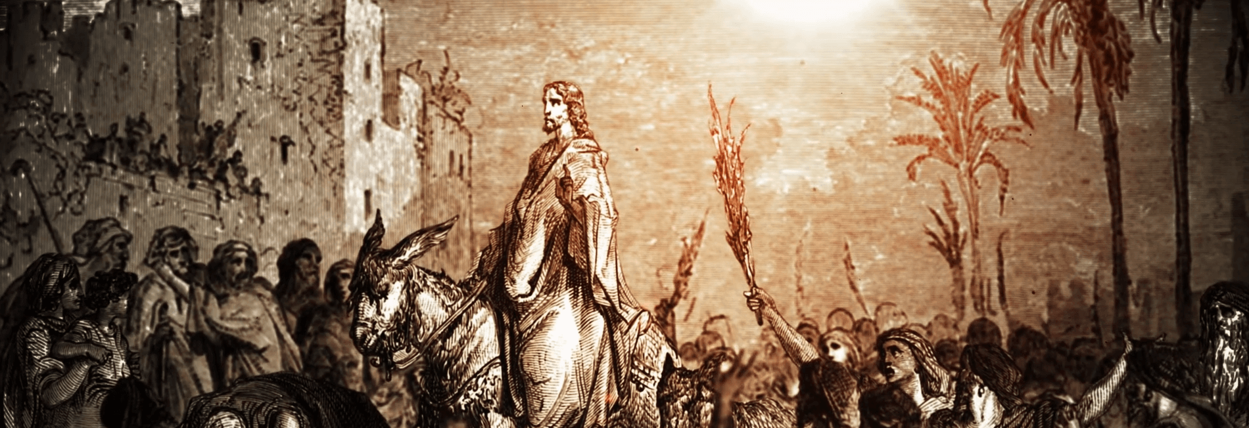
Questions for reflection and response:

Slide 18
Questions for reflection and response:
Are you determined to follow Jesus and grow resilient faith?

Slide 19
Questions for reflection and response:
Are you determined to follow Jesus and grow resilient faith?
What is keeping you from adapting to change?

Slide 20
Questions for reflection and response:
Are you determined to follow Jesus and grow resilient faith?
What is keeping you from adapting to change?
How is God calling you to let go and press on toward the goal?
Notes:
[BRIEF COMMENT ON EACH POINT]
Closing Prayer
Jesus, you are the pioneer and perfecter of faith. So, Lord, we ask that you would give us your faith this morning. The resilient faith we see in you and in the early church. Set us free from those things that are holding us back. Help us to heal. Help us to let go. Help us to grow.
Holy Spirit, we invite you to work in each of our hearts, and in the life of our congregation. Give us determination. Help us to adapt. Make us resilient. And prepare us for life and living on the other side of the wilderness. So that we might experience more of the Kingdom in us and around us, for the sake of the gospel, and the glory of you name. Go with us now into Holy Week. And continue to teach us about your love and your power to save.
In the precious name of Jesus we pray, Amen.

