Slide 1
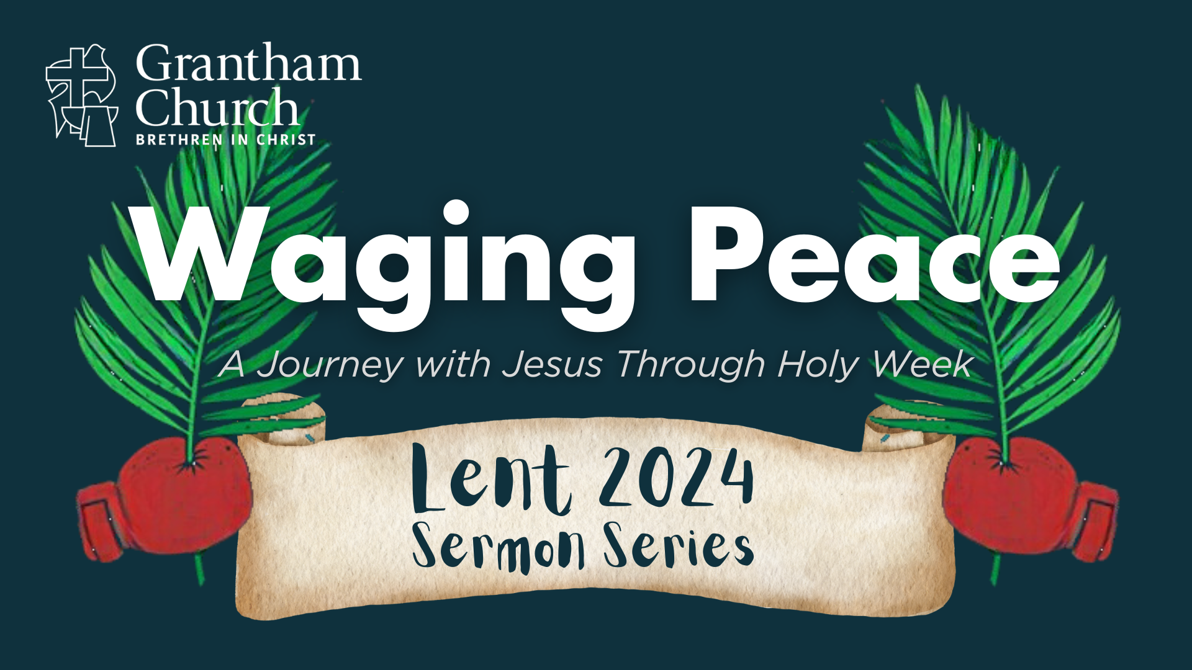
Notes:
[BRIEF INTRO]
Welcome/Greeting
Lent to Easter series (next 7 weeks) – Waging Peace: A Journey with Jesus Through Holy Week – At the beginning of Holy Week, Jesus looked out over Jerusalem and cried aloud, “If only you knew the things that make for peace.” And then Jesus spends each day confronting injustice, calling out oppressors, and contending for peace. But what if—despite our familiarity with the events of Holy Week—we have not fully understood or embraced how Jesus makes peace and calls us to do the same? Therefore, this Lent to Easter we’re going to journey with Jesus through Holy Week and seek to discover anew why he is called the Prince of Peace, and what it looks like when we are waging peace like him.
This series is based on Jason Porterfield’s book… [NEXT SLIDE]

Slide 2

Notes:
Fight Like Jesus: How Jesus Waged Peace Throughout Holy Week, published by Herald Press (2022). I’ll be following the book fairly closely, so you may want to get the book from Amazon. We do have a copy of it in our church library if you’d like to check it out. And in addition, there is now a collection of books related to this series on the bookshelf close to the office in the lobby.
As the series summary indicates, each week we will focus on the peacemaking ways of Jesus as we see them from one day to the next during Holy Week. And so, for the first sermon in our series we begin at the beginning of Holy Week with Palm Sunday… [NEXT SLIDE]

Slide 3
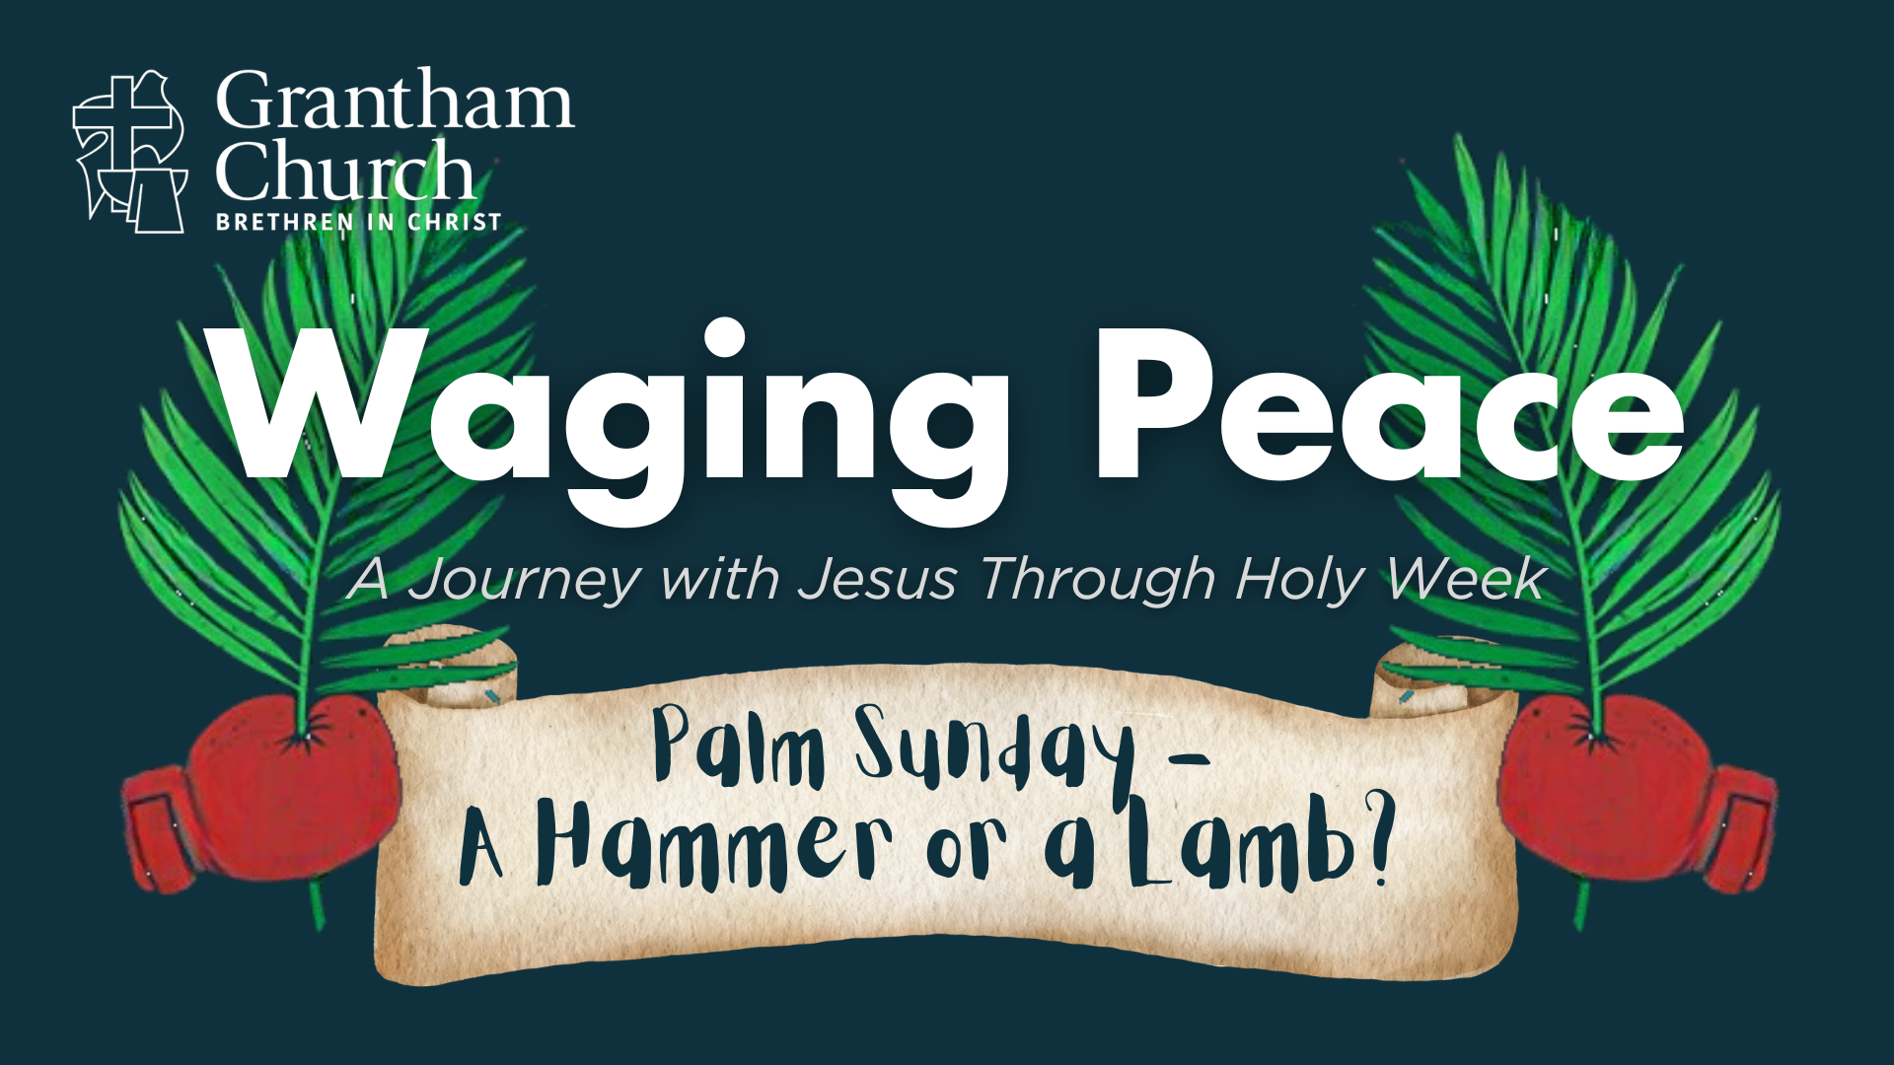
Notes:
In a message entitled, A Hammer or a Lamb?
The first day of Holy Week is known as Palm Sunday. It’s the day when Jesus, the final week of his life, rode into Jerusalem on a donkey while being lauded as Messiah by many of his fans and followers. But as we will see this morning, while many people celebrated his arrival, Jesus wept. Why? Well, as the hours and days pass, it becomes clear that the crowds didn’t understand who Jesus was, and they ultimately rejected his way of peacemaking.
So, in this first message of our series, I want to invite us to see the so-called “triumphal entry” as the key to understanding Holy Week, and then ask that we would open our hearts to receive and embrace the peacemaking ways of the sacrificial Lamb.
[BRIEF PRAYER]
Jesus’ entry into Jerusalem on Palm Sunday is included in all four gospels, but each gospel writer tells the story with slight variations… [NEXT SLIDE]

Slide 4
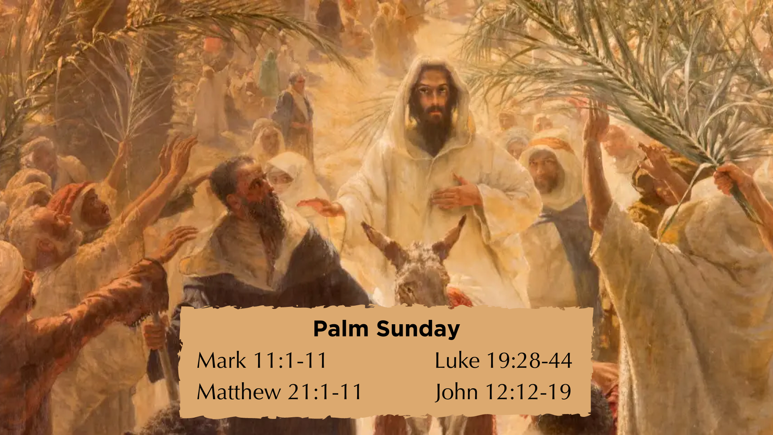
Notes:
See the gospel references to Palm Sunday on the screen
CONTEXT: (1) A few days before the Passover, Jesus had been staying in Bethany, where he had raised Lazarus from the dead! (2) upon hearing this news, a large crowd comes to Jesus; (3) Knowing their intentions, Jesus begins to plan his ”triumphal entry” into Jerusalem; (4) the crowd that gathered in Bethany follow Jesus as they intend to parade him into the city; (5) According to John 12:12-14, it appears that Jesus hopped on the donkey once he began to see the waving of palm branches and hear the shouts of Hosanna.
Why the donkey? Jesus is fulfilling Zech 9:9-10, but he is also making a statement!
Hosanna – is the Aramaic form of a two-part Hebrew word – Hosiah (help us) and the ending na, giving it a sense of urgency; “Save us now!” or “Please deliver us!”
What about the palm branches? They are not being used as the ancient equivalent of a giant foam hand that people wave at ballgames! Rather, they tap into Israel’s political memory and symbolize revolution and independence, going back 200 years to when the Jewish people, led by the Maccabees, revolted against the Seleucid empire. I’ll come back to that later.
You got the picture? Now, how does Jesus respond to this scene that is unfolding? Listen to what Luke tells us in the Gospel of Luke chapter 19, verses 41-42… [NEXT SLIDE]

Slide 5
Luke 19:41-42 NRSV
⁴¹ As he came near and saw the city, he wept over it, ⁴² saying, “If you, even you, had only recognized on this day the things that make for peace! But now they are hidden from your eyes.
Notes:
[READ & BRIEF COMMENTS]
v. 42 NLT: “How I wish today that you of all people would understand the way to peace. But now it is too late, and peace is hidden from your eyes.”
Why does Jesus cry over the city? (1) the lack of understanding by his disciples leading up to this day as it relates to Messianic expectations; (2) the scene that was unfolding since raising Lazarus; and (3) Jesus knows what is coming for him, and also for Jerusalem.
“If you had only recognized the things that make for peace!” What is “peace” according to Jesus? Jesus, having his heart and mind shaped by the Hebrew Scriptures, has in mind the Hebrew concept of shalom. What is shalom? Shalom is more than the absence of conflict and violence. Shalom is about the presence of goodness and blessing; it looks like health, harmony, and wholeness in every facet of life. Shalom is about us flourishing in our relationship with God, with others, and all of creation. Shalom (God’s peace) is what it looks like when everything is as God wants it to be. This is the sort of peace that Jesus worked for and calls his followers to actively advance until he comes again to bring the fulness of the Kingdom.
But of course, we can hear in Jesus’ lament that many fail to understand who he is and what he is about: the shalom of God. And yet, this is what Jesus intends to reveal very plainly to us during Holy Week, as Jason Porterfield insightfully points out for us… [NEXT SLIDE]

Slide 6
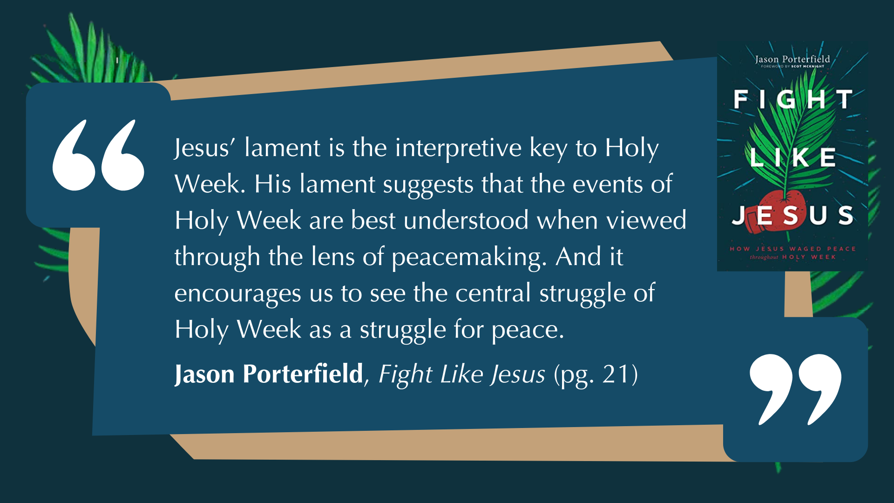
Notes:
[READ & BRIEF COMMENTS]
Now, back to Jesus’ entrance into Jerusalem. Let’s consider what else was likely happening at the same time Jesus is being heralded like a king down one road, through the Eastern gate into Jerusalem. Some scholars believe that Jesus would have known that on the first day of Passover someone else was also coming into town to “keep the peace”--the Pax Romana—during Passover, a Jewish festival which commemorated God’s deliverance of Israel from slavery and freedom from the oppressive Egyptian empire!
The Roman prefect Pontius Pilate was scheduled to travel down from Caesarea Maritima (his coastal palace and military center) and arrive through the West gate to flex Rome’s imperial muscles and discourage any violent revolts during Passover, the largest and most sacred Jewish holiday that Pilate knew had a history of producing riots, rebellions, and revolts.
Here is an image I’ve shown before to help us imagine what the scene might have looked like on Palm Sunday… [NEXT SLIDE]

Slide 7
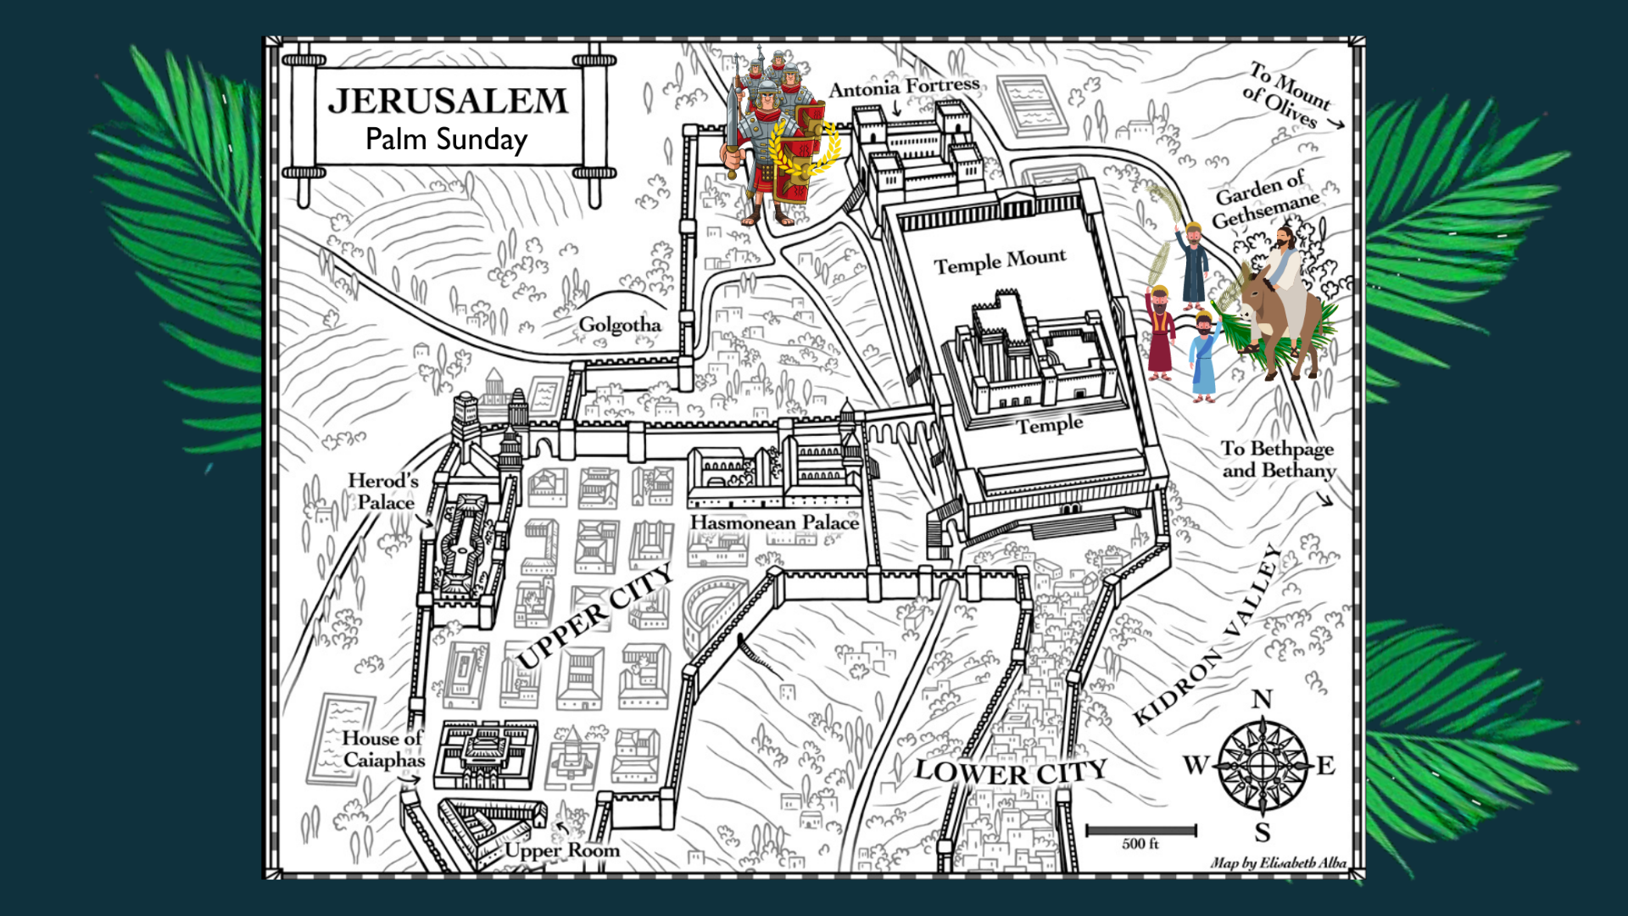
Notes:
[BRIEF COMMENTS]
Jesus came from Bethany, over the Mount of Olives, through the eastern gate
Pilate came through a western/north-western gate from Caesarea (likely the Fish gate)
Is it possible that these two processions were happening at the same time? Or maybe Jesus comes riding in on a donkey right after Pilate’s grand entrance.
Listen to how NT scholars Marcus Borg and John Dominic Crossan describe this Roman parade into Jerusalem in their book The Last Week… [NEXT SLIDE]

Slide 8
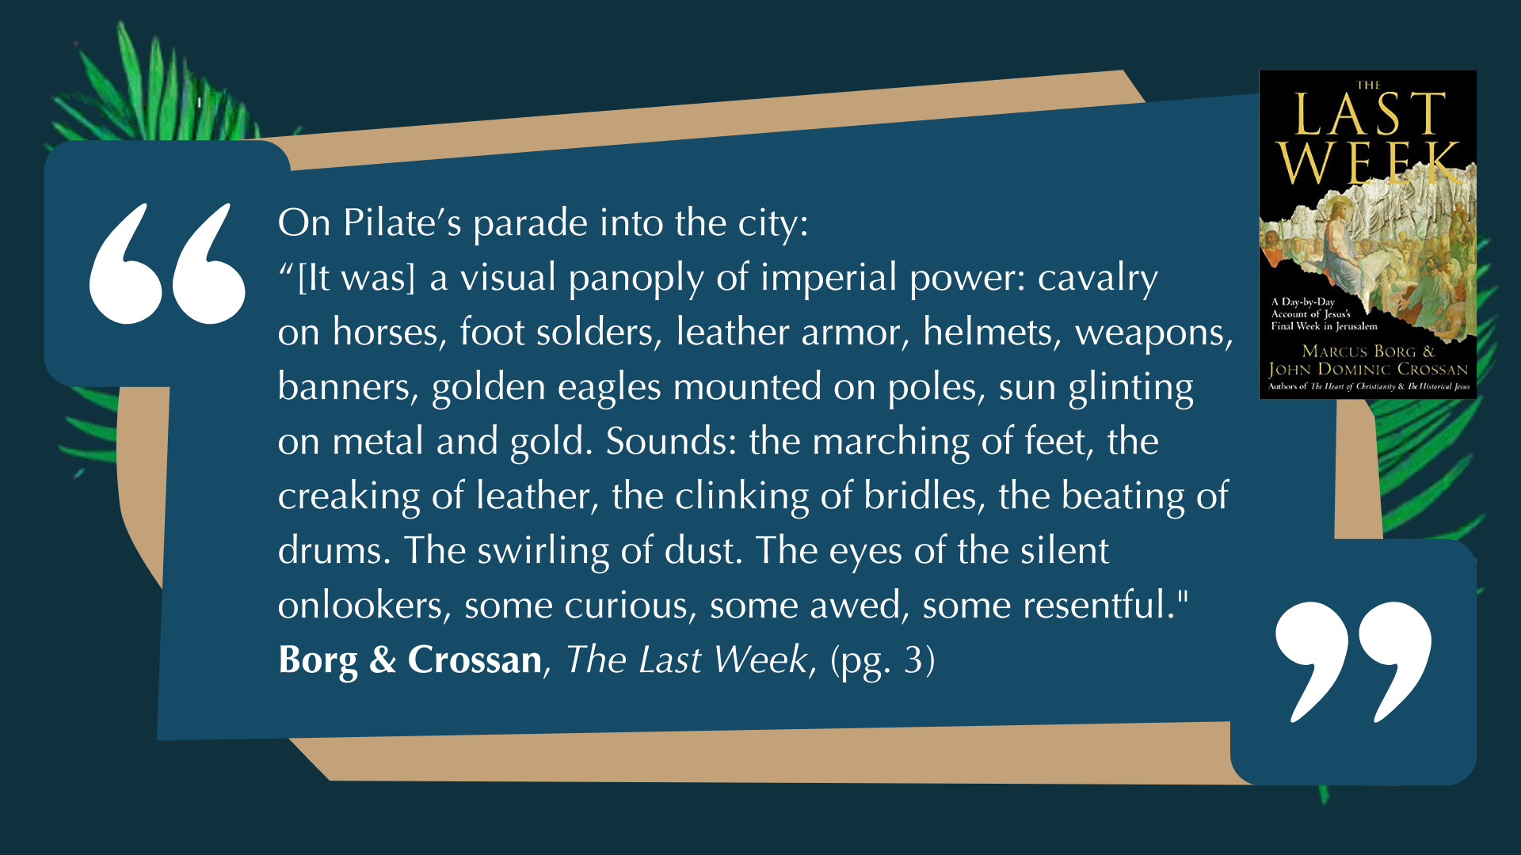
Notes:
[READ & BRIEF COMMENTS]
And to help us envision the contrast of power and what constituted as “peace” on Palm Sunday, let’s see these two images next to each other… [NEXT SLIDE]

Slide 9
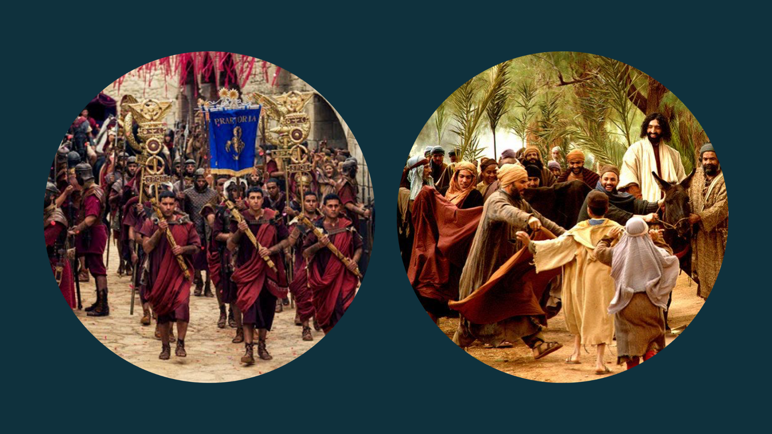
Notes:
Look at the contrast between the Roman parade of “law and order” and power-over, and Jesus’ counter-procession of peace and power-under. Folks, Jesus knew what he was doing. Surely, we can’t help but notice that the image on the right is intended to be a bit ridiculous in contrast to Pilate’s procession. In fact, the counter-procession of Jesus looks downright silly, powerless, and vulnerable to those captivated by earthly power and violence to bring about peace.
And this act of Jesus was aimed at those who think real power looks like conquering heroes on horseback with the glory of their entourage. It was intended to communicate that real power isn’t about threats, brutal force, and military might. Instead, his arrival into Jerusalem is a flat-out denouncement of worldly kingdom thinking that salvation comes by the sword.
Folks, think about it. As Crossan points out, Jesus rode "the most unthreatening, most un-military mount imaginable: a female nursing donkey with her little colt trotting along beside her.” Is it a bit comedic? Yes. Is it a bit prophetic? Certainly. But it’s also wholly reflective of God’s true character and the ways of his Kingdom, to which we have been called as peacemakers. And it’s entirely consistent with everything we’ve seen up to this point with how Jesus wages peace.
But again, this is not what his fans and followers wanted. They kept hoping that he would be the kind of military Messiah they had always dreamed of, and that they have had before in King David or in Judas Maccabeus, also known as “the Hammer” of God. [NEXT SLIDE]

Slide 10
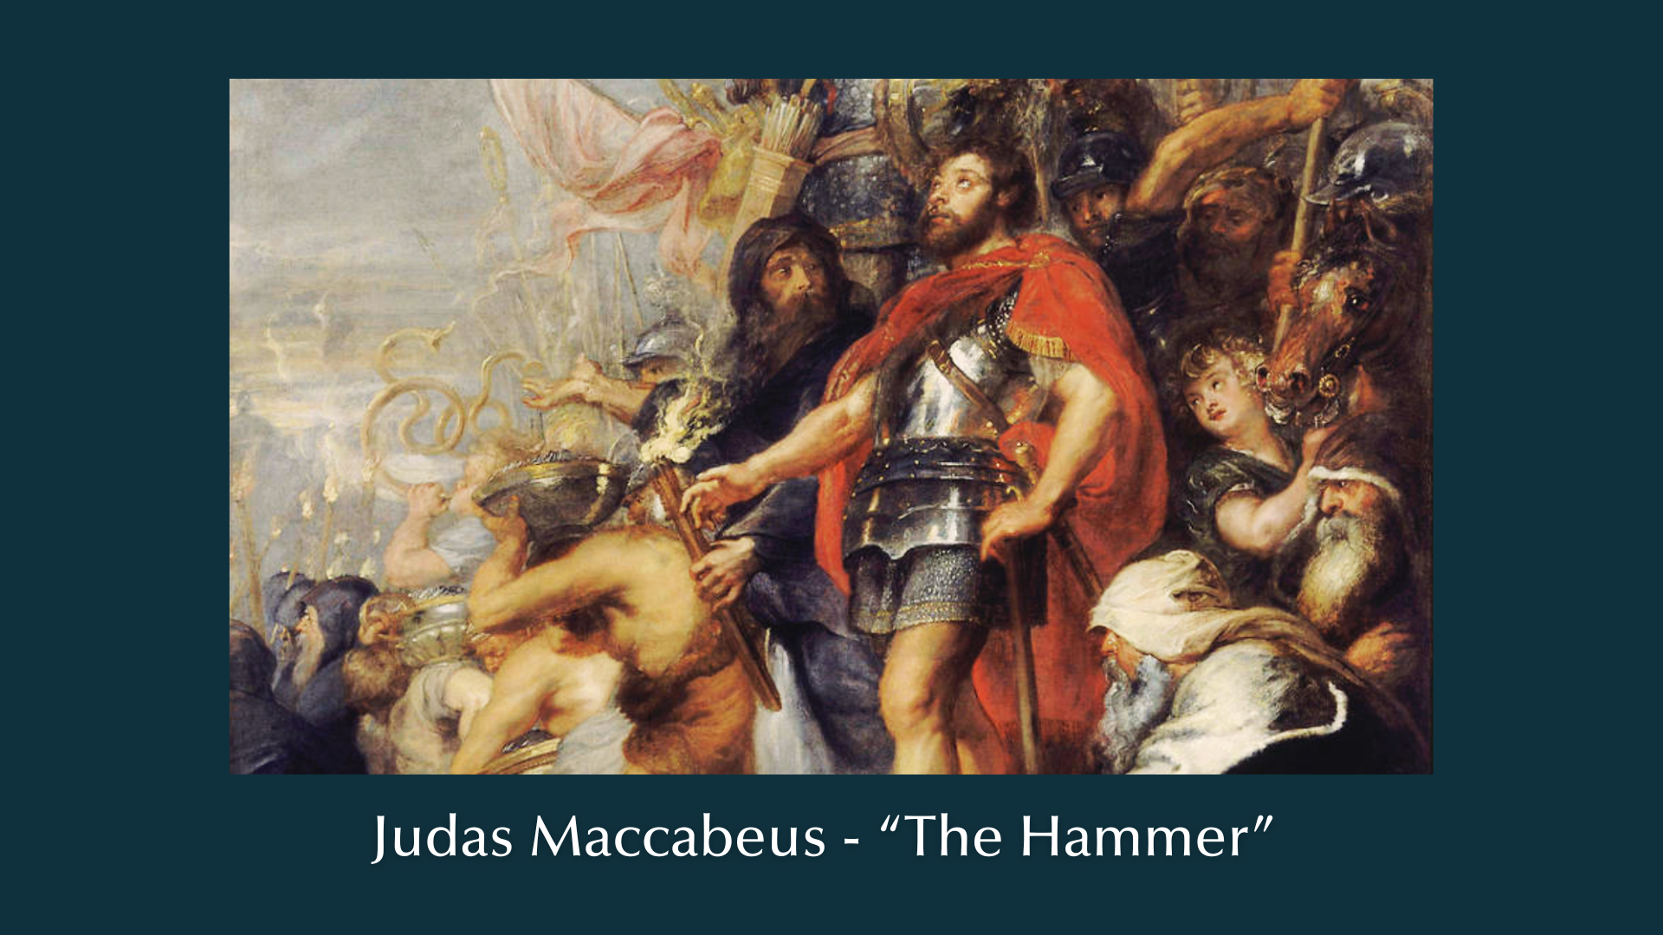
Notes:
You can read about Judas Maccabeus in what protestants call the apocryphal books between the histories of the Old and New Testament. In about 167 BC, when the Seleucid empire ruled over Israel, the son of an old rebellious priest was commissioned by his father (on his deathbed) to avenge their people and pay back the Gentiles in full. Judas did just that and he was so successful and fierce in battle that they gave him the nickname Maccabeus, which means the hammer. And when Judas recaptured Jerusalem and made his way back into the city to cleanse the temple, his followers celebrated by… that’s right… by waving palm branches.
And so, when Jesus came riding into Jerusalem on Sunday, the waving of palm branches was a symbol of their quest for independence, it represented their nationalist aspirations, it was like waving a separatist movement’s flag; it was a way of saying: Jesus will bring the hammer once again. Jesus will set us free from Roman occupation. Jesus will be our liberator.
This is what the crowd wanted from Jesus that day. And Jesus wept. You see… Jesus did come to bring peace—God’s shalom. He did come as our savior and liberator. But not in the way people expected. Not in the way some of his followers still want him to come today.
Brothers and sisters, Jesus wasn’t the hammer of God. As John the Baptist declared in the waters of the Jordan, and John the Apostle testified to in his vision of the heavenly throne room in Revelation, Jesus is altogether different. Jesus is the sacrificial Lamb of God. [NEXT SLIDE]

Slide 11
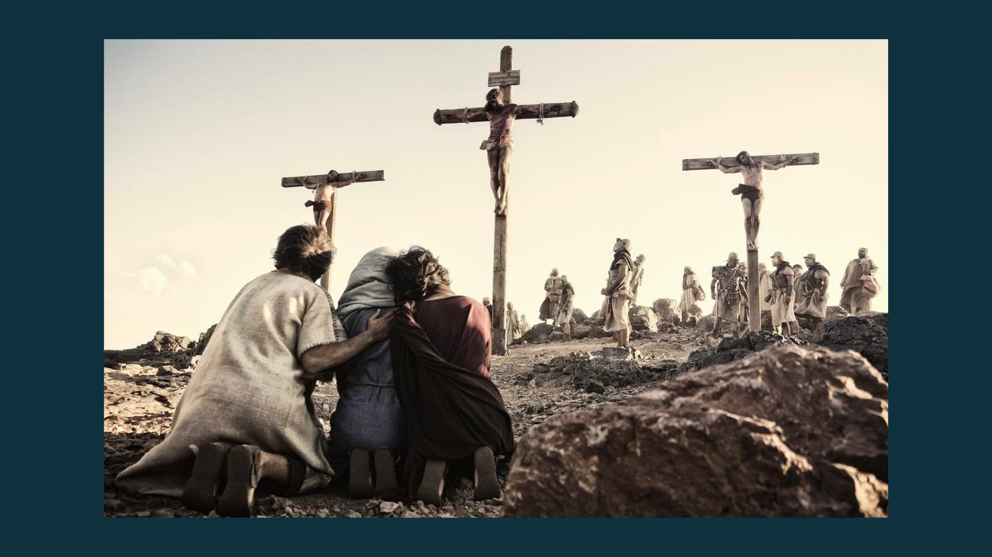
Notes:
And our Lord’s commitment to God’s shalom in Holy Week will lead him to the cross. My friends, the cross of Christ is not a result of God setting aside his true character so that the Son of God can die for our sins, only to come back later as a violent King. No, the cross is the quintessential expression of what God is really like. And the cross is what happened to the spotless Lamb of God because of our sins, one of which is our misplaced trust in peace that comes by a hammer.
And so, on the first day of Holy Week, let us look ahead to Friday (which Jesus no doubt would have seen coming) and acknowledge that this is where the way of the hammer leads. And this is why Jesus also weeps for us who do not understand the things that make for peace.
Before we close the message with some questions, each week in this series I’m going to give us some “lessons in peacemaking” based on what we’ve seen that day in Holy Week. Real quick, here are three lessons for us from Palm Sunday… [NEXT SLIDE]

Slide 12
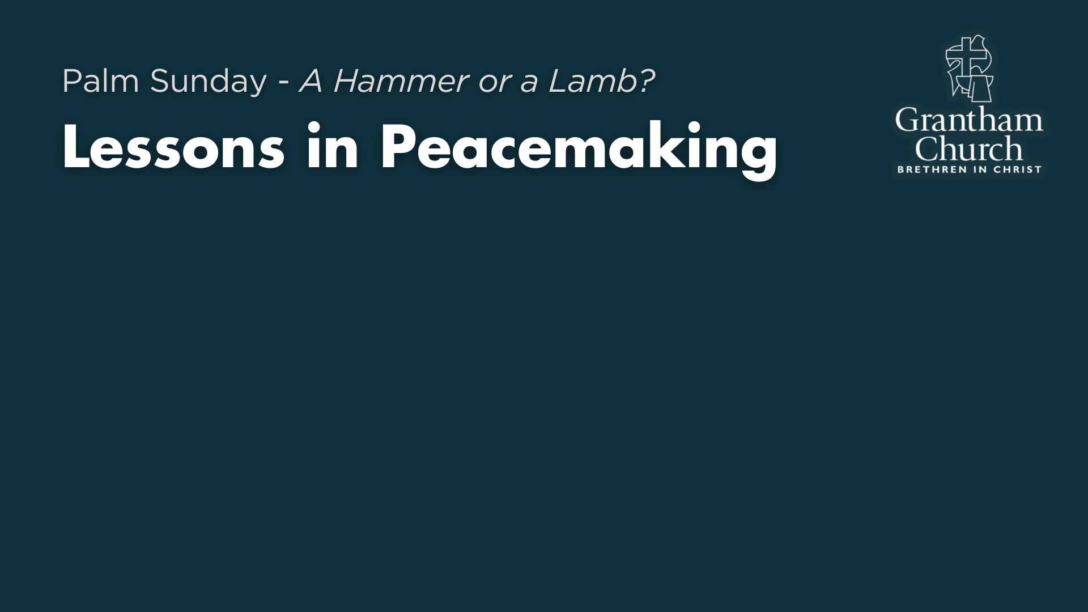

Slide 13
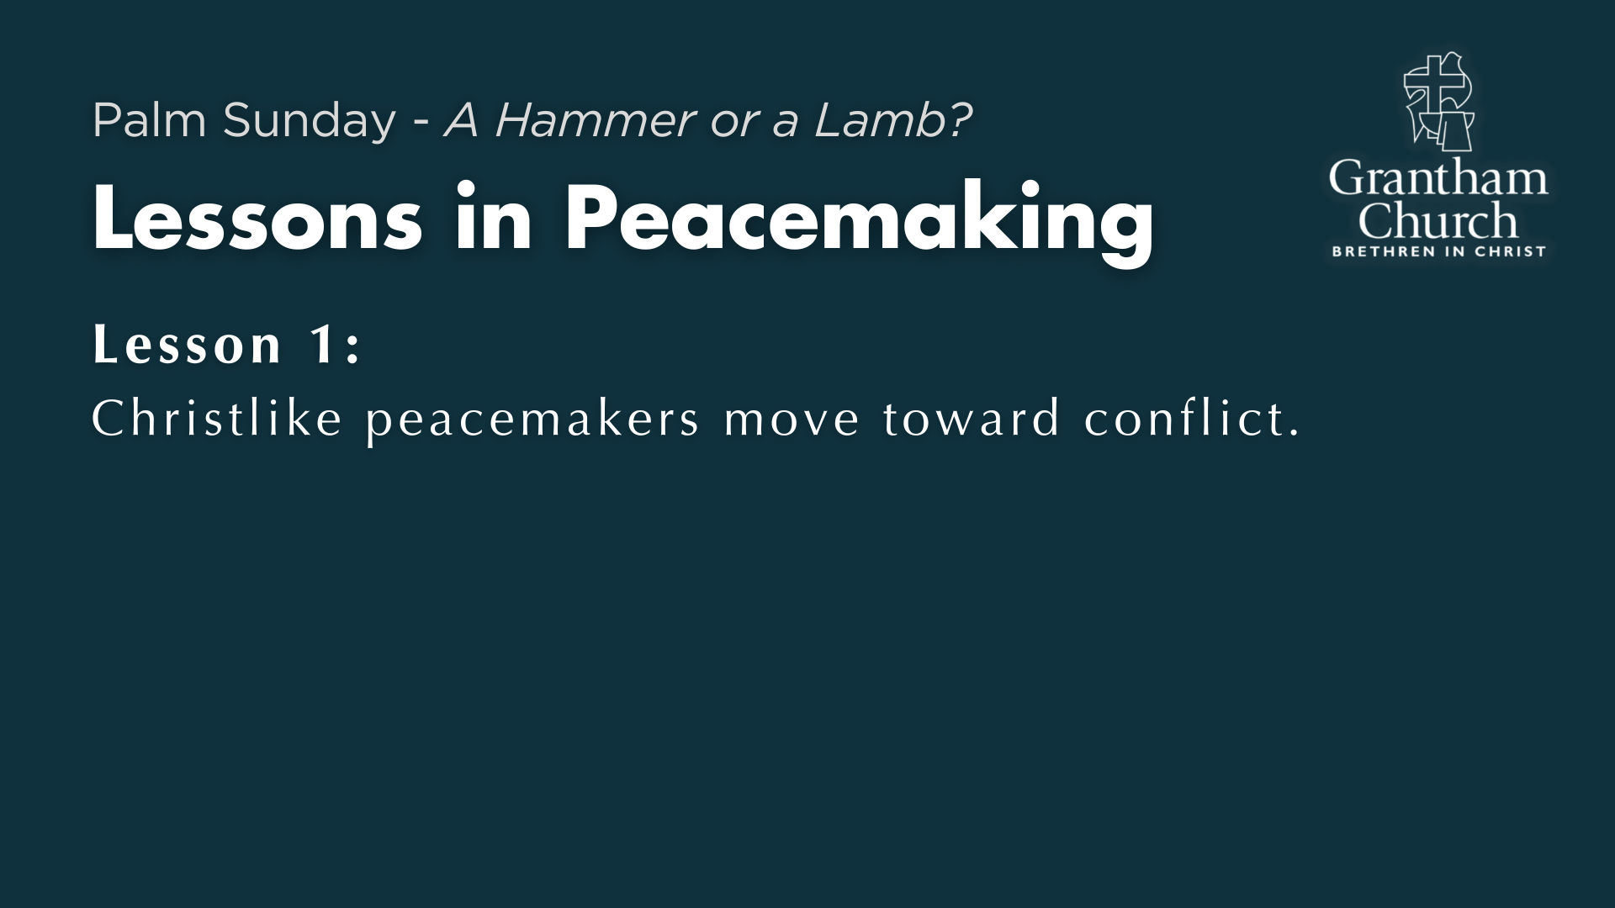

Slide 14
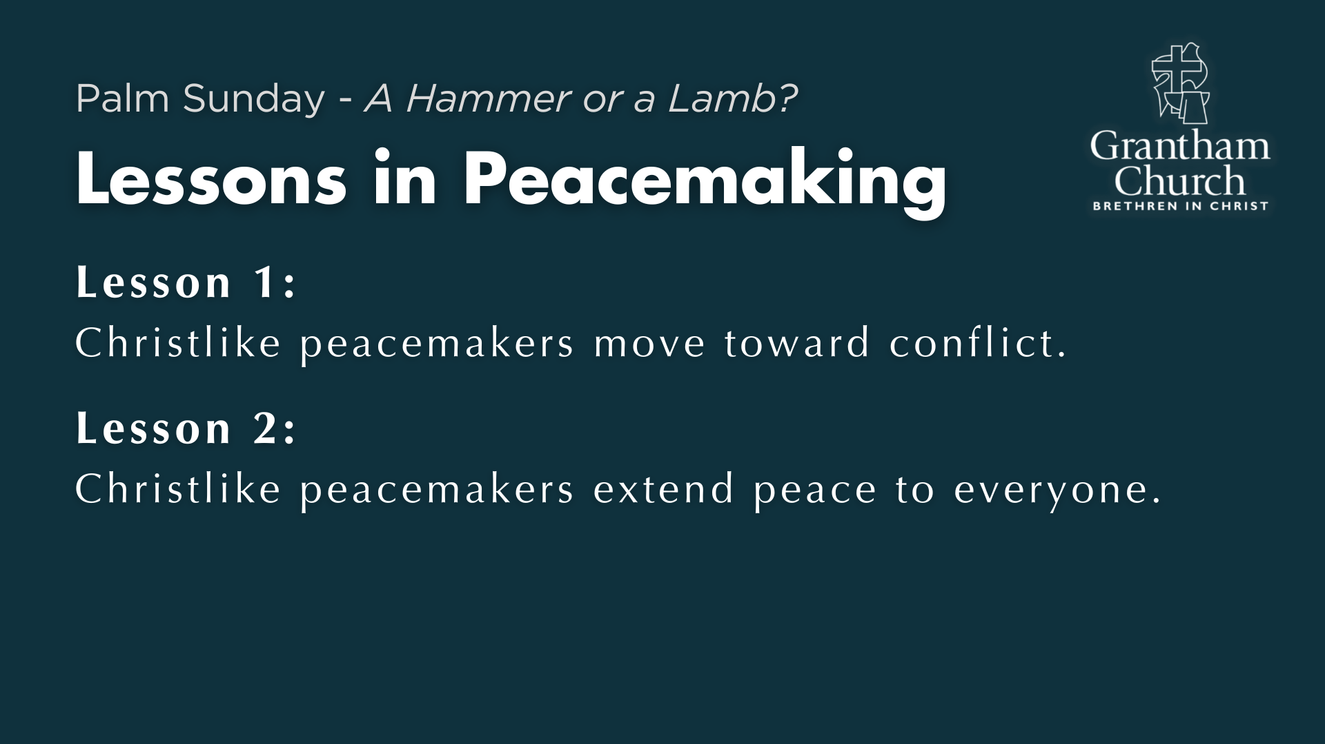

Slide 15
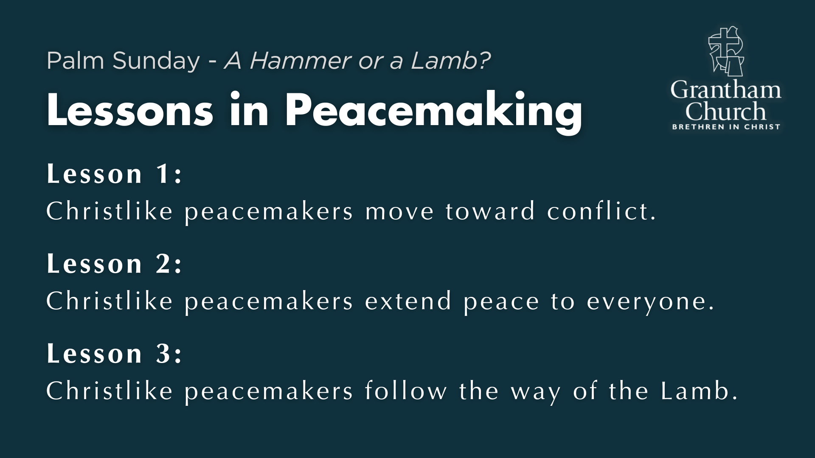
Notes:
[BRIEF COMMENT ON EACH LESSON]
Lesson 1: Christlike peacemakers move toward conflict.
Lesson 2: Christlike peacemakers extend peace to everyone.
Lesson 3: Christlike peacemakers follow the way of the Lamb.
Finally, here are some questions for personal reflection and to help us respond to what the Spirit is saying to us through the message… [NEXT SLIDE]

Slide 16
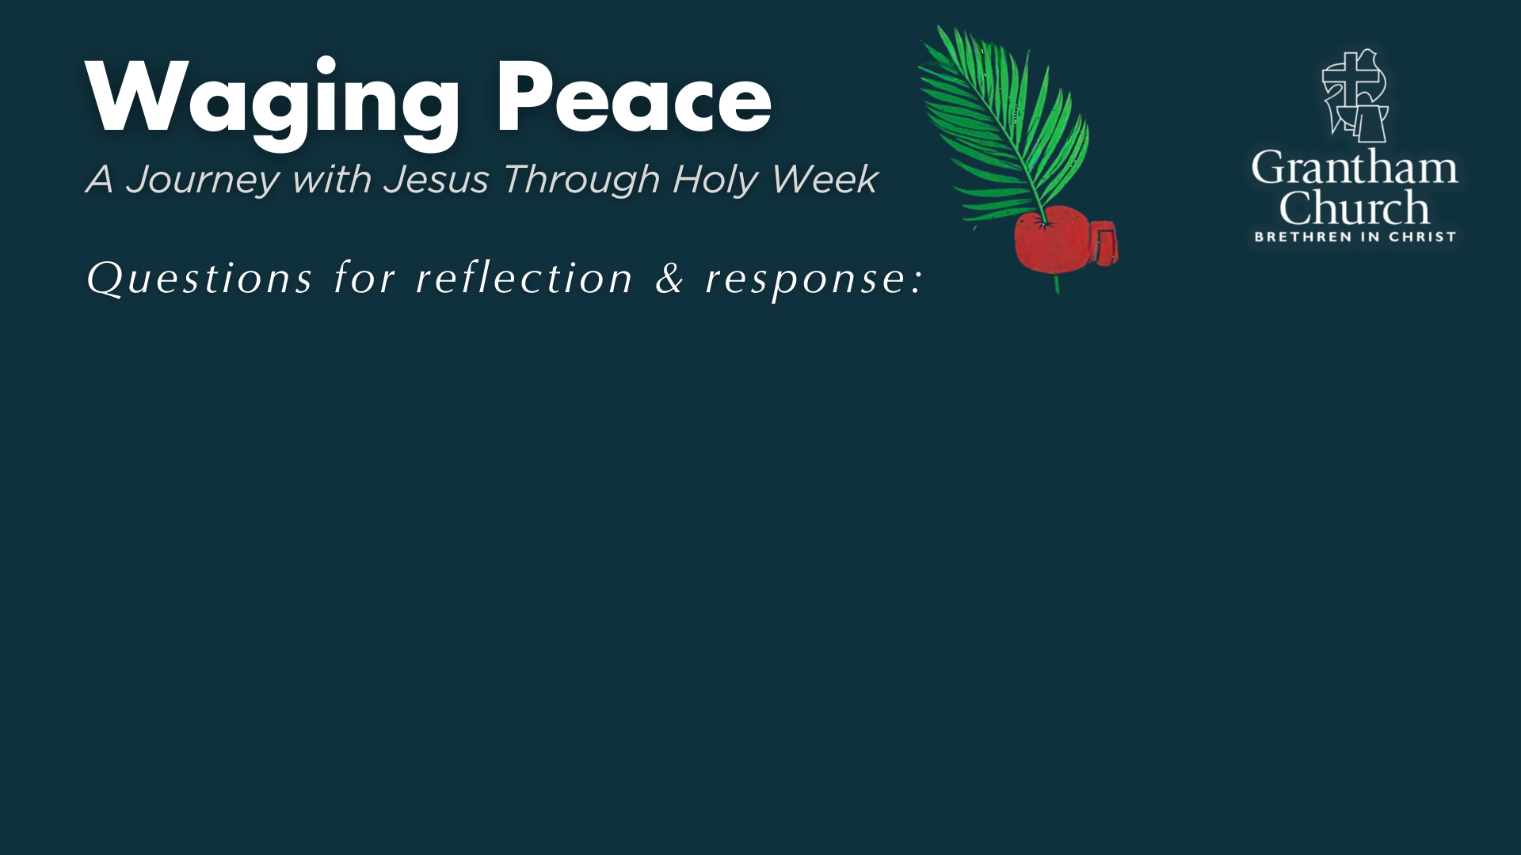

Slide 17
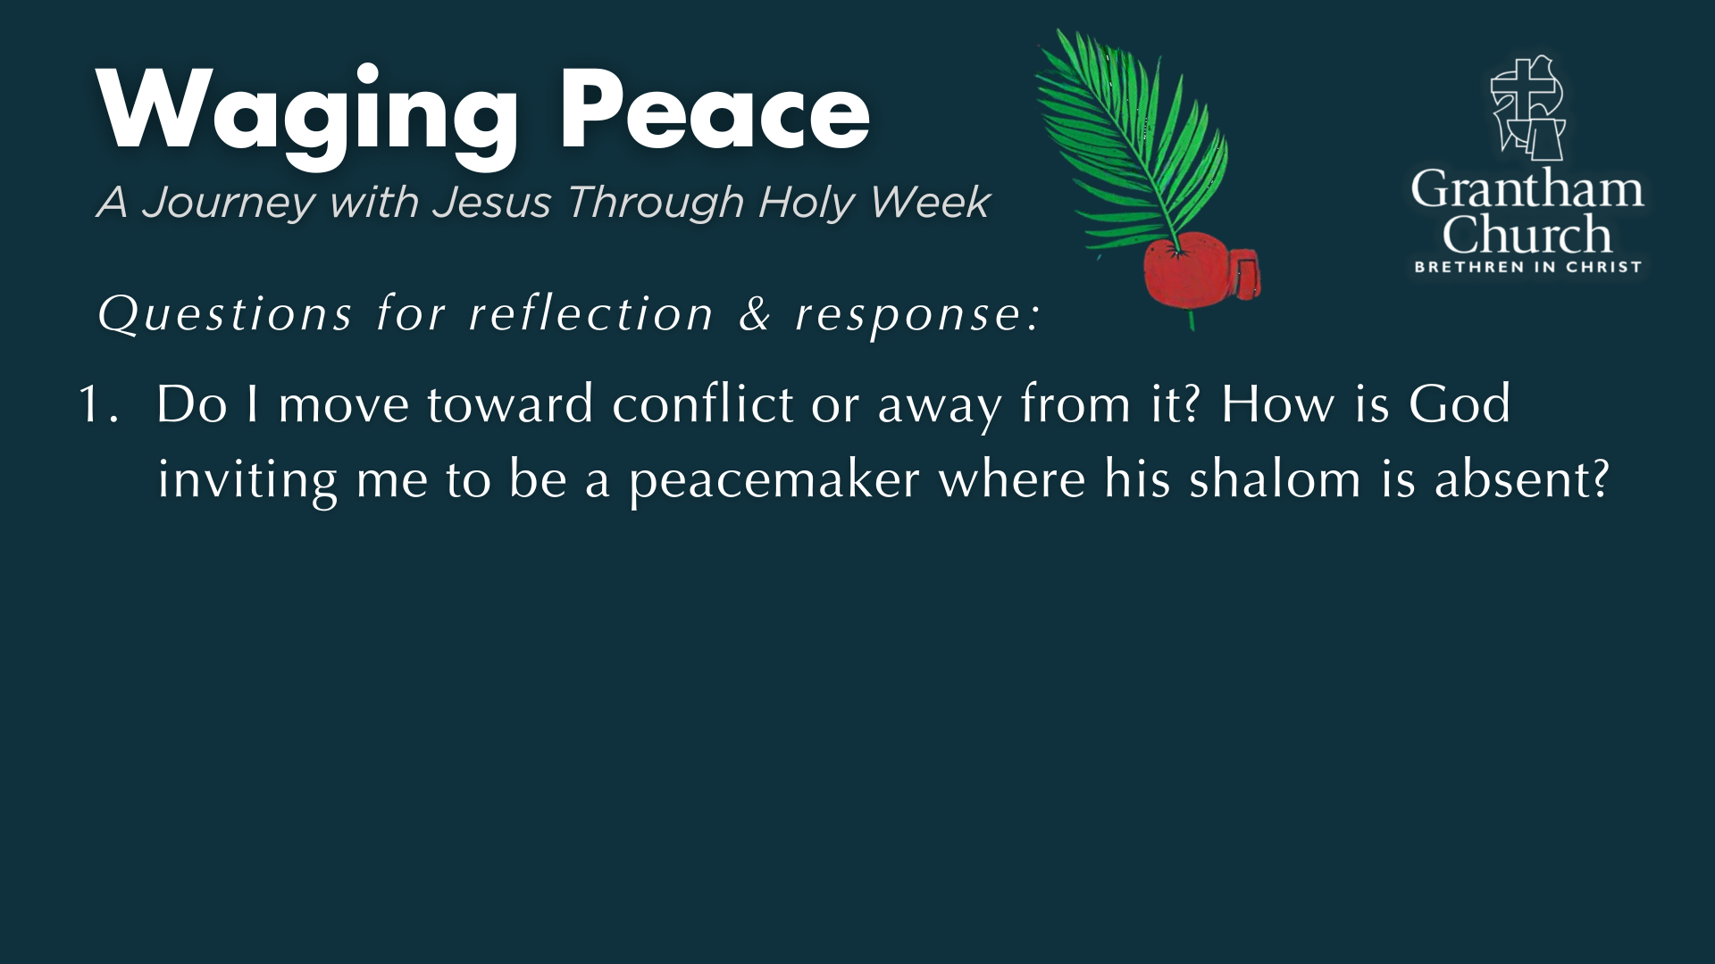

Slide 18
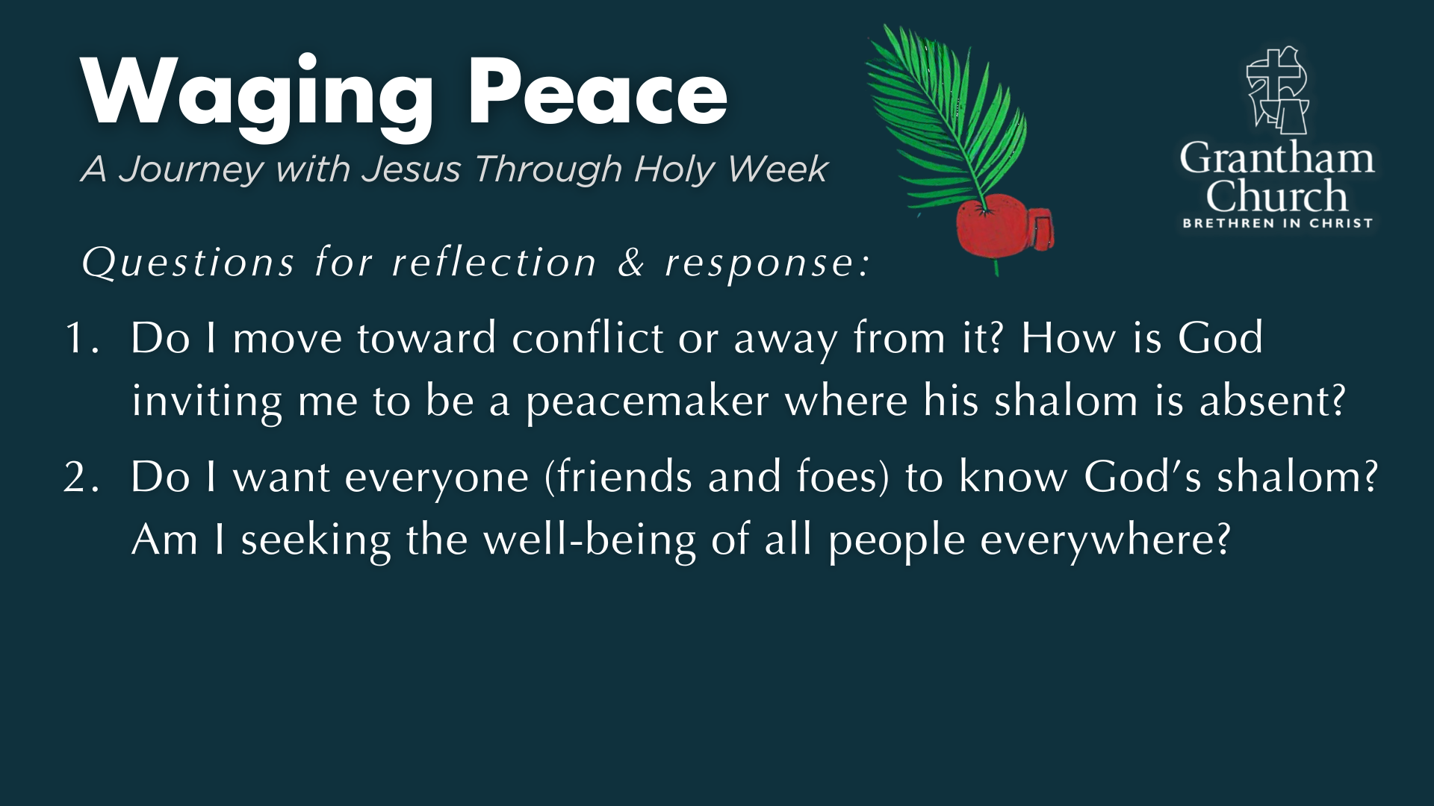

Slide 19
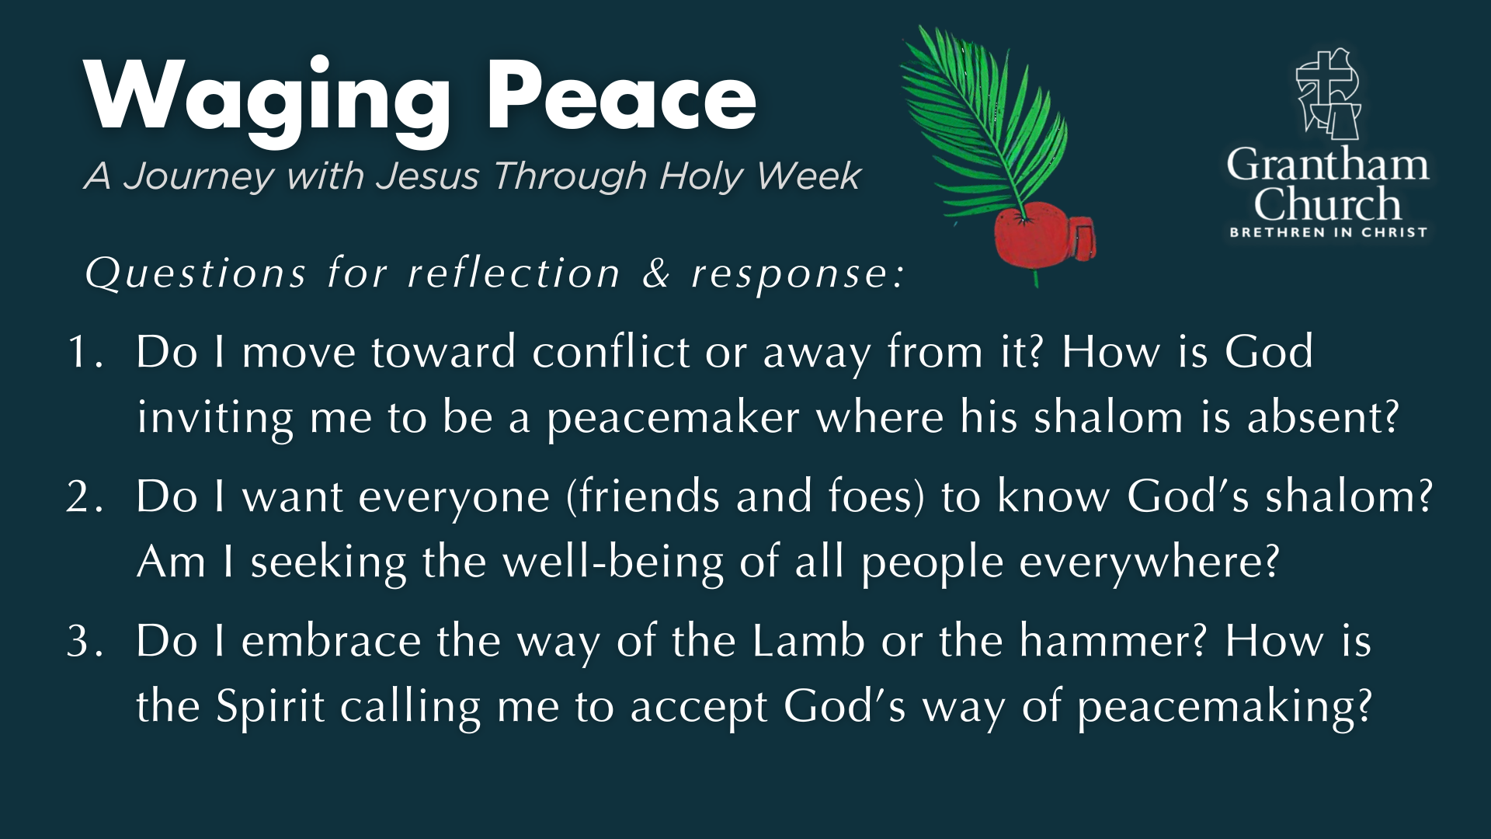
Notes:
[READ & COMMENT ON EACH QUESTION]
1. Do I move toward conflict or away from it? How is God
inviting me to be a peacemaker where his shalom is absent?
2. Do I want everyone (friends and foes) to know God’s shalom?
Am I seeking the well-being of all people everywhere?
3. Do I embrace the way of the Lamb or the hammer? How is
the Spirit calling me to accept God’s way of peacemaking?
Let’s pray… [NEXT SLIDE FOR CLOSING PRAYER]

Slide 20
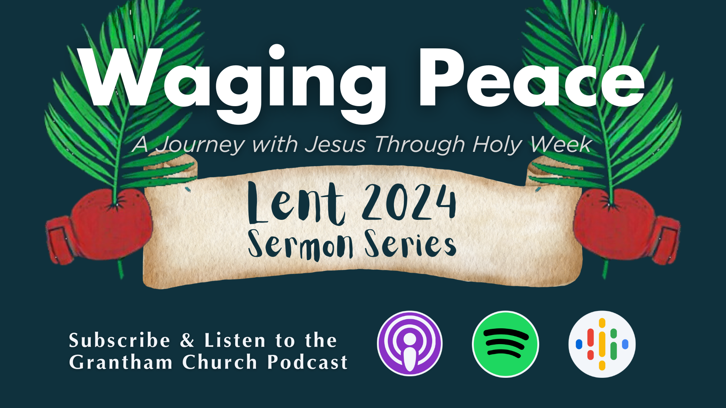
Notes:
[CLOSING PRAYER]
Series Benediction – adapted from a “Franciscan Benediction”
May God bless you with discomfort…
Discomfort at easy answers, half-truths and superficial relationships,
Discomfort, so that you will hunger and thirst for righteousness.
May God bless you with anger…
Anger at injustice, oppression, and exploitation of people,
Anger, so that you will work for God’s Kingdom vision of shalom.
May God bless you with tears…
Tears to shed for those who suffer pain, rejection, starvation and war,
Tears, so that you will reach out to comfort them
And turn their pain into joy.
And may God bless you with foolishness…
Foolishness to believe that through the Spirit you can live like Jesus,
Foolishness, so that you will do what others claim cannot be done. Amen.
Grantham Church, go in peace… to love and serve the Lord.

